Slide 1
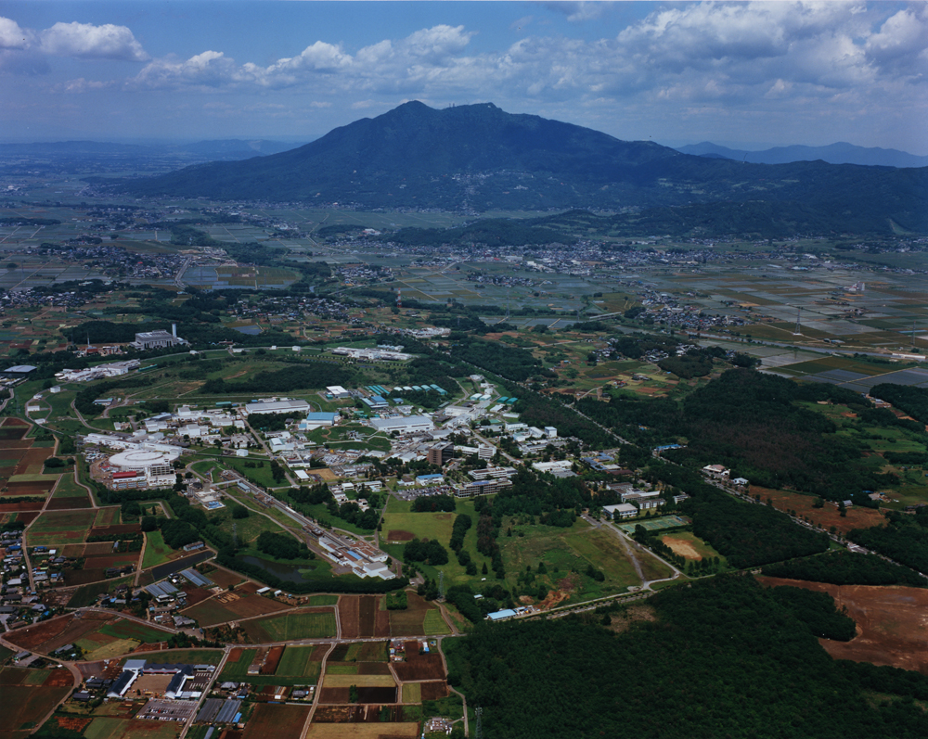
ルミノシティ調整
Y. Funakoshi
Accelerator Laboratory, KEK
2017.9.8@SuperKEKB国内レビュー

Slide 2
Contents
Phase 2 commissioning
衝突調整
  Dithering system（水平方向の衝突調整用システム）の最近の進展と立ち上げ
  垂直方向の衝突調整
ルミノシティ調整

Slide 3
SuperKEKB commissioning phases
Feb. 2016 ~ June 2016
Feb. 2018 ~ July 2018
~ autumn 2018
Phase 1
w/o QCS and Belle II
vacuum scrubbing
basic machine tuning
Phase 2
w/QCS and Belle II
w/o Vertex detector
BKG study
Luminosity tuning
Target luminosity:
1~2 x 10³⁴ cm⁻² s⁻¹
Phase 3
Physics Run
Luminosity tuning
No beam collision
Already done!
Damping ring commissioning: ~ Dec. 2017

Slide 4
Tasks in Phase 2
Basic tuning
  Beam injection of the beam from DR, vacuum scrubbing…
Performance check of QCS magnets
Squeezing IP beta functions at IP
  Optics corrections
Beam collision tuning with “Nano beam scheme”
Belle II beam BG study and tuning
Other studies: electron clouds, other instabilities…
Luminosity tuning
Physics Run

Slide 5
衝突調整
衝突状態のサーチ
ビーム衝突フィードバック（軌道フィードバック）システムの立ち上げ
ビームアボート後の衝突の確立の手法

Slide 6
ビーム衝突のサーチ
Closed orbit correction of each beam
Bunch timing adjustment
  Rough adjustment: search for collision bucket
    BPM measurement, luminosity monitor?
  Fine adjustment: RF phase scan
    Observer horizontal beam-beam deflection
Orbit adjustment
  Scan orbits
    beam-beam deflections
    Luminosity
    beam lifetime

Slide 7
軌道フィードバックシステム
アルゴリズム
  Vertical
    Beam-beam deflection (like KEKB)
    Based on COD measurements using BPMs
  Horizontal
    Dithering system (like PEP-II)

Slide 8
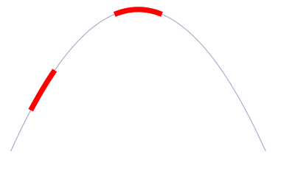
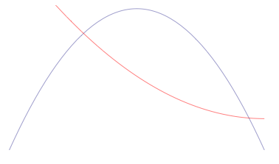
Orbit feedback at IP :Algorism
Beam-beam deflection (SLC, KEKB vertical)
Luminosity feedback (dithering)(PEP-II)
Beam size feedback (KEKB horizontal)
Δy at IP=
~5nm ~1/10σ_{y}*
BPM
Δy at BPM= ~1.3μm
IP
SupeKEKB case
BPM
When we shake the beam at around the peak of the
luminosity (dithering), the dithering frequency in the
luminosity is minimized and there appears twice of the
the dithering frequency.
Luminosity
y
Luminosity
At KEKB before installation of crab cavities,
the vertical beam of LER was used for the
horizontal orbit feedback at IP.
Beam size
σ_{y} (LER)
x

Slide 9
Horizontal orbit feedback
Difficulty to develop based on the beam-beam defection like the vertical case
  Small ξx
    ξx ~ 0.0028(e+), 0.0017(e-)
  Two sources of horizontal beam-beam kick
    Horizontal offset and shift of collision timing
We need a different method for the Hor. feedback.
  Luminosity feedback (dithering) (like PEP-II)
  Beam size feedback (like KEKB Hor. feedback before crab)
Effect of horizontal offset
  Due to Hor. offset, the two beams collide at the position which is shifted from the waist point.
  The crab waist seems to compensate this shift of waist.
  However, actually the situation becomes worse with the crab waist, since we have to keep the both beams at the design collision point with this scheme.
Feedback speed
  Fast vibration of IR quads is tolerable. We do not need very fast feedback ( slower than ~ 1 Hz).

Slide 10
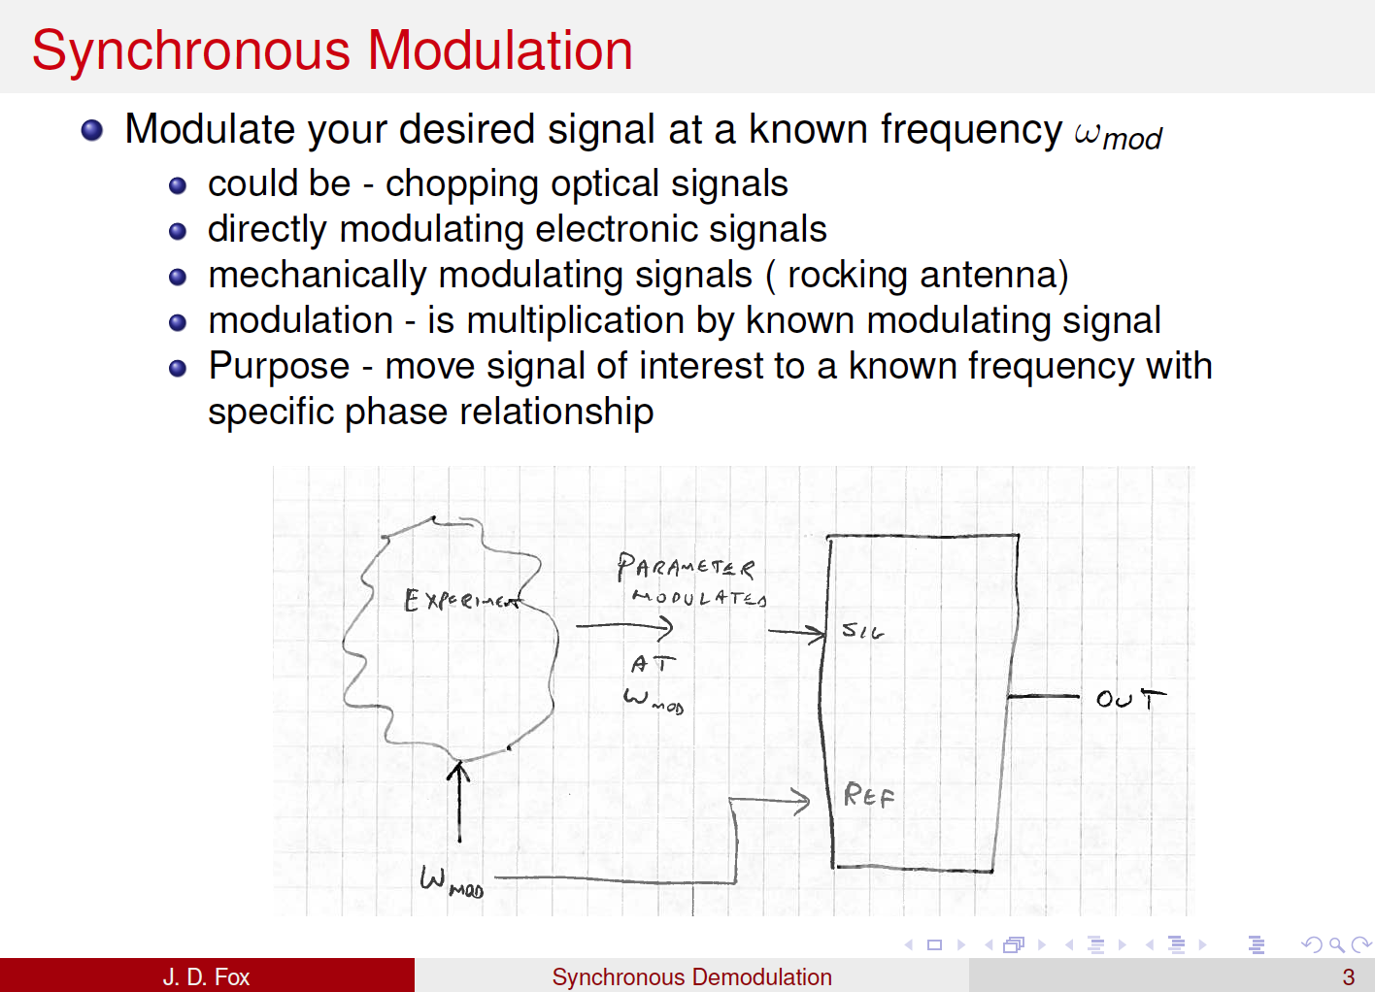
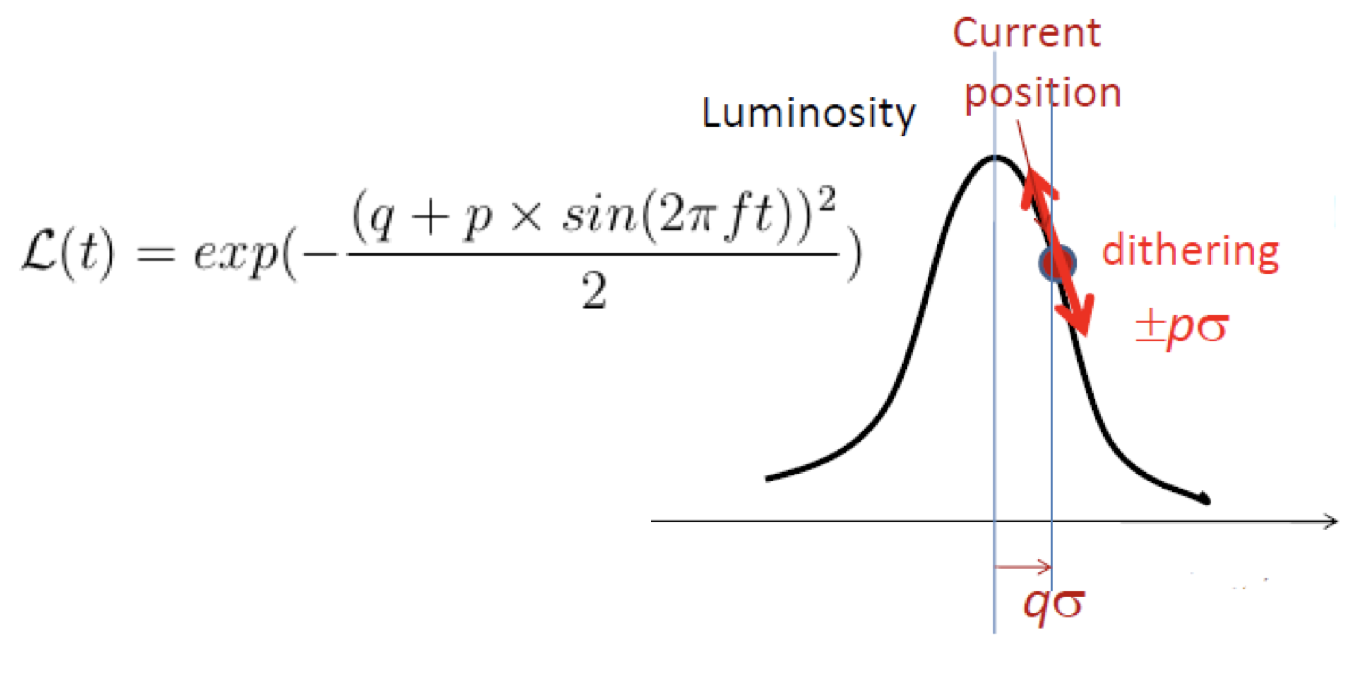

Slide 11
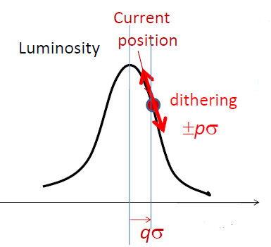
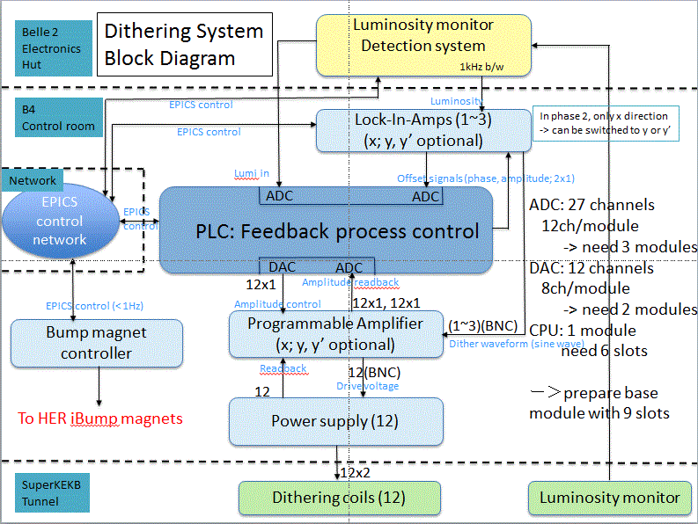

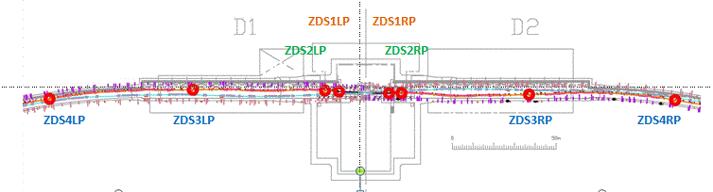
Fast luminosity monitoring - Plan for 2018 (and beyond... ) (1)
01/2018-06/2018: tests during phase II of SuperKEKB commissioning
- Bhabha acquisition and first luminosity measurement tests
- Single beam background characterization
- Luminosity DAQ output provided to the SuperKEKB monitoring system and dithering system tests:
8 locations for the dithering coils in LER around IP.

Slide 12
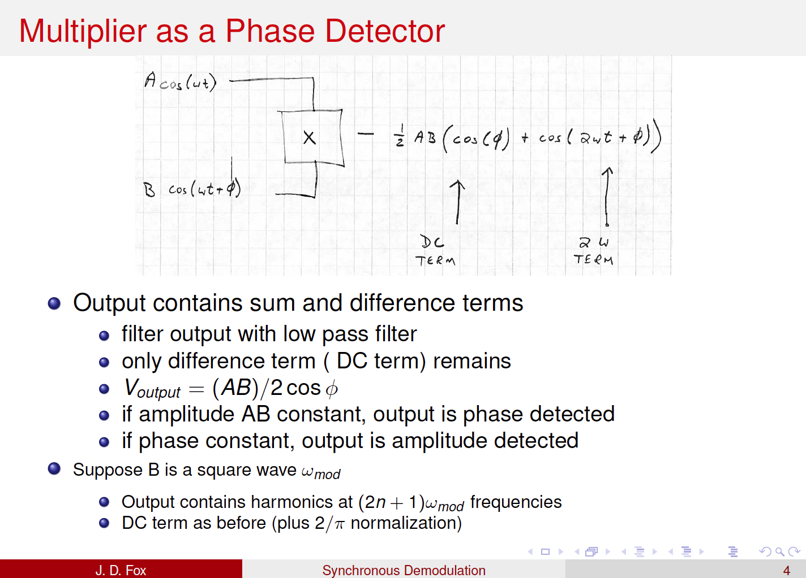

Slide 13
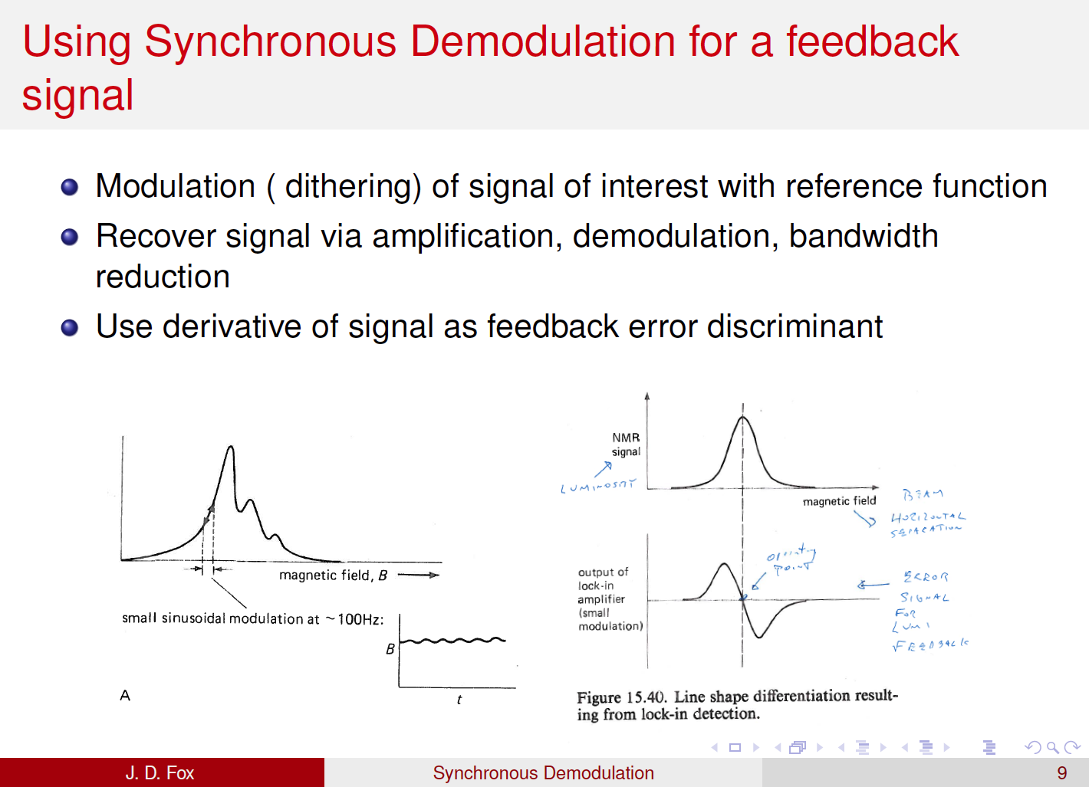

Slide 14
Belle 2
Electronics
Hut
Dithering System
Block Diagram
Luminosity monitor
Detection system
1kHz b/w
B4
Control room
EPICS control
Luminosity
Lock-In-Amps (1~3)
(x; y, y’ optional)
In phase 2, only x direction
-> can be switched to y or y’
EPICS control
Network
Lumi in
Offset signals (phase, amplitude; 2x1)
EPICS control network
ADC
ADC
ADC: 27 channels
12ch/module
-> need 3 modules
DAC: 12 channels
8ch/module
-> need 2 modules
CPU: 1 module
need 6 slots
ー＞prepare base
module with 9 slots
EPICS
control
PLC: Feedback process control
DAC
ADC
12x1
Amplitude readback
EPICS control (< 1Hz)
Amplitude control
12x1, 12x1
Bump magnet controller
Programmable Amplifier
(x; y, y’ optional)
(1~3)(BNC)
Dither waveform (sine wave)
Readback
12(BNC)
12
Drive voltage
To HER iBump magnets
Power supply (12)
12x2
SuperKEKB
Tunnel
Dithering coils (12)
Luminosity monitor
Luminosity monitor

Slide 15
Orbit Feedback collaborators
Horizontal orbit feedback system
  Organizer
    M. Masuzawa, Y. Funakoshi
  Dithering coils, programmable amp (designed and fabricated at SLAC)
    U. Wienands, A. Fisher and others (SLAC)
  Fast luminosity monitor
    S. Uehara (Belle-II group)
    P. Bambade, C. Rimbault, D. EL Khechen, D. Jehanno, S. D. Carlo, C. Pang (LAL Group)
  Other hardware preparation (Lock-in Amp, Power supplies, PLC, DAC,cabling…)
    T. Oki, S. Nakamura, T. Kawamoto (Magnet Group) + Control group
  Software, Simulations
    U. Wienands, T. Oki, T. Kawamoto, Y. Funakoshi + Control group
Vertical orbit feedback system
  H. Fukuma and beam monitor group
    BPMs, feedback circuits….
  N. Ohuchi, H. Yamaoka (QCS group)
    QCS supports and vibration measurement, Simulation on QCS vibrations

Slide 16
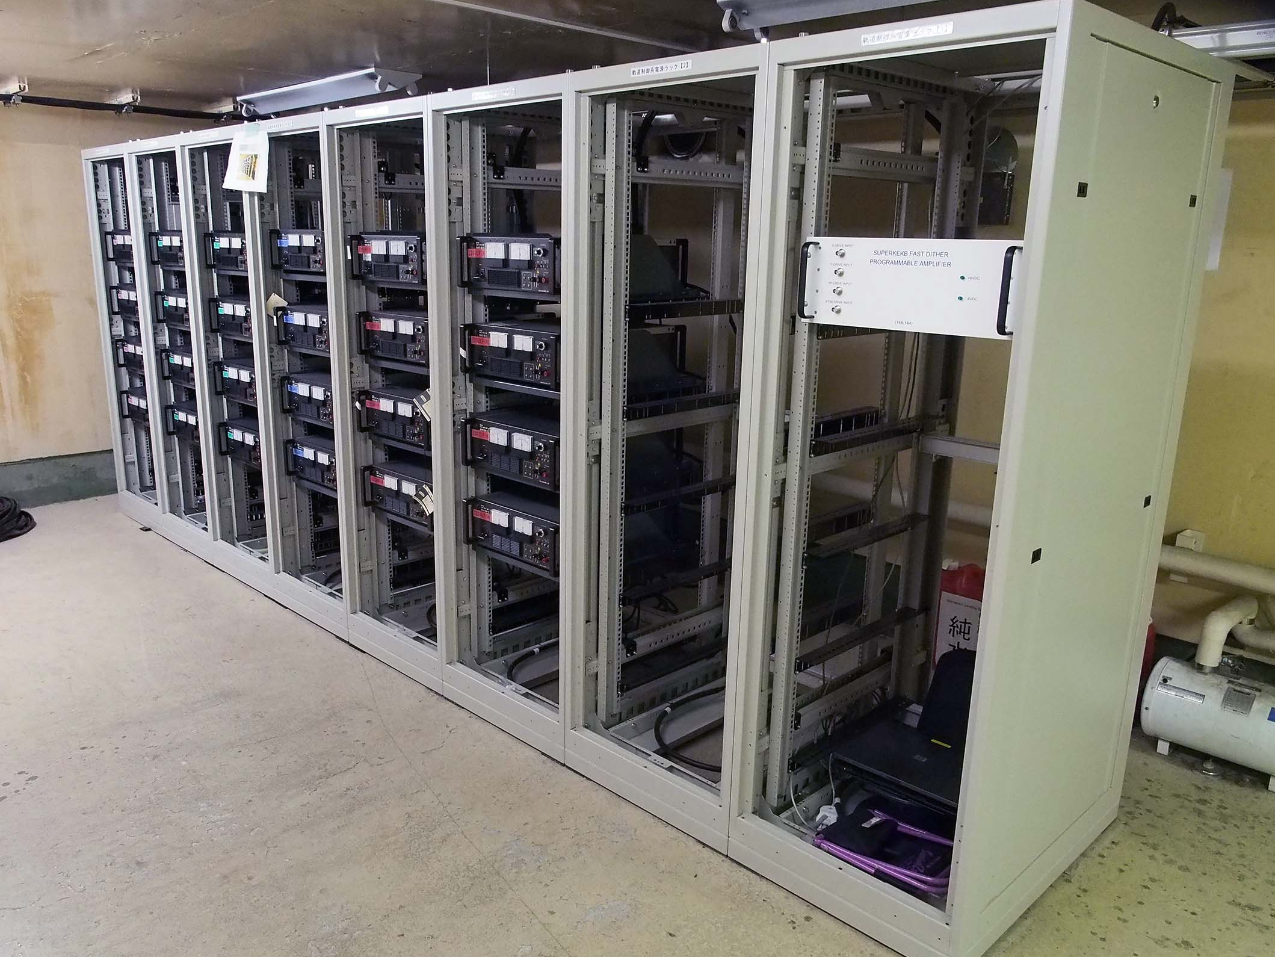
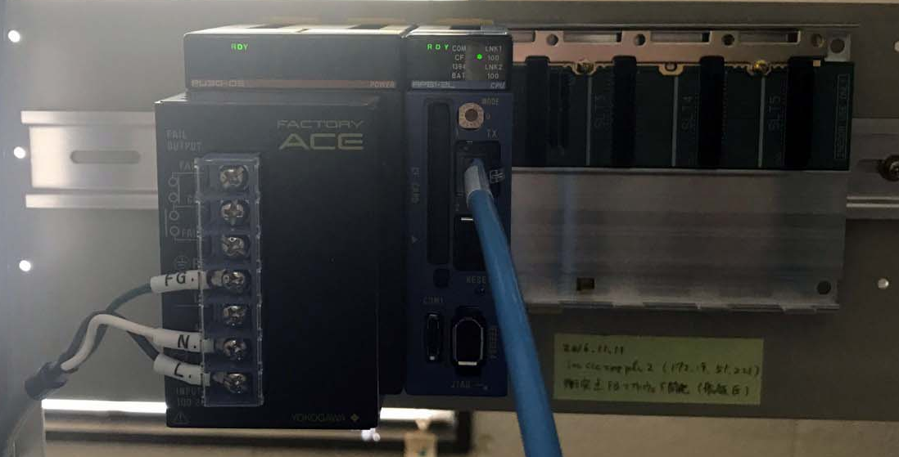
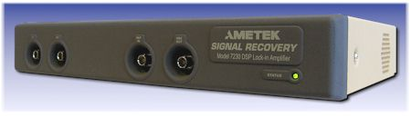
Dithering system components (TB4 control room, old)
Components for the dithering system has been installed.
Takasago BWS60-5
Power amps. for
SLAC
Programmable amp.
iBump
(HER)
Dithering (LER)
Signal Recovery Model 7230 DSP Lock-in amp.
Yokogawa FA-M3
Programmable logic controller

Slide 17
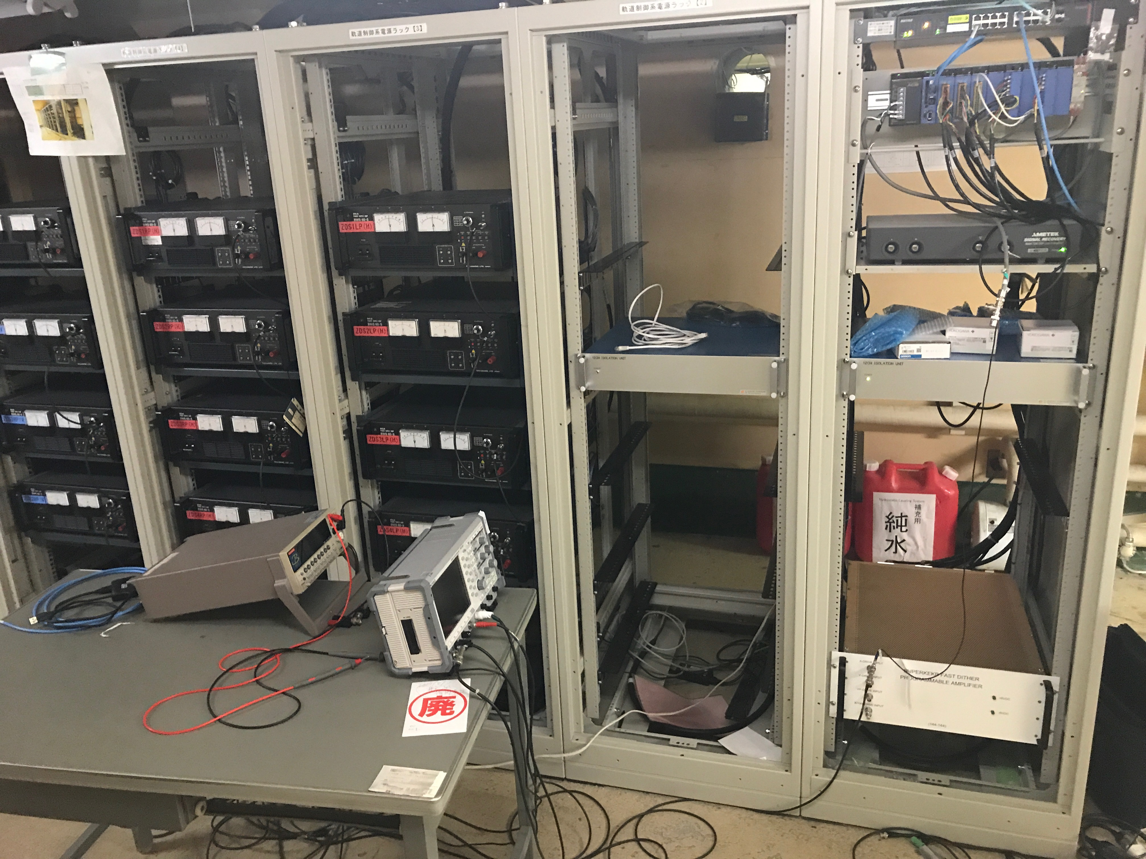
Tsukuba B4 control room (new)
PLC, DAC, ADC
Lock-in Amp
Programmable
Amp

Slide 18
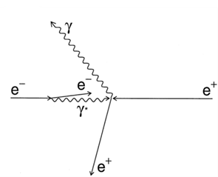
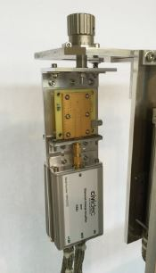
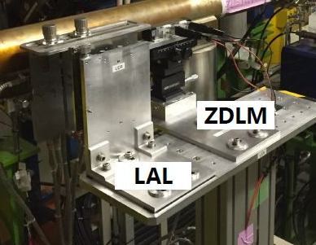
Fast Luminosity Monitoring at LAL ↔ KEK
C. Rimbault
Goal: Realization of a fast luminosity monitor based on radiative Bhabha scattering measurements for SuperKEKB luminosity feedback, tuning and backgrounds studies (BEAST).
  Aimed precision for Train Integrated Luminosity (TIL): δL/L ∼ 10 ⁻² to 10⁻³ in 1 to 10ms
  Fast signal from each bunch crossing for Bunch Integrated Luminosity (BIL),
  2500 bunches/train, collisions every 4 ns
Measure the radiative Bhabha process at vanishing photon scattering angle
  Rate proportional to Luminosity
  Large cross section ∼ 0.2 barn
Two complementary techniques developed at LAL and KEK:
  ∼ 5x5x0.5 mm³ single crystal CVD diamond sensors (CVD DS) pairs coupled to fast charge / current amplifiers (LAL)
  Cerenkov detector + scintillator (ZDLM group @ KEK)
positioned together outside of the beam pipe
Two optimized locations fixed in 2014 and 2015:
- In High Energy Electron Ring : 30m downstream the Interaction Point for Bhabha photon detection
- In Low Energy Positron Ring : 11.9m from IP for Bhabha scattered positron detection

Slide 19
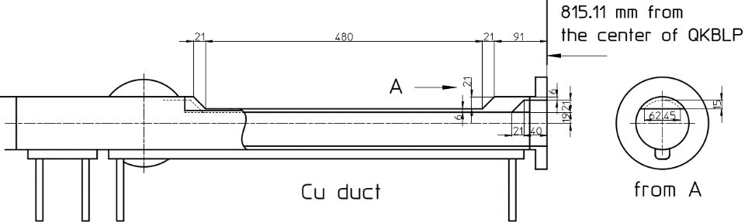
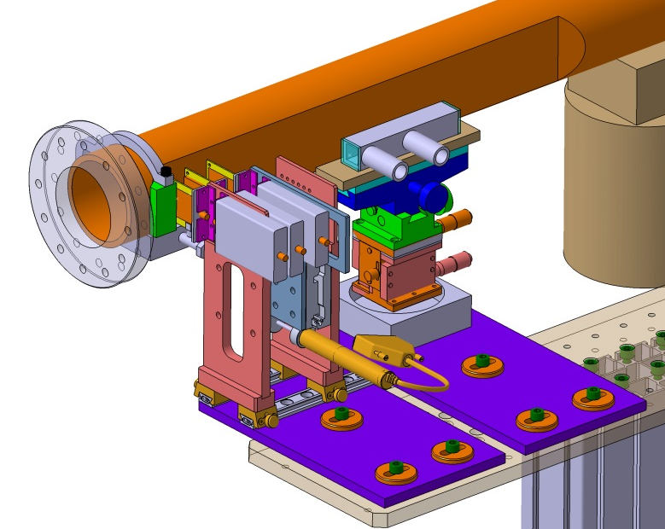

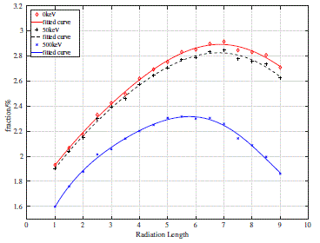

July 2016 → December 2017 : Prepare phase 2 commissioning (1)
Development of FPGA based DAQ for the phase II :
  ➔Luminosity firmware development:
  signal pulse reconstruction algorithm: A1-A4
  ➔test on Train Integrated Lumi (TIL) & Bunch
  Integrated Lumi (BIL) reconstruction: almost validated
Installation of a window in LER (confirmed for spring 2017)
➔ Adaptation of existing pillar for phase 2
➔ radiator design study: trapezoid shape Tungsten radiator
with thickness of 6*RL will be used.
Fraction of detected Bhabha which can be achieved in 140$μm$ DS with different thickness radiator

Slide 20
Recent progress in preparation of the dithering system
Hardware
  Network connection in TB4 control room: done
  Cabling among devices: almost done
  Installation and setup of PLC in TB4 control room: done
  Fast luminosity monitor: to be ready by the start of Phase 2
Software
  Soft IOC on PLC: setup done
  EPICS records for Lock-in-am, DAC, ADC: prepared
  Feedback control software written in Maple (U. Wienands)
    Transferring to SAD script is going on. Simulation will be done on SAD.
    In the actual operation, it will work in soft IOC on PLC in the present plan.
System tests in TB4 control room
  System test of Lock-in Amp was done.
  System test of programmable amp was done.
    U. Wienands stayed at KEK for a week for the test at the end of August.

Slide 21
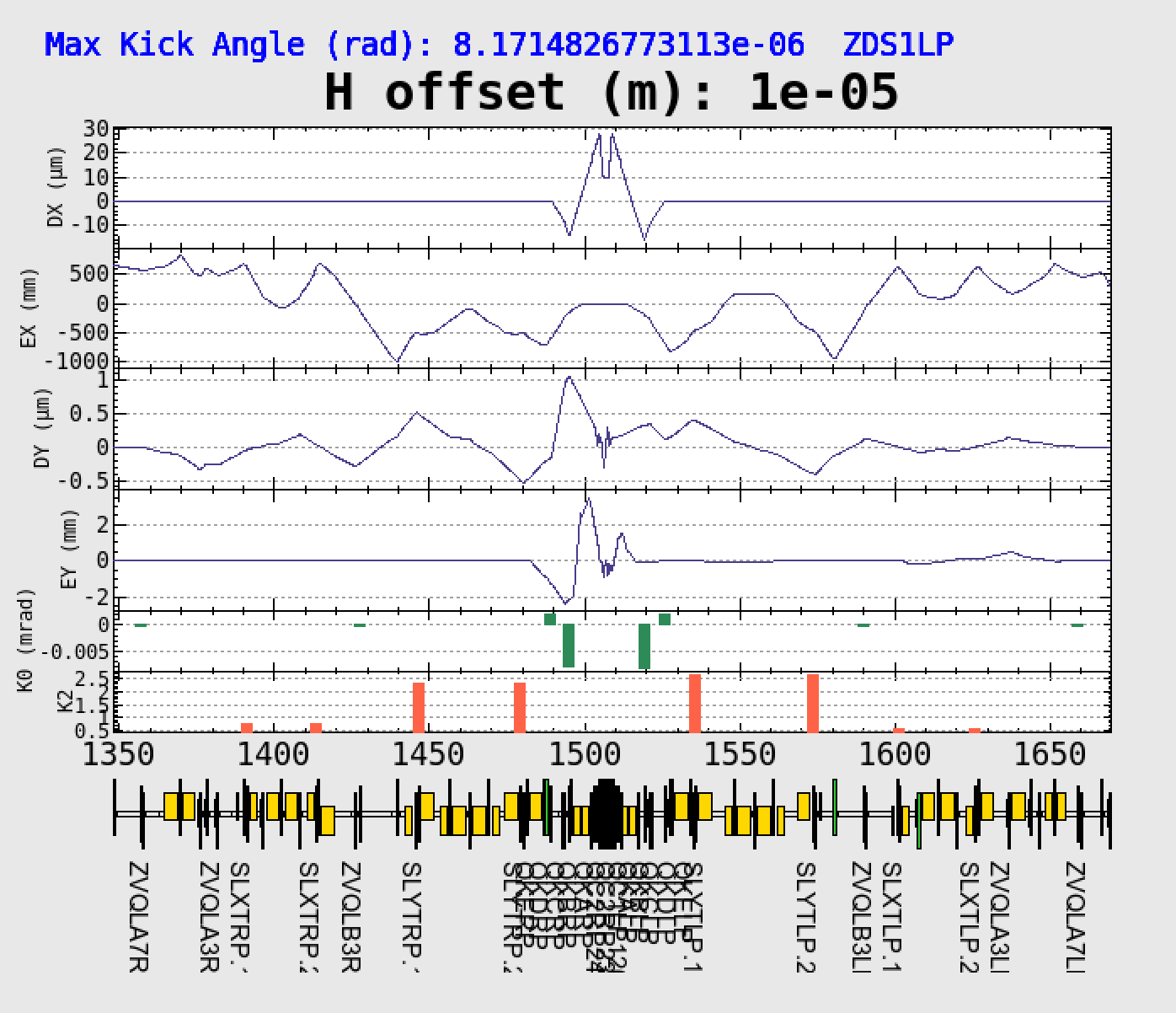
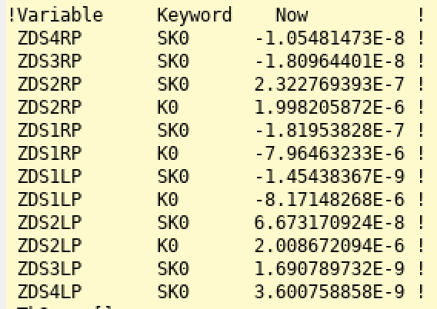
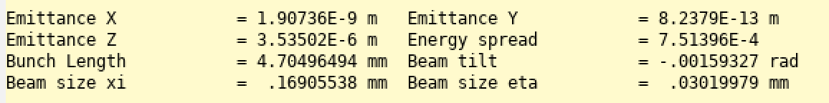
iBump LER (Phase 3)
Bump Height: 10 μm
Bumpがない時：8.18E-13 m

Slide 22
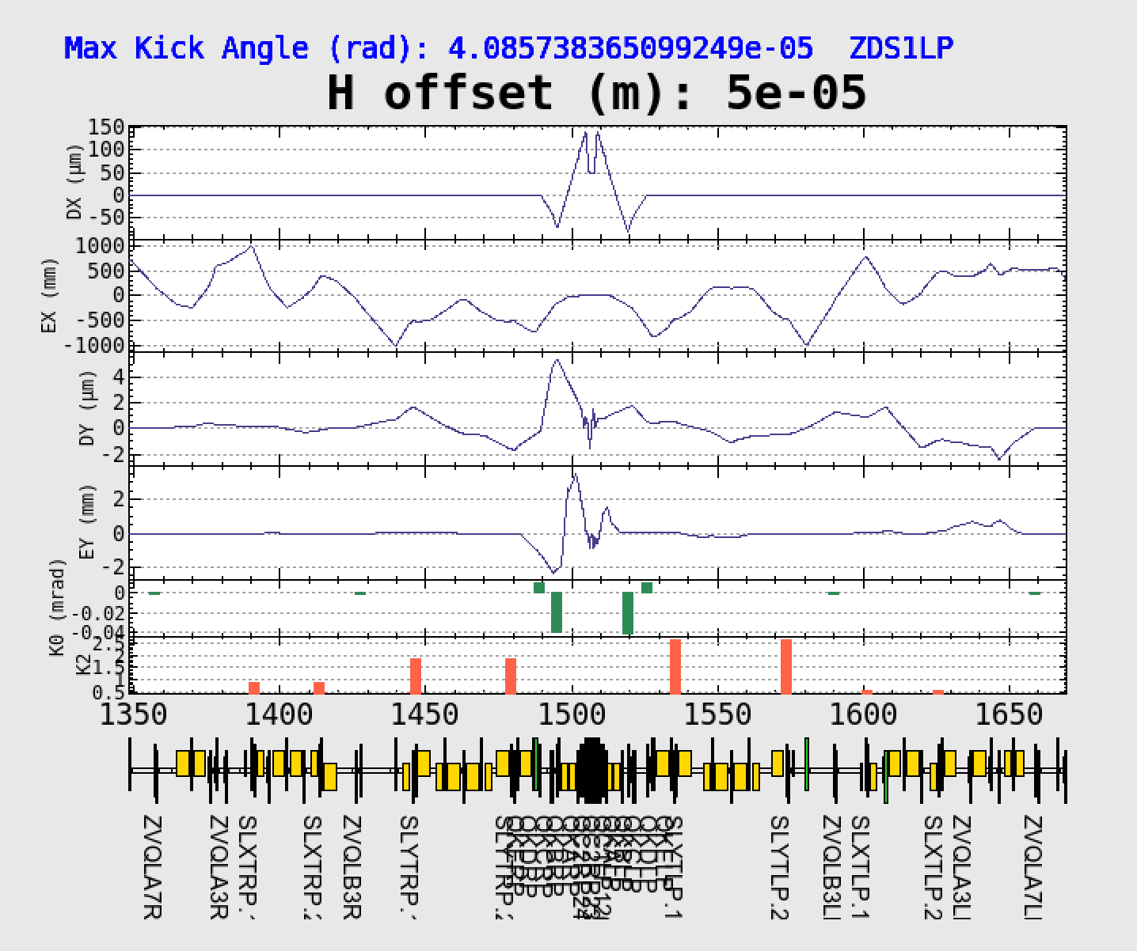
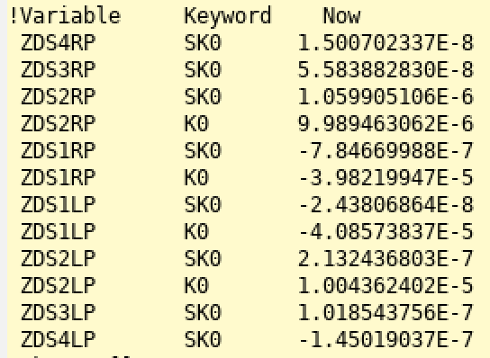
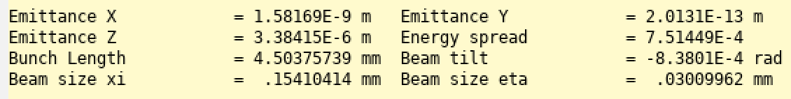
iBump LER (Phase 2 4x8)
Horizontal kick < 44.4μrad
Bumpがない時：1.96E-13 m

Slide 23
Parameters for dither simulation
initial
nominal
ultimate
Luminosity | 1 x 10³⁴ cm⁻² s⁻¹ |  | 1 x 10³⁵ cm⁻² s⁻¹ |  | 8 x 10³⁵ cm⁻² s⁻¹
 | LER | HER | LER | HER | LER | HER
I_{beam} [A] | 1.0 | 0.8 | 2.7 | 1.95 | 3.6 | 2.6
# of bunches | 2500 |  | 2500 |  | 2500
ε_{x}/ε_{y} (nm/pm) | 2.2/44 | 5.2/104 | 3.2/51.84 | 4.6/77.28 | 3.2/8.64 | 4.6/12.88
β_{x}*/β_{y}* (mm) | 128/2.16 | 100/2.4 | 128/1.08 | 100/1.2 | 32/0.27 | 25/0.30
σ_{x}*/σ_{y}*(μm/nm) | 16.8/308 | 22.8/500 | 20.2/237 | 21.4/305 | 10.1/48 | 10.7/59
σ_{x}*_{eff} (μm) | 249 | 208 | 249 | 208 | 249 | 208
ξ_{x}/ξ_{y} | 0.0033/0.024 | 0.0013/0.0257 | 0.0083/0.049 | 0.0052/0.046 | 0.0028/0.0881 | 0.0012/0.0807
Δx (lumi:20% drop) | ~110μm |  | ~55μm |  | ~10μm
Lumi. meas. | 1kHz |  | 1kHz |  | 1kHz
accuracy | ~5 x 10⁻³ (w/ radiator) |  | 1.3 x 10⁻³(w/o radiator) |  | < 1 x 10⁻³
σ_{x}*_{eff} = σ_{z}sinφ

Slide 24
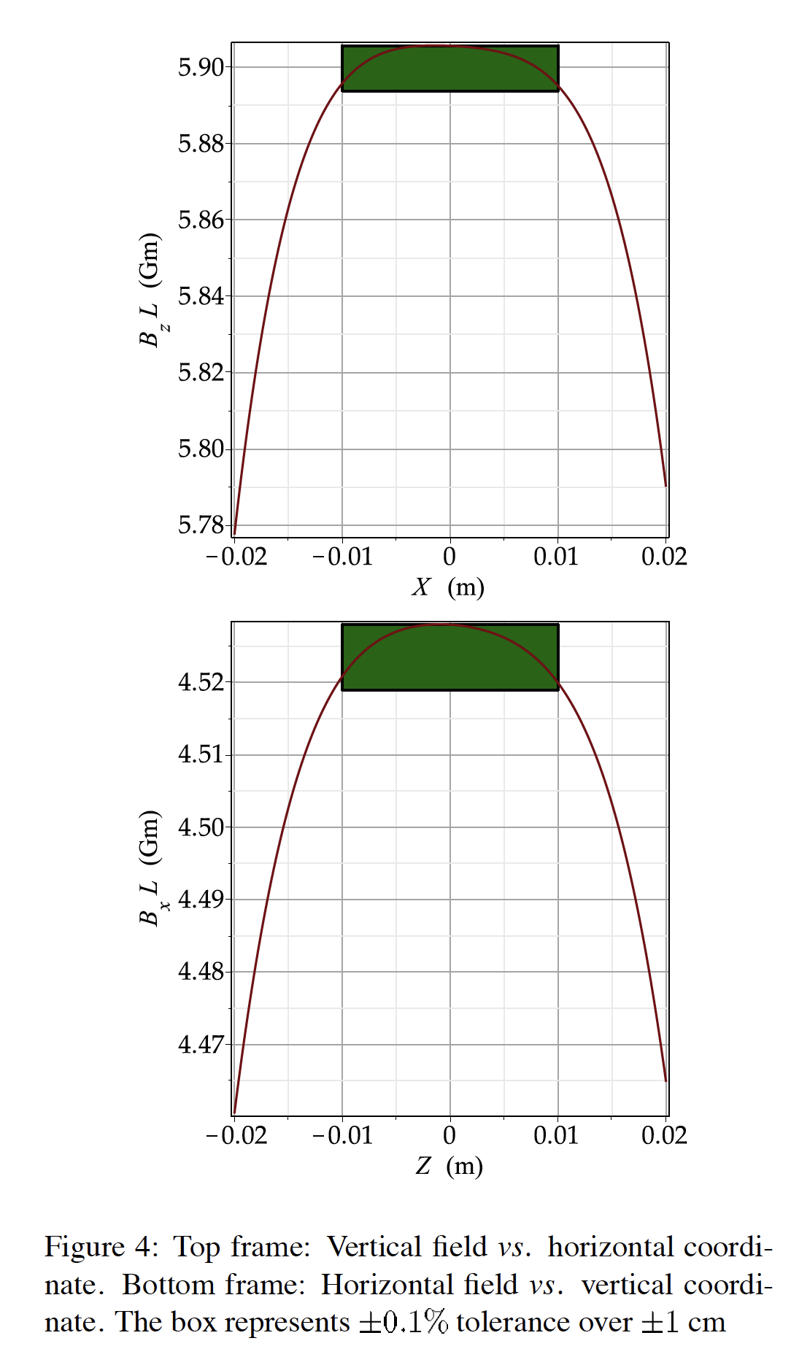
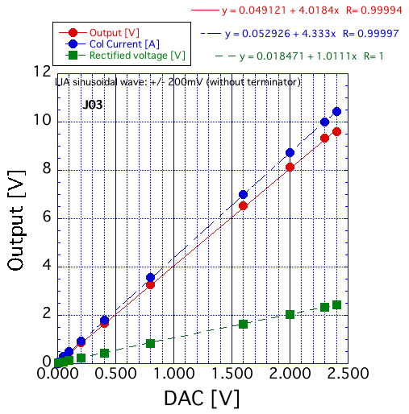
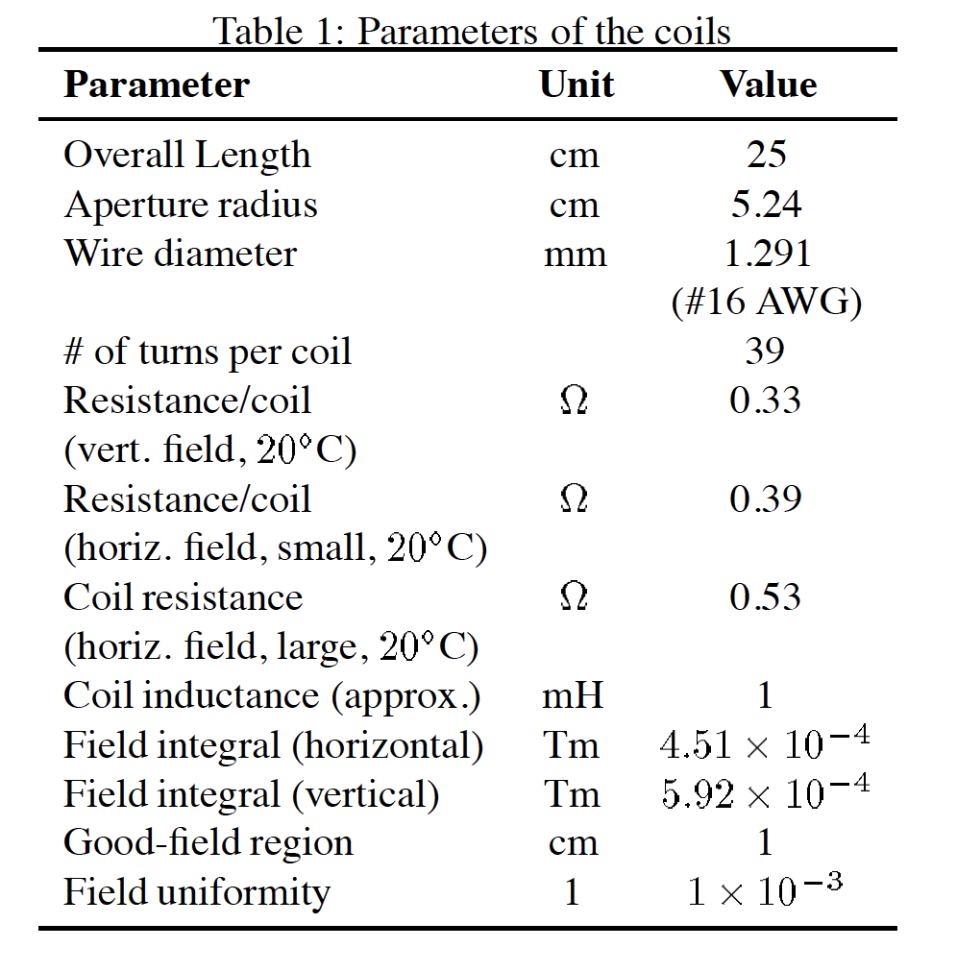
Field measurements and programmable amp calibration data
Measured on Aug. 31st 2017

Slide 25
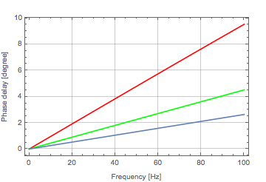
T. Oki
Damping and phase delay of a magnetic field
Damping ratio Phase delay
Phase difference: ~ 5 degrees
@77Hz among coils
A.W. Chao and M. Tigner, Editors,
Handbook of
Accelerator Physics and Engineering,
World Scientific, Singapore (1999), p. 268
Red: outer radius = 51mm, thickness = 6mm
Green: outer radius = 48mm, thickness = 3mm
Blue: outer radius = 42mm, thickness = 2mm

Slide 26
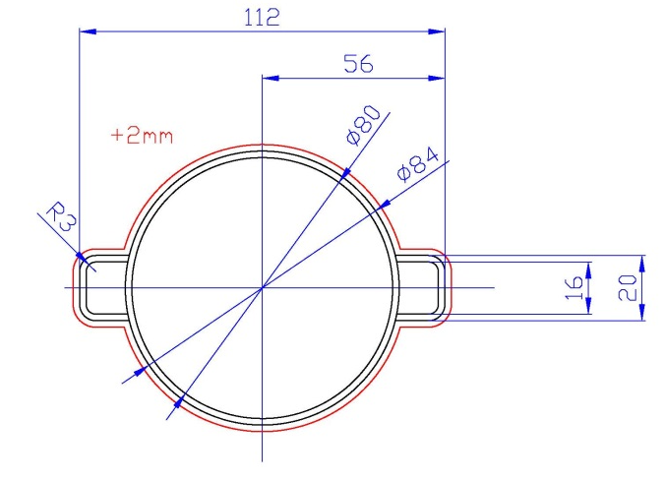
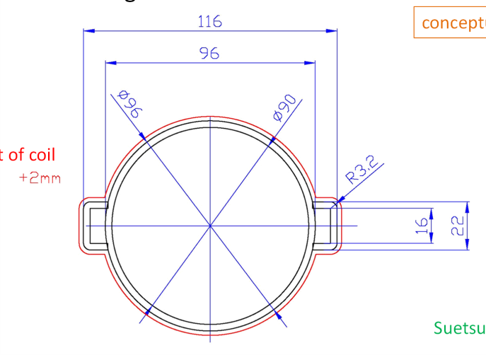
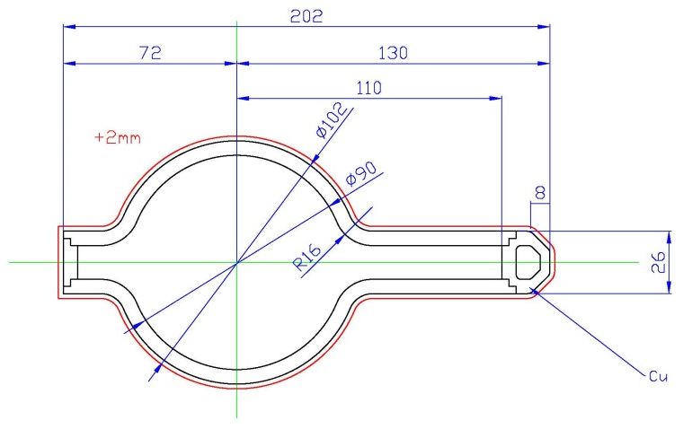
Conceptual drawing for 3 type of beam pipes
ZDS1{L, R}P
  Inner diameter: 80 mm
  Thickness: 2 mm
ZDS2{L, R}P
  Inner diameter: 90 mm
  Thickness: 3 mm
  10 μm Cu coating inside.
ZDS{3, 4}{L, R}P
  Inner diameter: 90 mm
  Thickness: 6 mm
  10 μm Cu coating inside.
All pipes are made of SS316L.
Y. Suetsugu

Slide 27
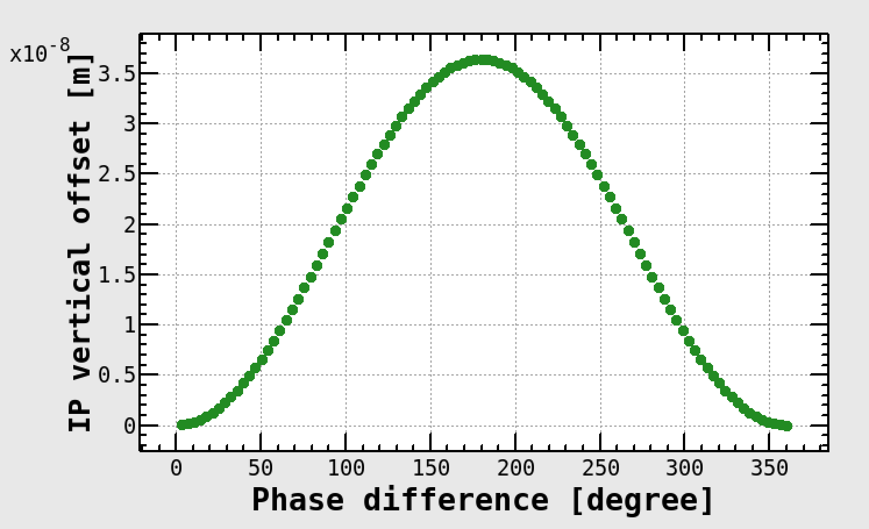
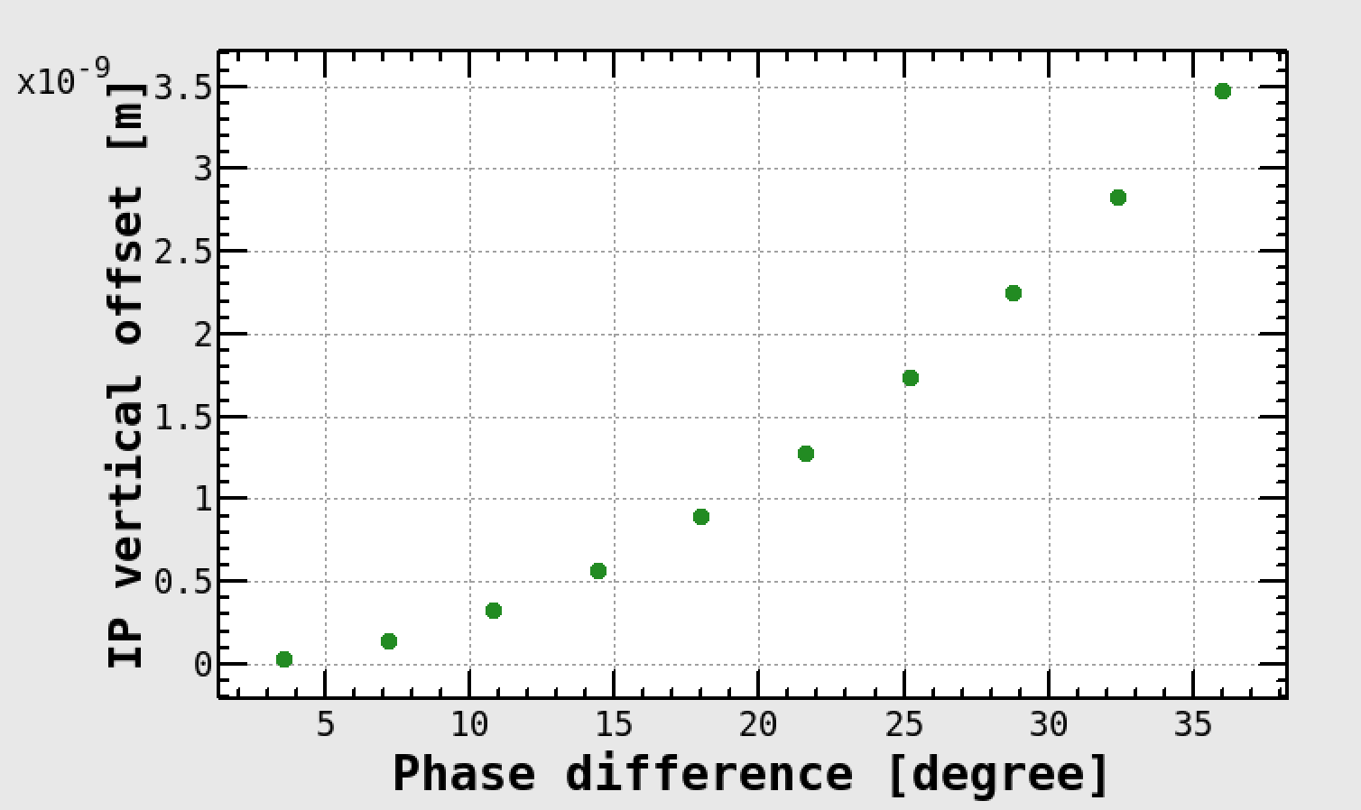
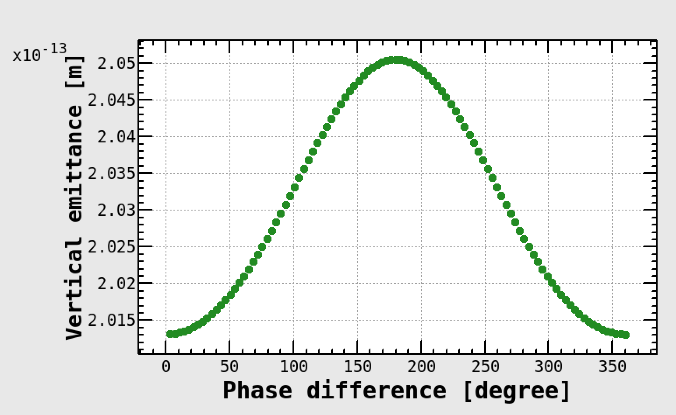
Effect of phase difference among coils
Phase 2 4x8

Slide 28
T. Oki
Damping of magnetic field due to eddy current
Damping ratio
SS316L
Copper
(KEKB
LER pipe)
Dithering
freq. range
A.W. Chao and M. Tigner, Editors,
Handbook of
Accelerator Physics and Engineering,
World Scientific, Singapore (1999), p. 268
1k 10k 100k
Resistive and thinner pipe suppresses the damping effect.

Slide 29
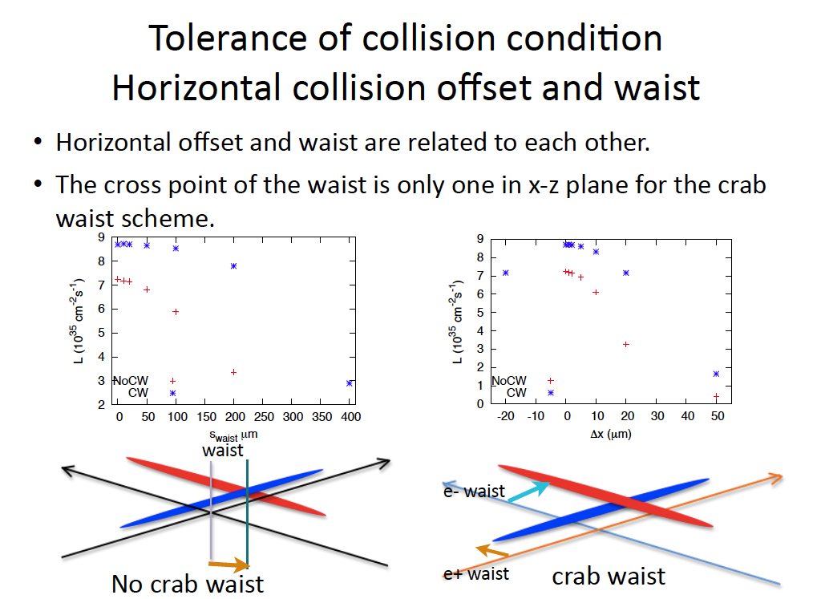
K. Ohmi
β_{y}*~300μm
S_{waist}:1/10 β_{y}* (~30μm)
-> Lum. Loss ~ 3.5%
Δx = Tan[2φ]*Δs
Δs=30μm -> Δx = =2.5μm

Slide 30
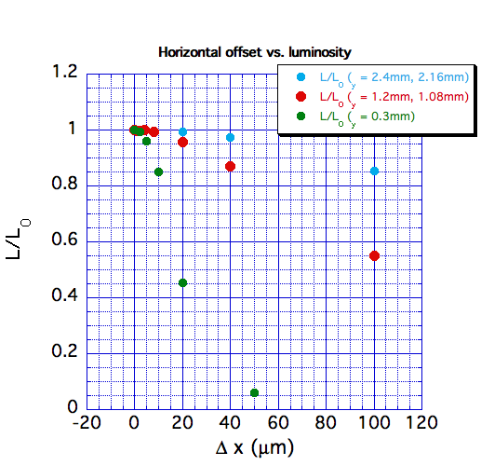
Luminosity degradation due to horizontal orbit shift at IP
β_{y}*
8
4
1

Slide 31
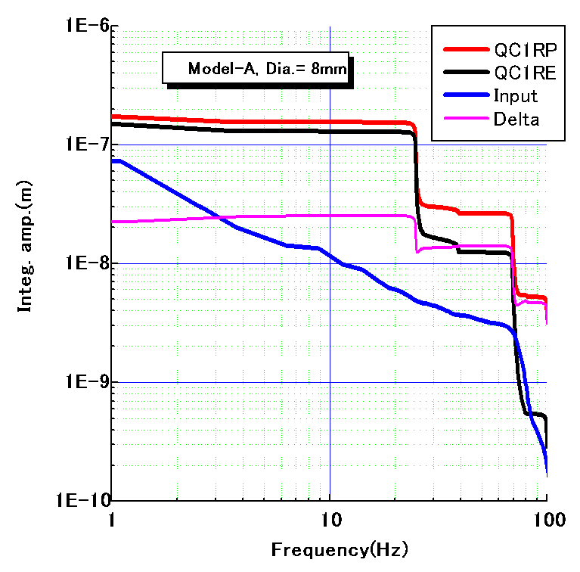
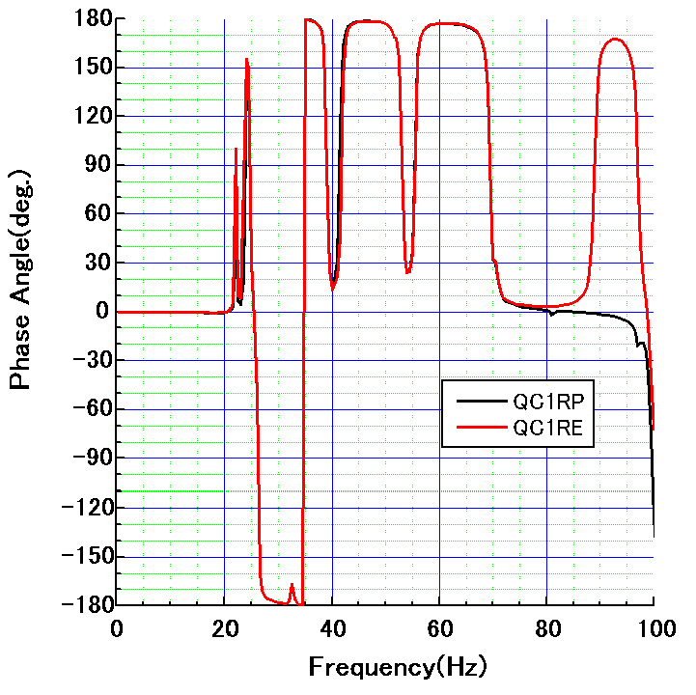
Estimation of QCS vibration and luminosity degradation
1000
100
10
1
0.1
(vertical)
Integral amplitude (nm)
Measured
ground motion
(input data)
Phase (deg.)
25 nm@25 Hz
H. Yamaoka
QC1RP and QC1RE vibrate with same phase,
but the amplitude difference still arises: 25 nm at 25 Hz…
Phase 3
Luminosity degradation (based on beam-beam simulation by K. Ohmi)
Frequency (Hz) | 24.85 | 38.93 | 69.34 | 99.60
Δy_{IP*}^{rms} (nm) | 18.63 | 1.72 | 8.29 | 3.14
L/L₀^{average} (%) | 95.4 | 99.8 | 99.7 | 99.7
15 (recent meas.)
40
84
Feedback rejection gain
-16.7dB (19 nm -> 2.8 nm)
-23dB (40nm -> 2.8 nm)

Slide 32
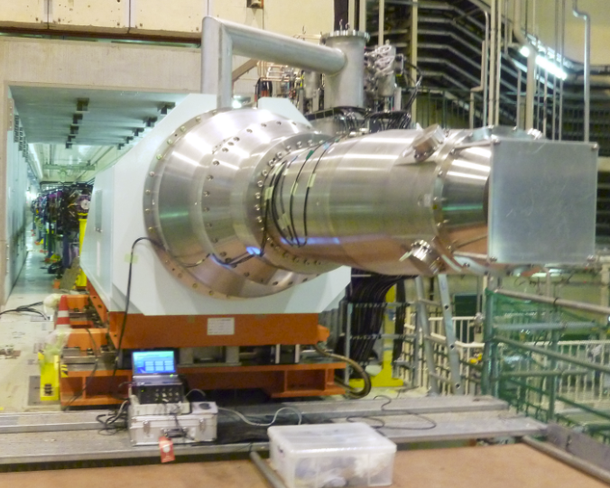
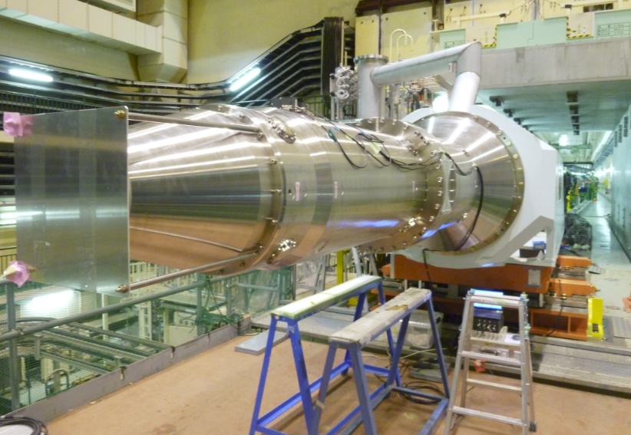
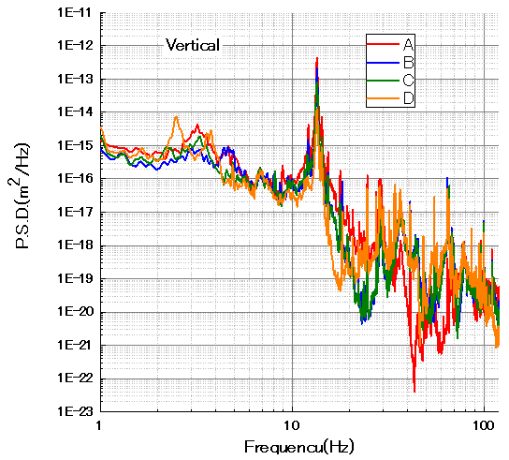
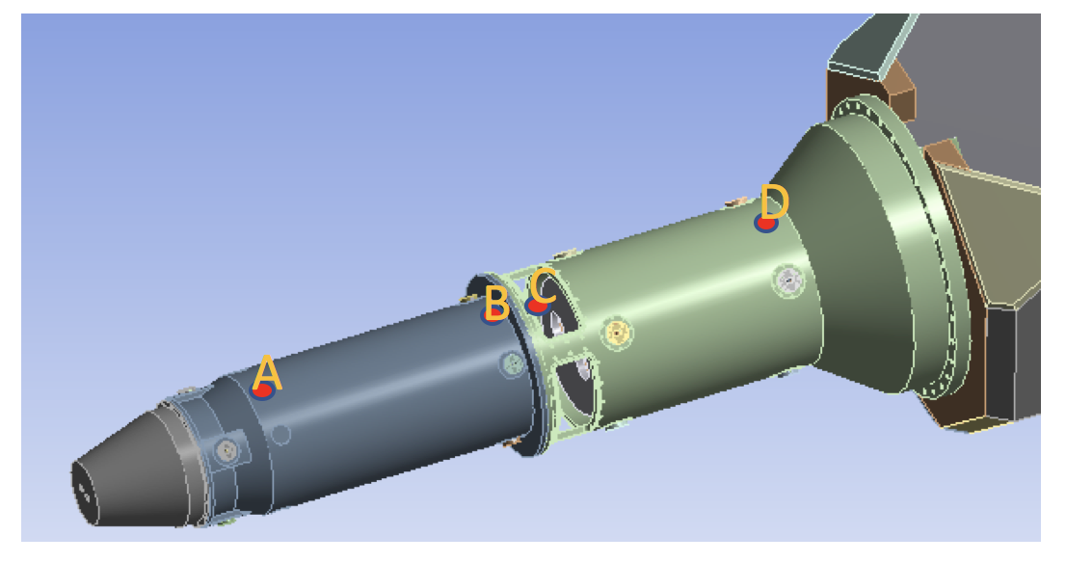
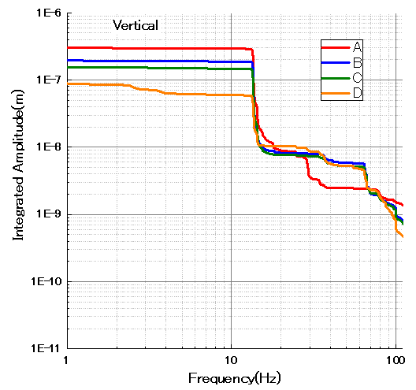
QCSLとQCSRクライオスタットの振動測定（山岡さん）
・2017/3/6の電磁石打合せの資料より…。
鉛直方向
QCSL: 45nm@20Hz
QCSR: 300nm@15Hz
注意：前頁のはコイルの振動で、こっちはクライオスタット

Slide 33
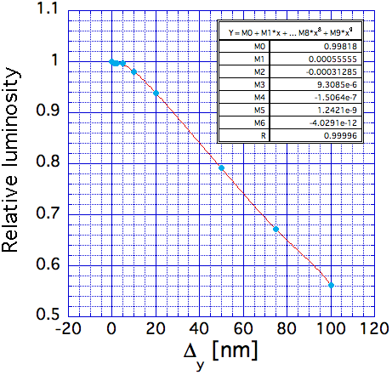
Beam-Beam simulation results
K. Ohmi
Just 20 nm offset leads to 6 % degradation of luminosity.

Slide 34
Commissioning of orbit feedback systems
Tuning of iBump orbit
  iBump in HER: COD measurements -> correction so that the bumps are closed.
  iBump in LER (dither orbit):
    Response of bpm signal (phase) to coil excitation by using LIM
    observe the 77 Hz component at two BPMs outside of the bump with 90 degree phase difference in each horizontal and vertical directions -> correction so that the 77 Hz components are minimized
    correction using turn-by-turn BPMs?
    Prior to those corrections, should we do corrections by using a DC bump?
Setup the orbit feedbacks
  Vertical feedback
  Horizontal feedback (dithering)
    A. Fisher (SLAC) will stay at KEK in the commissioning of dithering system
    U. Wienands will stay at KEK for about 1 month in the commissioning of dithering system.

Slide 35
ビームアボート後の衝突の確立の手法
KEKBでは、二つのビームを衝突状態に持っていく途中（過渡現象）でビームロスするなどの現象が見られ、苦労する場合があった。
  Nano beam 衝突はでどうか？
    実際にやって見ないとわからないことも多いが、予めシミュレーションをやっておきたい

Slide 36
ルミノシティ調整
基本的なマシンパラメータの確立
  IP beta functions
  Betatron tunes
  Beam currents, Number of bunches
Tuning items
  Tuning knobs
    X-Y coupling
    waist points
    IP dispersions
    Target values of orbit feedback
    Betatron tunes
  Method of parameter search
    Scan, scan, scan,,,,,

Slide 37

Strategy of Beta Squeezing in Phase-2
We hope to squeeze the IP beta functions down to 4 x 8 in Phase 2.
If possible, 4 x 4 is desirable.
Phase | LER |  |  | HER
 | βx* [mm] | βy* [mm] | scale | βx* [mm] | βy* [mm] | scale
2.0* | 384 | 81 | 12 x 300 | 400 | 81 | 16 x 270
2.1 | 384 | 5.4 | 12 x 20 | 400 | 6 | 16 x 20
2.2 | 256 | 2.16 | 8 x 8 | 200 | 2.4 | 8 x 8
2.3 | 128 | 2.16 | 4 x 8 | 100 | 2.4 | 4 x 8
2.4 | 128 | 1.08 | 4 x 4 | 100 | 1.2 | 4 x 4
3.x | 32 | 0.27 | 1 x 1 | 25 | 0.30 | 1 x 1
adiabatic squeezing
Y. Ohnishi

Slide 38
Issues
IR design and dynamic aperture
Optics corrections & Low emittance tuning
Beam-beam related issues
IP orbit control to maintain beam collision
Beam loss and beam injection
Electron clouds
Injector upgrade for low emittance & high intensity beams
Detector beam background
The items in red were partially studied in Phase 1.

Slide 39
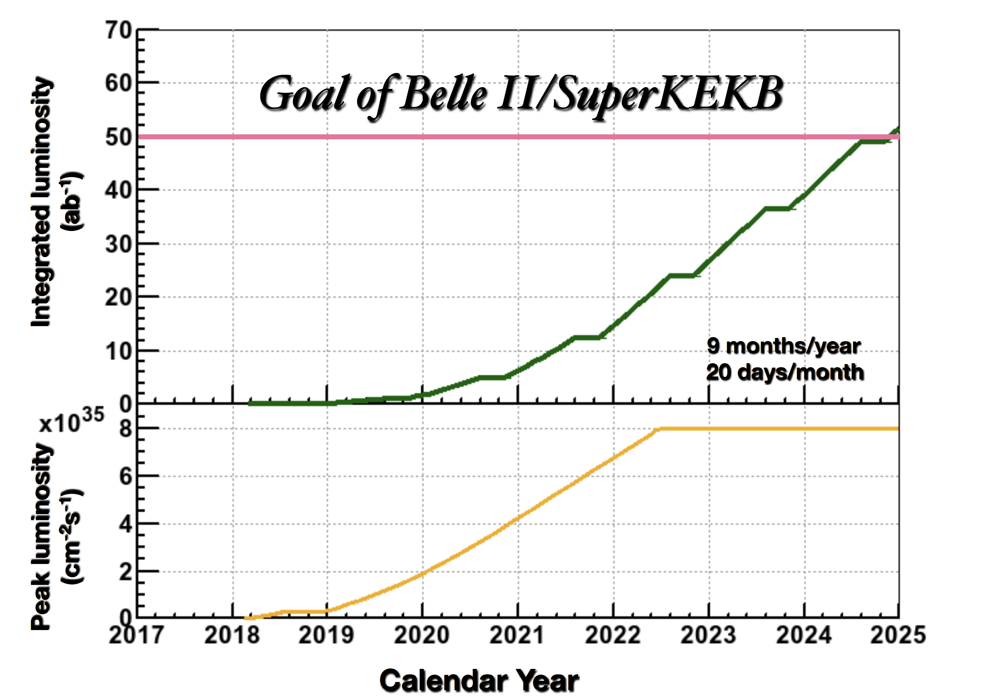
SuperKEKB Luminosity Projection
A lot of difficult works should be done in Phase 2 and 3.

Slide 40
Spare slides

Slide 41
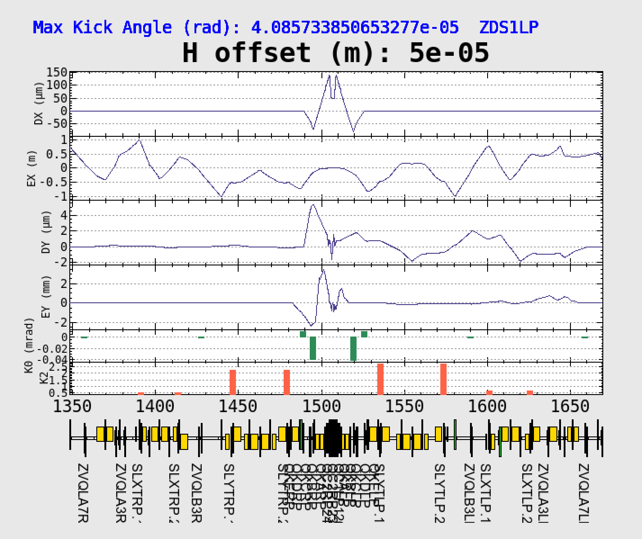
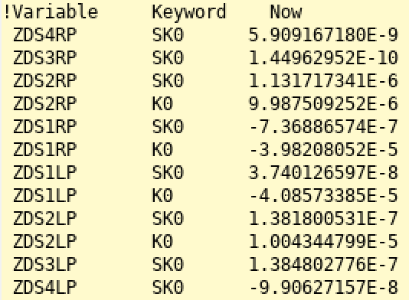
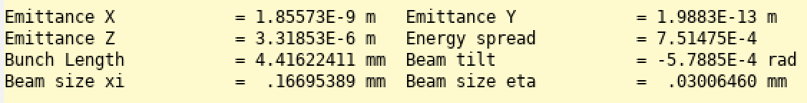
iBump LER (Phase 2 8x8)
Bump Height: 10 μm
Bumpがない時：1.96E-13 m

Slide 42
iBump steering kick angle
iBump FB | 積分磁場（Tm） | kick angle(mrad) @7GeV @5A | Commemnt
垂直ステアリング | 0.00335 | 0.143571429 | 江川・植木さんの磁場測定結果
水平ステアリング | 0.00611 | 0.261857143 | 江川・植木さんの磁場測定結果
Dithering | 積分磁場（Tm） | kick angle(microrad) @4GeV @5A
Horizontal | 0.000451 | 33.825 | UliさんのIPAC論文
Vertical | 0.000592 | 44.4 | UliさんのIPAC論文

Slide 43
Shift of collision timing makes a horizontal kick
With the drift of collision timing ->no shift of collision point ->no waist problem
However, the drift of collision timing makes a beam-beam defection and interferes with the detection of the true hor. offset.
Hor. offset from shift of collision timing
  offset：Δx=c Δt sinφ
  Tolerance for true horizontal offset: Δx corresponding Δt =0.20ps ->RF phase of 0.07°
Lorentz boost
φ
projection
Δt -> Δx=c Δt sinφ

Slide 44




Luminosity and beam-beam parameter with superbunch collision
Luminosity
Beam-beam parameter
σx^{effective} = σz sinφc
φc

Slide 47

Fabrication and field measurement
Fabrication and measurement of coils will be finished by this March.
U. Wienands, S.D. Anderson, MFD Metrology, SLAC

