Slide 1
Vacuum System for SuperKEKB (mainly for LER arc section)
Y. Suetsugu
on behalf of KEKB Vacuum Group
Design
Upgrade strategy
Design of key components
Beam pipes
Movable masks (collimators)
Countermeasures against EC
Present status and plans
Manufacturing of components
Plans
Summary

Slide 2
Upgrade strategy_1
Goal of vacuum-system upgrade is to realize;
Ultra-high vacuum
Pressure on the order of 10⁻⁷ Pa with beam
Maintain small emittance, Reduce background noise to detector, Avoid ion instability [HER]
Beam pipes (components) with low beam impedance
Maintain small beam emittance and short bunch length, Avoid single and multi-bunch instabilities
Stable and robust system
Against high beam current (SR, HOM)
Design based on established techniques, but introducing advanced idea at the same time.
High cost efficiency
Make use of the change to the nano-beam scheme
Continuous use of vacuum systems and reuse components in KEKB as much as possible.

Slide 3
Upgrade strategy_2
In concrete terms;
Infrastructures, such as electric lines, cooling water pipes, control systems are basically reused as it is, after maintenance.
Cooling water pipes should be rearranged. Especially for Wiggler section.
Capacity of water cooling system should be enhanced.
Radiation shielding scenario should be reconsidered around collimators (Beam loss: ~20 times of KEKB).
Pumping and monitoring system
Pumps: NEG as main pump, and Ion pump as auxiliary pump: Oil free and capture pumping system
Ion pumps are reused, and NEG is replaced with new one.
Disconnected to atmosphere during beam operation.
Rough pumping: Turbo molecular pump and drag pump
Oil free, Rough pumping system are reused.
Vacuum gauges (CCG), L-angle valves, thermo sensors, etc. are reused, with some new backups.

Slide 4
Upgrade strategy_3
Beam pipes
New beam pipe: Beam pipes with antechambers.
Low beam impedance, Higher strength against intense SR
Less photoelectron effect to position beam [LER] : Electron-cloud formation is suppressed.
Add more powerful countermeasures against electron cloud (EC) effects [LER].
Solenoid field, Rough surface at side wall, TiN coating
New technique: Clearing electrode, Grooved surface
Main components
Bellows chambers, gate valves, movable masks (collimators), stoppers, etc. are designed to fit the beam pipes.
Higher strength against higher beam currents
Main upgrade is the replacement of beam pipes and other main vacuum components.

Slide 5
Design of key components_1
Key components presented here:
Beam pipes
Beam pipes with antechambers
Aluminum-alloy beam pipe for LER
Countermeasures against electron cloud effects
Pumps
NEG strips
Connection flange
MO-type flange (Al and Cu)
Bellows and Gate valves
Comb-type RF shield
Movable mask (collimator)
Conceptual designing has just started.

Slide 6
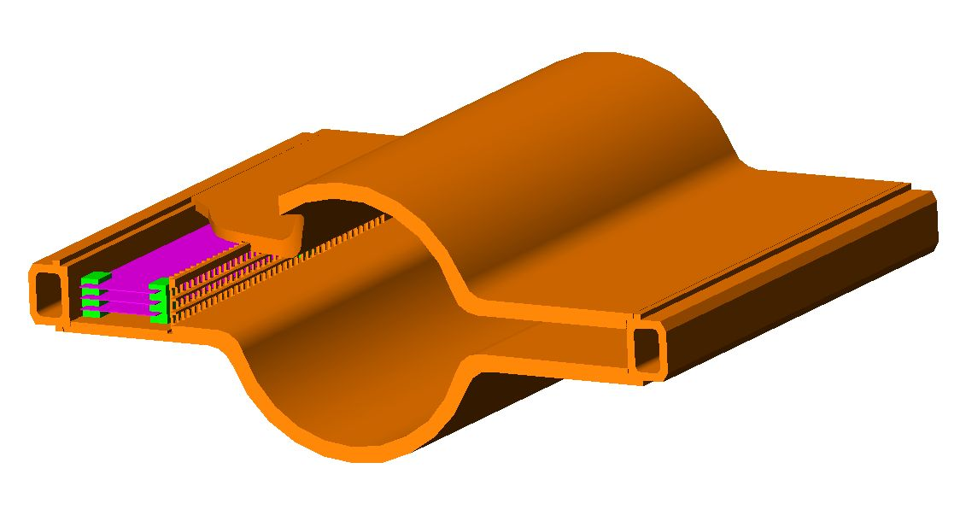
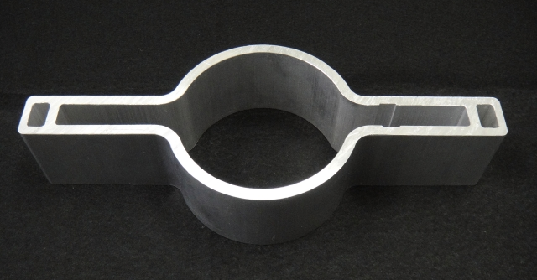
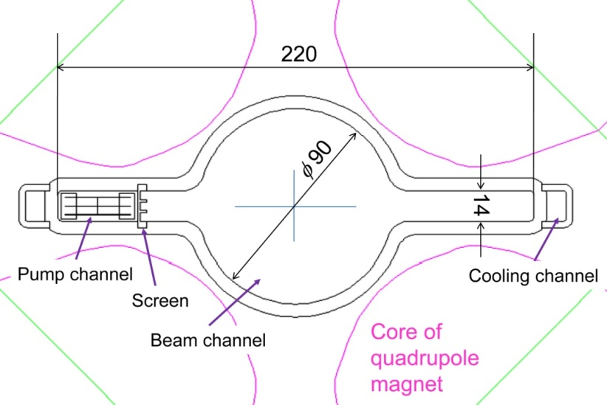
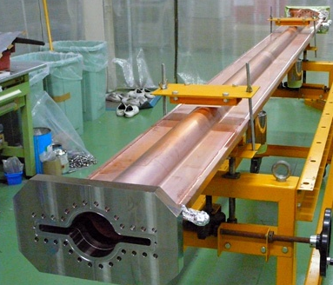
Design of key components_2
Beam pipes: Beam pipes with antechambers
Small effect of photoelectrons, low beam impedance, low SR power density
The cross section should fit to the existing magnets.
Aluminum alloy is available for LER arc section (see next). Copper is required for wiggler section (and HER).
Available by cold-drawing technique (copper) or extrusion technique (aluminum)
Copper beam pipes have been tested in KEKB.
Concept
Aluminum
(A6063)
NEG strip
Conductance:
~ 88 l/s/m
Beam
SR
^{t}6 mm
Copper
(OFC)
BPM
Q magnet

Slide 7
Design of key components_3
Aluminum-alloy beam pipe for LER
In the nano-beam scheme,
Max. SR power density ~ 3 W/mm² (ref: HER ~15 W/mm²) owing to long curvature of bend
→ Aluminum alloy is available.
Merit (compared to copper):
Cost reduction
Easy manufacturing (TIG welding is available.)
Easy handling (light)
Aluminum beam pipe with antechambers (extrusion)

Slide 8
Design of key components_4
Aluminum-alloy beam pipe for LER
Problems to be considered (compared to copper case):
Relatively high gas desorption and high secondary electron yield
→ With TiN coating in any way to suppress electron cloud effect
High resistive wall impedance
→ Not so serious owing to a large aperture
Vibration of beam pipe → Eddy current in Q → Beam oscillation
→ A problem in Spring-8. Rigid fixing of beam pipe was effective.
Radiation issues: (T. Sanami, KEK)
Leakage of SR (ε_{r} = 1.8 keV):
− Dose < 1 MGy for 10 years :OK
− Checked experimentally in KEKB.
Shielding of loss particle
No big difference between
Al and Cu in a simulation.
(by MARS15 + MCNP)
Dose rate
Al chamber
Cu chamber
Al-alloy beam pipe is adopted for LER beam pipe

Slide 9
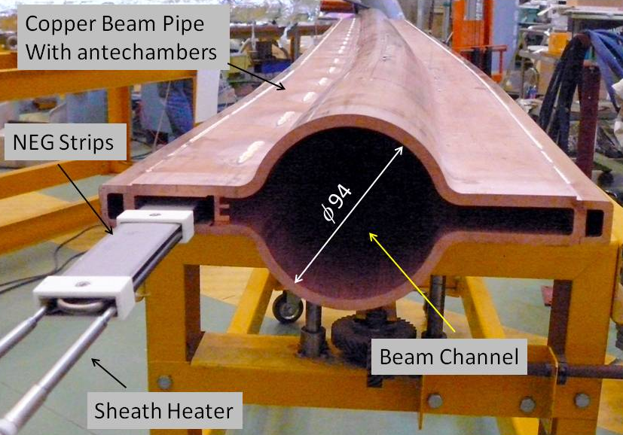
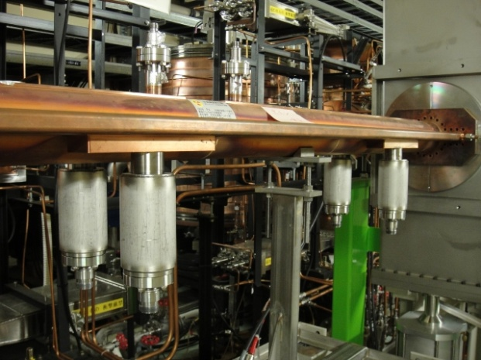
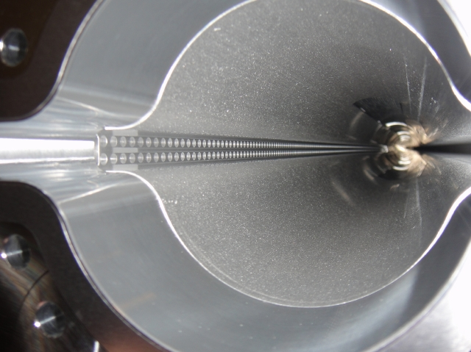
Design of key components_5
Main Pump (NEG)
Arc: Available in one of antechambers (inside of the ring)
Make the most of distributed pumping system: effective pumping.
Effective pumping speed of ~ 80 l/s/m.
Straight: Lumped pump ports at both antechambers.
Ion pumps: Placed every 10 m
Helpful at higher pressure
Diameter φ 4 mm,
thickness 5 mm
2 row: 333 holes/m
C~2.5x10⁻¹ m³/s/m
S_{eff}~ 1.x10⁻¹ m³/s/m
Arc section
Straight section
(Wiggler section)
Screen

Slide 10
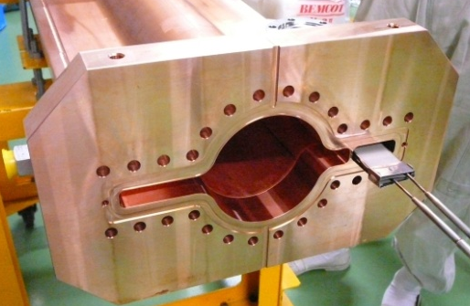
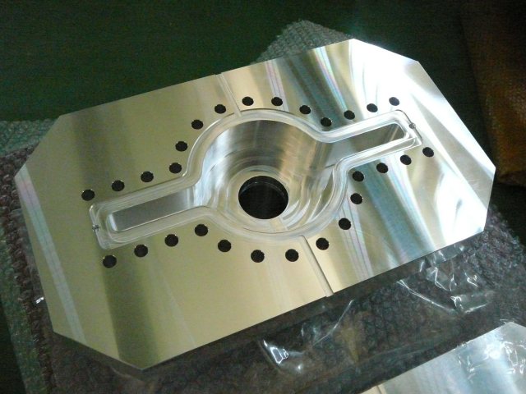
Design of key components_6
Flange : MO-type Flanges
Thermally strong, sure RF bridge, applicable to antechamber scheme, low beam impedance
In addition to stain-less flanges, copper alloy and aluminum-alloy flanges had been developed.
Easy welding to pipes, reduction in heating by wall loss
Several copper flanges have been installed into the ring and tested.
Copper-alloy flange (CrCu)
Aluminum-alloy flange (A2219)

Slide 11
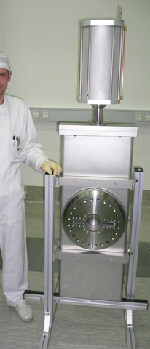
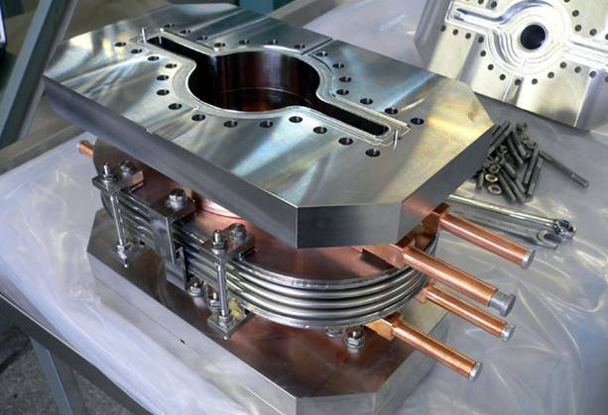
Design of key components_7
Bellows and gate valves with comb-type RF-shield
Sure RF shielding, thermally strong
Applicable to antechamber scheme
Finger-type for some cases, if flexibility is required.
Trial models has been installed into the KEKB ring and tested with beam.
Fitting to beam pipe with antechambers
Reduction in the temperature of bellows has been
demonstrated.
Gate valve
Bellows chamber for antechamber
Comb-type RF shield (Gate valve)

Slide 12
Design of key components_8
Countermeasures against electron cloud (EC) effect [LER]
Serious issues for recent positron and proton storage rings.
Sections | L [m] | L [ %] | Countermeasure | Material
Total | 3016 | 100
Drift space (arc) | 1629 m | 54 | TiN coating + Solenoid | Al (arc)
Steering mag. | 316 m | 10 | TiN coating + Solenoid | Al
Bending mag. | 519 m | 17 | TiN coating + Grooved surface | Al
Wiggler mag. | 154 m | 5 | Clearing Electrode | Cu
Q & SX mag. | 254 m | 9 | TiN coating | Al (arc)
RF section | 124 m | 4 | (TiN coating +) Solenoid | Cu
IR section | 20 m | 0.7 | (TiN coating +) Solenoid | Cu or ?
New
By using these countermeasures, the average electron density on the order of 10¹⁰ e⁻/m³ will be obtained.
Threshold of head-tail instability: ~1.6×10¹¹ e⁻/m³

Slide 13
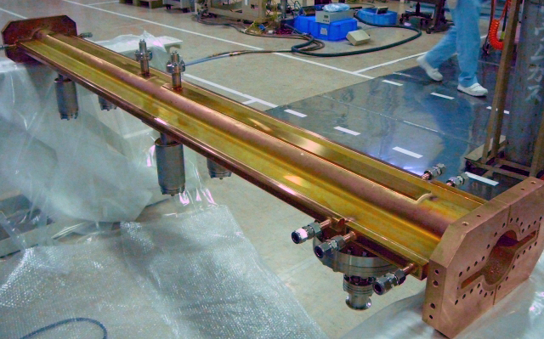
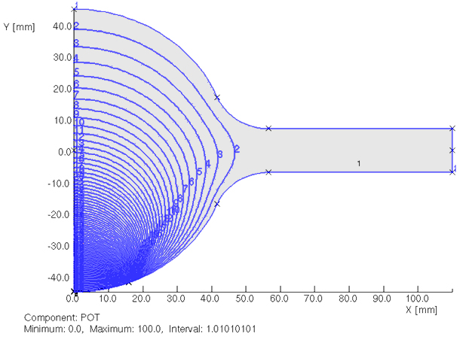
Design of key components_9
Some new techniques for EC mitigation
Clearing electrode for wiggler section.
Attract electrons by electrostatic field
Very thin electrode has been developed
0.1 mm tungsten on 0.2 mm Al₂O₃
Small impedance and effective heat
transfer
Have been tested in KEKBdeveloped
Expected reduction ratio: 1/100
Also demonstrated in CesrTA
Manufacturing has already started.
Inside view
0 V
Equipotential lines
Beam channel
(φ 90mm)
+75 V
~3kV/m
Antechamber
Electrode
+500 V
Beam pipe with clearing electrodes

Slide 14
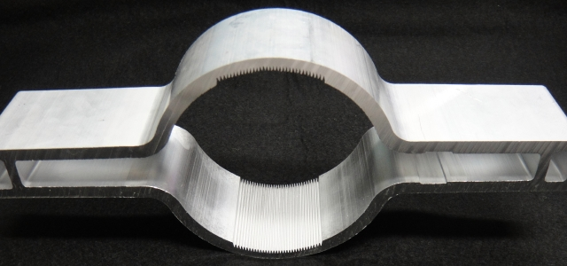
Design of key components_10
Grooved surface for bending magnets section
Reduce effective SEY structurally
Have been tested in KEKB, and also
in CesrTA
Extrusion test of aluminum beam pipe
was successful.
With TiN coating
(Roundness)
B
R_{t}
d
by L. Wang et al.
(Depth)
Aluminum beam pipe with grooves
Grooves
Valley ：R0.1~0.12
Top ：R0.15
Angle：18~18.3°

Slide 15
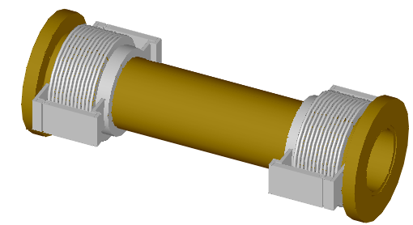
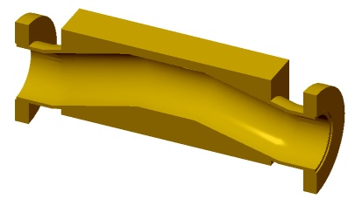
Design of key components_11
Movable mask (collimator)
Indispensable in order to reduce background noise of BELL-II
Long R&D history in KEKB
Stealth type was proposed, but not yet realized.
For SKEKB,
High thermal strength against wall heating (~ 1 mm from beam for vertical type)
Low beam impedance (ex. Against TMC instability)
Fitting to antechamber scheme
Robust against impact of beam in case
Placed at both sides of the ring
HOM absorbers (near to masks)
Concept of Ver.4 in KEKB will
be available, at least in the
beginning stage:
how to fit to antechamber
scheme?
Bellows Chamber
Ver.4 in KEKB
Mask Chamber
Bellows Chamber
Beam
One candidate: PEP-II type
Mask Head
(Ti)

Slide 16
Design of key components_12
Movable masks for KEKB (Ver.4) and PEP-II
PEP-II type
Pair-type
(Two mask heads)
“NO structural problem in this design. Intense excited HOM have heated up bellows chambers and NEG elements near the masks.”
(from M. Sullivan [SLAC])

Slide 17
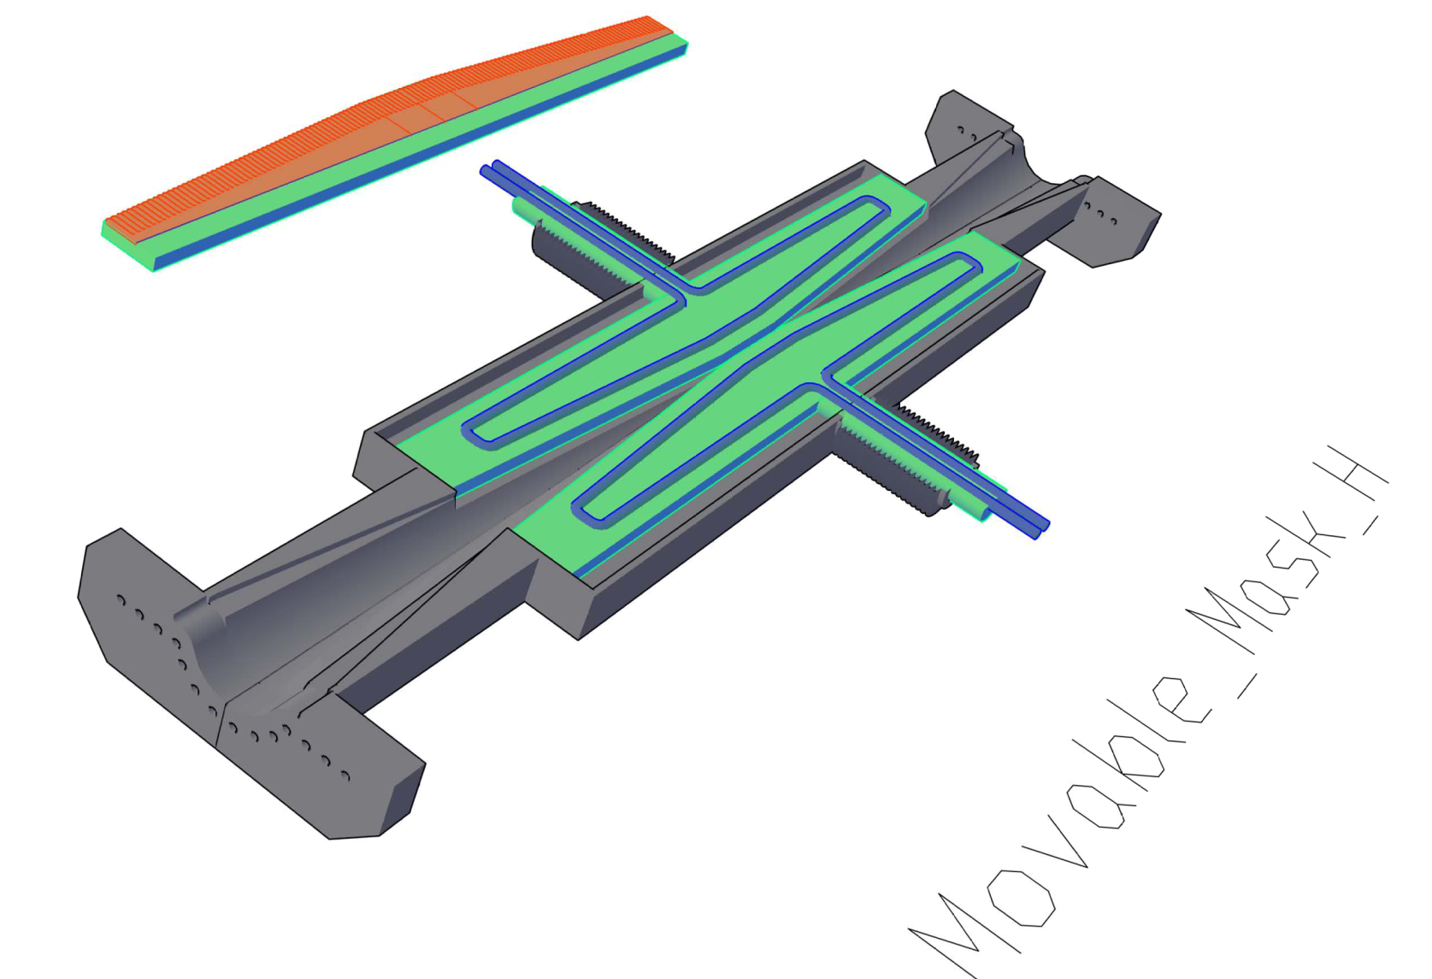
Design of key components_13
Concept of horizontal movable mask
RF shield fingers around body (GridCop?)
Pair-type
d = 5~10 mm
1500
Mask head: Graphite?
(t~1 mm?)
Length ~0.5 R.L.
Mask body: Copper
Cooling water
Reduced aperture at the mask head eliminates trapped modes.
Beam
Mask head
Tapered pipe
Cooling water
φ90

Slide 18
Design of key components_14
Concept of vertical movable mask
Pair-type
RF shield fingers around body (GridCop?)
1500
Beam
φ90
Tapered pipe
Mask head
d = ~1 mm
Cooling water

Slide 19
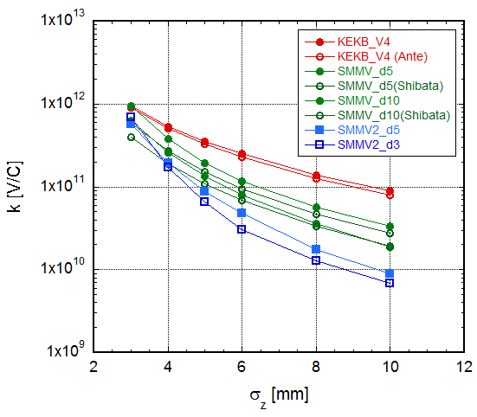
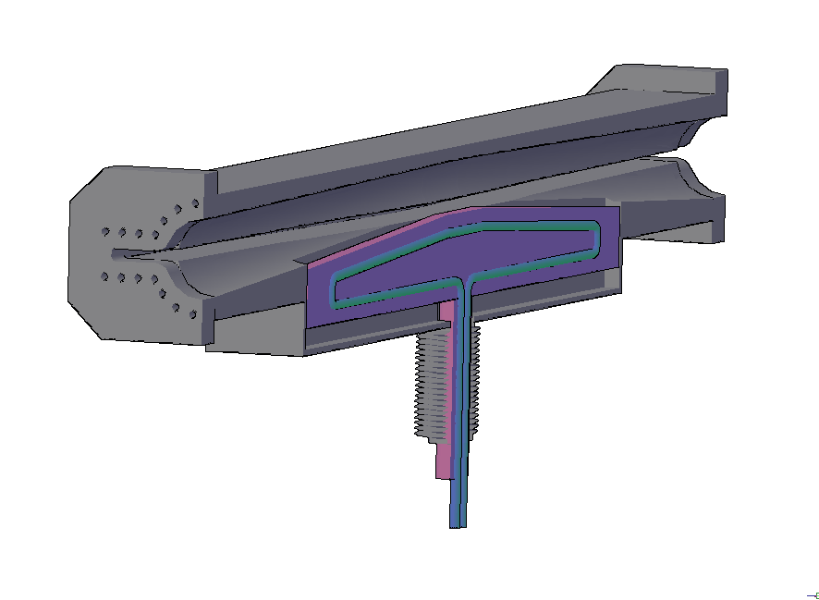
Design of key components_15
Loss factors (k)
Calculated by GdfidL, 3D model
Dependence on bunch lengths (σ_{z} )
Smaller than that for present Ver.4 (KEKB): owing to long ramp?
Small dependence on d
No big difference between single- and pair-type versions: Pair- type is smaller?
d: distance between beam and mask head
Log scale
（d=10 mm）
Single-type
（d=5, 10 mm）
Single-type
Pair-type
（d=3, 5 mm）
(Thank to K. Shibata)

Slide 20
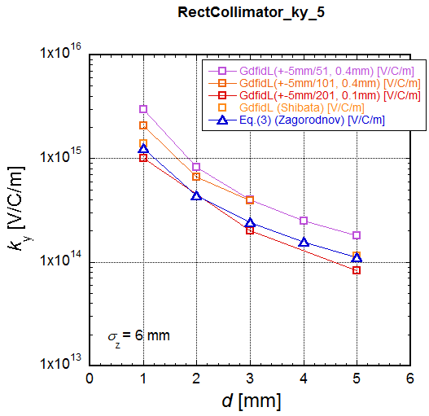
Design of key components_16
Kick factors (k_{y})
Calculated by GdfidL, 3D model, σ_{z} = 6 mm
Dependence on d
Pair-type
Large dependence on d
k_{y} for pair-type is approximately twice of that for single-type.
Log scale
(V)
Horizontal
d = 5 mm
k_{y} = 8×10¹³ V/C/m
(H)
Vertical
d = 1 mm
k_{y} = 1 ×10¹⁵ V/C/m
(Thank to K. Shibata and D. Zhou)
Ref.:I. Zagorodnovet al., EUROTeV-Report-2006-074

Slide 21
Design of key components_17
Threshold current for TMC (LER)
Transverse mode coupling instability (TMC)
Threshold formula (from B. Zotter, Handbook of Accelerators)
[A/bunch]
where
C₁ ~ 8
f_{s} = 2.13 ×10³ Hz
E/e = 4 × 10⁹ eV
β ~ 20 m (in Arc), ~1 m (in Local Correction)
k⊥ (σ_{z} ) = (kick factor, V/C/m)
Σ = (total number)
Design bunch current = 1.44 mA/bunch
For 1 mask (2 heads)
d = 5 mm [H, Arc]:
k_{y} = 8×10¹³ V/C/m →
I_{th} = 43 mA/bunch
d = 1 mm [V, Arc]:
k_{y} = 1 ×10¹⁵ V/C/m →
I_{th} = 3.4 mA/bunch
d = 1 mm [V, LC]:
k_{y} = 1 ×10¹⁵ V/C/m →
I_{th} = 68 mA/bunch
(With non-linear collimation scheme)
4 horizontal at arc masks will be available.
1 vertical masks at LC will be OK.

Slide 22
Design of key components_18
Wall loss
For a beam pipe with a radius of a [m], a bunch with a length of σ_{z} [m], the wall loss per meter is (from A. Piwinski, Handbook of Accelerators)
I_{b}=Bunch current
C=Circumference(=3000m)
Z₀=Vacuum impedance(= 377Ω)
σ_{c}=Conductivity (1/Ω)
μ = 1, Γ(3/4) = 1.225
For d = 1 mm:
If graphite (σ_{c}=2×10⁵ 1/Ωm) is used, P’=2.55 W/m. For 2500 bunches、P’= 32 kW/m. If ½ of total current concentrated in 1 mm width, P = 50 W/mm² (32 × π/2).
→ Very hard to deal
If tungsten (σ_{c}=2×10⁷ 1/Ωm) instead, P = 5 W/mm²
→ Well manageable with water cooling.
How about damage? Easy replaceable?

Slide 23
Design of key components_19
For movable mask;
The design has just started.
Start with a conventional idea
To be investigated are;
Bench marking of simulation code.
Results of GdfidL seem to Strongly depends on mesh sizes.
Evaluation of influence on beam dynamics
TMC, Banana effect, etc.
Choice of head material
Good electrical conductivity, High thermal strength, Easy bonding
Candidates: Mo, Ta, W, Re, Rh, Ru,,,
Simulation of heating by EGS4 has also started. (by T. Sanami)
Possibility of increasing beam size
Non linear optics (under investigation by Y.Ohnishi)
If novel ideas are required;
Spoiler using channeling in a crystal (Si)
Collimator using Laser, Electron beam,,,,
Long term has restarted again……

Slide 24
Present status and plans_1
R&Ds of components have almost finished.
Conceptual design of movable masks has just begun.
Manufacturing of some beam pipes had started.
Beam pipes with clearing electrode and Q beam pipe for LER wiggler section is under manufacturing (~220 m).
Copper beam pipes
will be delivered this fiscal year.
Together with some bellows chambers (16 pieces)
Beam pipes and bellows chambers for LER arc sections and straight sections will be ordered soon.
LER arc : Beam pipes for drift [S], beam pipes for bend [B], beam pipes for quad (with BPM) [Q]: ~1860 m (Al alloy)
LER straight: Chicane section and downstream of wiggler section and wiggler beam pipes: ~135 m (Cu)
Bellows chambers: 450 pieces (Al)

Slide 25
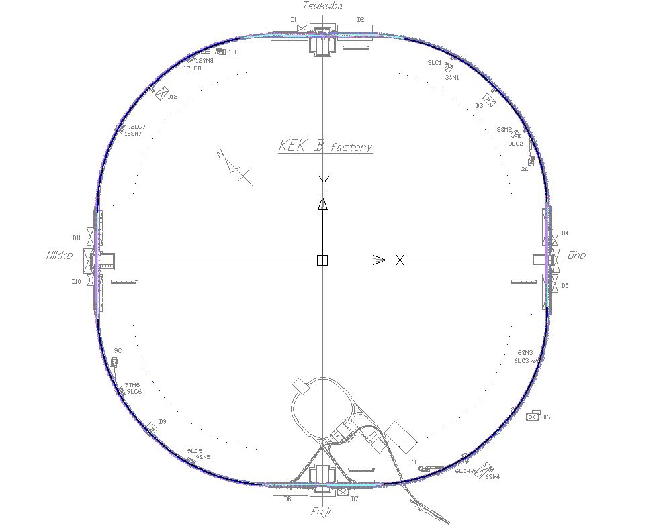
Present status and plans_2
Delivered and ordered this year [LER]
(IR)
(Local Correction)
Arc section
Chicane section
Wiggler section
Wiggler section
(RF)
Except for
Skew SX section
Beam dump
Tapers
(RF)

Slide 26
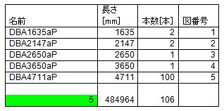
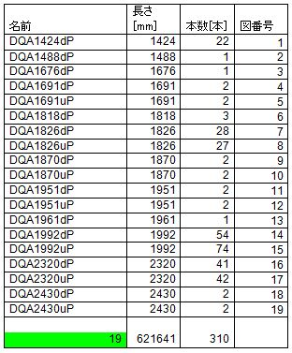
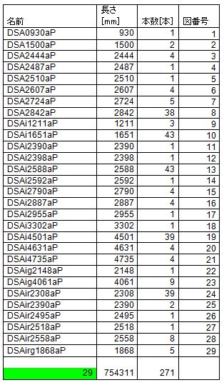
Present status and plans_3
Varieties of beam pipes for arc section
B beam pipe
Q beam pipe
S beam pipe
Total: 1860 m (except for bellows chambers)
Bellows chambers 450 : 90 m

Slide 27
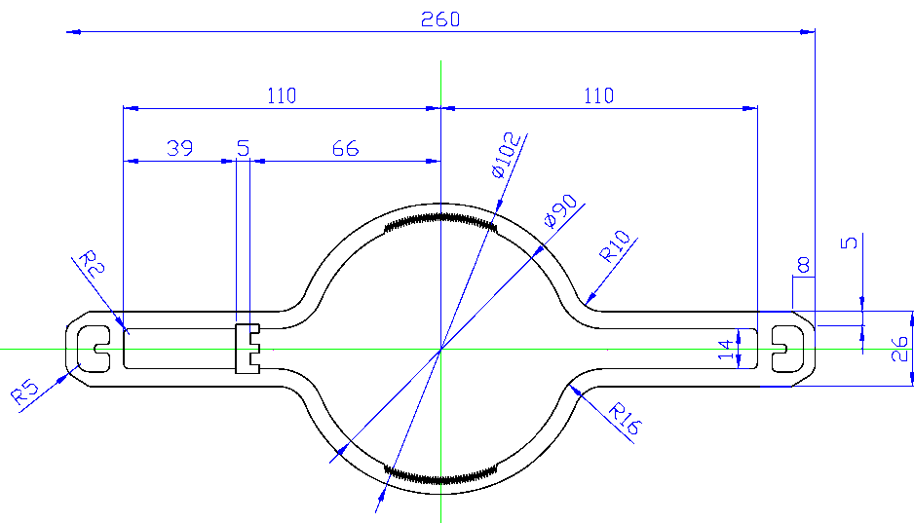
Present status and plans_4
Typical cross sections
Typical B beam pipe
Arc [S, Q]
Arc [B]
Grooved surface
NEG pump port
Photon mask

Slide 28
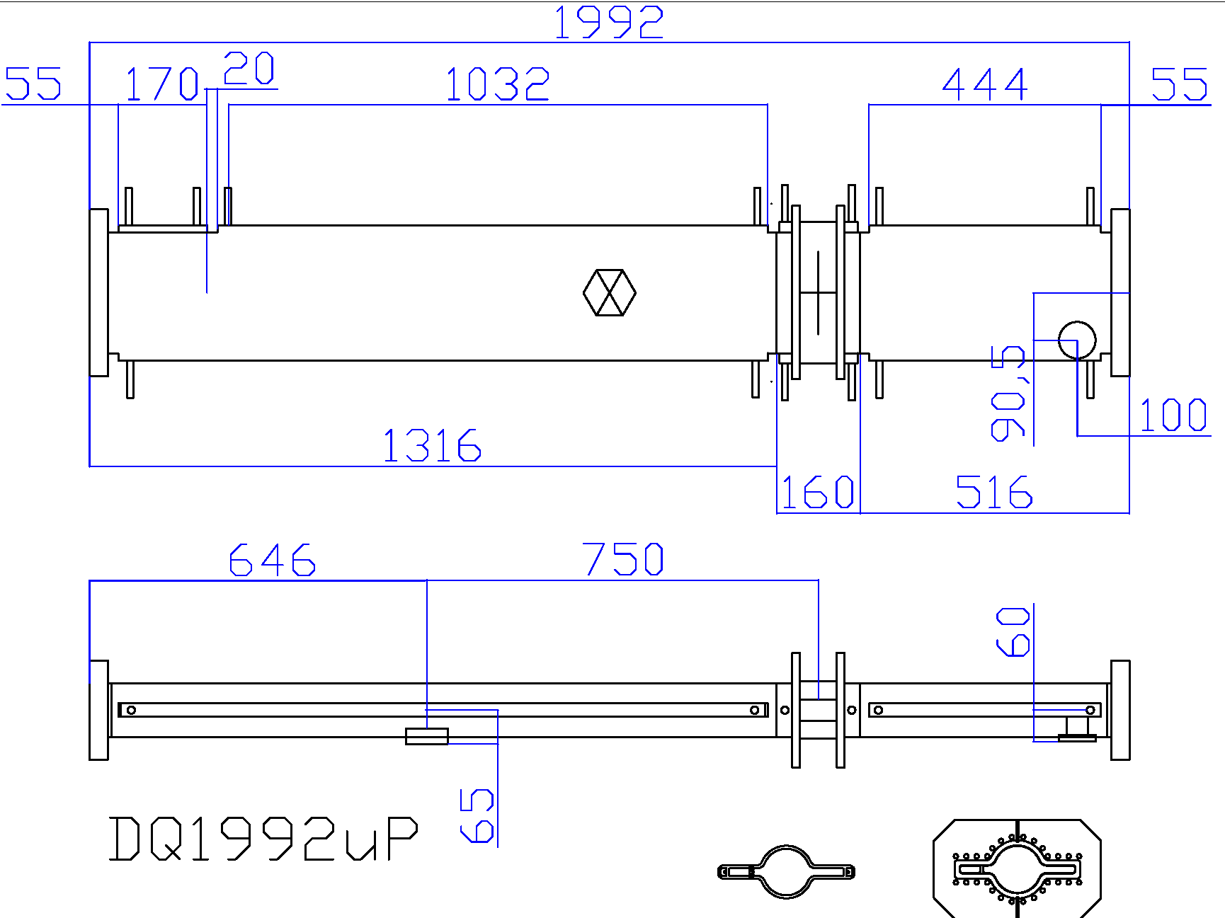
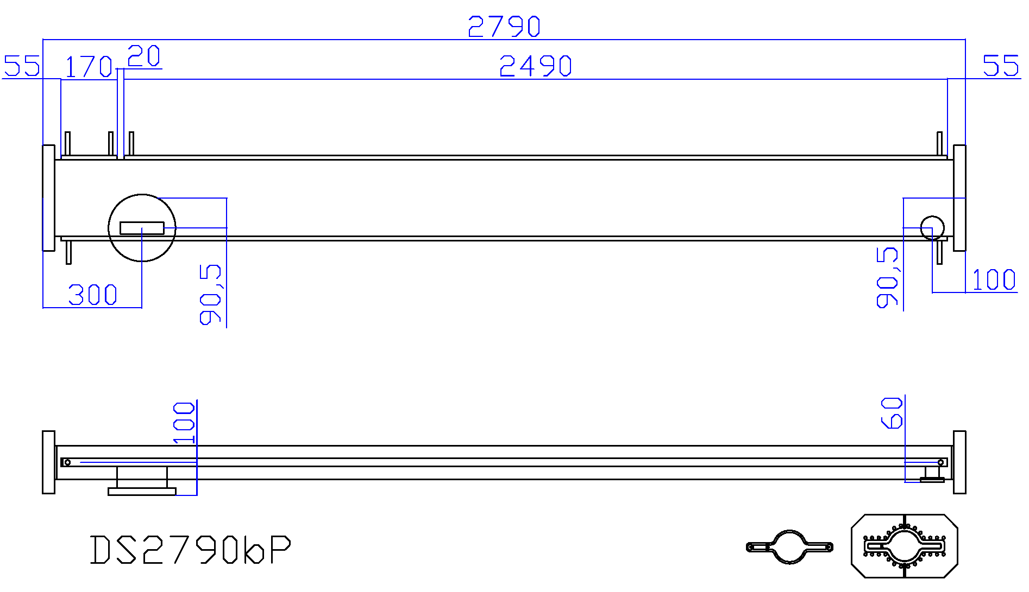
Present status and plans_5
Typical Q beam pipe
Typical S beam pipe
BPM block
NEG pump port
Photon mask
Ion pump port
NEG pump port
Photon mask

Slide 29
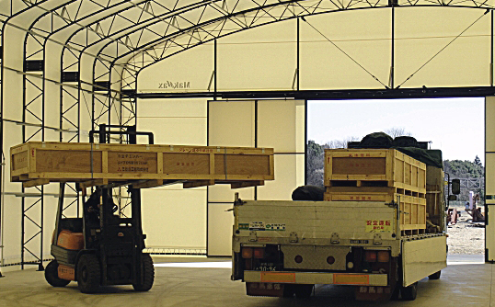
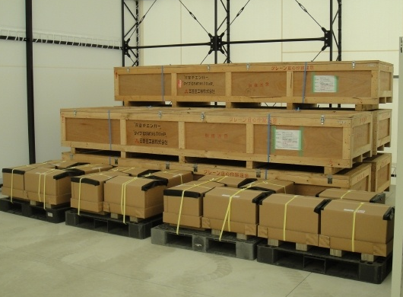
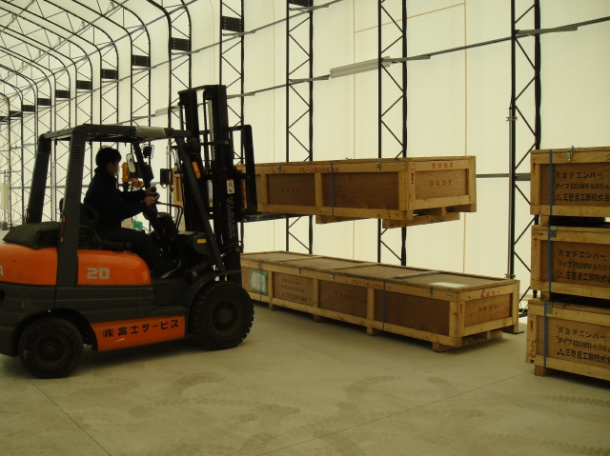
Present status and plans_6
Wiggler beam pipes (Cu)
Beam pipes and bellows chambers have been gradually delivered.
They will be stored for a while in a new tent.
The beam pipes are filled with dry nitrogen
The packages of bellows are filled with dry nitrogen
Stock area of beam pipes
(Thank to M. Shirai)

Slide 30
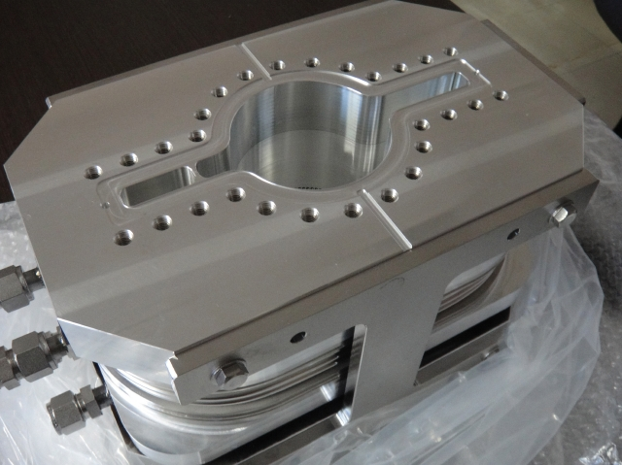
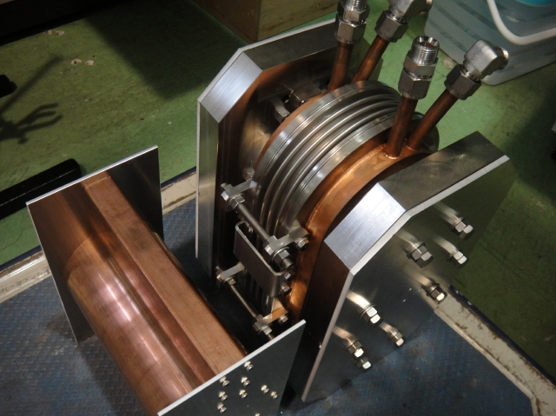
Present status and plans_7
Bellows chambers
Some bellows chambers for wigglers have delivered.
Bellows chambers with aluminum body were manufacturing for test.
RF properties were checked by comparing a dummy pipe.
Aluminum bellows chamber
Measurement of RF properties (S₁₁, S₁₂)
(Thank to T. Abe, KEKB RF group)

Slide 31
Present status and plans_8
Remained beam pipes [fixed plan]
Tsukuba straight sections incl. local correction sections: 165x2 = 330 m (Cu 200 m?) [LER and HER]
Fuji cross sections [LER]: 7 m [LER]: 11 m [HER]
HER Wiggler sections: 121 m
Special beam pipes, ex. Tapered beam pipe, dump chambers, X-ray monitor chambers [LER and HER]
IR beam pipe [HER and LER]
For ARES cavities (Fuji, Nikko, Oho): 182 m
Manufacturing of these chambers will start soon.
Design of special chambers, such as injection chambers, dump chambers, X-ray monitor chambers, will also start soon.

Slide 32
Present status and plans_9
Beam pipe manufacturing time schedule (preliminary)

Slide 33
Present status and plans_10
Pre-baking and TiN coating in KEK
Workflow of beam pipe assembly
Transfer of beam pipes to OHO experimental hall.
TiN coating
Assembly of NEG pumps
Prebaking (150°C 24 hours)
N₂ filling
Transfer of beam pipes to reservation area, or into tunnel.
TiN coating
5 sets for Q and S beam pipe, and 2 sets for B beam pipe.
One coating process will take 4~5 days.
Coating for 800 beam pipes (arc section) will take ~1.5 years.
 | SUN | MON | TUE | WED | THU | FRI | SAT
Q&S_1
Q&S_2
Q&S_3
B_1
Setting
Baking
TiN coating
Disassembling
(by K. Shibata, M. Shirai)

Slide 34
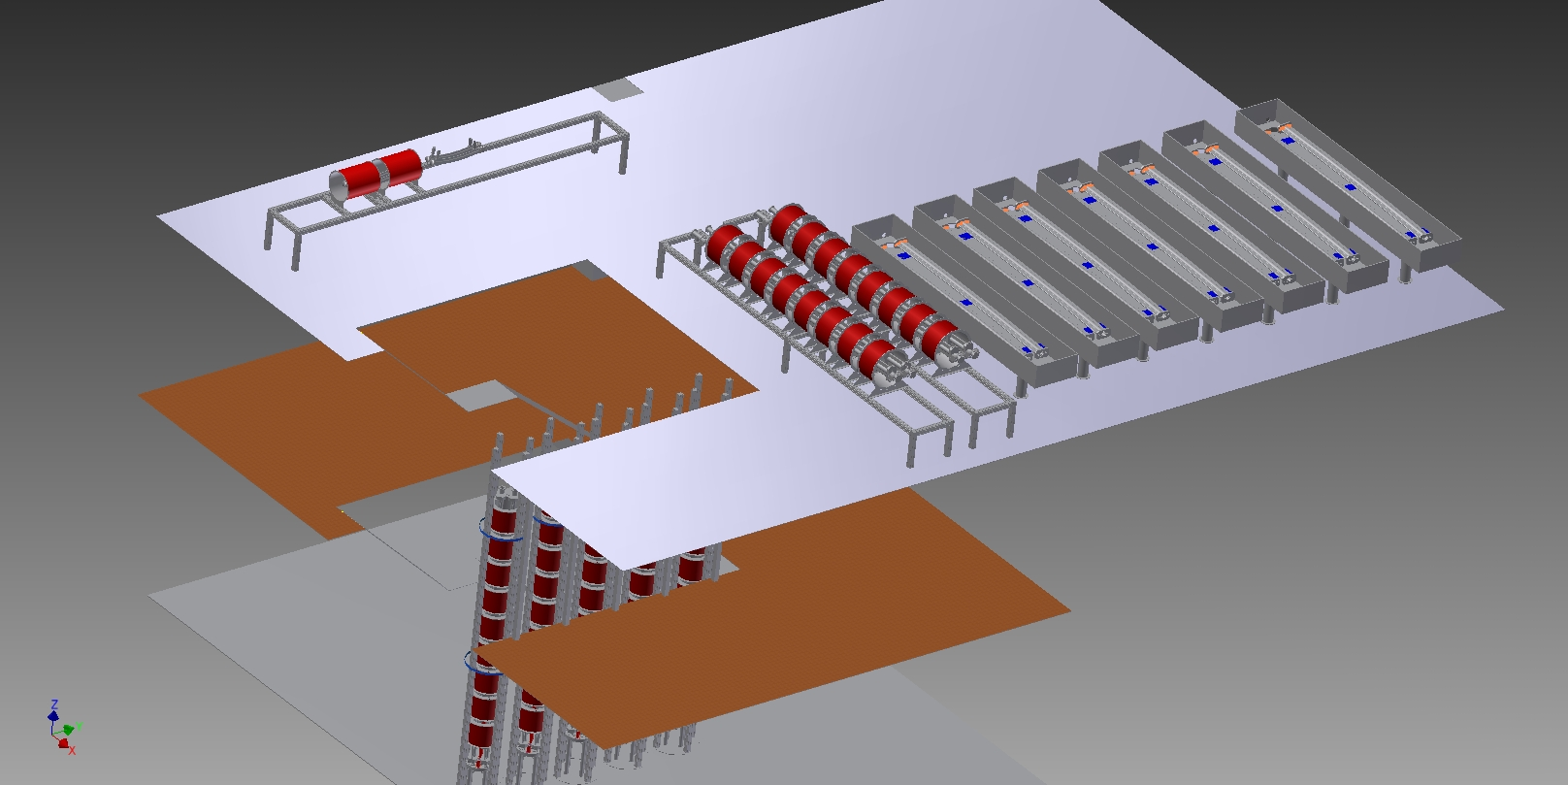
Present status and plans_11
Pre-baking and TiN coating facility in KEK
The facility will be set up in autumn at OHO experimental hall this year.
Three floors
(by H. Hisamatsu)
TiN coating for B beam pipe
TiN coating for S, Q beam pipe
Baking stations

Slide 35
Summary
Upgrade of the vacuum system for Super-KEKB has started.
The design basically continues the policy in KEKB, introducing new ideas.
Most of designs and R&Ds for key components have finished.
Aluminum-alloy beam pipe is now adopted for LER.
More powerful countermeasures against EC effects are embedded especially in dipole magnets.
Further studies are required for movable masks.
Baking and TiN coating facilities will be ready this year.
Manufacturing of beam pipes and bellows chambers for LER wiggler sections had started last year.
For LER arc and straight sections, It will start this year.
Remained parts of LER and HER will follows.

Slide 36
Thank you for your attention

Slide 37
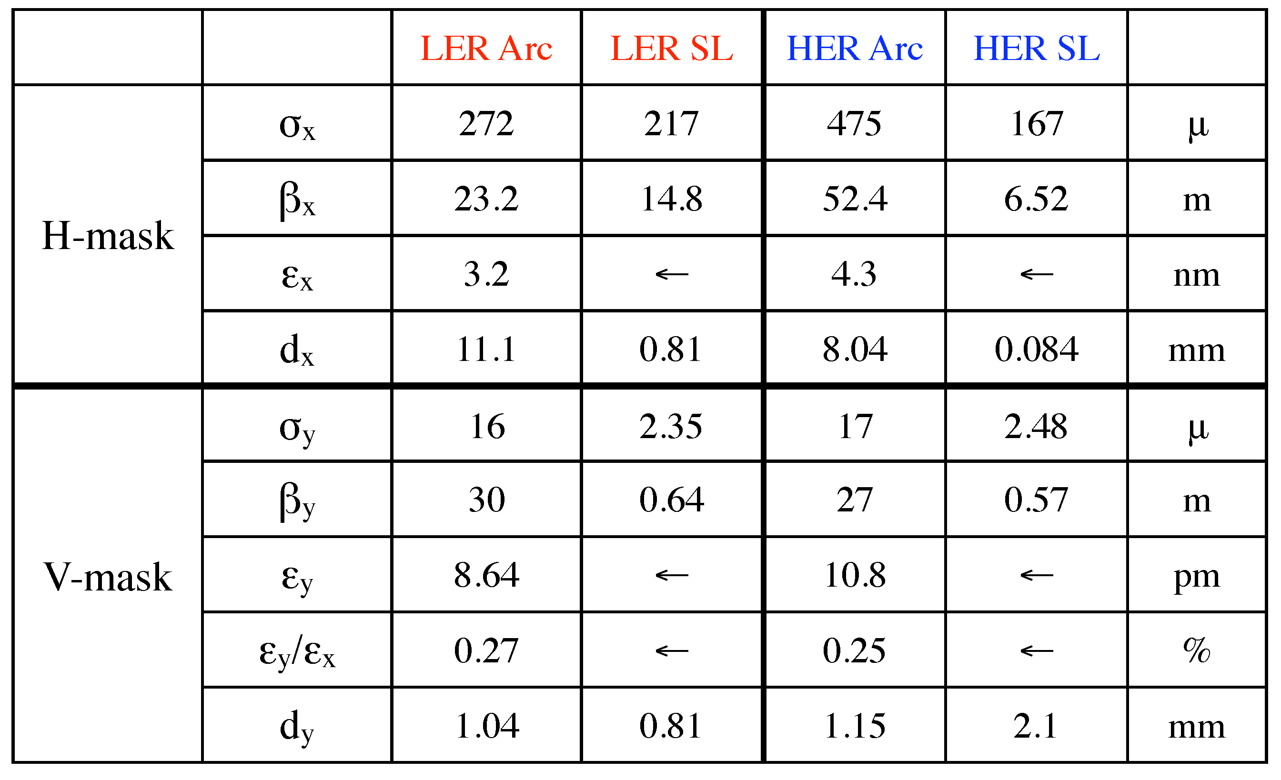
Movable Mask
Possible mask locations and beam parameters (Y. Ohnishi)
*
*
*Non-linear collimation scheme

Slide 38
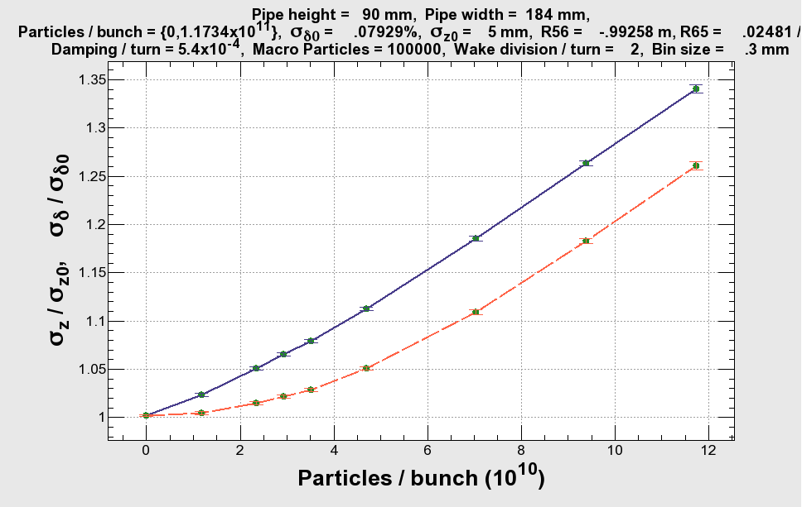
CSR (LER)
Microwave Instability (H. Ikeda, K. Oide)
For σ_{z} = 5 mm

Slide 39
k_{z} and k_{y}
Loss factors and kick factors for main components

Slide 40
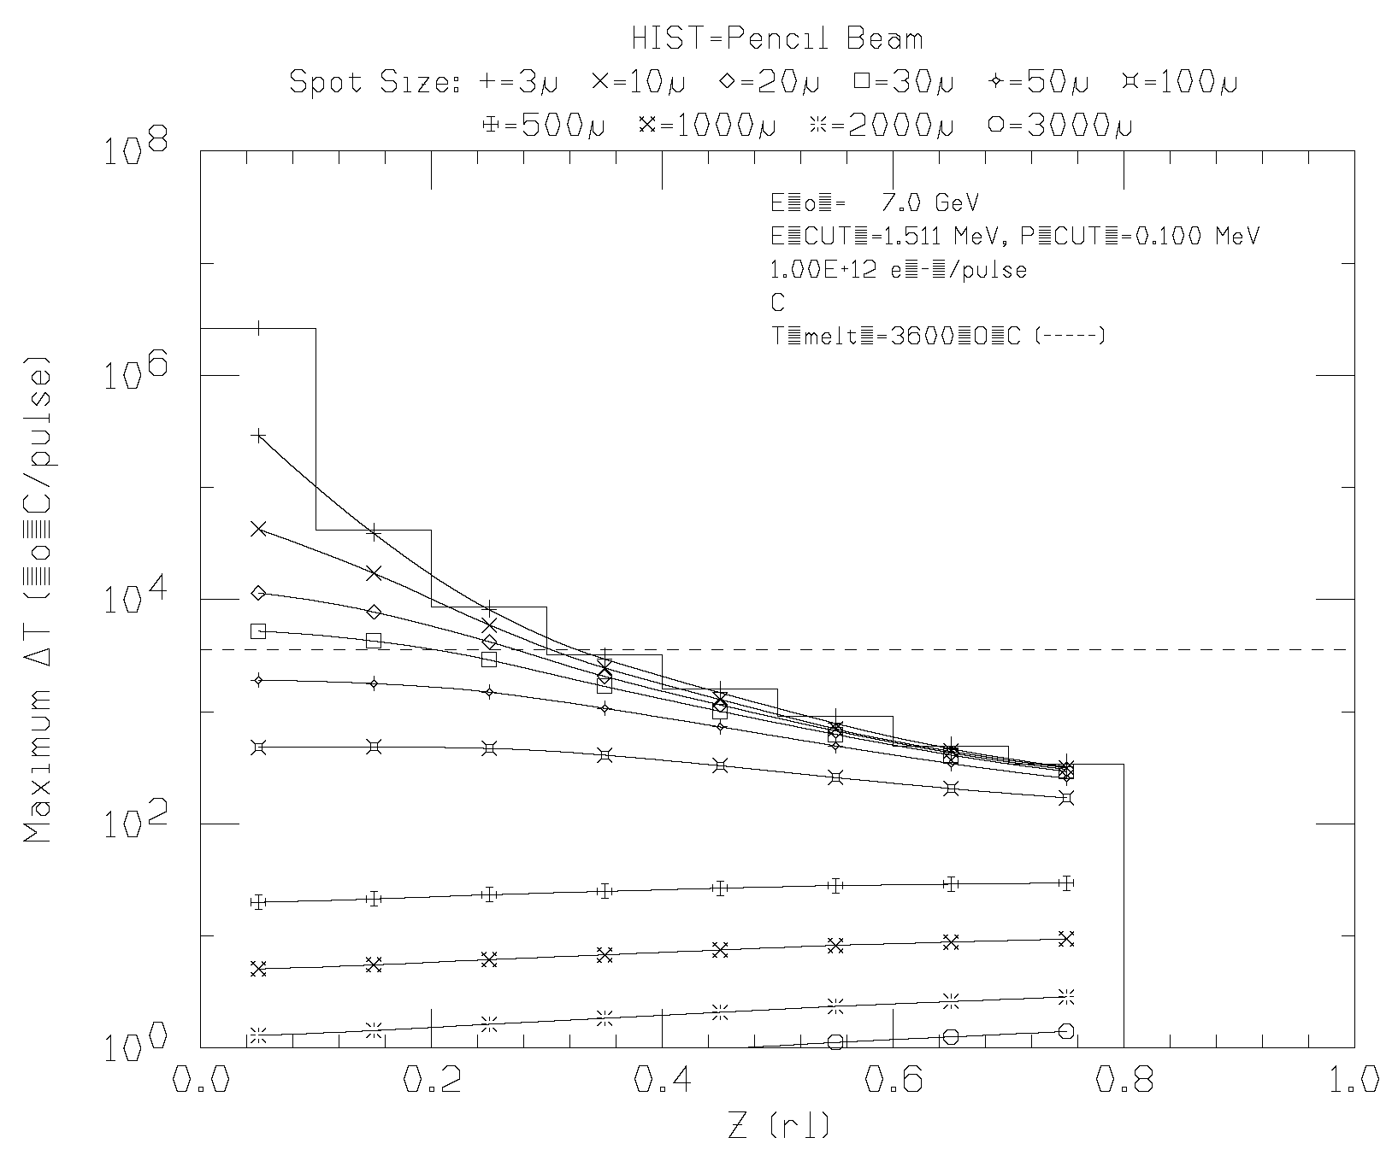
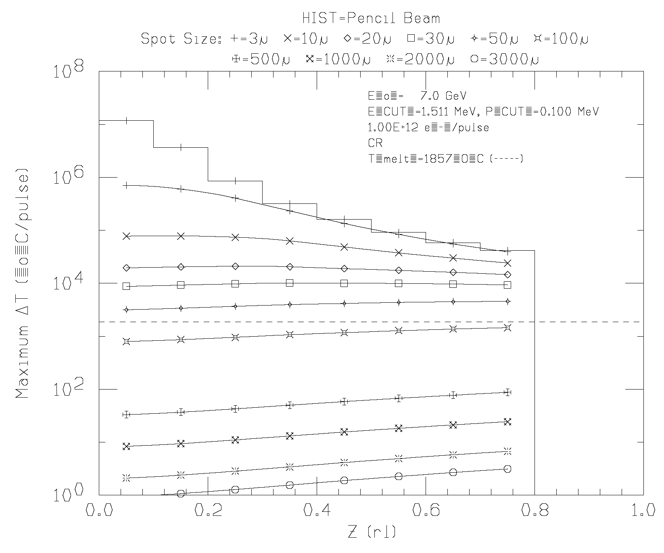
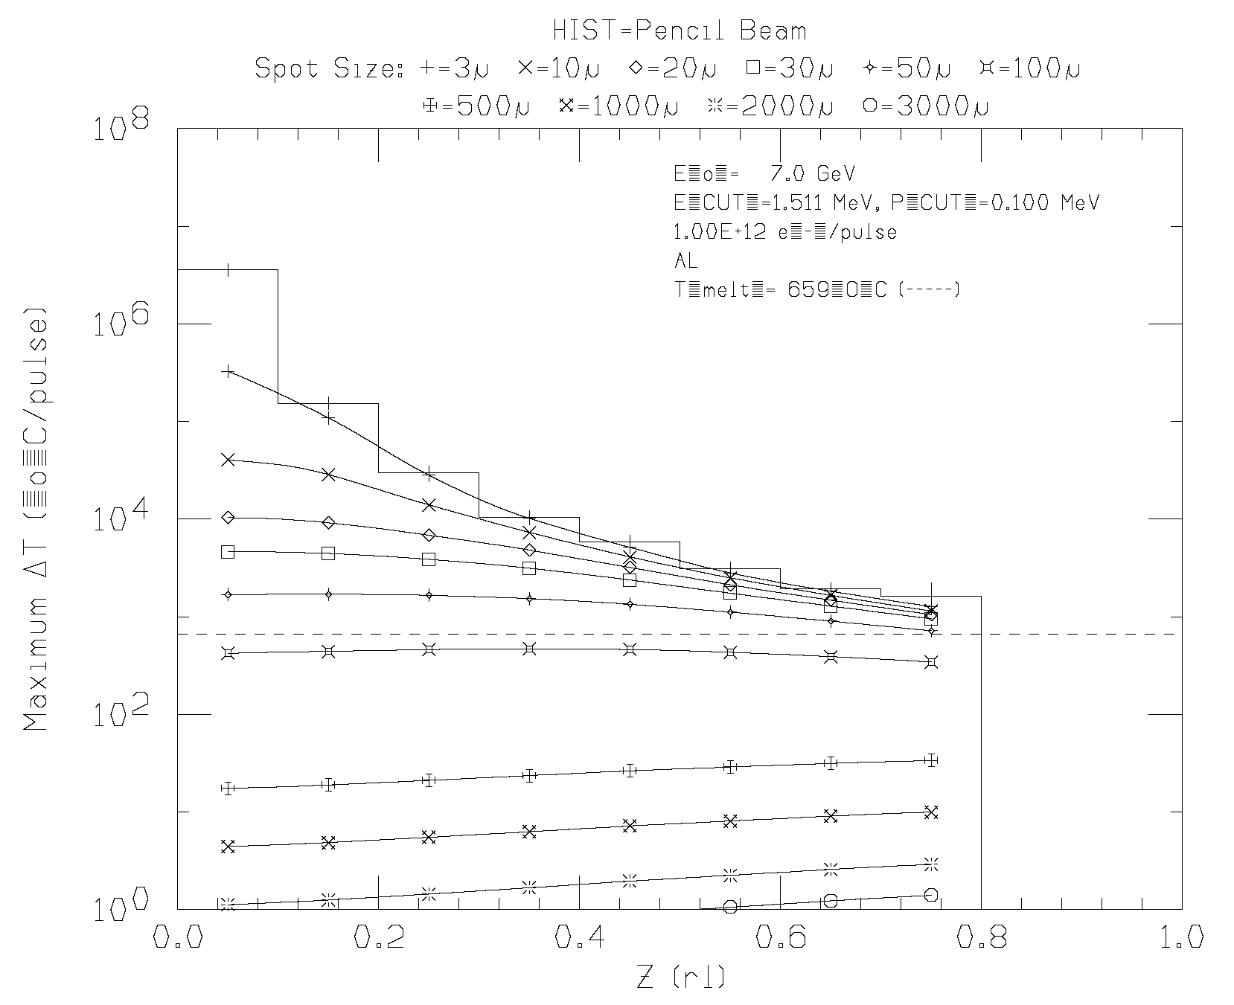
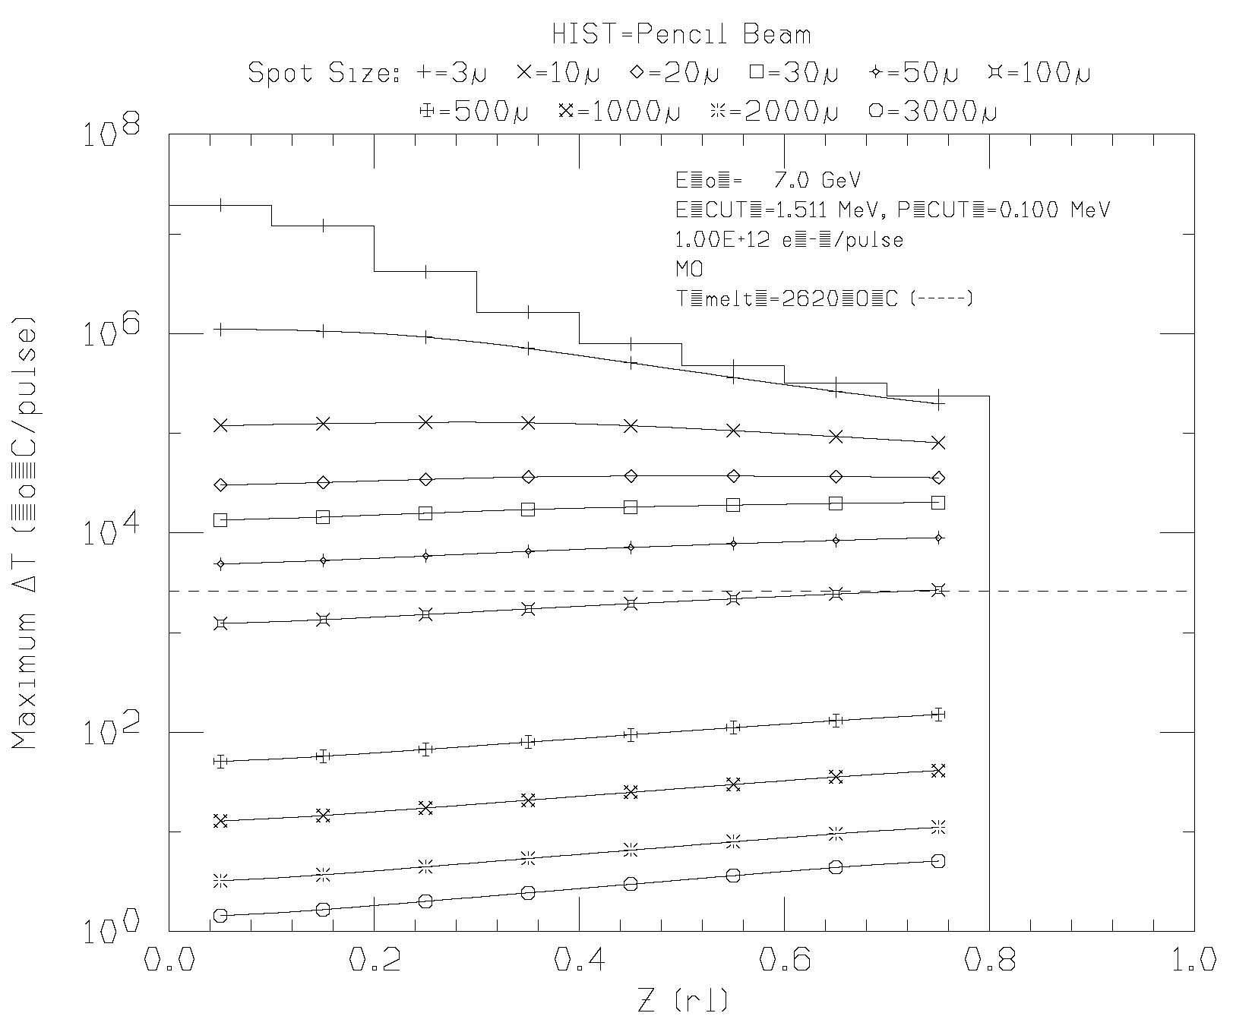
Materials of mask head
Temperature rise simulation by EGS4

