Slide 1
Belle II Experiment
Yutaka USHIRODA (IPNS, KEK)
KEKB Review Meeting
Feb. 7, 2011

Slide 2
Outline
Introduction
Detector Design
Machine-Detector issues
Construction Cost and Schedule
Summary

Slide 3
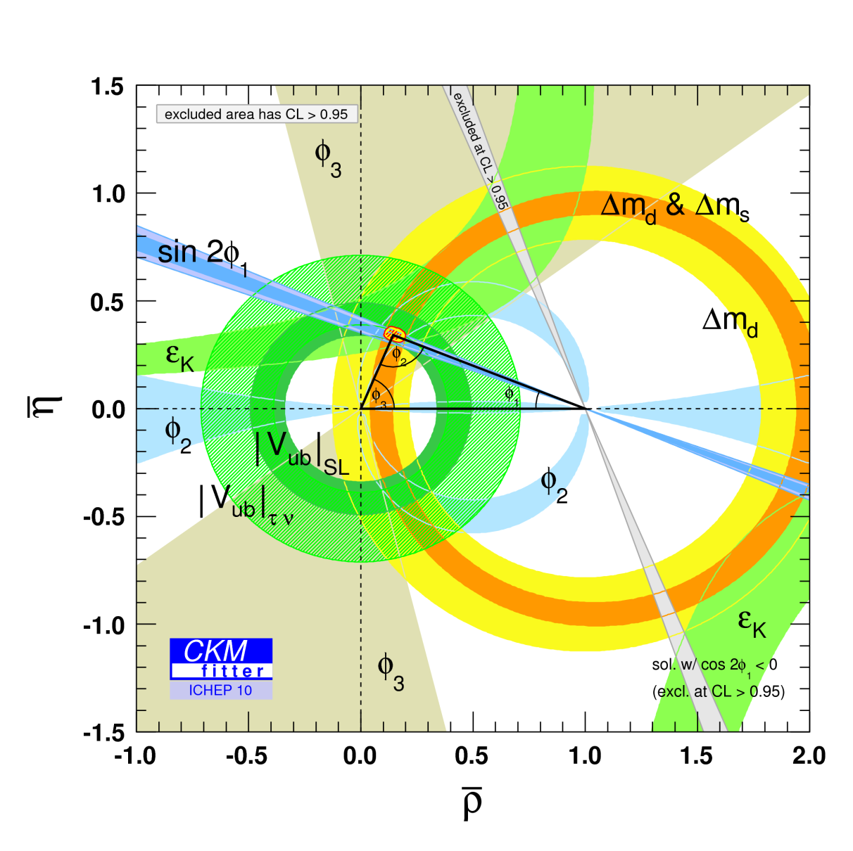
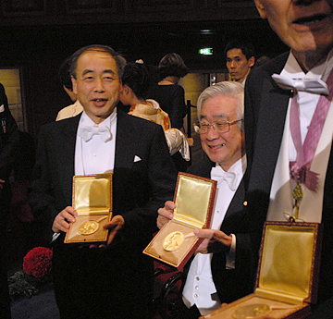
Primary Target of KEKB/Belle
… was to confirm Kobayashi-Maskawa mechanism.
… and was so successful.

Slide 4
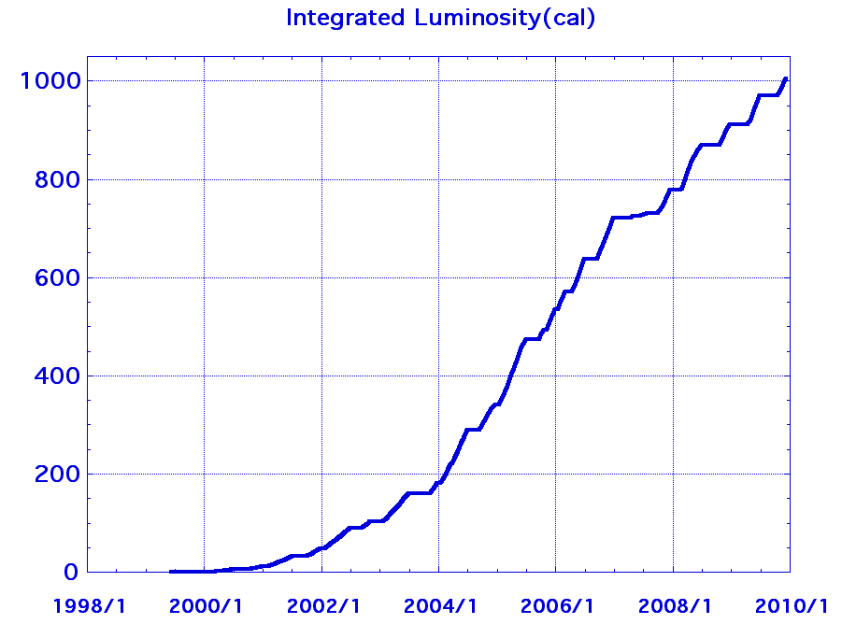
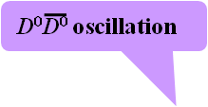
Hot news from Belle in the past
333 physics publications
Data size （fb⁻¹）
b→dγ transition
Z(4430)＋
CP violation in B→Kπ decay
Anomalous CP violation in B→Kπ decay
X（3872）
CP violation in neutral B system
B→τν decay
CP violation in penguin decays
Precise determination of SM (CKM)
Some unexpected observations such as new hadronic resonances
  (possible, but omitted in SM)
(Yet unclear) hints of new physics (impossible in SM, possible in NP)

Slide 5
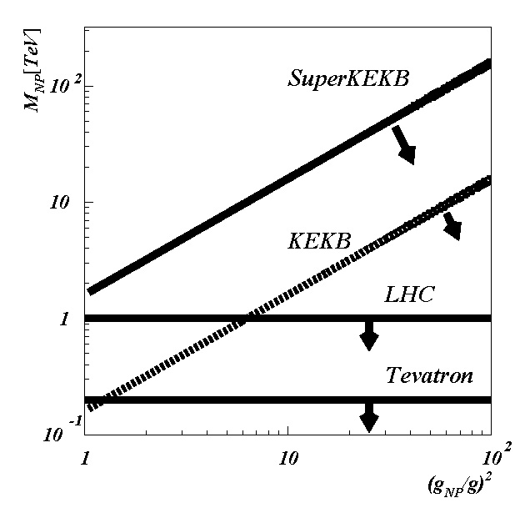
Goal of Super B-factory
… is to search for NP,
discover it,
and determine model and parameters.
Or, to search for NP,
and constrain model and parameters.
ATLAS/CMS may discover it.
Yes, but they cannot measure flavor couplings and not good at determining models.
LHCb started in good shape.
Yes, but they are not good at measuring neutral particles involved in many important decay modes (BF(Bgτν), S(K_{S}π⁰γ), K⁰π⁰, …).
Next-generation flavor factory in clean environment of e⁺e⁻ collisions is important.
g SuperKEKB/Belle II
Minimal Flavor Violation
Enhanced Flavor Violating Couplings

Slide 6
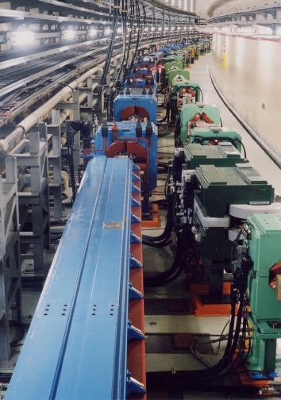

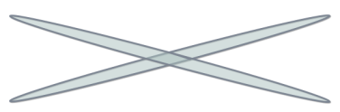
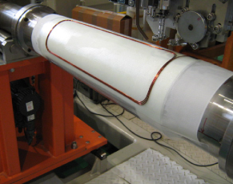
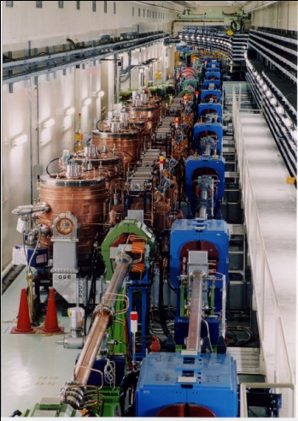


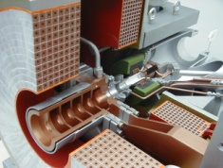
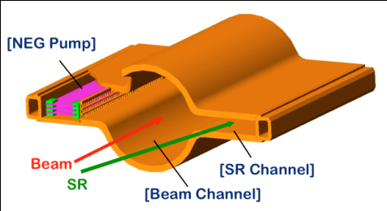
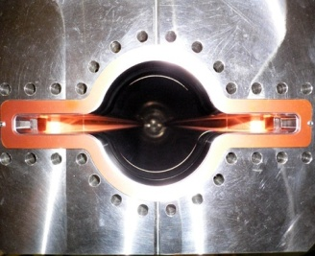

SuperKEKB and Belle II
Belle II
e⁺ 4GeV 3.6 A
Colliding bunches
New IR
e⁻ 7GeV 2.6 A
New superconducting /permanent final focusing quads near the IP
New beam pipe
& bellows
SuperKEKB
Replace short dipoles with longer ones (LER)
Add / modify RF systems for higher beam current
Low emittance positrons to inject
Positron source
Redesign the lattices of HER & LER to squeeze the emittance
Damping ring
New positron target / capture section
TiN-coated beam pipe with antechambers
Low emittance gun
Low emittance electrons to inject
Target: L = 8x10³⁵/cm²/s

Slide 7
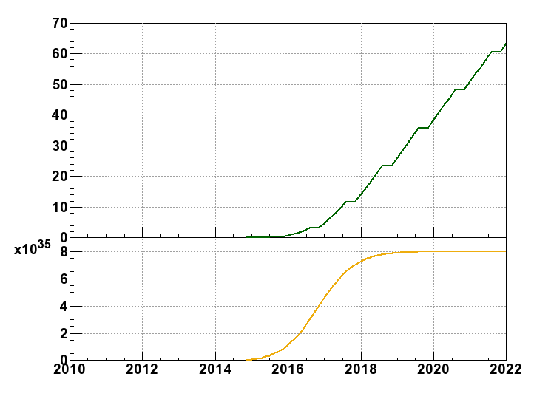
Luminosity prospect
Milestone of SuperKEKB
9 month/year
20 days/month
We will reach 50 ab⁻¹
in 2020~2021.
Integrated Luminosity
(ab⁻¹)
Commissioning starts
in 2nd half of FY2014
Peak Luminosity
(cm⁻²s⁻¹)
Shutdown
for upgrade

Slide 8
Organization in KEK
M. Yamauchi
KEK-DG
KEKB ARC
BPAC
B Factory Board
(Bファクトリー推進委員会）
Acc. group
Exp. group
and many other field-level barrier-free interactions between machine and detector groups:
SuperKEKB kentoukai,
Belle II Executive Board meeting,
Belle II General Meeting
SuperKEKB Optics meeting,
IR technical meeting,
IR assembly meeting,
Belle II SVD mechanical meeting
…
(addition by YU)
KEK’s executive board
KEK’s board of directors
Administration department
Facility department
Public relations office
Computing research center
Cryogenics center
Mechanical engineering center
Radiation safety office
Executive committee
(Bファクトリー推進室）

Slide 9
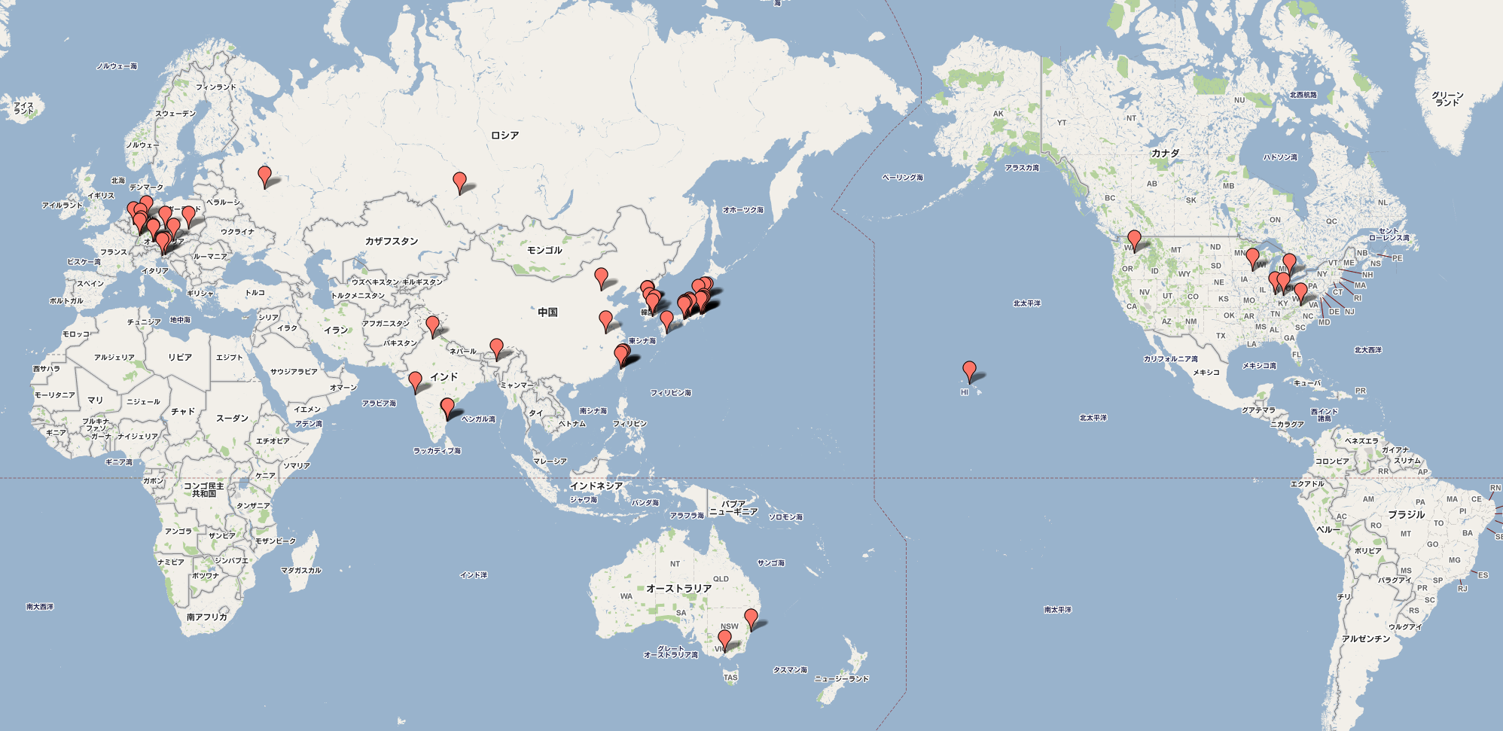
Belle II Collaboration
13 countries/regions, 57 institutes, 384 collaborators (Jan. 2011)

Slide 10
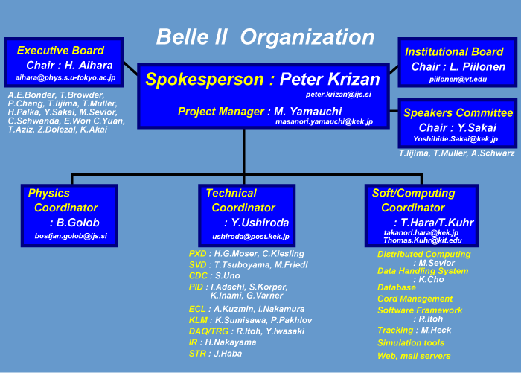
Belle II Organization
EB mtg.
~1/month
IB mtg.
~3/year
Collaboration mtg.
3/year
Workshops, meetings
+Task forces

Slide 11
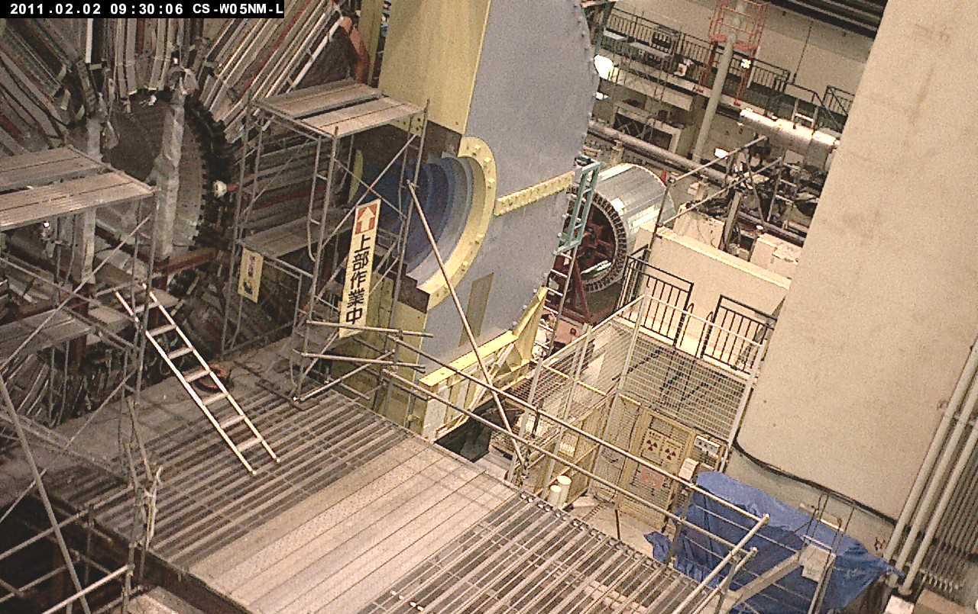
Tsukuba-hall webcam
Beam Pipe and Vertex Detector extraction: on Nov. 10, 2010
Belle Detector Roll-out: Dec. 9, 2010
End-caps, CDC, B-ACC, TOF extraction: in Jan. 2011

Slide 12

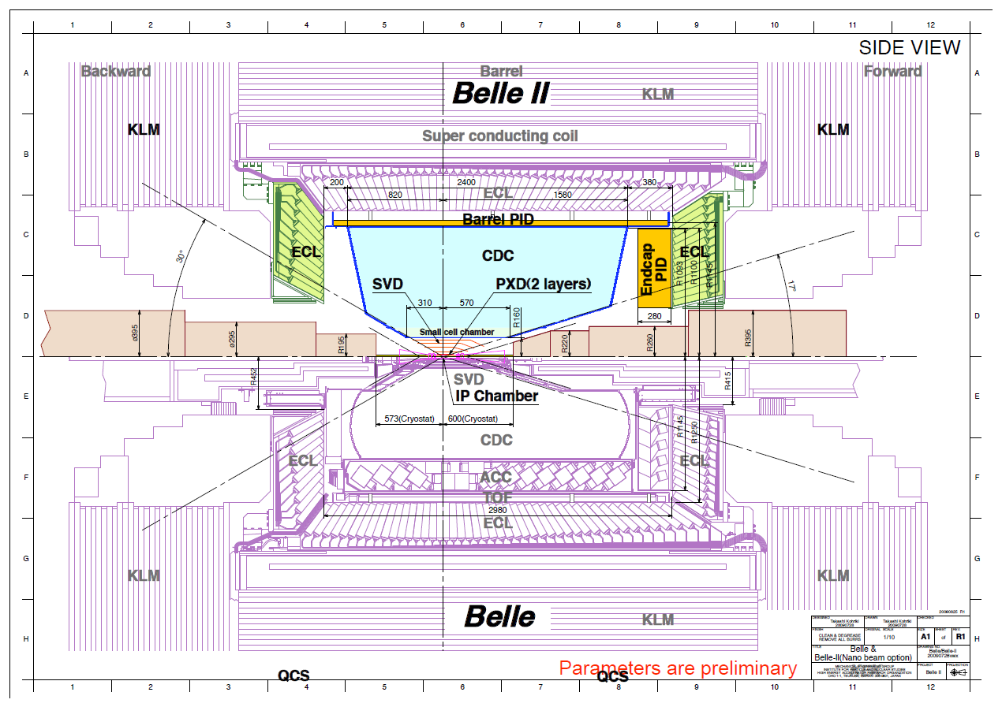
Belle II Detector (in comparison with Belle)
SVD: 4 DSSD lyrs g 2 DEPFET lyrs + 4 DSSD lyrs
CDC: small cell, long lever arm
ACC+TOF g TOP+A-RICH
ECL: waveform sampling (+pure CsI for end-caps)
KLM: RPC g Scintillator +MPPC(end-caps)

Slide 13
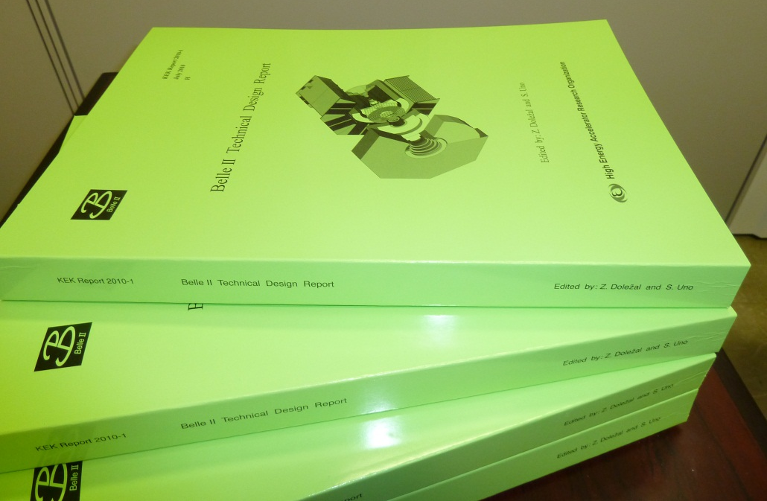
Technical Design Report
arXiv:1011.0352: http://arxiv.org/abs/1011.0352
KEK Report 2010-1: http://www-lib.kek.jp/cgi-bin/kiss_prepri.v8?KN=201024001&OF=8.
Belle II web page: http://b2comp.kek.jp/~twiki/pub/Organization/B2TDR/B2TDR.pdf
Reviewed by BPAC members + external experts in May and in Nov.
Printed in Nov.

Slide 14
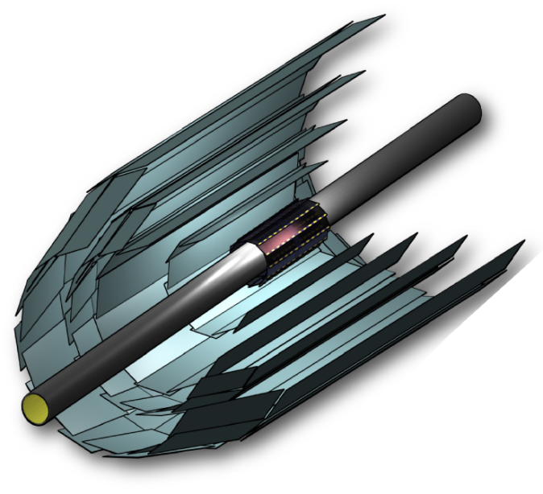
Vertex Detector
Belle II Belle
Beam Pipe r = 10mm 15mm
DEPFET
Layer 1 r = 14mm
Layer 2 r = 22mm
DSSD
Layer 3 r = 38mm 20mm
Layer 4 r = 80mm 43.5mm
Layer 5 r = 115mm 70mm
Layer 6 r = 140mm 88mm

Slide 15
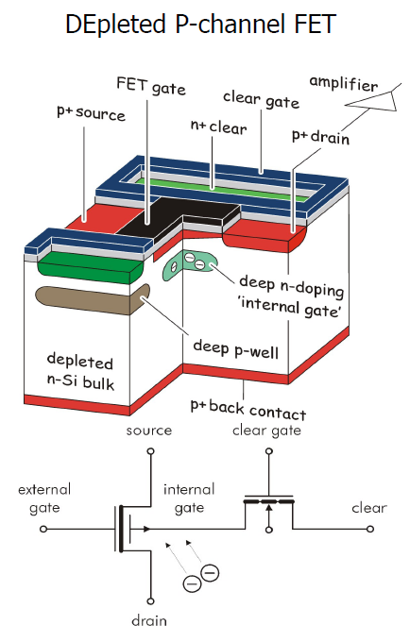
PXD (DEPFET)
Each pixel is a p-channel FET on a completely depleted bulk
A deep n-implant creates a potential minimum for electrons under the gate (“internal gate”)
Signal electrons accumulate in the internal gate and modulate the transistor current (g_{q} ~ 400 pA/e⁻)
Accumulated charge can be removed by a clear contact (“reset”)
Fully depleted: => large signal, fast signal collection
Low capacitance, internal amplification: => low noise
High S/N even for thin sensors (50µm)
Rolling shutter mode (column parallel) for matrix operation => 20 µs frame readout time
=> Low power (only few lines powered)
DEPFET:
http://aldebaran.hll.mpg.de/twiki/bin/view/DEPFET/WebHome

Slide 16
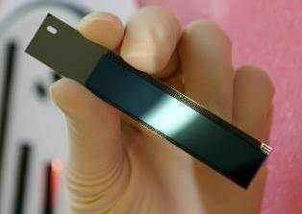
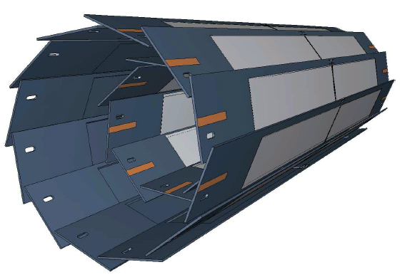
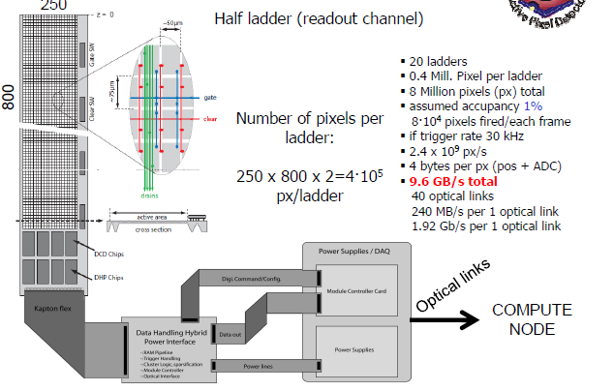
DEPFET for Belle II
radius pixel thickness
Layer 1 r = 14mm 50x50μm² 75μm(0.18%X0)
Layer 2 r = 22mm 50x75μm² 75μm
total of 8 Mpx
Mechanical mockup
Power consumption in sensitive area: 0.1W/cm² => air-cooling sufficient

Slide 17
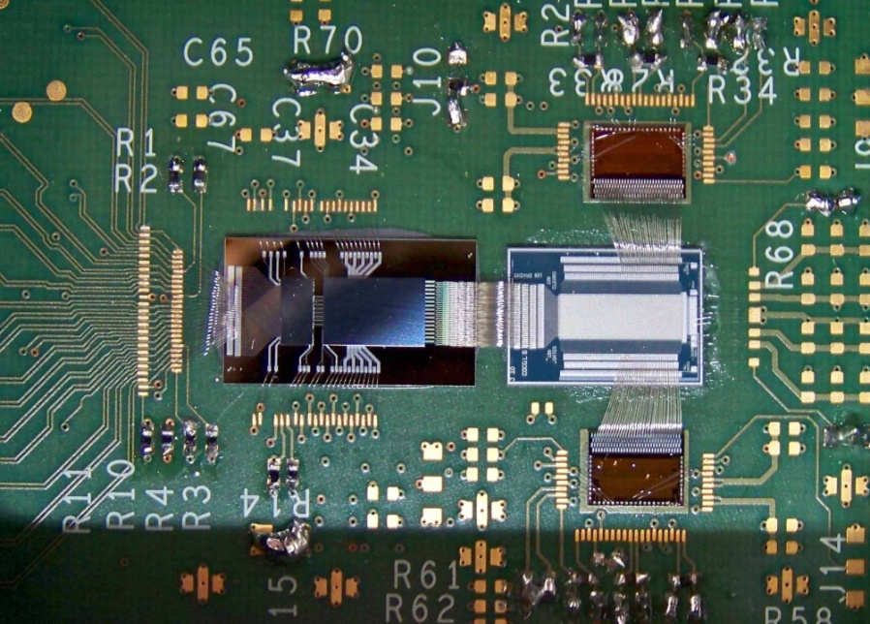
Test System
DCDB readout chip,
Bump bonded on interface board
PXD5 DEPFET matrix
Switcher control chip
New switcher and DCD is tested with a DEPFET PXD5 matrix
So far the system reaches 120ns sampling time with 40nA (~ 100 electrons) noise
Some fine tuning needed to reach full speed (<100ns) (tests started 2 weeks ago)
Side remark: flipping and bump bonding of DCDB in adapter board worked without problems

Slide 18
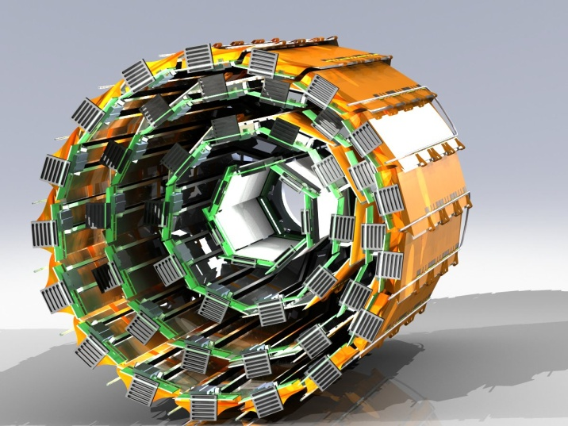
SVD (DSSD)
HPK resumed DSSD production with 6’’ wafers
Two types of rectangular sensors and
Trapezoidal sensors for slanted part (still under discussion)

Slide 19
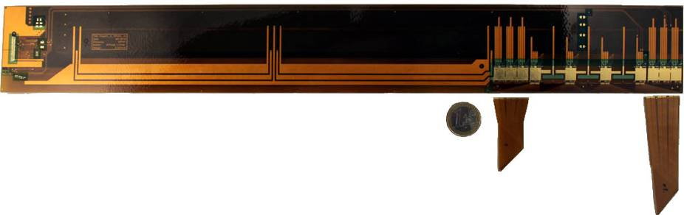
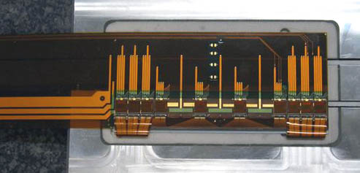
Flex PCBs and APV25
Origami PCB
Origami PCB
  3-layer design
  237µm thick (nominal)
PA0, PA1 and PA2
  2-layer design
  145µm thick (nominal)
PA0
glued onto hybrid
PA1
PA2
Thinned APV25
(300μmg~100μm)
~0.55%X₀/layer

Slide 20
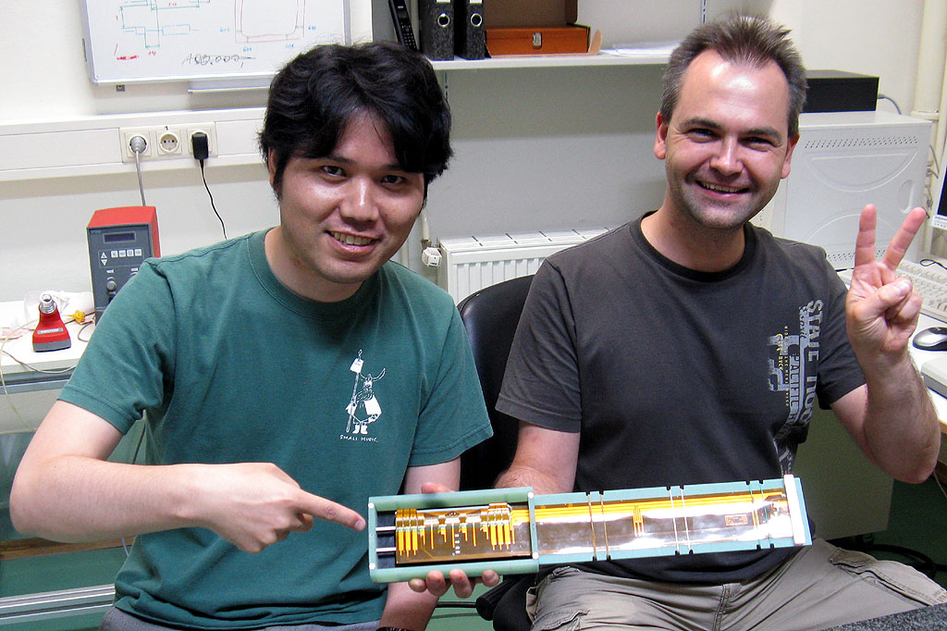
First prototype ladder
A prototype ladder using the first 6 inch DSSD from HPK has been assembled and tested.

Slide 21
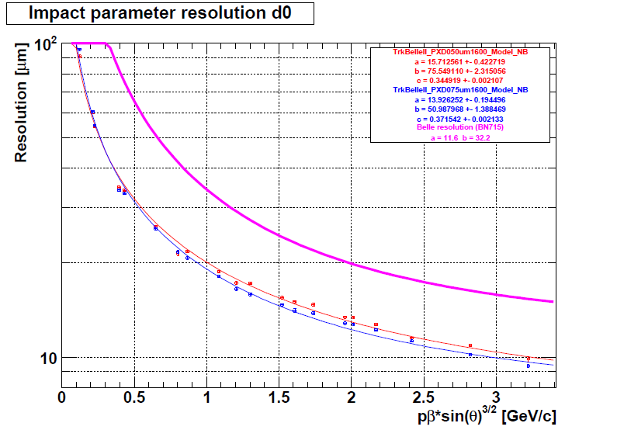
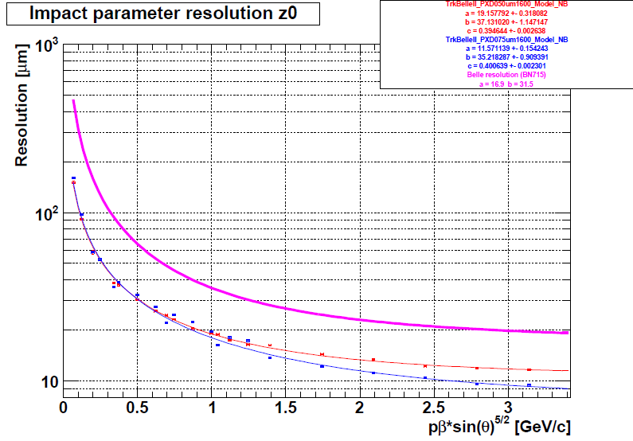
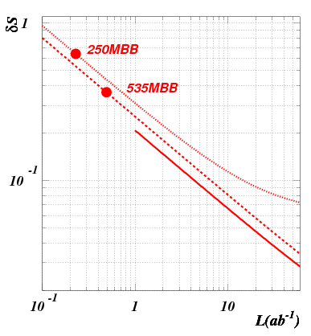
Expected performance
Significant improvement in IP resolution!
Pixel detector close
to the beam pipe
Less Coulomb
scatterings
σ[μm]
Belle
σ[μm]
Belle II’
Belle II
20μm
10μm
0
1.0
2.0
0
1.0
2.0
pβsin(θ)^{3/2} [GeV/c]
pβsin(θ)^{5/2} [GeV/c]
Significant improvement in δS(K_{S}π⁰γ)
γ
Ks track
π⁺ π⁻
γ
B vertex
IP profile
γ
Larger radial coverage of SVD
B decay point reconstruction
with K_{S} trajectory

Slide 22

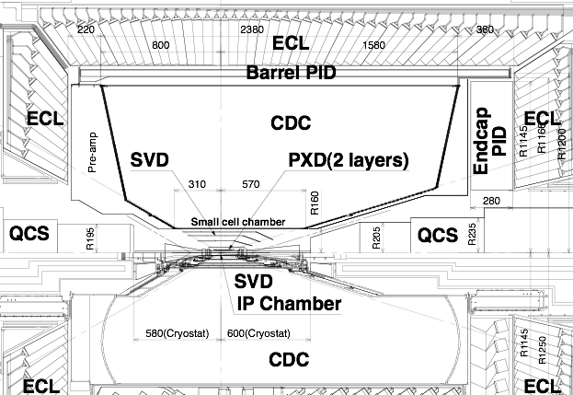

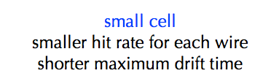
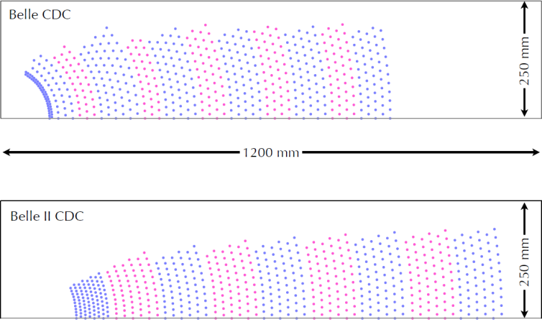
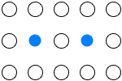
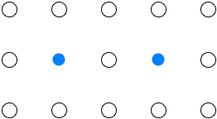
Central Drift Chamber
longer lever arm
improve resolution of momentum and dE/dx
Belle
 | Belle | Belle II
inner most sense wire | r=88mm | r=168mm
outer most sense wire | r=863mm | r=1111.4mm
Number of layers | 50 | 56
Total sense wires | 8400 | 14336
Gas | He:C2H6 | He:C2H6
sense wire | W(Φ30μm) | W(Φ30μm)
field wire | Al(Φ120μm) | Al(Φ120μm)
Belle II
small cell
normal cell
10 mm
18 mm
6~8 mm
10~20 mm

Slide 23
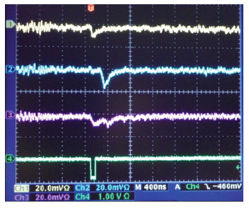
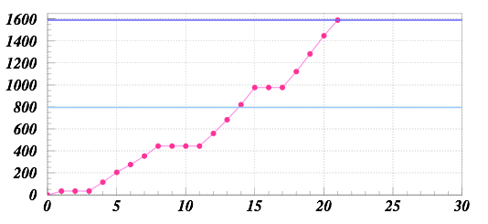
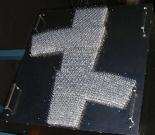
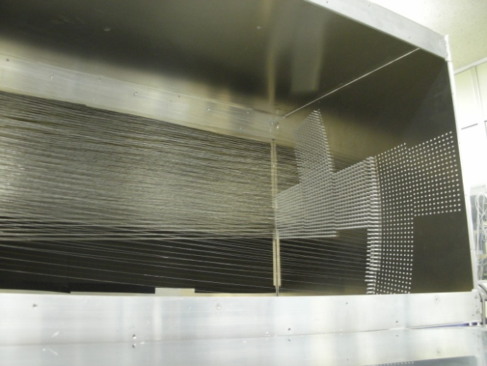

Test chamber fabrication for 3D TRG study
making cable
HV test
signal check
Cosmic ray
Number of wires
wire stringing
July 9
July 29
Aug. 12
1205 field wires
384 sense wires
Analog signal of β-ray
with current Belle AMP
Full-length (540x570x2200) test chamber has also been made

Slide 24


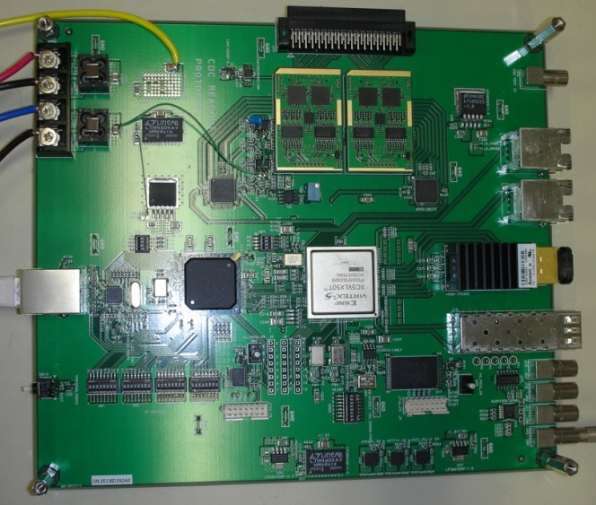
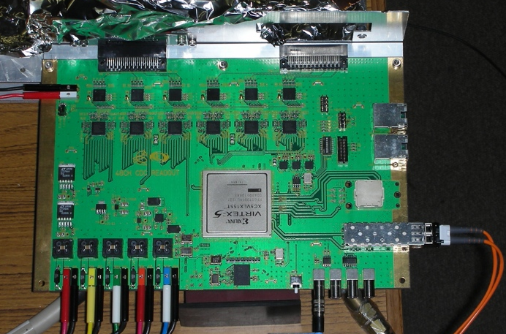
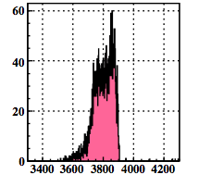
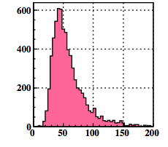
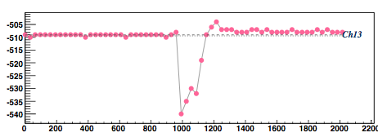
Status of new 48ch board for CDC
16ch board
48ch board
AMP shaper ASIC chip
4ch/chip
AMP shaper discriminator chip
8ch/chip
Delivered on Oct. 26
FADC
discriminator
FADC
Rocket I/O
for data transfer
ethernet port
for data transfer
NIM input for TRG
NIM input for TRG
200mm x 175mm
230mm x 150mm
TDC
Energy loss
~200ns
waveform sampling with
32MHz FADC

Slide 25

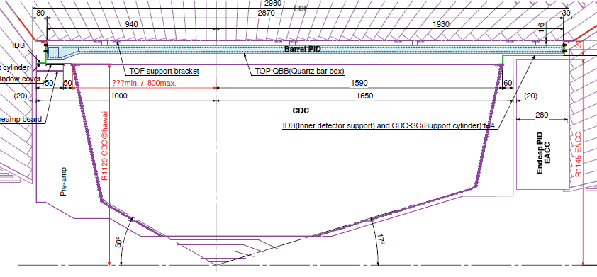
Particle Identification Devices
Endcap PID: Aerogel RICH (ARICH)
200mm
Barrel PID: Time of Propagation Counter (TOP)
Cherenkov photon
Quartz radiator
Aerogel radiator
Focusing mirror
Small expansion block
Hamamatsu MCP-PMT (measure t, x and y)
n~1.05
Hamamatsu HAPD
+ new ASIC
Aerogel radiator
Hamamatsu HAPD + readout
200

Slide 26
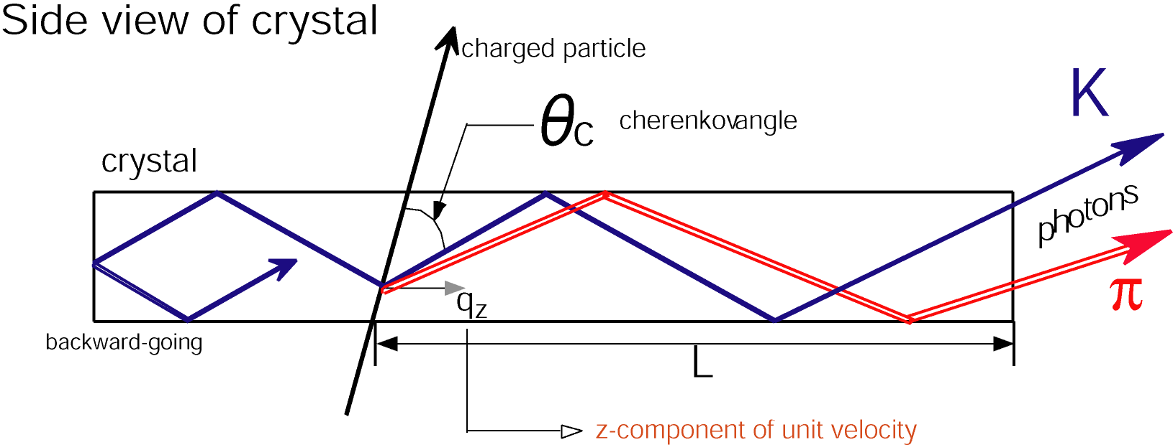
Time of Propagation Counter (TOP)
Quartz radiator
  2.6m^{L} x 45cm^{W} x 2cm^{T}
  Excellent surface accuracy
MCP-PMT
  Hamamatsu 16ch MCP-PMT
    Good TTS (<35ps) & enough lifetime
    Multialkali photo-cathode → SBA
Barrel PID: Time of Propagation Counter (TOP)
Quartz radiator
Focusing mirror
Small expansion block
Hamamatsu MCP-PMT (measure t, x and y)
TOP
MCP-PMT
～1.2m
TOF

Slide 27
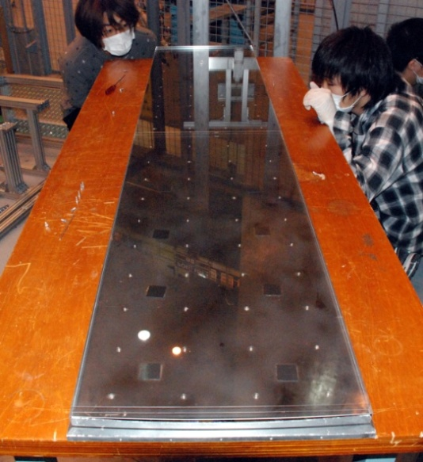
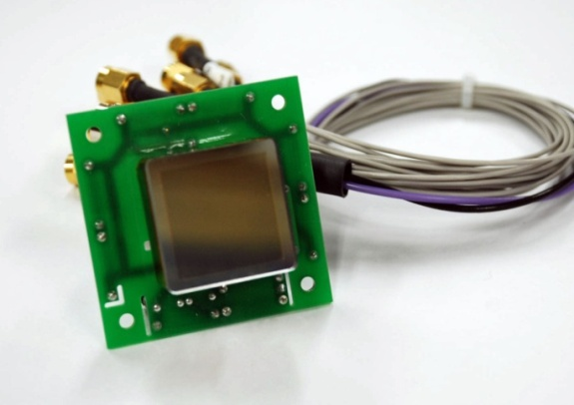
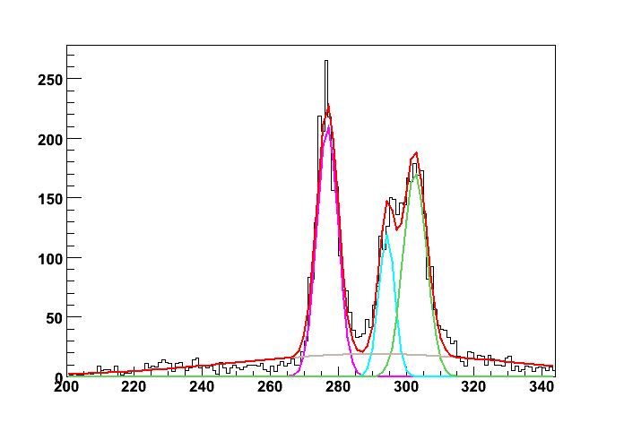


TOP (Barrel PID)
quartz
Beam spot
Beam test done in 2009
  # of photons consistent
  Time resolution OK
915mm
3rd
2nd
875mm
1st
Quartz Radiator
Hamamatsu MCP-PMT
Time resolution
beam data
1st
Simulations
1st
3rd
3rd
2nd
2nd
# of photons
[1count/25ps]
[1count/25ps]

Slide 28



Test beam result
Test Beam setup
Aerogel
Clear Cherenkov image observed
Cherenkov angle distribution
Hamamatsu HAPD
Q.E. ~33% (recent good ones)
Single photon angle resolution σ₀ = 13.5mrad
# of photoelectrons Npe = 15.3
6.6 σ π/K at 4GeV/c !

Slide 29

Expected Performance (Luminosity gain)
No upgrade
BAD
Upgrade
GOOD
No upgrade
BAD
Upgrade
GOOD
B⁰gρ⁰γ
FWD BRL | ACC only | dE/dx only | As good as Belle | A-RICH
TOF, dE/dx NA | –74% | –69% | –68% | –62%
TOF NA | –41% | –35% | –32% | –22%
As good as Belle | –10% | –4% | 0% (definition) | +12%
TOP opt.0 | +27% | +33% | +40% | +59%
TOP opt.2 | +45% | +51% | +60% | +83%
Completely different world with excellent PID detectors!

Slide 30

Upgrade of ECL
For Day 1
Upgrade electronics to do waveform sampling & fitting
Upgrade crystals for end caps (pure CsI + photomultiplier as the baseline)

Slide 31





New shaper/readout boards
Basically ready for mass production
(minor revisions because we still have time.)
One of older versions has been installed in Belle to readout part of the end cap in 2008. Tested OK.

Slide 32

KLM: K_{L}&Muon detector
GENERAL LAYOUT
One layer: 75 strips (4 cm width)/sector
5 segments
1 segment = 15strips
Two orthogonal layer = superlayer
F&B endcap KLM:
  Total area ~1400 m²
  16800 strips
  the longest strip 2.8 m; the shortest 0.6 m
WLS fiber in each strip
Hamamatsu MPPC at one fiber end
mirrored far fiber end
RPC g Scintillator (End cap)
also inner 1,2, or 3 layers of Barrel(?)

Slide 33





One strip
MPPC: Hamamatsu
1.3×1.3 mm 667 pixels
(used in T2K ND)
fiber: Kuraray Y11 MC
Scintillator bar: Vladimir (Russia)
(used in T2K ND)
part II
part I

Slide 34





Test modules adjacent to Belle KLM (2008)
Muon tag

Slide 35

EKLM Module-0 assembled in
ITEP into the frame mock-up

Slide 36

Close view of frame support structure
and strips with SiPM connectors
Strip SiPM connector

Slide 37

Close view of strips.
Segment’s plastic plates are easily seen
Y-strip
X-strip
Plastic plates

Slide 38
Machine-Detector issues
  ✓ IR design g Tuesday morning
  ✓ Beam Background g Tuesday morning
  ✓ Machine commissioning strategy
  ✓ Injection veto and PXD
  ✓ Beam energy asymmetry (settled)
  ✓ Detector rotation

Slide 39
Machine commissioning strategy
1. Our BG estimation (MC/extrapolation) has large uncertainty.
2. We don’t like to burn our precious detectors before taking data.
3. We won’t roll-in Belle II until we are confident about the BG level.
We will prepare dedicated detector (BEAST II) for machine commissioning to monitor the BG level and compare with our estimation.
Machine parameters for BEAST II must be close enough to the design values so that natural extrapolation would work. Unpredictable jump should be avoided.
(somewhat small beam size, some beam current and some luminosity needed)
MC
BG level
BEAST II with Solenoid magnet (?)
No discrimination power if MC is correct.
Machine parameter
(I,L,σ, …)
Design value
Discussion started

Slide 40

Injection veto
~1ms
~3ms
Level 1 trigger is blocked after injection because BG is too high.
dead-time
Suppose n = 100, W1=1μs and m=300,
6.5% dead-time @ 50Hz injection.
DEPFET pixel detector integrates data for 20μs.
= 2 revolutions of noisy bunches.
Pixels are all exposed till the end of 2nd phase (4ms)
20% dead-time @ 50Hz injection.
Trying to increase the frame rate (20μs g 5μs), but still 10% dead-time @ 50Hz injection.
Any ideas
to reduce injection repetition rate (by reinforcing injectors?)
to achieve quiet injection, fast background dumping
are welcome.

Slide 41

LER Beam Energy (settled)
3.5GeV g 4GeV to mitigate Touschek lifetime.
We are not so happy (25-30% loss in TCPV, 6% gain in full-recon.).
Larger boost, better Δt resolution
Smaller boost,
Larger acceptance
worse
− J/ψK⁰ tCPV
− φK⁰ tCPV
− B→τν BR
better

Slide 42

Detector Rotation
Two beams have finite crossing angle (83mrad).
Belle solenoid axis must be bisector of the angle, but now it is not.
Either Belle or two rings must be rotated.
Parameters are OLD
Rotation is technically possible.
Additional cost (very preliminary estimate: 3 oku yen)
Possible damage in detectors (?)
Concern from bad experience of buckled CsI container when constructing Belle.
We will rotate Belle IF two rings cannot be rotated after all.
Cost to be covered by machine group.

Slide 43

Belle II Construction Schedule

Slide 44

Construction Cost
Cost profile in FY2011-2014
~40 Oku yen in three-four years
(w/o comp. )
½ covered by KEK, ½ by collaborating institutes

Slide 45
Summary
SuperKEKB/Belle II with L=8×10³⁵ cm⁻²s⁻¹is can explore many fruitful flavor physics in coming 10-15 years.
Belle detector disassembly by end of Jan. as scheduled.
Detector R&D, part of construction going on. On schedule so far.
Several machine-detector issues to be cleared. Close cooperation of two groups is necessary.

Slide 46
Backup

Slide 47

Super B Factories
Although there exist interesting possible hints for the NP at the present B factories, all the results are consistent with the SM.
NP should exist at the higher energy scale, possibly in TeV region considering the hierarchy problem → LHC will discover it.
Super B factories can help the identification of the NP,
i.e. whether it is SUSY or others, or how SUSY breaking occurs.
SUSY scenario
Observables
@ Super B factories or other experiments
[based on T.Goto et.al. PRD77, 095010(2008)]

Slide 48

Physics with 50(75) ab⁻¹
Two recent publications:
Physics at Super B Factory (Belle II) arXiv:1002.5012
SuperB Progress Reports: Physics (SuperB) arXiv:1008.1541
In addition to the topics in this talk,
Upper limits
Photon polarization of B→K*γ.
B→K^{(∗)}νν.
CPV in D.
LFV in τ decay.
…
τ decay
Integ. Lum.（ ab⁻¹ ）
Reach of B factories
Super B factories

Slide 49



B⁻ → τ⁻ν – charged higgs limits
$$r_{H}=\frac{Br\left(B→τν\right)}{Br{\left(B→τν\right)}_{SM}}=\left.1−\frac{m_{B}^{2}}{m_{H}^{2}}\tan^{2}β\right.$$
b
u
W/H±
τ
ν_{τ}
→ limit on charged Higgs mass vs. tanβ
5 ab⁻¹
50 ab⁻¹

Slide 50







B → K*γ t-dependent CPV
$$P\left(B^{0}→f;Δt\right)=\frac{e^{−∣Δt∣}/τ}{4τ}[1+S_{CP}^{f}sin\left(ΔmΔt\right)+A_{CP}^{f}cos\left(ΔmΔt\right)]$$
SM:
$$∣S_{CP}^{K_{S}π^{0}γ}∣≈\left({2m}_{s}/m_{b}\right)sin2Φ_{1}≈0.04$$
Left-Right Symmetric Models:
$$∣S_{CP}^{K_{S}π^{0}γ}∣≈0.67cos2Φ_{1}≈0.5$$
D. Atwood et al., PRL79, 185 (1997)
$$S_{CP}^{K_{S}π^{0}γ}=−0.15±0.20$$
$$A_{CP}^{K_{S}π^{0}γ}=−0.07±0.12$$
HFAG, Winter’09
$$σ\left(S_{CP}^{K_{S}π^{0}γ}\right)=0.09@{5ab}^{−1}$$
$$0.03@{50ab}^{−1}$$
(~SM prediction)

Slide 51
LFV and New Physics
τ→3ℓ,ℓη
τ→ℓγ
Neutral Higgs mediated decay.
Important when MSUSY >> EW scale
bkg. free (U.L. ∝ 1/L)
SUSY + Seasaw
Large LFV
bkg. from ee→ ττγ (U.L. ∝ 1/√L)
Upper limits
model Br(τ→μγ) Br(τ→ℓℓℓ )
mSUGRA+seesaw 10⁻⁷ 10⁻⁹
SUSY+SO(10) 10⁻⁸ 10⁻¹⁰
SM+seesaw 10⁻⁹ 10⁻¹⁰
Non-Universal Z’ 10⁻⁹ 10⁻⁸
SUSY+Higgs 10⁻¹⁰ 10⁻⁷
Integ. Lum.（ ab⁻¹ ）
Reach of B factories
Super B factories

Slide 52
Comparison with LHCb
 | Belle | Belle II | Belle II | LHCb
 | ~ 0.5 ab⁻¹ | 5 ab⁻¹ | 50 ab⁻¹ | 10 fb⁻¹ [5yrs]
ΔS(φK_{S}) | 0.22 | 0.073 | 0.029 | 0.14
ΔS(η’K_{S}) | 0.11 | 0.038 | 0.020 | ---
φ_{s} from S(J/ψφ) | --- | --- | --- | 0.01
S(K*γ) | 0.36 | 0.12 | 0.03 | ---
S(ργ) | 0.68 | 0.22 | 0.08 | ---
ΔB/B(B → τν) | 3.5σ | 10% | 3% | ---
B_{s} → μμ | ∙ | ∙ | ∙ | 5σ @ 6 fb⁻¹
τ → μγ [×10⁻⁹] | <45 | <30 | <8 | ---
τ → μμμ [×10⁻⁹] | <209 | <10 | <1 | ---
φ₂ | 11⁰ | 2⁰ | 1⁰ | 4.5⁰
φ₃ | 16⁰ | 6⁰ | 2⁰ | 2.4⁰
Advantage:
LHCb
Modes where the final states are charged only.
B_{s}
B_{c}, Λ_{b}
…..
B factories
Modes with γ, π⁰ .
Modes with ν .
τ decays.
K_{S} vertex.

Slide 53



ASICs for control and readout
ACTIVE AREA
Switcher
Control of gate and clear
32 x 2 channels
Switches up to 30V
AMS 0.35 µm HV technology
Tested up to 36 Mrad
DCDB
Amplification and digitization of DEPFET signals
256 input channels
8-bit ADC per channel
92 ns sampling time
UMC 189nm
Rad hard design
DHP
Signal processor
Common mode correction
Pedestal subtraction
0-supression
Timing and trigger control
IBM 90 nm
Rad hard design
½ size (32 channel) test chip
All three chips fabricated and successfully tested

Slide 54

Test Beam in 2009 (ILC version)
Array of 6 DEPFET modules
TB 2009
120GeV π
(Not a typical) event display

Slide 55


Radiation Damage
DEPFET based on a MOS structure
problem with ionising radiation:
Creation of fixed (positive) charges in the oxide layer and at the interface
Attracts electrons at the Si/SiO₂ interface
Need more negative gate voltages to compensate
=> Shift of transistor threshold
Gate oxide
Solution: thin oxides
< 2.5V shift at 10Mrad
For standard DEPFETs the thereshold voltage shifts reach 14 V after 4 Mrad
Too large for safe operation!

Slide 56





CDC: End-plate
Design finalized.
Purchased in this FY.

Slide 57



Performance of 1-bar/2-bar TOP
1-bar
2-bar
Incident angle fluctuation (1mrad)
Timing fluctuation (25ps)
Performance similar (weighted) for physics case studies
3% fake~4σ

Slide 58
Configuration choice (May, 2010)
Two configurations show similar performance
1-bar configuration shows stable performance as a function of increased timing jitter. 2-bar need precise, continual timing calibration during experiment operation.
1-bar case has larger forward acceptance and requires readout only in the backward direction. (forward cable routing is very crowded)
We chose the 1-bar configuration as baseline, with 2-bar as a backup option, due to these practical considerations.

Slide 59


MCP-PMT photocathode
Typical QE at max.
  Bialkali (SBA); 28%
  Multialkali (MA); 24%
Performance check by simulation
  Difference QE distribution makes different chromaticity effect.
SBA shows better performance.
  → Chose SBA.
  We push HPK to improve QE during production.

Slide 60

MCP-PMT: improvement in lifetime
New MA
Protections against
Ion feedback
Neutral gas
were effective.
SBA1
SBA2
Old MA
5 yr
0
1
10
Belle II year

Slide 61

End-cap Particle Identification
Ring imaging Cherenkov counter based on silica aerogel radiator
  Space limited -> proximity focusing with expansion distance of 20 cm
  Requirements
    Transparent silica aerogel
    Photo-detector
      Single-photon sensitivity
      Pixel 5x5mm²
      Operational in 1.5T
      Compact
    Readout electronics
      ~70K channels
２０ｃｍ
n=1.05 aerogel
|σ_{c}(π)-σ_{c}(K)| = 23 mrad at P=4GeV/c
Target: More than 4 σ π/K separation at 4 GeV/c

Slide 62






Novel “focusing” radiator
Possible only with aerogel !
Simple accumulation of radiator layer gives more photons, but degrades PID performance
➔ Multiple aerogel layers with different indices
4cm-thick single index aerogel
σ_{θ}(1p.e.) = 22 mrad
Npe ~ 10.6
σ_{θ}(track) = 6.9 mrad
Focusing by 2cm+2cm aerogel (n1:1.047, n2:1.057)
n1
n2
σ_{θ}(1p.e.) = 14.4 mrad
Npe ~ 9.6
σ_{θ}(track) = 4.8 mrad
NIM A548(2005)383

Slide 63
HAPD QE Improvement
HAPD QE has been greatly improved with “super bialkali” technology by Hamamatsu.
32%
25%
Peak QE > 30% has been achieved

Slide 64
Studies to Reduce Neutron Damage
  Thinner APD to reduce neutron induced lattice deficits
P⁺
：electron
：hole
APD Δ leakage current (10¹²n/cm²)
P
N
Thick P
N⁻
Current, thick N,
thin N
N⁺
Contribution of N-layer (hole) is about 1/100 of that of P-layer (e).
→ Thinner P layer
Improvement confirmed with APD irradiation tests
→ presumably this improves HAPD tolerance, too
→ HAPD irradiation test is under way.
thin P

Slide 65



Status of Readout Electronics for Aerogel RICH
~74mm
(~final size)
Trial production of the front end board in progress (Ljubljana).
Prototype Merger board will be designed in this fiscal year.
The design of the next version of the ASIC (S03) has just started.
Shorter shaping time.
Production schedule depends on HAPD & front-end board development

Slide 66



Front-end electronics of ECL
Back-end DAQ

Slide 67

ECL Collector module
Role of the module:
Configure Xilinx FPGA on ShaperDSP modules
Synchronize sampling process on all 12 ShaperDSP modules
Collect data from 12 connected ShaperDSP modules
Calibration signal generation
Interface with remote PC for stand-alone operation
Provide interface with Belle II TTD and DAQ
Status:
Prototype module … produced
Remote firmware configuration on ShaperDSP … established
Interface with remote PC …established
Calibration signal generation … established
Rocket-I/O … to be tested soon

Slide 68


Shaper DSP module
Key features:
16 channels per module
τ=0.5μs shaper
FADC
Waveform fitting
  Output pulse height, timing, and quality of fit
Fast shaper + Variable gain amp. for trigger output.
Status:
Prototype module … produced
New revision … to be submitted in this FY
Linearity <0.3%
(0.5% for Belle)
 | Belle | Belle II
Linearity | <0.5% | <0.3%
Shaping time | 1μs | 0.5μs
ENE | ~200keV | ~300keV
ENE (w/ pile-up noise) | 500-1000keV | 400-600keV

Slide 69
Most critical path of each subsystem
Simpler Be pipe by new companies
(g 4 months)
 | Most crucial item | Necessary time
BP | Design study, Beryllium pipe production | 1-1.5 years, 1 year
PXD | Sensor production | 1.5 years
SVD | Sensor production | 2 years
CDC | Drilling small cell end-plate | 9 months after getting skilled
TOP | Quartz bar production | 2.3 years
A-RICH | HAPD production | 1.3 years
ECL | (To exchange pre-amps If we do so)
KLM | Scintillator bar production | 1.5 years,
New companies (in US)
g 1 year

Slide 70
Commissioning procedure
No earlier than 2014.10
Roll-in position
phase 2
Linac commissioning,
MR commissioning phase 1
Main Ring commissioning with Solenoid. VXD is not installed in Belle II.
Field measurement along beam line.
GCR
Physics Run
<1 month Global Cosmic Ray w/o B field if required.
Main Ring commissioning with BEAST II, without Solenoid, probably with Aluminum beam pipe.
VXD = BP+PXD+SVD (scenario 1)
BEAST II
Belle II w/o VXD
Belle II
t
Roll-out position
Belle II roll-in
Belle II
VXD
VXD installation
Global Cosmic Ray
w/ and w/o B-field
Belle II constructed
Extensive Software-completion Phase
(slow-control, online, alignment, PXD-ROI, … )

