Slide 1
Overview of Construction Status
Two topics are included in this talk:
Recovery of KEKB rings from the earthquake
Construction status
K. Akai (KEK)
Feb. 20, 2012
17th KEKB Accelerator Review Committee

Slide 2
Recovery of KEKB Rings from the Earthquake

Slide 3
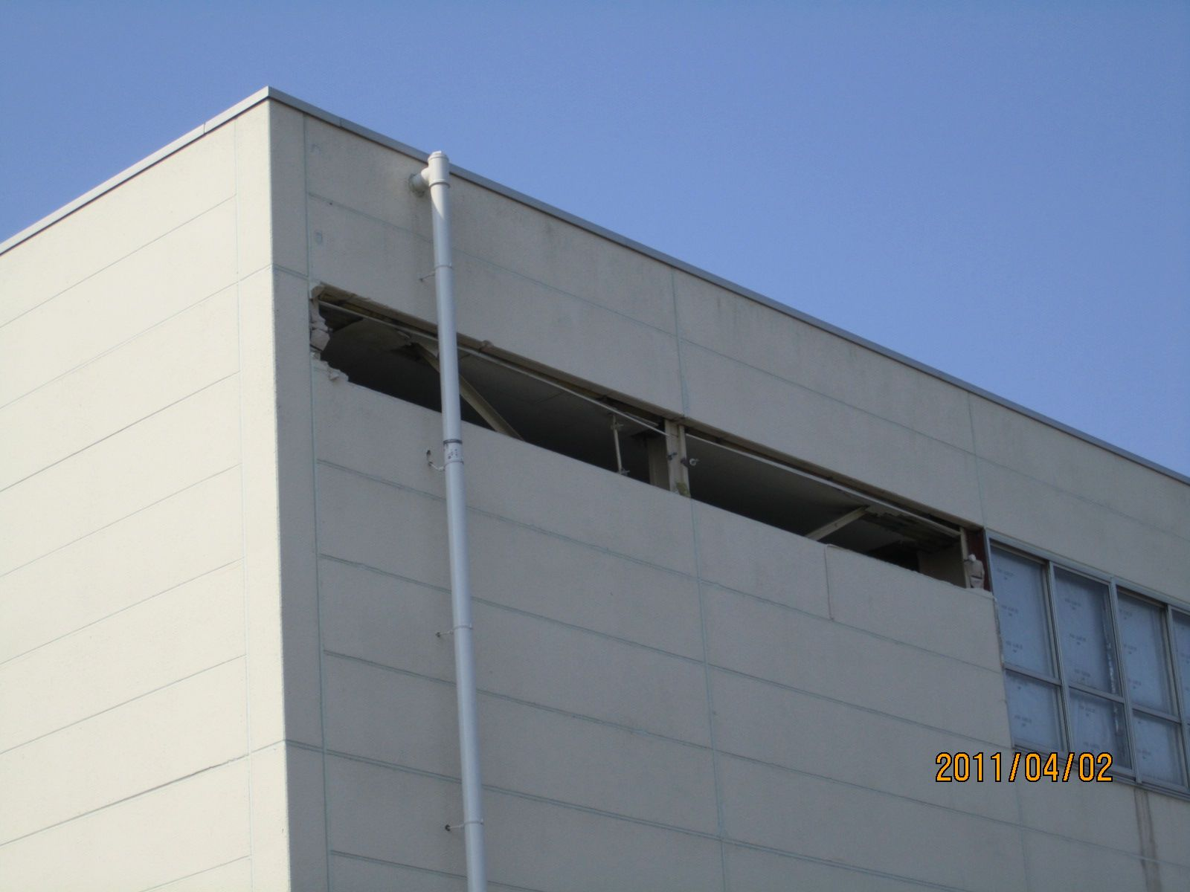
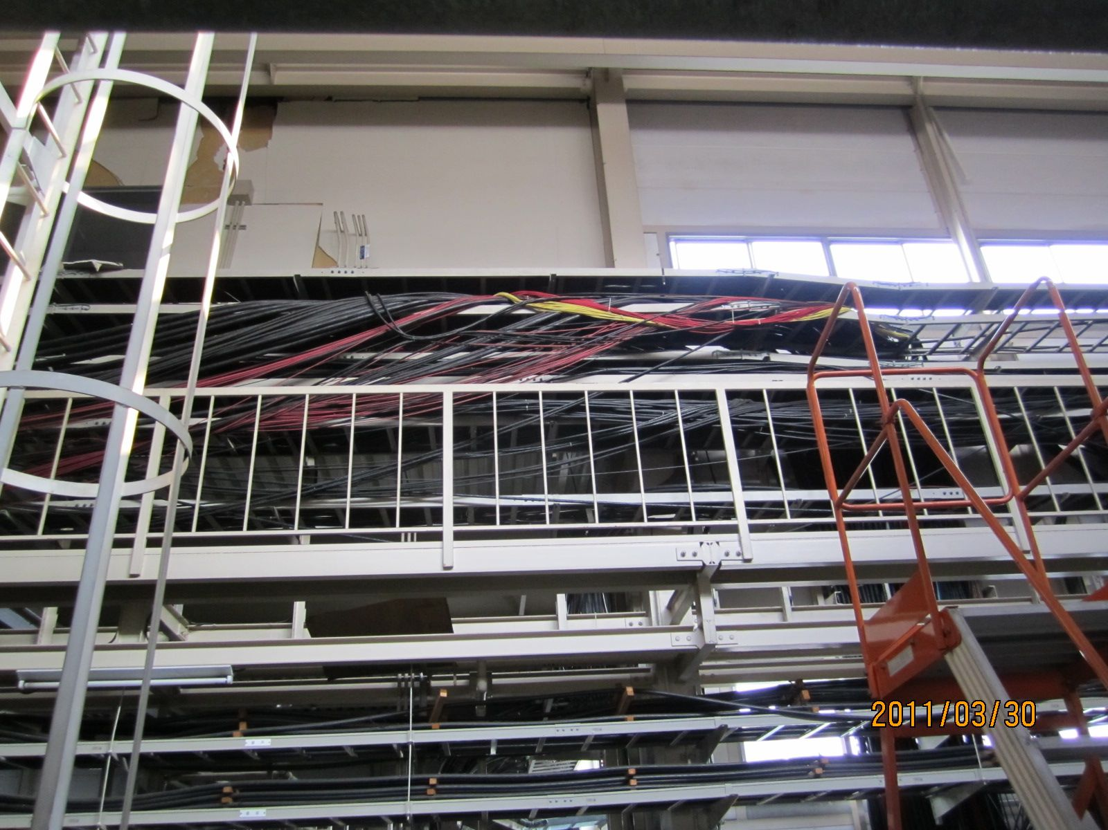
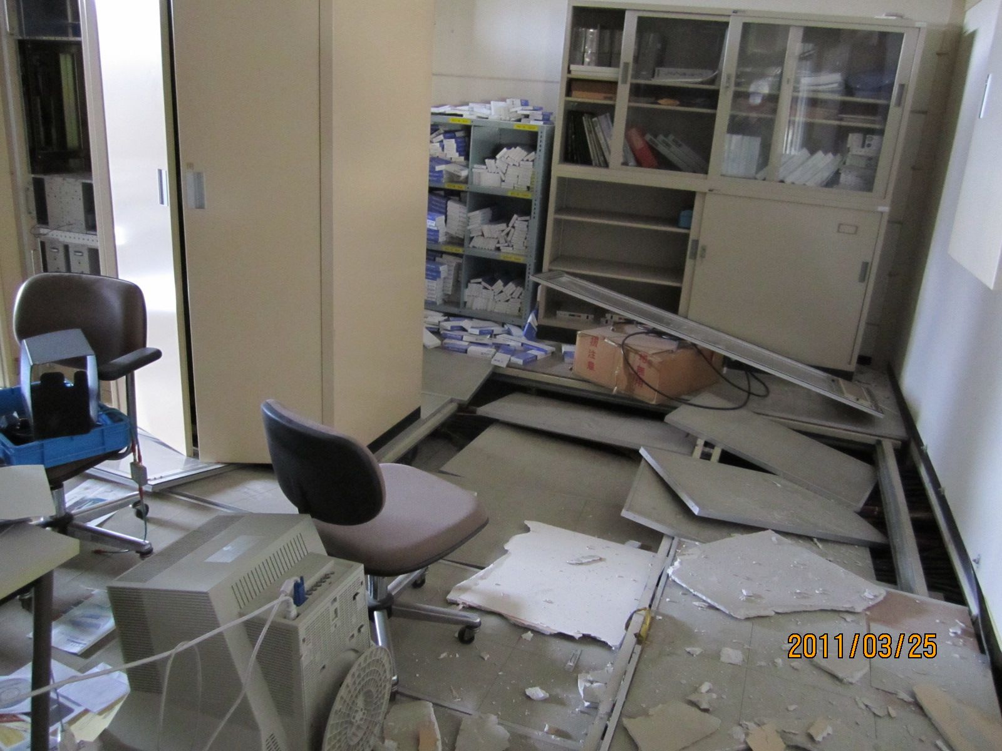
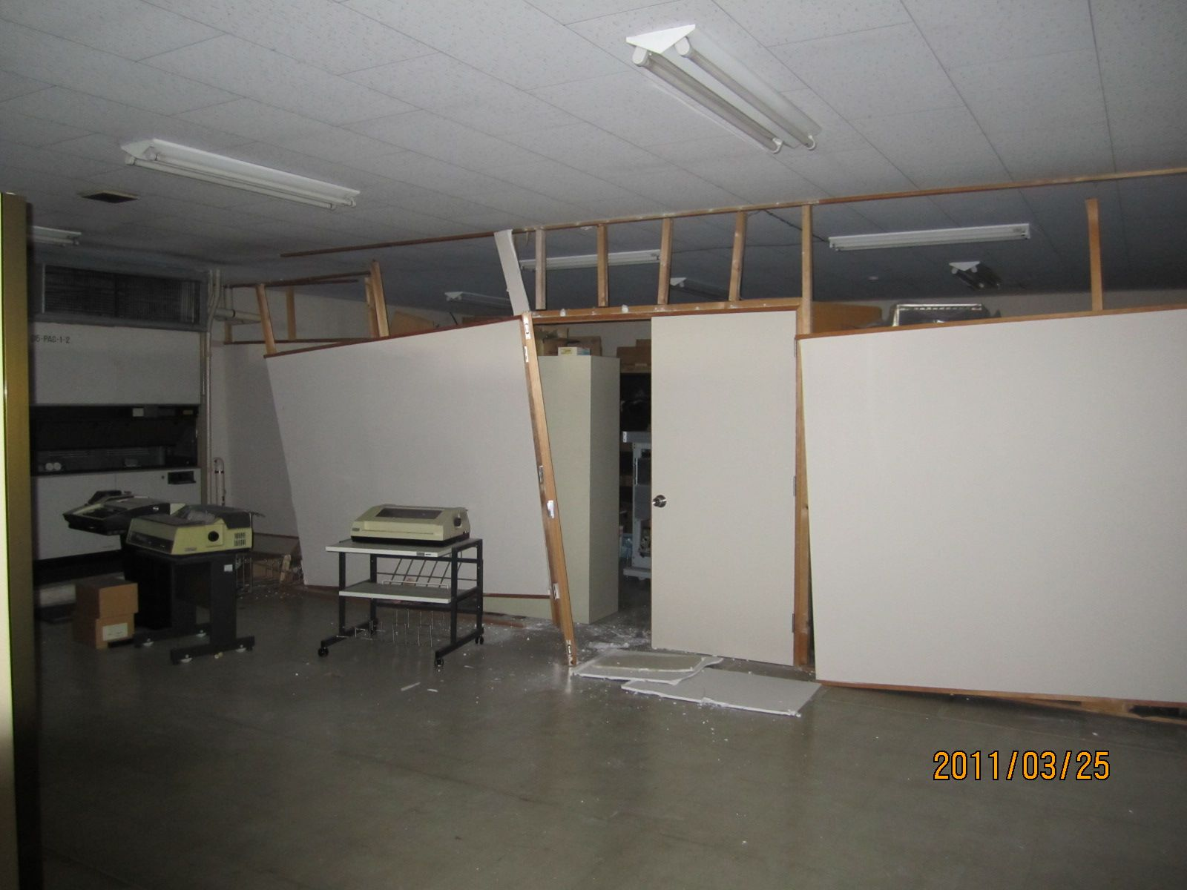
D5 power supply building
Wall panel fell down
Cables out of rack
Panels and floor in the control room

Slide 4
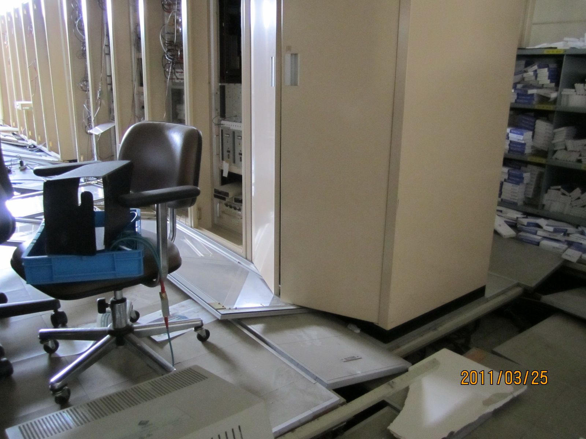
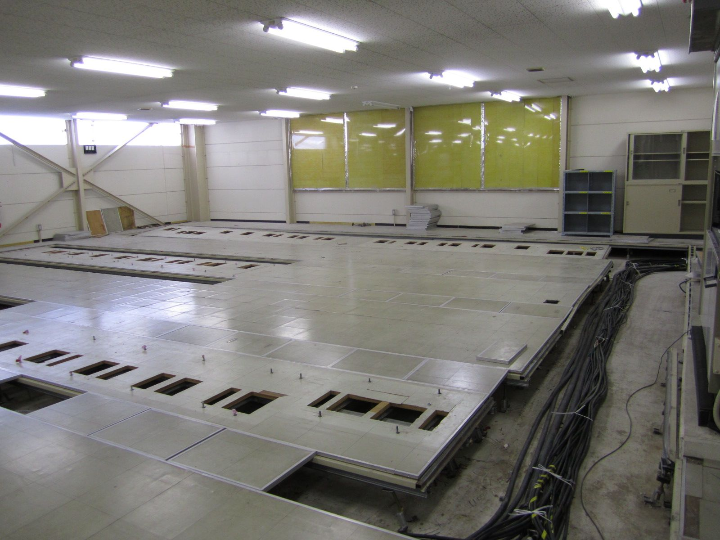
LLRF in D5
20cm fell down
More than 10 LLRF control racks for 2 RF stations fell down with floor by 20cm. Cables under the floor also damaged.
Other 10 racks fell down by 1cm.
More than 30 racks have been removed. Most of the cables, some of which are directly connected to tunnel, were also removed.
Repair floors underway.
New LLRF system to be installed.

Slide 5
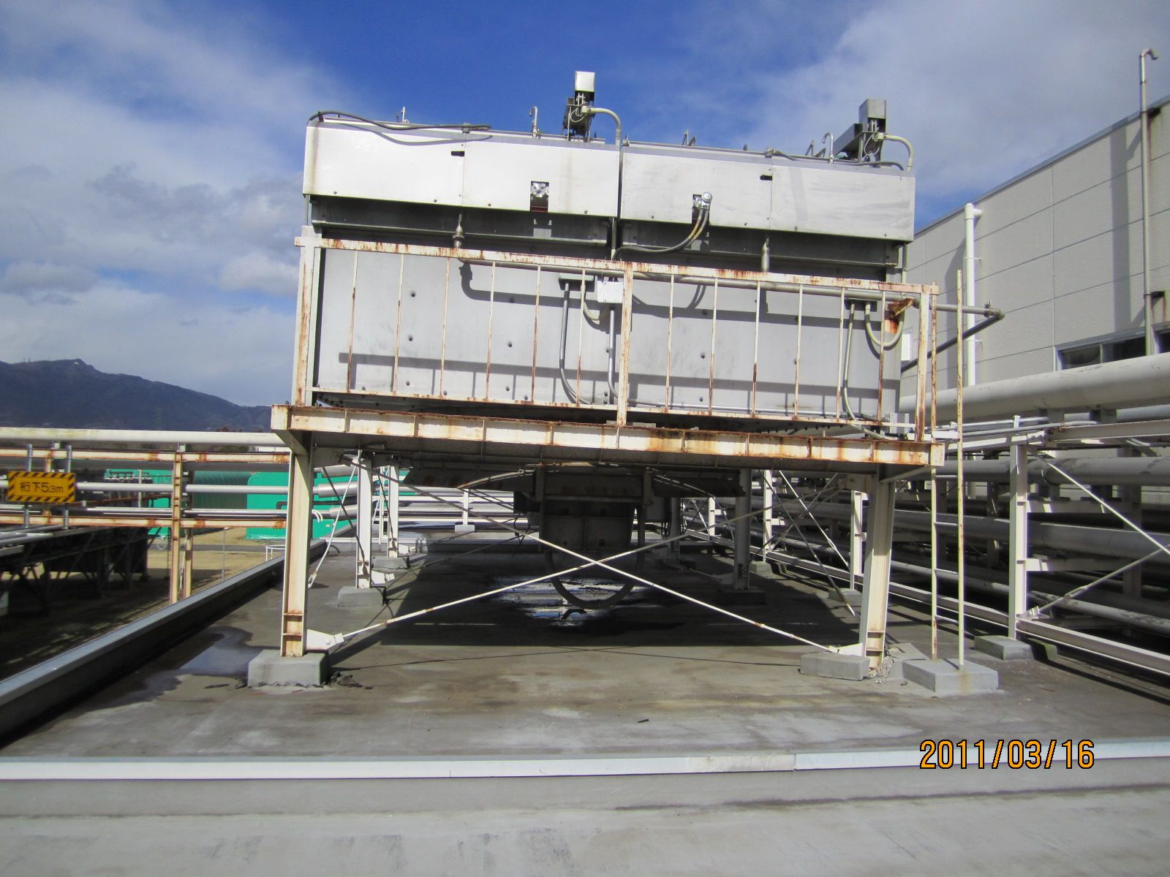
Air-fin cooler on the roof for klystrons
Stands of air-fin coolers and base plates on the roof are damaged.
Damaged in D1, D2, D4 and D5.
AFC on D4 roof

Slide 6
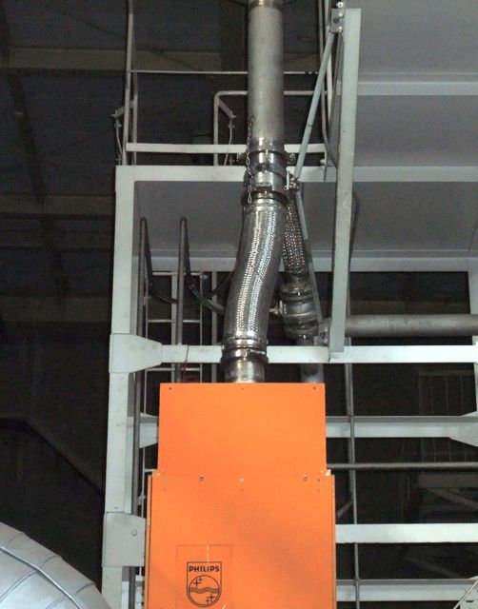
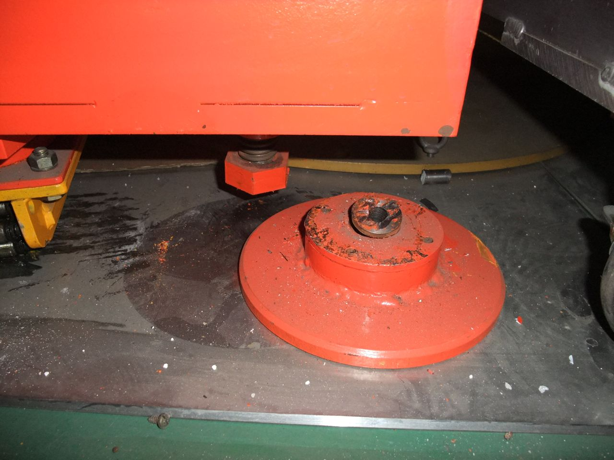
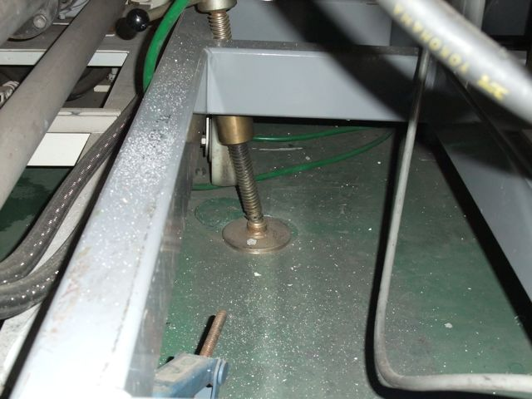
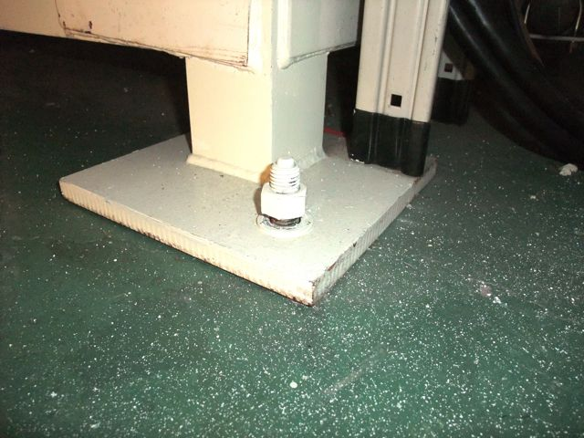
Klystrons
Stoppers of klystron sockets are damaged (half of all 35 klystrons).
Klystron positions moved (almost all).
M. Yoshida
Position moved
Stoppers damaged
Stoppers deformed
Anchor bolts at cooling tower released
Pumping system successfully restarted, and vacuum in klystrons was healthy.
Stoppers are being reinforced.
High power test to be conducted.

Slide 7
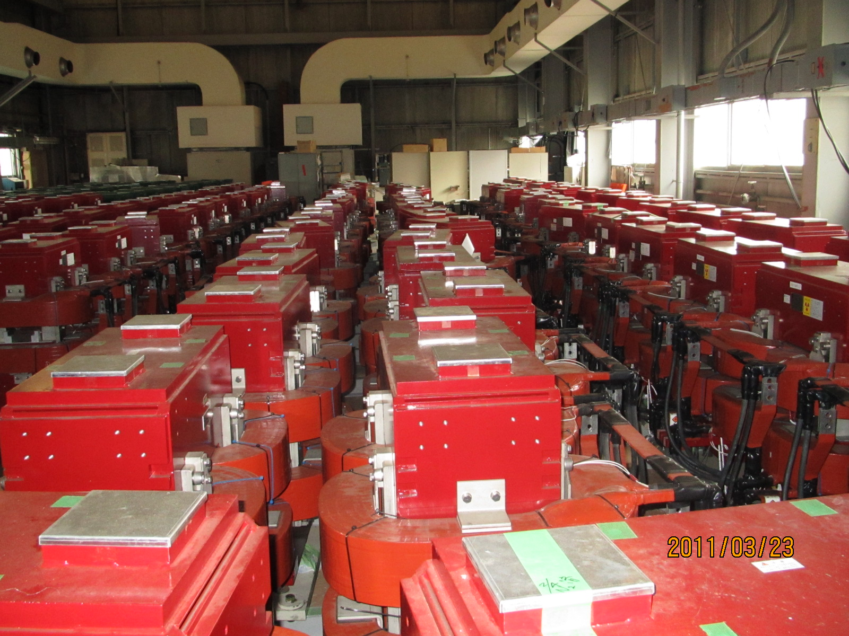
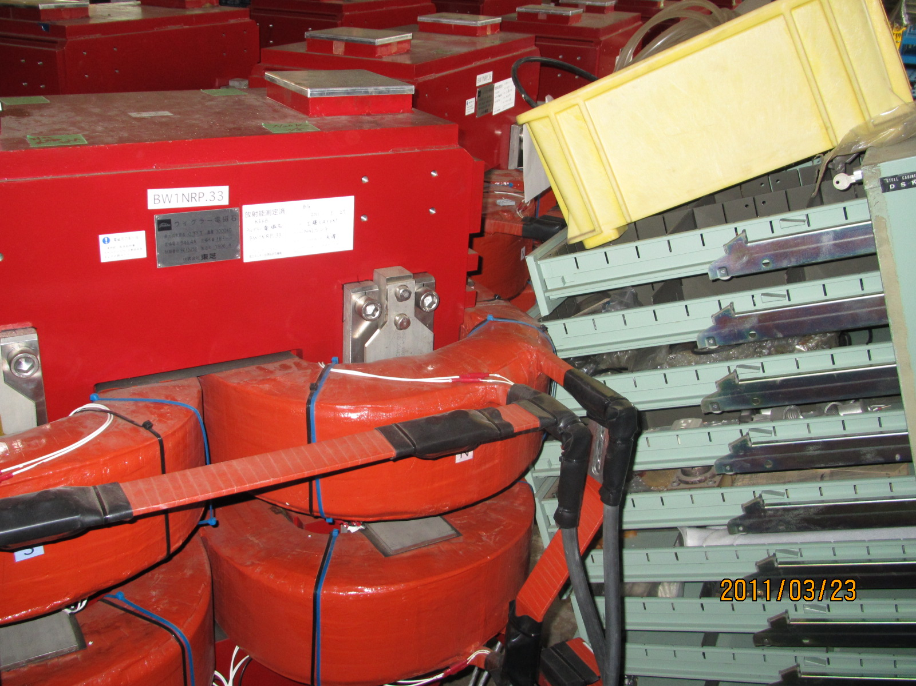
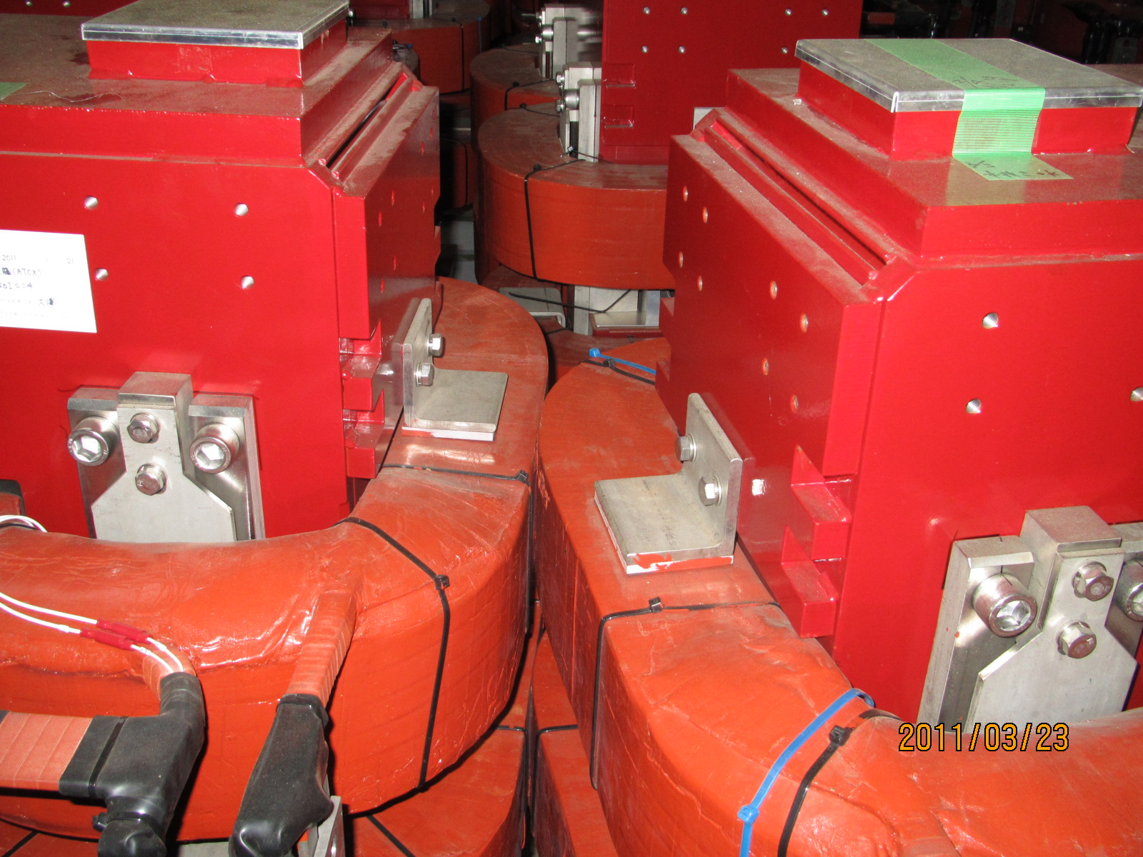
Wiggler magnets in stock building
Magnets that were stocked in a building moved and collided each other.
Coils of some magnets seemed deformed.

Slide 8
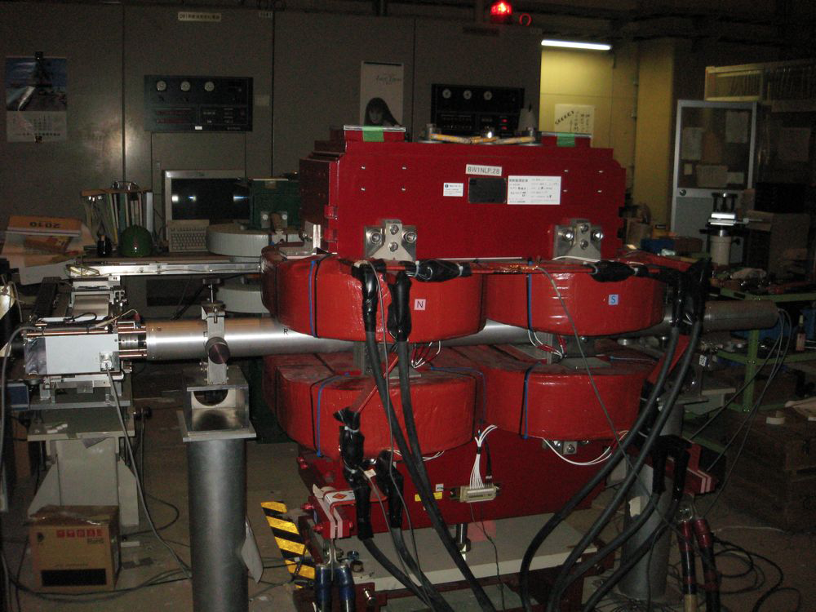
Wiggler magnets check after 3.11
Field measurement of all (~150) wiggler magnets was performed.
Fortunately, all magnets are found healthy.

Slide 9
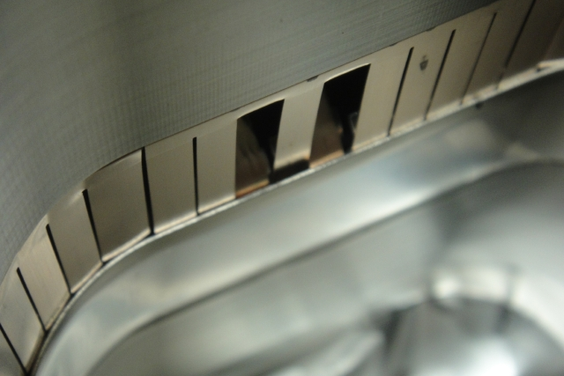
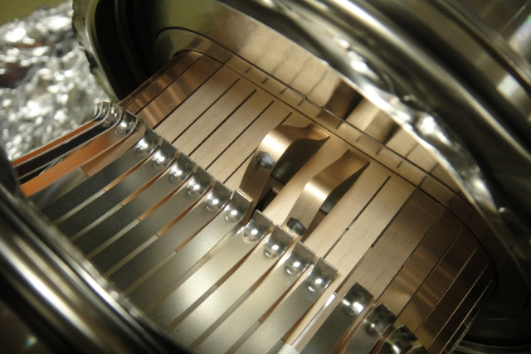
Beam pipe bellows
21 bellows in D1 were opened, and checked inside.
One of them had damage on three RF contact fingers.
It is suspected that it shrank due to the earthquake.
3 bellows in D11 were opened and checked inside.
One of them had damage on three RF contact fingers.
It is suspected that it shrank after expanded to almost its limit.

Slide 10
X-ray check of all bellows planned
Damage inside bellows can be checked using X-ray without opening to the air.
All HER bellows will be checked this year.
Y. Suetsugu
撮影条件
IPサイズ：3・1/3×12インチ
X線：110kV、5mA
距離：700㎜
露出：5sec

Slide 11
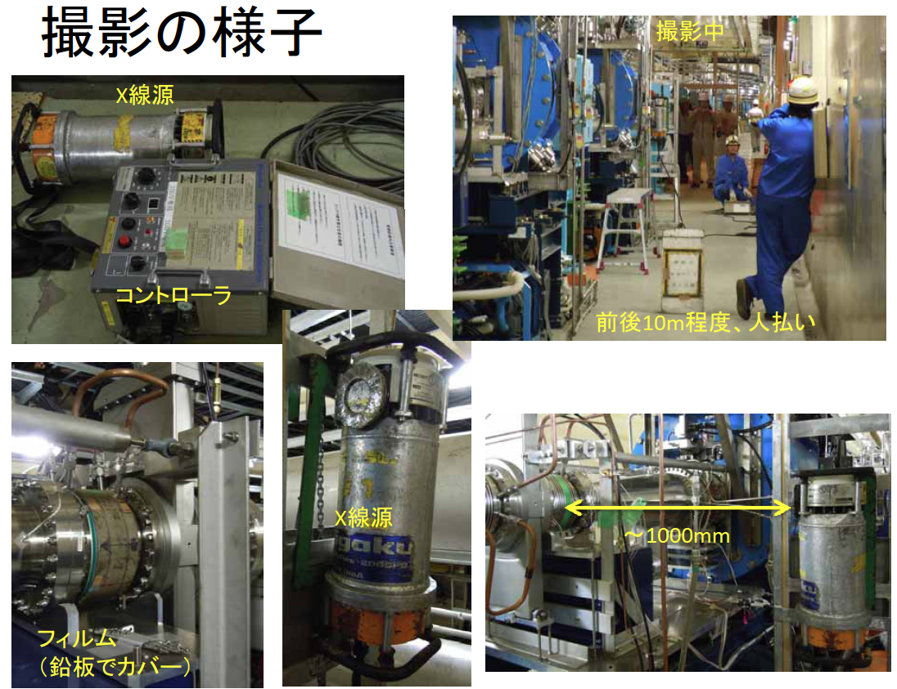
Bellows X-ray check

Slide 12
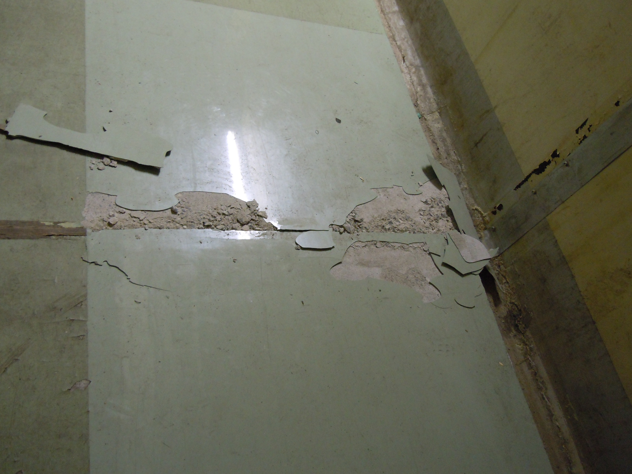
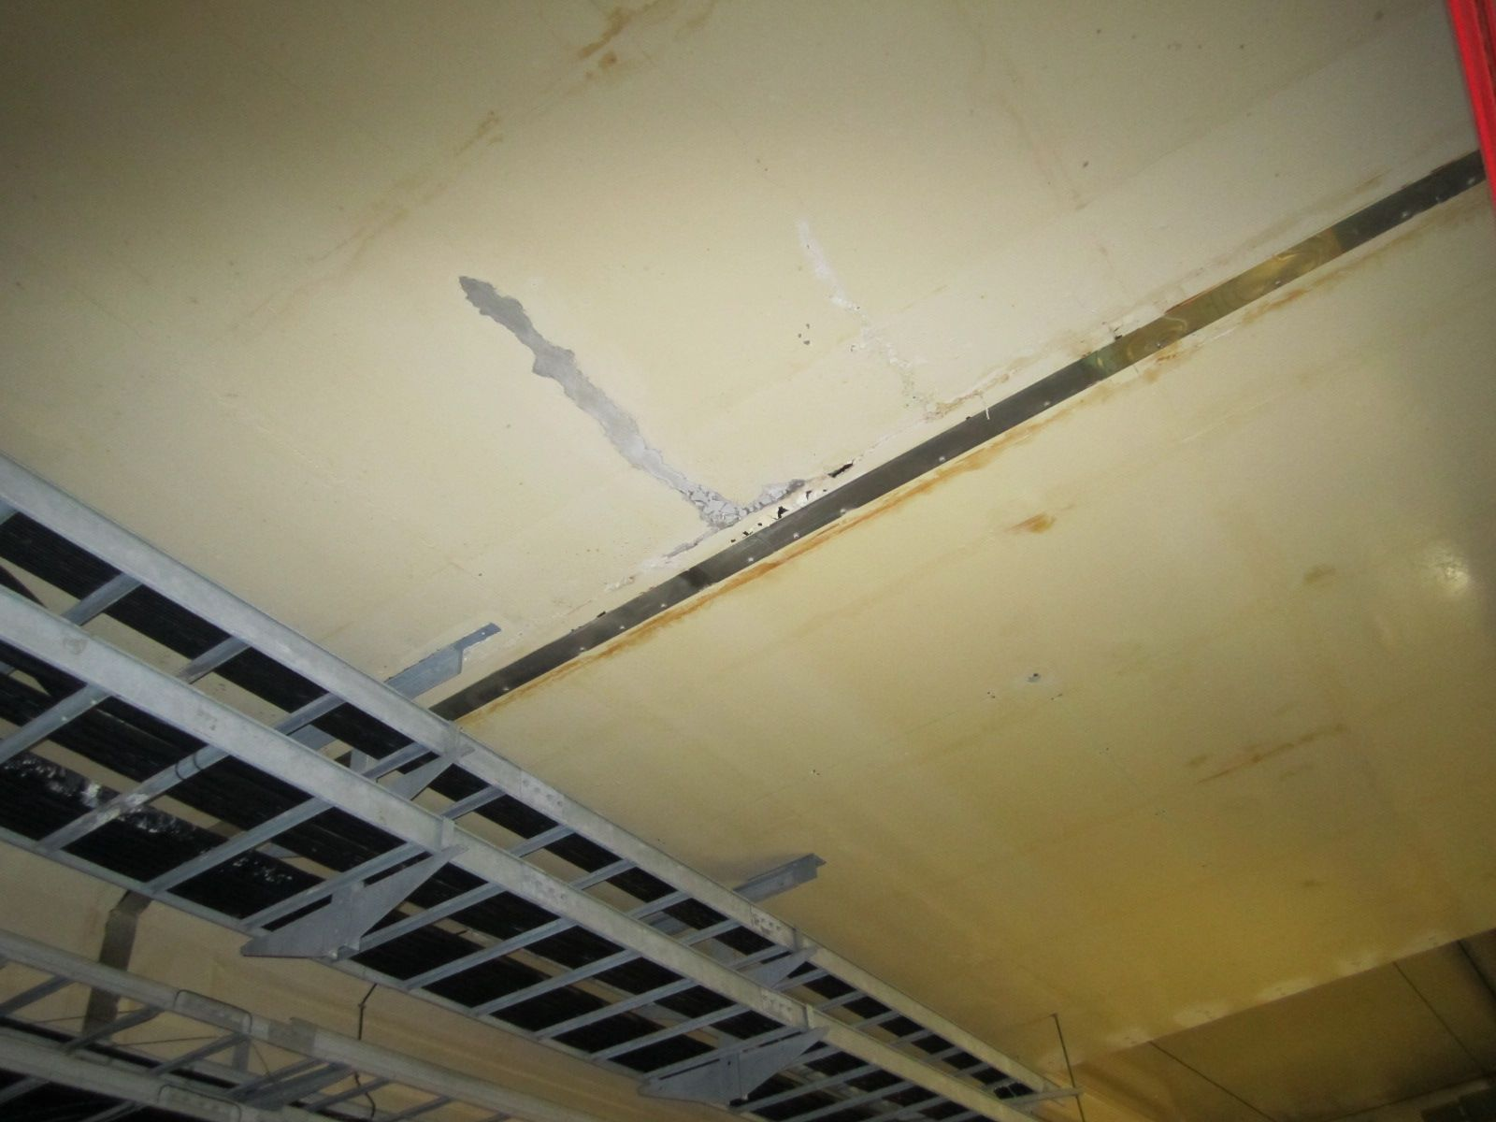
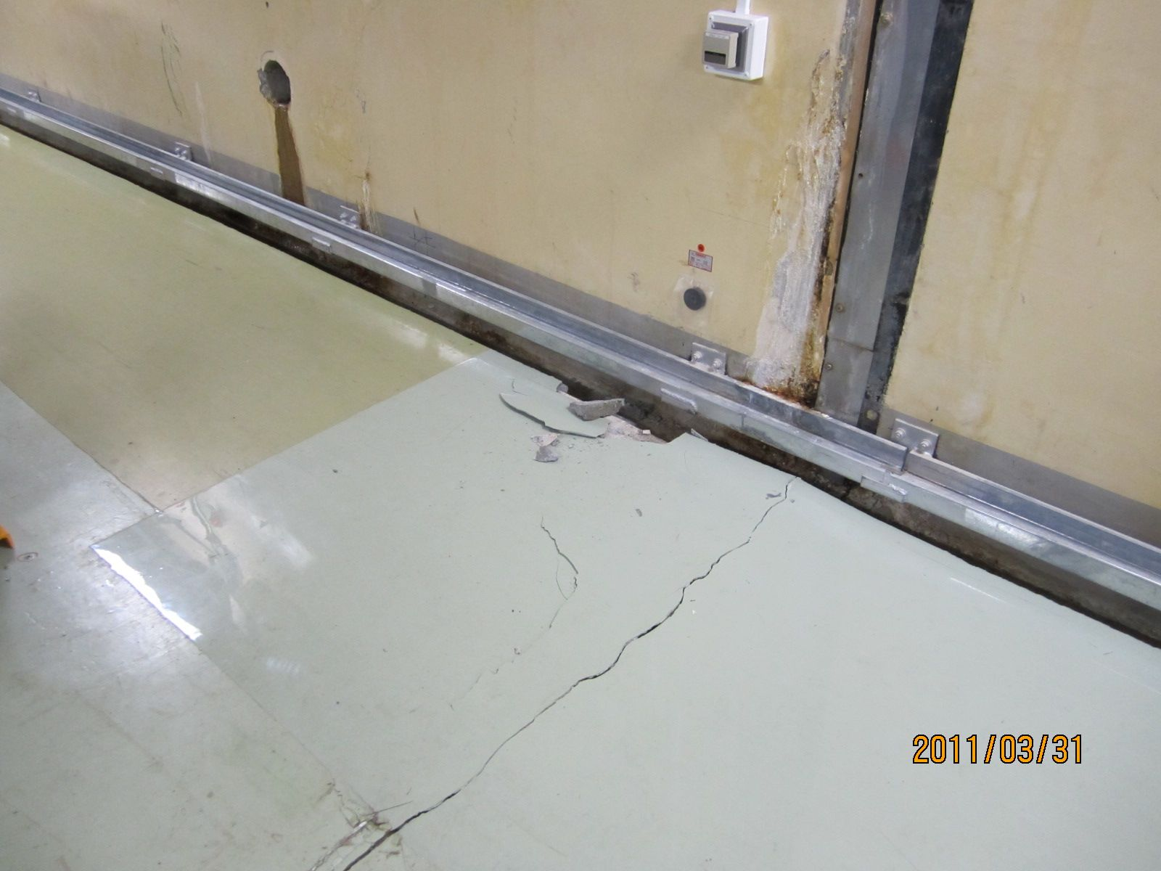
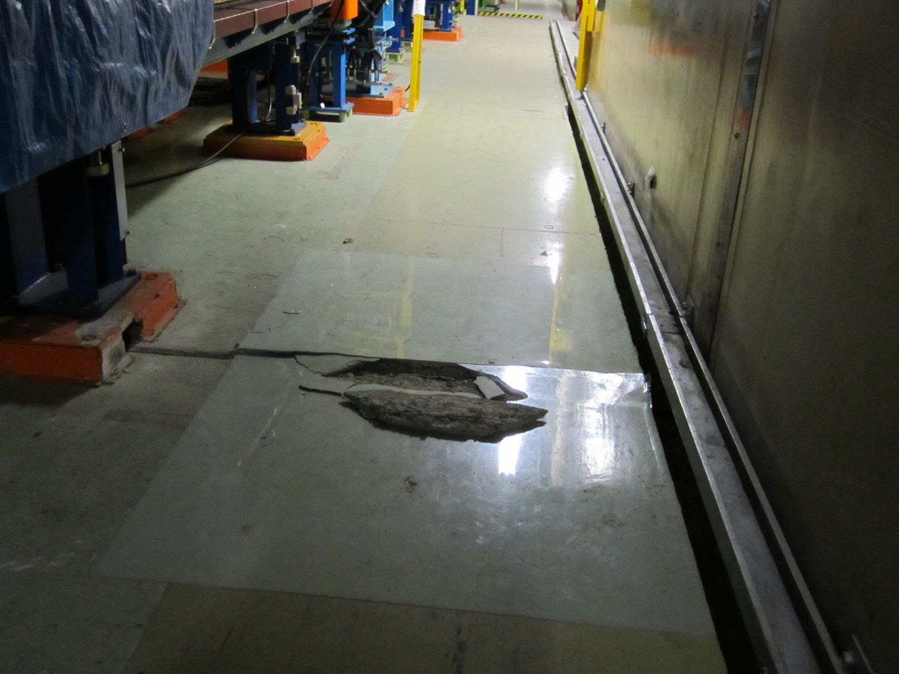
Tunnel floor, wall, ceiling
Big gap (several mm) generated at expansion joints.
Alignment of magnets shifted accordingly.
↑ Floor crack at D11 expansion joint
↓ Floor crack at Fuji expansion joint
↑ Water leak at D10 expansion joint ceiling
↓ Floor crack at the same expansion joint

Slide 13
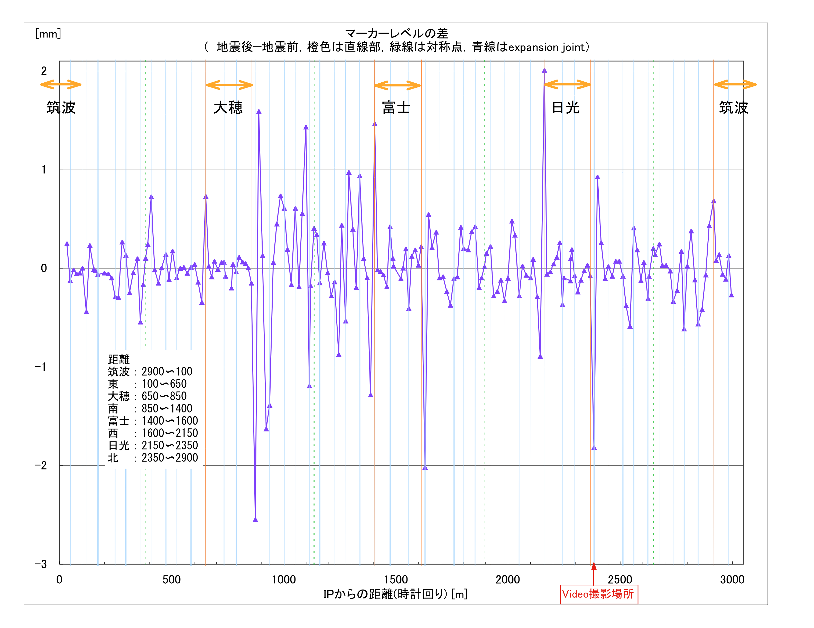
Difference between before and after the earthquake
Magnet group
Moved in the whole ring. In particular, as much as 4mm at the expansion joints between straight and arc sections. Re-alignment of whole ring is necessary.

Slide 14
Summary of the earthquake issues
Damages
Serious damage on various components in power supply buildings, including klystron stands, air-fin cooling towers, LLRF, and monitor control system.
Damages on components in the tunnel seemed lighter than those in the buildings.
HER bellows had some troubles. Need investigation.
The expansion joints in the tunnel moved, and magnets alignment changed.
Other components such as radiation shields, cooling pipes, some magnets.
Recovery
Urgent cures (vacuum leak check, field measurement, system check etc.) were done immediately.
Fortunately, all wiggler magnets in stock buildings found healthy, according to field measurement.
Large scale recovery work started after the supplementary budget for restoration and rehabilitation became available in January 2012.
Investigation of damages still continues, including X-ray survey of bellows, high-power test of klystrons, etc.

Slide 15
Construction Status

Slide 16
SuperKEKB construction schedule
Revised on Feb. 10, 2012
FY2010
FY2011
FY2012
FY2013
FY2014
KEKB stop,
Construction start
We are here
T=0
in FY2014
(early 2015)
Dismantle KEKB
Fabrication
Beam pipes and vacuum components
Baking, TiN coating
Install, system check
Fabrication
SuperKEKB
commissioning
Magnets and power supplies
Field measurement
Install, alignment, system check
RF system
Reinforce and rearrange
System check
Monitor & control,
Beam transport
R&D
Fabrication
Optics and hardware design, R&D
Install, system check
QCS and IR hardware
Fabrication
Install, system check
MR buildings construction
MR infrastructure
Cooling system reinforcement
Damping Ring
Components Fabrication
DR tunnel construction
Install, alignment, system check
DR buildings construction
e+e- Injector
Upgrade and operation for PF/PF-AR
Injector low emittance

Slide 17
Commissioning plan
Phase 1: commissioning with Beast II
Start early 2015 in FY2014, and continues for about half an year.
Hardware and optics tuning, vacuum scrubbing, BG study, and collision tuning will be performed.
Target luminosity in this phase is 1x10³⁴ cm⁻²s⁻¹.
Belle II solenoid is required to be implemented by then for the low beta beam tuning.
Phase 2: commissioning with Belle II
Start at the end of 2015.
Machine tuning continues to increase luminosity with Belle II data taking.
This plan is agreed between SuperKEKB accelerator and Belle II.

Slide 18
Prioritizing for T=0
Emittance
The design emittance is targeted from the beginning (T=0). Main Ring magnets, beam pipes, injection system, etc. should be completed by then. The Injector and DR should satisfy the low emittance at T=0.
βy*
Although we may start with detuned optics, βy* should be squeezed in the commissioning phase in about half year. Necessary hardware to achieve design βy* must be implemented by T=0.
Beam current
Considering budget profile and schedule, about half the design beam current is targeted in the first commissioning phase.
Some components as well as infrastructure needed for the design beam current may be postponed after T=0. However, works that are difficult to do after the commissioning, such as rearrangement of cavities, reinforce cooling pipes in tunnel, will be completed by T=0.
Bunch charge at Injector
Charge requirement for Linac and DR is set to match the beam current increase (roughly, 1 nC at T=0, 2 nC at +1year, 4nC at +2 years). This is to make a clear target for the RF e- gun and e+ source R&D and the Linac and DR construction schedule.

Slide 19
Beam Energy
Design
Original design maximum energy is 11.05GeV at Υ(6S).
Recent request for higher energy
Requirement to investigate feasibility and issues for higher energy more than 11.5 GeV to around 12GeV was given by Belle II last autumn. The high energy running, if any, will be after several years running at Υ(4S) ~ Υ(6S).
Investigation
We investigated limitations from various components such as Linac, BT, QCS, Power supply for magnets, etc. Present attainable E_{cm} is 11.24GeV, limited by e- Linac and e+ BT magnets.
In order to inject the electron beam to HER at the required energy for 12 GeV operation, there must be huge reinforcement of Linac (replacement of S-band with C-band, 7.571 -> 8.6 GeV; current estimation of cost is about 24 Oku-Yen).
From the viewpoint of the cost and labor, energy ramp-up of HER is supposed to be more realistic, so we will study its possibility.
Development of C-band units for Linac will also be promoted.

Slide 20
Request from Belle II regarding high energy running of SuperKEKB
November 8, 2011
Dear Akai san, Enomoto san and Koiso san,
( cc to Oide san )
On behalf of the Belle II collaboration, we would like to ask you and the KEKB accelerator team to investigate the maximum possible obtainable center of mass energy of Super KEKB and the issues associated with achieving it.
A reason for this request is a recent discovery by Belle of the two charged bottomonium resonances in the Upsilon (5S) decays. This remarkable result likely means that we now enter a new era of heavy quarkonium physics for which Super KEKB can provide unique opportunities. In particular, based on Heavy Quark Effective Theory, we expect the existence of exotic bottomoinum states near and above the thresholds of B*B*bar, Upsilon (5S).
These states, however, cannot be produced in a single-pion transition from Upsilon (5S) due to G-parity conservation rule. The only possible way to produce them can be by the emission of a rho meson from highly excited Upsilon states, and therefore, the total CMS energy of about 12 GeV is necessary. We expect meaningful physics results with running at this high energy even in case of significant luminosity degradation.
Hence, we request Super KEKB group kindly provide us with the information regarding its feasibility and the issues associated with high energy running. It is our strong wish to understand the limiting factors of high energy running and to work with you to solve the potential problems if possible.
We thank you very much in advance and look forward to hearing from you.
Peter Krizan
Spokesperson, the Belle II collaboration
Hiroaki Aihara
Chair of the Executive Board, the Belle II collaboration

Slide 21
Limitations for Higher E_{cm}
e⁻ Linac (present limit)
e⁻ BT magnets
QC1E(HER) 90% quench limit
4.364 GeV @ 860A
Power supply of LER main dipoles
11.6
11.8
12 GeV
QC1P(LER) 90%
E={7.32,4.18}
A
11.05 GeV; original E_{cm}, max
B
E
11.24 GeV;
present attainable E_{cm}, max
C
e⁺ BT magnets
(with replacing power supplies)
D

Slide 22
Design Issues to be fixed
Optics and IR design
Both sides of IR (300m Tsukuba) vacuum components and magnets production scheduled in FY2012.
QCS fabrication should start in FY2012.
Sextupole scheme
Rotation sextupole magnets are required in LER.
In HER, normal sextupole and independent skew-sextupole may be OK at T=0.
BG, Collimation system, radiation shield
BG estimation, movable masks R&D, investigating radiation going on.
Requirement for BPM detectors
Specification and how many at T=0?
Injection scheme
Synchrotron injection in HER?
Abort system
Possible scheme to abort nano beam.

Slide 23
Budget
Budget
Total construction budget is 314 Oku-Yen for Rings, Injector, and Belle-II.
Most of the budget comes year-by-year based.
Operation budget is expected in FY2014 and later.
FY2010
FY2011
FY2012
FY2013
FY2014
FY2015
FY2016
Very Advanced Research SP (100 Oku-Yen)
SuperKEKB commissioning
Other budgets for construction (214 Oku-Yen)
We are here
Operation budget (continues - - - )
Unit: Oku-Yen (~1.2M$)
FY2010 | FY2011 | FY2012 | FY2013 | FY2014 | Total
75.0 | 10.5 | 14.5 | 0 | 0 | 100.0
0 | 41.6 | 40.2 | 61.6 | 46.7 | 190.0
0 | 4.5 | 12.4 | 7.2 | 0 | 24.1
75.0 | 56.6 | 67.1 | 68.8 | 46.7 | 314.1
Supplied | Supplied | Submitted to the Diet | To be submitted to the Diet | To be submitted to the Diet
VARSP
Others
Facility
Total
Status

Slide 24
Human Resources
HR of KEK staff
Change of permanent staff members from the last MAC
Apr. 2011: One retired. Three newly hired. Two joined from other groups.
July 2011: One joined from other group.
Apr. 2012: Two will retire. Three expected to be newly hired. Some join?
Senior staffs after retirement
Young members at term positions
Other helps
Collaborations going on
KEKB operation crew (company persons) to help construction work
Situation of short HR seems getting better
Date | Status | Needed FTE | Available FTE of permanent staffs | Non-permanent staffs added
Dec. 2010 | under construction | 77 | 56 | 61
Apr. 2011 | under construction | 77 | 60 | 66
Apr. 2012 | under construction | 77 | 62 +some? | 67 + some?

Slide 25
Vacuum system
Fabrication of vacuum components -> Talk by Y. Suetsugu
Aluminum ante-chamber beam pipes for LER arc sections (700 pieces, 2km length) on going in FY2011.
Bellows and gate-valves for arc and wiggler sections to be completed soon.
Copper beam pipes for wiggler sections in LER and HER to be completed soon.
Beam pipes, bellows and gate-valves in Tsukuba straight section for both rings to be ordered in FY2012 and 2013.
Movable masks, SR and X-ray monitor chambers will be made in FY2013 and 2014. Currently, R&D is going on.
Replacement of some HER components for higher beam current before or after T=0 depends on budget.
Baking and TiN coating system -> Talk by K. Shibata
Deck for vacuum work in Oho has been rebuilt after old AMY detector of TRISTAN was removed.
The first baking system and the first TiN coating station has been built in the vacuum deck.
More sets of baking and coating stations will be built soon.

Slide 26
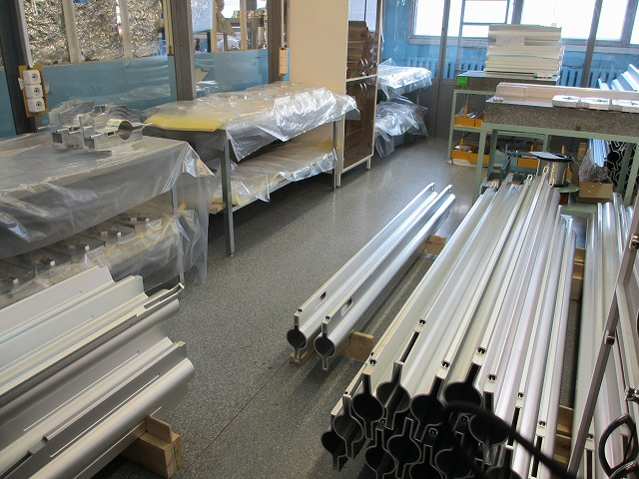
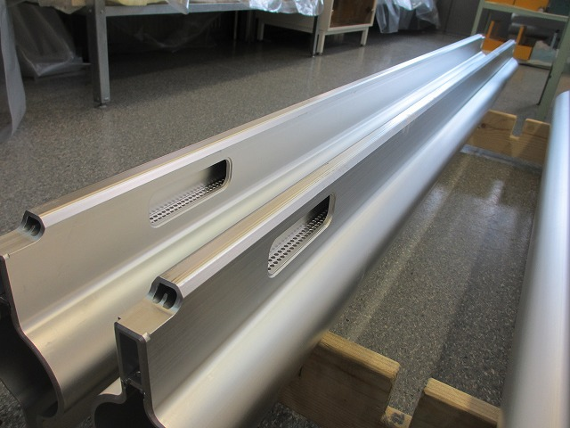
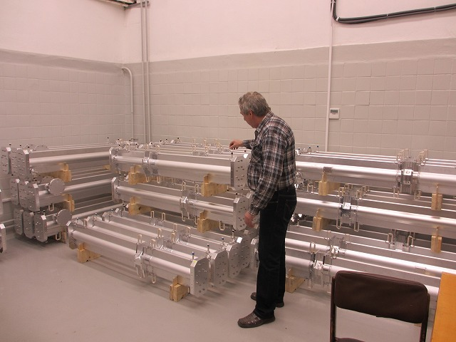
LER beam pipe fabrication @BINP

Slide 27
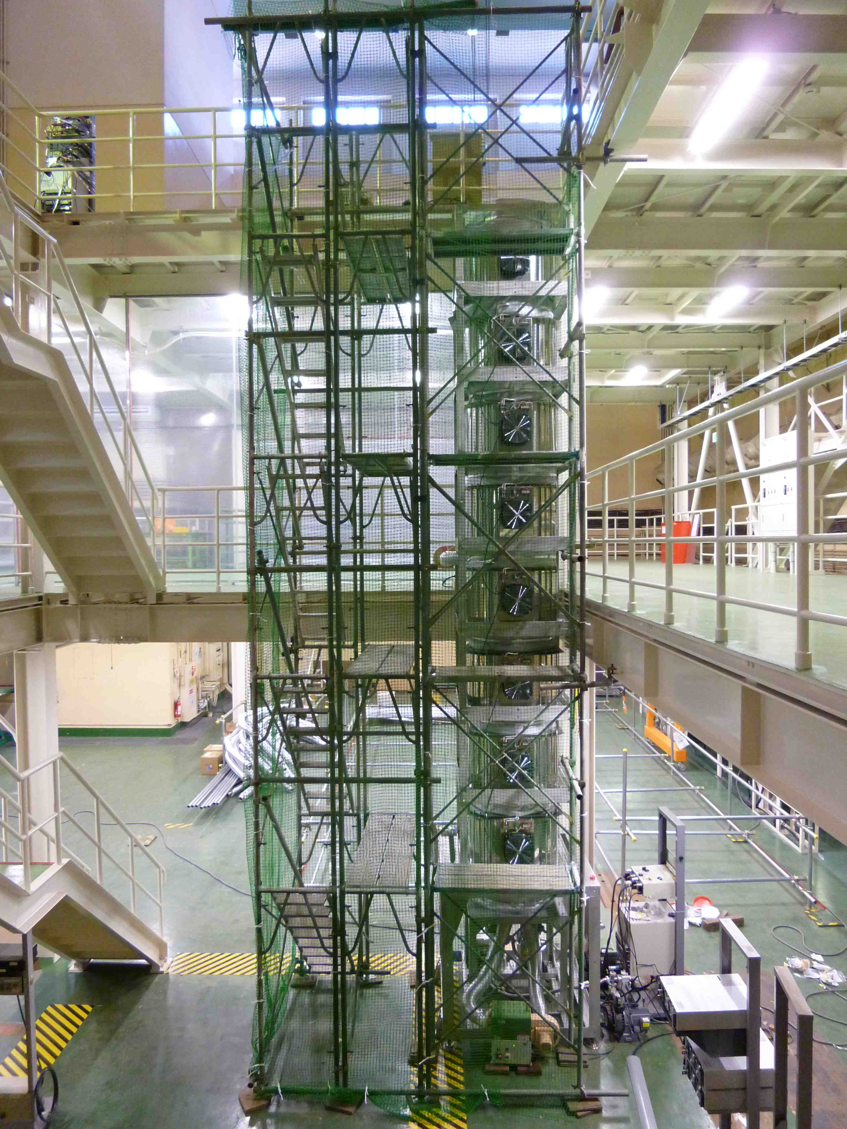
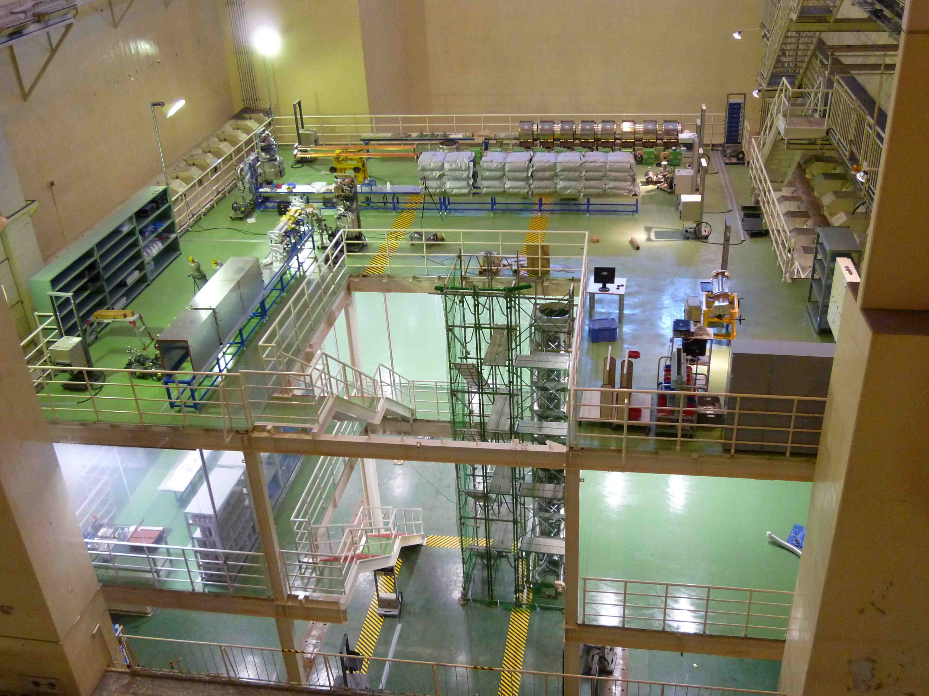
TiN coating machine
TiN coating machine (1st vertical type) in Oho experimental hall

Slide 28
Magnet system
-> Talk by H. Iinuma
Fabrication of magnets
Fabrication and field measurement of LER 4m dipole magnets is going on. They will be installed in tunnel in the first half of FY2012.
Half-pole and single-pole wiggler magnets, LER V-steering magnets, some of Q magnets on going in FY2011.
Fabrication of power supplies for magnets
Power supplies for main dipole magnets and wiggler magnets are going on in FY2011.
Power supplies of medium and small power will be ordered in FY2012 or later.
Power supplies for DR: some are ongoing, others will be in FY2012.
Alignment and tunnel measurement
Measurement after the earthquake showed significant movement of tunnel.
Introducing GPS system and investigating the ground (boring, etc.) going on.

Slide 29
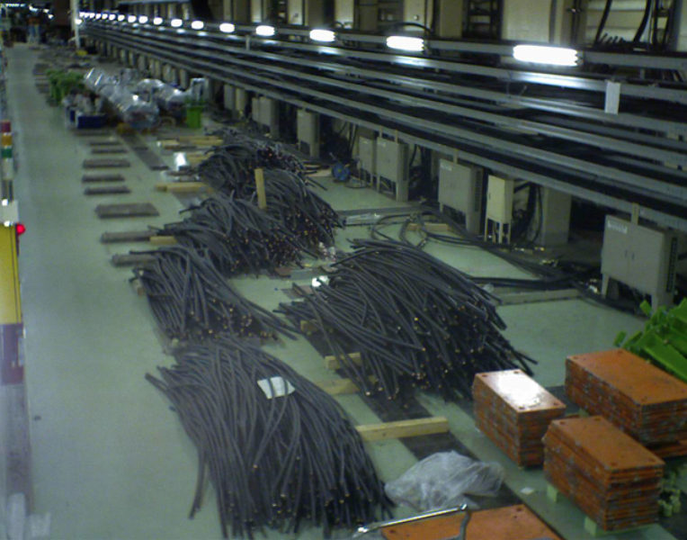
Dismantle Tsukuba straight section
Removed power cables
Dismantle both sides of IR (D1 and D2) done.
Magnets and cables have been removed.
Old base plates were removed, and the floor has been cleared up.

Slide 30
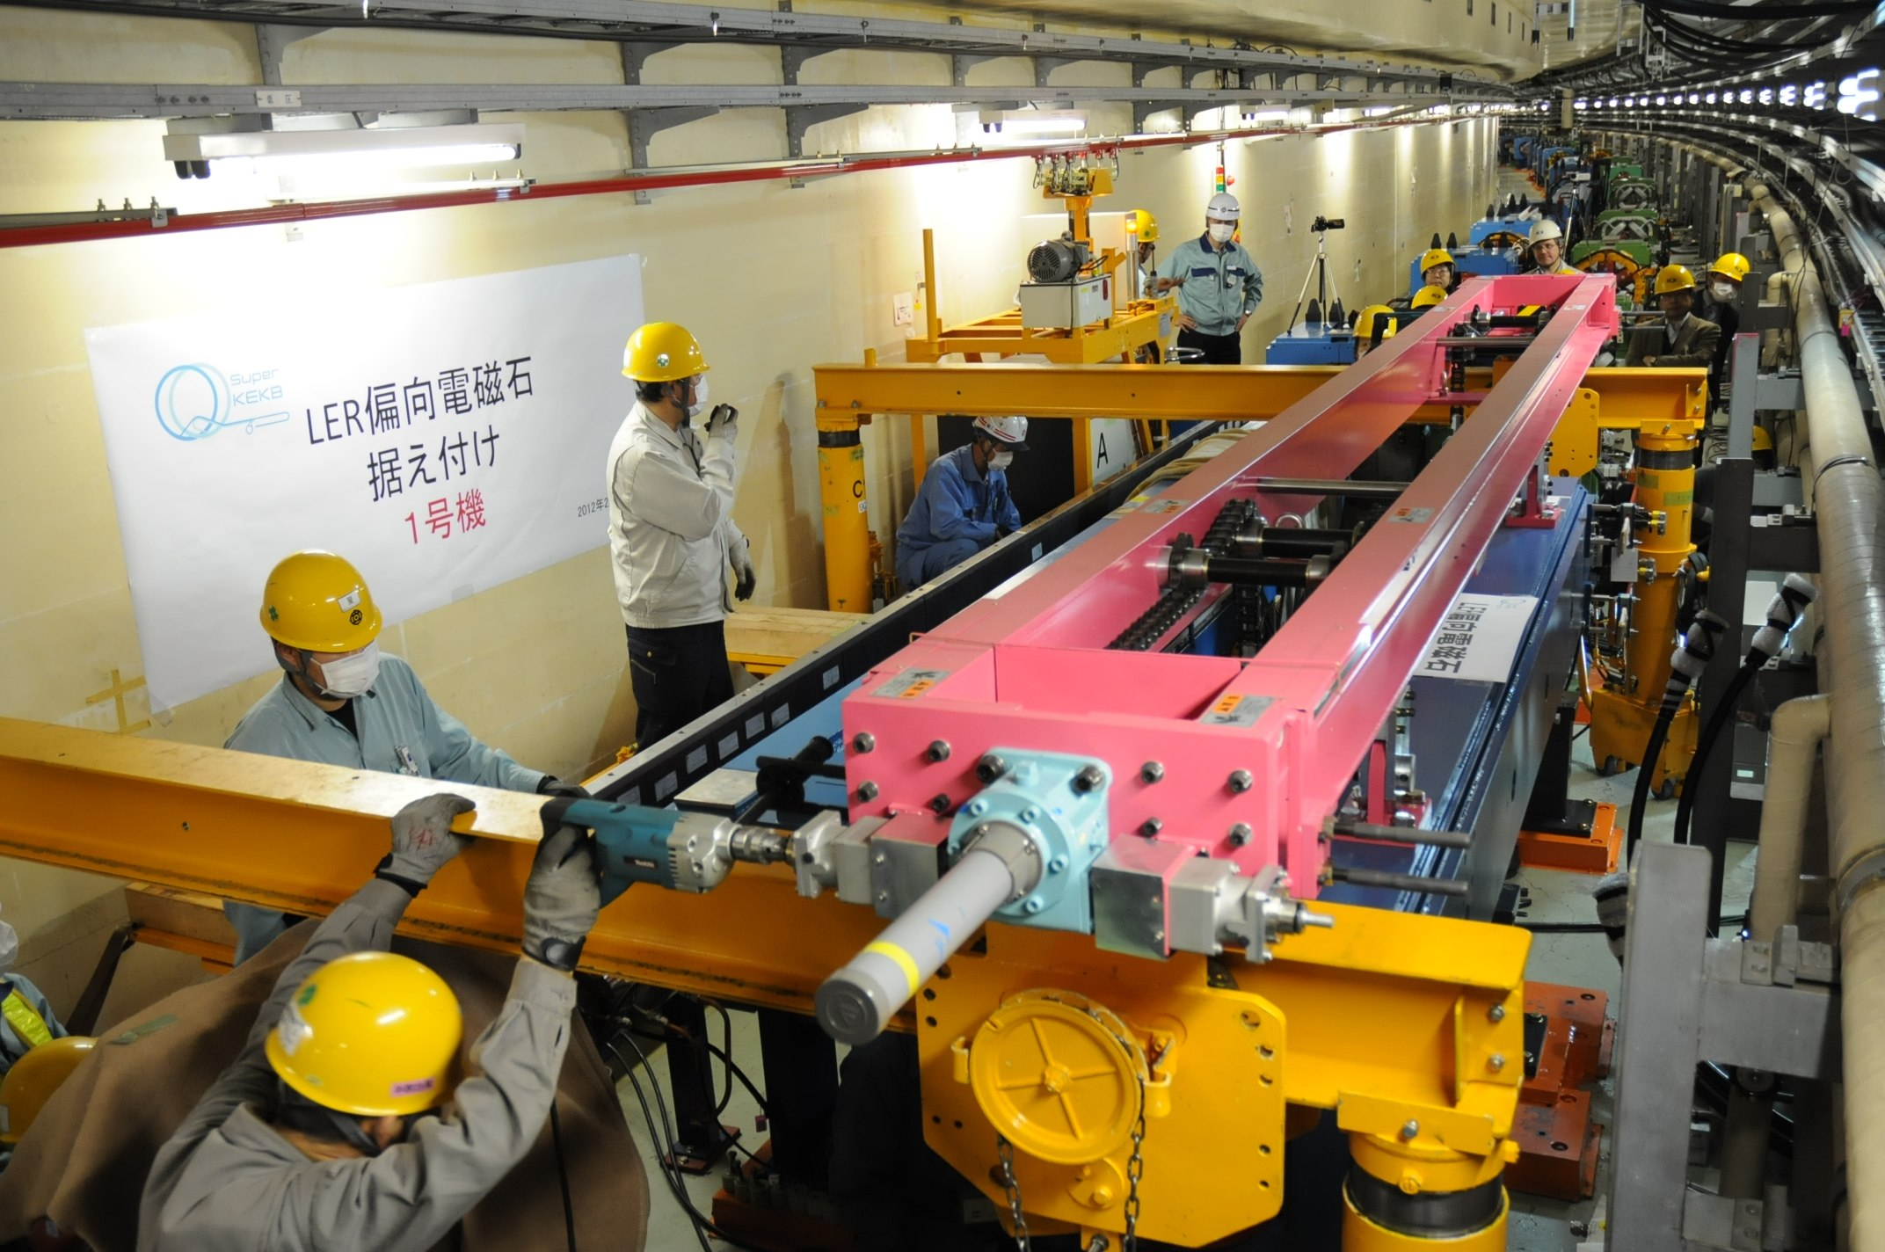
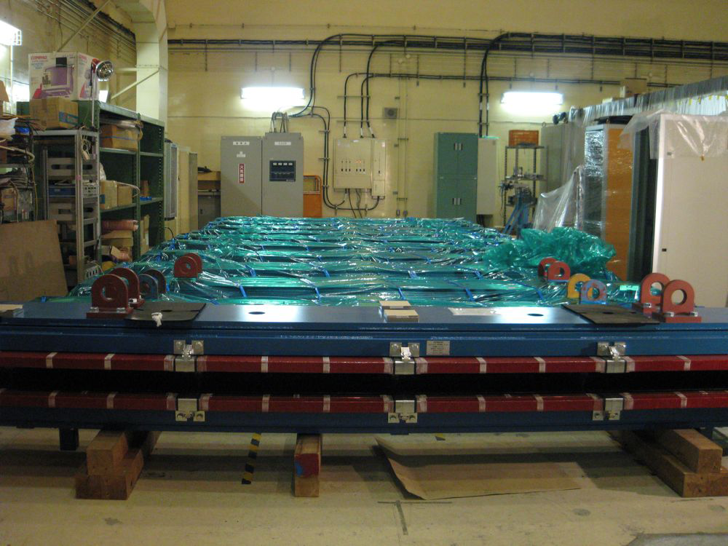
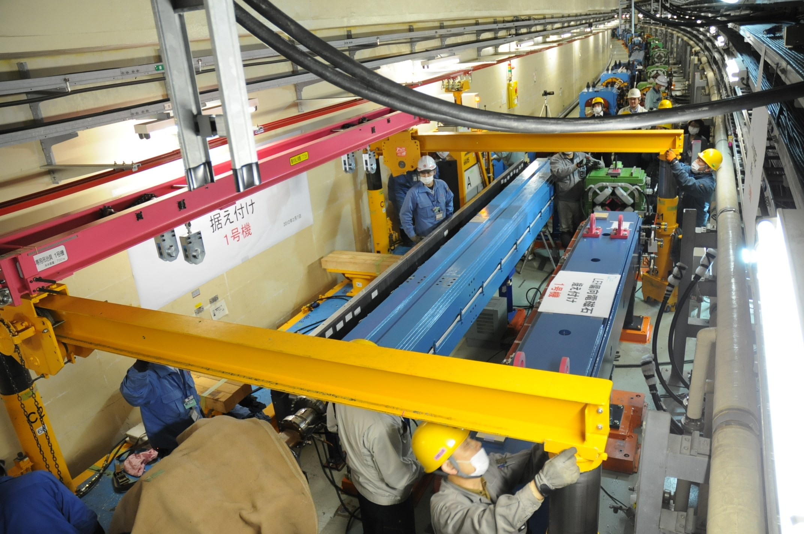
LER new 4m dipole magnets
Field measurement set up
The first goods delivered to KEK.
Install test in the outer LER over existing magnets in the inner HER.

Slide 31
Interaction Region
A lot of critical issues
Optics design
QCS design and fabrication
IR hardware design and assembly
Background
Storage beam
Injection transient, blow-up, mask, IR aperture
Vacuum pressure at large beta (beam-gas)
Error tolerance at local chromaticity correction and correction method
Ripple of power supply
Collision feedback
Will be presented in the following talks today:
Dynamic aperture and IR modeling (A. Morita)
Error Tolerance and Optics Correction (H. Sugimoto)
IR Magnets (N. Ohuchi)
Beam Background (H. Nakayama)
IR Vacuum Chamber and Assembly (K. Kanazawa)
Collision Feedback (Y. Funakoshi)

Slide 32
RF system
Upgrade items
Change to 1 klystron to 1 ARES cavity scheme to increase beam power
Rearrange ARES cavities
Change input coupler of the ARES to increase coupling β from 3 to 6
Add klystrons, power supplies, HPRF and LLRF
Cure for increasing HOM power -> Talk by Y. Morita
Develop new LLRF -> Talk by T. Kobayashi
Damaged LLRF in D5 by the earthquake will be replaced with new ones.
Develop Damping Ring Cavity -> Talk by T. Abe
Replace old components with new ones (klystrons, power supplies, etc.)

Slide 33
KEKB
D4
OHO
D5
D7
FUJI
D8
D10
NIKKO
D11
Lower
power
1
2
2
2
1
2
2
2
2
1
2
2
2
2
1
C
B
A
A
B
C
E
E
D
C
B
A
A
B
C
D
E
D
C
B
A
A
B
C
D
E
F
HER
LER
Add 3 power supplies (done)
SuperKEKB (commissioning: T=0)
Replace 4 old VP-klystrons in D10 with new klystrons
D4
OHO
D5
D7
FUJI
D8
D10
NIKKO
D11
2
2
2
2
2
2
1
2
2
2
2
1
2
2
2
2
H
G
D
C
B
A
A
B
C
D
E
F
E
D
C
B
A
A
B
C
D
E
D
C
B
A
A
B
C
D
5 spare klystrons to be installed this year
Add 2 cavities (done)
Relocate 6 cavities HER->LER (done)
4 cavities to be removed this year
2
Type “A” power supply (for two klystrons)
ARES cavity
SC cavity
Crab cavity
Klystron, HP&LLRF system
1
Type “B” power supply (for one klystron)

Slide 34
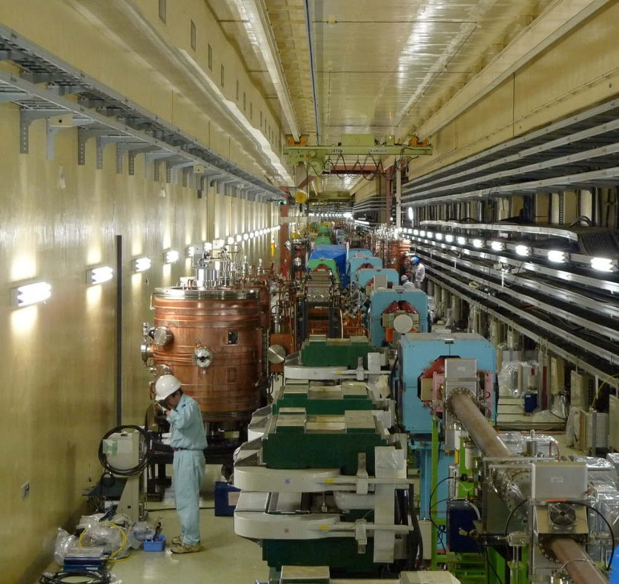
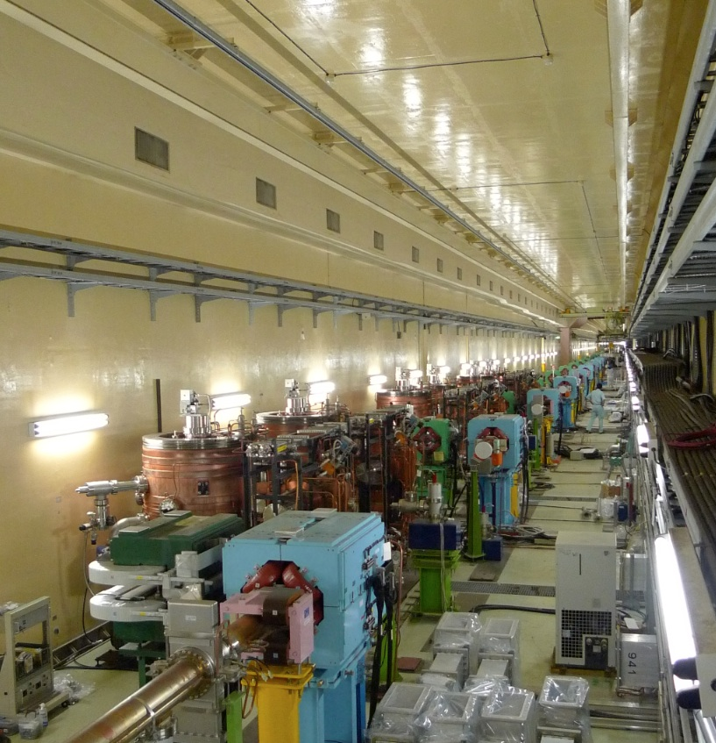
Relocate ARES cavities in D5
To convert 6 ARES cavities from LER to HER.
(KEKB-D5): 6 cavities in LER
On the way
Done
3 cavities in LER
3 cavities moved to HER
6 cavities
moved to HER (done)

Slide 35
More reinforcement of RF for design beam current (after T=0)
add 2 more klystrons, HP&LL,
add 1 more power supply
add 2 more klystrons, HP&LL,
add 2 more power supply
add 1 or 2 SCC
add 2 klystrons, HP&LL
OHO
FUJI
NIKKO
D4
D5
D7
D8
D10
D11
2
2
2
2
2
2
2
2
2
2
2
2
2
2
2
2
2
2
H
G
F
E
D
C
B
A
A
B
C
D
E
F
F
E
D
C
B
A
A
B
C
D
E
F
D
C
B
A
A
B
C
D
E
F
Klystron, HP&LLRF system
2
Type “A” power supply (for two klystrons)
ARES cavity
SC cavity
Crab cavity
1
Type “B” power supply (for one klystron)
The reinforcement after T=0 depends on requirement, machine performance and budget.

Slide 36
Monitors, Control, Beam Transport
Present status
R&D on various monitor components including BPM detectors, bunch-by-bunch feedback system, X-ray monitors is going on.
Fabrication of BPM electrodes, amplifiers for FB, etc. is going on.
Design of beam abort system in progress.
Will be presented in the following talks:
Beam diagnostics, Feedback systems (M. Tobiyama)
Photon Monitors (J. Flanagan)
Synchrotron Injection (T. Mori)
Beam Abort System (T. Mimashi)
Control and Timing System (K. Furukawa)

Slide 37
Reinforce Cooling system
Need for increasing cooling power
Three times for vacuum system (5MW→16MW).
1.5 times for magnet system (10MW→16MW).
How to do this
Four new buildings for cooling system will be built in FY2012〜2013.
Cooling tower of existing system will be reinforced for higher current.
Replace existing cooling pipes in tunnel with larger aperture ones to increase water flow.
Issue
Replacing cooling pipes is necessary almost all around the ring. This may interfere various works in the tunnel such as installing magnets and beam pipes. Furthermore, some of the existing or newly installed magnets may need to be temporarily moved. This may cause schedule delay.
Measure
Possible ways of doing this work with minimum interference are now being studied by various contractors. Design of cooling system and piping is also ongoing. They will give reports by the end of this March to help us decide the way and schedule of tunnel work.

Slide 38
12M
New buildings for cooling system
New buildings for power supply
3M
9M
To build 6M, an old building for PS main ring power supply will be dismantled.
6M

Slide 39
Damping Ring
Design
Optics design is almost fixed.
Remaining issue is to determine beam pipe cross section size from the view point of CSR and acceptance. -> Talk by H. Ikeda
Components
Fabricating magnets and power supplies are ongoing as scheduled.
Test beam pipes (aluminum, ante-chamber) is being made. Mass production will be planned in FY2012.
R&D of DR cavity is going on. A prototype cavity will be completed in FY2011, and will be high-power tested soon.
Tunnel and buildings
See, next slide.
Issue
Since tunnel construction delayed for six months due to the earthquake, installation of components will start only one year before T=0. Schedule in FY2014 will be very tight with installation, cabling and piping, system check, etc.

Slide 40
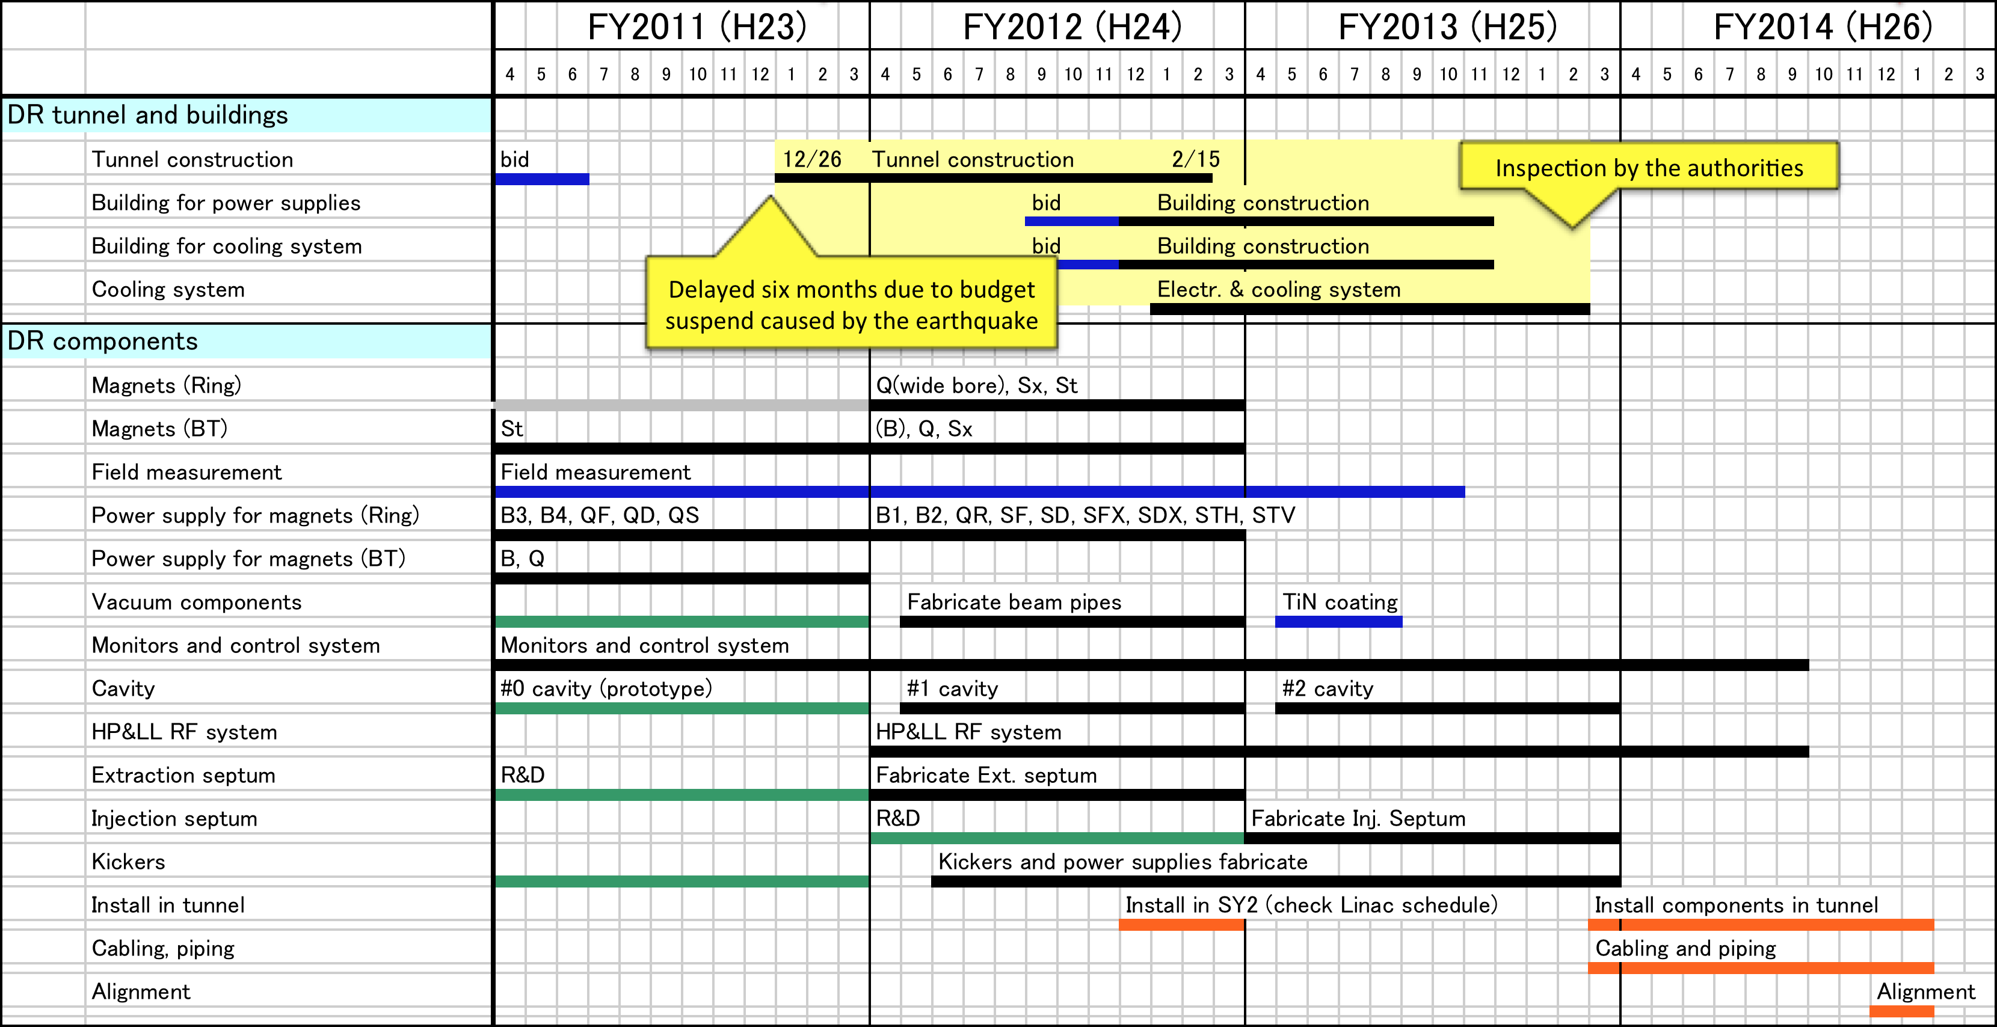
Damping Ring
DR tunnel construction delayed for six months due to the earthquake.
Installation can start after the inspection of buildings, only one year before T=0.
very tight schedule
in FY2014

Slide 41
Summary
The earthquake caused some delay and additional works for SuperKEKB construction, but we manage to recover to be in time for T=0.
Design work and construction work are going on at the same time in consistent ways. But time limit for some critical designs will come soon.
So far, budget is supplied as planned, except for the delay due to the earthquake.
Shortage of human resources is getting better.
Construction is well ongoing, prioritizing for T=0.

