Slide 1
Main Ring Magnet System
Magnet design & measurements Installation, survey & alignment
M. Masuzawa
K. Egawa
Y. Ohsawa
H.Iinuma (new! Relatively young!!)
Superconducting magnet
Design & measurements
N. Ohuchi
M. Iwasaki
H. Yamaoka
Z. Zong
Power supply design, tuning
Installation & Cabling
N. Tokuda
T. Oki
T. Kawamoto
T. Sueno
Retired but still active,
no time to rest
R. Sugahara
K. Tsuchiya

Slide 2
Contents
After the earth quake
Tunnel Damage
Visible mostly at the expansion joints
Survey tunnel from inside and outside
Damaged magnets in the storage area
Current status
Magnet installation
Field measurement
R&Ds
Rotation mechanism of the sextupole magnets
Additional windings of the correction coils of the sextupole magnets
Activities for the fiscal year 2012

Slide 3
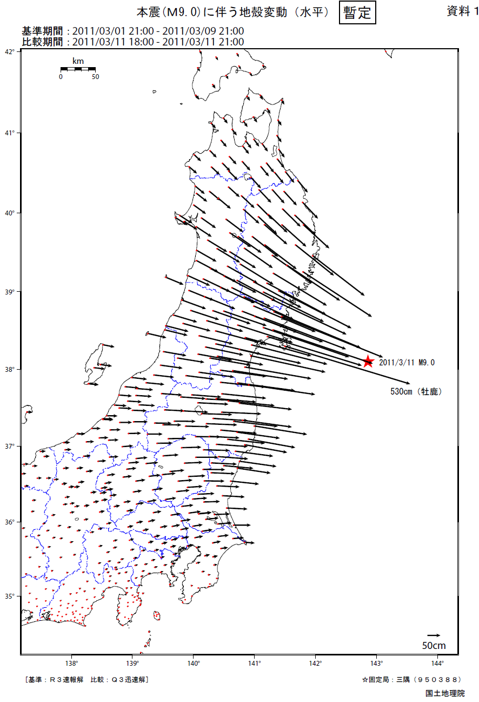
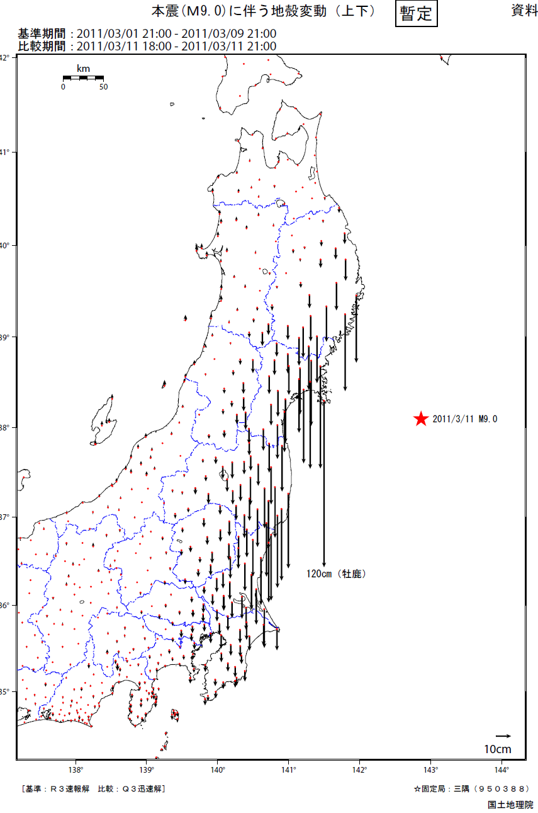
I. After the earth quake
Damages
Tunnel: Visible mostly at the expansion joints
Storage area: most magnets are supposed to be re-used
Activities for recovery
Survey tunnel from inside and outside
Data from Geospatial Information Authority of Japan (GSI)
Horizontal
Vertical
Tsukuba Δ0.51m
Compared to Shimane (1000km away)
Tsukuba Δ -0.1m Compared to Shimane (1000km away)

Slide 4
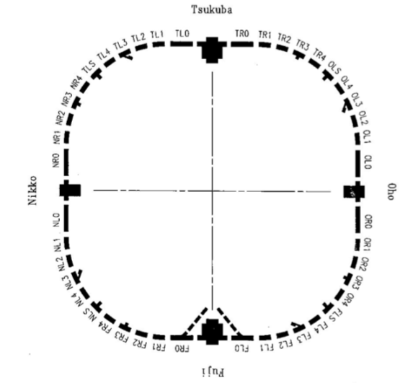
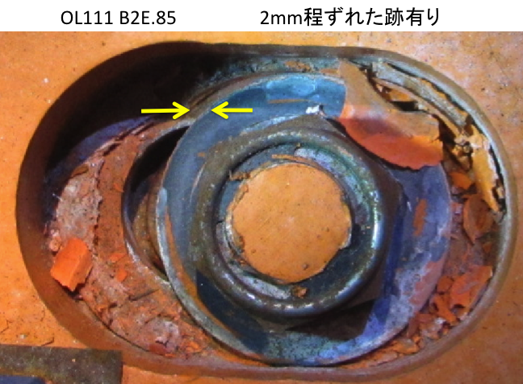
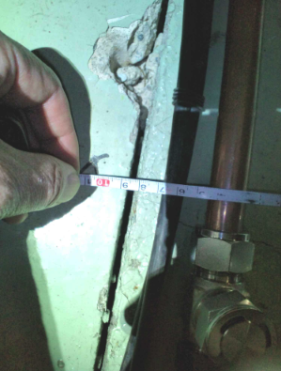
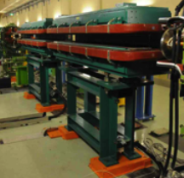
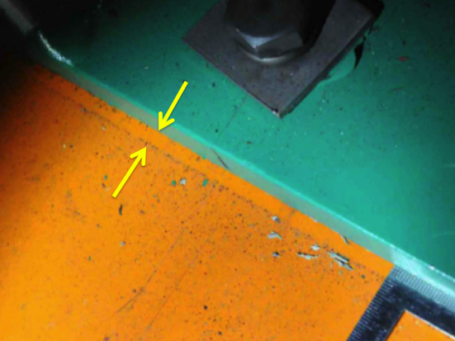
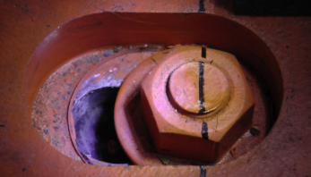
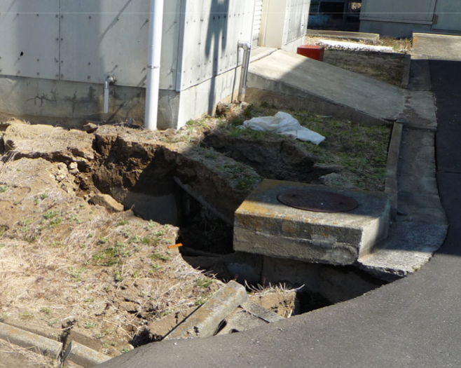
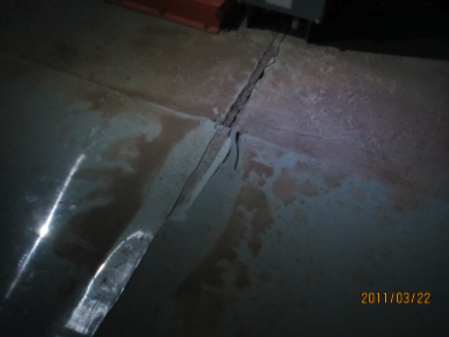
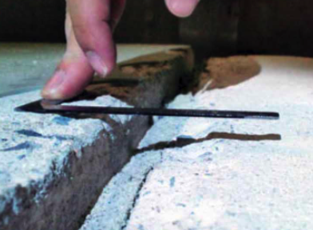
Few mm displacement
cracks
8mm
Magnet position shifts
in the horizontal direction
Comparison between
Nov. 2010 and May 2011.
liquefaction phenomena
Just above outside
Uneven floor

Slide 5
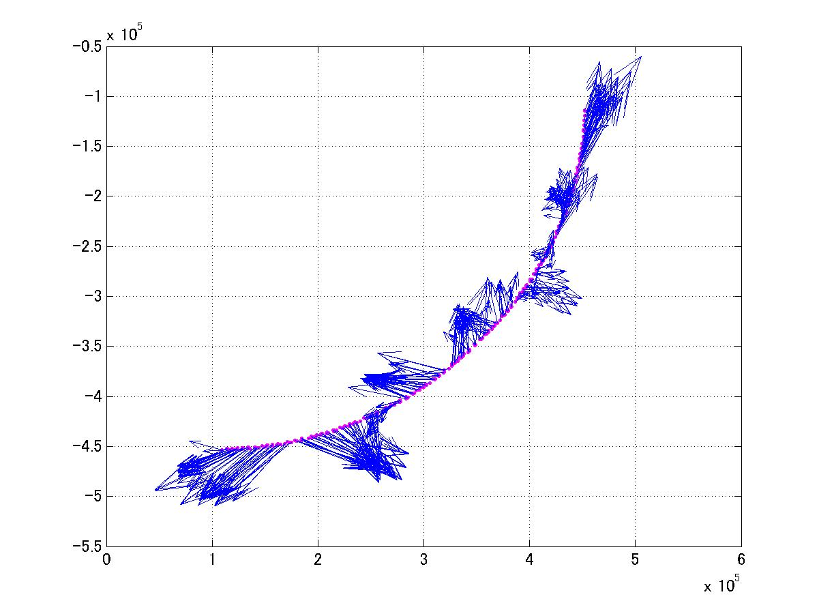
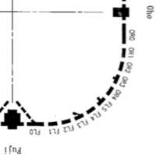
Survey tunnel from inside and outside (1)
[mm]
Oho exp. hall
Magnet position shifts in the horizontal direction.
Comparison between Feb.2010 and June 2011.
The south arc
section
Arrows not to scale
Max. deviation is about 3 mm in
both X & Y directions.
Y
X
Direction changes
at the expansion joints indicated by red arrows.
Fuji exp. hall
Another full-survey will start within few months.
[mm]

Slide 6
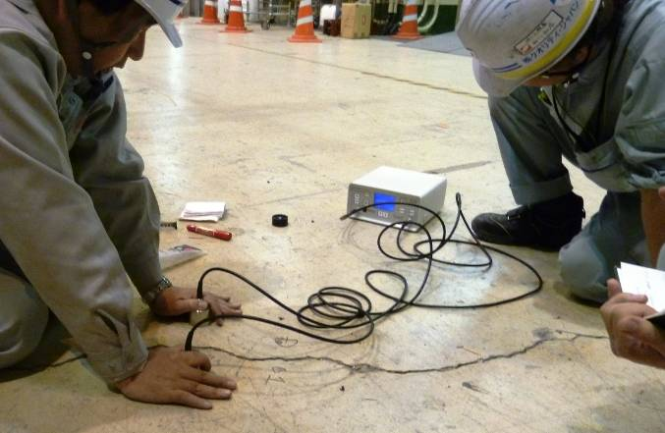
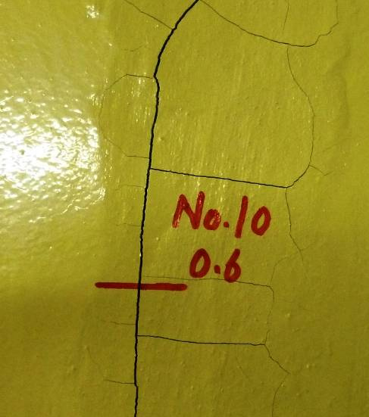
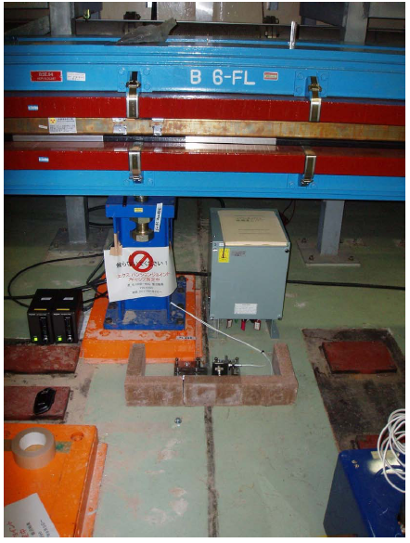
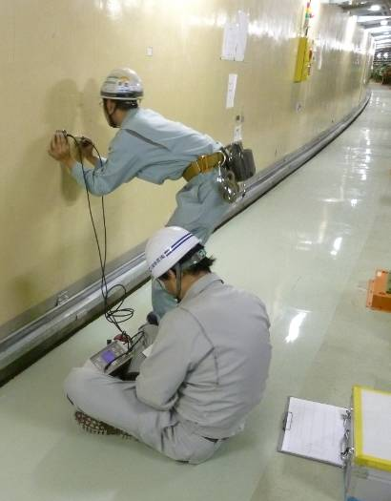
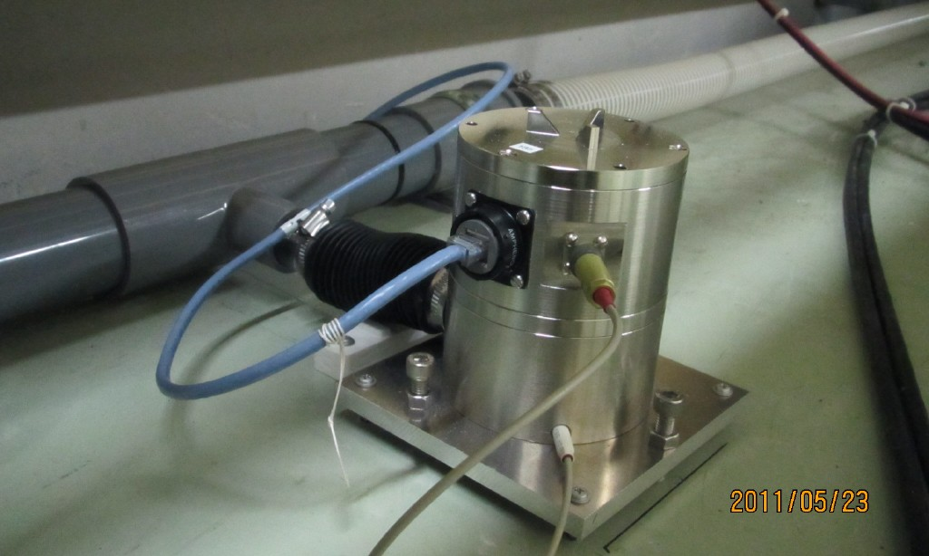
Survey tunnel from inside and outside (2)
Measure cracks on the floor at BELLE
Measure cracks depth on the wall.
Quick circumferential length measurement
Depth: 30cm~80cm, >1.2m
Not yet fixed!!
Monitor GAP distance at expansion joints
Measure Level by Hydrostatic water Level System (HLS)

Slide 7
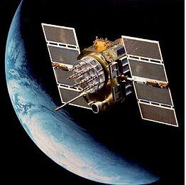
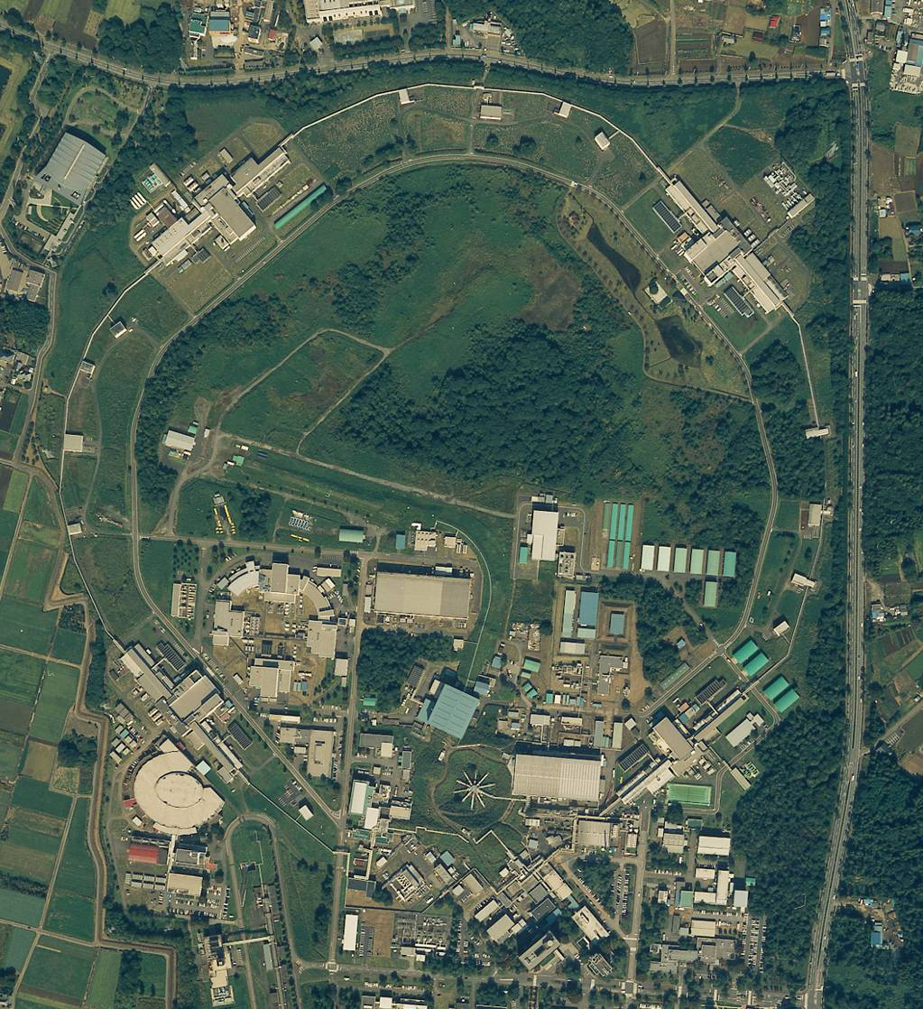
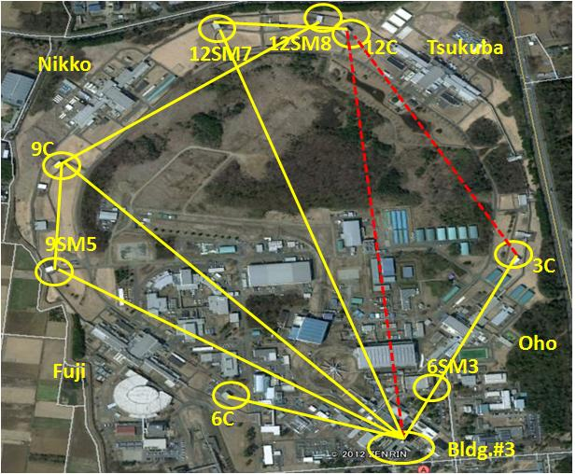
Survey tunnel from inside and outside (3)
Deformation meas. by
Global Positioning System
Soil surveying
Five GPS antennas are mounted on the KEKB buildings, which can access to the tunnel
S7
S6
One GPS antenna is mounted on bldg.#3
GPS network is utilized for tunnel network!
S8
B2
S5
boring
Method for Swedish weight sounding test
S9
S4
Trying
S10
Direct views
S3
B1
S11
S2
S1
work in progress
Feb. 13- Mar. 30
Now installing!

Slide 8
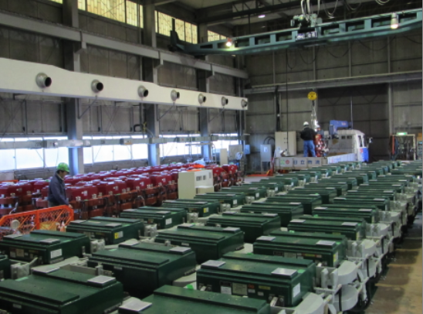
Some magnets were damaged in the storage area
All of the KEKB Wigglers are needed at SuperKEKB
About 10 KEKB LER dipole magnets are needed at SuperKEKB
~10 needed
All needed
Before the earthquake

Slide 9
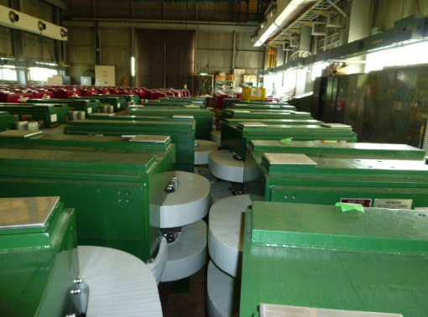
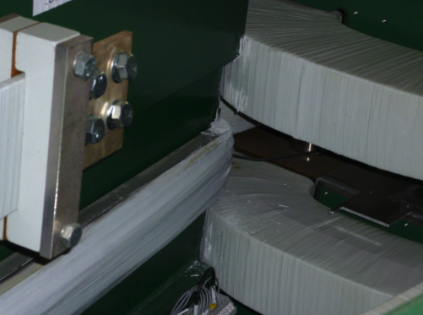
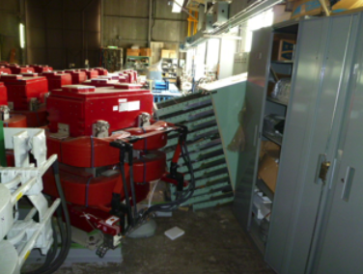
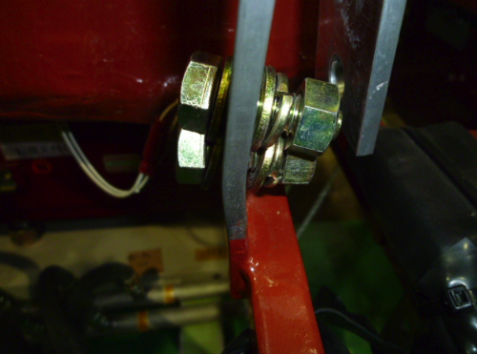
Damaged in the storage area
Wiggler Magnets:
All of the wiggler magnets were checked by field measurements and confirmed to be OK. →See next page
Dipole Magnets:
Many of them are damaged and unusable.
There are probably 10~15 healthy magnets, though they need to be checked by field measurements this year.
After the earthquake

Slide 10
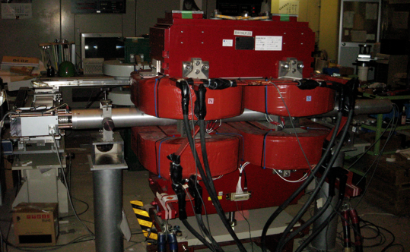
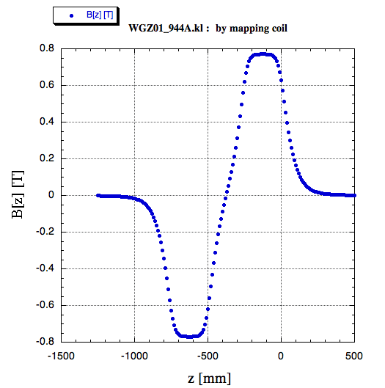
KEKB wiggler : re-measurement
The KEKB wigglers were re-measured.
Two reasons are ;
The KEKB wigglers will be re-used in SuperKEKB. The maximum currents will be increased from 950 A ( I_{max_KEKB} ) to 1400 A.
The KEKB wigglers were taken out from the tunnel and were in storage. They collided with each other due to the big earthquake (Mar. 11-th 2011).
(B)
A rotating coil ( long, right and left coils ) was used for the measurement.
These 3 probes of the rotating coil had been well calibrated during the last measurement.
(A)
Measure absolute values of area (A) and (B)
Measure residual field : (A)+(B)
long coil
left coil
right coil

Slide 11
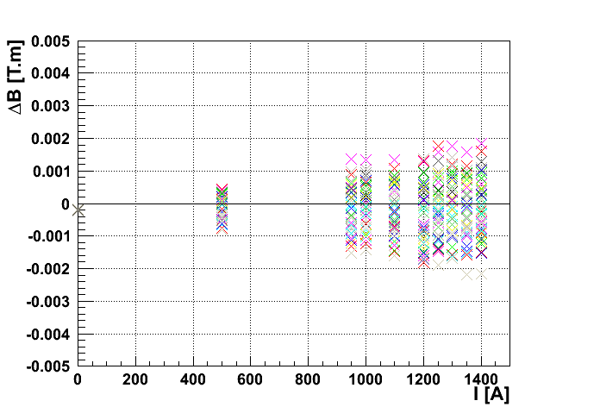
Results: All KEKB-wigglers are OK.
Excitation check: (A), (B)
Residual field check: (A)+(B)
projection
(B)
(A)

Slide 12
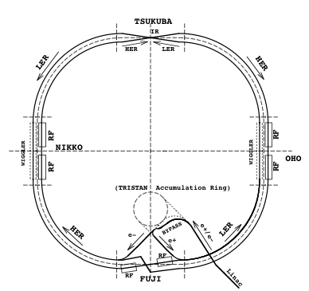
II. Current status(1)
1. Magnets, cables and etc removed.
Showing 4 completed items in the tunnel
3. In all sections:
KEKB LER dipoles and dipole correctors removed from the tunnel.
SuperKEKB LER dipole positions surveyed and marked on the floor and base plates installed.
2. KEKB wigglers & cables removed.
4. Installation of the 1st SuperKEKB magnet (LER dipole) in the tunnel.

Slide 13
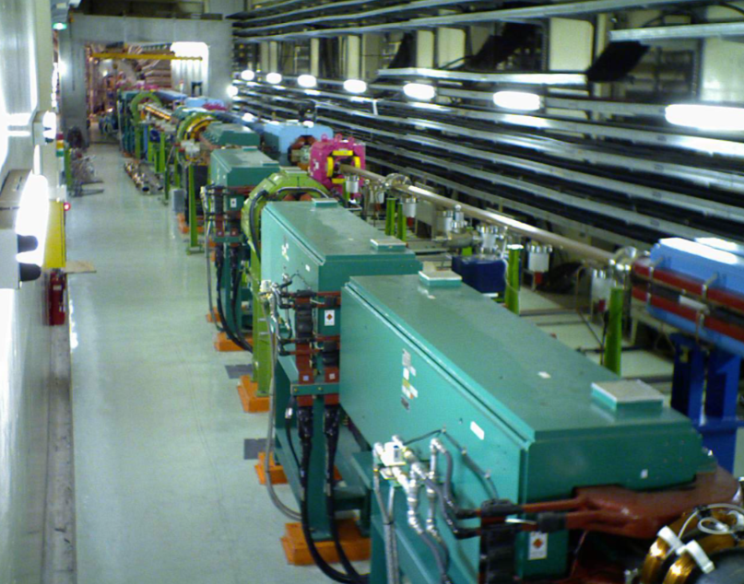
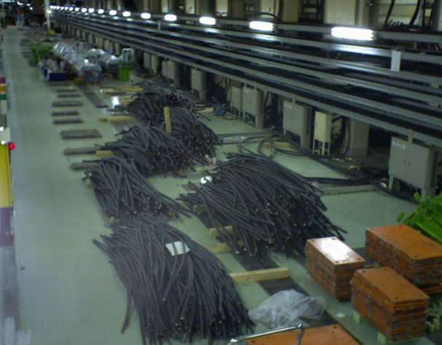
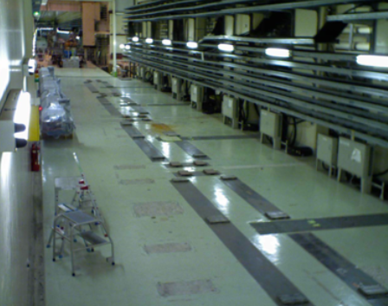
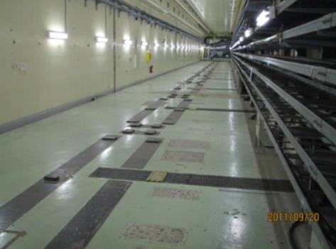
1. Tsukuba straight sections (L/R sides of the IP)
R-side
R-side
R-side
L-side

Slide 14
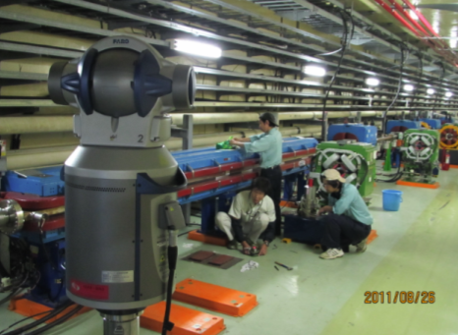
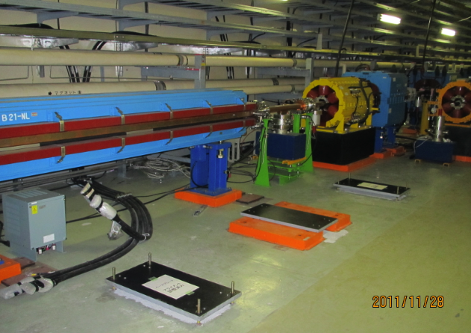
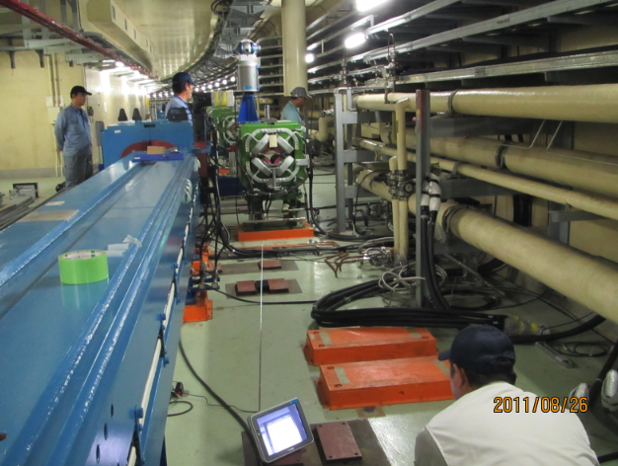
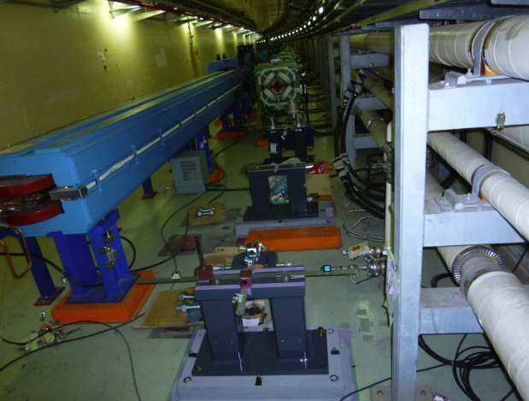
3. A) Survey for the new (longer) LER dipole
magnets with laser tracker
3.B) Base plates (3/dople) installation
in progress.
LER inner ring
LER inner ring
LER outer ring
HER long dipole
in the way.
LER outer ring

Slide 15
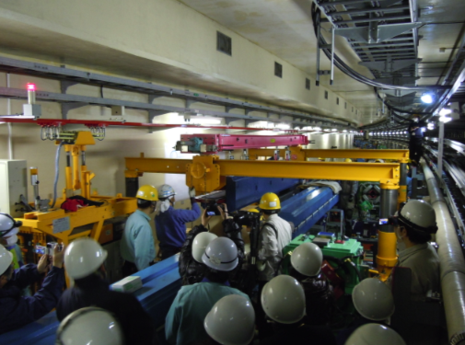
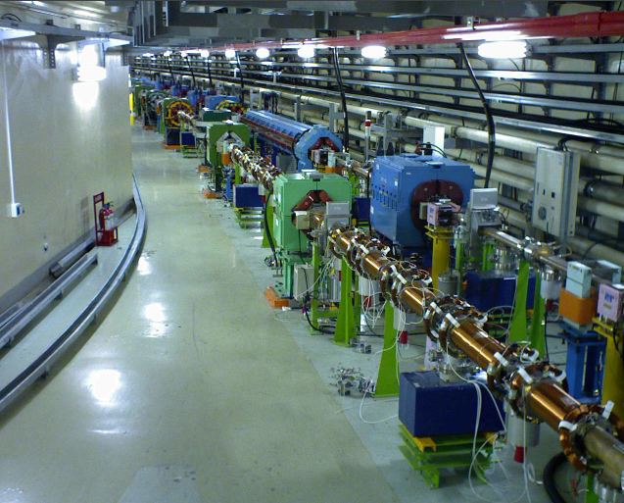
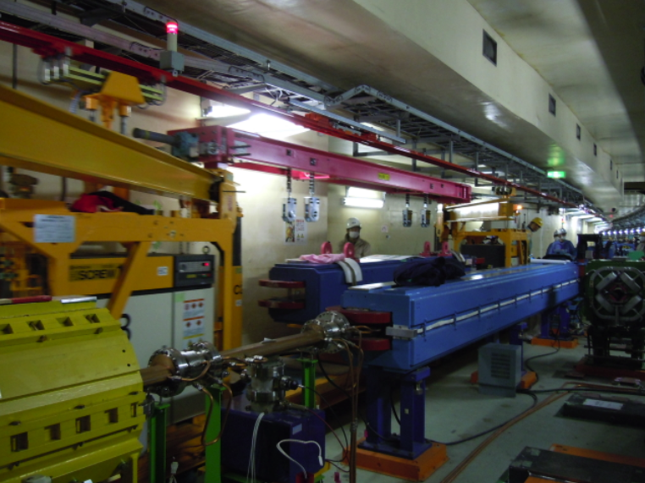
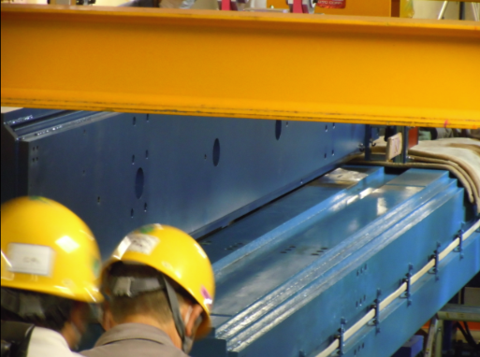
4. Installation of the 1st SuperKEKB magnet (LER dipole) in the tunnel.
String, move and set !
Access road
Go over the magnet!
Over the HER dipole
Tight clearance (~6mm)

Slide 16
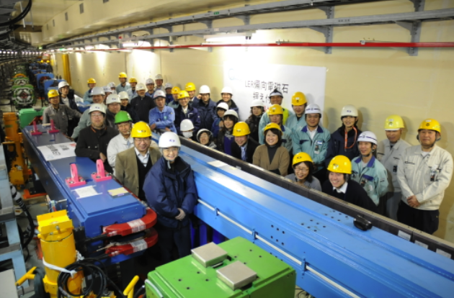
Done!
Feb.7th 2012
1st installation of the SuperKEKB magnet on Feb.7th 2012.
The main purpose of this installation was to debug the tools and methods for installing
the 4 m dipole over the 6 m dipole.
We installed 2 dipole magnets. The rest of the LER dipoles are scheduled to be
installed this year.

Slide 17
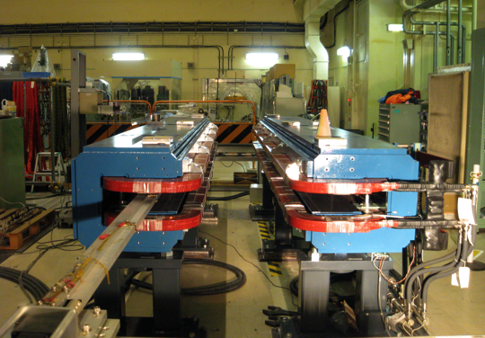
II. Current status (2)
SuperKEKB_LER_B_{arc} : measurement status
skbLB_new
skbLB_new
111 / 142 dipoles have been delivered.
95 dipoles have been measured by a long flip coil system.
79 dipoles are in storage.

Slide 18
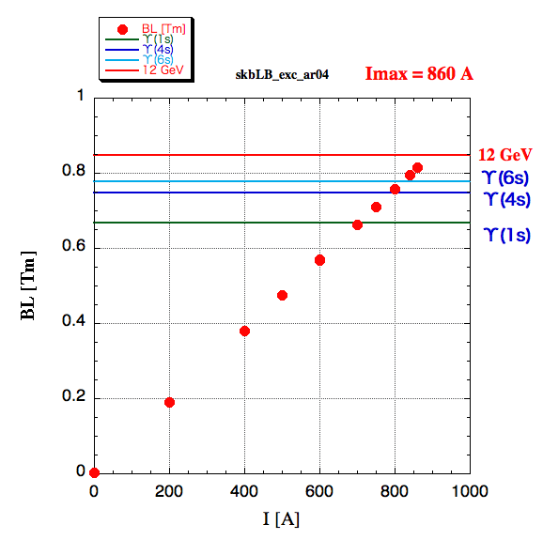
Excitation check
assuming the energy ratio E_{LER}/E_{HER} = 4/7
I [A] | B_{center} NMR [T] | Poisson | B_{NMR}/B_{μ=∞}
730 | 0.1660075 |  | 0.9953
760 | 0.1728672 |  | 0.9955
800 | 0.1819504 |  | 0.9954
840 | 0.1910295 | 0.19035 | 0.9953
860
cf. : Due to constraints of LINAC, the injection and QCS system,
E_{LER_max} = 4.28571 GeV, E_{HER_max} = 8.75875 GeV
k = 0.0561 & E = 4.28571 GeV
BL = 0.802 Tm

Slide 19
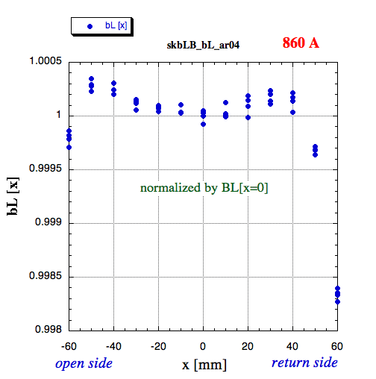
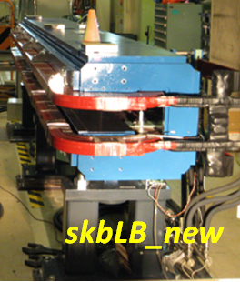
bL[x] measured by long flip coil
measure 4 times at each point.
Their variation (example) is ;
average | 5024673.5
σ | 285.697
σ /average | 5.7e-05
Scan every 50mm step
Measure 0A, 500A, 700A, 800A as well.

Slide 20
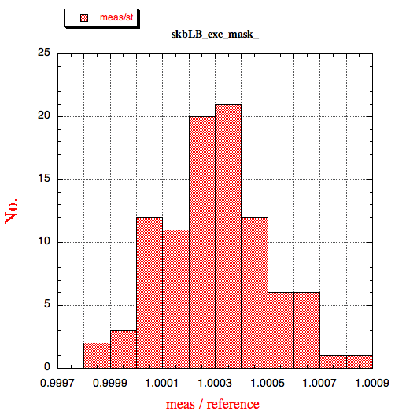
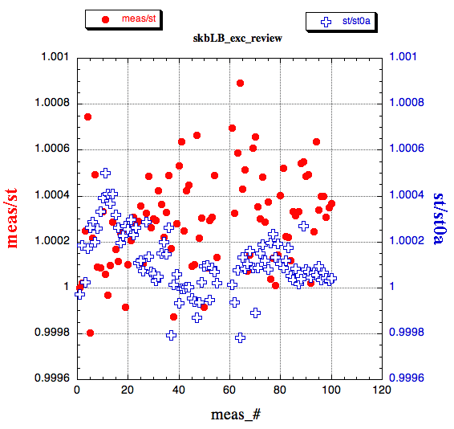
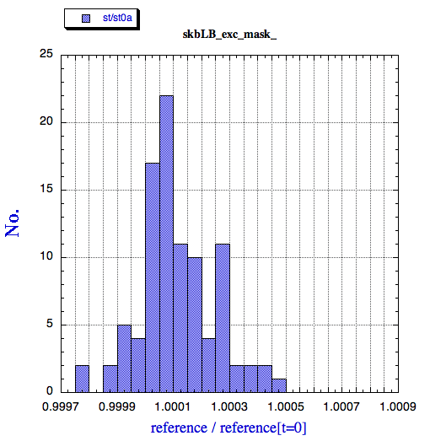
each measured / reference (#1) @ 860A
No. of mag. | 95
average | 1.0002958
standard deviation | 0.000205
reference variation @ 860A :
st.[ t ] / st.[ t₀ ]
No. of mag. | 95
average | 1.000114
standard deviation | 0.000132

Slide 21




R&Ds
Rotation mechanism of the sextupole magnets
Mechanical rotation :
-30<Δθ<30 degrees (over spec?)
24 sextupole magnets needed for LER (+ needed for HER?)
Additional windings of the correction coils of the ALL sextupole magnets (~100/ring)
Needs to establish faster way to wind coils
Work is needed to be done IN the tunnel!
(photo from KEKB. 20 turns/pole with a single wire )
Δθ = 0 degree
Δθ = 15 degree

Slide 22





Rotation mechanism of the sextupole magnets
Gear teeth
KEKB Sextupole (L=300 mm,~700kg) as a test load.
Worm gear

Slide 23



Additional windings of the correction coils
2.2 mm²
AWG 14
3 mm²
AWG 12
➔ We will try to wind an additional ~50 turns/pole efficiently on the poles of the magnets in the beam line.
➔Use of flat cables is being investigated.
➔Temperature rise for multi layer cases.

Slide 24

Activities for the fiscal year 2012
In the tunnel: many and many!
Preliminary, very
Field measurement plan
Field measurement
GPS network
LER new dipole : ongoing
new wigglers : from spring 2012
LER_Q ( L_{eff} =0.5837 ) : from spring 2012
HER_Qx : from spring 2012
etc…..

Slide 25
In the tunnel
Both ends of IR
✔Magnets, cables,,, scheduled to be removed.
In all sections:
✔LER dipoles (100),
LER vertical dipole correctors(~220),
LER wigglers (280)
scheduled to be installed this year.
Totally new beam lines
Two important keys :
Careful scheduling with a work of the vacuum/magnet cooling water system by the Plant and Facilities Department,
Control tunnel temperature at SuperKEKB operating value for precision survey and alignment!
✔Two quads/tunnel
will be installed.
✔36 KEKB wigglers scheduled to be installed in HER next month.
✔7 quadrupole magnets
replaced by shorter ones this year.

Slide 26
Thanks

Slide 27
New magnets ( normal ) production status
2012.2.15
LER magnet | number | specification | status
Dipole B_arc, B_lc | 114 (+2) + 24 (+2) | fixed | being delivered
Wiggler : half / single pole | 112 (+2) / 56 (+2) | fixed | will be delivered in Mar. 2012
Short dipole | 2 | not yet | 2012
Q ( Leff =0.5837 ) | 20 | ≈ kb_Q.rf | will be delivered in Mar. 2012
QK ( skew Q ) | 10 | not yet | 2012
SL + skew Sx ( rotatable) | 8 + 24 | not yet | 2012
Vertical Corrector | ~ 220 | fixed | will be delivered

Slide 28
New magnets ( normal ) production status cont.
2012.2.15
HER magnet | number | specification | status
Dipole (4 m) ⊂ LER dipole | 13 | = LER B_lc | being delivered
BC* L_{eff} = 0.3444 | 8 | not yet | 2012
additional kb wiggler | + 22 | fixed | ?
Q ( 0.56 m ) | 38 (+ 1) | ≈ kb_Q.arc | Contract process has started.
Q ( 1.12 m ) | 2 (+ 1) |  | Contract process has started.
Qx | 8 (+ 1) | ≈ KB_QX | delivered
QK ( Leff = 0.3444/0.3723 ) | 6 + 2 | not yet | 2012
SL + skew Sx (rotatable) | 8 + 24 | not yet | 2012

Slide 29


10 turns (x 10 A) = 100 AT are wound with the main coil.
These will be used to generate normal quadrupole field for beam-based alignment.
A request was made by the optics group to prepare additional windings to generate
skew quadrupole field.
➔Power supplies will be newly made for the additional coils.
➔Specifications have not been fixed yet. We will try to wind an additional ~50 turns/pole efficiently on the poles of the magnets in the beam line.
➔Use of flat cables is being investigated.

Slide 30



Δθ = 0 degree
Δθ = 15 degree
Gear teeth
Rotation by steeping motor
3 degrees/0.36 million pulses & 3 degree/gear tooth
Takes ~4 minutes to rotate 15 degree
Very smooth rotation up to ±10 degree
becomes heavier beyond ±10 degree
Rotation up to ±30 degree achieved
Reproducibility, coupling to the horizontal/vertical motion, stability etc, need to be checked (and probably need to be improved).
Handling of the power cables and cooling water pipes need to be examined.
Δθ = -15 degree
KEKB Sextupole (L=300 mm, ~700kg) as a test load.

Slide 31




bL[x] measured by long flip coil
measure 4 times at each point.
Their variation (example) is ;
average | 5024673.5
σ | 285.697
σ /average | 5.7e-05

Slide 32





Slide 33






We made 8 pass-through holes on each top of building along KEKB ring
Bldg.#3
GPS Antenna
6C
XY-stage
Look up view from access road to the tunnel@6C
Look down view from the scope

Slide 34
In all sections:
✔KEKB LER dipoles and dipole correctors
removed from the tunnel.
✔SuperKEKB LER dipole positions surveyed and marked on the floor and base plates installed.
✔LER dipoles (100),
LER vertical dipole correctors(~220),
LER wigglers (280)
scheduled to be installed this year.
✔Magnets, cables and etc removed.
✔Magnets, cables,,,
scheduled to be
removed.
Totally new beam lines
✔KEKB wigglers & cables removed.
✔Two quads/tunnel
will be installed.
✔36 KEKB wigglers scheduled
to be installed in HER
next month.
✔7 quadrupole magnets
replaced by shorter ones this year.
✔ done
✔ to be done soon/this year

