Slide 1
Overview of Design Issues
17th KEKB Accelerator Review
Feb. 20, 2012
Haruyo Koiso

Slide 2
Parameters
 | 2011 Feb. HER no wiggler | 2012 Feb. HER 60% wigglers
Energy (GeV) (LER/HER) | 4.0/7.00729 | 4.0/7.00729
β_{y}* (mm) | 0.27/0.30 | 0.27/0.30
β_{x}* (mm) | 32/25 | 32/25
ε_{x} (nm) | 3.2/5.3 | 3.2/4.6
ε_{y} /ε_{x} (%) | 0.27/0.24 | 0.27/0.28
σ_{y}(nm) | 48/62 | 48/62
ξ_{y} | 0.0897/0.0807 | 0.0881/0.0801
σ_{z} (mm) | 6/5 | 6/5
I_{beam} (A) | 3.6/2.6 | 3.6/2.6
N_{bunches} | 2500 | 2500
Luminosity (10³⁴ cm⁻² s⁻¹) | 80 | 80
HER ε_{x} with 60% wigglers is used as the nominal value.
Lower HER ε_{x} can relax some other parameters (β_{x/y}*, ε_{y} /ε_{x} , etc. ).
At present, larger ε_{y} /ε_{x} in HER is adopted.

Slide 3
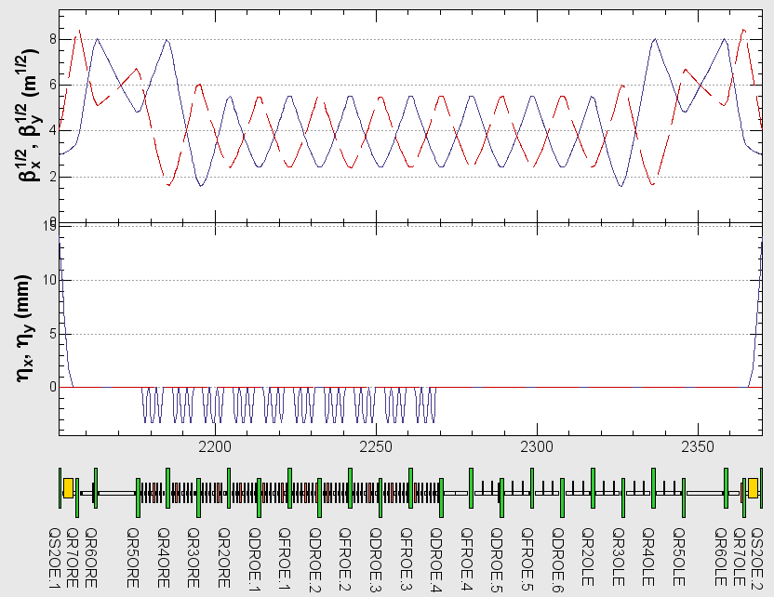
HER Wiggler Section
Oho Straight Section
beam
Reuse LER wiggler
RF section
・Decrease the horizontal emittance with wigglers.
・Only reuse LER wiggler magnets at T=0. (60%)
・Install more wigglers if possible. (40%)

Slide 4
IR Design
Design of IR (magnets, vacuum chamber, beam background estimation, collimation system, collision feedback system, etc) has been improved.
Iron yokes for 3 more superconducting quadrupoles (QC1LE, QC1RE, QC2RP)
More precise correction of higher multipoles
Optimization of solenoid field distribution
Optimization of physical aperture
Modeling of IR optics has also been improved by using 3D magnetic field calculation.
Touschek lifetime is marginally kept to be ~600 sec.
Lattice design of IR (Tsukuba section + a part of arcs) is required to be finalized around the end of this fiscal year (March 31) to meet the construction schedule.
-> A. Morita, Ohuchi, Nakayama, Kanazawa, Funakoshi, et al.

Slide 5
Injection
The synchrotron injection (fully or partially) will be necessary in HER because the transverse aperture is not sufficiently large for the betatron injection.
With the beam-beam interaction, simulations say that transient vertical blowup occurs after the betatron injection even in LER, which causes beam loss or background.
Optimization of phase space profile by octupole correctors may cure this blowup.
Good qualities of injected beams with sufficient intensities are essential for stable operation with very short lifetimes.
Overall (Touschek, luminosity and beam-gas) lifetime: LER/HER 360/373 sec, estimated by A. Morita.
Needs optimization of beam distribution in Linac/BT lines.
-> M. Yoshida, T. Kamitani, H. Ikeda, T. Mori, et al.

Slide 6
Error Correction
Estimation of error tolerance and development of optics correction system have been in progress.
Requirements for beam diagnostics and control system (number of monitors, accuracy, speed, etc) are being decided step by step.
Error tolerances of IR magnets ( vibration, ripple of power supplies, etc) are very small. Realistic solution to maintain good conditions of optics and collision should be developed.
Sufficient correction and tuning knobs for optics correction and luminosity tuning should be equipped.
Correction winding of each quadrupole (0.5%)
Skew quadrupole windings of each sextupole (Δy ~ 1 mm)
Rotated sextupoles or skew sextupoles to correct chromatic couplings
etc.
-> H. Sugimoto, Y. Funakoshi, et al.

Slide 7
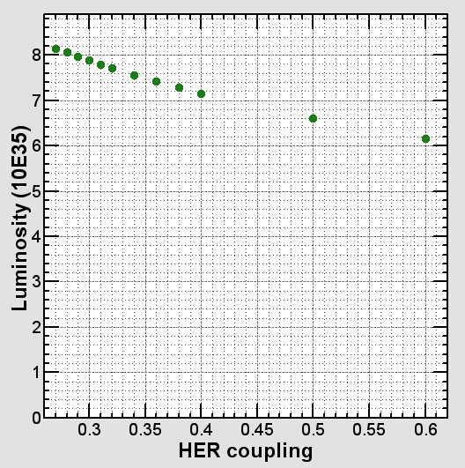
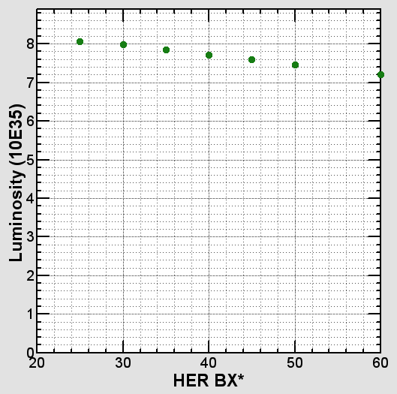
Example of Parameter Dependence
90%
90%
HER coupling
0.28 -> 0.329 %
to keep ξ_{y LER}<0.09
Luminosity degradation depending on some parameters are not so steep.
We will find several ways to reach 90 % of the target luminosity.

Slide 8
backup

Slide 9
