Slide 1
Magnet Power Supply System
T. Kawamoto
T. Sueno
N. Tokuda
T. Oki
17th KEKB Accelerator Review Committee

Slide 2
Contents
Existing KEKB power supplies.
New power supplies to be developed for SuperKEKB.
R&D and the preliminary test results.

Slide 3
Existing KEKB Power supplies
We have ~ 2300 power supplies:
Class | # of power supplies | Typical load
Small-class (< 10 A, 0.5 kW) | 1885 | Steering magnet etc
Medium-class (< 500 A, 100 kW) | 368 | Local Quads
Large-class (< 500 A, 500 kW) | 14 | Quad families
Megawatt-class (< 1250 A, 1 MW) | 6 | Bending and Wigglers
To be reused
after appropriate maintenance and overhaul : in progress.
To be reused.
Current setting resolution will be improved by 20-bit DAC.
Rubbished and replaced by newly developed PSs: in progress.
Typical spec.
Stability | < 20 ppm / day
Ripple | < 10 ppm
Setting resolution | < ± 50 ppm (16-bit DAC)

Slide 4
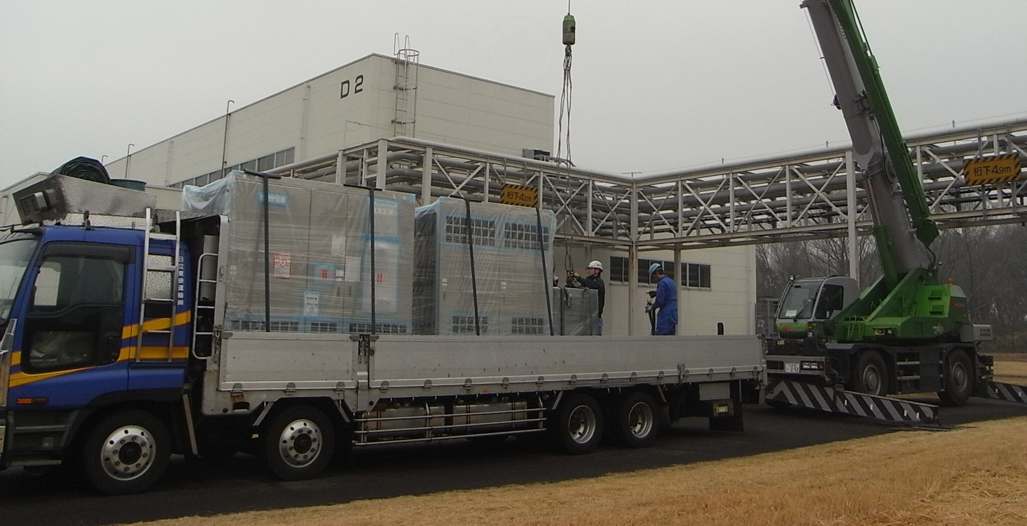
First new megawatt-class power supply
Just delivered to KEK in last week
(B2E, 2012/Feb./15th @D2)
Other 9 power supplies for bending and wigglers
will be delivered by end of March.

Slide 5
New Power supplies to be developed for SuperKEKB
*:developed in FY2011; †: in FY2012; ():spec./# has not been fixed.
Power | # of power supplies | Typical load
0.95 MW | 2* | LER / HER Bends.
0.4~1 MW | 8* / 1† | LER / HER Wiggs.
< 100 kW | (~ 50) | Local Q
~ 10 kW (1000 A) | (~ 10) | QCS main
~ 0.5 kW (± 50 A) | (~ 50) | QCS correction
< 70 kW | 23* | Damping Ring (Q, B …)
< 630 kW | 2† | Damping Ring (Bends.)
< 36 kW | (Many) | Damping Ring (Others)
Target spec. of power supply for Bends and Wiggs.
Stability | < 2 ppm / day
Ripple | < 1 ppm
Setting resolution | < ± 0.1 ppm (~23-bit)

Slide 6
R&D 1: higher current-setting resolution
For more precise setting of the current,
increasing the DAC bits from present 16 to 20 or more is necessary.
  Step 1. Try new commercial use 20-bit DAC.
  (AD5791: released in 2010/March/11th by Analog Devices)
  Step 2. Two 20-bit DAC’s are combined for 24-bit resolution.
  Step 3. For 24-bit resolution, another scheme has been tried:
  summing the output of sixteen (= 2⁴) 20-bit DAC’s.
1/2²⁰
Setting value
in 20-bit (major)
+
DAC
+
1/2⁴
Setting value
in 4-bit (minor)
+
1/2⁴
DAC

Slide 7
Preliminary test result: two 20-bit DAC's 24-bit system
Increasing DAC input digital value by 1 least significant bit (LSB),
DAC output voltage is measured by DMM KEITHLEY 2002.
(range: 2 V, integrate time in Power Line Cycles (PLC): 50, 10 moving digital filter)
+2
0
−2
−4
−6
−8
DAC output voltage (μV)
2 μV
0 1 2 3 4 5^{×1000}
Time (s)
1 LSB (0.6 μV) response can be seen.

Slide 8
R&D 2: current-stability improvement
Digital feed back control for long-term stability improvement.
minor-
voltage loop
current loop
Setting value
in 20-bit (major)
+
+
+
DAC
+
-
-
-
Setting value
in 4-bit (minor)
+
1/2⁴
DAC
-
Error Detection
DMM
DCCT
N
P
Output terminal

Slide 9
Preliminary test result: digital feedback system
Long-term stability test was performed by using
a medium-class power supply (15 V, 500 A).
measured by DMM (20 V range, 10 PLC, 10 moving Filt)
0.2 ppm (2 μV/10 V)
1.4 ppm / 8 hrs
(peak-to-peak fluctuation included)
8 hrs
2 ppm (20 μV/10 V)
7.5 ppm / 8 hrs
8 hrs

Slide 10
Summary
Small/medium-class power supplies:
Overhaul is in progress.
Large-class power supplies for the Quad families:
Improvement is planned for more precise setting resolution,
increasing the DAC bits from present 16 (LER)/18 (HER) to 20.
And overhaul is planned.
Megawatt-class power supplies:
Old PSs were rubbished,
and have been replaced by newly developed PSs: in progress.
New 10 megawatt-class power supplies for the main ring and
23 medium-class power supplies for the damping ring
are to be delivered by end of March 2011.
R&D has been performed, and the preliminary results are satisfactory.
24-bit setting resolution and digital feedback system
have been applied to the new 10 megawatt-class power supplies.

Slide 11
Back-up slide

Slide 12
Why sixteen DAC's 24-bit system?
Care must be taken to the monotonicity of two DAC’s 24-bit system
Not so bad
Bad

Slide 13
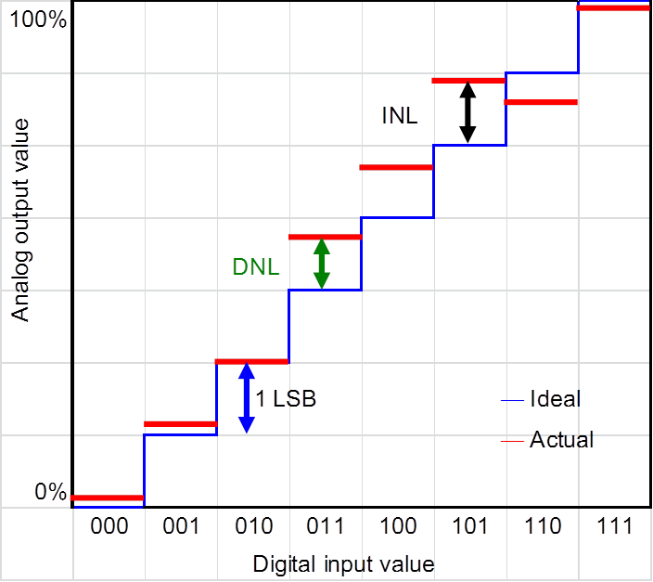
Non linearity and monotonicity
LSB: least significant bit
DNL: differential non linearity
INL: integral non linearity
Lose monotonicity
AD7846K (16-bit): DNL ±0.5 LSB max
INL ±2 LSB
AD5791B (20-bit): DNL ±0.75 LSB typ. (test result: <±0.1 LSB）
INL ±0.5 LSB typ. (test result: -0.2～+0.6 LSB）

Slide 14
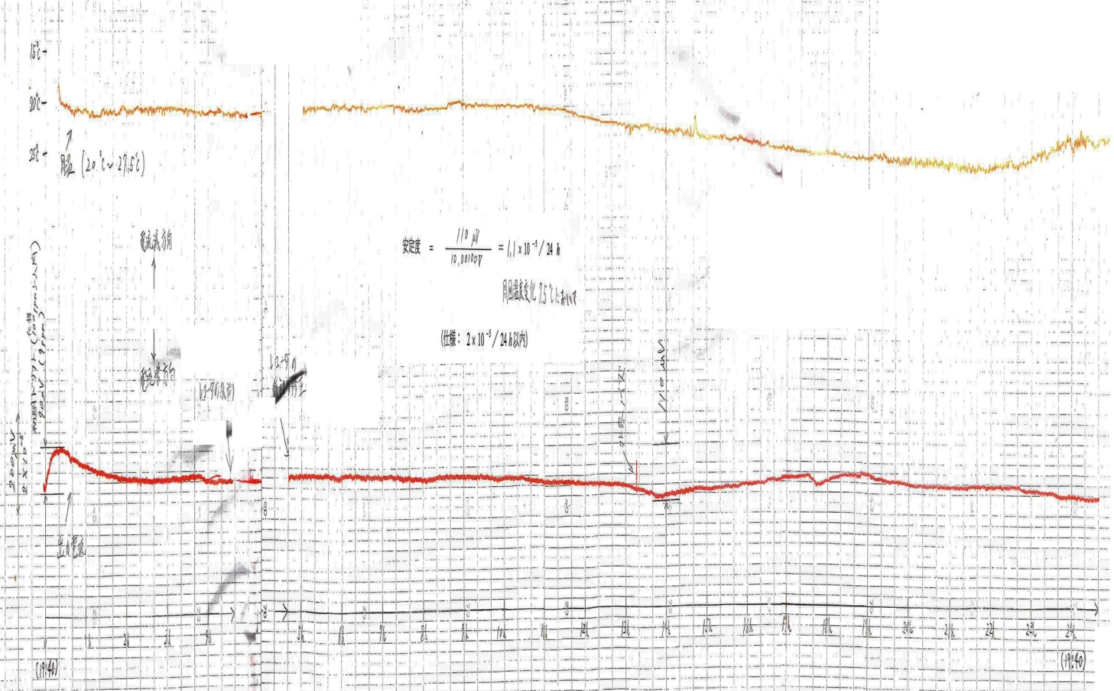
Typical long-term stability
Prototype power supply for QCS main coil
  Power supply: Transistor-dropper type (1000 A-30 V).
  Test Load: 1.2 mΩ resistor
15℃－
Temp: 20 ～27.5 ℃
25℃－
Initial drift
9 ppm
Stability: 11 ppm / 24 hrs.
24 hrs.

Slide 15
How much jitter on the measured current
For precious control, lower jitter is necessary on the current monitoring.
Current is measured by a DCCT and a DMM.
      Power supply: Transistor-dropper type (1000 A-30 V).
    DCCT: 1000 A / 10 V output
    DMM: KEITHLEY 2002 (10 PLC, 20 V range)
10 μV corresponds to 1 ppm
Noise level: 0.6 μV

Slide 16
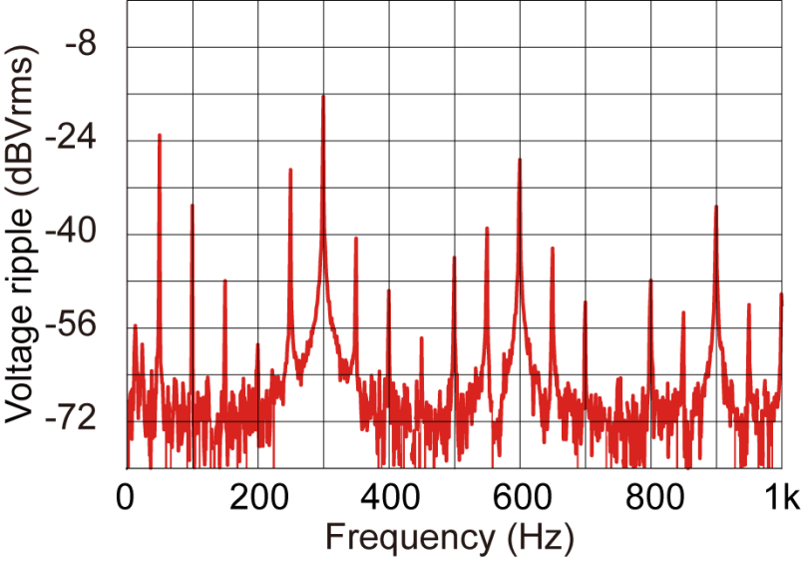
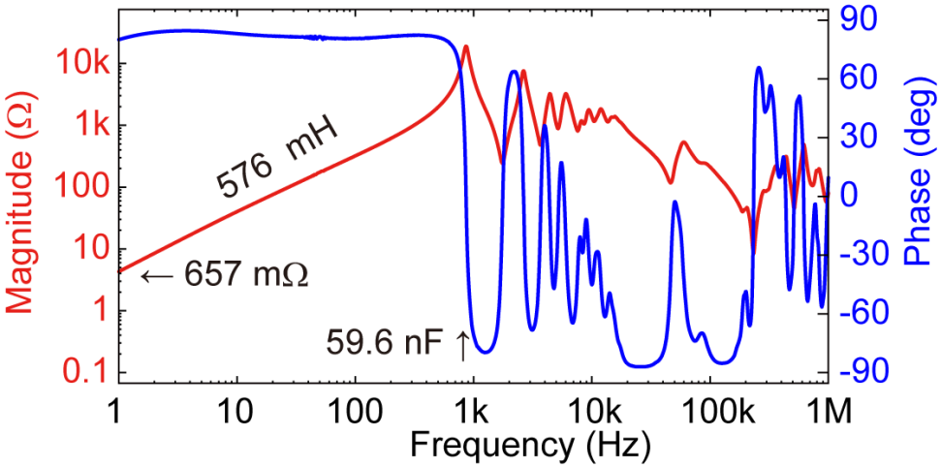

Typical ripple
QF4E magnet system
  Power supply: Transistor-dropper type (500 A-380 V).
  Load: 40 Quads connected in series around KEKB ring.
Measured voltage ripple
Measured load impedance
50 Hz 300Hz
Z ~ 0.66 Ω + 0.58 H ( f < 1kH)
50 Hz: 0.7 ppm
300Hz: 0.3 ppm

Slide 17
Schedule

