Slide 1
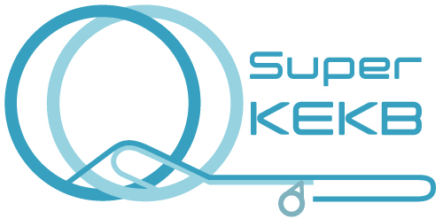
Optics Correction
Hiroshi Sugimoto (KEK)
for SuperKEKB Optics Group
Contents
1. Correction of XY Coupling and Vertical Dispersion
2. Correction of Betatron Function
3. Full Optics Correction

Slide 2
Introduction
Correction of beam optics errors will be a critical factor in SuperKEKB.
Innovative optics measurement & correction schemes are probably necessary at high-current beam operation.
i.e. Horizontal & vertical (XY) coupling measurement with single-pass BPMs.
(Ref. Ohnishi’s talk @ the 16th KEKB review)
On the other hand, KEKB based optics measurement using closed orbit distortion (COD) will be employed at early stage of the commissioning and low-current and non-collision operation.
It is informative to investigate how effective is KEKB based scheme.
Today’s Report
Optics Correction with KEKB based scheme
1. XY-Coupling and Vertical Dispersion
2. Betatron Function
3. Full Optics Correction

Slide 3
XY-Coupling and Vertical Dispersion

Slide 4
Measurement & Correction Scheme
XY-coupling measurement & correction.
1. XY-coupling is estimated by observing the vertical
leakage orbits associated with horizontal kick.
2. Suppress the vertical leakage orbit by skew correctors.
Vertical dispersion measurement
Use vertical orbit response with RF frequency change.
RF frequency
Orbit change
Phase slip factor
Frequency change

Slide 5
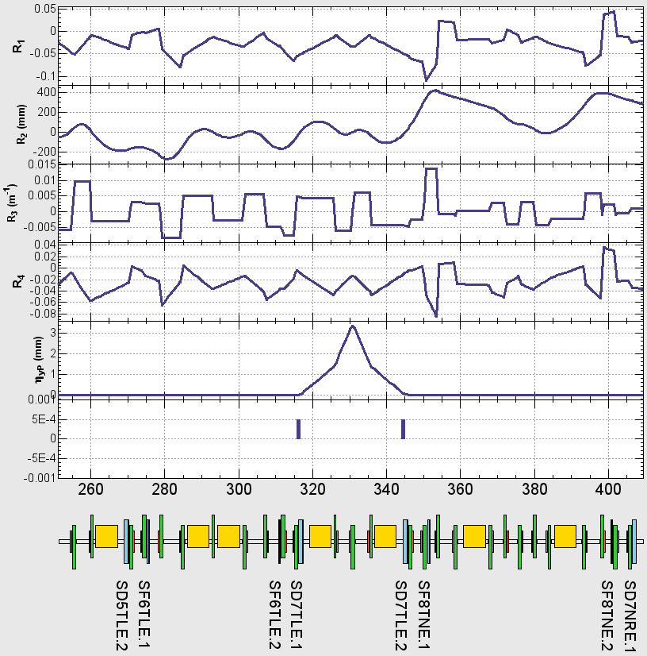
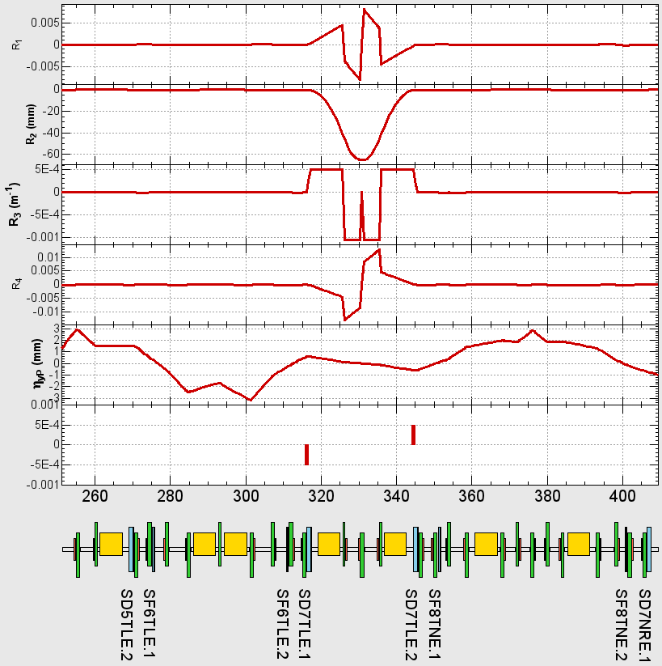
Correctors
Skew winding of sextupole magnet will be available.
Symmetric / asymmetric excitation of skew-corrector pare can be used as orthogonal correctors for coupling and vertical dispersion.
Symmetric Excitation
(XY-coupling corrector)
Asymmetric Excitation
(Vertical-dispersion corrector)
Coupling
parameters
Vertical dispersion
Skew-field
SD
SD

Slide 6
Simulation
Assumptions
- No orbit drift in time.
- Zero-current (ignore intra-beam scattering in emittance evaluation).
- No error source in the IR region.
Error Source
 | Vertical misalignment [μm] | Rotation error [μrad]
Normal quadrupoles | 0 | 100
Normal sextupoles | 100 | 0
Sextupoles (local chromaticity) | 50 | 0
All errors are Gaussian distributed.
Skew correctors are adjusted by measured optics and response matrix of the model lattice with singular value decomposition.

Slide 7
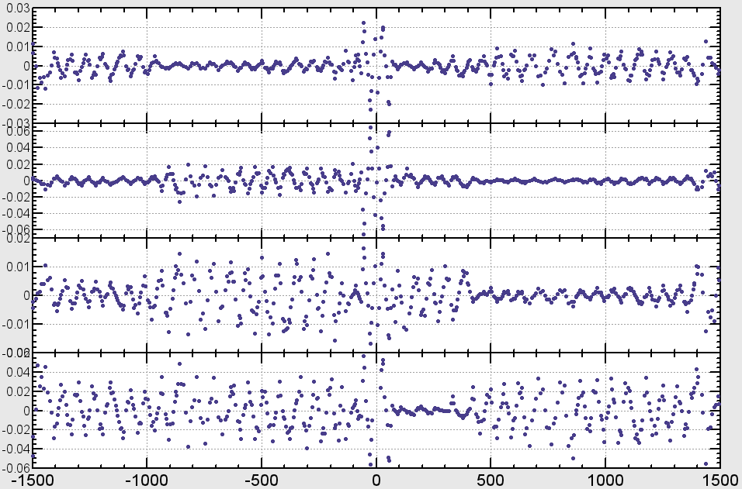
Simulation Example
No BPM Jitter
Before Correction
Vertical leakage orbit
IP

Slide 8
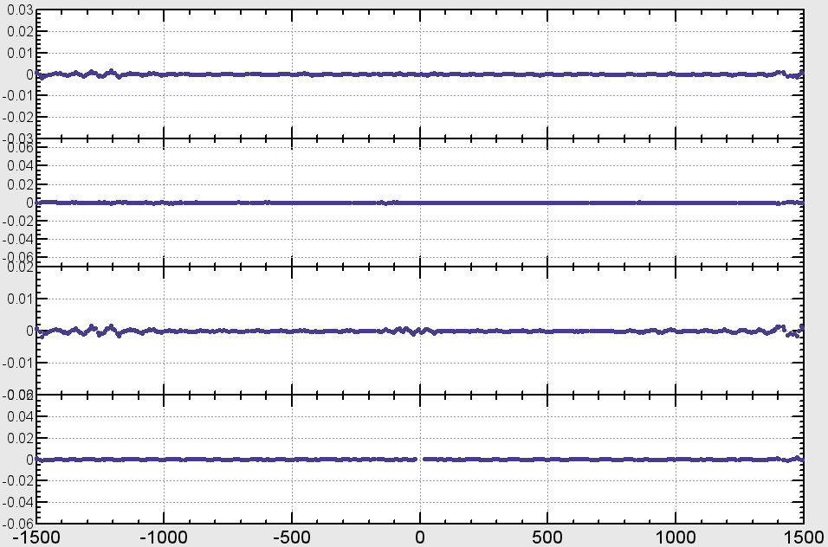
Simulation Example (No BPM Error)
After Correction

Slide 9
Vertical Emittance and BPM Jitter Error
100 simulations with different seed of random numbers.
Emittance before correction
Emittance after 1 correction
Jitter Error 0 μm
Jitter Error 2 μm
Jitter Error 5 μm
Design
Target
Corrections of XY-coupling and vertical dispersion effectively reduce vertical emittance.

Slide 10
Vertical Emittance and BPM Jitter Error
100 simulations with different seed of random numbers.
Emittance before correction
After 5 corrections
Jitter Error 0 μm
Jitter Error 2 μm
Jitter Error 5 μm
Design
Target
Iterative correction is effective especially when BPM jitter error is large

Slide 11
Vertical Emittance and BPM Rotation Error
100 simulations with different seed of random numbers.
Vertical Emittance after 5 corrections
Design
Target
0.1 mrad
0.3 mrad
0.6 mrad
BPM rotation error should be less than 0.5 mrad for the target vertical emittance.

Slide 12
Dynamic Aperture (DA)
100 simulations with different seed of random numbers.
Before Correction
After Correction
Design
DA is dramatically improved by the optics correction.

Slide 13
Betatoron Function

Slide 14
Beta Measurement
Ref. A. Morita et al, PRSTAB 10, 072801 (2007)
Analyze CODs induced by steering kicks.
COD at the i th BPM induced by j th steering kick in two forms.
Find
and
which reproduce measured beam positions
The solution is obtained by iteratively minimize two quadratic functions.

Slide 15
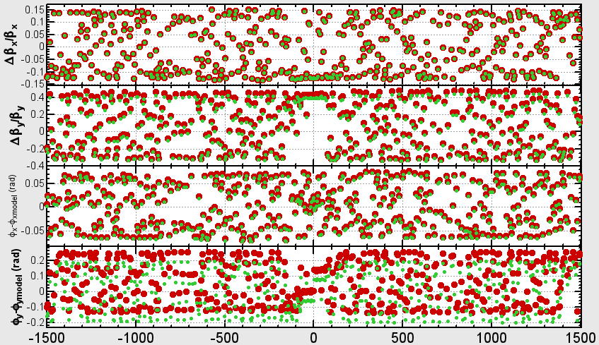
Beta Measurement @ SuperKEKB HER
No BPM Jitter
Exact
Measured
IP
This scheme inevitably has two ambiguous.
1. Scaling of beta function
2. Phase origin

Slide 16
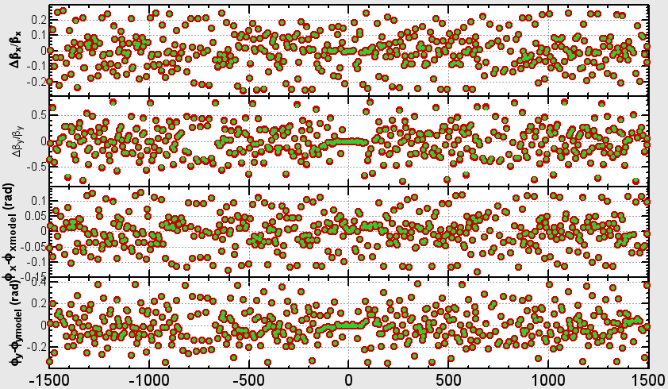
Beta Measurement @ SuperKEKB HER
No BPM Jitter
Exact
Measured
IP
To avoid the ambiguous
we use difference between neighborhood BPMs in the optics correction.

Slide 17
Simulation of Beta Correction
Assumptions
- No orbit drift in time.
- Zero-current (ignore intra-beam scatteringin emittance calculation).
- No error source in the IR region.
- Exact values of perturbed tunes are known.
Error Source (Gaussian distributed)
Beta Measurement
- Use 6 horizontal and 6 vertical orbit kicks.
- Orbit amplitude at Arc section is about < 1mm.
Corrector
all quadrupoles (fudge factor of the electric power supplies)

Slide 18
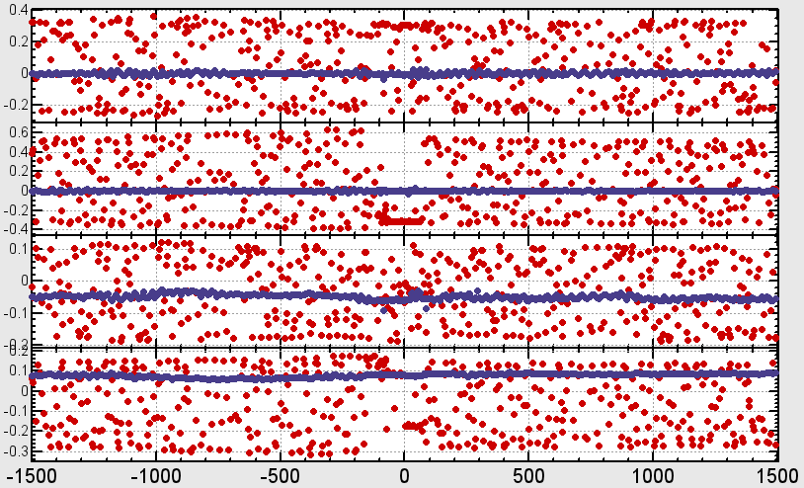
Beta Correction @ SuperKEKB HER
No BPM Jitter
Before
After
Before
After

Slide 19
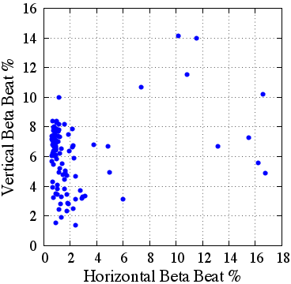
Global Beta Beat After Correction (SuperKEKB HER)
100 simulations with different seed of random numbers.
BPM Jitter 2 micron
Typically, global beta beat for 2 micro bpm jitter is within ~5% for horizontal and within ~10% for vertical betatron motion.

Slide 20
Full Optics Correction

Slide 21
Measurement Method and Corrector Knob
All measurements are based on COD or its response.
 | Measurement Method | Corrector Knob
COD | BPM reading | Horizontal/Vertical Steerings
XY Coupling | COD response associated with horizontal steering kick | Skew winding of sextupoles
Vertical Dispersion | COD response associated with RF frequency change | Skew winding of sextupoles
Betatron Function&Phase | COD response associated with steering kick | quadrupole (fudge factor)
Horizontal Dispersion | COD response associated with RF frequency change | Horizontal mover of focusing sextupoles

Slide 22
Simulation Condition
Error Source
 | Horizontal misalignment [μm] | Vertical misalignment [μm] | Rotation error [μrad] | ΔK/K
Quadrupoles | 100 | 100 | 100 | 2.5*10⁻⁴
Sextupoles | 100 | 100 | 0 | 0
Assumptions
- No orbit drift in time.
- Zero-current (ignore intra-beam scattering in emittance calculation).
- No error source in the IR region.
- Exact values of perturbed tunes are known.
Beam optics is unstable if we introduce the error sources at once.
Thus, we gradually increase the error amplitude with the optics corrections.

Slide 23
Emittance
100 simulations with different seed of random numbers.
Target
Jitter Error 5 μm
Jitter Error 2 μm
Jitter Error 0 μm
Design
Iterative correction with adjusting correction parameters is necessary to improve vertical emittance.
Reached vertical emittance is sensitive to the correction parameters especially when BPM jitter is large.

Slide 24
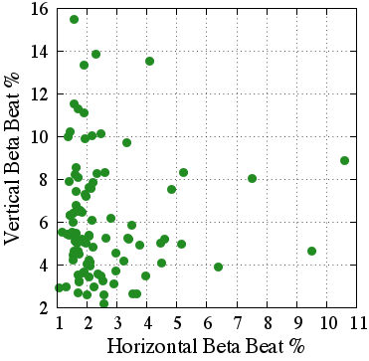
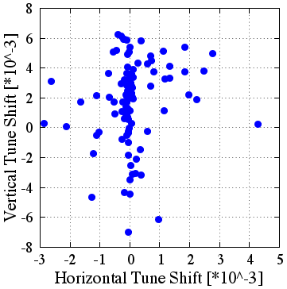
Beta Beat After Optics Correction
2 micro BPM Jitter
100 simulations for different random seeds.
Vertical beta beat is typically within ~10%, and ~5% for horizontal direction.

Slide 25
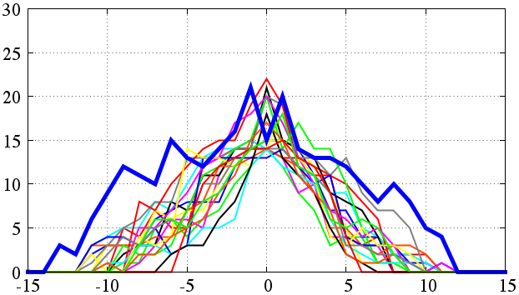
Dynamic Aperture
2 micro BPM Jitter
20 samples
Design
On-momentum aperture is improved to the design level.
Optimization of higher order multipole magnets is necessary to improve off-momentum aperture (in progress)

Slide 26
Summary and …
COD based scheme is applied to SuperKEKB HER lattice.
Iterative corrections is necessary to reduce vertical emittance.
BPM rotation should be less than 0.5 mrad for the target vertical emittance.
In typical case, global beta beat is within ~5% for horizontal and within ~10% for vertical betatron motion.
After full optics corrections, we can reach the target vertical emittance.
Achieved vertical emittance is sensitive to the correction parameters especially when BPM error is large.
On-momentum DA is improved to the design level.
As for off-momentum DA, it is expected to be improved by tuning higher order multipole fields, but not confirmed yet.
To be studied
More detailed study on optics measurement using single-pass BPM.
Error source in IR region.
Orbit drift
Thank you for listening!
and so on…

