Slide 1
KEK’s Roadmap
Fumihiko Takasaki
KEKB-Review 21/2/2012

Slide 2
New Management Structure
Directors nominated
IPNS
Masanori Yamauchi
DG
Atsuto Suzuki
Kazuyoshi Yamada
IMSS
Acc L
Katsunobu Oide
Adv RL
Syuichi Ban
JAEA
J-PARC
Yet to be nominated

Slide 3
New Management Structure
Trustees nominated
Research Promotion
Future Research Plan
Yasuhiro Okada
DG
Int’l Corporation
Atsuto Suzuki
Budget Planning
Masaharu Nomura
Network
Nobukazu Toge
Public Relation
J-PARC
Yet to be nominated
Education

Slide 4
KEK’s Roadmap
Form a Taskforce within KEK
for the Roadmap
Consultation with the Research Communities
International Review

Slide 5
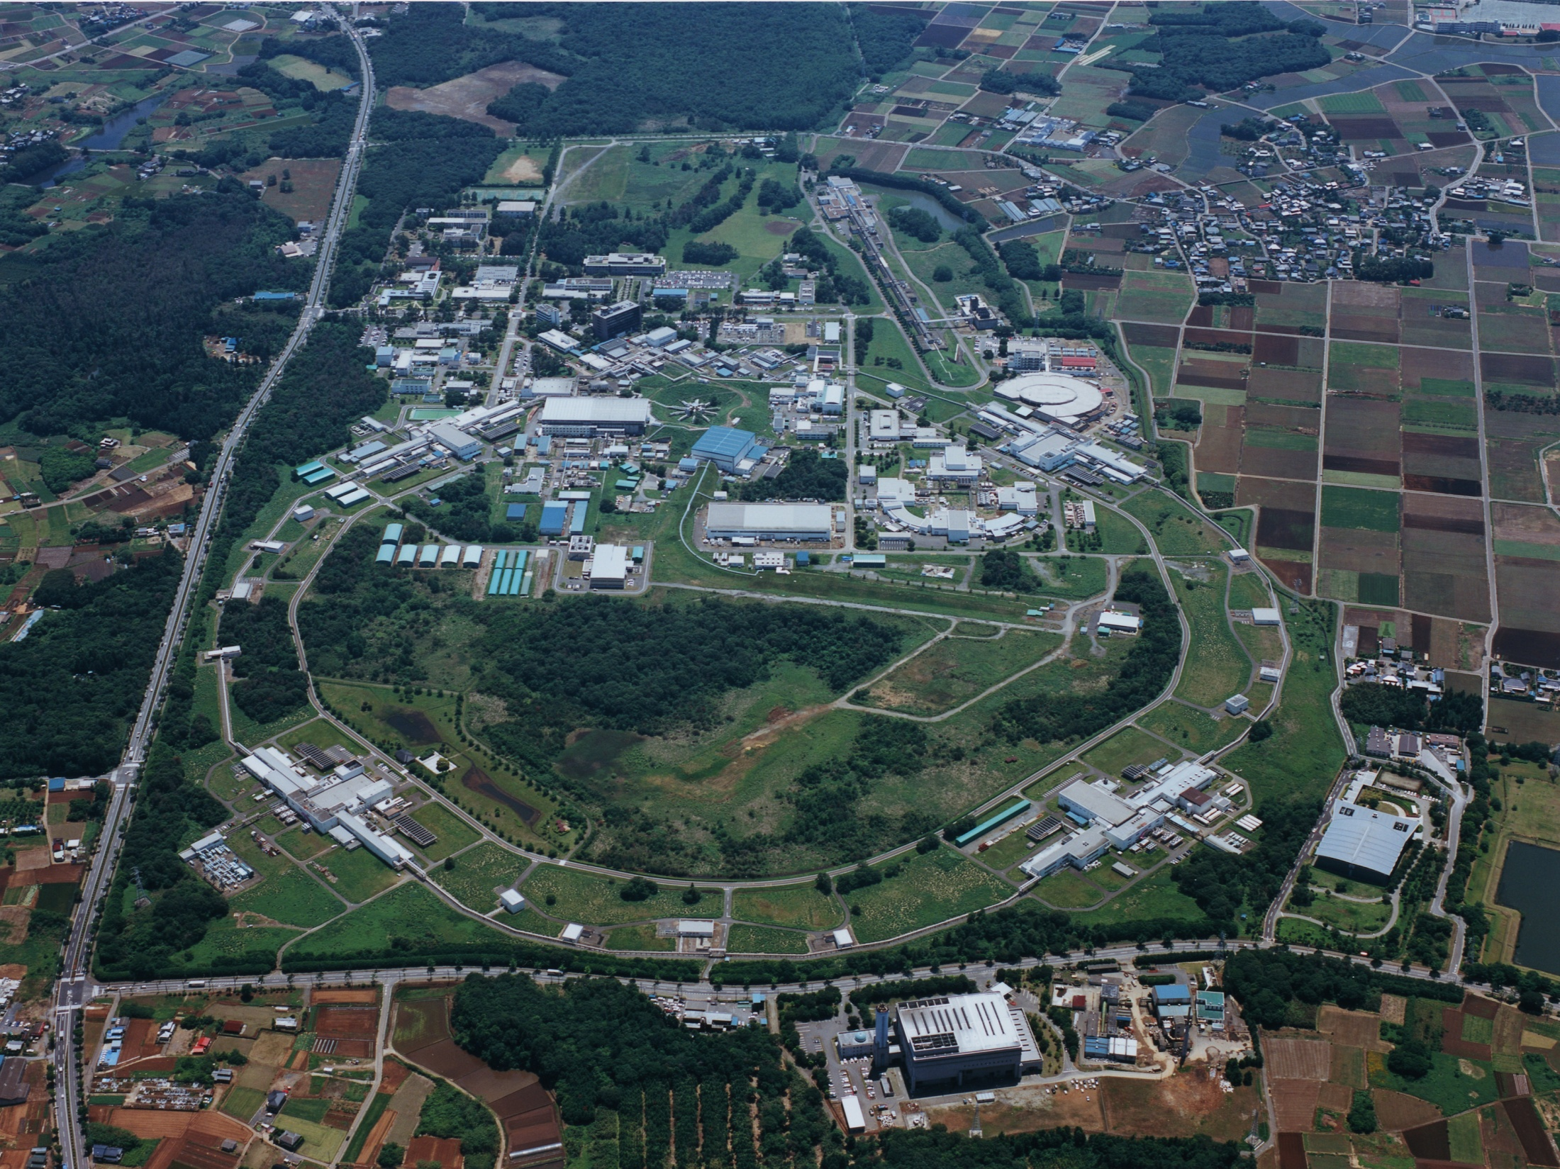
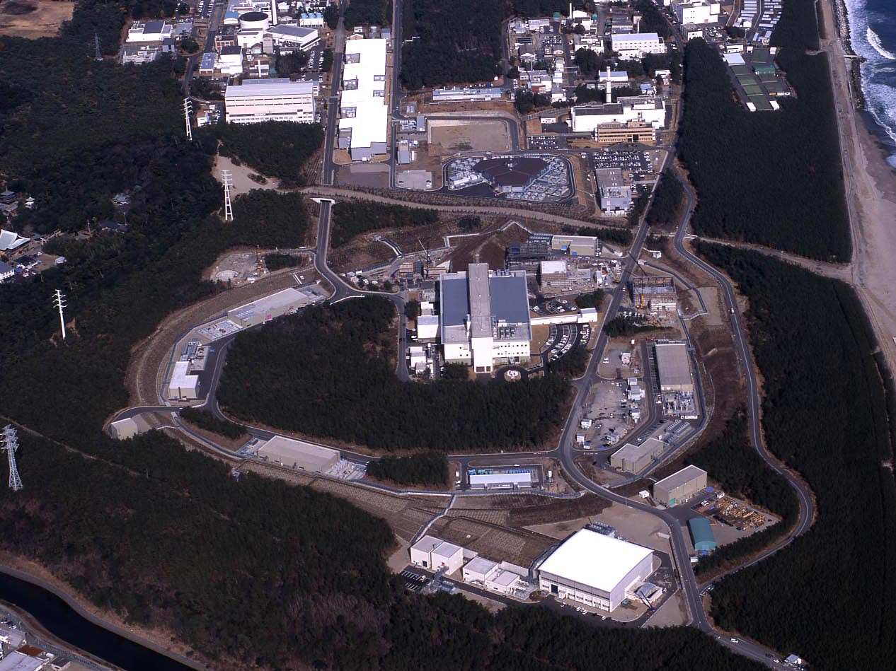
Facilities for Research at KEK
Two Campuses of KEK
Tsukuba
Electron LINAC
Super-KEKB Ring
Photon Factories
Acc. Test Facilities
Tokai
J-PARC
Proton LINAC
RCS
Main Ring

Slide 6
KEK Roadmap (2009 – 2013)
2006
2008
2010
2012
2014
2016
2018
J-PARC
construction experiment + upgrade
KEKB
experiment upgrade experiment
PF/PF-AR
experiment
LHC
construction experiment + upgrade
R&Ds for Advanced Accelerator and Detector Technology
Detector R&D
ERL
C-ERL R&D
construction test experiment
PF-ERL
R&D construction experiment
ILC
ILC R&D CDR
construction
Host and Site: Yet to be decided

Slide 7
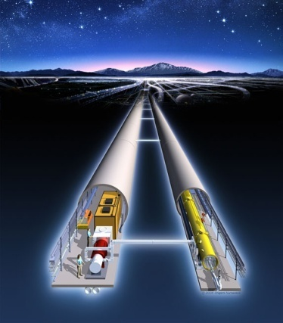
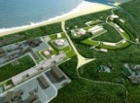
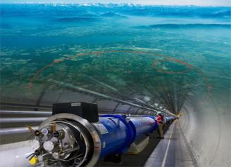
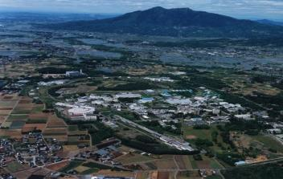
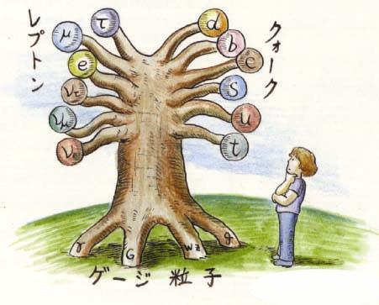
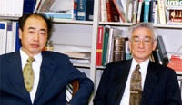
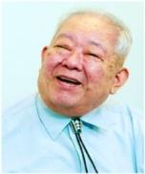
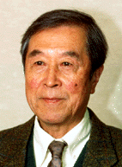
Quest for
Birth-Evolution
of Universe
Quest for Unifying
Matter and Force
International Linear Collider（ILC）
Scientific Activities
Technology Innovation
Talented Human Resources
Lepton CP Asymmetry
Beyond Standard Physics
Beam
Power-Upgrade
SuperKEKB
J-PARC
Operation
Power-Upgrade
KEK-B
Quark CP Asymmetry
LHC
Lepton
Quark
ν_{τ}
[Origin of Matter]
ν_{μ}
Quest for Neutrinos
ν_{e}
Quest for 6 Quarks
[Origin of Force]
Higgs Particle [Origin of Mass]

Slide 8
New Direction ???
Non Accelerator Science
Astro-particle Physics
New Idea for Accelerator Science
Computer Science

