Slide 1
Overview of Ring Construction Status and Schedule
Kazunori AKAI
March 4, 2013
18th KEKB Accelerator Review Committee

Slide 2
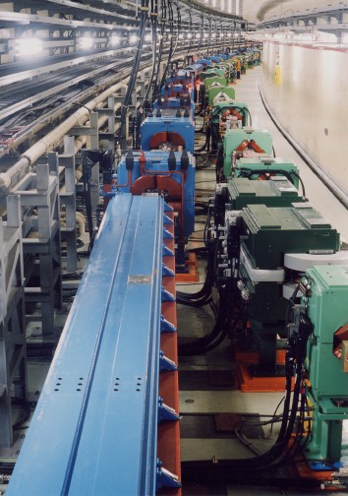
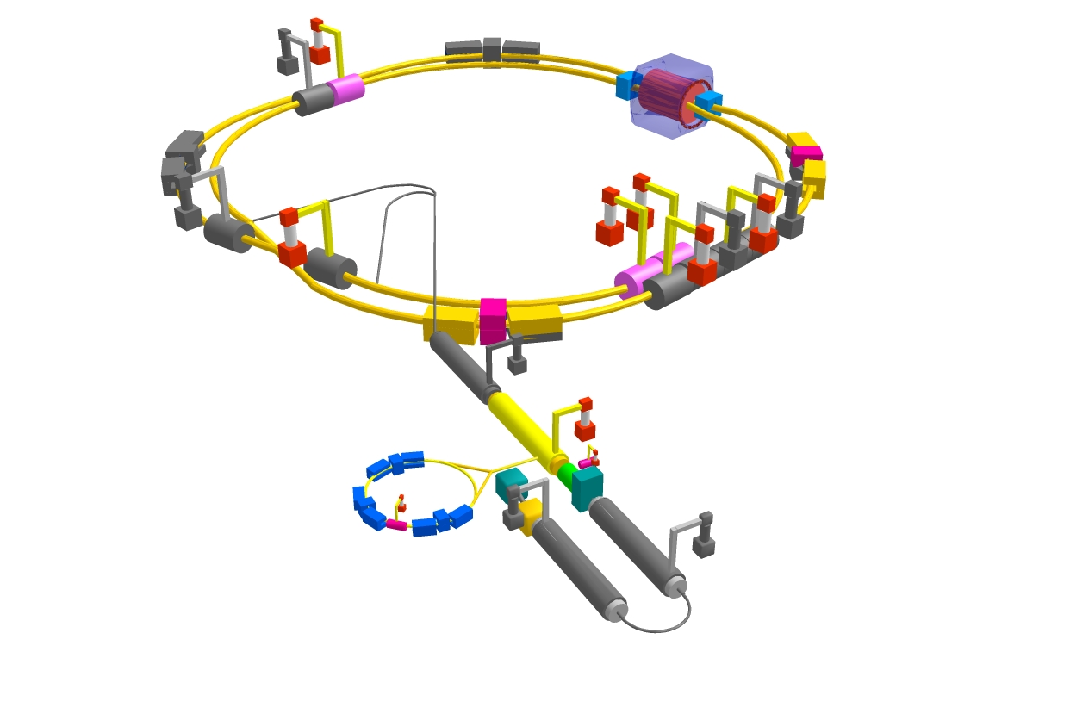
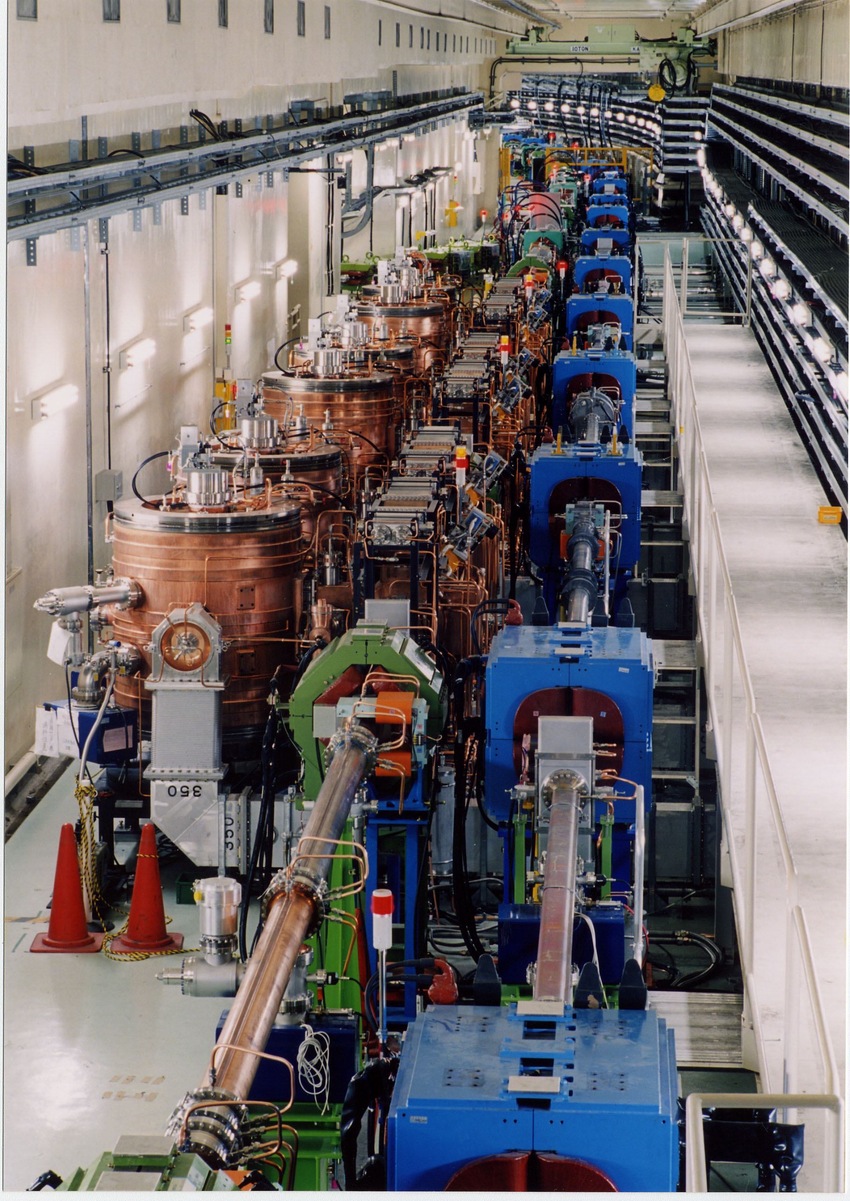
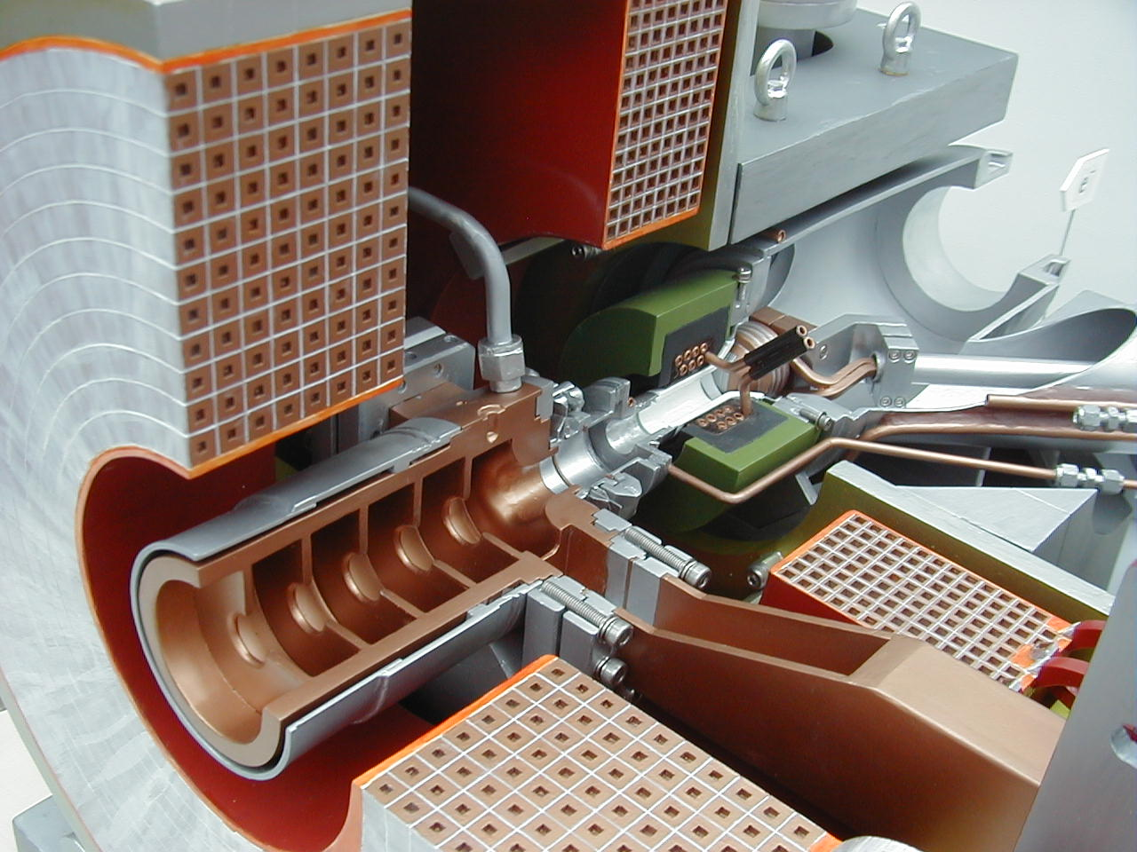
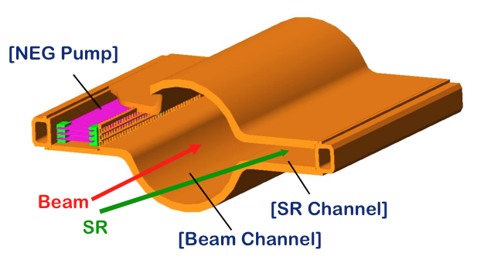
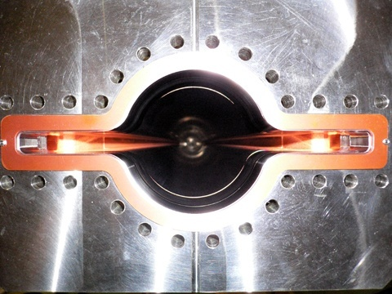
KEKB to SuperKEKB
Colliding bunches
Belle II
New IR
New superconducting final focusing magnets near the IP
e- 2.6 A
New beam pipes
& bellows
e+ 3.6 A
Reinforce RF systems for higher beam currents
Redesign the lattice to squeeze the emittance (replace short dipoles with longer ones, increase wiggler cycles)
Improve beam monitors and control system
New positron capture section
e+ Damping ring
Replace beam pipes to suppress electron cloud (TiN-coated beam pipe with antechambers)
Low emittance electron gun
To get x40 higher luminosity

Slide 3
SuperKEKB rings master schedule
Calendar
2010
2011
2012
2013
2014
2015
2016
・・・
Japan FY
2010
2011
2012
2013
2014
2015
2016
now here
KEKB operation
SuperKEKB-MR(LER&HER) construction
SuperKEKB commissioning
optics design
dismantling KEKB
phase 1
w/o QCS
w/o Belle II
phase 2
w/ QCS
w/ Belle II (no VXD)
phase 3
w/ full Belle II
fabrication and tests of MR components
TiN coating & baking of beam pipes
DR commissioning during phase 1
install, assembly and set up
final assembly,
RF conditioning
MR buildings construction
reinforce electricity and cooling facility
reinforce RF, vac, etc.
for higher beam current
cool down in beam line
cool down
w/Belle II
fabricate QCS-L
fabricate QCS-R
detector upgrade to Belle II
rotation
VXD install
roll in
roll in
Belle roll out
roll out
optics design
SuperKEKB-DR construction
fabrication and tests of DR components
DR tunnel construction
install, assembly and set up
DR buildings construction
electricity and cooling system
3

Slide 4
Commissioning Scenario
Commissioning will be performed in three phases.
Phase 1: w/o QCS, w/o Belle II
basic machine tuning
low emittance beam tuning
vacuum scrubbing
Belle II people request enough vacuum scrubbing in this stage (before Belle II roll in).
At least one month at beam currents of 0.5~1A.
DR commissioning
Phase 2: with QCS and Belle II, but no VXD
low beta* beam tuning
small x-y coupling tuning
collision tuning
study beam background
Belle II people want to carefully check beam background before VXD installation.
Phase 3: with QCS and full Belle II
physics run
luminosity increase
This scenario was agreed between KEKB and Belle II.
We keep another scenario (scenario B in the next slide) as a back up in case of delay of Belle II construction.

Slide 5
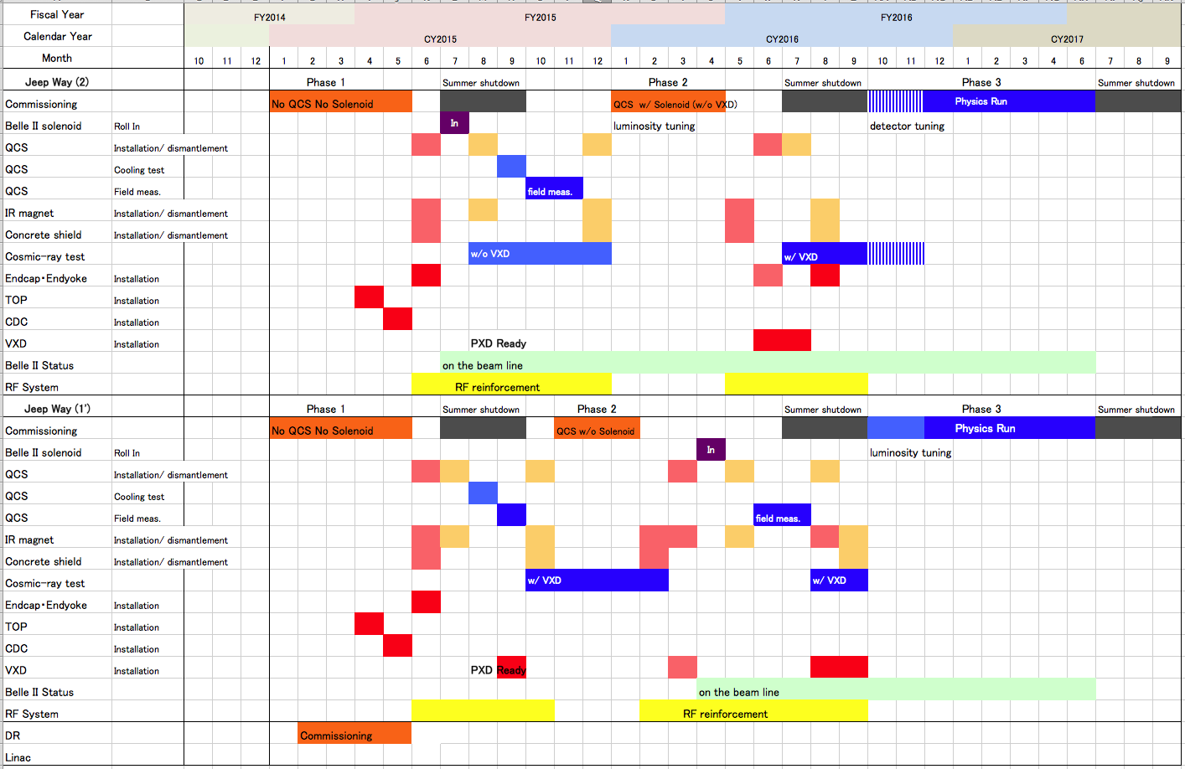
Commissioning schedule
Scenario A (base line)
First target luminosity
1 x 10³⁴ cm⁻²s⁻¹
First target luminosity
1 x 10³⁴ cm⁻²s⁻¹
Scenario B (back up)

Slide 6
Fabrication status of beam pipes, etc.
Fabrication year | Ring, location | Material | Number | Length (m)
JFY2010 | LER wiggler beam pipes | Cu | 77 | 223
JFY2011 | HER wiggler beam pipes | Cu | 22 | 64
JFY2011 | Chicane, wiggler downstream beam pipes | Cu | 70 | 177
JFY2011 | HER symmetry point beam pipes | Cu | 24 | 35
JFY2011 | LER RF straight section beam pipes | Cu | 4 | 12
JFY2011 | LER arc section bellows | Al | 690
JFY2010-11 | Wiggler section and HER arc section bellows | Cu | 259
JFY2011 | LER arc section gate valves |  | 24
JFY2011 | LER arc section beam pipes | Al | 687 | 1861
JFY2012 ongoing（+2013） | LER Tsukuba straight section bellows |  | 135
JFY2012 ongoing（+2013） | HER Tsukuba straight section bellows |  | 135
JFY2012 ongoing | LER Tsukuba straight section gate valves |  | 7
JFY2012 ongoing | HER Tsukuba straight section gate valves |  | 6
JFY2012 ongoing | DR arc section beam pipes | Al
JFY2012 ongoing | LER arc skew sextupole beam pipes | Al |  | ~ 32
JFY2013 scheduled | LER Tsukuba straight section beam pipes | Cu and Al |  | ~ 330
JFY2013 scheduled | HER Tsukuba straight section beam pipes | Cu |  | ~ 330
JFY2013 scheduled (+2014) | LER Fuji straight section beam pipes | Al or Cu |  | ~ 30
JFY2013 scheduled (+2014) | HER Fuji straight section beam pipes | Al or Cu |  | ~ 30
JFY2013 scheduled (+2014) | IR section beam pipes, collimators, SRM chambers
JFY2013 scheduled (+2014) | DR straight section and transport line beam pipes | Al

Slide 7
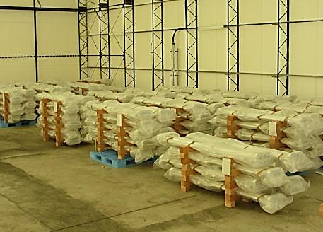
Beam pipes treatments
Baking and TiN coating system have been constructed at Oho experimental hall in KEK. Treatment of beam pipes is well ongoing.
About 1000 beam pipes will be baked and TiN-coated in two years.
Vacuum group working deck in Oho exp. building
Four baking systems operating on the upper floor (B2).
Checking and preparation work on the middle floor (B3).
Five vertical TiN coating systems from B4 to B2 through.
B2
B3
B4
A part of beam pipes in a stock house

Slide 8
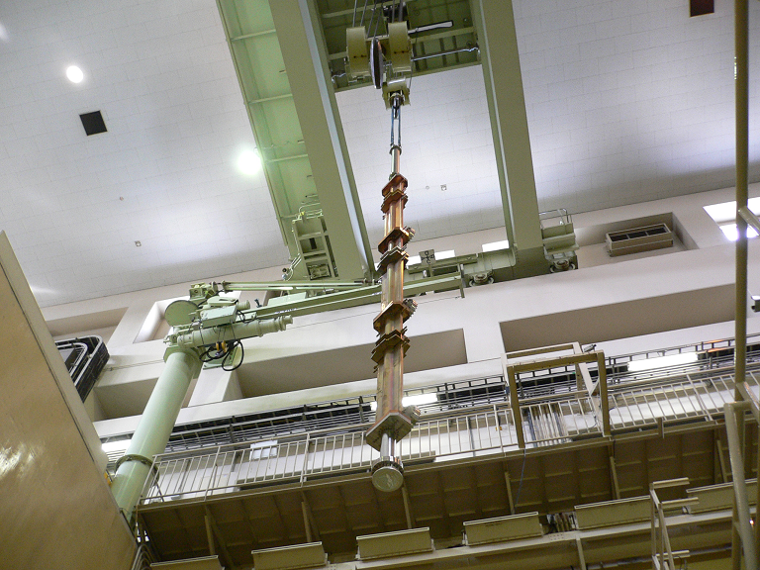
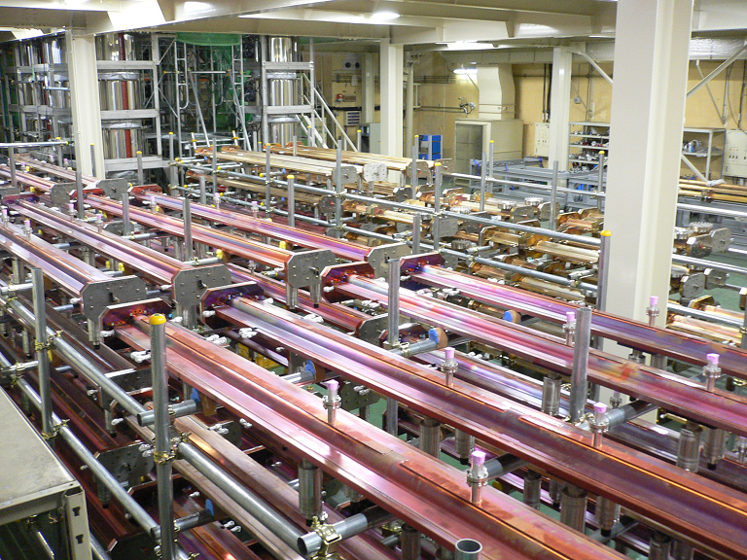
K. Shibata
(upper): Inserting ante-chambers into a vertical TiN coating system. (lower): Top-side view of ante-chambers in two lines set in the coating system.
(upper and lower): Copper and Aluminum beam pipes after baking and TiN coating. They are temporary stocked in Oho B4 until moved to tunnel or other stock houses.

Slide 9
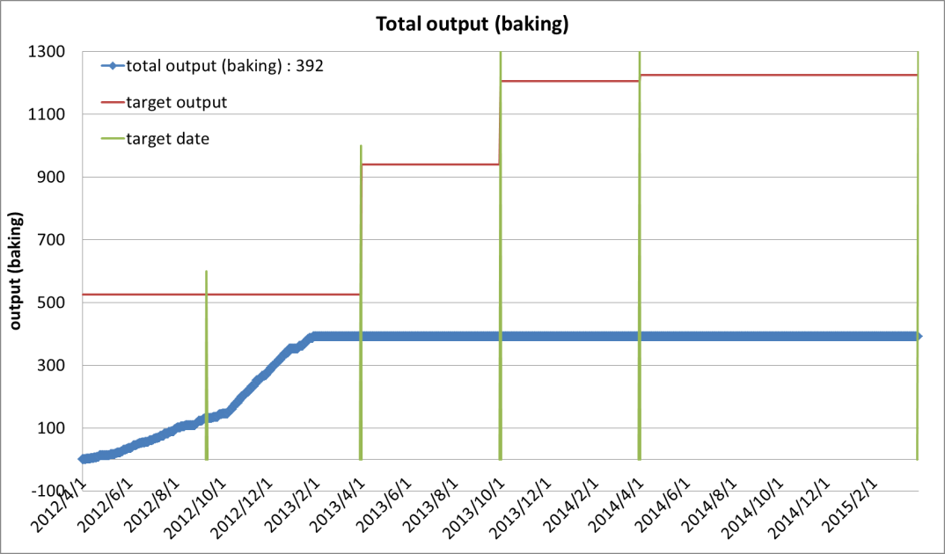
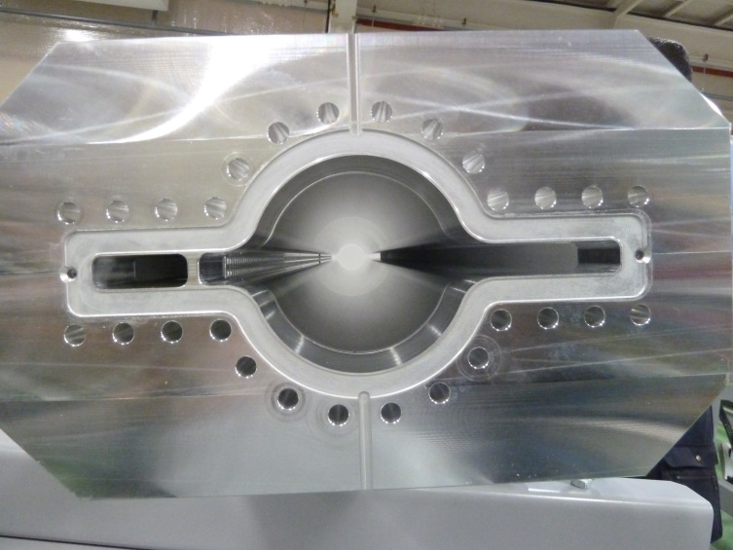
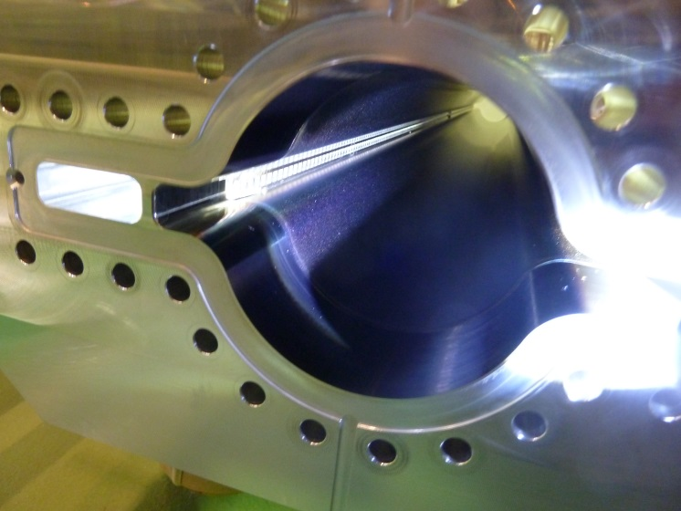
Al ante-chamber before coating
Target
here
After baking
After TiN coating
before baking

Slide 10
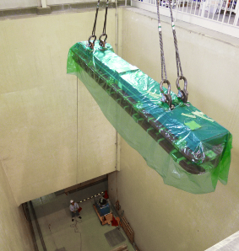
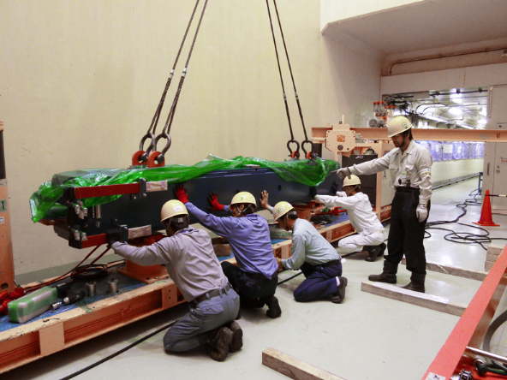
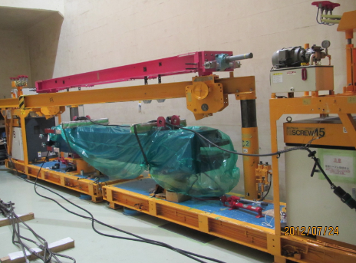
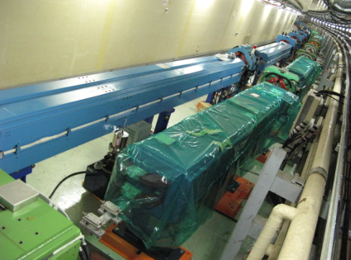
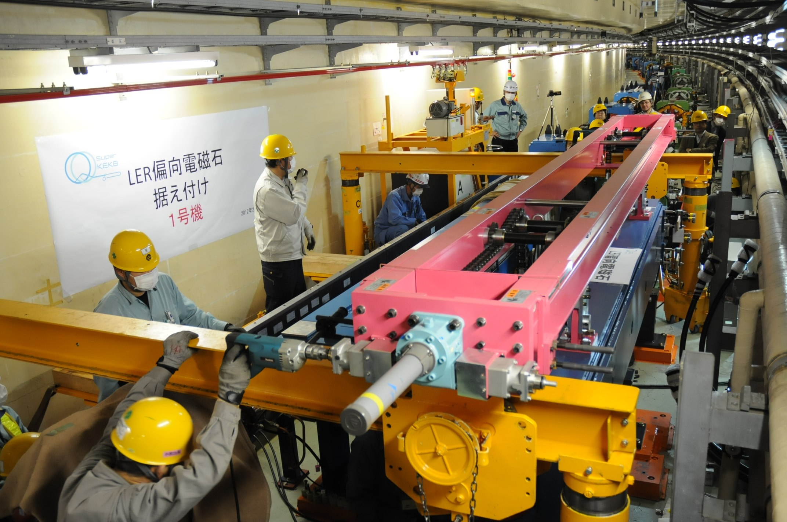
100 new LER bend magnets installation completed
field measurement
move into tunnel
carry on an air-pallet
install done
carry over existing HER dipole

Slide 11
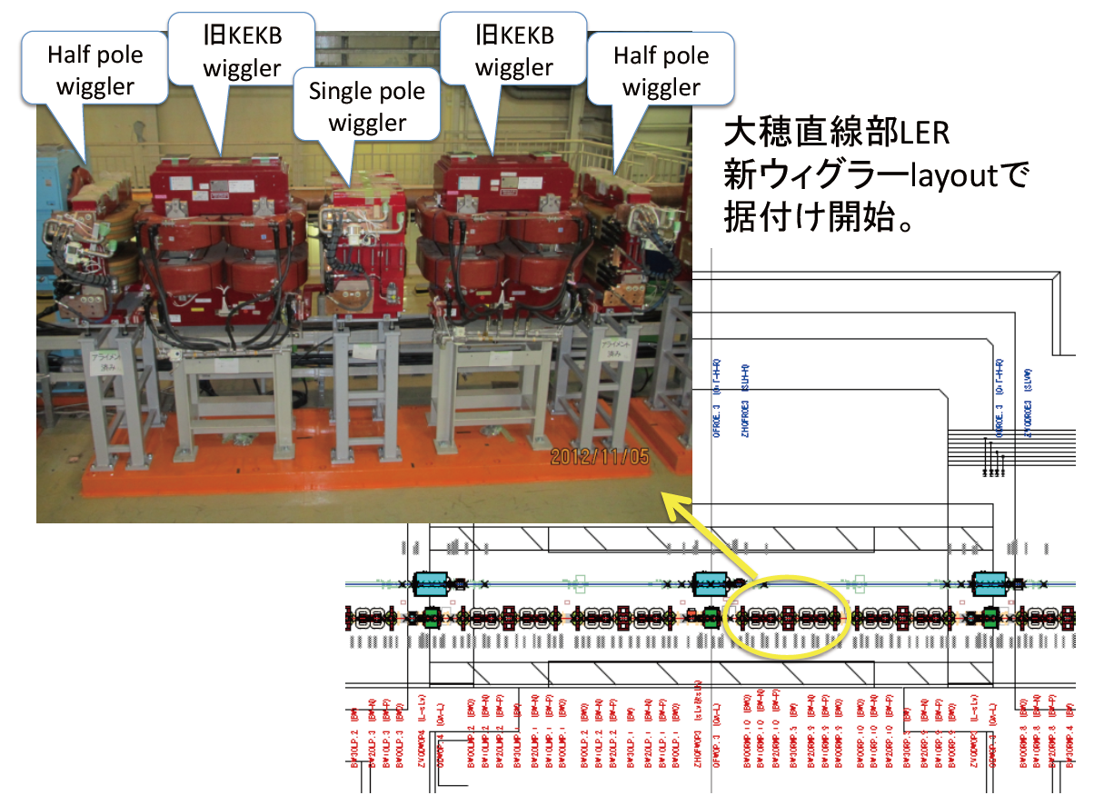
Construction of new beam lines in Tsukuba straight section.
New LER wiggler layout in Oho D4 straight section
Installation of 100 new LER bending magnets done
V-steering magnet

Slide 12
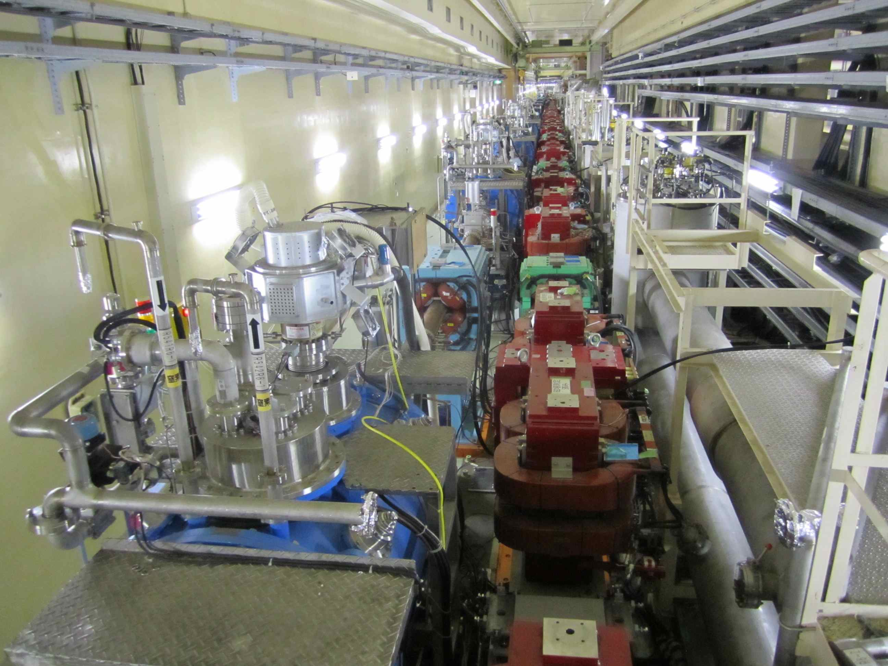
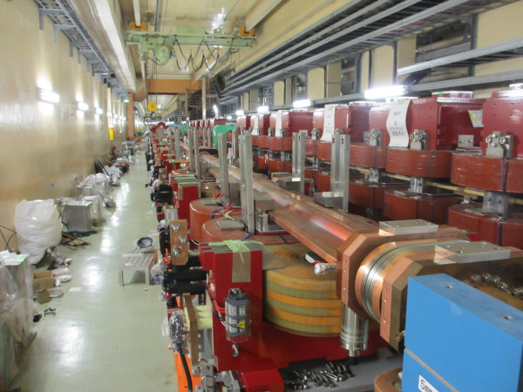
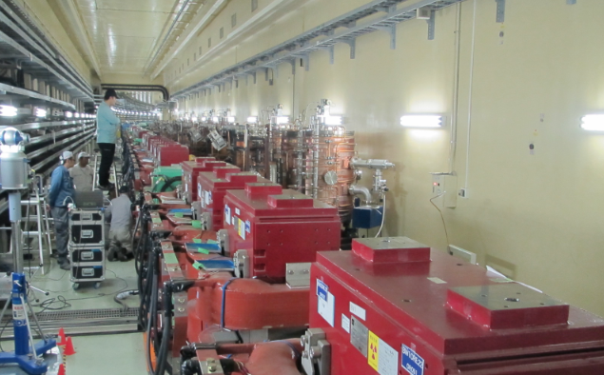
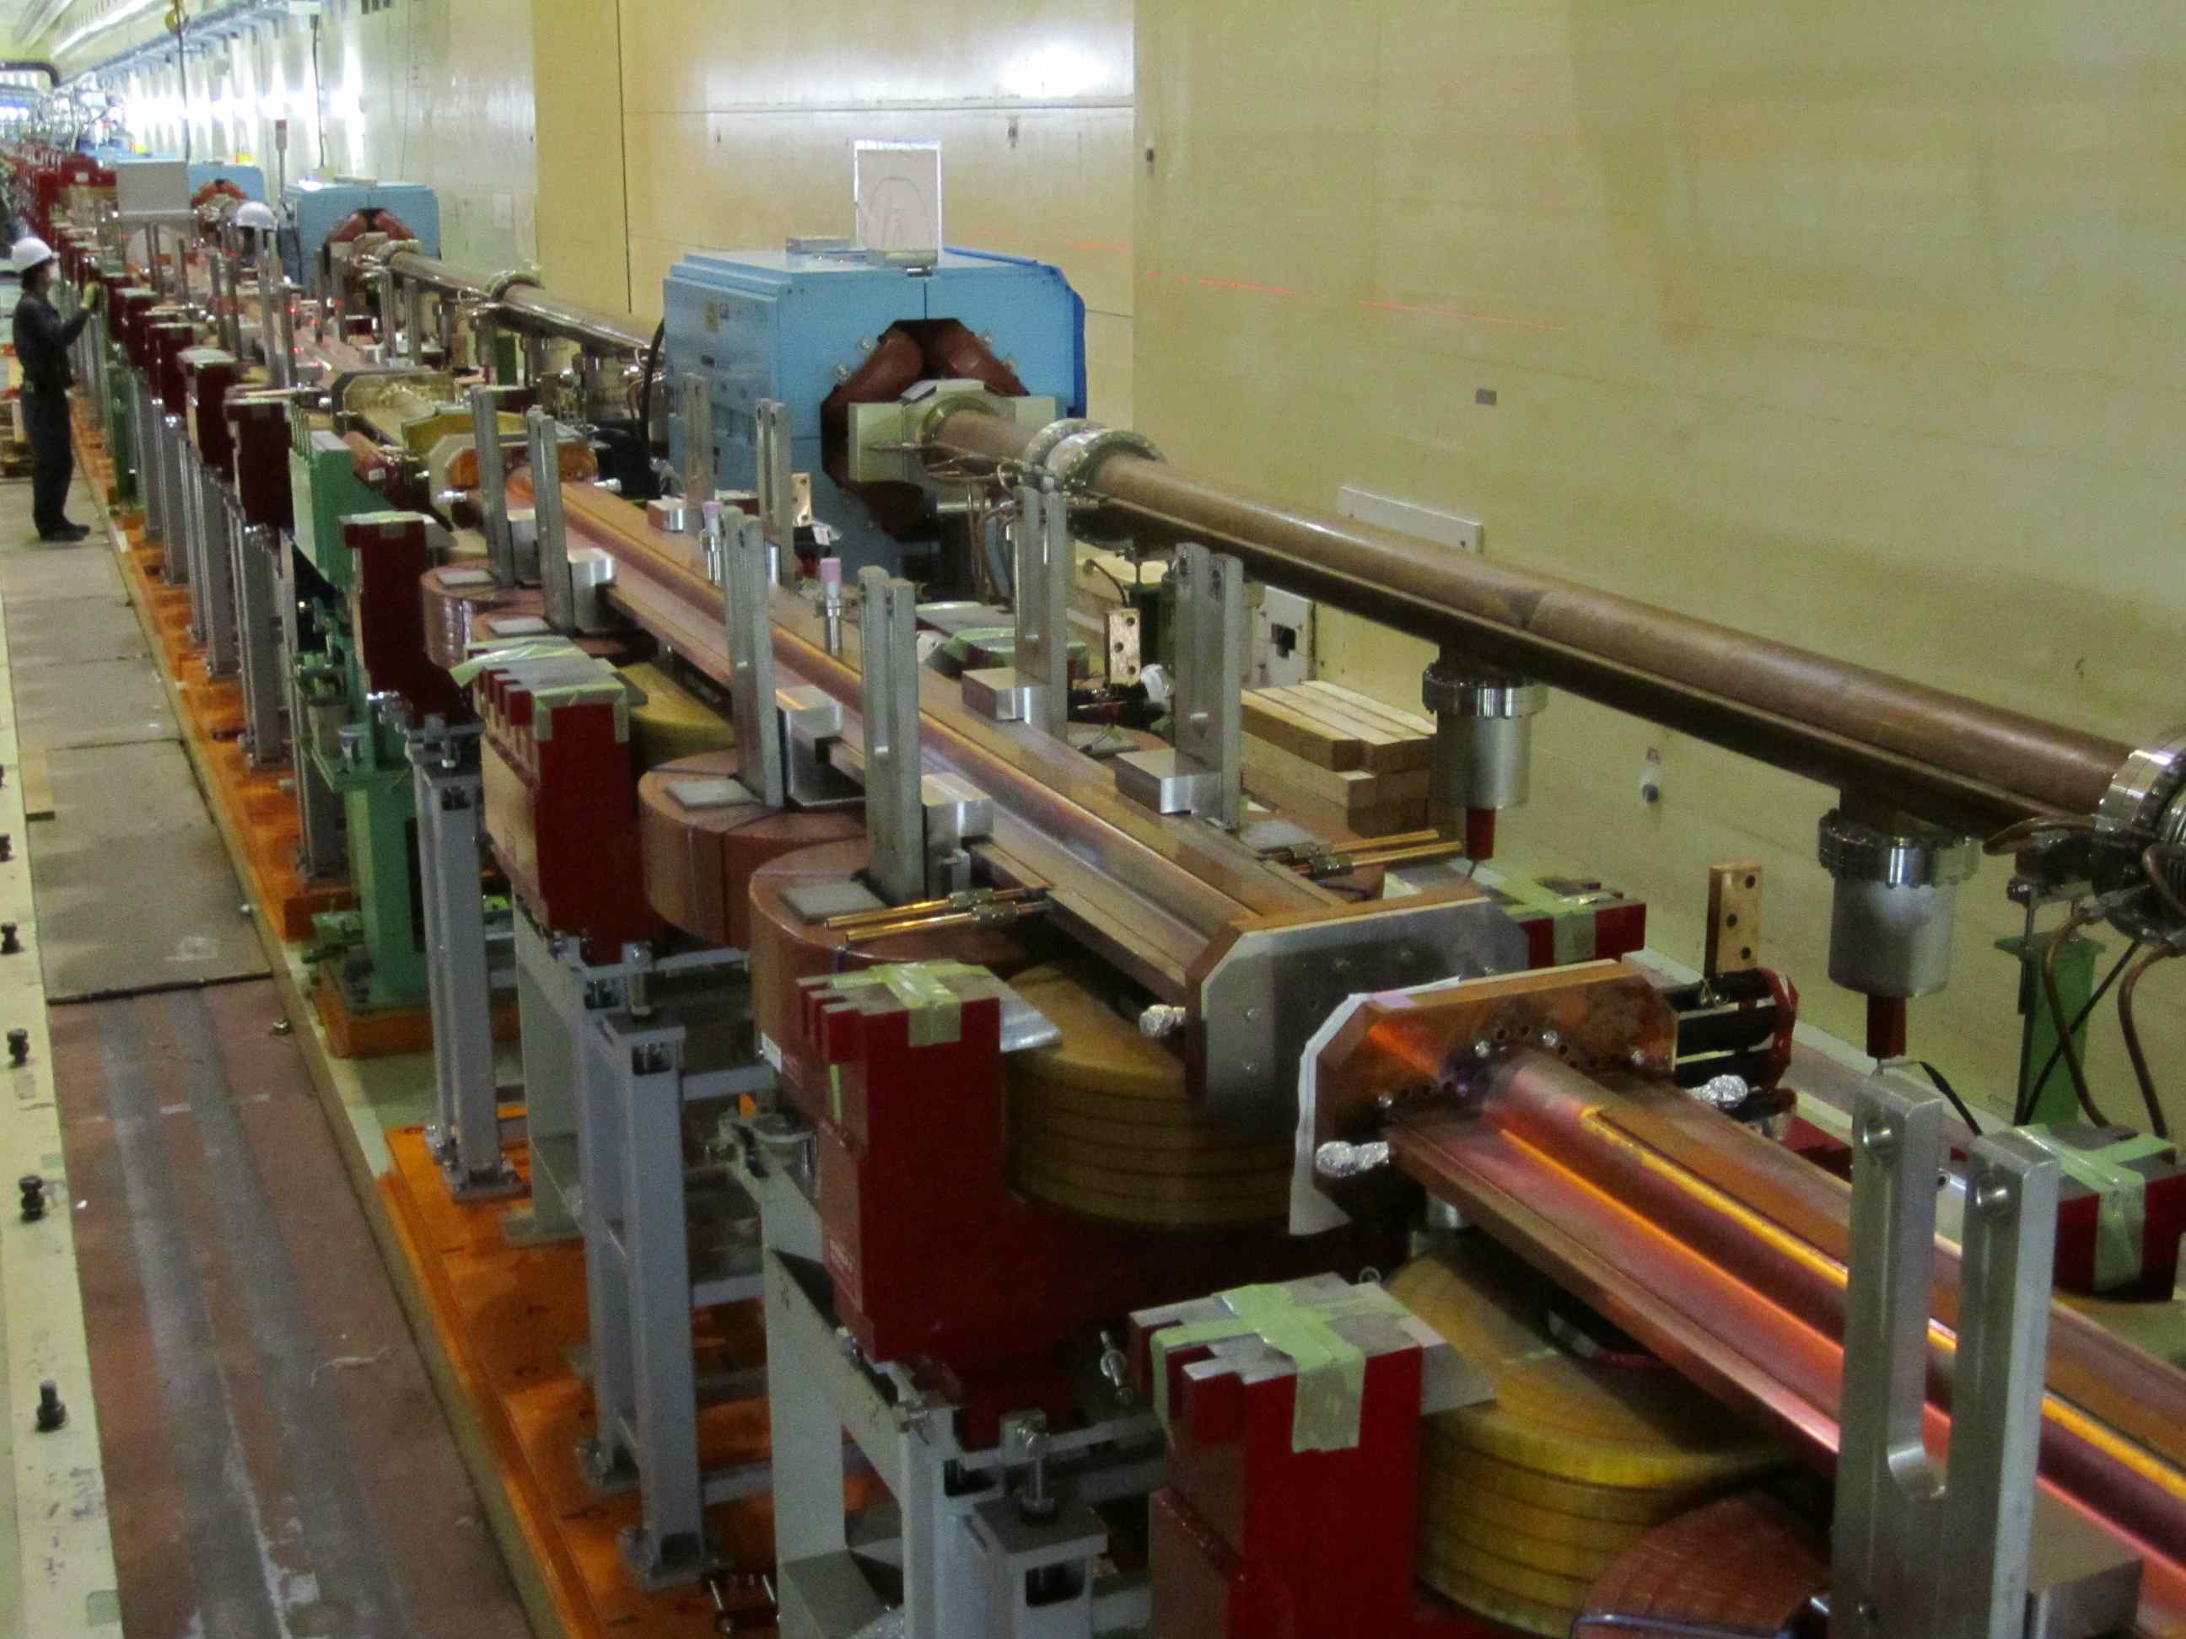
Wiggler sections
LER Wiggler
Nikko
LER Wiggler
Installation of LER wiggler chambers in Nikko and Oho straight sections will be completed in March.
Oho
Installation of HER wiggler chambers in Oho straight section is done.
HER Wiggler

Slide 13
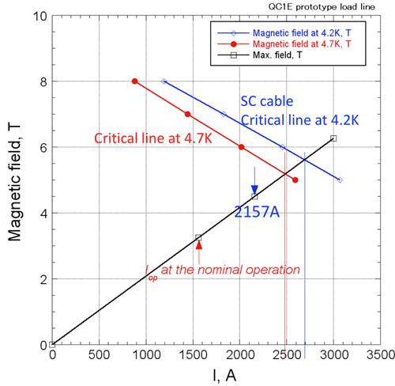
Final focus SC quads (QCS)
Eight final focus QCS with 40 corrector coils are to be used.
Fabrication of QCS-L started in July 2012, and will be completed in JFY2013.
Fabrication of QCS-R is scheduled in JFY2013 and 2014.
Corrector coils are being wound at BNL under BNL/KEK collaboration.
Prototype magnet was made at KEK. Test results show sufficient margin for operation.
QC1LE prototype magnet
Successfully tested without any quench up to 2157A, well over the design current (1560A) for nominal operation.
I_{4S}/I_{c@4.7K} = 62.8%
I_{12GeV}/I_{c@4.7K} = 87.0%
Sufficient margin for operation

Slide 14
Design improvement of QCS since last ARC
Radiation shield is implemented in the QCS cryostat to reduce background to Belle II.
It turned out that Radiative Bhabha scattering seriously deteriorates photo-multiplier of Belle II TOP detector: the life time reduces unacceptably (~1/20).
To solve the problem, more radiation shield is added. In particular, Tungsten alloy is used as a part of vacuum vessel of QCS for shielding.
Permendur yokes and shields are adopted to reduce leak fields.
The yokes of QC1E and QC2P have the magnetic field from -0.5 T to 0.5T in the good canceling condition of Belle solenoid field by the accelerator SC solenoids. With 1% change in the Belle solenoid field, the magnetic field in the yokes reaches 1T.
In order to reduce leak field on the other beam, Permendur yokes and shields that have higher saturation field were adopted.
Corrector coils
It was found that dynamic aperture is deteriorated by possible skew-sextupole component of QC1 field.
Corrector coils in QCS-R is being reconsidered to have sextupole cancellation. (No change can be made for QCS-L, which already started fabrication.)
Optics design
IR optics design has been almost finalized so that fabrication of magnets and beam pipes in Tsukuba straight section can start in early JFY2013.

Slide 15
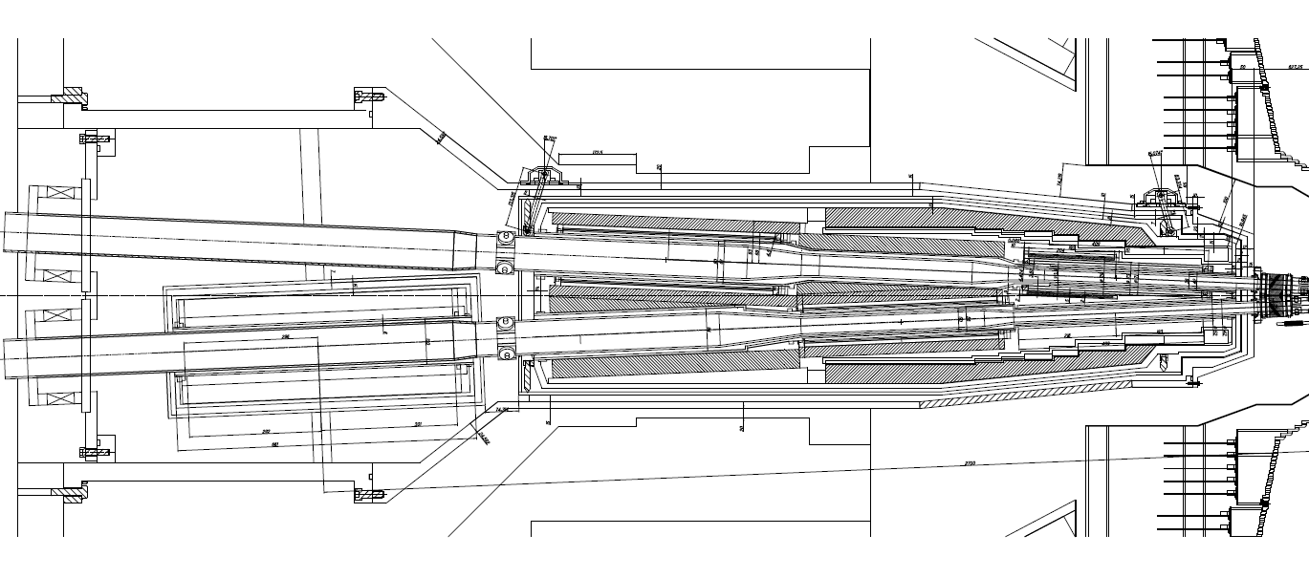
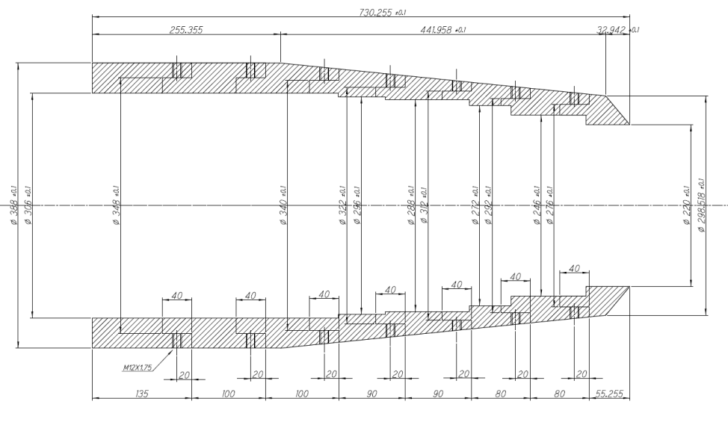
Permendur yoke for QC2LP
Permendur magnetic shield
for LER beam
Permendur yoke for QC1LE
Permendur magnetic shield
for HER beam
Reconsider collector coils in QCS-R
Tungsten alloy for radiation shield

Slide 16
N. Ohuchi, et al.

Slide 17
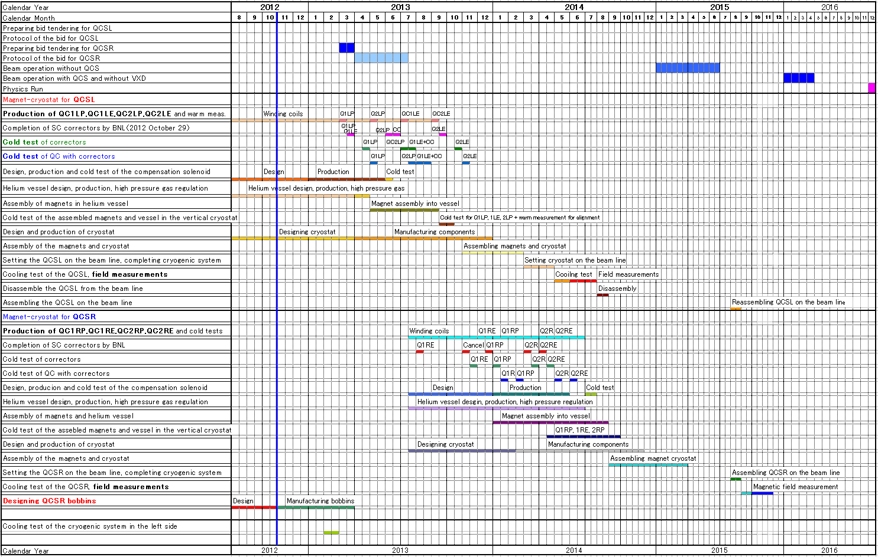
SuperKEKB QCS const. and commissioning schedule
N. Ohuchi
Cooling test on beam line
QCS-L production
Field measurement
with Belle II solenoid
QCS-R production

Slide 18
RF system
Upgrade of RF system to cope with twice beam currents and 2.5 times beam power
Change to 1 klystron : 1 ARES cavity scheme from 1:2
RF stations are being added.
ARES cavities are rearranged, and the input couplers are replaced with improved ones.
Measures for HOM power increase in SC cavities
Existing HOM dampers are considered marginal at about 2A in HER.
Measures are being investigated for the design current of 2.6A:
Replacing tapers and gate-valves with larger bore ones to reduce loss factor.
Adding dampers to disperse HOM power for each damper.
New Low-Level RF control system
A prototype system has been completed. It was operated with a klystron and an ARES cavity, and good performance was demonstrated.
LLRF for eight stations will be replaced with new ones. Fabrication will start in May this year.

Slide 19
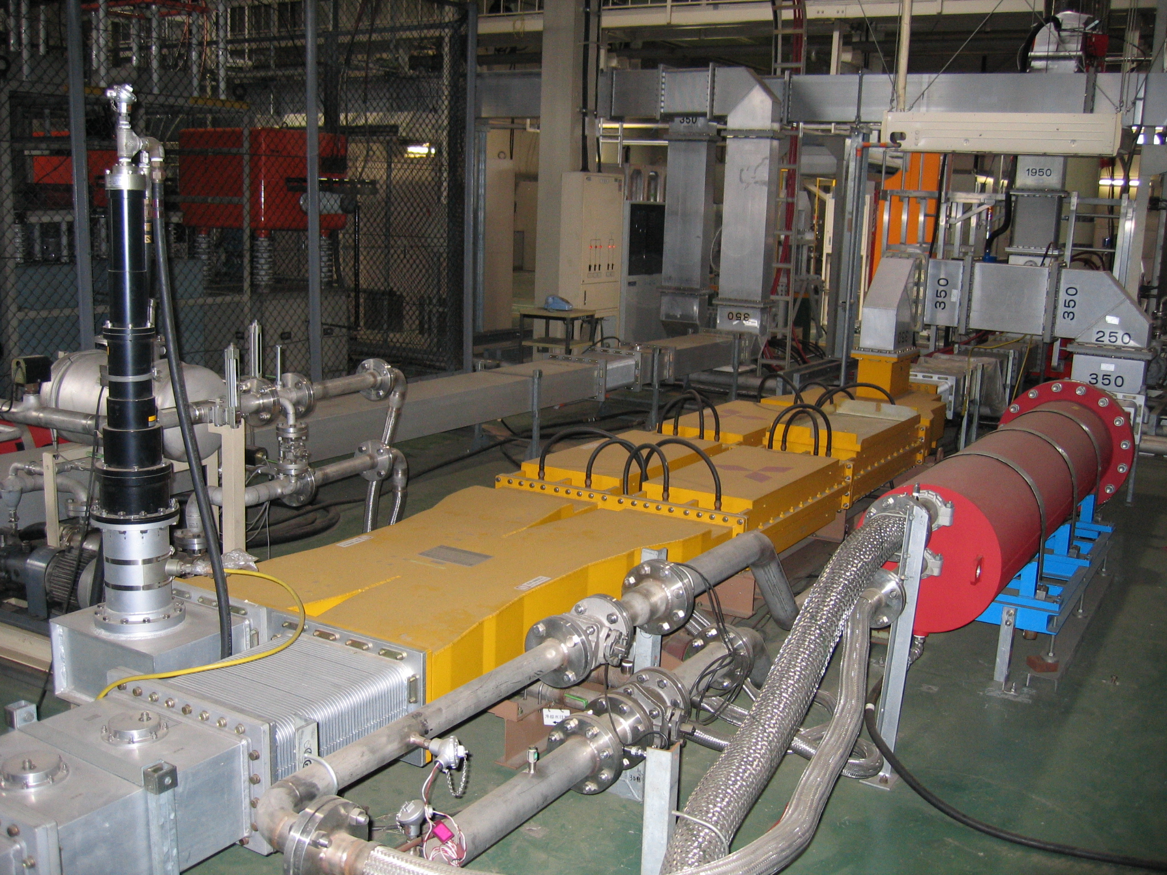
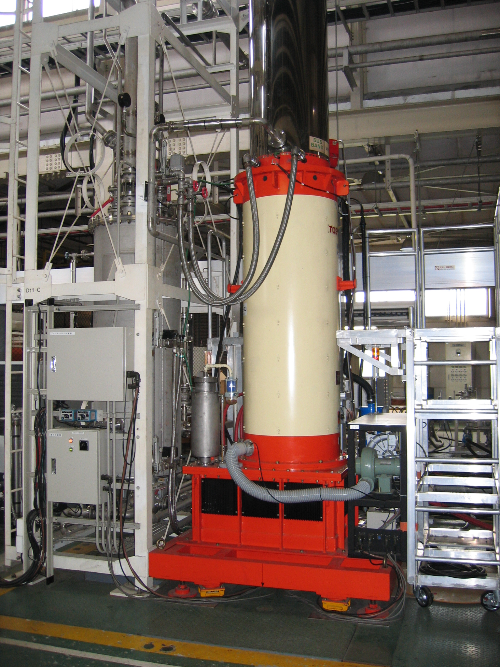
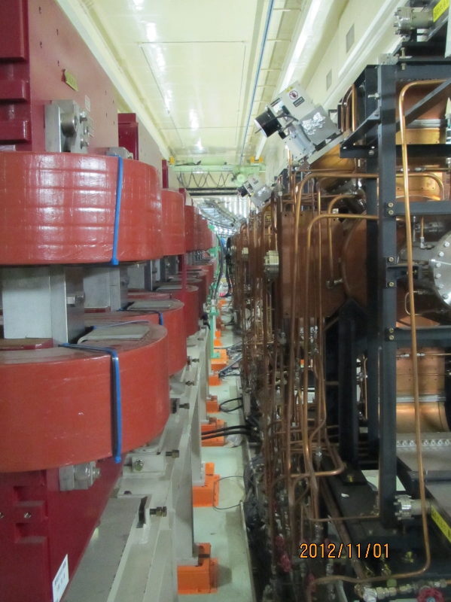
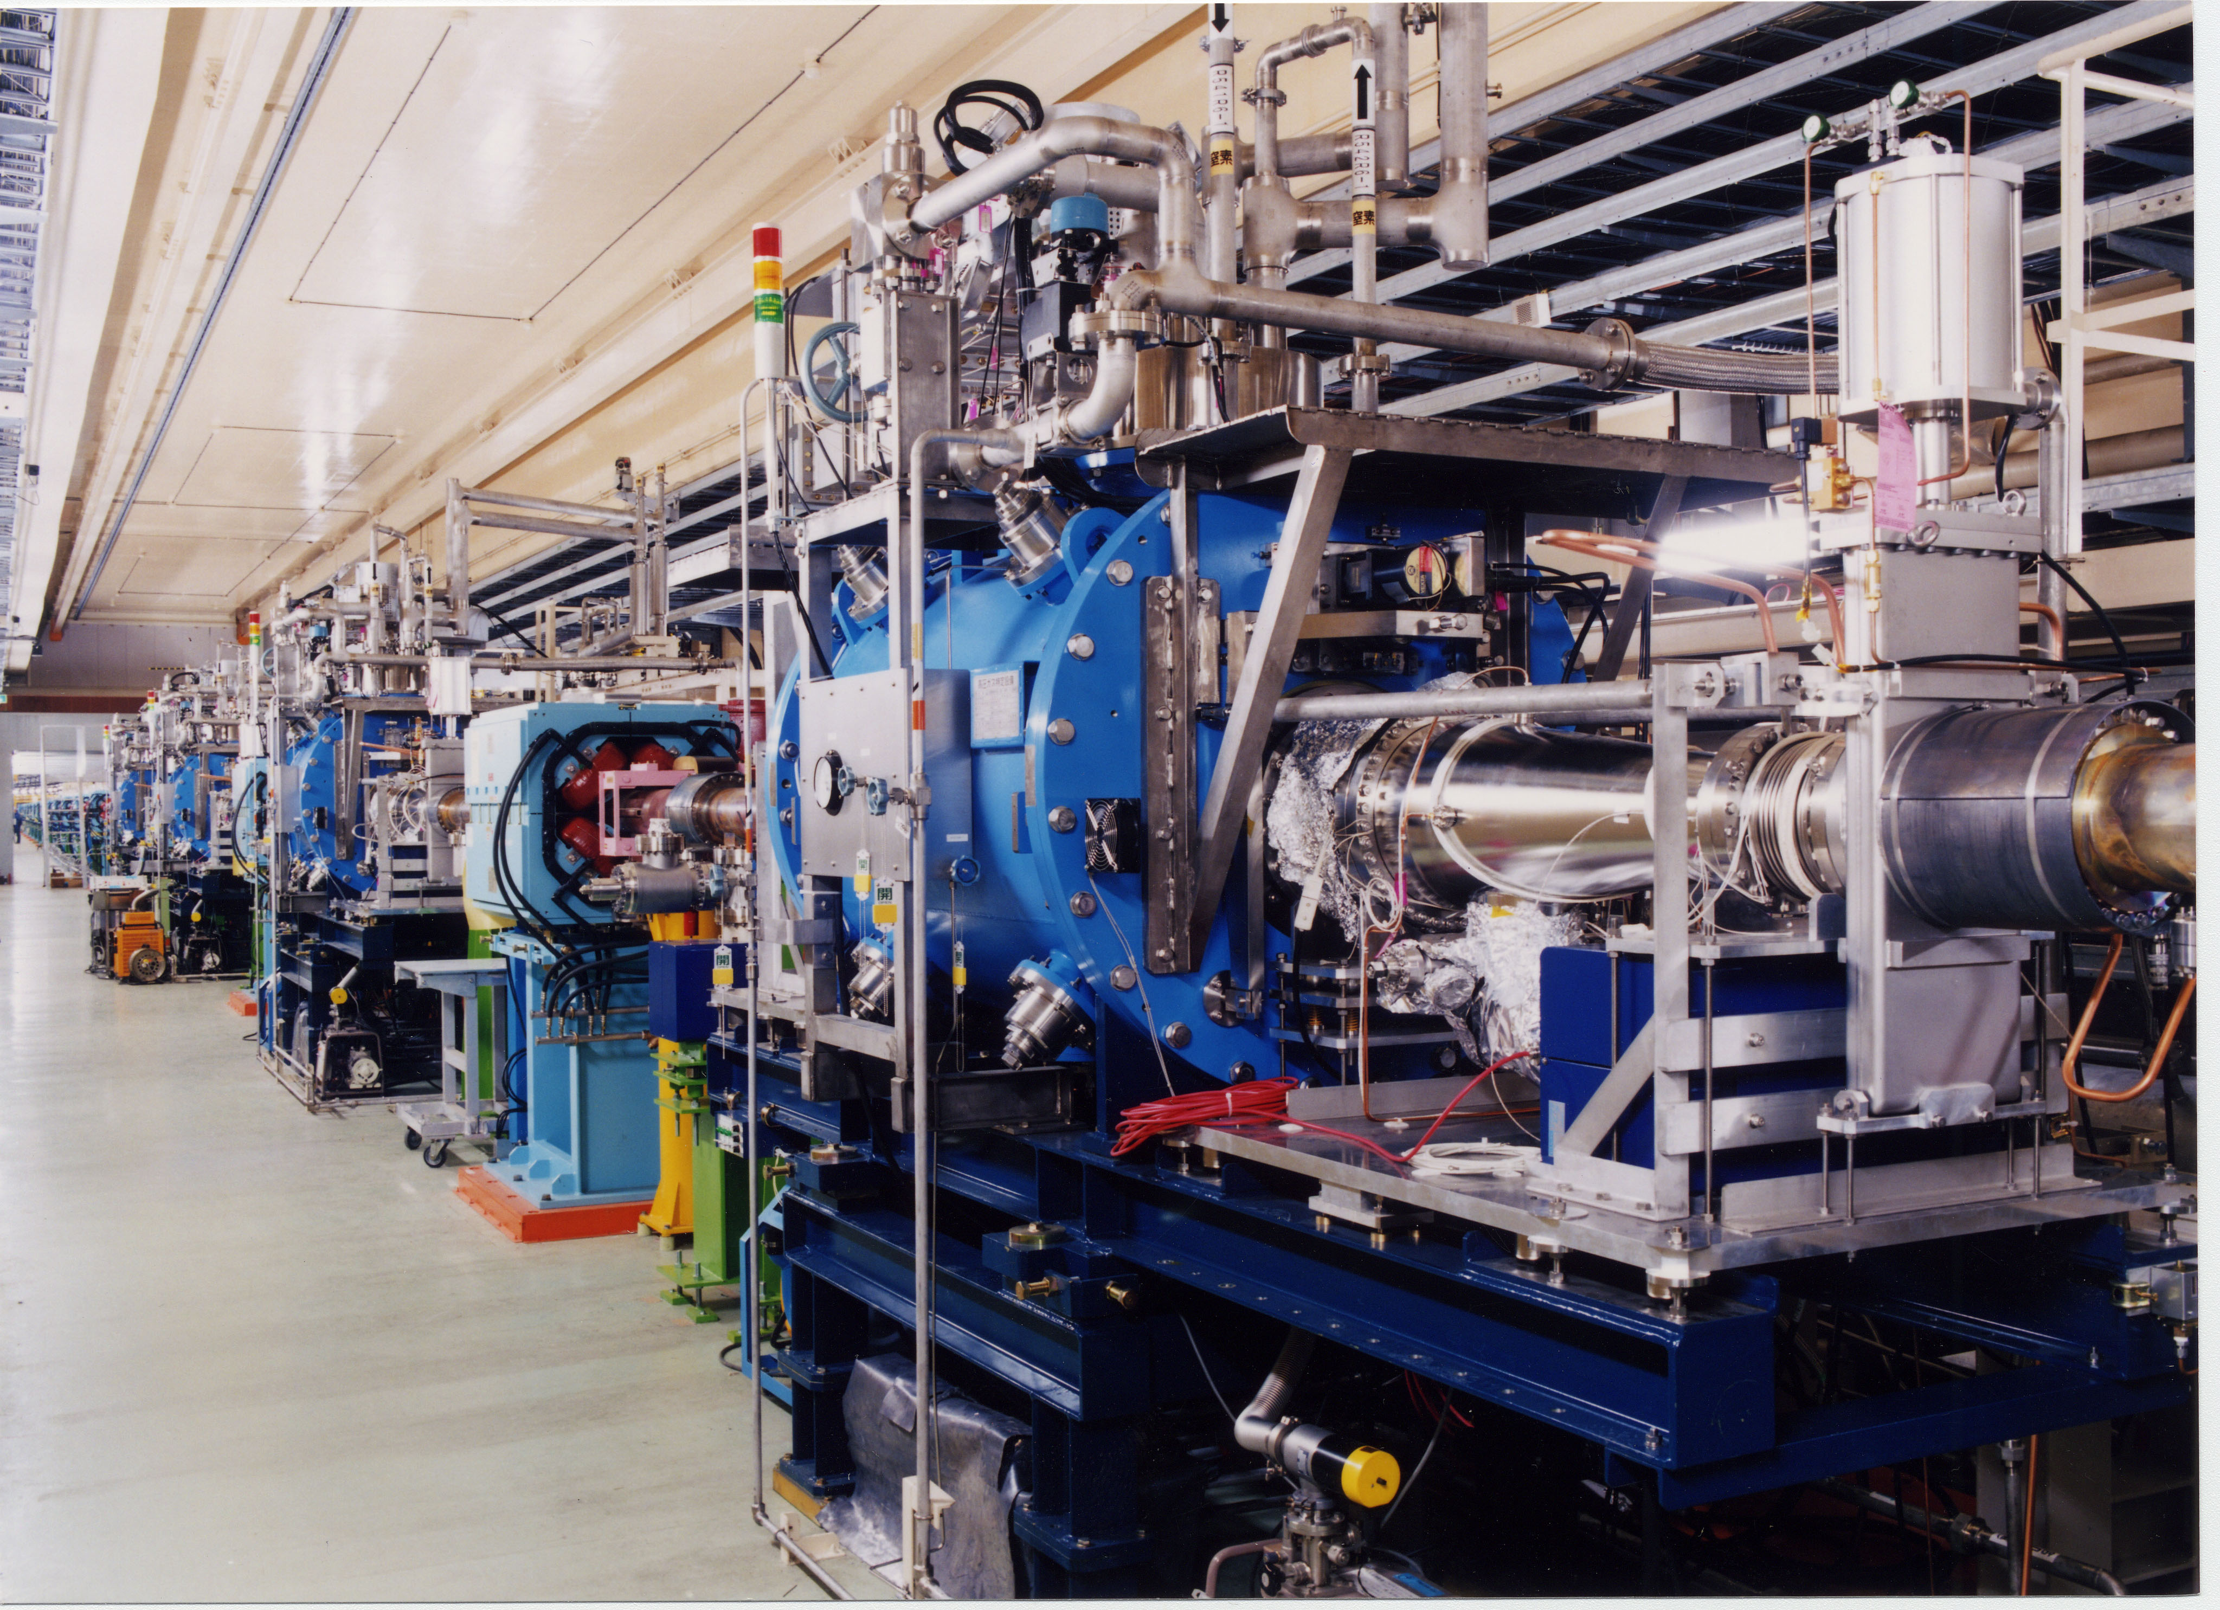
RF high power system
1.2MW CW kystron
Superconducting cavities
Six ARES cavities in D5 moved from HER to LER. HER wiggler magnets were installed close to the ARES.

Slide 20
KEKB-RF
D4
OHO
D5
D7
FUJI
D8
D10
NIKKO
D11
1
2
2
2
1
2
2
2
2
1
2
2
2
2
1
C
B
A
A
B
C
E
E
D
C
B
A
A
B
C
D
E
D
C
B
A
A
B
C
D
E
F
HER
LER
SuperKEKB-RF
(phase 1)
add 5 klystrons, HP&LL
add 3 power supplies
D4
OHO
D5
D7
FUJI
D8
D10
NIKKO
D11
done
done
2
2
2
2
2
2
1
2
2
2
2
1
2
2
2
2
H
G
F
E
C
A
A
B
C
D
E
F
E
D
C
B
A
A
B
C
D
E
D
C
B
A
A
B
C
D
ongoing
ongoing
add 2 ARES
done
done
convert to LER
remove 4 ARES
done
done
Klystron, HP&LLRF system
2
Type “A” power supply (for two klystrons)
ARES cavity
SC cavity
SC crab
1
Type “B” power supply (for one klystron)

Slide 21
KEKB-RF
D4
OHO
D5
D7
FUJI
D8
D10
NIKKO
D11
1
2
2
2
1
2
2
2
2
1
2
2
2
2
1
C
B
A
A
B
C
E
E
D
C
B
A
A
B
C
D
E
D
C
B
A
A
B
C
D
E
F
HER
LER
SuperKEKB-RF
(ultimate)
add 5 klystrons, HP&LL
add 3 power supplies
add 2 more klystrons, HP&LL,
add 1 more power supply
add 2 klystrons, HP&LL
add 2 power supplies
D4
D5
D7
D8
D10
D11
2
2
2
2
2
2
2
2
2
2
2
2
2
2
2
2
2
2
H
G
F
E
D
C
B
A
A
B
C
D
E
F
F
E
D
C
B
A
A
B
C
D
E
F
D
C
B
A
A
B
C
D
E
F
add 2 ARES
add 2 SC (option)
convert to LER
remove 4 ARES
Klystron, HP&LLRF system
2
Type “A” power supply (for two klystrons)
ARES cavity
SC cavity
Crab cavity
1
Type “B” power supply (for one klystron)

Slide 22
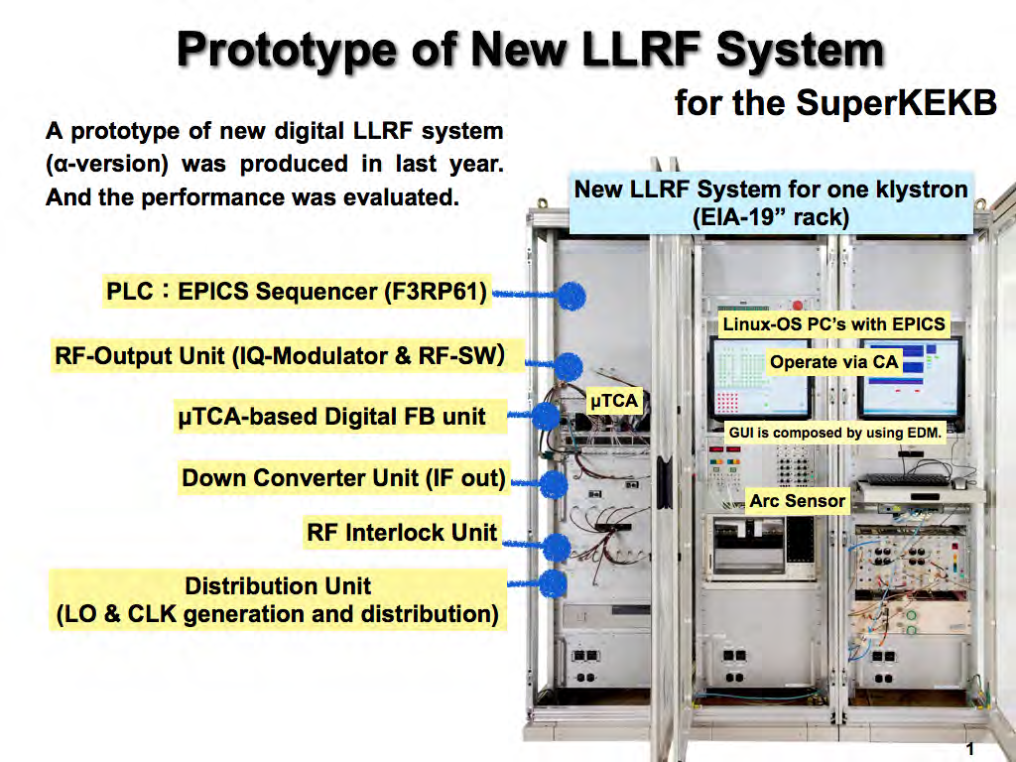
Demonstration test in high-power operation at D8-D station successfully done in November last year.

Slide 23
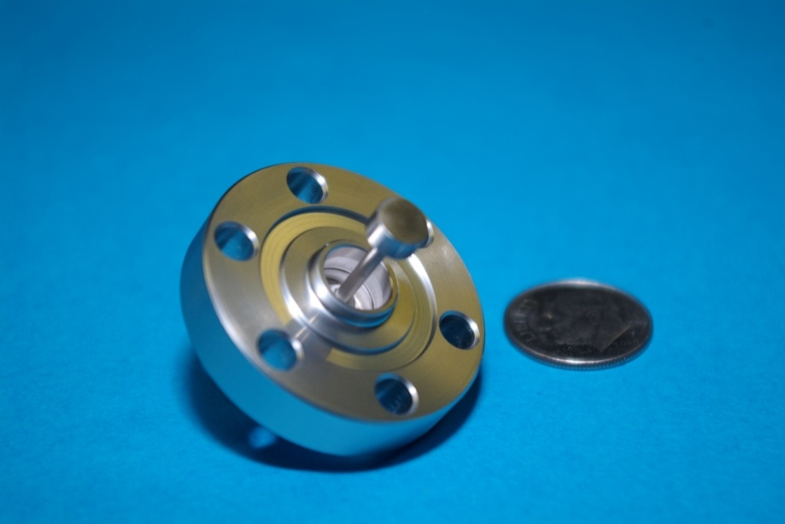
Beam instrumentations
BPM
Mass production of new narrow band detectors at 509MHz will go in JFY2013.
Turn-by-turn detectors of the minimum required number for T=0 (35 per ring) will be fabricated in JFY2013.
Fabrication of button electrodes and cables is ongoing.
Installation of the electrodes on vacuum chambers has started.
Feedbacks
Two sets of short strip line kickers which cover two transverse feedback loops with 90 degrees phase difference will be installed in each ring.
iGp digital filters have been already purchased.
Longitudinal feedback system will be installed in LER to suppress the instability caused by ARES cavities. Four DAFNE type kickers will be used.
IP orbit feedback system is being developed.
Beam size monitors
(Visible light monitor) Development of a diamond extraction mirror is in progress to reduce the heat deformation of the mirror due to synchrotron radiation power.
(X-ray monitor) A coded aperture imaging method for the measurement of the transverse beam size has been successfully tested at CesrTA at Cornell university.
(Large Angle Beamstrahlung Monitor) LABM is being built mostly at Wayne State University (G. Bonvicini et al.).
Button electrode

Slide 24
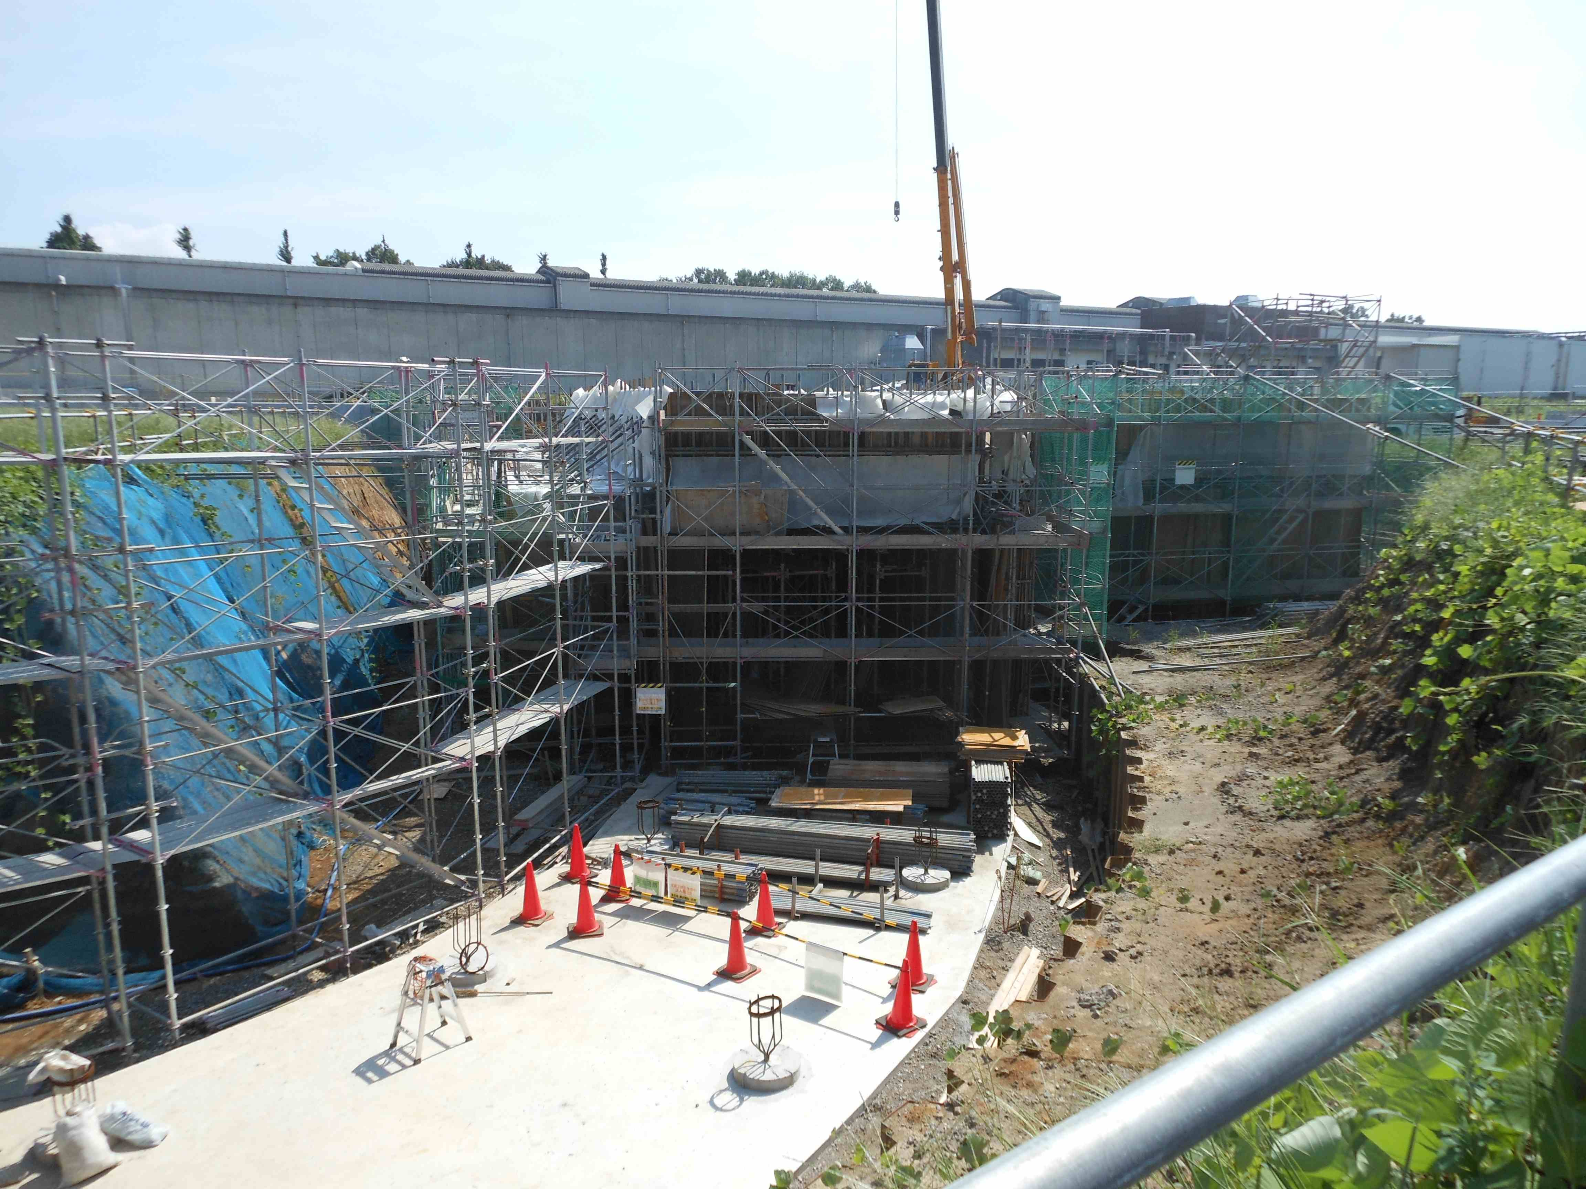
Positron Damping Ring
Injector Linac
Tunnel construction
e+ Damping Ring
circumference 136m
Tunnel construction under way in 2012-13; half year delay due to budget suspend caused by the earthquake.
Buildings will be constructed in JFY2012-13 after tunnel completed.
Fabrication of accelerator components ongoing. Installation starts in 2014.
DR commissioning will start in 2015.

Slide 25
Accelerator components for DR
Magnets
Fabrication of most of magnets and power supplies have completed.
Field measurement is ongoing.
Sextupole magnets, H-steering magnets, some of power supplies will be fabricated in JFY2013.
Vacuum system
Fabrication of ante-chamber beam pipes for arc sections is ongoing this year.
Beam pipes for straight section and transport line will be fabricated next year.
RF cavity
A prototype cavity has been high-power tested successfully.
Two cavities will be ready by the commissioning.
Monitors
Fabrication of BPM, feedbacks, loss monitors, etc. is ongoing.
Injection system
Control and timing system

Slide 26
Facility and infrastructure
Calendar
2010
2011
2012
2013
2014
2015
2016
・・・
Japan FY
2010
2011
2012
2013
2014
2015
2016
now here
Facility and infrastructure for MR and DR
Design of MR buildings
MR buildings construction
Design of cooling system
upgrade cooling facility
construct a new bank at Oho transformer
Design of DR tunnel, buildings, cooling system
DR tunnel construction
DR buildings construction
electricity and cooling system
Construction of DR tunnel, new buildings, upgrading cooling system and electricity, etc., are ongoing by the facilities department of KEK with close communication with the accelerator group.
Overview of Ring construction status and schedule (K. Akai)
26
26

Slide 27
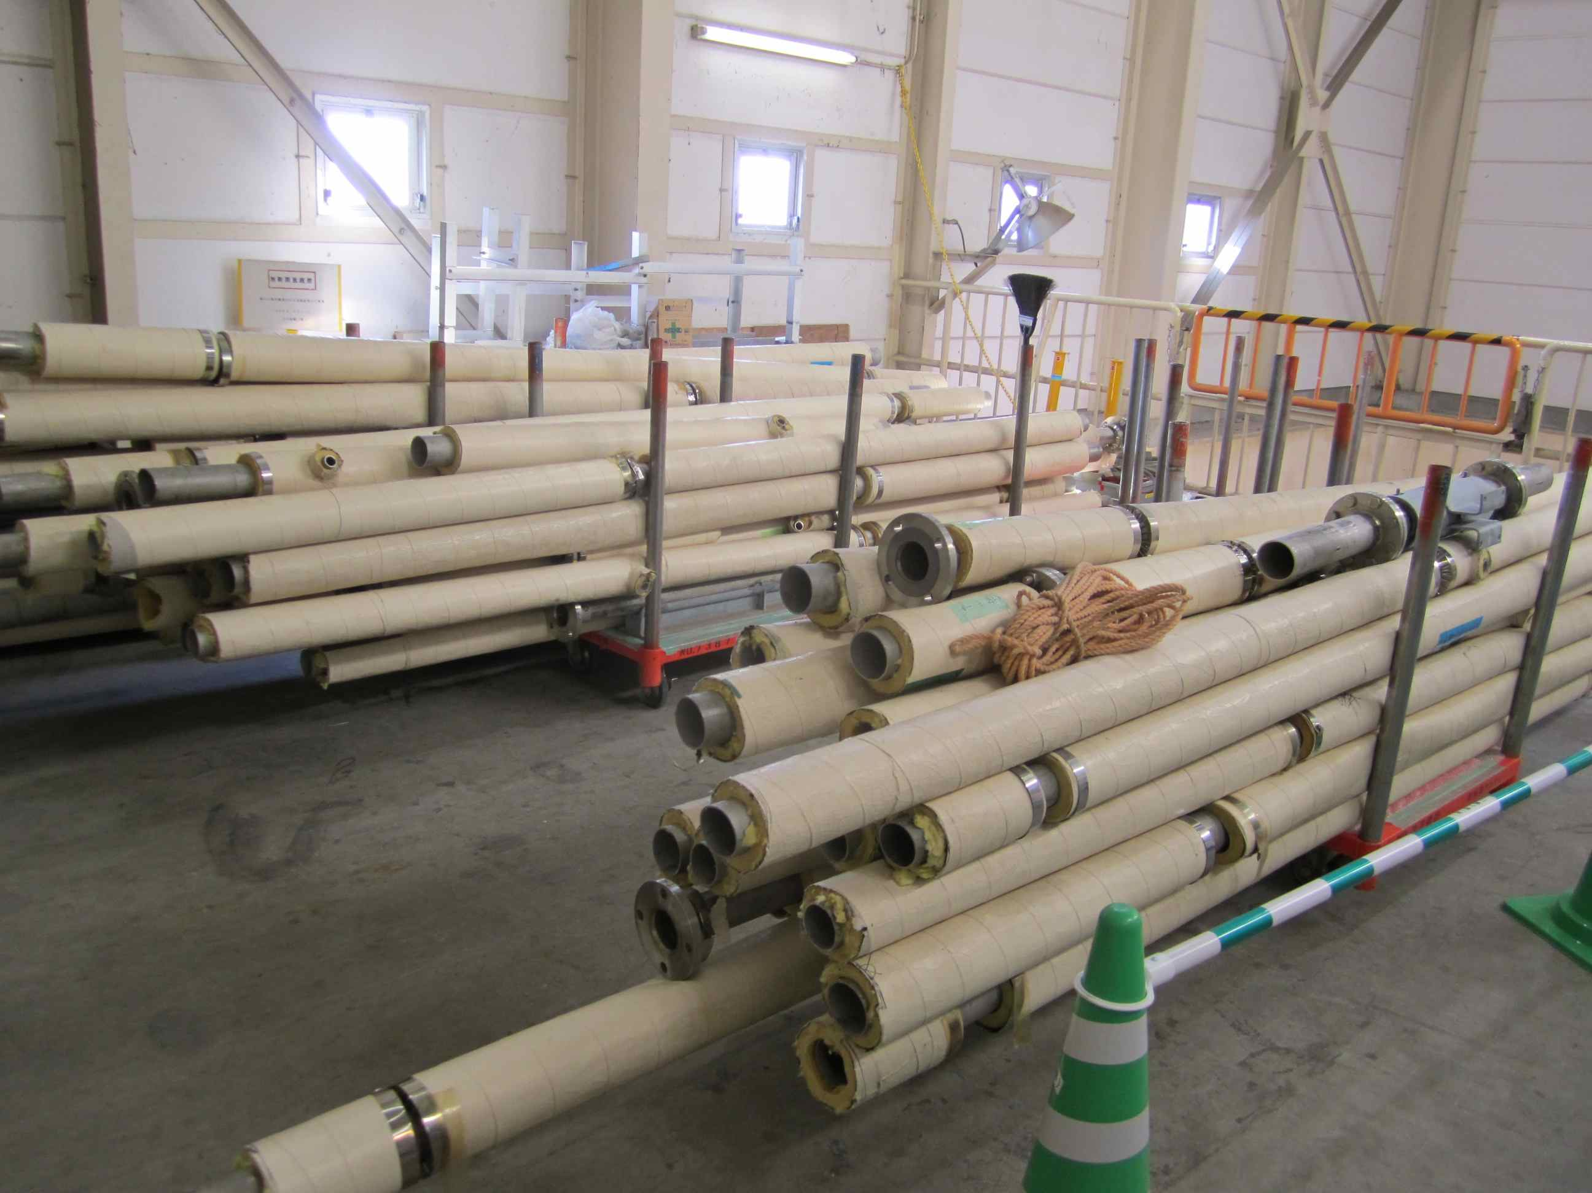
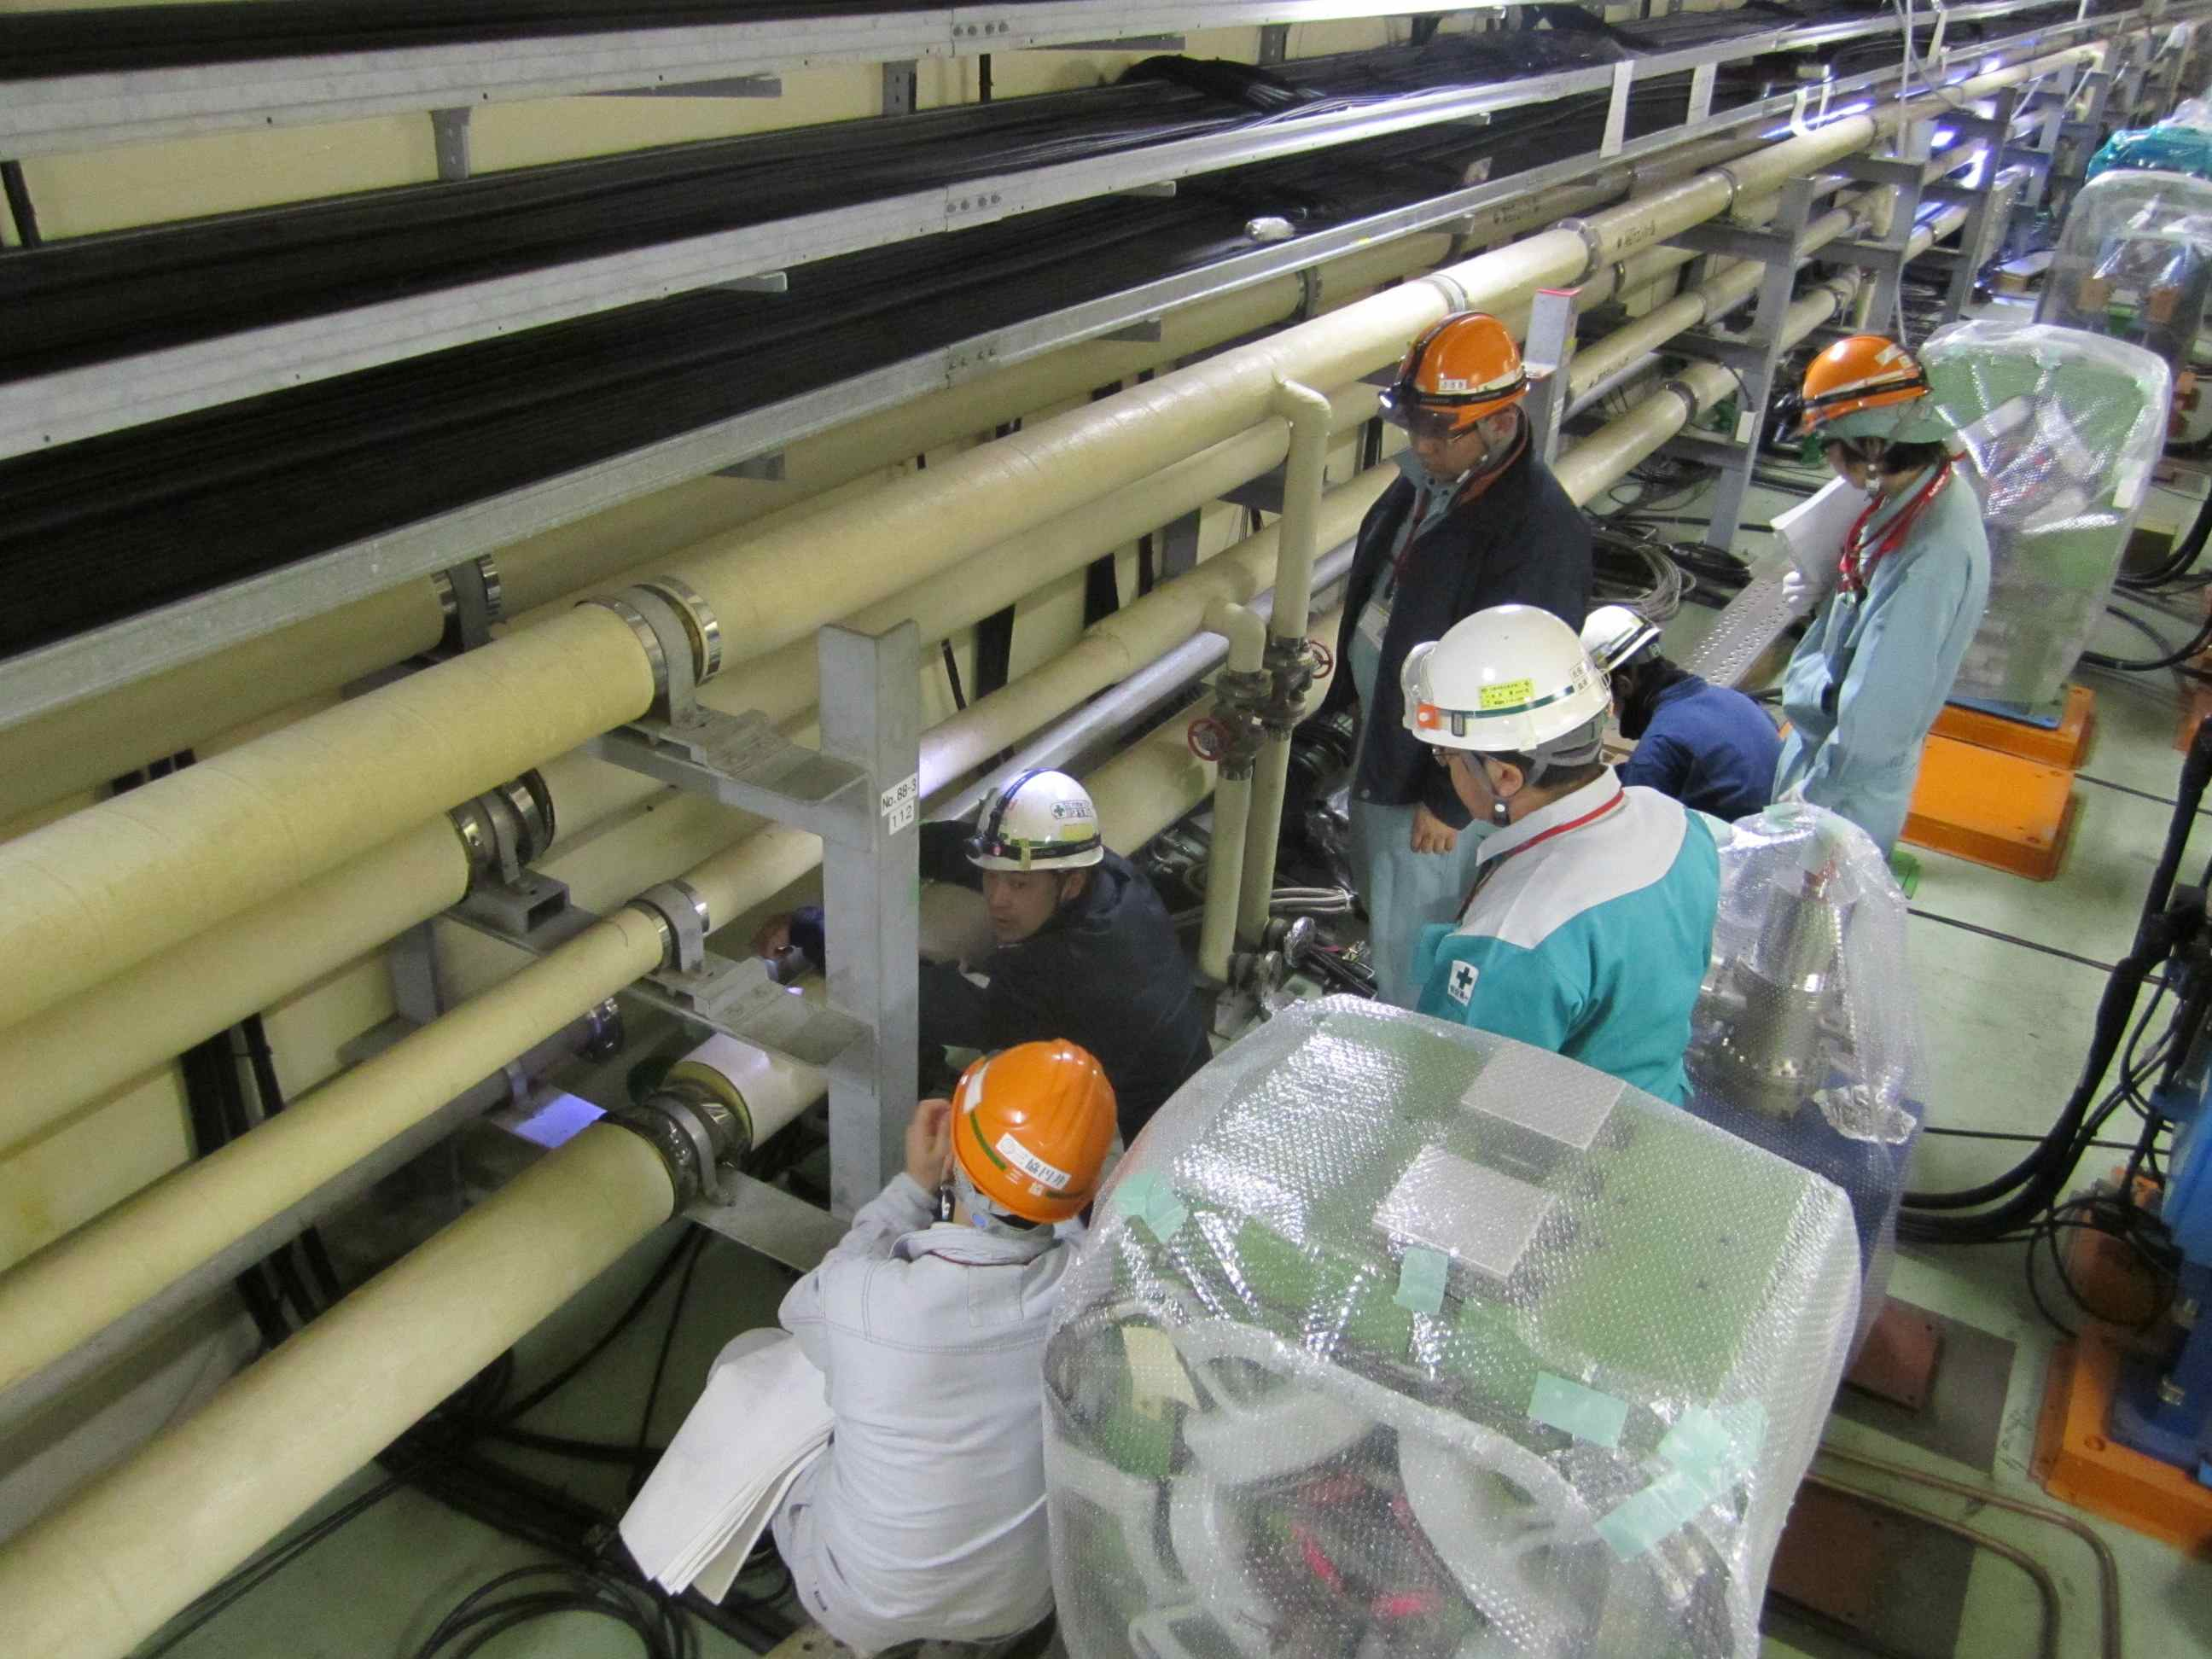
Upgrade MR cooling system
Cooling system needs to be reinforced due to:
the increase of beam power on vacuum chambers, in particular on wiggler chambers at Oho and Nikko straight sections.
the increase of wiggler magnets and other magnets in both rings.
System |  | unit | KEKB | SuperKEKB | comment
Vacuum | Flow rate | l/min | 6400 | 12800
 | Power | MW | 4.5 | 17.8 | ΔT = 10→20℃
Magnet | Flow rate | l/min | 15200 | 23270
 | Power | MW | 10.6 | 16.2 | ΔT = 10℃
Cooling pipes removed from tunnel
Upgrade
Construction of four new buildings for cooling system starts this FY.
Replacing cooling pipes and renewing valves around the ring are ongoing.
Replacing cooling pipes in the arc section

Slide 28
Reinforce electricity facility
Due to the increase of RF stations and wiggler magnets in the Oho section, an electricity bank of 15 MW needs to be added at the Oho transformer.
The new bank at Oho will be constructed in JFY2013 and 2014. At T=0 only the existing facility is used, and the new bank will be connected in summer 2015.
Data provided by M. Ono.
Transformer | power | KEKB | SuperKEKB | comment
Tsukuba | MW | 5.1 | 9.0 | the existing facility can provide
Oho | MW | 10.4 | 25.3 | a 15 MW bank needs to be added
Fuji * | MW | 15.4 | 22.9 | the existing facility can provide
Nikko | MW | 14.3 | 16.3 | the existing facility can provide
* AR is not included.

Slide 29
Overall budget (original)
Budget
Total construction budget is 314 Oku-Yen for Rings, Injector, and Belle-II.
Most of the budget comes year-by-year based.
Operation budget is expected in FY2014 and later.
JFY2010
JFY2011
JFY2012
JFY2013
JFY2014
JFY2015
JFY2016
Very Advanced Research SP (100 Oku-Yen)
SuperKEKB commissioning
Other budgets for construction (214 Oku-Yen)
We are here
Operation budget (continues - - - )
Unit: Oku-Yen (~1.1M$)
JFY2010 | JFY2011 | JFY2012 | JFY2013 | JFY2014 | Total
75.0 | 10.5 | 14.5 | 0 | 0 | 100.0
0 | 41.6 | 40.2 | 61.6 | 46.7 | 190.0
0 | 4.5 | 12.4 | 7.2 | 0 | 24.1
75.0 | 56.6 | 67.1 | 68.8 | 46.7 | 314.1
Supplied | Supplied | Supplied
VARSP
Others
Buildings
Total
Status

Slide 30
Budget situation in JFY2013-14
Construction budget
unit: Oku-yen (~1.1M$)
37.6
30.5
JFY2013
JFY2014
Shisetsu-seibi-hi
(facilities expense)
24.5
Budget for buildings is not included.
appropriated
to be appropriated
B project expense
7.6
for rings, Linac and Belle-II
appropriated as JFY2012 supplementary budget.
KEK burden, etc.
6.6
1.5
not appropriated
probably missing
(KEK budget is being reduced year by year.)
Operation budget
not fixed

Slide 31
Cost up since last ARC
As the optics and hardware design is improved, higher performances are required for some of the accelerator components, which increases fabrication cost.
radiation shield in the QCS cryostats
Permendur yokes of QC1E and QC2P and shields on the other beam line
improving corrector coils in the QCS
power supplies for magnets
Estimation of fabrication cost of some other components also increased.
Some of the reasons are due to cost up for materials and/or changes in the exchange rate. Some others may be related to the effects of the Earthquake.

Slide 32
Plans for MR
MR commissioning as planned.
We understand that we should start first beam operation of MR (hopefully LER and HER both, at least one of them) during JFY2014 (by March 2015). This is important since JFY2014 is the last year when the official construction budget is supplied.
The commissioning scenario that was agreed with Belle II group should be respected.
We plan to start MR beam commissioning in January 2015, so every components and works necessary for this has the highest priority.

Slide 33
Plans for DR
Original plan
The DR commissioning start in Feb. 2015, about one month later than the MR commissioning start.
Issues with the original plan
Many components need to be fabricated in JFY2013, but as mentioned, we should manage reduced budget situation and cost up of MR components.
Tunnel construction delayed by half year due to the Earthquake. Buildings construction will delay accordingly. Then schedule of installation, alignment, cabling and piping, system check and conditioning became much tighter.
New plan under discussion
The DR commissioning start in May or June 2015. It is about three months delay from the original plan, but still during phase 1 commissioning period.
DR will be operated for about one month in phase 1, which keeps benefit to operate the DR prior to phase 2 when QCS and Belle II is installed.
Merits with the new plan
Production of some components can be put off to JFY2014. This relaxes the budget situation.
Schedule of installation and other works also relaxes.

Slide 35
Summary
Construction is well ongoing.
Budget is tight. Schedule is also very tight. But we keep commissioning start in JFY2014 (target is Jan. 2015).
Design is improved.
In particular, the IR region optics and hardware design.
Beam loss estimation ongoing (not mentioned in this talk).
Commissioning will go in three phases.
Main Ring commissioning will start w/o QCS in Phase 1.
QCS and Belle II (w/o VXD) will be commissioned in Phase 2.
Physics run with full Belle II (with VXD) will start in Phase 3.
This scenario was agreed between the accelerator group and Belle II.
New plan for DR
It manages the budget reduction and cost up of MR components.
It also relaxes the very tight schedule for the DR construction.
This plan is under discussion.

Slide 36
Back up slides

Slide 37
Comparison of two scenarios during commissioning phase 2
 | Scenario A (w/ solenoid) | Scenario B (w/o solenoid)
Optics correction(1) Squeezing IP beta functions | We can do full tuning. | We can do something. But we will have to do tuning w/ Belle II solenoid almost from scratch.
Optics correction(2) Achieving a small x-y coupling | We can do full tuning. | We can do something. But we will have to do tuning w/ Belle II solenoid again anyway.
Collision tuning | We can do full tuning. | The beam collision may not be possible w/o Belle II solenoid.
Belle II background Study and tuning | The real beam background can be studied. Also some test detectors can be installed at the place of VXD. | Some studies can be possible.
Risk to Belle II | Maybe we can avoid the risks by adiabatic tuning (start from small beam currents, with detuned optics). | Less risk

Slide 38
Comparison of two scenarios (cont’d) during commissioning phase 2 (cont.)
 | Scenario A (w/ solenoid) | Scenario B (w/o solenoid)
Works for accelerator setup | Less works. | One more QCS field measurement. (heavier load to QCS group)
Cosmic-ray run w/ VXD | Less time before phase 3. Can also be done in the beginning of phase 3. | More time before phase 3.
Expected time for the first target luminosity (1 x 10³⁴ cm⁻²s⁻¹) | Earlier (maybe during phase 2). | Later (3〜5 months after phase 3 start).

Slide 39
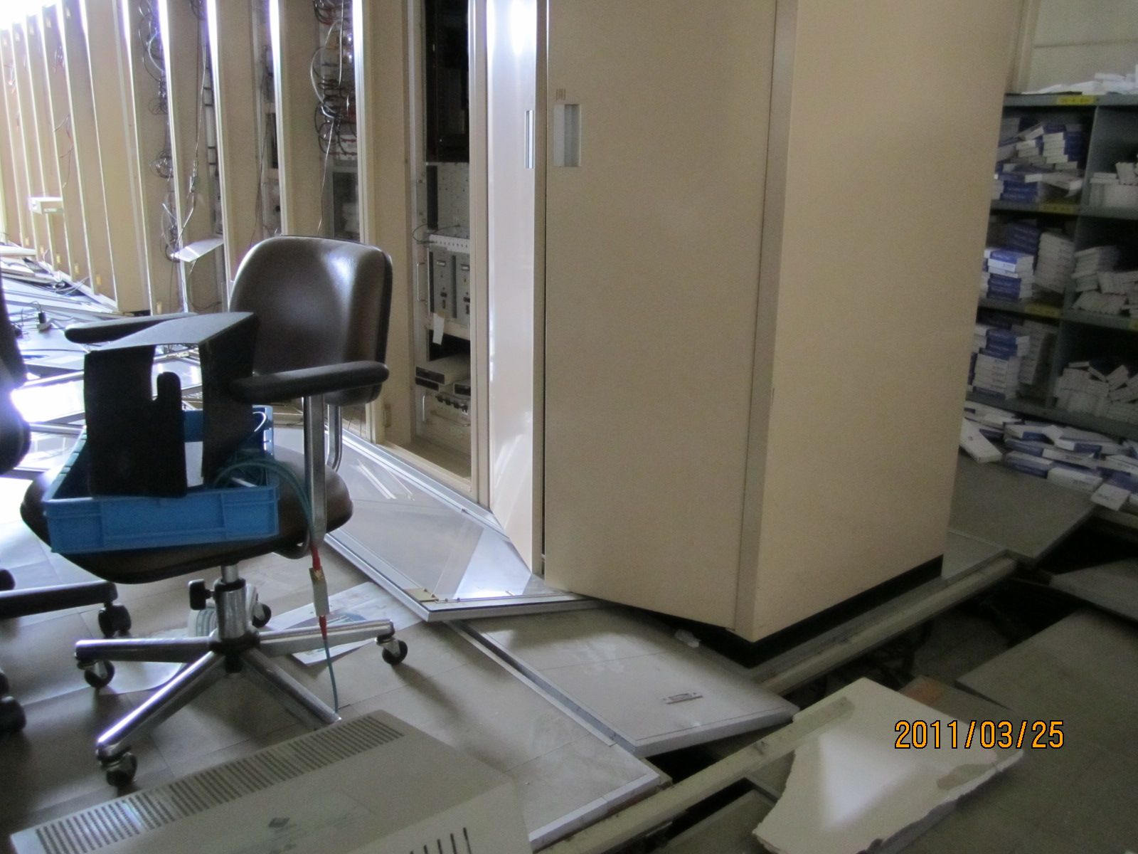
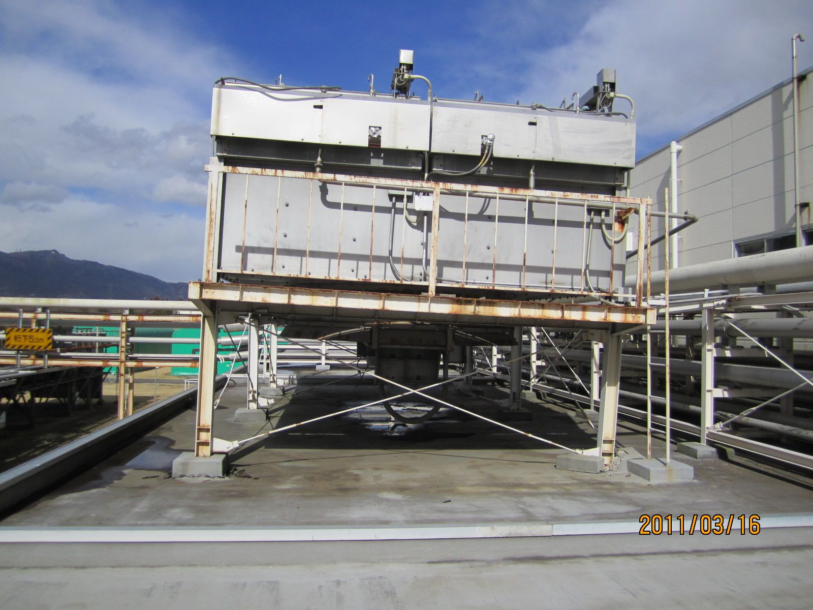
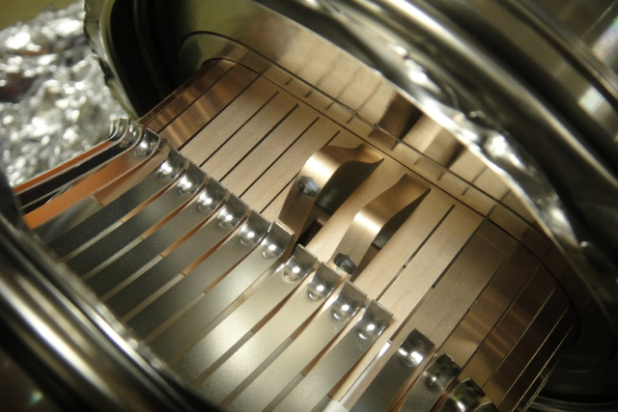
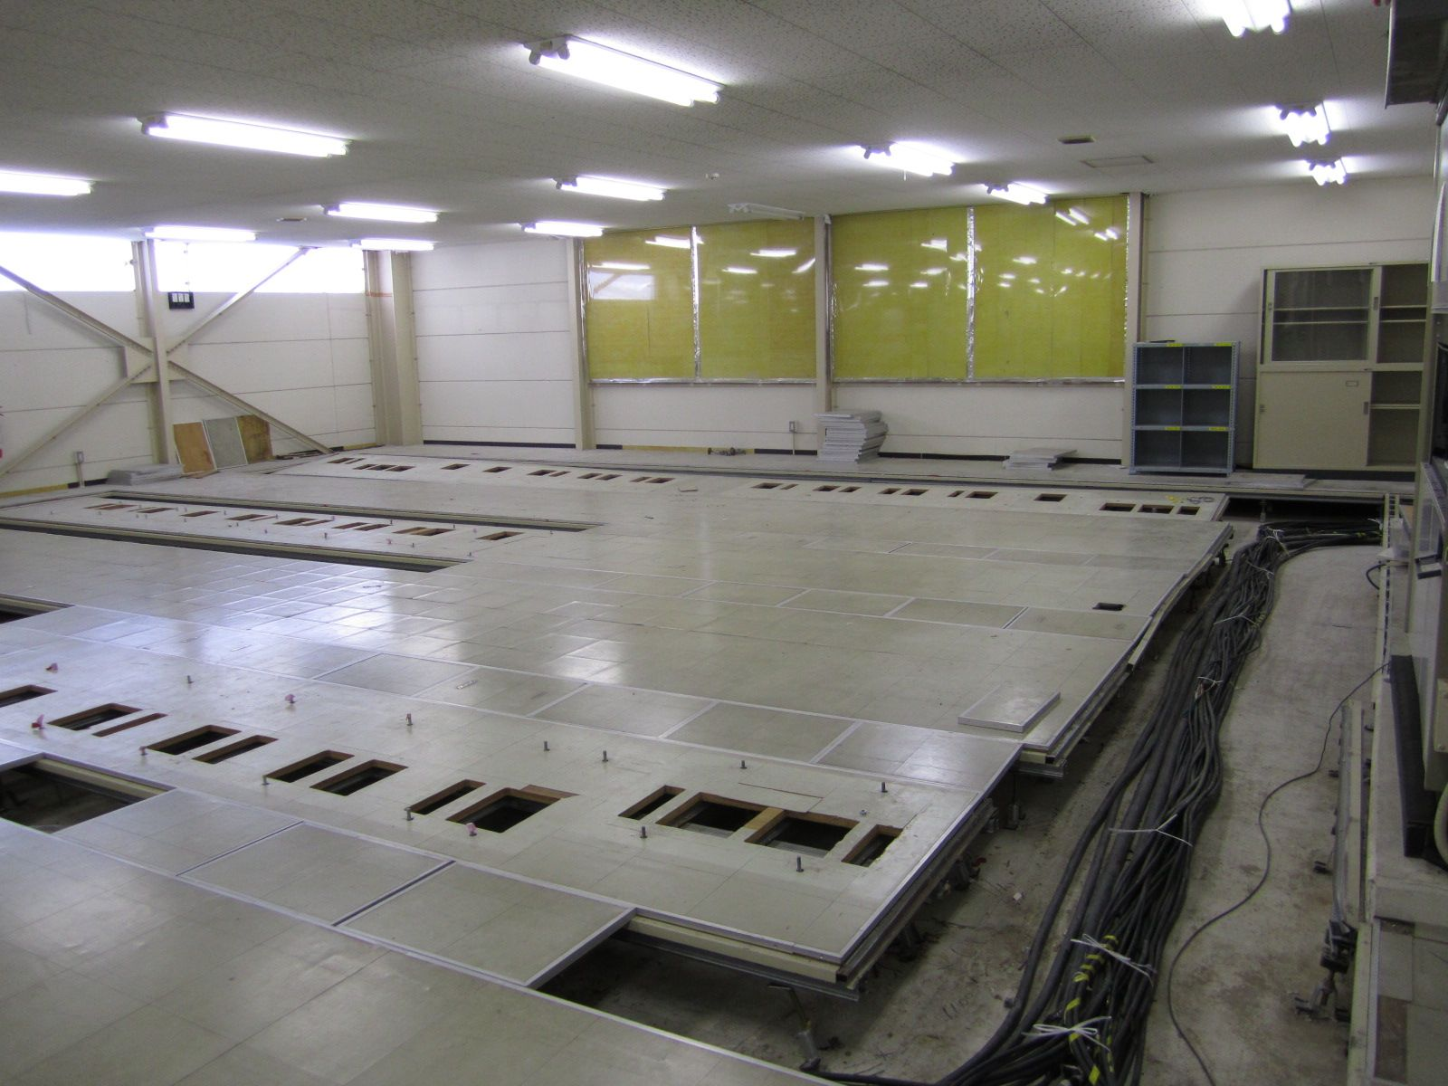
Recovery from the earthquake_1
RF control system
Air-fin cooler for klystrons
Bellows chambers
20cm fell down
Recovery ongoing
Recovery almost done
X-ray check
Control systems and cables were removed, floors renewed.
New control system will be built.

Slide 40
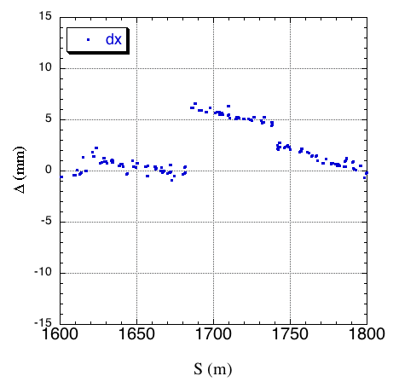
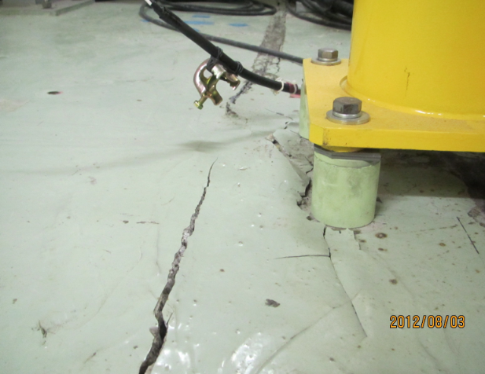
Recovery from the earthquake_2
M. Masuzawa
Rough measurements and adjustments after the big earthquake are in progress.
Measurement in horizontal direction using a laser-tracker.
This year rough adjustments will be performed to smooth out local big movement.
Precise alignment will be performed in 2013 and 2014 at better conditions.

