Slide 1
Beam Loss Simulation at SuperKEKB
Y. Funakoshi
KEKB Review
2013. 03. 05

Slide 2
Beam Loss Simulation
Needs of simulation on loss distribution around the ring
Estimation of detector beam background (Y. Nakayama)
Design of radiation shield
Design of beam loss monitor
Simulation
Touschek: Y. Ohnishi
Beam-gas Coulomb: Y. Funakoshi
Radiative Bhabbha: Y. Funakoshi

Slide 3
Comparison of beam loss
 | KEKB (design) |  | KEKB (achieved) |  | SuperKEKB
 | LER | HER | LER | HER | LER | HER
Radiative Bhabha | 21.3h | 9.0h | 6.6h | 4.5h | 28min. | 20min.
Beam-gas | 45h^{a)} | 45h^{a)} |  |  | 24.5min.^{b)} | 46min. ^{b)}
Touschek | 10h | - |  |  | 10min. | 10min.
Total | 5.9h | 7.4h | ~133min. | ~200min. | 6min. | 6min.
Beam current | 2.6A | 1.1A | 1.6A | 1.1A | 3.6A | 2.6A
Loss Rate | 0.12mA/s | 0.04mA/s | 0.23mA/s | 0.11mA/s | 10mA/s | 7.2mA/s
a) Bremsstrahlung
b) Coulomb scattering, sensitive to mask setting
Beam loss accompanied with the beam injection should be added.

Slide 4
Beam-gas Coulomb simulation

Slide 5
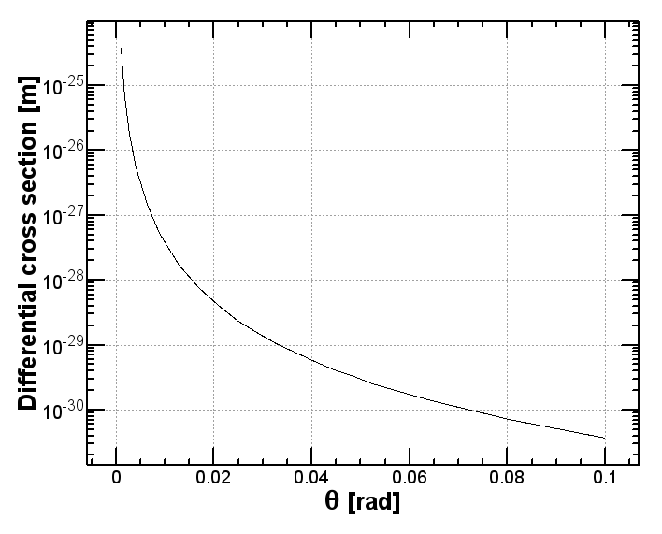
Cross section of Beam-Gas scattering (Coulomb scattering)
Differential cross section
Scattering angle: θ
Azimuthal angle: φ
Total cross section
θ > θ_{c}
+1 comes from Mφller scattering. No energy loss is considered.
Gas: CO
γ = 4GeV/511keV
θ_{c}

Slide 6
Beam Lifetime from Coulomb scattering against residual gas
Parameters (LER)
Gas: CO
Pressure: 1 x 10⁻⁷ Pa
Temperature: 300°K
Acceptance
Vertical: QC1: 13.5mm (β_{ym} ~ 2888m)
Horizontal: 20 σ_{x}
Lifetime
Lifetime calculated = 1961 sec (@QC1_{ap}=13.5mm), 1186 sec (@QC1_{ap}=10.5mm)
Lifetime ~ 1468 sec
vertical mask: 2.0mm (β_{ym} ~ 104.57m)

Slide 7
HER integral of vertical beta function
HER:
average vertical beta function = 52.78m
The area (IP +/- 100m) causes 68% of beam loss from beam-gas Coulomb scattering if the vacuum pressure is constant around the ring.
The area (IP +/- 4m) causes ~7% beam loss. If the vacuum pressure in this region gets worse by a factor 10, the beam loss increases by about 63%.

Slide 8
LER integral of vertical beta function
LER:
average vertical beta function = 47.90m

Slide 9
Tracking
Starting points: each SAD element (minimum distance: 50cm)
# of turns: 3~10 turns (tracking of 30 turns is under way)
Minimum scattering angle（θ_{c}） depends on ring position
Azimuthal angle φ : uniform distribution
# of particles
~0.2 ~ 2 x 10⁶ particles in the ring
Consider beam size distribution
Mask setting
Optimized for Touschek background

Slide 10
Setting values for masks
Y. Ohnishi

Slide 11
Loss distribution HER beam-gas Coulomb
sher_5753
V-mask
H-mask
H-mask
H-mask
｛
｛
Tracking: 3 turns
Total lost particles in simulation:
1.16x10⁶ (45.4 GHz)
Analytic calculation: 59GHz
IR Loss (-4m < s < 4m)
~1.09MHz (28 events)

Slide 12
Loss distribution LER beam-gas Coulomb
sler_1684
V-mask
H-mask
H-mask
｛
Tracking: 10 turns
Total lost particles in simulation:
0.097x10⁶(126.6GHz)
Analytic calculation: 197GHz
IR Loss (-4m < s < 4m)
~141MHz (108 events)

Slide 13
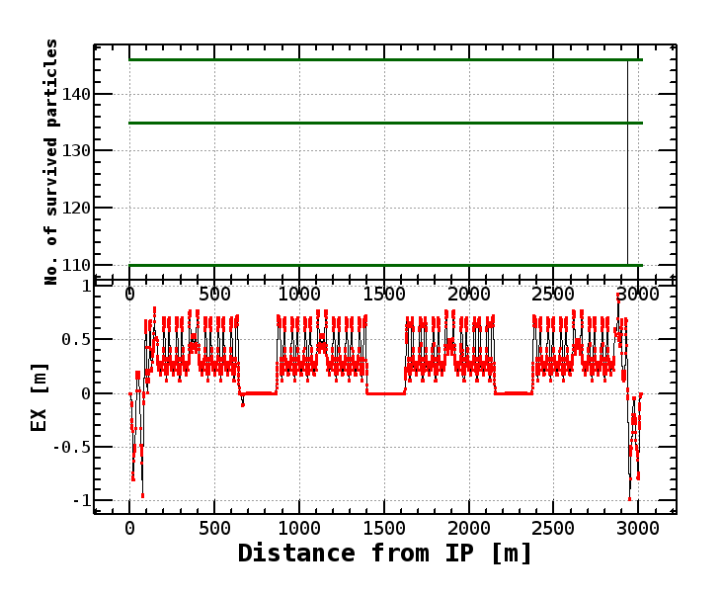
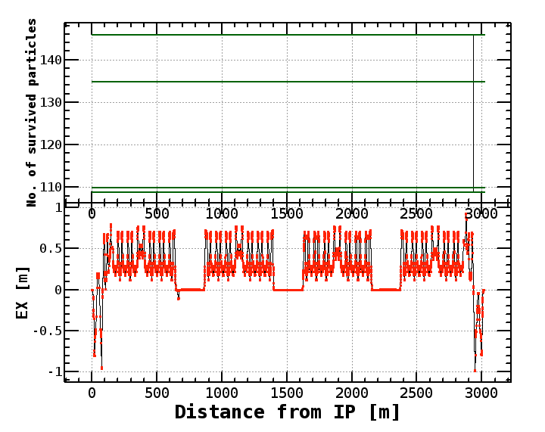
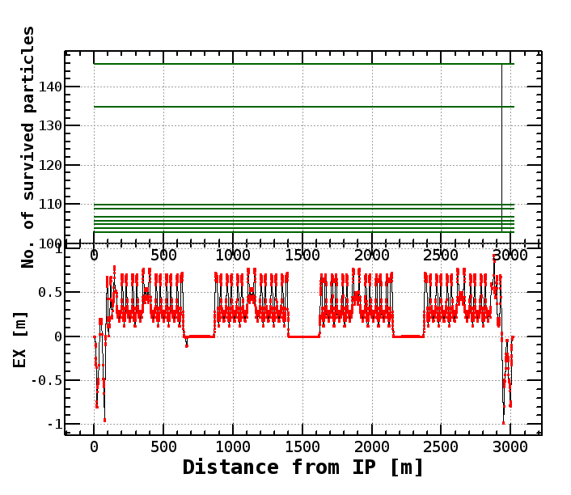
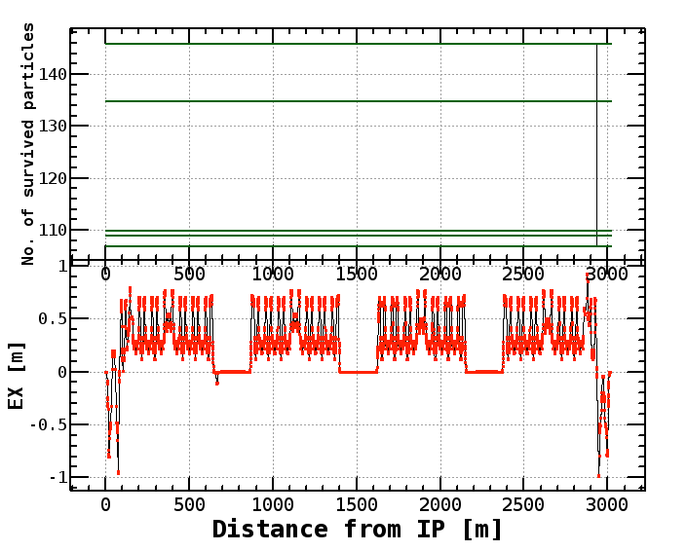
3 turns
10 turns
30 turns
Element name: APT.6002
S [m] = 2934.3069853702323
BX = 16.68318748342323
BY = 142.88788115847524
sigmax = .00023463699345008804
sigmapx = 1.4064278405024721e-05
sigmay = 4.3429483433398944e-05
sigmapy = 3.0394098562656846e-07
sigmaz = .006
sigmae = .000809
Theta_c = 1.8337874570821454e-05
Length which element represent for [m] = 5.098814615590072
Number of particles = 146
15 turns

Slide 14
Radiative Bhabha simulation

Slide 15
Radiative Bhabha (LER)
1 turn tracking
Multi-turn effects are small.
0.5% < ΔE < 100%: using analytic formula

Slide 17
Radiative Bhabha (LER) beam loss rate per m
sler_1684
H-mask
CoordinateBeamLoss2013_3_5_1_18_32.dat
Loss rate = 2.04mA/s -> τ = 29.4min. (3.6A)

Slide 18
Radiative Bhabha (HER)

Slide 20
Radiative Bhabha (HER) beam loss rate per m
sher_5753
H-mask
CoordinateBeamLoss2013_3_5_0_28_36.dat
Loss rate = 2.14mA/s -> τ = 20.2min. (2.6A)

Slide 21
Touschek Beam Loss Y. Ohnishi

Slide 22
sler_1672_5 loss distribution
Y. Ohnishi

Slide 23
sher_5745_1 loss distribution
Y. Ohnishi

Slide 24
Sum of 3 processes

Slide 25
Beam loss rate (LER) sum of 3 processes
V-mask
H-mask

Slide 26
Beam loss rate (HER) sum of 3 processes
V-mask
H-mask

Slide 27
How to use the simulation results
IR loss
Touschek, Radiative Bhabha -> already Nakayama san uses data for Belle II background estimation
Beam-gas Coulomb -> to be sent to Nakayama san
Other loss
I already passed a preliminary results of LER to radiation safety section. They started an estimation. After finishing the beam-gas simulation under way, I will send them the results.

Slide 28
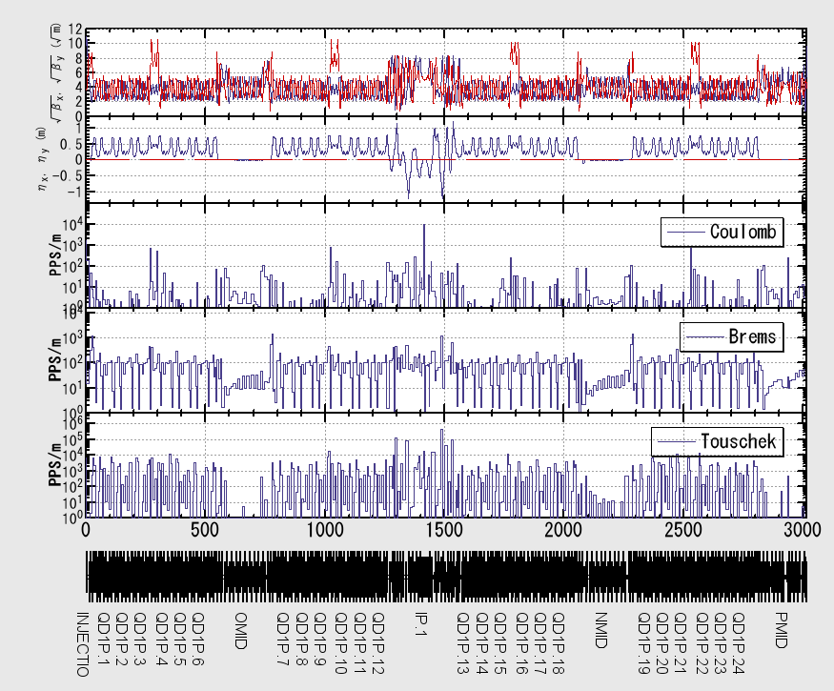
Phase-1 LER
Y. Ohnishi
1 mA/bunch, 1 nTorr k = 10%

Slide 29
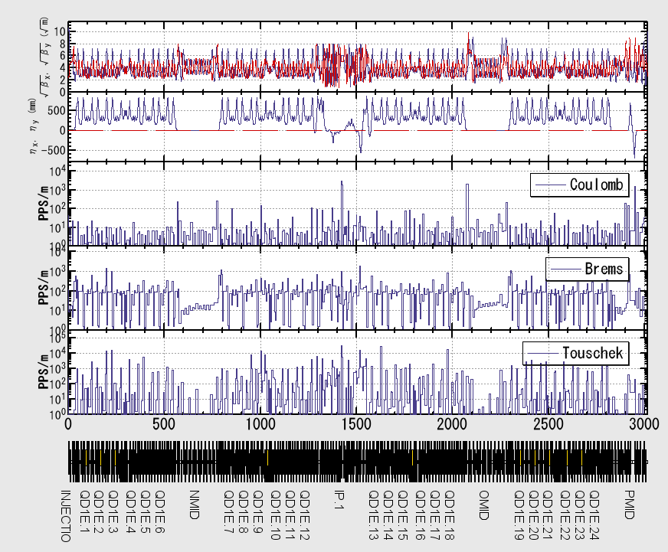
Phase-1 HER
Y. Ohnishi
1 mA/bunch, 1 nTorr k = 10%

Slide 30
Backup

Slide 31
Beam loss power (LER) sum of 2 processes (beam-gas, radiative Bhabah)

Slide 32
Total cross section
Correction for finite beam size is included.
σ(ε>1.5%)= 1.55 x 10⁻²⁵ cm²
σ(ε>5.0%)= 1.05 x 10⁻²⁵ cm²
σ(ε>20%) = 0.51 x 10⁻²⁵ cm²
σ(ε>50%) = 0.20 x 10⁻²⁵ cm²
Assuming particles are lost with energy loss of ε>1.5%,
Beam lifetime = 30.15 min. (L=8x10³⁵ /cm²/s, Ib=3.6A, LER case)
Loss rate 1.99mA/s

Slide 33
Correction for cross section due to finite beam size
Energy acceptance = 1.0%
~60nm (SuperKEKB, κ=0.4%)

Slide 34
Created distribution of Coulomb scattering angles

Slide 35
Loss distribution (power) HER beam-gas Coulomb
V-mask

Slide 36
Radiative Bhabha (HER)
1 turn tracking
Multi-turn effects are small.
0.5% < ΔE < 100%: using analytic formula

Slide 38
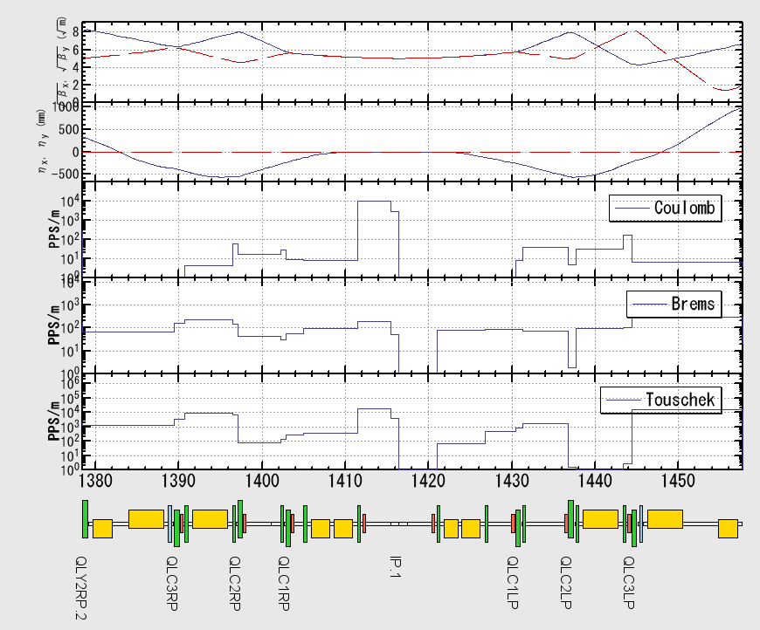
Phase-1 LER
φ40 mm

Slide 39
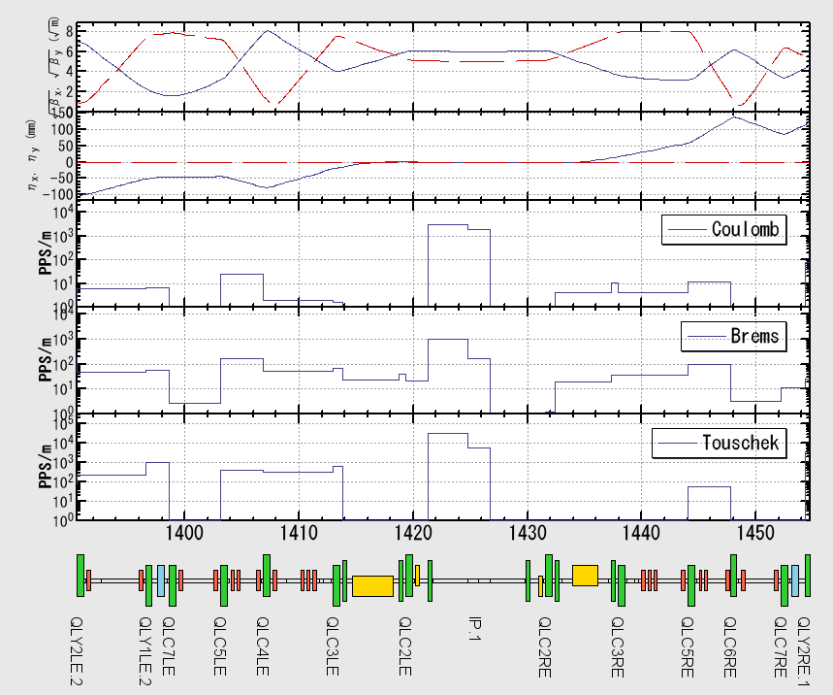
Phase-1 HER
φ40 mm

Slide 40
Summary
Total beam loss / bunch
Phase 1 | Nb | Touschek PPS | Coulomb PPS | Brems. PPS | Total PPS
HER | 6.28x10¹⁰ | 1.41x10⁶ | 6.17x10⁴ | 2.94x10⁵ | 1.76x10⁶
LER | 6.28x10¹⁰ | 8.74x10⁶ | 9.95x10⁴ | 2.72x10⁵ | 9.11x10⁶
condition | 1 mA/bunch | 10 % coupling | Pave= 1 nTorr |  | 1.09x10⁷
w/o movable masks
#bunches = 1000 - 2000
Pave = 1 nTorr - 10 nTorr
sher_5755_beast
sler_1684_beast

Slide 41
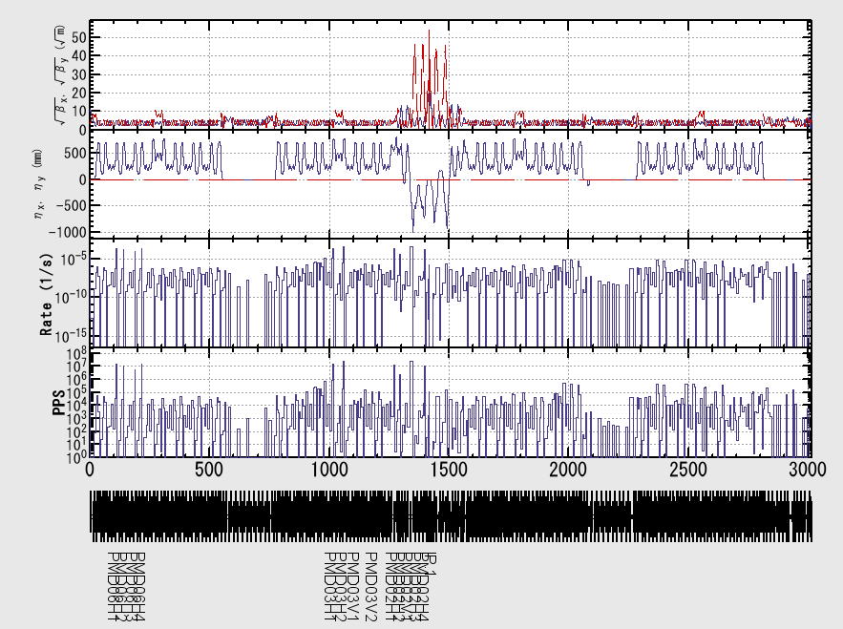
Phase-2 LER
Touschek loss

Slide 42
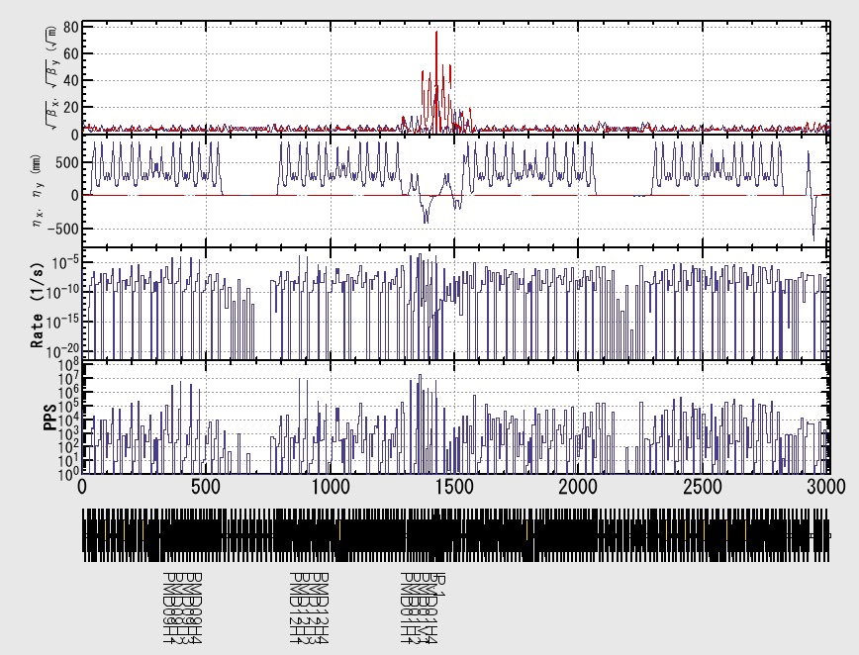
Phase-2 HER
Touschek loss

