Slide 1
Ring Commissioning
Y. Funakoshi
KEKB Review
2013. 03. 05

Slide 2
Commissioning schedule
Start-up time of SuperKEKB
SuperKEKB commissioning is expected to start in January 2015.
QCS schedule
Due to the background issues, the fabrication schedule of QCS’s on the right side of IP will be delayed.
SuperKEKB commissioning will start w/o QCS magnets.
Linac commissioning
Linac beams are expected to be ready by the SuperKEKB ring commissioning.
Damping ring
Commissioning of damping ring will start sometime after commissioning of SuperKEKB rings. (May or June 2015)
RF system reinforcement
Works for reinforcements will continue in FY2015 and FY2016 due to budget constraint.

Slide 3
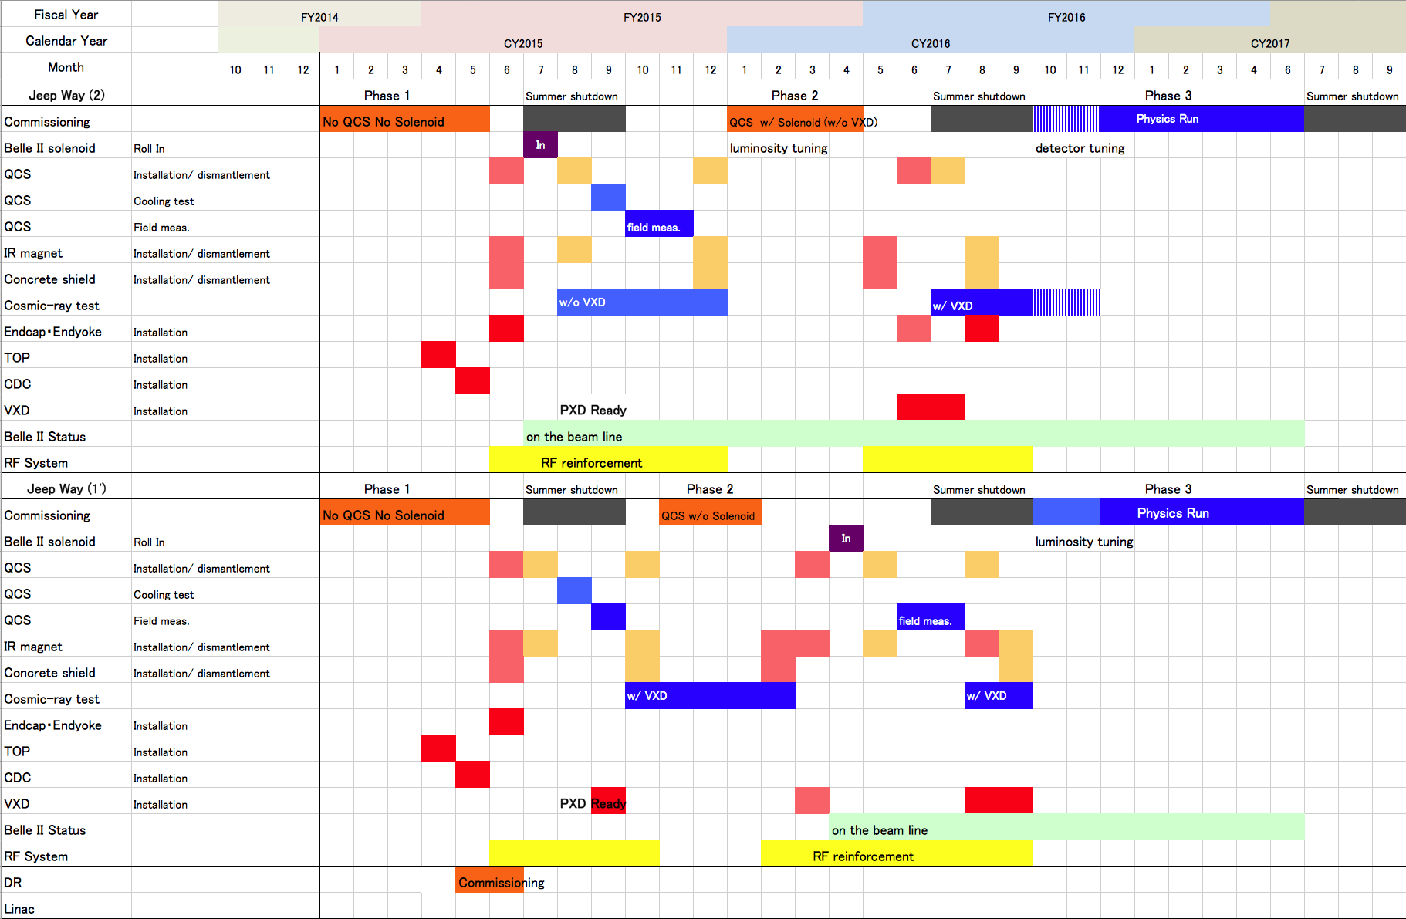
Two possible scenarios
First target luminosity
1 x 10³⁴ cm⁻²s⁻¹
Scenario A
First target luminosity
1 x 10³⁴ cm⁻²s⁻¹
Scenario B

Slide 4
Consensus between SuperKEKB accelerator group and Belle II group
To proceed with Scenario A (phase 2 commissioning with QCS and Belle II solenoid)
To keep Scenario B (phase 2 commissioning with QCS without Belle II solenoid) as a backup option for some unexpected situations.
This proposal by the accelerator group was accepted at the Belle II EB meeting on Sep. 27th.

Slide 5
Procedures of machine commissioning
Commissioning I :Basic commissioning of machine (~ 1.5 month)
Linac tuning
Damping Ring tuning (new at SuperKEKB)
BT tuning
Injection tuning (including beam timing and simultaneous injection)
COD correction, Optics correction (rough correction)
Tuning on beam abort system
Tuning on beam monitor system (including beam feedback)
Tuning and measurement on radiation safety
Tuning on other hardware systems
Test and debugging various kinds of control softwares
Commissioning II : Vacuum scrubbing (>~3 months)
Commissioning III : More sophisticated tuning
Optics measurements and corrections
Squeezing IP beta function (more difficult than KEKB)
Achieving a small x-y coupling (more difficult than KEKB)
Beam collision tuning and luminosity tuning (more difficult than KEKB)
Belle II beam background: study and tuning (more difficult than KEKB)
Increasing beam currents (final target is higher than KEKB)
Study on the other beam dynamics issues

Slide 6
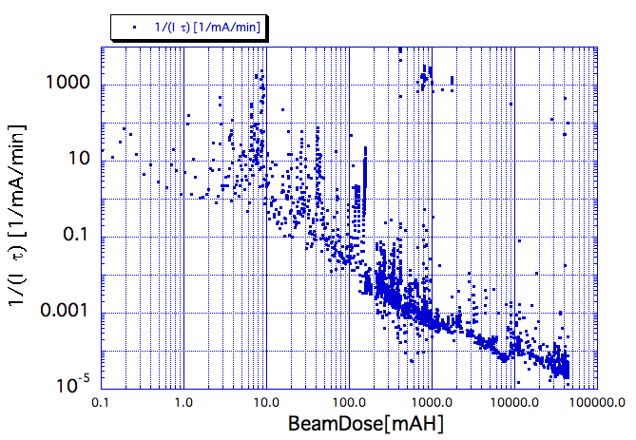
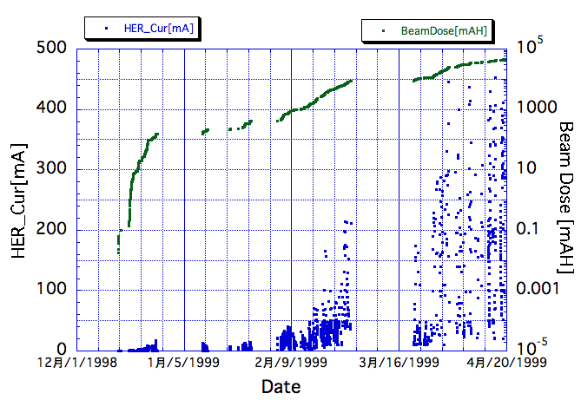
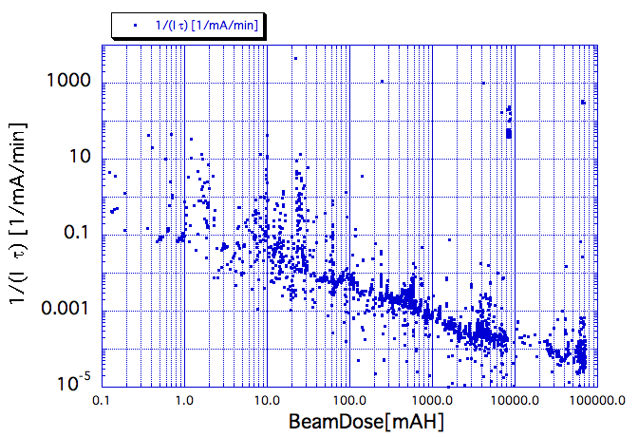
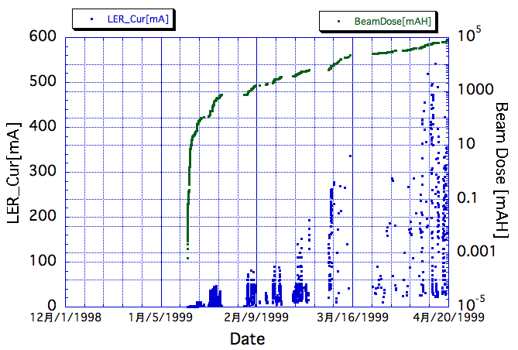
Vacuum scrubbing at KEKB （HER/LER）
HER
HER
LER
LER

Slide 7
SuperKEKB Commissioning Meeting 2011.11.08 Kikuchi, M.
DR Commissioning
LTR commissioning 2 days
BPM commission
First turn 1 day
COD meas. and correction 2 day
BPM commission
Optics meas. 2 days
RTL commissioning 2 days
Injection to LER
25 Hz operation
SR commission
Vacuum scrubbing ~14 days
~ 9 days
~ 3 weeks
by wishful thinking
M. Kikuchi

Slide 8
Commissioning phase 1 (2015 Jan. ~ May)
Machine condition
No QCS, No solenoid (no Belle II)
Tuning items
Special optics for phase 1
Commissioning item I (basic commissioning)
Commissioning item II (vacuum scrubbing)
HER beam current ( ~< 1A)
LER beam current (~ <0.5A with low emittance beam)
Belle II people request enough vacuum scrubbing in this phase (before Belle II roll-in).
At least one month with beam currents of 0.5 ~ 1 A.
Damping ring commissioning (from May or June)
If possible, we hope to check LER injection of the e+ beam from DR.
Commissioning III
Belle II Background study with Beast II Detector
Achieving a small x-y coupling
In phase 1, we can study without IR.
Beam size monitor will have to work (with low beam current ~30mA?).

Slide 9
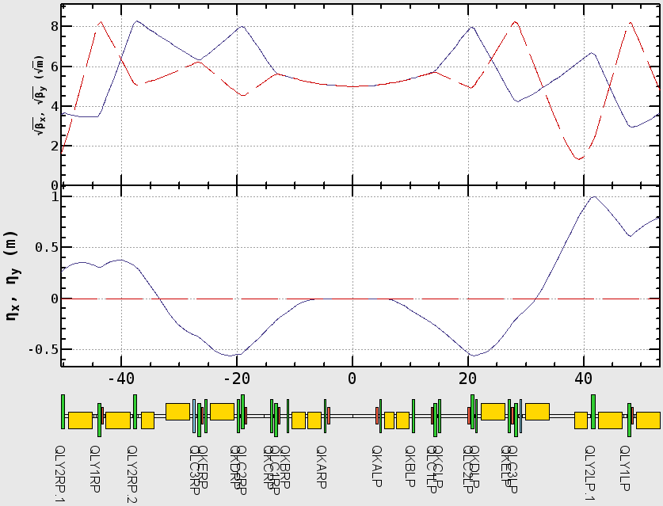
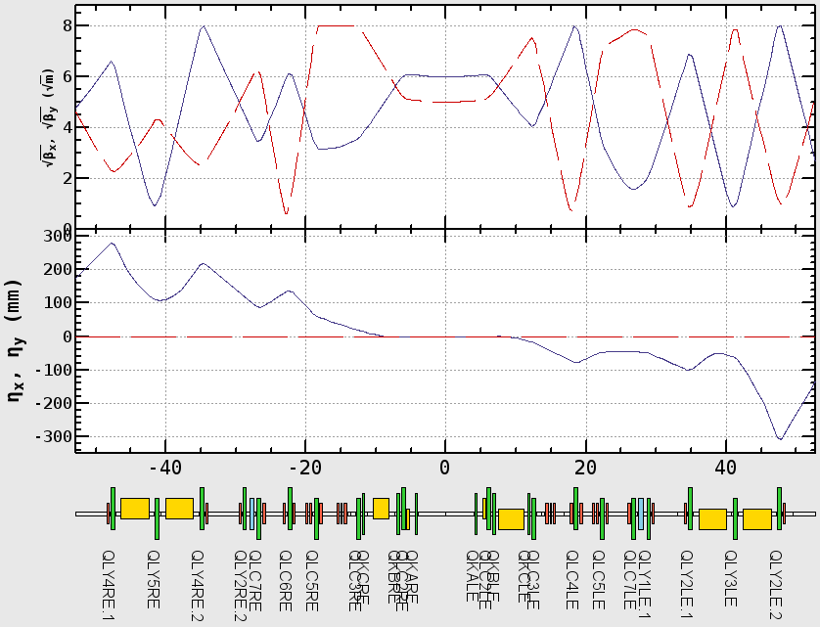
Phase 1 - Linear Optics -
H. Sugimoto
Optics W/O QCS and solenoid has been designed
QCS and solenoid is replaced by drift space.
Machine tuning except for IR is expected to be done in this phase.
LER
HER
Drift
Drift

Slide 10
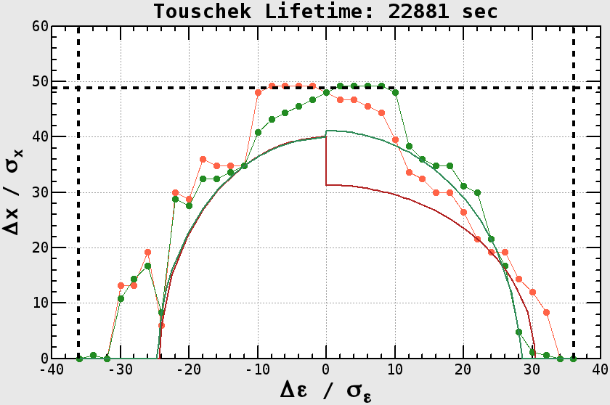
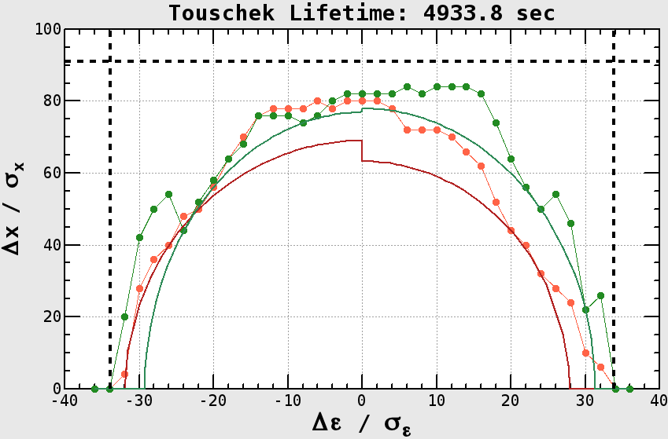
Phase 1 - Dynamic Aperture -
H. Sugimoto
DA example assuming, - Design bunch current. - 2% emittance ratio.
Beam loss estimation is ongoing from view point of radiation protection.
Funakoshi-san’s talk
HER Touscheck Life ~6.3 hours
LER Touscheck Life ~1.4 hours
Physical Aperture
RF Bucket
Notes:
Physical aperture LER 91*sigma
Physical aperture HER 48*sigma
rf bucket HER 36.07
rf bucket LER 33.89

Slide 11
SuperKEKB beam-beam simulation
Lattice non-linearity and space charge effect is not considered.
SuperKEKB design
 | LER | HER
ε_{x} [nm] | 3.2 | 4.6
ε_{y} [pm] | 8.64 | 11.5
κ [%] | 0.27 | 0.25
SuperKEKB design luminosity
K. Ohmi
Strong-strong method (PIC)
For the long-rage force, the gaussian distribution was assumed.
Smaller (single beam ) vertical emittance gives higher luminosity. Much lower vertical emittance than the design (about half) will be needed to achieve the design luminosity. A tentative target of x-y coupling w/o beam-beam is 0.15%.
At SuperKEKB, low emittance tuning will be very important.

Slide 12
Comparison of emittances of colliders
Future colliders
LEP3
Existing colliders
TLEP-H
From Beam Dynamics Newsletter No. 31
Courtesy of F. Zimmermann, H. Burkhardt and Q. Qin

Slide 13
Comparison of emittances of colliders [cont’d]
Future colliders
Existing colliders
LEP3
TLEP-H

Slide 14
A Possible BEASTII Strategy
Modular design, where we can easily add/remove sub detectors as required
Perhaps grouped into Inner BEAST, Outer BEAST
Three configuration: T0, T1, T2
Y. Sakai
All scenario
Scenario B
Scenario A
BEASTII-T0
BEASTII-T1
BEASTII-T2
 | w/o QCS, w/o solenoid | w/ QCS, w/o soldenoid | w/QCS, w/ solenoid , No SVD, PXD
ECL shielding | N | N | N
Diodes & beam abort | Y | Y | Y
Micro-TPCs | Y | Y | Y, in dock
BGO | N | Y | ?
CDC prototype | N | Y | N
SVD, PXD ladders & monitors | N | Y | Y
Diamonds | Y | Y | Y
Phase 1
Phase 2
Phase 2
Outer Beast
Inner Beast
For BEASTII_T2, place some sub system in PXD DOCK space
Keep up development of all BEAST sub systems.

Slide 15
Commissioning phase 2 (2016 Jan. ~ April)
Machine condition
With QCS, with Belle II (no VXD)
Full accelerator tuning, no physics run
Target luminosity at the end of this phase: 1 x 10³⁴ cm⁻² s⁻¹
Tuning items
Injection tuning w/ Belle II detector starting from detuned optics
Commissioning item II (vacuum scrubbing)
Continue to increase beam currents
Commissioning III
Belle II Background study with Belle II (and with Beast II)
Achieving a small x-y coupling with IR
Squeezing IP beta functions
Collision tuning with the nano-beam scheme
Establishment of collision feedback
Other beam dynamics issues
Luminosity tuning

Slide 16
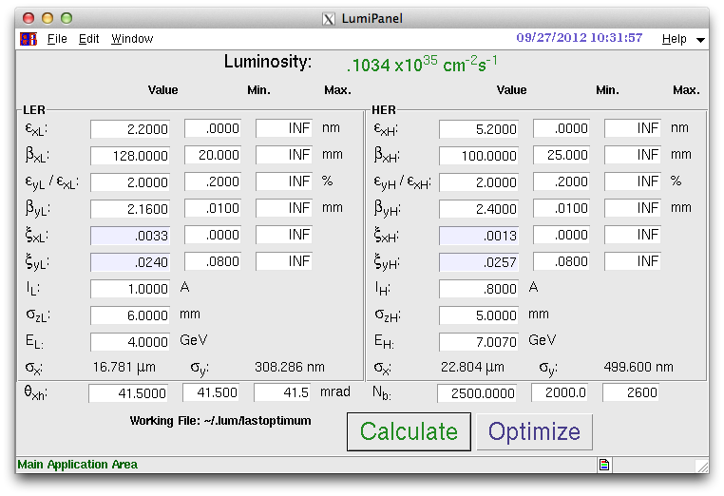
Detuned Optics (4x8)
Example of Parameters for 10³⁴ cm⁻²s⁻¹
βx*: x4, βy*: x8, coupling =2 %, ξy ~ 0.025, ILER = 1 A.
The effect of intra-beam scattering is decreased in LER.

Slide 17
Commissioning phase 3 (2016 Oct. ~ )
Machine condition
With QCS, with Belle II including VXD
Continue full accelerator tuning. Physics run will start after some detector tuning period.
Tuning items
Commissioning item II (vacuum scrubbing)
Continue to increase beam currents
Commissioning III
Achieving a small x-y coupling with IR?
Squeezing IP beta functions
Other beam dynamic issues
Continue luminosity tuning

Slide 18
Summary
The SuperKEKB accelerator ground and Belle II ground agreed that the ring commissioning will be done with 3 phases. There are two possible scenarios. Scenario A has the first priority. Scenario B is kept for the situation where Belle II schedule delays.
Phase 1 (scenario A) (2015 Jan. ~ May)
No QCS, No Belle II
Basic commissioning, vacuum scrubbing, low emittance tuning, detector background (Beast II), DR commissioning
Phase 2 (scenario A) (2016 Jan. ~ April)
w/ QCS, w/ Belle II (no VXD)
Full accelerator tuning, no physics run, detector background (Beast II)
Target luminosity = 1 x 10³⁴ cm⁻² s⁻¹
Phase 3 (scenario A) (2016 Oct. ~ )
w/ Belle II (w/ VXD)
Continue accelerator tuning, Belle II tuning, physics run will start.

Slide 19
Future prospects
Tasks to be done (from summer 2013)
More concrete and detailed scenarios for beam commissioning
Development of operation software
Ask for your cooperation
SuperKEKB is an extremely difficult machine
Low-beta, Low-emittance, nano-beam scheme, high beam currents, high luminosity
Pioneer for new accelerator physics
Experiences in other laboratories are extremely helpful
SLAC, BINP, DAFNE, , SuperB, Cornell….

Slide 20
Spare slides

Slide 21
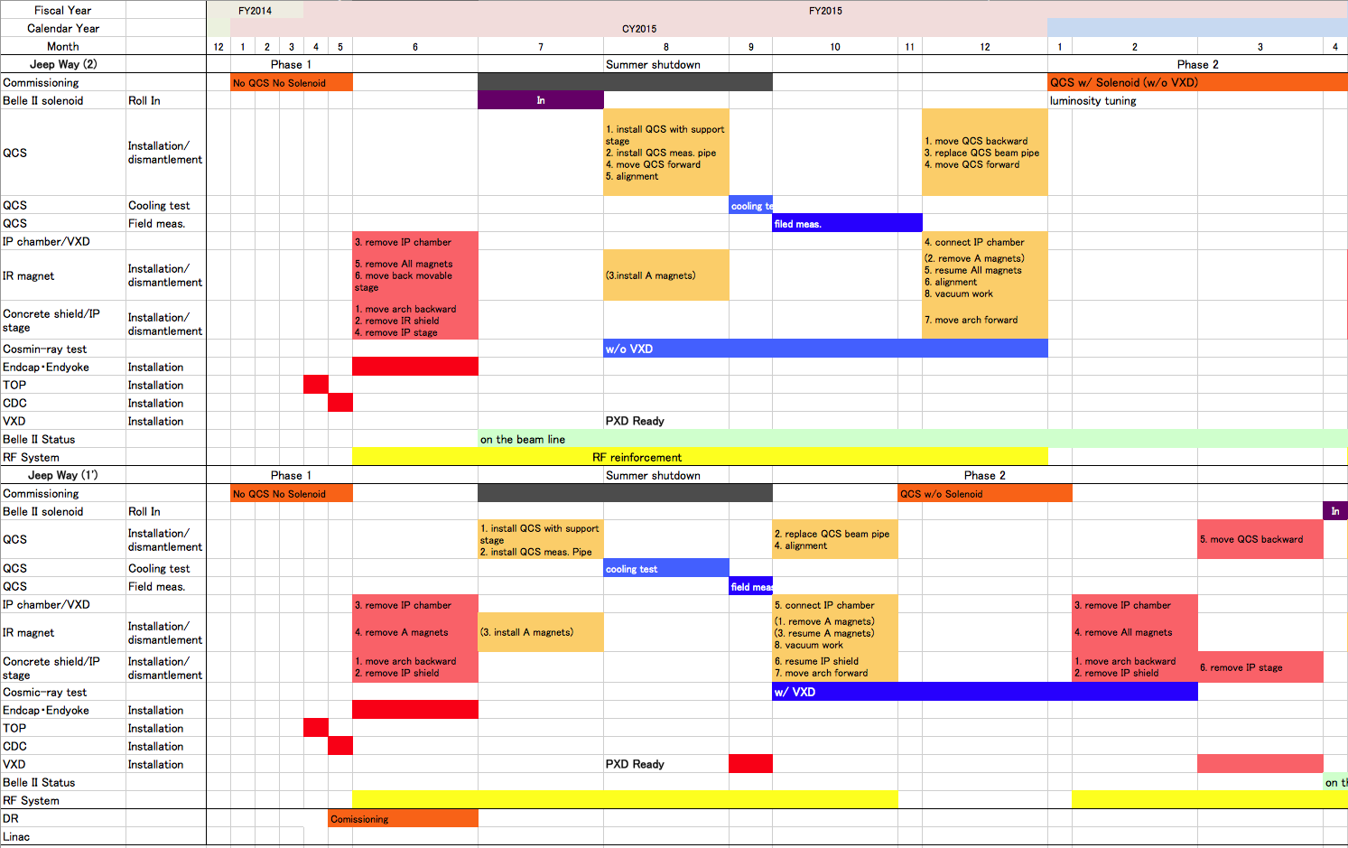
Detailed Schedule 1
Scenario A
Scenario B

Slide 22
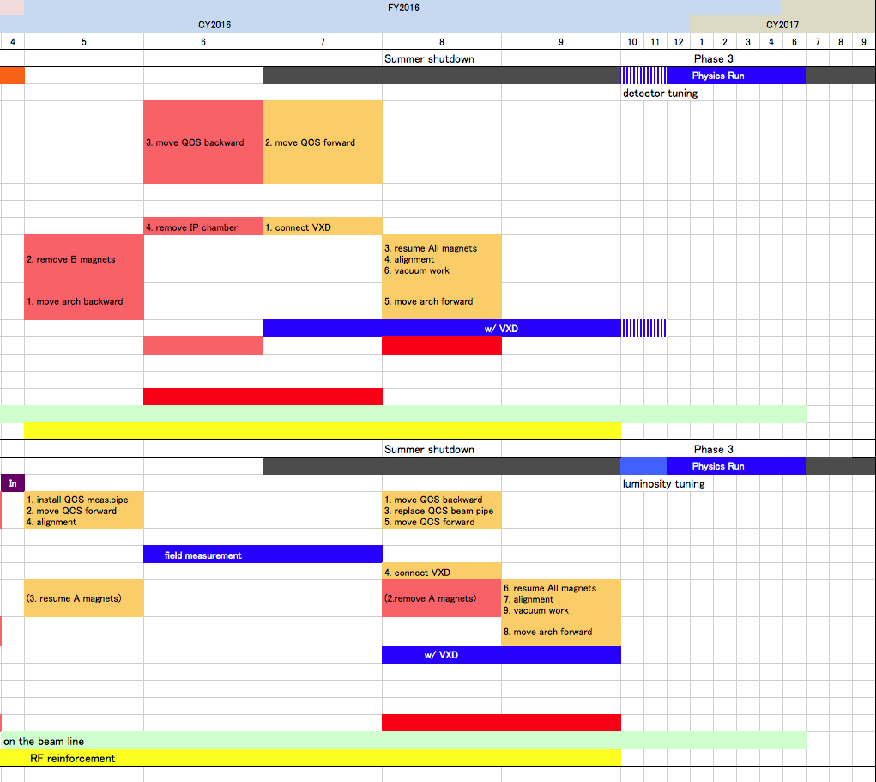
Detailed Schedule 2
Scenario A
Scenario B

Slide 23
Comparison of two scenarios during commissioning phase 2
 | Scenario A (w/ solenoid) | Scenario B (w/o solenoid)
Optics correction(1) Squeezing IP beta functions | We can do full tuning. | We can do something. But we will have to do tuning w/ Belle II solenoid almost from scratch.
Optics correction(2) Achieving a small x-y coupling | We can do full tuning. | We can do something. But we will have to do tuning w/ Belle II solenoid again anyway.
Collision tuning | We can do full tuning. | The beam collision may not be possible w/o Belle II solenoid.
Belle II background Study and tuning | The real beam background can be studied. Also some test detectors can be installed at the place of VXD. | Some studies can be possible.
Risk to Belle II | Maybe we can avoid the risks by adiabatic tuning (start from small beam currents, with detuned optics). | Less risk

Slide 24
Comparison of two scenarios (cont’d) during commissioning phase 2
 | Scenario A (w/ solenoid) | Scenario B (w/o solenoid)
Works for accelerator setup | Less works. | One more QCS field measurement. (heavier load to QCS group)
Cosmic-ray run w/ VXD | Less time before phase 3. Can also be done in the beginning of phase 3. | More time before phase 3.
Expected time for the first target luminosity (1 x 10³⁴ cm⁻²s⁻¹) | Earlier (maybe during phase 2). | Later (3〜5 months after phase 3 start).

Slide 25
Commissioning III : More sophisticated tuning
Optics measurements and corrections (1) : squeezing IP beta functions at IP
We will squeeze the IP beta functions with observing the beam lifetime, the injection rate and the Belle II background. This study can be done with small beam currents (~30mA).
QCS’s are vital for this study. We can do something without solenoid (Belle II). However, we need to start tuning with solenoid (Belle II) almost from scratch.
This tuning is most important for the luminosity at SuperKEKB. A factor 20 of the luminosity gain is expected by squeezing beta functions.
The first target of vertical beta function at IP (βy*) is 10 times larger values of the design values.
Optics measurements and corrections (2) : achieving a small value of x-y coupling
We need to measure the beam size with x-ray monitor.
The beam size measurements will be possible with small beam currents with relatively high bunch currents.
We do not need the solenoid winding for clearing the electron clouds.
Although it is worthwhile to do this study w/o Belle II solenoid, we also need to do the study also with Belle II solenoid.
Collision tuning
We have no experience on the beam collision with Nano-beam scheme.
Finding beam collision, establishing orbit feedback system（including dithering system）
Luminosity tuning like at KEKB (this kind of tuning will continue many years.)
It is worthwhile to do this tuning w/o solenoid. However, there is a possibility that the beam collision will not be possible w/o Belle II solenoid.
Belle II (Beast II) background study, tuning

Slide 26
Revised on April 1st 2012

Slide 27
Facilities
27
M. Ono
Storage and staging areas needed for magnet and vacuum components.
Need increased cooling water for klystrons and magnets:
24 klystrons for ARES cavities, 8 klystrons for SCC
Magnet cooling water needs double (4 plants -> 8)
Electricity:
Electricity Consumption: June-09
KEKB/KEK total
(Design option) | KEKB:MW | ΔMW | KEK:MW | ΔMW
Present(Average) | 45 |  | 64
Nano Beam: June-09 | 70.7 | 24.3 | 96 | 32
Upgrade: Feb.-09 | 94.8 | 49.8 | 120 | 56
Super: ‘07-July | 102.6 | 57.6 | 128 | 64
Recent Design(Feb.-10): Add 2 ARES units--> +(3~4)MW

