Slide 1
Overview of Electron / Positron Injector Linac Status
Kazuro Furukawa
<kazuro.furukawa@kek.jp>
for Linac division

Slide 2
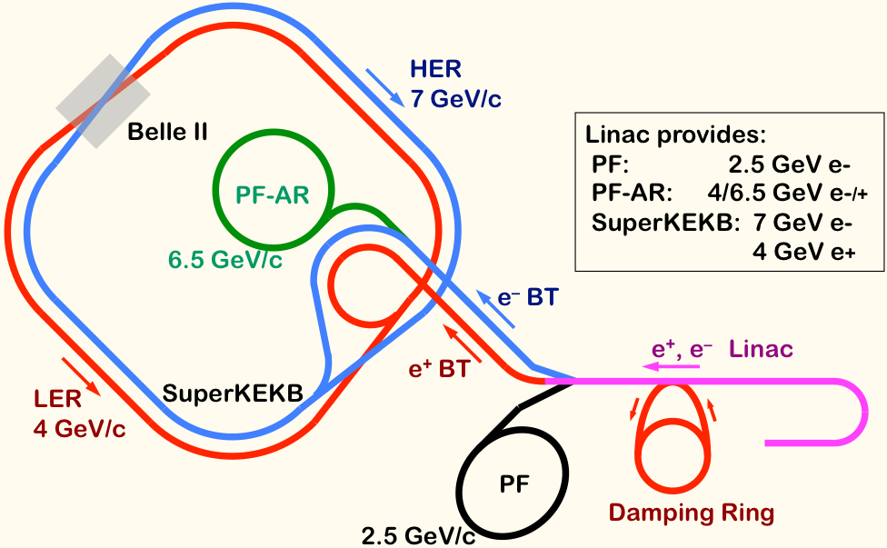
Mission of electron/positron Injector in SuperKEKB
Linac Overview
40-times higher Luminosity
  Twice larger storage beam → Higher beam current at Linac
  20-times higher collision rate with nano-beam scheme
    → Low-emittance beam injection from Linac (20μm)
    → Shorter storage lifetime (→ Higher Linac beam current)
Linac challenges
  Low emittance e-
    with high-charge RF-gun
  Low emittance e+
    with damping ring
  Higher e+ beam current
    with new capture section
  Emittance preservation
    with precise beam control
  4+1 ring simultaneous injection
40x Luminosity
e+ efficiency
2x beam current
RF-gun
Notes:
Higher Injection Beam Current
To Meet the larger stored beam current and shorter beam lifetime in the ring
4~8-times larger bunch current for electron and positron
Reconstruction of positron generator, etc
Lower-emittance Injection Beam
To meet nano-beam scheme in the ring
Positron with a damping ring
Electron with a photo-cathode RF gun
Emittance preservation by alignment and beam instrumentation
Quasi-simultaneous injections into 4 storage rings
SuperKEKB e–/e⁺ rings, and light sources of PF and PF-AR
Improvements to beam instrumentation, low-level RF, controls, timing, etc

Slide 3
Review Items in 2012 and Reviewer’s Comments
Linac disaster recovery
  Earthquake is a natural disaster, a Force Majeure. In view of the manpower shortage in the Linac and Storage Ring groups, the committee suggests that the management team look into timeline, milestones and resources, and revise the schedule accordingly.
RF gun and low-emittance transport
  Aggressively pursue a demonstration of the QTW gun with LaB₆ cathode and the full power laser.
Positron source
  CSR effects in the bunch compressor should be examined. A protection scheme for the target should be developed at least conceptually.

Slide 4
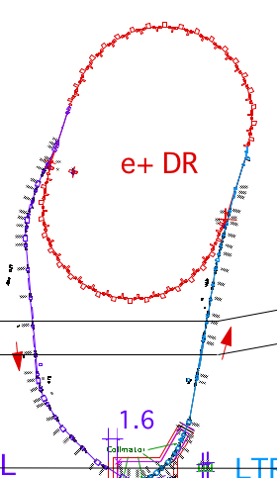
Facility Upgrade
Linac Facility
Ohsawa et al.
Addition of electric power and cooling water is crucial for the upgrade
  However, the facility division starts the design only after the budget is secured
  It was only approved in JFY2012 (the facility budget is different from the project one)
Basic schedule
  Design JFY2012, Building JFY2013, Facility JFY2014
  Should not affect PF and PF-AR operation
  Not available during initial commissioning
high current
gun
50 Hz (e+ or e-)
pulse-by-pulse
mode switching
1.1 GeV
Damping Ring
circ. 136 m
PF
low emittance
RF gun
2.5 GeV e-
0.1nC x 1
Bunch
Compressor
PF-AR
6.5 GeV e-
3.5 GeV
10nC x 2 (prim. e-)
5nC x 2 (inj. e-)
Energy-spread
Compression System
LER
S-band
linac
3T
RF gun
4.0 GeV e+ 4nC x 2
ECS
e+ target &
capture section
C-band
modules
HER
7.0 GeV e-
5nC x 2
    Positron capture section
    920 kVA, 900 lit/min
    Damping ring BT (LTR, RTL)
    310 kVA
    Switch yard (3SY)
    300 kVA, 460 lit/min

Slide 5
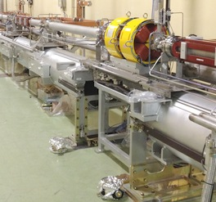
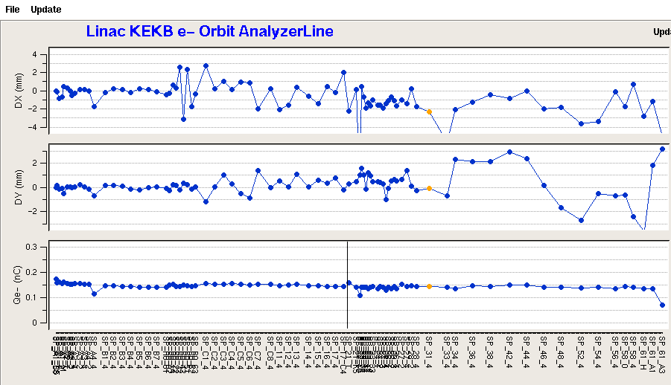
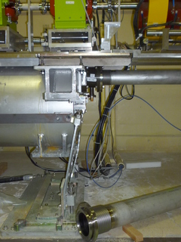
Girder Recovery and Alignment
Higo et al.
Re-constructing soft-structure girder into hard-structure
Alignment with
  120m and 480m long-baseline laser between girders
  Laser tracker within a girder (~10m)
  Target: 0.1mm local / 0.3mm global alignment
    Several iterations necessary for low-emittance beam transport
Beam transport/acceleration test for 600m (Nov.2012)
  For the first time after the earthquake
X
Y
Charge
Beam along 600-m linac

Slide 6
Microwave Power Source Upgrade
Pulsed power modulators
  Nine compact modulators are introduced
  Share the same basic design for klystron, flux concentrator, and gun high voltage
Fast LLRF controllers, power amplifiers, and LLRF monitors
  For simultaneous injection and bucket selection
  Pulse-to-pulse stability monitor
  50Hz event-based synchronized controls
Michizono et al.

Slide 7
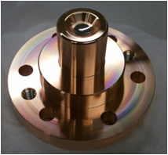
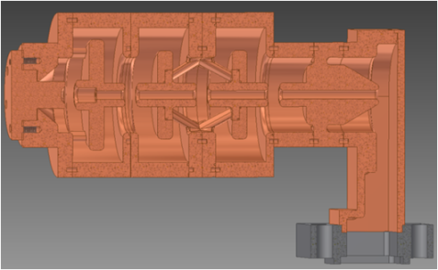
RF Gun Development
RF Gun for Low-emittance Electron Beam
Yoshida et al.
Photo cathode : stability, longer life, efficiency
  At first LaB₆, then Ir₅Ce → 5nC / bunch
Laser : higher power, pulse width control
  Nd:YAG medium, LD excitation → ~1.5mJ / 30ps / pulse at 266nm
  Polarization control for slant irradiation
  Yb:YAG fiber laser is introduced
Cavity : better focusing field, higher gradient
  DAW (Disk and washer) type cavity
  Development of quasi-travelling-wave side-coupled cavity as well
Test stands
  RFgun at A-1 is constructed with fiber laser for SuperKEKB
  RFgun at 3-2 was used to inject into PF with proper synchronization
  Long-period demonstration will be performed
Ir₅Ce
DAW

Slide 8
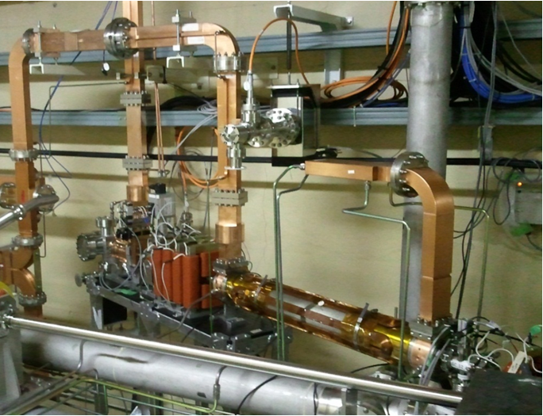
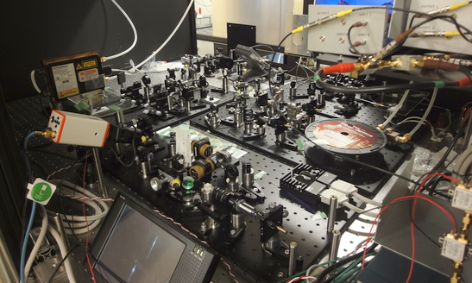
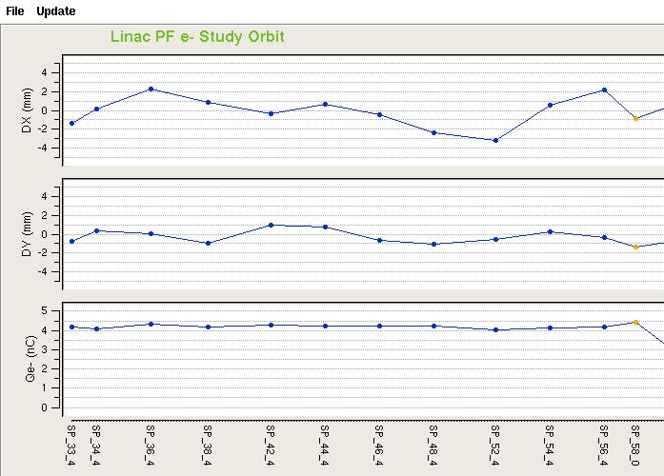
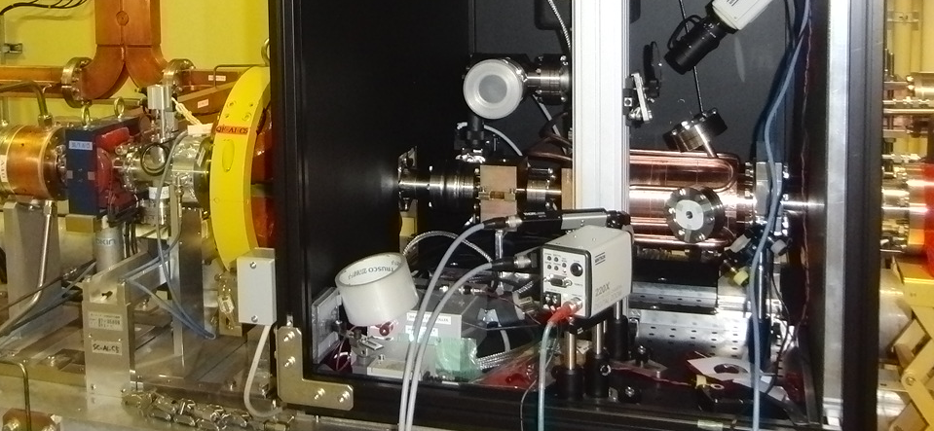
Beam Acceleration Test (RF-gun)
Step-by-step beam tests
  4.5nC 240m acceleration
  Fiber-laser-based RF-gun
X
Y
Charge

Slide 9
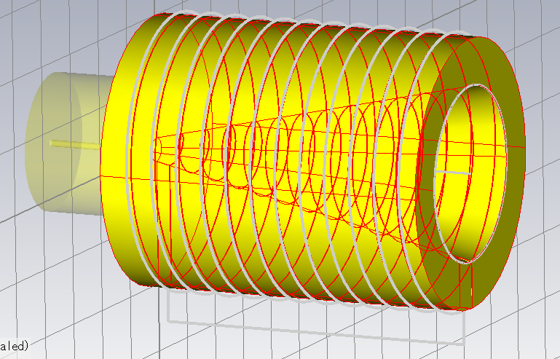
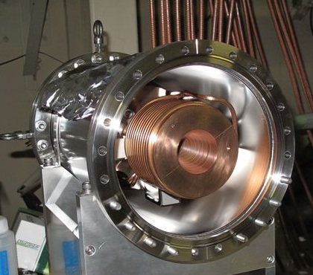
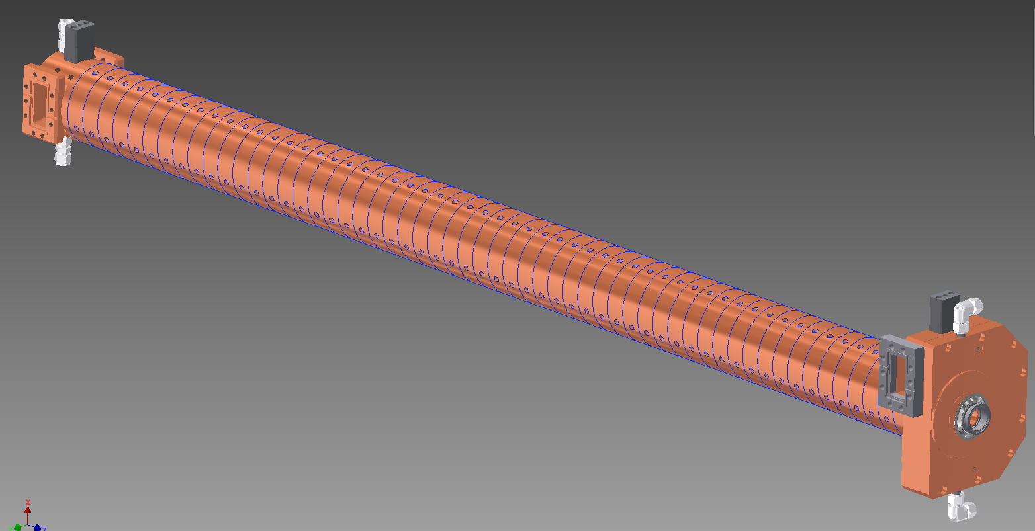
Positron Generator Development
Positron Capture for High-current Positron
Kamitani et al.
Flux concentrator
  Collaborations with BINP and IHEP
  Finalized optimization of field and mechanical design
  Fabricated 1st version of 2nd generation, being tested
Large-aperture S-band (LAS)
cavity structure
  Positron capture tracking simulation
  L-band structure as backup
  with co-linear load
Magnet design and fabrication
  Solenoid and pulsed steering and quad
  magnet system
Reliability
  Strategy for failed component replacement
  Acceleration gradient distribution and
  optimization with backups
LAS

Slide 10
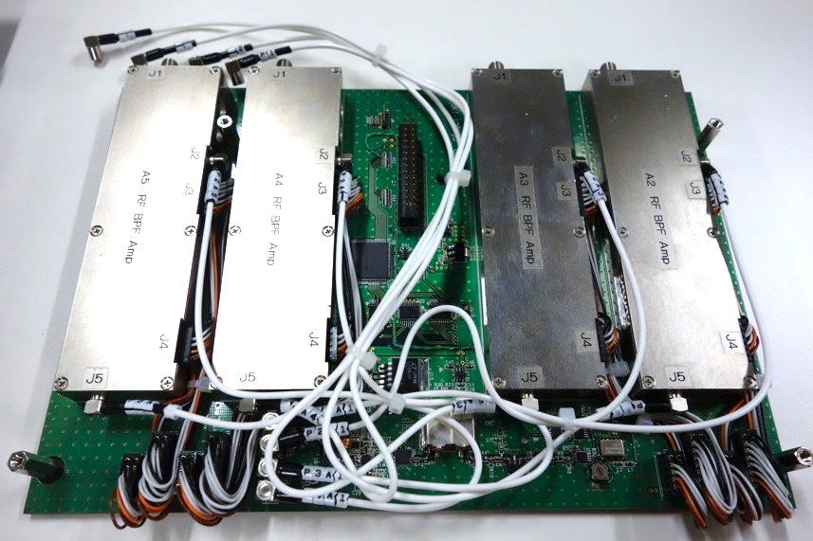
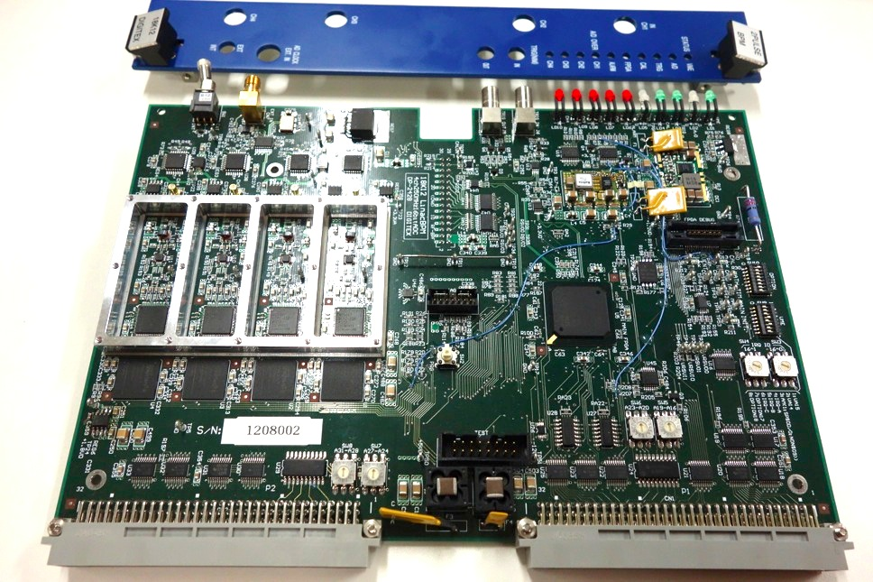
Beam Monitors: BPM and WS
Suwada et al.
    Limited performance with present 8-bit 10GS/s digitizers (oscilloscopes)
New BPM readout for precise orbit/emittance controls
  Fast attenuator for 0.1-10nC (SuperKEKB, PF, PFAR) dynamic range
  Helical BSF (300MHz) for 2-bunch (96ns apart) readout
  16bit 250MS/s ADC, FPGA data processing
  50Hz event-control synchronization
New wire scanner readout was also developed

Slide 11
Single Machine, Multiple Virtual Accelerators (VAs)
Dual-layer Controls
Simultaneous injection, one of the VAs is active at a time
Independent parameter set for each VA, ~200 parameters are switched every 20ms pulse
e⁻ Gun
ARC
PF Injection
e– (2.5GeV)
e⁻ Gun
ARC
KEKB-LER Injection
Event-based Control System
Primary e– (3.5GeV)
e⁺ (4GeV)
e⁺ Target
e⁻ Gun
ARC
KEKB-HER Injection
e– (7GeV)
e⁻ Gun
ARC
PF-AR Injection
e– (6.5GeV)

Slide 12
Example of Beam Mode Pattern : e⁺ 25Hz / e– 25Hz
Dual-layer Controls
Interleaved e+ and e-, dependency between pulses mostly decoupled
With bucket selection at the both DR and MR
e⁻ Gun
ARC
Primary e– (3.5GeV)
e⁺ (4GeV)
20ms
e⁺ Target
e⁻ Gun
ARC
e– (7GeV)
20ms
e⁻ Gun
ARC
Primary e– (3.5GeV)
e⁺ (4GeV)
20ms
e⁺ Target
e⁻ Gun
ARC
e– (7GeV)

Slide 13
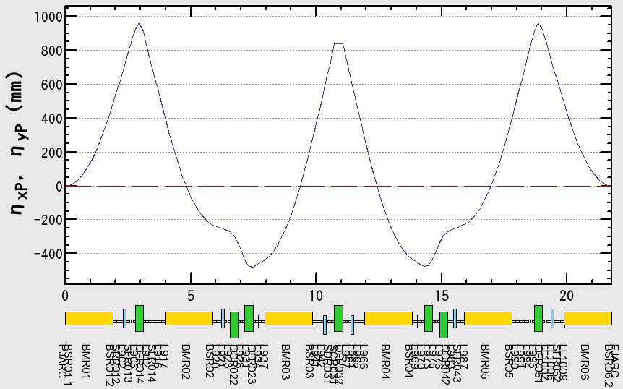
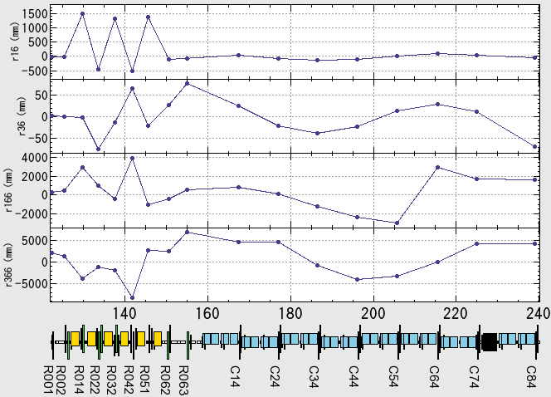
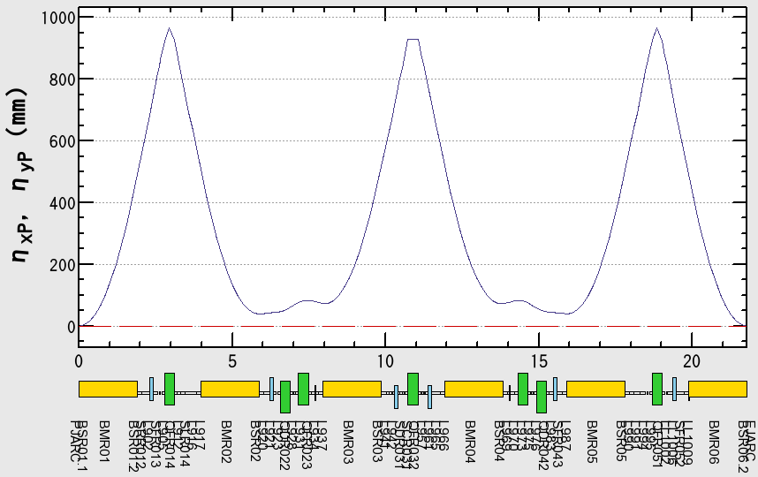
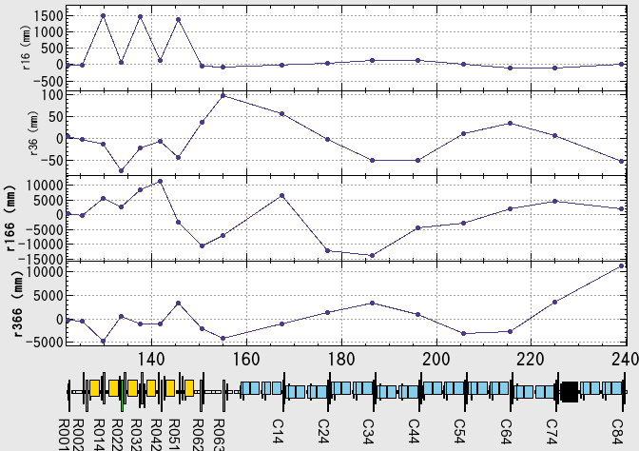
Preliminary Beam Tests in Autumn 2012
  Beam test along 600-m Linac
  for the first time after the earthquake
  Latter half was tuned for PF/PFAR injection
  Alignment will be recovered by 2014
  For energy spread optimization
  Longitudinal beam profile management
  by photo-cathode RF-gun (30ps square shape)
  and bunch compression at the middle of linac
  are crucial
    Preliminary R56 control
    was performed
    Design and measurement
    of dispersion function
    with R56=0 and R56=-0.6
X
Y
Charge
Beam along 600-m linac
R56=0
R56=-0.6
Design
Measurement

Slide 14
Schedule
Schedule
Winter 2013 : DR switchyard / DR tunnel construction
Spring 2013 : A1-RF-gun, Alignment
Summer 2013 : Installation of many components
  ECS, FC (gen.2), DC solenoids, Klystron modulators, WS, etc
Autumn 2013 : e– then e+ commissioning (limited current)
  Half Linac: PF injection, Day: construction, Night: commissioning
Spring 2014 : Pulsed steering, Alignment
Summer 2014 : Installation of additional components
  Cooling water, FC (gen.3), BPM, Pulsed magnets, New PFAR BT, etc
Autumn 2014 : Linac Commissioning
Winter 2015 : MR (then DR) injection commissioning
…

Slide 15
Summary
Much progress in disaster recovery and construction.
Still expecting many challenging items to overcome
Many items are connected with beam emittance and energy spread management
Injector should start at first !
RF Gun (M. Yoshida)
Alignment and Support (T. Higo)
Positron Source (T. Kamitani)
Flux Concentrator Modulator Development (M. Akemoto)
Commissioning of Electron Beam (M. Satoh)
New Transport Line for PF-AR (H. Takaki)
Construction status of the damping ring and the beam transport (N. Iida)
Control (T. Nakamura)

Slide 16
Thank you

Slide 17
Linac Upgrade for SuperKEKB
Linac Overview
Higher Injection Beam Current
  To Meet the larger stored beam current and shorter beam lifetime in the ring
  4~8-times larger bunch current for electron and positron
Lower-emittance Injection Beam
  To meet nano-beam scheme in the ring
  Positron with a damping ring, Electron with a photo-cathode RF gun
  Emittance preservation by alignment and beam instrumentation
Quasi-simultaneous injections into 4 storage rings
  SuperKEKB e–/e⁺ rings, and light sources of PF and PF-AR
  Improvements to beam instrumentation, low-level RF, controls, timing, etc
SuperKEKB injector Linac
50 Hz (e+ or e-)
pulse-by-pulse
mode switching
high current
gun
1.1 GeV
Damping Ring
circ. 136 m
PF
low emittance
RF gun
2.5 GeV e-
0.1nC x 1
Bunch
Compressor
PF-AR
6.5 GeV e-
3.5 GeV
10nC x 2 (prim. e-)
5nC x 2 (inj. e-)
Energy-spread
Compression System
LER
S-band
linac
3T
RF gun
4.0 GeV e+ 4nC x 2
ECS
e+ target &
capture section
C-band
modules
HER
7.0 GeV e-
5nC x 2

Slide 18
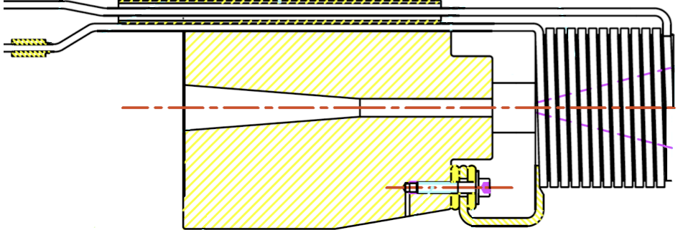
Linac Upgrade for SuperKEKB
PF
2.5 GeV
0.1nC x 1
B
A
New RF-gun
5 nC for e–, 10nC for e+
IrCe cathode, Fiber laser, DAW cavity
1.1 GeV
e+ damping ring
J-arc
1.5 GeV
Primary e– for e+
3.2 GeV, 10nC x 2
Bunch
Compression
Energy
Compression
Energy
Compression
LER
4.0 GeV e+
4nC x 2
SY3
Bunch
Compression
5
HER
7.0 GeV
5nC x 2
20 um
C
1
New e+
Capture
with FC
2
SY2
3
4
PF-AR
6.5 GeV
5nC
As a high-field (several Tesla) pulsed solenoid for the positron source of the SuperKEKB injector, KEK is going to fabricate a SLAC-type flux concentrator.
Technical advices from the IHEP experts and design information by the IHEP drawings are quite useful in the development.
Flux
Concentrator
electron
beam
positron
beam

