Slide 1
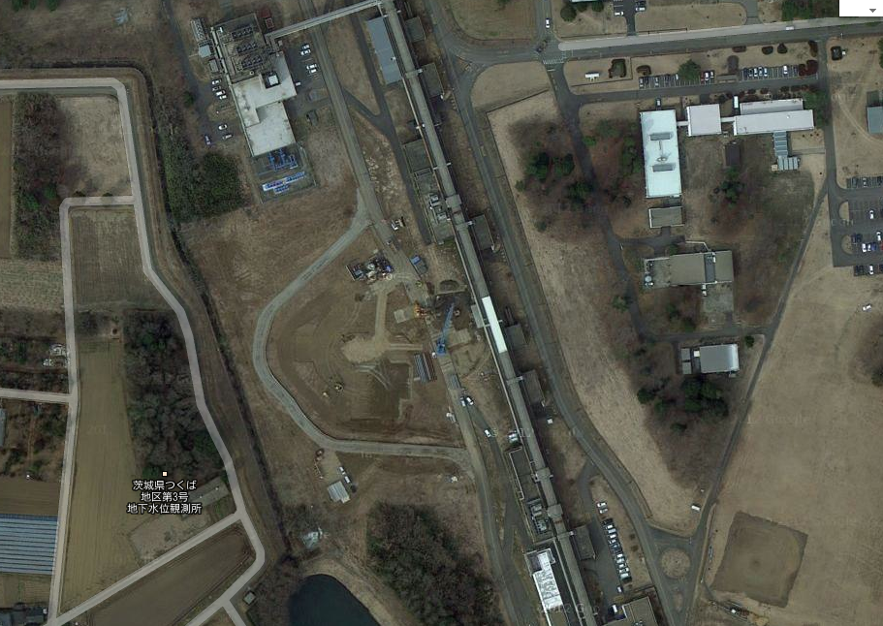
Construction Status of the Damping Ring and the Beam Transport Lines The new HER Abort System
5/Mar/2013
18th SuperKEKB Review Committee
Naoko Iida
Google earth
Notes:
I would like to talk about two subjects.
One is about the DR and the BT status, and another is the new HER abort system.

Slide 2
Contents
Construction status
Damping ring (DR)
Beam transport lines (BTs)
2nd switching yard (SY2)
3rd switching yard (SY3)
Milestones of DR, LTR, and RTL
The new HER abort system
Abort system utilizing DC sextupoles
Construction of Abort system
Notes:
The contents of my talk is like these.

Slide 3
Construction status of the Damping Ring and the Beam Transport lines

Slide 4
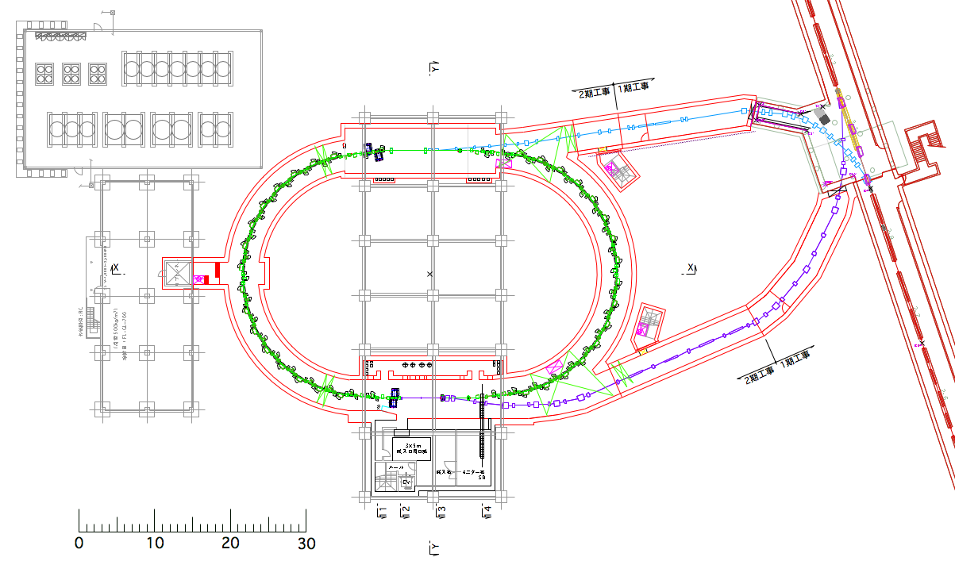
Plain view of DR
e+ beam
Sector-3
LTR
Damping Ring
Safety
fence
SY2
LINAC
Sector-2
Safety
fence
RTL
Machine building
Power supply building
Notes:
This is a plain view of DR.
Here is Sector-2 of LINAC. The e+ beam comes from here, is injected to DR through LTR,
goes around for 20ms, and is extracted and returns to the LINAC through RTL.
The extraction and return region is called the second switching yard.
Safety fences will be installed around here and here.
Power supply building and machine building will be built above the DR.

Slide 5
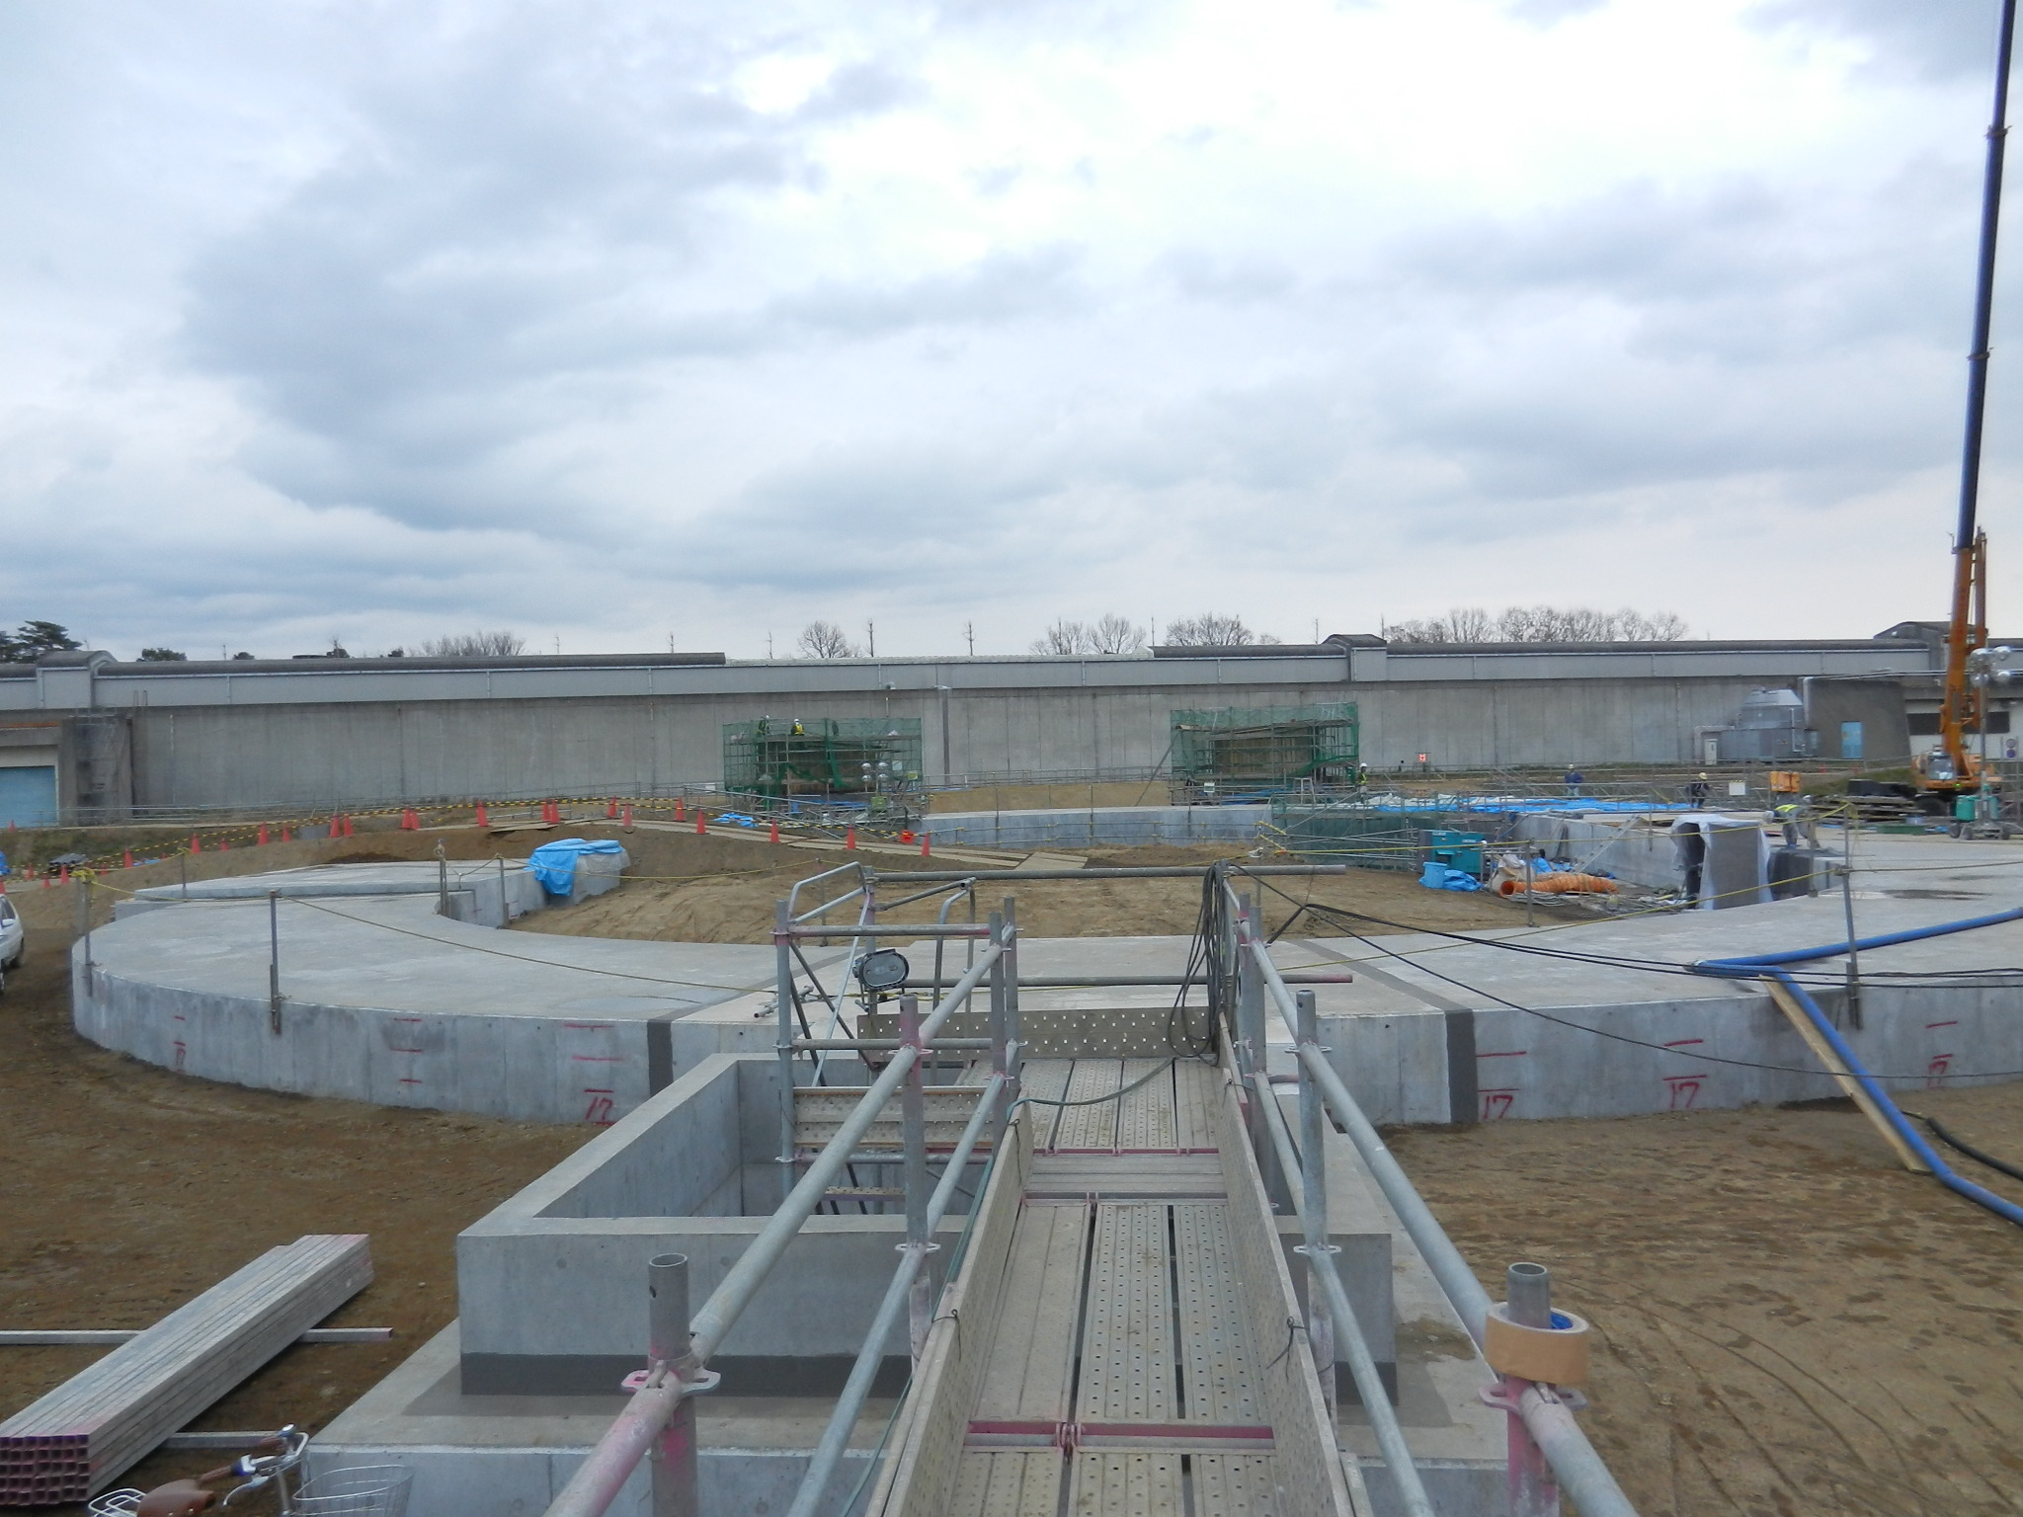
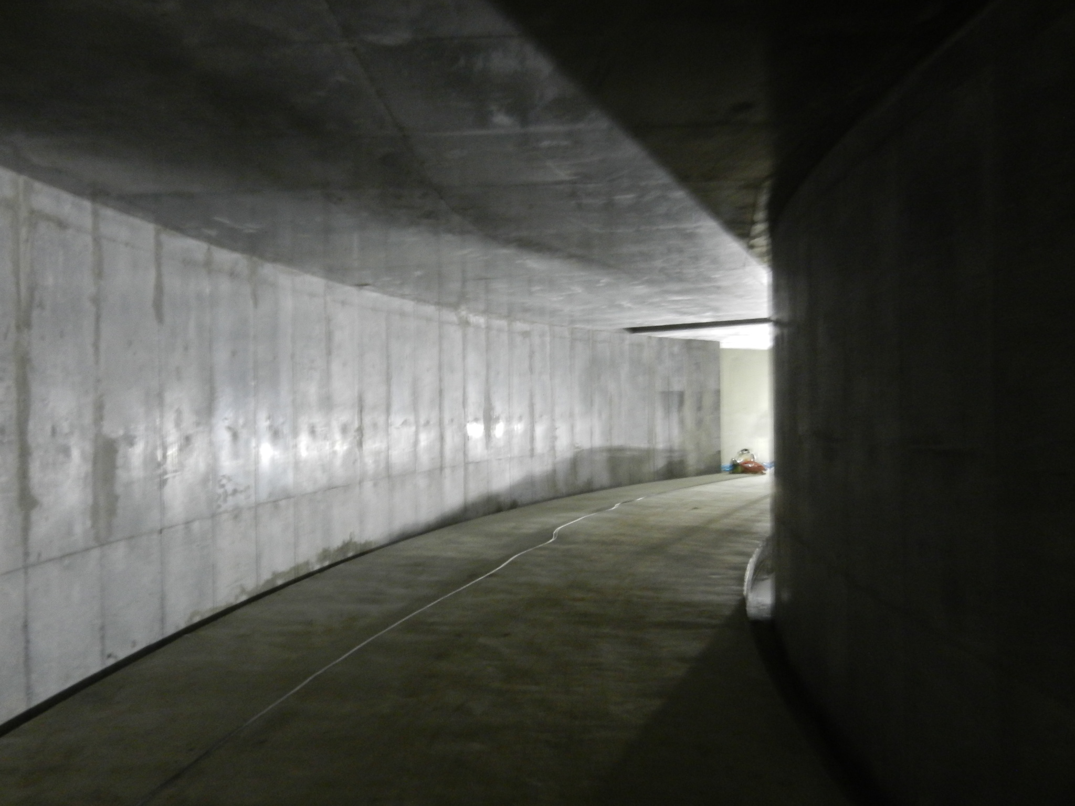
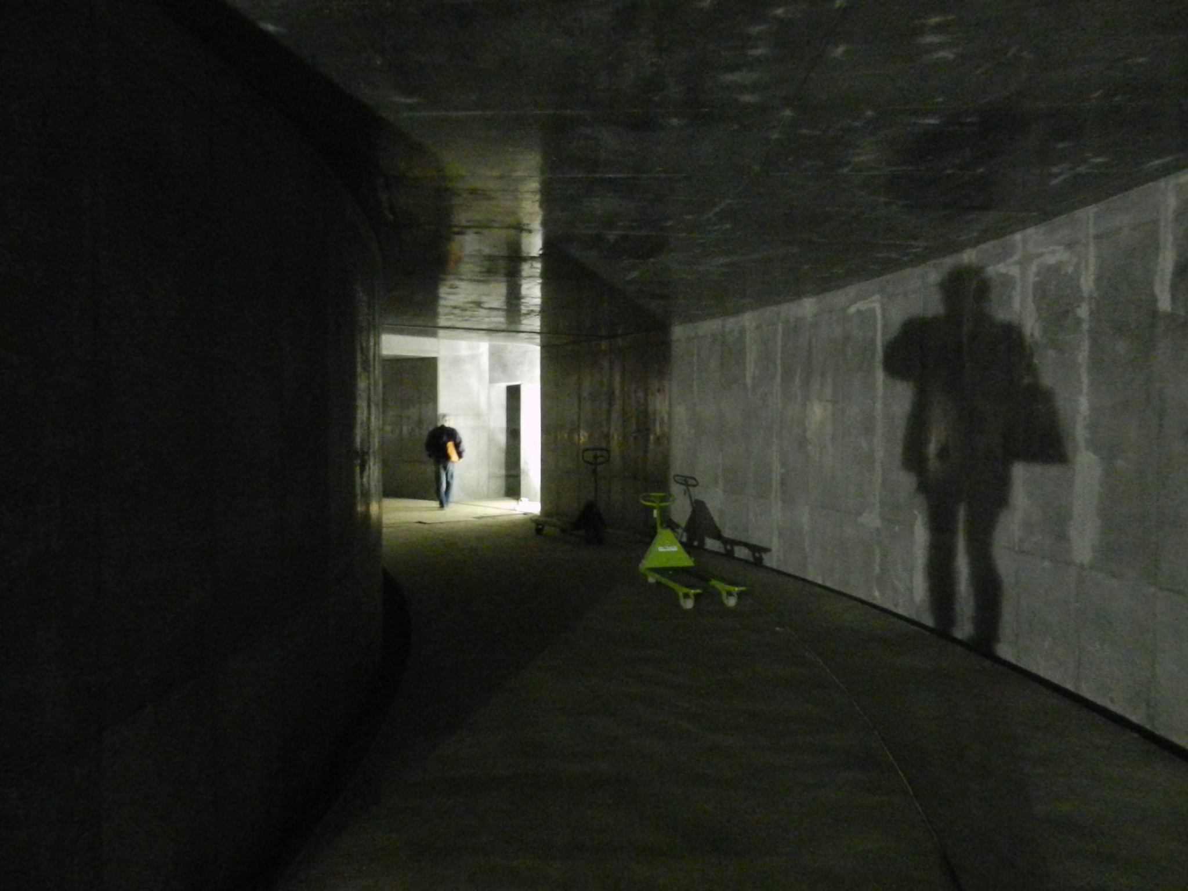
DR under construction on 18/Dec/2012
LINAC
DR tunnel
Inside DR tunnel
Notes:
These are photographs of DR under construction in December last year.
Here is DR tunnel, and this is LINAC.
These are inside the DR tunnel at the time.

Slide 6
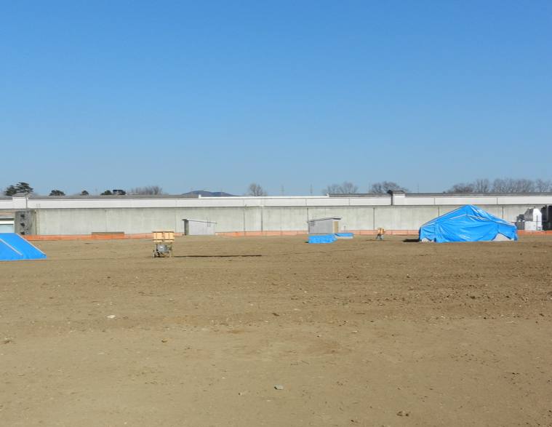
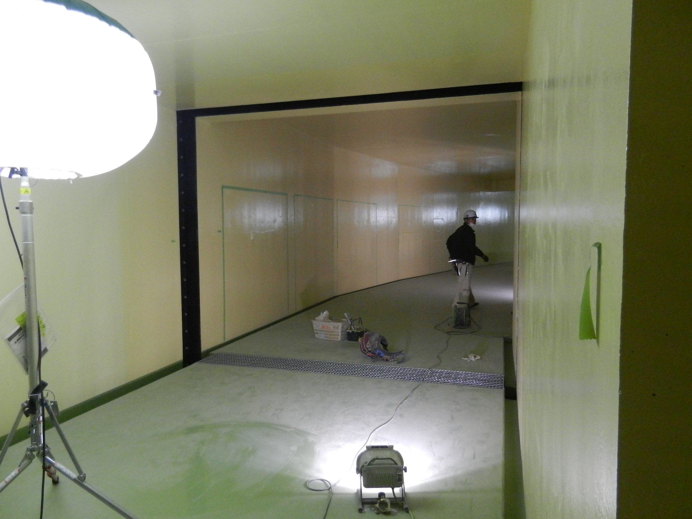
DR under construction on 26/Feb/2013
LINAC
DR
Now DR has been buried.
The construction of the building above the DR will start from April.
Inside DR tunnel
Notes:
These are photographs in February this year.
Now DR has been buried.
The construction of the buildings above the DR will start.
The tunnel becomes clean.

Slide 7
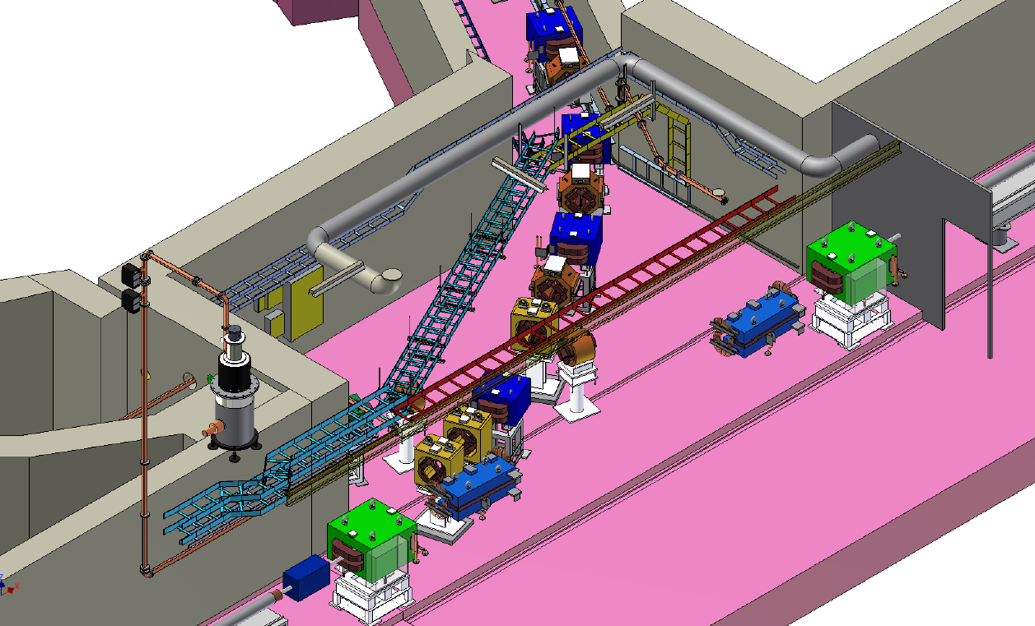
3D Drawing of SY2
DR
The narrow tunnel of LTR will be very complicated with magnets, cable racks, pipes for cooling water and wave-guides, and so on.
e+
e+
e+
LINAC
Notes:
This is a 3D Drawing of the SY2.

Slide 8
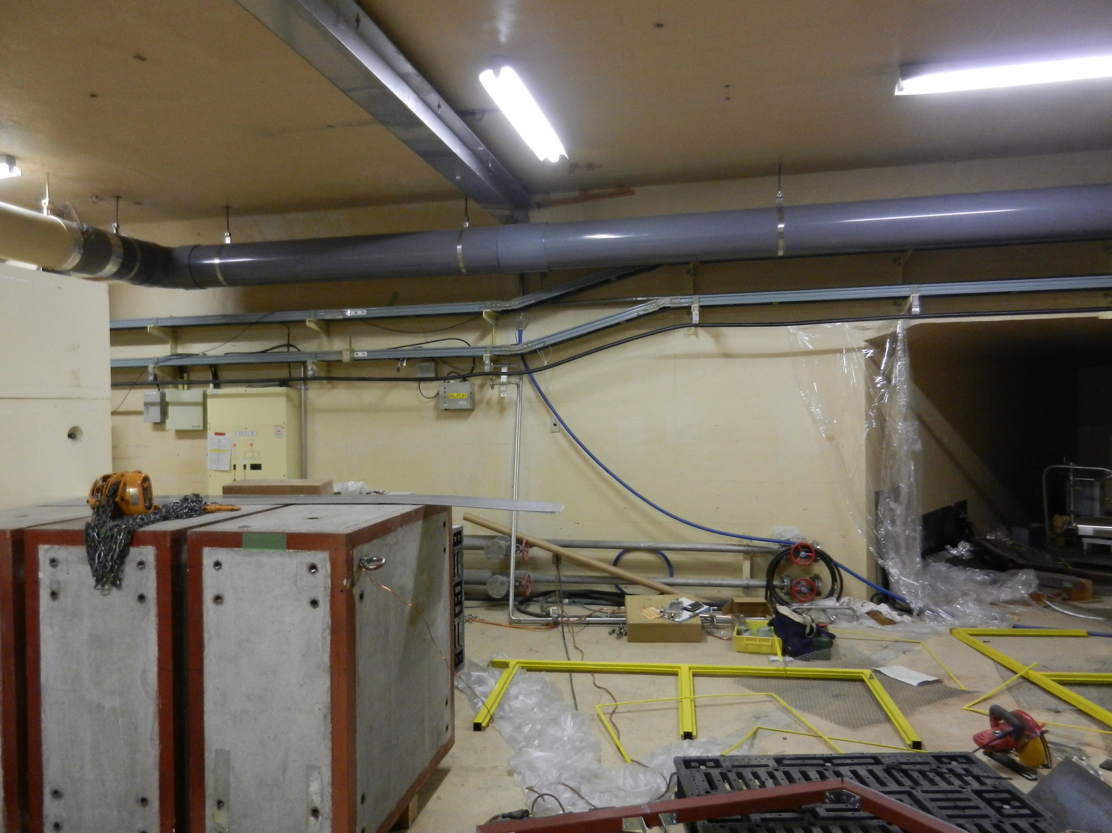
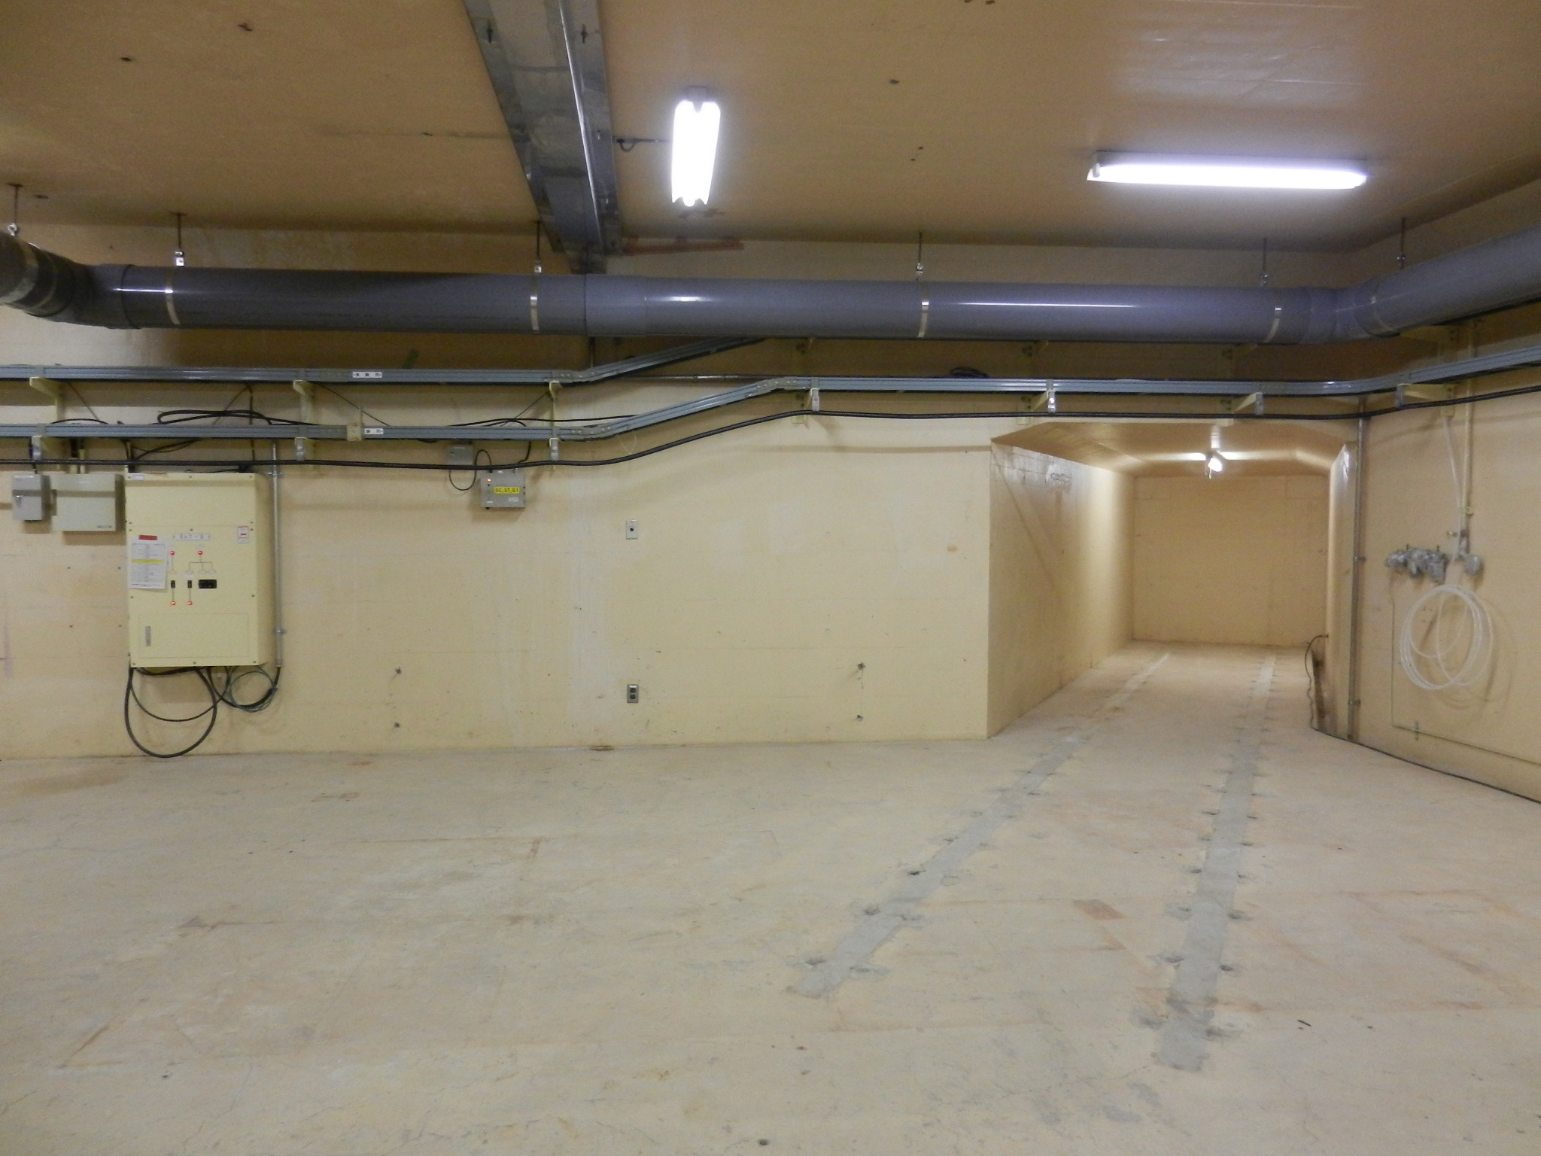
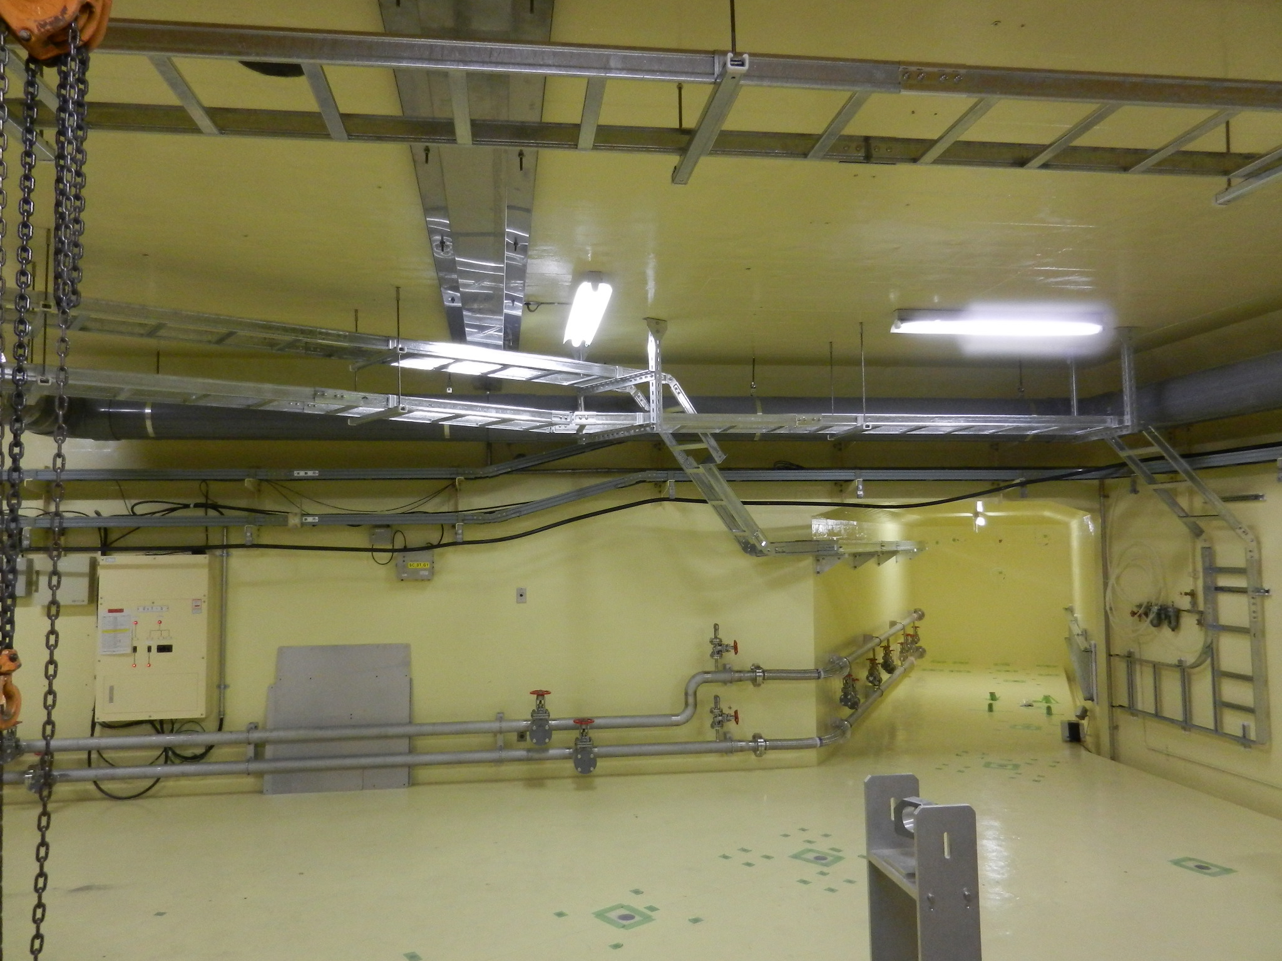
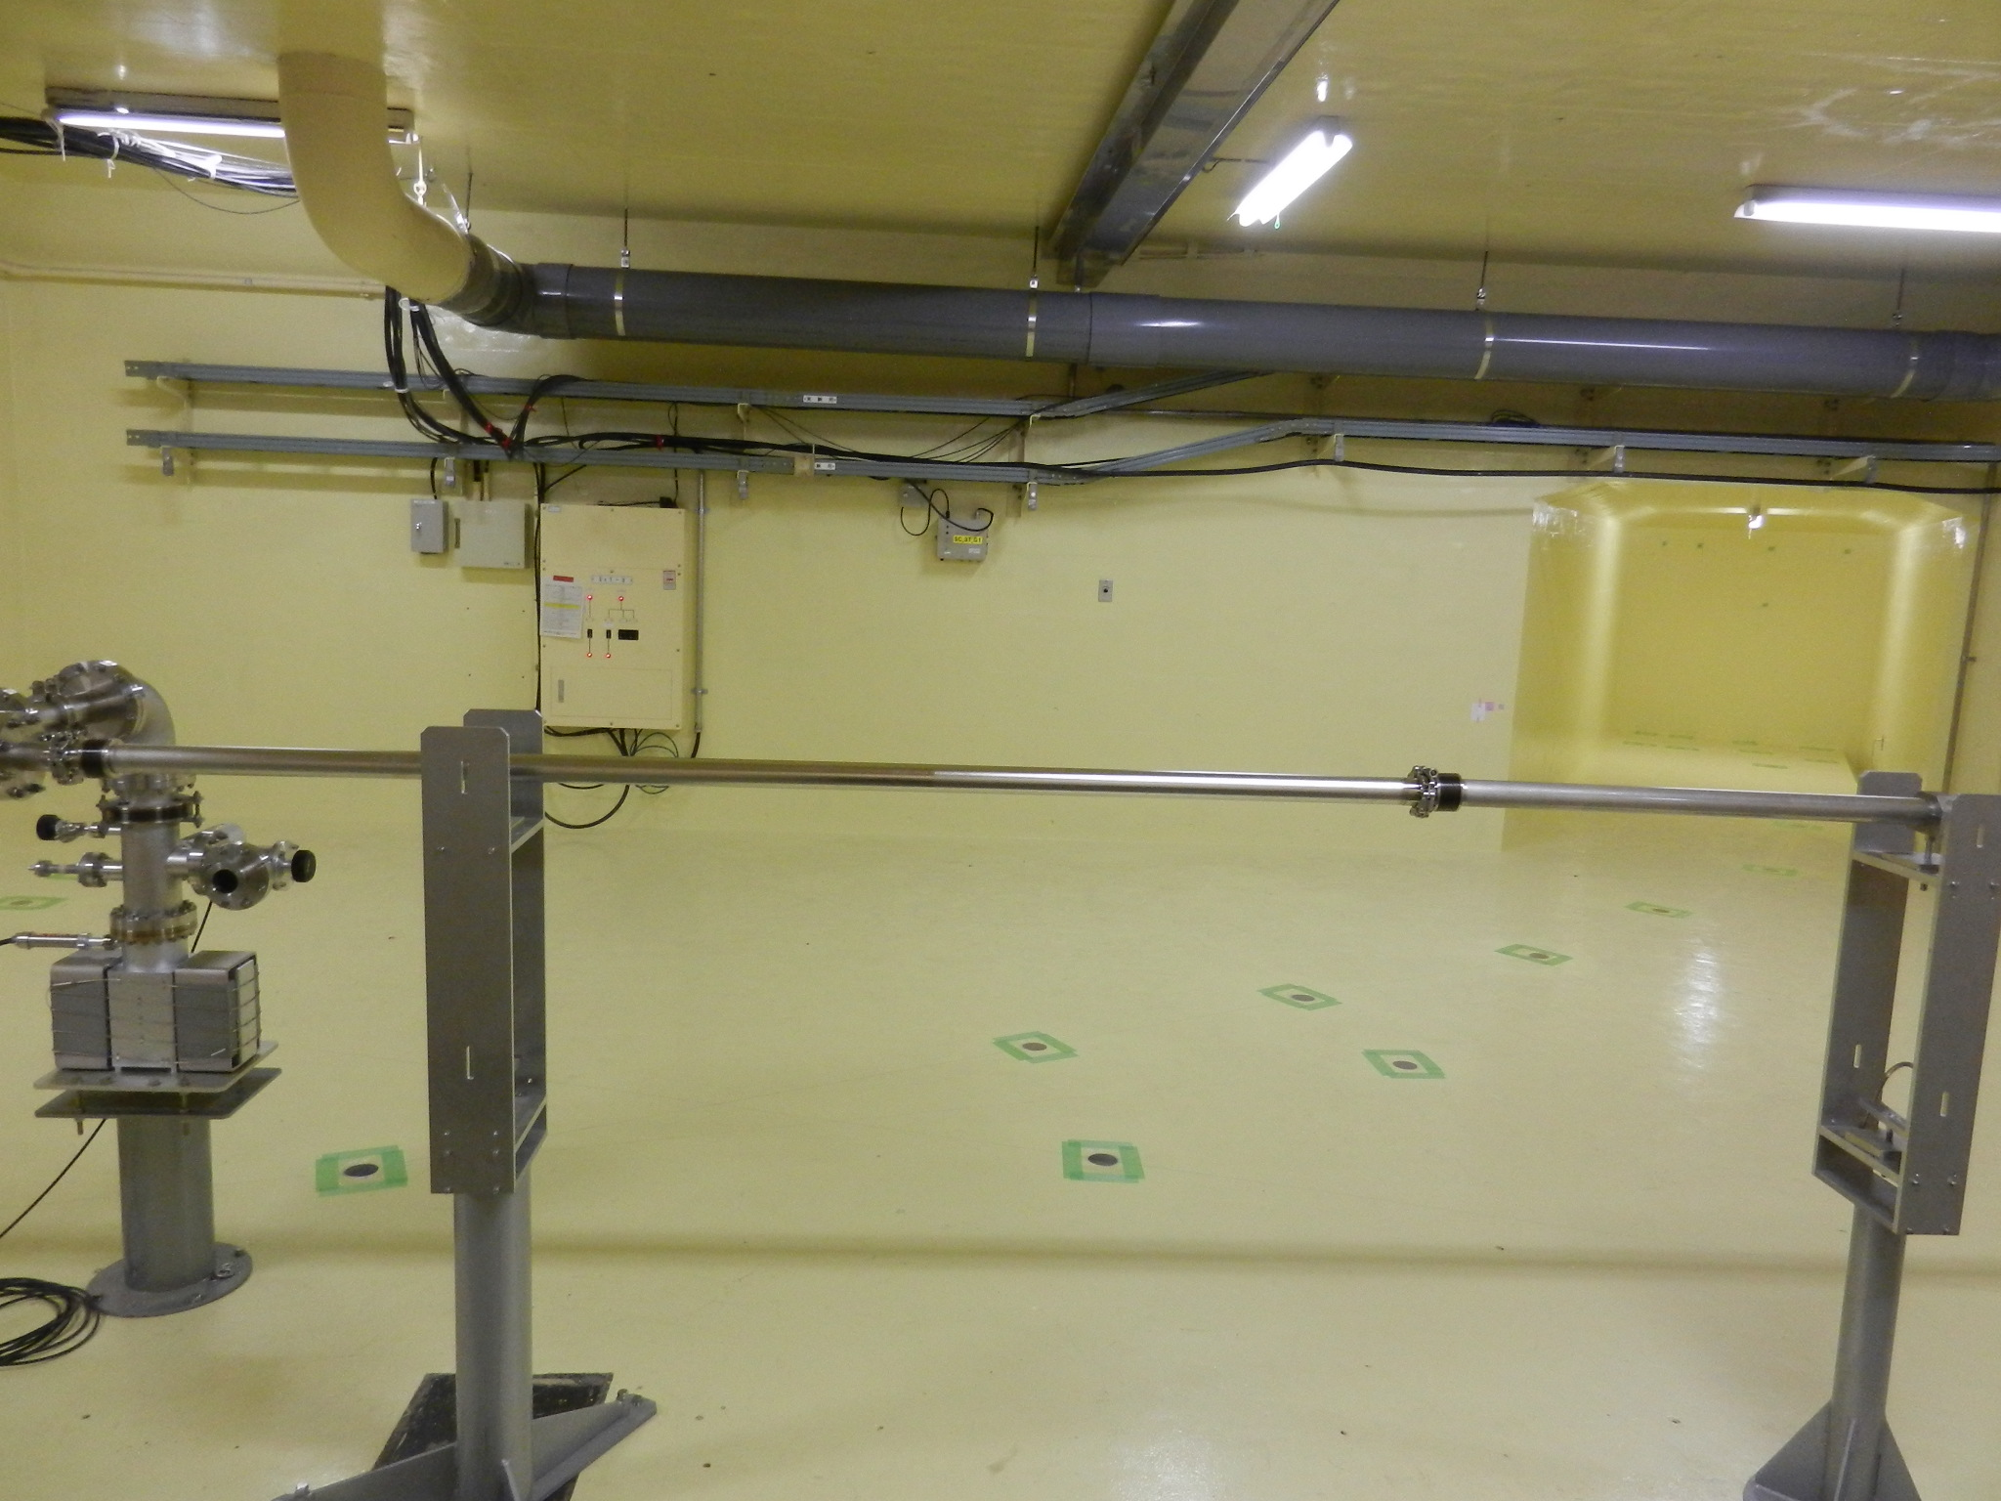
SY2 Construction
5/Sep/12
11/Oct/12
Cleaning
2m
LTR
for
DR
Painting,
Placing
anchor holes,
Drilling
holes to DR
many things were placed complicated.
It was re-freshed.
26/Feb/13
14/Dec/12
Piping for cooling water,
Installing cable racks
The magnets will be installed the next summer.
Notes:
These are pictures of the second switching yard. This is the narrow tunnel.
In last September, many things were placed complicated.
But after cleaning, it was re-fleshed.
After painting, placing anchor holes, drilling holes to DR, it was like this.
After piping for cooling water, and installing cable racks, it is in such a state now.
The magnets will be installed the next summer.

Slide 9
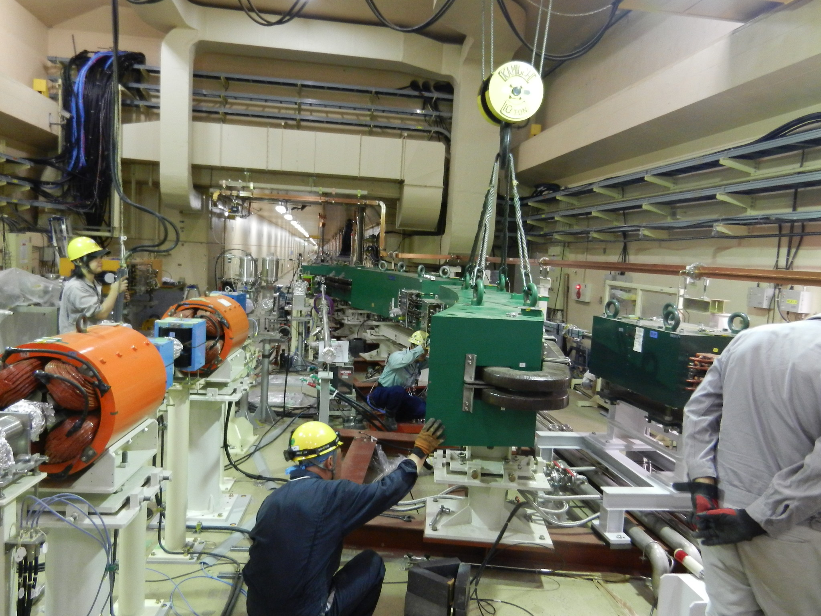
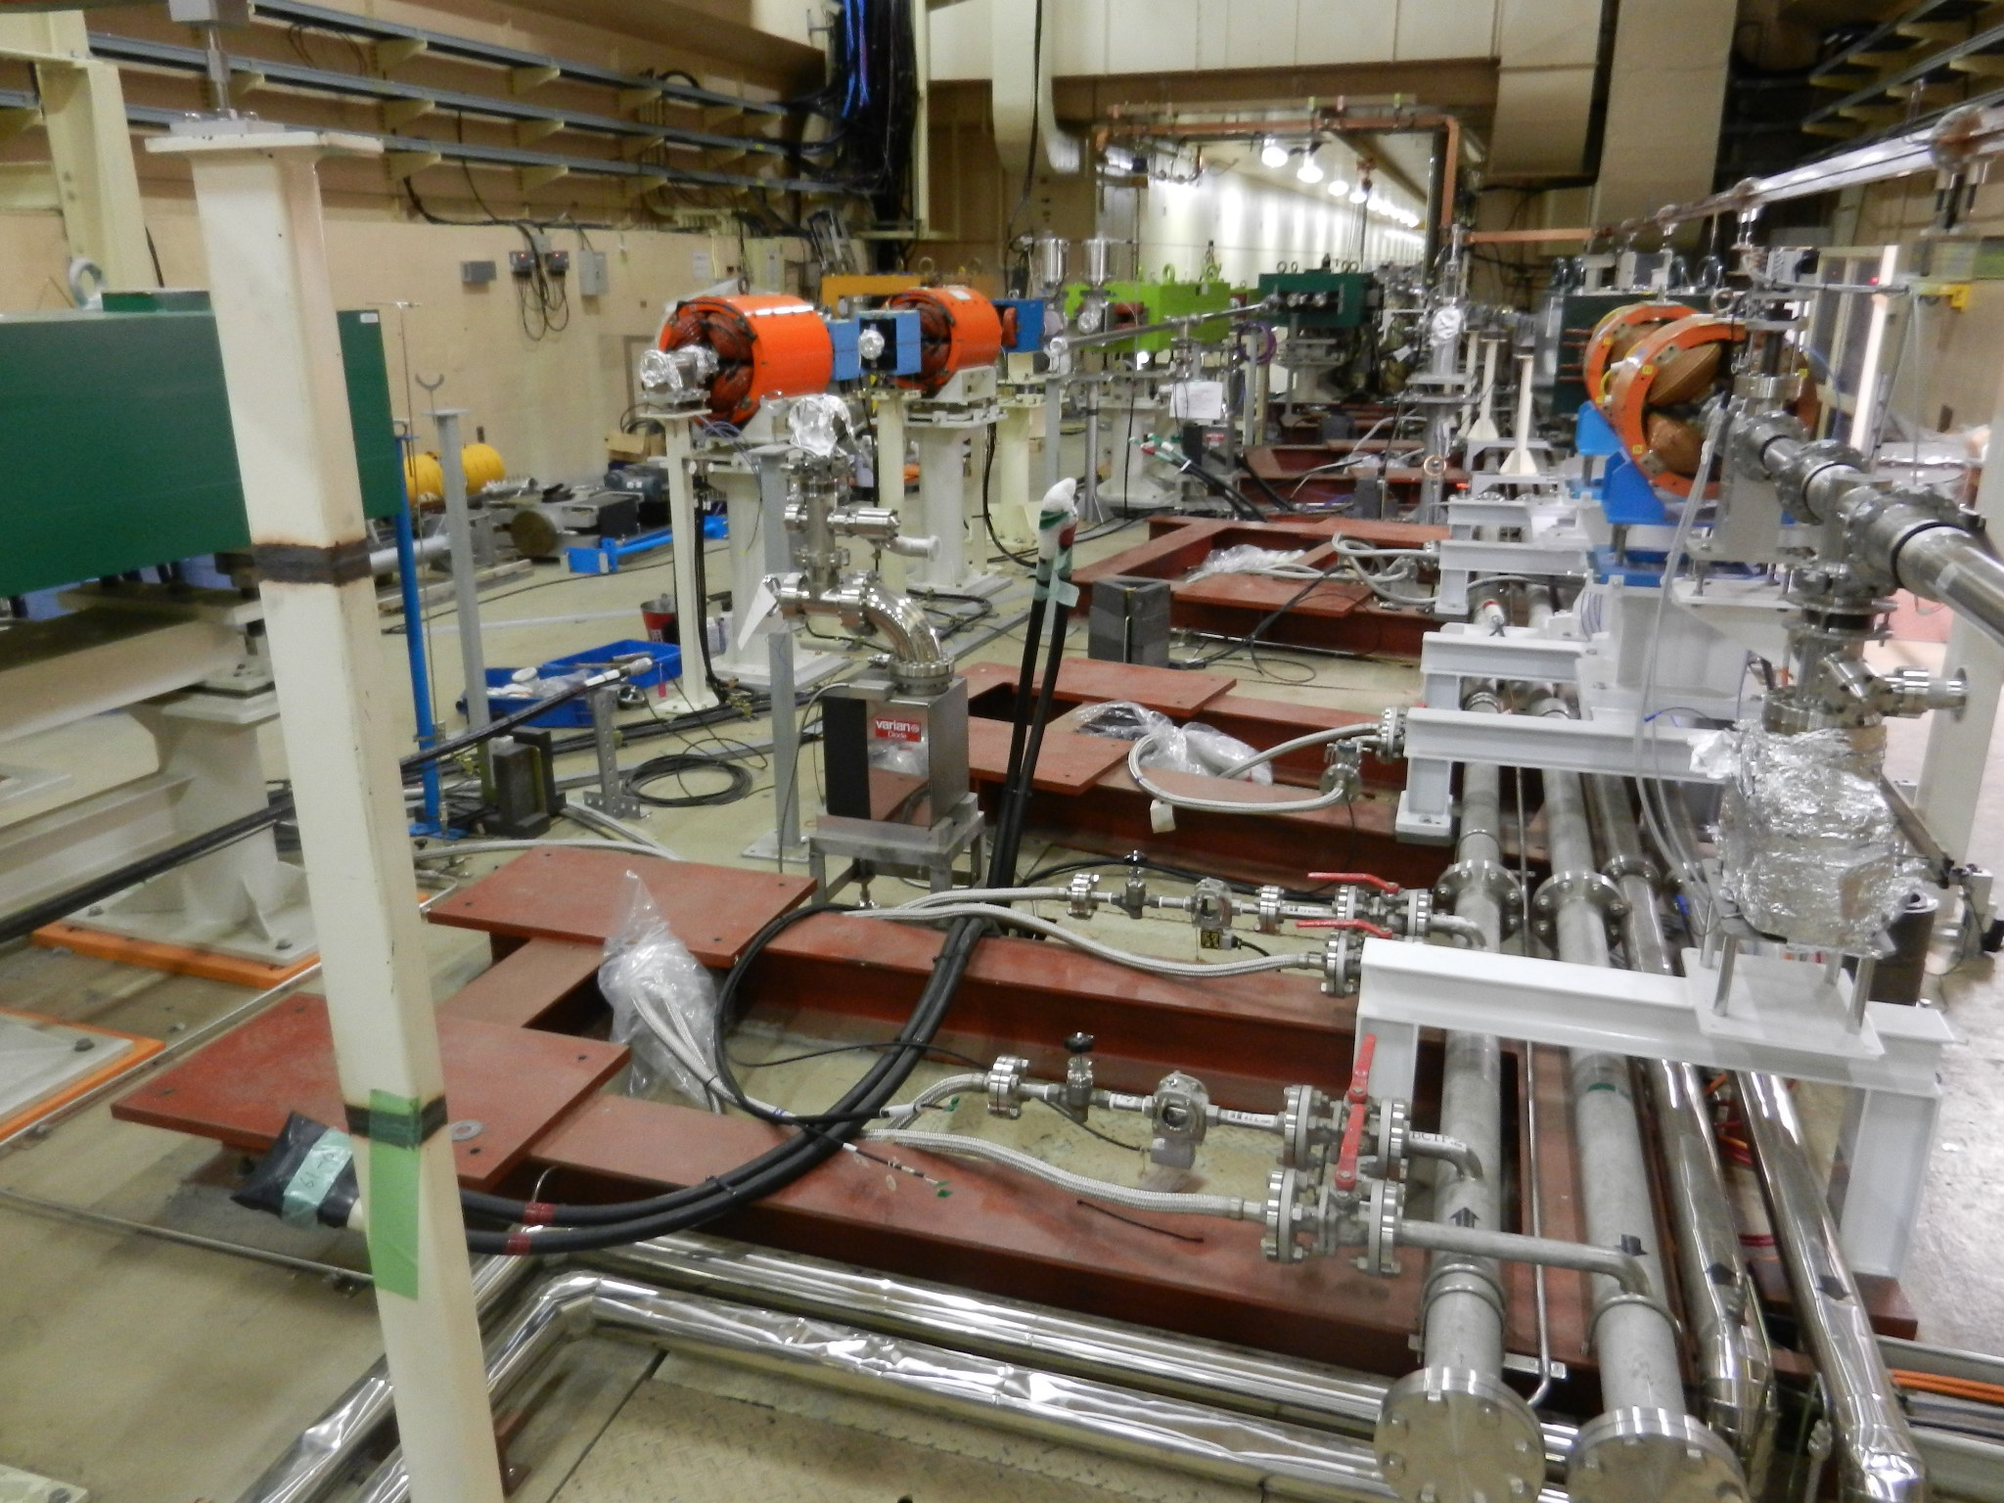
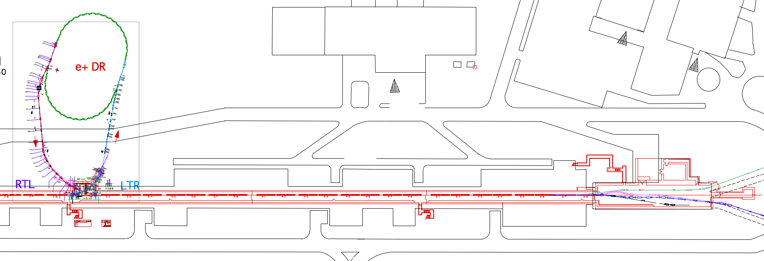
SY3 Construction
20/Jul/12
New Energy Compression System(ECS) of positron line at the end of LINAC is under construction, which is needed to change the energy of positron from 3.5 GeV to 4 GeV.
Magnets of ECS were removed
and the new ones will be installed
in this summer.
DR
Chicane of ECS
PF
SY3
LER
HER
Notes:
Now here is the 3rd switching yard.

Slide 10
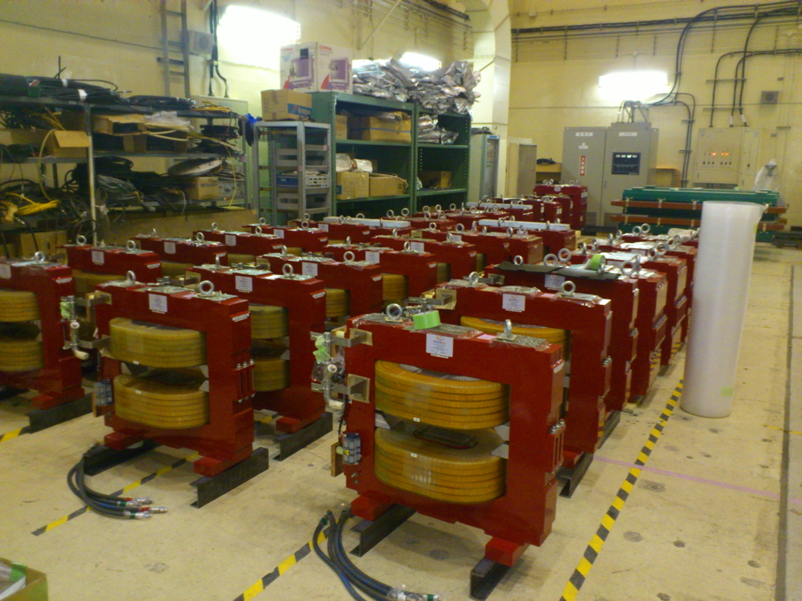
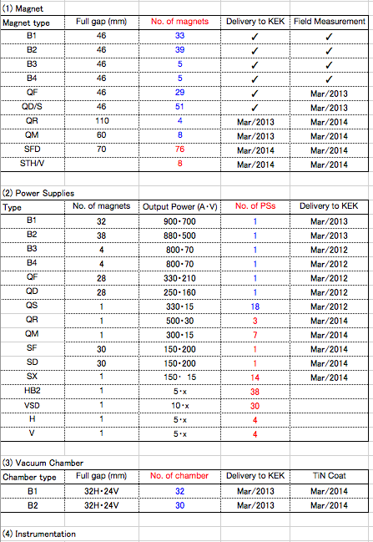
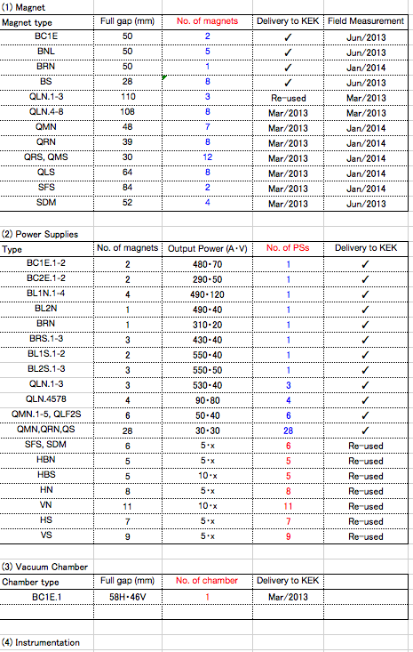
Construction of main Components
DR
LTR, RTL
Magnet
Magnet
Power supply
Power supply
Vacuum chamber
Vacuum chamber
Beam instrumentation
Beam instrumentation
Kicker, Septum
Notes:
The status of construction of main components is like this.
This is magnet, Power supply, Vacuum chamber, beam instrumentation, Kicker, and Septum.
I am sorry the characters are too small, but the important is the numbers of the components.
The blue characters shows finishing of delivery, and red ones are not yet.
In DR, The bigger magnets and power supplies are already delivered.
In LTR and RTL, almost all the magnets and power supplies have been delivered.
The vacuum chambers and beam instrumentation and kickers and septums will be ordered from now for both of DR and LTR, RTL.

Slide 11
Milestones of DR, LTR, and RTL
Sep/2014
LINAC commissioning will start.
Access to LTR and RTL area will be limited due to the LINAC commissioning.
By this time, the construction of LTR,RTL has to be completed.
May/2015
The beam from DR will be injected to LER.
Notes:
This is the milestones of the DR, LTR and RTL.
In September,

Slide 12
The New HER Abort System utilizing DC Sextupoles
Notes:
Let me move to the next subject,

Slide 13
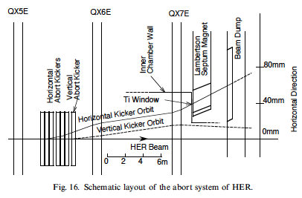
Abort system of KEKB
The horizontal abort kickers kick the stored beam out of vacuum chamber (The rise time〜500nｓ). The beam is extracted through Ti window to the atmosphere before entering the Lambertson magnet.
Power density on the Ti window is diffused by introducing vertical kicker that sweeps the beam vertically.
The beam comes out to the atmosphere from a vacuum through the Abort window(Ti) at the entrance of Lambertson magnet.
The beam is bent downward by Lambertson and leads to Dump.
K. Satoh
Notes:
The KEKB Abort system is like this.
The horizontal kickers kick the beam horizontally and out of the vacuum through the Abort winsdow, Lambertson magnet kicks downward to the Dump.

Slide 14
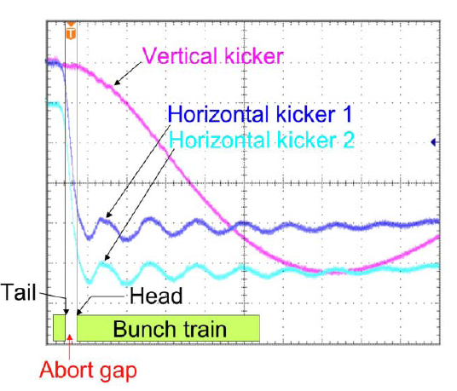
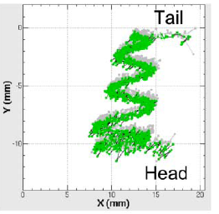
Abort system of SuperKEKB
KEKB
In SuperKEKB, the low emittance beam has a possibility of destroying the abort window more than KEKB.
Enlarging horizontal beam size is needed other than the vertical sweep.
Horisontal kicker：
fast kick to the Abort window
Vertical kicker：
slow sweep vertically
SuperKEKB(LER)
SuperKEKB(HER)
Horisontal kicker：
fast kick to the Abort window
Vertical kicker：
slow sweep vertically
PULSEd quadrupole：
enlarge the horizontal beam size
Horisontal kicker：
fast kick to the Abort window
Vertical kicker：
slow sweep vertically
DC sextupole：
enlarge the horizontal beam size
Vertical kicker
20μm
6μm
beam profile at Abort window
±σx
±σx
V.kick
Maximum power density at the turning point !!
V.kick
T. Mimashi
Notes:
In SuperKEKB, the low emittance beam has a possibility of destroying the abort window more than KEKB.
So enlarging horizontal beam size is needed other than the vertical sweep.
At the last review committee, Mimashi-san showed the abort system using pulsed quadrupoles.

Slide 15
17th KEKB Review by T. Mimashi
 | HER(7 GeV) |  |  | LER
 | H | V | Q | H | V | Q
θ(mrad) | 4.6 | 0.35 | - | 1.68 | 1.05 | -
B (T,T/m) | 6.7e-2 | 2.5e-2 | 1.5 (B’) | 3.3e-2 | 4.1e-2 | 1.5(B’)
I total (kA) (/coil) | 14.9 (2.5) | 0.47 | 11.7 (2.2) | 3.6 (1.8) | 0.8 | 4.3 (2.15)
Gap (mm) | 70 | 70 | 35 Bohr Rad | 70 | 70 | 42.5 Bohr rad
L of Ferrite | 400x6 | 400x1 | 400x8 | 350x2 | 350x1 | 400x2
# of coil | 6 | 1 | 8 | 2 | 1 | 2
L of Ceramic | 500x6 | 500x1 | 500x8 | 500x2 | 500x1 | 500x2
Too many !
Abort Kicker and Pulsed Quadrupole magnet Specifications
Notes:
For LER, it is no problem for installing pulsed quadrupole.
However, for HER, the number of quadrupoles is too many.

Slide 16
Abort optics with DC sextupole
K. Oide
Instead of pulsed quadrupoles, a DC sextupole is used for enlarging the horizontal beam size.
A DC sextupole is installed between the abort kickers and the abort window. The deflected beam feels an additional quadrupole kick effectively.
Another DC sextupole is needed to make a pair of sextupoles for cancellation of the geometrical nonlinearity. The pair of Sextupoles is connected by I or - I transformation.
Notes:
So for HER, Abort DC sextupole is proposed.
Cancellation of Geometrical aberration

Slide 17
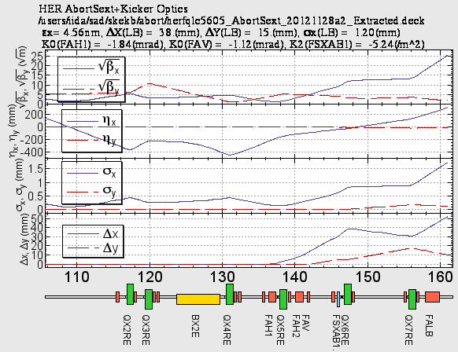
Abort beam parameters for the ring optics of the Synchrotron injection
HER
herfqlc5605_AbortSext_20121128a2_Extracted.deck
e- Beam
Beam dump
Abort window
Abort kickers
Abort sextupole
Notes:
This is a new abort optics in Synchrotron injection scheme.
Electron beam comes from the left side.
Here are Abort kickers, sextupole, and abort window.
At the sextupole, the horizontal orbit becomes about 40mm, and at the abort window, the beam size is 1.2mm, which is large enough.
This beam size is about 5 times larger than that without the sextupole.

Slide 18
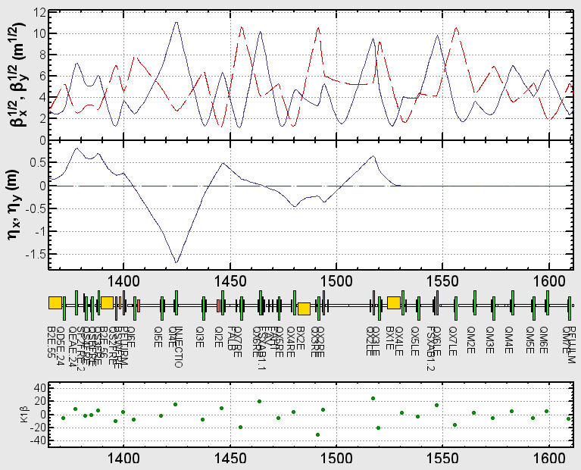
HER Optics for Synchrotron injection
/users/iida/sad/skekb/injection/her/herfqlc5605_20111227_AbortSext_20120316a2.deck
Matching：
βx₁=βx₂
βy₁=βy₂
ν_{x1}-ν_{x2}=1.5
ν_{y1}-ν_{y2}=1.0
1: AbortSext(1)
2: AbortSext(2)
ηx=0
at the center
of the sexts.
εx=4.646nm
εy=11.62pm
e- Beam
AbortSext(1)
AbortSext(2)
Abort region
Injection point
Emittance changes are negligible.
Notes:
This is HER optics around Fuji straight section.
e- beam comes from the right side. This is an injection point. . This is the abort region shown in the previous slide.
For the synchrotron injection scheme, there is a large non-dispersion region.
We searched the position of one more sextupole and found here is the best.
We matched the beta functions at the two points, and made the dispersion function 0 crossing at the center of the sextupole.
After these matching, the emittance changes are negligible.

Slide 19
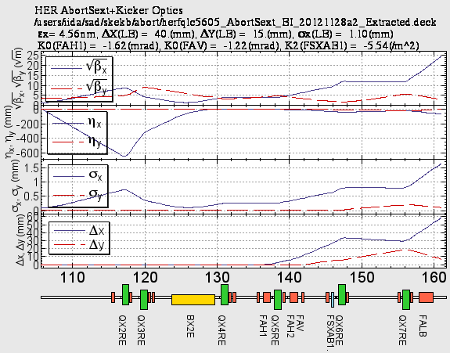
Abort beam parameters for the ring optics of the Betatron Injection
HER
herfqlc5605_AbortSext_BI_20121128a2_Extracted.deck
e- Beam
Beam dump
Abort window
Abort kickers
Abort sextupole
Notes:
Similarly, also in the betatron injection scheme, we can design the abort optics using the DC sextupole.

Slide 20
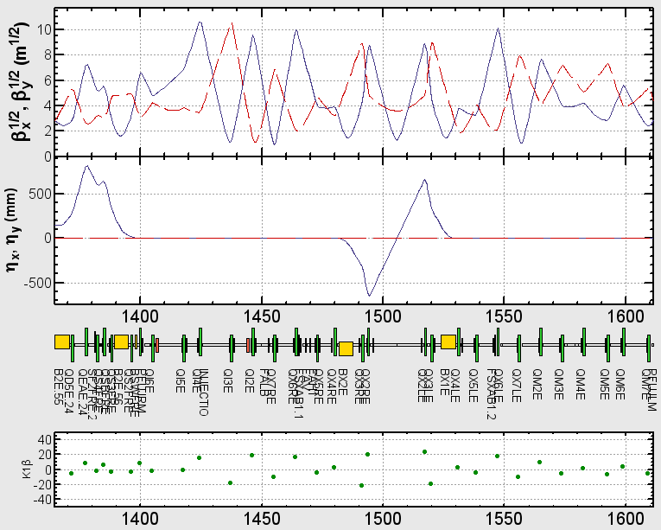
HER Optics for Betatron injection
/users/iida/sad/skekb/injection/her/herfqlc5605_AbortSext_20120316a2.deck
Matching：
βx₁=βx₂
βy₁=βy₂
ν_{x1}-ν_{x2}=1.5
ν_{y1}-ν_{y2}=1.0
1: AbortSext(1)
2: AbortSext(2)
ηx=0
at the center
of the sexts.
εx=4.511nm
εy=11.28pm
e- Beam
AbortSext(1)
AbortSext(2)
Abort region
Injection point
Emittance change is negligible.
Notes:
This is the same graph as the synchrotron injection scheme.
The emittance change is also negligibly small.

Slide 21
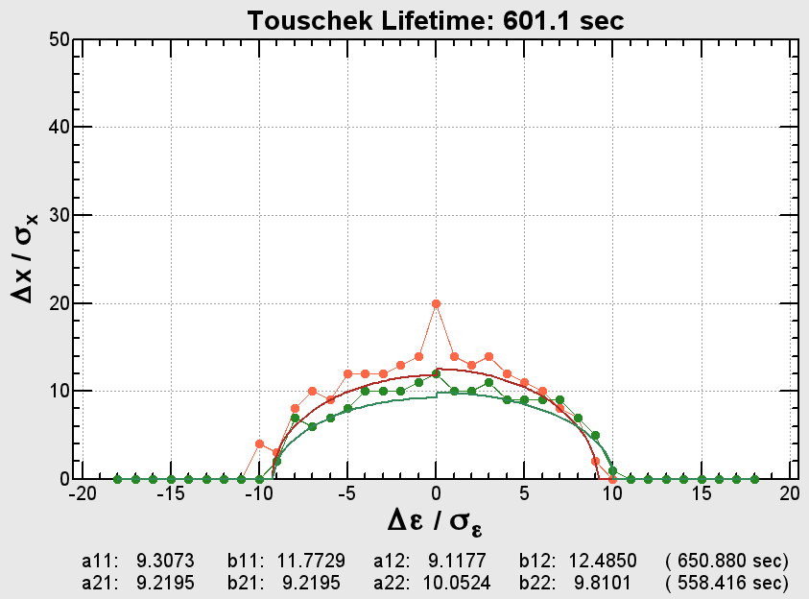
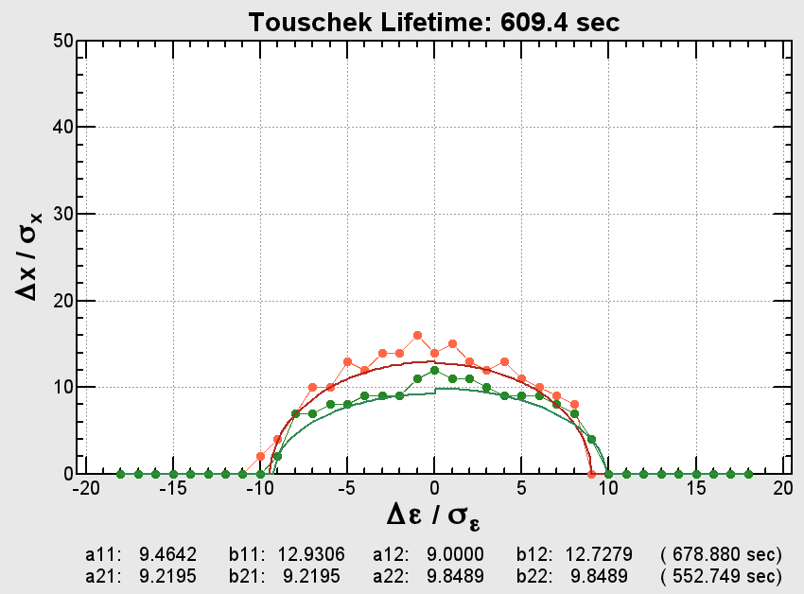
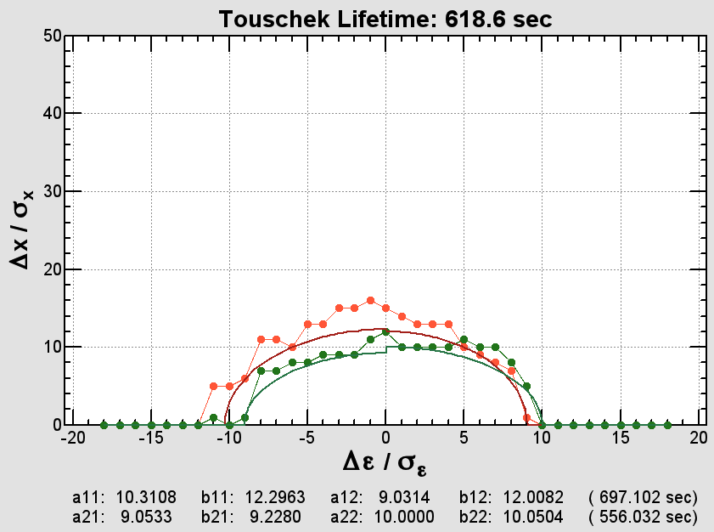
Dynamic aperture
Y. Ohnishi
The life time is optimized for each sextupoles.
Case1: SEXT FSXAB1 =(L =.334 K2 =0 ) -> 610 sec Case2: SEXT FSXAB1 =(L =.334 K2 =2.777278350689298 ) -> 600 sec Case3: SEXT FSXAB1 =(L =.334 K2 =4.52820764294694 ) -> 620 sec
Case2:K2=2.777
Case1:K2=0
Case3:K2=4.528
At the several values of K2, tousheck life times are almost same.
No adverse effect due to the insertion of the Abort sextupoles.
Notes:
The dynamic aperture was checked by Ohnishi-san.

Slide 22
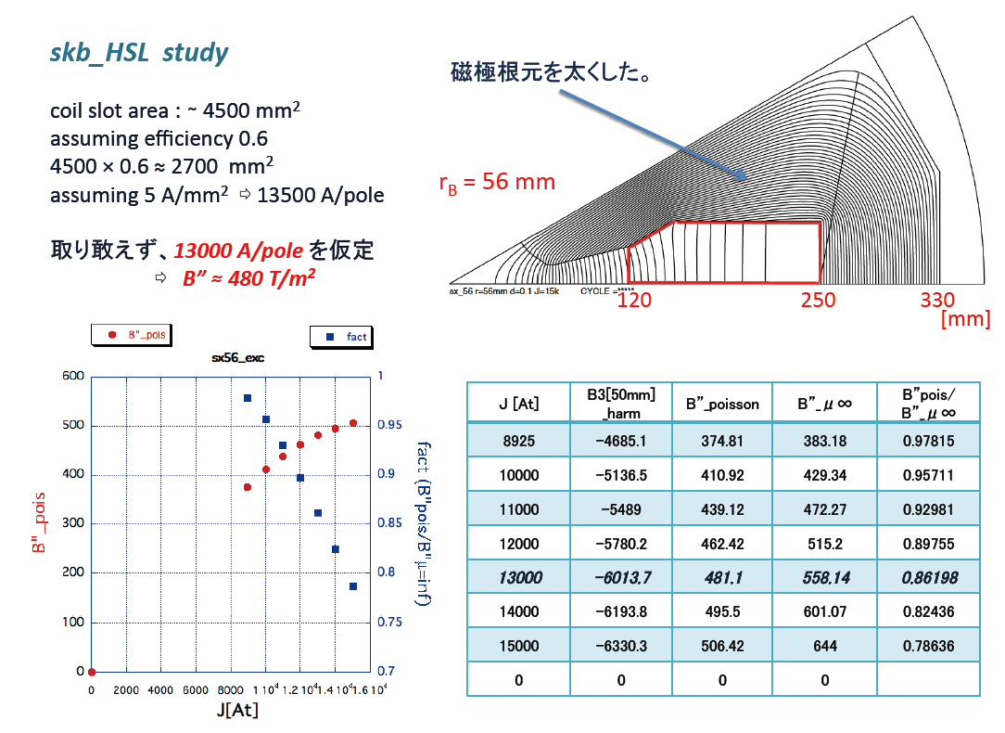
Magnet design of the sextupole
The specification is not special.
K. Egawa
Power supply: 20V 600A
Notes:
Egawa-san designed the magnet.
The specification is not so special.
The power supply for this is also not challenging.

Slide 23
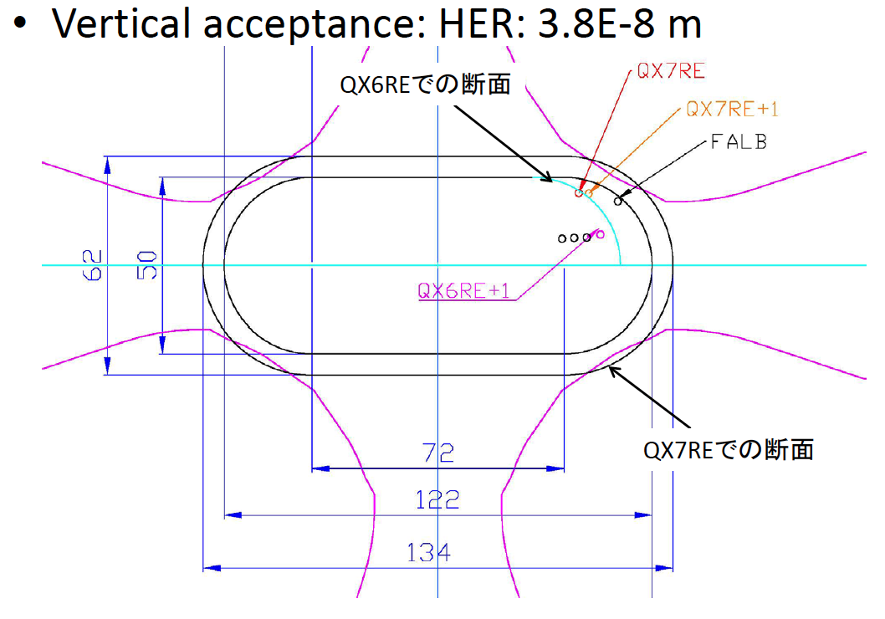
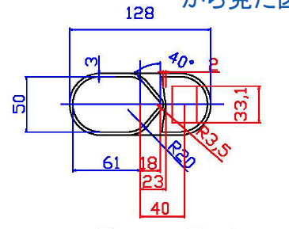
Chamber in the abort region
Y. Suetsugu
Abort window
The coherent betatron oscillation is considered.
The chamber apertures have been designed so that the aborted beam with the coherent oscillation is accepted.
When the amplitude of coherent betatron oscillation is expected to be larger than the aperture of the window, the beam must be aborted. The detection of beam oscillation should be faster than the growth rate of the oscillation.
This is still under undergoing now.
Notes:
The chamber design is under going by Suetsugu-san.

Slide 24

Construction of the Abort systems
Phase 1
The new HER abort system is installed.
The chambers of Fuji straight section
The chambers near the injection (kickers and abort kickers) will be smaller than those of KEKB.
The LER abort system is still old.
Since DR is not completed at the beginning of Phase 1, the emittance of the injected beam is large.
All of the new LER chambers in the abort section and the new injection chamber with a narrow slit have smaller apertures than those of KEKB. The slit is for improving the vacuum pressure around the septum.
They should be installed at the same time in order to avoid a cavity structure. The larger beam without damping ring can not pass through the narrow slit.
So at the time the abort system is still old.
The stored current of LER must be low to protect the abort window. (500mA max)
Phase 2
The new LER abort system is installed.
Notes:
This is a last slide of my talk.

Slide 25
Backup slides

Slide 26
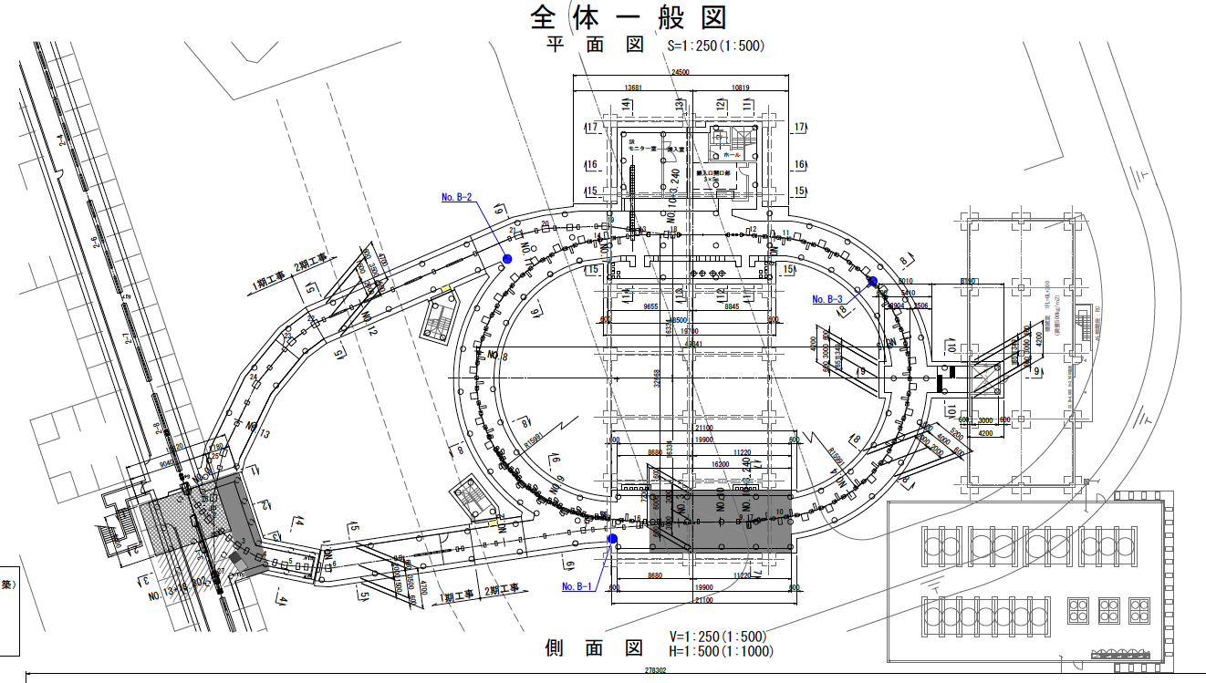
Plan view of DR
e+ beam
Damping Ring
RTL
LINAC
Sector-2
SY2
Sector-3
LTR

Slide 27
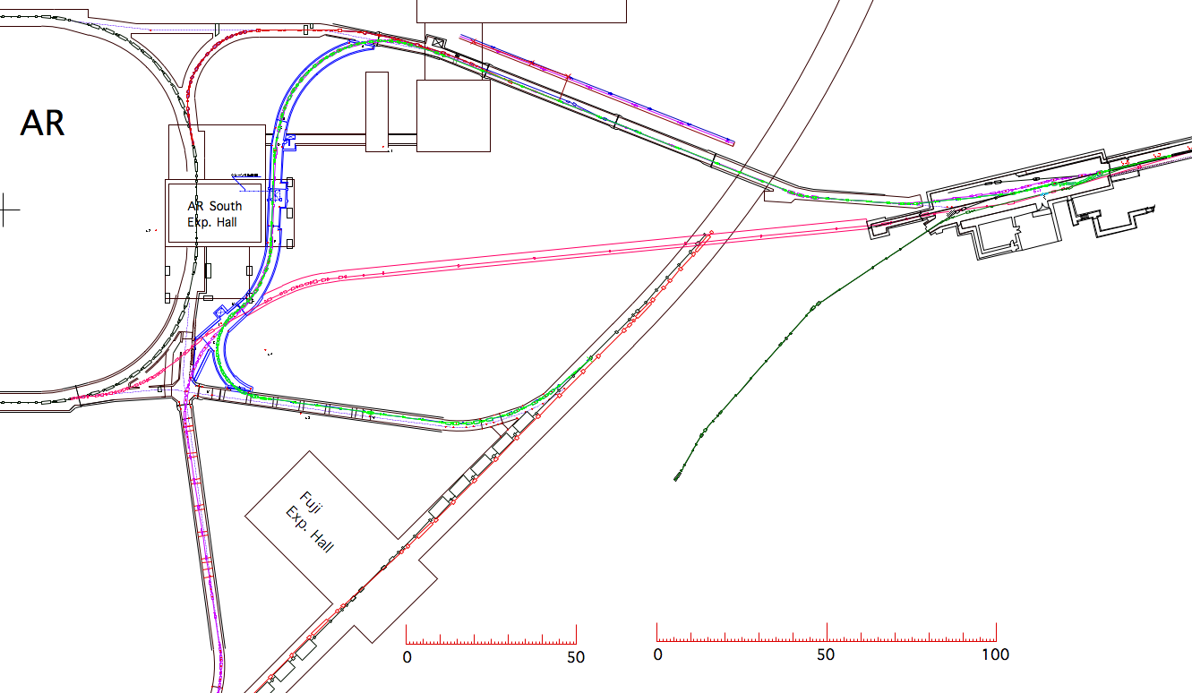
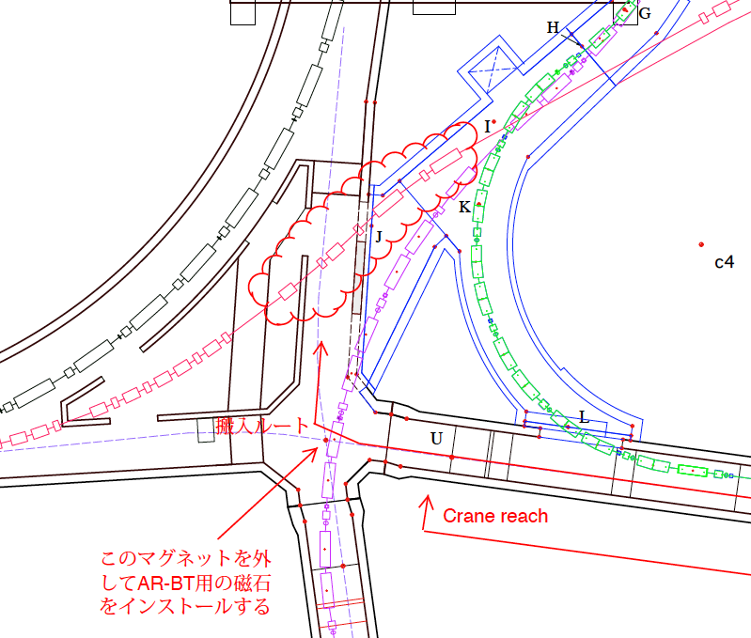
Work for AR/BT in 2015
The new AR direct injection line
Carry-in Route
This magnet will be moved during the AR-BT magnets installation
Notes:
As Takaki-san talked, in 2015, the new AR direct injection line will be constracted.
For this work, the re-used magnets are carried out from here, and are carried from here.
one bending magnet will be moved.

Slide 28
Recent discussion of DR
Beam abort of MR
When the beam in LER is aborted, the 2 or 4 positron bunches are still stored in the DR.
The interval of the extraction trigger signal is 20 ms in minimum.
Time from the abort trigger to the working of the abort system is a few 100 μs.
What do we do with them ?
Wait for injection ready and inhibit the extraction signal.
Inject to LER and continue the experiment.
Inject to LER and abort again after 1 minute for charging the abort magnet.
Make a small beam dump in the RTL or LINAC using a pulsed steering magnet or DC steering magnet.

Slide 29
KEKB Abort system
Abort (pulsed) kickerで周回ビームを水平に蹴る(立ち上がり時間〜500nｓ)。 同時に垂直にゆっくりSweepすることで、Abort窓でビームが１点に集中しないようにする
Abort窓(Lambertson magnet入口)で真空から大気に出る。
Lambertsonで大きく下に曲げてDumpに導く。
K. Satoh

Slide 30
SuperKEKB Abort system
Abort (pulsed) kickerで周回ビームを水平に蹴る。
Abort窓(Lambertson magnet入口)で真空から大気に出る。
Lambertsonで大きく下に曲げてDumpに導く。
KEKB
SuperKEKB(w AbortQ)
SuperKEKB(w DC-Sext)
Abort kicker(水平)：
Abort窓に蹴り出す。
Abort kicker(垂直)：
垂直にSweepさせる。
Abort kicker(水平)：
Abort窓に蹴り出す。
Abort kicker(垂直)：
垂直にSweepさせる。
Abort quad：
Abort窓での水平ビーム
サイズを大きくする。
Abort kicker(水平)：
Abort窓に蹴り出す。
Abort kicker(垂直)：
垂直にSweepさせる。
DC Sext：
kickerによってΔX蹴られた場所にDCの六極を設置することで、四極成分を感じAbort窓での水平ビームサイズを大きくする案（生出さん）。
kickerがFireしない場合、ビームは六極の中心を通り、四極を感じない。 -Iの場所に対の六極を置くことでNon-linear成分をCancelする。
Vertical kicker
20μm
6μm
Abort窓
±σx
±σx
また、SuperKEKBのHERでは、今までのBetatron injectionではなく、
Synchrotron injectionを試みる予定である。
入射点付近に設置しているAbort systemも、Synchrotron injectionのOpticsで検討した。
V.kick
Ringingは、折り返しが危ない
V.kick
T. Mimashi

Slide 31
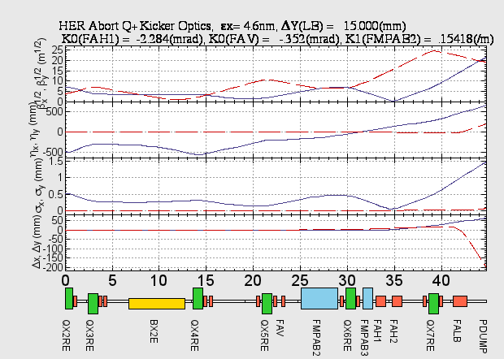
HER Abort optics with Pulsed Quadrupoles
17th KEKB Review by T. Mimashi
N.Iida et al
Pulsed quadrupoles

Slide 32
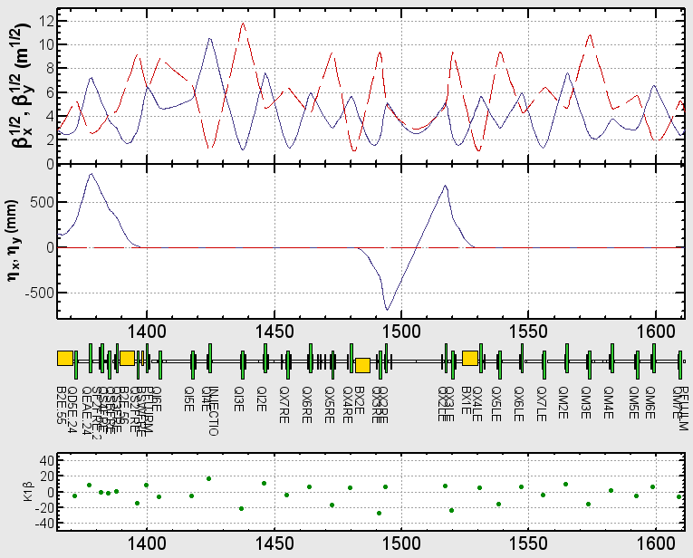
HER Optics for betatron injection
Betatron Injection
εx=4.559nm
εy=11.40pm
e- Beam

Slide 33
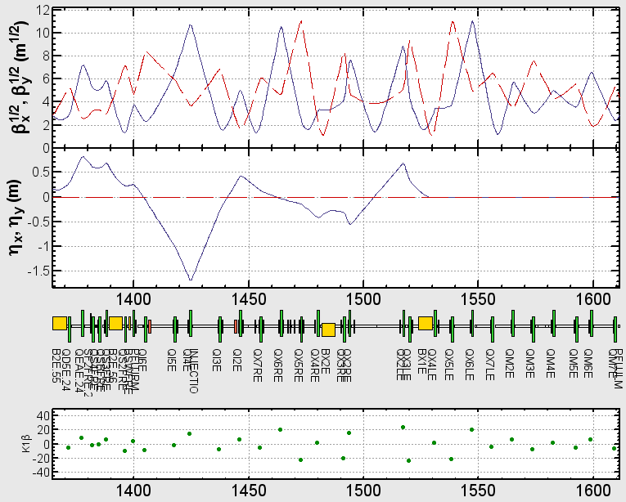
HER Optics for Synchrotron injection
T. Mori et al.
εx=4.644nm
εy=11.61pm
e- Beam

