Slide 1
Beam Diagnostics
The 18th KEKB Accelerator Review Committee
March 5th, 2013
KEKB Monitor Group
M. Arinaga, J. Flanagan, H. Fukuma, H. Ikeda, H. Ishii,
S. Kanaeda, K. Mori, M. Tejima and M. Tobiyama

Slide 2
Contents
Introduction
Beam Position Monitor System
Bunch Feedback Systems
Photon Monitor System
Misc.
Construction Plan
Summary

Slide 3
Introduction
System | Quantity
 | HER | LER | DR
Beam position monitor (BPM) | 466 | 445 | 84
Displacement sensor | 100 | 100
Transverse bunch by bunch feedback | 1 | 1 | 1
Longitudinal bunch by bunch feedback |  | 1
Visible light monitor | 1 | 1 | 1
X-ray light monitor | 1 | 1
Beamstrahlung monitor | 1 | 1
Gated measurement | 1 | 1
Tune monitor | 1 | 1
Loss Monitor | 200 |  | 34
DCCT | 1 | 1 | 1
Bunch current monitor | 1 | 1 | 1

Slide 4
Beam Position Monitor System

Slide 5
Beam Position Monitor System
Decisions made after last ARC
70 turn-by-turn BPM detectors out of 270, 35 in each ring, will be installed for Phase 1.
  The detectors will be mainly used for injection tuning.
Four medium-band detectors will be installed for Phase 1.
  The detectors will be used for measuring orbit variation near local chromaticity correction sextupoles. No orbit feedback will be applied.
  HER : SLYTRE.1, SLYTRE.2
  LER : SLYTRP.1, SLYTRP.2
Four BPMs will be used for triggering the beam abort if a large horizontal orbit deviation is observed. The purpose of the monitors is to protect extraction windows for aborted beams.
A monitor measuring longitudinal position/phase of the injected bunch will be installed.
  We are considering the use of commercial Libera based detectors for items 2, 3 and 4 above.

Slide 6
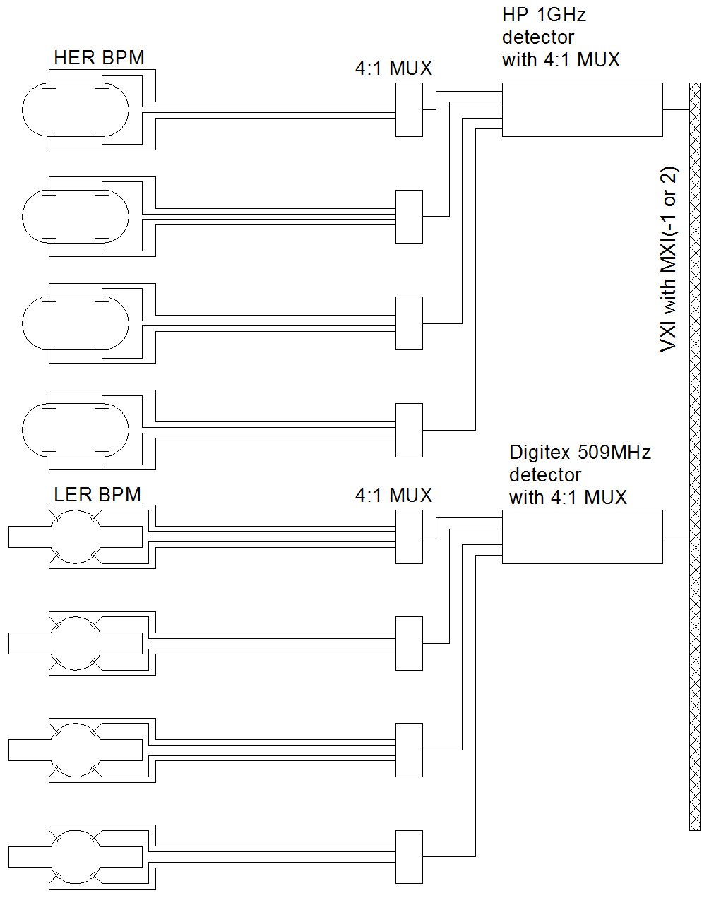
Configuration of main BPM system
Gated TbT
Super-heterodyne detectors in KEKB BPM system are also main detectors in SuperKEKB.
Detection frequency in LER is lowered to 509 MHz due to the chamber cutoff frequency of 989 MHz.
Selected 270 BPMs have gated turn-by-turn monitoring function.
Gated TbT

Slide 7
BPM system at Phase 1
Type | Function | Resolution | Repetition | Number of units
Narrow-band of KEKB | Closed orbit correction, CCC, optics measurement | 3μm | 0.25Hz | 109 (already have.)
New narrow-band with 509MHz detection | As above | 2 to 3 μm | 0.25Hz | 133
Gated turn by turn | Injection tuning, optics measurement | 50 - 100μm | 100kHz | 70
Medium-band | Measurement of orbit variation | < 2 to 3 μm | 10kHz | 4
One narrowband detector covers four BPMs.
IP feedback detectors might be tested though they are not needed at Phase 1.

Slide 8
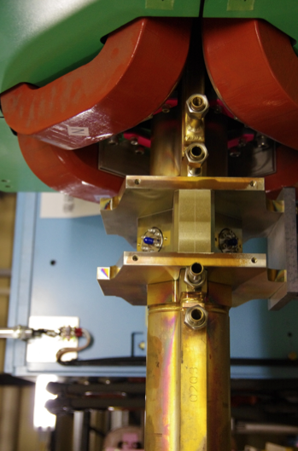
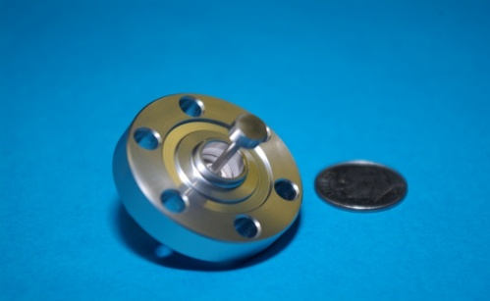
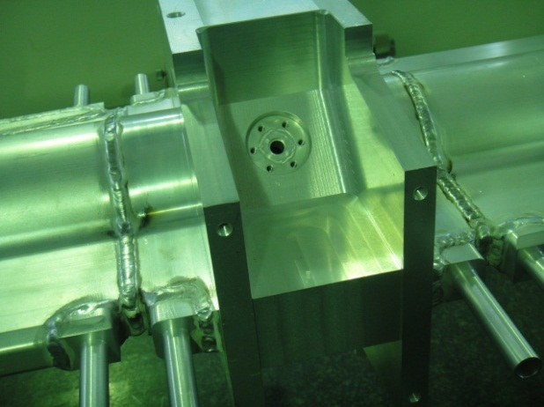
Button electrode and BPM support for the LER
•Button electrode
  Production of all electrodes is completed.
  The electrodes are being installed on BPM blocks after coating with TiN.
    Diameter : 6mm
    Flange type for easy replacement and for removal during TiN coating of the chamber
    Pin-type inner conductor for tight electrical connection..
BPM block
  All BPM blocks connected to LER arc chambers have been made by the vacuum group.
Button electrode
BPM block at wiggler sections
BPM block in arc sections

Slide 9
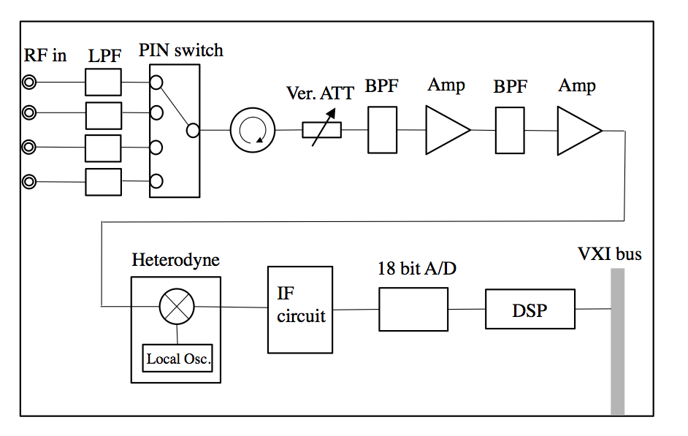
509 MHz Narrowband Detector
Twenty 509 MHz narrowband detectors have been ordered in this FY.
Mass production of 120 units is scheduled in next FY.
Super heterodyne detector with 509MHz detection
MUX 4:1
BPM
VXI module

Slide 10
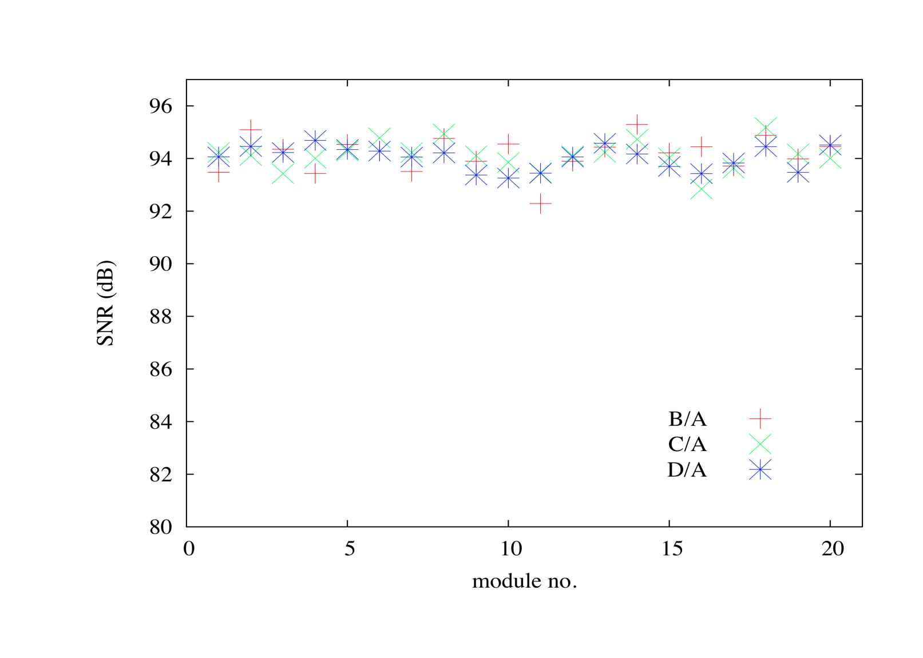
509 MHz Narrowband Detector : Performance (tentative)
•Performance of the detectors is being measured at the company as part of the production.
Ratio SNRs (B/A, C/A, D/A) are larger than 90 dB.
  (A, B, C, D : voltages of four electrodes)
Temperature at the measurement: 25deg.

Slide 11
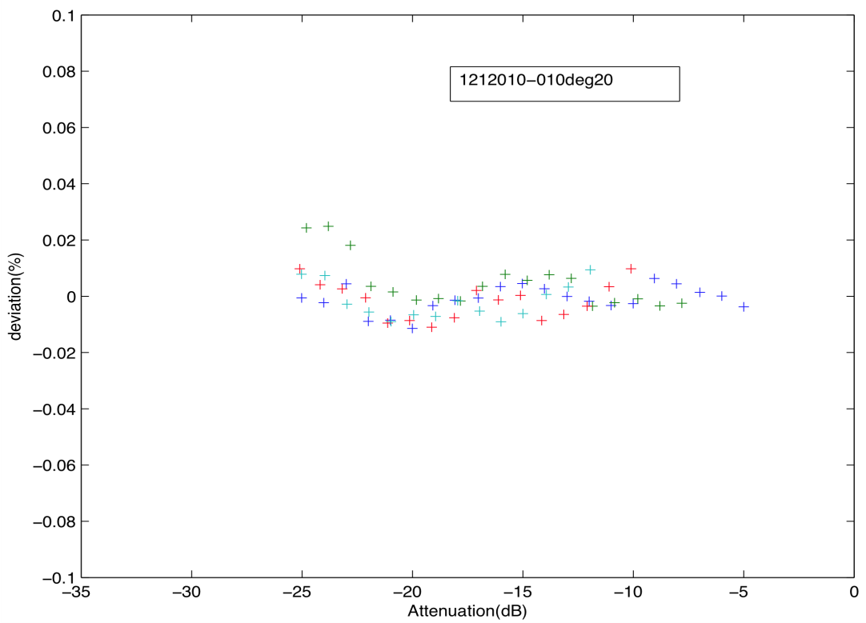
2) Apparent position shift by changing attenuation of the variable attenuator from 0 to 55dB is about 3 μm p-p.
3) Linearity is better than 0.05% in the voltage range of 1/4 full scale to full scale.
Channel A
Linearity was measured by changing input power level with variable and fixed attenuators.
Attenuation at each setting of the attenuators was calibrated by the fit to data.
deviation from a line
Example of linearity analysis

Slide 12
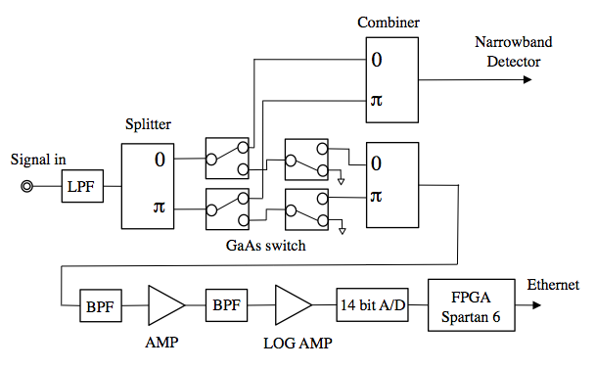
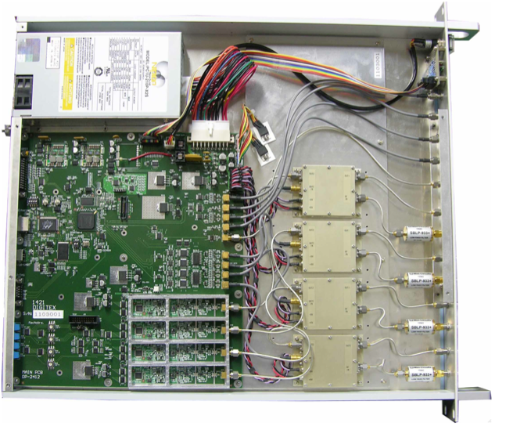
Gated turn-by-turn detector
Twelve turn-by-turn detectors have been ordered in this FY.
60 turn-by-turn detectors will be ordered in next FY for Phase 1.
Fast gate
•
glitch cancellation circuit
FPGA(Spartan6)
Log amp & ADC
Fast gate
Switch : Hittite GaAs MESFET, DC – 12GHz
Log amp : ADL5513 (AD)
ADC : ADS850 (TI)

Slide 13
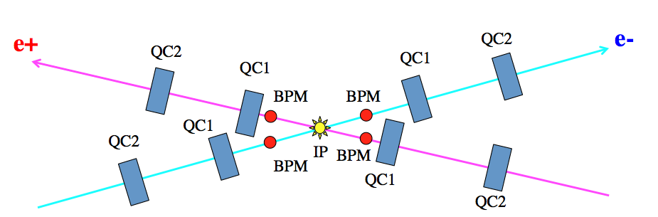
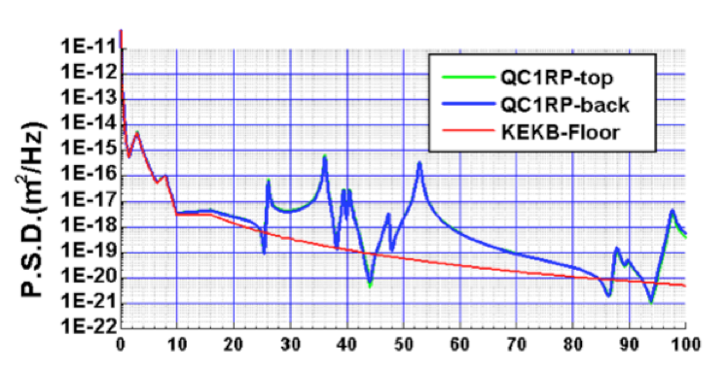
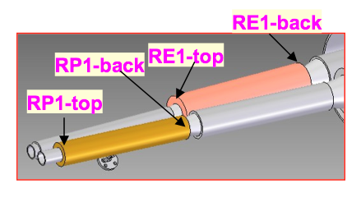
IP Feedback Detector
Main sources of orbit movement: vibration of quadrupoles closest to IP
Main frequency components: 3, 36, 53Hz (simulation)
Tentative specification for the detector
  Resolution < 1 μm
  Repetition 5kHz
  Bandwidth 1kHz
Hz
Movement of QC1RP by a simulation (H. Yamaoka)

Slide 14
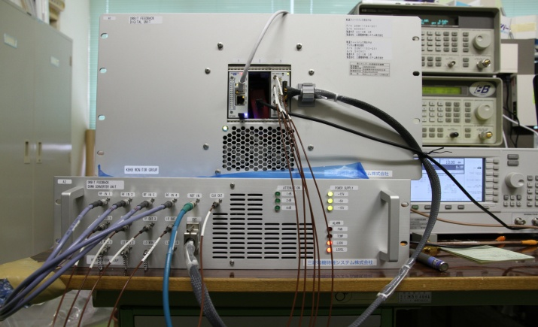
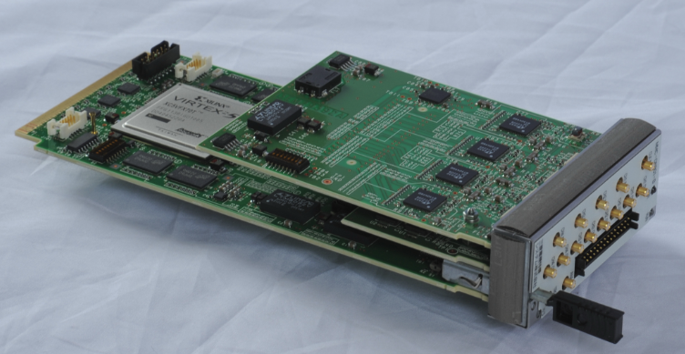
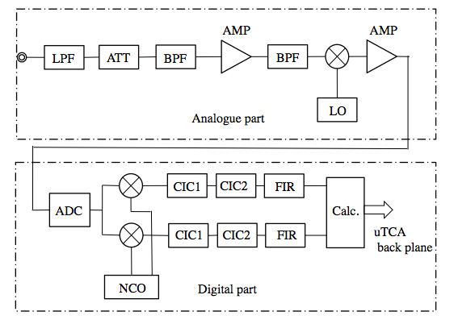
IP Feedback Detector : Detector
Prototype
μTCA
Down-convert 508.8MHz component to intermediate frequency (IF) of 16.9 MHz with an analog mixer to reduce the degradation of the SNR by the clock jitter of ADC.
AD conversion
Digital filters (2 CICs, 1 FIR)
Position calculation
Analog part
analogue down converter
Digital part
Digital processor board
The digital part is implemented in a μTCA board developed for SuperKEKB LLRF system.
EPICS is embedded in the board.

Slide 15
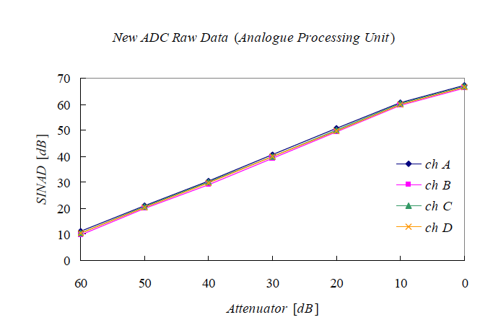
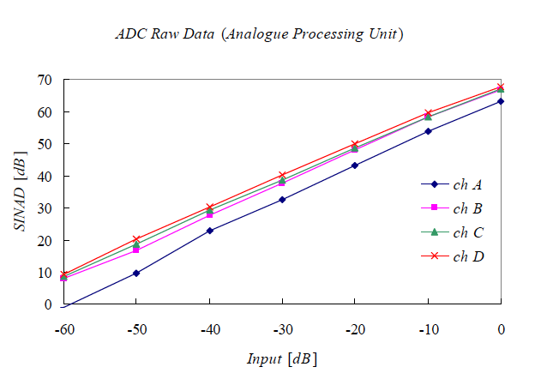
IP Feedback Detector : Activity in this FY
New digital processor board
  A new digital processor board developed for LLRF was tested.
  Difference of SINAD among four channels is improved comparing with the old module.
  73-taps FIR was implemented to reduce the group delay to 1ms.
A measurement showed that resolution is about 0.1μm after the change of FIR.
new board
old board
Comparison of SINAD between old and new LLRF digital boards.

Slide 16
2) Improvement of analog part
  a)Expansion of dynamic range of the down converter to remove saturation of SINAD.
  Rearrangement of level distribution through circuit elements by removing LNA and using a high P1dB(30dBm) and high gain(36) IF amp.
  b)Phase noise improvement
  Replacement of the switching power unit with a series dropper regulator.
  A new oscillator board for sampling clocks and local signals
  Separation of power lines between analogue and digital parts
  Hoping for clock jitter reduction from 1.66 ps to 1ps.
  The modified circuit will be tested this spring.
•
Saturation of SNR

Slide 17
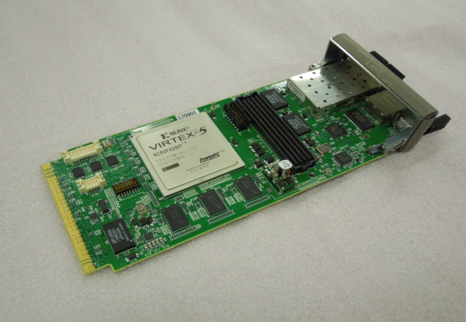
IP Feedback processor unit (μTCA)
Prototype of a feedback processor module has been made.
Implemented with Matlab/Simulink with system generator (HDL coder) for easy coding.
Simple PID algorithm is implemented now.
We are planning a feedback simulation using Co-simulation with Simulink and the ML507 evaluation kit.
A receiver and a power supply interface will be developed in next FY.
FabricA
FPGA Vertex 5FXT
GTX
Corrector P.S.
SFP
GTX
MATLAB/Simlink+Xilinx System Generator
GTX
from BPM degital processing boards
Extension
GTX
SFP
GTX
GTX
GbE server
GTX
FIFO
PLB
PPC440
Embedded EPICS
DRAM
JTAG

Slide 18
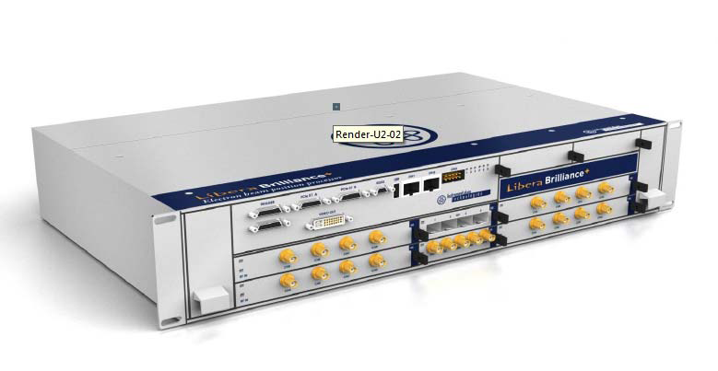
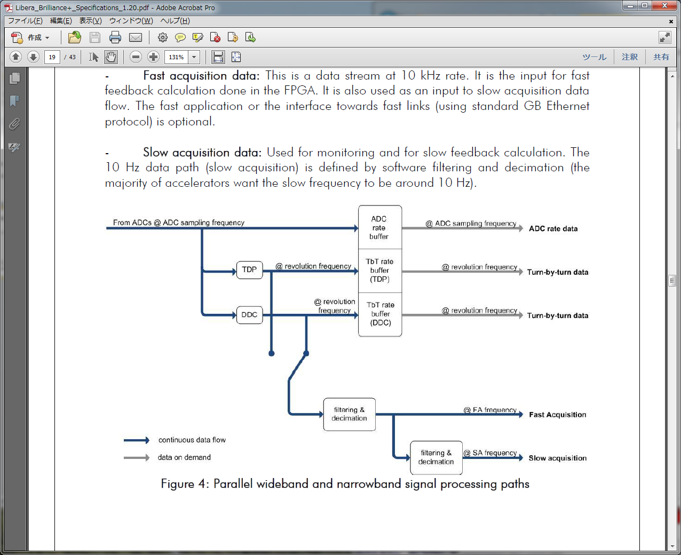
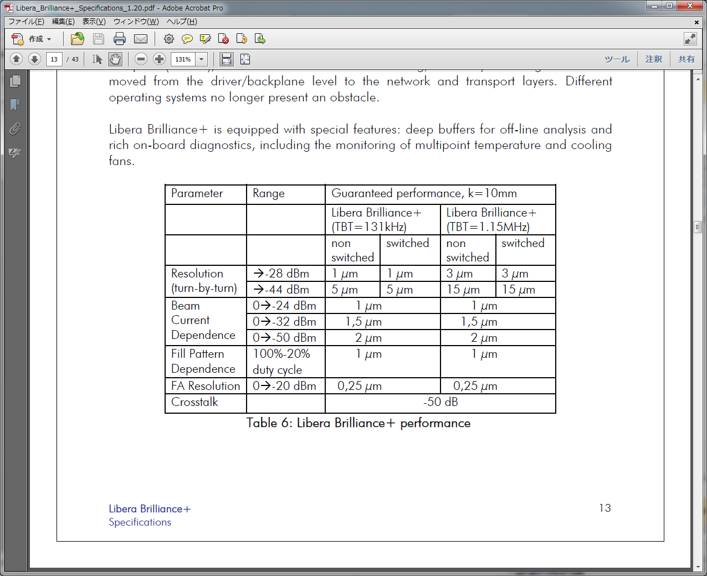
Libera brilliance+ (by Instrumentation Technologies)
•We are considering the use of commercial Libera based detectors for medium band detectors, orbit interlock modules and longitudinal phase monitors.
•Three acquisition modes : Turn-by-turn, FA (repetition 10kHz), SA (repetition 10 Hz)
•One Libera brilliance+ was purchased and is being tested at laboratory.

Slide 19
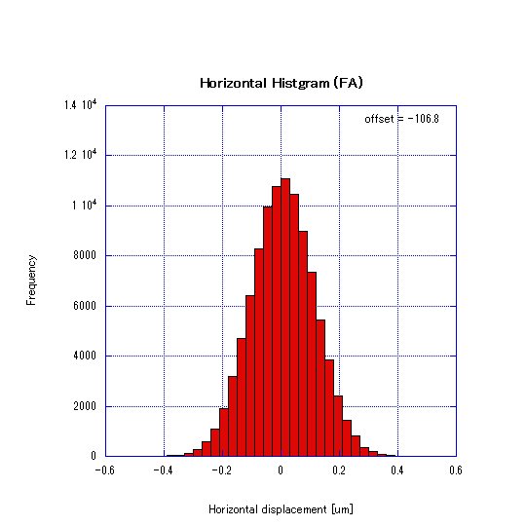
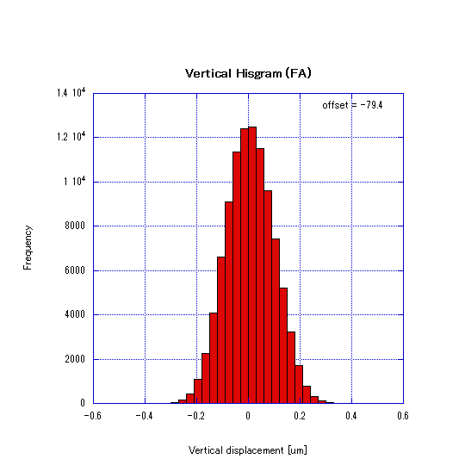
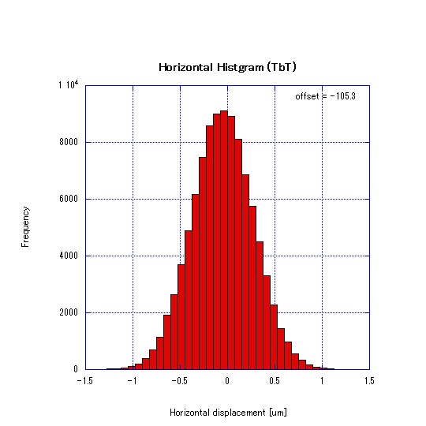
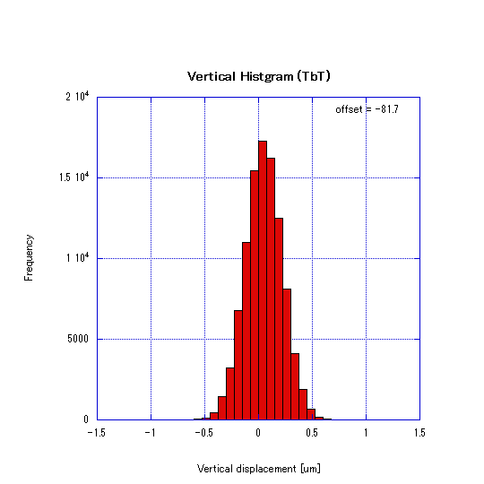
Bench test of Libera brilliance+
1) Resolution
horizontal
vertical
horizontal | vertical
0.105 [μm] | 0.075 [μm]
[μm]
[μm]
(r.m.s.)
Measurement of resolution of FA data
horizontal
vertical
horizontal | vertical
0.310 [μm] | 0.160 [μm]
[μm]
[μm]
(r.m.s.)
Measurement of resolution of Turn by Turn data
The resolution is good enough for the medium-band detector.

Slide 20
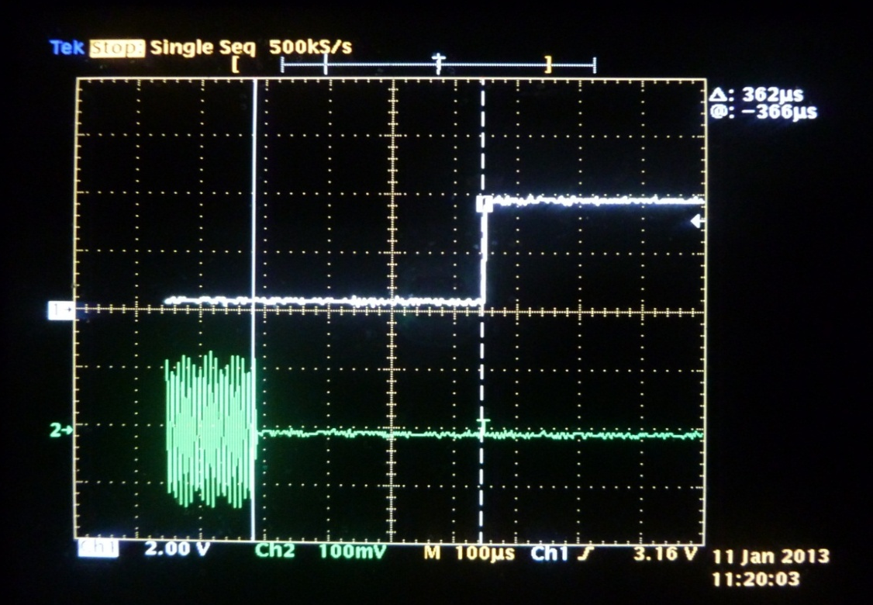
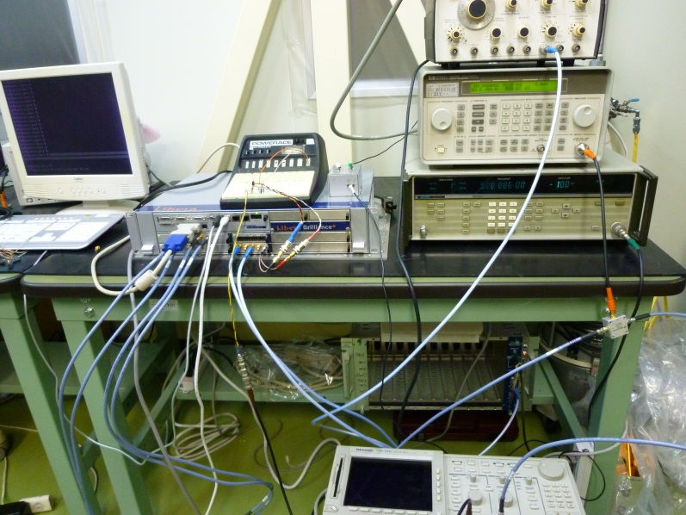
2) Interlock latency
Pulse generator
circuit
Libera Brilliance+
SG
SG output
Interlock
Frequency divider
oscilloscope
SG Off
interlock
Latency
400±50μs (40 turns ≈ a synchrotron period)
Probably, the latency is not short enough for our purpose .
The assessment by the company shows interlock latency will be reduced to a few turns by using Turn-by-Turn data if software is modified.

Slide 21
Main work in next FY
•Production of 120 509MHz detectors
•Production of 60 gated turn by turn detectors
•Development of a receiver and power supply interface for IP orbit feedback.
•Development of a feedback algorism in the IP Feedback processor unit.
•Order/fabrication of the medium-band detectors, the orbit interlock modules and the longitudinal phase monitors.
•Design and fabrication of displacement sensors at rotatable sextupoles.
•Purchase of signal cables and so on.
•Schedule of cable connection of BPMs is not decided yet because it strongly depends on vacuum, magnet and facilities work in the tunnel.

Slide 22
Bunch Feedback Systems

Slide 23
Preparation status
Most of the hardware needed for the SuperKEKB rings (HER, LER, DR) will be ready by the end of this FY.
  Bunch detection circuits
  iGp12 digital filters
  Digital QPSK back-end
  Temperature monitor systems
  Position monitor chambers
  Transverse kickers
    Longitudinal kickers : still in design stage
  High power final amplifiers (Transverse, Longitudinal)
  1.5kW high power attenuators
  Circulators, low-pass filters for Longitudinal Kickers
  High power cables, bpm cables

Slide 24
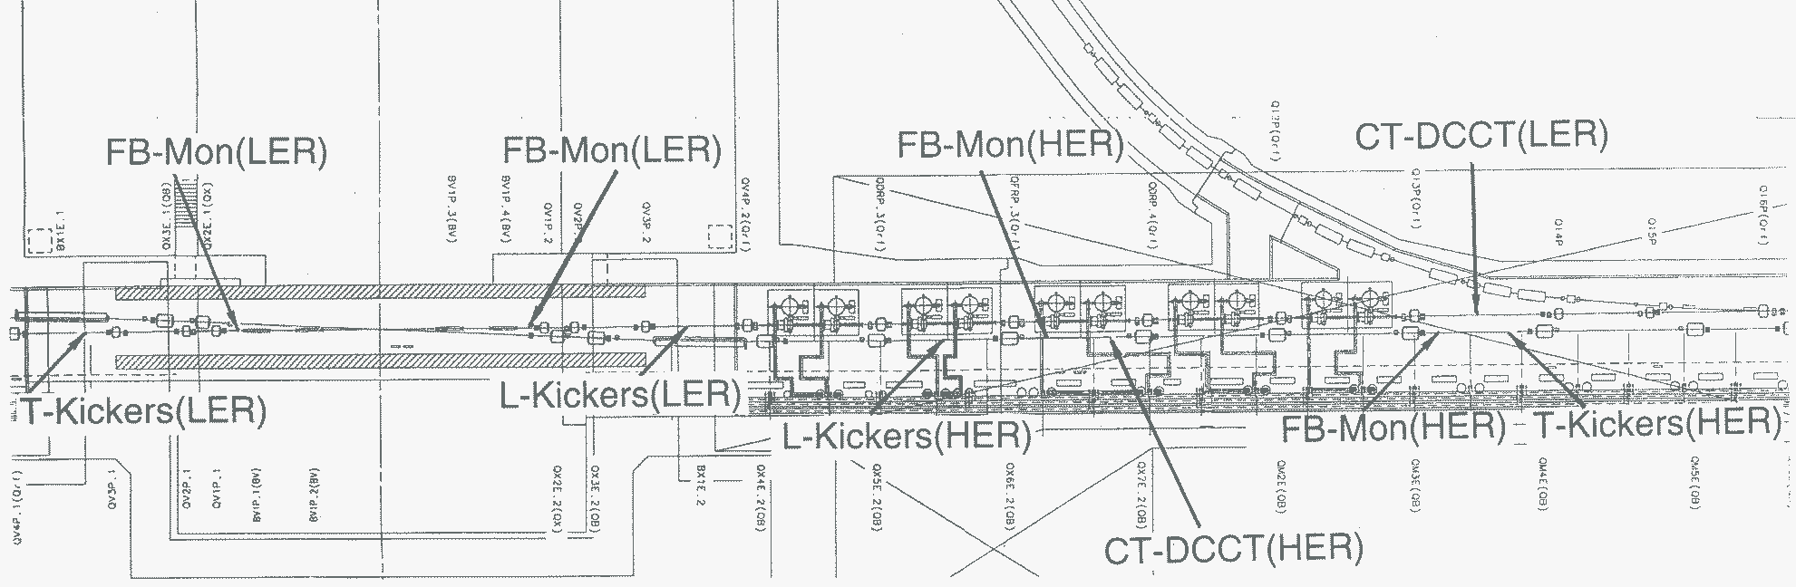
(Optional)
New FB monitor using glass-type sealing feedthroughs (all)
Move HER Upstream monitor one section downstream to adjust phase advance
Add another transverse stripline kicker next to the original one
Prepare better longitudinal kickers for LER. HER is optional.

Slide 25
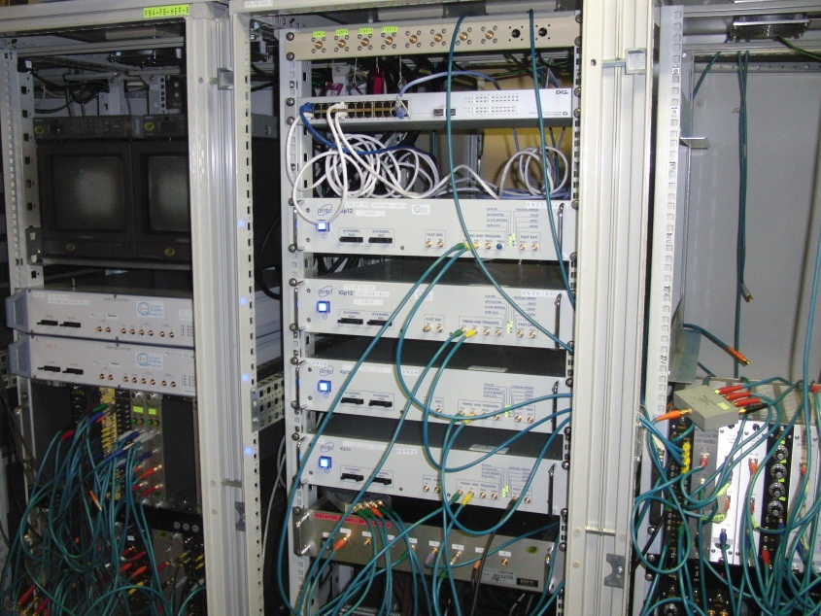
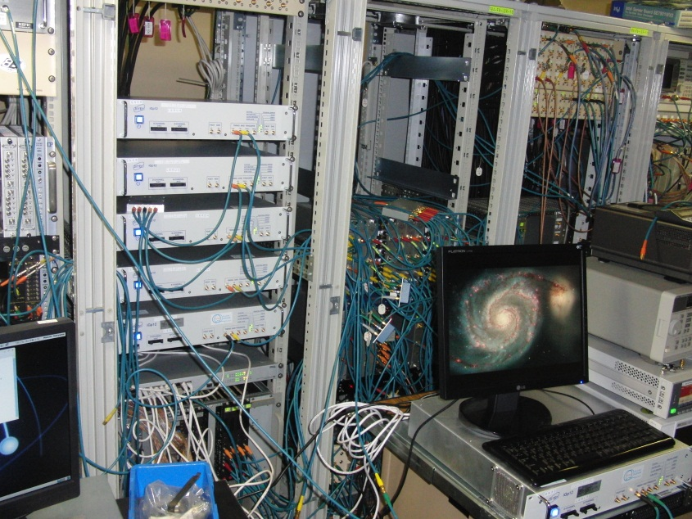
iGp12s
HER
LER

Slide 26
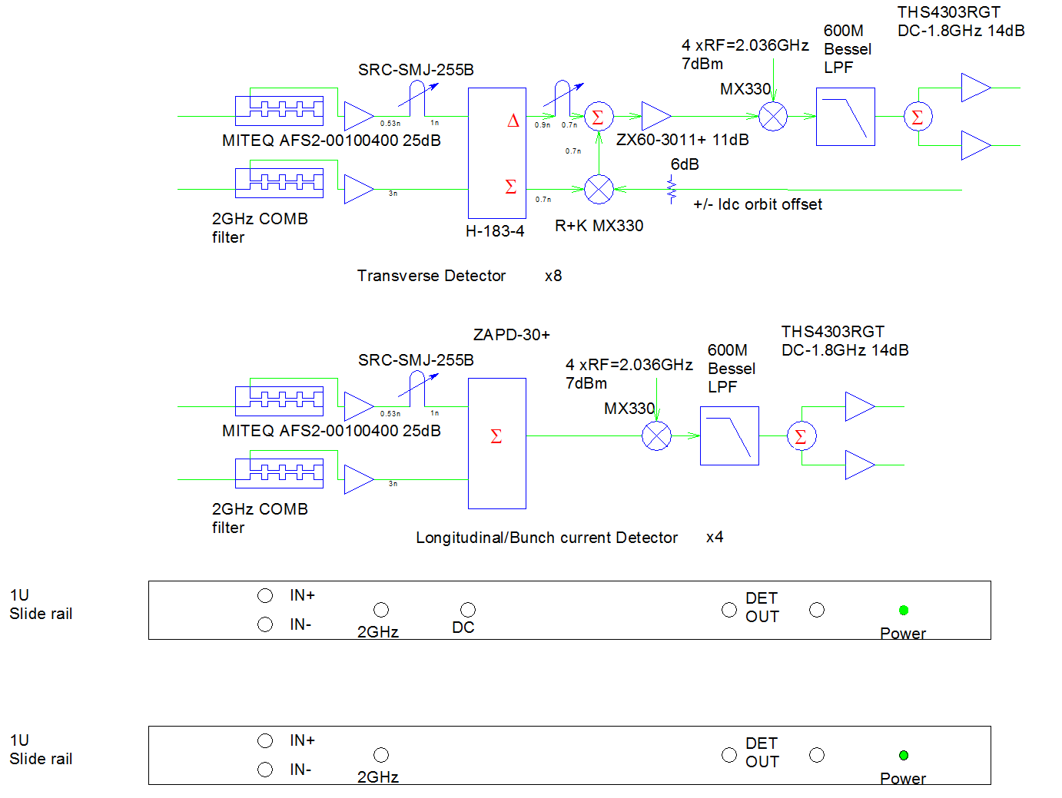
Bunch detection electronics

Slide 27
Power amplifiers
Transverse power amplifiers
  10k-255MHz Pmax=500W amplifiers
    R+K : 10 units ready (2 for spares)
  10k-255MHz Pmax=250W amplifiers
    (AR250A250, used for KEKB) : 11 units ready
      8 for SuperKEKB MR, 3 for Damping Ring
Longitudinal power amplifiers
  900MHz-1.8GHz Pmax=500W amplifiers
    R+K : 8 units ready
    Milmega : 2units ready (for spares)

Slide 28
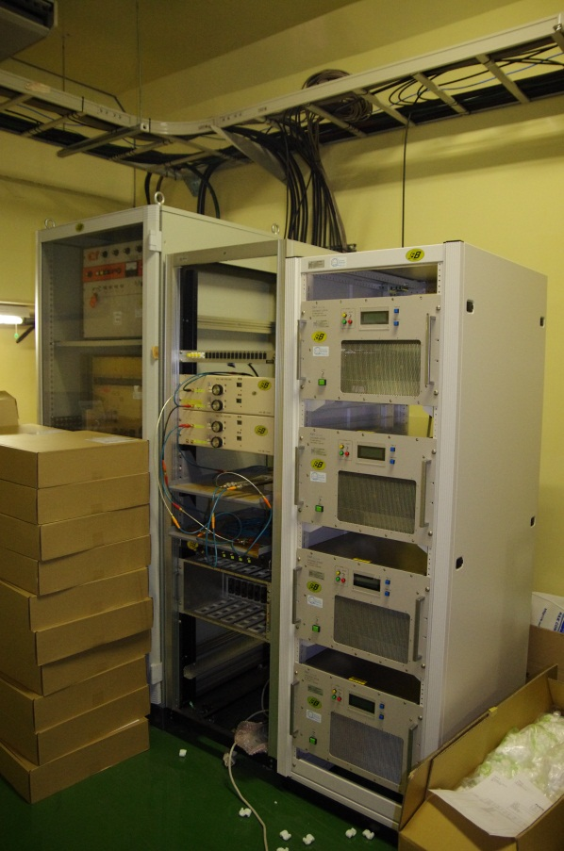
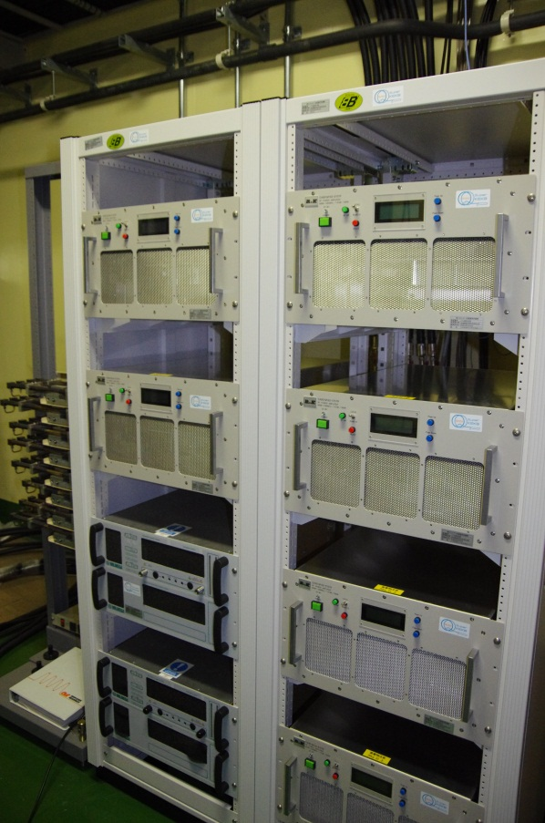
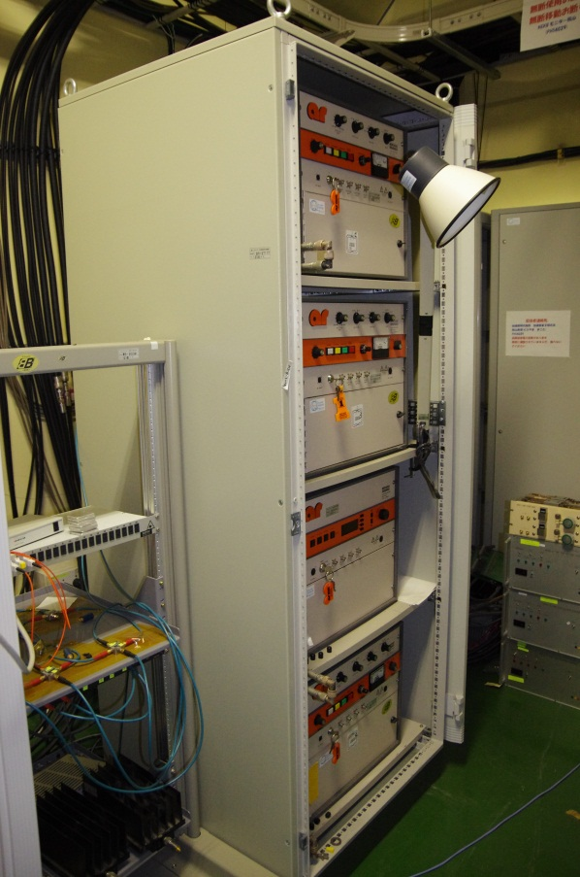
High power amplifiers
LER Longitudinal
HER Transverse
LER Transverse

Slide 29
Next FY
Fabricate longitudinal kickers for LER
Re-arrange the local control room (FB4) to install new detection circuits
Cabling work (High power, bpm, temperature monitor)
  Installation of vacuum components? (Depends on vacuum schedule.)
Tuning of the digital circuits (iGp12, iGp8, bunch current monitors, etc)
  Mainly FPGA firmware
Special monitors related to bunch feedback systems
  Pilot bunch excitation using PLL tech. (by iGp12?)
  Gated measurement systems (tune, beam-beam kick) using old BOD?

Slide 30
Photon Monitor System

Slide 31
Photon Monitors
SRM: Synchrotron Radiation Monitor
  Visible light monitor, Interferometer, streak, etc.
  σ_{z}, σ_{x} (σ_{y})
XRM: X-ray Monitor
  Pinhole, URA mask, etc.
  σ_{y} (σ_{x})
LABM: Large Angle Beamstrahlung Monitor
  SR-like radiation from interaction point (~300-600 nm)
  Can measure relative offsets and size ratios at collision point.
CSM: Compton-scattering based beam energy monitor
  Brand new subject, collaboration with SLAC under US-Japan program, and possibly BINP.
  Not much to say about this yet!

Slide 32
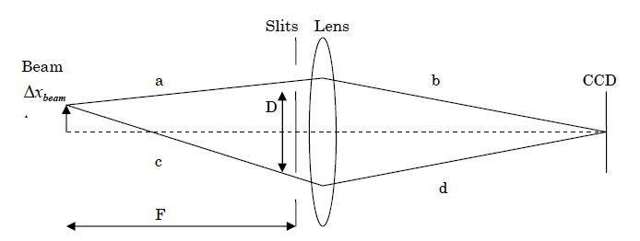
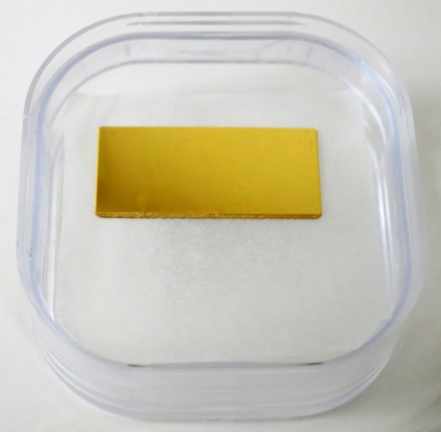
SRM: Interferometers
•Resolution fundamentally limited by measurement wavelength and opening angle between slits from beam (D/F).
•Max. slit separation determined by beam spread and mechanical considerations.
Vertical beam size measurement is possible with interferometers, though is near the limit of the interferometer resolution, and single-shot measurement is not possible.
To minimize deformation due to heat load, gold-coated diamond mirrors are under development.
  28 mm x 18 mm prototype in fabrication now.
Cavities below optics hut floors in D4 and D8 klystron galleries have been filled to reduce the amount of floor vibration, which had been a problem during KEKB operation.
D4 hut has been expanded to accommodate second optical table and x-ray monitor readout space.
Diamond mirror prototype

Slide 33
SRM: Summary
Reuse present source bend locations
  LER bend becomes longer, to reduce heat load
  HER remains the same
Move extraction chambers downstream ~few meters
  Put mirror in antechamber for reduced impedance
Floors under above-ground tunnel components have been reinforced to reduce vibrations
Transfer lines will be rebuilt to be better sealed against air flow
σ_{z}: Streak Camera→OK
σ_{x}: Interferometer→OK (not single-shot, though)
σ_{y}: Interferometer
  Will be difficult to get required resolution
  Not possible to get single-shot (single bunch, single turn) measurements, which will probably be needed for low-emittance tuning, based on experience at CesrTA.
  However, should be useful for cross-checking with x-ray monitor at larger beam sizes.

Slide 34

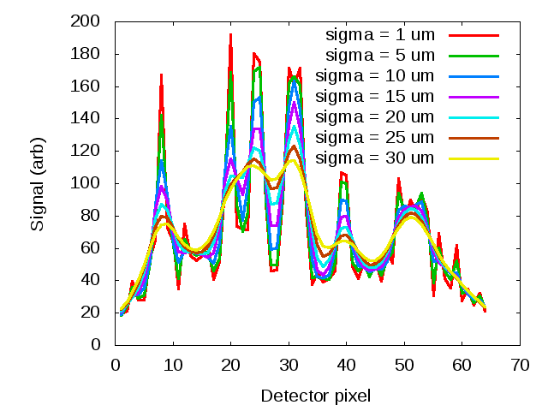
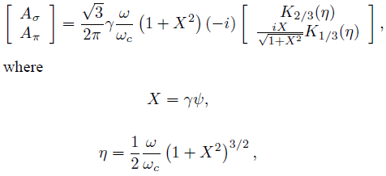
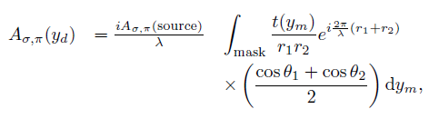
XRM: Coded Aperture Imaging
Technique developed by x-ray astronomers using a mask to modulate incoming light. Resulting image must be deconvolved through mask response (including diffraction and spectral width) to reconstruct object. Open aperture of 50% gives high flux throughput for bunch-by-bunch measurements. Heat-sensitive and flux-limiting monochromator not needed.
We need such a wide aperture, wide spectrum technique for shot-by-shot (single bunch, single turn) measurements.
Uniformly Redundant Array (URA) for x-ray imaging to be used at SuperKEKB
Source distribution:
+
Kirchhoff integral over mask
(+ detector response)
→ Detected pattern:
Simulated detector response for various beam sizes at SuperKEKB LER

Slide 35
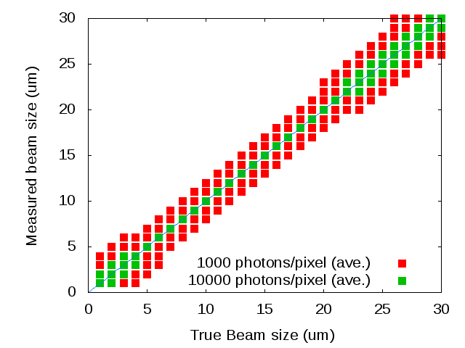
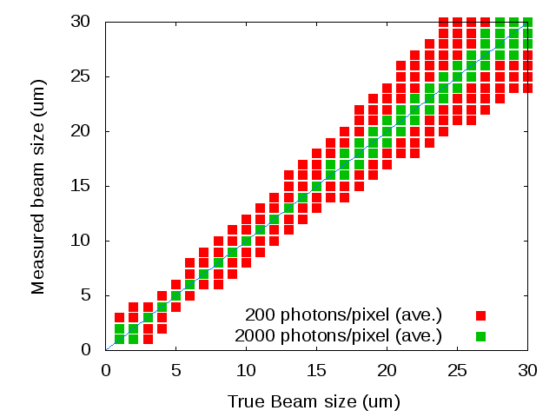
XRM: SuperKEKB x-ray monitor
HER
•Red points: using 64-pixel detector of same type as at CesrTA (Fermionics)
Green points: using detector with improved photon detection efficiency at higher x-ray energies (to be developed)
Mask:
  59-element, 10 μm/element URA
  High-power design
    10 μm Au mask
    625 μm Si or CVD diamond substrate
    Test at CesrTA
  Other patterns, materials under study
Detector:
  64-channel, 50 μm InGaAs detector (same as at CesrTA) can be used at first.
  For better detection efficiency at 10-20 keV (SuperKEKB), deep-pixel design being developed at SLAC under the US-Japan program.
LER

Slide 36
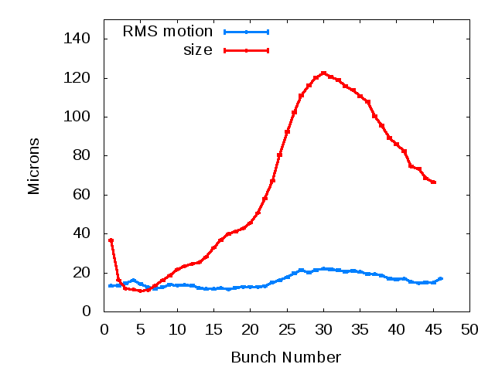
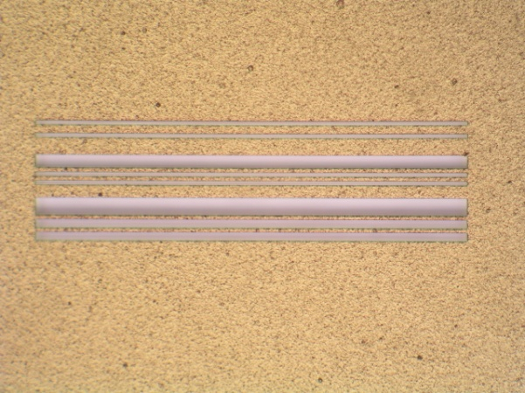
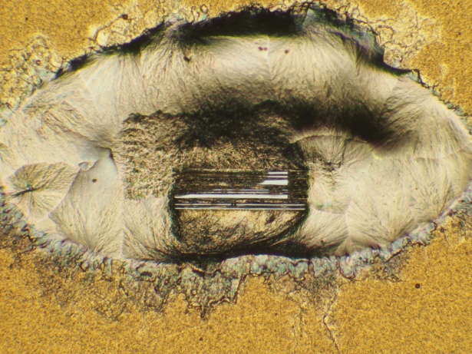
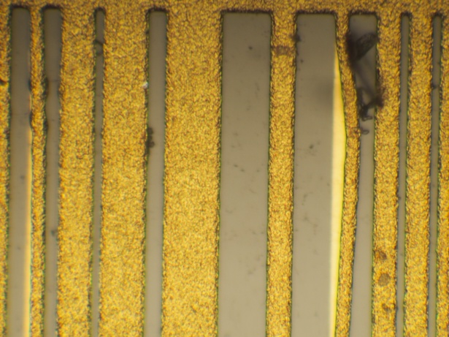
XRM: Coded Aperture tests at CesrTA
Low-energy masks:
  Continued study of systematics in analysis of coded aperture data.
  Coded aperture regularly used for electron-cloud and Intra-Beam Scattering (IBS) studies.
  Evaluated new designs for low-energy mask, selected one design (Cornell design) for testing at CesrTA in 2013.
High-energy mask high-power tests:
  Au+Si mask tested at 120% of SuperKEKB SR power load
    Melted!
  Au+Si mask survived at 100% previously.
  Flaw in heat sink design possible -- will change design for SuperKEKB.
  Au+CVD (diamond) mask installed for testing in April 2013
    Will use factory-damaged mask for burn test at D Line.
    Will use good mask for imaging test at C Line.
Examples of bunch-by-bunch data (electron-cloud blow-up study data)
Single-shot data average for each bunch
Au+Si mask after 100% SuperKEKB equivalent power:
Au+Si mask after 120% SuperKEKB equivalent power:
Factory-damaged Au+CVD mask for burn test:

Slide 37
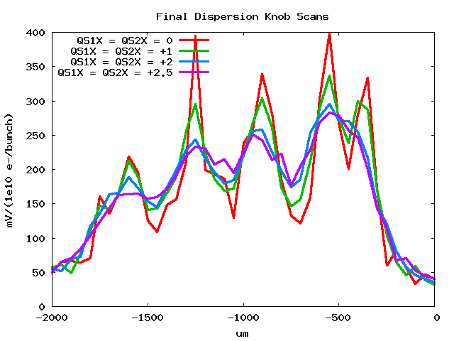
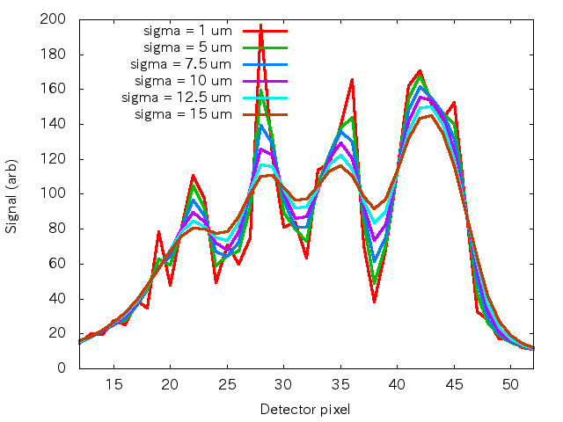
XRM: Coded Aperture tests at ATF2
Data: Dispersion Knob Scans
Simulations
Measured beams of 7.5 μm or less with scanned-pixel measurements
→New world record for coded aperture measurements

Slide 38
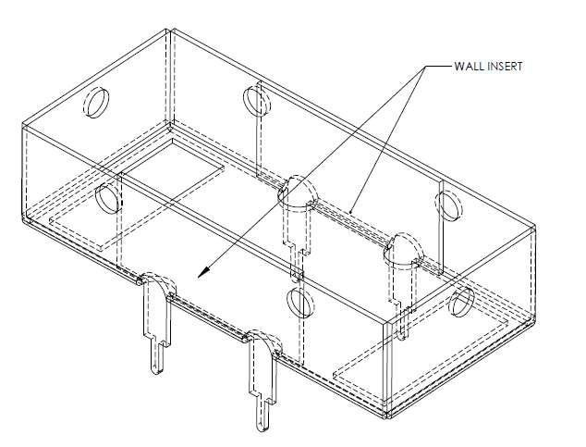
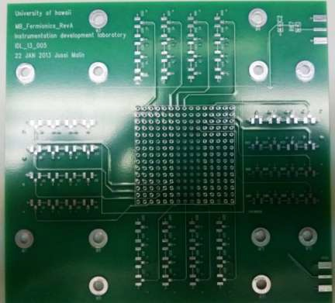
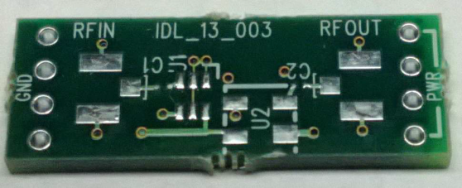

XRM: Readout development
High-speed readout for SuperKEKB (U. Hawaii)
  Evaluated STURM2 motherboard design in lab and at U. Hawaii XFEL.
  Based on results, have redesigned motherboard layout, especially:
    Improved shielding for pre-amp daughter cards
    Re-designed detector daughter card for improved signal impedance.
  New boards designed and laid out, and fabrication started.
    Plan to test at UH XFEL, and ATF2.
Shielded pre-amp daughter card:
New detector daughter card:

Slide 39
XRM: Summary
Source bends upstream of SRM source bends
  LER bend is reused KEKB LER bend magnet (at half strength)
  HER uses same current arc bend magnet
  Some modifications to magnets downstream of source point have been requested of magnet group, to accommodate x-ray extraction line.
σ_{y}: Coded Aperture Mask
  Single-shot (single-bunch, single turn) resolution expected to be sufficient.
  Single-shot mode probably be needed for low-emittance tuning, based on experience at CesrTA.
σ_{x}: Possible, if single-shot measurements are needed
  SRM should work for this in slow integration mode
Being developed in collaboration with Cornell U., U. Hawaii and SLAC
  Testing different components at CesrTA and ATF2
Development work continuing on detector and readout

Slide 40

LABM: Large Angle Beamstrahlung Monitor
The radiation of the particles of one beam due to the bending force of the EM field of the other beam
Beamstrahlung POLARIZATION at specific azimuthal points provides information about the beam-beam geometry.
G. Bonvicini

Slide 41



LABM: Layout
4 viewports and associated 5.6 mm² mirrors on Beam Pipe (KEK), at 7-8 mrad w.r.t beam axis
4 narrow acceptance telescopes, which count photons in two polarizations and 4 bands (32 channels total, WSU)
Build flexible electronics for a variety of beam measurements (Tabruk U. (Saudi Arabia), WSU)
Be extraction mirror prototype (2 mm x 2.8 mm) and extraction windows fabricated. (KEK)
Optical channel
Tunnel floor
Optics box

Slide 42




Beamstrahlung Monitor
2012 results (Wayne State U.):
First (of two) optics box built and tested.
Second optics box started.
Remote-controlled primary mirror for optical transfer line built and tested.
24 elbows for optical transfer lines built.
Electronics for readout at SuperKEKB under development with Tabruk U. (outside of Nichibei).
Calculations for beam test at Frascati carried out.
Prototype optics box
PMT mounts inside optics box
Final optics box
Movable mirror

Slide 43

LABM: Extraction mirror prototype (KEK)
Currently in fabrication

Slide 44
Beamstrahlung monitor
Plans for 2013
At Wayne State:
  Complete second optics box
  Complete 3 more remotely controlled Primary Mirrors for optical transfer lines
  Build relay line interfaces with accelerator extraction window flange
  Precision bench test calibration of all viewports and PMTs of both optics boxes
  Prepare for beam test at Frascati
    Design and make optical transfer beam pipes and supports.
    Beam test would start summer 2013, continue 10 months.
  Finalize electronics (collaboration with Tabruk U.)
At KEK:
  Finalize design of extraction mirror, make production versions.
  Extraction window flange hardware.

Slide 45
Photon Monitors Schedule
2013:
  SRM
    Final mirror prototyping and testing
    Extraction chamber design
  XRM
    Continue heat and imaging tests with high-power optics at CesrTA
    Continue Electronics and detector development
    Construction of major components of extraction beamline.
  LABM
    Construction of second optics box and extraction mirrors.
    Continue electronics readout development
    Frascati beam test planned starting in summer, 2013.
  CSM
    Investigate design of system with SLAC and BINP.
At SuperKEKB turn-on (non-collision):
  SRM & XRM commissioning and emittance measurements
  LABM commissioning and background studies
Sometime soon after (real, non-bakeout) turn-on:
  LABM comissioning and collision measurements
Somewhat further ahead:
  Compton-scattering-based beam energy monitor

Slide 46
Ｍｉｓｃ．

Slide 47
CT, DCCT
Remodeling the original DCCT in progress
  Exchange the old cables
  New circuit to allow increase in maximum beam current from 3 A to 5 A
  Tune the step response of DR DCCT if needed.

Slide 48
Loss Monitor
Re-use the sensors (ion chamber and PIN PD) of KEKB.
Because of recent results of beam loss simulation, we are studying whether the dynamic range of readout is sufficient or not, and will redesign it if necessary.
  R&D: next FY
  Production: FY2014
If we increase the number of channels, extra cabling is necessary.

Slide 49
DR Monitor
BPM
  Electrode, Detector, Signal cable: ready
FB
  Kicker, Amp&filter, FT&cable, Low level: ready
SRM
  Extraction mirror, transport line, streak camera, gated camera and optical elements: ready
  extraction mirror chamber : need to consult with vacuum group
DCCT
  Remodeling in progress
Loss Monitor
  Sensor: Reuse the linac ion chambers
  Read-out: FY2014
  Cables: ready
Control rack, VME rack, NIM BIN etc. : ready

Slide 50
Construction Plan:MR
R&D
fabrication, installation
 |  | FY2012 | 2013 | 2014 |  | 2015
BPM | Electrode
 | Detector |  |  |  |  | More TbT
 | Displacement censor |  | Local corr. SX
 | Signal cable
Bunch feedback | Kicker
 | Amp&filter
 | FT&cable
 | Low level
Photon Monitor | Visible light beam line
 | Extraction mirror
 | X-ray beam line
 | X-ray detector
 | Beamstrahlung monitor
 | Compton scattering monitor
Misc. | Loss monitor |  | readout
 | DCCT
 | Bunch current monitor
 | Gated measurement

Slide 51
Construction Plan:DR
 |  | FY2012 | 2013 | 2014 |  | 2015
BPM | Electrode
 | Detector
 | Signal cable
Bunch feedback | Kicker
 | Amp&filter
 | FT&cable
 | Low level
Photon Monitor | Visible light beam line |  | chamber
 | Extraction mirror
Misc. | Loss monitor |  | readout
 | DCCT
 | Bunch current monitor
 | Tune monitor
R&D
fabrication

Slide 52
Summary
Upgrade of beam diagnostics system is advancing smoothly. The installation schedule depends on other components. The tuning of each detector will be done.
BPM
  Electrode: ready
  Narrowband detector: production in next FY
  TbT: production in next FY and after
  Mediumband detector: order/fabrication in next FY
  Displacement sensor at local chromaticity correction section: design and fabrication in next FY
FB
  Most hardware is ready.
  Longitudinal kicker and special monitor (pilot bunch excitation, gated measurement): production in next FY.

Slide 53
Photon Monitors
  SRM: testing the final extraction mirror and design chamber .
  XRM: continue the testing of electronics, detector and construction of beam line.
  LABM: continue the readout system and construction of optics box and extraction mirror.
  CSM: future plan
DCCT/CT: ready
LM: studying specifications of readout electronics
DR
  R&D of LM readout, BCM and Tune meter
  Installation time is restricted after DR construction.

Slide 54
Spares

Slide 55
X-ray monitor
2012 results
High-speed readout for SuperKEKB
  Evaluated STURM2 motherboard design in lab and at U. Hawaii XFEL.
  Based on results, have redesigned motherboard layout, especially:
    Improved shielding for pre-amps daughter cards
    Re-designed daughter card for detector for improved signal impedance.
  New boards designed and laid out, and fabrication started.
    Plan to test at UH XFEL, and ATF2.
Shielded pre-amp daughter card:
New detector daughter card:

Slide 56
X-ray monitor
Plans for 2013
At Cornell:
  Test Au+CVD (diamond) high-energy mask at CesrTA.
    Imaging tests
    Burn tests
  Test new design of low-energy coded aperture (Cornell design) in 2013 at CesrTA.
  Continue systematics studies of x-ray optics at CesrTA, and continue using coded aperture optics for electron-cloud and IBS studies.
At UH:
  Complete fabrication of redesigned 64-channel readout system for SuperKEKB.
  Test 64-channel readout system at UH XFEL and ATF2.
At SLAC:
  Develop new high-energy detector for increased detection efficiency over SuperKEKB’s x-ray spectral range.

Slide 57
SRM: Extraction mirrors
Large incident power a source of heat-load induced deformations
SuperKEKB LER source bend is recycled arc bend, with bending radius twice that of KEKB source bend.
  Incident power becomes less than that of the KEKB HER, though more than that of the KEKB LER.
HER bend does not change, and incident power becomes a bit higher than that of the KEKB HER.
The heat deformation was already a great problem at KEKB, so would like to have a mirror that does not deform as much under the same heat load: diamond mirrors.

Slide 58




SRM: Diamond Mirrors
Monocrystalline diamond:
  Being developed by Seki Technotron
    10 mm x 20 mm x 0.5 mm prototype completed.
    20 mm x 20 mm x 1 mm prototype in fabrication
  Surface: 3 μm Au, with thin Cr layer below that.
  Diamond surface is (nearly) a single crystal, so good surface flatness expected (Ra ~ 2 nm, <~λ/50)
  Very good heat conductance and low thermal expansion coefficient makes apparent change in magnification smaller than that of Be mirrors used at KEKB:
    Berylllium: δmagnification = 43% @ HER full current
    Diamond: δmagnification = 3% @ HER full current
Diamond mirror temperature distribution due to 400W of SR power
Diamond mirror surface distortion due to 400W of SR power
Mirror surface distortion due to 200W of SR power at center of Be mirror
Mirror surface distortion due to 400W of SR power at center of Au+Dia mirror
ANSYS simulations: M. Arinaga

Slide 59
XRM: LER X-ray beamline
(Fuji D8)
Magnet passage
Optics box
X-ray beamline
Detector Box

Slide 60
XRM: HER X-ray monitor beamline (Oho D4)
Magnet passage
Optics box
Detector Box
X-ray beamline

Slide 61





STURM2
ASIC
XRM: Digitizer
STURM ASIC for high-speed readout (G. Varner).
Ver. 1 tested at KEK PF, March 2009.
Ver. 2 fabricated.
Ver. 2 specs:

Slide 62






XRM: 64-channel system
64-channel system for testing at ATF2
  Using Fermionics (low-energy) detector.
Digitizer
daughterboard
Preamp
board
Digitizer ASIC
(STURM2)
Computer
Detector Array
Motherboard
I/O Board

Slide 63




ATF2 x-ray beamline
During construction
Rotating mask holder
Detector table

Slide 64

XRM: SuperKEKB estimated single-shot resolutions
(SuperKEKB full current)
Beam to mask: 12 m
Mask to detector: 36 m
•Red points: using 64-pixel detector of same type as at CesrTA (Fermionics)
Green points: using detector with improved photon detection efficiency at higher x-ray energies (to be developed)
HER
Beam to mask: 8 m
Mask to detector: 32 m
Detected spectrum
(Fermionics detector)
LER

Slide 65

XRM: Detector
Tests with Fermionics detector at Photon Factory showed that detection efficiency at high energies is very low
  Active pixel depth is only 3.5 microns.
Detector development needed for the future
  Higher efficiency at hard x-ray spectrum seen at SuperKEKB
  Faster response for being able to directly diagnose head-tail instabilities at SuperKEKB.
  Trench diode design being pursued:
    Deep but narrow pixels
    First prototype fabricated at SLAC
    Detector development to continue

