Slide 1
Positron Source Upgrade
KEKB Review 2013
(FC modulator development is covered by M. Akemoto's talk )
KEKB injector linac
Takuya Kamitani

Slide 2
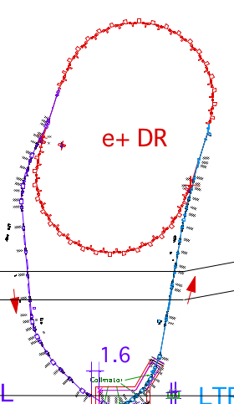
SuperKEKB Injector
SuperKEKB injector
50 Hz (e+ or e-)
pulse-by-pulse
mode switching
low emittance
RF gun
1.1 GeV
Damping Ring
circ. 136 m
PF
2.5 GeV e-
0.1nC x 1
AR (later)
6.5 GeV e-
Bunch
Compressor
LER, AR
3.5 GeV
10nC x 2 (prim. e-)
5nC x 2 (inj. e-)
Energy-spread
Compression System
S-band
linac
4.0 GeV e+
4nC x 2
3T
RF gun
ECS
e+ target &
LAS capture section
7.0 GeV e-
5nC x 2
HER
DR
positron target relocation from 2-1 to 1-5
for energy margin in DR injection
1-3
1-4
1-5
1-6
1-7
1-8
2-1
2-2
2-3
2-4
2-6
2-7
2-8
3-2
target
solenoid
FODO singlet system
Q triplet 3m
Q triplet 5m
LAS
Large Aperture S-band
accelerating structure
normal S-band

Slide 3
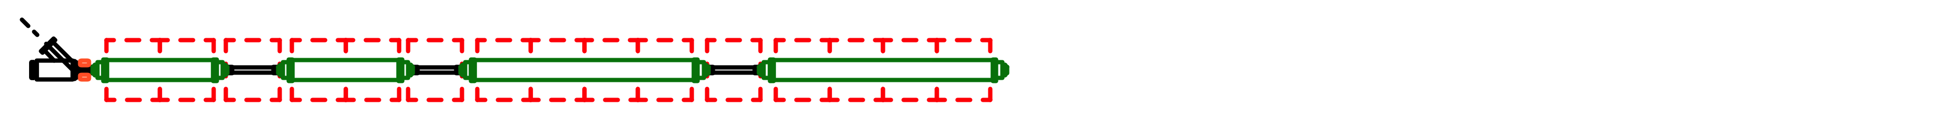
Positron Capture Section (PCS)
KEKB e+ capture section
QWT system (2.0 T x45mm + 0.4 T x8m)
air-core pulse coil DC solenoids
KLY1 (S-band) -> 2 x 1m 12 MV/m, aper 2a = 27 -> 25 mm
KLY2 (S-band) -> 2 x 2m 10 MV/m, aper 2a = 25 -> 21 mm
beam energy at capture section exit : 80 MeV
N(e+)/N(e-) = 10 % at 3.5 GeV linac-end
N(e+)/N(e-)/E(e-) = 2.5 %/GeV
SuperKEKB e+ capture section
AMD system (5.0 T x200mm + 0.4 T x15m)
flux concentrator DC solenoids
KLY1 LAS -> 2 x 2m 14 MV/m, aper 2a = 32 -> 30 mm
KLY2 LAS -> 4 x 2m 10 MV/m, aper 2a = 32 -> 30 mm
beam energy at capture section exit : 120 MeV
Deceleration capture
We omit L-band components and redesign PCS with all LAS configuration which can give sufficient e+ yield and satellite elimination.
N(e+)/N(e-) = 49 % at 1.1 GeV DR
N(e+)/N(e-)/E(e-) = 14 %/GeV
LAS : Large Aperture
S-band structure

Slide 4
e+ source issues discussed here
target & beam-spoiler design
for protection against target destruction
Flux Concentrator system development
(magnet, modulator, detachable girder)
Capture parameter optimization on
e+ yield and satellite particle elimination
e+/e- compatible optics design and
direct e+ injection without DR

Slide 5
(1) Positron Production Target &
Beam-Spoiler

Slide 6
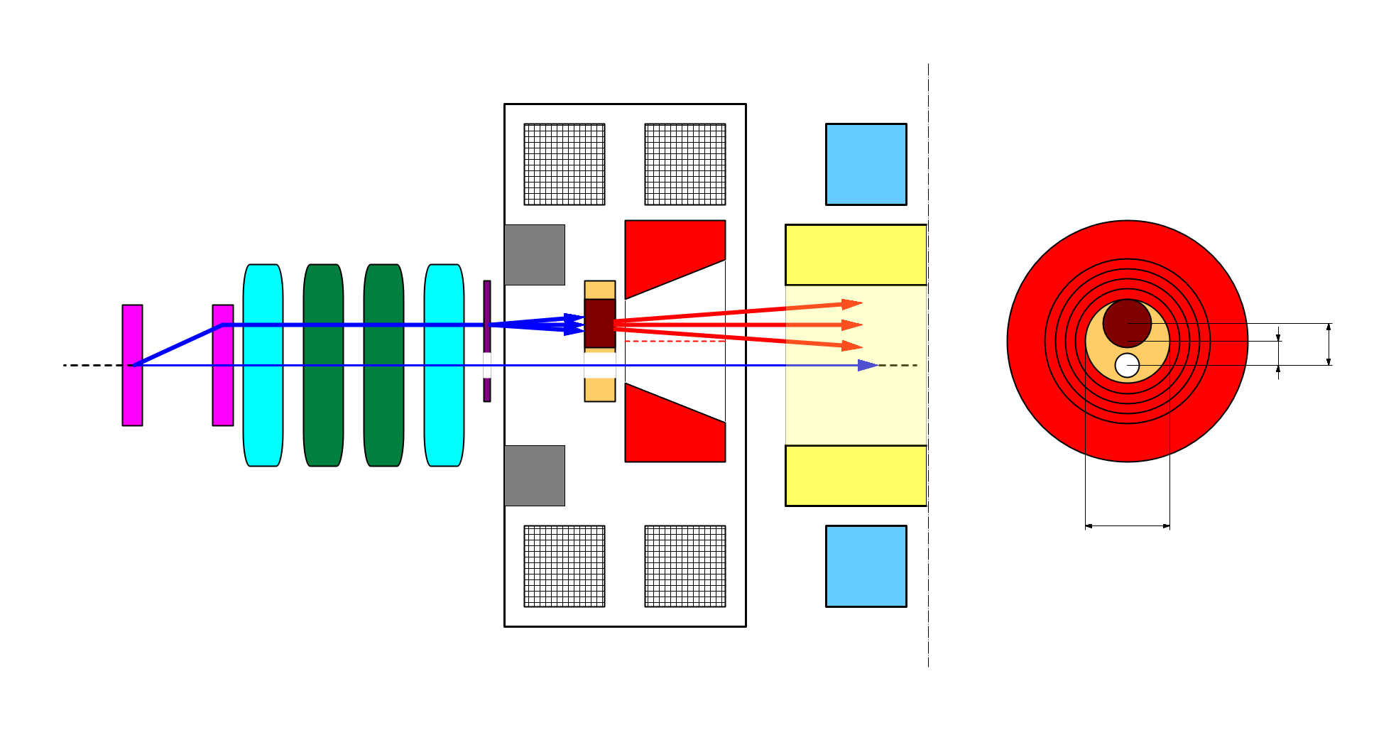
target offset & beam hole
side view
bridge coils
rear view
solenoid
target
diameter
4.0 mm
primary e-
DC QM
Accel.
structure
spoiler
target
offset
3.5 mm
target
e+
beam
hole
injection e-
2.0 mm
FC offset
hole
diameter
2.0 mm
Flux
Concentrator
pulse ST
7.0 mm
FC aperture
pulse QM
injection e- beam on axis to preserve low emittance
primary e- beam 2~3 mm off axis
(target offset 3.5 mm, FC offset 2.0mm)
e+ yield degradation by this offset
should be evaluated with full 3D tracking simulation

Slide 7
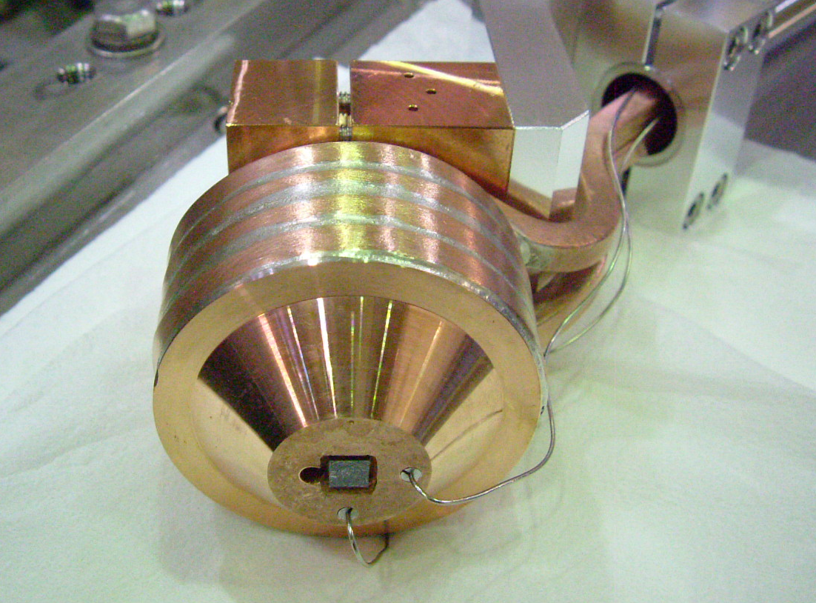
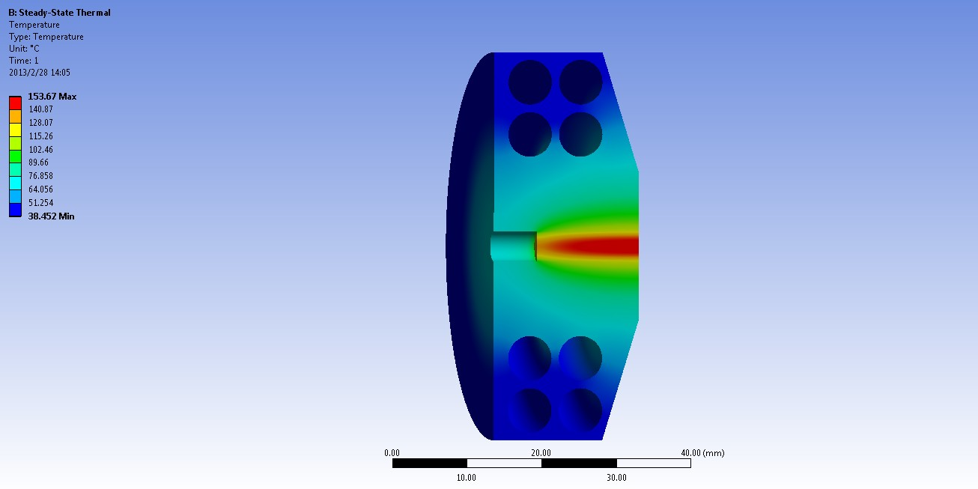
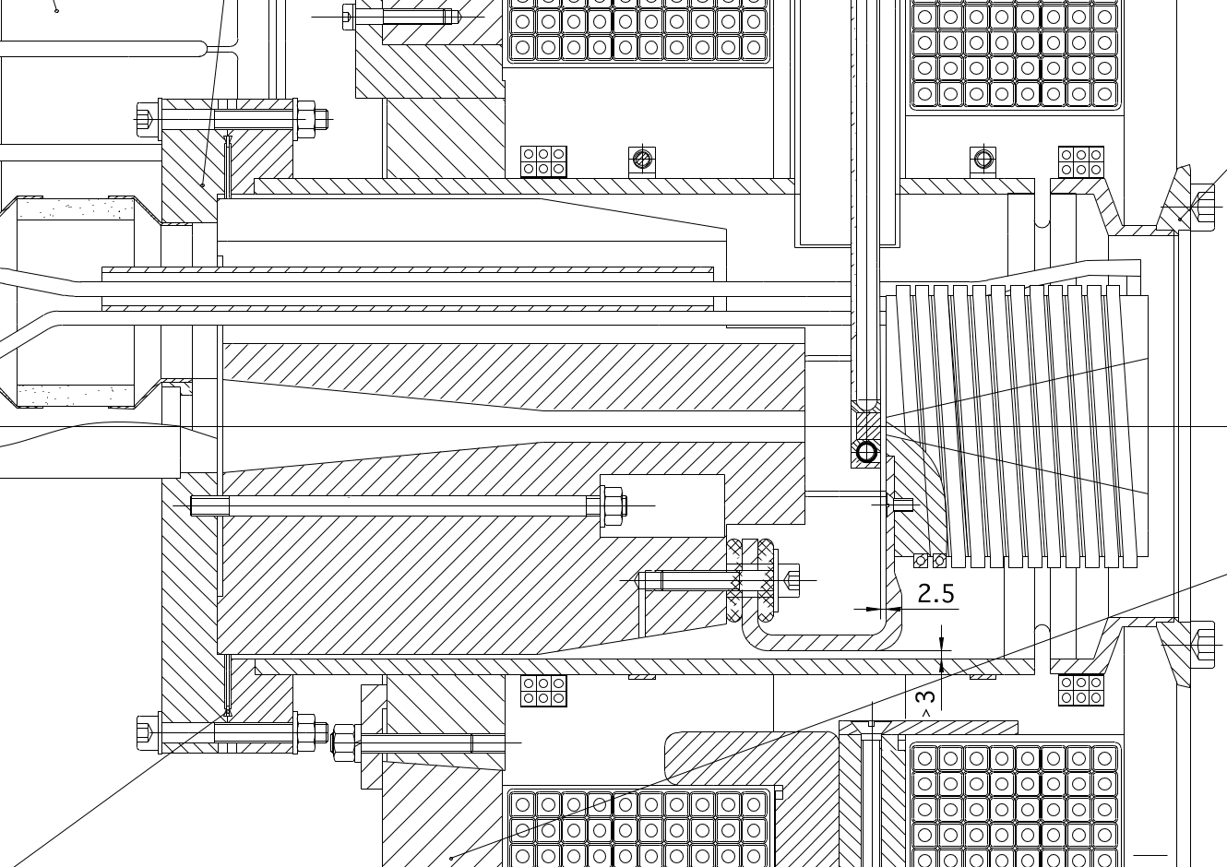
target shape & thermal analysis
target design is ongoing considering
cooling efficiency analysis and field reduction by eddy current
target size should fit in the available space
between a yoke and FC
KEKB e+ target
ANSYS calculation by L. Zang

Slide 8
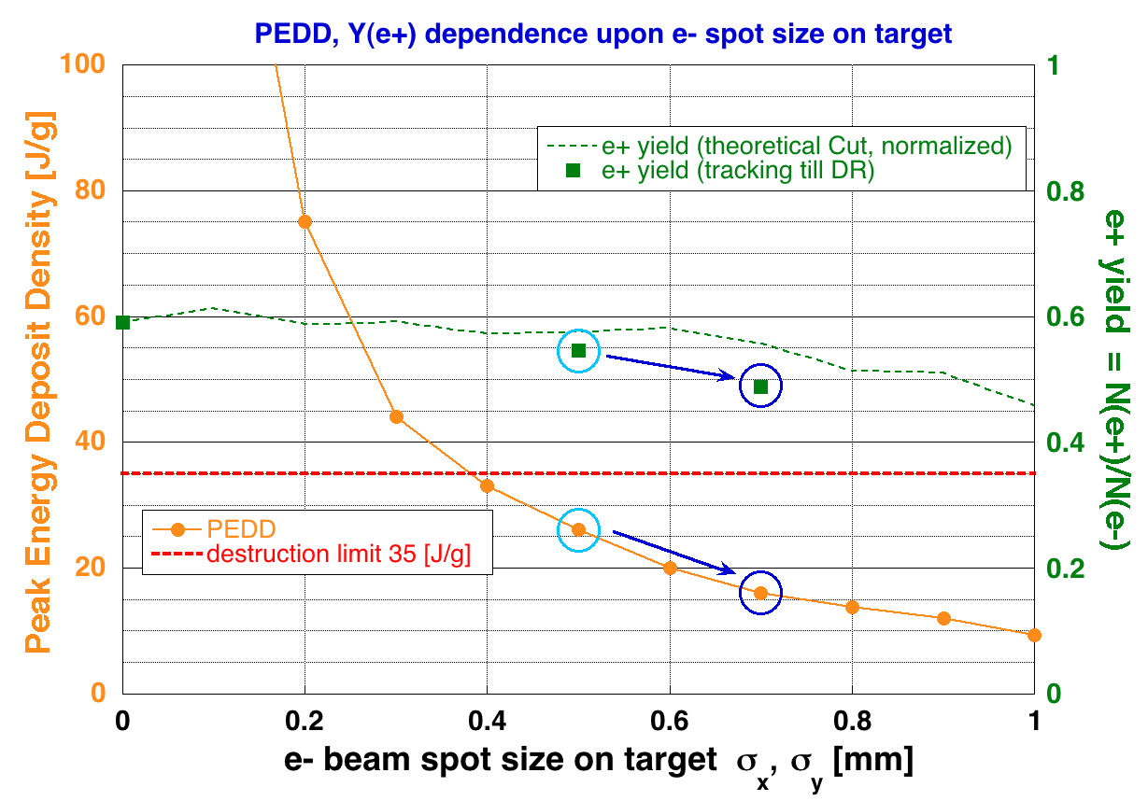
target destruction issue
FLUKA & yield calculation by L. Zang
We should enlarge design spot size 0.5 mm -> 0.7 mm for safety margin
at a cost of 10 % yield degradation

Slide 9
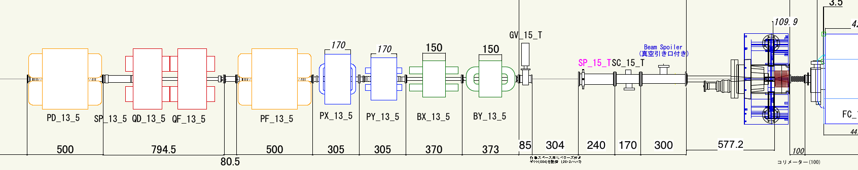
target protection
spoiler
target
primary e-
e+
hole
hole
injection e-
thickness t
distance D
beam spoiler to maintain spot size σ_{x ,}σ_{y}> 0.7 mm on target
avoid too small beam spot on spoiler & on target,
need monitoring spot sizes and focusing magnet settings
D & t should be optimized considering beam line layout
at a distance D = 3.0 (m), thickness t = 0.5 (mm) for Al plate

Slide 10
(2) Flux Concentrator system development

Slide 11
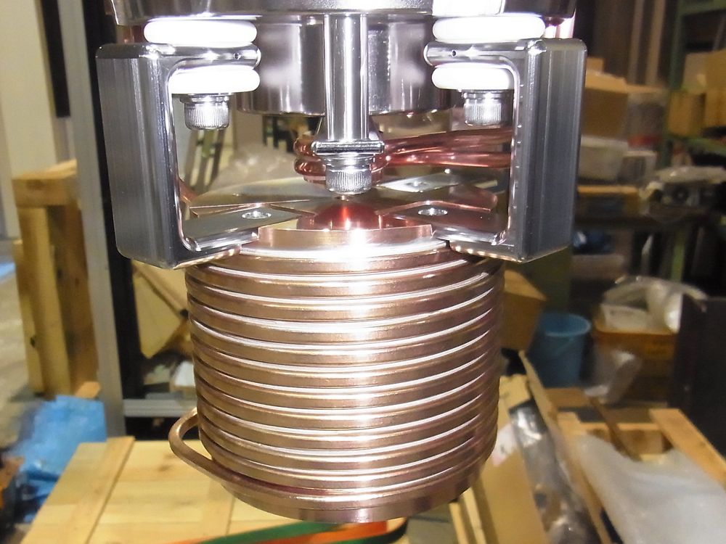
SLAC-type Flux Concentrator
First prototype is fabricated with helps of drawings from SLAC and IHEP
it is for stand-alone test with a simplified vacuum chamber
started a test operation and field measurement with a prototype modulator
conductor is made of HRSC copper
prototype-1
SLAC-type FC | parameters
length | 100 mm
outer diameter | 100 mm
inner diameter (min.) | 7 mm
inner diameter (max.) | 52 mm
peak current | 12 kA
pulse width | 5 μs (half-sine)
peak field | 3.9 T
inductance | 1.0 μH

Slide 12
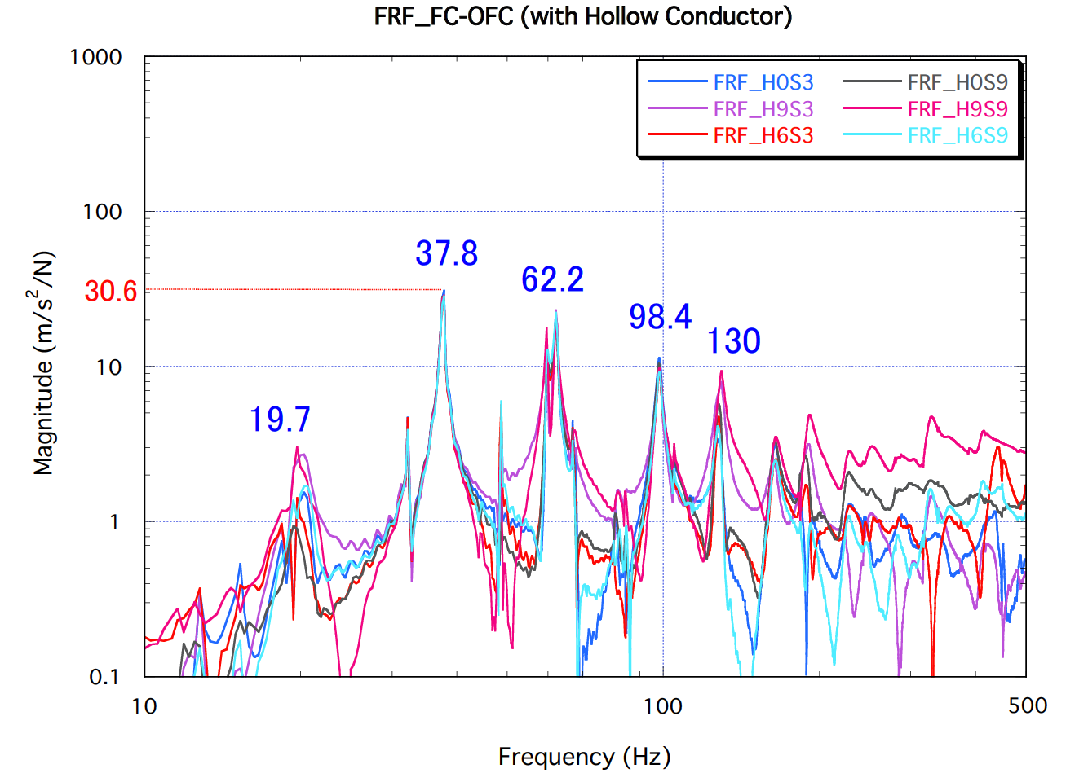
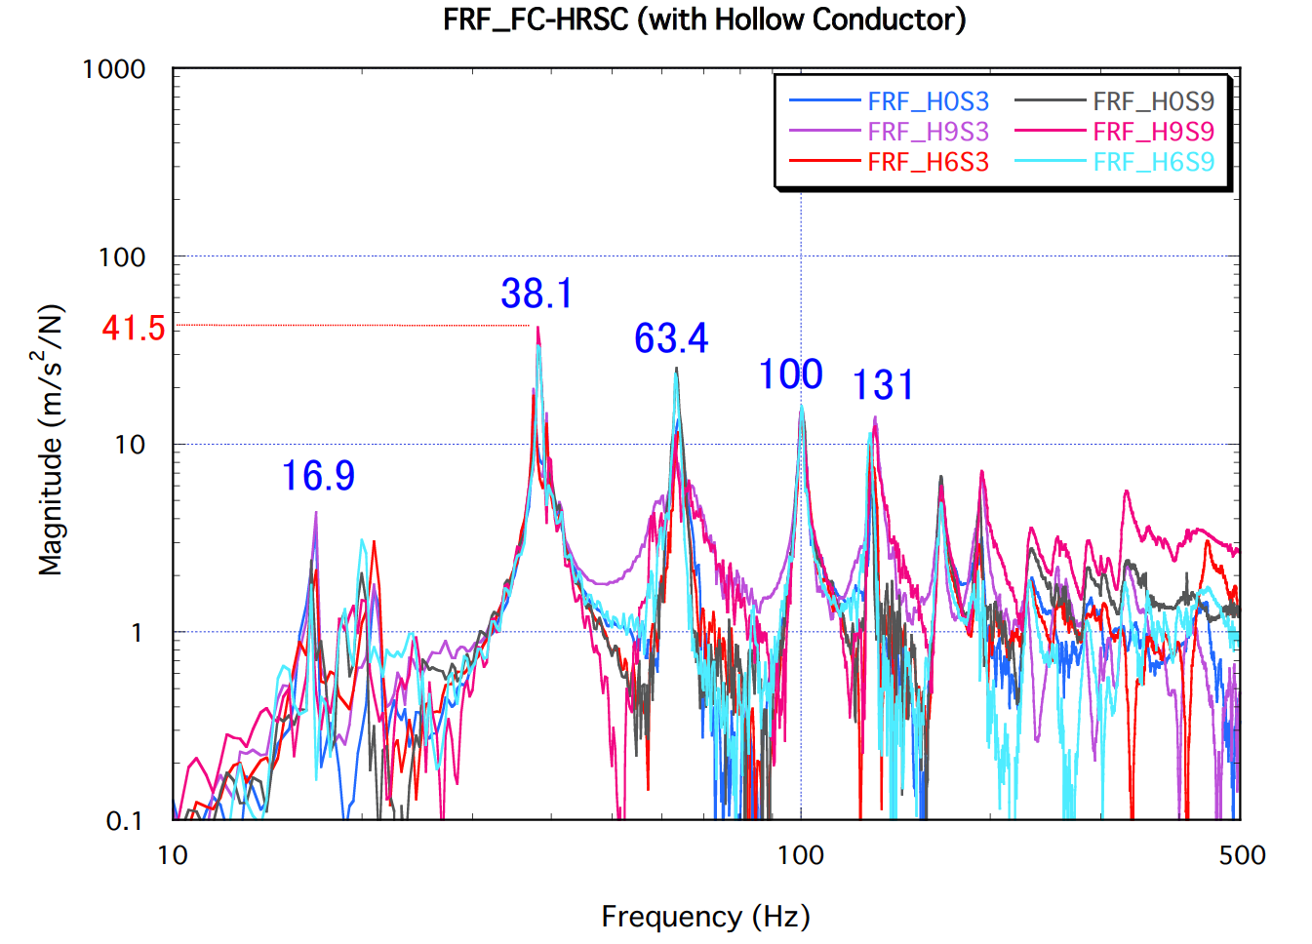
FC material choice
candidate material OFC & HRSC
Heat Resistance, high Strength & Conductivity copper (Mitsubishi Material co.)
vibration measurement gives similar result
avoid hardening of copper by manual pressing
difference in impedances
(80 % conductivity in HRSC)
decision will be made with results of operation tests of
prototype-1 (HRSC)
prototype-2 (OFC) under fabrication

Slide 13
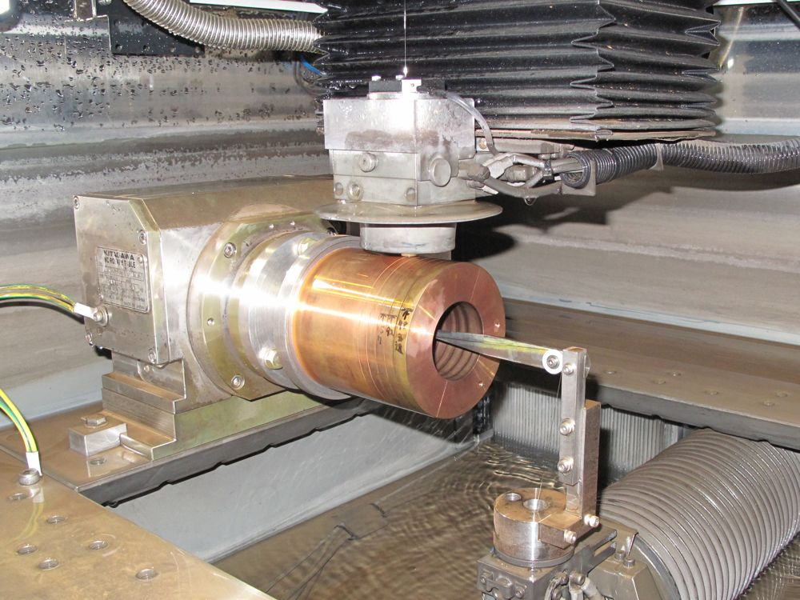
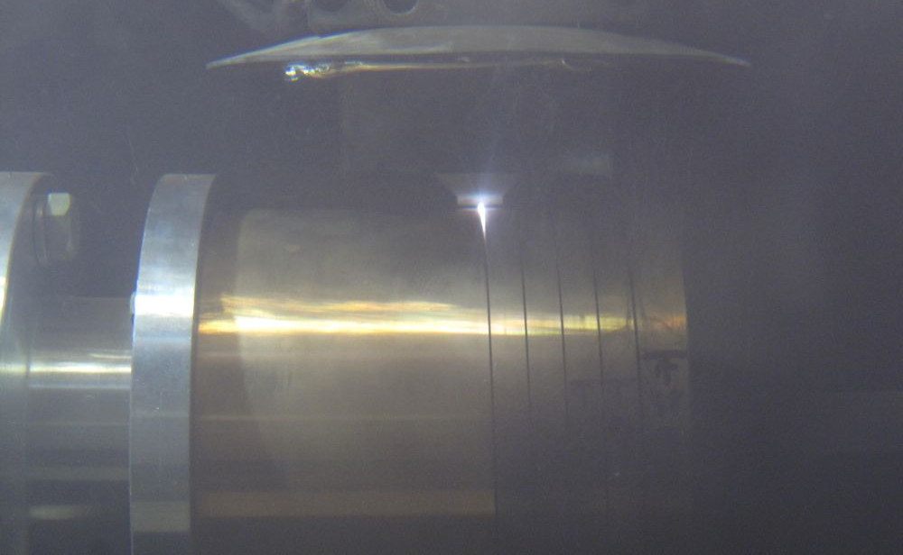
FC slit machining at KEK
Slit machining was performed
at KEK machine workshop
with an electrical discharge wire cutting machine.
0.15 mm thick wire
0.2 ~ 0.25 mm slit gap
special wire path shape with a sapphire pulley devised for FC fabrication
Machining by T. Takatomi & N. Okada

Slide 14
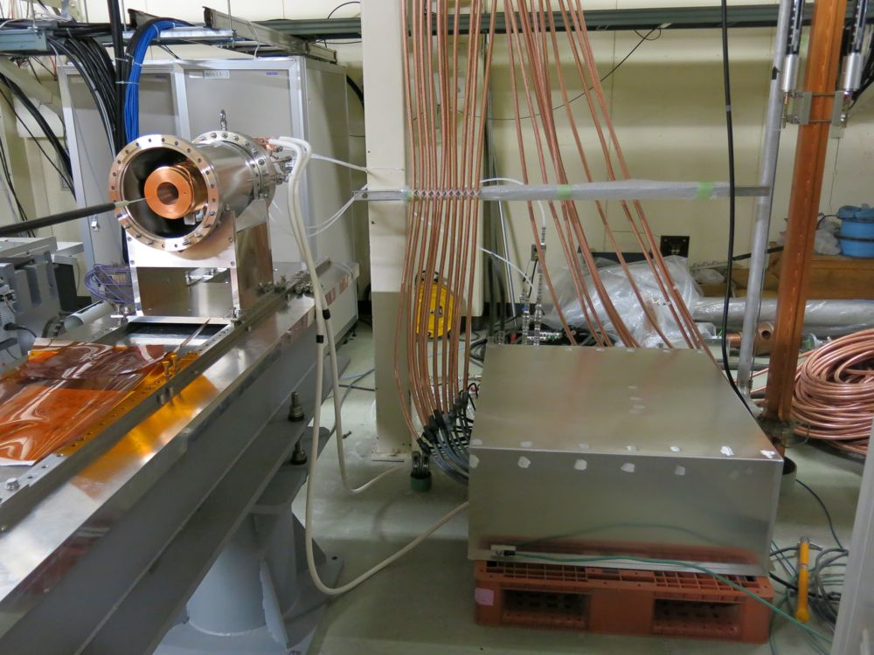
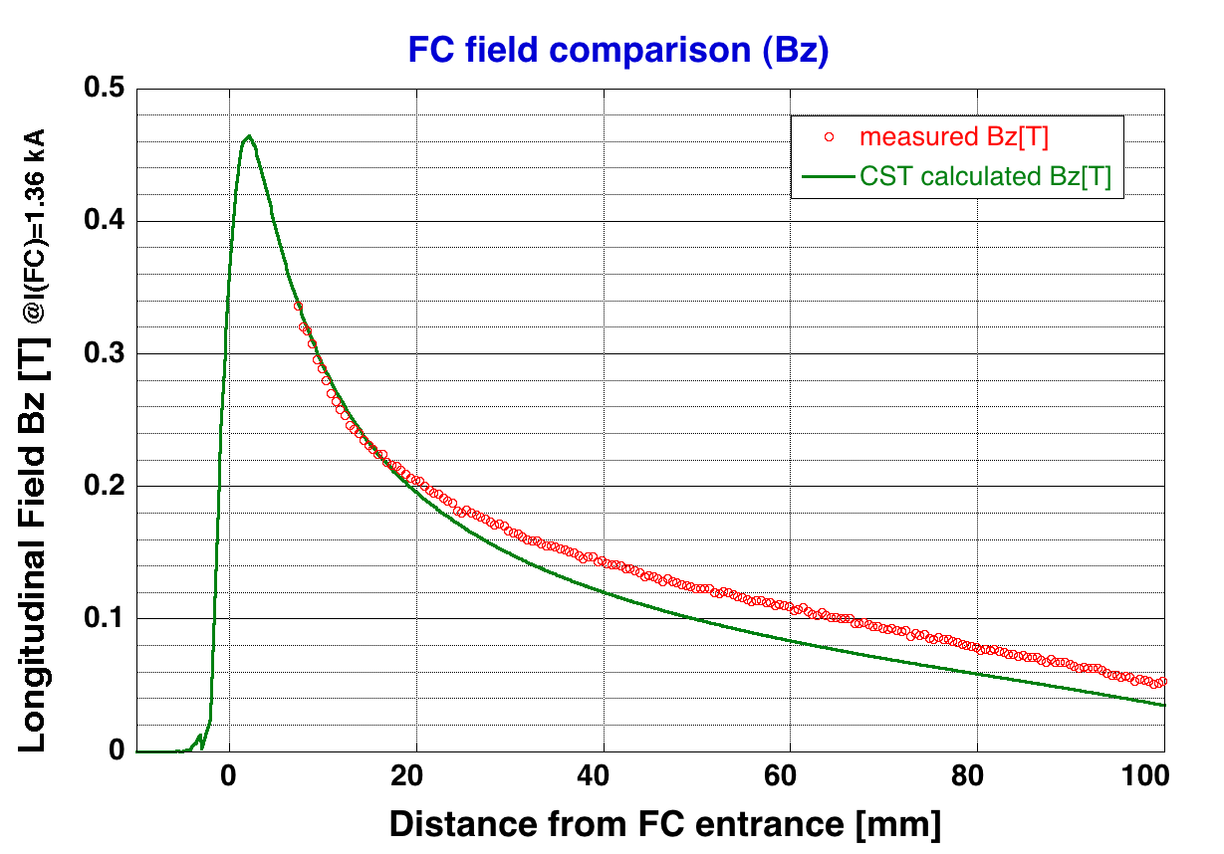
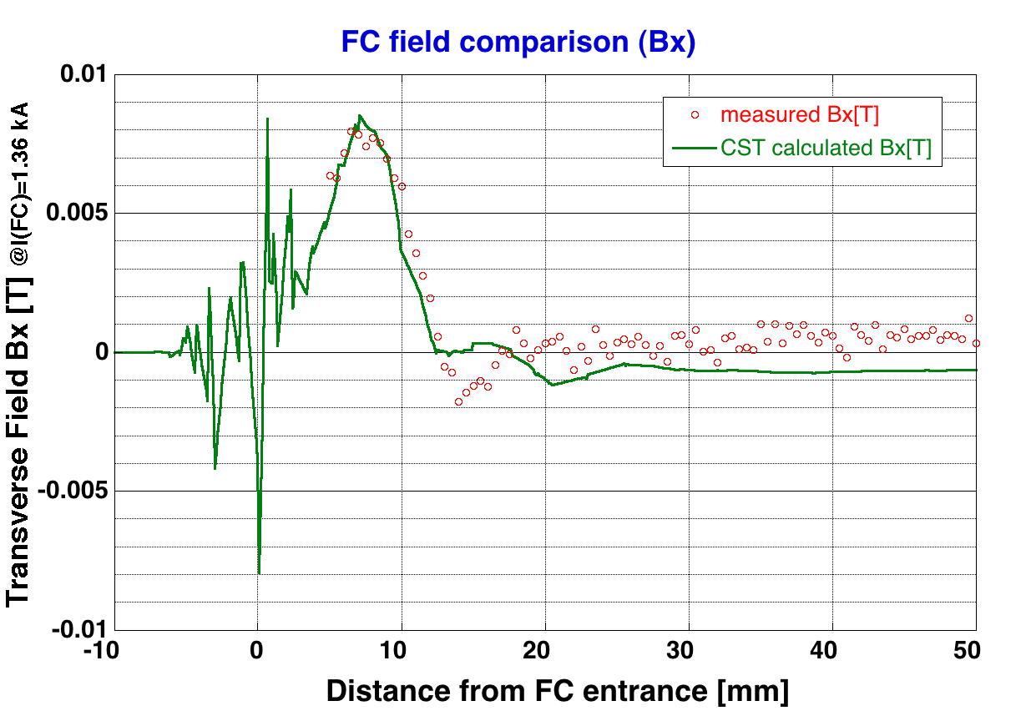
FC test stand
started operation on 2013/2/26
low current operation (1.36 kA) in the air for field measurement
high current operation (~6 kA) in a vacuum will start soon

Slide 15
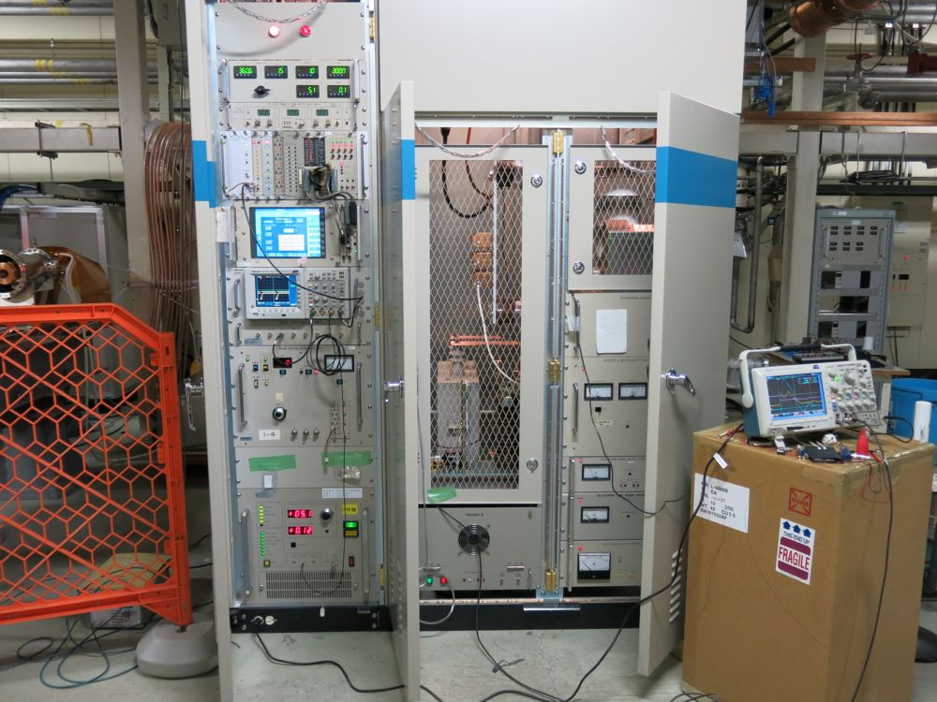
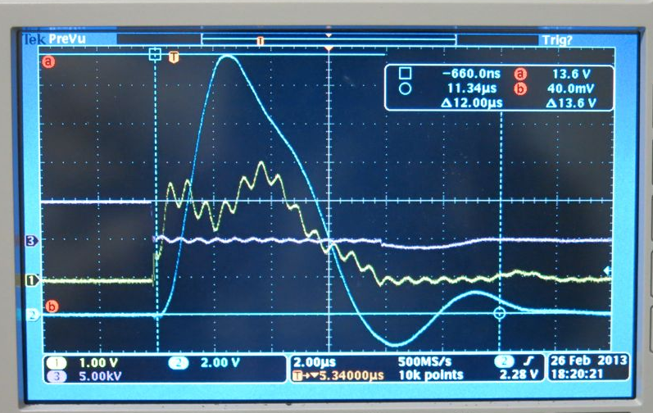
FC modulator (prototype)
modulator with thyratron
[1] prototype modulator
I_{peak} = 6 kA for FC tests and
for initial commissioning
(2013 Dec. -> 2014 Jun.)
[2] operation model modulator
I_{peak} = 12 kA for FC tests and for commissioning
(2014 Oct. -> )
half-sine 5 μsec pulse
stability 0.3% p-p
Details on the modulator is covered by M. Akemoto's talk

Slide 16
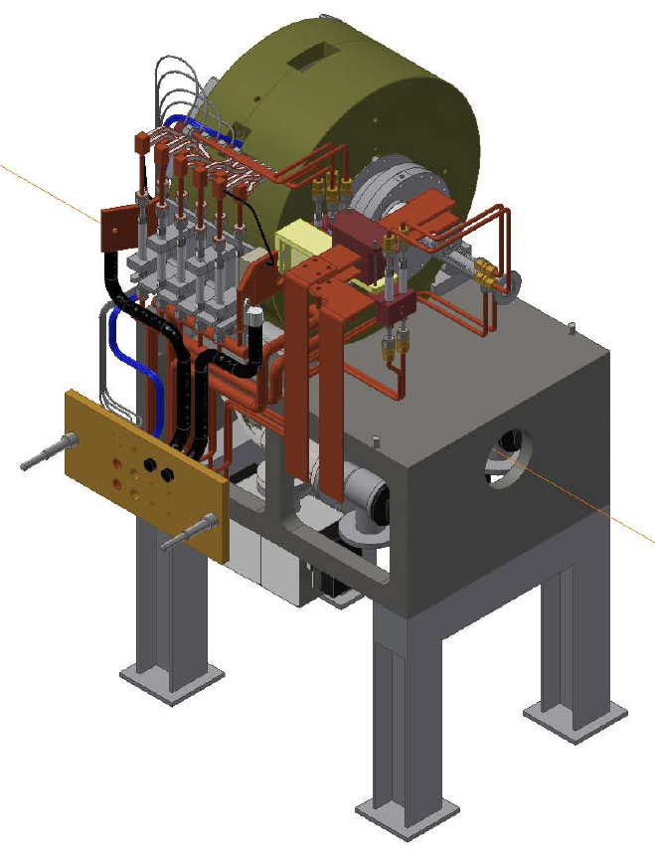
quick detachable girder
FC girder is designed to be quick detachable to minimize worker's radiation dose in FC exchange work.
wave guide disconnection in distant position from FC
quick coupling vacuum flange
quick coupling
water, electricity connection
Solton Co.
Staubli Co.

Slide 17
(3) Capture parameter optimization on
e+ yield and
satellite elimination

Slide 18
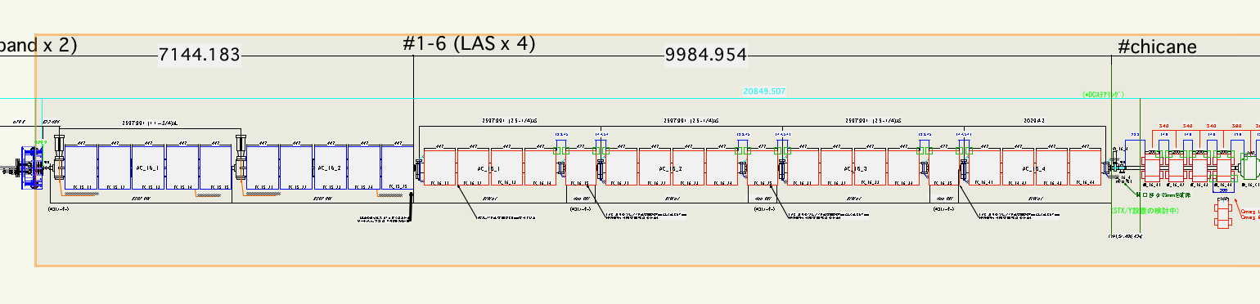
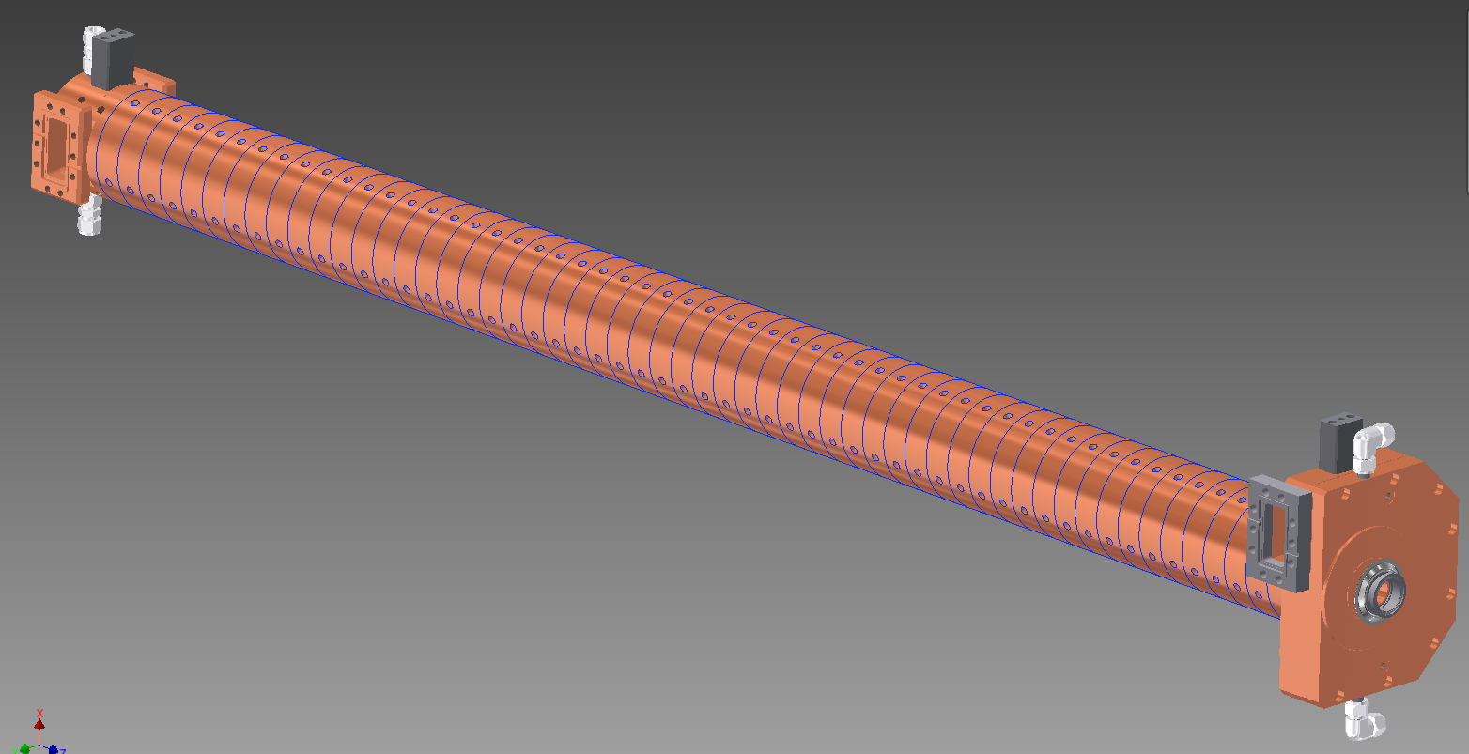
Capture Section with LAS
KLY
1-5
KLY
1-6
SLED
SLED
target
+FC
Solenoids
LAS 14 MV/m
deceleration & phase slip
LAS 10 MV/m
acceleration
Large Aperture
S-band structure
(LAS)
LAS with SLEDs for sufficient field gradient
breakdown issue of LAS in solenoid field
non sharp-peaked RF pulse shape

Slide 19
why no L-band in PCS ?
L-band first introduced for larger acceptance
Later, L-band found useful for satellite particle elimination
However, L-band components are costly
Recent simulation study shows capture section of all LAS can give sufficient satellite particle elimination as L-band
e+ capture with high-field deceleration is effective in this elimination

Slide 20
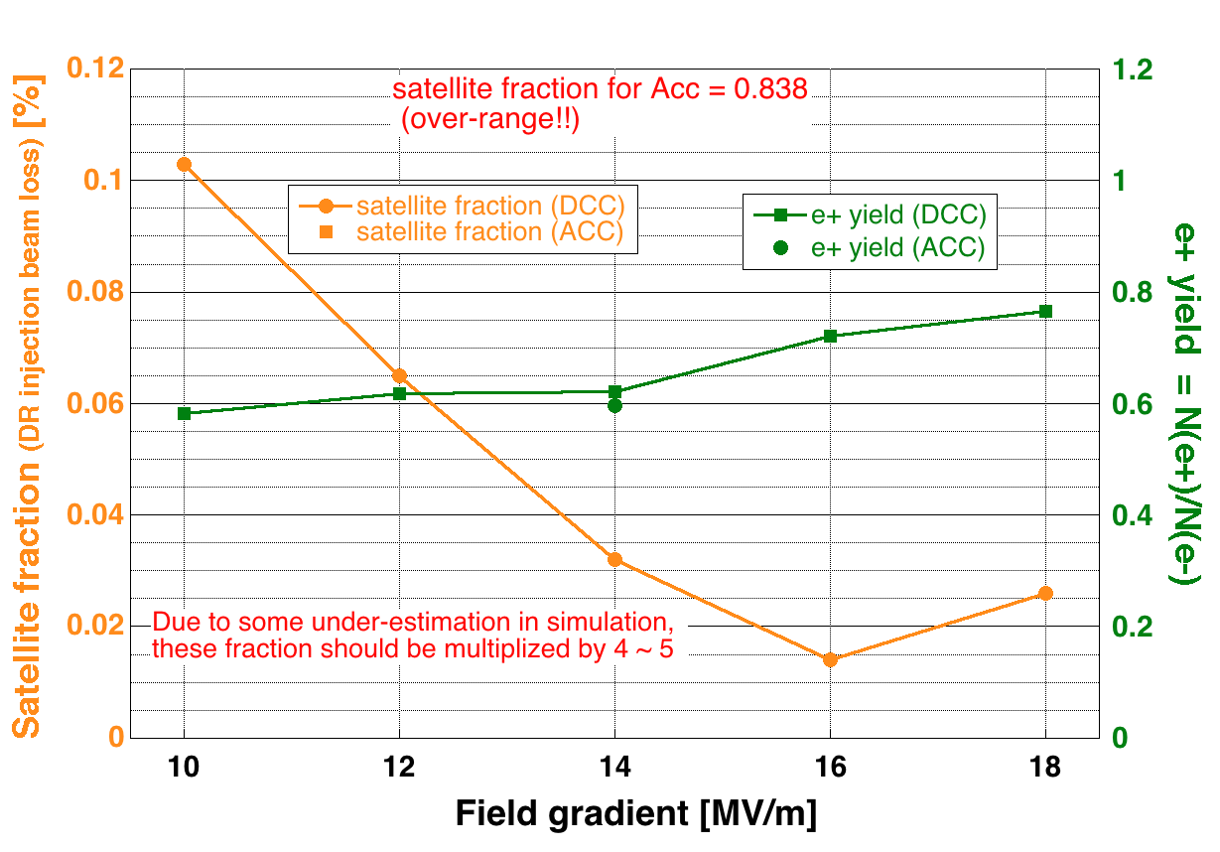
high-field decel. eliminate satellites
satellite fraction with Acc mode
is 10 times larger & over-scaled !!
field >= 14 MV/m
preferable

Slide 21
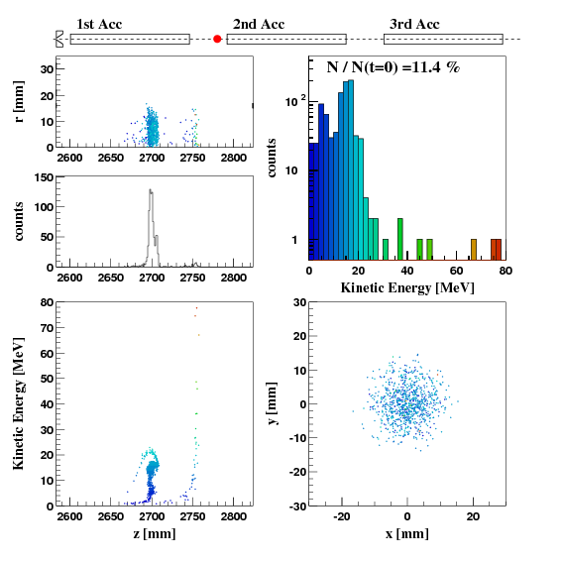
e+ capture simulation
capture tracking simulation with GPT by F. Miyahara & L. Zang
beam line optics design with SAD by T. Miura
beam line tracking simulation with SAD by N. Iida
capture parameters optimized with the simulations
deceleration capture with RF phase-slip
gives less satellite particles
See external movie file, capture-anim1.avi !!
Animation by F. Miyahara

Slide 22
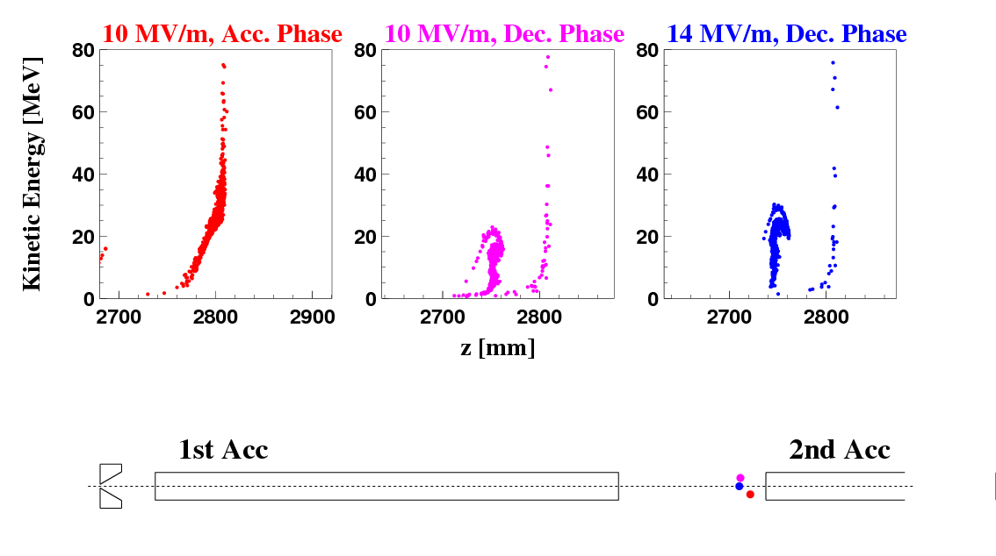
satellite formation
See external movie file, capture-anim2.avi !!
Animation by F. Miyahara
in deceleration capture, satellites are mainly generated
by low-energy particles at accel. structure gap
high-field deceleration can avoid this trap

Slide 23
(4) e+/e- compatible beam optics design & direct e+ injection
without DR

Slide 24
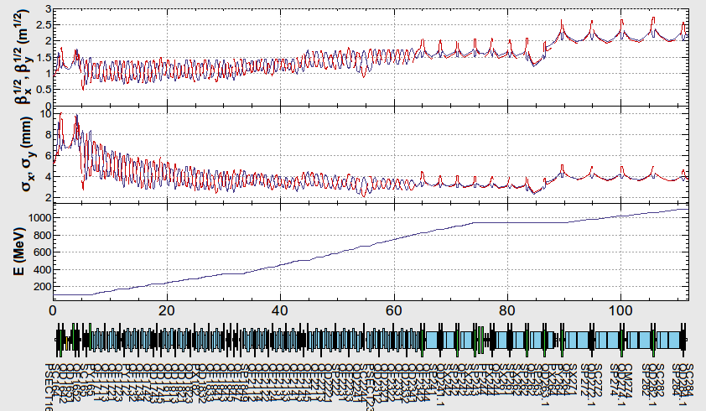
e+ beam line (1-6→2-8) & optics
before DR
SAD calculation by T. Miura
quads are densely placed in FODO
to accept large emittance e+
emittance halo
collimators x3
to
DR
PCS
1-7(LAS)
1-8(S)
2-1
2-2
2-3
2-4
2-6
2-7
2-8
matching
section
FODO
triplets

Slide 25
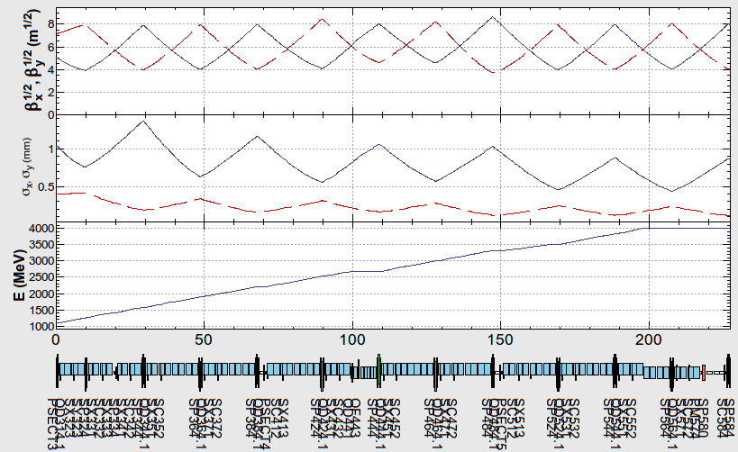
e+ beam line (3-1→5-8) & optics
after DR
SAD calculation by T. Miura
to switch optics flexibly for e+/e-/PF/AR, pulse quads are preferable
triplets are replaced by FODO and beam pipe aperture is reduced to half to relax pulse quad specification and cost
beam
from
DR
Sector-3
Sector-4
Sector-5
quads are sparsely placed for small emittance e+ from DR

Slide 26
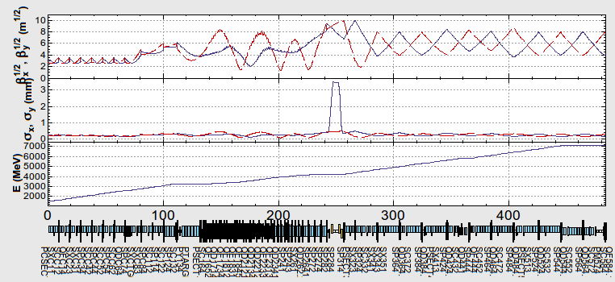
e- beam optics
SAD calculation by T. Miura
e+/e- compatible optics
with DC quads
pulse quads for mode dependent
optical setting
Sector-C
Sector-1
Sector-2
Sector-3
Sector-4
Sector-5
e+/e- compatible (compromised) optics in Sector-1, 2 of DC quads area
(e+ oriented optics with adjustment for e- matching)
e- oriented optics setting in Sector-3,4,5 by pulse quads
small acceptance in Sector-3,4,5 is sufficient for small emittance e-

Slide 27
direct e+ injection w/o DR
in early design stage, LER injection w/o DR is not expected
in sector-3, 4, 5, acceptance becomes smaller
by introducing pulse quads,
  [1] triplet->FODO
  [2] smaller aperture
this acceptance is sufficient for small emittance e+/e-,
but not for large emittance e+
very low e+ transmission in sector-3, 4, 5

Slide 28
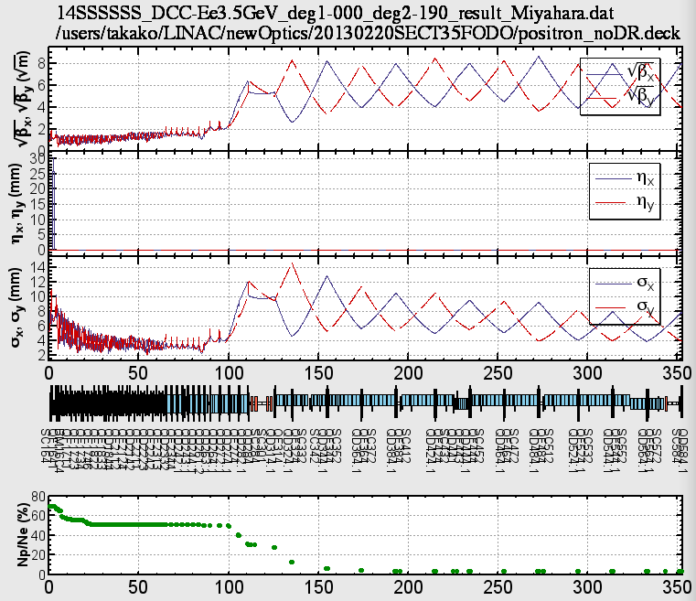
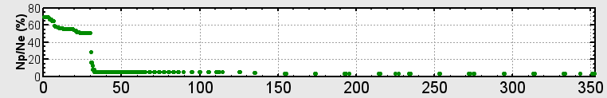
beam loss of large emittance e+
SAD tracking by N. Iida
e+ intensity
at linac-end
No Collimation Case
gradual beam loss & activation
0.355nC
e+ intensity at BT-line
will be ½ by energy acceptance
Collimation@1-8 Case
localized beam loss
0.346nC

Slide 29
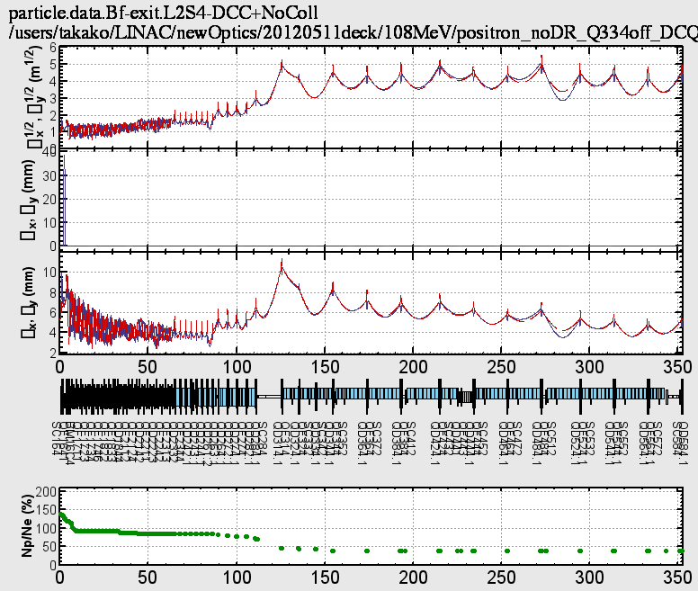
e+ injection with old quads ?
SAD tracking by N. Iida
Option to achieve
higher e+ transmission
Existing triplets in sector-3, 4, 5 with large aperture (a = 10 mm)
gives larger beam transmission in linac
cannot switch optics pulse-by-pulse with DC magnets
budget constraint on pulse quad fabrication and installation
e+ intensity
at linac-end
transmission efficiency at BT-line
should be evaluated !!
3.41 nC

Slide 30
Schedule & Summary

Slide 31
e+ schedule for next 1 year
components development & fabrication
e+ capture section installation (2013 Jul, Aug, Sep)
  DC solenoids & LAS installation
e- commissioning from A1-gun to linac-end (2013 Oct)
e+ target installation (2013 Nov)
  e+ target, FC & FODO (Sector-1, 2) installation
e+ commissioning (2013 Dec-2014 Jun)
[Constraints]
  e- intensity 5 nC (~ 10 nC)
  beam repetition ~ 1 Hz radiation limit, w/o shield around target
  FC current 6 kA (half of full spec.) prototype half spec. modulator
  DC solenoid currents 325 A (half of full spec.)
  water & electricity facilities are not yet upgraded
  pulse quads not yet installed

Slide 32
Summary
target & spoiler design is ongoing
FC prototype-1 started test operation
with a prototype (half spec.) modulator
Capture section with no L-band designed
for sufficient e+ yield and satellite elimination
e+/e- compatible optics in Sector-1, 2 and
independent optics with pulse quads in Sector-3, 4, 5 designed
direct e+ injection w/o DR gives large beam loss in linac
development, fabrication and installation of components will be performed for 1-st stage e+ commissioning at 2013 December.

