Slide 1
Construction of the Interaction Region
CDC
Inner
tube
QCSR
Support extension
IP Chamber
VXD unit
The 18th KEKB Accelerator Review Committee
KEK, 4-6 March 2013
K. Kanazawa
for
KEKB Vacuum Group
IR Technical Meeting Member
IR Installation Meeting Member
SVD/IR Mechanics Meeting Member

Slide 2
Contents
Sketch of the interaction region
Mile-stones and task schedule
Bridge reinforcement
Installation scenario
Vacuum around IR
IP chamber
Radiation shield
Summary

Slide 3
Sketch of the Interaction Region Phase 2
QCSL
QCSR
IP
Positron
Electron
Belle 2
Moving stage
Slide gate shield

Slide 4
Sketch of the Interaction Region Phase 1
Al IP chamber
(ID 4 cm, ~2 m long)
Temporal shield
(on the temporal stage)
Moving stage without QCSL support
Copper ducts with BPM
Fixed temporal stage

Slide 5
Mile-stone and Task Schedule
 | date | Belle rotation | QCS | Special magnets | Bridge reinforcement | QCS support and Moving stage | IP chamber | Ta beam pipe for QCS | Vacuum system | Installation scenario | Back ground estimation and Radiation shield | LABM | Luminosity monitor
 |  | Belle | MG(Cryo) | MG | MG | MG | Belle/VAC | VAC/MG(Cryo) | VAC | Belle/VAC | Belle/RSC/Acc | BM | Belle/Acc
Now | - Mar 2013 | Complete first stage | QCSL under fabrication |  | Decision |  |  |  |  |  |  | Fix position
 | Apr 2013 - Feb 2014 |  | QCSR fabrication start QCSL complete |  | (Must end before Oct 2013) | Bridge work L side complete | Ver. 1 final fabrication |  |  | Select scenario
QCSL test at IR | Mar 2014 - Aug 2014 |  | In situ test of QCSL |  |  | Mechanical test (L side)
 | Sep 2014 - Dec 2014 |  |  | Installation |  |  |  |  | complete |  | Phase 1 shield complete | Set up complete
Phase 1 | Jan 2015 - May 2015 |  | QCSR complete? |  |  |  |  | complete |  | Preparation complete |  | System test
 | Jun 2015 - Dec 2015 | Final adjust | QCS installation |  |  |  |  |  |  | 1 st test | Phase 2 shield complete
Phase 2 | Jan 2016 - Apr 2016 |  |  |  |  |  | Beast Feedback to var. 2 ? |  |  | Improvement
 | May 2016 - Sep 2016 |  |  |  |  |  |  |  |  |  | additional
Phase 3 | Oct 2016

Slide 6
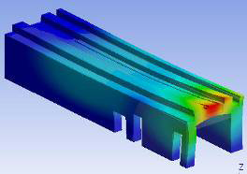
Bridge Reinforcement
The end of the bridge where QCS lies on is mechanically weak. For example the vertical oscillation of the place with 65 Hz is one of the lowest modes of the bridge oscillation.
The measured amplitudes during KEKB are tolerable if QC1E and QC1P oscillate with the same phase (this is the most probable case).
However. if a simple and effective way of reinforcement of this part is available, it should be done.
The chance of the work is quite limited. The decision should be done as soon as possible.
H. Yamaoka
65 Hz

Slide 7
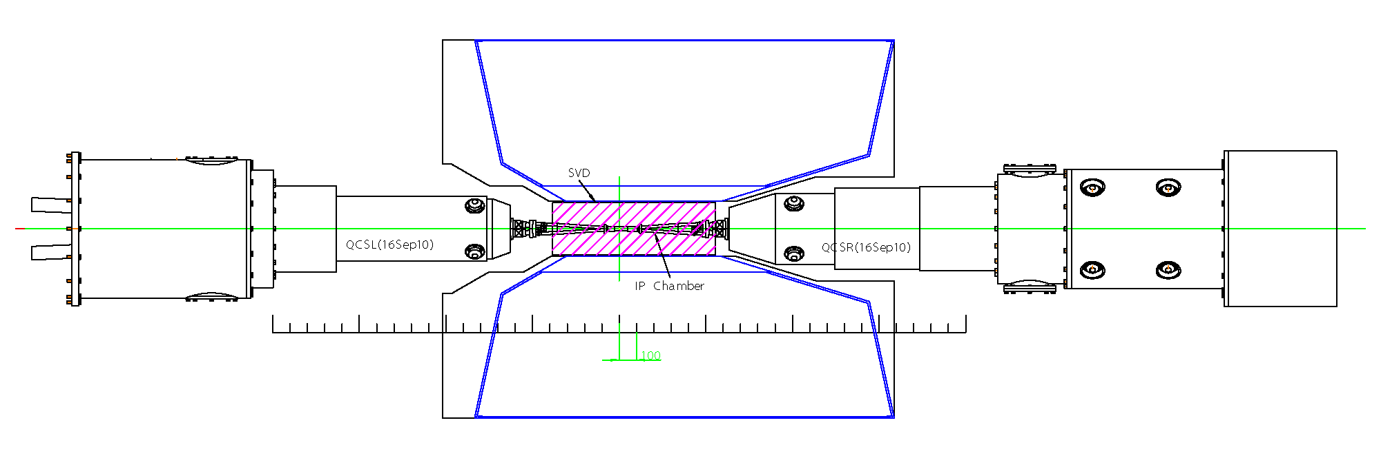
Installation Scenario Basic conditions
IP chamber is supported by VXD frame.
Both sides of IP chamber are fixed to the VXD frame transversally and are free longitudinally.
VXD is supported by CDC.
The R-side of VXD is aligned transversally and is free longitudinally.
The L-side of VXD is fixed to CDC.
QCS cryostats can move out.
Connection flanges for vacuum chambers.
Top view
Some work spaces to access flanges.
It will be possible to make use of these spaces.
Little work space to access flanges.
It is impossible to connect flanges by hands in this configuration.
CDC

Slide 8
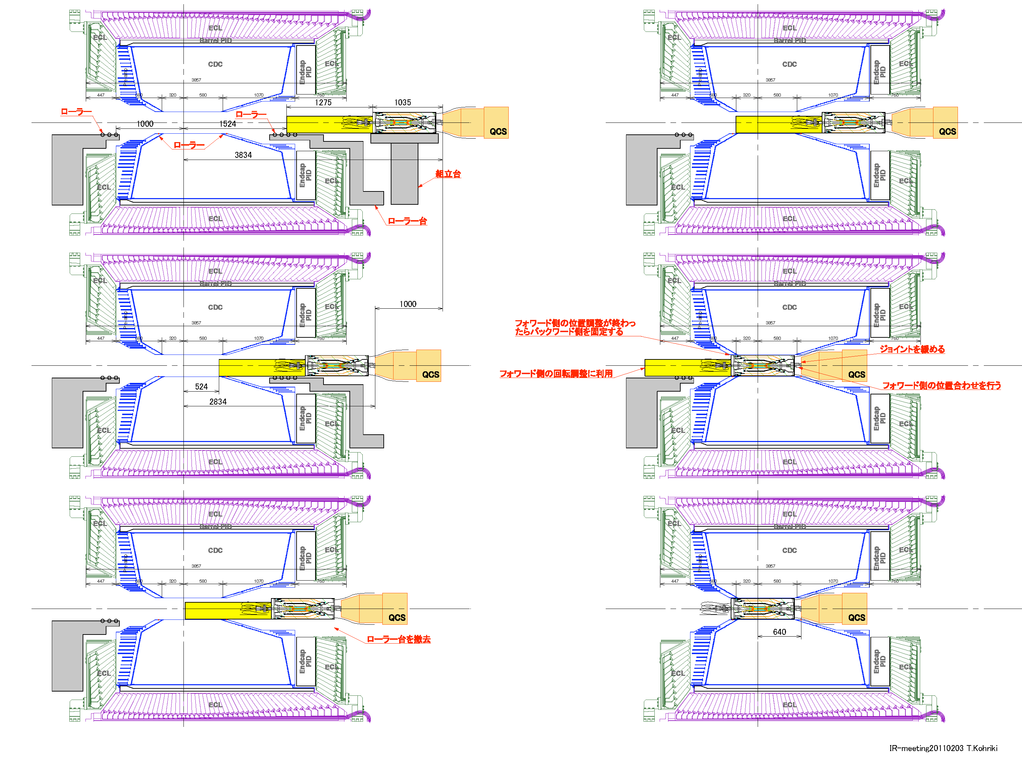
Installation Scenario - Baseline
T. Kohriki

Slide 9
Installation Scenario Alternative Scenario with Remote vacuum seal mechanism.
Some people feel uneasy on the situation that VXD unit is pushed by QCS in the baseline scenario.
They proposed an alternative scenario to slide VXD with manual force and a remote vacuum seal mechanism.
The mechanism is not yet valid with a mock-up test.
However the choice of the installation scenario has various impacts on detailed designs of VXD and surrounding components.
The decision on the choice cannot be delayed so long.
DESY

Slide 10
Vacuum around IR Layout of vacuum components near QCS in the R side
The beam pipe in the cryostat is made of Ta (red part in the figure). The maximum thickness of this pipe is 4 mm.
Pumps are located outside the cryostat.
The major gas load for the incoming positron line is photon-desorbed gas. That for the outgoing electron line is thermal outgassing.
electron
Ta beam pipes will be coated with Au or Cu to reduce ohmic power loss.
positron
SR power ~ 1.4 kW
Electron cloud in the cryostat beam pipe is expected to be suppressed by solenoid fields (~50 G is necessary).

Slide 11
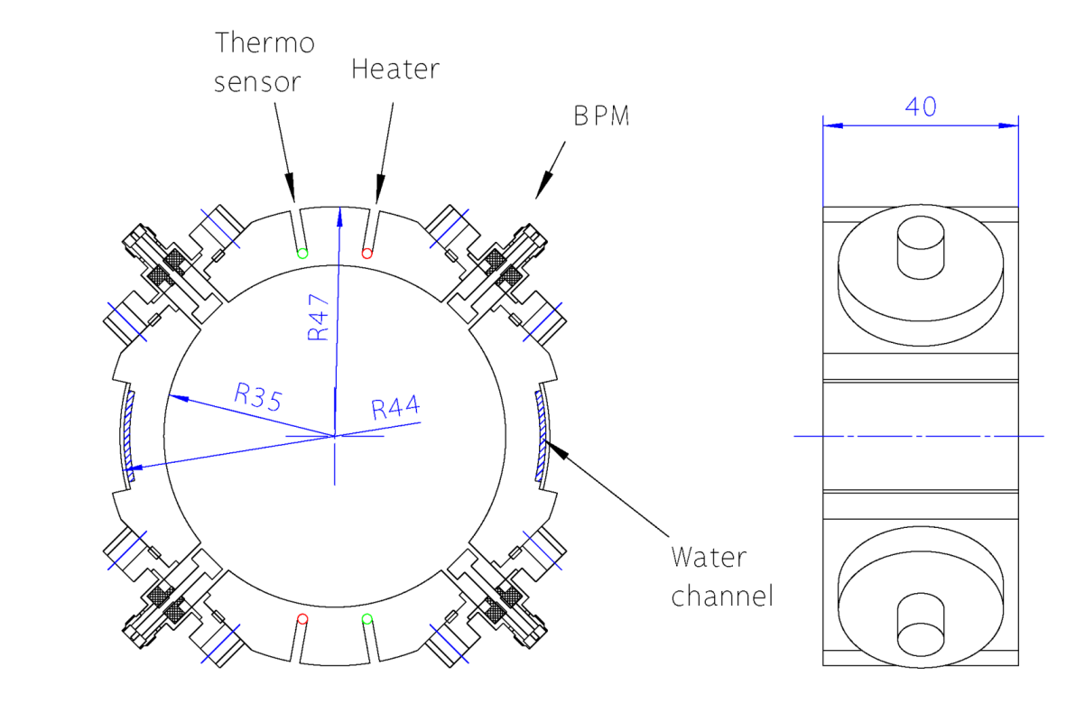
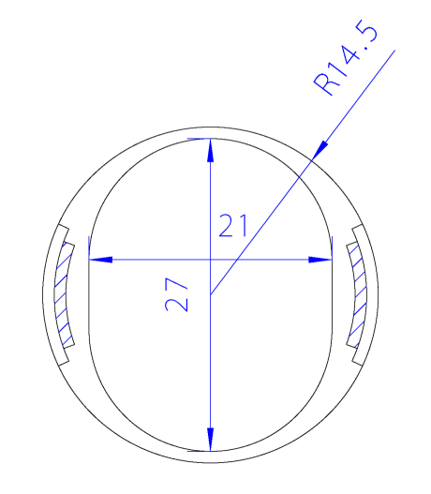
Vacuum around IR Typical cross section of Ta beam pipe
Vertically elongated aperture in QC1P
(Larger aperture is preferable but it is not available in the present design.)
BPM

Slide 12
Vacuum around IR Layout of vacuum components near QCS in the L side
The layout is similar to the R side.
positron
electron

Slide 13
Vacuum around IR Rough estimation of pressure near IP
P_{IP}
positron
P₀
Example: Incoming positron line
Assumptions:
The equation for a long tube gives good estimation for a short tube
At IP pressure is maximum
P₀ is determined by the total outgassing of the cryostat beam pipe and the pumping speed there (50 l/s).
The thermal outgassing rate is 1×10⁻¹¹ Torrl/s/cm² (1.33×10⁻⁸ Pa m³/s/m²).
The difference between P₀ and P_{IP} is determined by the local outgassing and the conductance of the beam pipe. It doesn’t depend on the pumping speed outside the cryostat.

Slide 14
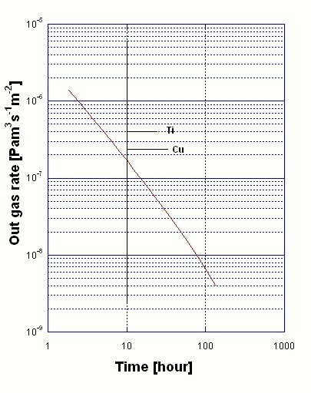
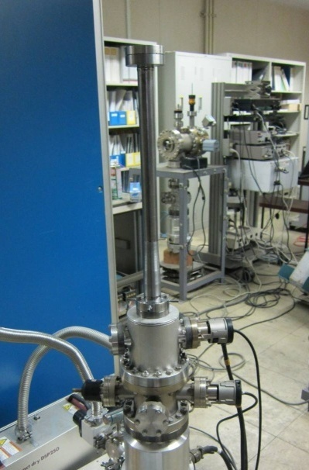
Vacuum around IR Test Ta beam pipe
A test Ta beam pipe with cooling channels, a taper, and conflat flanges was fabricated.
Ta pipe model for QCS with cooling path in the wall. This pipe has a weld seam between water and vacuum. The test with tap water caused no leakage at least for months.
Thermal outgassing of the Ta pipe. ‘Very low’
(H. Hisamatsu)

Slide 15
Vacuum around IR Photon-induced desorption of Ta, Au, and Cu (2nd)
Photo-desorption coefficients of Cu, Ta, and Au-coated Ta. Ta and Au-coating have a sufficiently low photo-desorption coefficient.
(At PF BL21, ε_{cr} = 4 keV, by Y. Tanimoto)

Slide 16
Vacuum around IR Consideration on IR pressure
At least, the pressure around the IP (±5m) must not affect the overall average design pressure of the ring (1×10⁻⁷ Pa). Therefore the target pressure in this region must be less than 1 × 10⁻⁷ × 3000/10 =3 × 10⁻⁵ Pa. A consideration on the beam-gas Rutherford scattering requires much lower pressure in the QC magnets where β is large.
The main gas source in this region is photon-desorbed gas due to the direct SR from the last bend. If a photo-desorption coefficient η is assumed to be 1 × 10⁻⁶ molecules/photon, The average pressure of this region will be a few × 10⁻⁶ Pa.
It was shown that Ta and Au-coating have a sufficiently low photo-desorption coefficient. It was also shown Ta has a very low thermal outgassing rate.
Still we are looking for an idea to improve IP pressure.

Slide 17
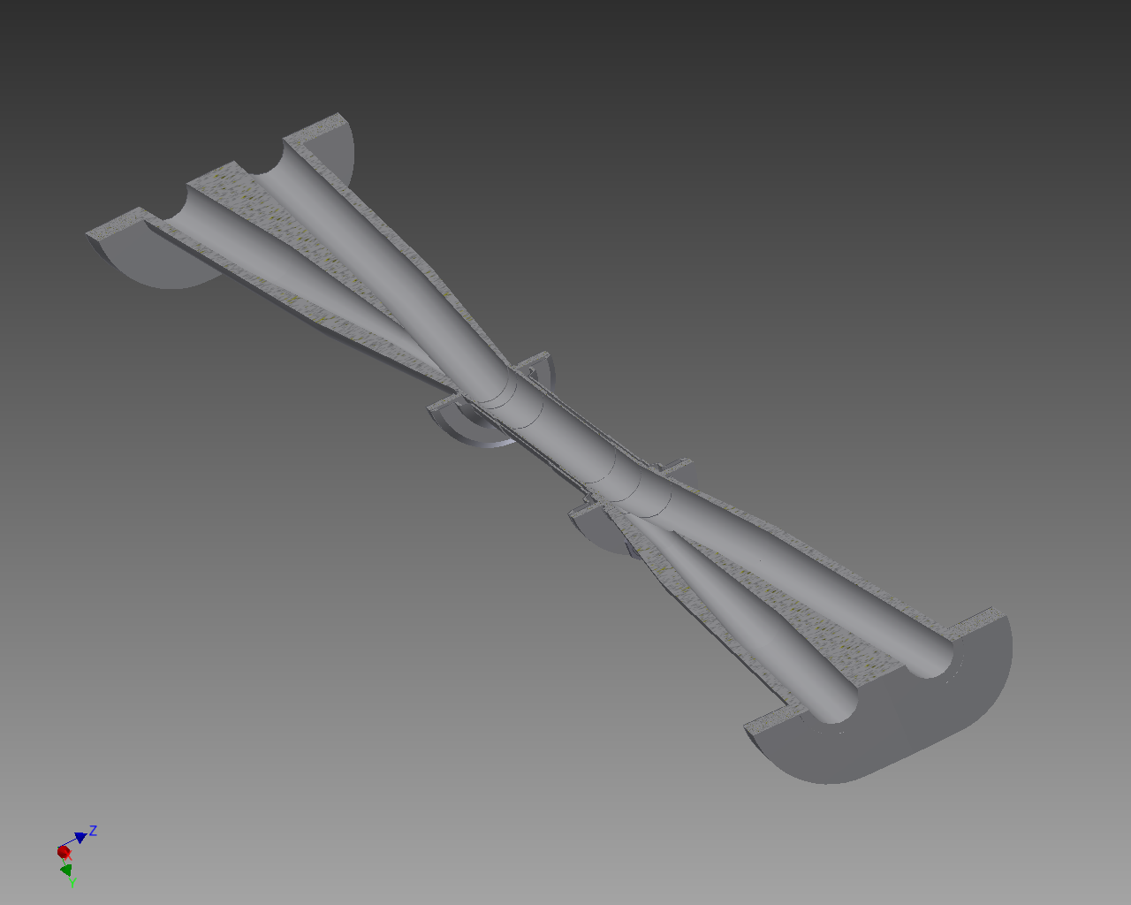
IP Chamber Cut View
Electron
S. Koike
Positron

Slide 18
IP Chamber Design feature
HIP = Hot Isostatic Pressing
The central straight part consists of double tube. Paraffin runs between them.
The connection between double tubes is done by Ti-Ti EBW.
1~2 μm
10~20 μm
1~2 μm

Slide 19
IP Chamber R&D
Done
Stress analysis
For the temperature difference between the two tubes at the center.
Changing support position of beam pipe
Fabrication test
Precise machining of Be pipes
NC machining of ridges
Be-Ti brazing
Ti-Ta HIP
EBW near by HIP
Pulsed sputter coating of Cu inside 2 cm Al pipe and its uniformity check
To be done (in preparation)
Stress analysis
Check the strength under dynamic force
Fabrication test
Au coating on Ti pipe
Effect of EBW on the coating
Simulation welding between inner and outer Ti pipes
Ta part will be fabricated in FY 2013 and the first version of IP chamber will appear within FY 2013

Slide 20
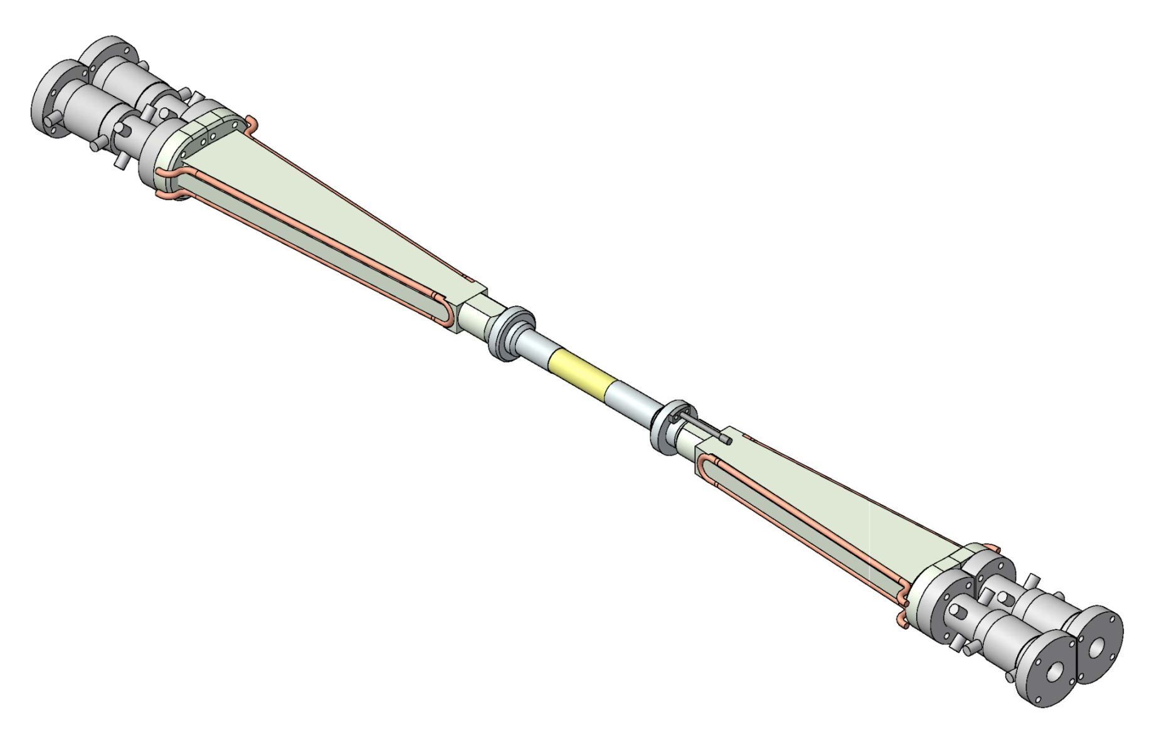
IP Chamber Cooling
The coolant is paraffin. The flow of paraffin can absorb a heat of ~270W for a temperature rise of 10℃.
WL: 210W (Ta)
e⁻
WL: 190 W (Ta)
SRQ: ~ 50 W
SRB: 100 W
WL: 70 W (bulk Au)
SRQ: few W
WL: 140 W (Ta)
Heat: 400 W.
Water cooling, ID 4 mm, L = 600 cm, v = 2 m/s
ΔT of water ~ 4°C
Heat transfer coefficient to water: 1.1×10⁴ W/m²/ °C
ΔT ~ 5 °C (between water and pipe)
WL: 270 W (Ta)
SRQ: ? W
SRB: 130 W
Ta will be coated with Au or Cu to reduce the wall loss.
e⁺
T. Kohriki

Slide 21
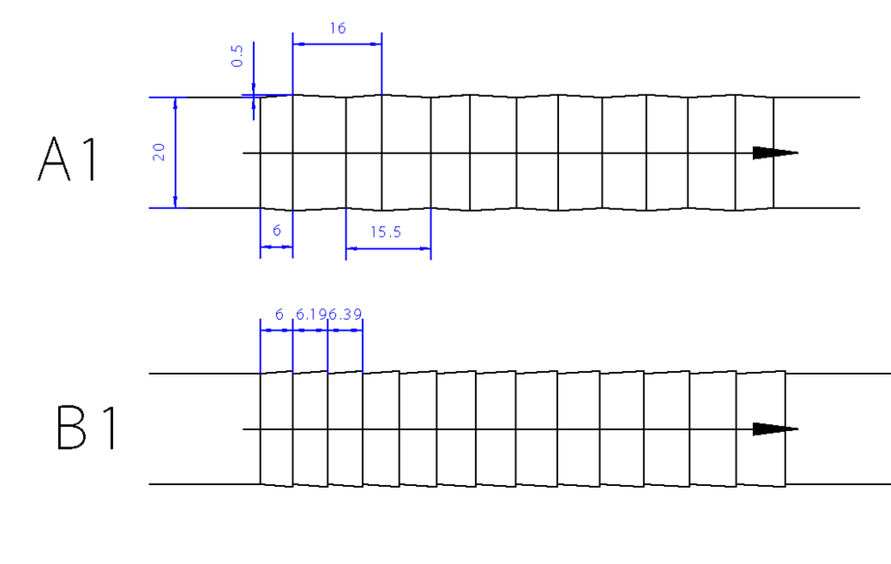
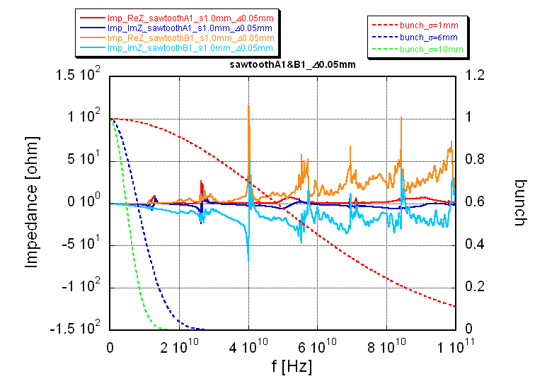
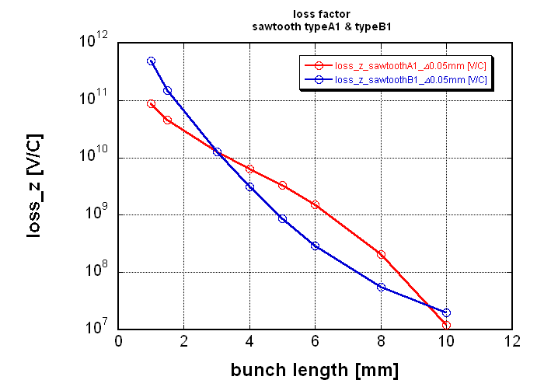
IP Chamber Are steep ridges permissible?
Gentle ridge
Steep ridge
Since the height of the ridge is only 0.5 mm, structures of impedance due to the sharpness of ridges appears in higher frequencies than a 6mm bunch spectrum.
Steep ridges are OK.
(K. Shibata, Y.H. Chin)
New ridge

Slide 22
IP Chamber Tip scattering on a ridge
T. Ishibashi, et al
Ta sample
Set up
CHESS (Cornell Univ.) G2 beam line
Photon energy : 9 keV
Slit : 2 mm (H) by 0.05 mm (V)
Detector angular resolution : 0.2 degree (FWHM)
Ratio of the scattered photon. The slope of the taper inside the pipe is 1.23 degree.

Slide 23
Radiation shield Phase 2
There are two major radiation sources in the interaction region. One is the LER horizontal collimator (upstream) to cut the halo created by Touschek effect. The other is the downstream LER beam pipes hit by off-momentum positrons and gamma rays due to the radiative Bhabha process.
(Y. Funakoshi, Y. Ohnishi)
The present design seems insufficient to keep the experimental hall free from radiation.
(H. Nakayama and T. Sanami).
Further investigation is necessary.

Slide 24
Radiation shield Phase 1
Now on-going estimation of the beam loss at phase 1 suggests this structure is sufficient for Phase 1.
(Y. Ohnishi, T. Sanami)

Slide 25
Summary
With the progress of the construction of SuperKEKB, the number of tasks to be solved for the interaction region is increasing.
Among them,
We must make decision on the bridge reinforcement as soon as possible.
The choice of the installation scenario has verious side effects. It cannot be delayed so long.
And,
We are still looking for an idea to improve IP pressure.

