Slide 1
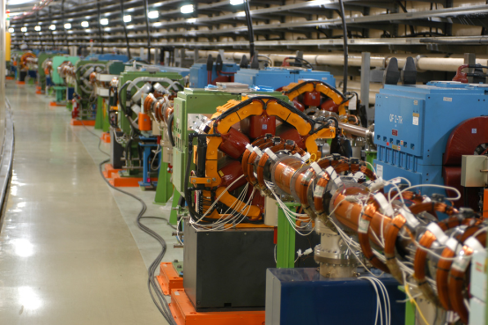
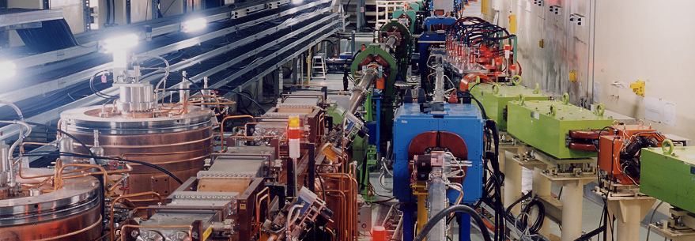
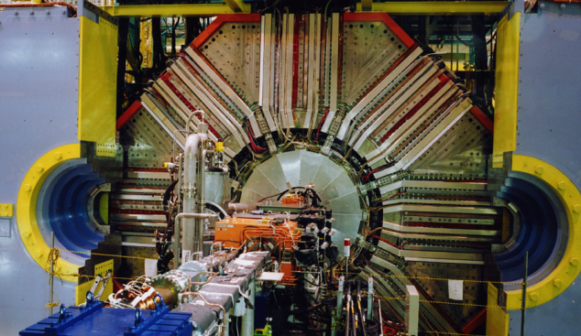
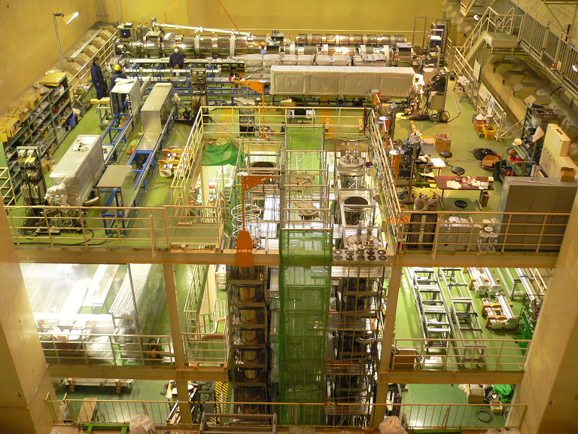
TiN Coating and Baking of Beam Pipes
KEKB Oho Lab. (2013.2.27)
The 18th KEKB Accelerator Review Committee
March 4, 2013
Kyo Shibata (on behalf of KEKB Vacuum Group)

Slide 2
Introduction 1
What should we do before the installation of new beam pipes?
For HER (e-) : Baking at the laboratory(not in-situ)
For LER (e+) and Damping Ring : Baking & TiN coating at the laboratory
How many beam pipes should be processed?
For HER (e-) : ∼180
For LER (e+) : ∼1000 (of which ∼ 25 have electron clearing electrodes and TiN coating is unnecessary. )
For Damping Ring : ∼100
Pre-installation works (coating and baking) started on last April.
Pre-installation work means:
Bringing beam pipes to KEKB Oho Lab. from storage area -> Coating (only for LER, 3days) -> Baking (3days) -> returning the beam pipes to storage area
Large-scale works by 10 workers with 4 coating equipments and 4 baking equipments started on last September.
2013/3/4 the 18th KEKB Accelerator Review Committee 2

Slide 3
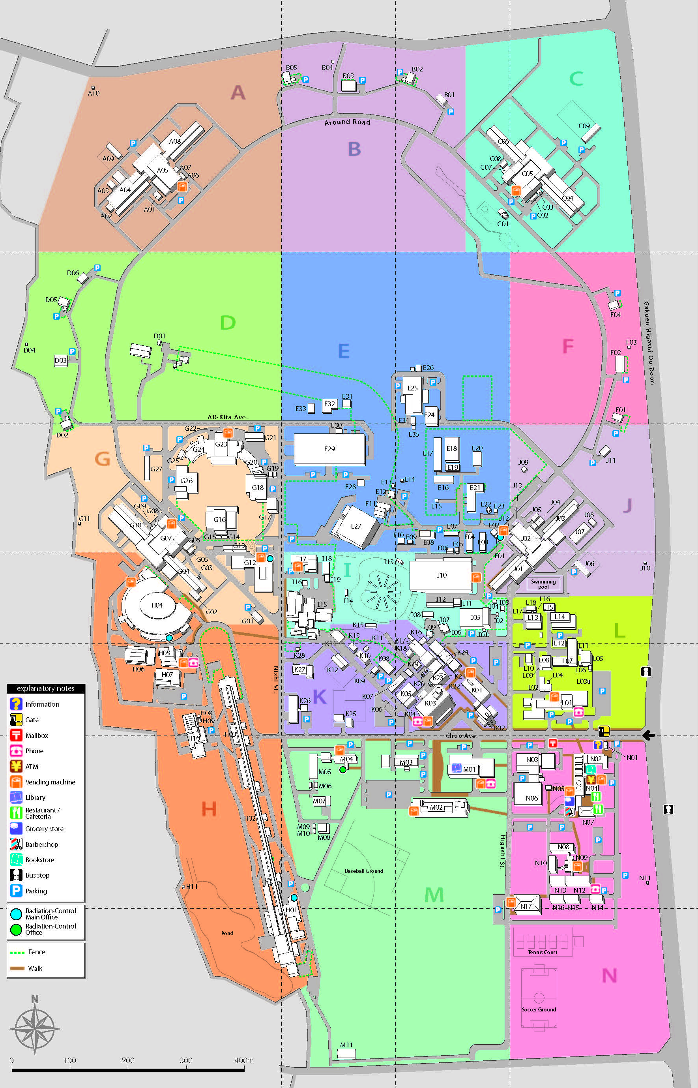
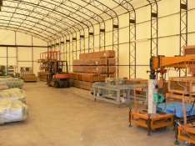
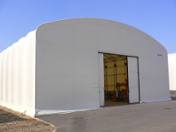
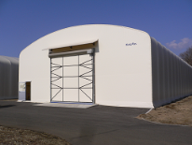
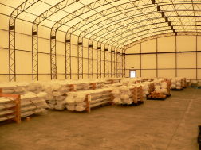
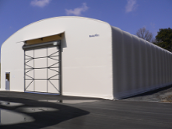
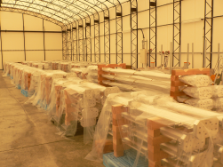
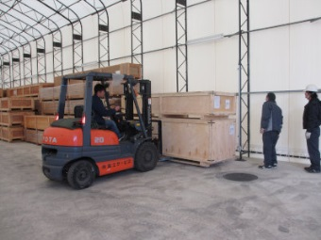
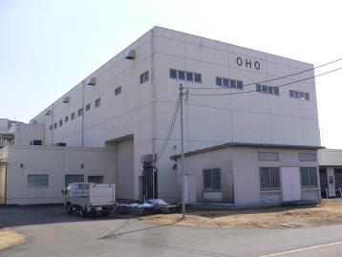
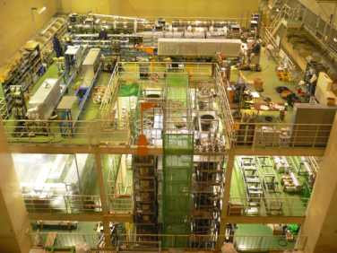
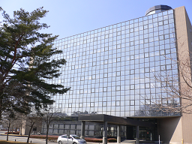
Flow chart of
pre-installation work
Storage area
Bringing beam pipes to KEKB Oho Lab. from storage area
Visual check on the beam pipe
LER beam pipe without electrode
HER beam pipe
TiN Coating
LER beam pipe with electrode
KEKB Oho Lab.
Assembling
(NEG pump & BPM electrode)
Baking
KEKB Oho Lab.
3-go-kan Bldg.
(You are here.)
Returning the beam pipes to storage area
2013/3/4 the 18th KEKB Accelerator Review Committee 3

Slide 4
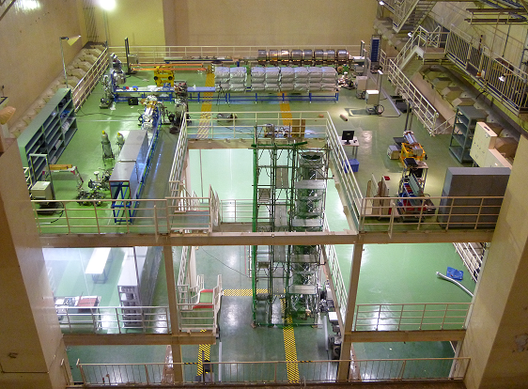
Introduction 2
What we did after last KEKB Review are
Setting up 2 more baking equipments and 4 coating equipments (vertical).
Large-scale work in this facility. (This will continue this year. )
Setting up 3 horizontal coating equipments for bent beam pipes. (in progress now)
Topics discussed in this talk are
Baking & TiN coating facility, Evaluation of TiN coating, Status report on baking and coating works and Future plan.
Working Schedule
Last year
Now
2013/3/4 the 18th KEKB Accelerator Review Committee 4

Slide 5
Layout of Oho laboratory 1
4 baking equipments : 2 long type (∼5 m) and 2 short type (∼3 m)
5 vertical TiN coating equipments (for straight beam pipes. one of them is back up.)
3 horizontal TiN coating equipments (for bent pipes. In preparation now. )
16m
Coating equipment (horizontal type)
Coating equipment (horizontal type)
Coating equipment (horizontal type)
Baking equipment (long type)
stairway
16m
Baking equipment (long type)
4.5mm
Clean room
Baking equipment (short type)
Baking equipment (short type)
Coating equipments (vertical type)
stairway
6.5 m
Oho experimental deck (top view)
2013/3/4 the 18th KEKB Accelerator Review Committee 5

Slide 6
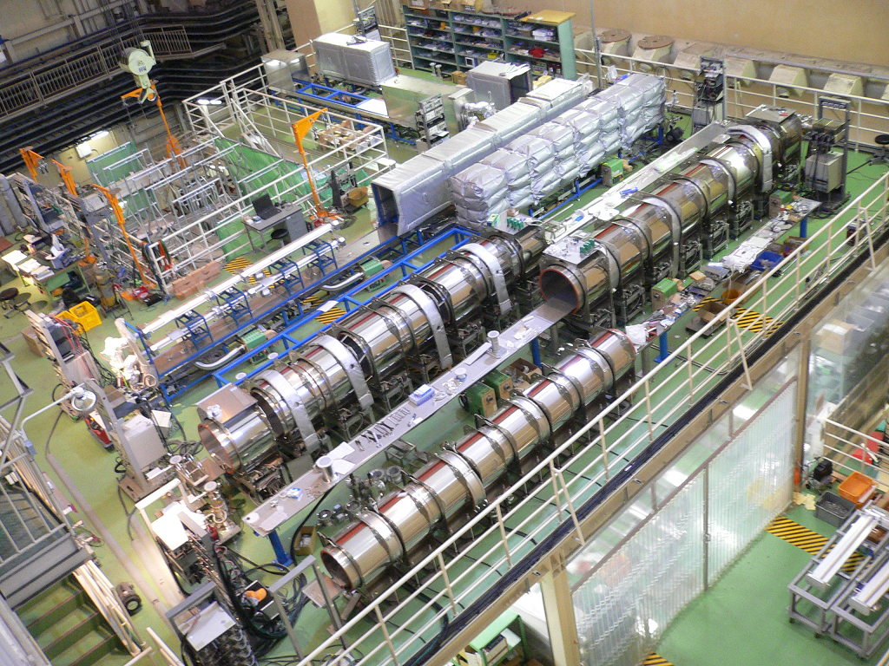
Layout of Oho laboratory 2
View from different place.
Baking equipment (short type)
Coating equipments (vertical type)
Baking equipment (short type)
stairway
16m
6.5 m
4.5mm
Baking equipment (long type)
Baking equipment (long type)
Coating equipment (horizontal type)
Coating equipment (horizontal type)
Coating equipment (horizontal type)
stairway
16m
Clean room
2013/3/4 the 18th KEKB Accelerator Review Committee 6

Slide 7
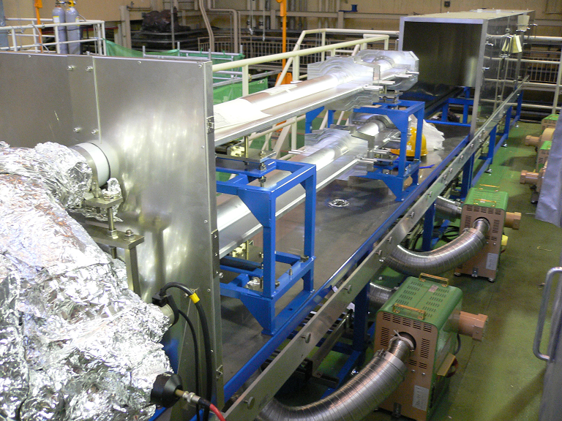
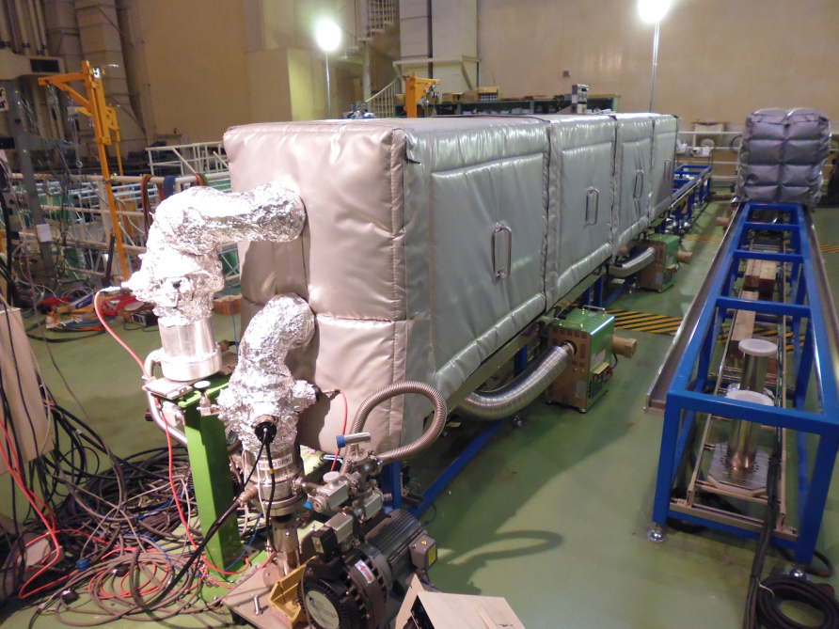
Baking 1 : Equipment
Hot-air heating method was adopted.
Two beam pipes are mounted up and down in one hot-air oven.
Hot-air oven consists of movable insulated walls and insulated frame.
Hot air is circulated in the hot-air oven.
Each pipe is evacuated by a turbo-molecular pump (0.3 m³/sec) during the baking.
Movable walls
Now baking
Beam pipe
(double decker)
Pumping unit
Hot-air circulator (7.5 kW)
Short type
Long type
2013/3/4 the 18th KEKB Accelerator Review Committee 7

Slide 8
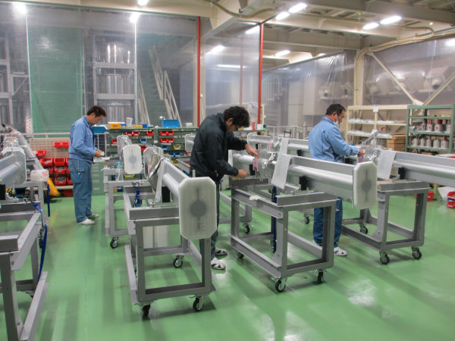
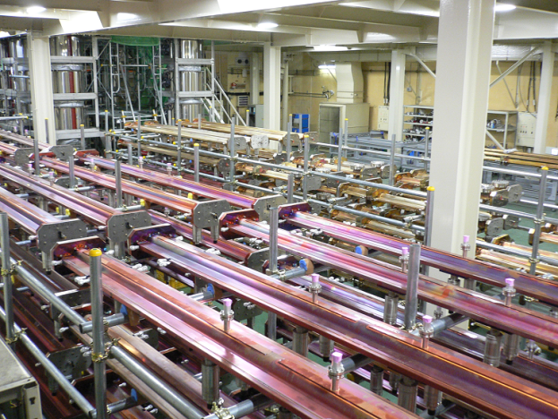
Baking 2 : Baking conditions
Baking conditions
Temperature : ∼150 °C (∼120 °C for beam pipes with electrodes)
Baking period : ∼26 hours
It was confirmed that the temperature of the beam pipes in the oven became ∼150 °C within a several hours if the temperature setting of the hot-air circulator was ∼175 °C.
Targeted pressure after baking : < 10⁻⁷ Pa
NEG pump is activated at the same time.
Before baking
TiN coating (if necessary)
Installation of NEG pumps and BPM electrodes at Oho clean room.
After baking
Filling with dry nitrogen up to atmospheric pressure.
Isolating the beam pipe and putting a blank flange on the beam pipe.
Keeping the beam pipe in the storage area until the installation.
Clean room
Storage area (Oho lab.)
2013/3/4 the 18th KEKB Accelerator Review Committee 8

Slide 9
Baking 3 : Rate of baking output
Baking work started on last April.
Baking work started on small scale with 2 baking equipments on last April.
On last September large-scale works with 4 baking equipments started.
Total output by last month (2013/2/28) is 481.
Averaged daily output : 0.8 (small-scale), 2.0 (full-scale), 1.4 (total)
Averaged weekly output : 5.5 (small-scale), 13.9 (full-scale), 10.0 (total)
Small-scale work
Large-scale work
2013/3/4 the 18th KEKB Accelerator Review Committee 9

Slide 10
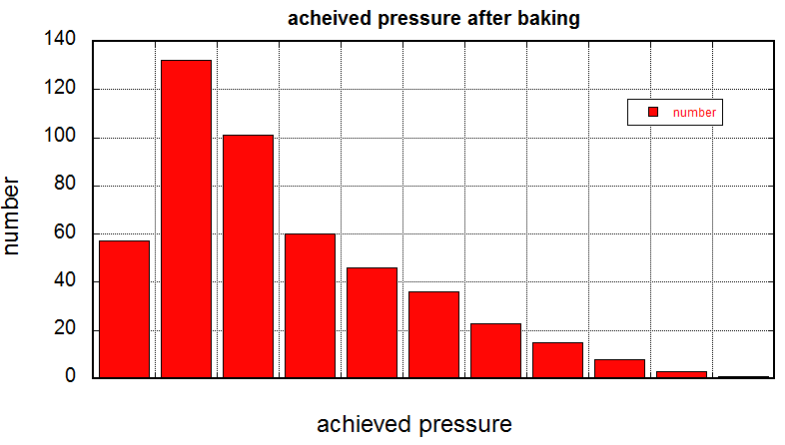
Baking 4 : Achieved pressure after baking
For almost all beam pipes, achieved pressures after baking are below 1×10⁻⁷ Pa.
If achieved pressure is higher than 1×10⁻⁷ Pa, the beam pipe is baked again. (only 3 cases so far)
Mass pattern after baking is not monitored. (Although 2 of 4 baking equipment have RGAs, we don’t use them.)
< 1
1∼2 2∼3 3∼4 4∼5 5∼6 6∼7 7∼8 8∼9 9∼10
10 <
[x10⁻⁸ Pa]
2013/3/4 the 18th KEKB Accelerator Review Committee 10

Slide 11
TiN coating 1 : Coting method
For SuperKEKB LER, it is an important issue to mitigate the electron cloud instability.
In order to reduce the electron cloud, inner surfaces of almost all LER beam pipes are coated with TiN (except beam pipes with clearing electrodes).
TiN coating tests had been performed and the coating method was established.
TiN coating is done by a DC magnetron sputtering of Ti in Ar and N₂ atmospheres.
A Ti cathode rod (-400 V) is set on the center axis of beam pipe (hung from the top on in case of the vertical type).
Gases are supplied into the beam pipes uniformly though the Ti rod.
Magnetic field (16 mT) is supplied by solenoid coils.
Preliminary experiments were performed at a test stand to decide the coating parameters.
Thickness of TiN coating : 200 nm (at least)
Straight beam pipes are coated by vertical type and bent pipes are coated by horizontal type.
Mass Flow Controller
Ar gas (2.0 Pa)
N₂ gas (0.5 Pa)
Discharge Power Source
Solenoid Coil
Beam pipe
Solenoid Coil’s Power Source
Ti Cathode Rod (-400 V)
16 mT
Gauge
Test stand
Pumping System
Mass Spectrometer
2013/3/4 the 18th KEKB Accelerator Review Committee 11

Slide 12
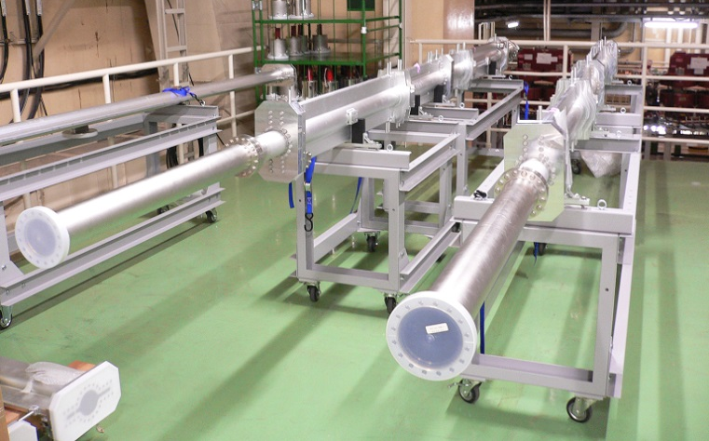
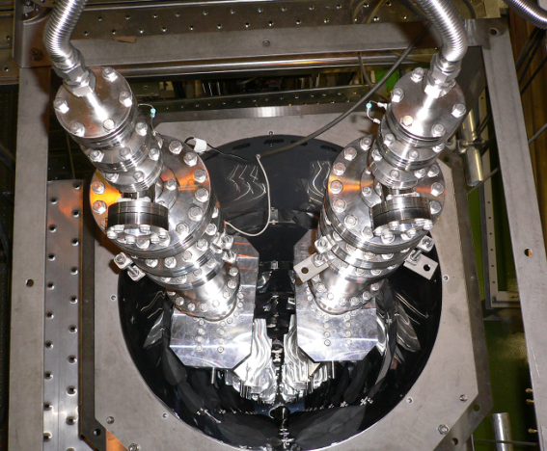
TiN coating 2 : Facility (vertical)
5 vertical equipments for straight beam pipes were built last year.
Large-scale work started on last September with 4 vertical equipments.
1 equipment is backup and not available now.
Beam pipe with a length up to 5.5 m can be coated.
Short beam pipes and dummy pipes are connected to make total length ∼6 m.
Two lines of the beam pipes can be mounted side-by-side in one equipment.
Combination of hot-air oven and circulators are adopted for pre-baking.
It is not available for bent beam pipes.
∼6 m
Dummy pipe for length tuning
Beam pipes
Two lines of beam pipes
5 coating equipments (vertical)
2013/3/4 the 18th KEKB Accelerator Review Committee 12

Slide 13
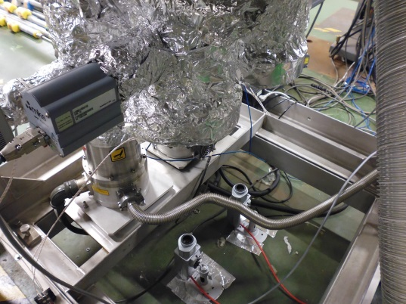
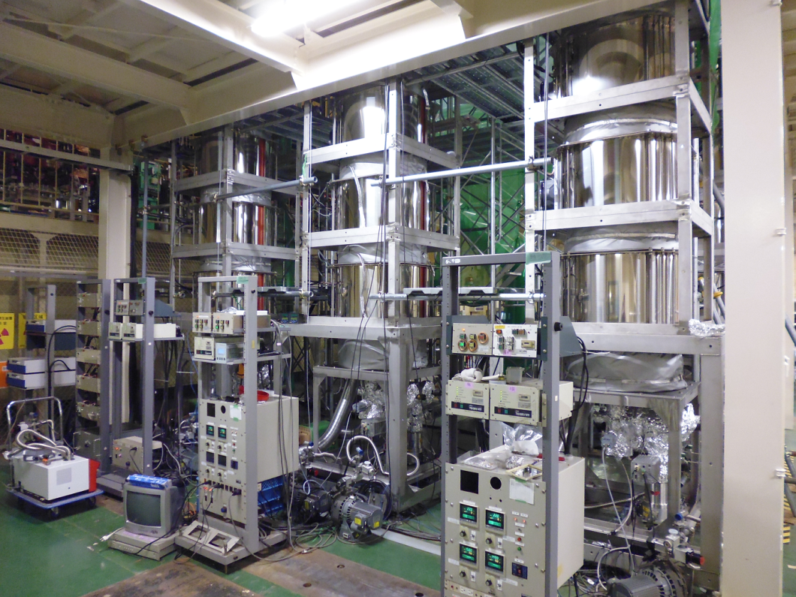
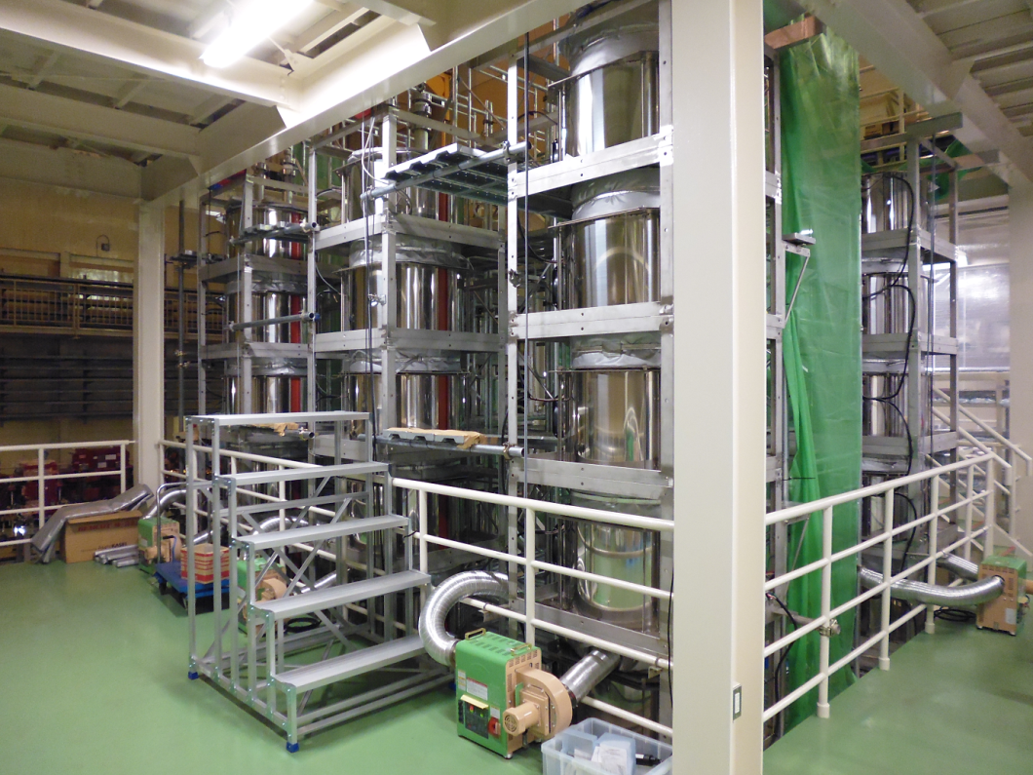
TiN coating 3 : View from bottom and middle floor
Viewing port and camera at the bottom to observe discharge
Solenoid coil
Hot air circulator
Pumping unit
Hot air circulator
Bottom floor
Middle floor
2013/3/4 the 18th KEKB Accelerator Review Committee 13

Slide 14
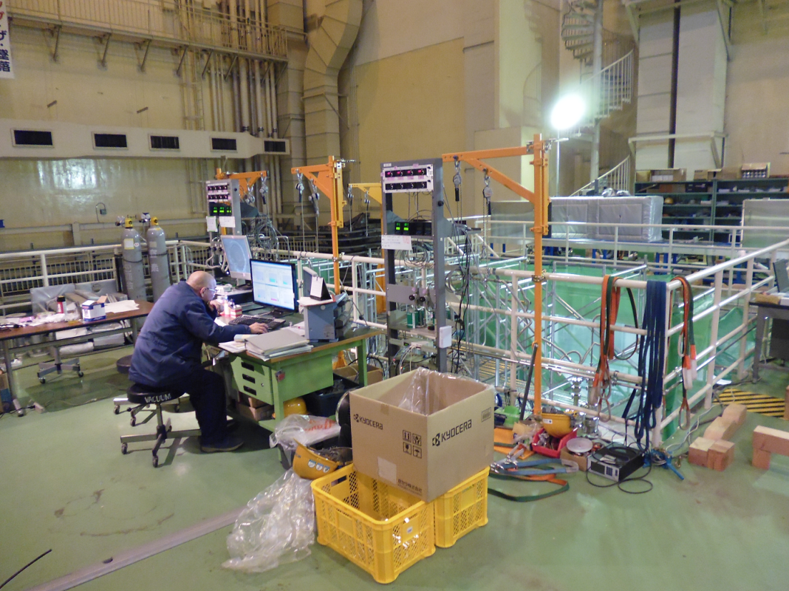
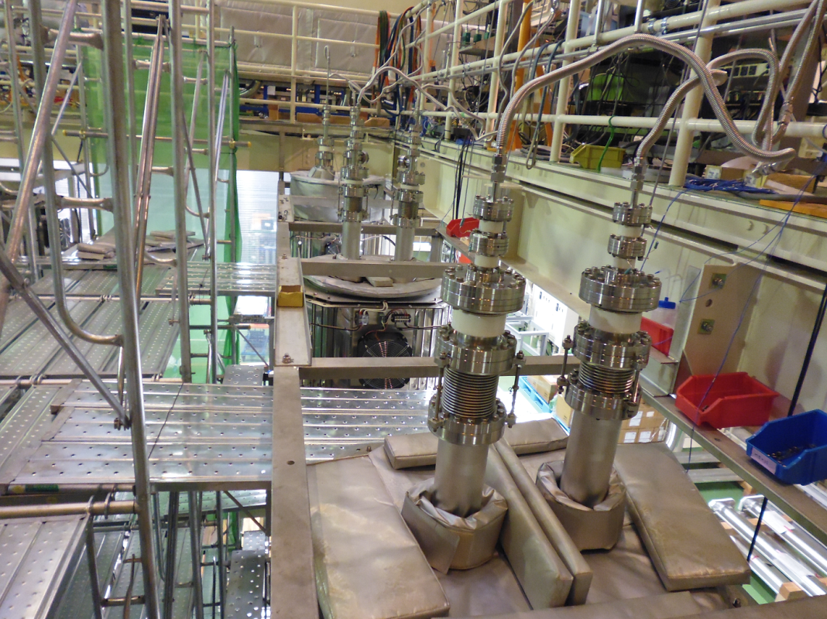
TiN coating 4 : View from top floor
Introduced gas line
Mass flow controllers
Control desk
2013/3/4 the 18th KEKB Accelerator Review Committee 14

Slide 15
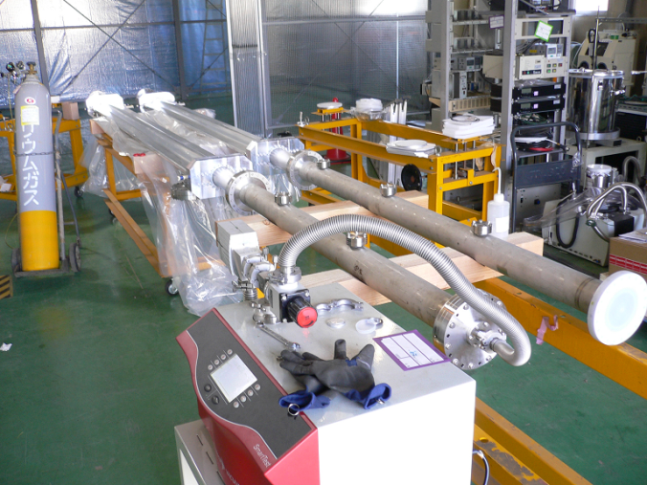
TiN coating 5 : Working process
Before coating (at Oho clean room)
Visual check on the beam pipe.
Putting blank flanges on pumping ports and BPM ports.
Connecting beam pipes and dummy pipes for length tuning. (if necessary)
Leakage test
Installation of beam pipes on coating equipment.
In coating equipment
Leakage test
Pre-baking (∼150 °C, ∼24 hours)
TiN coating (Discharge duration : ∼80 min.)
After coating
Filling with dry nitrogen up to atmospheric pressure.
Dismantling beam pipes
Installation of NEG pumps and BPM electrodes at Oho clean room.
Baking
Leakage test before installation
2013/3/4 the 18th KEKB Accelerator Review Committee 15

Slide 16
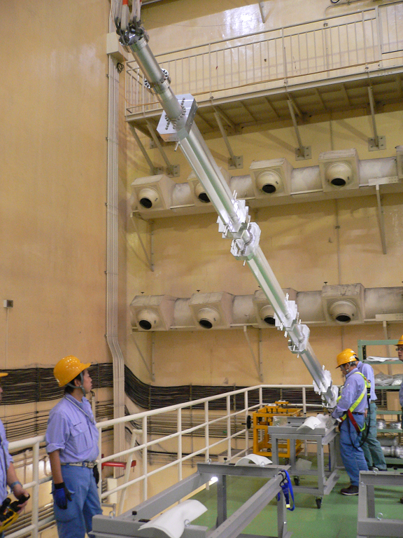
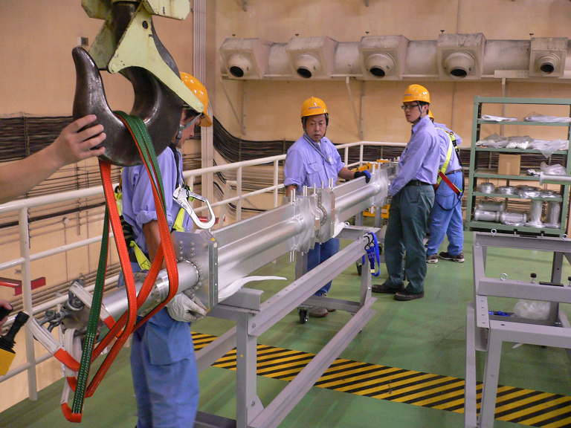
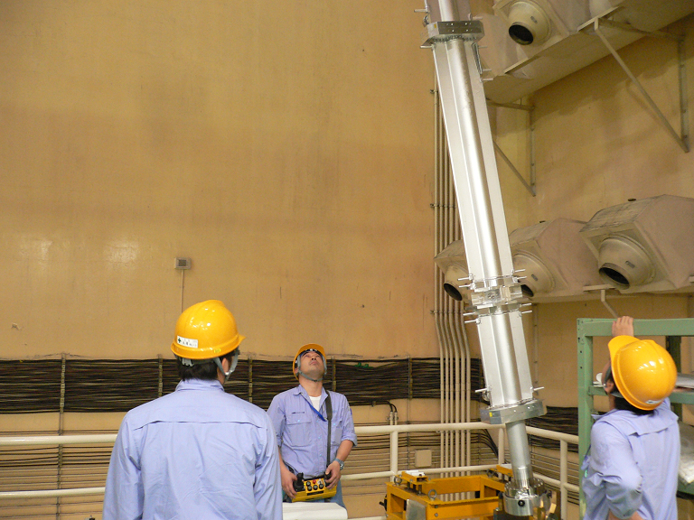
TiN coating 6 : Installation of beam pipes 1
Hinge assembly to get beam pipe upright
Beam pipes are transported and installed on the coating equipment by crane.
2013/3/4 the 18th KEKB Accelerator Review Committee 16

Slide 17
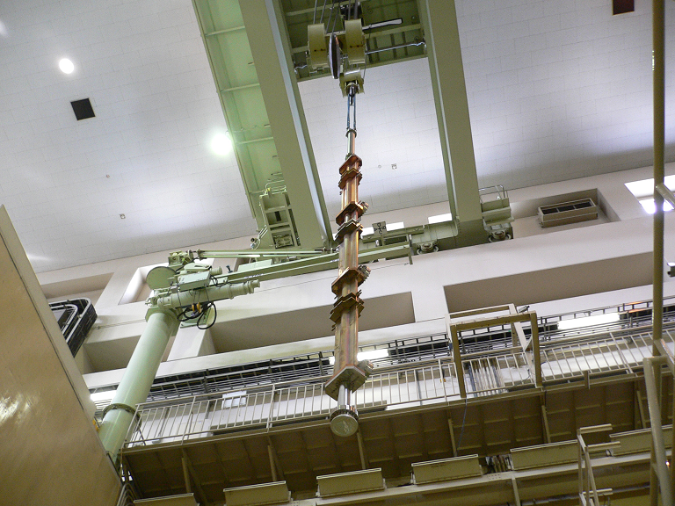
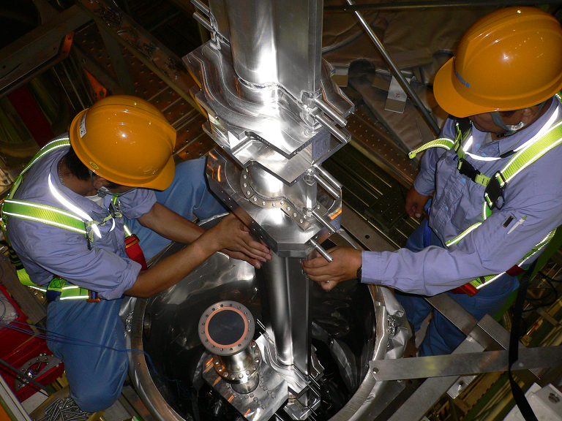
TiN coating 7 : Installation of beam pipes 2
Beam pipes are transported and installed in the coating equipment by crane.
2013/3/4 the 18th KEKB Accelerator Review Committee 17

Slide 18
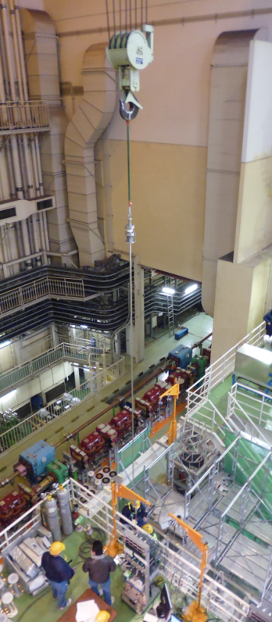
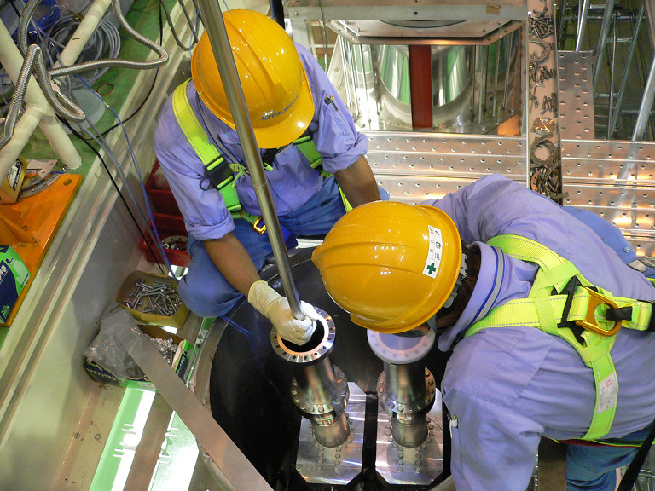
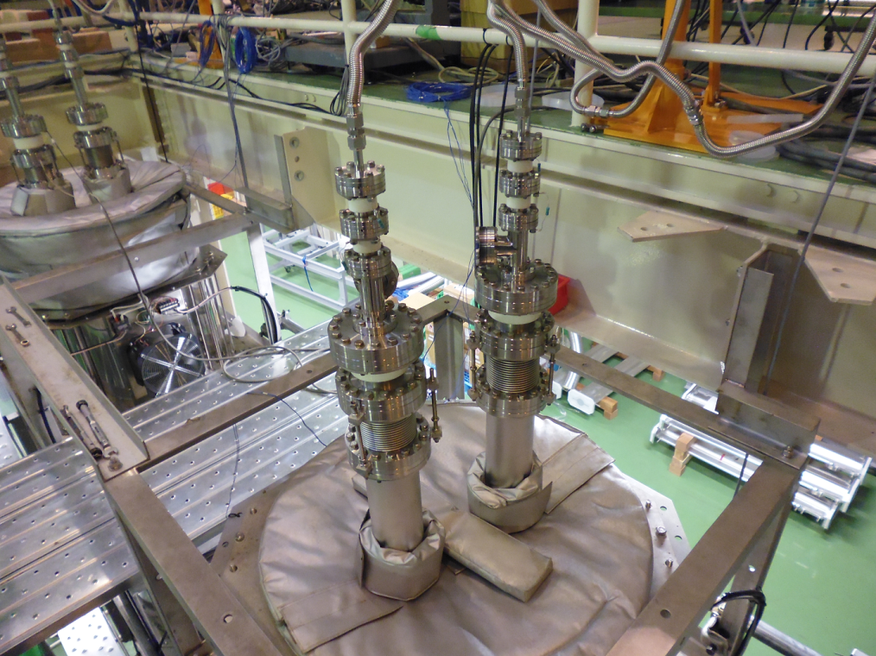
TiN coating 8 : Installation of beam pipes 3
Introduced gas line
Ti cathode
Insulator
Bellows for positioning of Ti cathode rod
Ti cathode rod (∼6m) is also installed by crane.
2013/3/4 the 18th KEKB Accelerator Review Committee 18

Slide 19
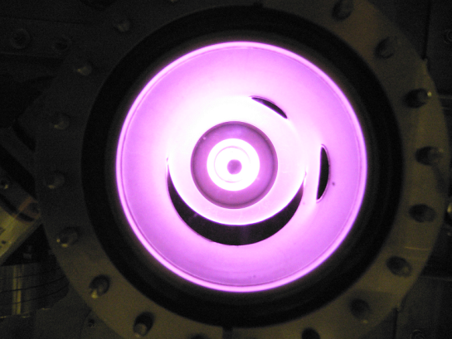
TiN coating 9 : Coating 1
Introduced gases : Ar (∼2.2 Pa), N2 (∼1.8 Pa)
Discharged current : 6.3 A
Required time : 5 min (Ti coating for base of TiN) + 75 min (TiN coating)
Partial pressure during discharge (just upstream of pumping unit)
1x10⁰
1x10⁻¹
1x10⁻²
1x10⁻³
1x10⁻⁴
1x10⁻⁵
1x10⁻⁶
1x10⁻⁷
1x10⁻⁸
Ar
Ti cathode rod
N₂
H₂
Partial Pressure [Pa]
Ti coating
TiN coating
View from viewport at the bottom
Time
2013/3/4 the 18th KEKB Accelerator Review Committee 19

Slide 20
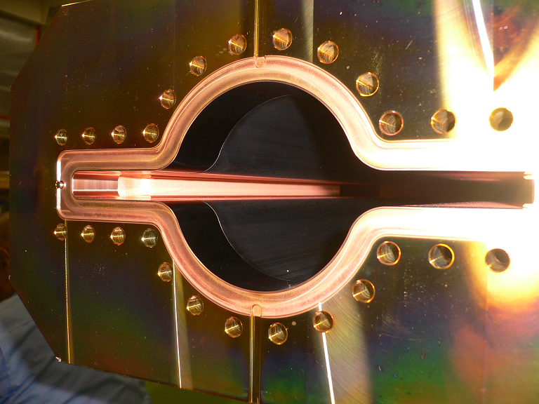
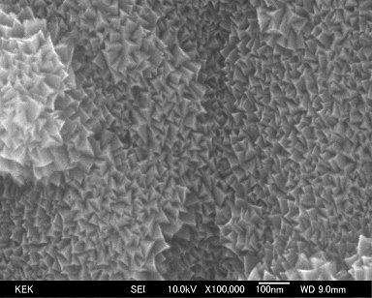
TiN coating 10 : Coating 2
Electron microscopic image of TiN coating
Cu beam pipe coated with TiN
2013/3/4 the 18th KEKB Accelerator Review Committee 20

Slide 21
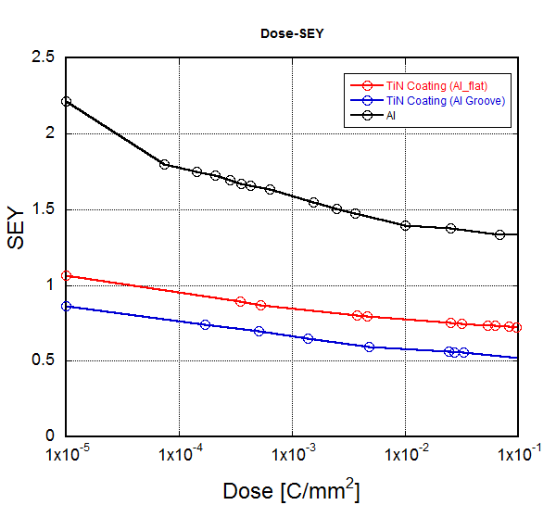
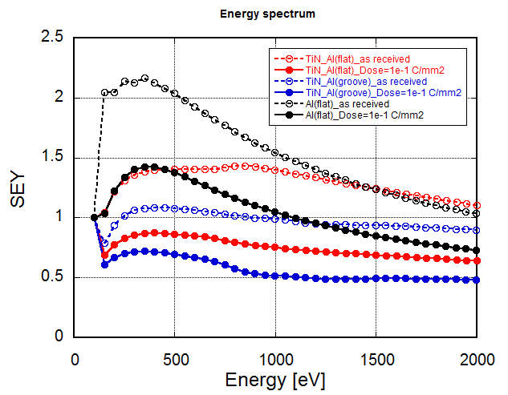
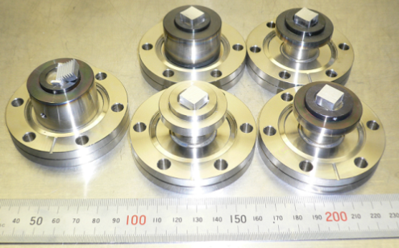
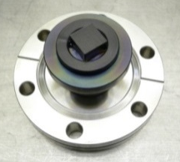
TiN coating 11 : Performance evaluation
SEY of Al samples coated with TiN at this facility were measured.
It was confirmed that SEY of TiN coating drops to below 0.8 after electron irradiation (incident electron energy : 250 eV)
It was also confirmed that the cylindrical cathode rod is available for grooved surface adopted in bent pipes.
Al samples before coating
By S. Terui
By S. Terui
2.2
1.3
1.1
TiN coated samples
0.9
0.72
0.5
Al flat
Al groove
2013/3/4 the 18th KEKB Accelerator Review Committee 21

Slide 22
TiN coating 12 : Rate of coating output
Coating work started on last July.
Coating work started on small scale with 1 coating equipment on last July.
On last September large-scale works with 4 coating equipments started.
Total output by last month (2013/2/28) is 411.
Averaged daily output : 1.0(small-scale), 1.9 (full-scale), 1.7 (total)
Averaged weekly output : 6.9 (small-scale), 13.6 (full-scale), 11.8 (total)
Small-scale work
Large-scale work
2013/3/4 the 18th KEKB Accelerator Review Committee 22

Slide 23
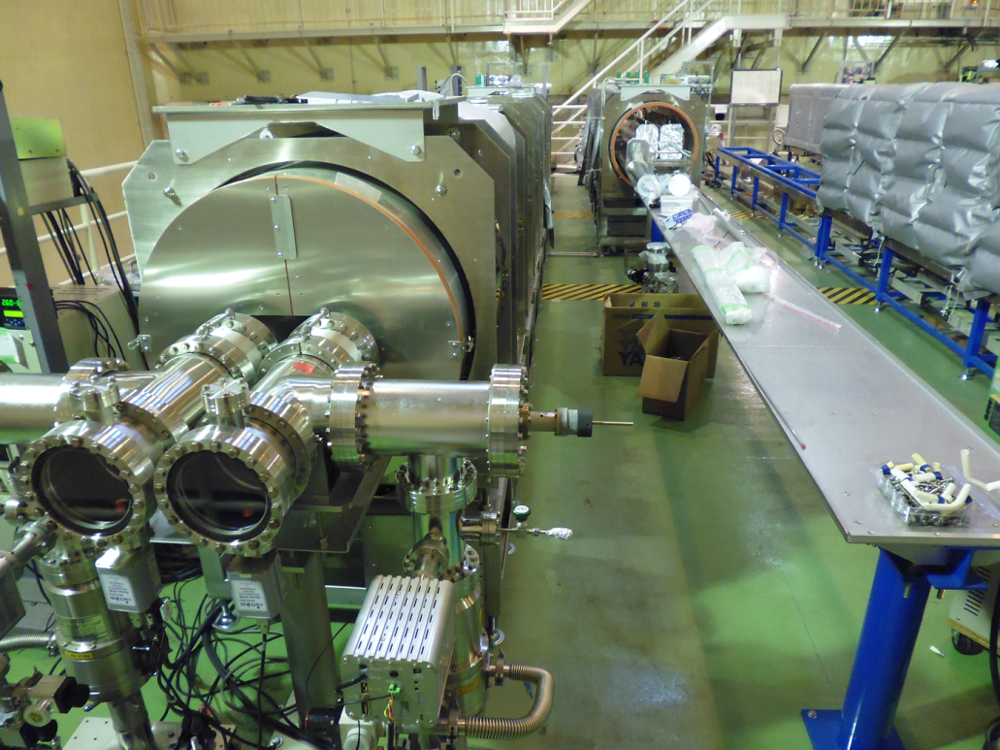
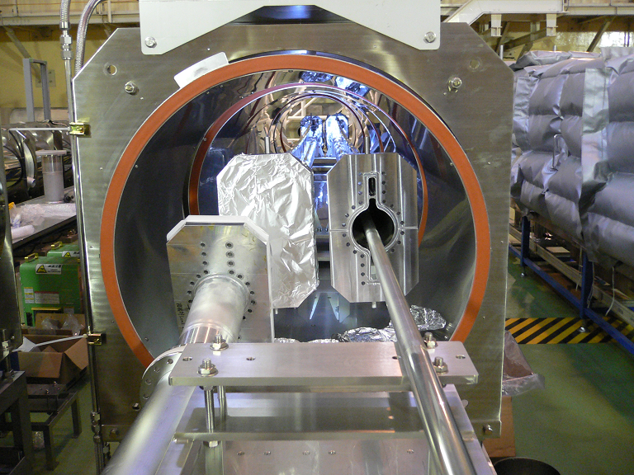
TiN coating 13 : Horizontal type 1
Horizontal coating equipments for bent beam pipes are in preparation now.
2013/3/4 the 18th KEKB Accelerator Review Committee 23

Slide 24
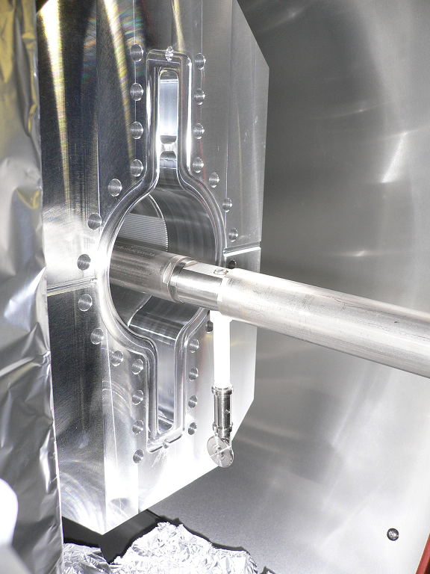
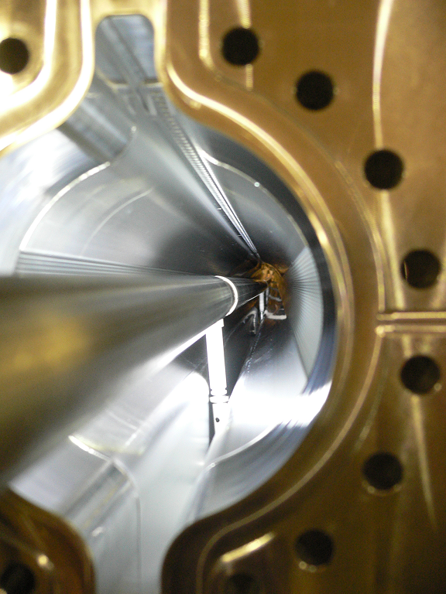
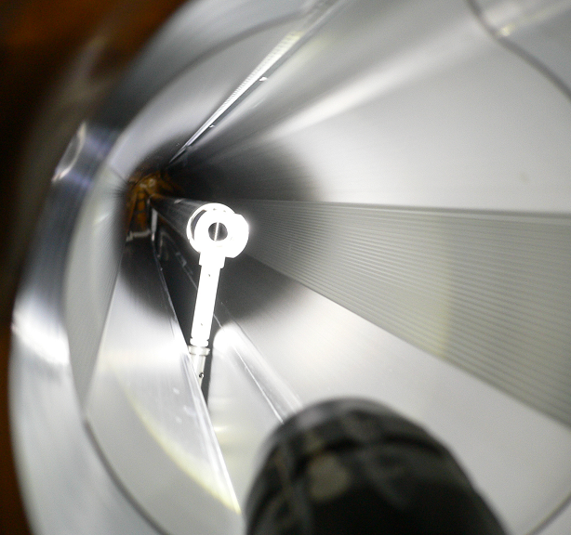
TiN coating 14 : Horizontal type 2
Discharge test will be done this month
Large-scale work with 2 equipment will start on April.
Installation test of Ti cathode rod in bent pipe
2013/3/4 the 18th KEKB Accelerator Review Committee 24

Slide 25
Troubles
We had some troubles especially in the early stage.
Deformation (1 Cu pipe) and cracks (3 Al pipes) of pipes at welding lines.
Caused by stress mainly added during crane works.
Change in our assembly and handling processes to decrease stress.
Damaged beam pipes will be repaired.
Vacuum leak at a welding line between connection flange and pipe
Repaired by extra welding
Interruption of baking due to shutdown of pumps cased by earthquake or electrical outage.
Returning to the starting point of baking.
Melting of NEG pump (GP50) during activation
Change in power feeding method.
Abnormal discharge during TiN coating.
Caused by insulation failure.
Removal of coating from insulator.
Difficulty reducing residual H₂O in coating equipment .
Removal of dust on the bottom of coating equipment.
We have a lot less trouble recently.
MO flange (Al) has the quality to last long and we had no problem with it after coating and baking so far.
Crack at welding line
Melted NEG pump
2013/3/4 the 18th KEKB Accelerator Review Committee 25

Slide 26
Future plan
Apr. 2013 ∼ Dec. 2013 : ∼390 beam pipes for LER and HER
Jan. 2014 ∼ Mar. 2014 : ∼80 beam pipes for Damping ring
April 2014 ∼ Dec. 2014 : ∼250 beam pipes for LER, HER and Damping ring
2013/3/4 the 18th KEKB Accelerator Review Committee 26

Slide 27
Summary
Pre-installation works (coating and baking) started on last April.
Large-scale works by 10 workers with 4 vertical coating equipments and 4 baking equipments started on last September.
So far 411 beam pipes were coated and 481 beam pipes were baked.
Though we had some troubles at the early stage, we have a lot less trouble recently and we are on schedule.
Horizontal coating facility will be operated on large scale from next month.
Coating test will be performed this month.
During next fiscal year (April 2013 - March 2014), ∼470 beam pipes will be treated.
2013/3/4 the 18th KEKB Accelerator Review Committee 27

