Slide 1
Optics Issues
Hiroshi Sugimoto for Optics Group
Notes:
1

Slide 2
Contents
Optics Design Issues Except for IR - Tsukuba straight line, nominal tune, Beast optics, etc. - Tunnel subsidence effect on vertical emittance
IR Optics Design - Design changes - Dynamic aperture and Touschek lifetime
Error Field from Final Focusing Magnets (QCS) - Normal sextuple error field - Skew sextuple error field - Possible design change plan

Slide 3
Optics Design Issues Except for IR
Notes:
3

Slide 4
Machine Parameters
Change LER vertical tune from 44.57 to 44.57
 | LER | HER
Energy (GeV) | 4.0 | 7.00729
Current (A) | 3.6 | 2.6
#of bunches | 2500 | 2500
β_{x}* (mm) | 32 | 25
β_{y}* (mm) | 0.27 | 0.30
ε_{x}* (nm) | 3.2 | 4.6
ε_{y}* (pm) | 8.64 | 11.5
σ_{z}* (mm) | 6 | 5
ν_{x} , ν_{y} | 44.53 , 46.57 | 45.53 , 43.57
ν_{s} | -0.0247 | -0.0280
ξ_{y} | 0.0881 | 0.0807
Luminosity (10³⁴ cm⁻² s⁻¹) | 8x10³⁵

Slide 5
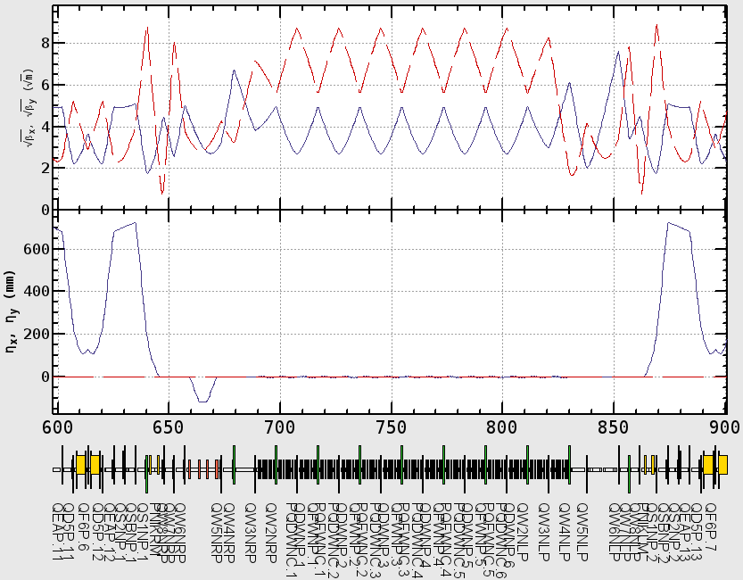
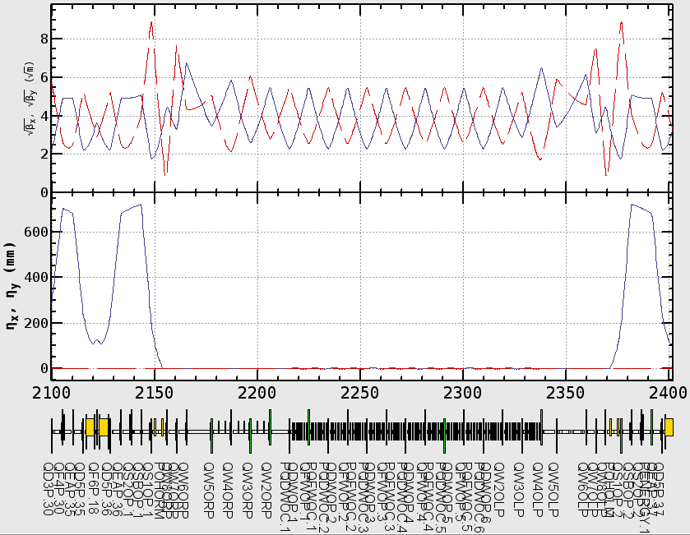
LER Optics Changes - Wiggler Section -
Vertical beta is suppressed to mitigate the beam-gas scattering effects.
Integer part is increased by 2 while keeping the fractional part.
Old
New
β_{x}
β_{y}
η_{x}
η_{y}

Slide 6
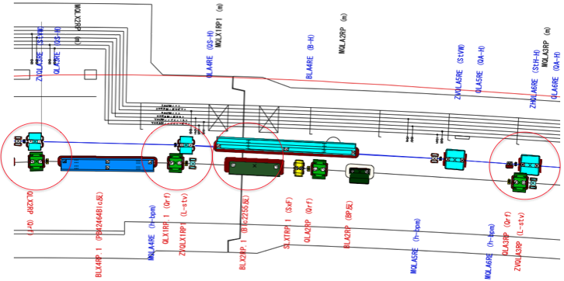
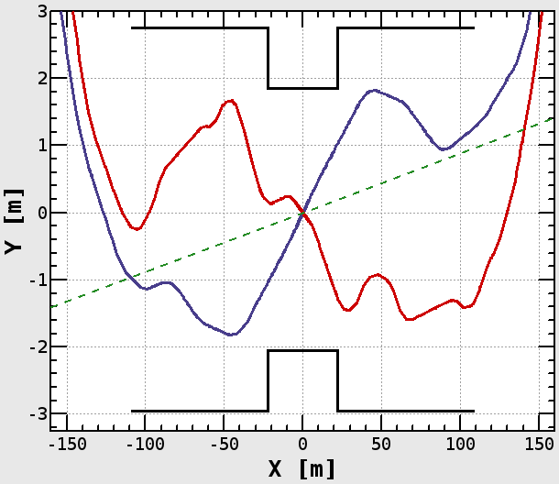
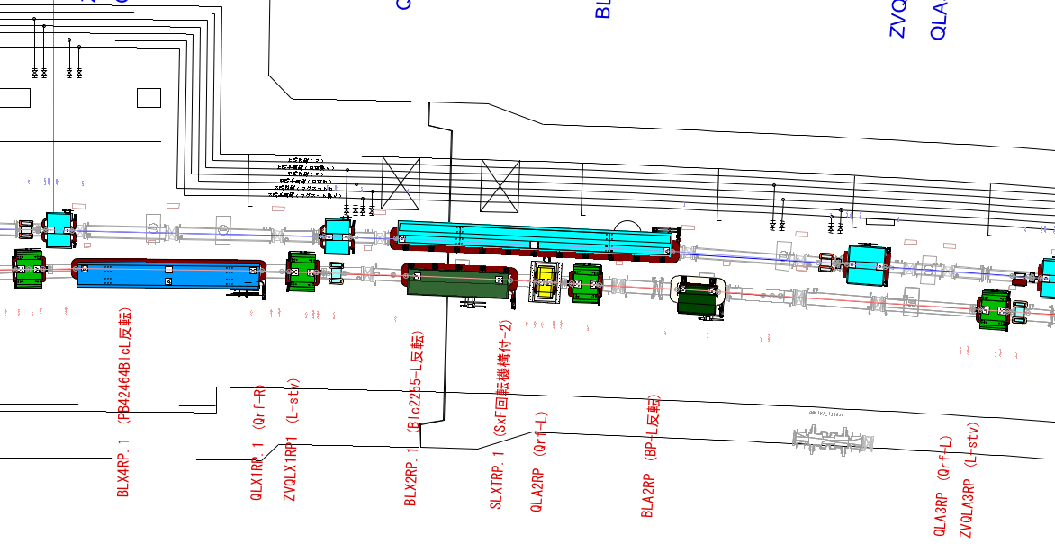
Tsukuba Straight Line is Finalized
Interference problem between LER&HER has been resolved while keeping optics, orbit length and IP geometry.
concrete shield
LER
IP
Belle Axis
HER
concrete shield

Slide 7
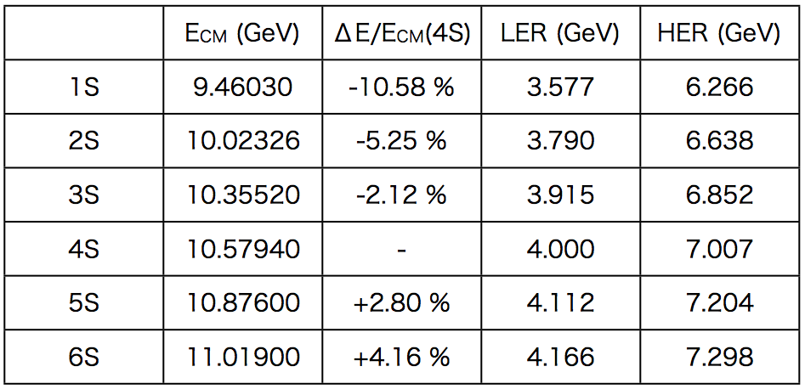
Off 4S Operation
Capability of off-4S operation is confirmed considering limitation of magnet field strength.
Optics and hardware design is carried so that keep the capability.

Slide 8
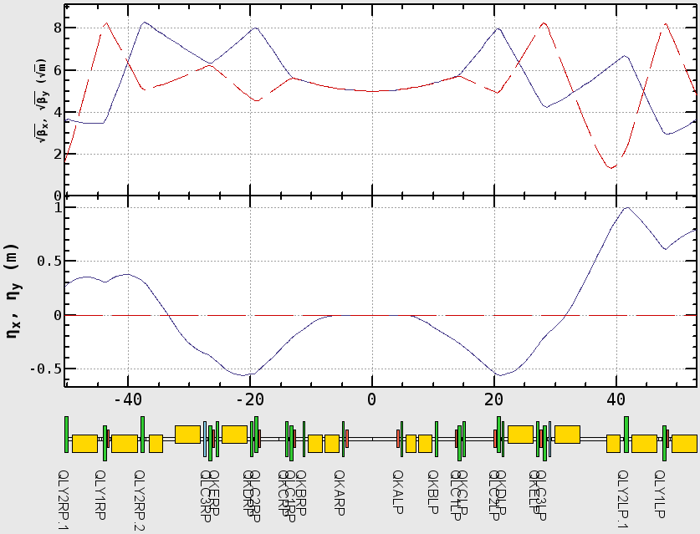
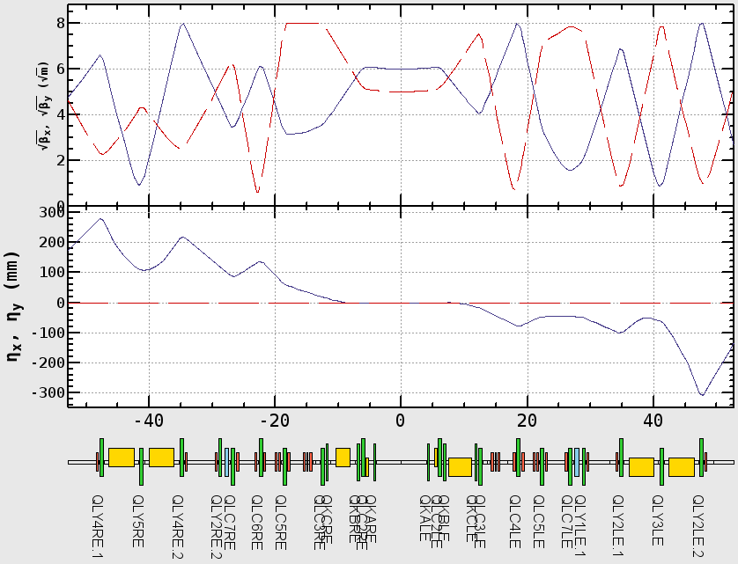
Phase 1 - Linear Optics -
Optics W/O QCS and solenoid has been designed
QCS and solenoid is replaced by drift space.
Machine tuning except for IR is expected to be done in this phase.
LER
HER
Drift
Drift

Slide 9
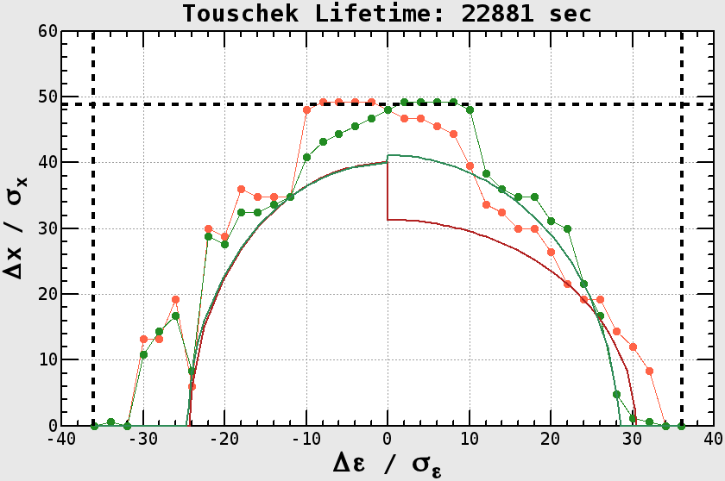
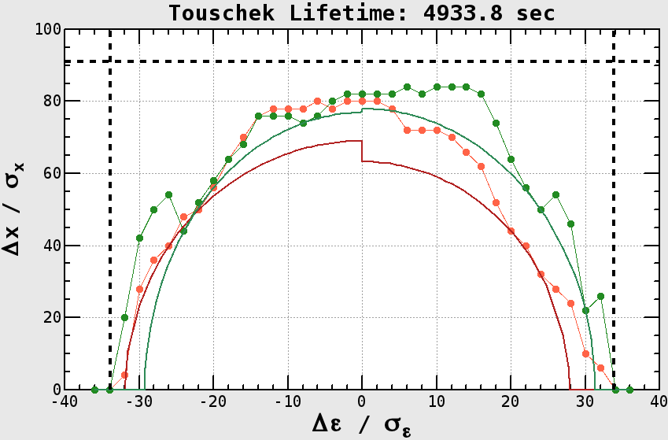
Phase 1 - Dynamic Aperture -
DA example assuming, - Design bunch current. - 2% emittance ratio.
Beam loss estimation is ongoing from view point of radiation protection.
Funakoshi-san’s talk
HER Touscheck Life ~6.3 hours
LER Touscheck Life ~1.4 hours
Physical Aperture
RF Bucket
Notes:
Physical aperture LER 91*sigma
Physical aperture HER 48*sigma
rf bucket HER 36.07
rf bucket LER 33.89

Slide 10
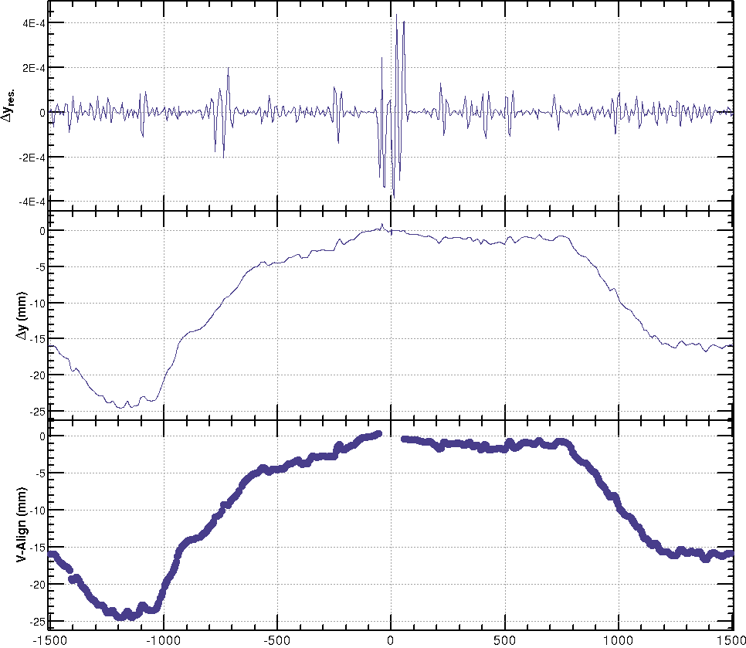
Simulation of Tunnel Subsidence
The subsidence effect is investigated with numerical simulation.
Put the subsidence to design lattice as a vertical misalignment of each magnet.
Simulation
Marker Level (Measurement)
BPM Readings
Numerical Simulation
Import
Beam Orbit
Misalignment
IP
IP
Change amplitude of misalignment, and evaluate vertical emittance.

Slide 11
Simulation of Tunnel Subsidence (cont’d)
ε_{y}
σ_{ηy}
ε_{y}
W/O Optics Correction
σ_{ηy}
ε_{y}
W/ Optics Correction
Target (ε_{y}=5pm)
σ_{ηy}
Vertical emittance exceeds the target values, 5pm, after 7 years when 2mm/year is assumed.

Slide 12
Simulation of Tunnel Subsidence (cont’d)
What is the most dominant source of emittance dilution?
ε_{y}
Target (ε_{y}=5pm)
W/ V-LCC misalignment
ε_{y}
σ_{ηy}
σ_{ηy}
ε_{y}
W/O V-LCC misalignment
σ_{ηy}
V-LCC misalignment has very critical impact on emittance.
Need special care for orbit control or/and alignment in this region.

Slide 13
IR Optics Design
Notes:
13

Slide 14
IR Design
All quadrupoles except for QC1P have iron yoke for preventing field leakage to the another beam line
Canceller coils are installed for HER beam line to suppress leakage filed from LER QC1 magnet.
All magnets have super-conducting corrector coils. - Normal&Skew Dipole, Skew Quad, Octupole

Slide 15
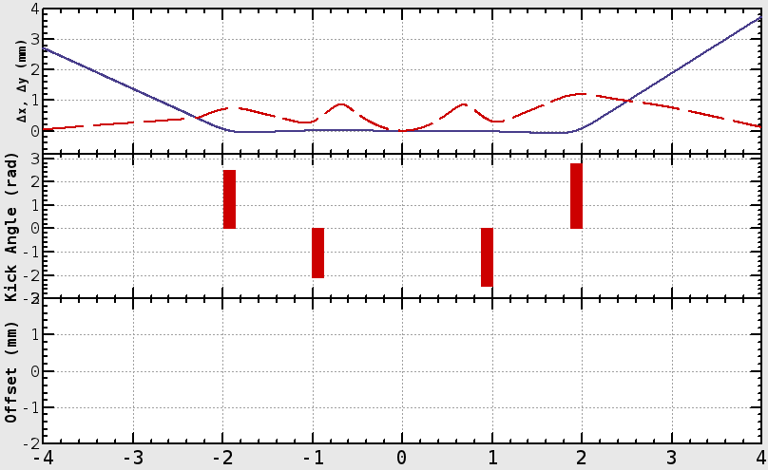
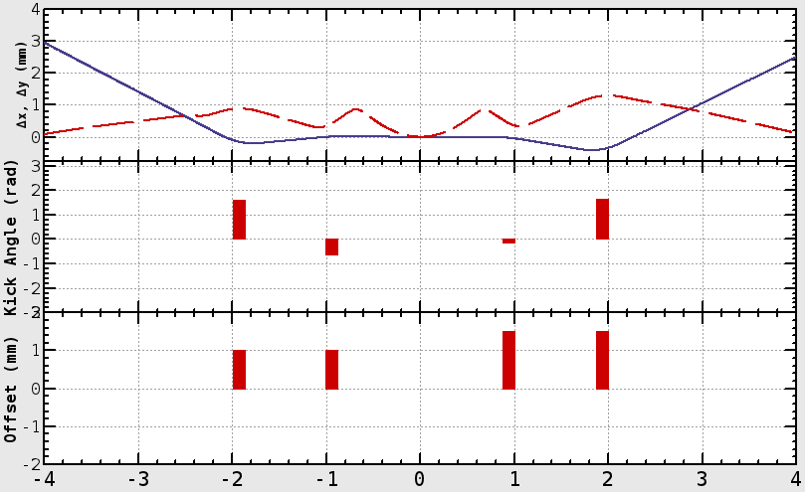
IR Design Upgrade
LER QCs now have vertical offset to reduce dipole corrector strength.
Old
New
Beam orbit
IP
Vertical Kick Angle
Vertical Offset
QC1RP
QC1LP
1.0mm
1.5mm
QC2RP
IP
QC2LP
Vertical Kick Angle
Magnet | QC1LP (mrad) | QC2LP (mrad) | QC1RP (mrad) | QC2RP (mrad)
Old | 2.472 | 2.746 | -2.082 | 2.491
New | -0.149 | 1.651 | -0.644 | 1.602

Slide 16
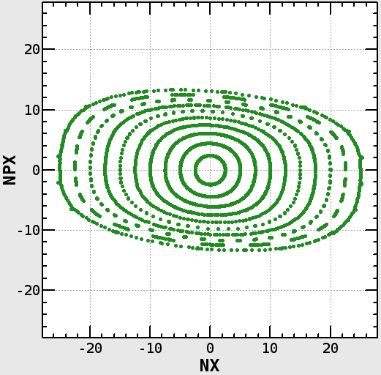
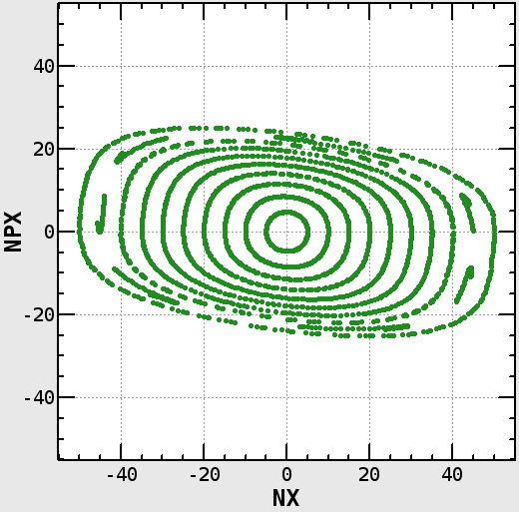
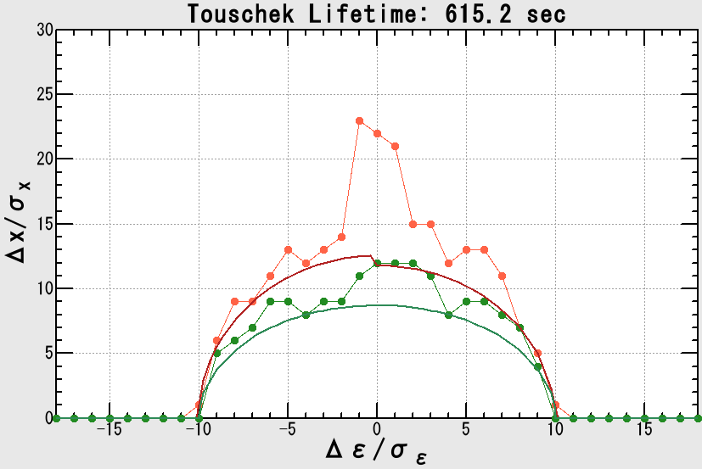
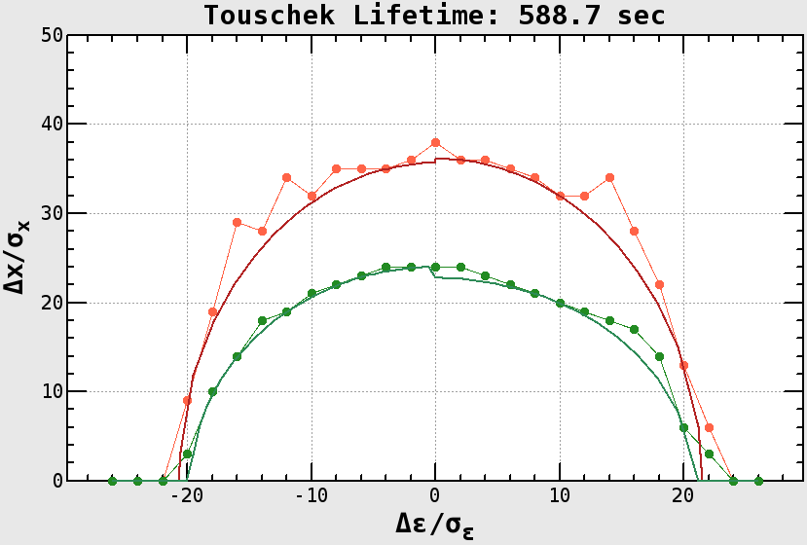
Dynamic Aperture & Touschek Lifetime
Touschek lifetime is optimized with Down-hill simplex method.
Available knobs are 54 sextupole families and 4 octupole magnets.
Lifetime of both beams is almost reached the target value, 600 sec.
HER 615 sec
LER 588 sec

Slide 17
Error Field from QCS
Notes:
17

Slide 18
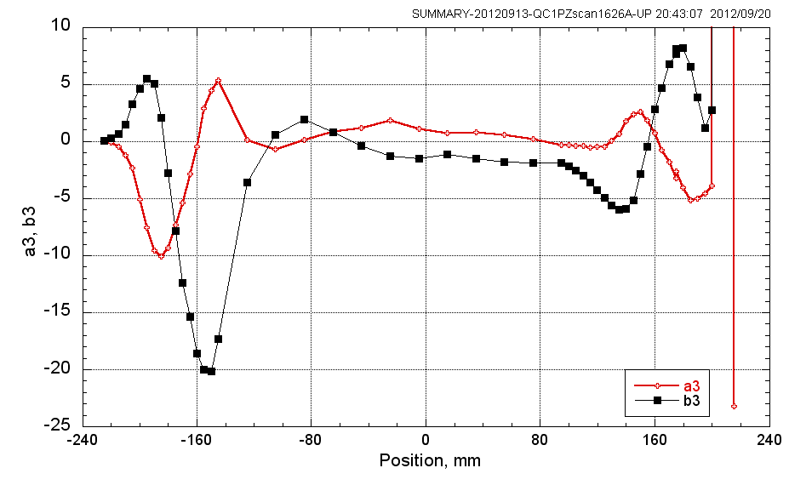
Field Measurements of QCS Prototype
Unexpected normal&skew sextupole have been observed.
Their magnetic field strength is ~0.1% of quadrupole field.
Ohuchi -san’s talk
Field profile along QC1P
Skew Sext.
Field strength relative to quad. field [x10⁻⁴]
Normal Sext.
Longitudinal position [mm]
Impact on dynamic aperture has been investigated.

Slide 19
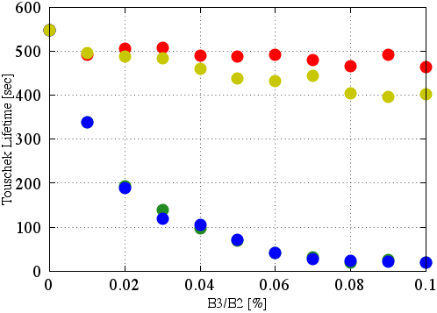
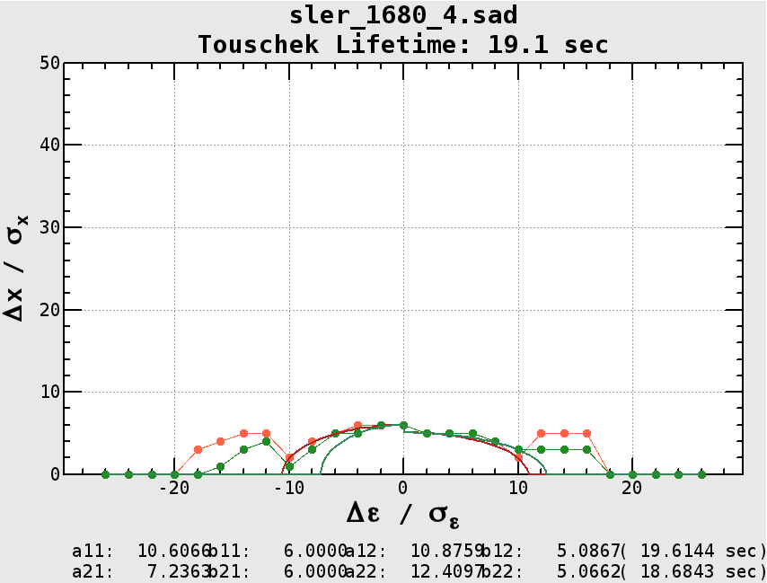
LER DA with Normal Sextupole Error Field
Thin lens Sextupoles are inserted to QC1L and QC1R.
There magnitudes are same, but signs are independent.
Evaluate DA for 4 possible combinations of sign at each error field strength.
QC1L w/ sext. error
IP
QC1R w/ sext. error
Same Sign
Effect is very critical.
Opposite Sign

Slide 20
Sextupole Corrector Coil
Only R-size design can be changed. (L-size is already fixed)
No more space for installing the corrector to QCS itself.
We are considering installation between QC1R and QC2R.
LER
Octupole
Octupole
Octupole
QC2RE
QC2LP
Octupole
QC1RE
QC1LP
IP
Sextupole Coil
Sextupole Coil
QC1RP
QC1LE
Octupole
QC2RP
HER
QC2LE
Octupole
Octupole
Octupole

Slide 21
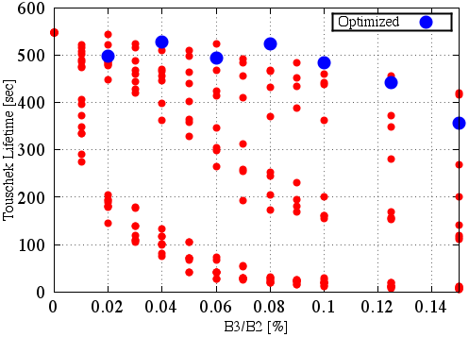
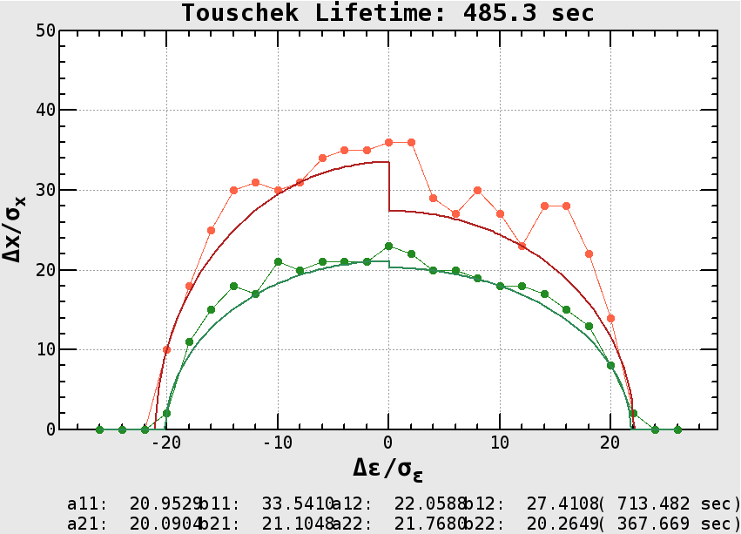
DA Improvement by Corrector Coil
Introduce sextupole error to ALL QCs.
Check whether we can mitigate DA degradation by optimizing the corrector strength.
DA degradation is improved, but B3/B2 < 0.1% is preferable.

Slide 22
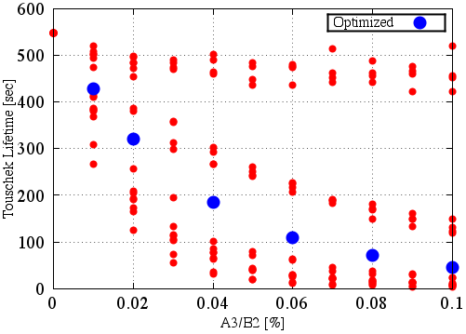
Skew Sextupole Error Field
Analogous calculation for skew sextupole error field.
Different feature compared to the normal sextupole case.
DA Improvement is not enough level.

Slide 23
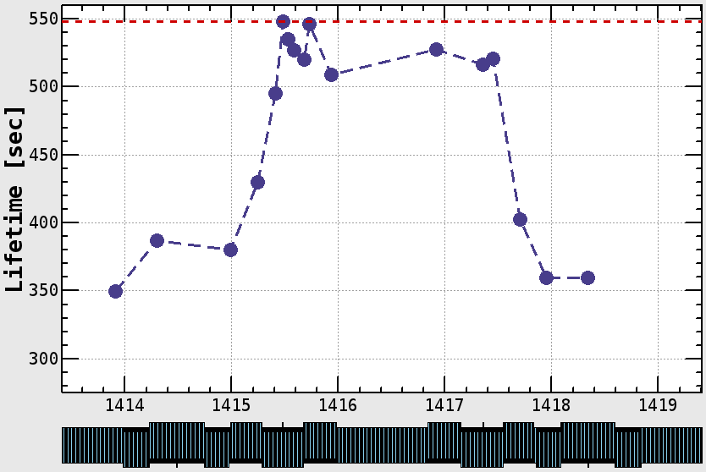
Lifetime and Corrector Coil Position
DA survey with changing corrector position.
Only QC1RP has skew sextupole error.
Design
Scan effective corrector position
QC2R
QC1R w/ error
IP
QC1L
QC2L
Corrector coil must be installed between QC1L & QC1R

Slide 24
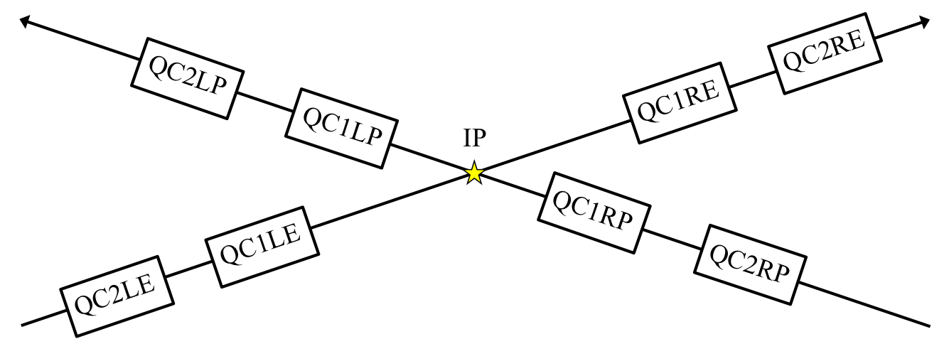
Design Change Strategy
Points to be considered.
Need 1 normal sextupole corrector.
Need 2 skew sext. correctors.
One of skew sext. must be installed to QC1R.
Each QC can have only one corrector coil
Possible to install additional coil between QC1R and QC2R.
Octupole
Octupole
Octupole
Octupole
Octupole
Octupole
Octupole
Octupole

Slide 25
R-side Design Change Plan (Not Fixed Yet)
Possible Plan
Install normal Sext. coil (+octupole) to between QC1 and QC2.
Install skew Sext. coil to both QC1 and QC2 instead of octupoles.
Skew Sext.
Skew Sext.
Octupole
Octupole
Octupole
QC2RE
QC2LP
Octupole
QC1RE
Normal Sext. (+ Oct.)
QC1LP
IP
QC1RP
Normal Sext. (+ Oct.)
QC1LE
QC2RP
QC2LE
Octupole
Octupole
Skew Sext.
Octupole
Octupole
Skew Sext.

Slide 26
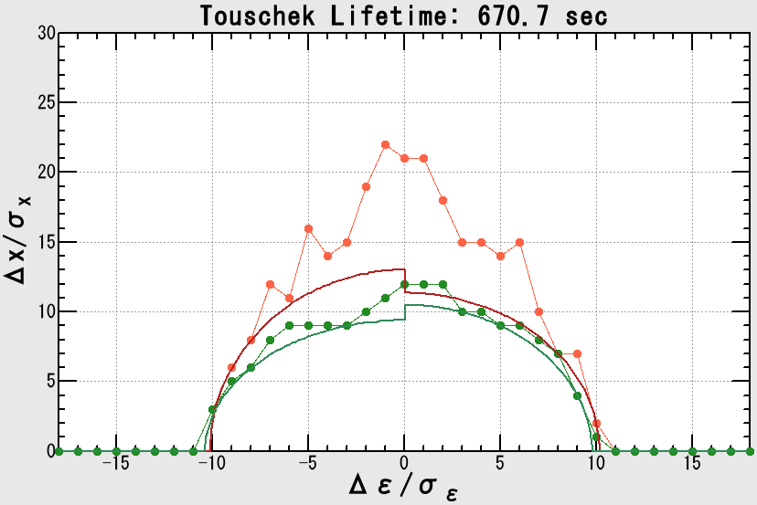
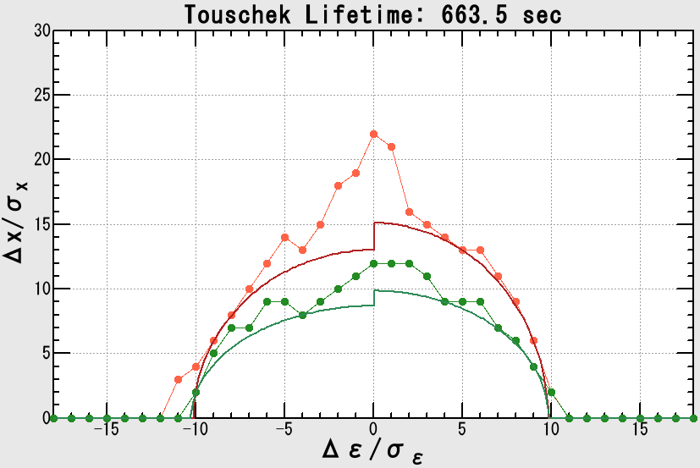
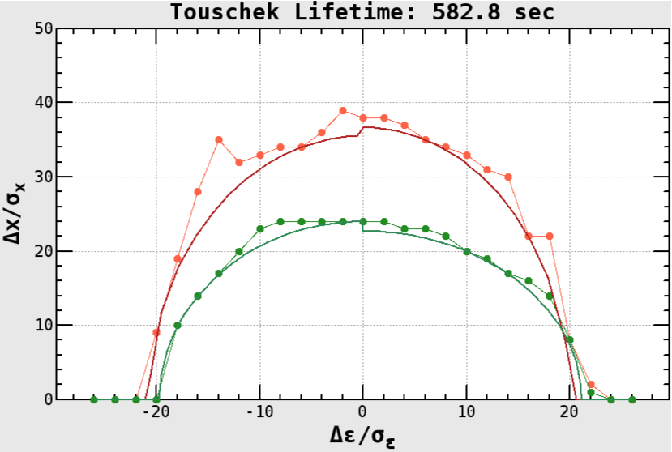
DA W/ and W/O R-side Octupoles
Touschek lifetime estimated by DA seems OK.
HER W/ Octupoles ~ 670 sec
HER W/O Octupoles ~ 660 sec
LER W/ Octupoles ~ 580 sec
LER W/O Octupoles ~ 590 sec

Slide 27
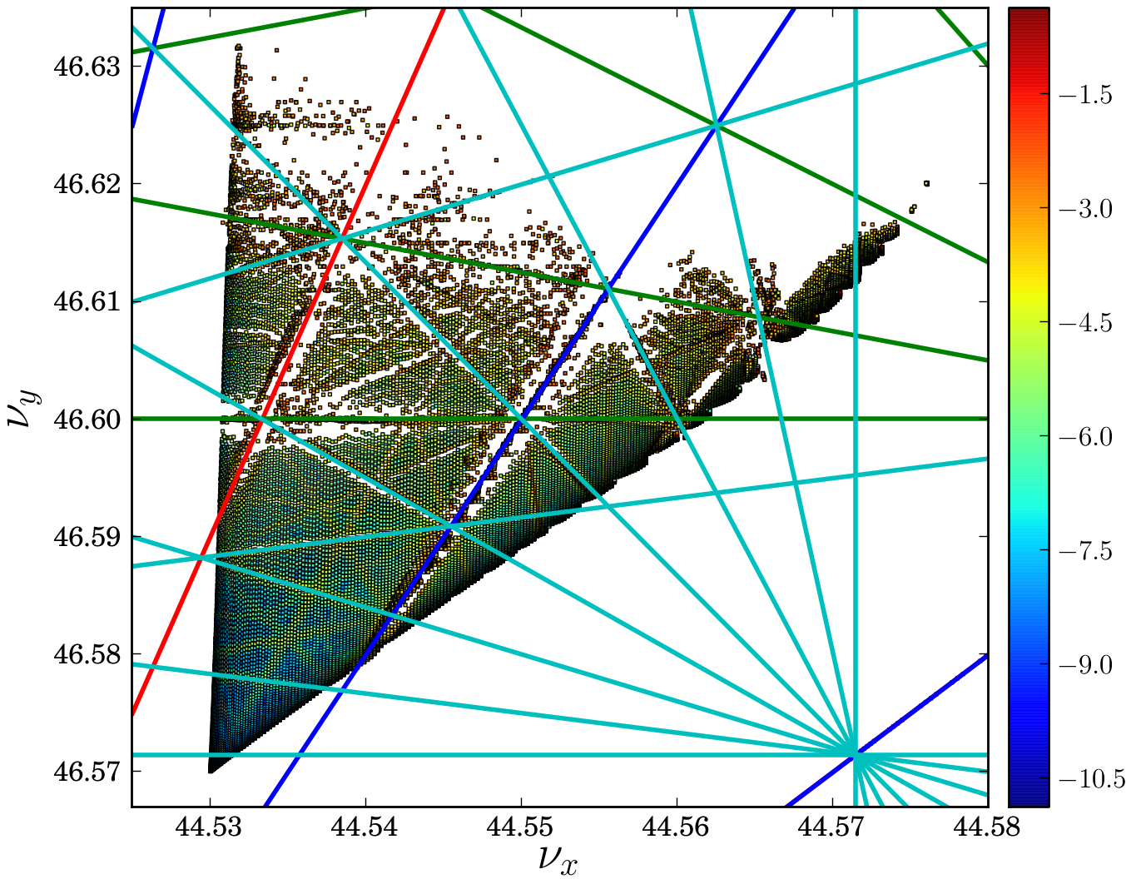
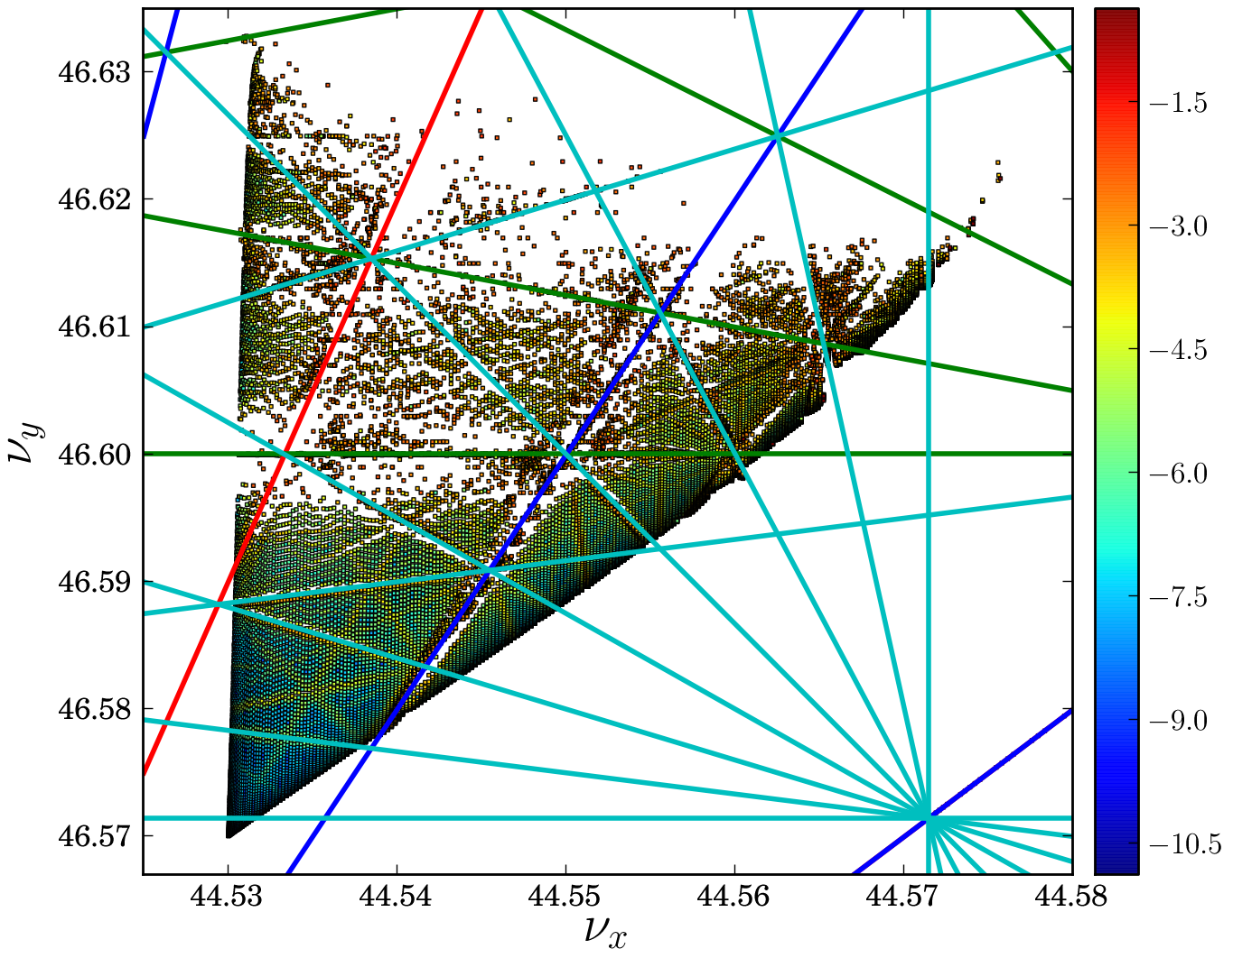
Side Effect of Removing Octupole from QC1
HER
No remarkable effect is observed so far.
LER
FMA indicates enhancement of some ronances.
W/ Octupoles
W/O Octupoles
4th order 5th order
6th order 7th order

Slide 28
Summary
Optics Design and Issues (Except for IR) - Almost completed. - Minor changes related to detailed hardware design is now continued. - Need special cares for orbit control or/and alignment in V-LCC region.
IR Design - Vertical offset is adopted to LER-QCS for saving dipole corrector strength. - Lifetime of both beams is almost reached the target value, 600 sec.
Error Field from QCS - Nomal&Skew sextuple error field has critical effects on DA. - Additional corrector coil is planned to install.
Thank you for listening!

Slide 29
Appendix
Appendix

Slide 30
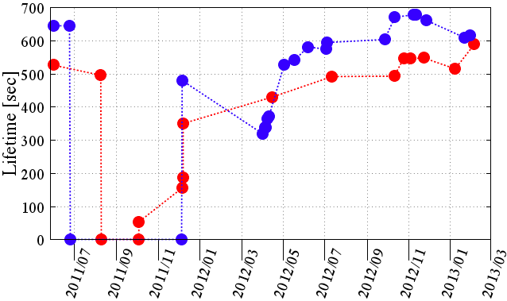
Touschek-Lifetime History
DA has been steadily improved by feedback cycle between Optics & Magnet group.
HER
LER
2D IR Model
3D IR Model

