Slide 1
Overview of Ring Construction Status and Schedule
Contents:
Ring construction status
Budget, schedule and HR
Kazunori AKAI
KEK, Accelerator Laboratory
Mar. 3, 2014, @19th KEKB Review

Slide 2
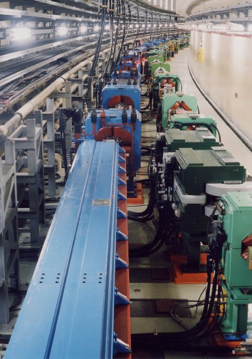
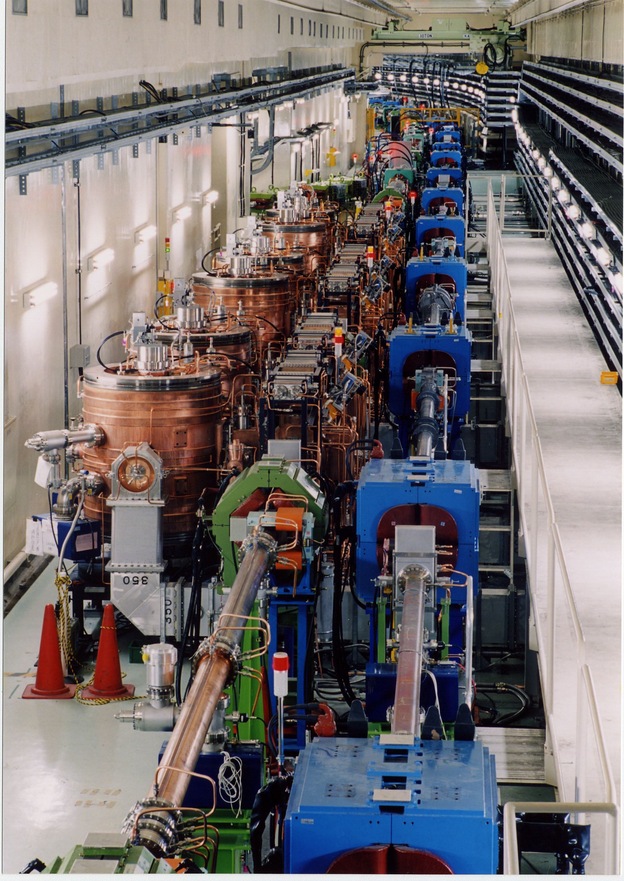
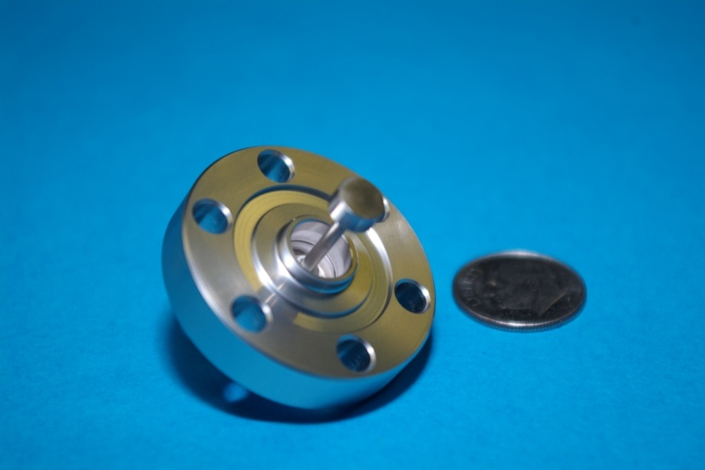
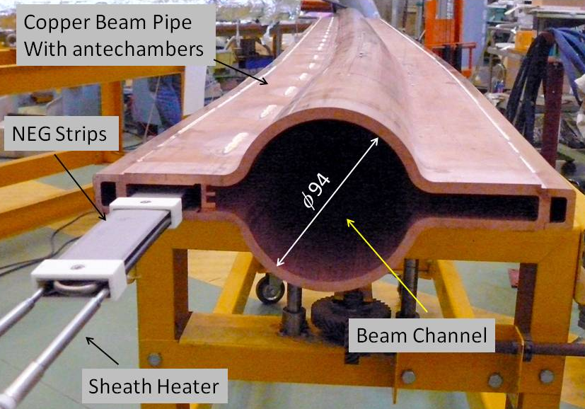
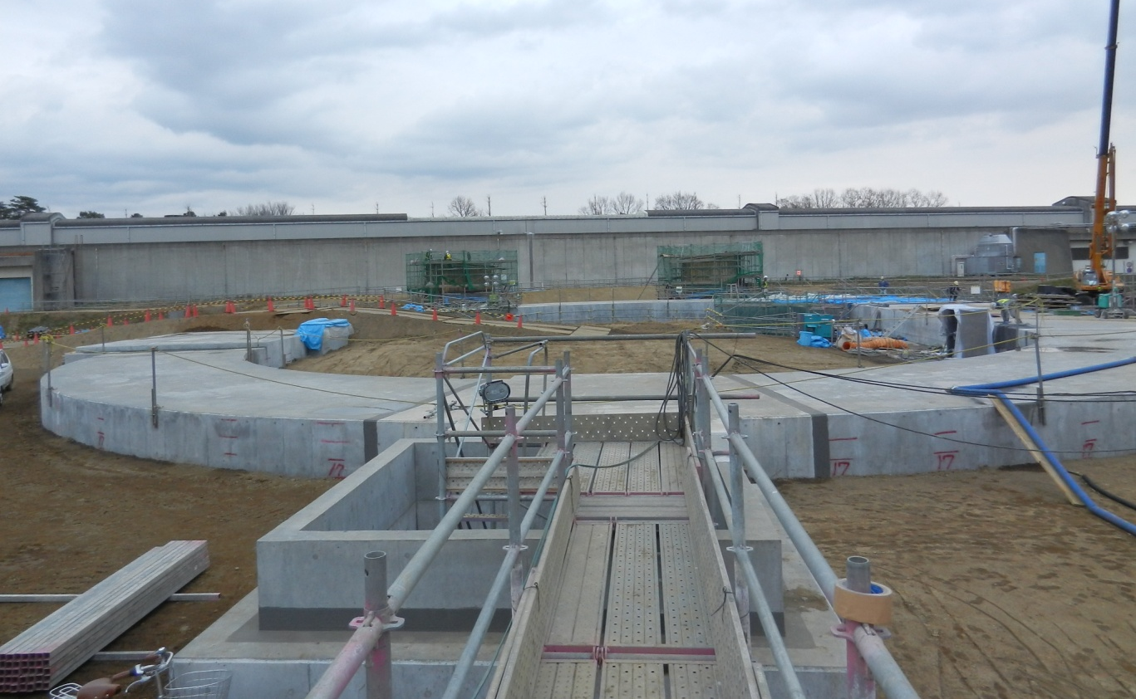
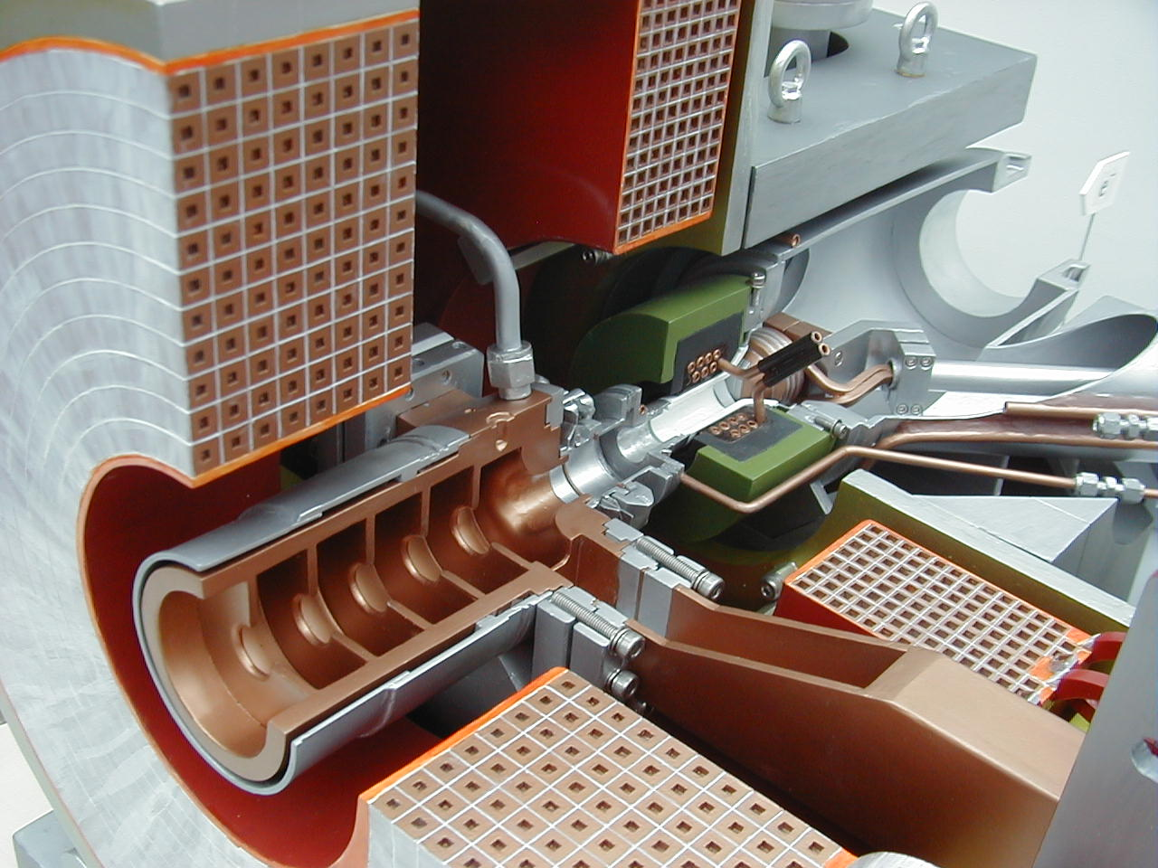
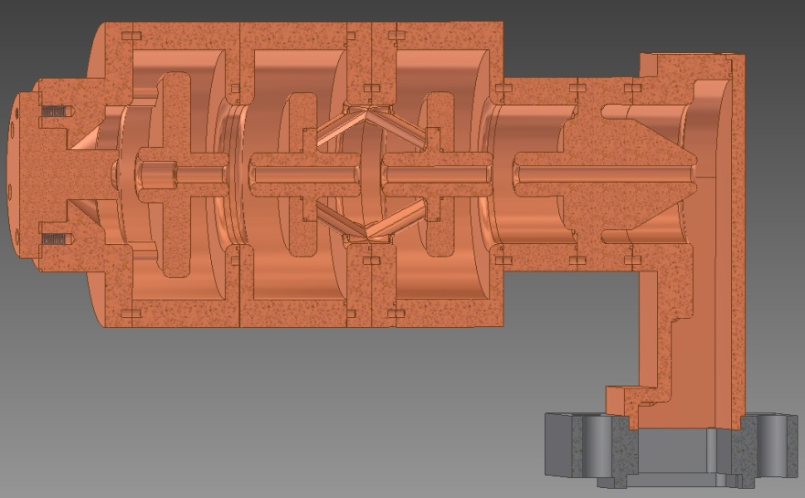
Upgrade to Belle II detector
Colliding bunches
New superconducting final focusing magnets near the IP
e⁺ 3.6A
e⁻ 2.6A
KEKB to SuperKEKB
Redesign the lattice to squeeze the emittance (replace short dipoles with longer ones, increase wiggler cycles)
Nano-Beam scheme
extremely small β_{y}*
low emittance
Beam current double
Reinforce RF systems for
higher beam currents
Replace beam pipes with TiN-coated beam pipes with antechambers
40 times higher luminosity
2.1x10³⁴ --> 8x10³⁵ cm⁻²s⁻¹
Improve monitors and control system
Injector Linac upgrade
Upgrade positron capture section
DR tunnel
Low emittance
RF electron gun
New e+ Damping Ring

Slide 3
SuperKEKB rings master schedule
Calendar
2010
2011
2012
2013
2014
2015
2016
・・・
Japan FY
2010
2011
2012
2013
2014
2015
2016
now here
KEKB operation
SuperKEKB-MR(LER&HER) construction
SuperKEKB commissioning
optics design
dismantling KEKB
phase 1
w/o QCS
w/o Belle II
phase 2
w/ QCS
w/ Belle II (no VXD)
phase 3
w/ full Belle II
fabrication and tests of MR components
TiN coating & baking of beam pipes
install, assembly and set up
DR complete before phase 2
cabling and piping
final assembly,
RF conditioning
MR buildings construction
reinforce RF, vac, etc.
for higher beam current
reinforce electricity and cooling facility
cool down
w/Belle II
fabricate QCS-L
fabricate QCS-R
detector upgrade to Belle II
rotation
roll in
roll in
Belle roll out
roll out
SuperKEKB-DR construction
VXD install
optics design
fabrication and tests of DR components
DR tunnel construction
install, assembly and set up
DR buildings construction
electricity and cooling system

Slide 4
Commissioning phases
Phase 1
No QCS, No Belle II solenoid
Basic machine tuning
Low emittance tuning
Vacuum scrubbing
Belle II people request enough vacuum scrubbing in this stage (before Belle II roll in).
At least one month at beam currents of 0.5~1A /ring.
DR is not needed in this phase.
Phase 2
with QCS and Belle II (w/o VXD)
Low beta optics tuning
Small x-y coupling optics tuning
Beam collision tuning
Belle II background study
DR commissioning
Target luminosity at this stage is 1 x 10³⁴ cm⁻²s⁻¹
Phase 3
Physics run

Slide 5
Ring Construction Status

Slide 6
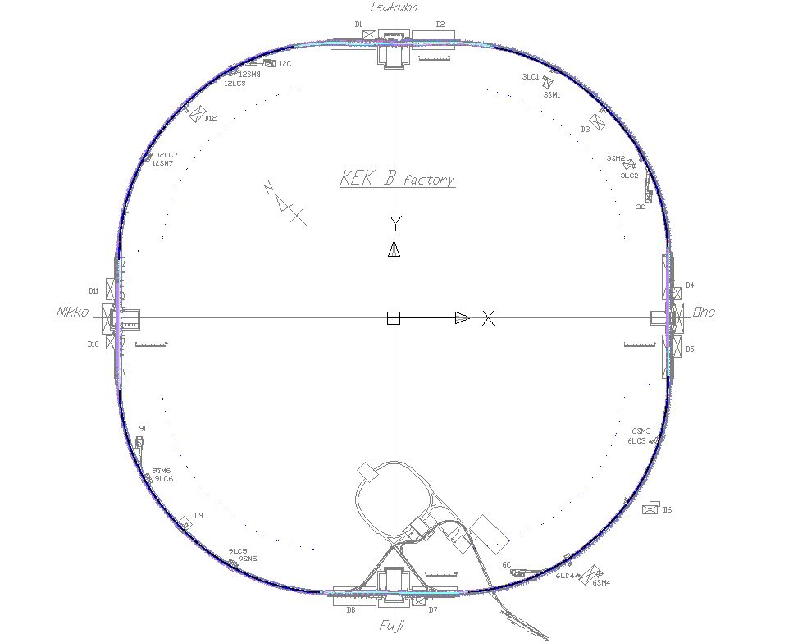
MR Magnet & Vacuum Status
Interaction Region
Magnets close to the IP in fabrication this FY.
Beam pipes for the IR (Phase 1) next FY
Installation of IR magnets and beam pipes next FY.
Superconducting magnets under construction for Phase 2.
Tsukuba straight section
Most of magnets (except IR) installed.
Beam pipes in fabrication this FY.
Installation of beam pipes next FY.
Arc sections
LER new bending magnets installed.
Installation of most of other new magnets to be done in this FY.
Beam pipes and bellows connection to be completed in this FY.
24 sextupole magnets with tilting table to be installed next FY.
Oho and Nikko straight sections
Wiggler magnets installed.
Beam pipes installed.
Around the ring
Power cables, control cables ongoing.
Piping for cooling water ongoing.
Alignment on going.
(these works continue in FY2014)
Cooling facility reinforcement
Replacing cooling pipes in tunnel completed.
New buildings construction (2012-13).
Pumps and other equipments under construction: to be completed in Sep. 2014.
Power supply buildings
Power supplies fabrication ongoing.
Cabling and piping.
Starting up power supplies.
(these works continue in FY2014)
Fuji straight section
Most of KEKB magnets and beam pipes are reused.
Beam pipes for injection, abort, crossing etc. are in fabrication this FY. (some will be later)
Installation of these new beam pipes next FY.

Slide 7
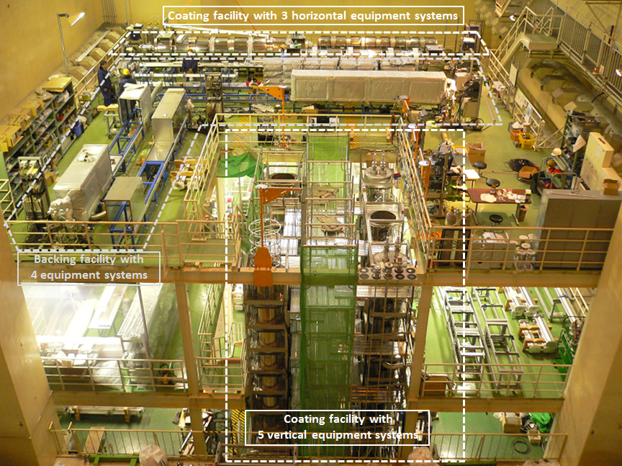
Beam pipes preparation
Fabrication
Most of MR vacuum components, such as beam pipes, pumps, bellows etc., required for Phase 1 were already ordered, and will be delivered in this fiscal year.
Tsukuba straight section, beam injection/abort sections, SR monitor sections, etc. were finally ordered last year (in JFY2013).
Only beam collimator system is still remained. (to be ordered in April 2014)
Baking and TiN coating
About 930 beam pipes already done using a facility in KEK site.
Output: 10 ~ 15 beam pipes per week
Preprocessing work for the rest of the beam pipes will start from this spring.
About 330 beam pipes shoule be processed, including the TiN coating for ~140 beam pipes.
Mainly for Tsukuba and Fuji straight section.
Preprocessing facility at Oho exp. hall

Slide 8
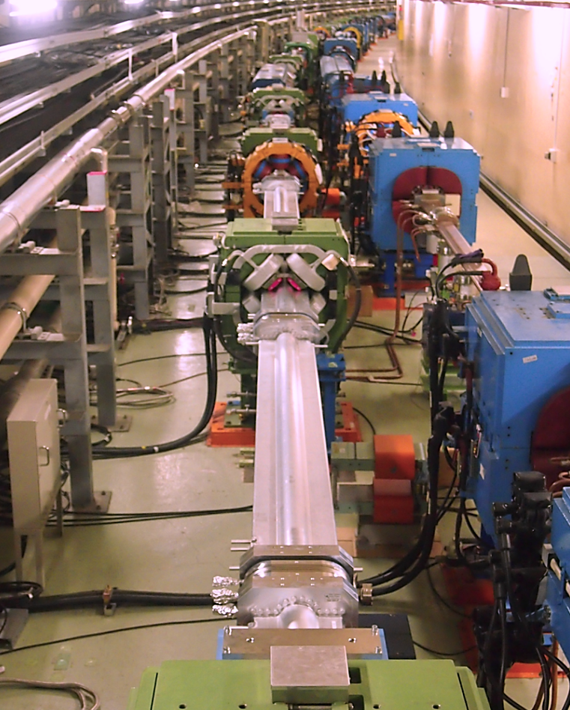
Beam pipes installation
Installation of beam pipes and bellows has started in 2013.
About 830 beam pipes were already installed for arc sections and wiggler sections, followed by the connection of bellows.
Some sections were already evacuated, and the control system was checked.
Installation of the remained beam pipes (Tsukuba straight section, injection/abort, SRM), and the following evacuation of the whole ring will start from this summer, and the MR vacuum system will be ready in this year.
Upgrade of monitoring and control system are in progress.
Cabling and piping of cooling water have started.
Beam pipes installed into arc section

Slide 9
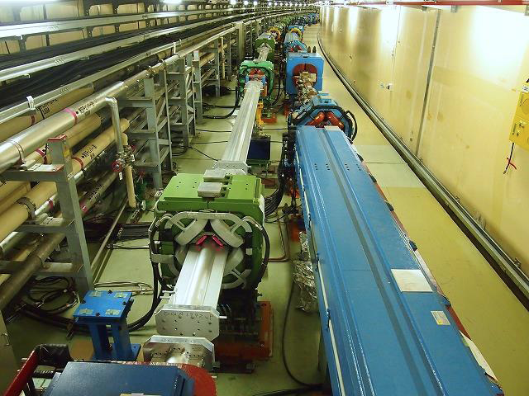
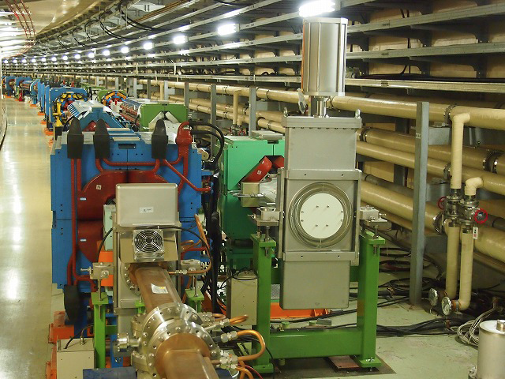
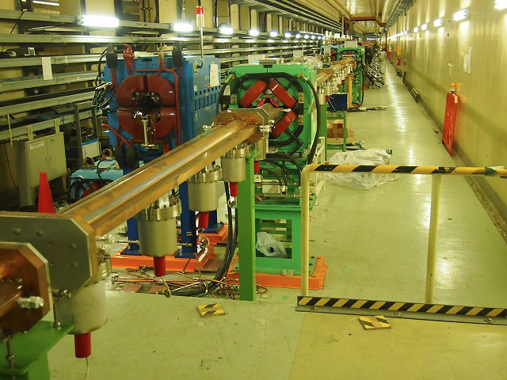
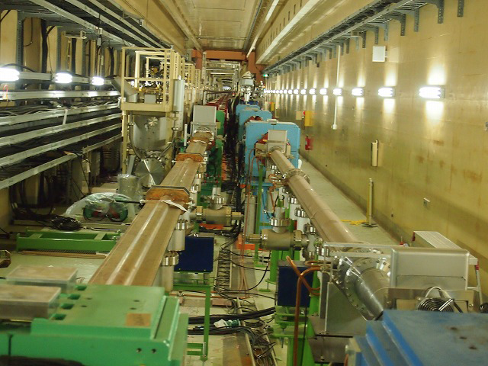
North tunnel
LER Gate valve in West tunnel
LER Oho wigger downstream
LER Nikko wigger downstream

Slide 10
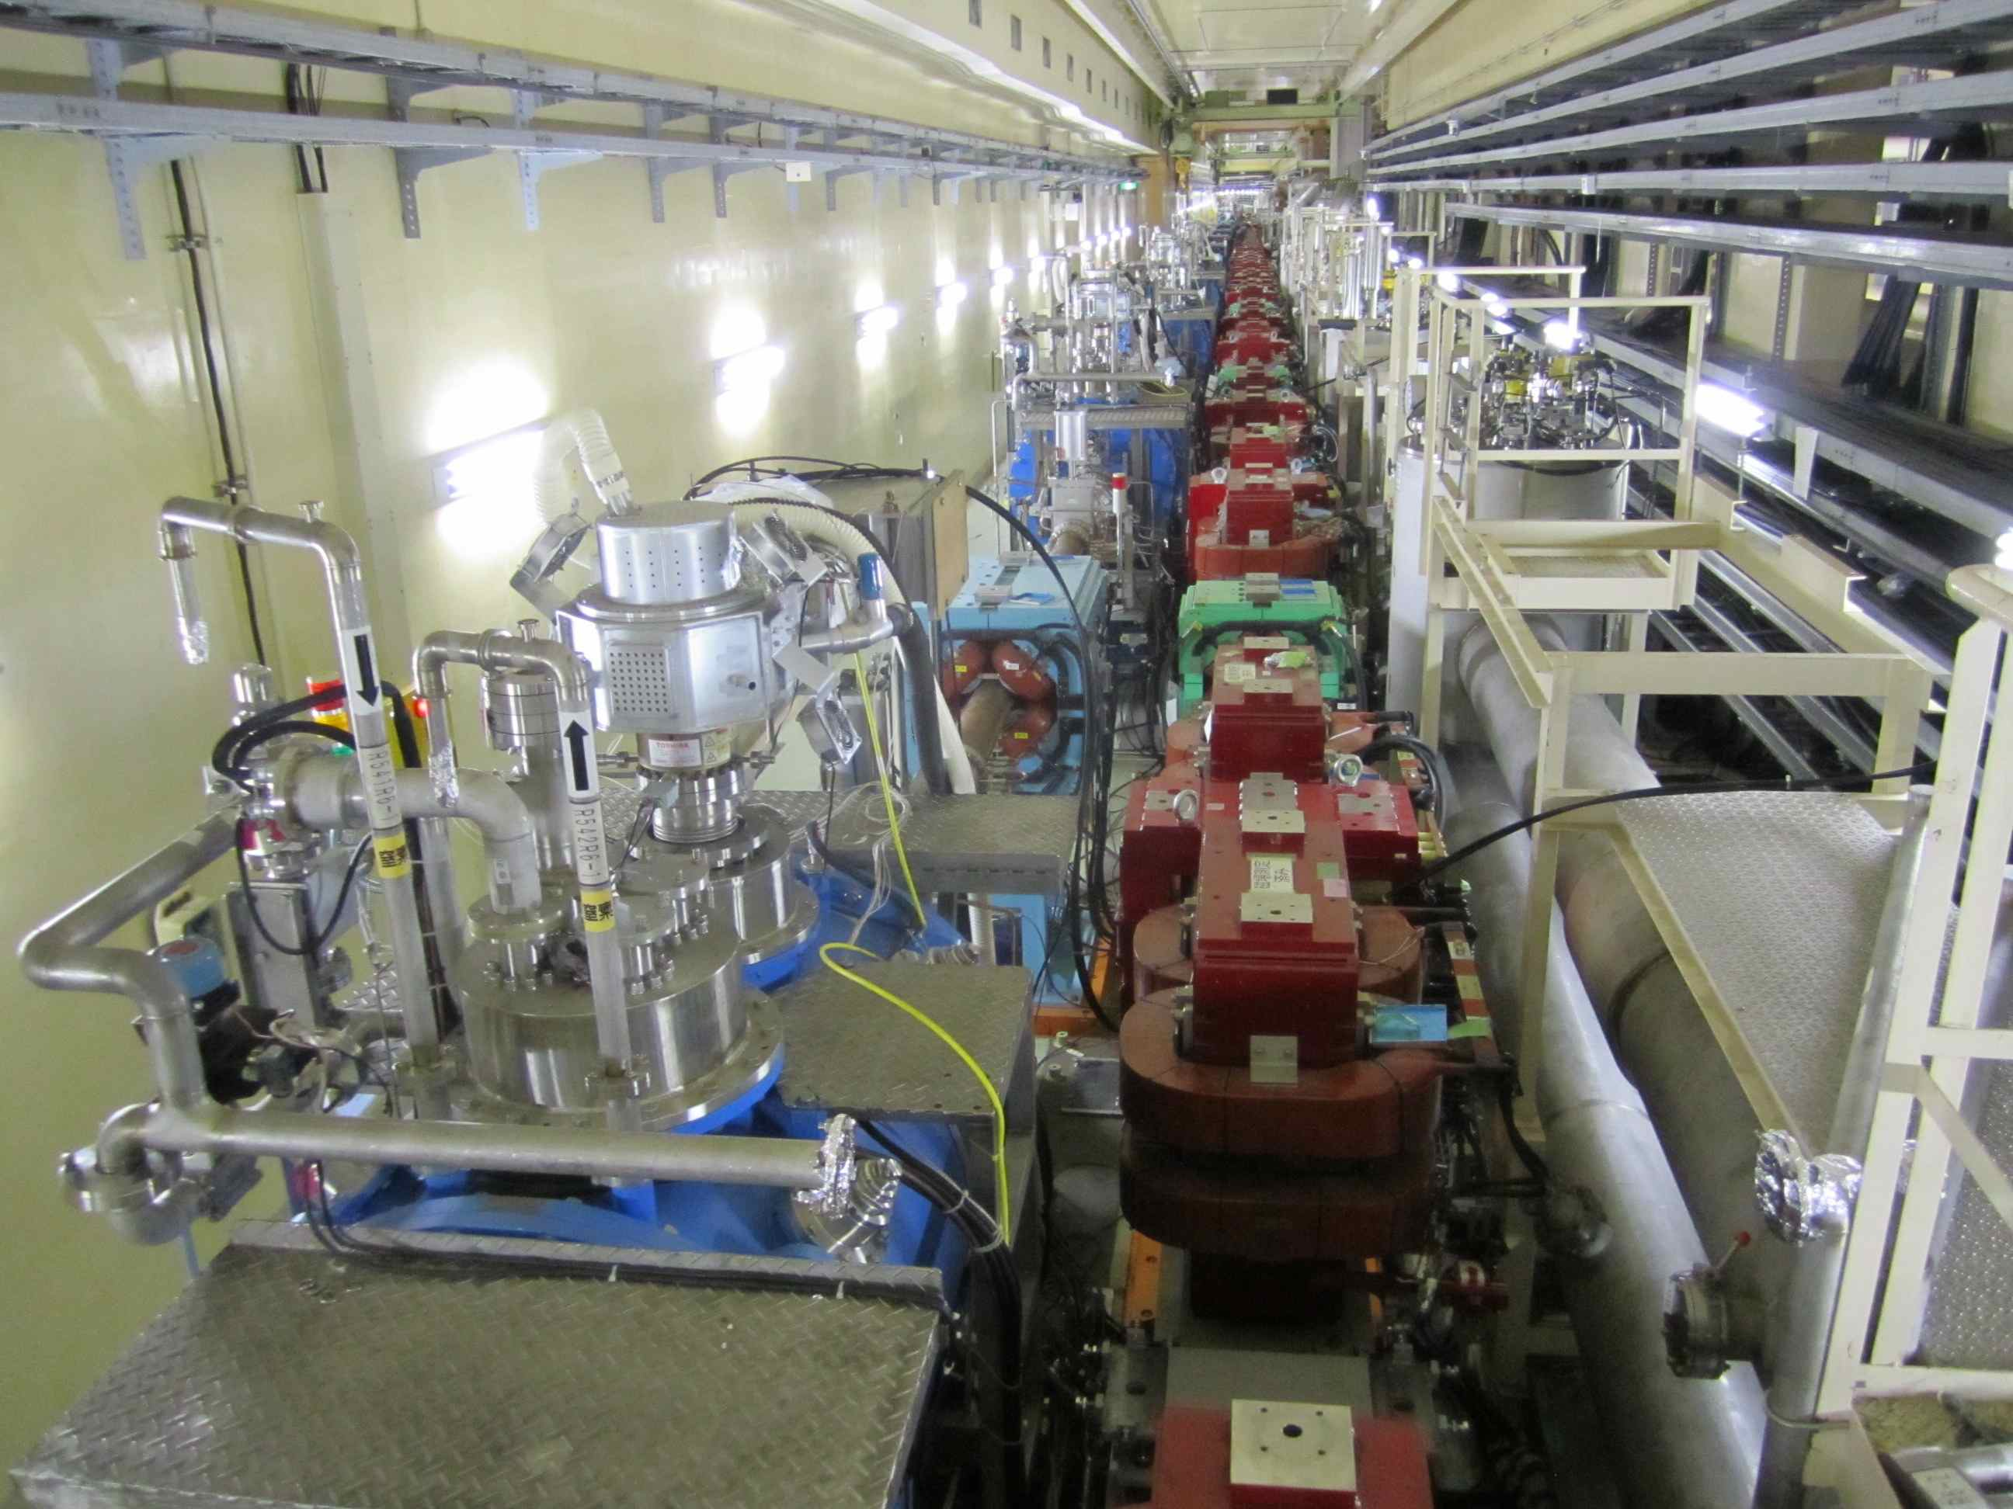
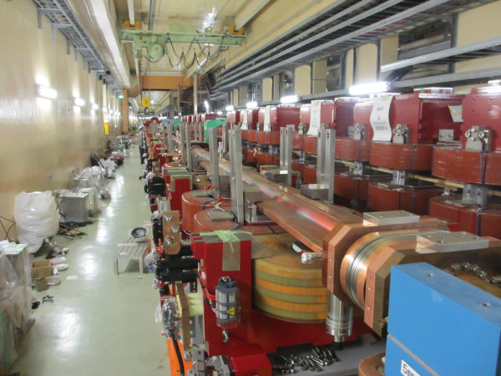
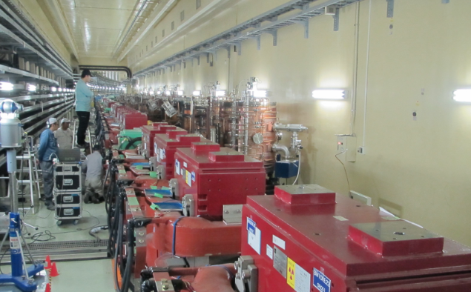
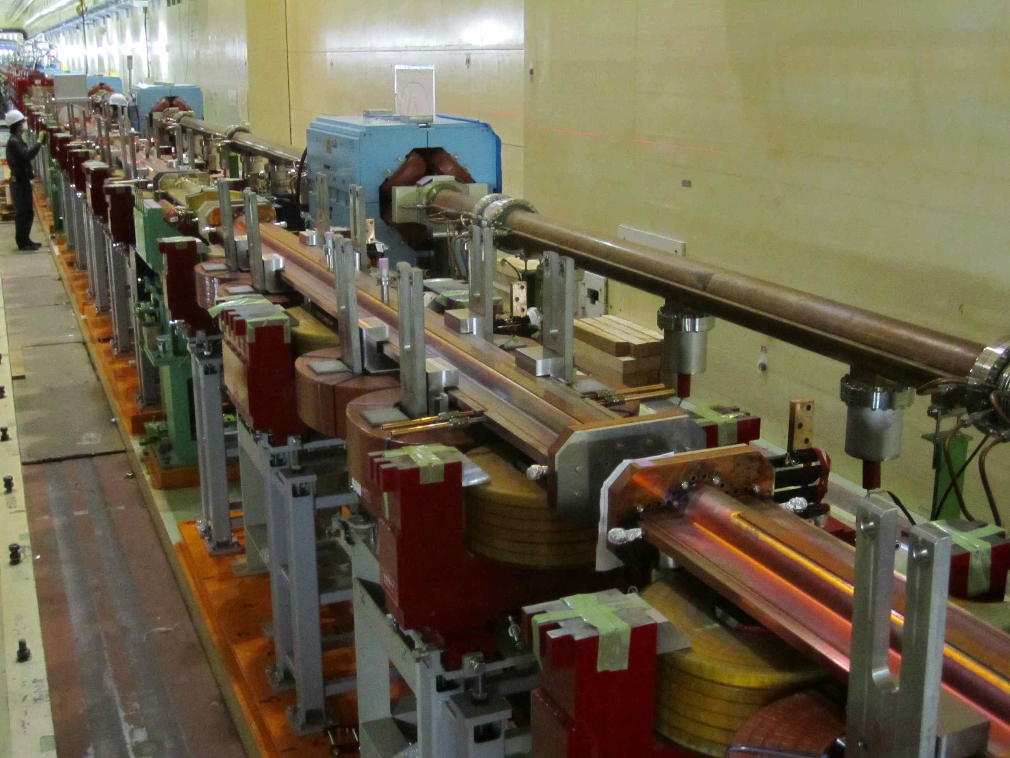
Wiggler magnets and chambers
LER Wiggler
Nikko
Installation of LER wiggler magnets and chambers in Nikko and Oho straight sections. -> Completed.
LER Wiggler
Oho
Installation of HER wiggler magnets and chambers in Oho straight section. -> Completed.
HER Wiggler

Slide 11
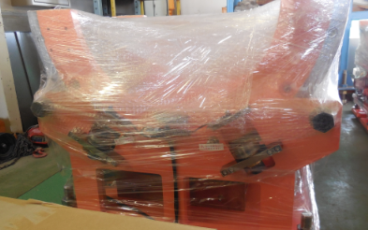
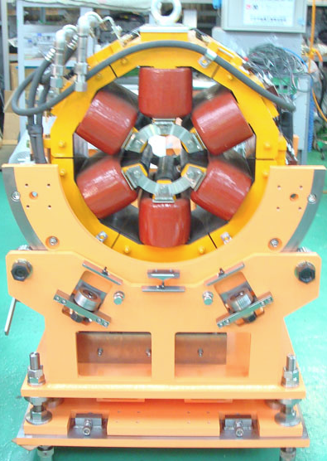
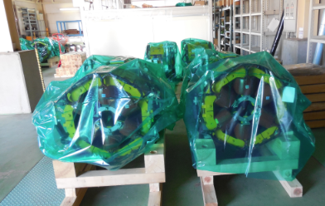
Tilting table for sextupole magnets Magnet modification and table production ongoing
M. Masuzawa,
R. Sugahawa
16 tables (of 24) arrived at KEK.
Assembled magnet: Proto type
Assembly work using survey instruments to adjust the tilting center will start sometime in February. Installation to the beam line will take place in JFY2014.
16 magnets (of 24) been modified and arrived at KEK.

Slide 12
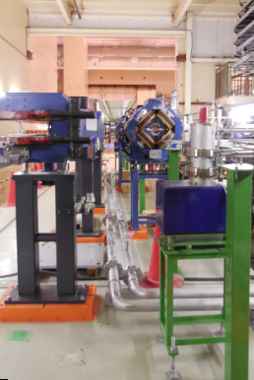
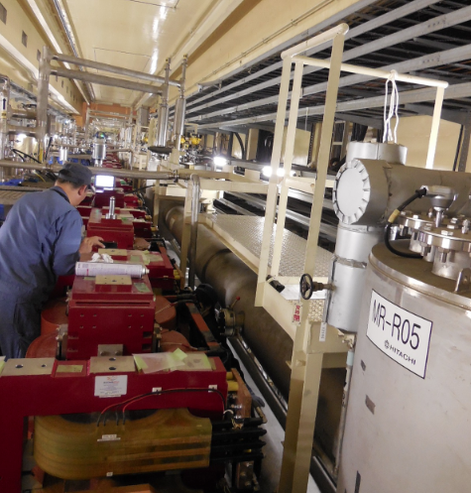
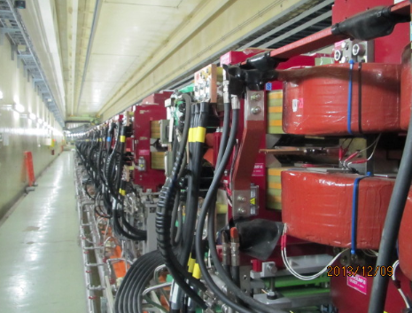
Piping, Cabling and Alignment
These works are also laborious, takes time and money.
SSC in HER
Cooling water pipes.
He pipe
Power cables between wiggler magnets been connected in the Oho and Nikko straight sections.
Workers adjusting the bolts, in between the magnet and the pipe,
not easily seen.
Nikko wiggler alignment in a very tight space

Slide 13
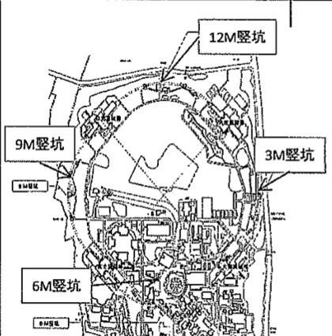
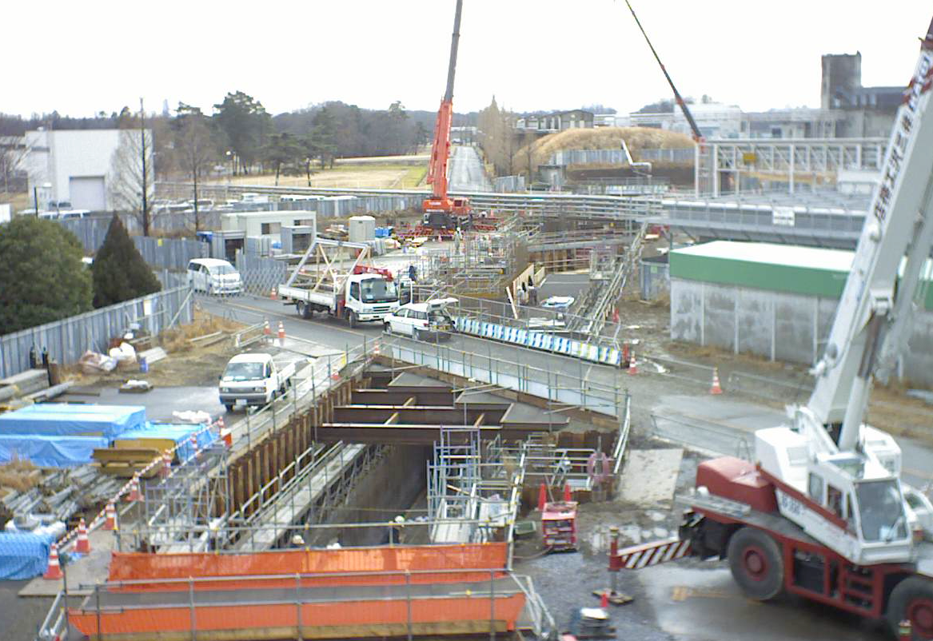
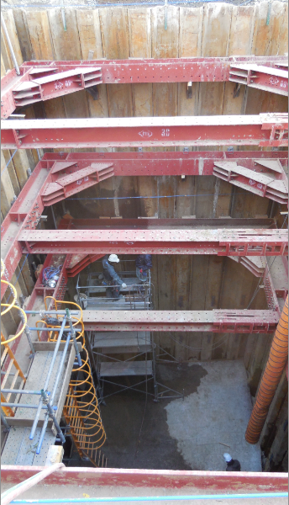
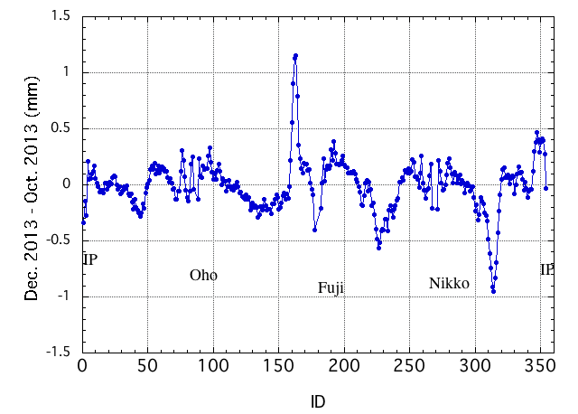
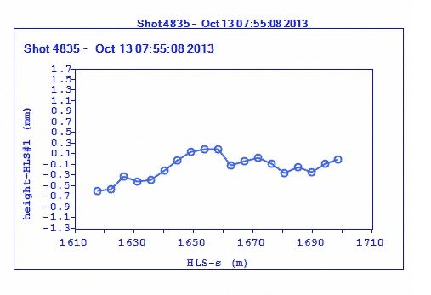
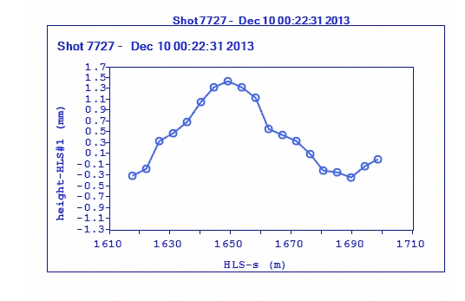
Alignment work ongoing Difficult to coexist with the heavy duty construction work above ground. Effects of the new utility buildings and new tunnel are clearly seen.
AR new tunnel
12M
Oct. 13, 2013
AR new tunnel
Oct. 13, 2013
Dec. 10, 2013
lebel change by 1.5 mm
Fuji

Slide 14
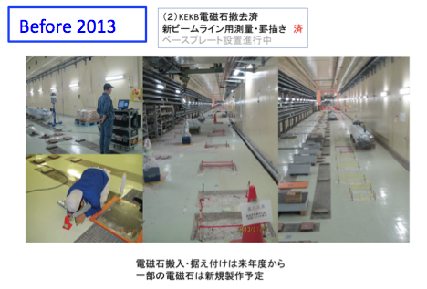
Tsukuba straight section

Slide 15
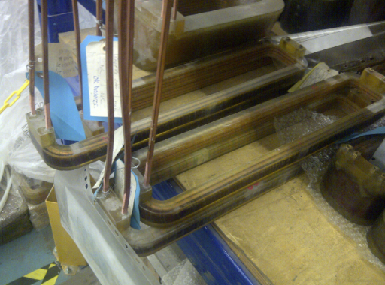
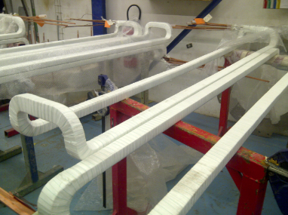
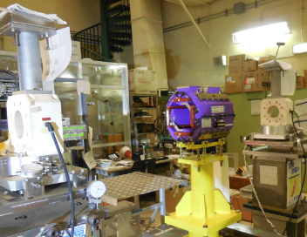
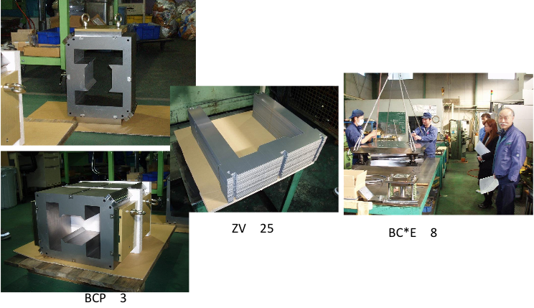
IR Magnet production status (QK* and BC* and etc.)
Two quadrupoles
(QLC2LE/QLC2RE)
Coils have been wound & impregnation is ongoing
M. Masuzawa et al.
~2.2m Dipoles
All coils have been wound
Yoke stacking and assembly will start in mid-February.
Small dipole magnets near the QCS (BC1LP,BC1RP) & other dipole magnets (BC*E) and etc.
Yoke stacking ongoing
All 16 (+1spare) Skew Quads (QK*) arrived at KEK and the magnetic measurements ongoing at KEK.

Slide 16
IR status – magnets and beam pipes
K. Kanazawa
New IR magnets are fabricated in FY2013.
Installation of the new IR magnets will start June 2014.
Beam pipes
fabrication
FY2013
Dummy
Stage (Phase 1)
Moving
stage
Beam pipes fabrication: Apr – Sep 2014
Beam pipes
fabrication
FY2013
Installation of beam pipes will start around August 2014.

Slide 17
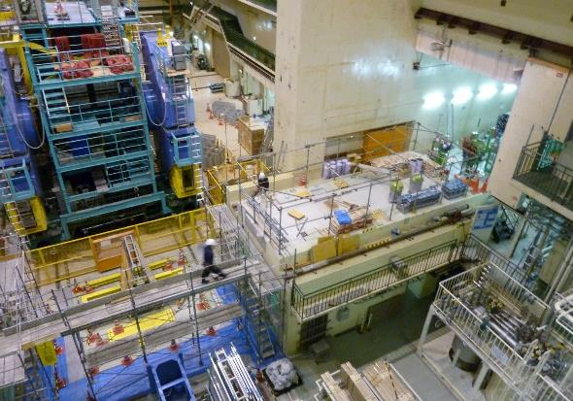
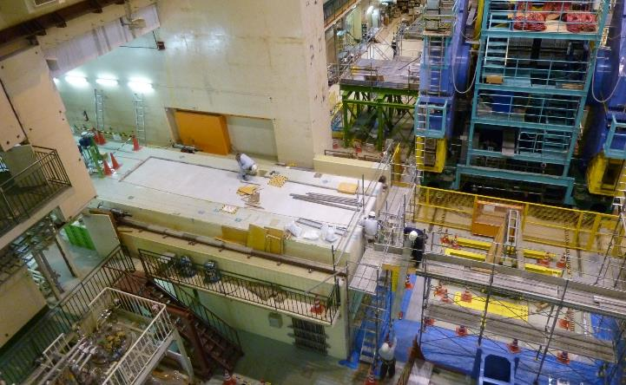
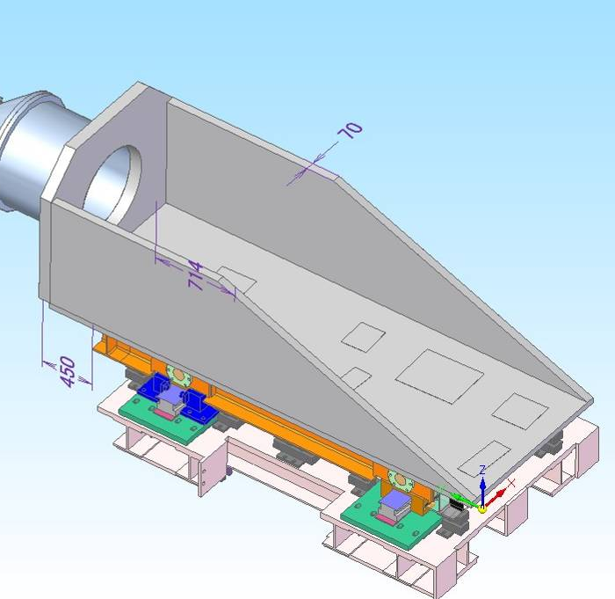
IR status – Accelerator floor
The accelerator floor has been modified for the new QCS moving stages.
The QCSL moving stage will be set on the floor in FY2013.
QCSL
moving stage
QCSR
moving stage to be fabricated
(dummy stage at Phase 1)
Pictures by
H. Yamaoka

Slide 18
IR status – Radiation shield
K. Kanazawa
A mini-shield for Phase 1 is going to be fabricated in Feb - Jun 2014.
Installation of the mini shield and the shield support stage: ~Aug 2014
Phase 1
IR
Mini shield for Phase 1
Existing shield
Shield support stage (re-use)
Additional shield to fill a floor gap (FY2013)

Slide 19
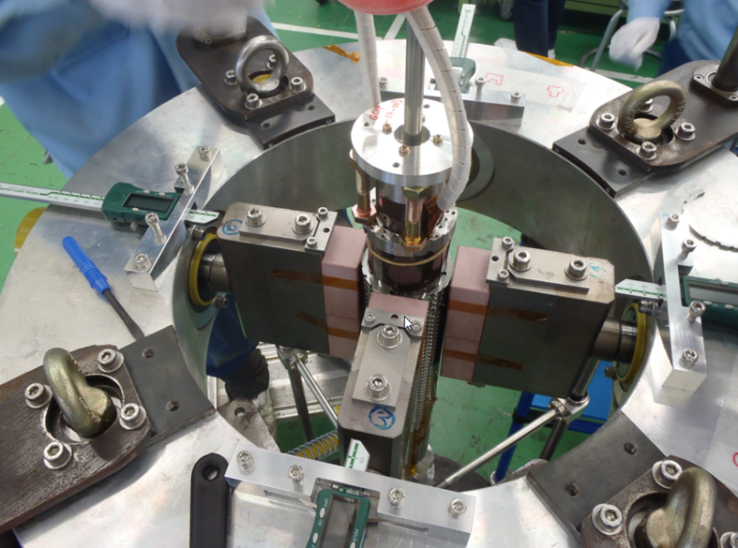
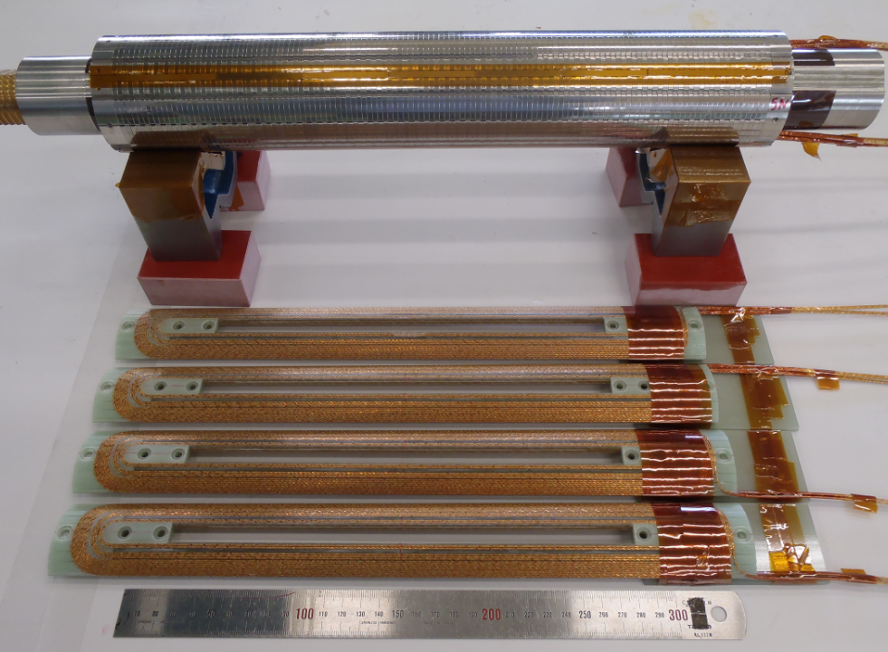
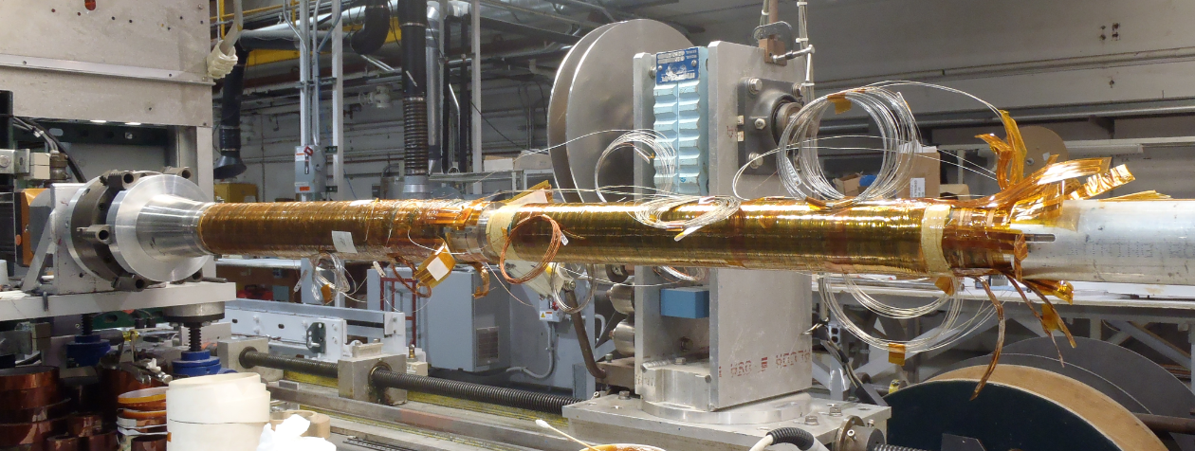
IR Superconducting Magnet
Left side magnets and cryostats
will be completed by Dec. 2014. (original schedule was Dec. 2013.)
to be cold-tested in KEK before installation in beam line.
Right side magnets and cryostats
main magnets will be completed in March.
collector coils windings at BNL started.
cryostats will be completed in Jul. 2015.
No time for cold-test before installation in beam line.
QC1LP collaring work at Mitsubishi Company
Details will be reported by Ohuchi-san.
QC1LP magnet
Corrector Coils
Leak Field Cancel Coils
Collaring work in Mitsubishi
QC1LE correctors coils in BNL at November 2013
SC coils for QC1RP

Slide 20
KEKB-RF
D4
OHO
D5
D7
FUJI
D8
D10
NIKKO
D11
1
2
2
2
1
2
2
2
2
1
2
2
2
2
1
C
B
A
A
B
C
E
E
D
C
B
A
A
B
C
D
E
D
C
B
A
A
B
C
D
E
F
HER
LER
SuperKEKB-RF
(phase 1)
add 5 klystrons, HP&LL
add 3 power supplies
D4
OHO
D5
D7
FUJI
D8
D10
NIKKO
D11
2
2
2
2
2
2
1
2
2
2
2
1
2
2
2
2
H
G
F
E
C
A
A
B
C
D
E
F
E
D
C
B
A
A
B
C
D
E
D
C
B
A
A
B
C
D
add 2 ARES
convert to LER
remove 4 ARES
Klystron, HP&LLRF system
2
Type “A” power supply (for two klystrons)
ARES cavity
SC cavity
SC crab
1
Type “B” power supply (for one klystron)

Slide 21
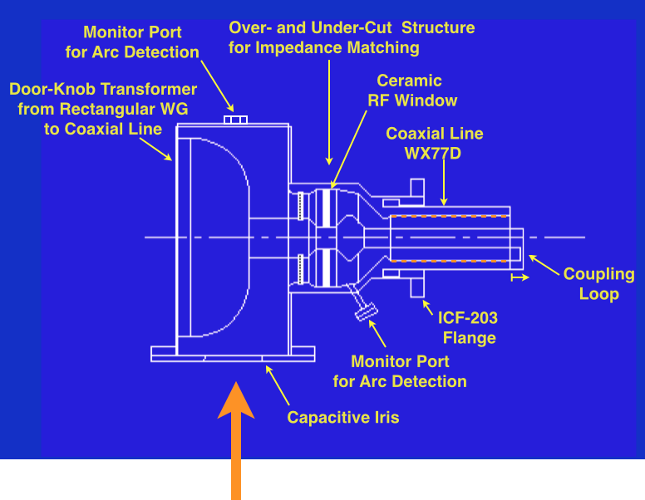
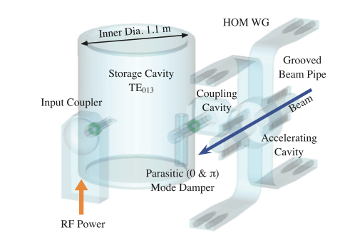
ARES Cavity System / Input Coupler / Performance Upgrade
Fine grooving inside the outer conductor of the coaxial line to suppress multipactoring discharge.
The coupling loop is extended to increase the input coupling factor.
The optimum input coupling factor β_{opt} is given by β_{opt} = 1 + P_{beam}/P_{c} .
Input Coupler
Power Handling Capability (Spec.)
P_{input} P_{c} P_{beam}
SuperKEKB : 750 kW = 150 kW + 600 kW
KEKB : 350 kW = 150 kW + 200 kW
P_{c} = 150 kW generating V_{c} = 0.5 MV per ARES cavity.
3D Transparent View of ARES Cavity System

Slide 22
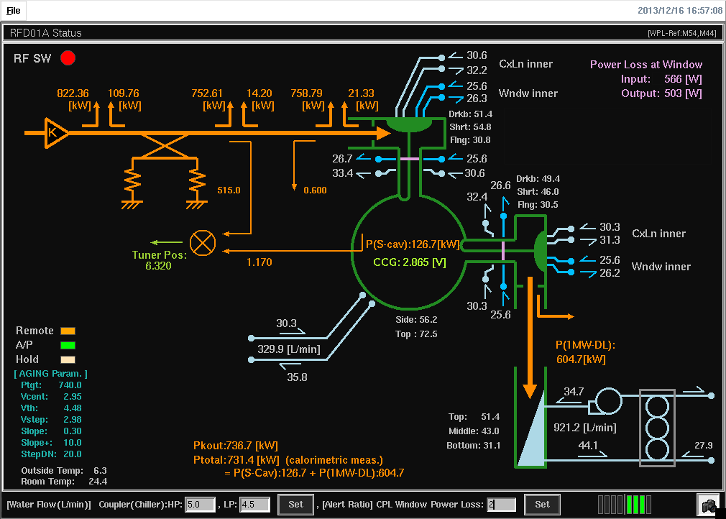
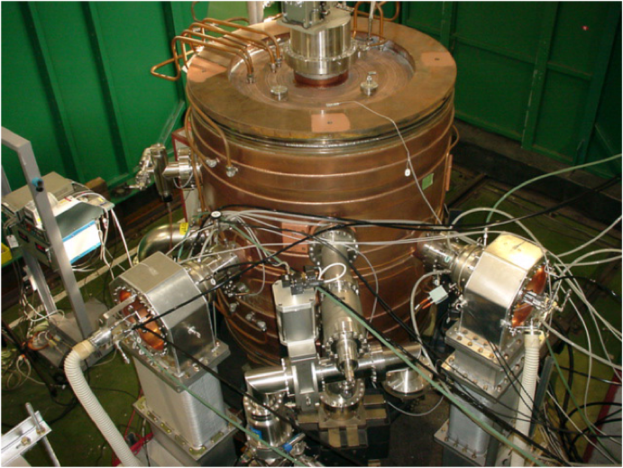
ARES Cavity System / Input Coupler / Production & Processing
ARES
Storage Cavity
Input Coupler
used as
Output Coupler
Input Coupler
Under Test
High Power Test Stand
To 1MW Water Load
RF Power from
1MW CW Klystron
(TOSHIBA E3786)
Snapshot of Status Monitor for RF Processing
T. Kageyama et al.
Status & Plans
So far, 10 couplers have been processed up to 750-800 kW.
By the end of this April, 4 more couplers are going to be processed.
In 2014, 10-14 out of 30 couplers existing in the MR tunnel will be replaced with new ones, and the ARES cavities will be all set for “T = 0”.

Slide 23
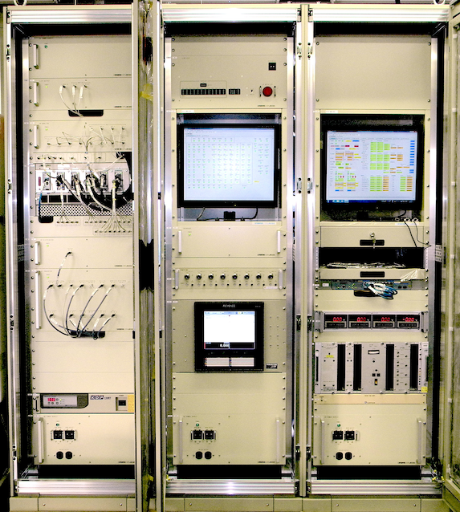
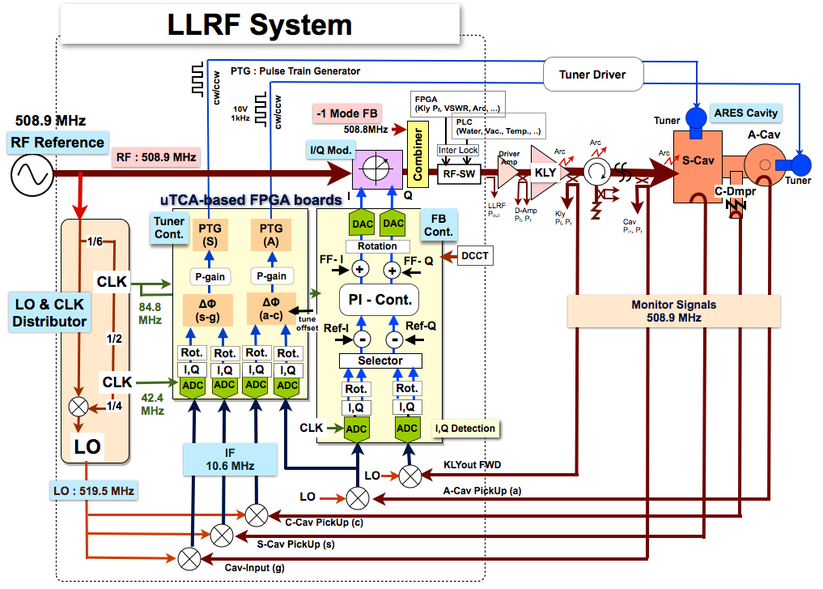
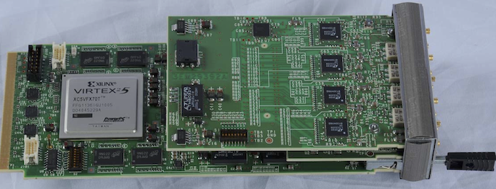
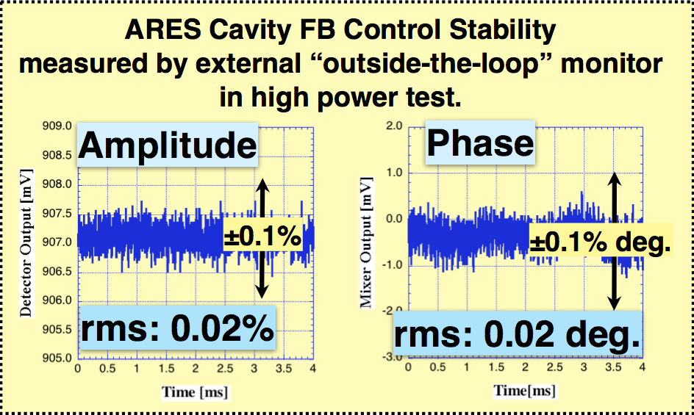
New LLRF control system
A digital LLRF control system, which is dominated by μTCA-platformed FPGA boards, has been developed for higher accuracy and flexibility, and many improvements were applied for SuperKEKB.
Now the quantity production of 8 systems is in progress. Six of them will be installed in D5 in March and two in D4 in June.
LLRF Control System for SuperKEKB
μTCA-Platform Digital LLRF Unit
FPGA Board (AMC)
16-bit ADC x 4ch,
16-bit DAC x 2ch

Slide 24
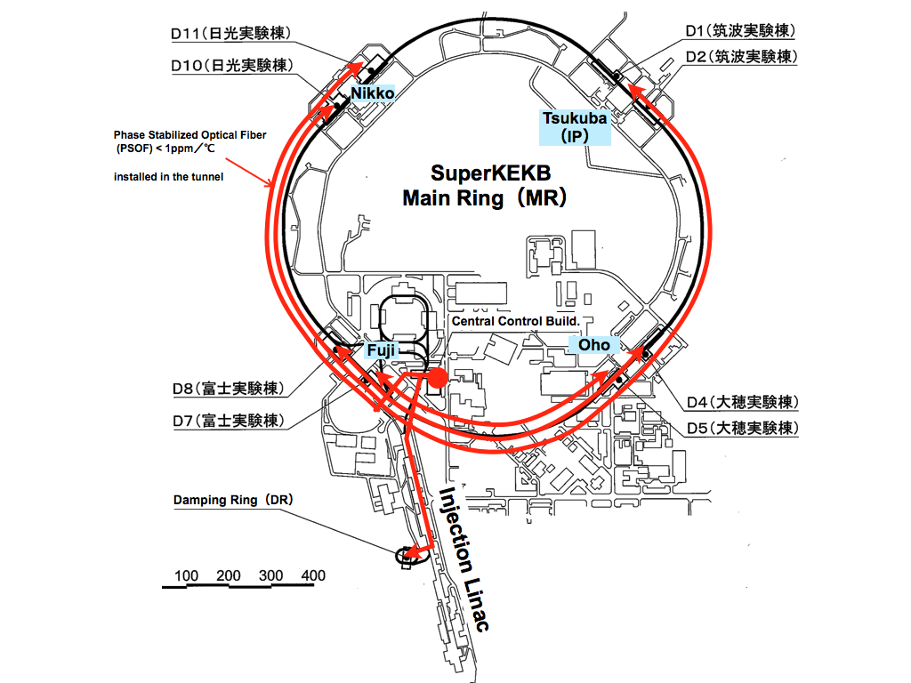
New LLRF reference distribution
Features
Optical distribution by means of “Star” configuration from the central control room (CCR).
“Phase Stabilized Optical Fiber (PSOF)”, which has small thermal coefficient, is adapted : < 1ppm/°C (5 ps/km//°C)
Furthermore, optical delay control of thermal drift compensation is applied at CCR for all transfer lines.
Status
Installation of the PSOF cables to all RF sections and Tsukuba-B3 was completed.
Optical transceivers and the drift compensation system will be install in this month.
Connection into the electronics hut of the Belle-II and extension to the DR will be done this year (next JFY).
T. Kobayashi et al.
Short term stability (time jitter) : ~0.1 ps (rms)
Long term stability (pk-pk) :
±0.1° @508.9MHz = ±0.55 ps is expected by the optical delay control.

Slide 25
RF cavity for Damping Ring
DR Cavity #1 (1st Production Version) has passed the High Power Test (HPT) up to Vc=0.95MV/cav over the Spec.: 0.8MV/cav.
Mounting test has been performed successfully with vacuum sealing.
Four HOM Waveguide Loads with SiC Tiles Inside
Movable Tuner
T. Abe et al.
V_{c}-Holding Endurance Test
Two Grooved Beam Pipes with SiC Tiles Inside
V_{c} [MV/cav] | Wall-loss Power [kW] | Total Holding Time [hours] | Number of Trips
0.80 | 144 | 30.5 | 1
0.85 | 164 | 18 | 0
0.90 | 186 | 14.5 | 3
0.95 | 210 | 8 | 1
DR #2 cavity is in fabrication this FY.
Two cavities configuration in DR

Slide 26
Beam Monitor System
Beam Position Monitors
All button electrodes have been fabricated and partly installed in the tunnel.
A hundred twenty 508 MHz narrowband detectors will be delivered by this March.
Gated turn-by-turn detectors are being fabricated. 117 units will be available by phase 1 commissioning.
R&D of IP orbit feedback system is in progress. A down-converter for signal detection has completed.
Bunch-by-bunch Feedback System
Transverse kickers, button electrodes, power cables and power amplifiers have been installed.
LER longitudinal kickers have been ordered and will be installed in August 2014.
Button electrode
508MHz narrowband detector
HER transverse kicker
HER button electrode
LER transverse kicker

Slide 27
Beam Monitor (cont'd)
Photon Monitors
1) Visible light monitors (horizontal and longitudinal size measurements)
Design of the mirror, the holder and the chamber have been finalized.
Fabrication of the mirrors and the holders will finish in this FY.
2) X-ray monitors (vertical size measurements)
Beam line design have been finalized.
Under fabrication are downstream section of beam line vacuum components, high-efficiency pixel detectors and 64-channel readout system.
3) Large-Angle Beamstrahlung Monitor (collision size/position offsets monitor)
Design of the extraction chamber has been finalized.
Optics boxes, optical-transfer-line components and extraction mirrors are being fabricated.
Diamond mirror for visible light monitors
64-channel readout system for x-ray monitors
Optics box and extraction mirror for LABM

Slide 28
Replacing pipes around the ring for reinforcing cooling system -> completed

Slide 29
New Damping Ring for positrons
DR tunnel construction
Fabrication of accelerator components ongoing.
Installation will start in FY2014.
DR commissioning will start in 2015.
Linac
Sector-3
Jun. 2012
e+ beam
Dec. 2012
Mar. 2013
Parameter | Value
Energy | 1.1 GeV
Bunches | 2 x 2
Circumf. | 135.5 m
H. damping | 10.87 ms
Ext. emittance (H/V) | 42.5/3.15 nm
Max. current | 70.8 mA
Completed
Machine building
Power supply building

Slide 30
Accelerator components for DR
Magnets
Fabrication of most of magnets and power supplies have completed.
Field measurement is ongoing.
Fabrication of sextupole magnets, H-steering magnets, some of power supplies on going in JFY2013.
Vacuum system
Regular beam pipes of the ring were already fabricated.
Septum, SR monitor chambers, NEG and ion pumps will be ordered in JFY2014.
RF system
#1 cavity has been high-power tested successfully.
#2 cavity fabrication ongoing in JFY2013.
Low-Level and High Power RF system to be constructed after buildings completed.
Monitors
Most hardware components are ready for installation (BPM, FB, SRM, etc.).
To be prepared in FY2014 are electronics for beam loss monitors, signal cables and air-conditioned racks.
Injection system
Kickers and power supplies will be ordered in JFY2014.
Control and timing system

Slide 31
Budget, Schedule and HR

Slide 32
Budget
Total construction budget is 314 Oku-Yen for Rings, Injector, and Belle-II.
Most of the budget comes year by year-based.
JFY2010
JFY2011
JFY2012
JFY2013
JFY2014
JFY2015
JFY2016・・
Operation (+Maintenance) budget
Commissioning start
KEKB Operation
Maintenance budget (~20 Oku-Yen/year)
SuperKEKB Operation budget
Construction budget
We are here
Very Advanced Research SP (100 Oku-Yen)
Other budgets for construction (214 Oku-Yen)
Construction budget
Unit: Oku-Yen (~1.1M$)
JFY2010 | JFY2011 | JFY2012 | JFY2013 | JFY2014 | Total
75.0 | 10.5 | 14.5 | 0 | 0 | 100.0
0 | 41.6 | 40.2 | 61.6 | 46.7 | 190.0
0 | 4.5 | 12.4 | 7.2 | 0 | 24.1
75.0 | 56.6 | 67.1 | 68.8 | 46.7 | 314.1
Supplied | Supplied | Supplied | see, next page | see, next page
VARSP
Others
Buildings
Total
Status

Slide 33
Budget situation in JFY2013-14
37.6
Construction budget
30.5
unit: Oku-yen (~1.1M$)
JFY2013
JFY2014
Shisetsu-seibi-hi
(facilities expense)
24.5
Budget for buildings is not included.
appropriated
to be appropriated
B project (construction)
7.6
for rings, Linac and Belle-II
appropriated as JFY2012 supplementary budget.
KEK burden, etc.
6.6
1.5
Last ARC in Mar. 2013
not appropriated
probably missing
(KEK budget is being reduced year by year.)
KEK management promised to supply remaining KEK burden of 8.1 Oku-Yen.
(6.1 Oku-Yen in FY2014 and 2.0 Oku-Yen in FY2015)
Then, planned construction budget will be fully supplied. This is good news, but ・・・

Slide 34
Operation budget issue
Deep cut in JFY2014 operation budget
Only 25.0 Oku-Yen was appropriated , much lower than 36.9 Oku-Yen that has once been sent from MEXT in the request for budgetary appropriations.
The B project operation/maintenance budget during construction period was 20.0 Oku-Yen/year. This is annually used for:
Electricity charges for Linac operation, facility and infrastructure
Operators for Linac, AR, BT, control, and refrigerator
Computor lease fee
Radiation safety (subcontructing)
Facility and infrastructure (subcontructing)
Minimum maintenance of KEKB, Linac and Belle
Minimum electricity charges during shut down of KEKB
In addition to the annual maintenance, 17 Oku-Yen was requested to conduct beam operation from 2015 January to March. A part of this is needed before beam operation starts:
Electricity charges for high power RF conditioning, magnet system adjustment with high power operation, test operation of Nikko refrigerator and Belle solenoid, etc.
Additional cost for operators and varioius subcontructings.

Slide 35
Impact on schedule
The impact of the operation budget cut in JFY2014 on schedule:
Unable to start beam operation in JFY2014 unless additional budget of at least 10 Oku-Yen that could be used for electricity charges comes.
Test operation of the refrigerator and Belle solenoid could be done in this FY. Also it is possible to start RF conditioning, magnet system adjustment with high power, etc.
With this budget, possible situation at the end of JFY2014 would be that construction is done and starting up of machine components started, but beam operation is not started.
Effort is being made in high level people to recover the budget cut.
Urgent needs:
It takes 3 - 4 months to make contracts. Procedure for major contracts for JFY2014 already started. This can be proceeded only within available budget.
In case no budget recovery:
Possible plans to meet the reduced budget are being discussed in accelerator group. An example will be shown next.

Slide 36
original schedule

Slide 37
A possible plan in case no recovery of budget.
original schedule
Physics Run start fastest
Plan A

Slide 38
Human Resources (KEK staff)
17th ARC in Feb. 2012
Date | Status | Needed FTE | Available FTE (permanent staff)
Dec. 2010 | under construction | 77 | 56
Apr. 2011 | under construction | 77 | 60
Apr. 2012 | under construction | 77 | 62
Change in two years (2012 – 2014)
 | New (FTE increase) | Retire(1) (FTE decrease) | Retire(2) (same FTE counted here) | tenure to permanent (same FTE counted here) | Change of FTE | Remarks
Apr. 2012 | +3 | -2 | 2 | 2 | +1 | One of the new staff came from other project
Jul. 2012 | +2 |  |  |  | +2
Apr. 2013 | +1 |  | 3.5 | 2 | +1
Apr. 2014 | +2 | -1 | 3 | 1 | +1
Total change |  |  |  |  | +5 | Slow, but steady improvement

Slide 39
Last ARC recommendation
There are number of components which must be systematically checked for their impact on the impedance budget. It is recommended that a single person be assigned as the “impedance police” responsible for checking and controlling every component which has an impedance contribution to MR.
D. Zhou "Impedance issues" to be presented today

Slide 40
Summary
Construction is well ongoing.
We had various kinds of troubles (not reported here in detail), but they have been solved or mitigated not to make significant schedule delay.
As a whole, construction is on schedule so far to start Phase 1 commissioning in 2015.
A serious issue is operation budget cut in JFY2014.
We are considering possible plans to meet the situation.
As for HR shortage, we had slow, but steady improvement since construction started in 2010.

