Slide 1
Main Ring Magnet system
Magnet design &
Field measurements
Installation
Survey & alignment
K. Egawa
H.Iinuma
M. Masuzawa
Y. Ohsawa T. Kawamoto
Power supply design
Testing
Tuning
Installation & Cabling
T. Adachi
T. Oki
T. Sueno
N. Tokuda
Retired but still active
R. Sugahara
K. Tsuchiya
Eleven people including senior
members

Slide 2
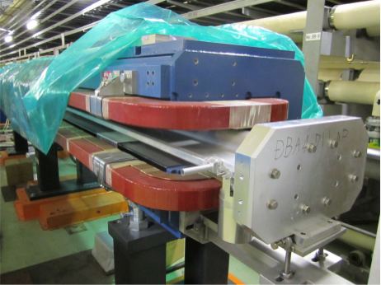
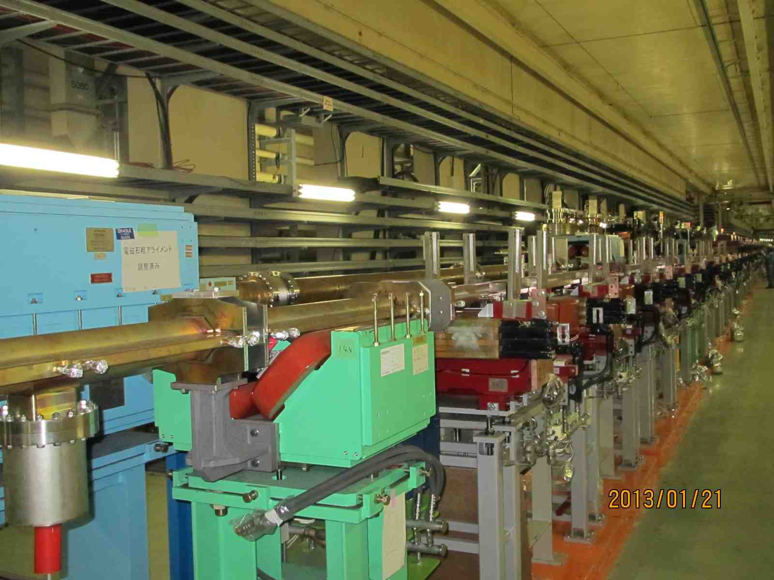
Since last review
In the tunnel
  Magnet installation to the Tsukuba section.
    ~60 dipoles, ~100 quadrupoles almost done.
      Sextupole magnets and steering magnets in FY2014.
  Top part of the LER magnets in the arc sections removed for vacuum
  chamber installation (and put the magnets back together again).
  ~500 magnets, done.
  LER horizontal steering magnet installation (~200) in the arc section almost done.
  HER vertical/horizontal steering magnet installation (~400) in the arc section almost done.
  Survey and 1st round alignment of the magnets in the tunnel are almost done.
  ⇒Tunnel temperature is 16 degree at places, ~10 degree lower than during the operation, which affects the alignment.
  Skew winding completed for all the sextupole magnets (~200).
  Cabling work of Power supply continues.
More fabrication
  Skew quads, IR magnets are ongoing.
  Tilting support for 24 sextupole magnets were fabricated.
  24 KEKB sextupole magnets were modified to fit in the tilting support.
Field measurement
Manufacture and overhaul of Power supplies
And more.
LER magnet in the arc section
Example of top part removed

Slide 3
In the tunnel

Slide 4
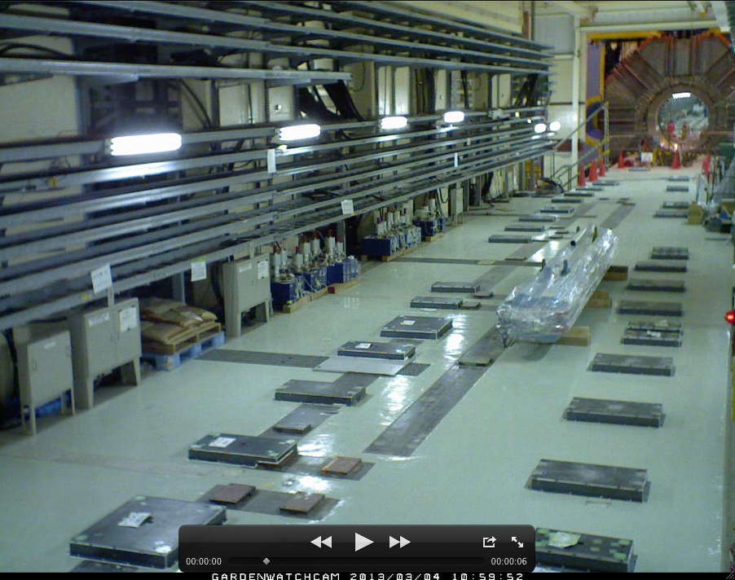
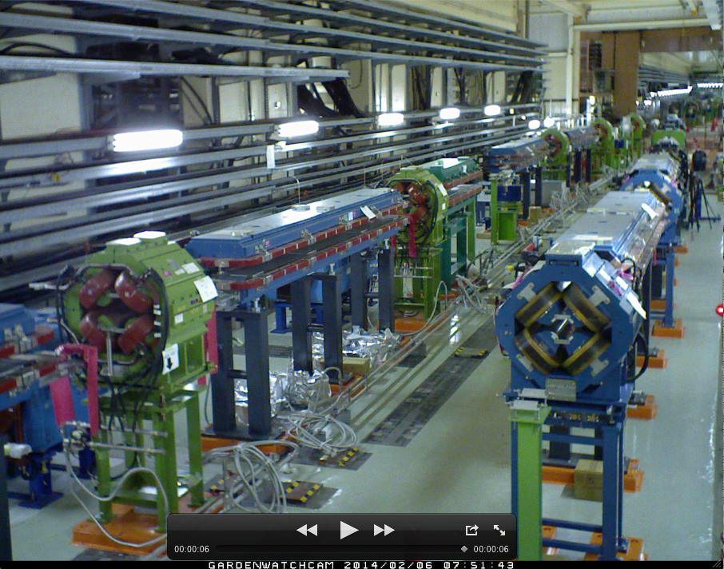
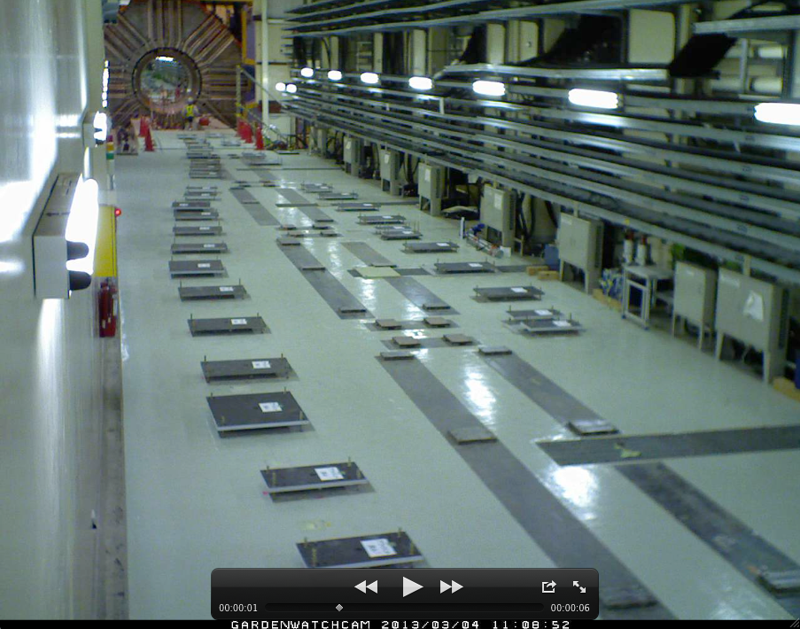
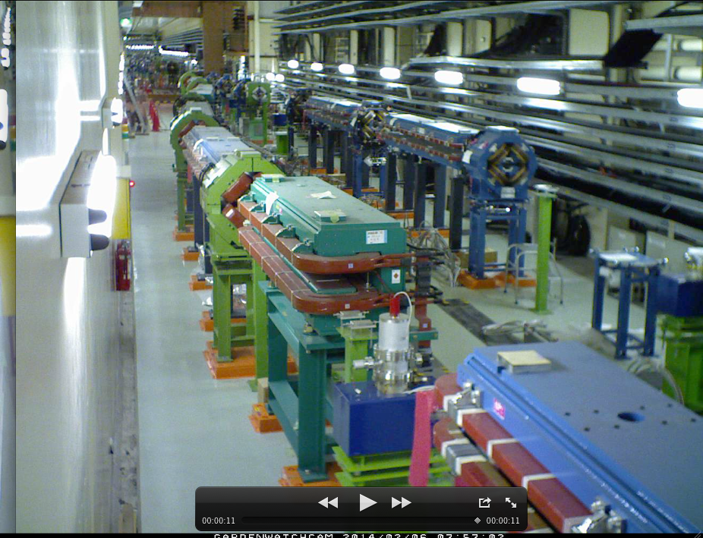
Magnet installation in the Tsukuba section
3/4/2013
2/6/2014
3/4/2013
2/6/2014

Slide 5
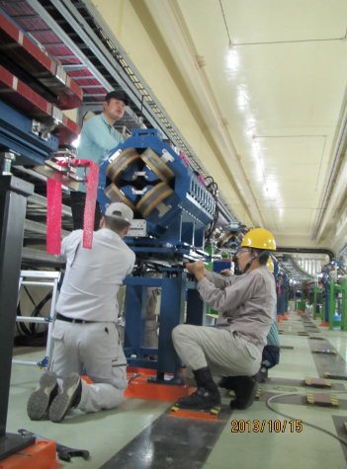
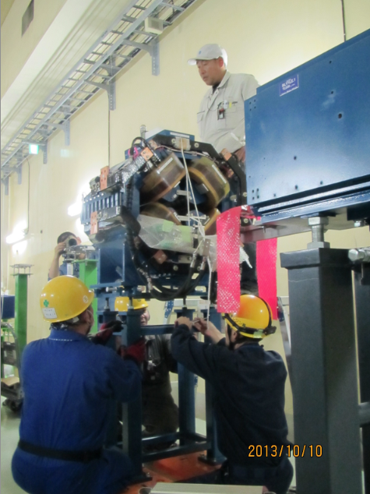
Masuzawa
Magnet installation & alignment at the Tsukuba section almost done
~60 dipoles, ~100 quadrupoles almost done.
Very tough work…
  Work pace: 40minutes/Long Dipole → 60m / week
  Two teams worked from the IP in clock and anti-clockwise directions.
Horizontal position is confirmed by Laser Tracker(LT）
Slope is confirmed by digital level
Height is confirmed by N3 with level marker on the wall, and LT.
Sextupole magnets and steering magnets are going to be installed in FY2014.

Slide 6
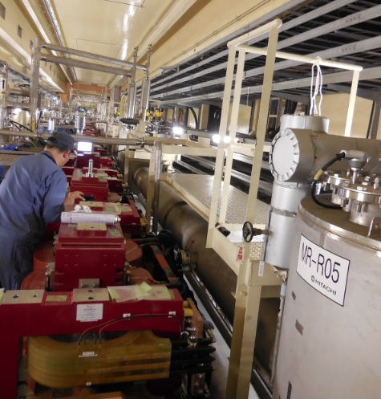
Alignment work is ongoing
Nikko wiggler alignment in a very tight space
Alignment accuracy depends on temperature!!
…However, tunnel temperature is 16 degree at places, ~10 degree lower than during the operation, which affects the alignment.
SSC in HER
He pipe
Workers adjusting the bolts, in between the magnet and the pipe,
not easily seen.
Linear coefficient of expansion 10⁻⁵ (1/°C)
Iron,concrete

Slide 7
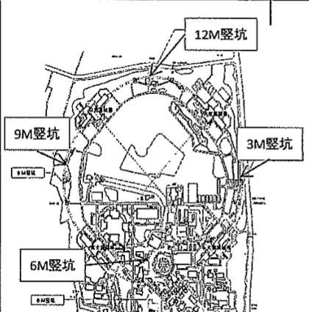
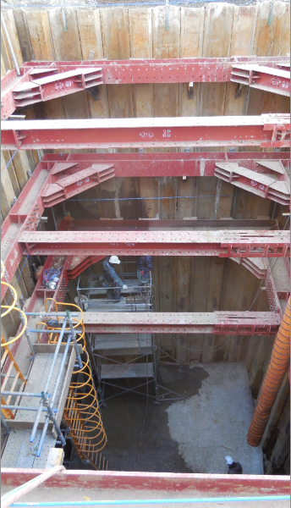
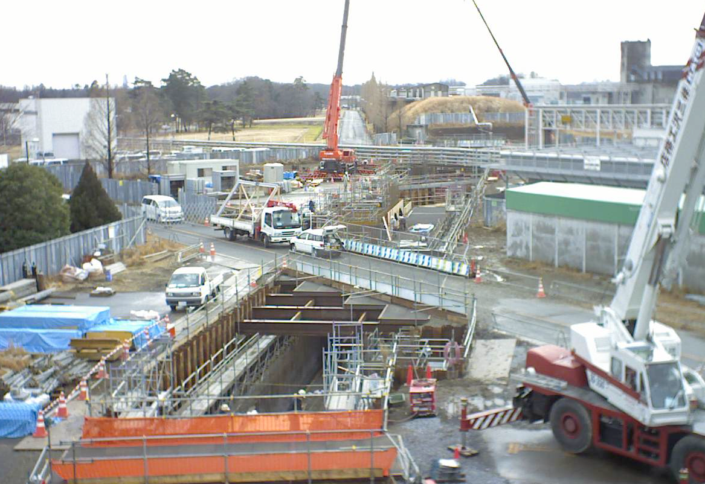
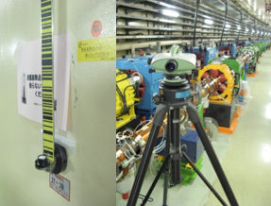
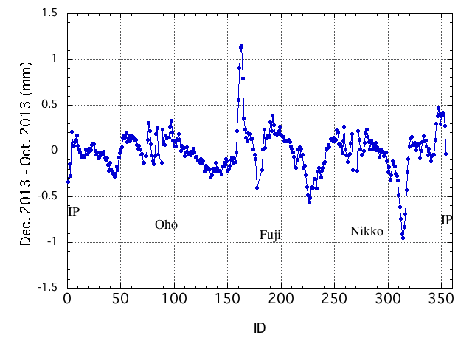
Alignment work is ongoing, but…
Difficult to coexist with the heavy duty construction work above ground.
Effects of construction of the new utility buildings and new tunnel are clearly seen.
Ohsawa
12M
AR new tunnel
AR new tunnel
1.3mm
Level Diff. from Oct. to Dec.
DNA03
Nikko wiggler alignment in a very tight space

Slide 8
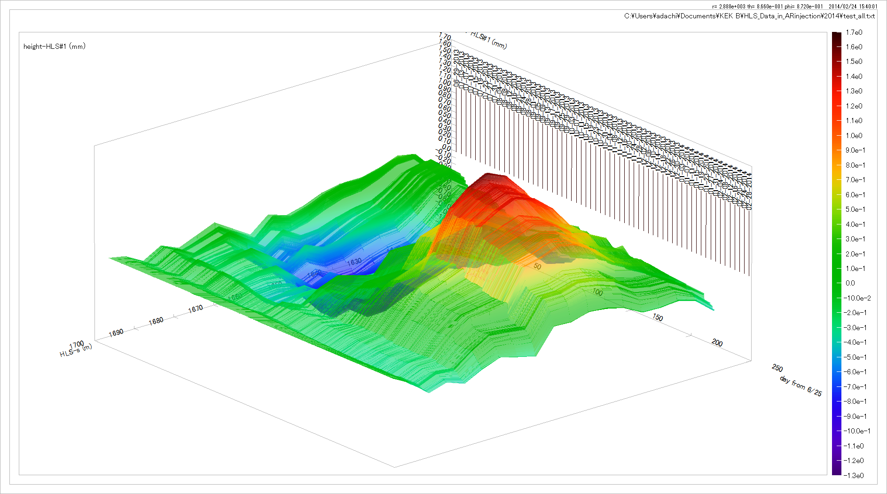
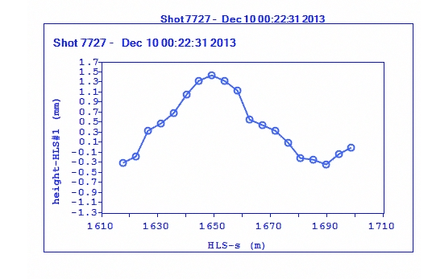
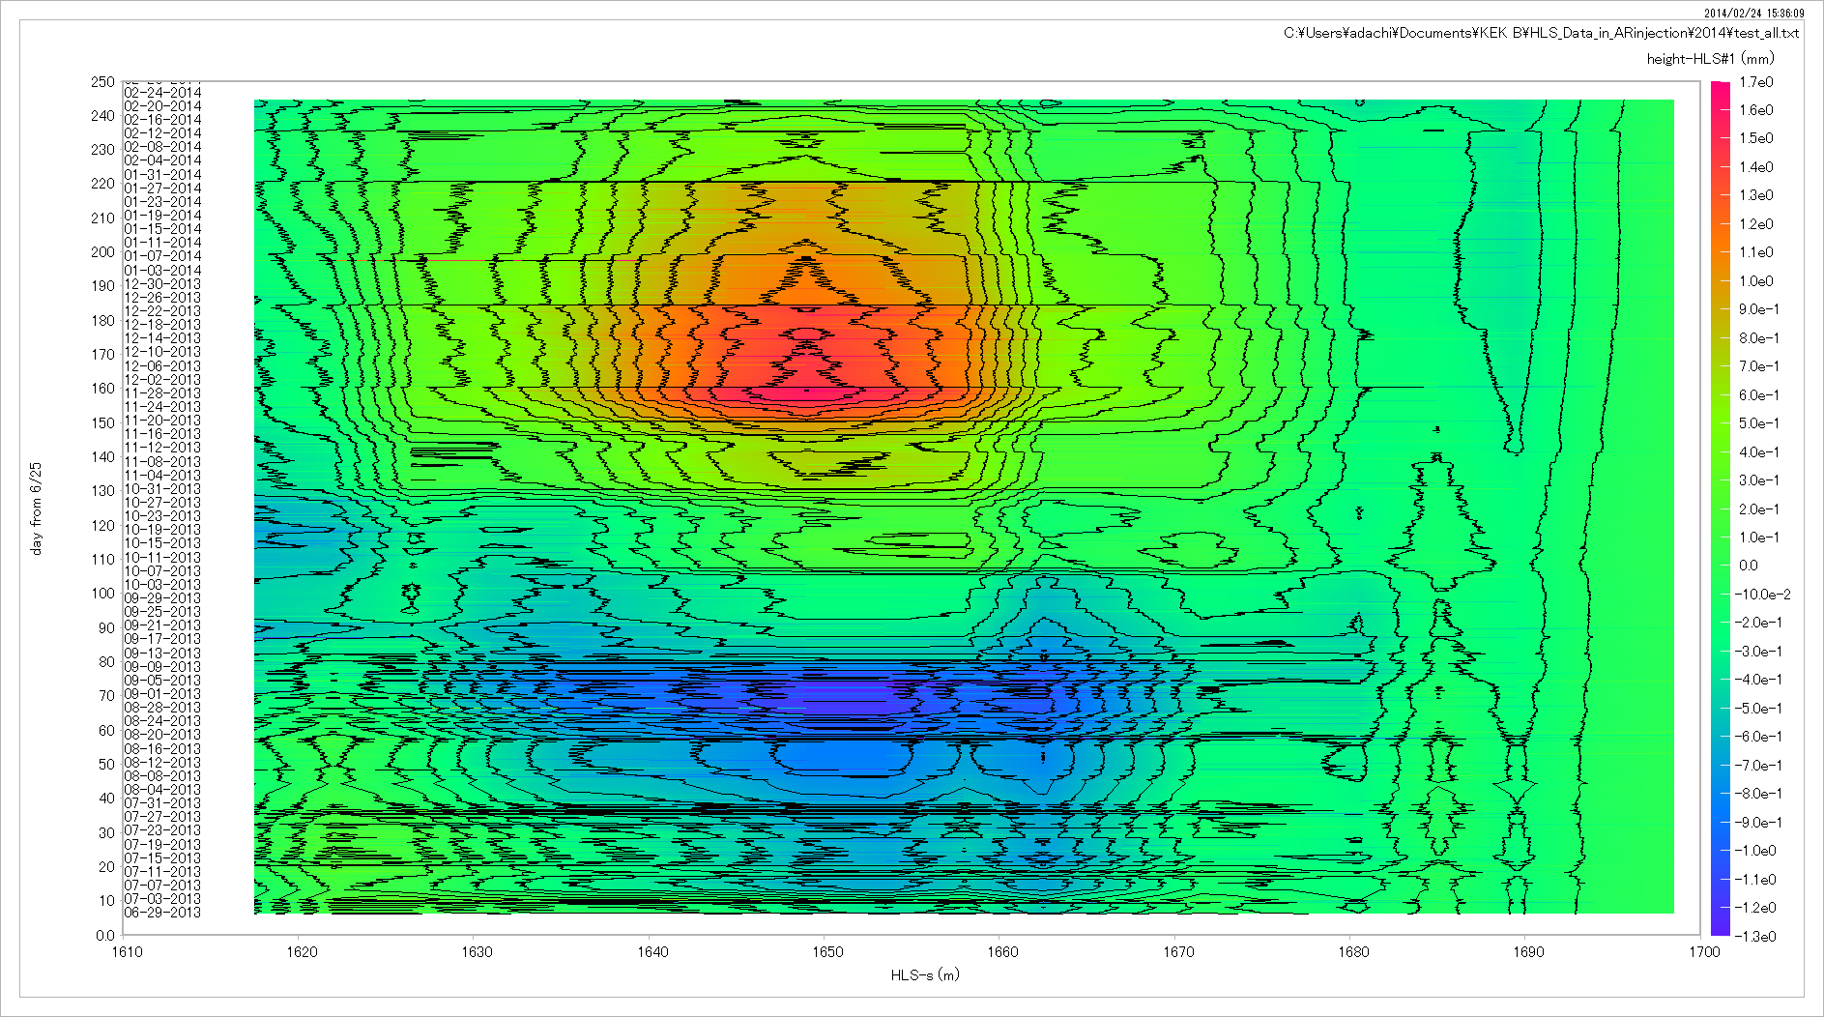
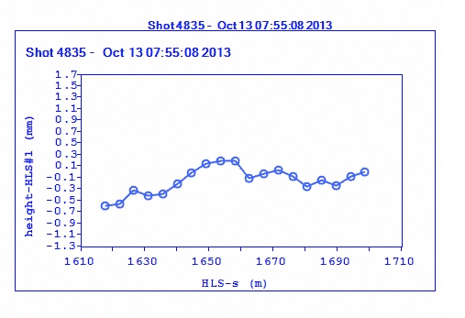
Consistent measurement by HLS
Kawamoto
Adachi
Hydrostatic Leveling System
1mm
+1.0mm
+0.5mm
Day from 2013.6.25 to 2014.2.24
0.0mm
-0.5mm
S (m) from 1620 to 1700
S=1650m
Dec.10
Feb.24
level change by 1.5 mm
Oct.13
Day from 2013.6.25 to 2014.2.24
Sep.2
S (m) from 1620 to 1700

Slide 9
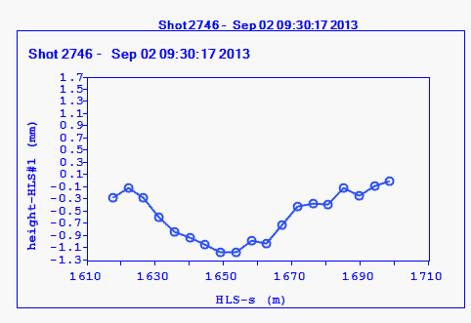
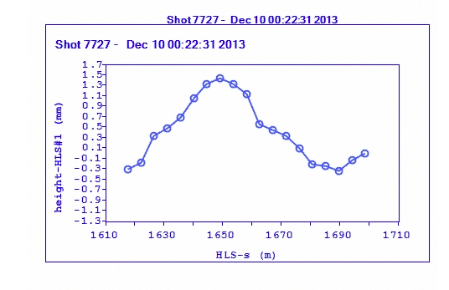
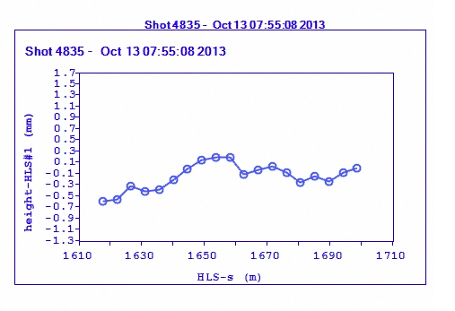
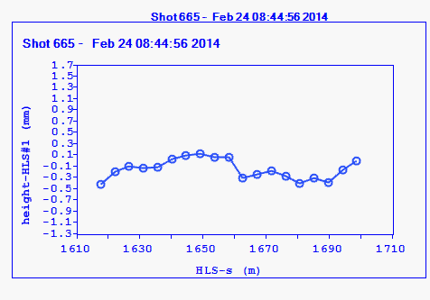
Sep. 2, 2013
2.7 mm
Dec. 10, 2013
Oct. 13, 2013
Feb. 24, 2014
We really worry how difficult a situation we will encounter with the final, fine alignment.

Slide 10
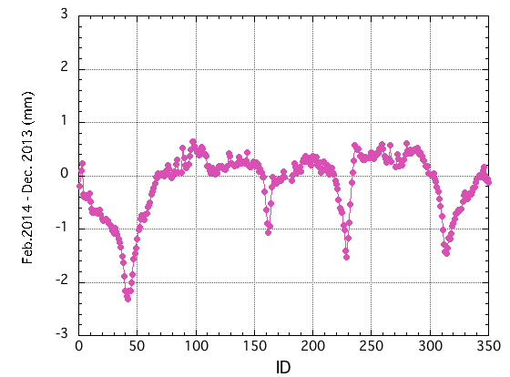
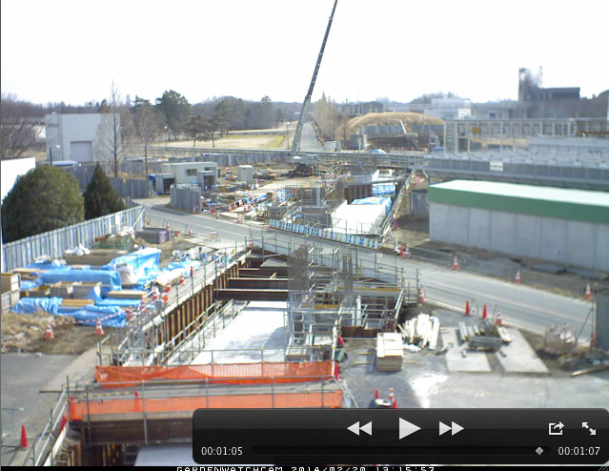
Ohsawa
Alignment work is ongoing, but…
Difficult to coexist with the heavy duty construction work above ground.
Effects of construction of the new utility buildings and new tunnel are clearly seen.
(1)Effects of new utility building “3M” have started to show.
(2)Concrete blocks have been placed in the new AR tunnel, which caused the KEKB tunnel to sink.
AR new tunnel
Level Diff. from Dec. to Feb.
6 mm
Very preliminary
Tunnel level change between Dec. 2013
and Feb. 2014 NEW!!! (very preliminary)
2014/3/3
Magnet Review 2014
10
Nikko wiggler alignment in a very tight space

Slide 11
I have this plot several hours ago.
And I do not know what to say now.
Very preliminary
AR new tunnel
Level Diff. from Oct. to Dec.
3M
Level Diff. from Dec. to Feb.
Keep watching!!

Slide 12
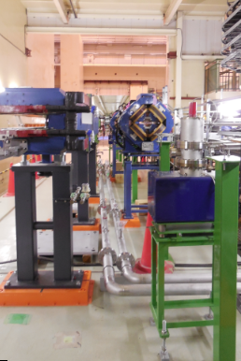
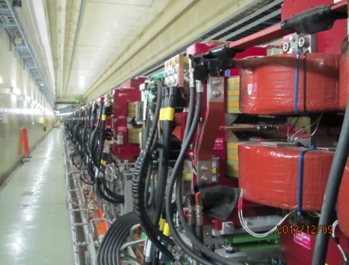
Cooling water pipes, power cables
Can you count how many wigglers in the line?
Power cables between wiggler magnets have been connected in the Oho and Nikko straight sections.
Wiggler polarity has been checked.
Part of the cooling water pipe lines
being installed.
(not connected to the individual
magnets yet)

Slide 13
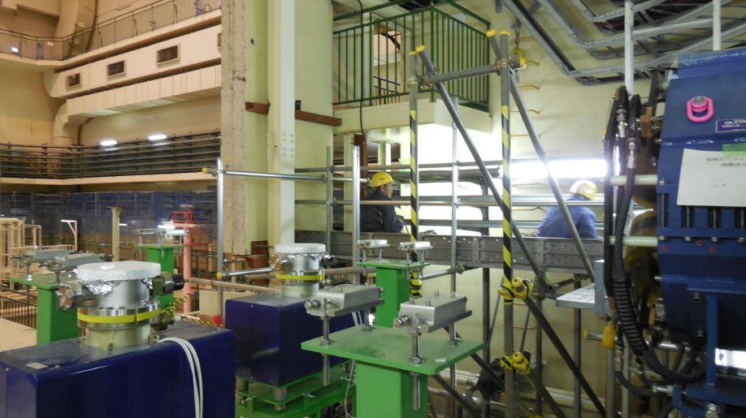
Power cable work for the Tsukuba straight section magnets

Slide 14
More fabrication
  Skew quads, IR magnets are ongoing: 60 magnets in total.
  Tilting support for 24 sextupole magnets were fabricated.
  24 KEKB sextupole magnets were modified to fit in the tilting support.

Slide 15
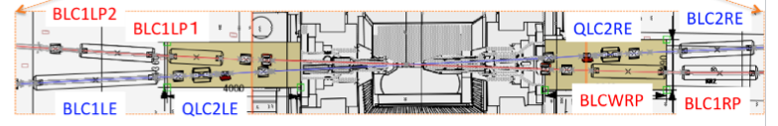
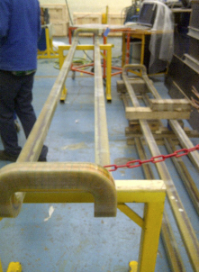
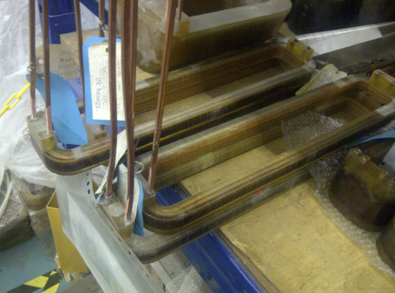
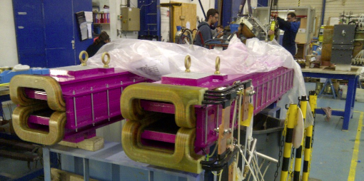
Iinuma, Masuzawa
Near IR Magnet production status (BL* and QLC2*)
~3.6 m long dipole
Yoke was sent to machining company. Coils have been molded and electrical tests are ongoing.
Two quadrupoles (QLC2LE/QLC2RE)
Coils are ready for assembly, which
will take place 1st week of March.
~2.2m Dipoles
All coils have been wound.
2 magnets (out of 4) have been assembled.
6 dipole magnets and 2 quadrupole magnets will be transported by air in March.

Slide 16
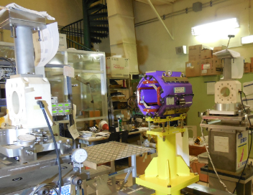
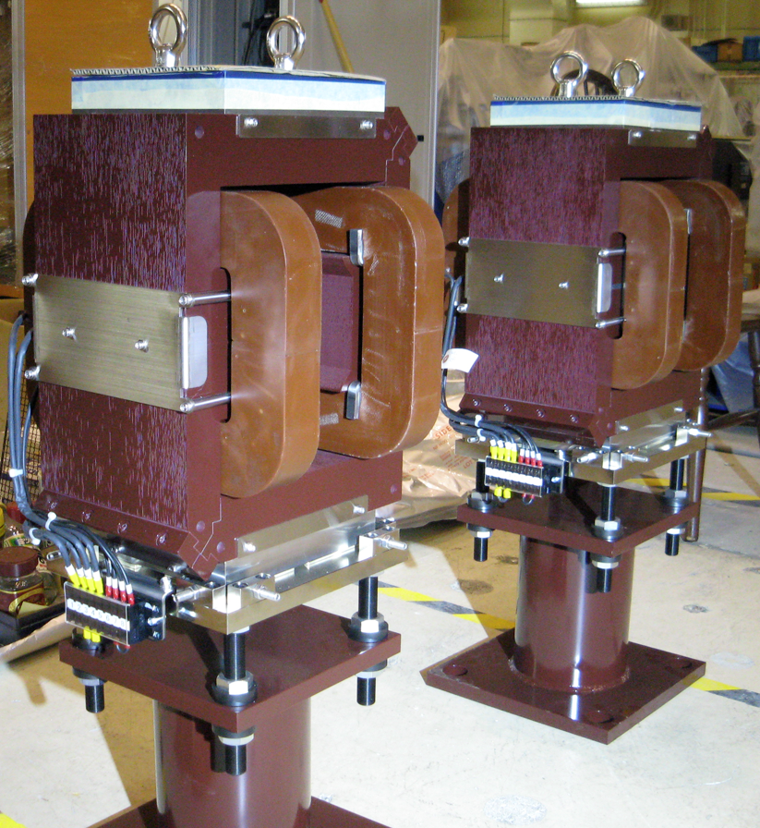
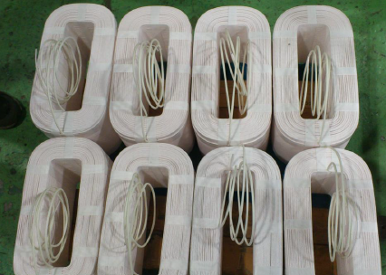
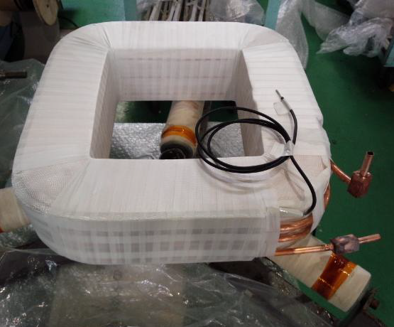
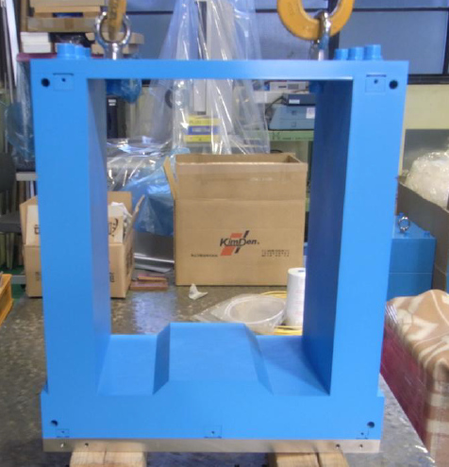
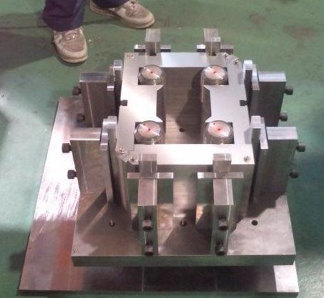
Near IR Magnet production status (QK* and BC* and etc.)
Small dipole magnets near the IP, BC1LP and BC1RP arrived at KEK and waiting for the field measurements.
Other small dipole magnets (BC*E) and etc. are being fabricated and scheduled to be shipped to KEK in the end of March.
All 16 (+1spare) Skew Quads (QK*)
arrived at KEK and the magnetic
measurements completed.
ZV* ×25
BCE* ×8

Slide 17
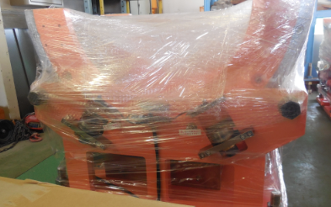
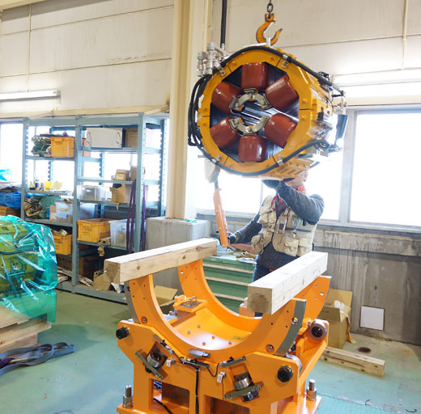
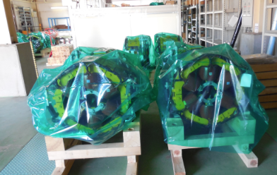
Tilting table for sextupole magnets production and magnet modification are almost completed
Sugahara, Masuzawa
16 tables (of 24) arrived at KEK.
24 KEKB sextupole magnets have been modified to fit to the tilting table.

Slide 18
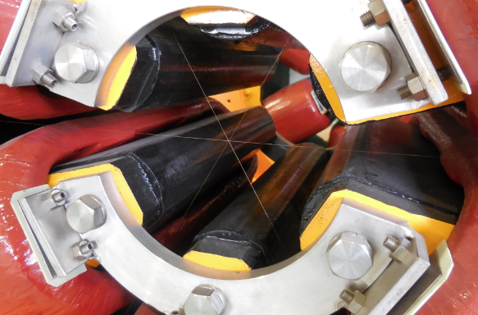
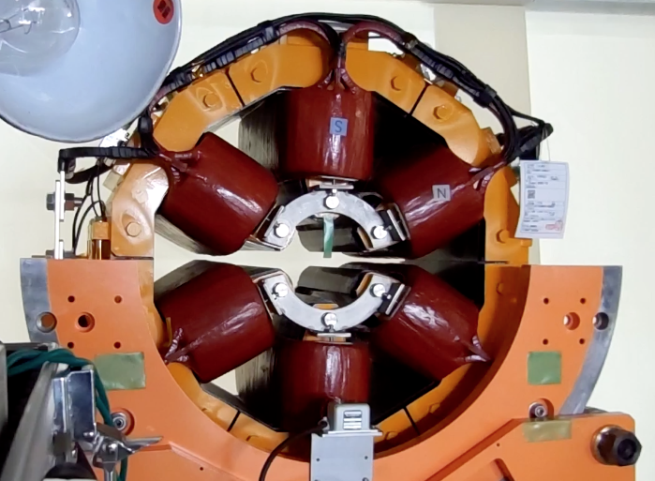
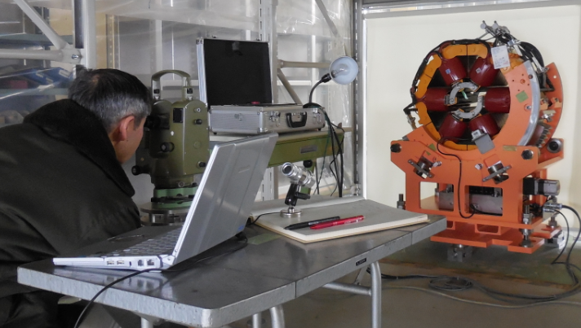
Alignment of the tilt axis to the magnet center ongoing
Using an optical scope to monitor the magnet center (crossed wires) as the magnet is tilted +/- 30 degree.
0.1mm φ wire spanned to indicate the magnet center.
From “normal” sextupole
to “skew” sextupole
R. Sugahara
Officially retired, but...

Slide 19
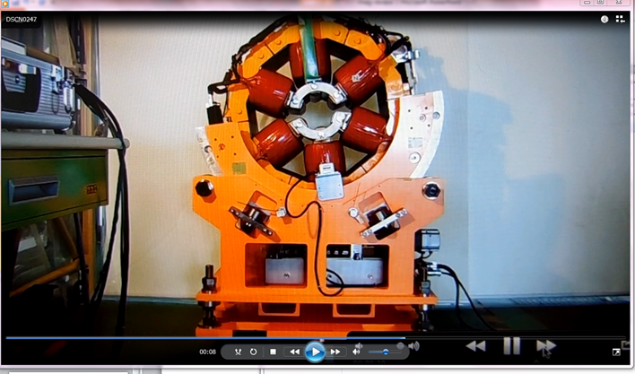
Special movie

Slide 20
Field measurement

Slide 21
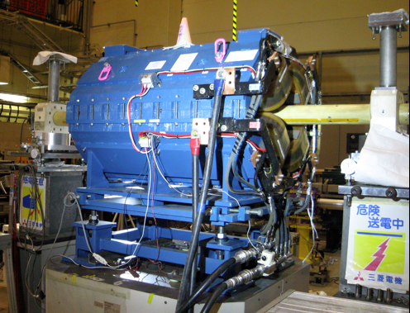
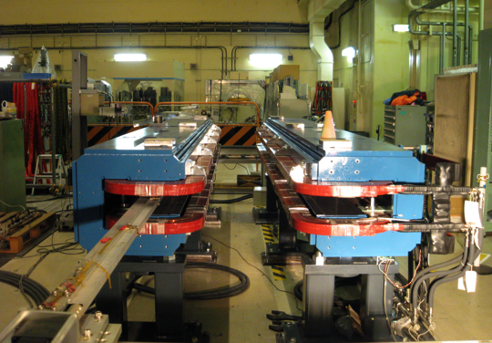
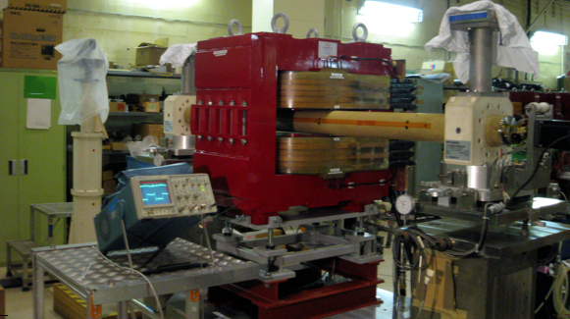
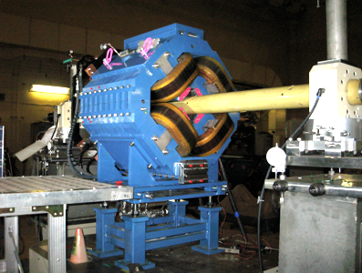
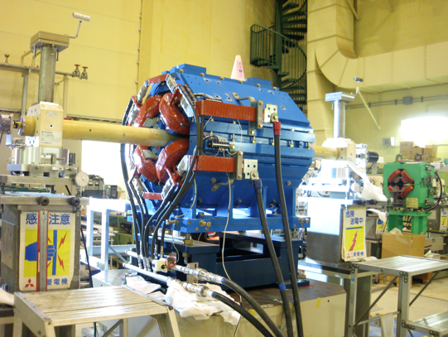
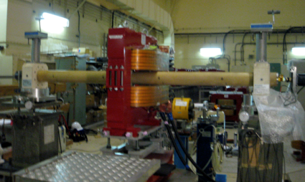


Status of magnet fabrication and field measurements
Egawa
More than two thousand magnets are now installed and aligned properly.
We fabricate more than 500 new magnets and measure magnetic field.
Magnet type | Number (new/reuse)
 | LER (e⁺) | HER (e⁻)
dipole | 171 (125/46) | 146 (23/123)
quadruple | 455 (27/428) | 379 (61/318)
sextuple | 108 (0/108) | 110 (10/100)
wiggler | 280 (168/112) | 60 (22/38)
H, V Corrector | 416(185,231) | 435(17,418)
total | 1330 (405/925) | 1130 (133/997)
New magnets (not all)
HER Qs×38
HER Q(1.12m)×3
LER dipole (4m)×142
Single pole wiggler×114
Half pole wiggler ×58
LER Qw×20
HER Qx×9
Skew Quads (QK*) ×16

Slide 22




Egawa
Brief look from field measurement
the Long-harmonic system
BL [Tm]
BL histogram
6m-long flip coil system
assuming the energy ratio
E_{LER} / E_{HER} = 4 / 7
BL@center
No. of mag. | 109
average | 1.0002983
standard deviation | 0.0001976
skbLB
reference
mass-measured
Good quality
22

Slide 23






mapping (new HER_Qs)
normal (u)
twin coil probe
reverse (d)

Slide 24



B2[z] / B2[0]
fine scale
pole ends
I (A) | L_eff_cor_u [mm] | L_eff_cor_d [mm] | L_eff_cor [mm] | estimation from harm-coil [mm]
500 | 566.65411 | 566.64801 | 566.65106
100 | 570.71851 | 570.70844 | 570.71344 | 570.72576
200 | 570.66632 | 570.61694 | 570.64166 | 570.61746
300 | 570.18652 | 570.18695 | 570.18677 | 570.12534
400 | 569.0094 | 569.00031 | 569.00488 | 569.04067
500 | 566.66705 | 566.64032 | 566.65369 | 566.91602
Good quality

Slide 25



Other new magnets to be measured. …
BLC*×6
QLC*×2
BCP*×2
ZV* ×25
BCE* ×8

Slide 26
4. Magnet Power Supply System

Slide 27
T. Adachi
T. Oki
T. Sueno
N. Tokuda
Power supplies of SuperKEKB magnets
~ 2300 power supplies operated in KEKB. Most of them are re-used in SuperKEKB. ~620 power supplies are overhauled.
~ 700 power supplies are manufactured for SuperKEKB as below.
output power or current | FY 2011 | FY 2012 | FY 2013 | FY 2014 | typical loads
0.95 MW | 2 | − | − | − | LER/HER Main Bends
0.4 - 1 MW | 8 | 1 | − | − | LER/HER Wigglers
2.4 - 50 kW | − | − | 102 | − | Local Bends, Quads, Sexts
0.5 - 0.8 kW | − | 29 | 100 | ~100 | Steering magnets, Correction coils
1.5 - 3 kW | − | − | − | ~240 | Solenoids against electron-cloud
800 - 2000 A | − | − | 2 | 6 | Supercond. Quads
200 - 500 A | − | − | − | 4 | Supercond. Solenoids
± 60 A | − | − | 4 | ~40 | Supercond. Correction coils
440, 630 kW | − | 2 | − | − | DR Main Bends
5 - 60 kW | 23 | − | 26 | − | DR Bends, Quads, Sexts

Slide 28



Installation of new mega-watt class power supplies
Mega-watt class power supplies are installed with their power receiving equipment.
Magnets being used as a test load for a running test.

Slide 29



Overhaul of medium class power supplies (< 100 kW)
Most of the medium class power supplies are being re-used in SuperKEKB. 339 power supplies has been overhauled.
Replacement of chemical capacitors, AC-DC converters, circuit breakers and IGBTs are performed. Ceramic capacitors are added at the output terminal to reduce switching noise.
Running test with dummy load is done at both factory and KEK.

Slide 30



Overhaul of small class power supplies (< 0.8 kW)
Only 129 of new small class power supplies were/will be manufactured,
while 1,885 small class power supplies are re-used in SuperKEKB
Some of the re-used power supplies were overhauled. The number of overhauled power supplies was only 265, limited by budget.
Running test with dummy load, however, has been performed for all of re-used supplies. Fault was found in 3% of power supplies.

Slide 31

Circuit breakers replacement
279 of circuit breakers (420 V/210 V/100 V) at 8 power supply buildings have been replaced.

Slide 32





Cabling
Stored cables are carried …
…and installed
from PS building
to KEKB tunnel.
Cabling for Nikko wigglers was heavy work: complicated, but little working space.

Slide 33
Schedule of magnets and power supplies
In the Tunnel
Sextupole magnets and steering magnets installation in Tsukuba and abort sections.
Installation of near-IR magnets
Cooling water pipes, power cables installation and adjustment
Survey and FINAL alignment of the magnets in the tunnel
Power Supply
Manufacture 350+40 new power supplies
Cabling
AC input : Feb. – March 2014
DC output : Sep. 2013 – May 2014
Interlock : Nov. 2013 – July 2014
Current monitor : May - July 2014
Network : May - July 2014
Start-up and tuning
- Test operation : January 2014.
- Full-scale start-up and tuning :
September 2014.
Field measurement and operation
More field measurement for new 66+α magnets in FY2013~Early FY2014
Prepare database of excitation parameters .
-- Address each magnet based on lattice
-- Grouping power supply “family”

Slide 34
And more.

Slide 35



Right side
IR mockup
Right side
ONLY 53mm between transfer tube and magnet
Installation may be tricky…
We made a mockup to study:
How to install magnets, pipes such a busy area?
How to connect cooling water, power supplies and other life lines for facility
Right side IR mockup@低真棟
(building just across the street)
3D-CAD Aoki

