Slide 1
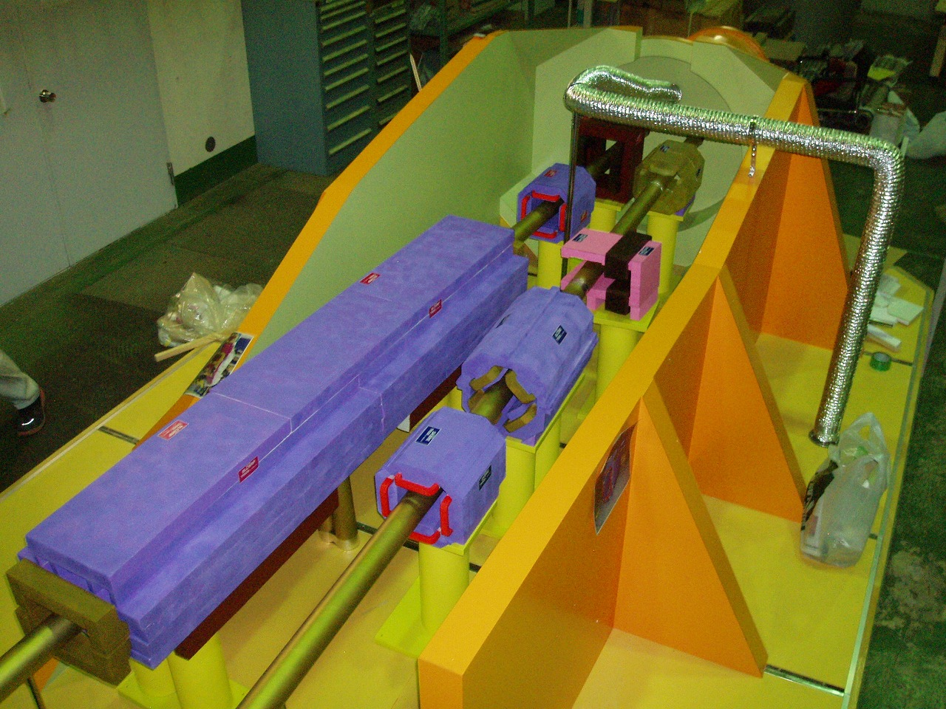
Interaction Region Overview (corrected)
The 19th KEKB Accelerator Review Committee
KEK, 3 - 5 March 2014
K. Kanazawa
for
KEKB Vacuum Group
IR Technical Meeting Member
IR Installation Meeting Member
SVD/IR Mechanics Meeting Member
© H. Iinuma

Slide 2
Contents
Towards Phase 1
Magnets and beam pipes for Phase 1
Design of the Large Angle Beam-strahlung Monitor (LABM) port
Concrete shield
Phase 2 and Phase 3 design
Final focus magnets (QCS) → Talk by N. Ohuchi
Moving stage → Talk by H. Yamaoka
IP chamber
Ta pipe in QCS cryostat
Installation of Vertex Detector (VXD)
Vacuum system of IR
Concrete shield
Summary

Slide 3
Magnets and beam pipes for Phase 1
New IR magnets are fabricated in FY2013.
Installation of the new IR magnets will start June 2014.
Beam pipes
fabrication
FY2013
Dummy
Stage (Phase 1)
Moving
stage
Beam pipes fabrication: Apr – Sep 2014
Beam pipes
fabrication
FY2013
Installation of beam pipes will start around August 2014.

Slide 4
Design of LABM port
A mirror is hidden in a groove to avoid heat-up due to HOM.
Detail of LABM system → Talk by J. Flanagan

Slide 5
Phase 1 concrete shield
The mini shield is going to be fabricated Feb - Jun 2014.
Installation of the mini shield and the shield support stage: ~Aug 2014
Phase 1
IR
Existing shield
+80 cm thick concrete wall to cover the gap between the accelerator tunnel ceiling and the gate shield (2014).
Mini shield for Phase 1
Shield support stage (re-use)
Additional shield to fill a floor gap (March 2014)

Slide 6
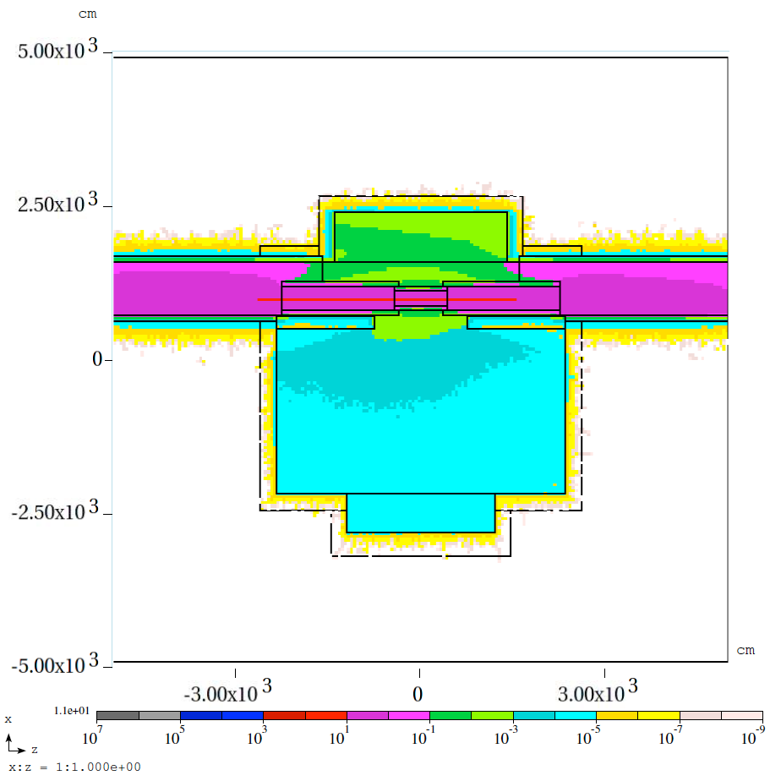
Example of MARS simulation
Beam loss estimation: Y. Ohnishi
Simulation: T. Sanami
Condition: LER, 1A, 10nTorr, uniform loss around IR.
Accelerator tunnel
Requirement: Keep the experimental hall in ‘Warning access’ so that general workers may join the construction of Belle II.
‘General radiation access’ level
Boundary fence
Beam current will be adjusted to keep the general radiation access area within the accelerator tunnel.
Hall (B3)
‘Warning access’ level

Slide 7
Phase 2 and Phase 3 IR
Phase 1
Belle II
w/o VXD (Phase 2)
w. VXD (Phase 3)
Ta beam pipe
Ta beam pipe
IP chamber
QCSL and QCSR
Moving stage
Moving stage

Slide 8
QCS and Moving stage
The accelerator floor has been modified for the new QCS moving stages.
The QCSL moving stage will be set on the floor within FY2013.
QCSL and QCSR will appear in IR during July to September 2015.
The QCSR moving stage will be fabricated in FY2014.
Detail of QCS → Talk by N. Ohuchi
Issues on QCS vibration → Talk by T. Oki
Moving stage → Talk by H. Yamaoka

Slide 9
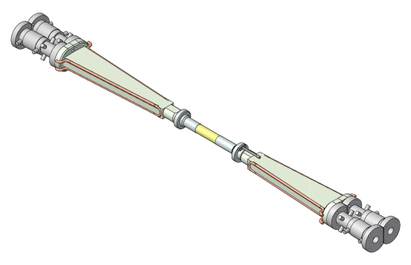
IP Chamber – Design feature
HIP = Hot Isostatic Pressing
Only taper parts are exposed to direct synchrotron radiation.
Taper: to reduce the number of photons entering into the central part
+
Ridges: to keep the direction of scattered photons away from Be
Negligible trap of HOM at the central part.
~10 μm
~10 μm
~10 μm

Slide 10
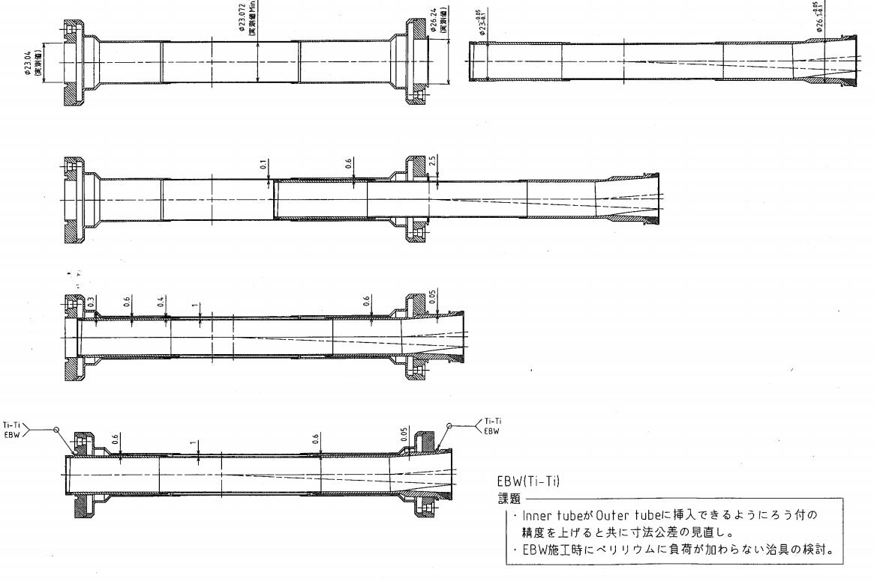
Central part of IP chamber
Ti
Ti
Ti
Ti
Be
Be
The central straight part consists of double tube. Paraffin runs between them.
Outer Be: 0.4 mm thick
Inner Be: 0.6 mm thick
Gap: 1 mm
The connection between double tubes is done by Ti-Ti EBW.

Slide 11
IP chamber
Related works performed for the design and production of IP chamber
Cooling test of the central part using a dummy model
Mechanical analysis
Impedance estimation
Measurement of tip-scattering of photon on a ridge
Photon-induced desorption measurement of Au coat, Cu, and Ta
Estimation of SR background inside chamber
DC sputter coating test
HIP and welding test under various conditions
Ref.
K. Kanazawa, The 18th KEKB Accelerator Review Committee, KEK, 4-6 March 2013,
K. Kanazawa, 7th Belle PAC, 10 -11 March 2013, KEK
Present status
The first IP chamber is now under fabrication.
A leak was found on a Be tube after brazing. (The leak was observed after brazing, disappeared when tested afterwards, and reappeared after Ti-Ti EBW.) The central part is now re-fabricated. We added a thermal cycle test of Be tubes before brazing.
The fabrication will complete June 2014.

Slide 12
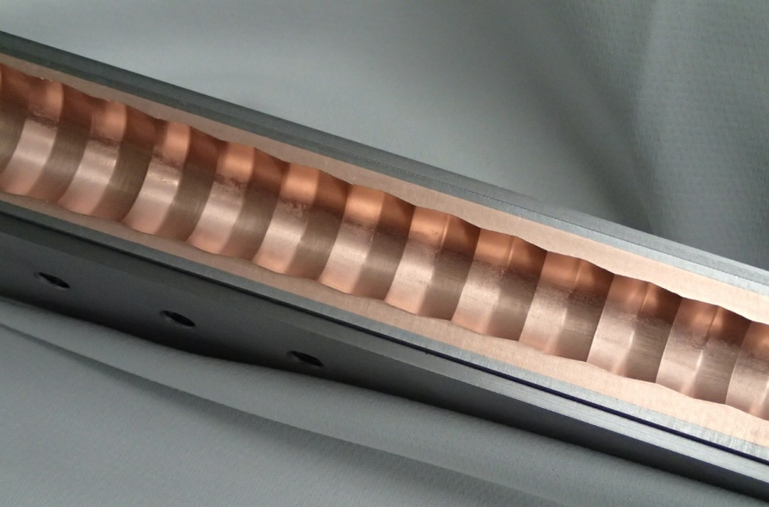
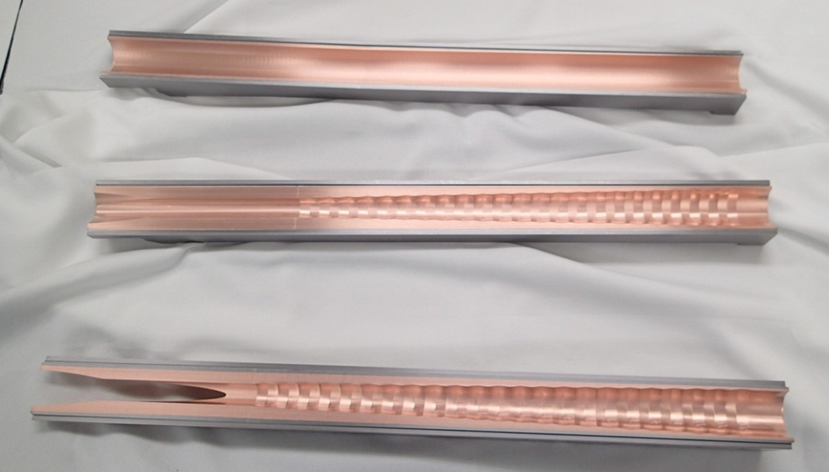
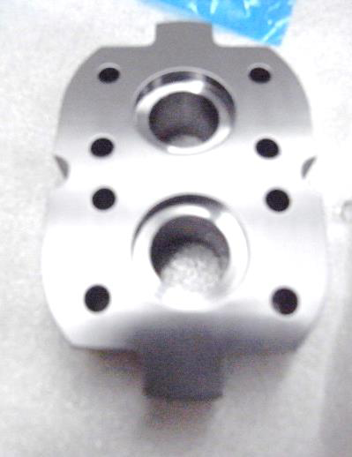
IP chamber (Ta part manufacturing)
Ridge
End flange
Metal Technology Co., Ltd

Slide 13
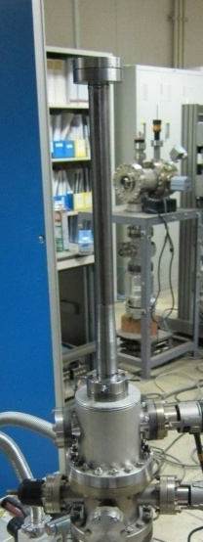
Ta beam pipe in QCS cryostat
Ta pipe for QCSL positron line
BPM
Inner wall of a He vessel
A model Ta pipe with cooling path in the wall. This pipe has a weld seam between water and vacuum. The test with tap water caused no leakage at least for months.
Inside: 10 μm Cu coating

Slide 14
Ta beam pipe setup (1)
Preliminary
Center of mass
Slide the central part of the cryostat
~40 kg
Without BPM pick-ups
Pipe support
Based on the idea of N. Ohuchi

Slide 15
Ta beam pipe setup (2)
Attach BPM pick-ups by screws and connect cables.
Actually, there are many pipes inside cryostat. This is not so easy work.
Leak check!
Ta beam pipes for QCSL will be fabricated in 2014. The design is in progress.
Ta beam pipes for QCSR will be fabricated in 2015.

Slide 16
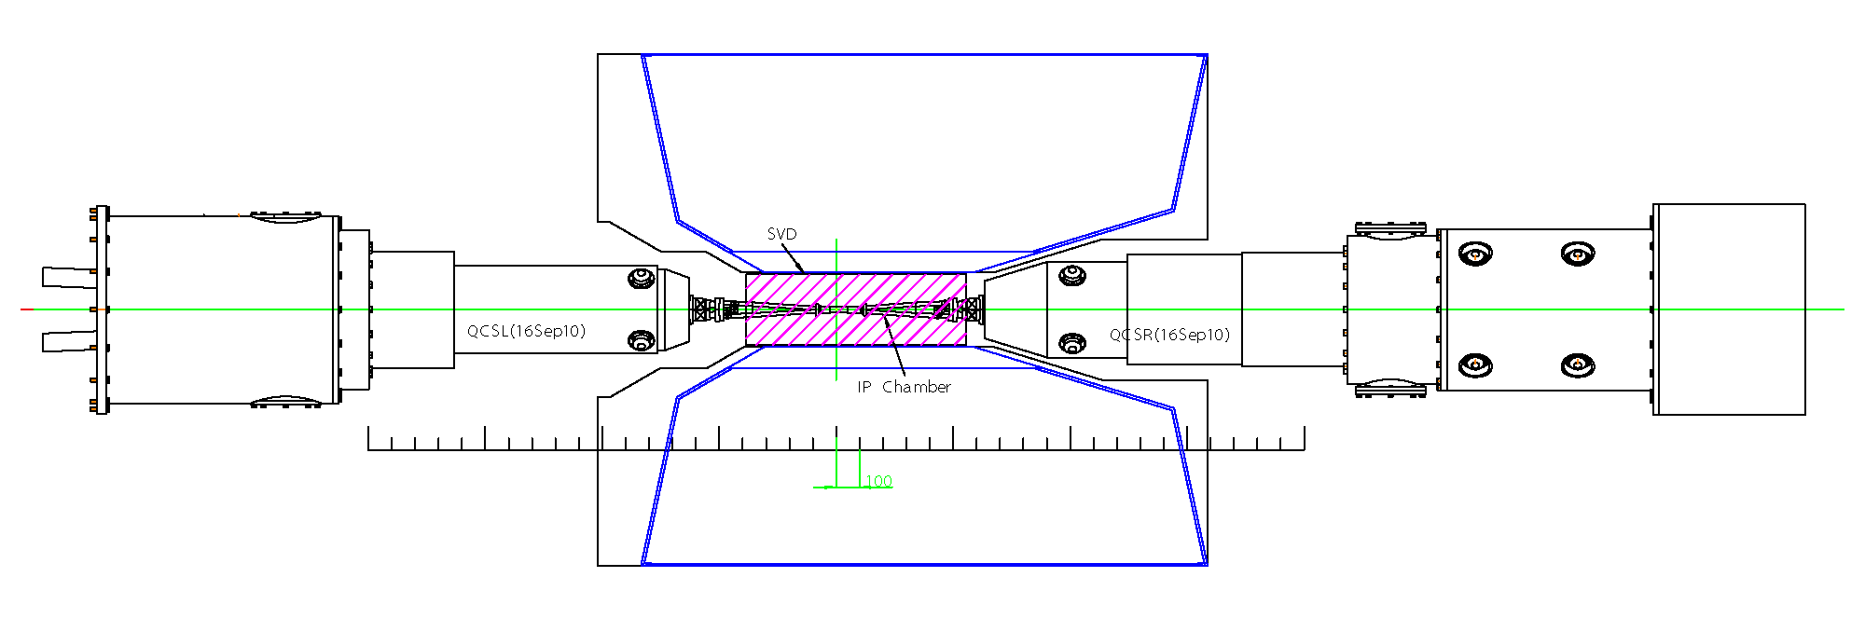
Installation Scenario Boundary conditions
IP chamber is supported by VXD frame.
Both sides of IP chamber are fixed to the VXD frame transversally and are free longitudinally.
VXD is supported by CDC.
The R-side of VXD is aligned transversally and is free longitudinally.
The L-side of VXD is fixed to CDC.
QCS cryostats can move out.
Connection flanges for vacuum chambers.
Top view
Some work spaces to access flanges.
It will be possible to make use of these spaces.
Little work space to access flanges.
It is impossible to connect flanges by hands in this configuration.
CDC

Slide 17
BPM and bellows between IP chamber and Ta beam pipe
CrCu
BPM pick-up
CrCu
Ta pipe
Bellows unit with a conventional RF-bridge.
A comb-type structure cannot give a sufficient flexibility for a small diameter.
Cooling channel
This piece will be fabricated in FY2014.

Slide 18
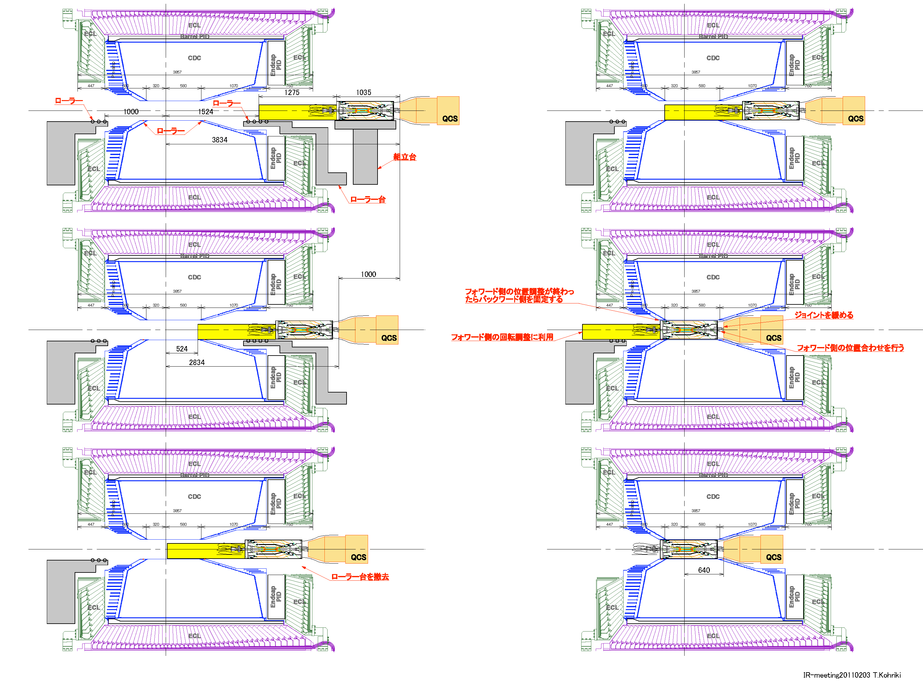
Installation Scenario - Baseline
VXD is connected to QCSR at first
Mock-up test at KEK
T. Kohriki

Slide 19
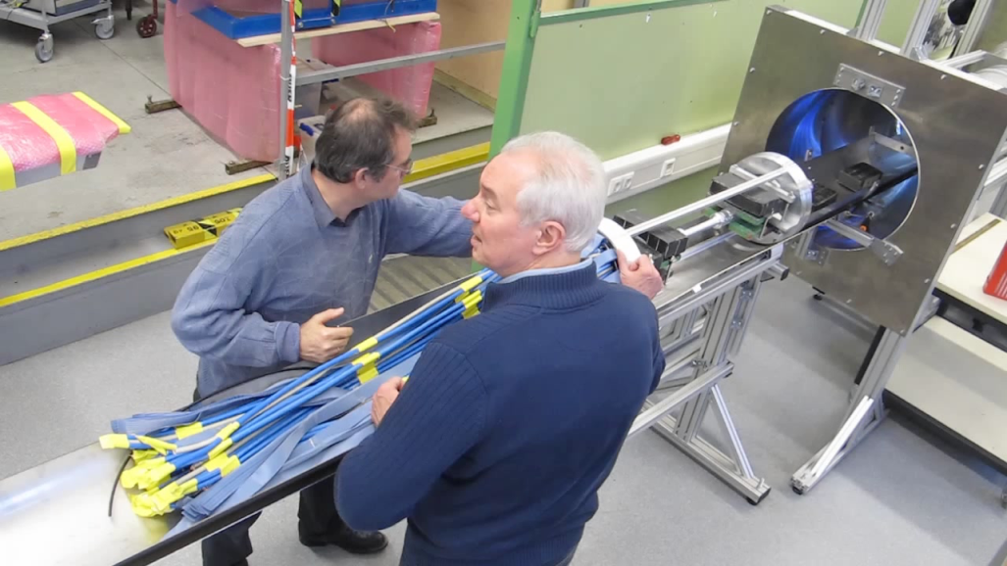
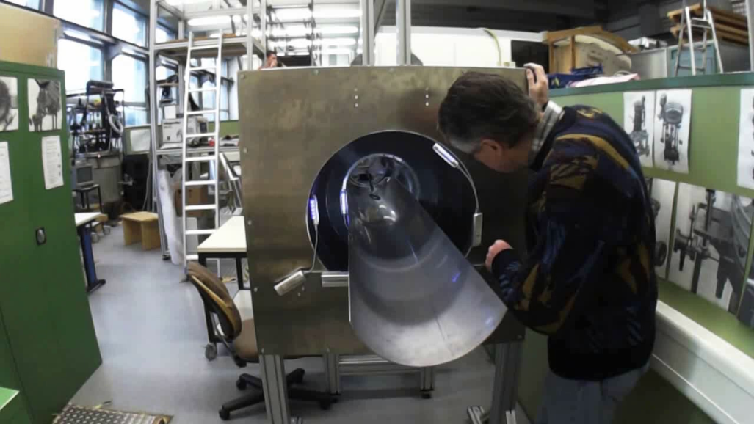
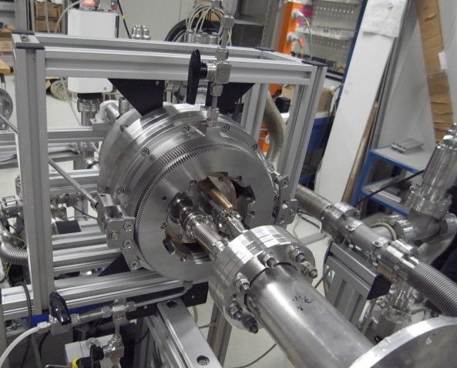
AIM (Alternative Installation Method)
Essential mechanism: RVC
(Remote Vacuum Connection)
VXD slides on a tray.
Press a vacuum flange with a hydraulic force and lock the position with a screw nut.
→ N. Carsten , Belle II focused review (Sep9-10, 2013, KEK)
Mock-up test at MPI
RVC test at DESY

Slide 20
Baseline vs. AIM
 | Baseline | AIM | Comments
Forward connection | Before VXD installation. | Use RVC after VXD installation. | Inaccessible to RVC after connection.
Backward connection | After VXD installation by hand? Use of RVC is now considered. | RVC | Accessible to RVC in case of trouble.
Driving force to push VXD | QCSR moving stage | Hand | The precision on the motion of the QCSR moving stage is guaranteed.
Basic philosophy | Work around IP should be cooperative for a low emittance collider. | If possible, detector remains untouched in case of a minor accelerator trouble.
Belle II position | Role-in | anywhere
RVC as a vacuum sealing mechanism has been well-established.
Installation scenario will be centralized in June 2014.
There is not VXD in Phase 2. However, the same installation method as in Phase 3 is applied for a validity check.

Slide 21
Vacuum system of IR
No vacuum pumps in this region

Slide 22
Vacuum system of IR Groove, pump channel, pump port
For sputter ion pump
Bending magnet chamber
For CapaciTorr® and NEXTorr®
® SAES Getters

Slide 23
Vacuum system of IR Consideration on IR pressure
The main gas source within 4 m from IP is photon-desorbed gas due to the direct SR from the last bend. If a photo-desorption coefficient η is assumed to be 1 × 10⁻⁶ molecules/photon, The average pressure of this region will be a few × 10⁻⁶ Pa. This will not affect the overall average design pressure of the ring (1×10⁻⁷ Pa). However, a consideration on the beam-gas Rutherford scattering requires much lower pressure in the QC magnets where β is large.
It was shown that Ta and Au-coating have a sufficiently low photo-desorption coefficient. It was also shown Ta has a very low thermal outgassing rate.
More detail → K. Kanazawa, The 18th KEKB Accelerator Review Committee, KEK, 4-6 March 2013,

Slide 24
Concrete shield for Phase 2 and 3
1. Floor block to fill a gap between the accelerator floor and the detector. This will be set March 2014.
Floor block
Gate shield
2. A concrete to reduce the front aperture of the gate shield. The frontend block of the gate shield will be modified to attach this concrete (2015).
3. Extension of the wall of the experimental hall (2015).
4. Add 45 cm concrete on the top of the gate shield (2015).
5. 80 cm thick concrete wall to cover the gap between the accelerator tunnel ceiling and the gate shield (2014).

Slide 25
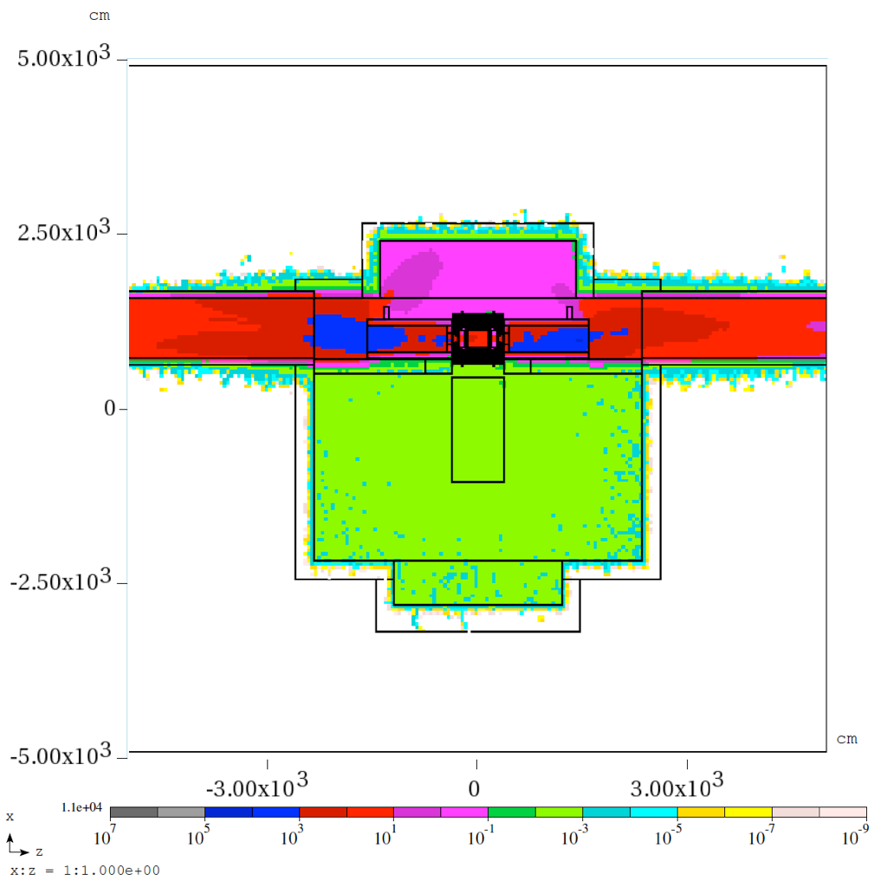
MARS simulation
Beam loss estimation: Y. Ohnishi, Y. Funakoshi
Simulation: T. Sanami
Condition: Full spec
Requirement: Warning access during Phase 2
Since the target luminosity in Phase 2 is 1/80 of that in Phase 3, The requirement will be satisfied. If necessary, we will add a local shield around the radiation source.
General radiation access
Local radiation sources → Talk by H. Nakayama

Slide 26
Summary
Towards Phase 1
Preparation of beam pipes and magnets is on schedule.
Design of LABM port is proposed, and will be tested with beam.
Concrete shield for phase 1 is now under construction.
Phase 2 and Phase 3 design
QCS → Talk by N. Ohuchi
Moving stage → Talk by H. Yamaoka
IP chamber for phase 2 is now under fabrication. Though we had a trouble on Be pipe, the fabrication will complete June 2014.
Ta pipe in QCS will be produced in FY2014 and 2015. There still remain some design details to be finalized.
Installation of VXD is now considered with two scenarios. They will be centralized in June 2014 B2GM.
Vacuum system of IR is now fixed. All beam pipes will appear before Phase 1. After Phase 2, no pump spaces are available within 4 m from IP. The average pressure of this region will be 10⁻⁶ Pa or higher.
A basic structure of the concrete shield for Phase 2 and Phase 3 is now fixed.

