Slide 1
Collision feedback
OKI, Toshiyuki
on behalf of the working group
2014/MAR/3rd
19th KEKB Accelerator Review Committee

Slide 2
Introduction
 | SuperKEKB | KEKB
ε_{y} | ~8.6pm (LER) | 150pm
β_{y}* | 0.27mm(LER) | 5.9mm
σ_{y}* | 48nm | 940nm
The beam size is 20 times smaller than one of KEKB.
How to collide beams successfully is much more difficult than KEKB.
High luminosity machine can be spoiled by the small vibration of QCS (QC1, QC2) caused by ground motion, even if it didn’t affect KEKB.

Slide 3
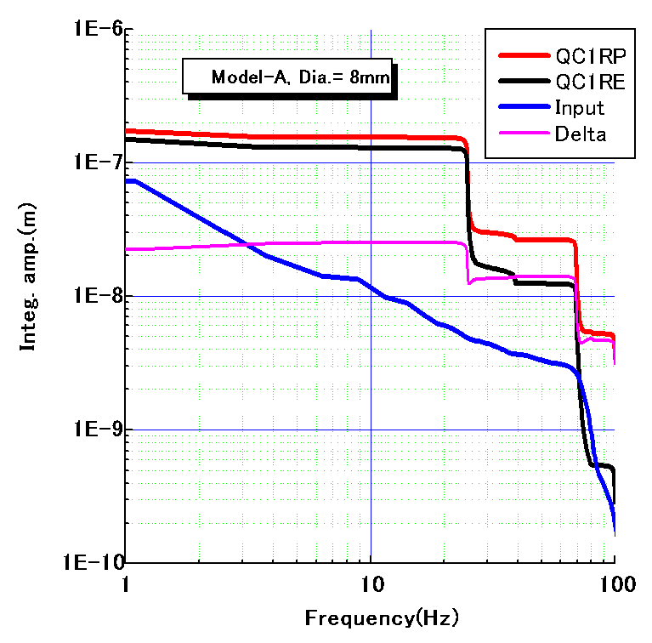
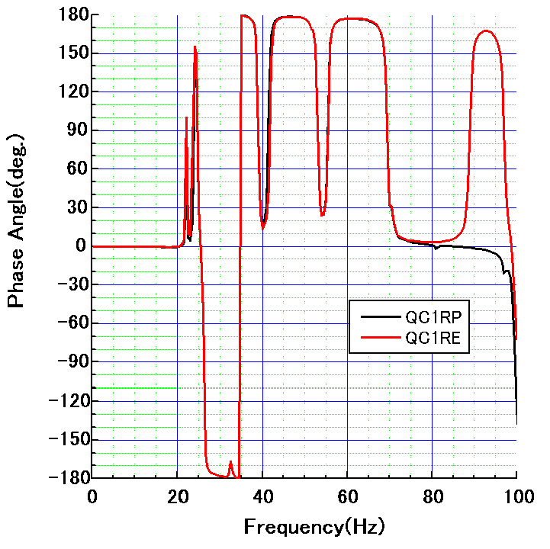
Estimation of QCS vibration and luminosity degradation
1000
100
10
1
0.1
(vertical)
Integral amplitude (nm)
Measured
ground motion
(input data)
Phase (deg.)
25 nm@25 Hz
H. Yamaoka
QC1RP and QC1RE vibrate with same phase,
but the amplitude difference still arises: 25 nm at 25 Hz…
Luminosity degradation (based on beam-beam simulation by K. Ohmi)
Frequency (Hz) | 24.85 | 38.93 | 69.34 | 99.60
Δy_{IP*}^{rms} (nm) | 18.63 | 1.72 | 8.29 | 3.14
L/L₀^{average} (%) in case of model-A (and F) | 95.4 (96.1) | 99.8 (99.8) | 99.7 (99.8) | 99.7 (99.8)
Y. Funakoshi

Slide 4
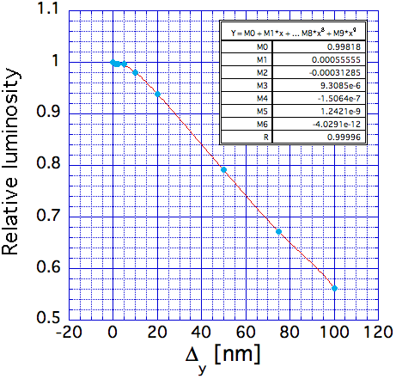
Beam-Beam simulation results
K. Ohmi
Just 20 nm offset leads to 6 % degradation of luminosity.

Slide 5
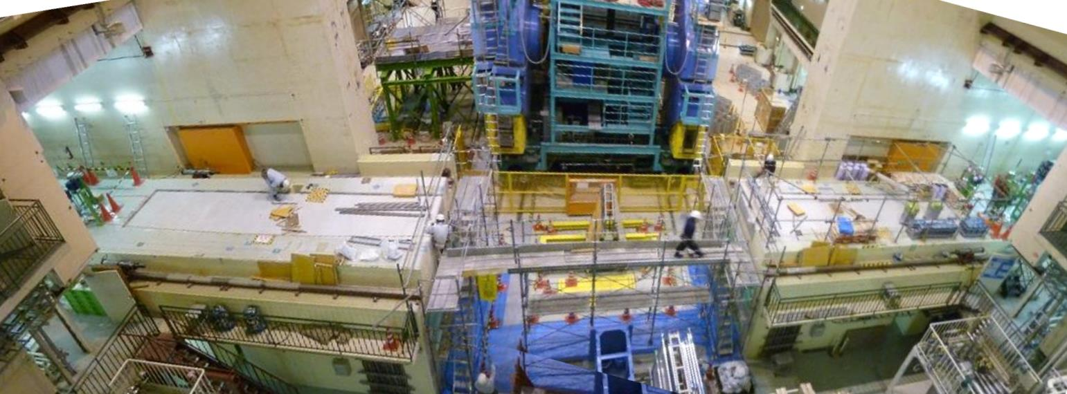
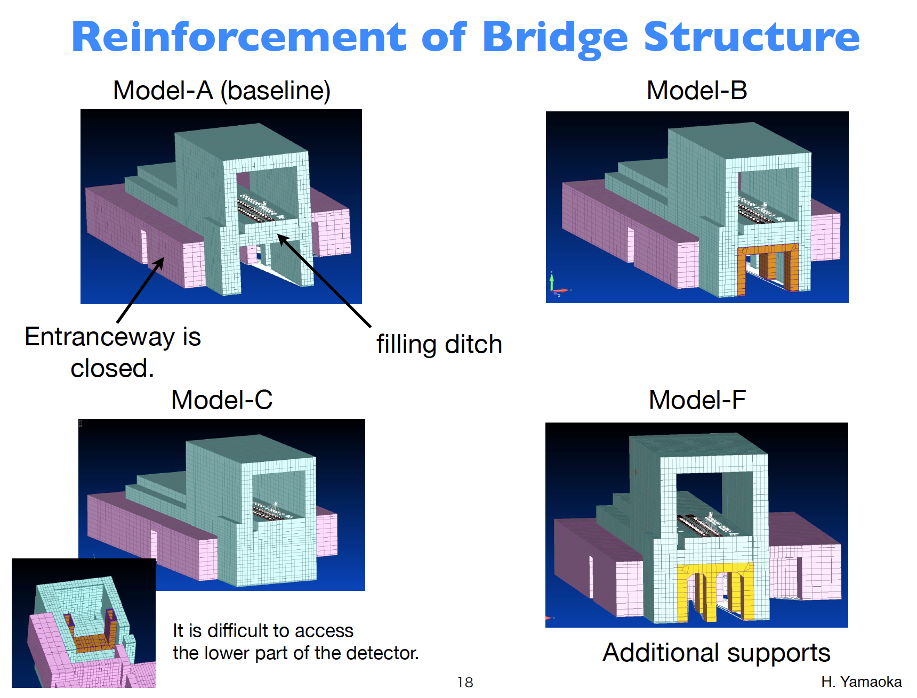
Reinforcement of bridge structure
H. Yamaoka
2013 Dec.

Slide 6
Feedback scheme in vertical direction (y and y’)
The orbital feedback system was used successfully for KEKB, which is based on beam-beam kick calculated from the BPM readouts at both sides of the IP.
Offset at IP
Δy= ~5nm (0.1 σ_{y}*)
Difference at BPM
Δy = ~1.3μm
4 BPMs
(0.5m from IP)
beams are deflected
by beam-beam kick
For SuperKEKB, It will be expected to work well.
The target resolution of BPM is the order of micrometer.
Prototype BPM was tested by using sinusoidal input signal.
0.1μm resolution has been obtained, successfully.
H. Fukuma

Slide 7
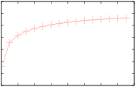
Rejection gain evaluation of the feedback system
plant
1st order lag
(delay = 0.21ms)
H. Fukuma
delay
3 clocks
reference
+
PID
+
D
Ga
Ge
−
+
monitor out
PID tuning
Ziegler-Nichols
ps & magnet
1st order lag
(delay = 0.1ms)
disturbance
M
monitor LPF(FIR)
Fs = 32kHz
Group delay of LPF =0.4ms
10
0
− 10
− 20
− 30
− 40
− 50
− 60
Result shows
−16.7dB@25Hz is expected.
Amplitude of Δy_{IP*}^{rms} @25Hz will be
reduced from 19 nm to 2.8 nm.
Rejection gain (dB)
0 20 40 60 80 100 120 140 160
Frequency (Hz)

Slide 8
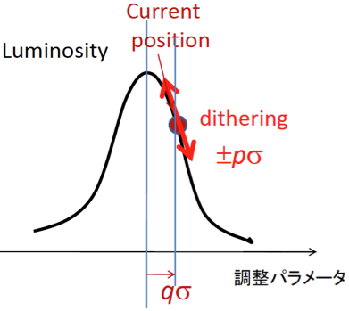
Feedback scheme in horizontal direction (x)
Beam-beam kick will not be a sensitive parameter for monitoring collision, as beam-beam parameter ξx is so small:
        ξx ~ 0.0028(e+), 0.0012(e-)
        (↔ ξy ~ 0.0881(e+), 0.0807(e-))
Beams are not so much deflected in horizontal direction.
⇒The Luminosity dither is being considered, which was used for PEP-II successfully.
When two beams overlap, the luminosity drops on either side of the peak, giving modulation at 2ω_{dith}.
Off center, there is additional modulation at the fundamental.
Dithering simulation by U. Wienands and S.Uehara:
Max. dithering amplitude, which corresponds to 10 % drop of the peak luminosity should be prepared.
Δx

Slide 9
Luminosity dither system for horizontal feedback
(+ vertical offset and angle)
  (1) Fast luminosity monitor (ZDLM): S. Uehara and P. Bambade.
(2) Electronics to discriminate dither signals:
  Lock-in amplifiers and/or digital technic are considered.
(3) Beam pipes: made of stainless steel for magnetic field penetration.
(4) Air-core dithering coils:
    - Dithering coils will be installed into 8 locations.
    - Dither frequency: 60~100 Hz is chosen to avoid power line interference.
    - Kick angle of dither coils: to generate ±50 μm horiz. bump.
    - Design work, production and field measurement are under way at SLAC.
(5) Power supplies for actuating coils: commercial bipoler PS (± 65 V, ± 5 A).
(6) Iron-core steering magnets at HER for orbit correction.

Slide 10
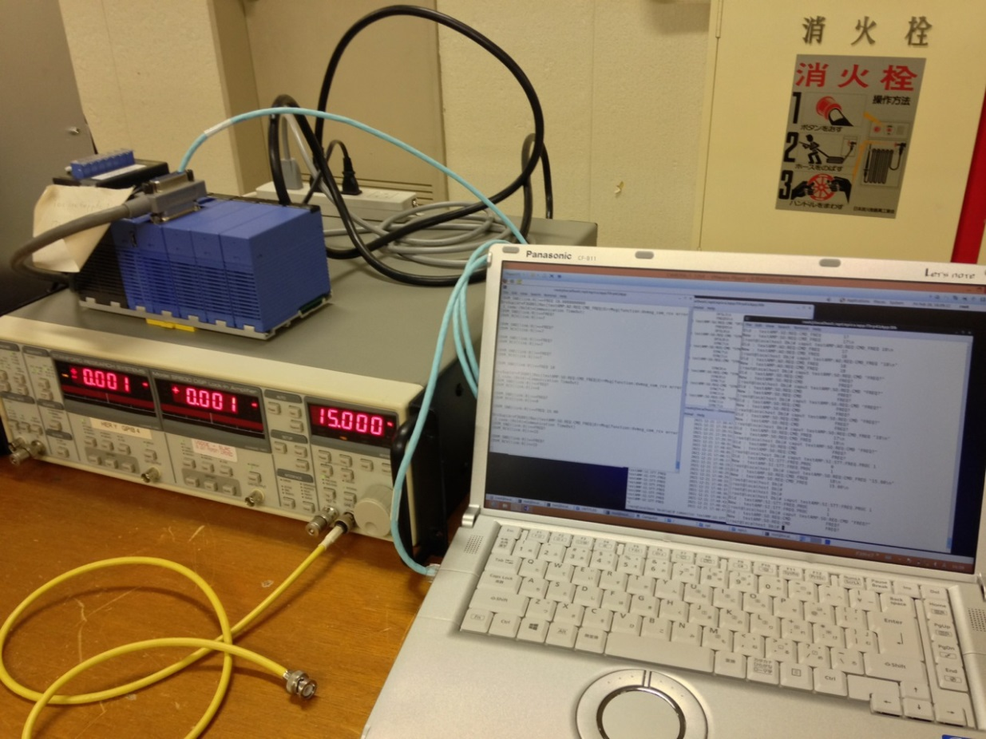
Lock-in amplifier: Stanford research systems model SR830
SLAC loaned us the Lock-in amp. last summer.
We have tried to use it with EPICS for a remote control.

Slide 11
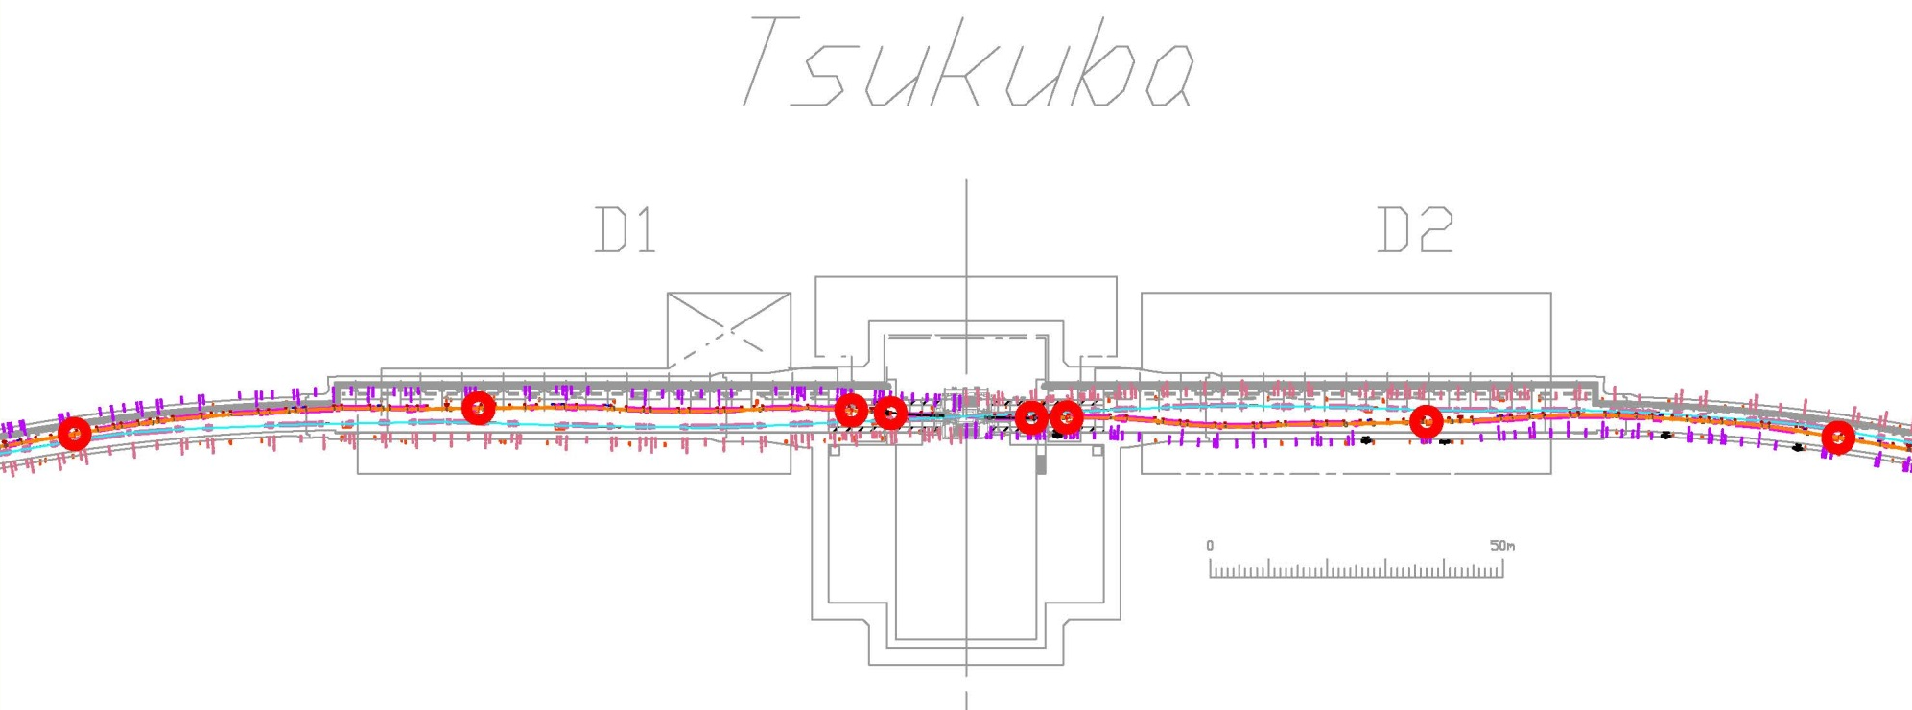
Locations for the dithering coils
8 locations for the dithering coils in LER around IP.
ZDS1LP
ZDS1RP
ZDS2LP
ZDS2RP
ZDS4LP
ZDS3LP
ZDS3RP
ZDS4RP

Slide 12
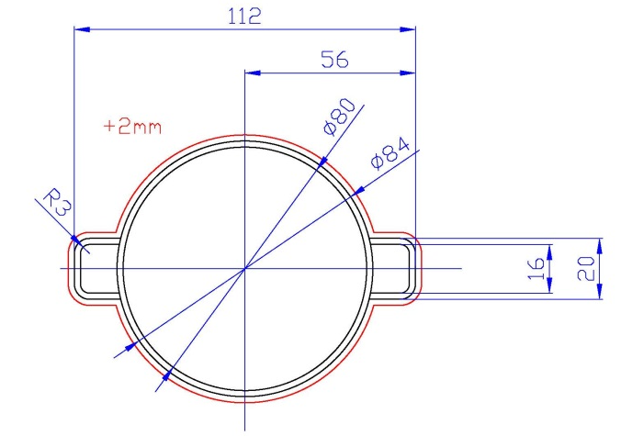
Designs for 3 type of beam pipes
Y. Suetsugu
ZDS1{L, R}P
  Inner diameter: 80 mm
  Thickness: 2 mm
ZDS2{L, R}P
  Inner diameter: 90 mm
  Thickness: 3 mm
  10 μm Cu coating inside.
ZDS{3, 4}{L, R}P
  Inner diameter: 90 mm
  Thickness: 5 mm
  10 μm Cu coating inside.
Pipes will be delivered to KEK by this March.
All pipes are made of SS316L.

Slide 13
Damping of magnetic field due to eddy current
Damping ratio
SS316L
Copper
(KEKB
LER pipe)
Dithering
freq. range
A.W. Chao and M. Tigner, Editors,
Handbook of
Accelerator Physics and Engineering,
World Scientific, Singapore (1999), p. 268
1k 10k 100k
Resistive and thinner pipe suppresses the damping effect.

Slide 14
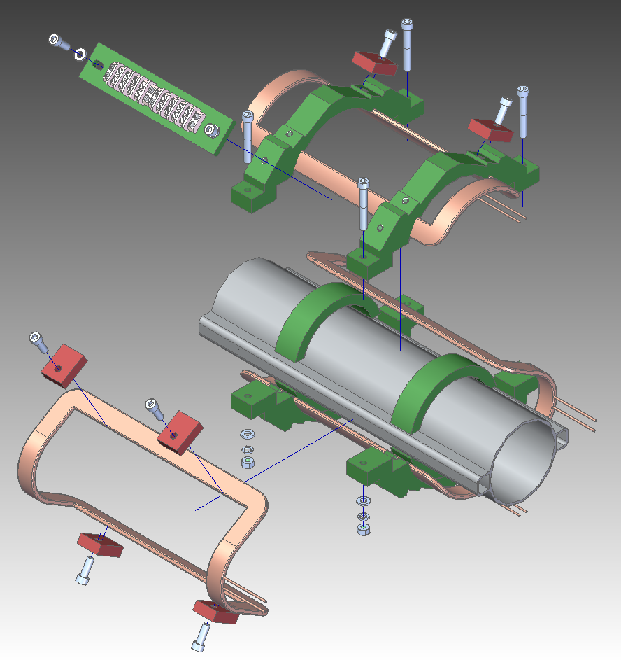
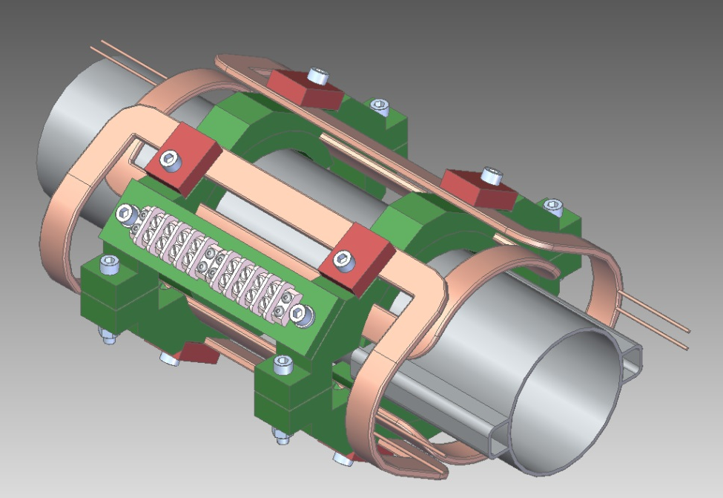
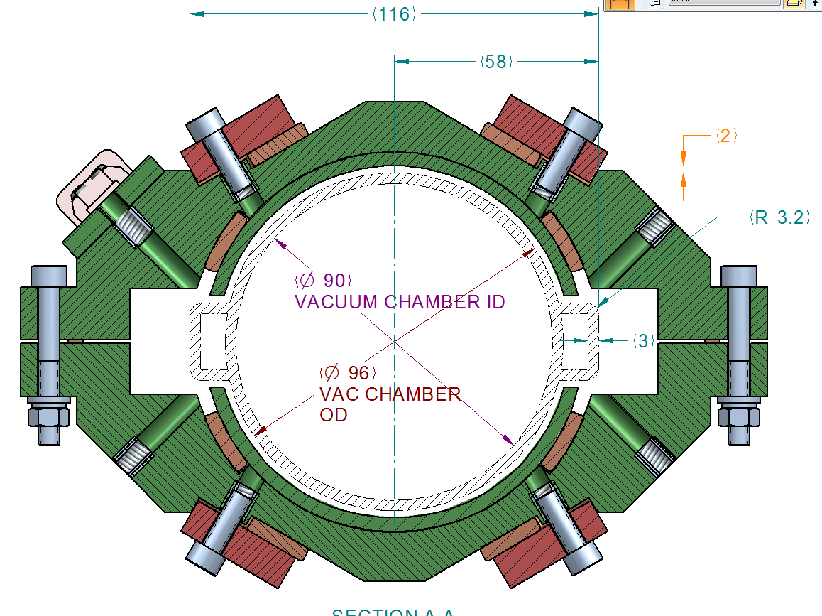
Coil mechanical design
M. Kosovsky, SLAC

Slide 15
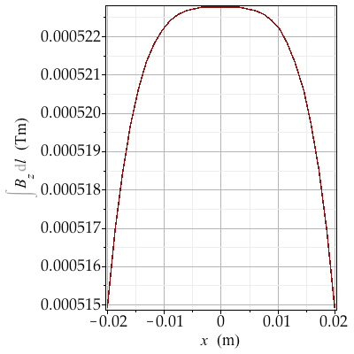
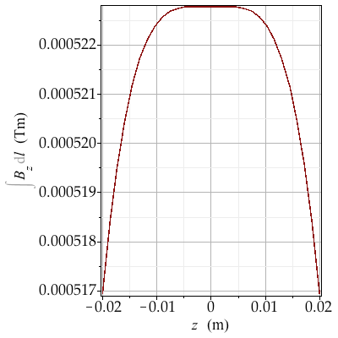
Coil field evaluation
Calculations show that the field quality meets the requirements:
10 mm (15 σ_{x} + 2 mm) radius of good field region for dB/B < 10⁻³
  ‒ verification of model using OPERA-3D was performed.
  ‒ Note: Effect of chamber eddy currents not included.
Example of horizontal coil
10⁻³
10⁻³
U. Wienands, SLAC

Slide 16
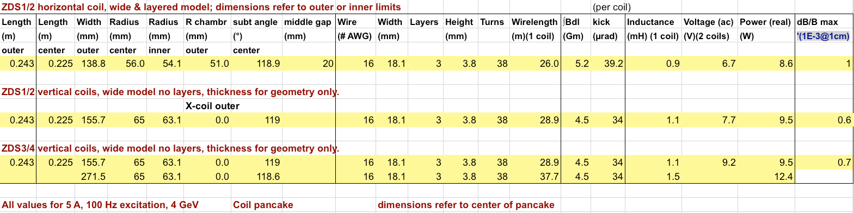
Coil parameter
Resistance, inductance and power are within acceptable limits
(up to ~ 10 V, 13 W/coil (real peak power) at 5 A, 100 Hz)
U. Wienands, SLAC

Slide 17
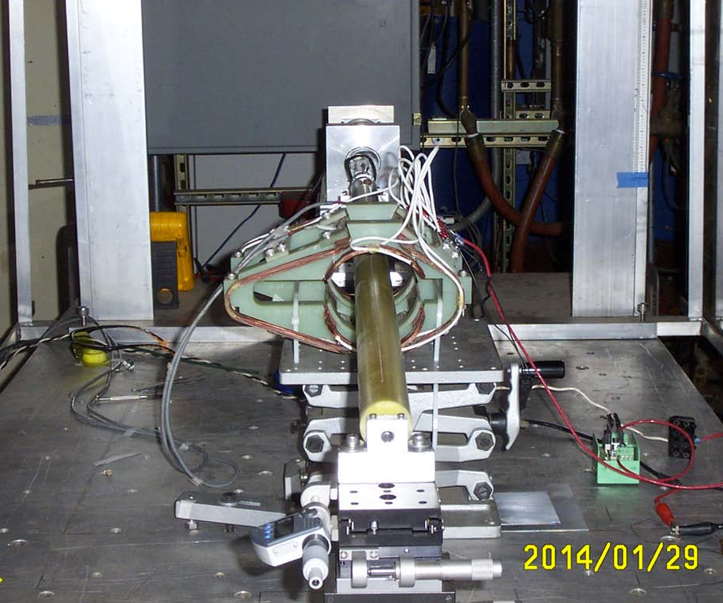
Fabrication and field measurement
Fabrication and measurement of coils will be finished by this March.
U. Wienands, S.D. Anderson, MFD Metrology, SLAC

Slide 18
Summary
— It is challenging to collide small beams successfully.
— For vertical offset and angle feedback:
Orbital feedback system is under consideration. It was used for KEKB and is based on beam-beam kick calculated from the BPM readouts at both sides of the IP.
— For horizontal offset feedback:
Luminosity dither is being considered as used for PEP-II, because beam-beam kick will not be a sensitive parameter for monitoring collision due to small beam-beam parameter.

Slide 19
Appendix

Slide 20
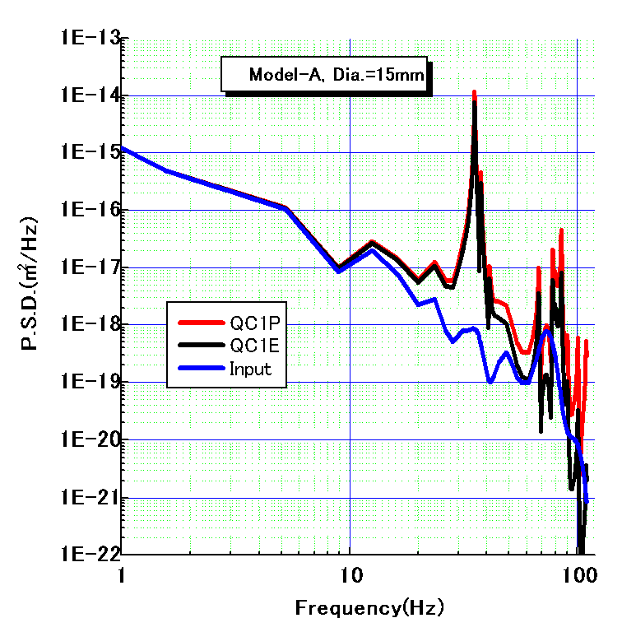
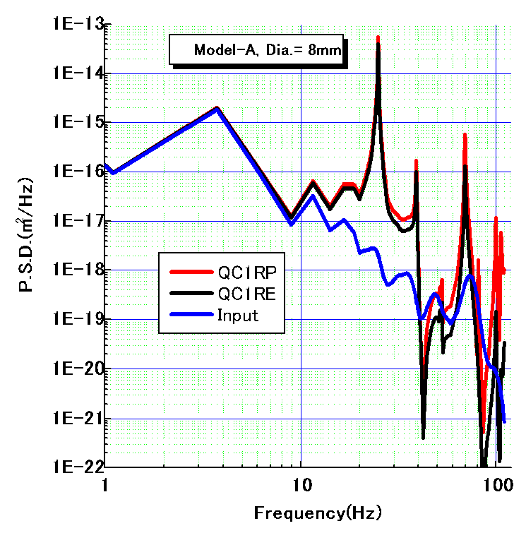
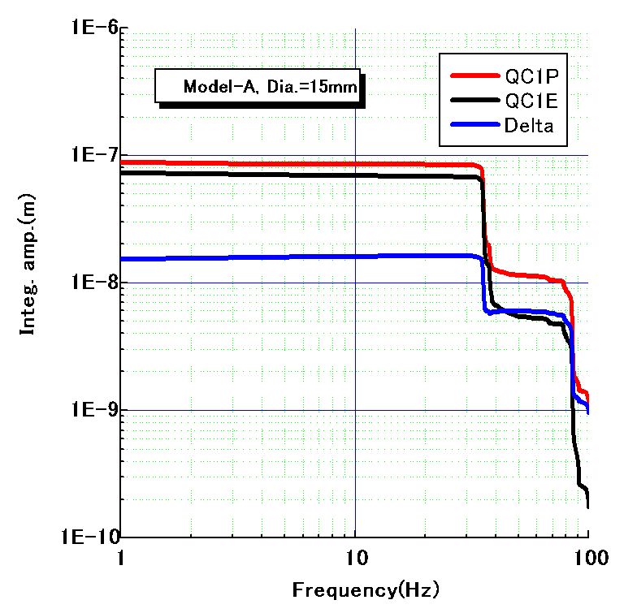
Model-A
R側
L側
Oscillation phases of
QC1RP and QC1RE.
25nm@20Hz
14nm@50Hz
H. Yamaoka

Slide 21
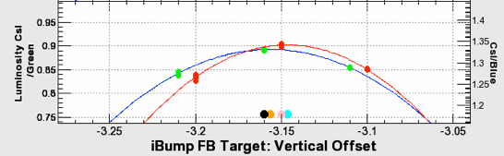
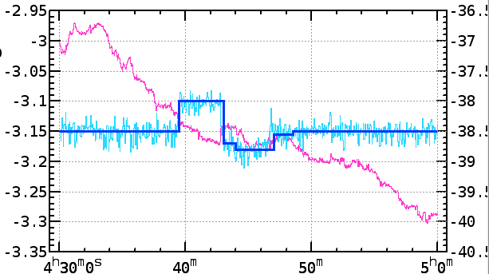
Experience at KEKB
(1) Finding good collision
1. Calculate beam-beam kick (b-b deflection)
using BPMs.
2. Change bb kick by changing setting of
steering magnets located on either side of the IP.
3. Luminosity scan: Lumi. vs bb kick.
M. Masuzawa
(2) Maintaining good collision
Luminosity scan
Beam-beam kick
Vertical bump height @IP
Bump height created by steering magnets @IP to maintain bb-kick

Slide 22
Damping and phase delay of a magnetic field
Damping ratio Phase delay
~1/(ωτ)
~ωτ
1/√2
π /4
τ =1/ω_{cutoff}
A.W. Chao and M. Tigner, Editors,
Handbook of
Accelerator Physics and Engineering,
World Scientific, Singapore (1999), p. 268

Slide 23
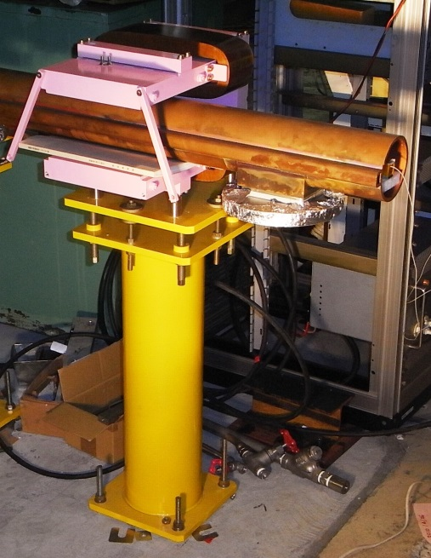
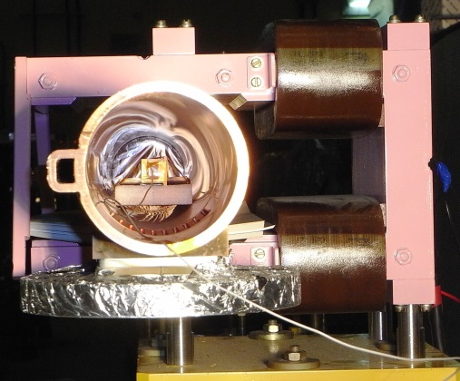
Test setup
KEKB LER beam pipe made of copper:
53 mm radius, 6 mm thickness.

Slide 24
— I (mA)
— B (mT)
— B/I (T/A)
— Phase difference (B−I) (deg)
Test results
Without beam pipe
With beam pipe

Slide 25
Material: Copper
Inner diameter: 94 mm
Thickness: 6 mm
Test result summary
1k 10k 100k
1k 10k 100k
Good agreement with calculation.
Strongly damped at the target frequency range: Dithering (60~100 Hz)

Slide 26
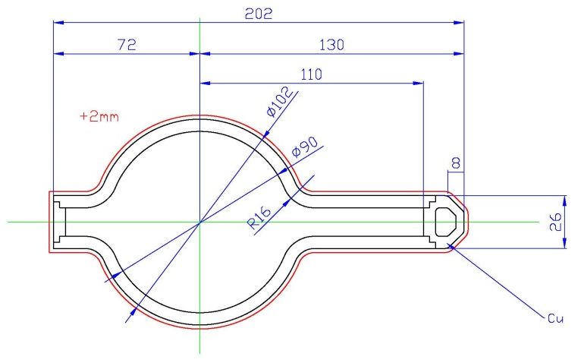
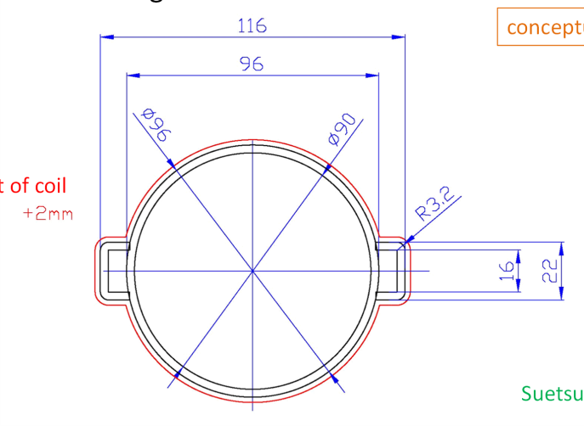
Conceptual drawing of beam pipes
Material: SS316L
Inner diameter: 90 mm
Thickness: 3 mm for round type, 6 mm for antechamber
10 μm Cu coating inside.
Suetsugu
Material: SS316L
Inner diameter: 80 mm
Thickness: 2 mm
Kanazawa

Slide 27
Calculations for the round SS beam pipes
τ =0.26, 0.12, 0.07 ms
1k 10k 100k
1k 10k 100k
Resistive and thinner pipe suppresses the damping effect.
The Cu coating is effective above 1 kHz.

