Slide 1
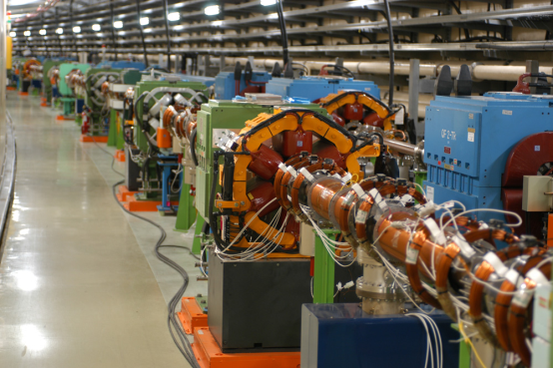
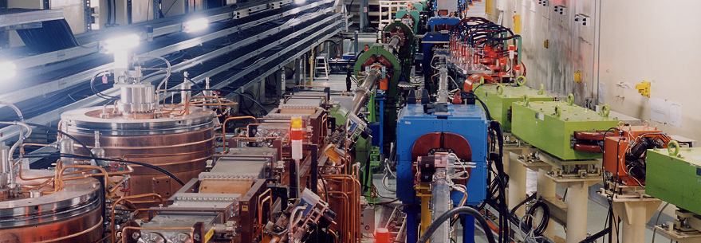
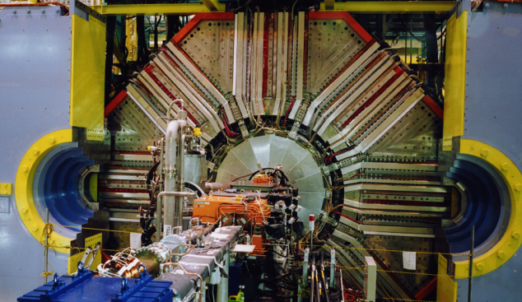
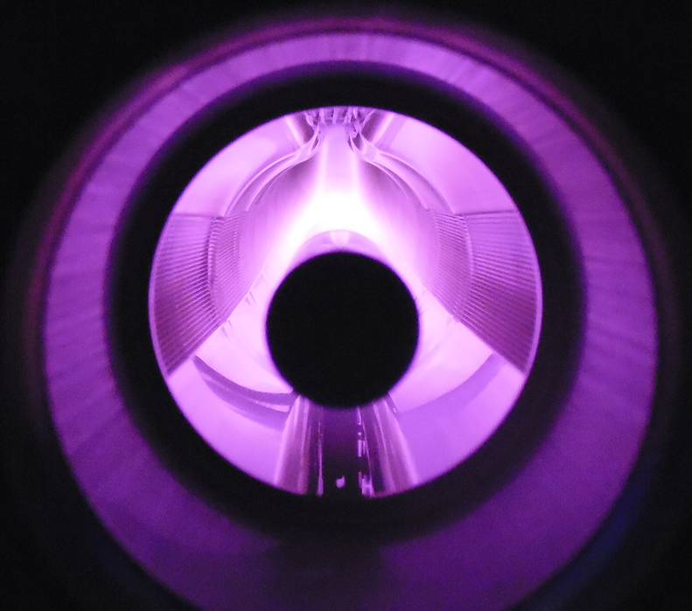


TiN Coating and Baking of Beam Pipes
Magnetron discharge sputtering for TiN coating
The 19th KEKB Accelerator Review Committee
March 3, 2014
Kyo Shibata (on behalf of KEKB Vacuum Group)

Slide 2
Introduction 1
What should we do before the installation of new beam pipes?
For HER (e-) : Baking at the laboratory(not in-situ)
For LER (e+) : Baking & TiN coating at the laboratory
For Damping Ring : TiN coating at the laboratory
For all beam pipes : assembling work (NEG pump , BPM electrode)
How many beam pipes should be processed?
For HER (e-) : ∼180
For LER (e+) : ∼1000 (of which ∼ 25 have electron clearing electrodes and TiN coating is unnecessary. )
Damping Ring : ∼100
Pre-installation work (coating and baking) started on April 2012.
“Pre-installation work” means:
Bringing beam pipes to KEKB Oho Lab. from storage area -> Coating (3days) -> Baking (3days) -> returning the beam pipes to storage area
Large-scale works by 10 workers started on September 2012.
2014/3/3 the 19th KEKB Accelerator Review Committee 2

Slide 3
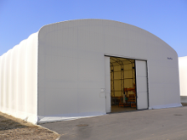
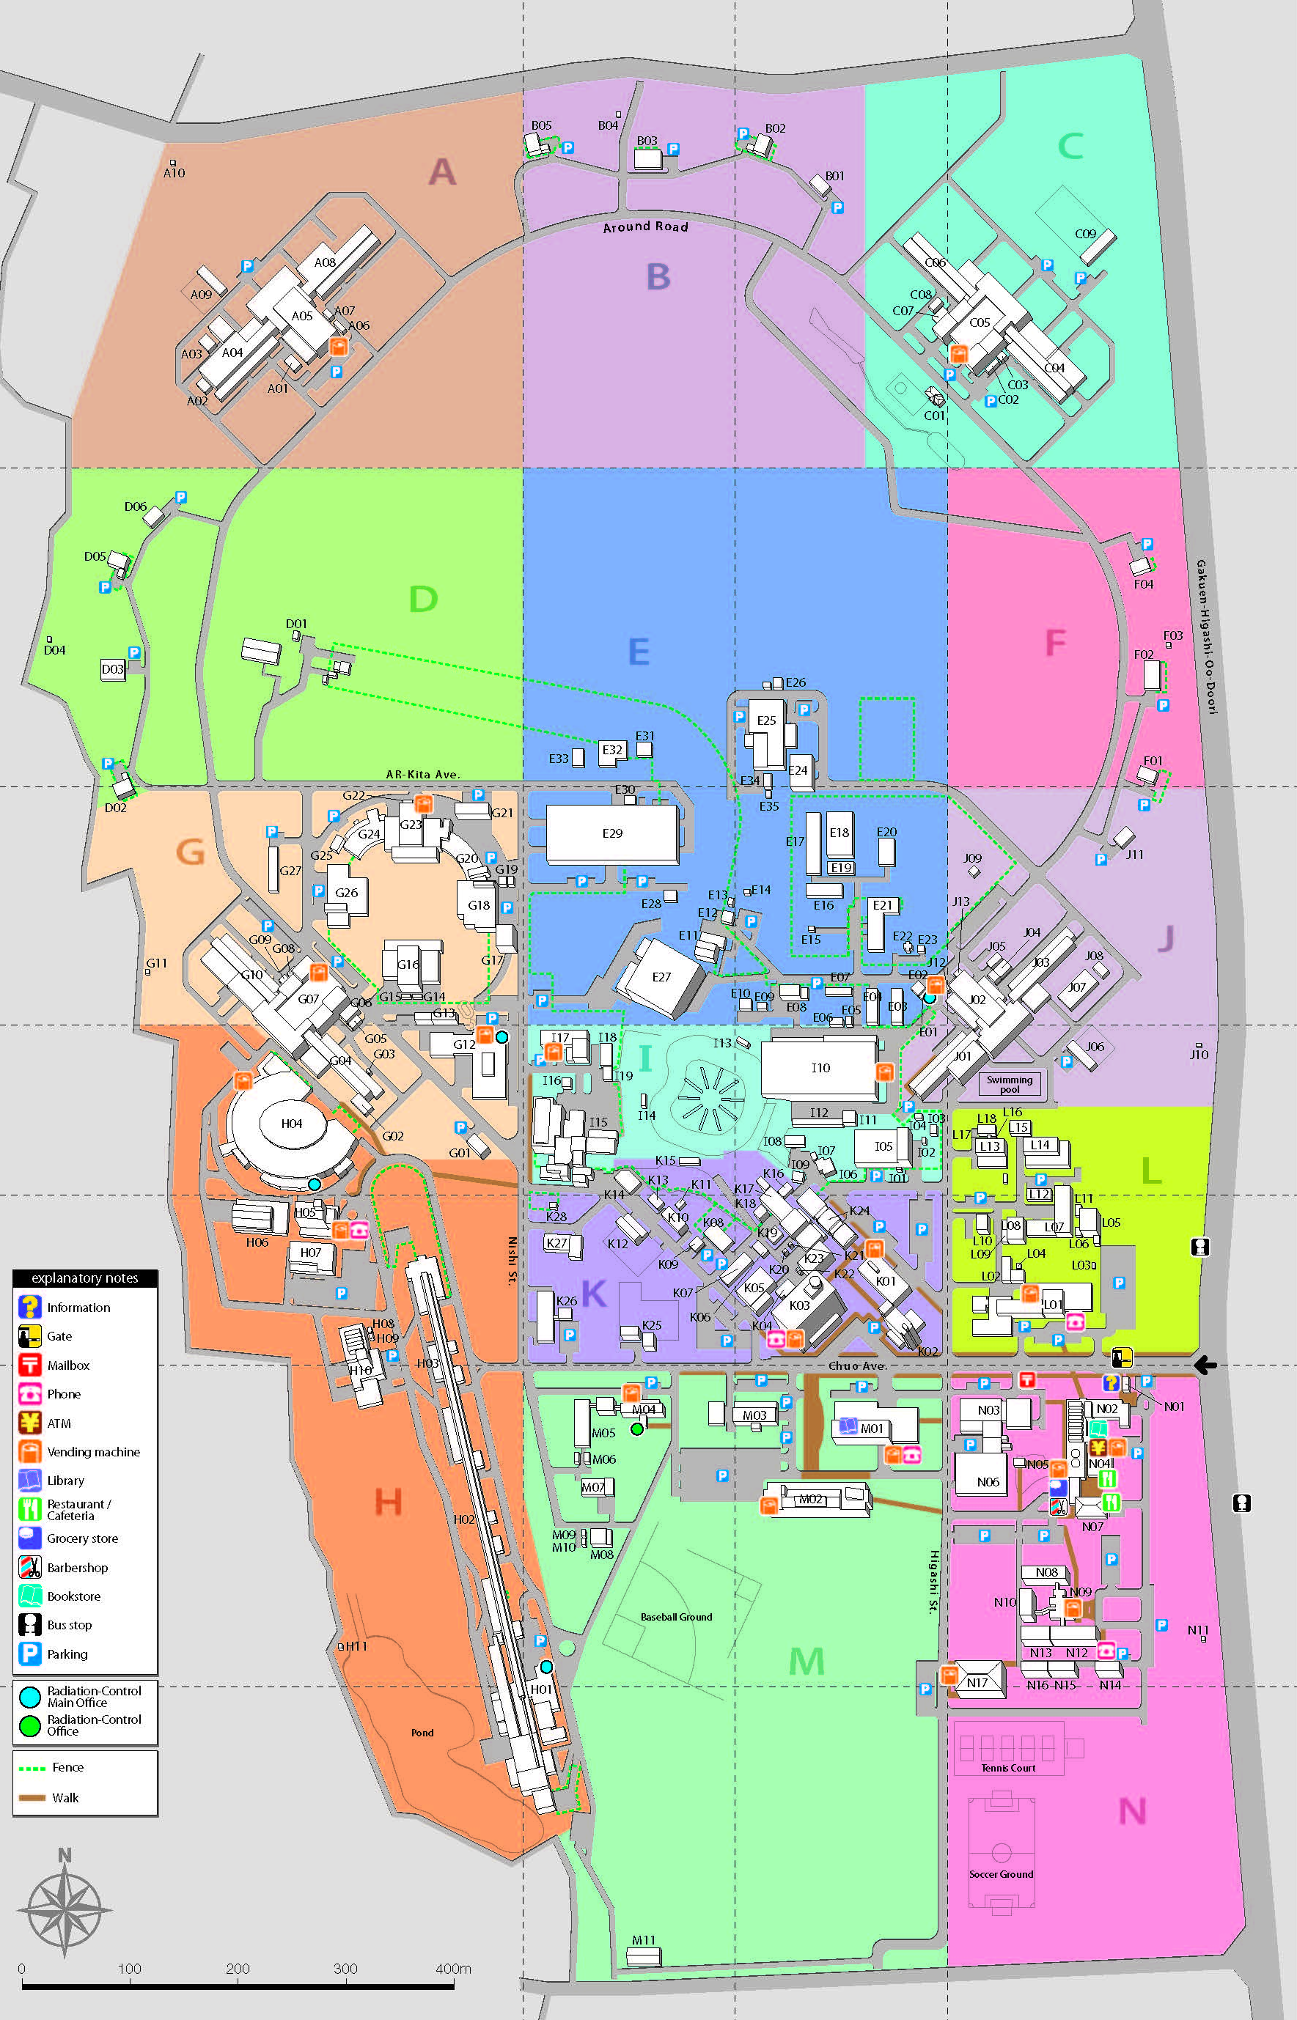
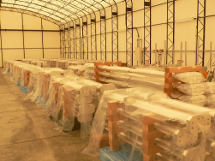
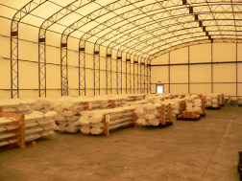
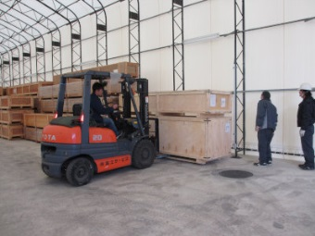
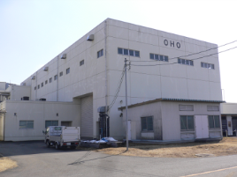
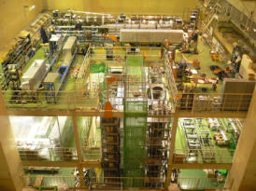
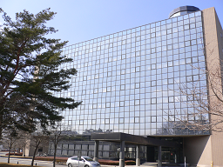
Flow chart of
pre-installation work
Storage area
Bringing beam pipes to KEKB Oho Lab. from storage area
KEKB Oho Lab.
Visual check on the beam pipe
LER beam pipe without electrode
DR beam pipe
HER beam pipe
TiN Coating
LER beam pipe with electrode
Assembling
(NEG pump & BPM electrode)
Baking
DR beam pipe
KEKB Oho Lab.
3-go-kan Bldg.
(You are here.)
Returning the beam pipes to storage area
KEK Tsukuba Campus
2014/3/3 the 19th KEKB Accelerator Review Committee 3

Slide 4
Introduction 2
What we did after last KEKB Review are
Setting up horizontal coating facility with 2 equipment systems for bent beam pipes.
Coating and baking of ∼430 beam pipes for LER and HER, of which 111 beam pipes were bent pipe and coated by the new horizontal facility.
Pre-installation works of 925 beam pipes were finished in total so far.
More 450 beam pipes (LER and HER : 350, Damping Ring : 100) must be coated and baked by the end of this year.
Modifying the horizontal coating facility for damping ring beam pipes. (in progress now)
Topics discussed in this talk are
Baking & TiN coating facility (review)
Status report on baking and coating works
Working Schedule
Now
2014/3/3 the 19th KEKB Accelerator Review Committee 4

Slide 5
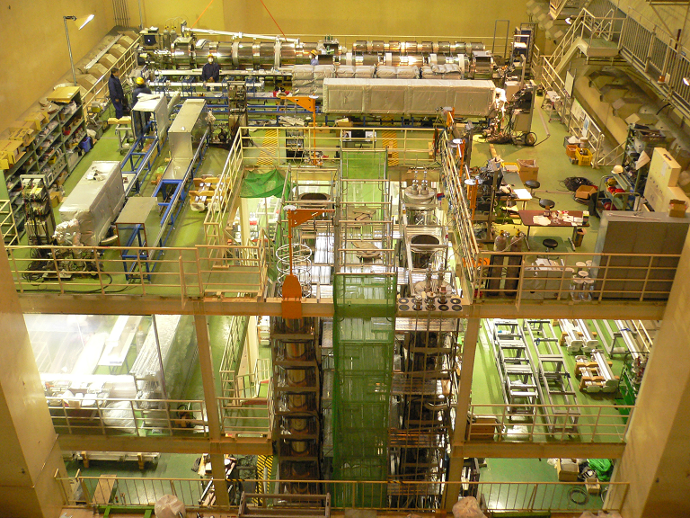
Layout of Oho laboratory 1
Baking equipment : 2 long type (∼5 m) and 2 short type (∼3 m)
Vertical TiN coating facility with 4 equipment systems for straight beam pipes
Horizontal coating facility with 2 equipment systems for bent beam pipes
16m
Coating facility (horizontal)
Baking equipment (long type)
stairway
16m
Baking equipment (long type)
4.5mm
Clean room
Baking equipment (short type)
Baking equipment (short type)
coating facility
(vertical)
stairway
6.5 m
Oho experimental deck (top view)
2014/3/3 the 19th KEKB Accelerator Review Committee 5

Slide 6
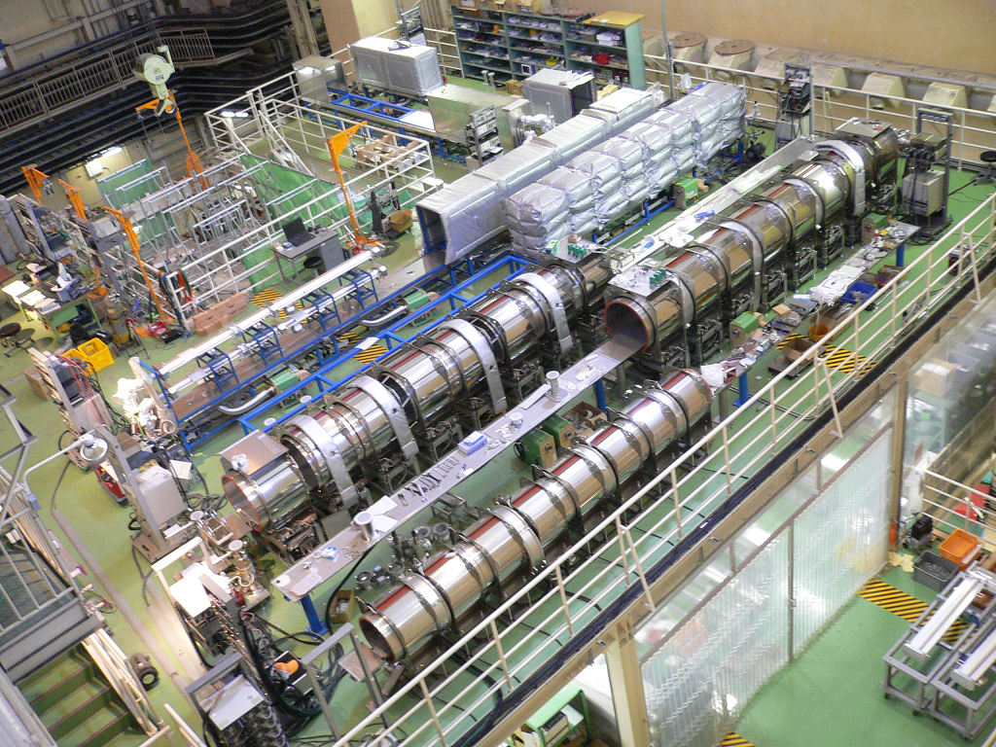
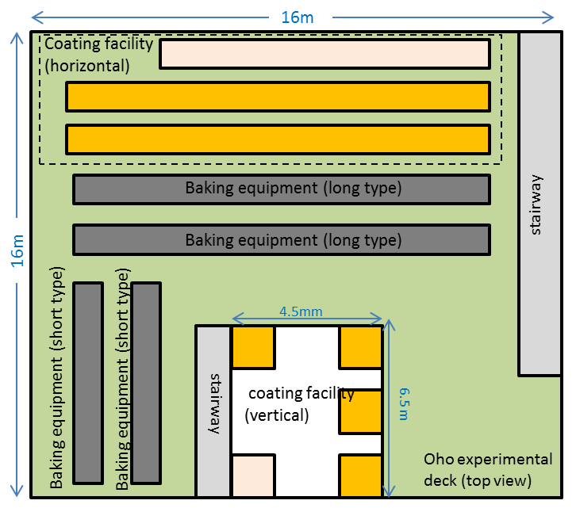
Layout of Oho laboratory 2
View from different place.
Clean room
2014/3/3 the 19th KEKB Accelerator Review Committee 6

Slide 7
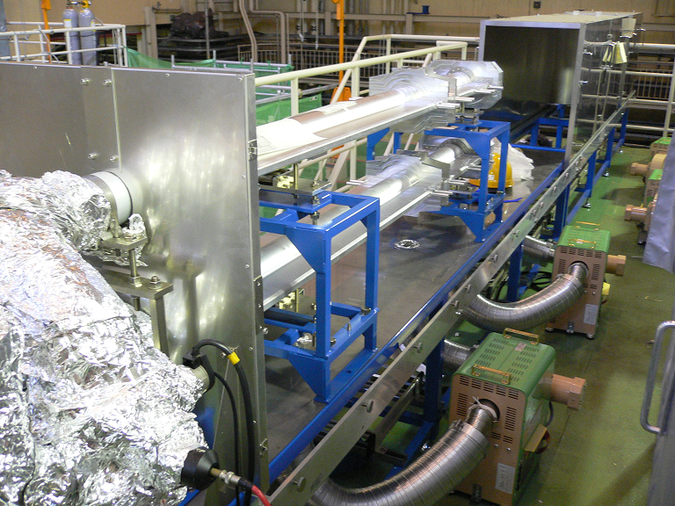
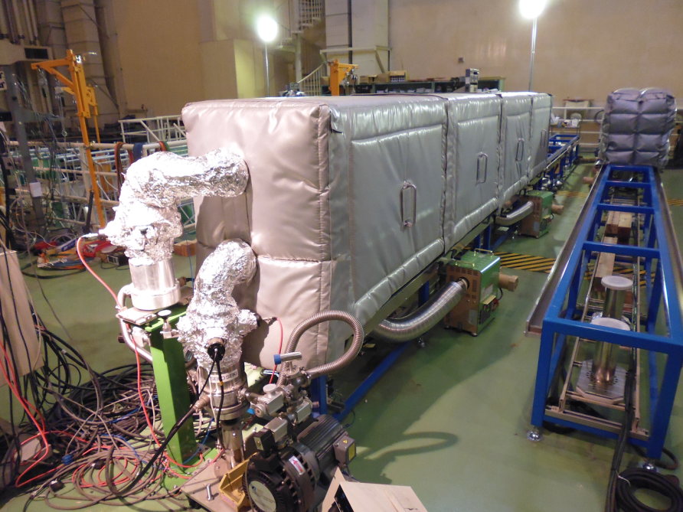
Baking 1 : Equipment
Hot-air heating method was adopted.
Two beam pipes are mounted up and down in one hot-air oven.
Hot-air oven consists of movable insulated walls and insulated frame.
Hot air is circulated in the hot-air oven.
Each pipe is evacuated by a turbo-molecular pump (0.3 m³/sec) during the baking.
Movable walls
Now baking
Beam pipe
(double decker)
Pumping unit
Hot-air circulator (7.5 kW)
Short type
Long type
2013/3/4 the 18th KEKB Accelerator Review Committee 7

Slide 8
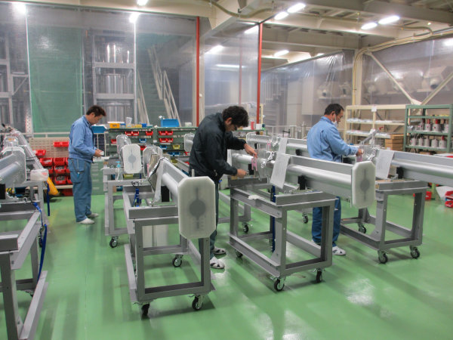
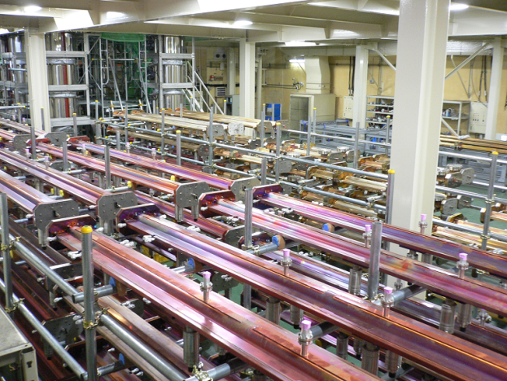
Baking 2 : Baking conditions
Baking conditions
Temperature : ∼150 °C (∼120 °C for beam pipes with electrodes)
Baking period : ∼26 hours
Temperature of the beam pipes in the oven became ∼150 °C within a several hours.
Targeted pressure after baking : < 10⁻⁷ Pa
NEG pump is activated at the same time.
Before baking
TiN coating (if necessary)
Installation of NEG pumps and BPM electrodes at Oho clean room.
After baking
Filling with dry nitrogen up to atmospheric pressure.
Isolating the beam pipe and putting a blank flange on the beam pipe.
Keeping the beam pipe in the storage area until the installation.
Clean room
Storage area (Oho lab.)
2013/3/4 the 18th KEKB Accelerator Review Committee 8

Slide 9
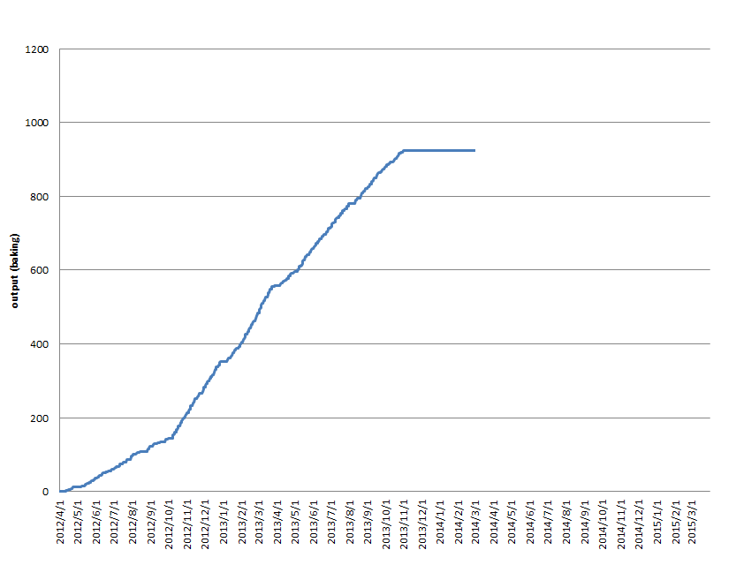
Baking 3 : Baking output
Baking work started on April 2012.
Total output by last month (2014/2/28) is 925.
More 350 beam pipes must be baked by the end of November at the latest.
Last year 367 beam pipes were baked in 7 months (from April to October).
Baking work will restart from April.
Now we are here.
(waiting for new beam pipes.)
2013/3/4 the 18th KEKB Accelerator Review Committee 9

Slide 10
Baking 4 : Achieved pressure after baking
For almost all beam pipes, achieved pressures after baking are below 1×10⁻⁷ Pa.
If achieved pressure is higher than 1×10⁻⁷ Pa, the beam pipe is baked again.
Mass pattern after baking is not monitored. (Though 2 of 4 baking equipment systems have RGAs, we don’t use them.)
< 1
1∼2 2∼3 3∼4 4∼5 5∼6 6∼7 7∼8 8∼9 9∼10
10 <
[x10⁻⁸ Pa]
2014/3/3 the 19th KEKB Accelerator Review Committee 10

Slide 11
TiN coating 1 : Coting method
For SuperKEKB LER and DR, it is an important issue to mitigate the electron cloud instability.
In order to reduce the electron cloud, inner surfaces of almost all LER beam pipes are coated with TiN (except beam pipes with clearing electrodes).
TiN coating tests had been performed and the coating method was established.
TiN coating is done by a DC magnetron sputtering of Ti in Ar and N₂ atmospheres.
A Ti cathode rod (-400 V) is set on the center axis of beam pipe.
Gases are supplied into the beam pipes uniformly though the Ti rod.
Magnetic field (16 mT) is supplied by solenoid coils.
Preliminary experiments were performed at a test stand to decide the coating parameters.
Thickness of TiN coating : 200 nm (at least)
Straight beam pipes are coated by vertical type and bent pipes are coated by horizontal type.
Mass Flow Controller
Ar gas (2.0 Pa)
N₂ gas (0.5 Pa)
Discharge Power Source
Solenoid Coil
Beam pipe
Solenoid Coil’s Power Source
Ti Cathode Rod (-400 V)
16 mT
Gauge
Test stand
Pumping System
Mass Spectrometer
2014/3/3 the 19th KEKB Accelerator Review Committee 11

Slide 12

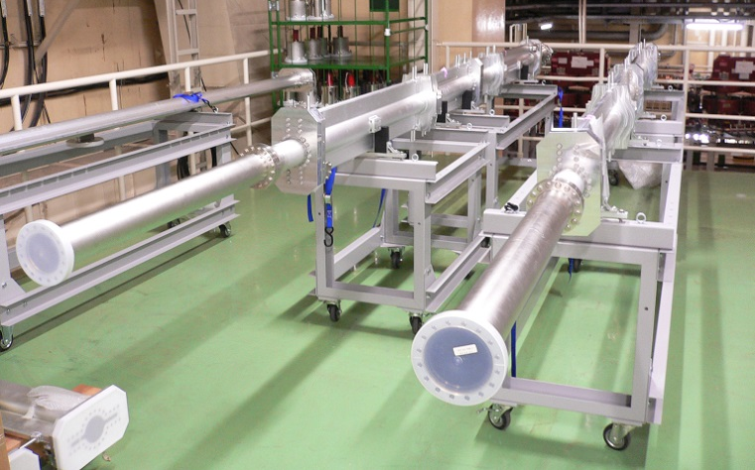
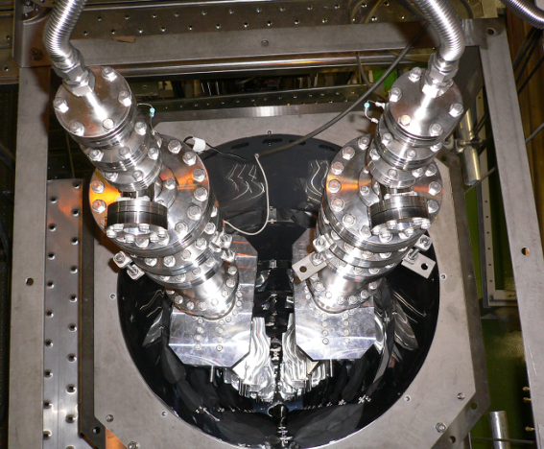
TiN coating 2 : Facility (vertical)
Straight beam pipes are coated by vertical facility with 4 equipment systems..
Ti cathode is hung from the top of the pipe.
Beam pipe with a length up to 5.5 m can be coated.
Short beam pipes and dummy pipes are connected to make total length ∼6 m.
Two lines of the beam pipes can be mounted side-by-side in one equipment.
Combination of hot-air oven and circulators are adopted for pre-baking.
It is not available for bent beam pipes.
Large-scale work started on September 2012.
∼6 m
Dummy pipe for length tuning
Beam pipes
Two lines of beam pipes
Vertical coating facility
2013/3/4 the 18th KEKB Accelerator Review Committee 12

Slide 13
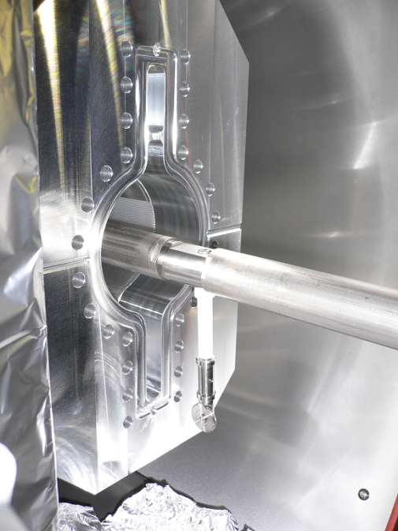
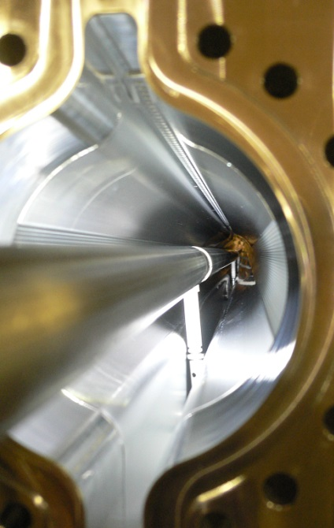
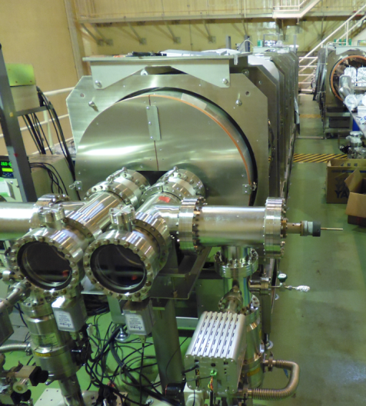
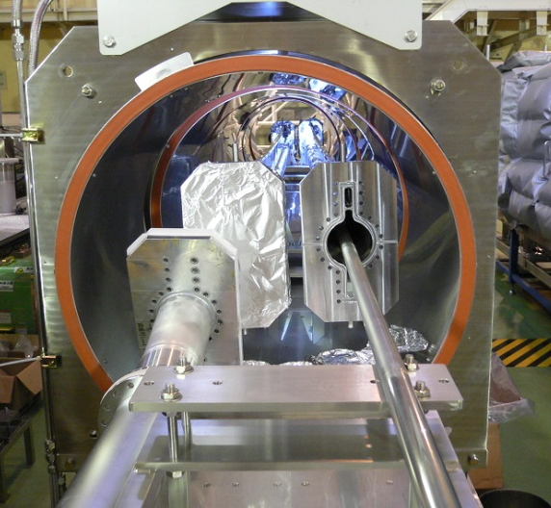
TiN coating 3 : Facility (horizontal)
Bent beam pipes are coated by horizontal facility with 2 equipment systems.
Basically, horizontal equipment has the same structure with vertical equipment.
Beam pipes lie down in the solenoid coils.
Ti cathode is set horizontally on the center axis of beam pipe by the ceramics supports with wheels.
Large-scale work started on April 2013.
2014/3/3 the 19th KEKB Accelerator Review Committee 13

Slide 14
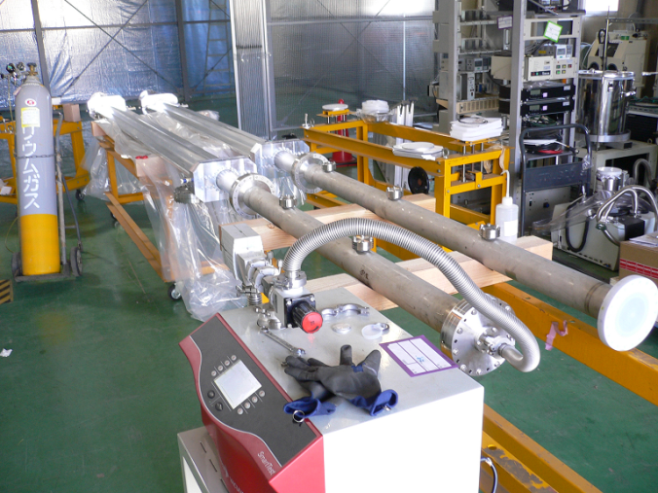
TiN coating 4 : Working process
Before coating (at Oho clean room)
Visual check on the beam pipe.
Putting blank flanges on pumping ports and BPM ports.
Connecting beam pipes and dummy pipes for length tuning. (if necessary)
Leakage test
Installation of beam pipes on coating equipment.
In coating equipment
Leakage test
Pre-baking (∼150 °C, ∼24 hours)
TiN coating (Discharge duration : ∼80 min.)
After coating
Filling with dry nitrogen up to atmospheric pressure.
Dismantling beam pipes
Installation of NEG pumps and BPM electrodes at Oho clean room.
Baking
Leakage test before installation
2014/3/3 the 19th KEKB Accelerator Review Committee 14

Slide 15
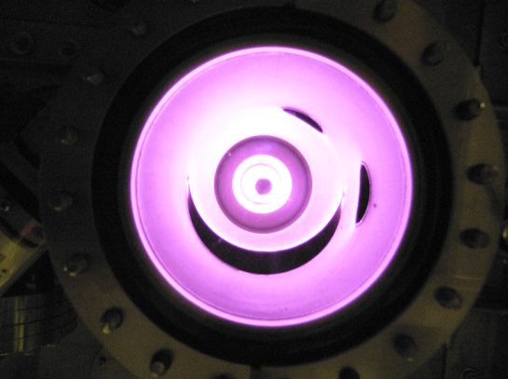
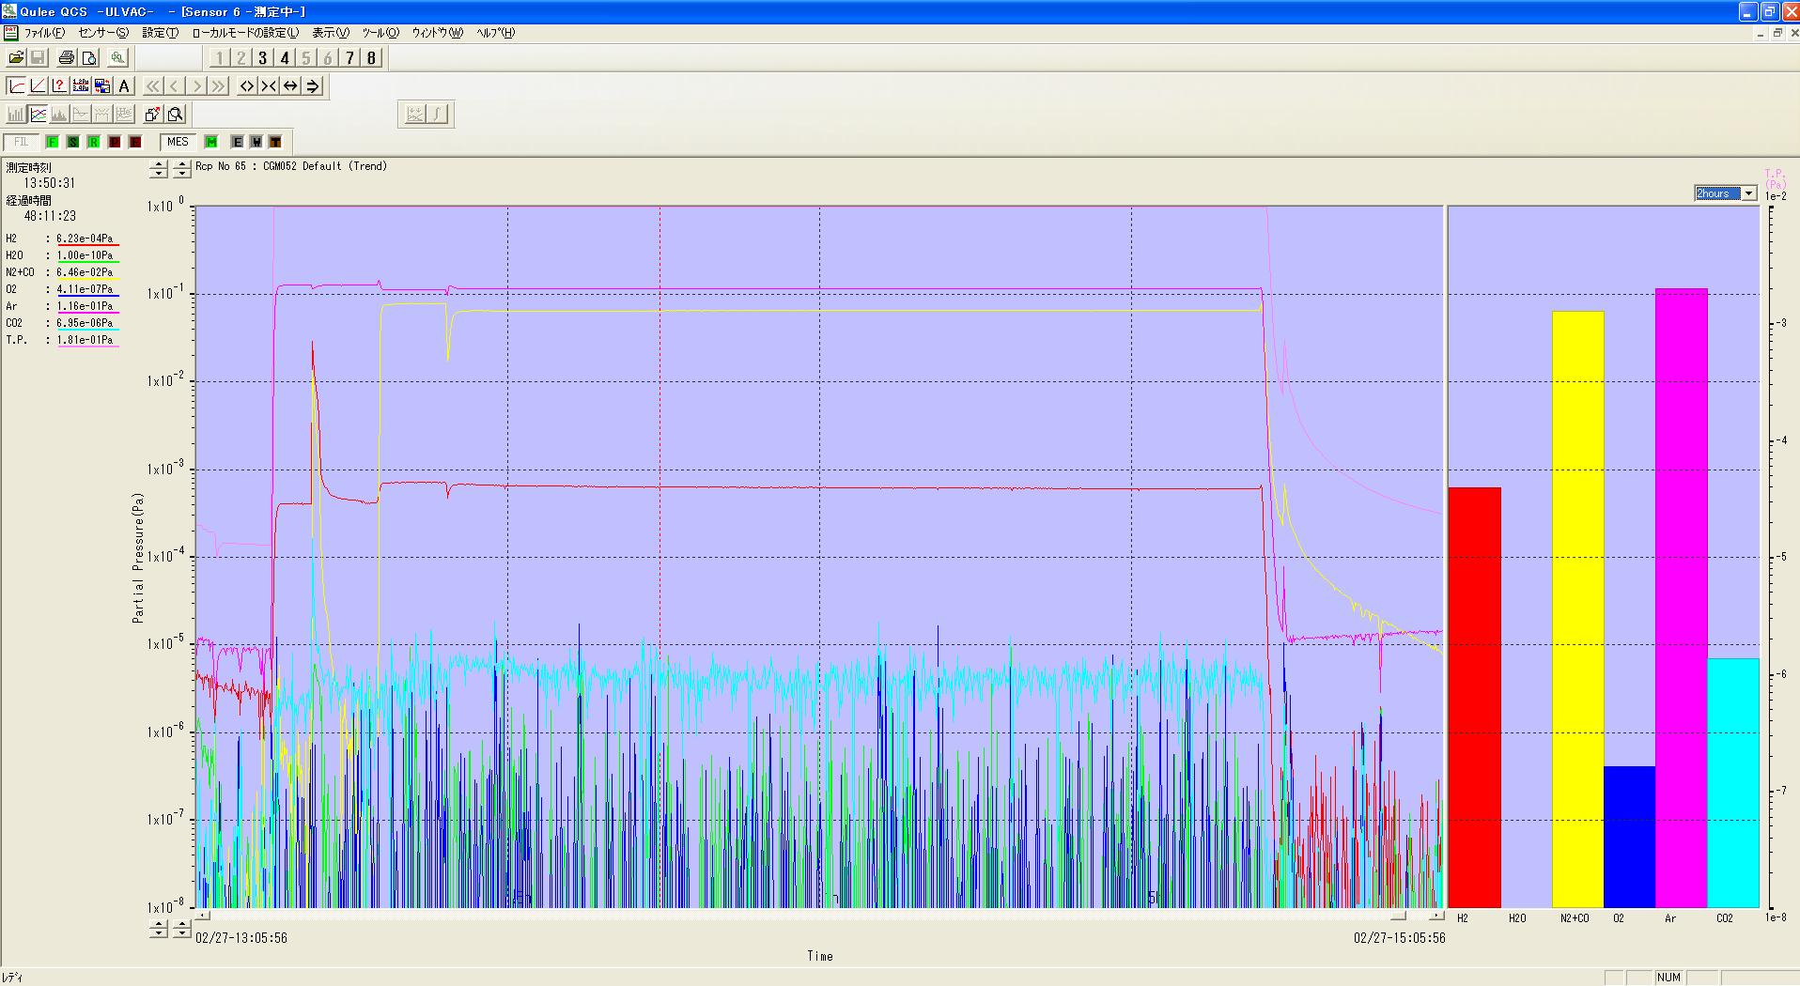
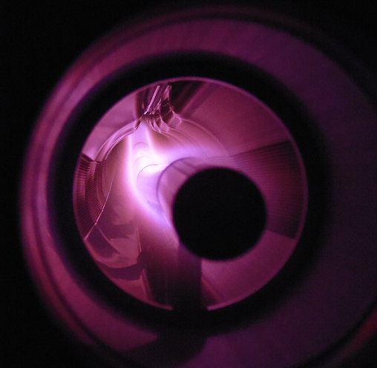
TiN coating 5 : Coating 1
Introduced gases : Ar (∼2.2 Pa), N2 (∼1.8 Pa)
Discharged current : 6.3 A
Required time : 5 min (Ti coating for base of TiN) + 75 min (TiN coating)
Vertical type
Partial pressure during discharge (just upstream of pumping unit)
1x10⁰
1x10⁻¹
1x10⁻²
1x10⁻³
1x10⁻⁴
1x10⁻⁵
1x10⁻⁶
1x10⁻⁷
1x10⁻⁸
Ar
N₂
Ti cathode rod
H₂
Horizontal type
Partial Pressure [Pa]
Ti coating
TiN coating
Time
2014/3/3 the 19th KEKB Accelerator Review Committee 15

Slide 16
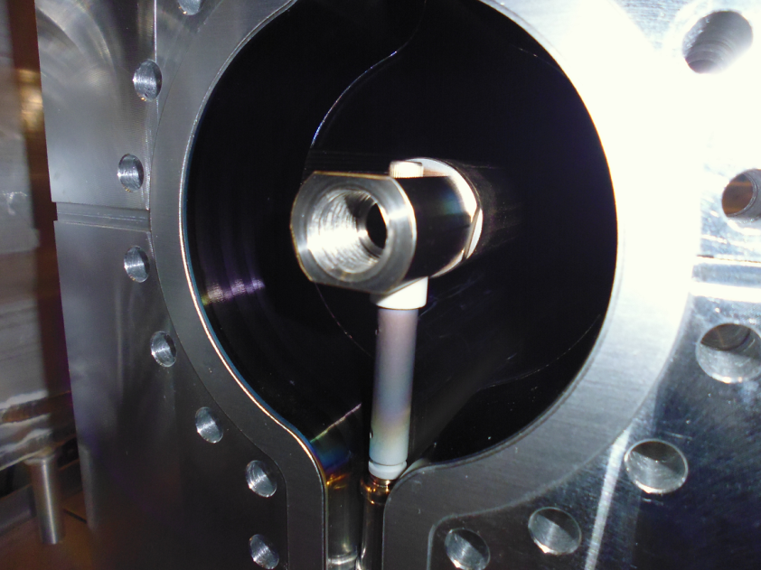
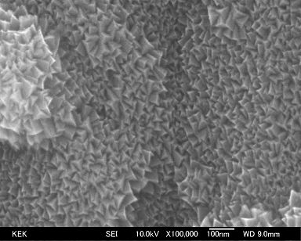
TiN coating 6 : Coating 2
Electron microscopic image of TiN coating
Beam pipe (bent type) was successfully coated.
Though the color of the ceramic support was changed, insulation breakdown did not occurred.
2014/3/3 the 19th KEKB Accelerator Review Committee 16

Slide 17
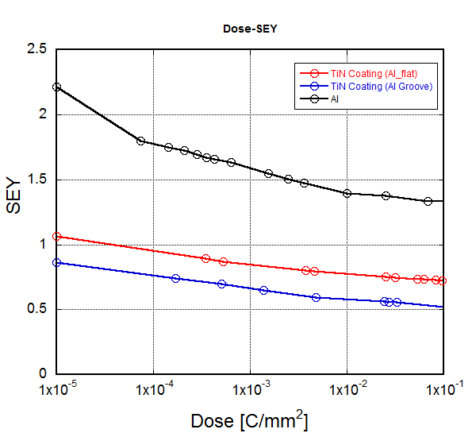
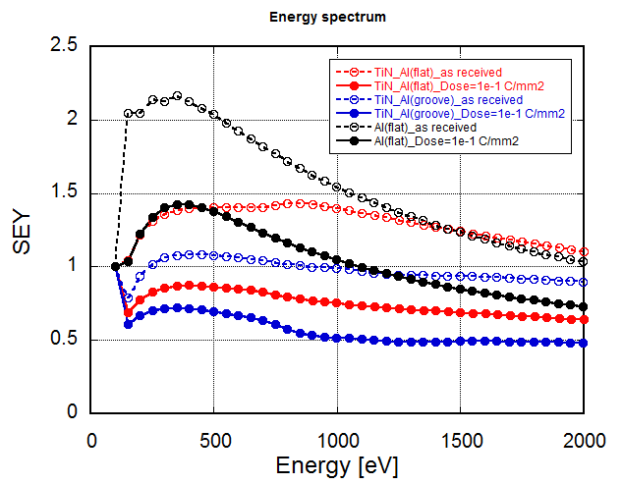
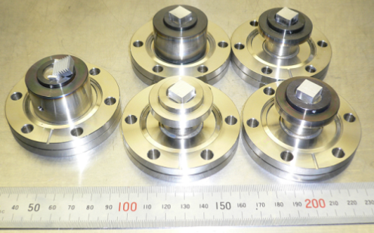
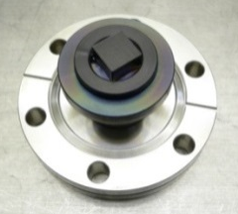
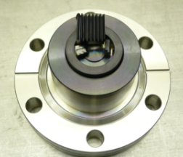
TiN coating 7 : Performance evaluation
SEY of Al samples coated with TiN at this facility were measured.
It was confirmed that SEY of TiN coating drops to below 0.8 after electron irradiation (incident electron energy : 250 eV)
Al samples before coating
By S. Terui
By S. Terui
2.2
1.3
1.1
TiN coated samples
0.72
0.9
0.5
Al flat
Al groove
2014/3/3 the 19th KEKB Accelerator Review Committee 17

Slide 18
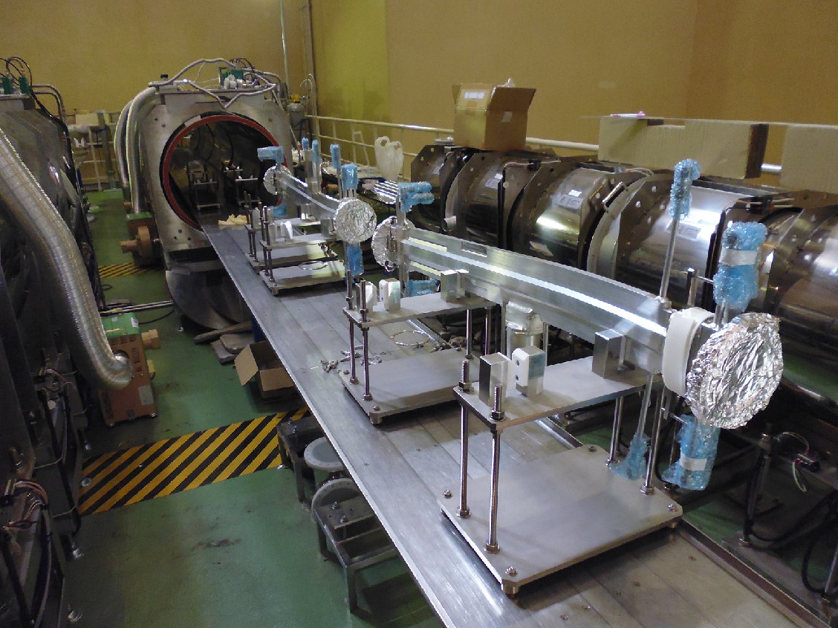
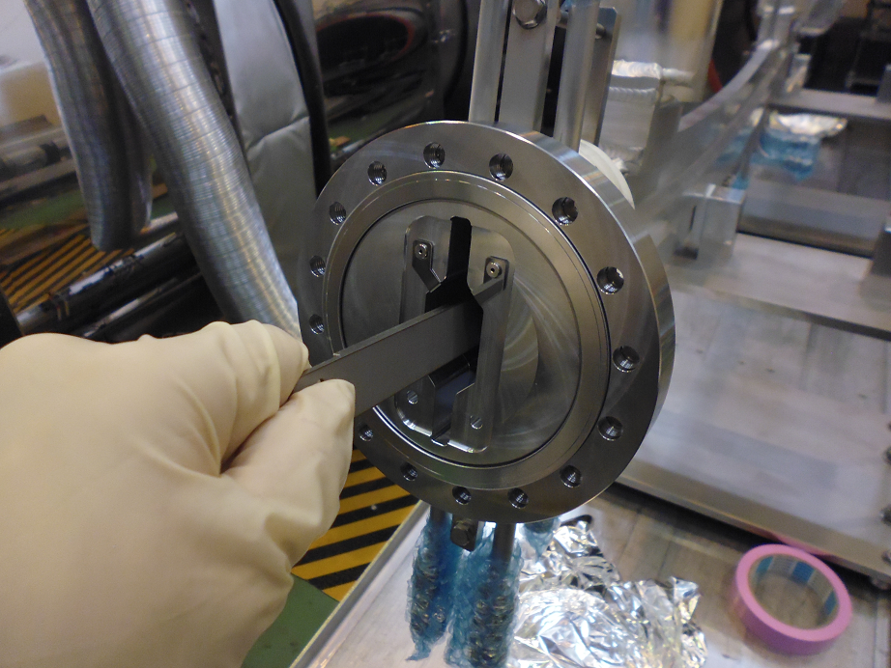
TiN coating 8 : Modification for DR 1
Coating of beam pipes for DR are done by the horizontal facility.
New Ti cathode plate with the same curvature as the beam pipe is required.
2014/3/3 the 19th KEKB Accelerator Review Committee 18

Slide 19
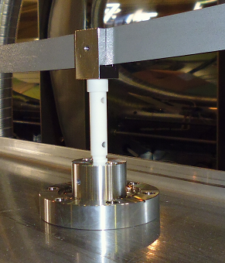
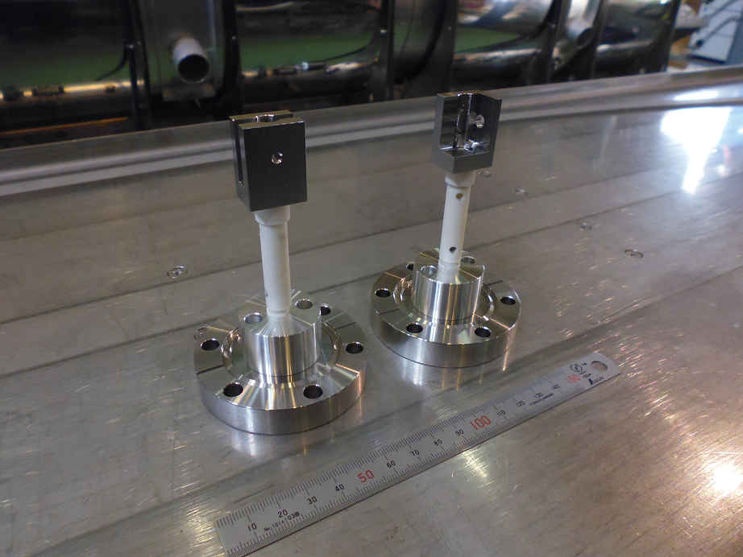
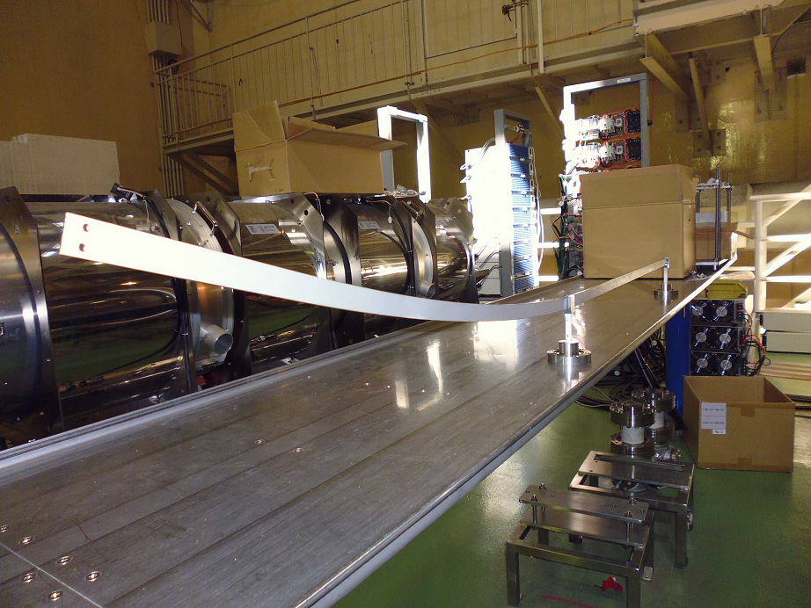
TiN coating 9 : Modification for DR 2
Modification for DR is nearly done.
Coating work will start soon.
2014/3/3 the 19th KEKB Accelerator Review Committee 19

Slide 20
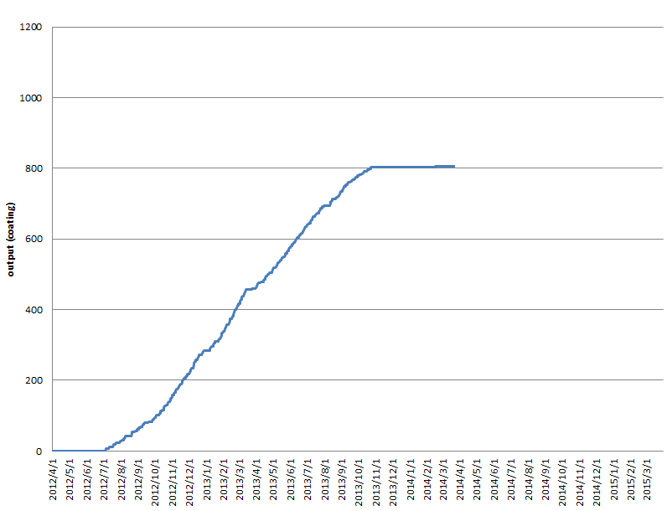
TiN coating 10 : Coating output
Coating work started on July 2012.
Total output by last month (2014/2/28) is 805.
More 280 beam pipes (LER:180, DR:100) must be coated by the end of this year.
Last year 345 beam pipes were coated in 7 months (from April to October).
LER : From April to October at the latest.
DR : March, November and December.
Damping ring (100)
LER (180)
Now we are here.
(modifying the horizontal facility and waiting for new beam pipes.)
2014/3/3 the 19th KEKB Accelerator Review Committee 20

Slide 21
Summary
Pre-installation works (coating and baking) started on April 2012.
Large-scale works by 10 workers started on September 2012.
Coating of bent beam pipes started on last April by the horizontal coating facility
Pre-installation works of 925 beam pipes were finished in total, of which 111 beam pipes were bent pipe and coated by the horizontal facility.
Pre-installation work has been performed well so far without any serious problems.
Though many connection flanges (MO flange) required treatment for scratches on the vacuum sealing surfaces after coating, this problem was solved by burnishing sealing surfaces with hand.
Pre-installation work is almost on schedule so far.
Modifying the horizontal coating facility for damping ring beam pipes is in progress now.
Coating work will start soon.
By the end of this year, ∼450 beam pipes must be baked and coated.
LER and HER (350): From April to November at the latest.
Damping Ring (100): March, November and December.
“450 beam pipes” seem to be an achievable goal.
2014/3/3 the 19th KEKB Accelerator Review Committee 21

