Slide 1
Magnet Support (Moving stage/ KEKB floor modification)
Mar 3rd , 2014
H. Yamaoka
and
Magnet group

Slide 2
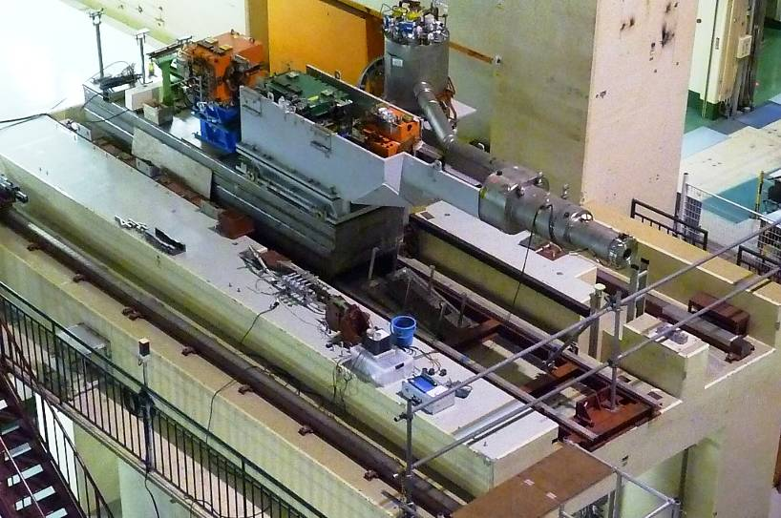
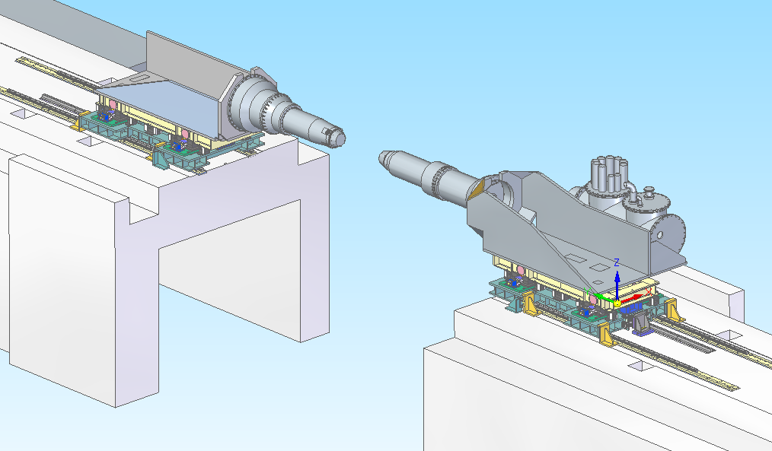
QCS support system for KEKB
QCS support system for SuperKEKB
QCS support frame
QCS-L
Filled
Moving stage
Precise flat surface floor
Concrete bridge

Slide 3
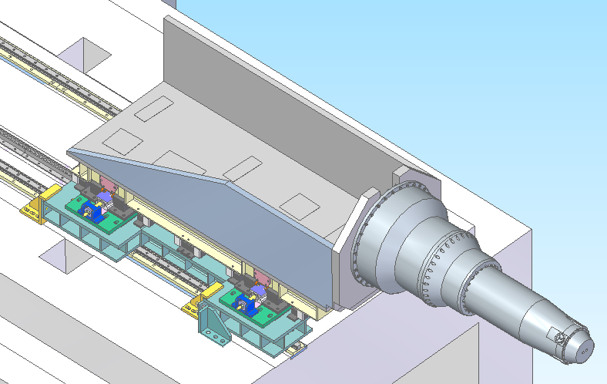
Mechanical design
4000kg
0.3G
4000kg
7000kg
Load conditions (Vertical dir.)
Self-weight (QCS)： 2500kg
Self-weigh(Supp. Frame): 10000kg
Weight of magnets: 4000kg
Magnetic force(axial dir.)
Inner direction： 7000kg
Outer direction: 4000kg
Seismic load
0.3G in the horizontal direction

Slide 4
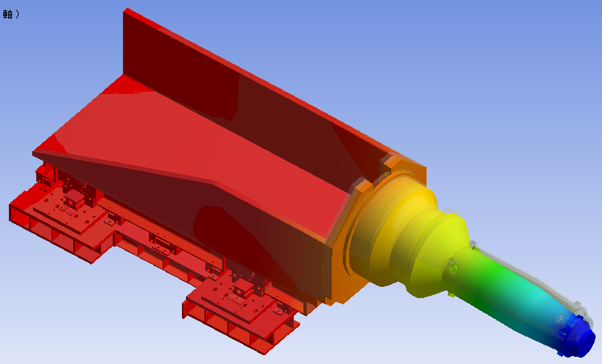
Static analysis
Vertical-dir.
(self-weight)
0.4mm
Axial-dir.
(Magnetic force)
0.7mm

Slide 5
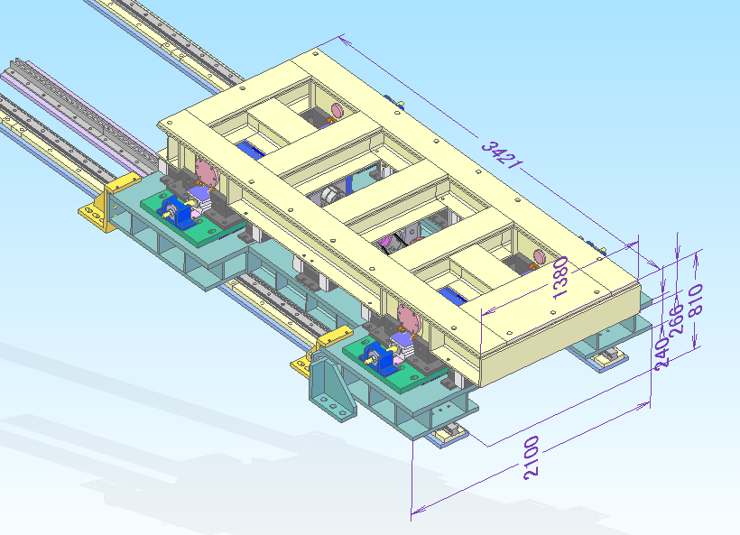
Moving distance = 3.35m
Linear guide rail
H250x250
Motor
Level adjustment system

Slide 6
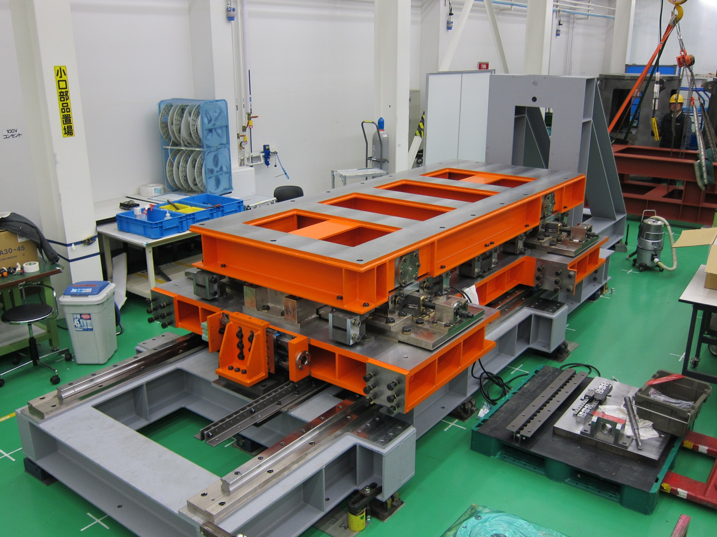
➔ Assembling is in progress…

Slide 7
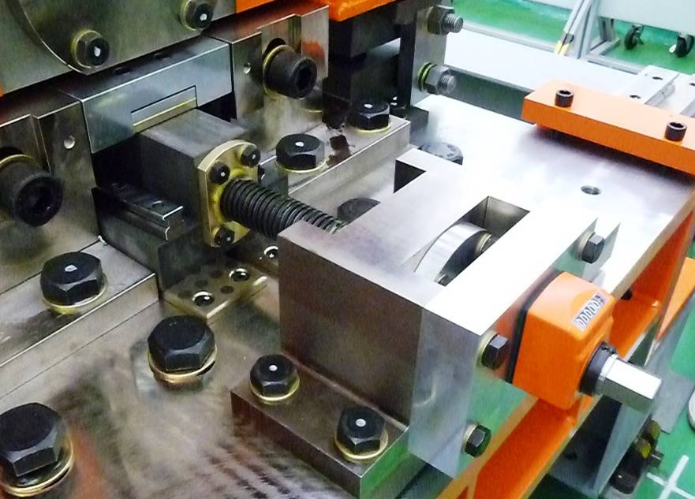
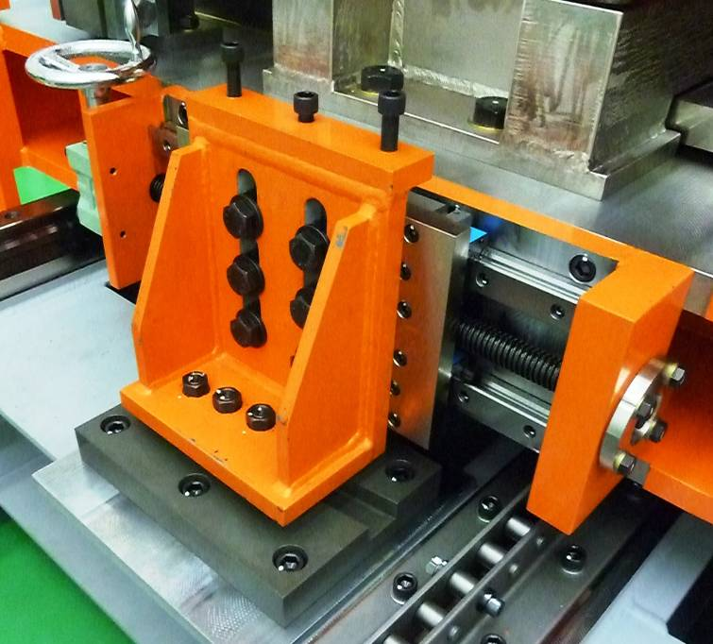
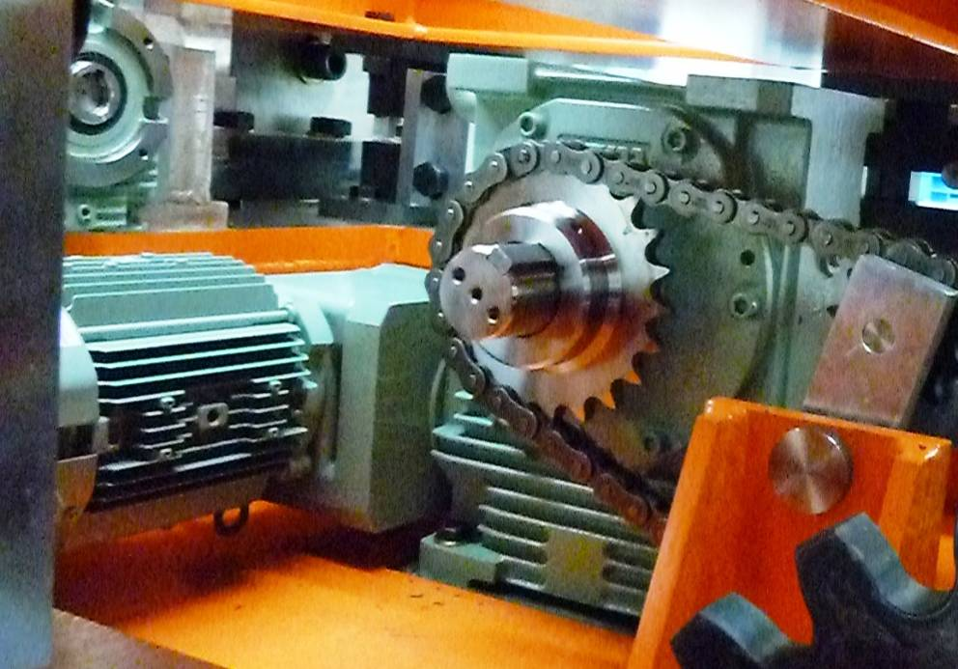
-2m/min
-Manual operation

Slide 8
KEKB concrete floor modification

Slide 9
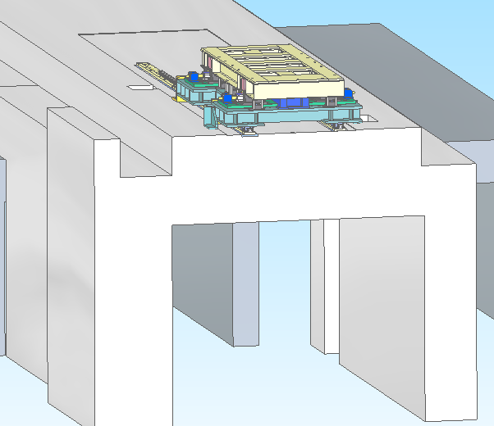
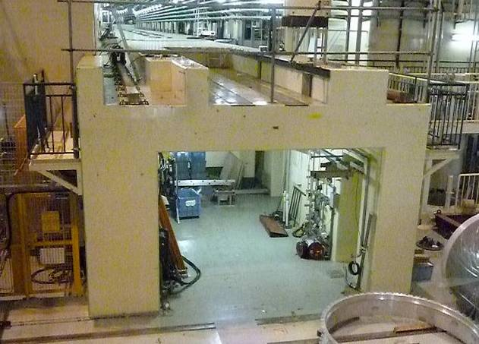
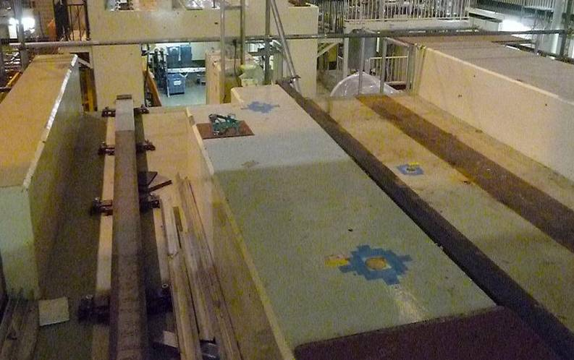
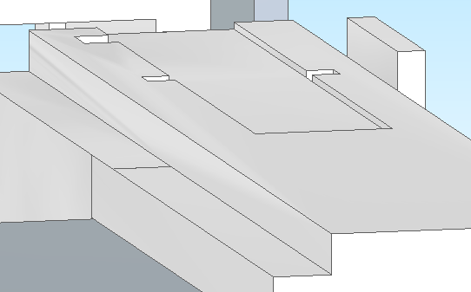
KEKB concrete floor modifications
L-side
-Make reinforced concrete floor.
-Make precise flat floor (self-leveling).
-Mount the movable table.
R-side
-Make reinforced concrete floor.

Slide 10
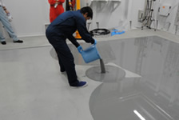
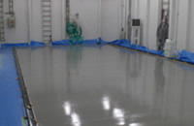
We apply self-leveling method.
Traditional way
Self-leveling method
Set base blocks
Level adjustment
with shims.
➔ - Save working time.
- Improve vibration property.

Slide 11
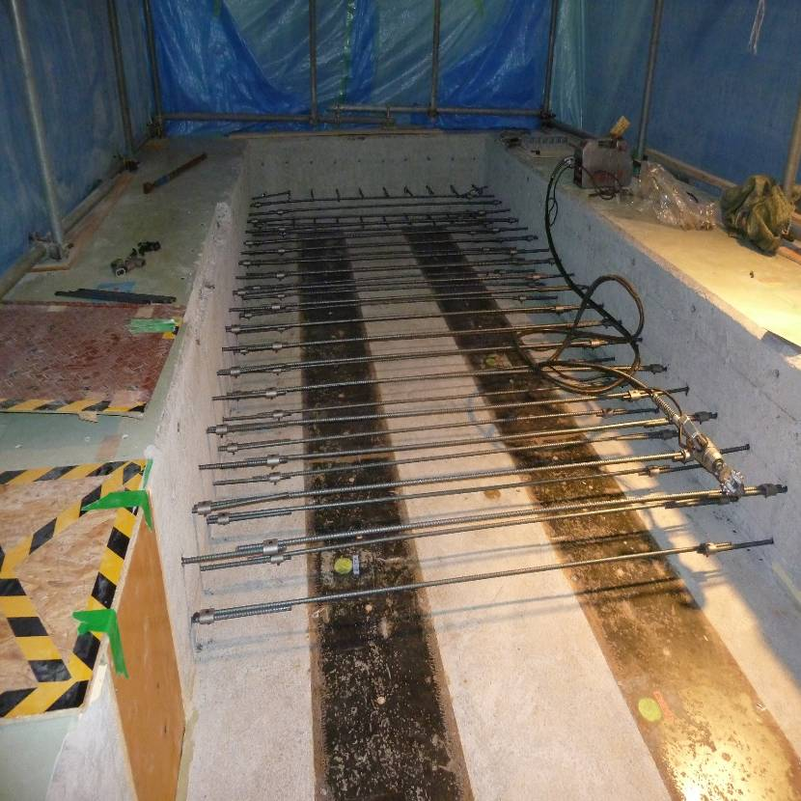
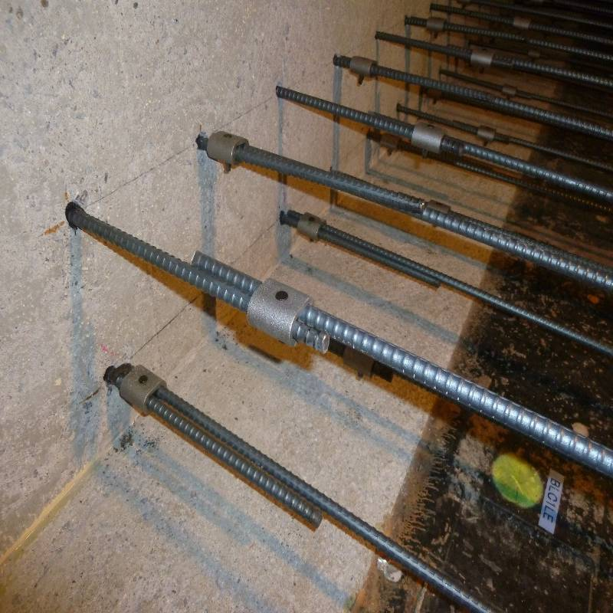
Set steel rods

Slide 12
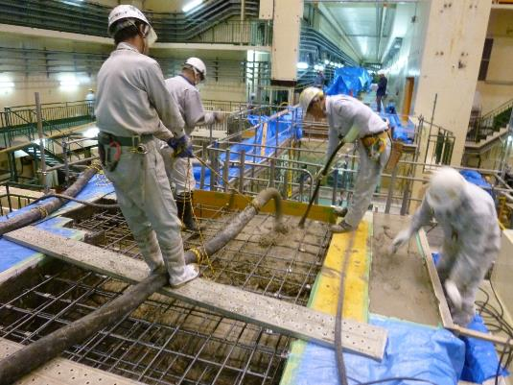
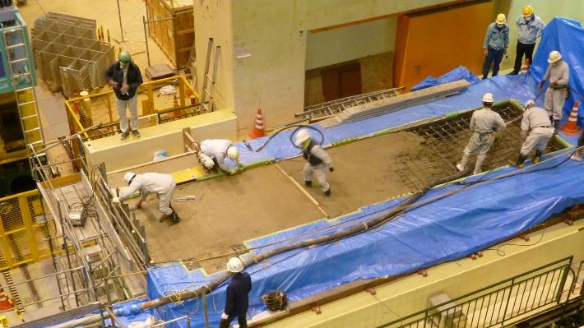
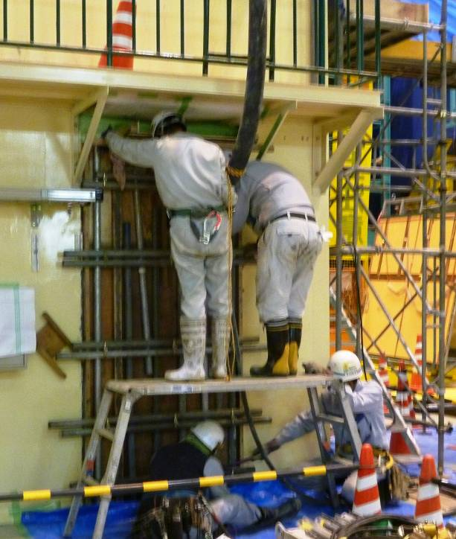
Dec.11, Fill with concrete

Slide 13
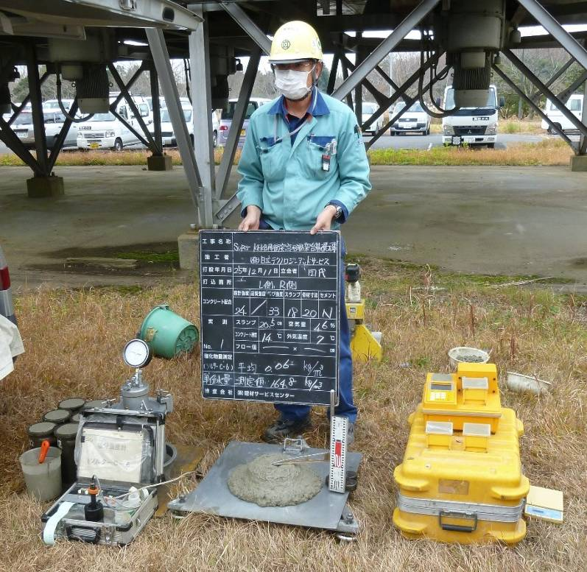
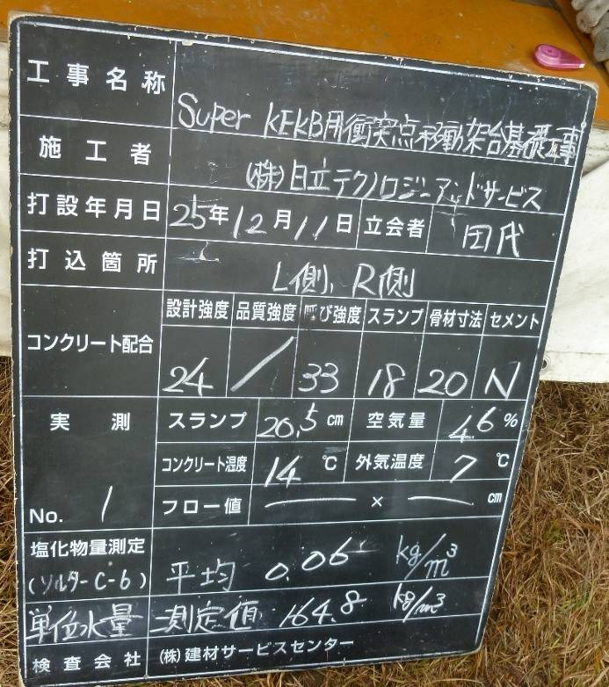
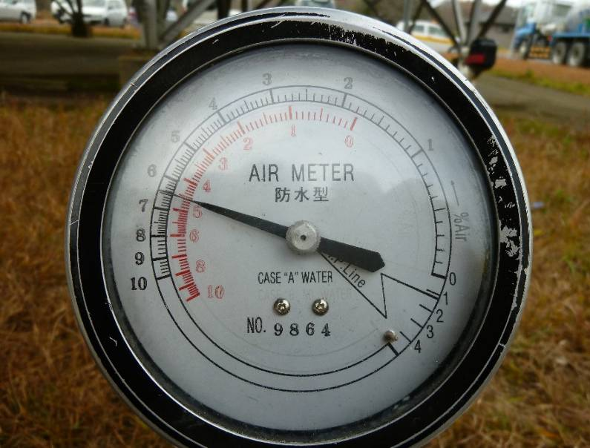
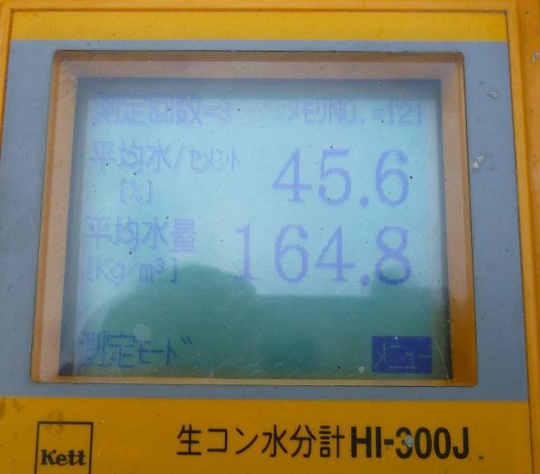

Slide 14
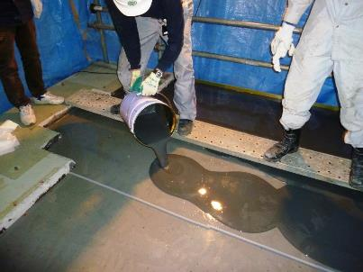
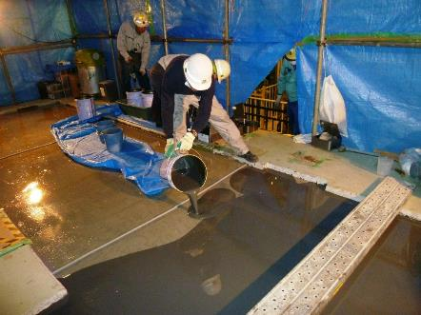
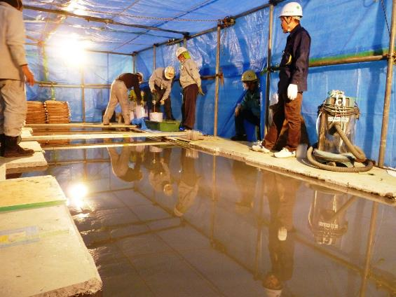
Dec. 07, High precision flat surface floor
(Self-leveling method)

Slide 15
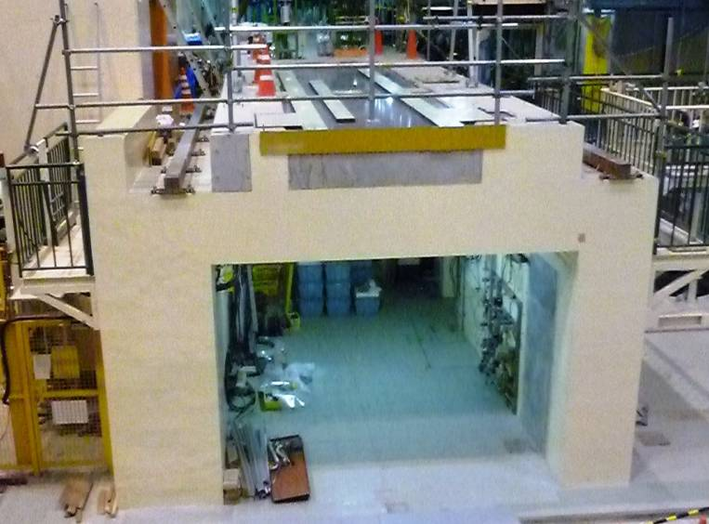
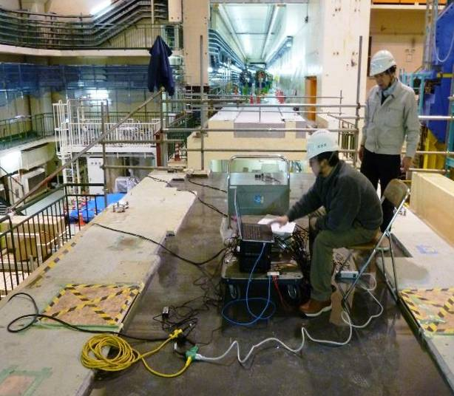
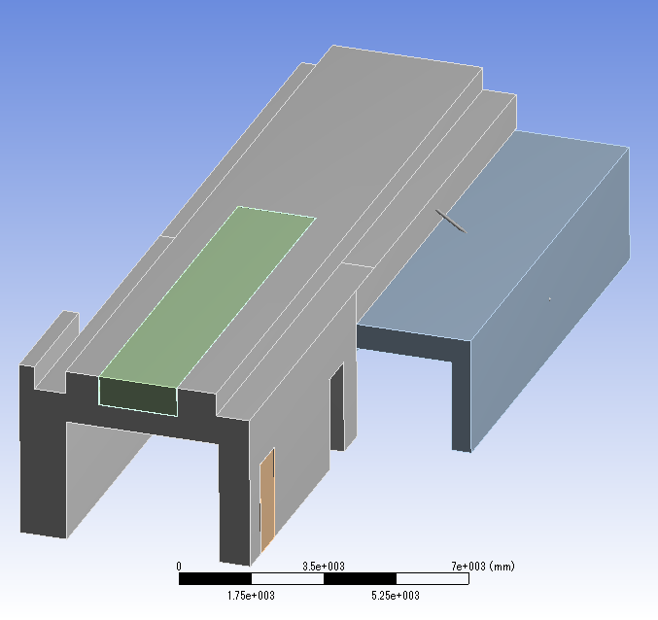
Modal test of concrete bridge
Measurement
Vibration properties must be changed
due to the modifications.
Resonant frequencies
Mode shapes
are measured and compared to FEM.
FEM
Spring constant:
1x10⁶N/mm
Fixed(Y)
Fixed

Slide 16
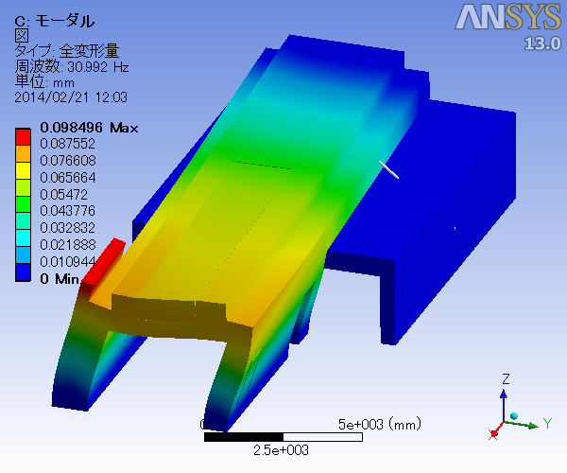
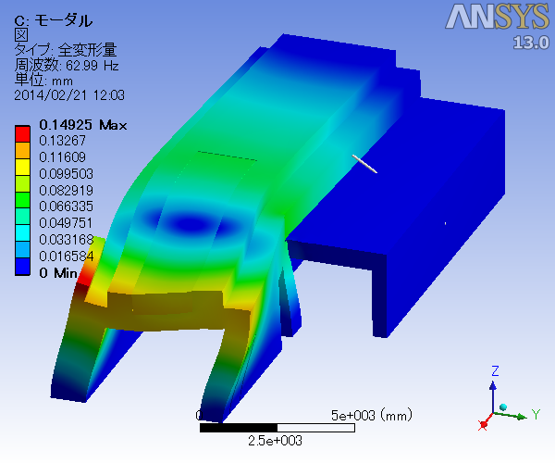
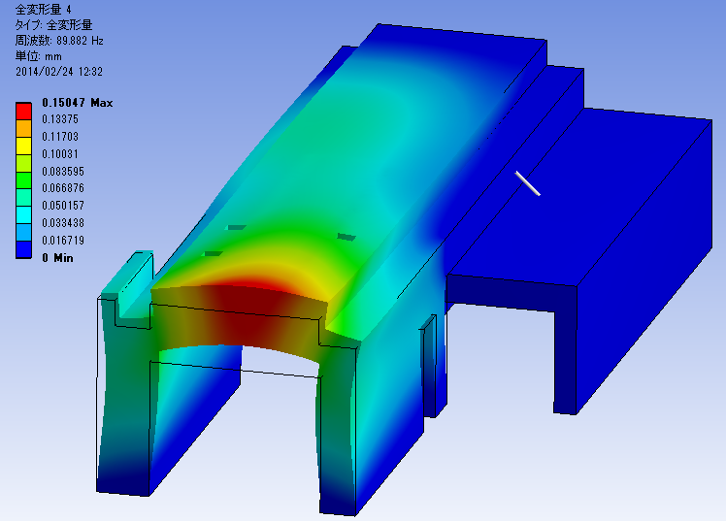
Measurement
FEM
31Hz
31Hz
63Hz
63Hz
89Hz
80Hz

Slide 17
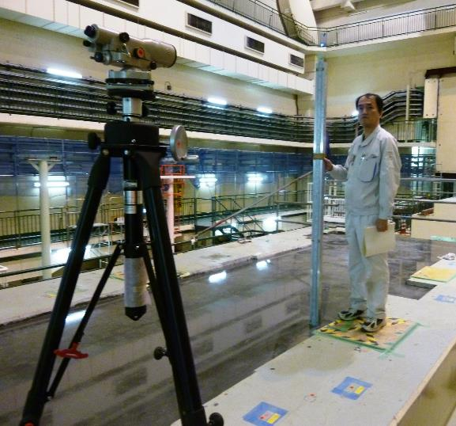
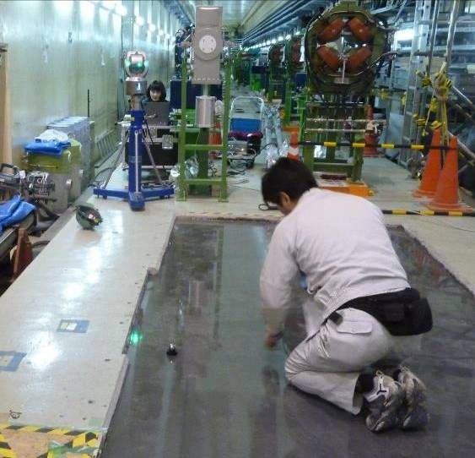
Jan. 6,7th ,Flatness of the floor was measured.
High precision level
Laser tracker

Slide 18
Result (Measured with Laser Tracker)
Unit: mm
 | 200 | 500 | 1000 | 1500 | 1800
0 | 0 | 0.02 | -0.029 | -0.033 | -0.058
500 | -0.017 | -0.008 | -0.06 | -0.045 | -0.045
1000 | -0.043 | -0.096 | 0.011 | -0.021 | -0.02
1500 | 0.008 | -0.034 | 0.011 | -0.06 | -0.033
2000 | 0.021 | -0.011 | 0.011 | -0.019 | -0.038
2500 | -0.018 | -0.005 | -0.008 | -0.074 | -0.05
3000 | -0.041 | -0.015 | -0.014 | -0.066 | -0.056
3500 | -0.018 | -0.022 | -0.035 | -0.04 | -0.061
4000 | -0.028 | -0.005 | -0.04 | -0.017 | -0.05
4500 | -0.015 | -0.036 | -0.028 | -0.092 | -0.081
5000 | -0.022 | -0.024 | -0.008 | -0.016 | -0.04
5500 | -0.046 | -0.057 | -0.04 | -0.047 | -0.055
6000 | -0.046 | -0.039 | -0.03 | -0.046 | -0.041
6500 | -0.061 | -0.045 | -0.047 | -0.033 | -0.045
7000 | -0.054 | -0.068 | -0.082 | -0.078 | -0.074
7500 | -0.087 | -0.086 | -0.081 | -0.097 | -0.086
8000 | -0.113 | -0.106 | -0.125 | -0.131 | -0.08
➔ Flatness is about less than 0.1mm.

Slide 19
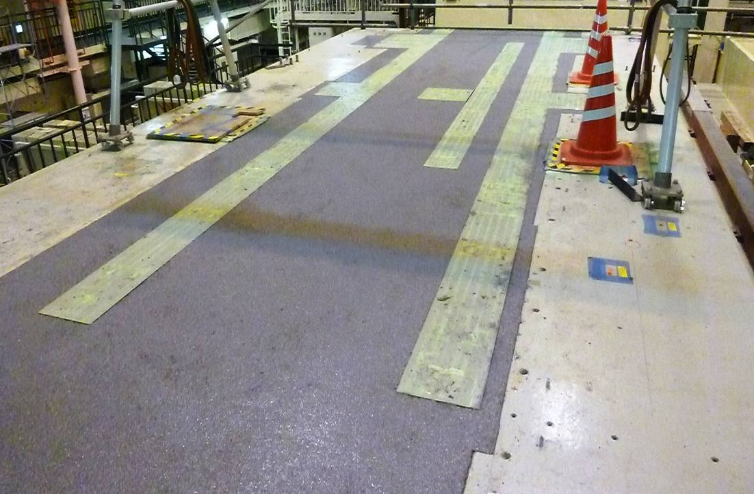
Conclusion
At KEK @ Mar. 3rd
-Modification of the floor is completed.
-Waiting to install the movable table.
Present situation
At factory of fabricator;
-Assembling is in progress…
Assembling in KEK,
→ Middle of March.

Slide 21
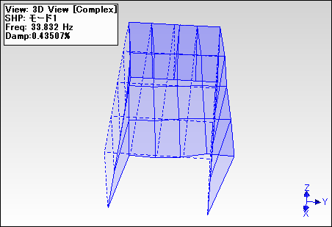
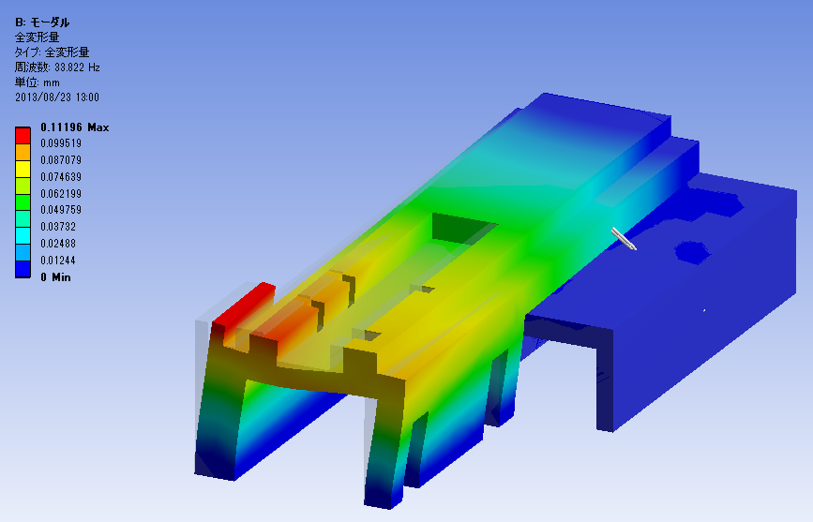
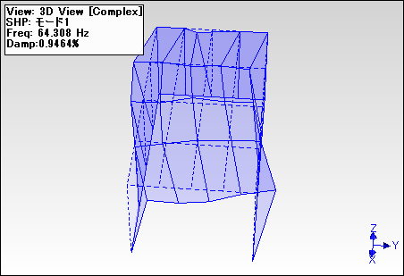
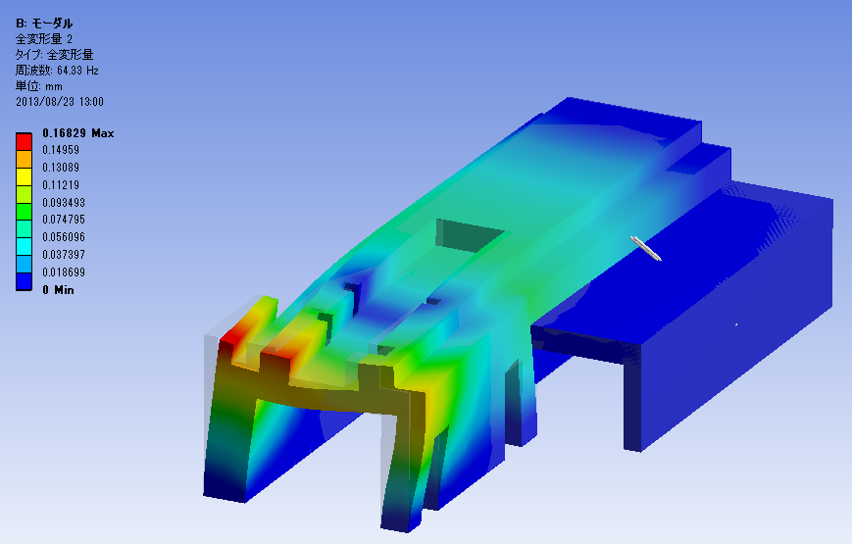
34Hz
34Hz
64Hz
64Hz
Measurement
ANSYS

Slide 22
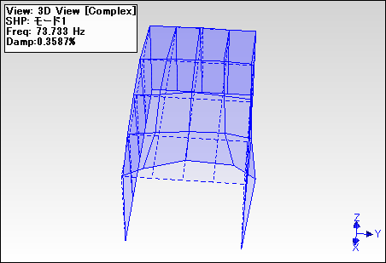
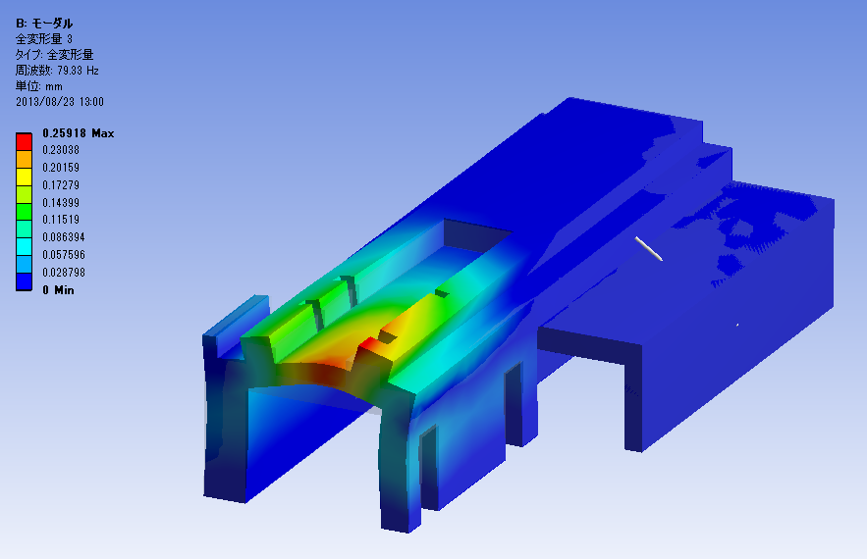
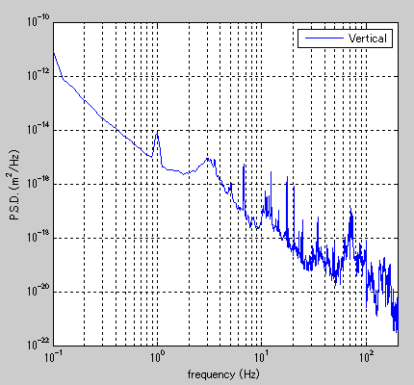
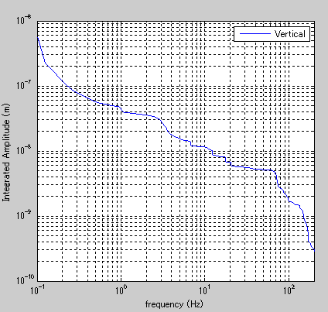
79Hz
74Hz
この点での各値
~5nm<70Hz
→ Measurement data is good agreement with calculation.

Slide 23
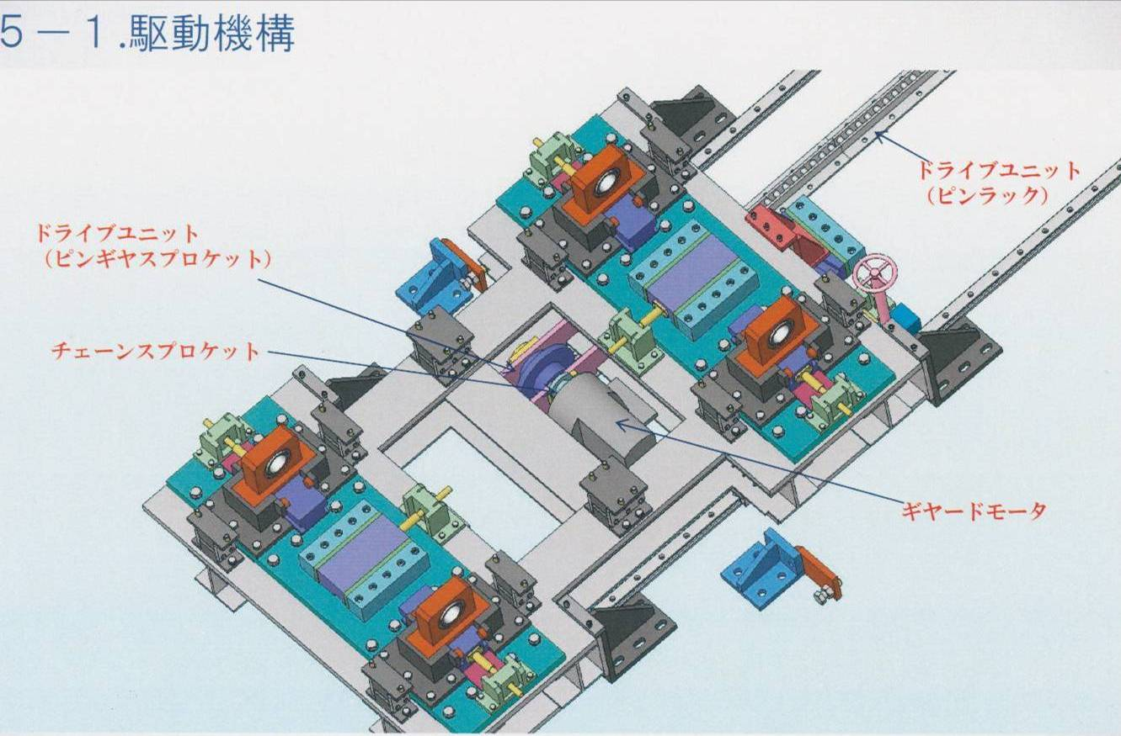
・Motor(2m/mim)
・Hand operation is possible.

Slide 24
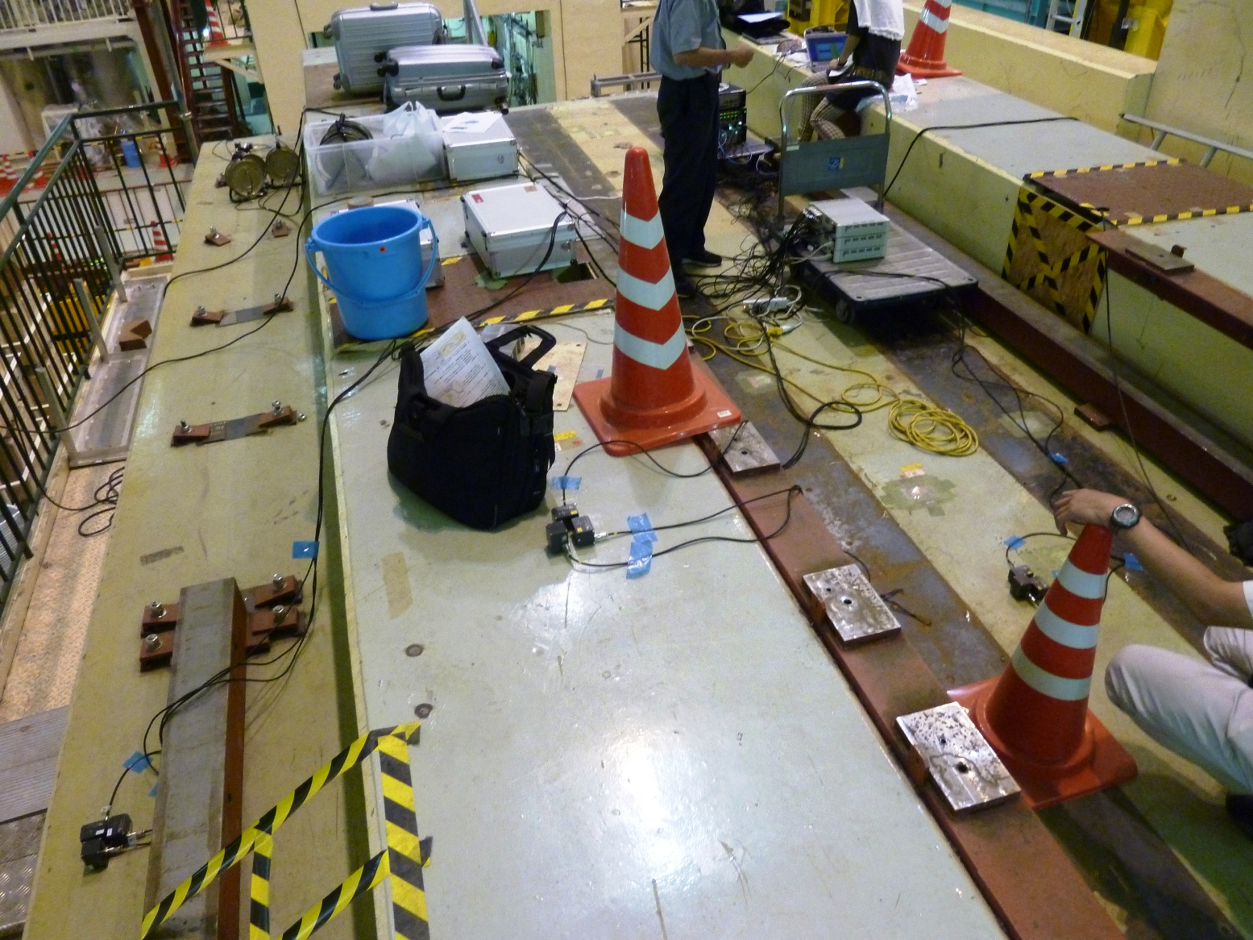
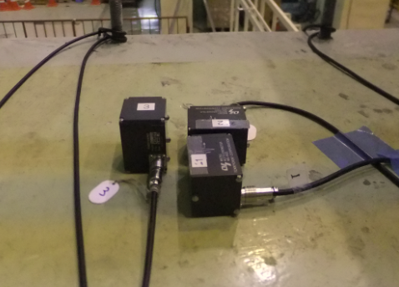
Modal test
Input
Operational Modal Analysis
From Wikipedia, the free encyclopedia
Ambient modal identification, also known as Operational Modal Analysis (OMA), aims at identifying the modal properties of a structure based on vibration data collected when the structure is under its operating conditions, i.e., no initial excitation or known artificial excitation. The modal properties of a structure include primarily the natural frequencies, damping ratios and mode shapes.
Y
Output
Z
X

