Slide 1
Ring commissioning
2015.2.24
SuperKEKB Review
Y. Funakoshi for the SuperKEKB commissioning group and IP orbit FB group

Slide 2
Injection time (question by F. Zimmerman to Kamitani-san)
Injection time
Linac beam charge: 1nC
Repetition rate: 50Hz
To accumulate 1A, it takes about 5 min.
In Kamitani-san’s talk, he mentioned e+ charge of 0.66nC/bunch at the end of Linac. In this case, it takes about 2.5 min. to store 1A in phase 1.
Actual injection time depends on the injection efficiency and the beam lifetime.
At KEKB, a typical injection time for storing the operation beam current (~1.0A e-, ~1.6A e+) was ~30min at 50Hz (sum of e- and e+ injection).

Slide 3
Beam lifetime
 | KEKB (design) |  | KEKB (operation) |  | SuperKEKB Design
 | LER | HER | LER | HER | LER | HER
Radiative Bhabha | 21.3h | 9.0h | 6.6h | 4.5h | 28min. | 20min.
Beam-gas | 45h^{a)} | 45h^{a)} |  |  | 24.5min.^{b)} | 46min. ^{b)}
Touschek | 10h | - |  |  | 10min. | 10min.
Total | 5.9h | 7.4h | ~133min. | ~200min. | 6min. | 6min.
Beam current | 2.6A | 1.1A | 1.6A | 1.1A | 3.6A | 2.6A
Loss Rate | 0.12mA/s | 0.04mA/s | 0.23mA/s | 0.11mA/s | 10mA/s | 7.2mA/s
4nC@25Hz
2.9nC@25Hz
a) Bremsstrahlung
b) Coulomb scattering, sensitive to collimator setting
As for loss rate, beam loss accompanied with the beam injection should be added.

Slide 4
Contents
Update of commissioning scenario
Operation tools
Update of dithering system for beam collision
Collaboration with other laboratories

Slide 5
Contents
Update of commissioning scenario
Operation tools
Update of dithering system for beam collision
Collaboration with other laboratories

Slide 6
Update of commissioning scenario
Time of commissioning
Phase 1: start from Jan.-Mar. 2016
Damping ring commissioning: start before phase 2
Phase 2: start from spring 2017?
Period of commissioning
Damping ring commissioning
3 weeks (old estimation) -> ~3 months (recent more realistic estimation)
More precise consideration of each step
Beast study
Emittance control bump system will be required sometime in phase 1.
We have discussing with Belle II group on the slow control system.
Which kinds of information are needed on both sides as the EPICS records.
How fast? and Time preciseness of the data?
Belle II people wanted to know the history of vacuum pressure change from the beginning of KEKB commissioning.
Required machine time for Beast: ~ 1 week (phase 1), ~2 weeks (phase 2)

Slide 7
SuperKEKB Commissioning Meeting 2011.11.08 Kikuchi, M.
DR Commissioning
LTR commissioning 2 days
BPM commission
First turn 1 day
COD meas. and correction 2 day
BPM commission
Optics meas. 2 days
RTL commissioning 2 days
Injection to LER
25 Hz operation
SR commission
Vacuum scrubbing ~14 days
~ 9 days
~ 3 weeks
by wishful thinking
M. Kikuchi

Slide 8
Commissioning phase 1 (updated) (~5 months)
Machine condition
No QCS, No solenoid (no Belle II), No beam collision
Tuning items (We assume ~1A beam current)
Linac tuning (if necessary)
Basic commissioning of machine (~ 1.5 month)
Injection tuning, Hardware check and bug fix, software bug fix
Vacuum scrubbing (>~3 months) <- important goal of Phase1
Belle II people request enough vacuum scrubbing in this stage (before Belle II roll-in). At least one month with beam currents of 0.5 ~ 1 A.
Detector beam background
Study with Beast detectors, check of collimator system (two new-type collimators in LER)
For beam background machine study, emittance control bump system should be ready to be used sometime in phase 1.
Some optics tuning
With day-1 optics
Low emittance tuning w/o Belle-II solenoid
Study of beam instability (FII, e-cloud, TMC)
Tuning on bunch-by-bunch feedback

Slide 9
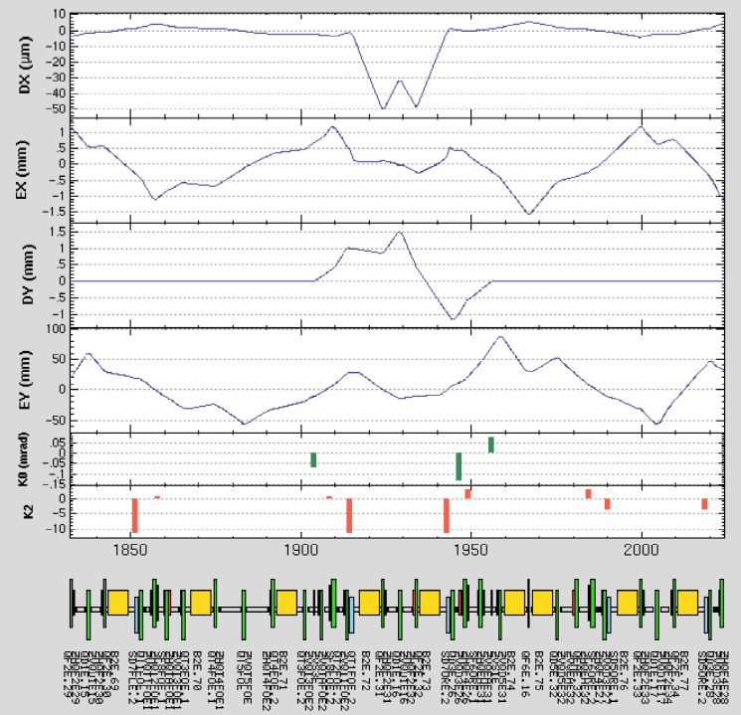
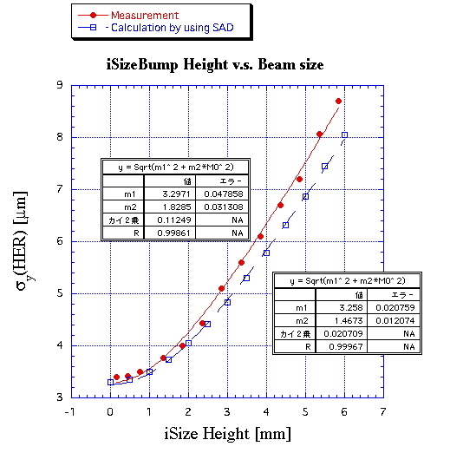
Emittance control bump system at KEKB HER (iSize bump system)
We need to reconfigure the emittance control bump systems for both ring to be used sometime in phase 1.

Slide 10
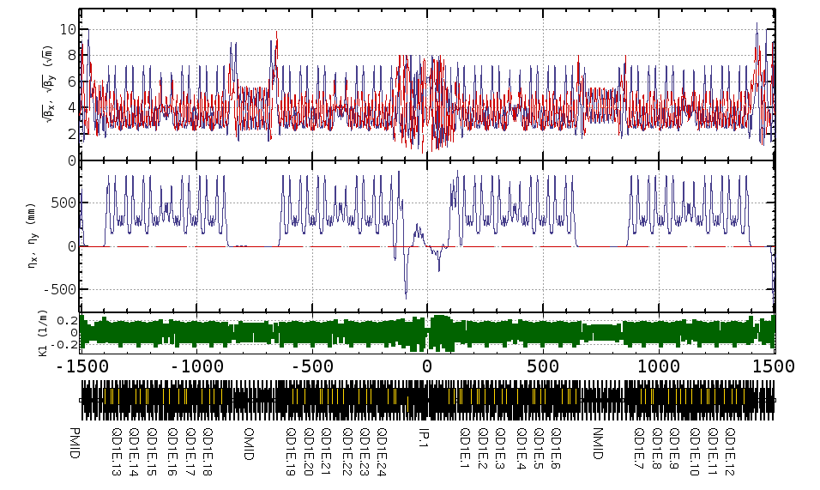
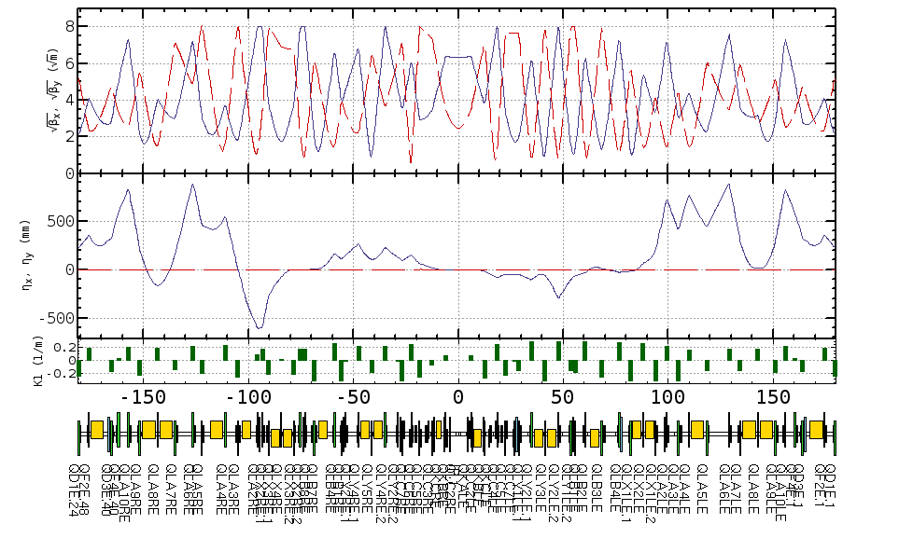
Phase 1 optics (HER)

Slide 11
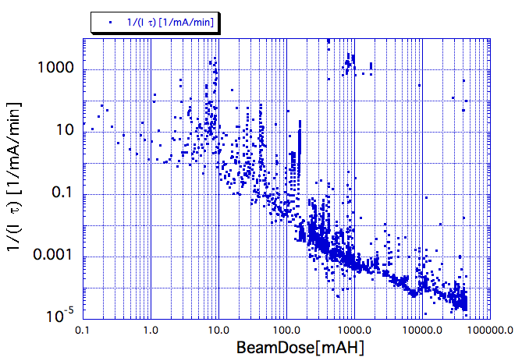
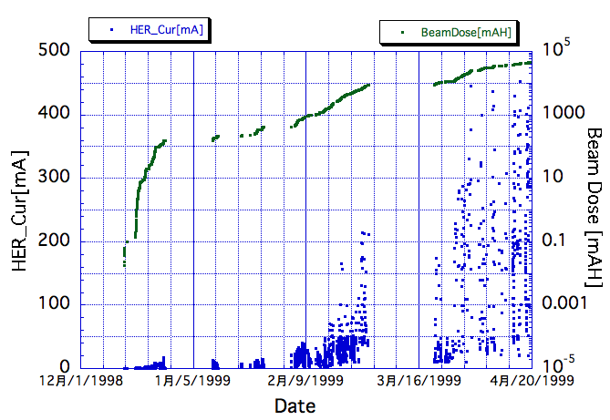
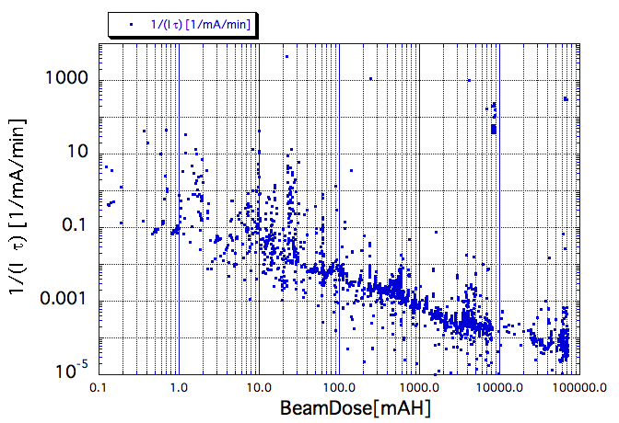
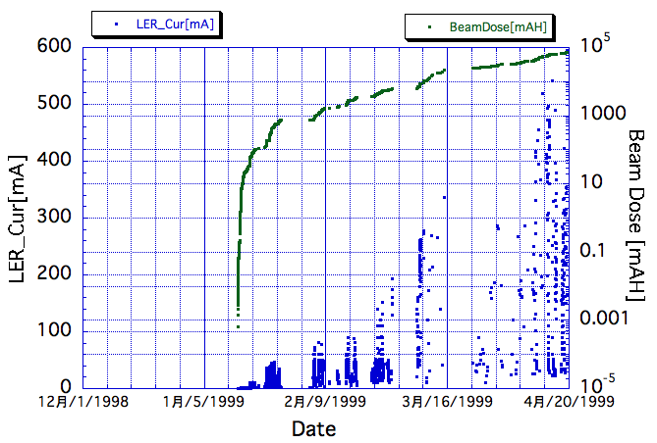
Vacuum scrubbing at KEKB （HER/LER）
HER
HER
LER
LER

Slide 12
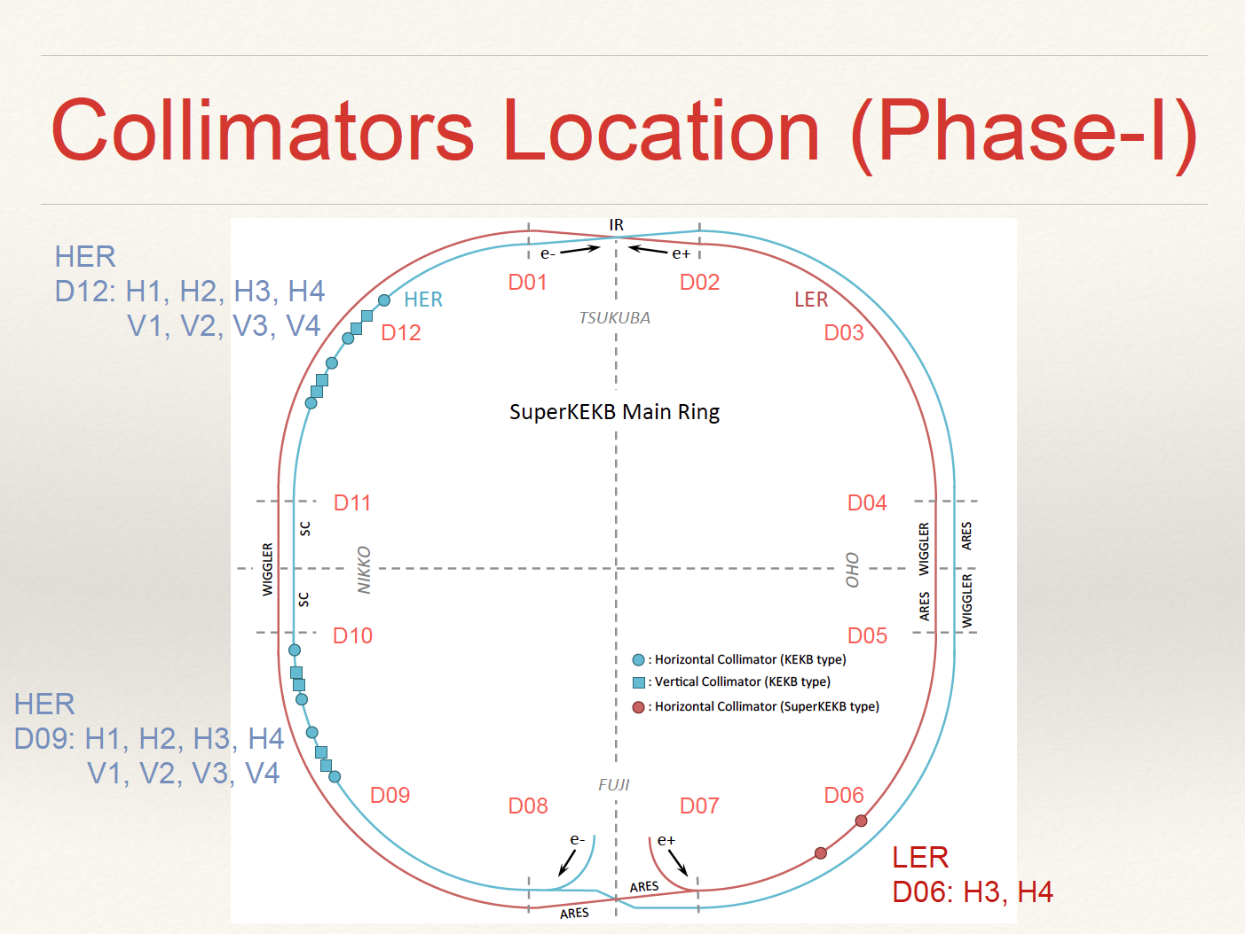
T. Ishibashi

Slide 13
Collimators location (phase 2)
Suetsugu

Slide 14
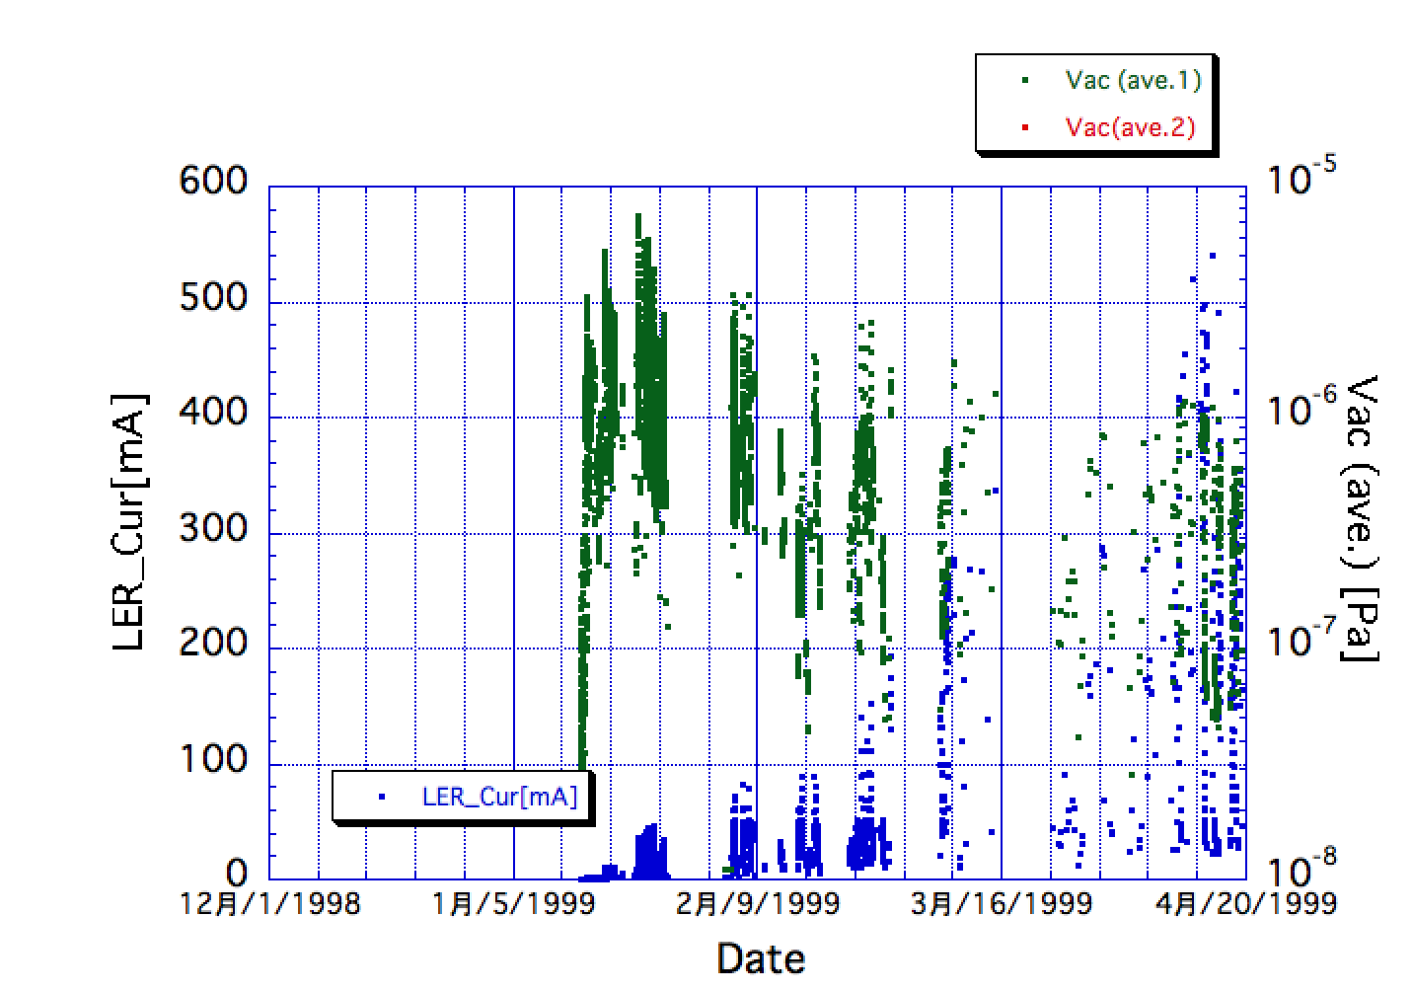
Vacuum pressure (LER) KEKB commissioning phase

Slide 15
Commissioning phase 2 (~5 months)
Machine condition
w/ QCS, w/ Belle II (w/o VXD),TOP detectors partially installed, full accelerator tuning, no physics experiment
Tuning items
Optics tuning
Tentative target values of IP beta’s: βx*: x4, βy*: x8
Optics tuning with QCS and Belle II solenoid
Low emittance tuning w/ Belle II solenoid
Optics tuning w/ beam collision
Detector beam background
Study with Belle II detector, test of continuous injection (BEAST)
Increase of beam currents (instability, RF power, vacuum issues)
Detector background may possibly give some restriction.
Continue upgrade for RF system (support ~70% of design beam currents)
Beam collision tuning
Orbit feedback (fast feedback, dithering system)
Collision tuning w/ “Nano-Beam” scheme
Luminosity tuning
Tuning knobs (x-y coupling at IP etc.)
Target luminosity: 1 x 10³⁴ cm⁻² s⁻¹ (design of KEKB)

Slide 16
Luminosity prospect in phase 2
Three parameters to determine the luminosity
Beam currents
RF system can support 70% of design currents.
We experienced many troubles to increase the beam currents at KEKB.
Beam-beam parameters
Our experience is that the beam-beam parameters were increased very slowly by the many trial-and-errors most of which were unsuccessful.
“Nano-beam scheme” is a new scheme. Maybe we will need a lots of trial-and-errors before we find effective tuning methods with this scheme.
IP beta functions
There is big uncertainty as to how low values of IP beta functions in phase 2.
I think that we have to make many efforts to squeeze the beta functions by making optics corrections (not easy task).
We may need hard time of many years until we approach the design IP beta functions.
The target luminosity in phase 2 is 1x10³⁴ cm⁻²s⁻¹.
There is big uncertainty whether we can achieve this luminosity.
My feeling is that exceeding the KEKB record luminosity (2.1 x10³⁴ cm⁻²s⁻¹) in phase 2 is very difficult, although it is worthwhile to challenge of course.

Slide 17
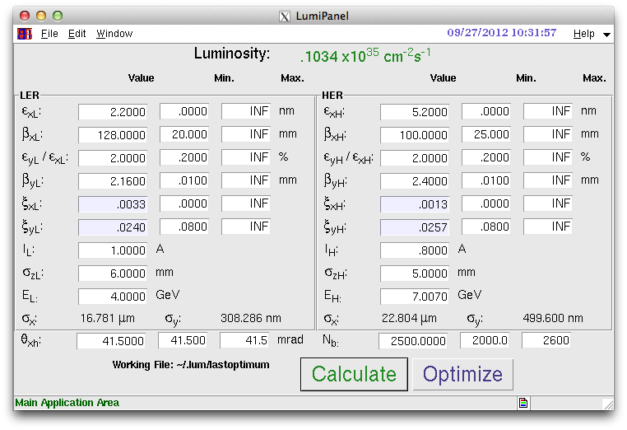
Detuned Optics (4x8)
Example of machine parameters for 10³⁴ cm⁻²s⁻¹
βx*: x4, βy*: x8, x-y coupling =2 %, ξy ~ 0.025, ILER = 1 A.

Slide 18
To do list for commissioning scenario
More concrete plan of each step
We have started discussion also for damping ring
Procedures of optics corrections in main ring and other tools related to the beam optics
Belle II and Beast related issues
Tools for collimator control
Operation energy in phase 2
Requirement to Belle II in phase 2
Beam operation mode from the viewpoint of radiation safety
others…

Slide 19
Contents
Update of commissioning scenario
Operation tools
Update of dithering system for beam collision
Collaboration with other laboratories

Slide 20
Operation tools
Commissioning group asked control group to develop operation tools
Alarm system
At KEKB, a member of commissioning group (K. Oide) developed the system.
Injection control system
Data logging system
KBLog system (upgrade the system used at KEKB)
CSS archiver system (backup)
Task launcher
SAD based system (KEKB) -> CSS based system (SuperKEKB)

Slide 21
New Alarm system for SuperKEKB
In KEKB, we used SAD-based alarm system.
In SuperKEKB, we are going to construct the CSS-based alarm system.
CSS-based Alarm System
Used at PF-AR from 2011 fall. ← operated with no problem so far
Recently installed at Linac.
(J-PARC is also considering to install the system.)
To apply the CSS-based alarm system to SuperKEKB
１） We must make sure that It stably operates under the several
10 thousands alarm data points. (~25,000 in KEKB)
→ We did load tests.
２） We must develop the software tools to meet our accelerator
operation system.
M. Iwasaki

Slide 22
CSS Alarm System
List of EPICS records
to be monitored
Alarm message/ Beep / etc..
XML
Definition setting file
IOC
IOC
IOC
IOC
IOC
IOC
Monitor EPICS records
(monitor the severity)
Alarm Config Tool
Initial setting
Channel Access
Alarm Server
Alarm status
Alarm DB
Show the Current Alarm Status
Alarm log
Alarm status
JMS (ActiveMQ)
Change the setting parameters
Alarm status
JMS2RDB
Alarm Client GUI
Write Alarm Log
Alarm history
Alarm log
Log DB
User
Operator
M. Iwasaki

Slide 23
Test of the CSS Alarm System
- By generating 50,000 test records, we did CSS alarm system load test.
→ Our Alarm system can stably operates.
- We also measured the start up time of the system.
Initial setting
Software IOC
(50,000 record)
Alarm Server
Alarm Config Tool
Alarm Client GUI
JMS2RDB
10-15minutes
20-30 seconds
Directly edit RDB
7minutes
2.5 minutes
20-30 seconds
Total 13.5 to 18.5 minutes
8-10 minutes if we directly edit RDB
Without the initial
parameter setting
Alarm Server
Software IOC
(50,000 records)
Alarm Client GUI
JMS2RDB
2.5 minutes
20-30 seconds
20-30 seconds
Total 3.5minutes
→ To change the alarm configuration during the operation, it takes 3-4 minutes.
Plan: We develop 1) the software IOC to take care of the records which cannot be
directly monitored , and 2) user interface tools.
Takuya Nakamura (Mitsubishi Electric SC) and K. Asano (KIS)
M. Iwasaki

Slide 24
Contents
Update of commissioning scenario
Operation tools
Update of dithering system for beam collision
Collaboration with other laboratories

Slide 25
Update of dithering system for beam collision
Orbit feedback system at IP
Vertical direction: system based on beam-beam deflection (observables: BPM orbit measurement)
Horizontal direction: dithering system (observables: luminosity)
For redundancy, dithering of IP vertical offset and angle can be done.
System layout
We will start with an analog system, which is a copy of PEP-II system, due to a lack of human resources. We will upgrade to a digital system, if necessary.
Components
Fast luminosity monitor, lock-in amps, coils for dithering, dither circuits (drive amps, amplitude and phase adjustment), actuators (slow bump systems which is commonly used for fast vertical feedback), control system (actual feedback algorithm which will be run in an IOC), Power supplies
Collaborations
SLAC
Fabrications of dither coils (2013) and dither circuits (2014)
Simulations (U. Wienands)
LAL-Orsay
Fast luminosity monitor

Slide 26
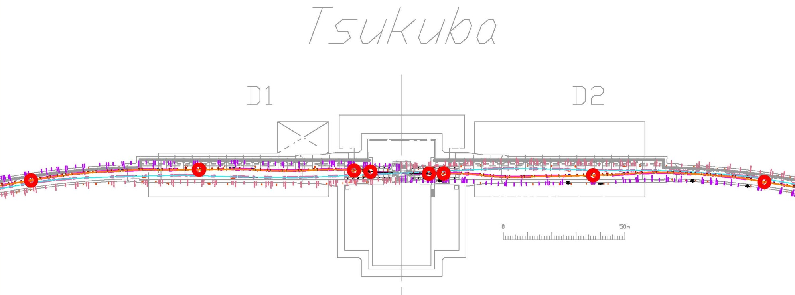
Locations for the dithering coils
8 locations for the dithering coils in LER around IP.
ZDS1LP
ZDS1RP
ZDS2LP
ZDS2RP
ZDS4LP
ZDS3LP
ZDS3RP
ZDS4RP

Slide 27
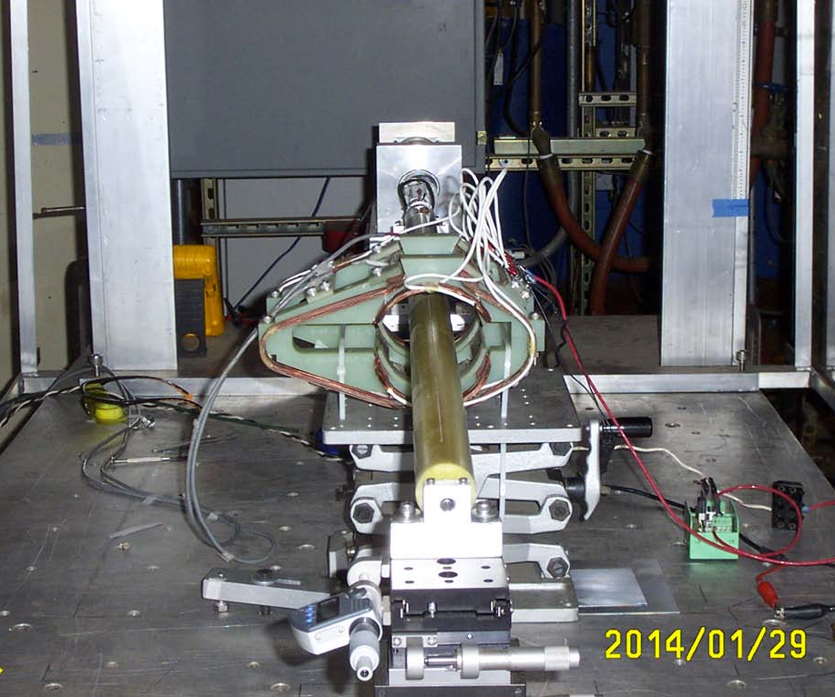
Dither coils: Fabrication and field measurement
Fabrication and measurement were done last year.
All sets of dither coils have been delivered to KEK and will be installed
in LER ring in coming spring.
U. Wienands, S.D. Anderson, MFD Metrology, SLAC

Slide 28
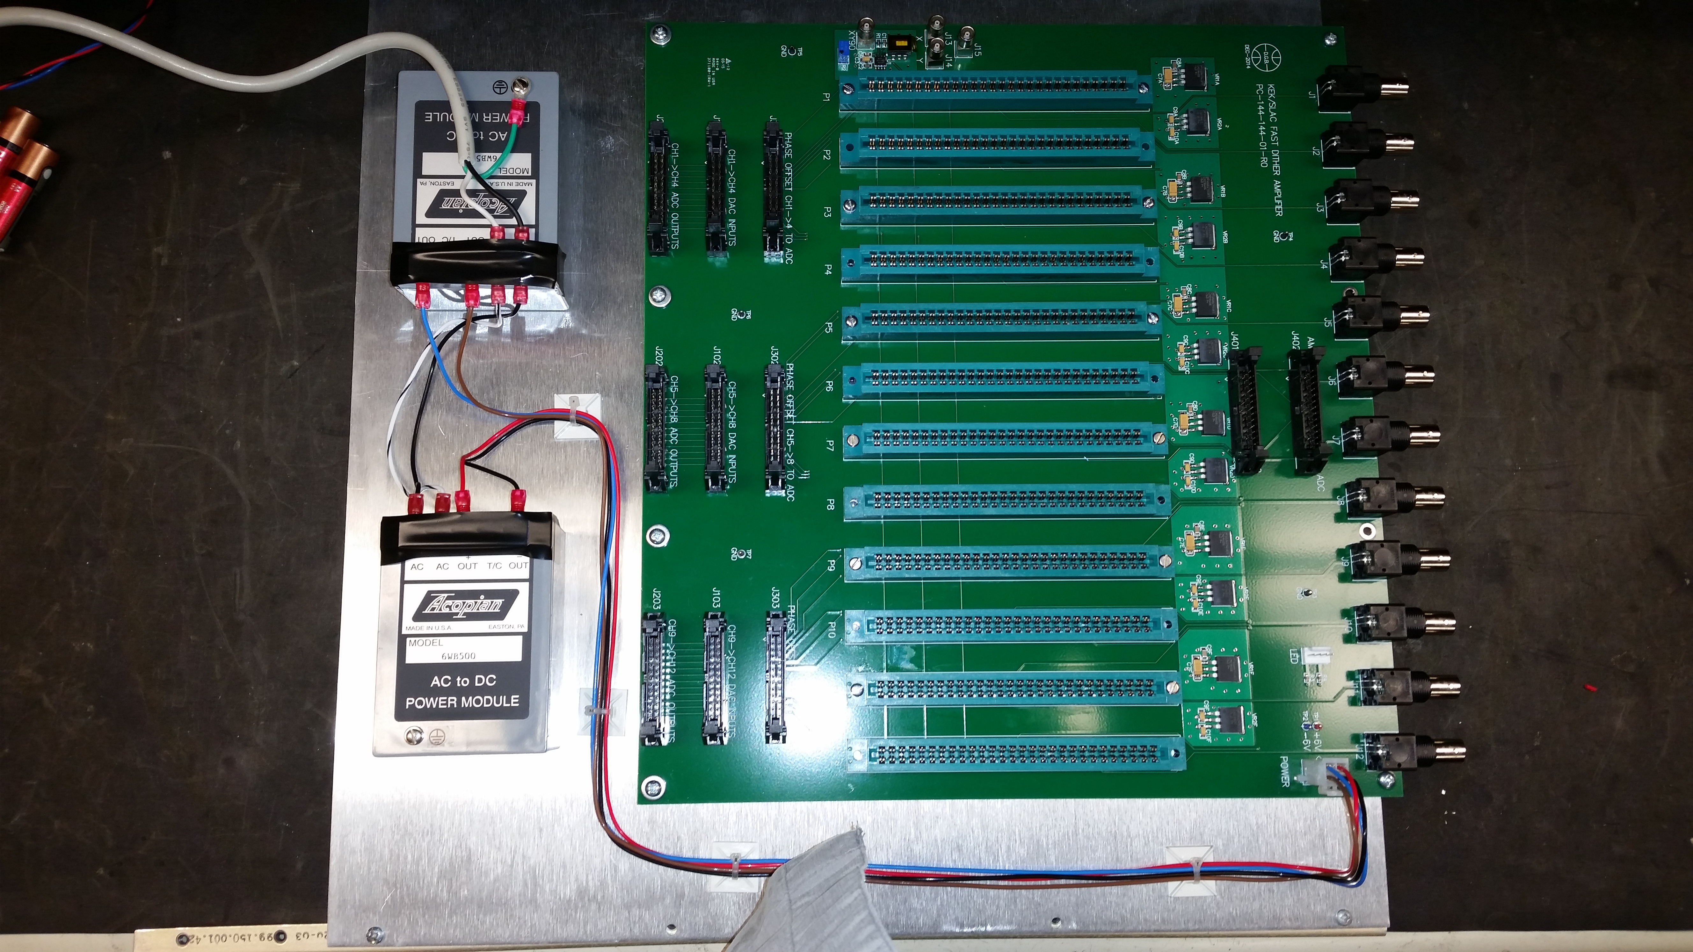
Dither Circuit
An amplifier board has been being fabricated at SLAC and will be completed within this fiscal year.
U. Wienands and D.Brown SLAC

Slide 29
Simulations on dithering system
U. Wienands (SLAC) has been doing the simulations by modifying a code used for PEP-II.
Input data for the simulations
Orbit dependence of the luminosity (K. Ohmi)
Information on accuracy of fast luminosity monitors (P. Bambade(LAL), S. Uehara(KEK))
QCS vibrations in the horizontal direction (H. Yamaoka)

Slide 30
Parameters for dither simulation
initial
First milestone
Design
Luminosity | 1 x 10³⁴ cm⁻² s⁻¹ |  | 1 x 10³⁵ cm⁻² s⁻¹ |  | 8 x 10³⁵ cm⁻² s⁻¹
 | LER | HER | LER | HER | LER | HER
I_{beam} [A] | 1.0 | 0.8 | 2.7 | 1.95 | 3.6 | 2.6
# of bunches | 2500 |  | 2500 |  | 2500
ε_{x}/ε_{y} (nm/pm) | 2.2/44 | 5.2/104 | 3.2/51.84 | 4.6/77.28 | 3.2/8.64 | 4.6/12.88
β_{x}*/β_{y}* (mm) | 128/2.16 | 100/2.4 | 128/1.08 | 100/1.2 | 32/0.27 | 25/0.30
σ_{x}*/σ_{y}*(μm/nm) | 16.8/308 | 22.8/500 | 20.2/237 | 21.4/305 | 10.1/48 | 10.7/59
σ_{x}*_{eff} (μm) | 249 | 208 | 249 | 208 | 249 | 208
ξ_{x}/ξ_{y} | 0.0033/0.024 | 0.0013/0.0257 | 0.0083/0.049 | 0.0052/0.046 | 0.0028/0.0881 | 0.0012/0.0807
Δx (lumi:20% drop) | ~110μm |  | ~55μm |  | ~10μm
Lumi. meas. | 1kHz |  | 1kHz |  | 1kHz
accuracy | ~5 x 10⁻³ (w/ radiator) |  | 1.3 x 10⁻³(w/o radiator) |  | < 1 x 10⁻³
σ_{x}*_{eff} = σ_{z}sinφ

Slide 31
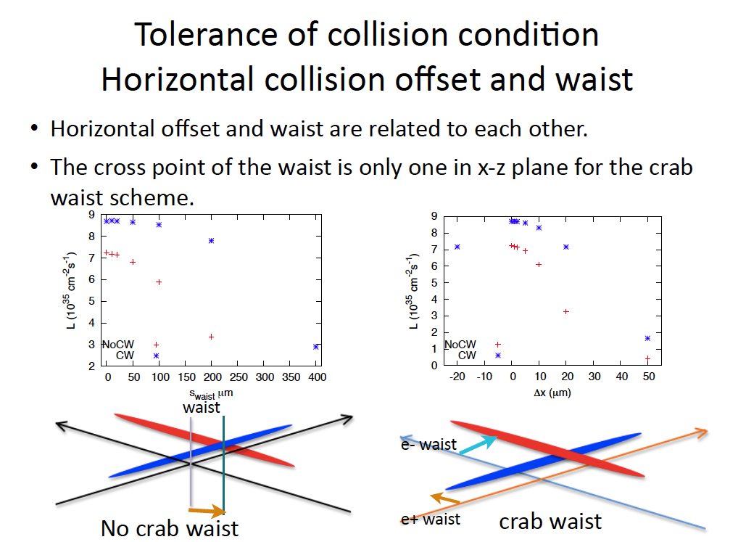
K. Ohmi
β_{y}*~300μm
S_{waist}:1/10 β_{y}* (~30μm)
-> Lum. Loss ~ 3.5%
Δx = Tan[2φ]*Δs
Δs=30μm -> Δx = =2.5μm

Slide 34
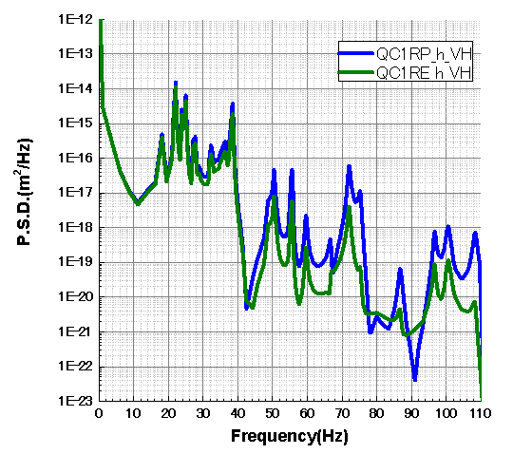
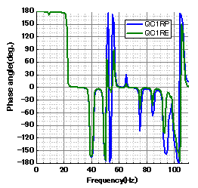
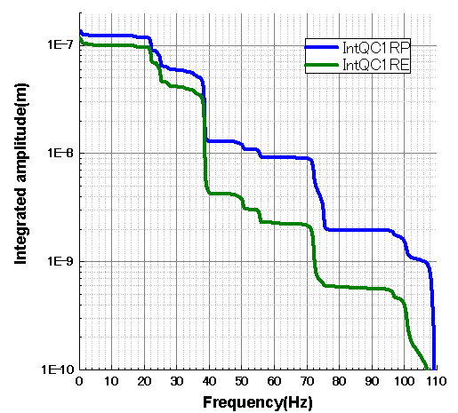
Results（QC1R)
Integrated amplitude (> 1Hz) ~< 0.1 μm
QC1RP and QC1RE vibrate coherently up to ~50Hz.
U. Wienands
Simulation by H. Yamaoka

Slide 35
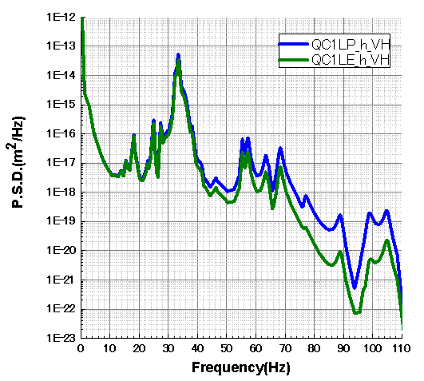
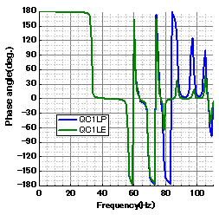
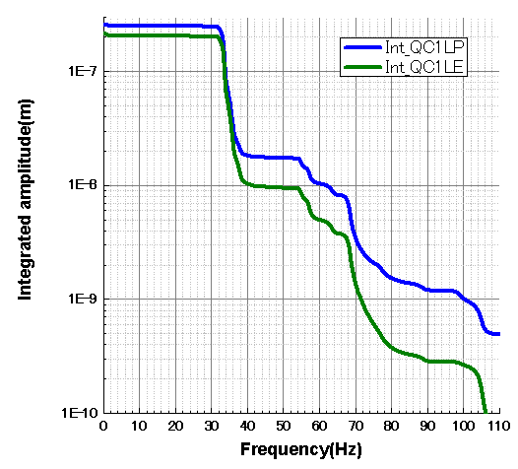
Results（QC1L)
Integrated amplitude (> 1Hz) ~< 0.2 μm
QC1LP and QC1LE vibrate coherently up to ~80Hz.
U. Wienands
Simulation by H. Yamaoka

Slide 36
Orbit change at IP with 1μm offset of QCS magnets
Lattice : sler_1689, sher_5769
 |  | K1 (/m) | Distancefrom IP [m] | β_{Q} [m] max. | β_{IP}[mm] | Δψ_{y}/2π | COD@IPfor 1μm Q-offset [μm]
QC1L (V) | LER | -1.721 | 0.920 | 2897.7 | 0.27 | 0.24995 | -0.734
 | HER | -1.206 | 1.165 | 5834.8 | 0.3 | 0.24995 | -0.768
QC1R (V) | LER | -1.712 | 0.930 | 2897.8 | 0.27 | 0.24995 | -0.736
 | HER | -1.140 | 1.172 | 5895.0 | 0.3 | 0.24995 | -0.730
QC1L (H) | LER | 1.721 | 0.920 | 153.0 | 32 | 0.24364 | 0.867
 | HER | 1.206 | 1.165 | 310.7 | 0.3 | 0.24616 | 0.901
QC1R (H) | LER | 1.712 | 0.930 | 156.9 | 32 | 0.24372 | 0.882
 | HER | 1.140 | 1.172 | 305.5 | 0.3 | 0.24619 | 0.857
>
>
>
>
V:1μm (QC1 offset) <-> ~0.7μm orbit change at IP
H:1μm (QC1 offset) <-> ~0.9μm orbit change at IP
COD
U. Wienands
Horizontal orbit vibration due to QC1 vibration (~ <1Hz) ~< 0.2 μm

Slide 37
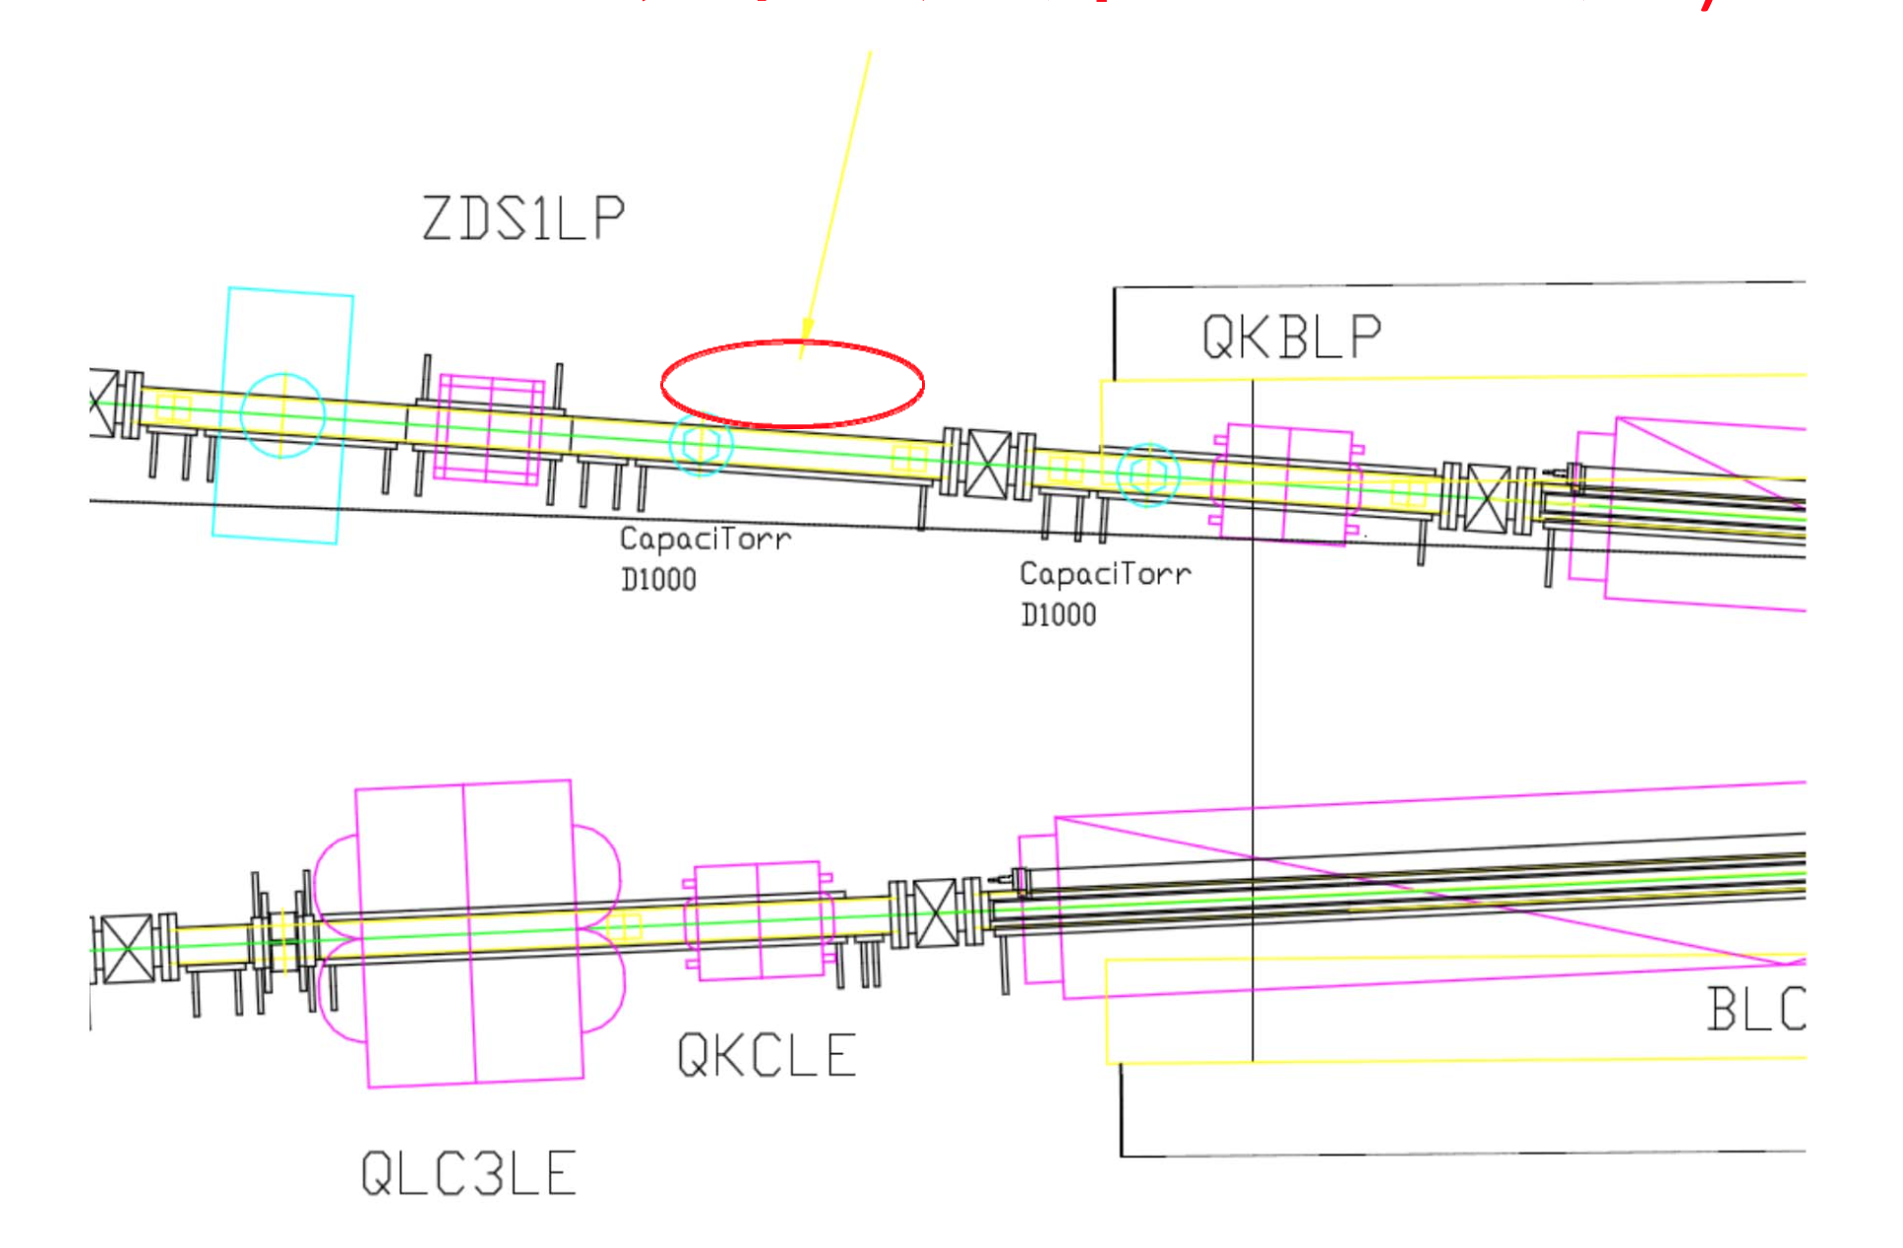
Location of fast luminosity monitor
12m downstream of IP Monitor detects lost positrons
As a backup, another fast luminosity monitor will be installed in 28m downstream of HER, which detects photons from Radiative Bhabha scatterings.

Slide 38
Proposed vacuum chamber modification for fast luminosity monitor by LAL
Kanazawa-san is considering the design for this chamber. Impedance issues have been studied by Shibata-san. The chamber is considered to install for phase 2 operation.

Slide 39
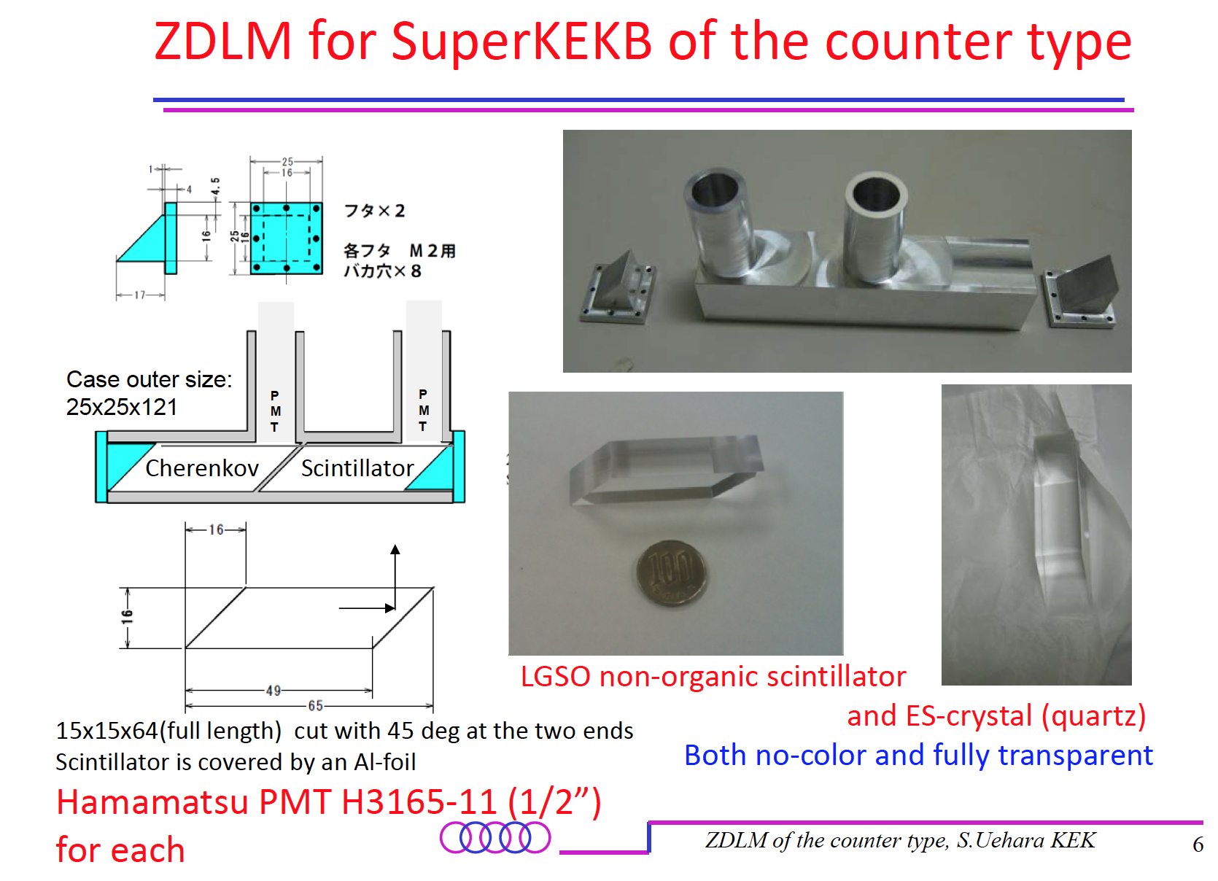
S. Uehara

Slide 40
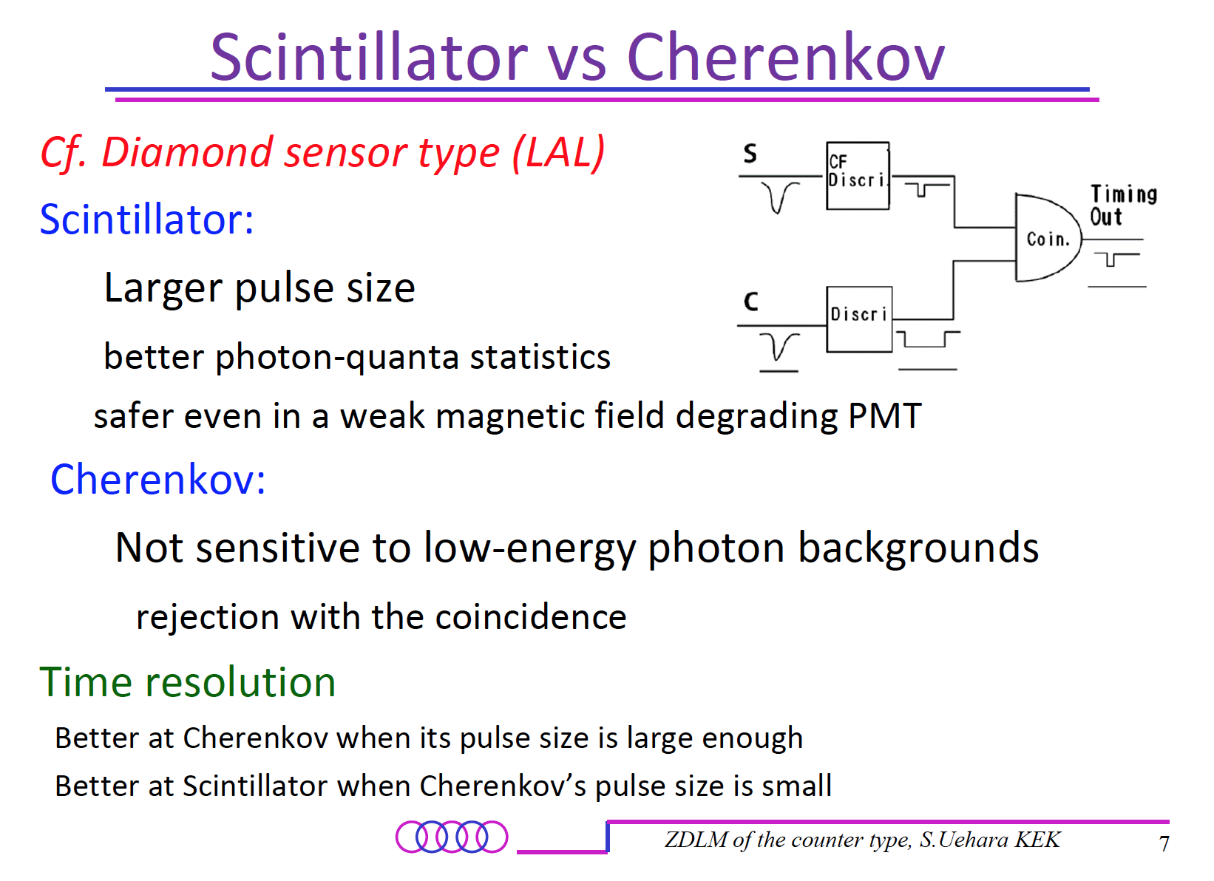
S. Uehara

Slide 41
Contents
Update of commissioning scenario
Operation tools
Update of dithering system for beam collision
Collaboration with other laboratories

Slide 42
Collaboration with other laboratories
Japan/US Cooperation Program
Coordinator: M. Tobiyama
TYL-FJPPL
Others
Collaboration with NLF, IHEP, BINP…
Very important for SuperKEKB

Slide 43
US-Japan collaboration
Collaboration with SLAC, FNAL, BNL, Cornell ...
Draws on deep experience base of US accelerator laboratories to solve these challenging problems.
Utilizes existing facilities and outstanding human resources of US laboratories to assist in constructing SuperKEKB accelerator components.
Develops and tests SuperKEKB components using working accelerators.
Both KEK and US laboratories have much to gain from collaboration.
Achieve high luminosity faster!
M. Tobiyama

Slide 44
Project overview
Development and fabrication of accelerator components important to the construction and operation of the SuperKEKB accelerator
Collaborate with SLAC to develop
IP collision feedback systems (4,500k JPY, to US 4,000k JPY)
Fast luminosity monitor
Beam collimators (7,500k JPY)
Beam background, Machine Detector Interface
Accelerator Physics
Main Ring commissioning
Damping Ring commissioning
Linac commissioning
BPM for Linac/BT
X-band deflecting cavity
Stripline kicker for high beam current
X-ray detector
Flux Concentrator to increase capture efficiency of positrons
Beam energy calibration using laser Compton scattering
M. Tobiyama

Slide 45
Project overview (cont)
R&D on accelerator technology important for the next generation of high luminosity colliders.
Development of general purpose bunch-by-bunch feedback systems (KEK, SLAC) (3,000k JPY, to US 2,000k JPY)
Development of bunch-by-bunch X-ray beam size monitor using coded aperture mask (KEK, Univ. Hawaii, Cornell Univ., SLAC)
(8,900k JPY, to US 8,900k JPY)
Development of Large Angle Beamstrahlung Monitor for collision monitoring (KEK, Wayne State U.) (1,100k JPY: to US 1,100k JPY)
Study of electron cloud instability and its cure (KEK, SLAC, LBNL, Cornell Univ., FNAL) (5,000k JPY)
Simulation of beam-beam interactions on various accelerators (KEK, SLAC, LBNL, Cornell Univ., FNAL) Total budget 30,000k JPY
R&D of injector components(KEK, SLAC) Travel 4,500k + 700k JPY
Supported by US-Japan Collaboration since FY2003
M. Tobiyama

Slide 46
Collaboration with LAL-Orsay
Framework
Collaborative work in the framework of TYL-FJPPL (Toshiko Yuasa Laboratory, France Japan Particle Physics Laboratory)
LAL: P. Bambade, C. Rimbault, D. E. Khechen, D.Jehanno
KEK: S. Uehara, Y. Funakoshi, M. Iwasaki
Budget (300kYen(KEK), ~7000€(LAL) in FY 2014)
Status
Fast luminosity monitor system based on diamond sensor has been being developed at LAL.
To determine the location of the monitor, beam loss simulations have been done using SAD and GEANT4.

Slide 47
SuperKEKB-LNF collaboration
Proposal by the LNF scientists (December 2013)
1) Feedbacks implementation (collaboration started already, Contact Person: Dr. Alessandro Drago),
2) Optics studies, in particular the problem of the “crab waist” sextupoles (Contact Person: Dr. Maria Enrica Biagini),
3) Lifetimes and backgrounds studies (Contact Person: Dr. Manuela Boscolo),
4) Rings injection studies (Contact Person: Dr. Susanna Guiducci).
Status
Things seem to have been delayed in Director General/Trustee-level communication between both labs.
We have received official endorsement from a Trustee (Okada-san) and have begun discussing and writing a rough draft of collaboration agreement.

Slide 48
Collaboration with Frascati
Proposal from LNF (Dec. 2013)
Four possible collaboration topics have been propsed:
1) Feedbacks implementation (collaboration started already, Contact Person: Dr. Alessandro Drago)
2) Optics studies, in particular the problem of the “crab waist” sextupoles (Contact Person: Dr. Maria Enrica Biagini)
3) Lifetimes and backgrounds studies (Contact Person: Dr. Manuela Boscolo)
4) Rings injection studies (Contact Person: Dr. Susanna Guiducci)
Status
Since the proposal was offered to KEK, things have been delayed in Director General/Trustee-level communication between both labs.
Recently, we have received an official endorsement from the trustee, Okada-san, and have begun discussing and writing a rough draft of collaboration agreement.
D. Zhou in this MAC

Slide 49
Remarks
The collaborative works with other laboratories have been very helpful for the construction of SuperKEKB.
The beam commissioning will start next year and the collaborations will be increasingly important, since SuperKEKB is very difficult machine for achieving the design performance.
Recommendations from the committee members are very important as the past recommendations.

Slide 50

Congratulations on the 20th anniversary of
the KEKB Accelerator Review Committee!!!
The KEKB accelerator members really appreciate your pertinent recommendations that we have got a lot of benefit from and the continuous encouragements and supports.
We wish to celebrate a great success of SuperKEKB
in the 30th anniversary of the review committee!

Slide 51
backup slides

Slide 52
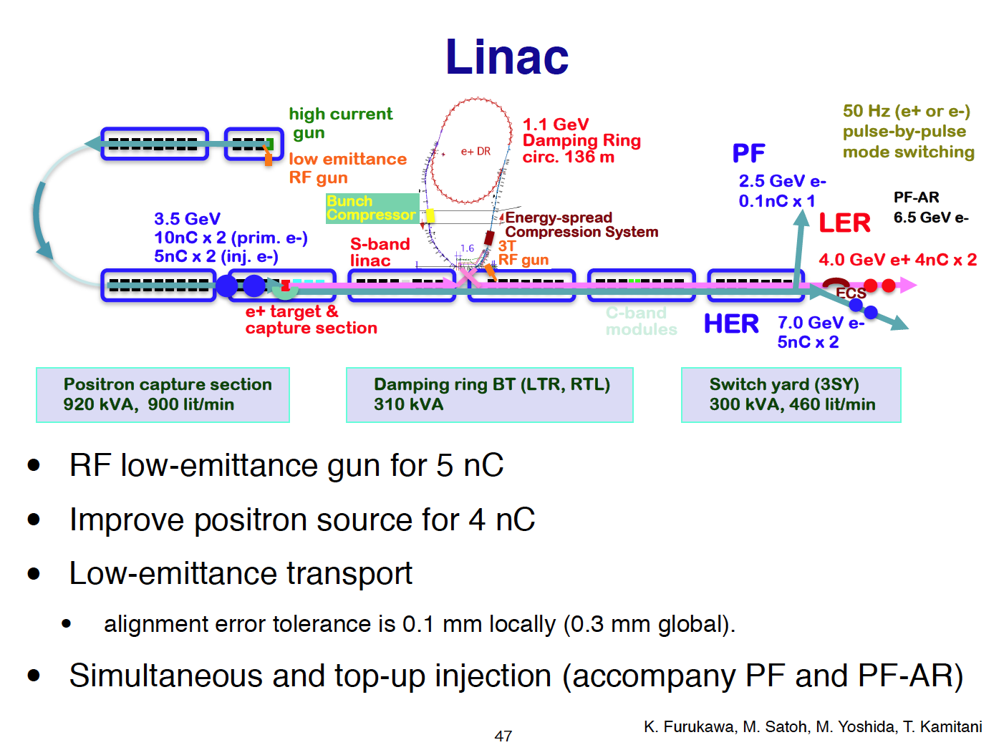
SuperKEKB requirements (tentative)
 | KEKB (e+/e-) | SuperKEKB (e+/e-)
Charge [nC] | 1/1 | 4/5
Normalized emittance[μm] | 2100/300 | 100/50 (H)
 |  | 20/20 (V)
09:50 Injector commissioning and issues 30'
Speaker: Masanori Satoh (KEK)

