Slide 1
Alignment of injector linac
KEKB Accelerator Review
24 February, 2015
Toshi Higo (Injector linac group)

Slide 2
Contents
Initial alignment along laser line
Hard ware alignment on each girder.
Floor movement
Near future development
Conclusion

Slide 3
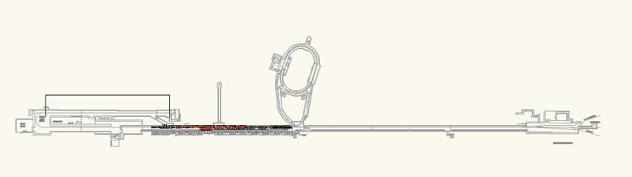
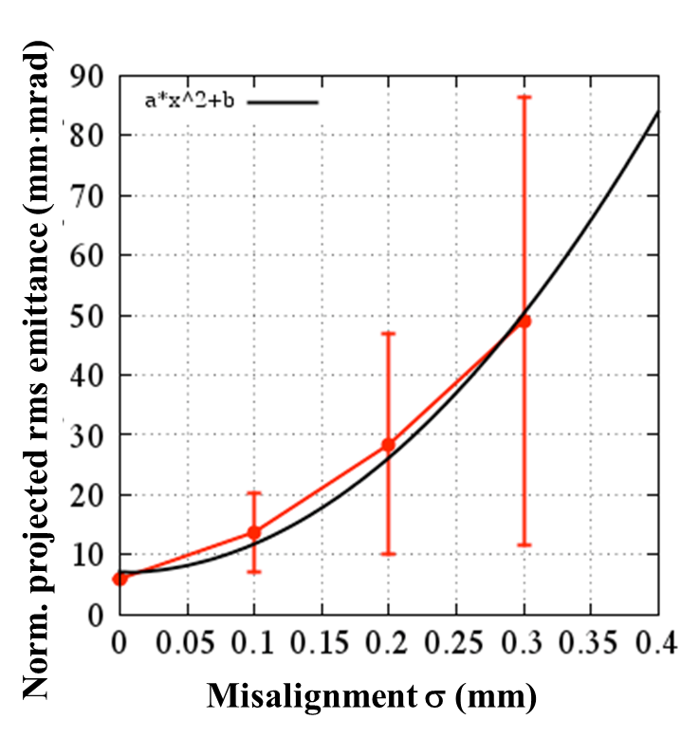
Linac layout and alignment requirement
120m
B
A
Rings
J-ARC
C
1
2
3
4
5
500m
σ < 0.1 mm: βγε 20 mm·mrad is almost satisfied.
σ > 0.1 mm: emittance preservation is required by some methods.
Requirement
Local σ < 0.1mm
Global σ < 0.3mm

Slide 4
Alignment method
Reflectors for laser tracker use
4
Reference point of girder
Hard ware
Mechanical reference
3
2
Girder set to laser reference by PD
Support set w.r.t. mecha. reference
Hard ware aligned with mecha. reference
Hard ware alignment checked by tracker
1
Laser PD
Girder

Slide 5
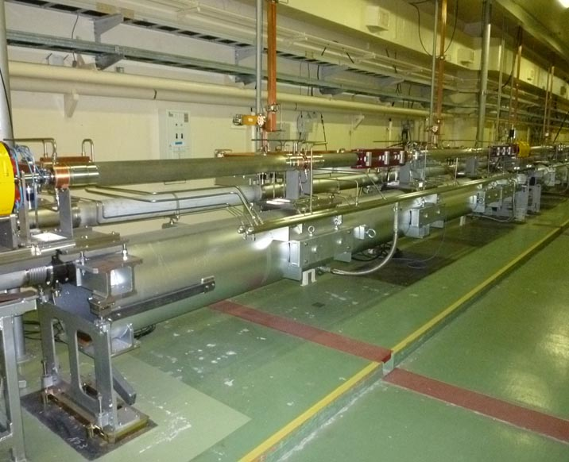
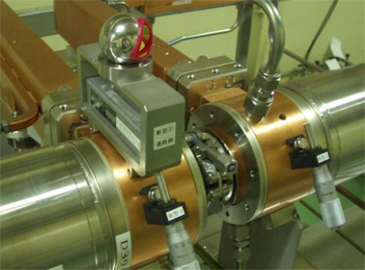
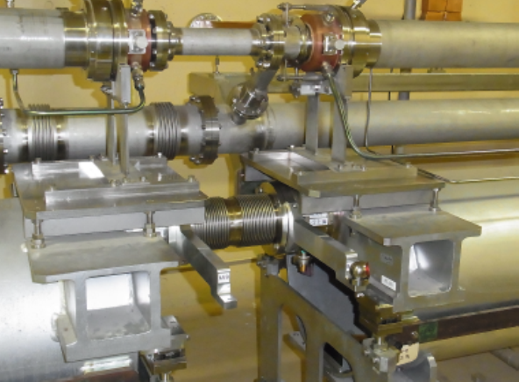
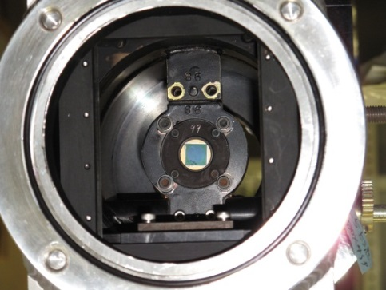
Hard wares around standard 9.6m girder
Acc Structure
e+- beam
He-Ne Laser line
Laser pipe
Accelerator Girder
4-segmented silicon PD (dia.=10mm)
Standard unit
Arm from PD
to reflector

Slide 6
Major steps since last review
Established 500m laser straight reference line over C—5
Established reference points for DR
Installed target/FC followed by LAS with Solenoid and large-aperture Q magnets
First girder alignment done in 3—5 sectors by laser PD
Hard ware alignment on each girder done with laser tracker
Done alignment on old Q magnets with laser tracker
Done stiffening of girders, especially positron line
Completed initial alignment of 3—5 sector with laser PD
Further evaluated floor movement
Installation of heavy radiation shield on positron generation system underway

Slide 7
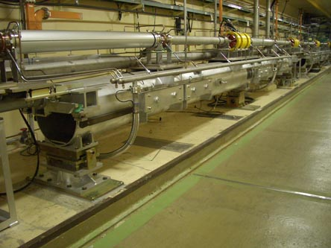
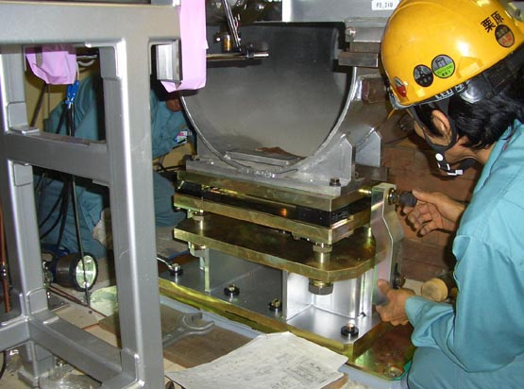
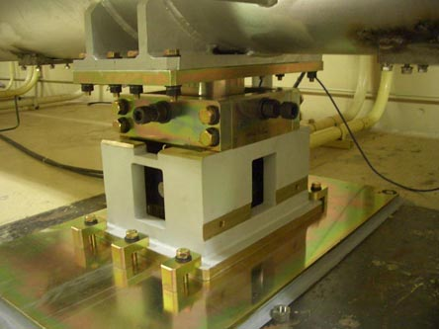
Stiffening of 9m-girder
Soft: metal plate spring
→
Stiff: slide roller with bolt fixing
Eigen mode frequency
Several → more than 10 Hz
End hor. slider
Center pivot

Slide 8
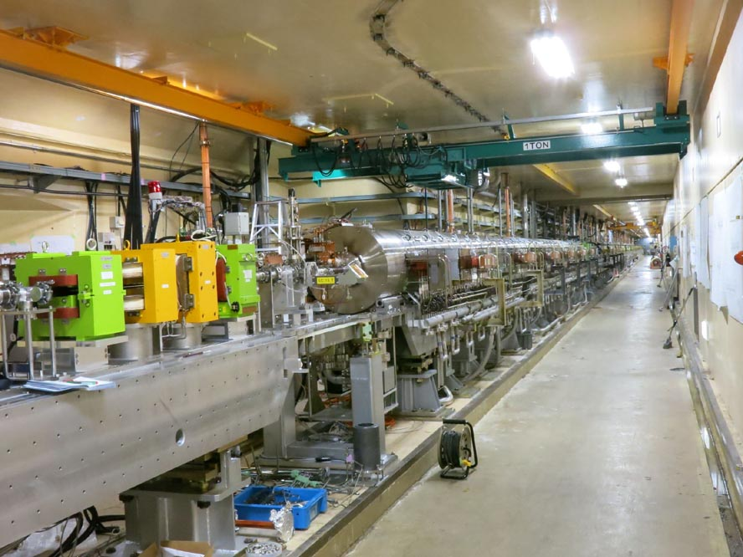
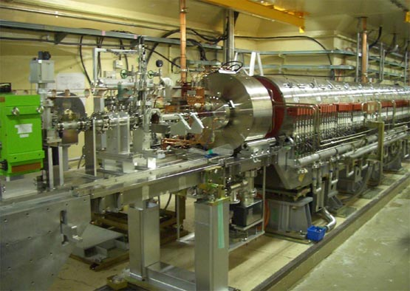
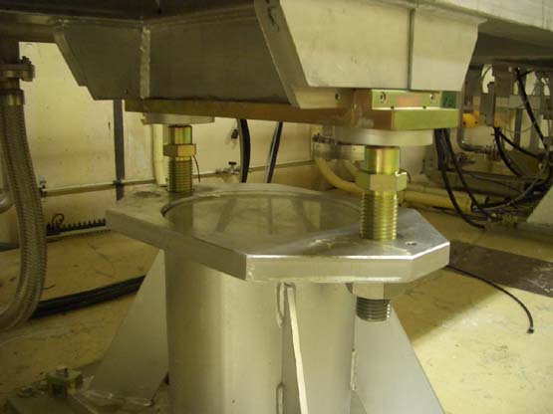
Positron generation and acceleration
FC
Solenoid
New aluminum girders
Road cell with ball
→ Jack bolt

Slide 9
1. Initial girder alignment

Slide 10
Straight laser reference line
500m laser line was stabilized by feed back.
We can routinely measure C-5 sector by laser PD system
Some developments may still be needed
Easy sensitivity calibration and absolute zero position
Cares against radiation damage
However, at a moment
Because the system is most practical, we utilize it for initial alignment
Automatic in/out devices were developed to monitor floor motion continuously

Slide 11
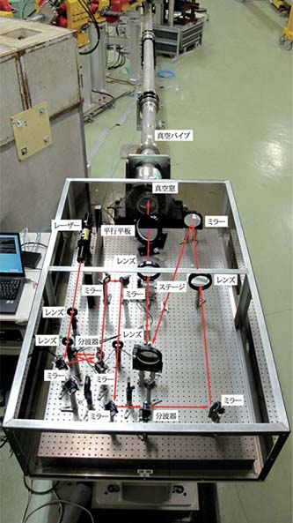
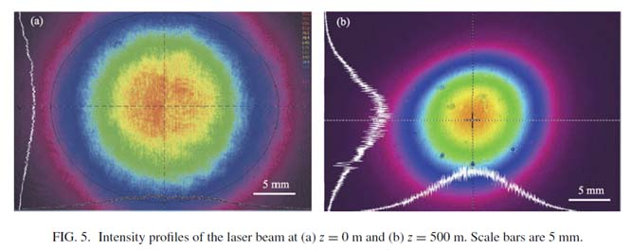
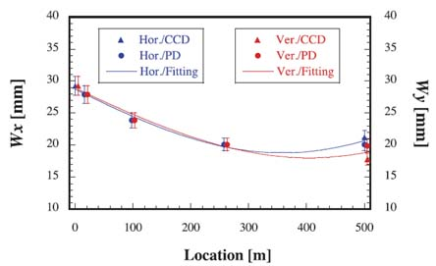
500m straight reference line by laser
Gaussian beam
Tilt feedback

Slide 12
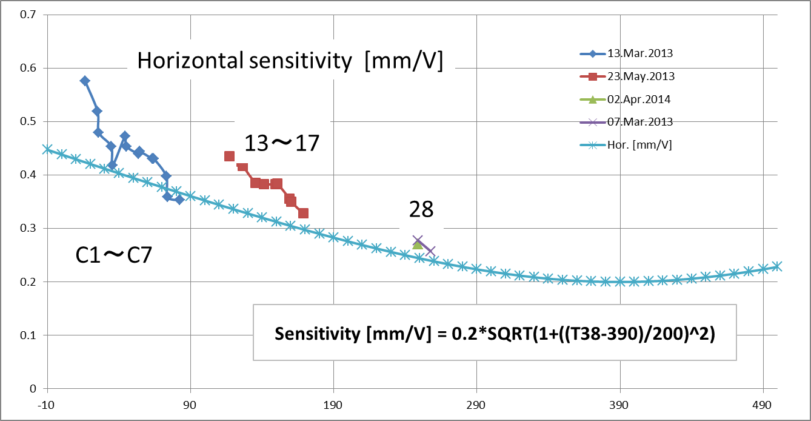
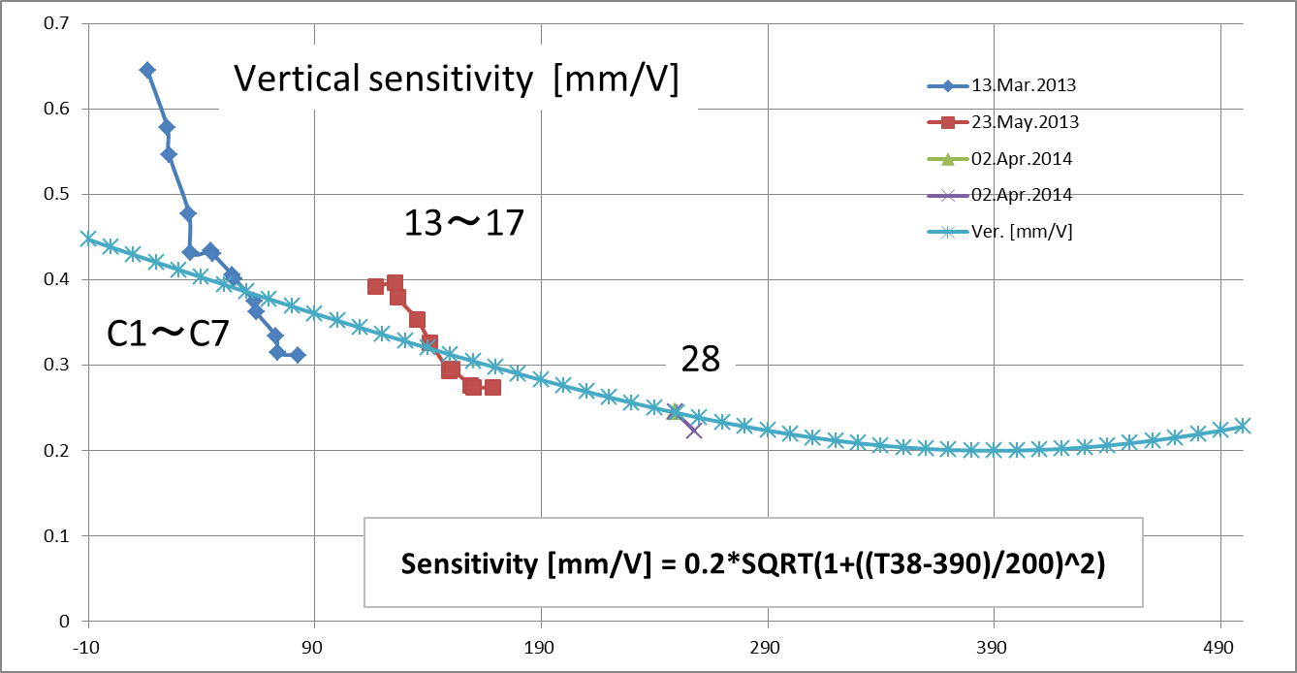
PD sensitivity
Fitted with Rayleigh function along 500m linac was used in the present analysis
Recent estimation from mechanical girder movement in 3—5 sector
Sensitivity varies by a factor 2 , but the center identified as zero output voltage should be OK

Slide 13
Finished initial alignment of girders
Girders in sectors 3—5 were quickly aligned in 2011 after the earthquake.
Positron generation area was installed by the summer 2014.
Until late July 2014, C—5 sectors were aligned with leaving V-shape residual.
In late Jan. 2015, all in the 3—5 sectors were aligned straight, except for the C-band unit at 44.

Slide 14
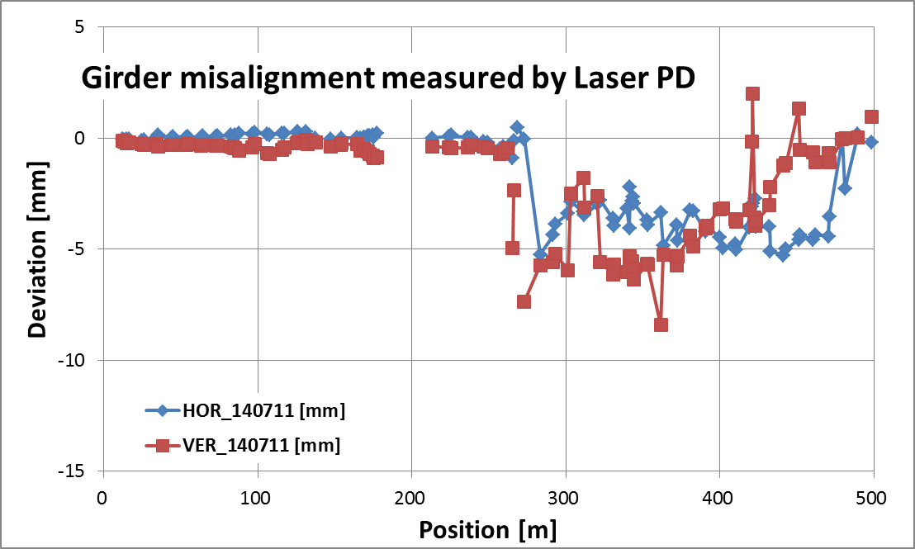
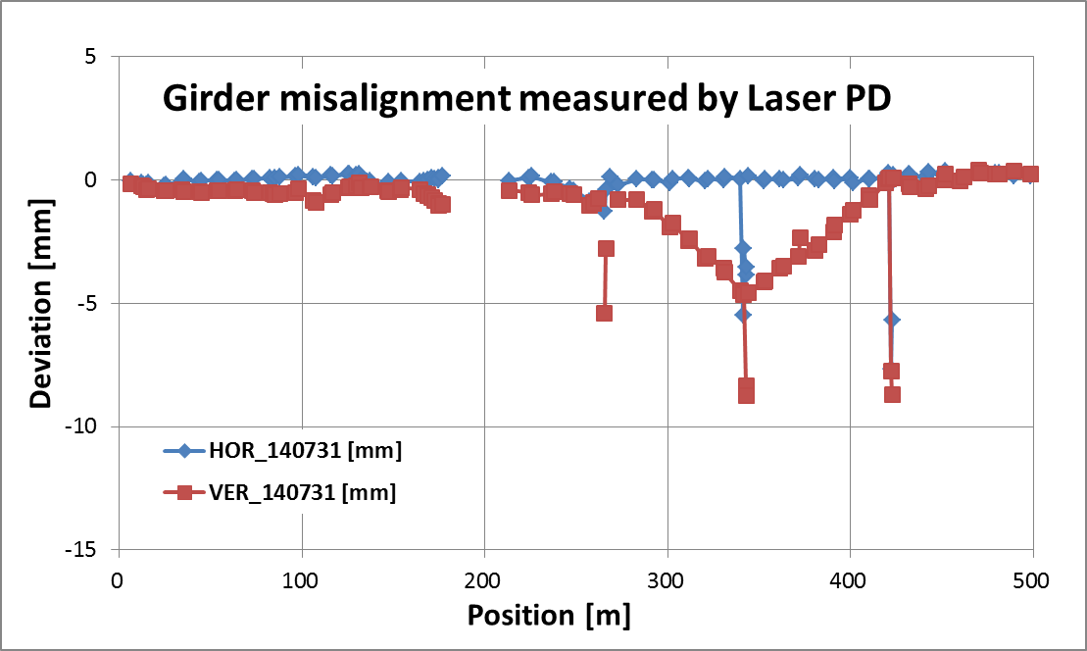
3—5 alignment in Summer 2014
C 1 2 3 4 5
C-2 sectors were aligned by laser PD, but 3-5 sectors were kept with preliminary alignment correction since earthquake.
After alignment in summer 2014.
Big spike-like misaligned points are those to be corrected between standard girders.

Slide 15
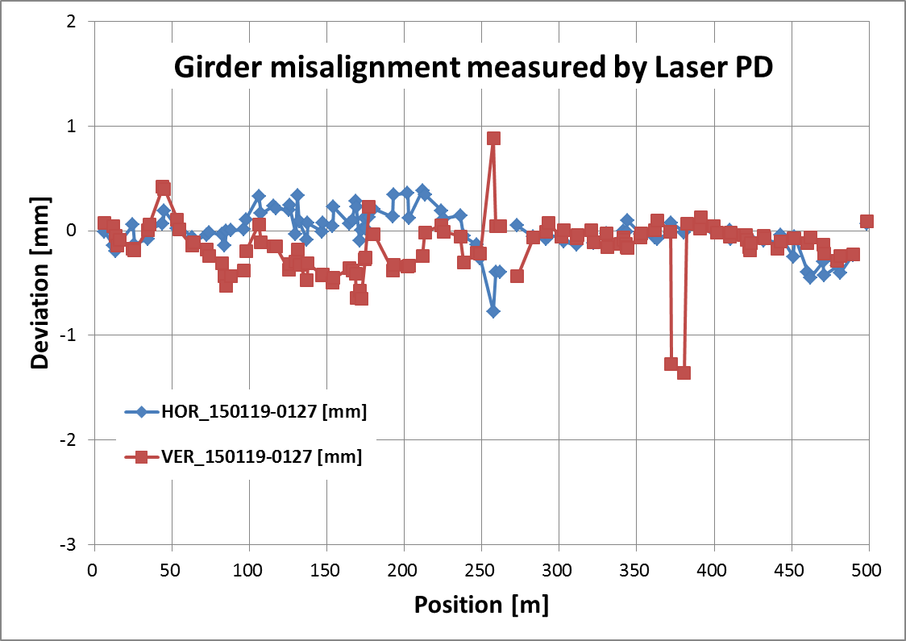
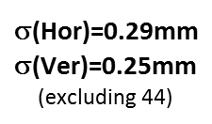
Present 500m alignment over C-5 after completion of initial alignment in late Jan. 2014

Slide 16
Summary of girder alignment
Girder alignment can be done with the present laser PD system probably within 0.2mm in sigma.
Residual misalignment of the first initial alignment was 0.3mm in sigma, mainly comes from those aligned earlier but moved later in a year scale.
Floor moves in a big scale, especially at expansion joint, so that the swift measurement is needed, or the movement should be taken into account.

Slide 17
2. Hard ware alignment on girder

Slide 18
Hard ware alignment on each girder
Accelerator structures in units at sectors 3-4-5 were corrected during summer shutdown in 2014, followed by those in sectors A-B-C-1.
Reflector base was put on the top of old Q magnets. Their alignment was measured and mostly corrected.
New Q magnets with big bore were set w.r.t. the mechanical reference on girder. Confirmation is yet to be done.

Slide 19

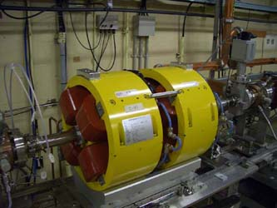
Reflector setting for hard ware positioning
Mounted on coupler OD
Reflectors for old Q-magnet
Arm from PD to reflector

Slide 20
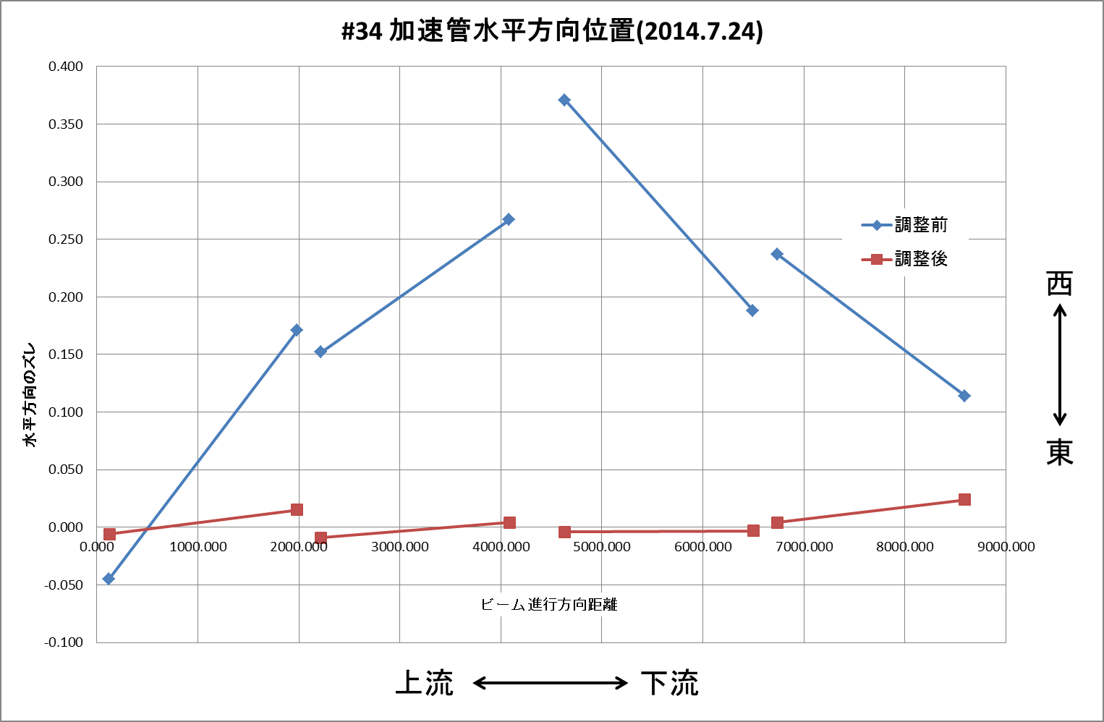
ACC str. In unit 34 Horizontal
ACC Structure
Before adjust
W
E
After adjust
10m size

Slide 21
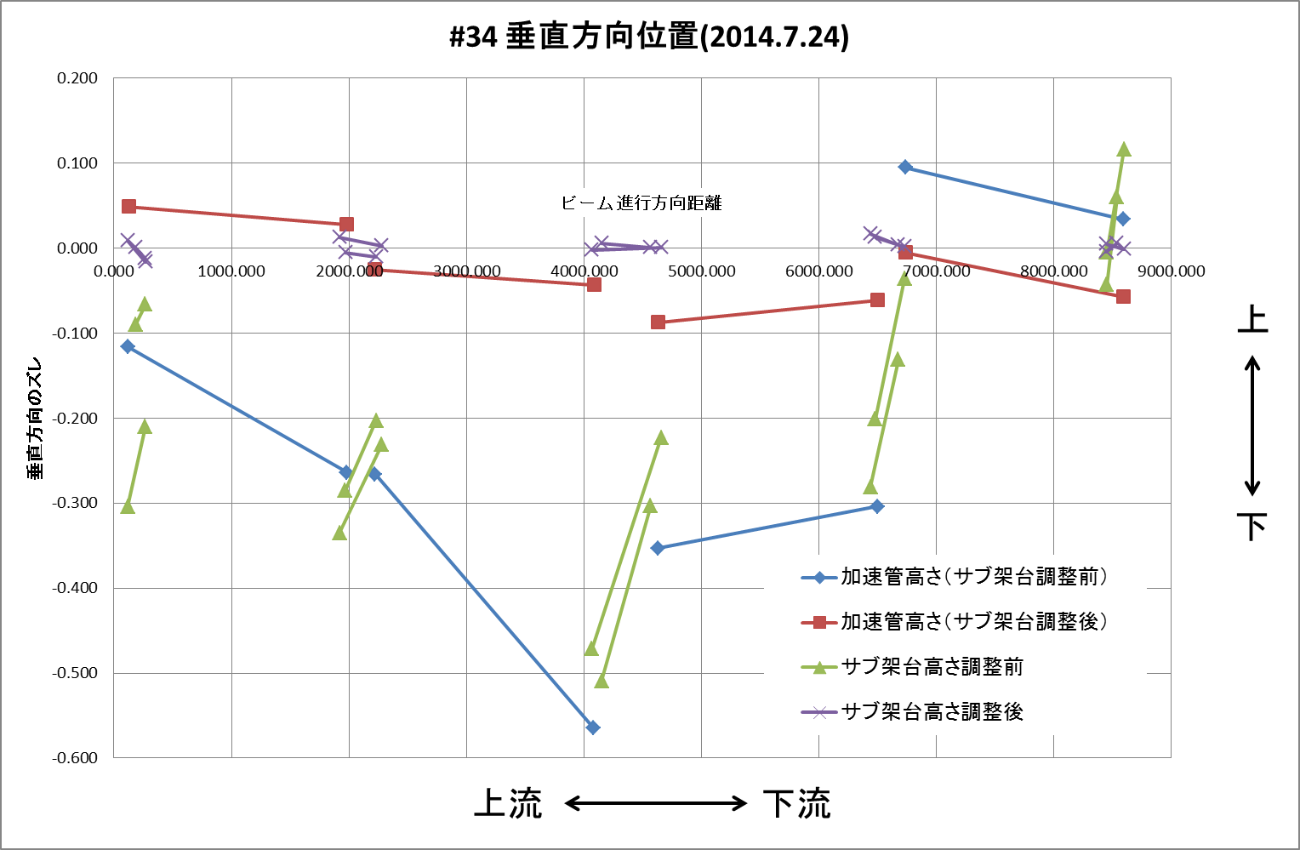
ACC str. In unit 34 Vertical
ACC Structure
Mecha. reference
After adjust
UP
DN
Before adjust
10m size

Slide 22
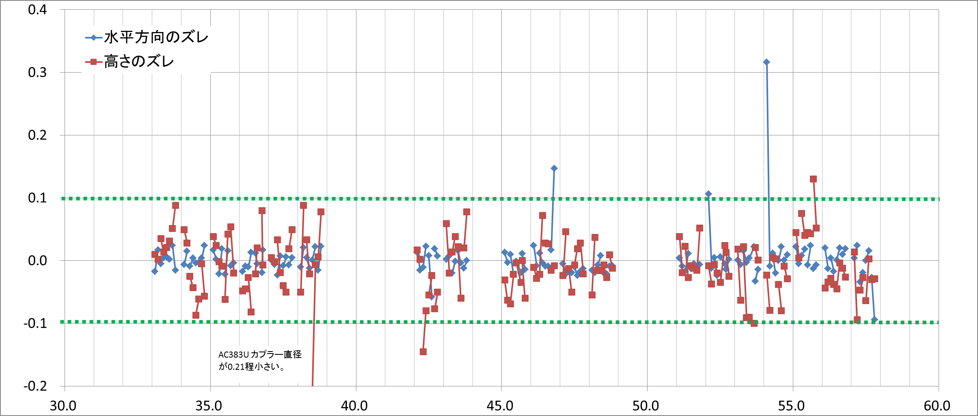
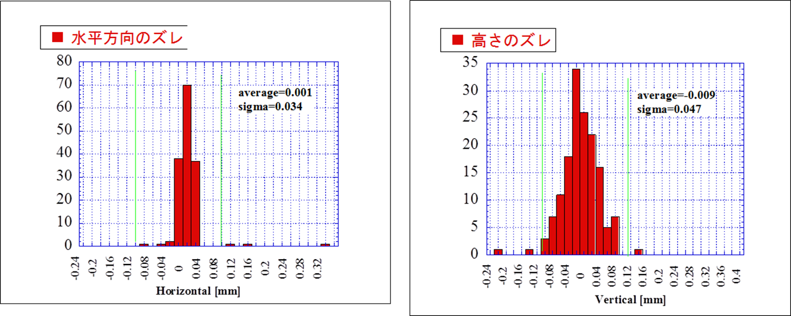
Hard ware alignment on a girders in sector 3—5
Horizontal
Vertical
Horizontal
σ=34μm
Vertical
σ=47μm

Slide 23
Alignment error estimation w.r.t. reference straight line
Laser straightness
Pointing stability being fedback → σ~0.05mm
Girder alignment error
Setting errors → σ~0.3mm
PD sensor setting error on holder → σ~0.015mm
Radiation damage of PD sensors → ?
PD center to girder for setting laser tracker reference
Arm setting error → σ_{v}~0.05mm
Girder reference to hard ware setting
Tracker confirmation of reference position → 0.05mm/5m
All the above in random manner
~0.3mm which will be improved by more alignment times to probably 0.2mm level, unless any systematic error is left

Slide 24
3. Floor movement

Slide 25
Floor moves significantly
It has been long pointed out.
Laser PD monitor over half a year showed
Significant movement being localized at junction
Mostly vertical (upward from summer to winter) by a few to several mm.
Following pages show the movements.

Slide 26
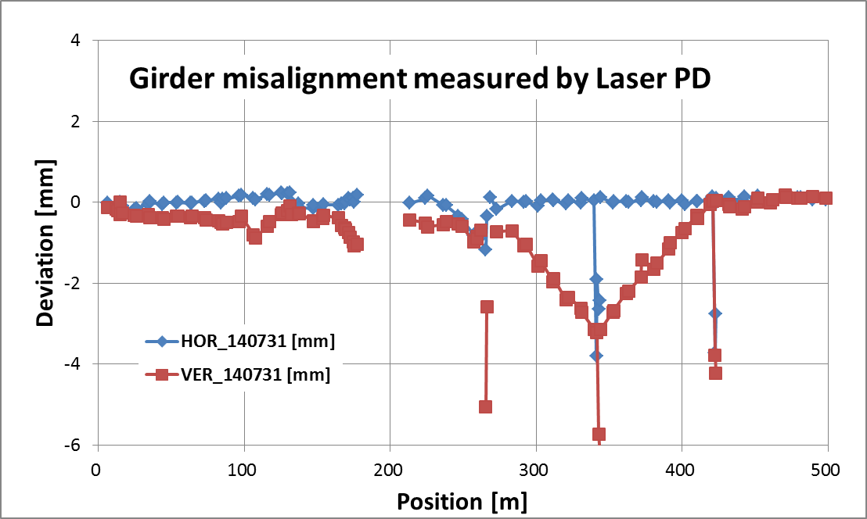
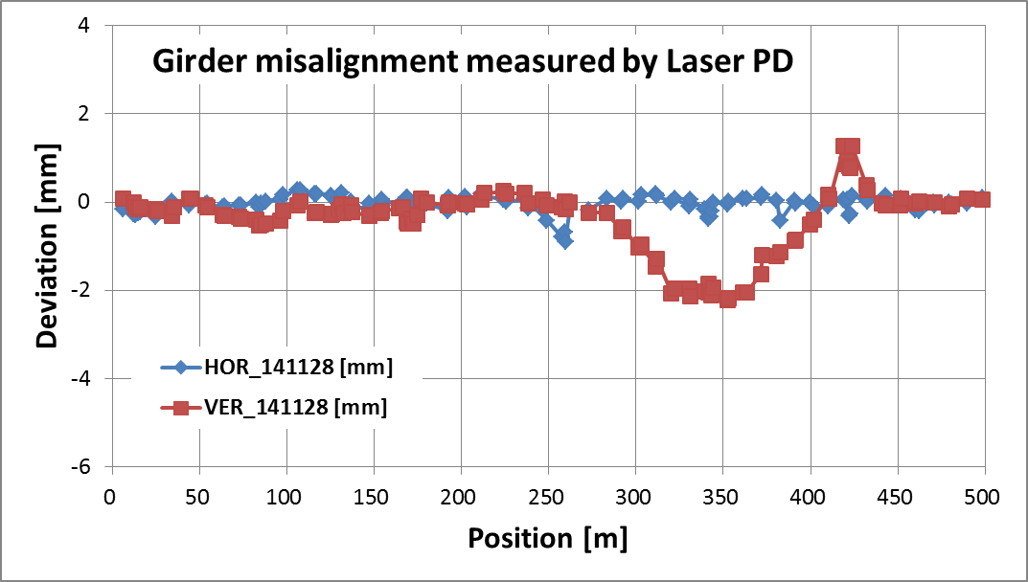
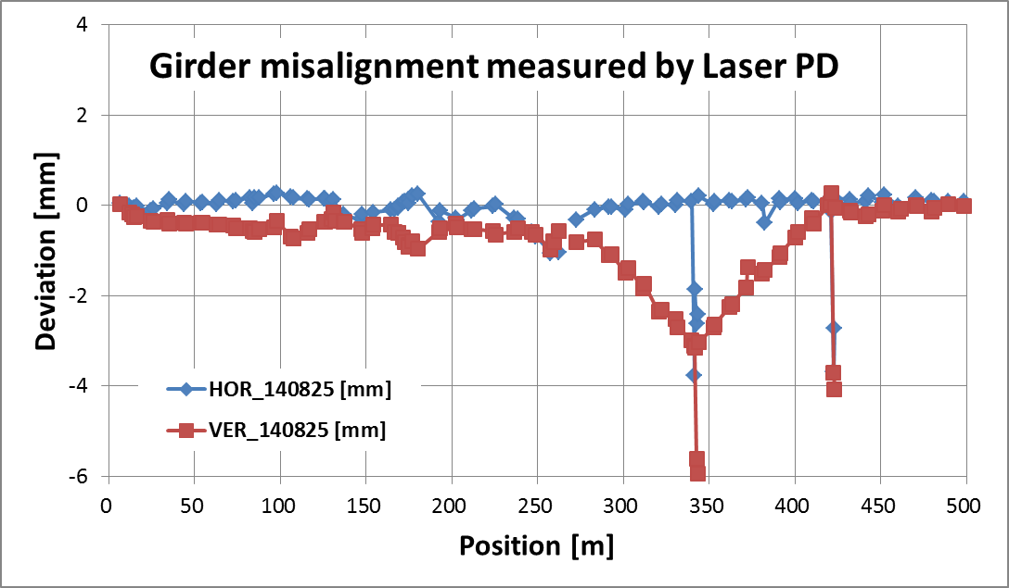
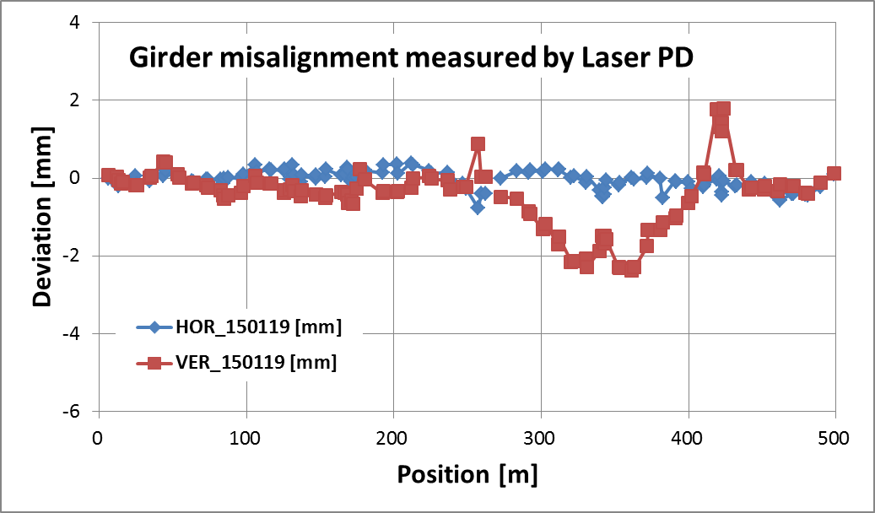
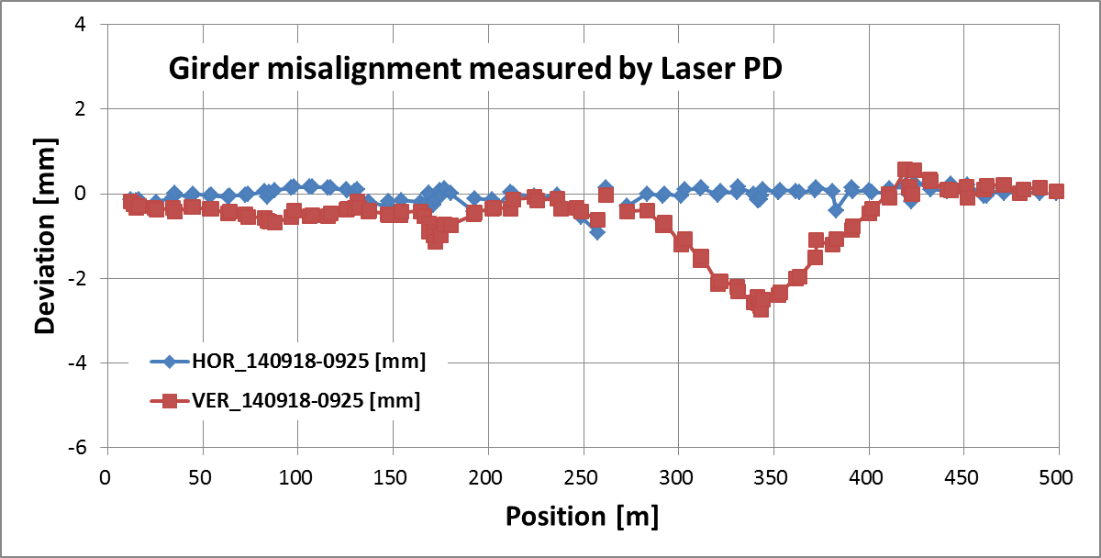
Variation in half a year from July to January

Slide 27
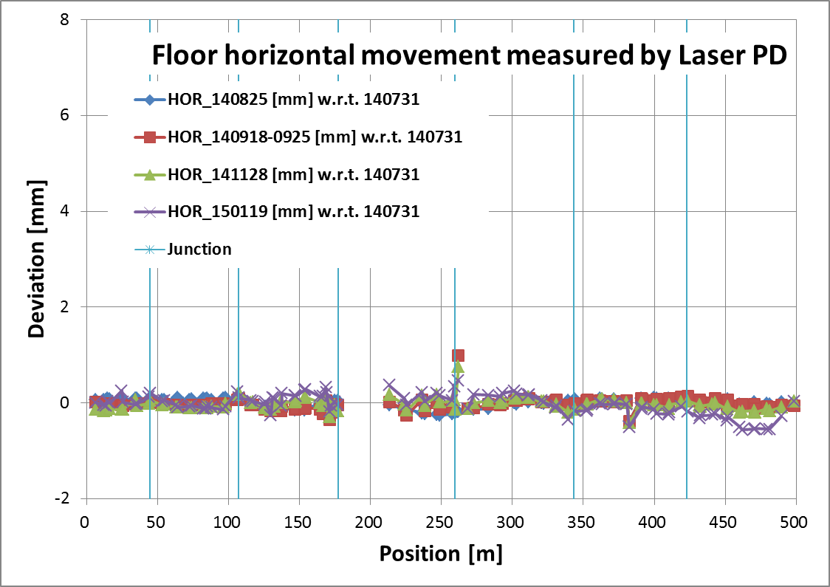
Floor horizontal movement in half a year from summer to winter
C3
11
18
28
38
48

Slide 28
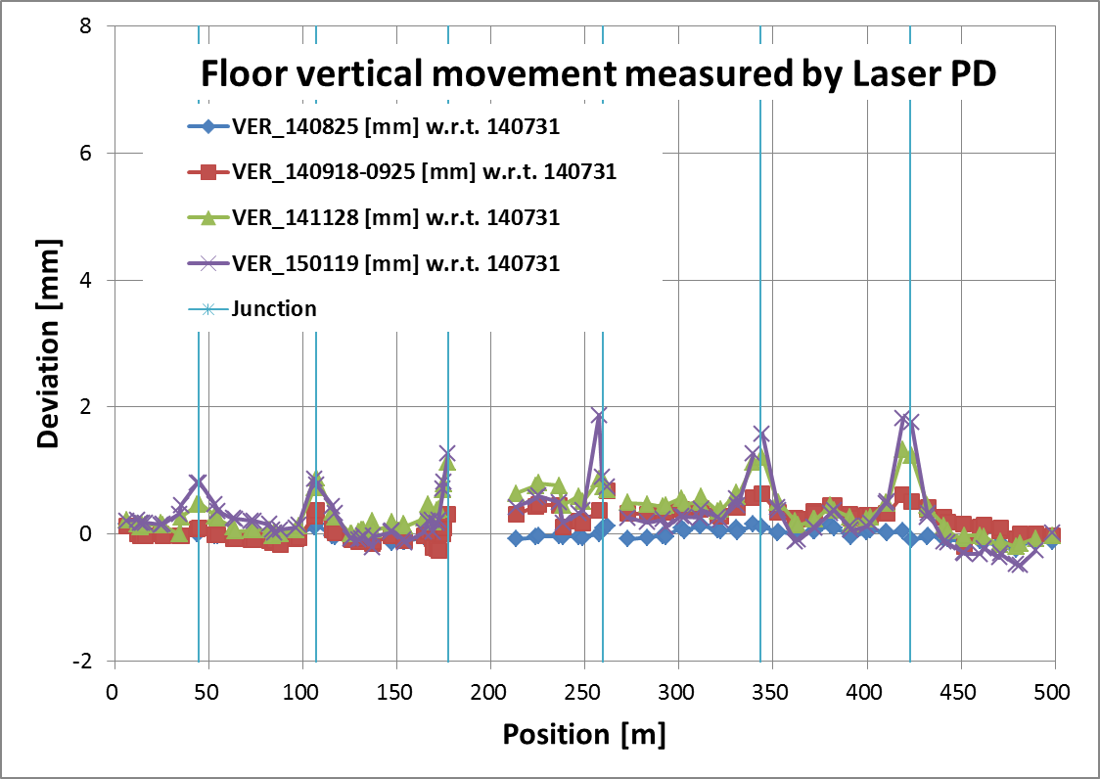
Floor vertical movement in half a year from summer to winter
C3
11
18
28
38
48

Slide 29
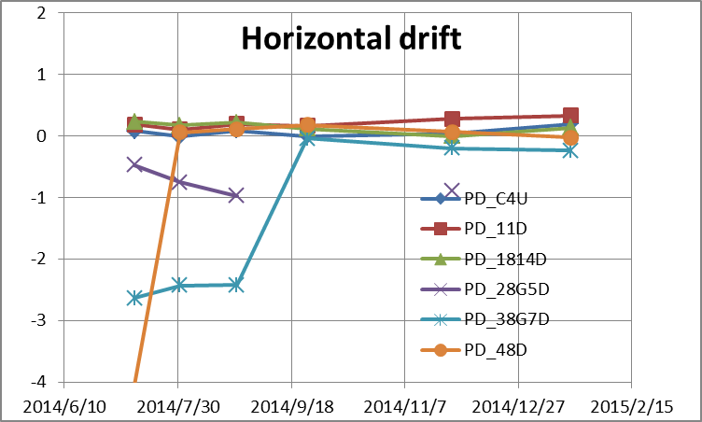
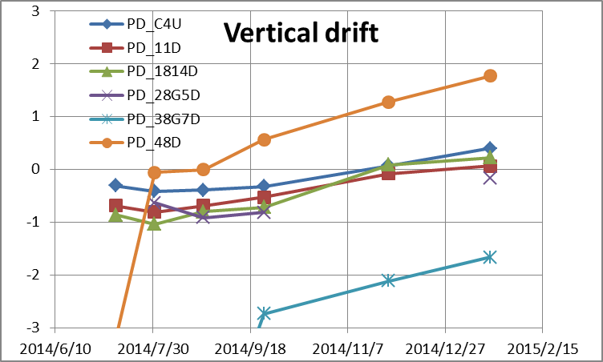
Long-term floor movement near junction
Not evident but
~0.05mm/month
Upward drift at junction
~0.3mm/month

Slide 30
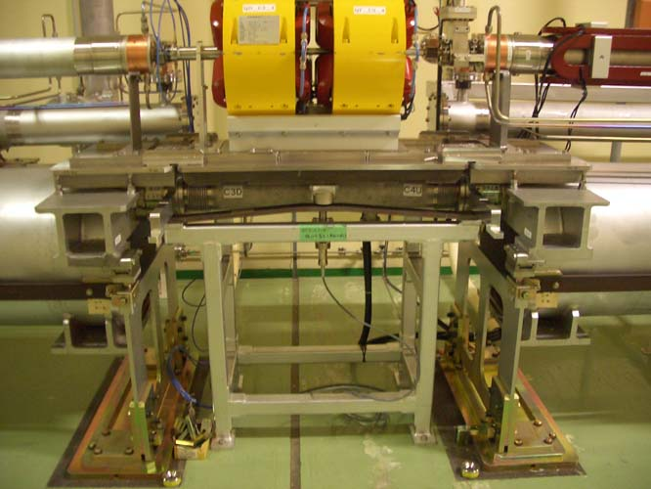
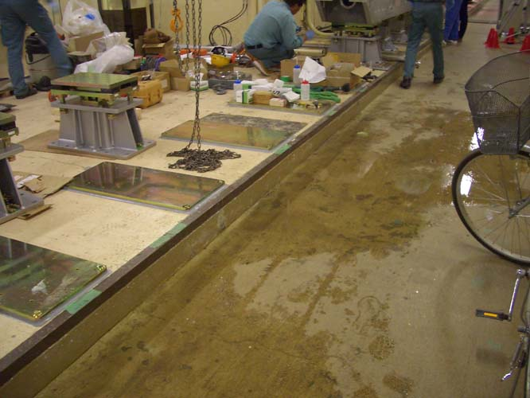
Junction and after-pouring concrete
15cm step not well stick on the base plate
Expansion joint between two solid plates

Slide 31
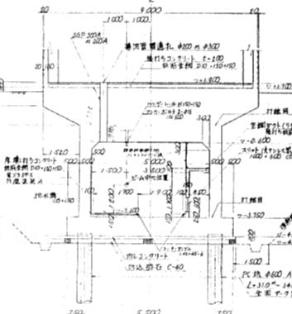
Tunnel basic structure
Klystron gallery
15cm-high after pouring concrete
Solid base
Concrete shield
40-50m deep piles
Tunnel
Base structure

Slide 32
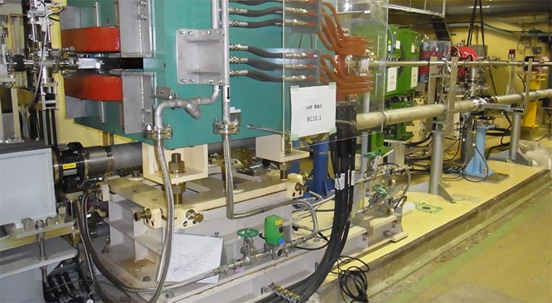
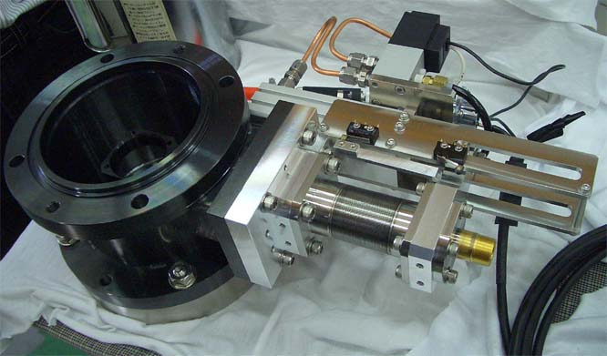
PD for continuous measurement
PD_28_REFUA
PD_28_G6DA
Located at
28 Expansion joint
Nov. 2014
Automatic IN/OUT

Slide 33
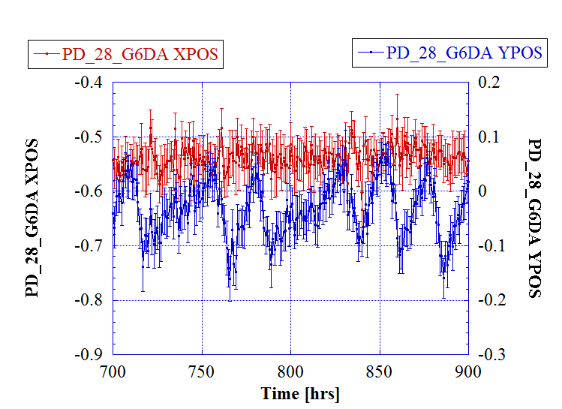
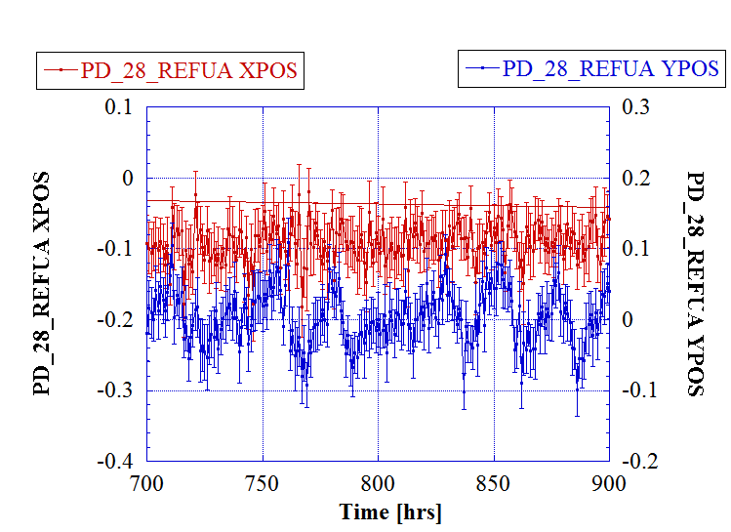
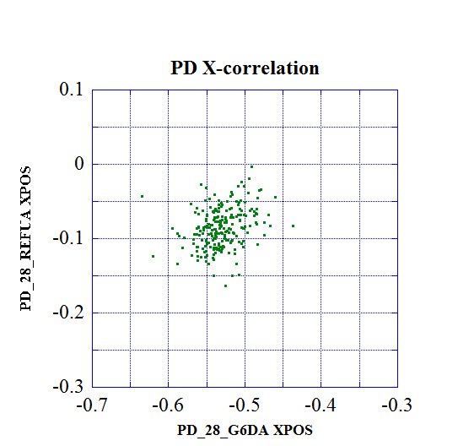
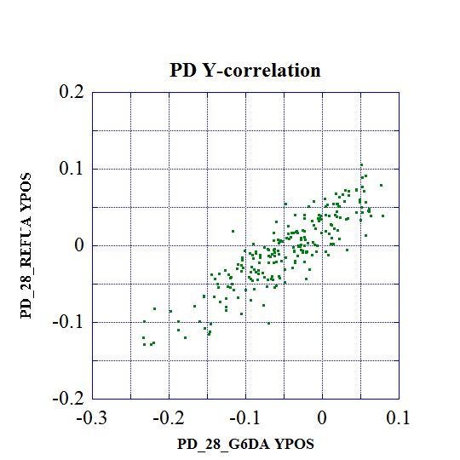
Daily motion between junction
Upstream from junction
Downstream from junction
Little hor. correlation
Well correlated in vertical plane
Ver. daily Oscillation
~ 0.1mm/day
Downstream
Downstream
Some correlated motion
Upstream
Upstream

Slide 34
Longer-term motion
Exists some drift
0.1~0.15mm/mo
Horizontal
Horizontal
0.1mm/1000hr/250m
A~10⁻⁵μm²/s/m
in ATL law
May not be only diffusive
Should see how it varies in a year range
Vertical
Vertical
40 days
15 days

Slide 35
Estimation of floor movement some typical observed values
Unit mm
 | Horizontal | Vertical
Daily | 0.1 | 0.1
Week | 0.1 | 0.1
Half a year | 0.5 | 2
Speed | 0.01mm/hour | 0.01mm/hour
We should study/develop the linac system
with these values in mind.

Slide 36
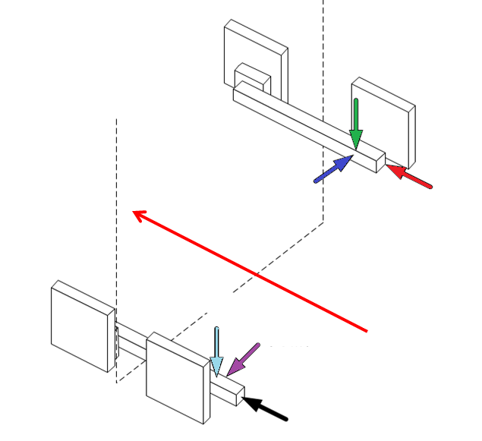
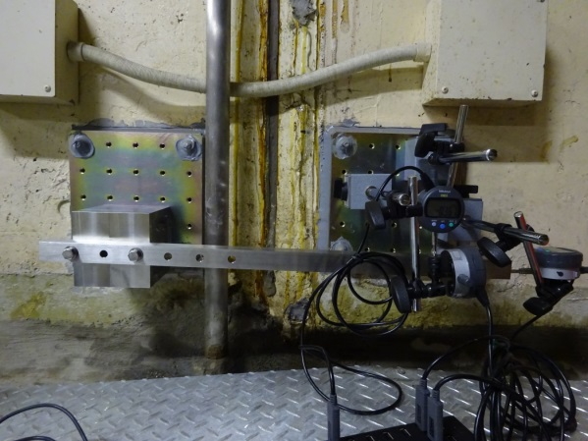
Trial to understand the expansion joint
Junction
East wall
Down
Notrth
Beam
Up
South
West wall

Slide 37
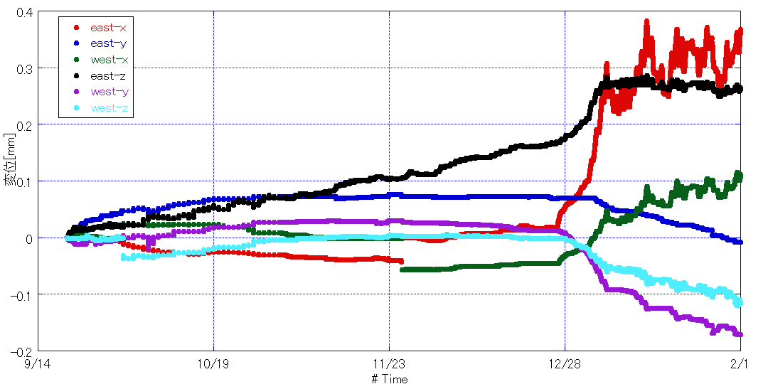
Junction relative movement at 28 19 Sep. 2014 – 31 Jan. 2015
↑ Up, East, North(beam line)
Up
North (beam)
0.4
0.3
0.2
0.1
0.0
-0.1
-0.2
East
Water flood due to typhoon
Linac stop
Air cond. restart
14 Sep.
23 Nov.
1 Feb.
↓ Down, West, South
Found daily movement, month-long drift, climate effect, etc. These are related to those observed in laser PD long-term result.

Slide 38
4. Near future developments

Slide 39
We should study and develop cures against floor movement
Near future for Phase-I
Make quantitative analysis at more places and more in systematic manner
Try to monitor movement with beam
May study other monitor methods, such as HLS
Development for phase-II and -III
Beam steering by targeting golden orbit
Movers, at least locally
Sophisticated compensation such as offset injection

Slide 40
Possible time frame in mind

Slide 41
Concluding remarks on alignment
Girder stiffening done.
Most of the hard wares set in the beam line, except for pulse-Q.
Initial girder alignment done with the residual ~0.3mm in sigma over 500m line.
Hard wares alignment on each girder improved to be 0.05mm in sigma.
Local smoothness will be improved by laser tracker.
Floor moves a few mm in half a year, mostly at expansion joint, while the daily motion ~0.1mm.
Floor movements should be evaluated at more points and with beam study to develop a practical cure method.

