Slide 1
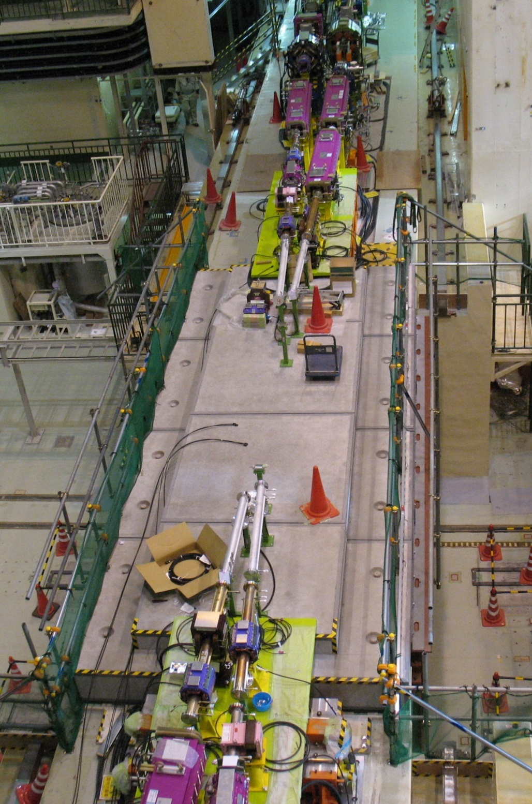


Interaction Region Mechanicals Overview
20th KEKB Accelerator Review Committee
KEK, 23-25 February 2015
Ken-ichi Kanazawa
for
KEKB Vacuum Group
IR Technical Meeting Member
IR Installation Meeting Member
SVD/IR Mechanics Meeting Member

Slide 2
Contents
Addressing the last committee report
Preparation toward Phase 1
Issues for Phase 2 and later
Summary

Slide 3
19th KEKB Accelerator Review Committee Report Executive summary
Recommendations:
4) The SuperKEKB/Belle II interaction region IR is extremely complex and the Committee recommends continued attention to the issues of the beam-beam interaction, beam lifetime, superconducting magnets, vacuum pressure, backgrounds, assembly, and machine detector interfaces.
Reply:
We continue our efforts.

Slide 4
19th KEKB Accelerator Review Committee Report Findings and comments (Pressure of IR)
Concerns:
There is no vacuum pumping over +/-4 m as agreed to by the Belle II detector as there is no space for internal or external pumps. The potential use of a vacuum simulation code is recommended to predict the vacuum profile in the IR region. This would be a good task for a young vacuum person leading to an optimized choice of vacuum pumping outside the IR beyond 4 m. The calculation of the pressure profile during the scrubbing phase profile is also very important to predict the validity of the concrete shielding. The simulation should take into account also methane degassing: the nearest pump to the interaction point has a very low pumping speed for CH₄. The indication that ‘the average pressure in the IR region will be 10⁻⁶ Pa or higher’ should be further investigated in detail with the hope of understanding the maximum pressure and making it as low as possible and consistent with Belle II operation. (See the next slide)
Recommendation:
New calculations of the expected vacuum pressures in the IR should be completed including the new chamber geometry, surfaces, and beam conditions.
Reply:
I agree the importance to investigate a pressure profile near IP. I made contact with R. Kersevan and M. Ady. I also attended the Molflow seminar by M. Ady held at KEK. We agreed to study somewhat simplified IR model. However, I have not yet prepared necessary data, because of the complexity of IR geometry. I think we should get some results until Phase 2 (not an urgent issue).

Slide 5
Vacuum system of IR
No vacuum pumps in this region
19th KEKB Accelerator Review, K. Kanazawa

Slide 6
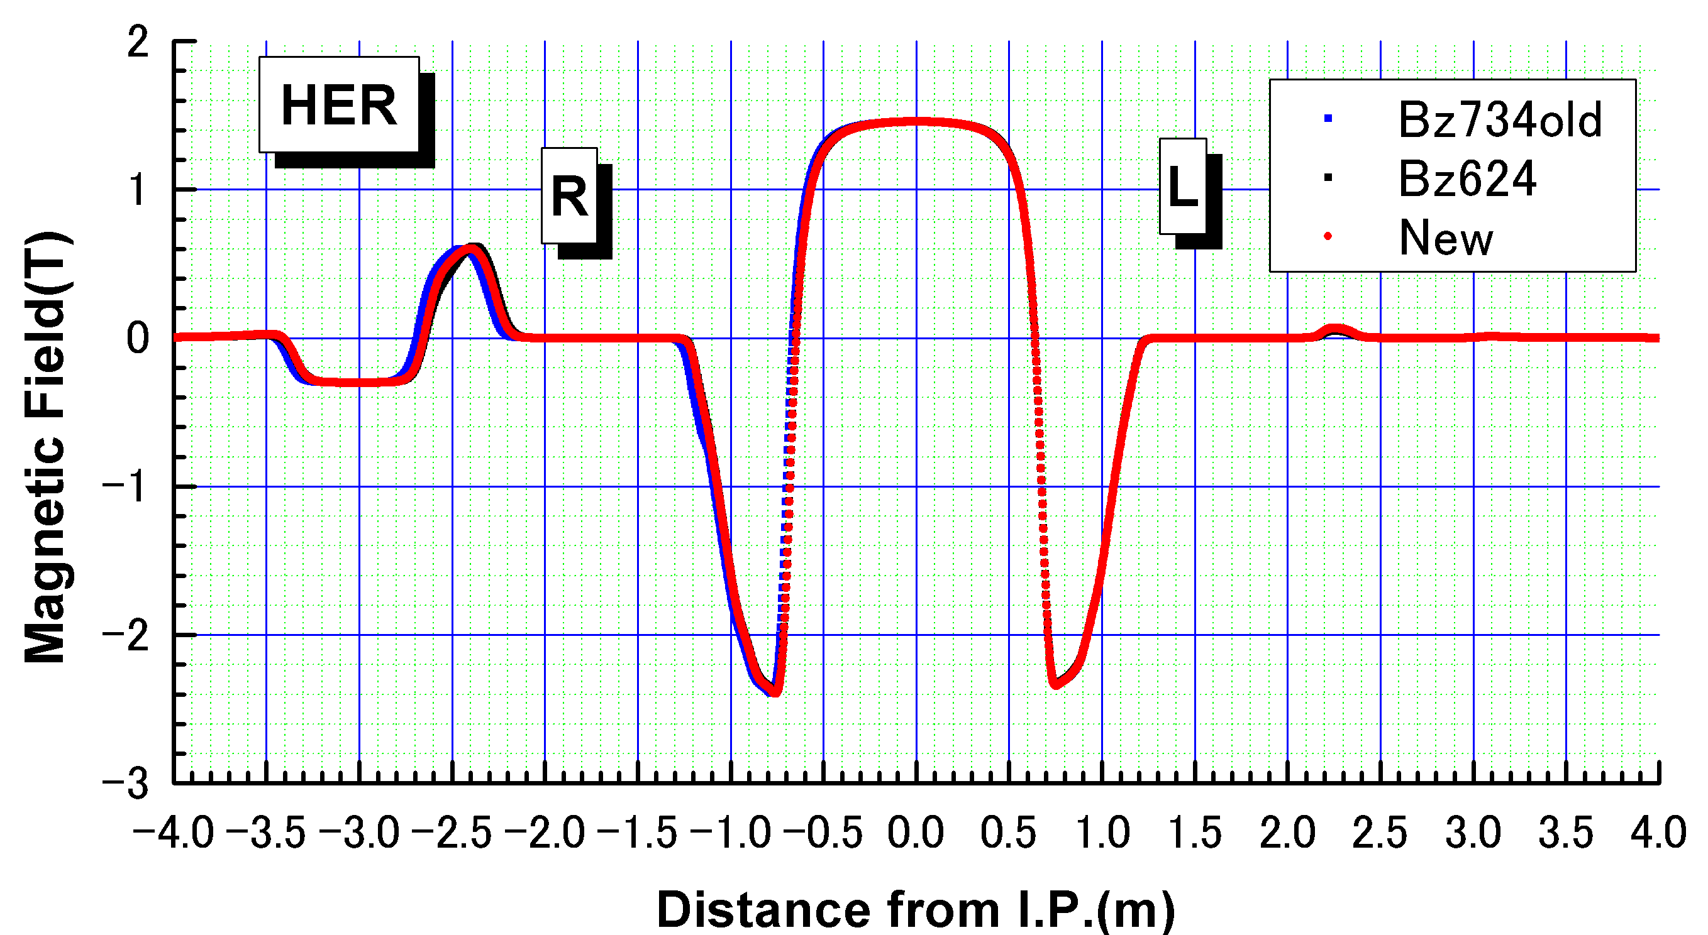
19th KEKB Accelerator Review Committee Report Findings and comments (Electron cloud in IR)
Concerns:
In the present design, there is no TiN coating in the IR region. It is not clear if scrubbing would be as efficient as in the rest of the accelerator. It is also not clear where solenoids could be installed in case electron cloud appeared in the IR chambers.
Reply:
For Phase 1, all positron beam pipes are TiN coated. Since the stored current at Phase 1 is 0.5 – 1 A. This is sufficient.
For later Phases, there is always a certain kind of magnetic fields. If we see a solenoid component, it is strong enough to suppress the cloud. However, simulation under the real complicated field pattern will be necessary to estimate a real density of the cloud. The effect of the cloud in a large beta-function region is large.
H. Yamaoka

Slide 7
19th KEKB Accelerator Review Committee Report Findings and comments (RVC)
Concerns:
A productive collaboration has been made with a group at DESY to explore the “remote vacuum connection”. A good solution is not yet defined. It is not clear when a decision will be taken and on which criteria.
Recommendation:
Perform laboratory tests on the reliability of the “remote vacuum chamber connection” under vacuum conditions.
Reply:
AIM with RVC was approved at 18th B2GM (18-21 June 2014).
For more on RVC, see later slides.

Slide 8
19th KEKB Accelerator Review Committee Report Findings and comments (Residual activation)
Concerns:
The Radiation Control Group should evaluate whether the larger backgrounds in the IR with SuperKEKB will lead to significant residual activation of the IR vacuum chambers. A possible consequence could be that if the IR region vacuum chambers need to be worked on, they may be too activated to quickly initiate a repair.
Reply:
For an electron collider, residual activation around IP is not serious compared to hadron colliders. Rather, radiation damage on detector components is an important issue. Radiation dose on the detector components is repeatedly estimated along with the estimation of beam background.

Slide 9
19th KEKB Accelerator Review Committee Report Findings and comments (QCS beam pipes)
Recommendations:
Finalize the vacuum chamber designs for Phase II within 4 m of the IP and proceed with engineering.
Reply:
See later slides.

Slide 10
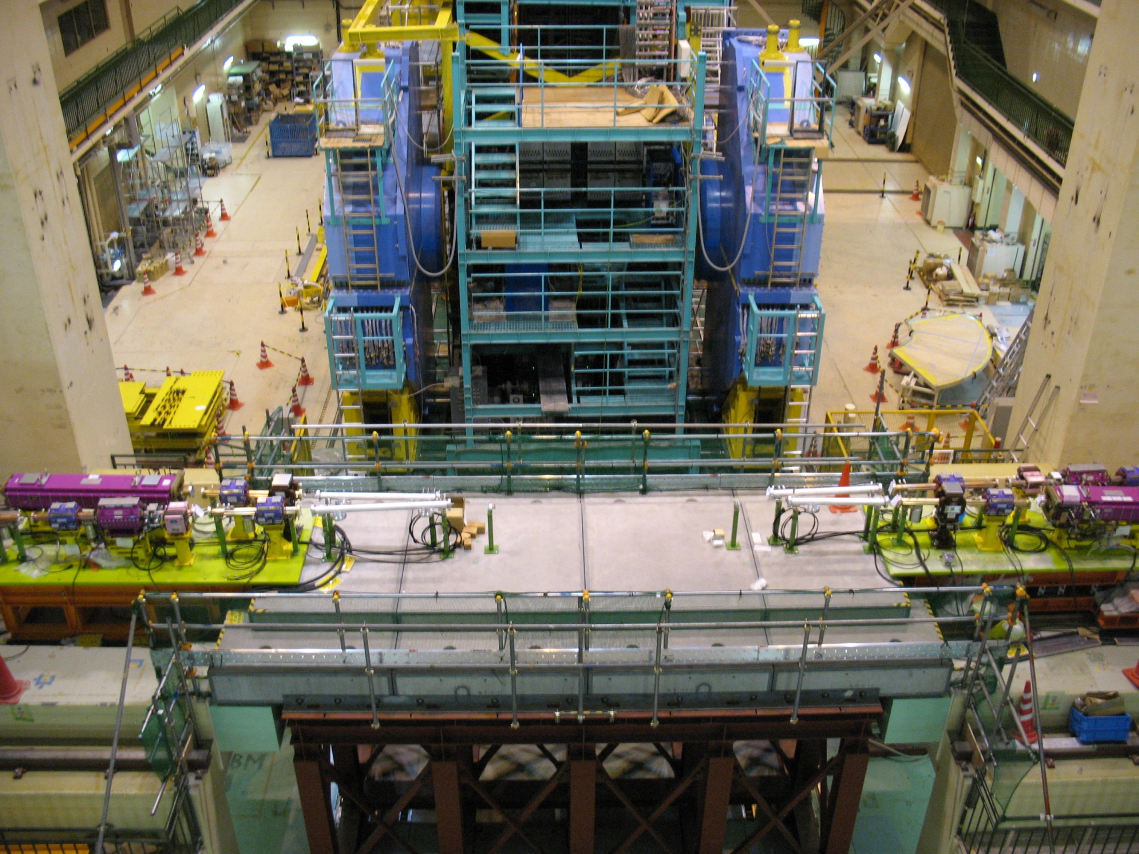
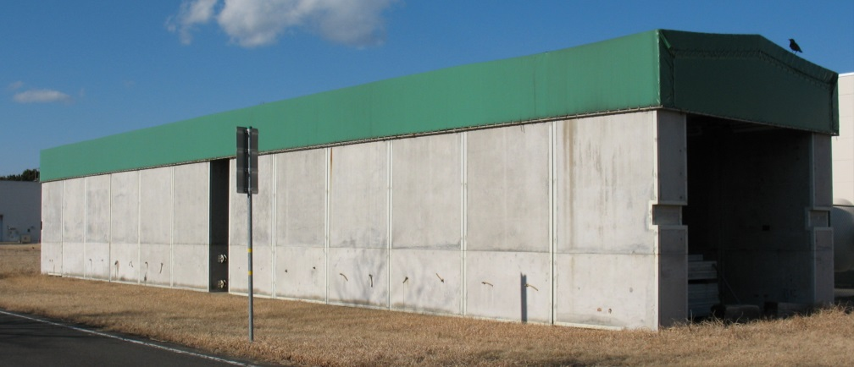
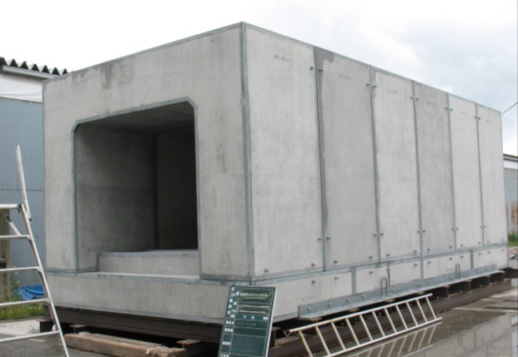
Preparation for Phase 1 (early 2016)
Gate shield
(Oct.-Nov. 2015)
New shield wall
(Sep. 2015)
New shield wall
(Sep. 2015)
LABM: July
Beast 2: September?
All beam pipes will be installed and connected till the end of June, and will be pumped down.
IP shield
(Oct.-Nov. 2015)

Slide 11
Preparation for Phase 1 Reinforcement of IP1 chamber
The central chamber for Phase 1 IR, IP1, developed a crack on a weld seam during preparation for TiN coating (K. Shibata).
The chamber will be re-welded and vertical fins and side bars will be attached for reinforcement. The work will complete before 19 June 2015.
Positron path
Side bar
Vertical fin
Position of the crack

Slide 12
Issues toward Phase 2 and later
QCS issues, fabrication, field measurement, and cables (N. Ohuchi and Magnet group)
IP chamber
RVC (Remote Vacuum Connection)
Beam pipes for QCS

Slide 13
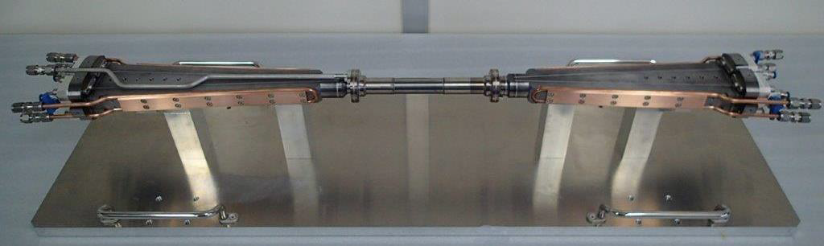
Issues toward Phase 2 and later IP chamber
The IP chamber for Phase 2 is completed. However, without feedback from Phase 2 experiences, the next chamber for Phase 3 must be fabricated.
S. Tanaka
Early 2018: The installation of VXD starts.
Early 2017: The assembly of VXD and its cosmic-ray test must start.
May 2017: Phase 2 run starts.
Therefore the next IP chamber mast be produced before Phase 2. Already, machining of Ta part was over. Comments on the present design are welcome.

Slide 14
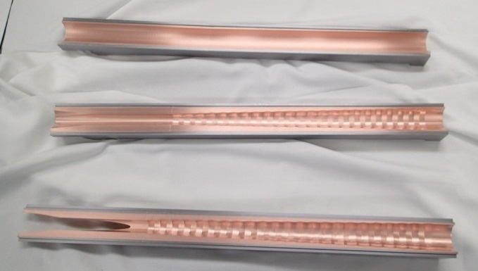
Issues toward Phase 2 and later IP chamber: Design feature
HIP = Hot Isostatic Pressing
Only taper parts are exposed to direct synchrotron radiation from the last bend.
Taper: to reduce the number of photons entering into the central part
+
Ridges: to keep the direction of scattered photons away from Be
~10 μm
(~10 μm)
~10 μm
Negligible trap of HOM at the central part.

Slide 15
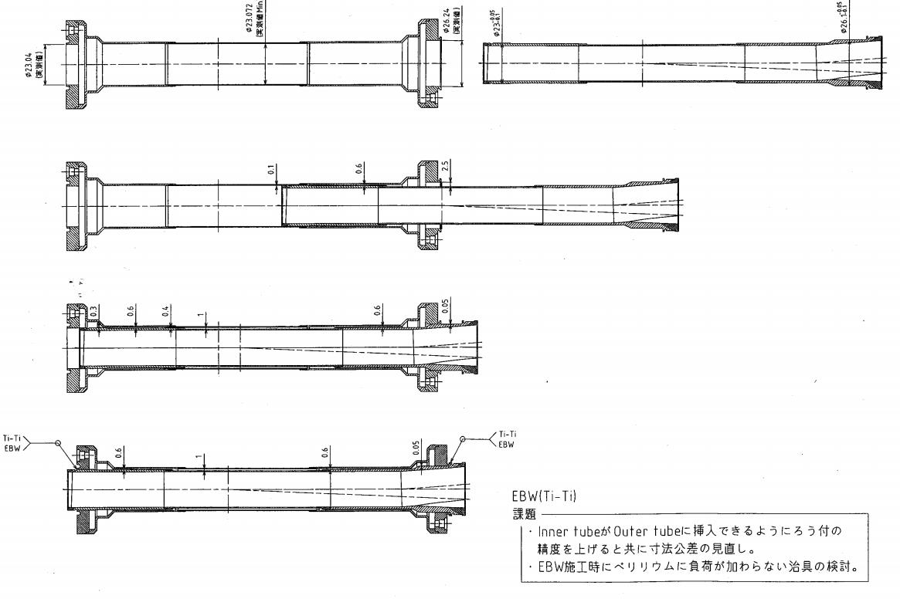
Issues toward Phase 2 and later IP chamber :Central part
Ti
Ti
Ti
Ti
Be
Be
The central straight part consists of double tube. Paraffin runs between them.
Outer Be: 0.4 mm thick
Inner Be: 0.6 mm thick
Gap: 1 mm
The connection between double tubes is done by Ti-Ti EBW.

Slide 16
Issues toward Phase 2 and later IP chamber: Underlying studies
Related works performed for the design and production of IP chamber
Cooling test of the central part using a dummy model
Mechanical analysis
Impedance estimation
Measurement of tip-scattering of photon on a ridge
Photon-induced desorption measurement of Au coat, Cu, and Ta
Estimation of SR background inside chamber
DC sputter coating test
HIP and welding test under various conditions
Ref.
K. Kanazawa, The 18th KEKB Accelerator Review Committee, KEK, 4-6 March 2013,
K. Kanazawa, 7th Belle PAC, 10 -11 March 2013, KEK

Slide 17
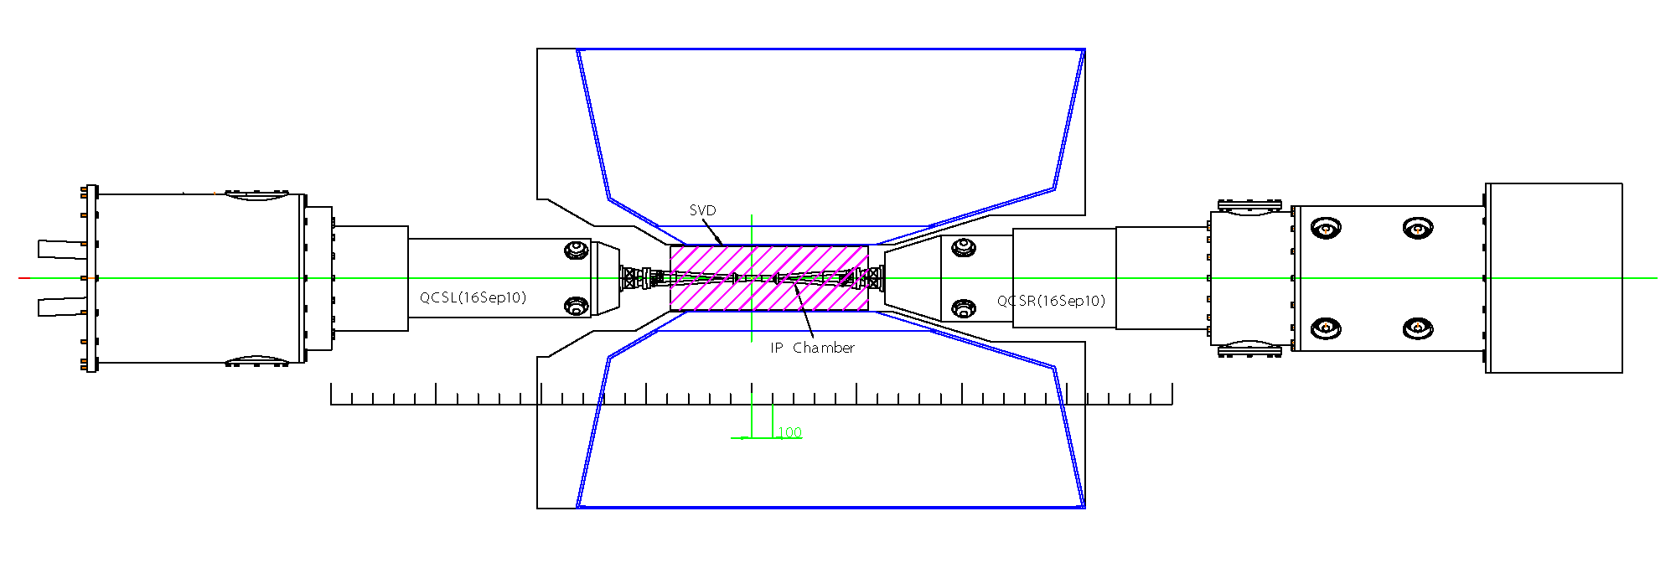
Issues toward Phase 2 and later RVC : Where to use
IP chamber is supported by VXD frame.
Both sides of IP chamber are fixed to the VXD frame transversally and are free longitudinally.
VXD is supported by CDC.
The R-side of VXD is aligned transversally and is free longitudinally.
The L-side of VXD is fixed to CDC.
QCS cryostats can move out.
Connection flanges for vacuum chambers.
Top view
Left-hand side
(Backward)
Right-hand side
(Forward)
Some work spaces to access flanges.
It will be possible to make use of these spaces.
Little work space to access flanges.
It is impossible to connect flanges by hands in this configuration.
CDC

Slide 18
Issues toward Phase 2 and later RVC: Bellows unit between IP chamber and QCS
BPM pick-up
CrCu
CrCu
QCS
side
Bellows unit with a conventional RF-bridge.
A comb-type structure cannot give a sufficient flexibility for a small diameter.
Cooling channel

Slide 19
Picture 14 -19: How RVC works.
Two bellows units are attached to a single flange with a retainer.

Slide 20
Picture 15
These components rotate to catch the bellows flange.

Slide 21
Picture 16

Slide 22
Picture 17
Cylinder for dry N₂ (about 50 bar)
These components shift to press the bellows flange to the cryostat.

Slide 23
Picture 18
This large screw nut turns to lock the mechanism.

Slide 24
Picture 19

Slide 25
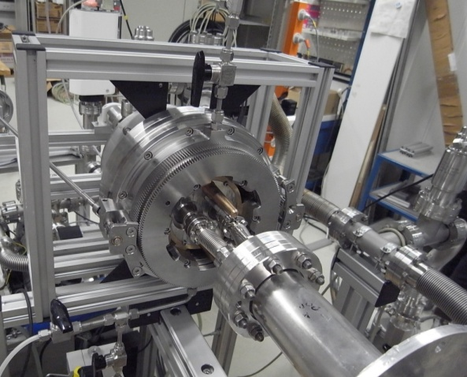
Issues toward Phase 2 and later RVC: Approval
AIM with RVC was approved at 18th B2GM (18-21 June 2014).
The mock-up of RVC was transported from DESY to KEK.
The vacuum tightness over several months (since November 2013) was verified. The demonstration included the opening and closing of the vacuum connection. After re-connection, the vacuum tightness was confirmed.
Emergency procedure when RVC is stuck was agreed.
Left-hand side: Make a space for hand access by removing some electronics of CDC, and detach RVC from QCSL.
Right-hand side: Pull out VXD with QCSR.
For the later deployment of the RVC, a Helium pipe for leak check after pipe connection and a guide tube for a fiber scope for visual inspection was requested by the vacuum group.
Comments from experiences on similar components are welcome.

Slide 26
Issues toward Phase 2 and later RVC: Boundary conditions (1)
The distance of the front face of QCS is fixed.
The basic shape of the front cap of QCS is fixed.
The position of the sealing surface between a QCS beam pipe and a bellows unit is fixed.
The length of the bellows unit is fixed.
The QCS-side end of the bellows unit must be modified to fit the RVC design.
These front caps made of heavy metal and stainless steal replace the original caps when RVCs are installed. The design of their front face must be done along with the design of RVC.

Slide 27
Issues toward Phase 2 and later RVC: Boundary conditions (2)
K. Ackermann (MPI)
The necessity of shields around the bellows unit next to IP chamber (Nakayama) is under discussion. Practically there is little space for the right hand side. The issue be discussed 8-9 May by Belle-II Members.

Slide 28
Issues toward Phase 2 and later RVC: scheduling
2015 Now (KEK Vacuum group and Belle-II group)
Boundary conditions related to the QCS cryostat is nearly fixed.
Space allocation around the right-hand side RVC is still under discussion. This will be discussed 8-9 May by Belle-II Members.
2015 June – December (KEK and DESY)
Design of RVC (DESY)
Design of the bellows unit (KEK/DESY)
Design of the front cap of QCS (KEK/DESY)
2016 (DESY and KEK)
Fabrication and Laboratory test of RVC (DESY)
Fabrication of the bellows unit (KEK/DESY)
Fabrication of the front cap of QCS (KEK/DESY)
2017 March – April (before Phase 2)(KEK and DESY)
Installation of RVC

Slide 29
Issues toward Phase 2 and later Beam pipes for QCS
The first design was completed for the QCSL positron pipe. Material is changed from Ta (very expensive) to Stainless steel. Since QCS has a thick heavy metal (W) shield around beam pipes, this change has little effect on detector back ground.
Four pipes will be prepared till March 2017.
Helium vessel
O-ring seal between beam pipes and the cryostat.
QC2LP
QC1LP
Bellows with O-ring seal
QC2LE
BPM
QC1LE
Heavy metal cap replaces the original cap after field measurement.
QCSL Cryostat
Beam pipe with a 4 mm thick wall, and with water cooling channels therein

Slide 30
Issues toward Phase 2 and later Beam pipes for QCS: Installation (1)
Center of mass
Slide the central part of the cryostat
Conceptual
~20 kg
Duct support tool
QCS support tool
Without BPM pick-ups
Pipe support
There is no rigid connection between these bodies.
Based on the idea of N. Ohuchi

Slide 31
Issues toward Phase 2 and later Beam pipes for QCS: Installation (2)
Attach BPM pick-ups by screws and connect cables.
Leak check!
This installation work seems very delicate. In preparing assist tools, necessary conditions must be discussed and be clarified.

Slide 32
Issues toward Phase 2 and later Beam pipes for QCS: Installation schedule
FY2015
Design of a duct support tool (Vacuum group)
Design of a QCS support tool (QCS group)
Fabrication of one or two beam pipes (Vacuum group)
FY2016
Fabrication of a duct support tool (Vacuum group)
Fabrication of a QCS support tool (QCS group)
Fabrication of remaining beam pipes (Vacuum group)
2017 March -
Installation:
1. Remove pipes for field measurement from QCS
2. Replace the front cap of QCS
3. Install beam pipes
4. Install RVC

Slide 33
Summary
Preparation for Phase 1 is steadily in progress.
The IP chamber for Phase 2 is completed. However, the next chamber for Phase 3 must be prepared without feedback from Phase 2 experiences. Any comments on the design are welcome.
The use of RVC was approved at 18th B2GM (18-21 June 2014) after a well-performed demonstration. It is helpful to hear from experiences of the use of similar remote mechanism in inaccessible conditions.
The first design was completed for the QCSL positron pipe. The cost of Ta beam pipe was found quite expensive. Material is changed to Stainless steel. Since QCS has a thick heavy metal (W) shield around beam pipes, this change has little effect on detector background.
The installation of QCS beam pipes seems a very delicate work. More attention to the process and the preparation is necessary.

