Slide 1
Injector Commissioning
Masanori Satoh
(Accelerator Laboratory, KEK)
for the Injector Linac Commissioning Group
The 20th KEKB Accelerator Review Committee, Feb. 23-25, 2015

Slide 2
Contents
Injector upgrade overview
Energy spread/low emittance preservation
Simultaneous top-up for 4-rings
Progress of injector commissioning
Issues
Summary and plan

Slide 3
Injector upgrade overview
Low emittance photo-cathode rf gun
e-: 1 nC, 100 mm⋅mrad (KEKB) => 5 nC, 20(H)/50(V) mm⋅mrad (SuperKEKB)
e+: 1 nC, 2100 mm⋅mrad (KEKB)=> 4 nC, 20(H)/100(V) mm⋅mrad (SuperKEKB)
Component alignment and fine beam control for low emittance preservation
New positron capture system (Flux concentrator, Large aperture S-band structure), and damping ring
New timing system (bucket selection for DR/MR)
Fast RF monitor, high precision BPM readout and other new subsystems
Simultaneous top-up injection
Main ring commissioning Phase-I: Jan. of 2016
e-/e+ 1nC w/o low emittance

Slide 4
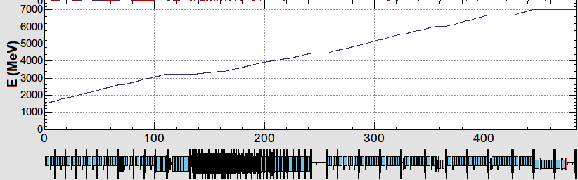
Energy profiles and beam properties
10 nC x 2 bunches x 50 Hz (SuperKEKB e+)
5 (1) nC x 2 bunches x 50 Hz (SuperKEKB e-)
5 nC (0.3) x 1 bunch x 5 (25) Hz (PF-AR)
0.3 nC x 1 bunch x 25 Hz (PF)
B
A
e-/e+ beams are delivered to 4-rings with different bunch charge and energy.
Beam acceleration modes must be switched by 50 Hz pulse-by-pulse for top-up injection.
Compatible settings for e-/e+ beams (DC Quads)
Pulsed Quad (Doublet) for pulse-by-pulse switching
low emittance
RF gun
1.5 GeV e-
1.1 GeV
DR
C
1
2
3
4
5
e+ target
e-:Chicane
HER: 7 GeV e-
5 nC x2
PF-AR: 6.5 GeV e-
4.219 GeV
Decelerate
5 nC x1
same energy
e-
LER: 2.5 GeV e+
4 nC x2
e+ target
e+
1.1 GeV
PF: 2.5 GeV e-
0.3 nC x1
1.5 GeV
C
1
2
3
4
5

Slide 5
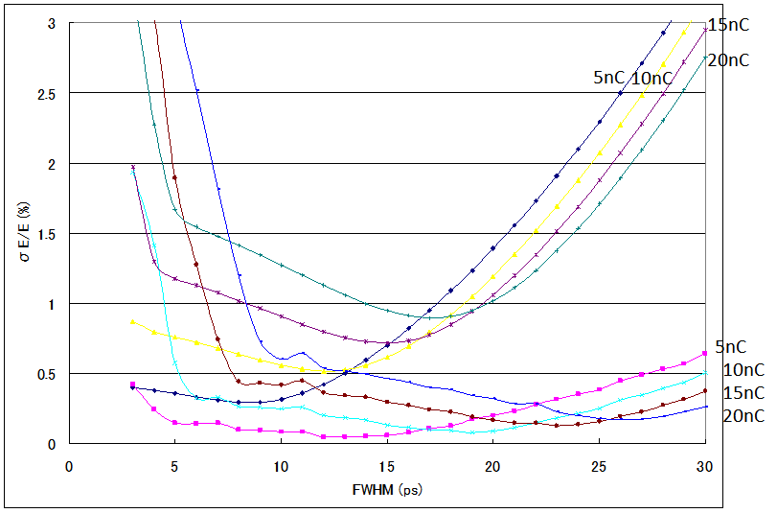
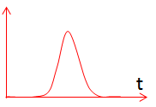
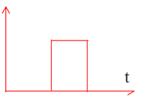
Energy spread requirement
Energy spread should be less than 0.1%.
Uniform beam distribution is necessary for mitigation longitudinal wakefield and reduce energy spread.
Temporal manipulation of laser system
Gaussian
Uniform
0.1%

Slide 6
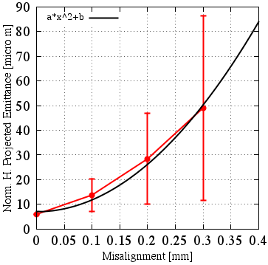
Emittance growth due to component misalignment
Sector Cto5: -10 deg rf phase R56 =-0.20
Simulation results from 100 different seeds.
Misalignment of Quadrupole magnets and Accelerating structure:
σ < 0.1 mm: βγε 20 mm·mrad is almost satisfied.
σ > 0.1 mm: emittance preservation is required by some methods.
<Emittance growth>
・quadratic curve as a function of misalignment
・final emittance depends on error seed
Norm. projected rms emittance (mm⋅mrad)
Simulation
SAD code, Elegant
Initial bunch charge: 5 nC
Initial emittance: 6 mm⋅mrad
Initial bunch length: 10 ps (FWHM)
Initial energy spread : 0.4%
Initial beam energy: 20 MeV
Uniform longitudinal beam distribution
20 mm·mrad
Misalignment σ (mm)

Slide 7
Offset injection for emittance preservation
Low emittance e- beam transport w/o damping ring
Emittance preservation is key issue for e- beam.
Offset injection: intentional change of misalignment seed.
Control the steering magnet at the beginning of Sector C
Bunch compression
Offset injection

Slide 8
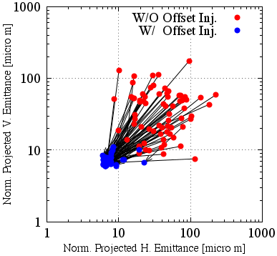
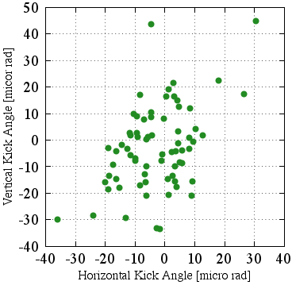
Offset injection (simulation)
Sector Cto5: -10 deg rf phase R56 =-0.20
Kick angle is relatively small.
Need a high-precision and stable orbit control.

Slide 9
Emittance w/ bunch charge fluctuation
Emittance simulation w/ 10 misalignment seeds (accelerating structure).
SectorC to Sector5 (Linac end)
Assuming 5 nC, initial emittance of 10 mm⋅mrad (SectorC)
When bunch charge increases by 10%, emittance increases by 6.5%.
Try simulations w/ measured component misalignment, dynamic beam line movement, energy jitter.
12.4 => 13.2 mm⋅mrad
5 nC => 5.5 nC

Slide 10
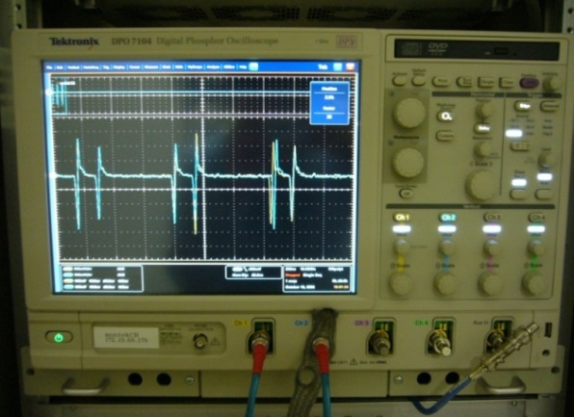
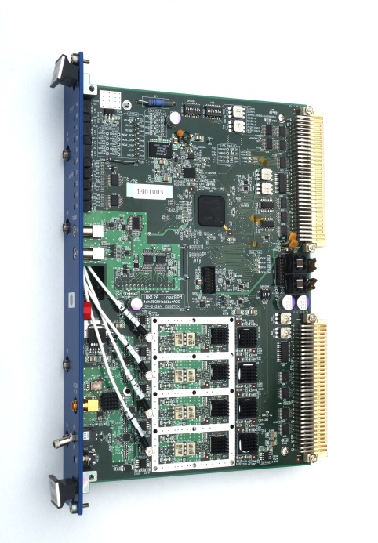
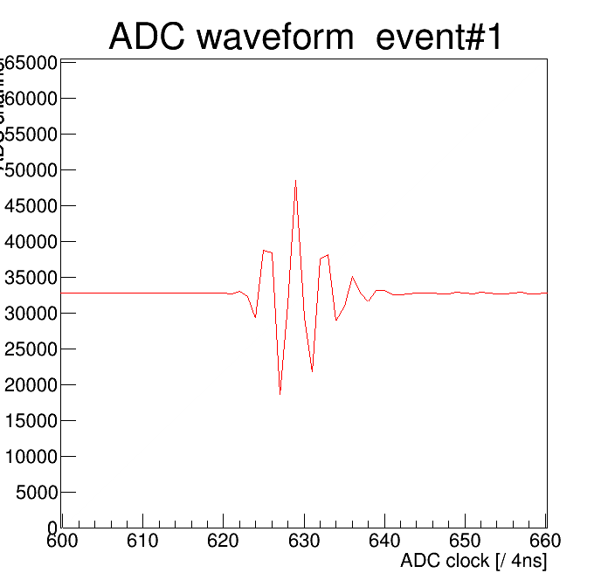
BPM readout system
Current system:
Windows-based digital oscilloscope
10 GSa/s, 8 bit, 1 GHz bandwidth, 4 channels
Twenty four systems process: 90 BPMs
Position measurement precision: 25～50 μm (3-BPM)
New system:
VME module w/ band-pass sampling scheme
250 MSa/s, 16 bit ADC,
BPF (fc: 180 MHz, BW: 60 MHz, 22 MHz)
Signal can be well damped within 80 ns
Meas. precision: 3 μm
~ 100 modules under pre-delivery inspection
80 ns

Slide 11
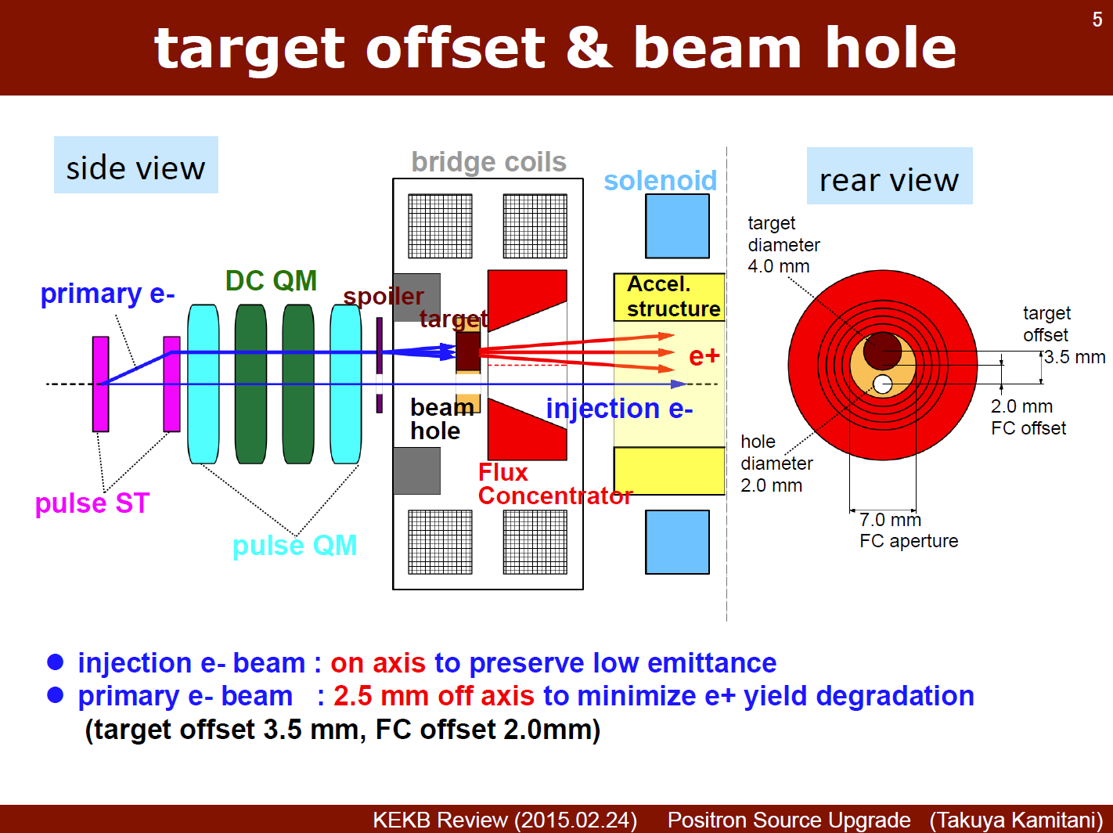
e-/e+ beam fast switching (SuperKEKB)
Positron production target with a hole (e- beam pass through inside a hole)
A hole is at the center of beam line for low emittance e- beam.
Same scheme was successful in KEKB operation.

Slide 12
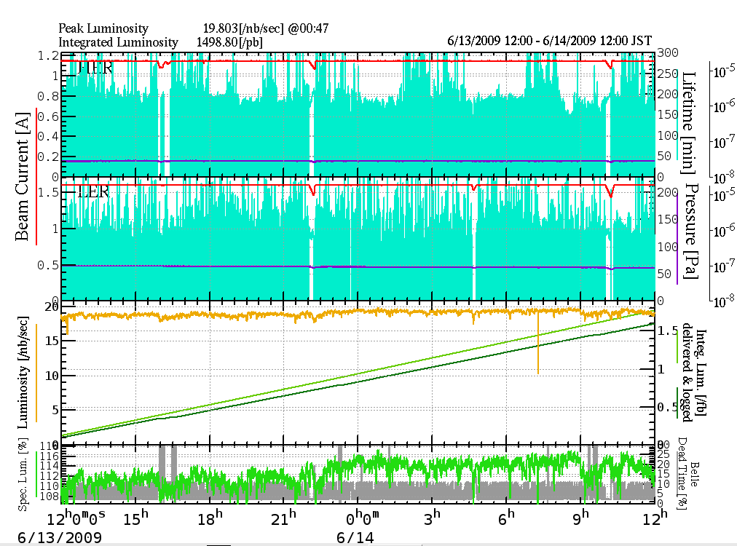
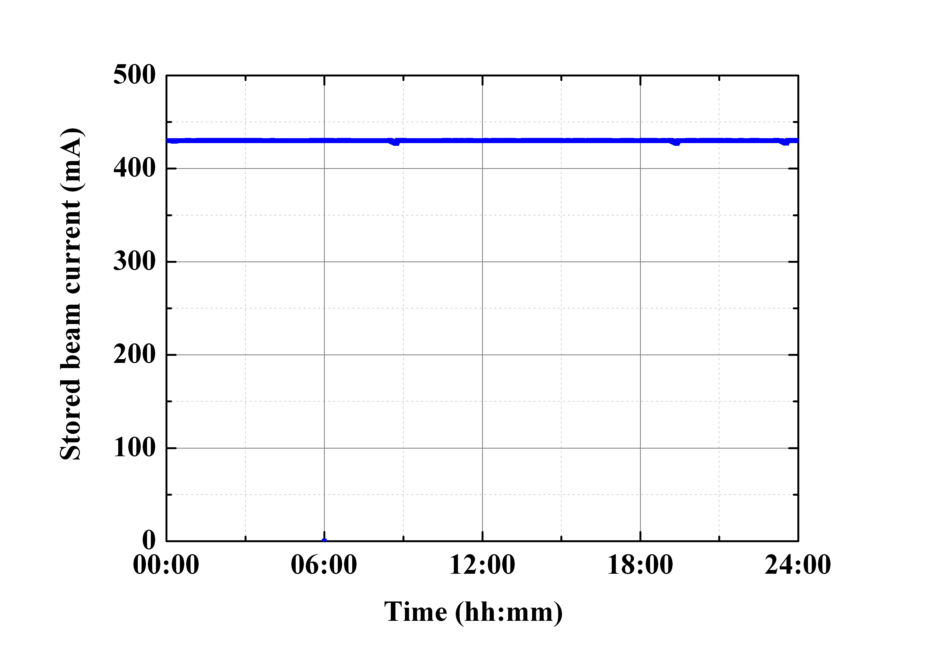
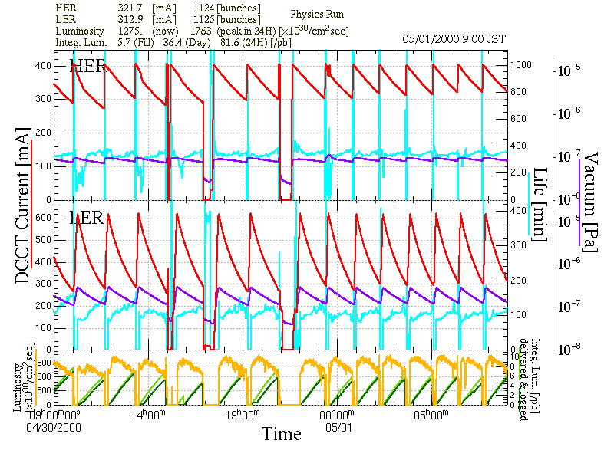
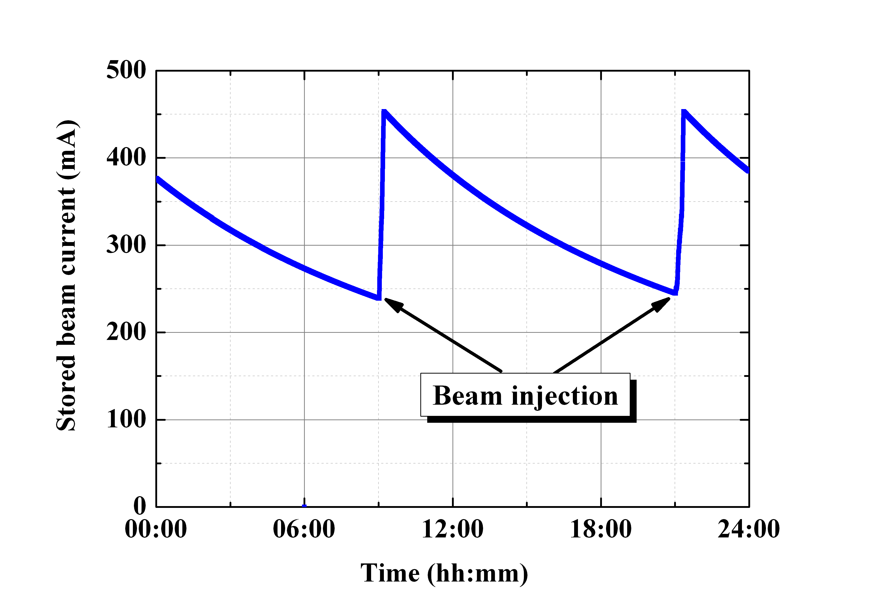
Simultaneous top-up injection for three rings
PF-AR injection (twice daily) interrupt KEKB injection.
Big issue for SuperKEKB operation.
Beam lifetime ~ 6 min.
Stored beam current stability in Apr. 2010. - KEKB: 1 mA (~ 0.05%) : e-: 12.5 Hz, e+: 25 Hz
- PF: 0.05 mA (~ 0.01%) : 0.5 Hz
Stored beam current stability in 2000. - KEKB: 300 mA (~ 50%)
- PF: 240 mA (~ 53%)
PF
KEKB e-
KEKB e+
Luminosity

Slide 13
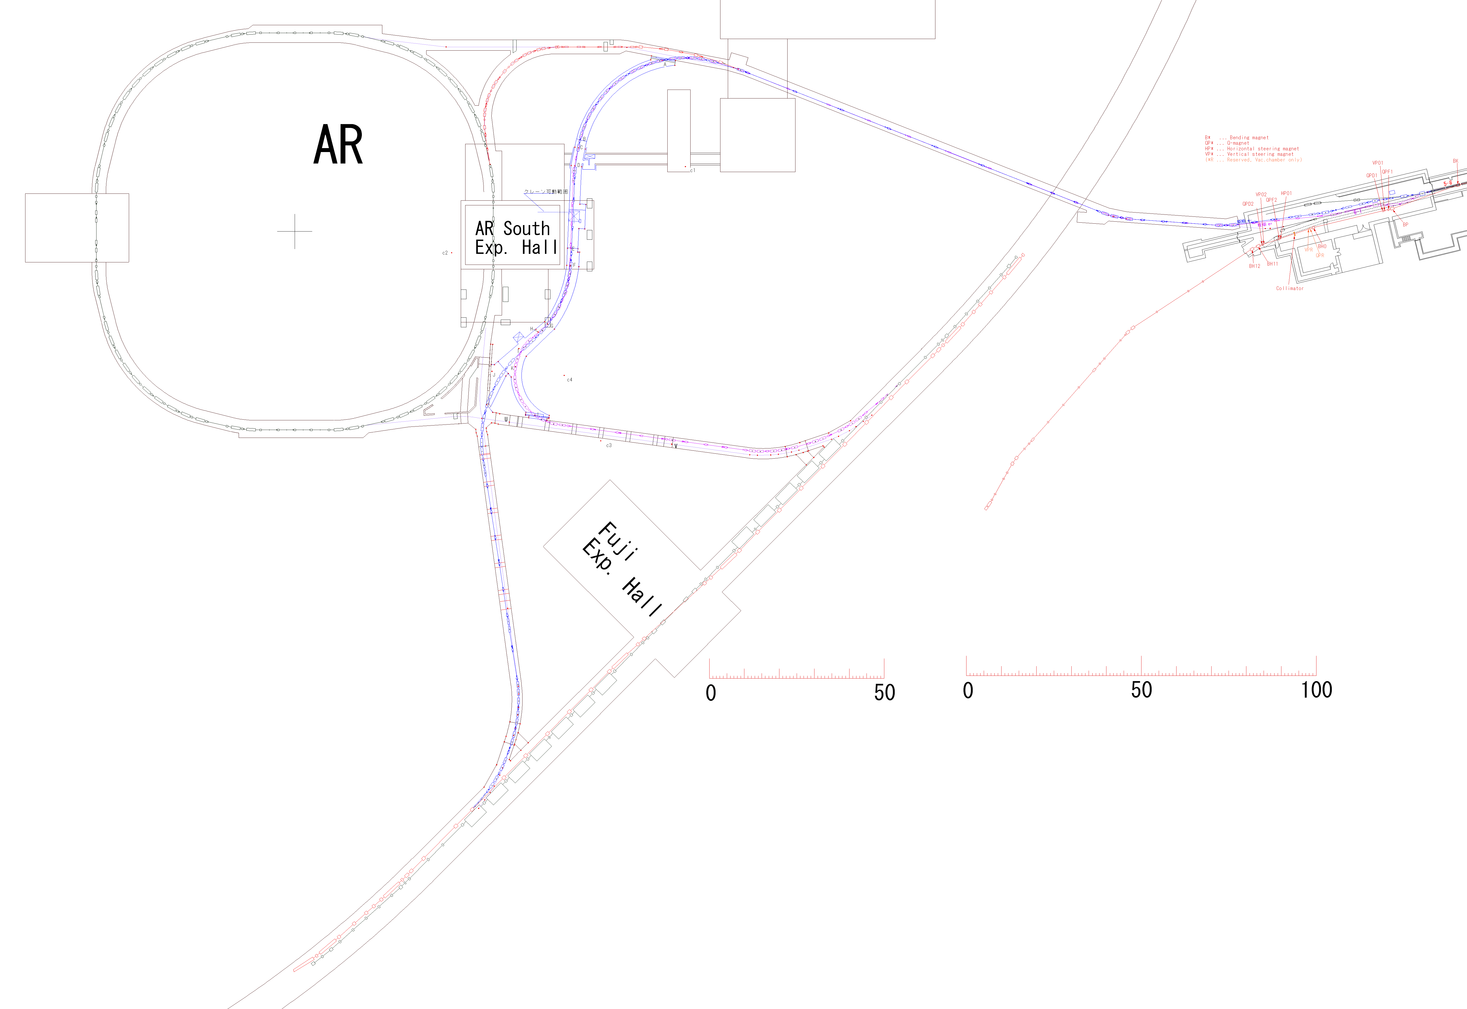
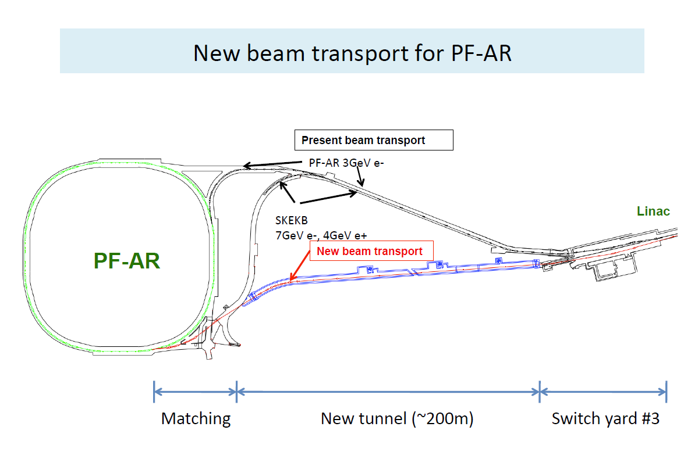
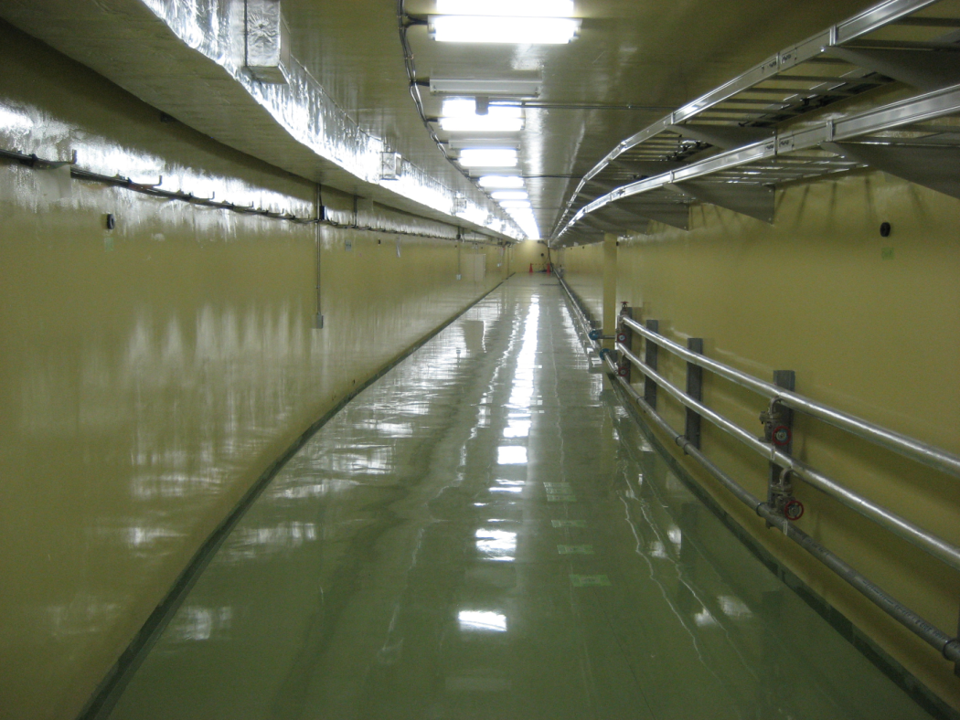
Simultaneous top-up including PF-AR injection
PF-AR and KEKB share the long part of beam transport line.
Existing tunnel space is very tight.
New tunnel has been constructed in Mar. of 2014.
Pulsed bend will be installed at #3 switch yard of Linac.
New BT will be available in Jan. of 2017.
H. Takaki (KEKB review 2013)

Slide 14
Injector commissioning
Injector commissioning has been started in Oct. of 2013.
Oct. and Dec. of 2013 (e+ beam line construction in Nov.)
Apr. ~ Jun. of 2014
Oct. ~ Dec. of 2014
Commissioning (Jan.-Mar. of 2015) was canceled. (operation budget)
Day shift: beam line construction, laser tuning
Evening shift: beam study
Early morning shift: beam study, rf conditioning

Slide 15
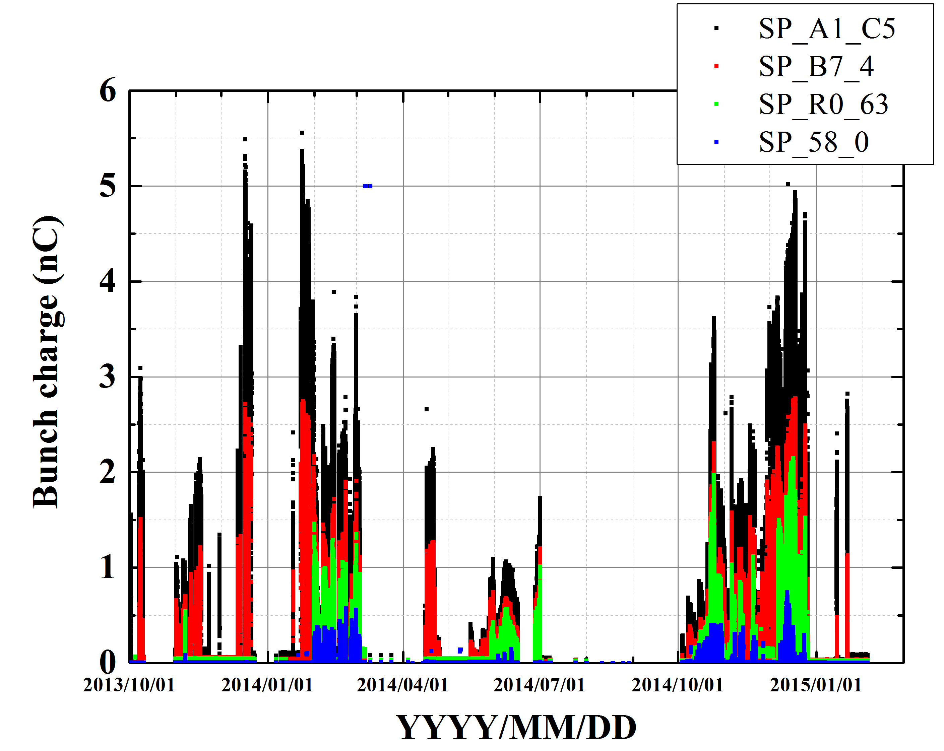
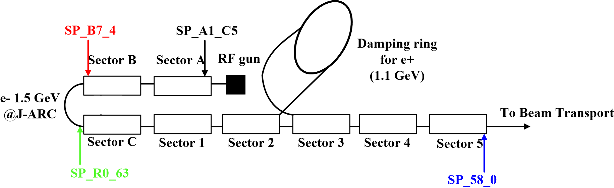
Charge history
5.6 nC
0.75 nC

Slide 16
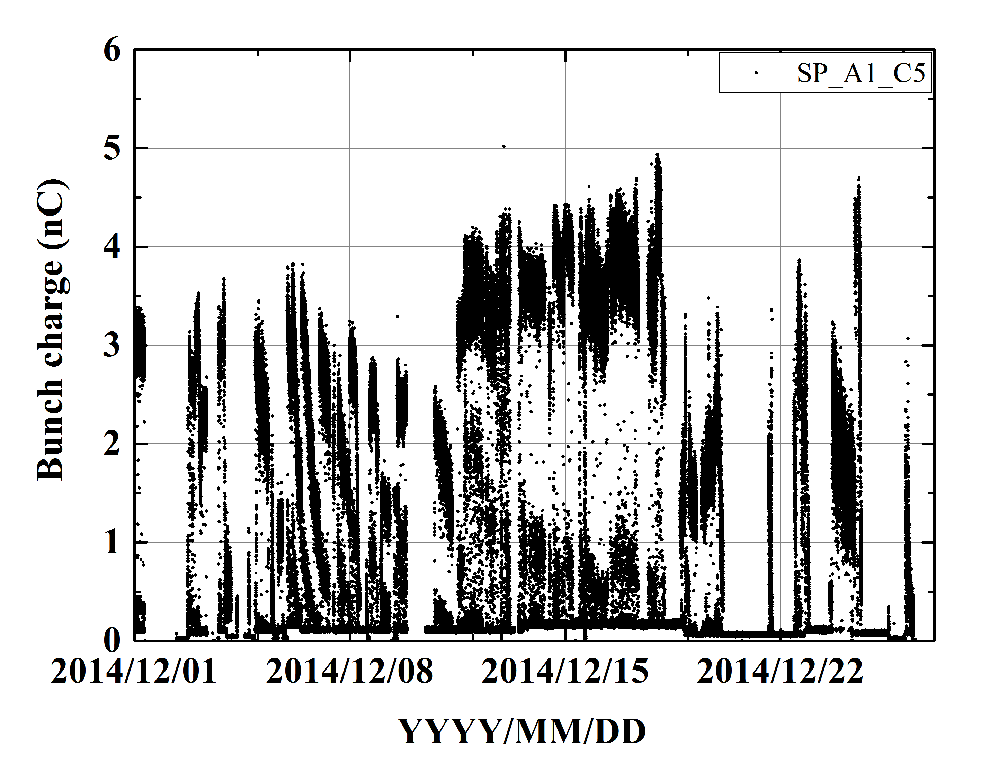
Bunch charge from rf gun in last Dec.
1 week

Slide 17
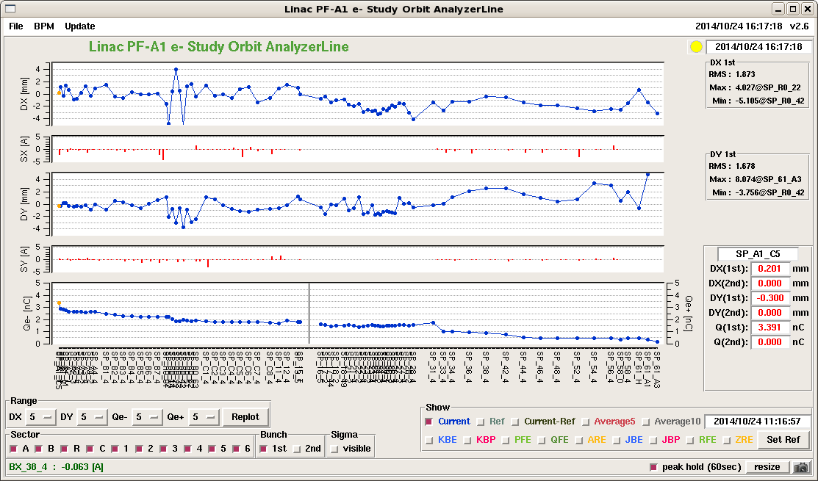
Beam orbit example
During commissioning, 3T gun continuously provides e- beam for PF ring (top-up).
Full Linac study can be conducted in Wednesday.
PF dedicated magnet settings are used in Sector3 - Sector5
RF Φ can switched in pulse-by-pulse (LLRF Φ control)
x (mm)
y (mm)
I (nC)
A1 rf gun
3T gun

Slide 18
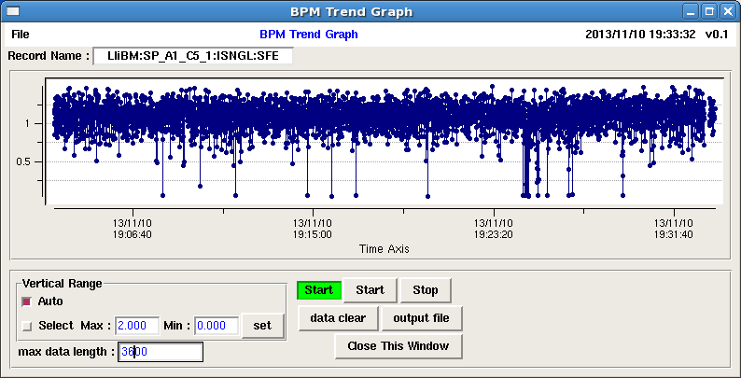
Typical beam charge stability
1 hour
σI: 10% ~ 20%
~ 2.5% (KEKB operation)

Slide 19
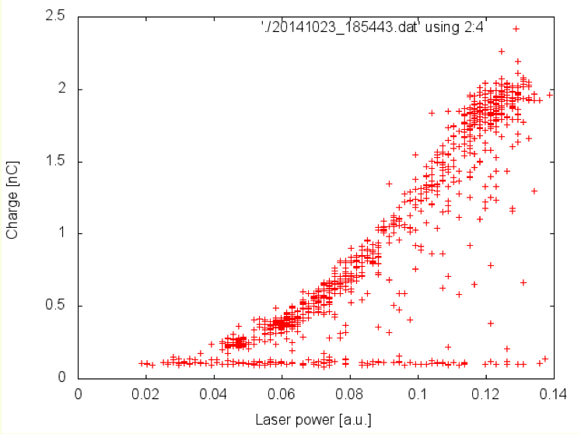
Bunch charge and laser power
Bunch charge (1st BPM) as a function of laser power.
Clear correlation between them
Bunch charge (nC)
Laser power (Arb. Units)

Slide 20
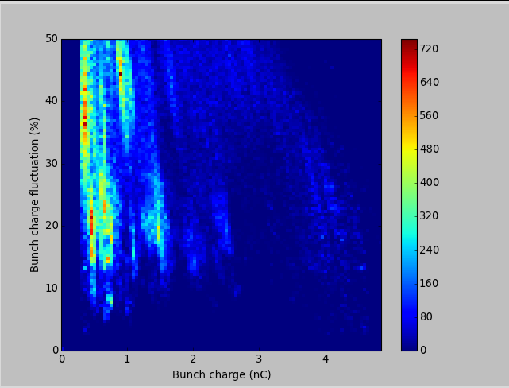
Bunch charge fluctuation
Bunch charge fluctuation as a function of bunch charge (2D histogram)
Oct. of 2013 – Dec. of 2014
Requirement for Phase-I

Slide 21
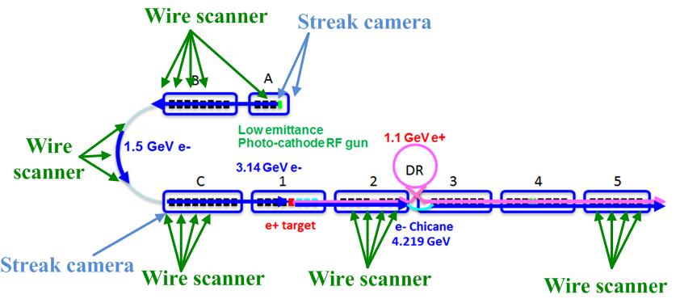
Beam diagnostics
Beam position measurement
BPMs x 90 (strip-line type electrodes)
Beam profile/Emittance measurement
Fluorescent screen monitors x100
Single wire scanner x1
Multiple wire scanner x5
Bunch length measurement
Streak camera x3

Slide 22
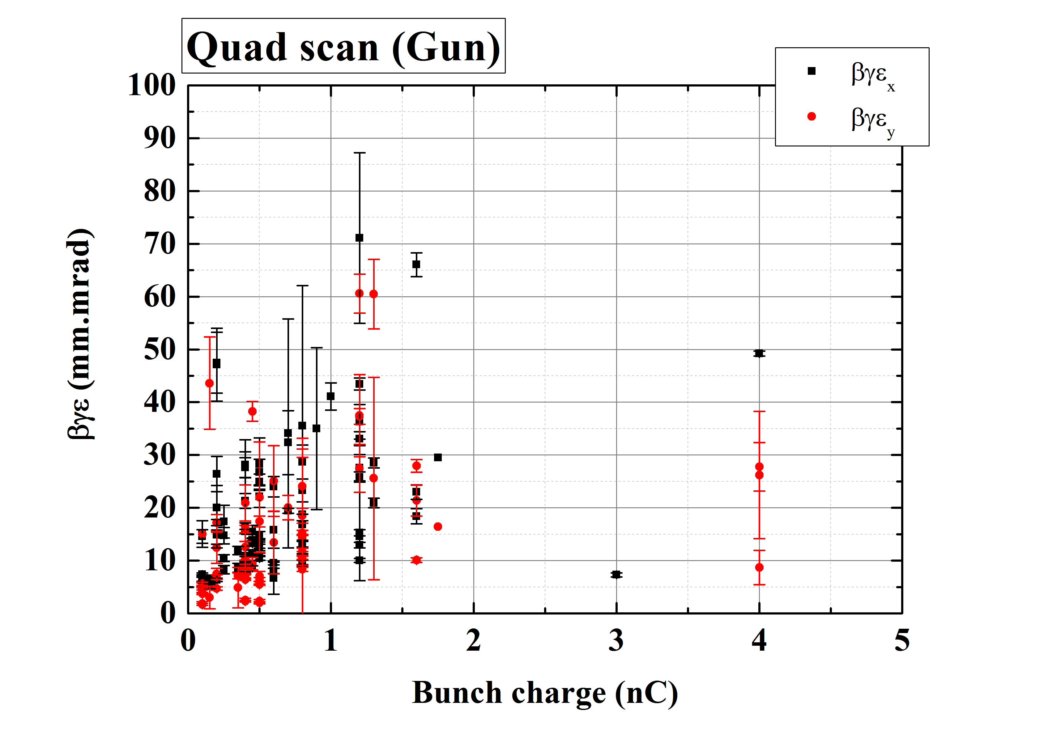
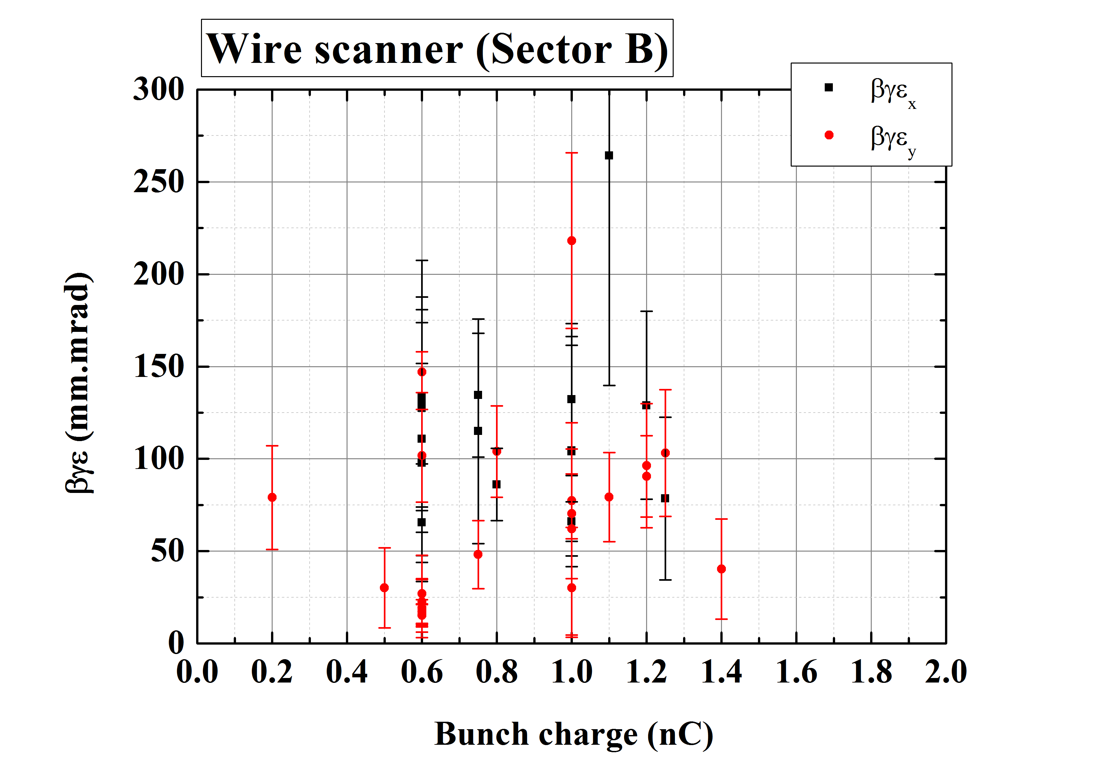
Emittance measurement
Emittance as function of bunch charge (drop the results w/ large error )
Small bunch charge (< 1 nC) shows good emittance at injector section.
< 10 mm⋅mrad (Vertical), < 15 mm⋅mrad (Horizontal)
Results at SectorB show larger emittance than our goal.
20

Slide 23
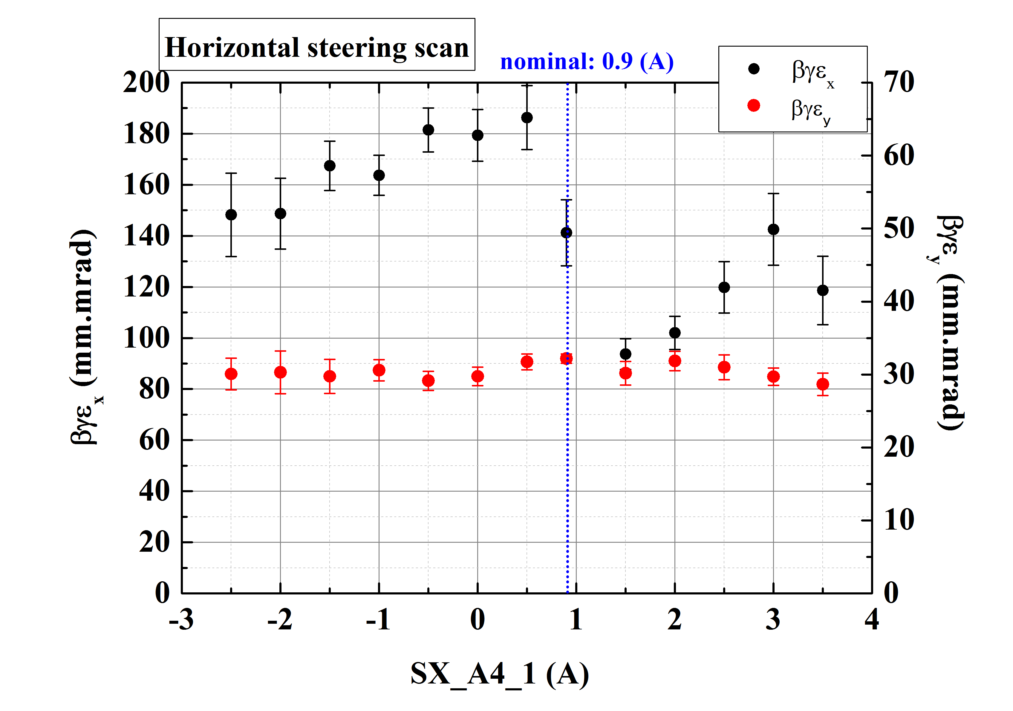
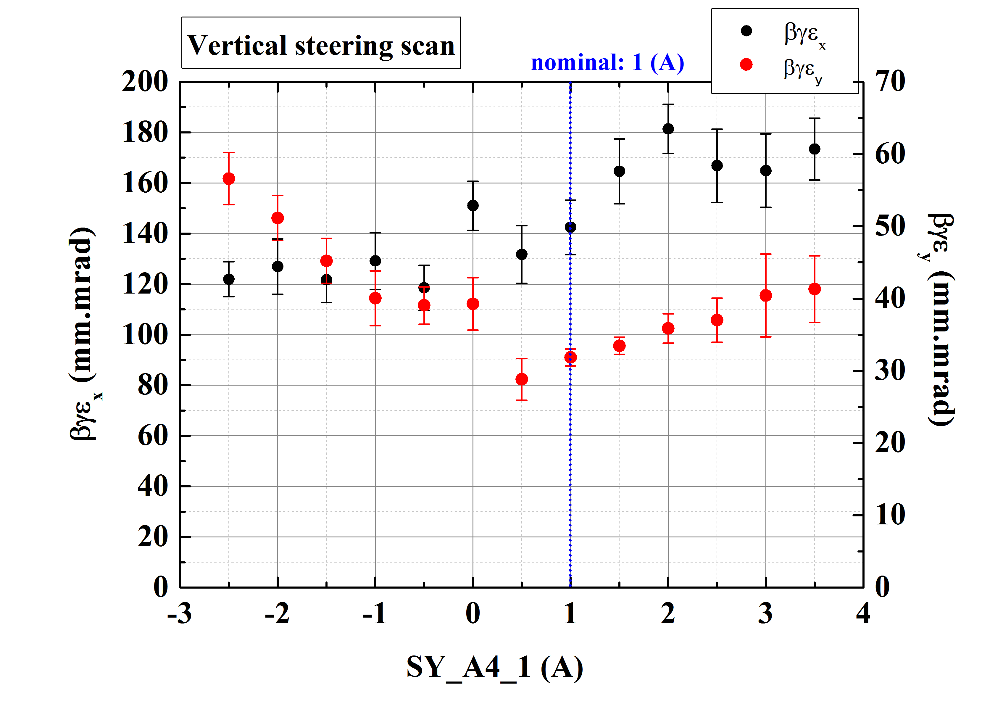
Offset Injection (experiment)
Feasibility of offset injection was studied w/ bunch charge of 0.3 nC.
Changing the excitation current of steering magnet at Unit-A4.
Emittance was measured multiple wire scanner at SectorB end.
We will conduct this measurement w/ various bunch charges.

Slide 24
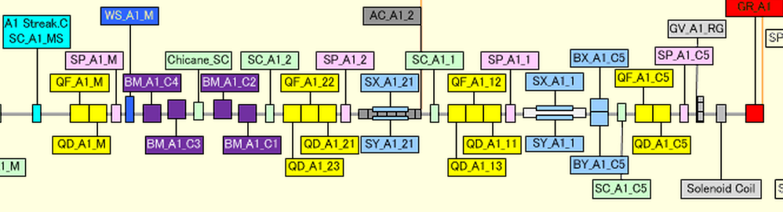
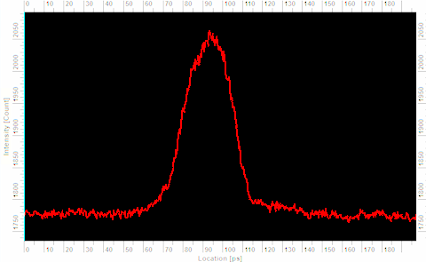
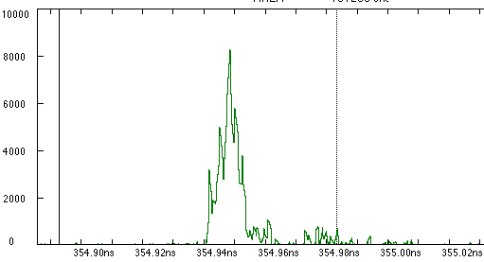
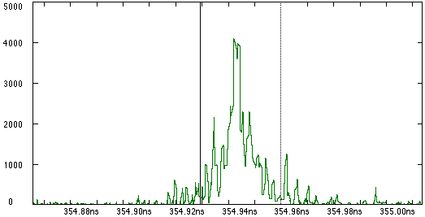
Bunch compression at Unit-A1
Chicane
Laser length
w/ bunch compression
w/o bunch compression
30 ps
10 ps
30 ps
A1 RF Φ -30°: 10 ps
A1 RF Φ 0°: 30 ps

Slide 25
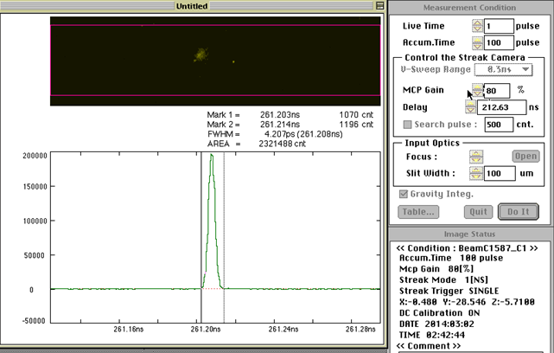
Bunch compression @ J-ARC
Isochronous (w/o bunch compression), R56 = -0.3 m (w/ bunch compression) w/ different RF Φ in SectorA/B
Clear bunch compression has not yet been measured.
Emittance measurement by multiple wire scanner at Sector2 w/ and w/o J-ARC bunch compression.
Streak camera at SectorC

Slide 26
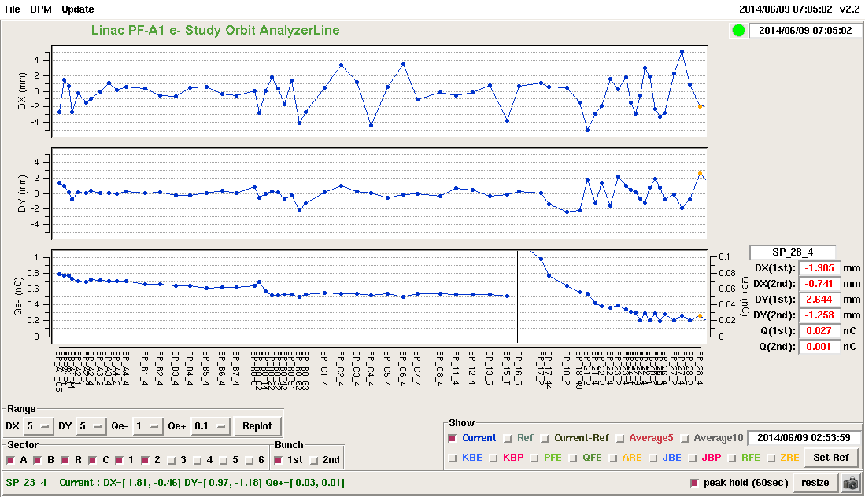
e+ beam measurement
First e+ beam was measured by current system at Jun. 9th 2014.
Primary e- beam charge: 0.5 nC
e+ charge: 0.02 nC @ SP_28_4
e- beam
target
e+ beam
x (mm)
y (mm)
I (nC)

Slide 27
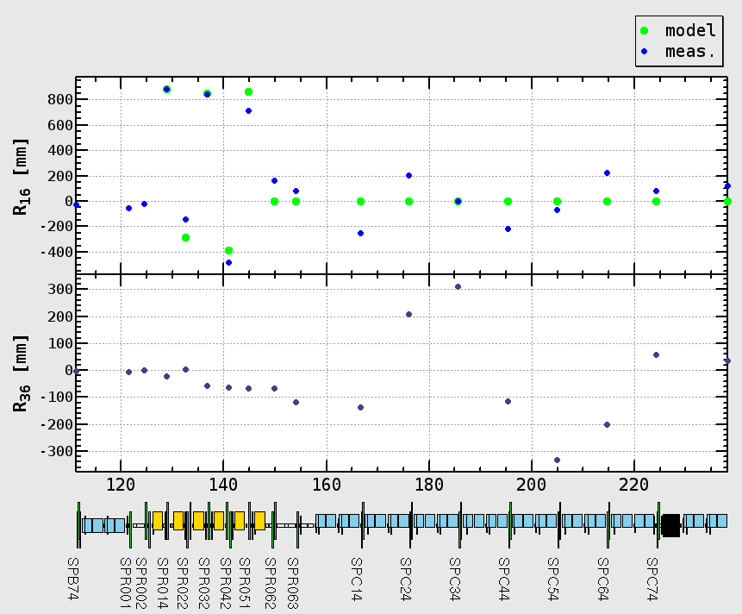
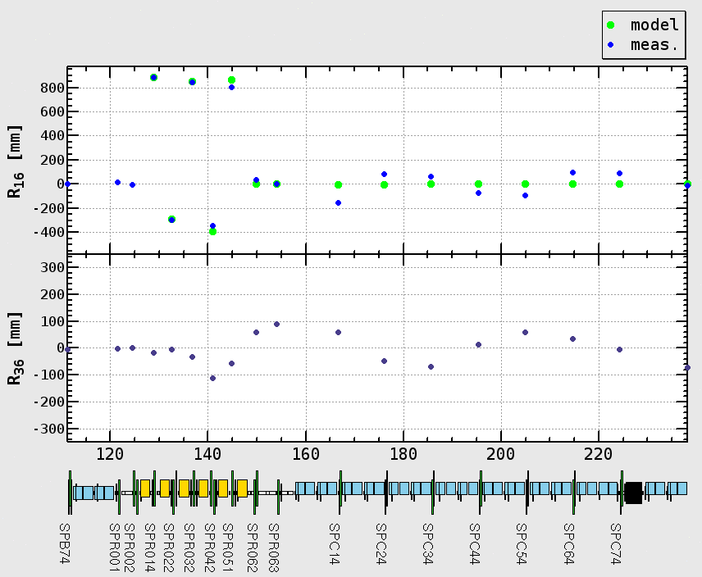
R16, R36 elements at J-ARC
R16, R36 values were measured at J-ARC and SectorC.
w/ and w/o fudge factors (B’ = A_{fudge} x B’_{model} )
Find suitable fudge factors
Typical fudge factors used for KEKB operation are 1% ~ 5%.
Design value
w/ fudge factors

Slide 28
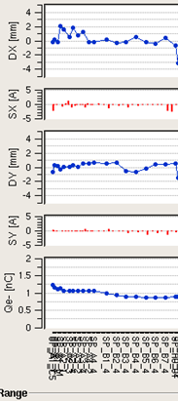
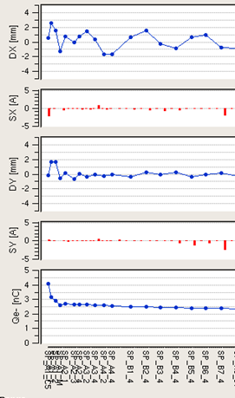
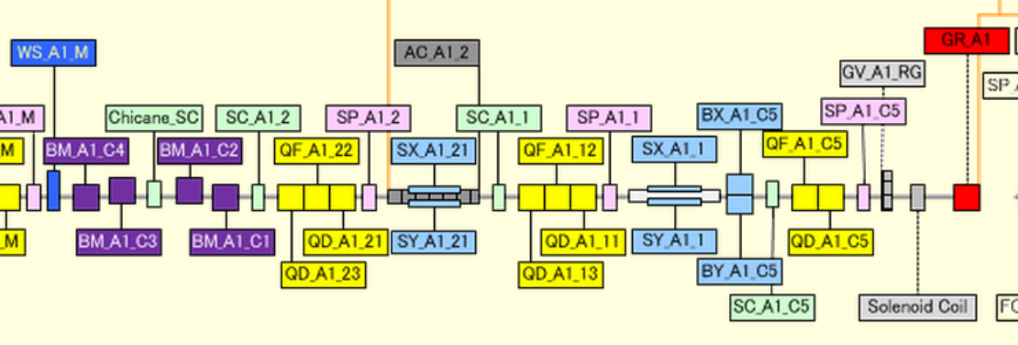
Beam loss at first acc. structure
x (mm)
y (mm)
Beam transmission rate is reduced at 2nd BPM (downstream 1st accelerating structure) when bunch charge from gun increases.
To improve it, 1st accelerating structure will be removed soon.
I (nC)
1 (nC)
4 (nC)

Slide 29
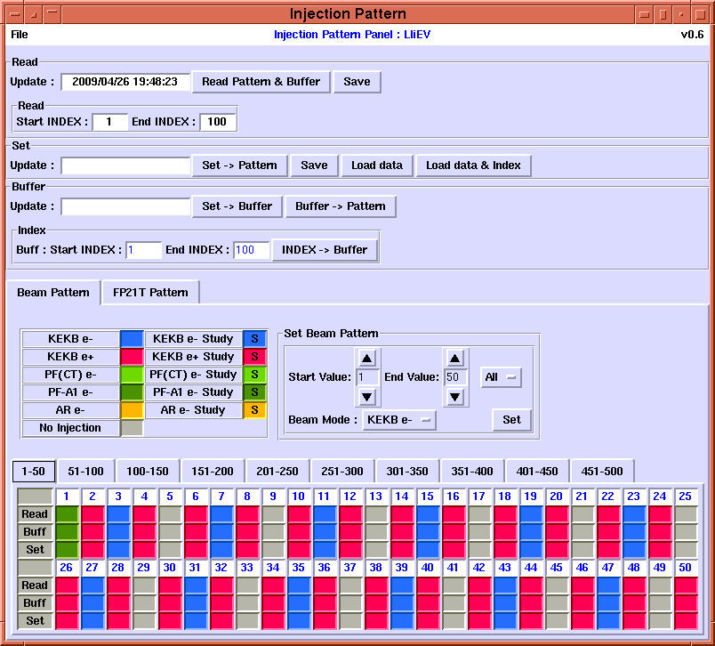
Timing system
Event generator (EVG)/Event receiver (EVR) based on VME64x. (Micro-Research Finland)
EVG (EVG-230) x1, EVR (EVR-230RF) x24
Arbitrary injection pattern can be set via HLA.
Main timing station
EVG
SH_A1
KL_B5/B6
SB_B
SB_A
Injection
e⁻ Gun
J-ARC
Cont-ABC
KL_51/52
e– BT (PF: 2.5GeV, 0.2nC)
e– BT (PF-AR: 6.5GeV, 5nC)
SB_C
SB_1
SB_2
SB_3
SB_4
SB_5
e⁺ BT (SuperKEKB: 4GeV, 4nC)
e⁺ Target
EVRs
e– BT (SuperKEKB: 7GeV, 5nC)
Cont-1
Cont-2
Cont-3
Cont-4
Cont-5

Slide 30
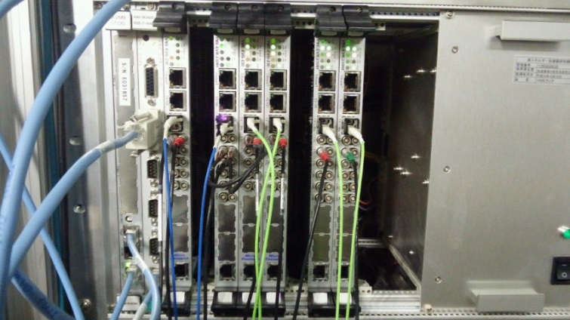
New timing system configuration
Main timing station
EVG#1
Main Rings
EVG
EVR
Damping Ring
Event signal (optical fiber)
Bucket selection: MR, DR
# of EVG: 1 => 3
CPU: MVME5500 => MVME6100
RTOS: VxWorks5.5 => 6.8
Firmware updated
EVR
PF-AR
PF
TTL
TTL
EVG#2
EVG#3
SH_A1
KL_B5/B6
SB_B
SB_A
Injection
e⁻ Gun
J-ARC
Cont-ABC
KL_51/52
e– BT (PF: 2.5GeV, 0.2nC)
e– BT (PF-AR: 6.5GeV, 5nC)
SB_C
SB_1
SB_2
SB_3
SB_4
SB_5
e⁺ BT (SuperKEKB: 4GeV, 4nC)
e⁺ Target
EVRs
e– BT (SuperKEKB: 7GeV, 5nC)
Cont-1
Cont-2
Cont-3
Cont-4
Cont-5

Slide 31
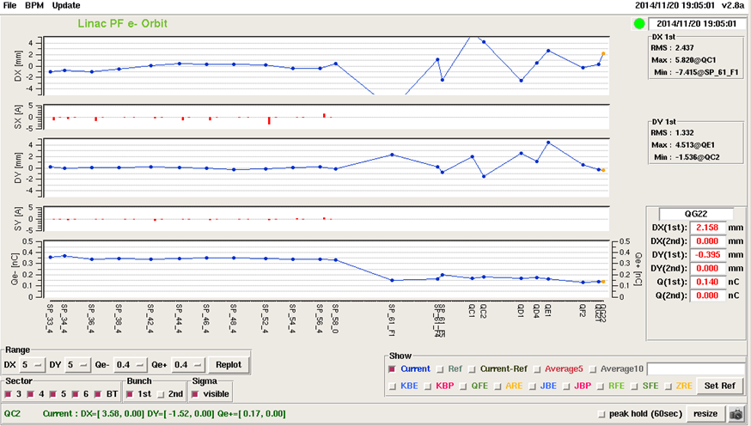
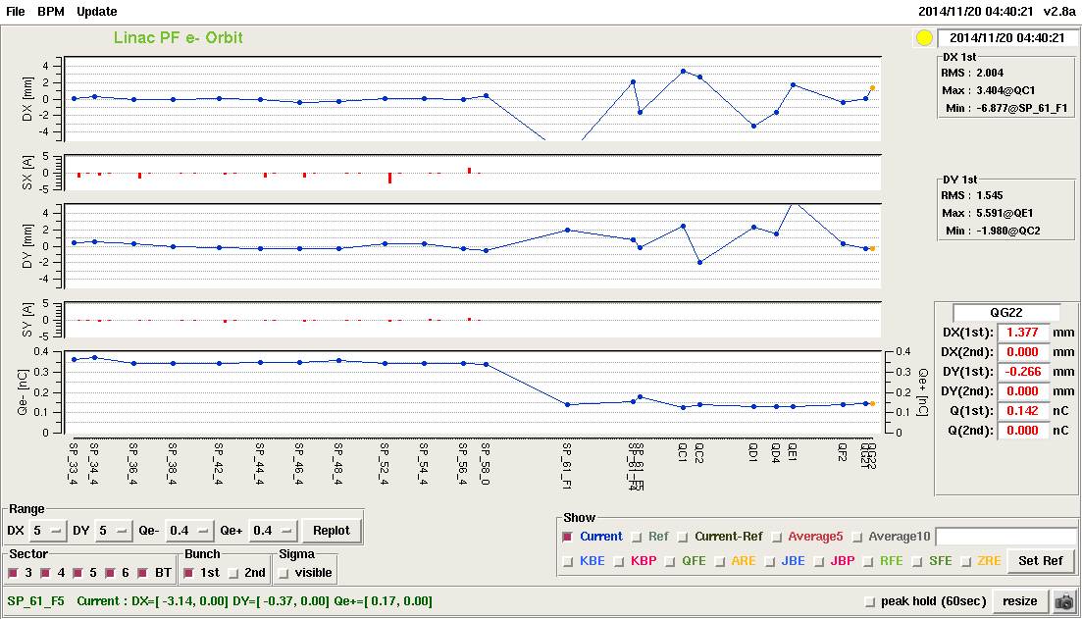
Beam injection study (new timing system configuration)
PF/PF-AR injection study were conducted w/ new EVG configuration and software.
Beam orbit and injection rate is quite similar between current and new system configuration.
Wire scanner/BPM works well.
Long-term stability will be tested after this Apr.
Beam orbit for PF injection (current system)
Beam orbit for PF injection (new system)

Slide 32
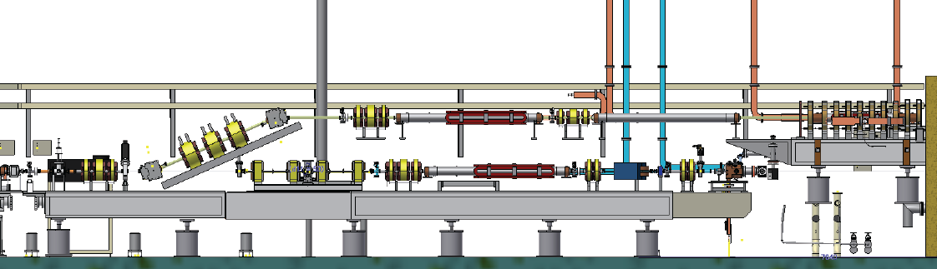
Unit A1 (reconfiguration)
Thermionic e- gun will be temporarily back in end of this Apr. (for radiation control license and e+ primary e- generation of 10 nC)
Keep the beam line for rf gun in current position.
Beam line level of beam line will be changed from 1200 mm to 1950 mm.
Spare magnets will be used for new beam line.
Thermionic e- gun commissioning will be started in early May.
Merger line
Thermionic e- gun
RF e- gun beam line
1200 mm
1950 mm

Slide 33
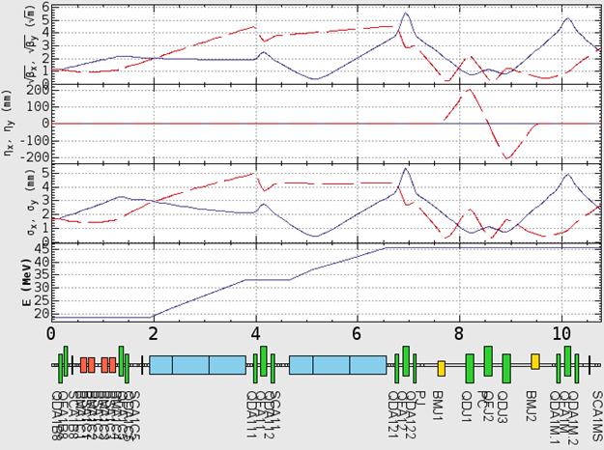




Optics design
Quadrupole triplets will be installed in merger line.
Beam size is not so large in comparison with bore radius of vacuum chamber .
Merger line
$\sqrt{β_{x}}$ $(\sqrt{m})$
$\sqrt{β_{y}}$ $(\sqrt{m})$
$$η_{x} (mm)$$
$η_{y}$ (mm)
Hor. beam size (mm)
Ver. beam size (mm)
Beam energy (MeV)

Slide 34
Issues
Injector commissioning
Oct. and Dec. of 2013/ Apr. ~ Jun. of 2014/ Oct. ~ Dec. of 2014
Not enough time for commissioning
e+ commissioning:
Installation of flux concentrator delayed from Dec. of 2013 to May of 2014.
Twice accidents in Dec. of 2013 and Dec. 2014 (cable burned)
First e+ beam was measured in Jun. of 2014.
Progress of LAS rf conditioning is slow.
Not enough primary e- bunch charge at target (≤ 1 nC)
e- commissioning:
Discharge of rf gun cavity. Not enough power for rf gun cavity (12 MW/20 MW)
Shot-by-shot beam stability of charge and position/angle from gun is not yet enough. Difficulty to keep the high bunch charge in long term period.
Beam loss at Unit-A1 (chicane) and J-ARC

Slide 35
Summary and Plan
Beam commissioning w/ A1 rf gun started in Oct. of 2013.
Not enough time for commissioning
5.6 nC (from rf gun), 0.75 nC (Linac end)
Stability is still issue. (Shot-by-shot and long term)
Unit-A1 reconfiguration will be completed before end of Apr. Thermionic e- gun commissioning in May.
Beam commissioning w/ thermionic e- gun (May, June)
Measure Quadrupole center to BPM center offset
Reduce beam loss at Unit-A1/J-ARC
Development of commissioning tools and tests (beam based alignment/emittance preservation)
Pulsed Quads (x2) and steering (x2) will be tested in Sector2.
Prepare stable e-/e+ beams (1 nC w/o low emittance) before MR commissioning Phase-I.

Slide 36
backup

Slide 37
e- beam parameters
 | SuperKEKB | KEKB
Energy (GeV) | 7.0 | 8.0
HER stored current (A) | 2.6 | 1.1
HER beam lifetime (min.) | 6 | 200
Maximum beam repetition (Hz) | 50 | 50
Max. # of bunch in an rf pulse | 2 | 2
Emittance (mm⋅mrad) | 50/20 (Hor./Ver.) | 100
Charge (nC) | 5 | 1
Energy spread (%) | 0.1 | 0.05
Bunch length σz (mm) | 1.3 | 1.3
Damping ring | - | -
Simultaneous top-up injection | 4 rings (SuperKEKB e-/e+, PF, PF-AR) | 3 rings (KEKB e-/e+, PF)

Slide 38
e+ beam parameters
 | SuperKEKB | KEKB
Energy (GeV) | 4 | 3.5
LER stored current (A) | 3.6 | 1.6
LER beam lifetime (min.) | 6 | 133
Maximum beam repetition (Hz) | 50 | 50
Max. # of bunch in an rf pulse | 2 | 2
Emittance (mm⋅mrad) | 100/20 (Hor./Ver.) | 2100
Charge (nC) | 4 | 1
Energy spread (%) | 0.07 | 0.125
Bunch length σz (mm) | 0.7 | 2.6
Damping ring | 〇 | -
Simultaneous top-up injection | 4 rings (SuperKEKB e-/e+, PF, PF-AR) | 3 rings (KEKB e-/e+, PF)

Slide 39
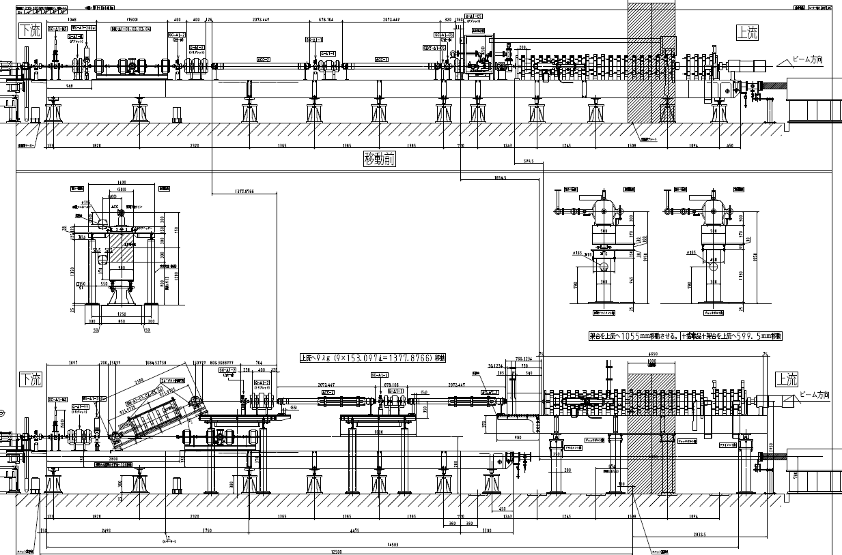
Design drawing of A1 beam line

Slide 40
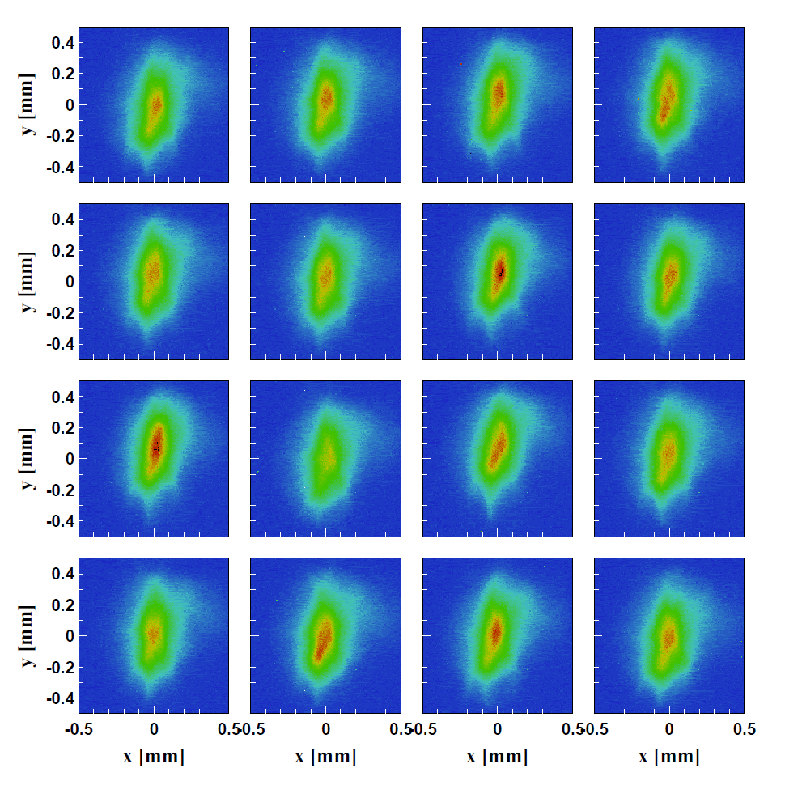
Shot-by-shot beam profile stability

Slide 41
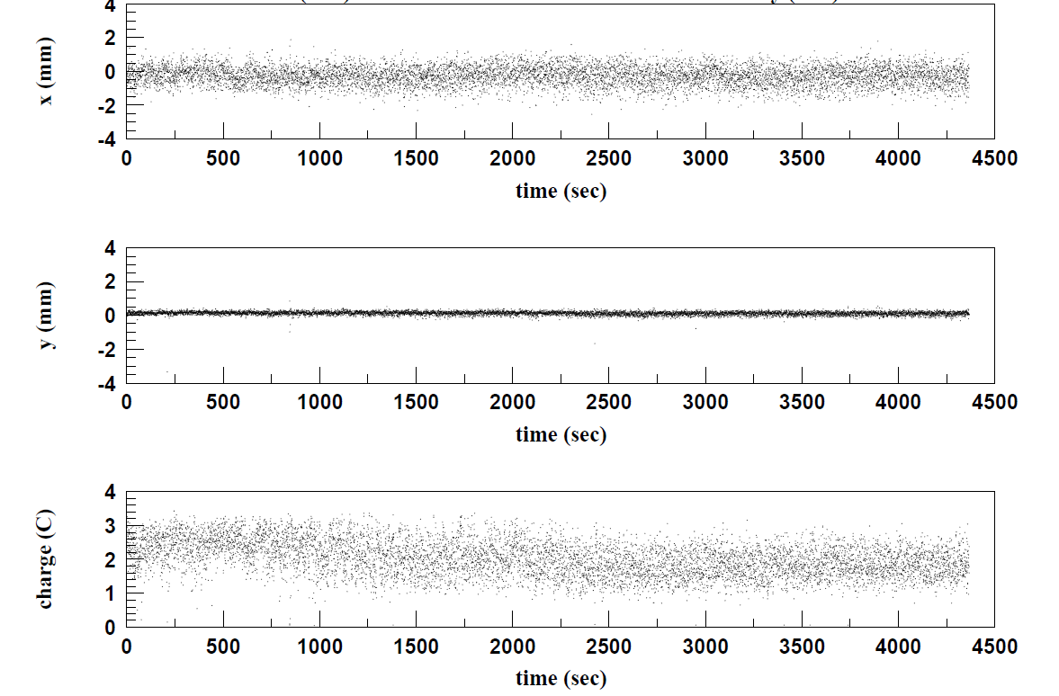
Beam position stability @ SP_A1_C5
Measured beam position at first BPM (SP_A1_C5)
σx ~ 0.57 mm
σy ~ 0.11 mm
Fluctuation of horizontal beam position is larger than vertical one.
30 min.

Slide 42


Emittance measurement example (Unit-A1)
Quadrupole scan
Screen monitor at chicane
Chicane
Horizontal
βγεnx: 15.43 mm·mrad
Vertical
βγεny: 9.42 mm·mrad

Slide 43

Emittance measurement example (Sector B)
Multiple wire scanner at the end of Sector B
Typical result (1 nC):
εn,x: 66.006 ± 10.755 mm⋅mrad
εn,y: 77.309 ± 14.522 mm⋅mrad
Charge stability is not so small. Software is under development for subtracting shot-by-shot beam fluctuation.

Slide 44


Emittance measurement
Emittance of rf gun and SectorB were measured by Quad scan and multiple wire scanner, respectively.
Results measured in Nov. and Dec. of 2014.
Vertical emittance is smaller than horizontal one.

Slide 45



Two bunch operation example
1st bunch charge
2nd bunch charge

Slide 46






Profile monitor
Screen material is made of 99.5% Al2O3 and 0.5% CrO3 (AF995R, Demarquest Co.). (t: 1 mm)
Linux/PLC (x31) control profile monitor (insert/remove, video signal select, limit switch, LED illumination, pneumatic air pressure).
EPICS IOC is running on Linux/PLC. HLA is implemented by Python.
Beam profile
Controller and HLA
Monitor and CCD camera

Slide 47



Profile monitor (cont’d)
7/97 were replaced by 30-μm-thick one for precise beam size/emittance measurement (Quadrupole scan).
CCD cameras have been replaced by new one.
Allied Vision: GC650 w/ GbE
Ext. trigger input
EPICS IOC, CSS for HLA

Slide 48


Energy spread measurement @ J-ARC
Measure beam energy spread by screen monitor (middle of J-ARC) w/ and w/o bunch compression at A1 chicane.
Bunch compression at A1 unit is effective for energy spread compensation.
A1 chicane On
(w/o bunch compression)
A1 chicane Off
(w/ bunch compression)

Slide 49
Summary of e- commissioning
Item | Requirement | Current status
Beam charge (nC) | 5 (10 for e+ primary) | 5.6 (first BPM) 0.58 (Linac end)
Beam energy (GeV) | 7 | 7
Normalized emittance (mm⋅mrad) | 50/20 (Hor./Ver.) (at the end of Linac) | 20/7 (Hor./Ver.) (from RF gun)
Bunch charge stability | 2.5% (KEKB), 1% (PF/PF-AR) | 10% ~ 20%
Bunch compression (Unit-A1) | 30 ps => 10 ps | 30 ps => 10 ps
Bunch compression (J-ARC) | 10 ps => 5 ps | n/a
Temporal manipulation of laser | Uniform shape | n/a
Emittance preservation | 20 mm⋅mrad (Linac end) | n/a
Max. beam repetition | 50 | 25
# of bunches | 2 | 2
Operation | Simultaneous top-up | n/a

