Slide 1
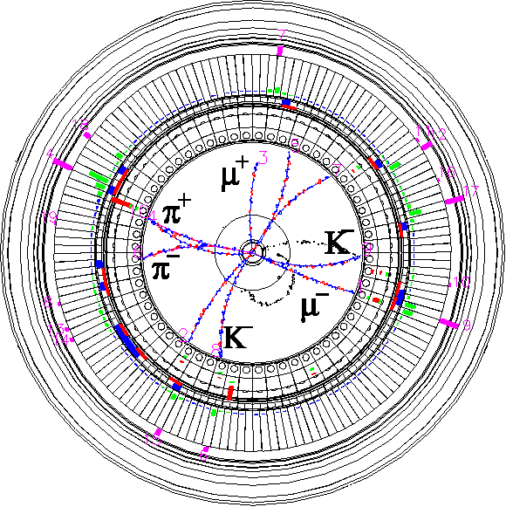


Vacuum
Progress and Troubles
of
Upgrade Works
The 20th KEKB Accelerator Review Committee
February 23, 2015
Kyo Shibata
(on behalf of KEKB Vacuum Group)
Inter-University Research Institute Corporation High Energy Accelerator Research Organization (KEK)
大学共同利用機関法人 高エネルギー加速器研究機構 (KEK)

Slide 2
Contents
Introduction
Pre-installation works
Installation
Collimator
Control
Damping Ring
Remained works
Summary
Original slides of Installation and trouble reports in Pre-installation works were provided by Suetsugu-san.
Original slides of Collimator and Control were provided by Ishibashi-san.
Vacuum system around IP was presented by Kanazawa-san (IR Overview).

Slide 3
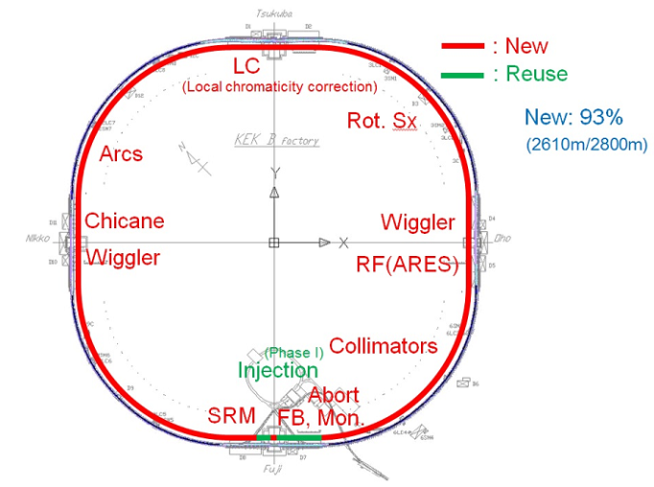
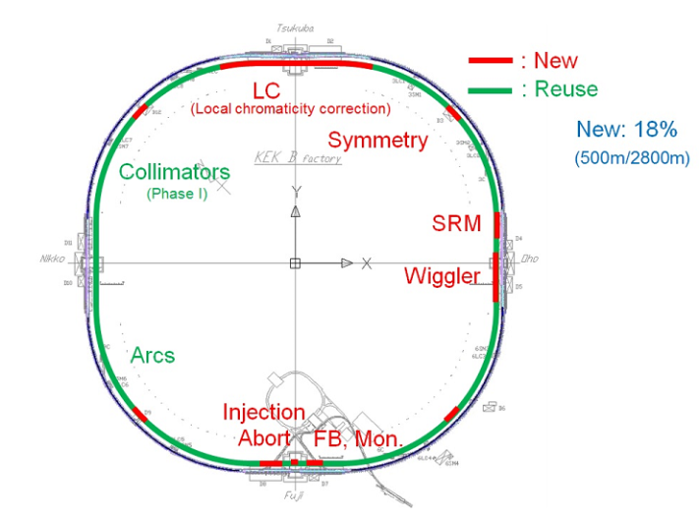
Introduction
Outline of upgrade of MR (except IR and Damping Ring)
LER : Most of beam pipes and components are replaced with new ones.
Replacement rate : 93 % (2610 m / 2800 m)
New 2 horizontal collimators (for Phase-I operation)
Countermeasures against electron cloud (clearing electrode, groove surface, TiN coating and solenoid field.)
HER : Most of beam pipes and components are reused.
Only local chromaticity correction, wiggler sections and etc. are replaced with new ones.
Replacement rate : 18 % (500 m/2800 m)
Design of control and monitoring system follows that of the KEKB.
Most of control devices are reused.
Pre-installation and installation works, fabrication of collimators, test of control system were done in this past year.
DR : Fabrication and TiN coating of beam pipes are now in progress.
LER
HER

Slide 4
Pre-installation works 1
Pre-installation works
Progress in this past year
Coating :
Main Ring : 179 beam pipes
Damping Ring : 38 beam pipes
Baking :
Main Ring : 354 beam pipes
Damping ring : 0 (as originally planned)
Pre-installation works for all beam pipes required for Phase-I except IP pipe have been finished successfully.
IP pipe was damaged with crack on welding line in the process of installation into vertical coating equipment.
SEY during the production and after long air venting was not measured. (pointed out in last KEKB Review)
Still unclear if the low SEY is conserved for a long time.
No air leak during the coating process.
Planning long-term SEY measurement .
Bringing beam pipes to KEKB Oho Lab. from storage area
Visual check on the beam pipe
LER beam pipe without electrode
DR beam pipe
HER beam pipe
TiN Coating
LER beam pipe with electrode
Assembling
(NEG pump & BPM electrode)
Baking
KEKB Oho Lab.
Returning the beam pipes to storage area

Slide 5
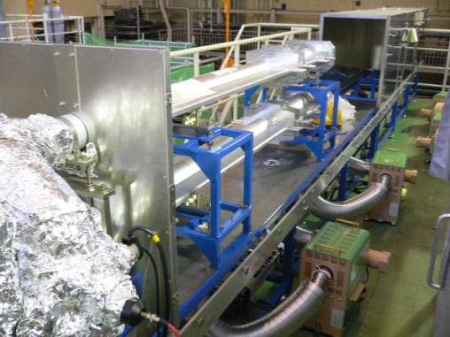
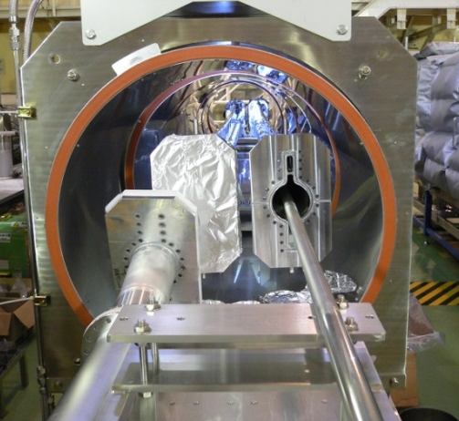
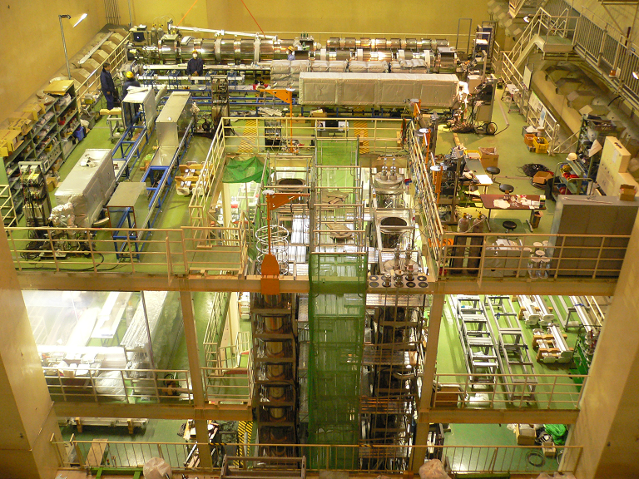
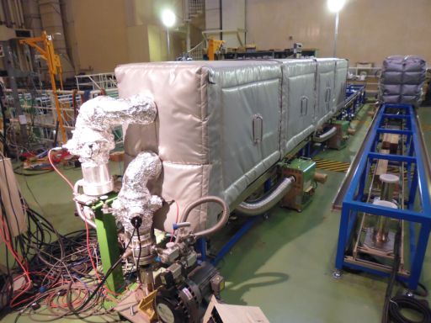
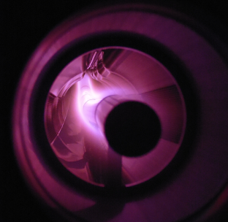
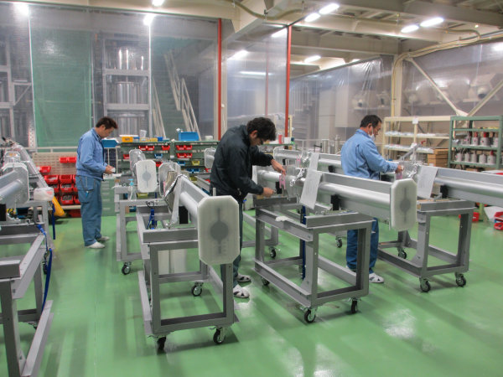
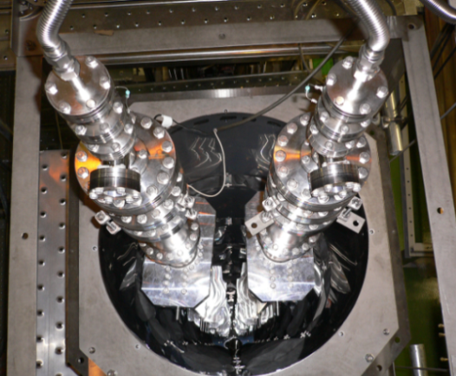
Pre-installation works 2
Hot-air heating method was adopted. (∼150°, 26 h)
Bent pipes were coated by horizontal coating equipment.
KEKB Oho Lab.
Baking equipment
Coating was done by DC magnetron sputtering of Ti in Ar and N₂.
Visual check and assembling were done in Oho clean room.
Straight pipes were coated by virtical coating equipment.

Slide 6
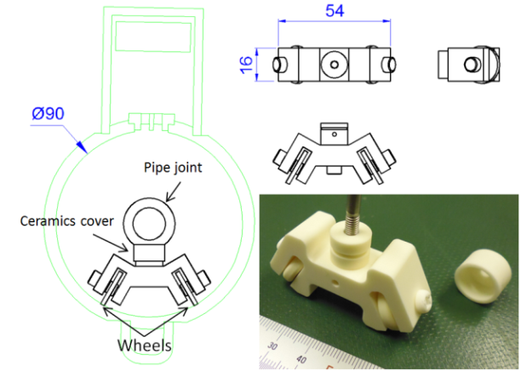
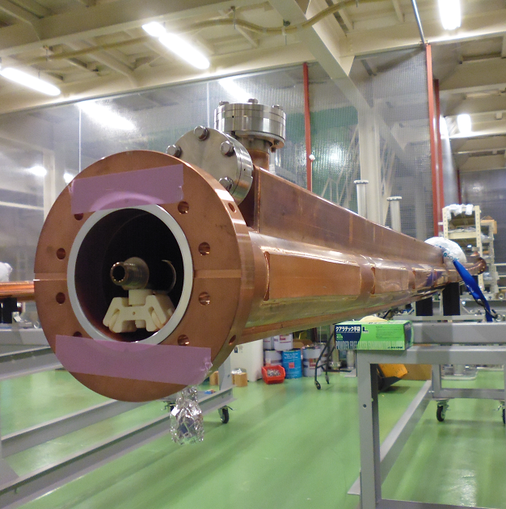
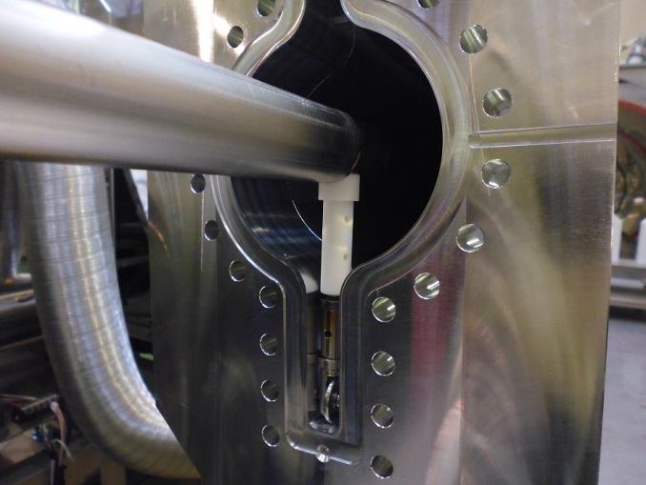
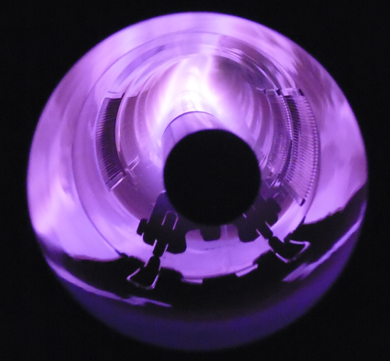
Pre-installation works 3
Coating of bent pipes without antechambers by horizontal facility
To coat bent pipe by horizontal facility, Ti cathode position is fixed by ceramics supports.
Conventional ceramics support is available only for beam pipes with antechambers.
About 10 bent pipes without antechambers were coated with new ceramics support.
Ceramics support on sidewall of beam pipe
(new type)
Ceramics support set in antechamber
(Conventional type)
Ti cathode
Ceramics cover for insulation protection
Ceramics support
Wheels
Magnetron discharge sputtering

Slide 7
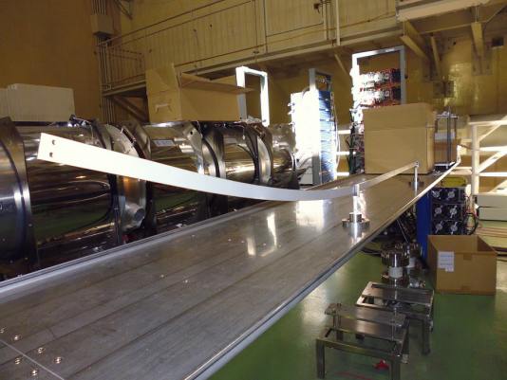
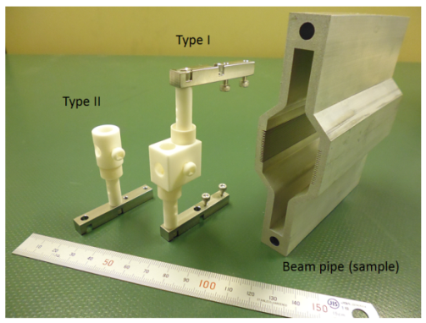
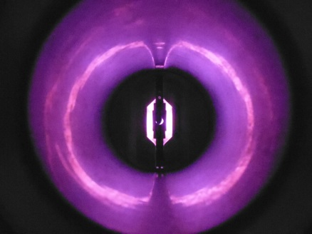
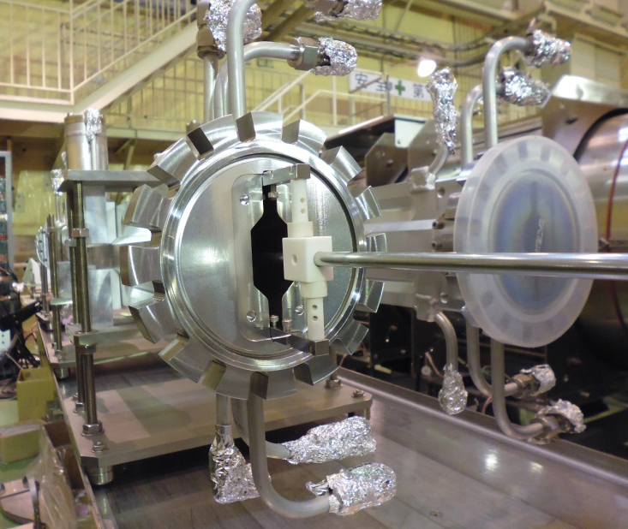
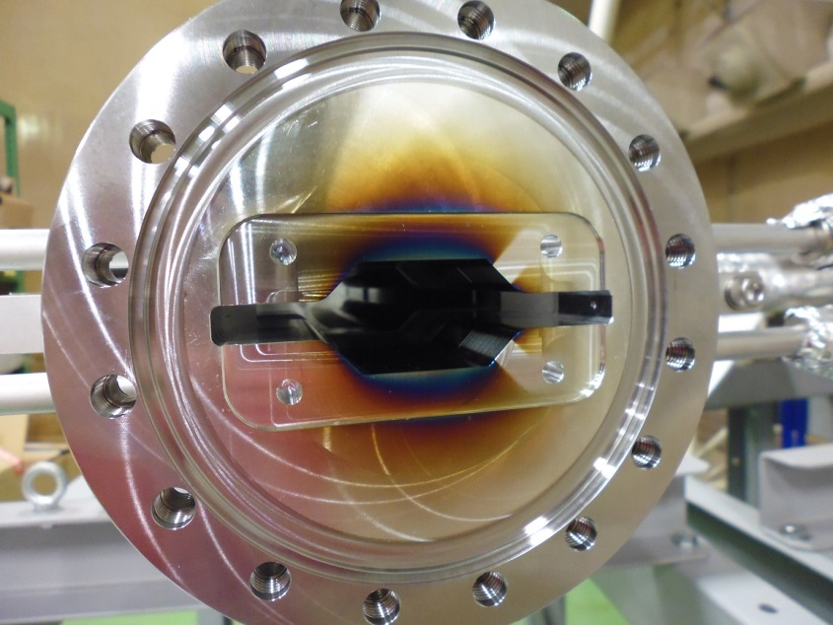
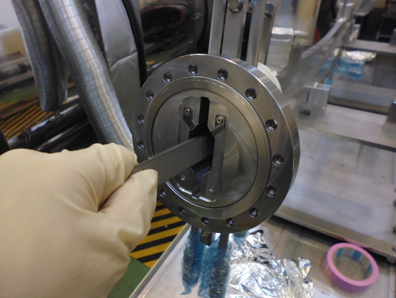
Pre-installation works 4
Coating of Damping Ring beam pipes by horizontal facility
Flat cathode shown in last review did not work.
Discharge didn’t occur in the center of beam pipe.
New cathode pipe worked well, and 38 beam pipes were coated so far.
More 36 beam pipes will be coated by the end of this fiscal year (3/31).
New ceramics supports
Magnetron discharge sputtering
New cathode pipe and ceramics support
Didn’t work
Ti cathode (pipe)
Ceramics support
Flat cathode

Slide 8
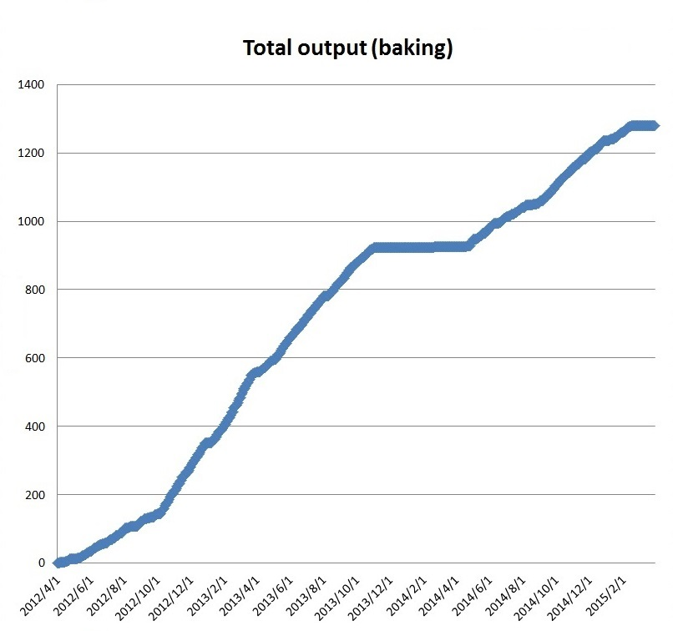
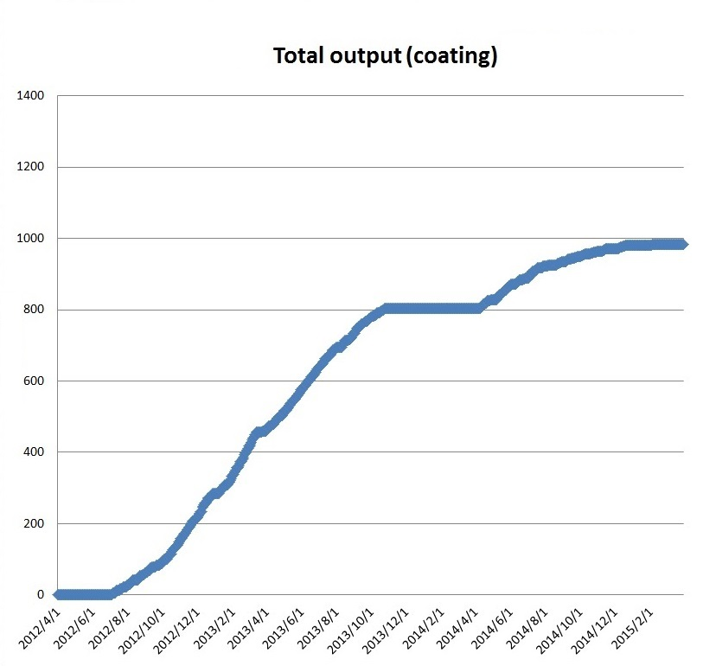
Pre-installation works 5
Total output of pre-installation works
Large-scale works by 10 workers was continued until the end of 2014. (by 3-4 workers this year.)
All planned works for MR finished this month.
Work pace decreased compared to the past fiscal years because of a variety and delay in delivery of beam pipes.
Baking
TiN coating (not counting Damping ring)
Finish!!
Finish!!
number
number
354 beam pipes
(this fiscal year)
179 beam pipes
(this fiscal year)
date
date

Slide 9
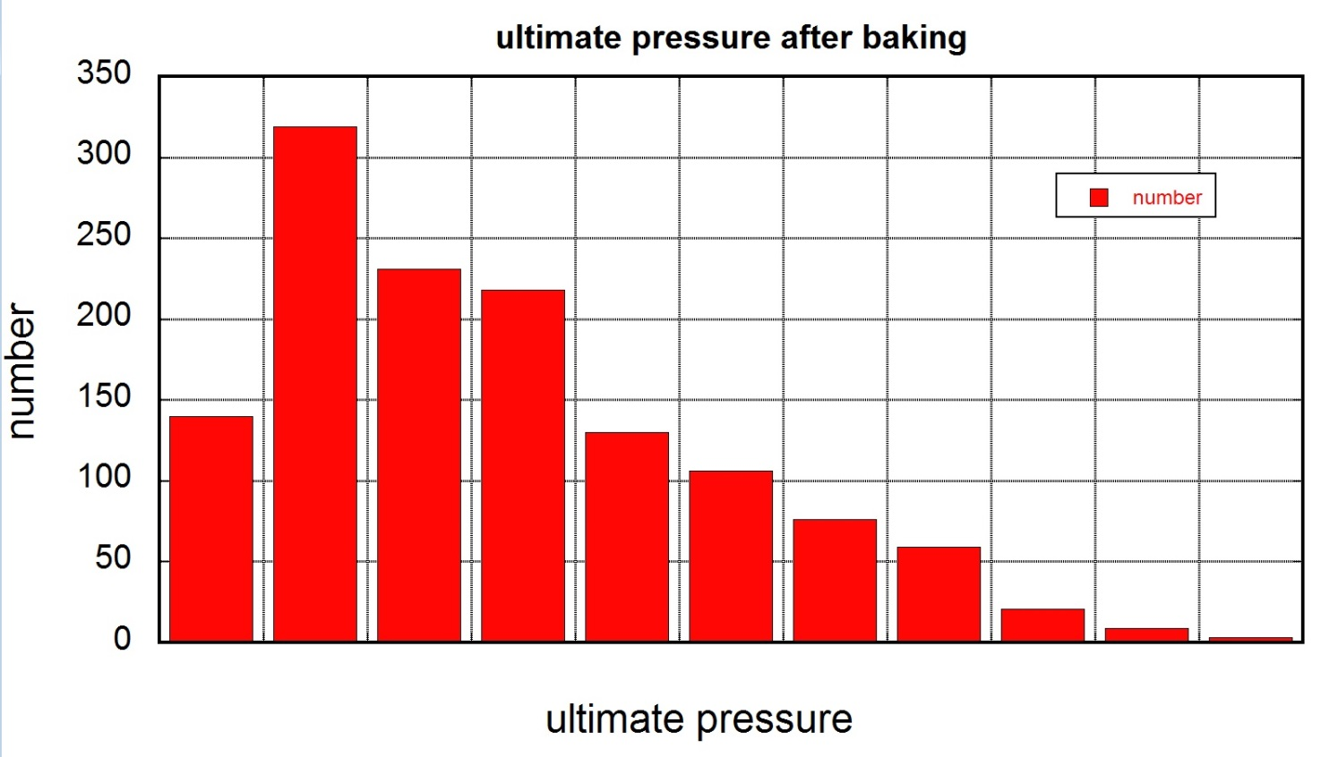
Pre-installation works 6
Ultimate pressure after baking
“Less than 1×10⁻⁷ Pa” is set as our criterion for check. (If not, beam pipe is re-baked.)
Almost all beam pipes meet our criterion for check.
Ultimate pressures higher than 5×10⁻⁸ Pa have been measured for many beam pipes. (pointed out in last KEKB Review.)
No measurement of residual gas
A variety of beam pipes: long (∼6 m) and short (∼150 mm), w/wo NEG, Cu and Al
Distribution of ultimate pressures
Criterion for check
Including data derived from all beam pipes.
< 1
1∼2 2∼3 3∼4 4∼5 5∼6 6∼7 7∼8 8∼9 9∼10
10 <
[x10⁻⁸ Pa]

Slide 10
Pre-installation works 7
Trouble 1 : High ultimate pressure (> 1×10⁻⁷ Pa)
In some beam pipes, the ultimate pressure after baking were higher than 1×10⁻⁷ Pa, which is our criterion of check.
Case 1 : Air leak from connection flange 1 (simple case)
Cause : Decrease in fastening power due to baking
Cure : Refastening flanges. Replacement of gasket and re-baking.
Case 2 : Air leak from connection flange 2
Cause : Wrong choice of gasket (Cu gasket on Al flange(CF203))
A few special Al beam pipes have Al CF203 flanges, though most of them have SUS CF203 flanges.
At worst knife-edges were damaged, and we gave up re-baking them to avoid further damage to flanges. (two beam pipes)
Case 3 : Leak at ceramic brazing of sheath heaters for NEG activation.
Next slide
Case 4 : Large gas desorption from beam pipe or NEG?
Cure : Re-baking. (If it fails again, replacement of NEG strips and heaters.)
In most cases the ultimate pressure reduced on the order of 10⁻⁸ Pa.

Slide 11
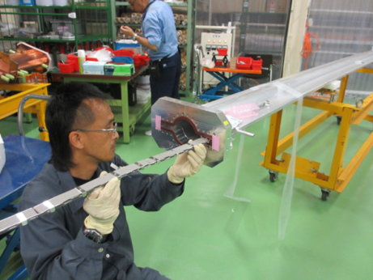
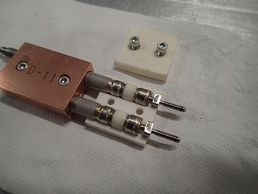
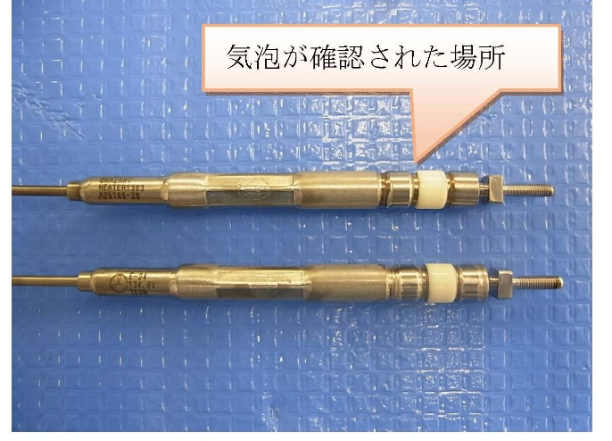
Pre-installation works 8
Trouble 2 : Leak at ceramic brazing of sheath heaters for NEG activation.
Cracks at the brazing between ceramics and stainless steel sleeve was found.
Gas desorption from the cracks leaded to high ultimate pressure even after NEG activation.
Low insulation resistance was also observed.
Cause :
Fastening of ceramic block for insulation was too strong, and the excess stress (moment) was applied to the brazing part, if the ceramic was brazed with a slight angle.
Cures :
Insert a thin spacer between ceramic blocks to avoid the excess stress on the brazing part.
Cracked heaters were re-fabricated.
Air leak
Excess stress
NEG with heater installed into beam pipe
Feedthrough of heater with insulation ceramic block
Leaked feedthrough of heater

Slide 12
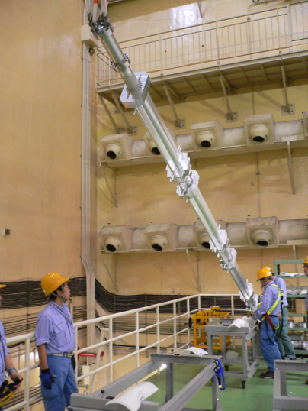
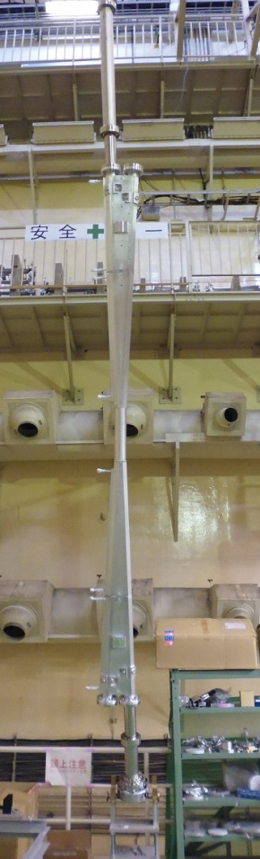
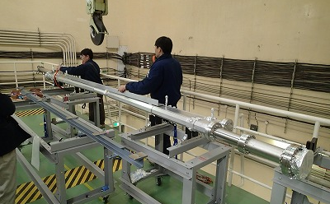
Pre-installation works 9
Trouble 3 : Crack at the welding line of X-shaped IP pipe.
In order to install the beam pipe into the vertical coating equipment, one end of the beam pipe was lifted up by crane while other was fixed to hinge assembly.
Crack occurred during crane operation.
Cause :
Concentration of stress (moment) at the center of beam pipe where the cross-section is smallest.
Cracked part has relatively weak structure.
Note:
This is not IP pipe. This picture is shown as reference.
Stress
Crack
Cures :
Re-welding in the manufacturer.
Improvement of structural strength
It will be repaired next fiscal year.
Lifting
Fixed to hinge assembly

Slide 13
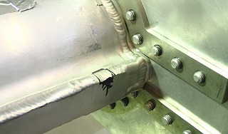
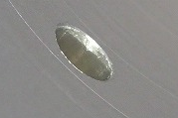
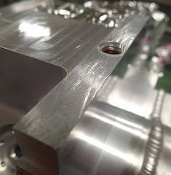
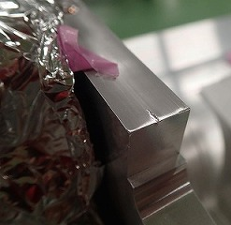
Pre-installation works 10
Other Troubles:
Air leaks of welding line of beam pipe occurred during the baking and coating. (2 beam pipes)
Cause : Bad welding ?
Cure : Re-welding at the manufacturers.
Lots of Burrs in the holes for BPM feedthrough. (risk of discharge)
Cause : Insufficient quality control in the manufacturer
Cure : Check all holes by KEK staff of beam monitor group
Deburring in KEK site by the manufacturer or KEK staff (in most case)
Bad insertion of helicoil for the tapped hole to fix the BPM electrode.
Cause : Bad quality control at the manufacturer
Cure : Re-installation of helicoil. (if failed, M4 tap was changed to M5 tap)
Defects or scratches on the standard surface of BPM block
Cause : Bad quality control at the manufacturer
Cure : Check all holes by KEK staff of beam monitor group
Polishing the defects to remove “projection”
Deburring
Shortage of BPM electrode and Helicoflex gasket
Cause : Miscalculation? Excess consuming?
Cure : Reorder. (Already delivered in last December and January)
Rescheduling pre-installation works
And so on.
Leak
Burr
Hole for BPM electrode
(inside view)
Scratches and defects

Slide 14
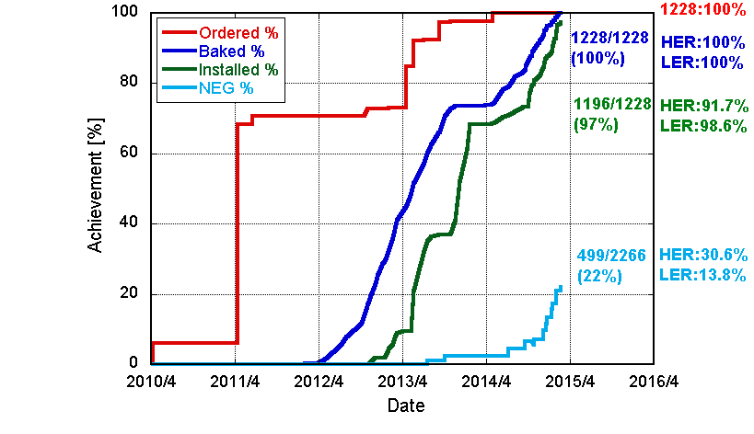
Installation 1
Installation of components into the tunnel
97% of beam pipes required for Phase-1 has been installed already.
Most of remained are those for HER around Tsukuba straight section and the beam injection section at Fuji straight section.
Main Ring [2015.02.19]

Slide 15
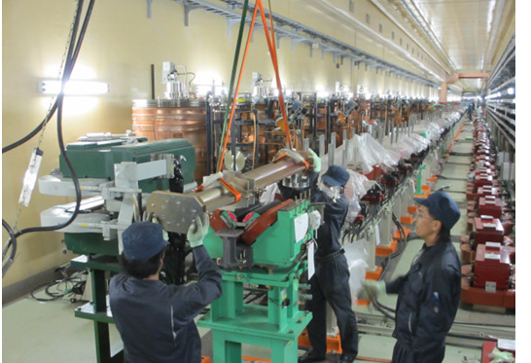
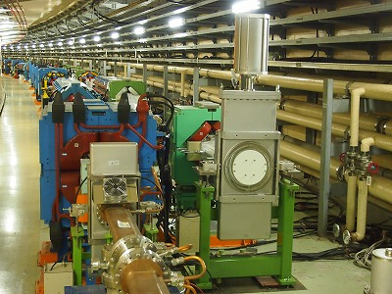
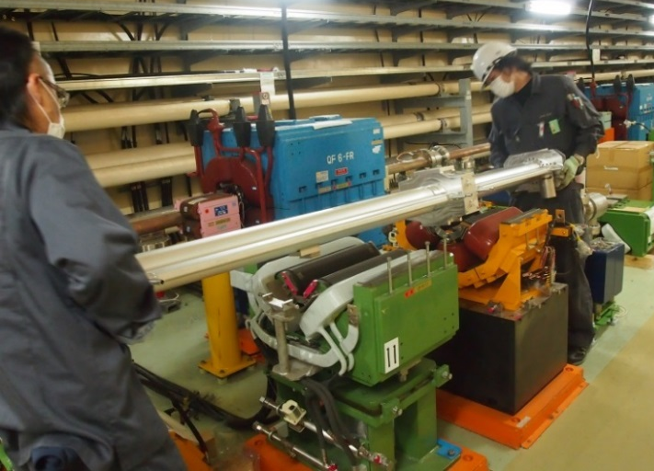
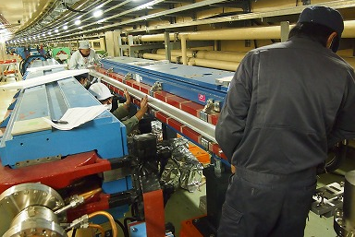
Installation 2
Installation into arc and wiggler sections were finished.
Beam pipe for wiggler
Gate valve at arc
Beam pipe for quad
Beam pipe for bend

Slide 16
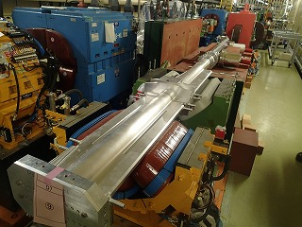
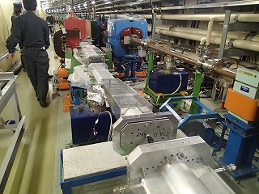
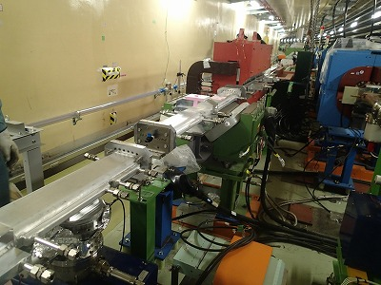
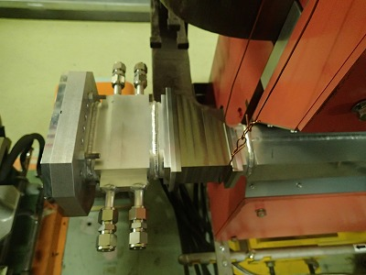
Installation 3
Installation of special beam pipes is almost finished.
Ti window
LER beam abort section

Slide 17
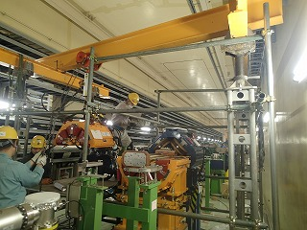
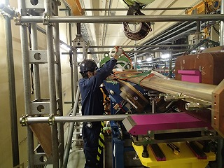
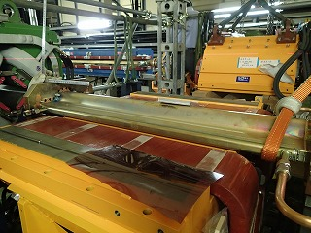
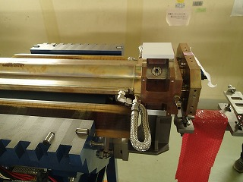
Installation 4
Installation of beam pipes for Tsukuba section is on going.
Straight section

Slide 18
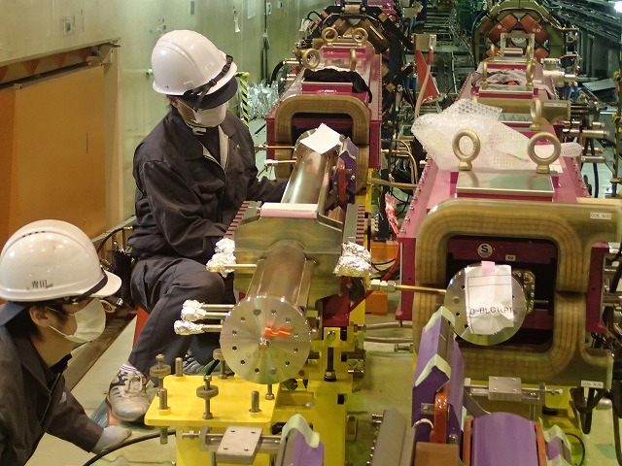
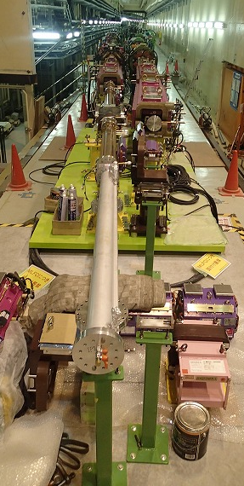
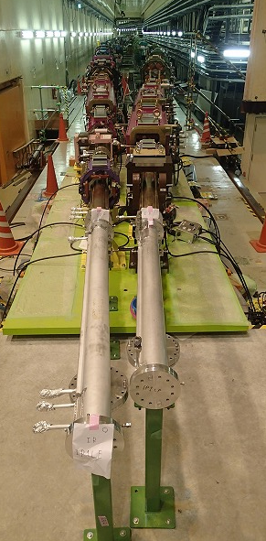
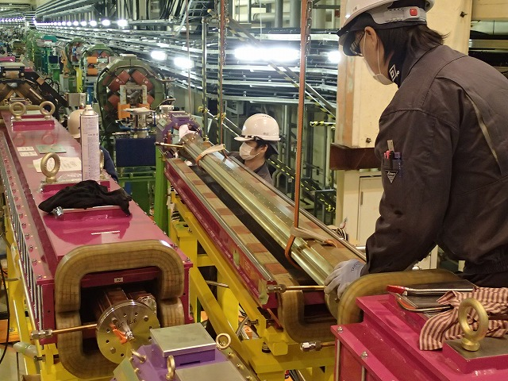
Installation 5
Installation of beam pipes for Tsukuba section is on going.
IR section

Slide 19




Installation 6
Installation of bellows chambers follows that of beam pipes.
Al bellows chamber
Cu bellows chamber
Cu-Al bellows chamber for GV

Slide 20
Installation 7
Evacuation and NEG activation
NEG activation has started from wiggler section and arc section in each region between gate valves.
In approximately 21% of both of the rings, NEG activations have been finished.
The average pressures less than 1×10⁻⁷ Pa were obtained after the NEG activation without beam pipe baking in-situ. (Ion pumps are baked.)
Main Ring [2015.02.19]

Slide 21


Installation 8
Trouble 1 : High rate of air leak at connection flanges (reported in last KEKB Review)
In the initial stage of bellows connection in the tunnel, the rate of air leak at the connection was higher (∼10%) than that experienced in the pre-installation work (<5%)
Possible causes:
Scratches or traces of machining (small steps and rolling) on the seal surface of bellows chambers
Difficulty in alignment of flanges (bellows chamber and beam pipe)
Bellows chamber is heavy.
Some beam pipes are already fixed to magnets
Oxide layer of aluminum gaskets?
Cures:
Polish of the sealing surfaces with abrasive cleaning pads (Scotch-Brite)
Polishing of gaskets (also effective sometimes)
The rate of leak decreased to less than 5% finally.
Tool to make the alignment easy (in preparation)
scratch on seal surface
Trace of machining
transcribed on used gasket

Slide 22



Installation 8
Trouble 2 : Cracks on the welding line (Case 1)
Welding line of BPM block of aluminum beam pipe cracked just after starting the evacuation in the tunnel. (3 beam pipes)
BPM block was rigidly fixed to Q-mag. via support.
Crack occurred on upper welding lines at Q-mag. side, where the longer beam pipe is welded.
No problem was reported in the pre-installation work.
Crack
Crack
Q-mag.
BPM block
BPM block
Longer pipe
Shorter pipe
Top view

Slide 23




Installation 9
Possible cause 1 : High moment due to the weight of bellows chamber at end.
It is suspected that the bellows chambers at ends was not rigidly fixed to the support.
There is also a possibility that the flange was aligned with some vertical excess-force to connect the bellows.
Connection of bellows
210 N
Atmospheric pressure
Simulation results:
The stress at top and bottom side further increase by the atmospheric pressure due to the antechamber cross section.
The stress at upper welding line is doubled with atmospheric pressure.
If the welding thickness is insufficient, such as less than 2 mm, the welding is likely to be cracked.
BPM block (fixed)
No atmospheric pressure
Crack point
210 N
Atmospheric pressure
210 N

Slide 24


Installation 10
Possible cause 2 : Thin welding thickness
With decreasing the welding thickness, the degree of cracking risk increases as shown in the simulation
The investigation using X-ray and cut samples revealed that the penetration depth is 1.5∼2 mm, whereas the design value is 2.5∼3 mm.
We checked the height of excess metal of most of beam pipes with BPM blocks (1254 welding lines in total).
Simulation of stress
Weight of bellows +
Atmospheric pressure
danger
safe
Weight of bellows +
No atmospheric pressure
Excess metal
Welding thickness
Penetration depth
Welding thickness t [mm]
Measurement results:
The height of excess metal are mostly in the range of 0.5∼2 mm.
If the height is less than 0.5 mm, the welding thickness can be less than 2mm.
It should be safe to re-weld these beam pipes.
(Average of 3 points near center)

Slide 25
Installation 11
Cures
Surely fix the bellows chambers to the supports before evacuation.
Avoid forced alignment of flanges.
Re-welding of the welding lines with a height of excess metal less than 0.5 mm.
Re-welding of the welding line with some defects, that were found in the investigation of excess metal.
No crack at this position has been observed since then.
However, great cares should be paid during the final alignment of magnets, where the beam pipes can move with magnets.

Slide 26



Installation 12
Trouble 3 : Cracks on the welding line (Case 2)
Crack was found on the welding line of flange in the special beam pipes for the rotating sextupole magnet, with a taper section from antechamber to circular cross section. (2 beam pipes)
No moment by the bellows. Not top or bottom. Not in the evacuation timing. (i.e., different case from Case-1)
In 2013 the similar crack at the same positon (but different beam pipe) was found in Oho Lab. Some of them were re-welded. (But this trouble occurred.)
There are 8 beam pipes with the same structure.
Cause:
Unclear (wrong welding condition? Structural stress?)
Cure:
Re-welding with other new flange.
We have to keep watching.
Beam pipe for rotating sextupole magnet
Crack
Crack

Slide 27


Installation 13
Trouble 4 : Interference with other components
Interferences between
Beam pipes and magnet coil, shims and various monitor sensor
Cooling pipes and magnet coils
Beam pipe support and magnet, power cables or support
And so on.
Cause :
Sometimes cut the beam pipe or cooling pipe
Sometimes move components.
Sometimes, re-disassembling of Q-mag. were required.
Thank a lot for the cooperation of other group.
Other troubles :
Air leak at welding line of gate valve (2 gate valves)
Cause :chemical cleaning solvent was remained at the welding line during the assembling process.
Cure :Re-welding at the manufacturer
Change of structure
Air leak in bellows chamber (2 bellows chambers)
Cause : unclear. Bad HIP condition?
Cure : Replaced by a reserved one. Asking the investigation and re-manufacturing to the manufacture
And so on.

Slide 28


Collimator 1
Plan and Location
Phase-I : 2 new models (horizontal type) for LER. (Conventional collimators are reused in HER.)
Phase-II : More 11 new models for LER, and 6 for HER. (not fixed yet for HER)
Phase-I
HER
D01: H1, H2, H3, H4, H5
V1
Phase-II
(not fixed yet for HER)
LER
D02: H1, H2, H3, H4
V1
D01
D02
D01
D02
LER
D03: H1, H2
V1, V2
D12
D03
D12
New
D03
HER
D12: H1, H2, H3, H4
V1, V2, V3, V4
HER
D12: H1, H2, H3, H4
V1, V2, V3, V4
D11
D04
D11
D04
D10
D05
D10
D05
D09
D06
D09
D06
D08
D07
New
D08
D07
New
HER
D09: H1, H2, H3, H4
V1, V2, V3, V4
HER
D09: H1, H2, H3, H4
V1, V2, V3, V4
LER
D06: H3, H4
LER
D06: H1, H2, H3, H4

Slide 29



Collimator 2
New collimators for Phase-I
Production of two horizontal collimators (D06H3, H4) was finished.
They will be installed on early next fiscal year.
Sliver plated INCONEL for the RF fingers and rhodium plated stainless steel for the contact surface were adopted. (pointed out in last KEKB Review)
Position of jaws is measured directly by displacement sensor. (pointed out in last KEKB Review)
Longitudinal length of the tip is 10 mm (>2 RL).
HOM absorber in the cavity is not considered yet. (pointed out in last KEKB Review)
R&D of HOM absorber chamber is now in progress.
Same technique may be applied to the collimator.
Ramp ∼12°
Tungsten
on tip
Cooling channel
Tapered beam pipe
Bellows

Slide 30


Collimator 3
Loss and kick factor vs d (distance between beam axis and head)
Impedances were estimated with GdfidL (bunch length σ_{z}= 6 mm)
Loss and kick factors of SuperKEKB type are smaller than those of KEKB type.
These results were used to estimate the threshold of the Transverse Mode Coupling Instability (TMCI)

Slide 31

Collimator 4
TMCI in LER (pointed out in last KEKB Review)
We estimated the threshold of the Transverse Mode Coupling Instability using actual β value at location of each collimator with σ_{z} = 6 mm.
D02V1 is the main impedance source because it would be used with the narrow aperture (d = ±2 mm).
The threshold is about 1.71 mA/bunch (Design value: 1.44 mA/bunch) in the latest collimator design.
TMC threshold (mA/bunch)
 | All Closed | Actual apertures |  | Bunch current (design)
Horizontal | 1.41 | 13.15 | > | 1.44 mA/bunch
Vertical | 1.32 | 1.71
Collimator Aperture List (mm)
D06H1 | -16.0/+17.0
D06H2 | -16.0/+16.0
D06H3 | -16.0/+15.0
D06H4 | -13.0/+13.0
D03H1 | -21.0/+20.0
D03H2 | -18.0/+20.0
D03V1 | -9.0/+9.0
D03V2 | -9.0/+9.0
D02H1 | -10.6/+12.0
D02H2 | -16.0/+20.0
D02H3 | -18.0/+21.0
D02H4 | -13.0/+9.0
D02V1 | -2.0/+2.0
C₁ : constant ≈8
f_{s} : synchrotron frequency
E : beam energy
β : beta function
k⊥ : kick factor

Slide 32
Control 1
Design of control and monitoring system follows that of KEKB.
Most of control devices that has been used since TRISTAN or KEKB are reused.
Priority was given to renewal of antiquated devices. (Budgetary restrictions)
CMAC to cRIO, VME to F3RP61, Renewal of Ion pump controller (gradually), and so on.
A set of a CCG and an ion pump is installed at intervals of 10 m.
At least one vacuum switch is installed in a section divided by two gate valves.
Interlocking operations are performed by PLC (pointed out in last KEKB Review)
CCG, Ion pump, NEG activation
HV to CCGs can be applied when the vacuum switch closes in the section.
Each CCG within intervals of 30 m is turned on, and this refers to the steady state for the vacuum in the section.
Steady state allows supplying power to ion pumps and NEG activation. (Cancelable)
Magnet current status is also checked for NEG activation to avoid the strip type NEG in the magnet oscillating with AC for the activation.
Gate valve
The sequence CPU in PLC checks the steady statuses of two vacuum sections divided with gate valves.
Gate valves can be opened when the statuses are steady .
Beam abort
Temperature sensors, flow meters, gate valves and beam stoppers can activate the beam abort trigger directly.

Slide 33

Control 2
Integrative tests for the control system was done successfully. (NEG activation)
NEG activation was performed by following procedure:
TMPs are started up, which are installed on angle valves.
High voltage is applied to CCGs and Ion pumps in the section
Ion pumps are baked using heaters for 1-2 days
NEG pumps are activated with a pattern operation for 0.5-2 days
Baking heaters of the ion pumps are turned off after 1-2 hours of the start of NEG activation.
Angle valves are closed just after the activation.
History of CCG pressures during and after NEG activation

Slide 34

Damping Ring 1
Fabrication of beam pipes has almost finished.
Remained pipes : Injection and extraction sections, beam pipe for SR monitor.
They will be fabricated next fiscal year.
Pre-installation works of beam pipes for arc sections are now in progress.
38 beam pipes for arc sections were coated so far.
More 36 beam pipes will be coated by the end of this fiscal year (3/31).
Baking of beam pipes will be done next fiscal year.
Installation will start next fiscal year at the earliest.
Delivery of NEG pumps, gate valves and beam stopper were completed.
Ion pumps and power supplies to them will be purchased next fiscal year.
Vacuum control system will be almost same as that of MR.
The number of control data item is much smaller than that of MR.
Injection section
(Not yet)
Fabrication finished.
SR monitor
(Not yet)
RF section
extraction section
(Not yet)

Slide 35





Damping Ring 2
Aluminum Beam pipes for arc sections
Antechambers on both sides of beam channel
Grooved structures at top and bottom of the beam channel (countermeasure against electron cloud)
Grooved structures at side walls of antechambers for antireflection of SR
Water cooling channel on both sides
Designed to fit narrow space
Having RF shielded bellows, BPM block and Pumping port
Type I
Two beam pipes in one cell
Type II
Type II
Type I

Slide 36
Damping Ring 3
Rough estimation of average pressure in arc sections
Required averaged pressure is lower than 1×10⁻⁵ Pa to obtain enough beam life time.
Beam pipes have three pumping ports in one cell with a length of about 2 m. (d ≈ 0.7 m)
Two of them are for the NEG pumps and one is for ion pump.
Average effective pumping speed will be 0.037 (just after activation) ∼ 0.025 m³s⁻¹
Photon stimulated desorption by SR is major dynamic gas load during beam operation.
After the sufficient scrubbing, η will drop to below less than 1×10⁻⁴ molec./photon.
1×10⁻⁵ Pa is achievable goal with sufficient scrubbing.

Slide 37
Remained works
Main Ring (for Phase-I operation)
Installation of components for Tsukuba local chromaticity region (HER) and Fuji beam injection/abort region (HER). Installation of collimators.
Installation will be finished by September.
Cabling (power supply, monitoring), piping of cooling water line at straight sections and piping of compressed air line.
Adjustment of flow rate of cooling water in whole ring.
Final alignment of beam pipes and bellows chambers.
NEG activation (Final check).
Final check of operation software.
All will be finished by December.
For Phase-II operation
Fabrication of remained collimators.
Fabrication of remained beam pipes for Damping Ring.
Purchase order of ion pumps, power supply, etc. for Damping Ring.
Pre-installation and installation works of Damping Ring.
And so on

Slide 38
Summary
Preparation for Phase-I operation is steadily in progress though some troubles occurred.
Pre-installation works : 100% except for IP pipe
Installation : ∼97%
Evacuation and NEG activations : ∼21%
Collimator : already completed and waiting for installation
All remained works for Phase-I will be finished by December.
We have begun works for Phase-II
Damping ring, Collimators, etc.
We welcome any comments or suggestions especially on
Aluminum welding.
Crack trouble seems to be a frequent occurrence.
What we should pay attentions to.
At the start of evacuation.
During Phase-I operation (vacuum scrubbing).

Slide 39
Fin.
Thank you for your attentions.

Slide 40
Back-up

Slide 41




New beam pipes
New beam pipes have antechambers.
Realize low beam impedance by putting SR masks and pump ports in antechambers
Effective to reduce photo electron effect
LER arcs: Aluminum alloy (A6063)
Formed by extrusion method
HER and Wigglers: OFC (C1011)
Formed by cold-drawing method
Beam pipes for wigglers
Beam pipes for bending magnets
Beam pipes for quad magnets

Slide 42




Connection flange
Step-less flange: MO-type flanges
Little step inside and low beam impedance
Adaptable to various types of cross sections
Various types of copper (C18200) and aluminum-alloy (A2219) flanges were developed.
Various types of MO flange
Cu Gasket for Cu flange
Test flange (SUS316)

Slide 43


Connection flange
Result up to now.
Type | Material | Cross section | Numbers
f90×220 | Al | Antechamber | 3288
f90×220 | Cu | Antechamber | 762
f90×220H24 | Al | Antechamber | 24
f80×220 | Cu | Antechamber | 20
f50×190 | Cu | Antechamber | 12
122×50 | Al | Racetrack | 8
f90 | Al | Circular | 24
f90 | Cu, SUS | Circular | 52
f80 | Cu | Circular | 8
Approximately 4140 flanges out of 4890 have been used (connections are ~2070).
The rate of air leakage at the first fastening is less than 5 % even in the ring.

Slide 44





Pumps
Main pump: Three layers of NEG strips ST707 (arc)
Installed into an antechamber: provide effective distributed pumping system
Activation by micro-heaters (sheath heaters) inserted between strips
Screens between pump and beam
Average pumping speed of 0.14 m³s⁻¹m⁻¹ for CO
3 layer NEG strips

Slide 45




Pumps
Auxiliary pump: Ion pumps
Noble pump with a pumping speed of ~ 0.4 m³s⁻¹. Every ~10 m.
Roughing pump: Turbo-molecular pump+Scroll pump
Photon line density at arc
Effective pumping speed and pressure
(η=1×10⁻⁶ mole. pho.⁻¹)
Eff. pumping speed
0.11 m³s⁻¹m⁻¹
Pressure
2.3×10⁻⁷ Pa
in average
Bending magnets

Slide 46
Countermeasures against electron cloud effect
Electron cloud instability can be a serious problem for LER (e+)
The threshold of electron density to excite the head-tail instability is ∼1.6×10¹¹ e⁻/m³.
By using these countermeasures, the average electron density on the order of 10¹⁰ e⁻/m³ will be obtained.
Various mitigation techniques were evaluated at KEKB LER.
by courtesy of Y. Suetsugu
Sections | L [m] | L [ %] | Countermeasure | Material
Total | 3016 | 100
Drift space (arc) | 1629 m | 54 | Antechamber + TiN coating + Solenoid | Al (arc)
Steering mag. | 316 m | 10 | Antechamber + TiN coating + Solenoid | Al
Bending mag. | 519 m | 17 | Antechamber +TiN coating + Grooved surface | Al
Wiggler mag. | 154 m | 5 | Antechamber + Clearing Electrode | Cu
Q & SX mag. | 254 m | 9 | Antechamber + TiN coating | Al (arc)
RF section | 124 m | 4 | (TiN coating +) Solenoid | Cu
IR section | 20 m | 0.7 | (TiN coating +) Solenoid | Cu, Al

Slide 47


Electron cloud mitigation 1 Antechamber
Antechamber is effective to mitigation of photoelectrons which can be source of the electron cloud.
Expected reduction efficiency of electron cloud in SuperKEKB LER is 1/5.
Almost all new beam pipes of LER has antechambers.
1/1284/3.07 (1284)
6~8 ns spacing
R = 4７ mm (Circular)
V_{r} = −30 V
Ph = 8×10¹⁵ Ph/s/m/ms
Test result in KEKB LER
Circular chamber
~1/5
~1/100
With
antechamber
Rough surface at the side wall (Ra ∼20) reduces the photon reflection.
by courtesy of Y. Suetsugu

Slide 48

Electron cloud mitigation 2 Solenoid field
It was confirmed that the solenoid field at drift section (50 G) is effective to both photoelectrons and secondary electrons in KEKB LER.
Expected reduction efficiency of electron could in SuperKEKB LER is 1/50.
Solenoid filed will be used as widely as possible in SuperKEKB LER.
It can not be available in magnets other than steering magnets because of no room for coil winding.
Test result in KEKB LER
by courtesy of
K. Kanazawa
Solenoid coil
B = 0 G
<1/1000
B = 50 G
8/100/2 (800)
4 ns spacing
R = 47 mm (Circular)

Slide 49


Electron cloud mitigation 3 TiN coating
TiN coating is effective to reduction of the secondary electrons.
Expected reduction efficiency of electron cloud in SuperKEKB LER is 3/5.
Almost all new beam pipes without clearing electrode are coated with TiN.
Test result in KEKB LER
Electron microscopic image of TiN coating
Al
by courtesy of
K. Kanazawa
Cu
Al + TiN
Cu + TiN

Slide 50



Electron cloud mitigation 4 Grooved Surface (in Bending Magnets)
Grooved surface can reduce effective SEY of beam pipe in bending magnet.
Secondary electrons hardly get away from the grooved structure in the dipole field.
Grooved structure is formed by extrusion method.
Beam pipe with groove structure can be bent.
Expected reduction efficiency of electron cloud in SuperKEKB LER is ½.
Beam pipe (SuperKEKB LER)
Valley ：R0.1~0.12
Top ：R0.15
Angle：18~18.3°
R_{t}
(Roundness)
B
d
(Depth)
by L. Wang et al.

Slide 51




Electron cloud mitigation 5 Clearing Electrode (in Wiggler Magnets)
Clearing electrode attracts the electrons by electrostatic field.
Very thin electrode was developed. (0.1 mm tungsten on 0.2 mm Al₂O₃)
It was tested in KEKB and CserTA.
It is expected to reduce the electron density around beam up to ∼1/100.
by courtesy of Y. Suetsugu
Beam pipe (SuperKEKB LER)
0 V
Valley ：R0.1~0.12
Top ：R0.15
Angle：18~18.3°
Electron density
Beam channel
(φ 90mm)
Beam pipe (Damping ring)
+75 V
~3kV/m
R_{t}
(Roundness)
B
Antechamber
d
(Depth)
Electrode (+)
L. Wang et al, EPAC2006, p.1489
+500 V
by L. Wang et al.

Slide 52

Electron Cloud Mitigation 6 Evaluation on Groove and Electrode
Effectiveness of the grooved surface and the clearing electrode was evaluated at KEKB LER.
Expected reduction efficiencies of electron cloud in SuperKEKB LER are ½ (groove) and 1/100 (electrode).
TiN-coated
flat surface
Grooved
surface
(β~20°)
Clearing
electrode
TiN
1/6~1/10
~1/10
Groove
Clearing electrode
by courtesy of Y. Suetsugu

Slide 53
TiN coating 1 : Coating method
For SuperKEKB LER, it is an important issue to mitigate the electron cloud instability.
In order to reduce the electron cloud, inner surfaces of almost all LER beam pipes are coated with TiN (except beam pipes with clearing electrodes).
TiN coating tests had been performed and the coating method was established.
TiN coating is done by a DC magnetron sputtering of Ti in Ar and N₂ atmospheres.
A Ti cathode rod (-400 V) is set on the center axis of beam pipe.
Gases are supplied into the beam pipes uniformly though the Ti rod.
Magnetic field (16 mT) is supplied by solenoid coils.
Preliminary experiments were performed at a test stand to decide the coating parameters.
Thickness of TiN coating : 200 nm (at least)
Straight beam pipes are coated by vertical type and bent pipes are coated by horizontal type.
Mass Flow Controller
Ar gas (2.0 Pa)
N₂ gas (0.5 Pa)
Discharge Power Source
Solenoid Coil
Beam pipe
Solenoid Coil’s Power Source
Ti Cathode Rod (-400 V)
16 mT
Gauge
Test stand
Pumping System
Mass Spectrometer

Slide 54



TiN coating 2 : Magnetron sputtering
Introduced gases : Ar (∼2.2 Pa), N2 (∼1.8 Pa)
Discharged current : 6.3 A
Required time : 5 min (Ti coating for base of TiN) + 75 min (TiN coating)
Vertical type
Partial pressure during discharge (just upstream of pumping unit)
1x10⁰
1x10⁻¹
1x10⁻²
1x10⁻³
1x10⁻⁴
1x10⁻⁵
1x10⁻⁶
1x10⁻⁷
1x10⁻⁸
Ar
N₂
Ti cathode rod
H₂
Horizontal type
Partial Pressure [Pa]
Ti coating
TiN coating
Time

Slide 55





TiN coating 3 : Magnetron sputtering
SEY of Al samples coated with TiN at this facility were measured.
It was confirmed that SEY of TiN coating drops to below 0.8 after sufficient electron bombardment (i.e. scrubbing). (incident electron energy : 250 eV)
Al samples before coating
By S. Terui
By S. Terui
2.2
1.3
1.1
TiN coated samples
0.72
0.9
0.5
Al flat
Al groove

