Slide 1
Status of Damping ring, beam transport line
20th KEKB ARC
M. Tawada
2015.02.24

Slide 2
Contents
Construction status of DR
Status report of DR &BT component
Field measurements for DR magnet
DR Kicker
HER Septum magnet
Remodeling of HER septum power supply
Schedule for the new injection component
DR install schedule & commissioning plan
Summary
- Vacuum, RF and monitor of DR were presented by Shibata-san, Kobayashi-san and Ikeda-san, respectively.

Slide 3
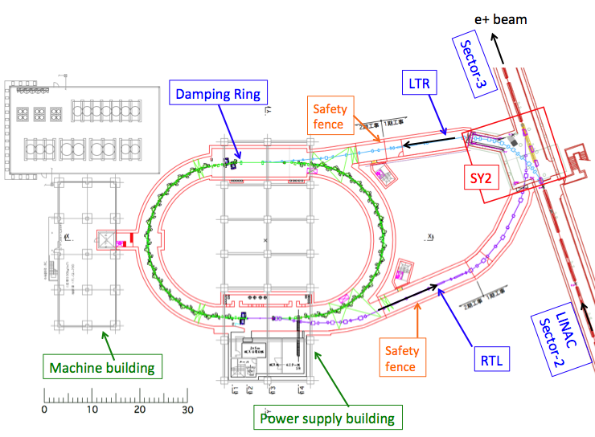
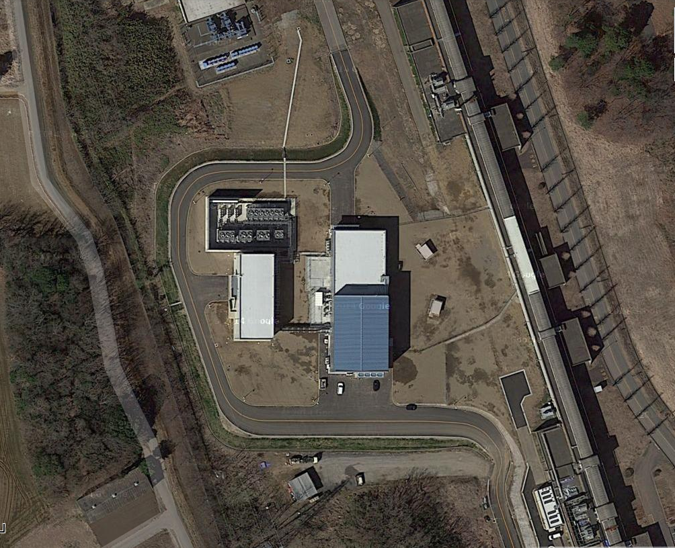
Damping Ring
DR is newly constructed at the end of Sector-2 of the Linac.
The positron beam of 1.1 GeV is injected into the DR.
After circulating in the DR for 40 ms, the damped beam is injected back into the LINAC.
LTR line with the energy compression system (ECS) is incorporated.
RTL line with bunch compression system (BCS) is incorporated.

Slide 4
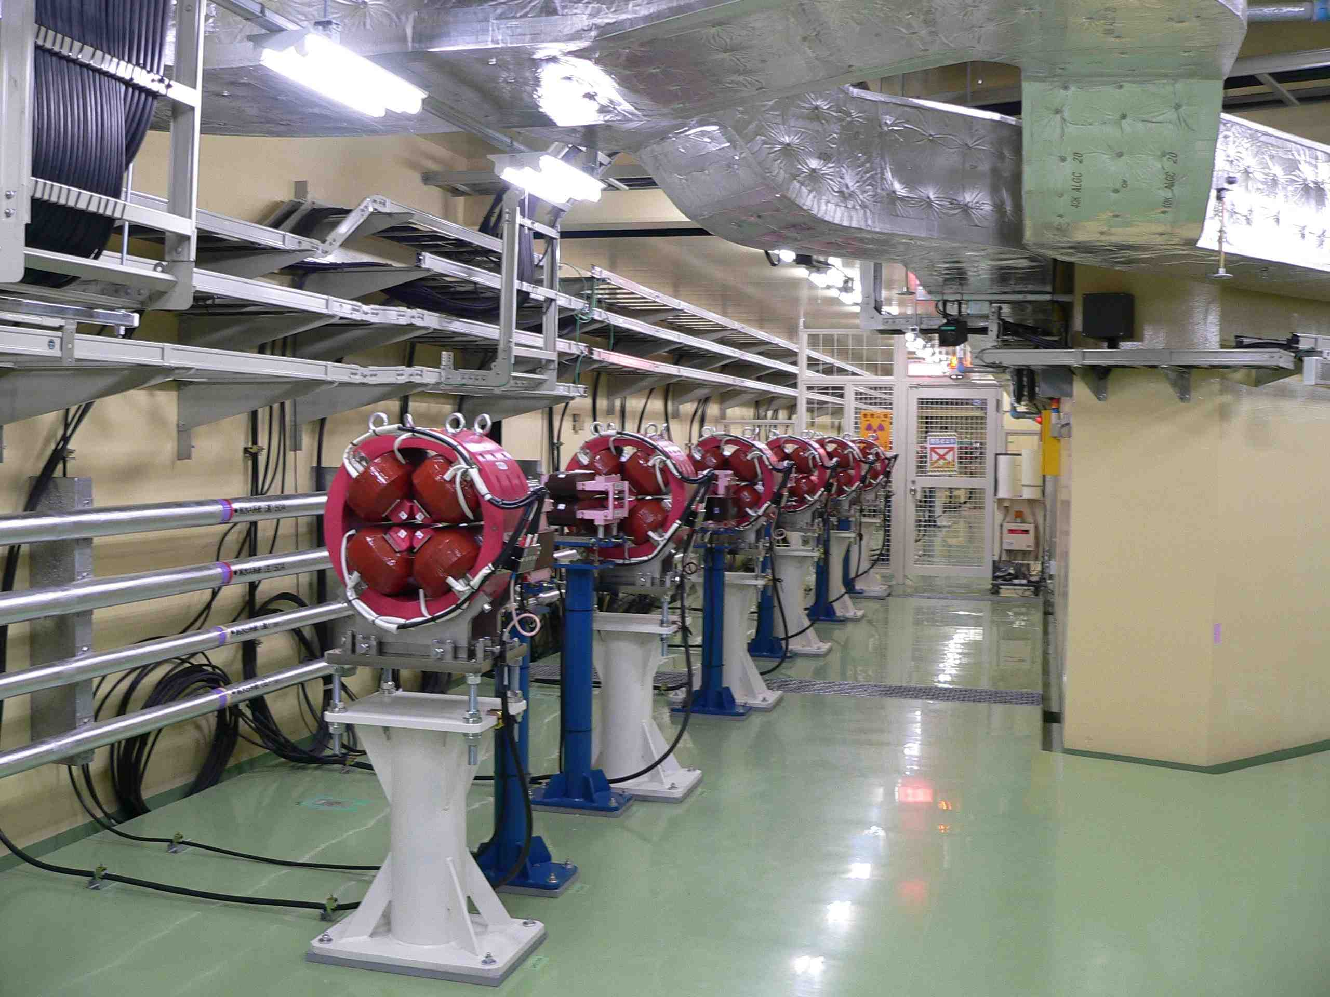
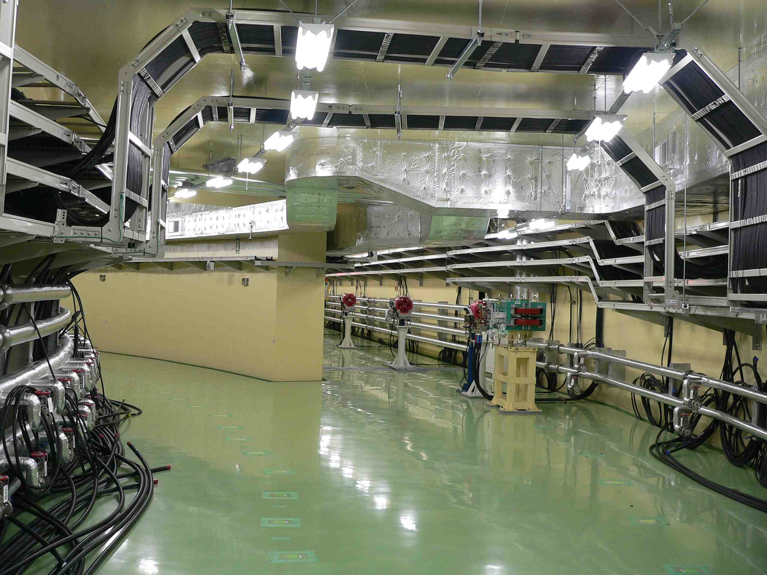
DR Beam transport lines (LTR & RTL)
Magnet installation was almost completed for the beam transport lines.
Power cables between PS and magnets were installed.
Monitor cables also installed.
LTR
RTL

Slide 5
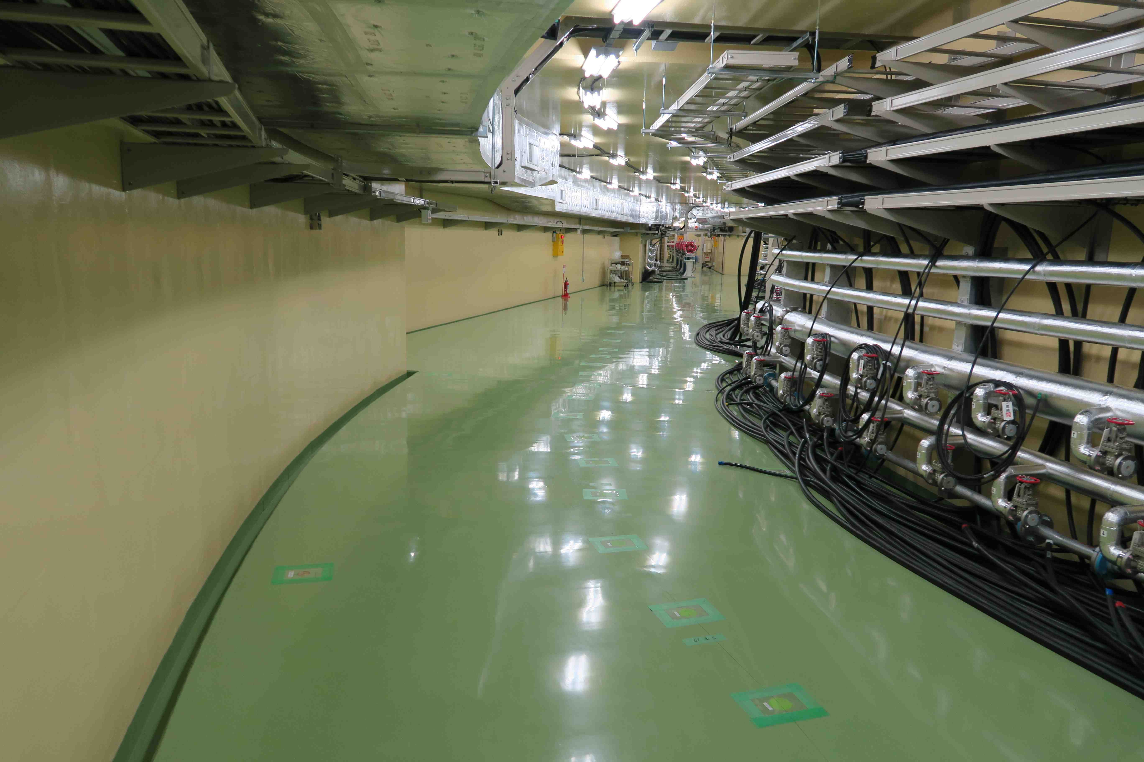
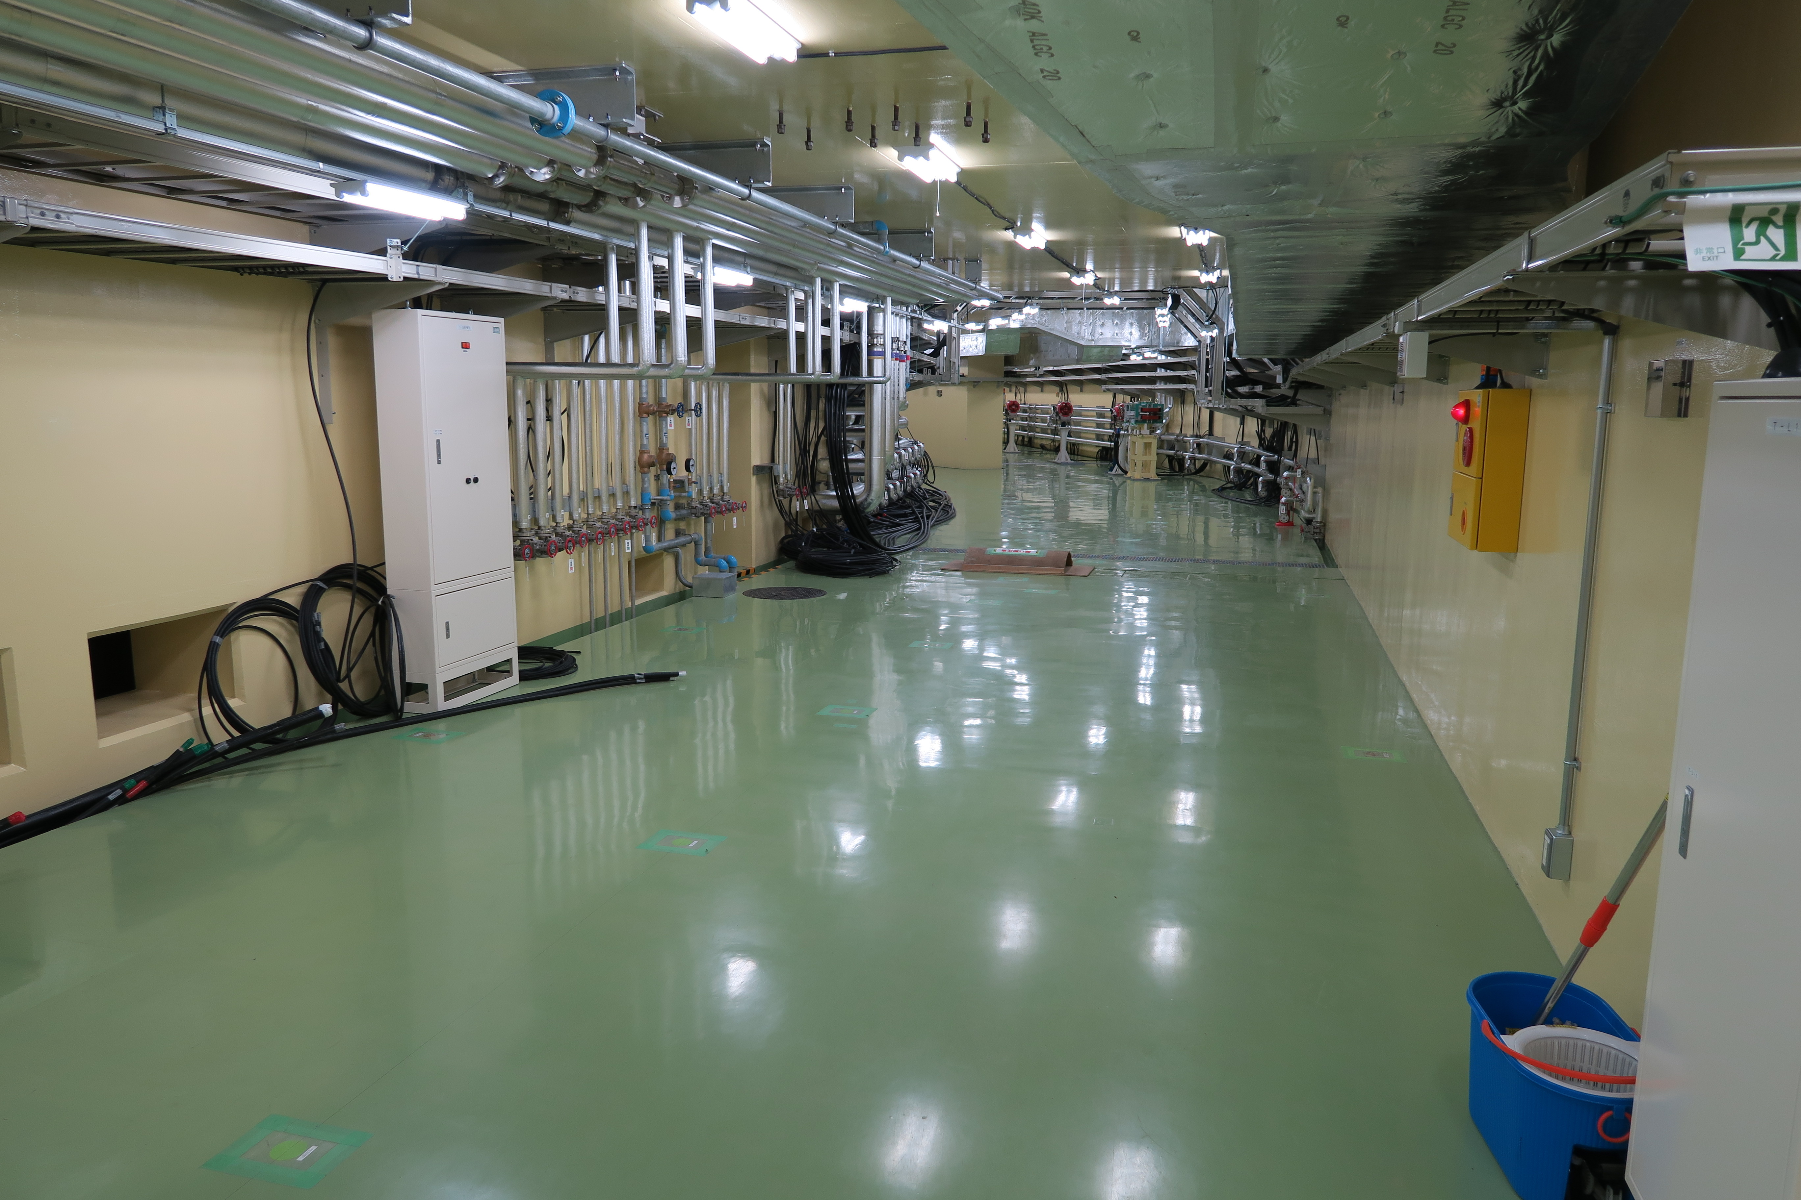
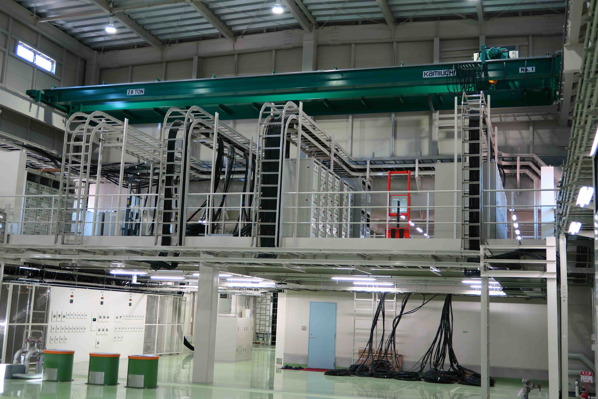
Damping Ring
Cable racks were installed in the power supply building.
Power cables for magnets were installed.
All power supplies for the magnets were delivered. (except for steerings.)
Ready for installation of the beam line components.
DR-North
DR-South
Power supply building

Slide 6
Status of DR & BT components

Slide 7
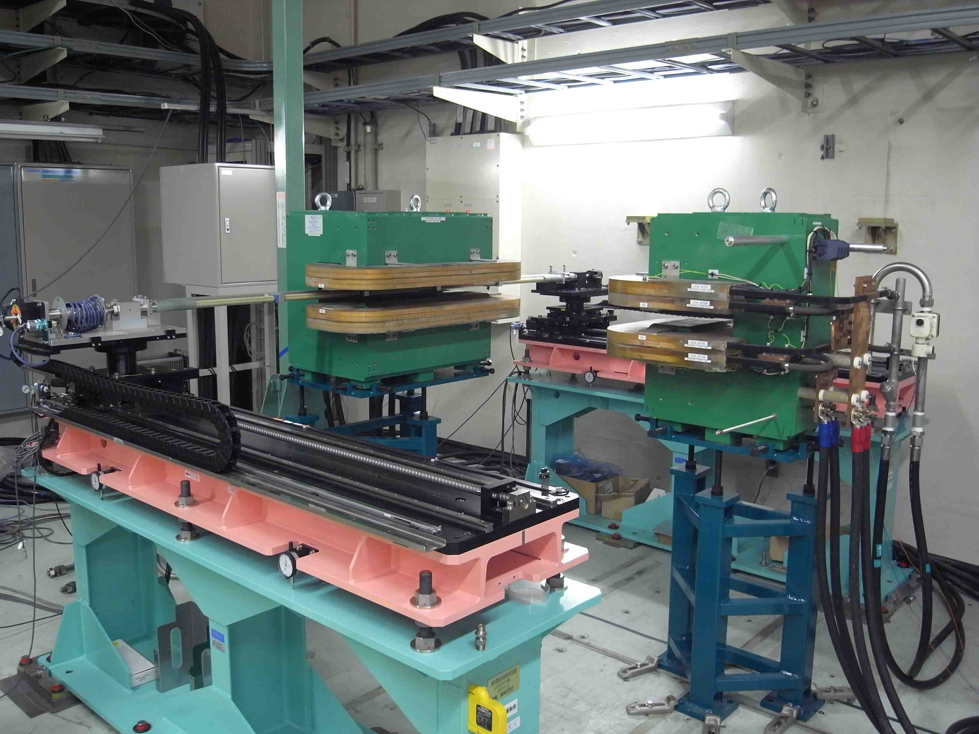
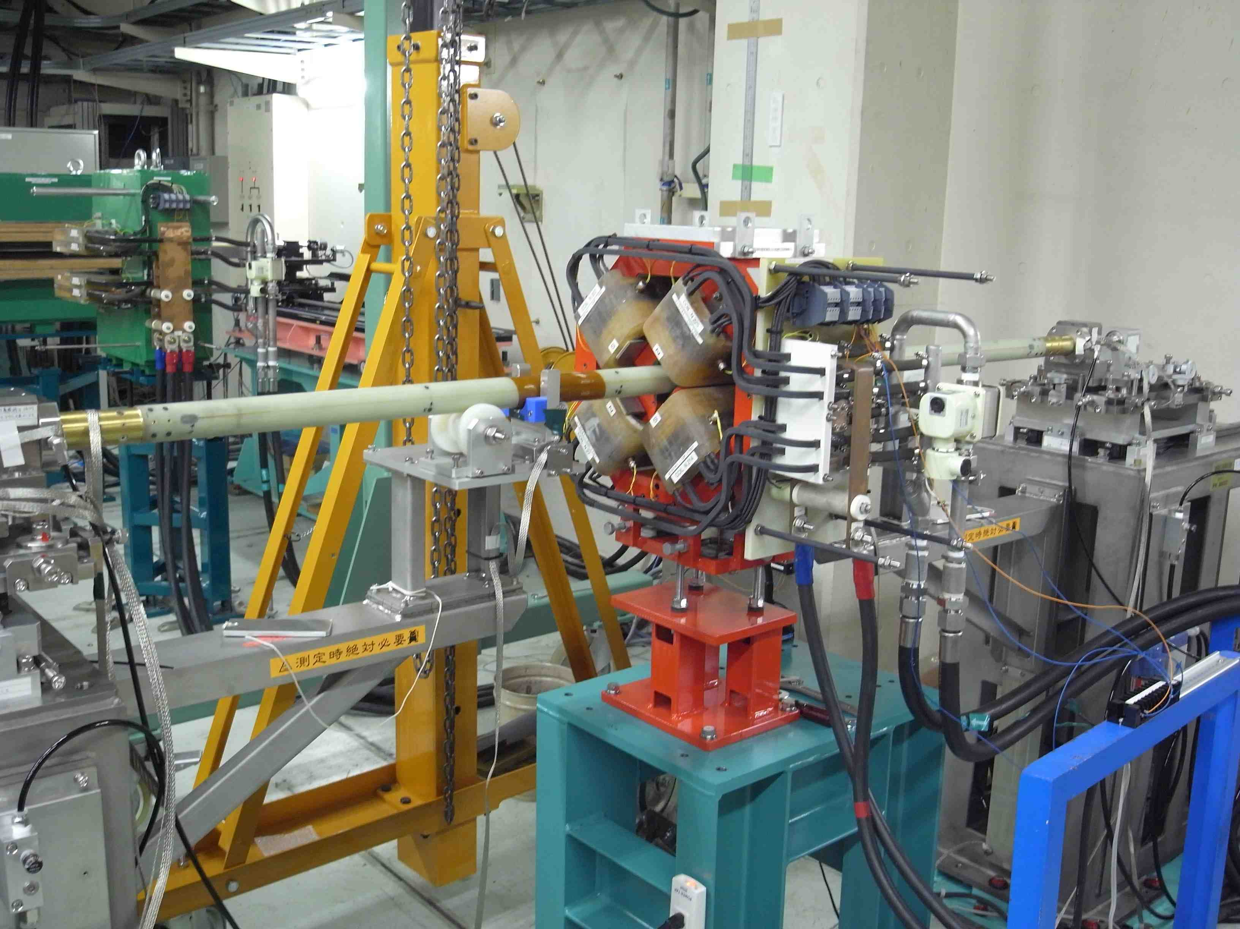
Field measurement for DR magnet
K. Harada & T. Ueda
Mass-measurements for B1-B4, QRD, QRF, Sx were completed.
Due to the trouble with harmonic coil, mass-measurement for QF/QD/QS was delayed.
End shim corrections are needed for QF/QD/QS . But it will be completed until June 2015.
Magnet | No. | Mass-measurement
B1 | 33 | completed
B2 | 39 | completed
B3 | 5 | completed
B4 | 5 | completed
QF/QD/QS | 52+26+1+1 | Not yet
QRD | 7+1 | completed
QRF | 3+1 | completed
Sx | 74+2 | completed

Slide 8
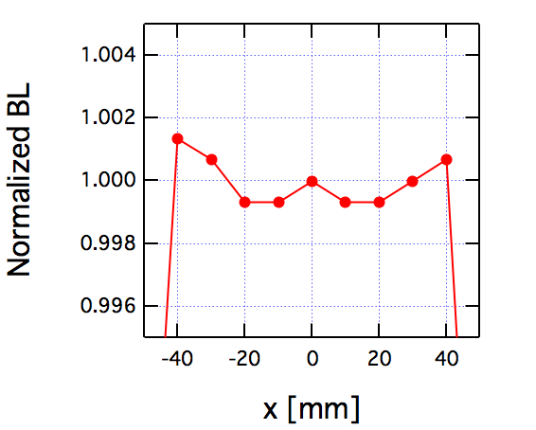
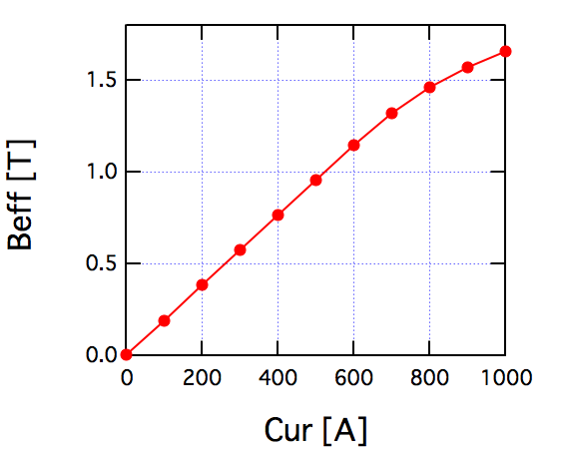
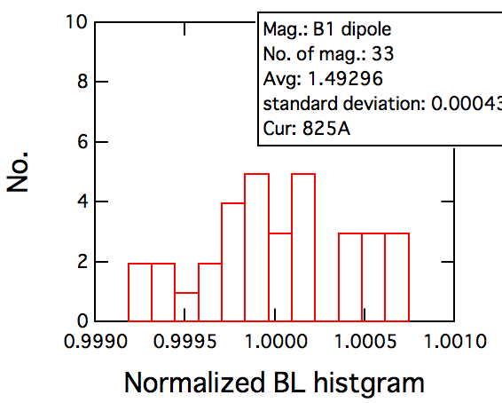
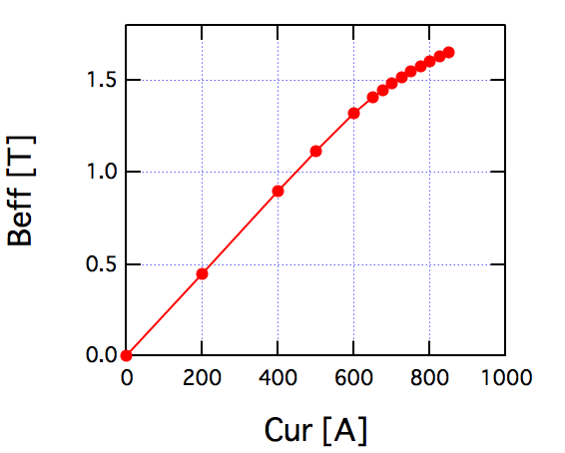
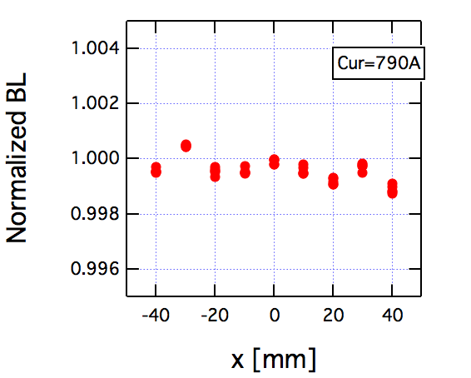
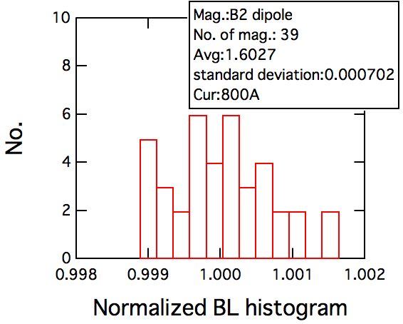
BL measured by long flip coil (B1 & B2 dipole magnet)
B1
B1
B1
B2
B2
B2

Slide 9
DR Inj. & Ext. Kicker
DR has 2 trains, which are separated about 100ns and 2bunches per train, which are separated 96 ns.
DR kicker has to inject or extract 2 bunches per pulse .
Rise time and fall time must be < 100ns.
2 kicker magnets for injection and extraction, respectively.
Inj. kicker
Inj. Septum
LTR
DR Kicker
Total deflection angle (mrad) | 5.2(inj.) 4.7 (Ext)
No. of bunch /pulse | 2
Bunch space (ns) | 96
Rise time (ns) | <〜100
Fall time (ns) | <〜100
Stability | <1% (Inj.) <0.1% (Ext.)
Max. repetition (Hz) | 50
RTL
Ext. kicker
Ext. Septum

Slide 10
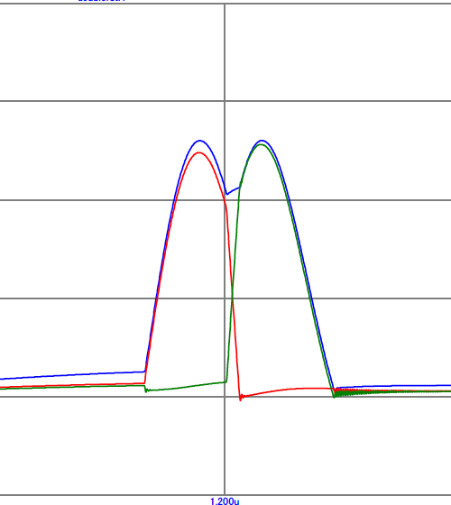
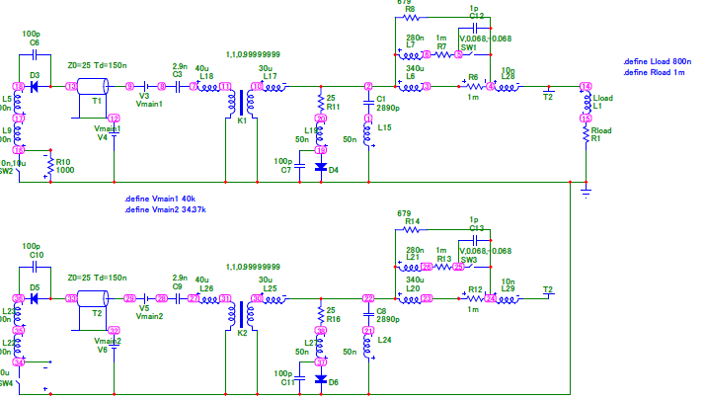
DR Inj. & Ext. Kicker
DR kicker are designed as an inductive (lumped) type kicker.
Inj. and ext. kicker are same design.
Pulse shape : double half-sine. (Two half-sine pulses are overlapped each other.)
Pre-pulse and tail noise should be < 5%.
Bunch feedback system is indispensable to compensate the pre-pulse and tail noise kick.
Saturable inductance
〜100ns
96ns
〜100ns
96ns
<5%
<5%

Slide 11
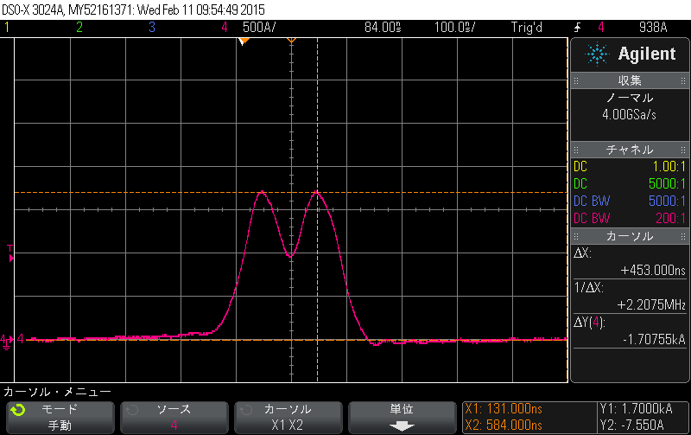
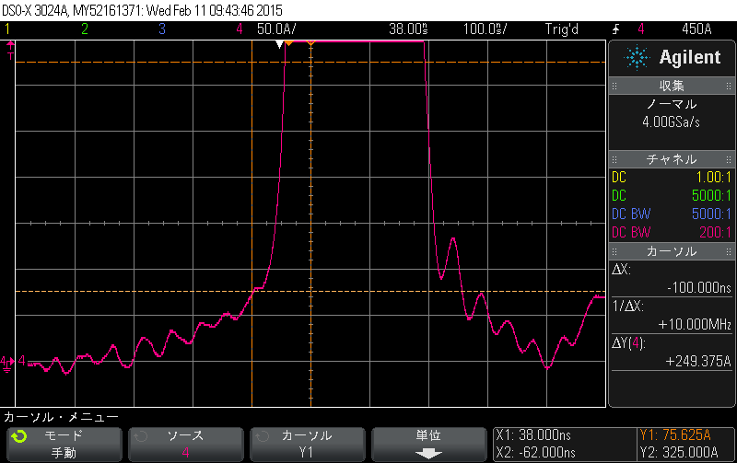
DR Inj. & Ext. Kicker
Type | lumped
Pulse shape | Double half-sine
Pulse width (ns) | 300
Length (mm) | 240
Aperture (mm) | 82(H) x 53 (V)
Mag. Inductance (uH) | 0.8
Bmax (T) | 0.04
Max Current (A) | 1710 (Inj.) 1550 (Ext.)
Jitter (ns) | < ±9 (Inj.) < ±2 (ext)
X：100ns/div Y:500A/div
I=1700Ap---→
Pre Pulse -100ns 75.6A 4.4%
In order to achieve short rise time, a saturable inductance is used.
Command charger is used to achieve the required stability.
Because of severe jitter requirements, DC PS are used for the cathode’s and reservoir’s heater of the thyratrons.
X：100ns/div Y:50A/div

Slide 12
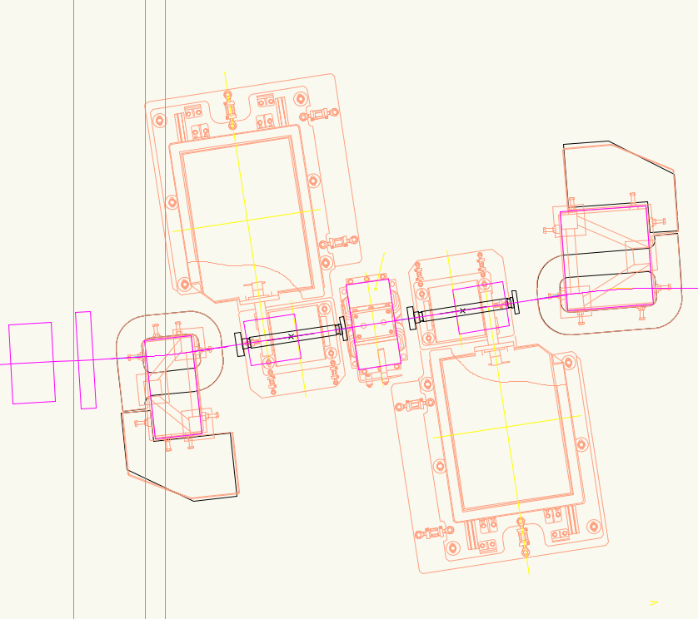
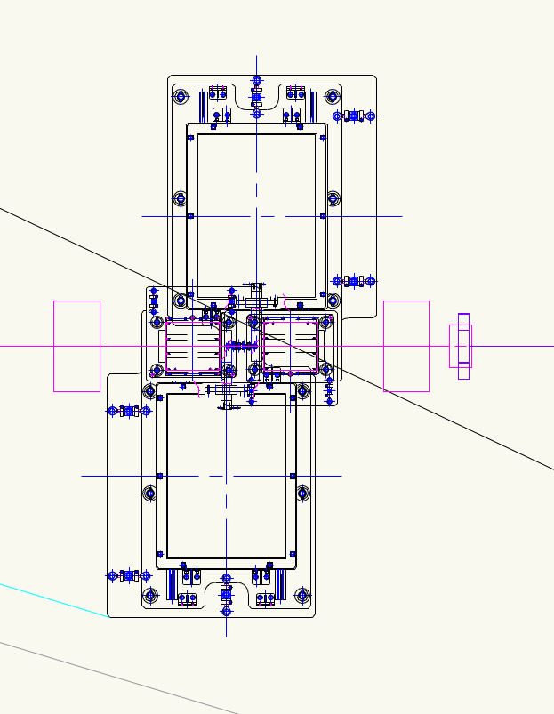
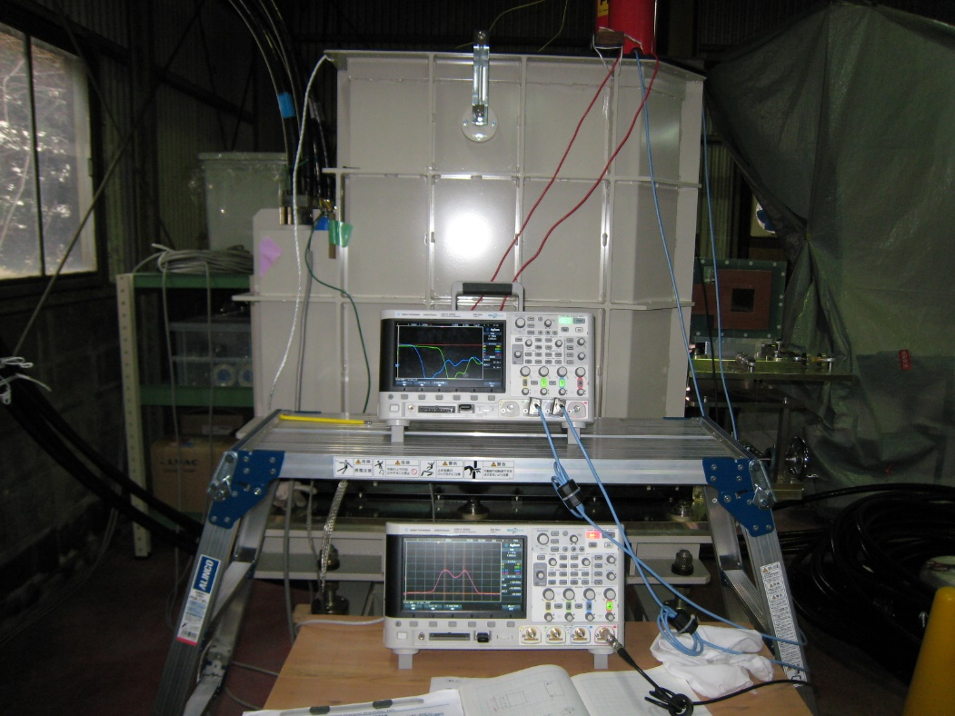
DR Inj. & Ext. Kicker
Issues:
Minimization of pre-pulse and tail noise.
Radiation hardness problem.
⇒Radiation shields for the magnetic switch are needed.
Timing jitter.
At first we use thyratron tube and we plan to replace it with solid-state switch later.
Ceramic duct with Ti coating.
Installation to DR tunnel.
Inj. kicker
Ext. kicker

Slide 13
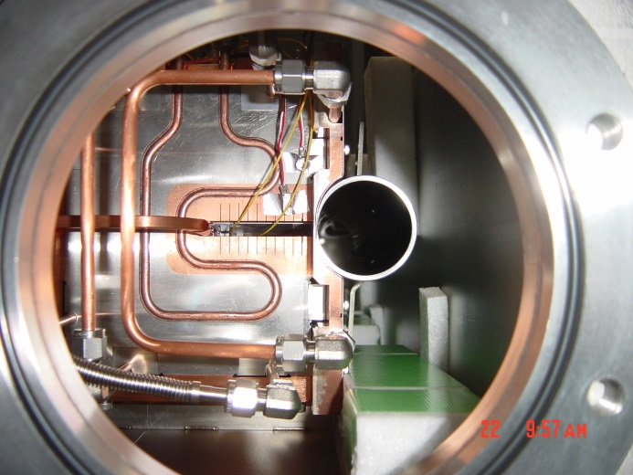
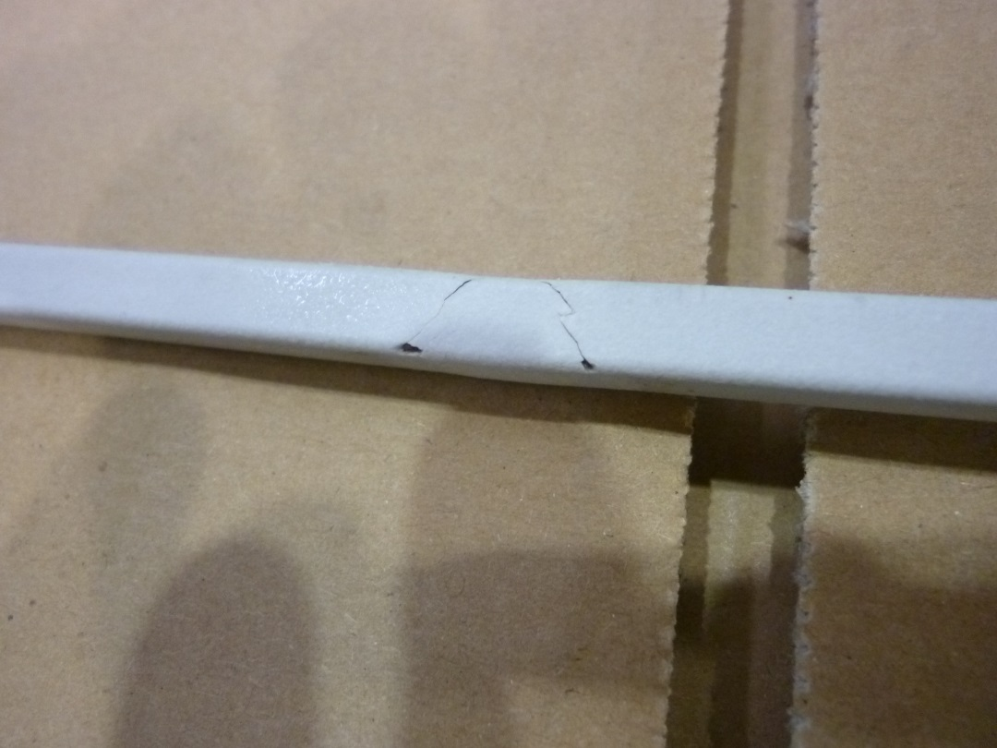
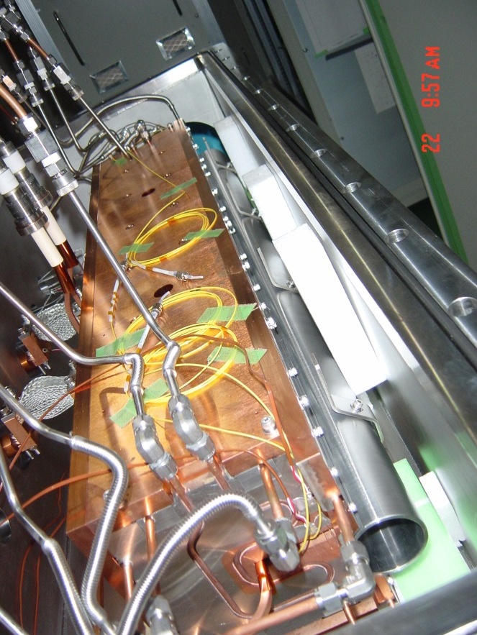
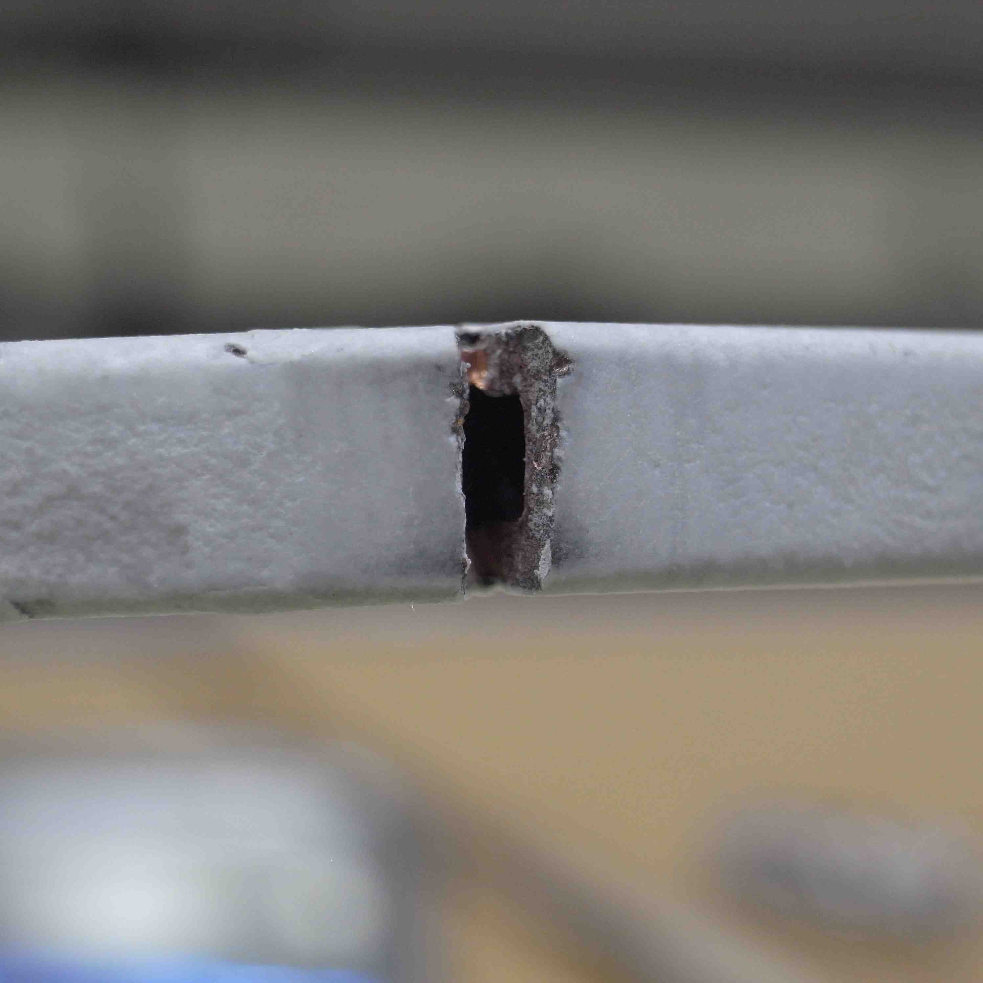
Prototype septum magnet trouble
T. Mori
In-vacuum septum
Cracked coil
Coil of prototype septum was broken with 1-hour operation with 50Hz.
The reason is not clear.
Damaged coil?
Metal fatigue phenomenon by the coil vibration?
Conductor size: 6x6-□3⇒6x8-φ4
We have tested with 6x8 coil for >20 hours operation with the prototype magnet.
⇒ No problem. So, we continue to fabricate the production magnets.
No. of coil hook: 9 (prototype magnet) ⇒ 17 (production magnet)
Stress for the coil can be expected to be reduced t o 1/4.

Slide 14
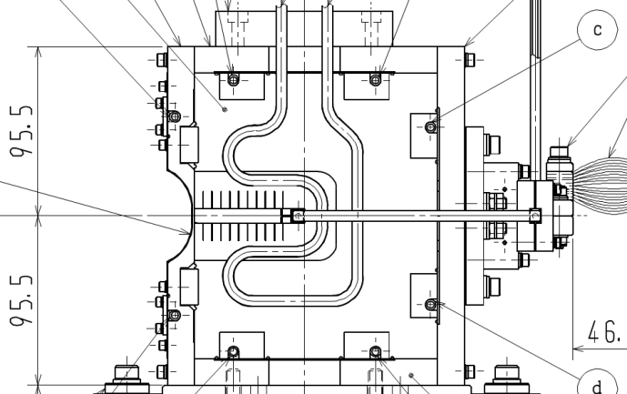
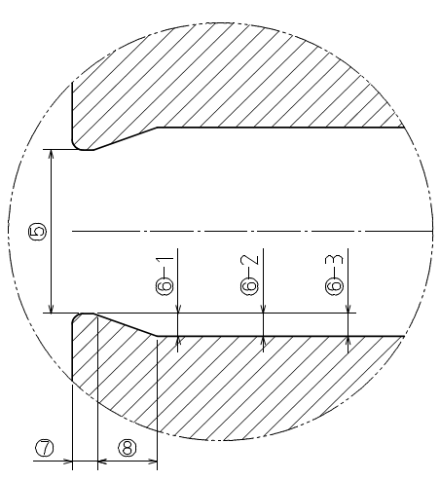
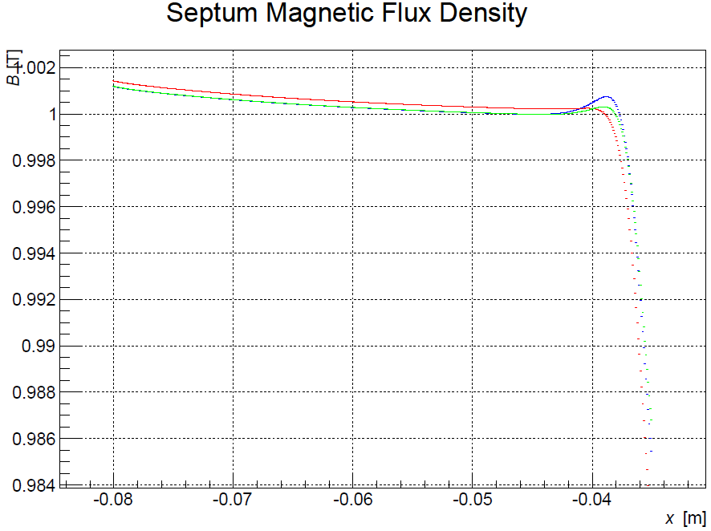
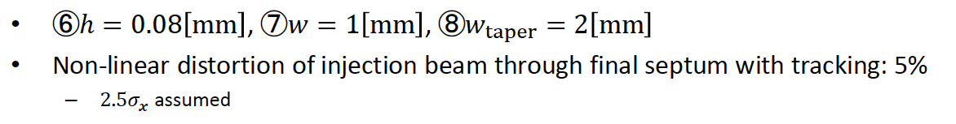
Shim Shape for Septum Core
T. Mori
Septum end
3 shims
H=0.08, w=1.0, w_{taper}=2.0
H=0.06, w=1.0, w_{taper}=2.0
H=0.1, w=0.5, w_{taper}=2.0
Shim shape for production magnet was optimized to meet the requirements.
Septum fields calculated

Slide 15
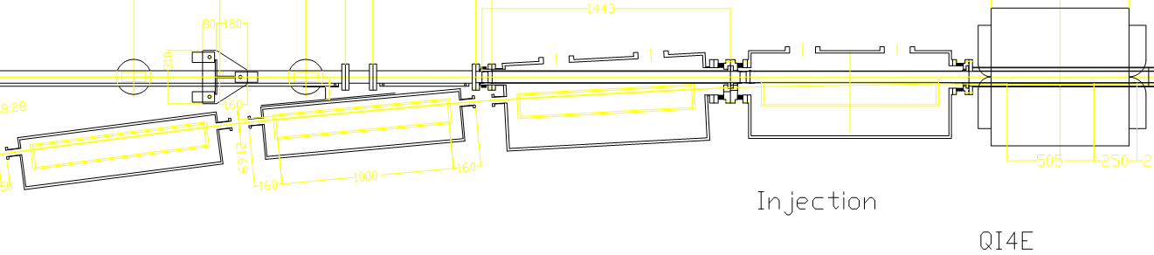
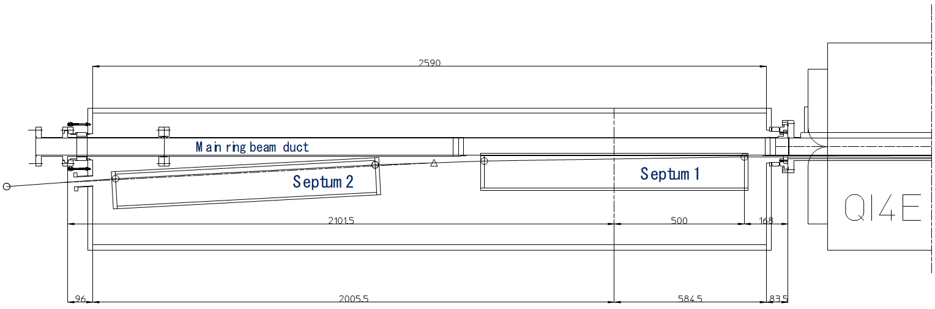
HER Septum Chamber Design
T. Mori & K. Kanazawa
Septum-3
Septum-3
Septum-2
Septum-1
Very tight
No changes
KEKB HER Septum Chamber
SuperKEKB HER Septum Chamber
2.6m
2-septum in 1-chamber

Slide 16
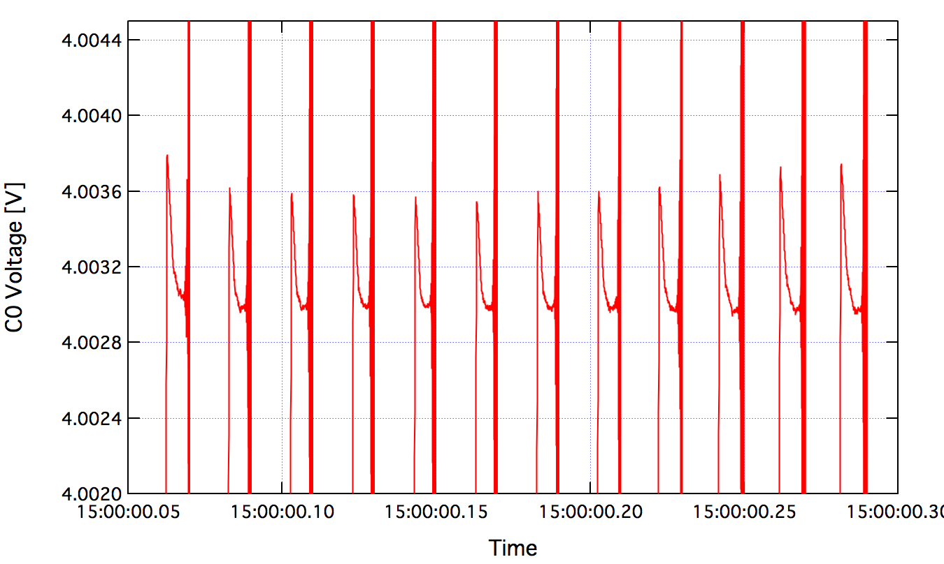
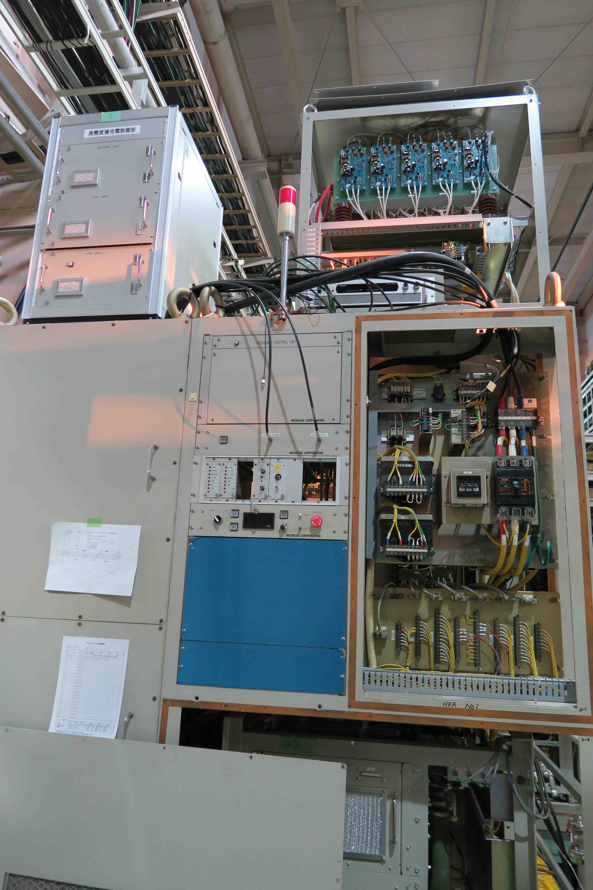
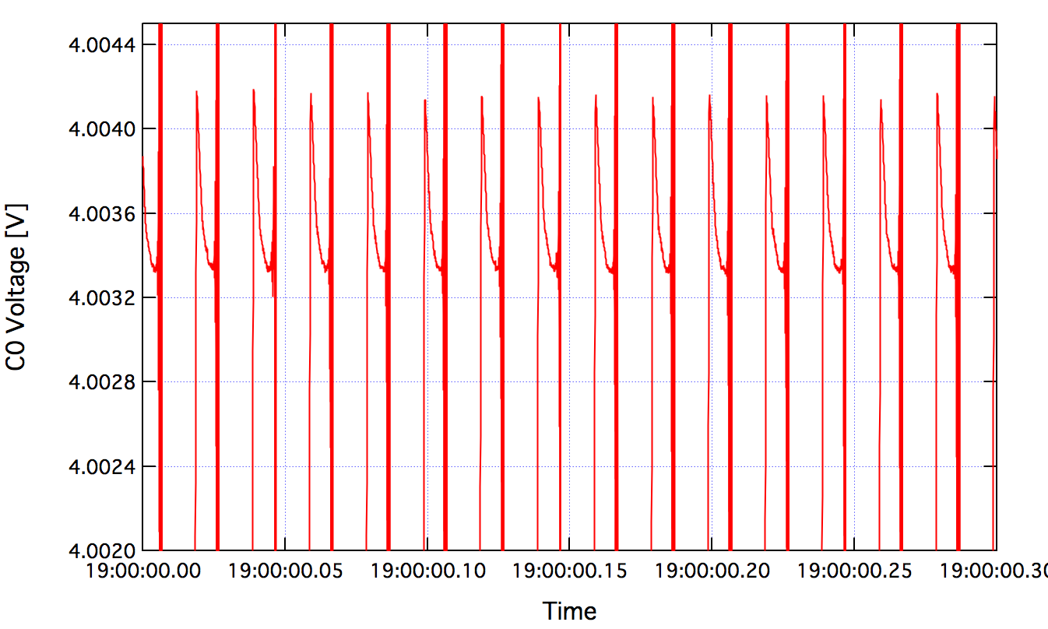
Stability improvement of septum PS
Because stability of KEKB septum PS was not so good, operator had to adjust it frequently.
Improve the stability of charging voltage.
Make the voltage monitor’s response faster.
Replace the charger using thyristor to that using switching power supply.
Control charging timing by replacing diode to thyristor.
Introduce high precision auxiliary charger.
⇒ Stability<±1E-4 for 4 hours was achieved.
Start
±1E-4
Aux. P.S.
4hour later
±1E-4
Issue:
During remodeling these PS, we found many parts, which are fabricated in KEKB were broken.
We need to repair these parts until the SuperKEKB operation.

Slide 17
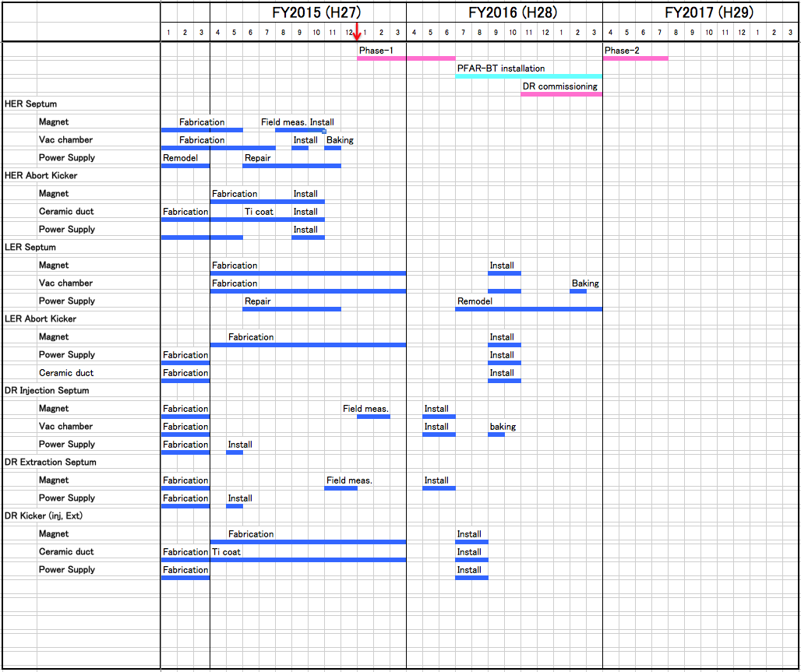
Schedule for the new injection components
19th KEKB ARC Recommendations:
Setup a solid schedule for the new injection components to be consistent with the DR schedule and meets the Phase II and Phase III milestones.
Reply:
HER Septum & HER Abort Kicker components will be fabricated until this summer.
LER Septum, LER abort kicker compoents must be fabricated in FY2015. And these will be installed between Phase-1 and Phase-2.
Fabrication of pulsed magnets and PS for DR will be completed in this fiscal year.

Slide 18
19th KEKB ARC Recommendations:
In order to complete the Damping Ring commissioning during a one-month period, a precise commissioning plan needs to be prepared with detailed procedures and decision trees and sufficient commissioning staff identified.
DR Schedule & Commissioning Plan

Slide 19
M.Kikuchi(2014.11.6)
The time span between Phase-I and Phase-II is 10 months.
DR beam-commisioning can be started on LINAC beam mode just before Phase-II.
Damping ring Construction schedule
M. Kikuchi
DR Commissioning will start before Phase-2.
Installation work continues in FY2015-2016.

Slide 20
N. Iida
Precautions for DR commissioning
LTR Injection
The power supply of injection kickers are located in DR tunnel.
The LTR beam tuning should be done in the state which some screen monitors at the end of LTR are put in.
Night-time
For example, 1:00 – 9:00
LINAC tuning
When the beam tuning of DR is over, vacuum scrubbing can be done.
DR needs about 2 [A.Hr].

Slide 21
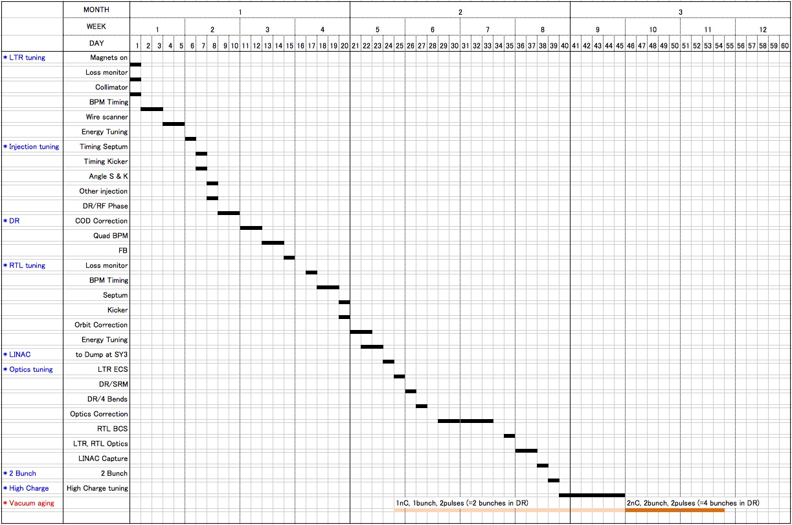
DR beam commissioning plan
N. Iida
>10 weeks for DR commissioning will be needed.

Slide 22
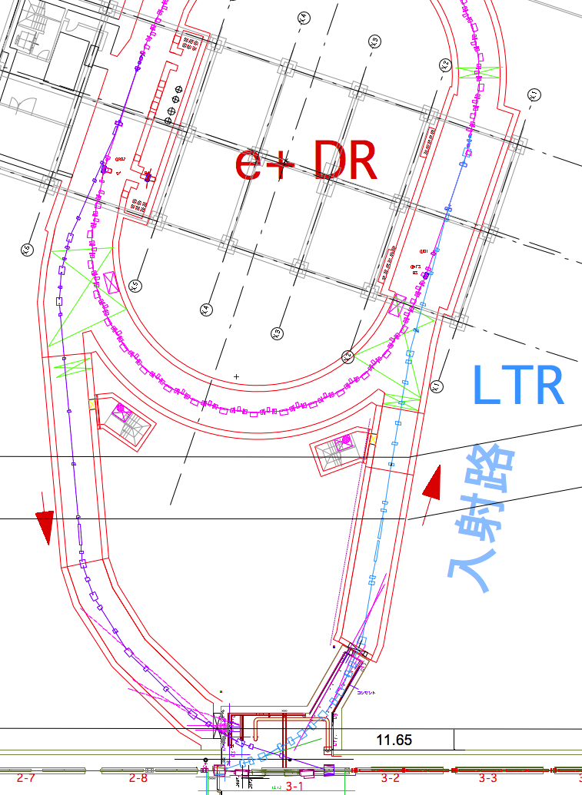
19th KEKB ARC Recommendations:
The beam in the Damping Ring (DR) needs to be aborted when the SuperKEKB rings abort their beams. The location and design of this DR abort system needs to be finalized and constructed to be ready for high current operation of SuperKEKB.
N. Iida
DR beam extraction due to the LER abort
When the LER beam is aborted,
Close the beam gate.
Close the beam shutter at the end of RTL.
After confirming the beam shutter closed, the extraction kicker of DR fires.
RTL
Beam shutter

Slide 23
Summary
DR
The DR tunnel is ready for installation of the beam line components of the DR.
Installation work for DR will continue in FY2015 and FY2016.
DR commissioning will start before Phase-2 and needs > 10 weeks.
HER & LER
New injection components for HER will be fabricated until this summer and will be installed by the end of this autumn.
To check the reliability, we must have a long term operation of the production septum magnet before the installation.
Many parts of Septum PS were broken and must be repaired until SuperKEKB operation.

Slide 24
Backup

Slide 25
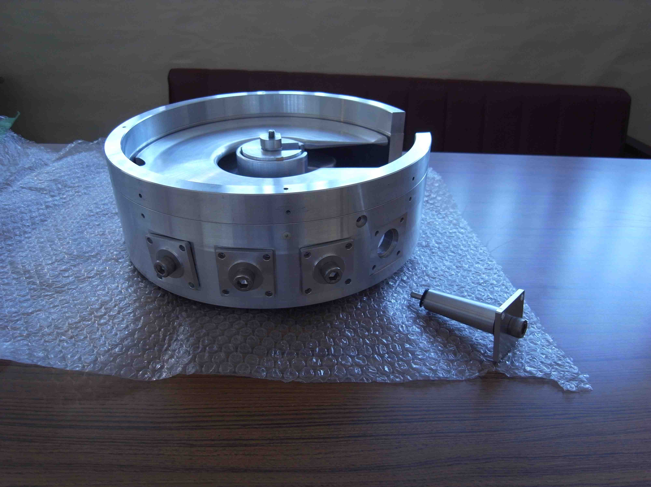
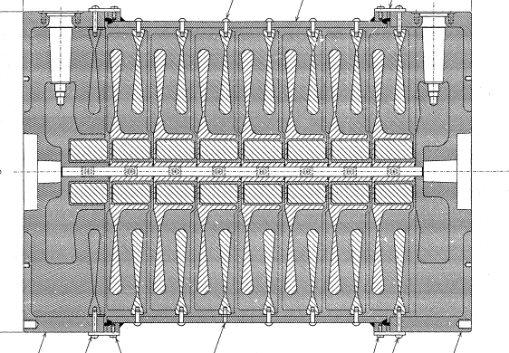
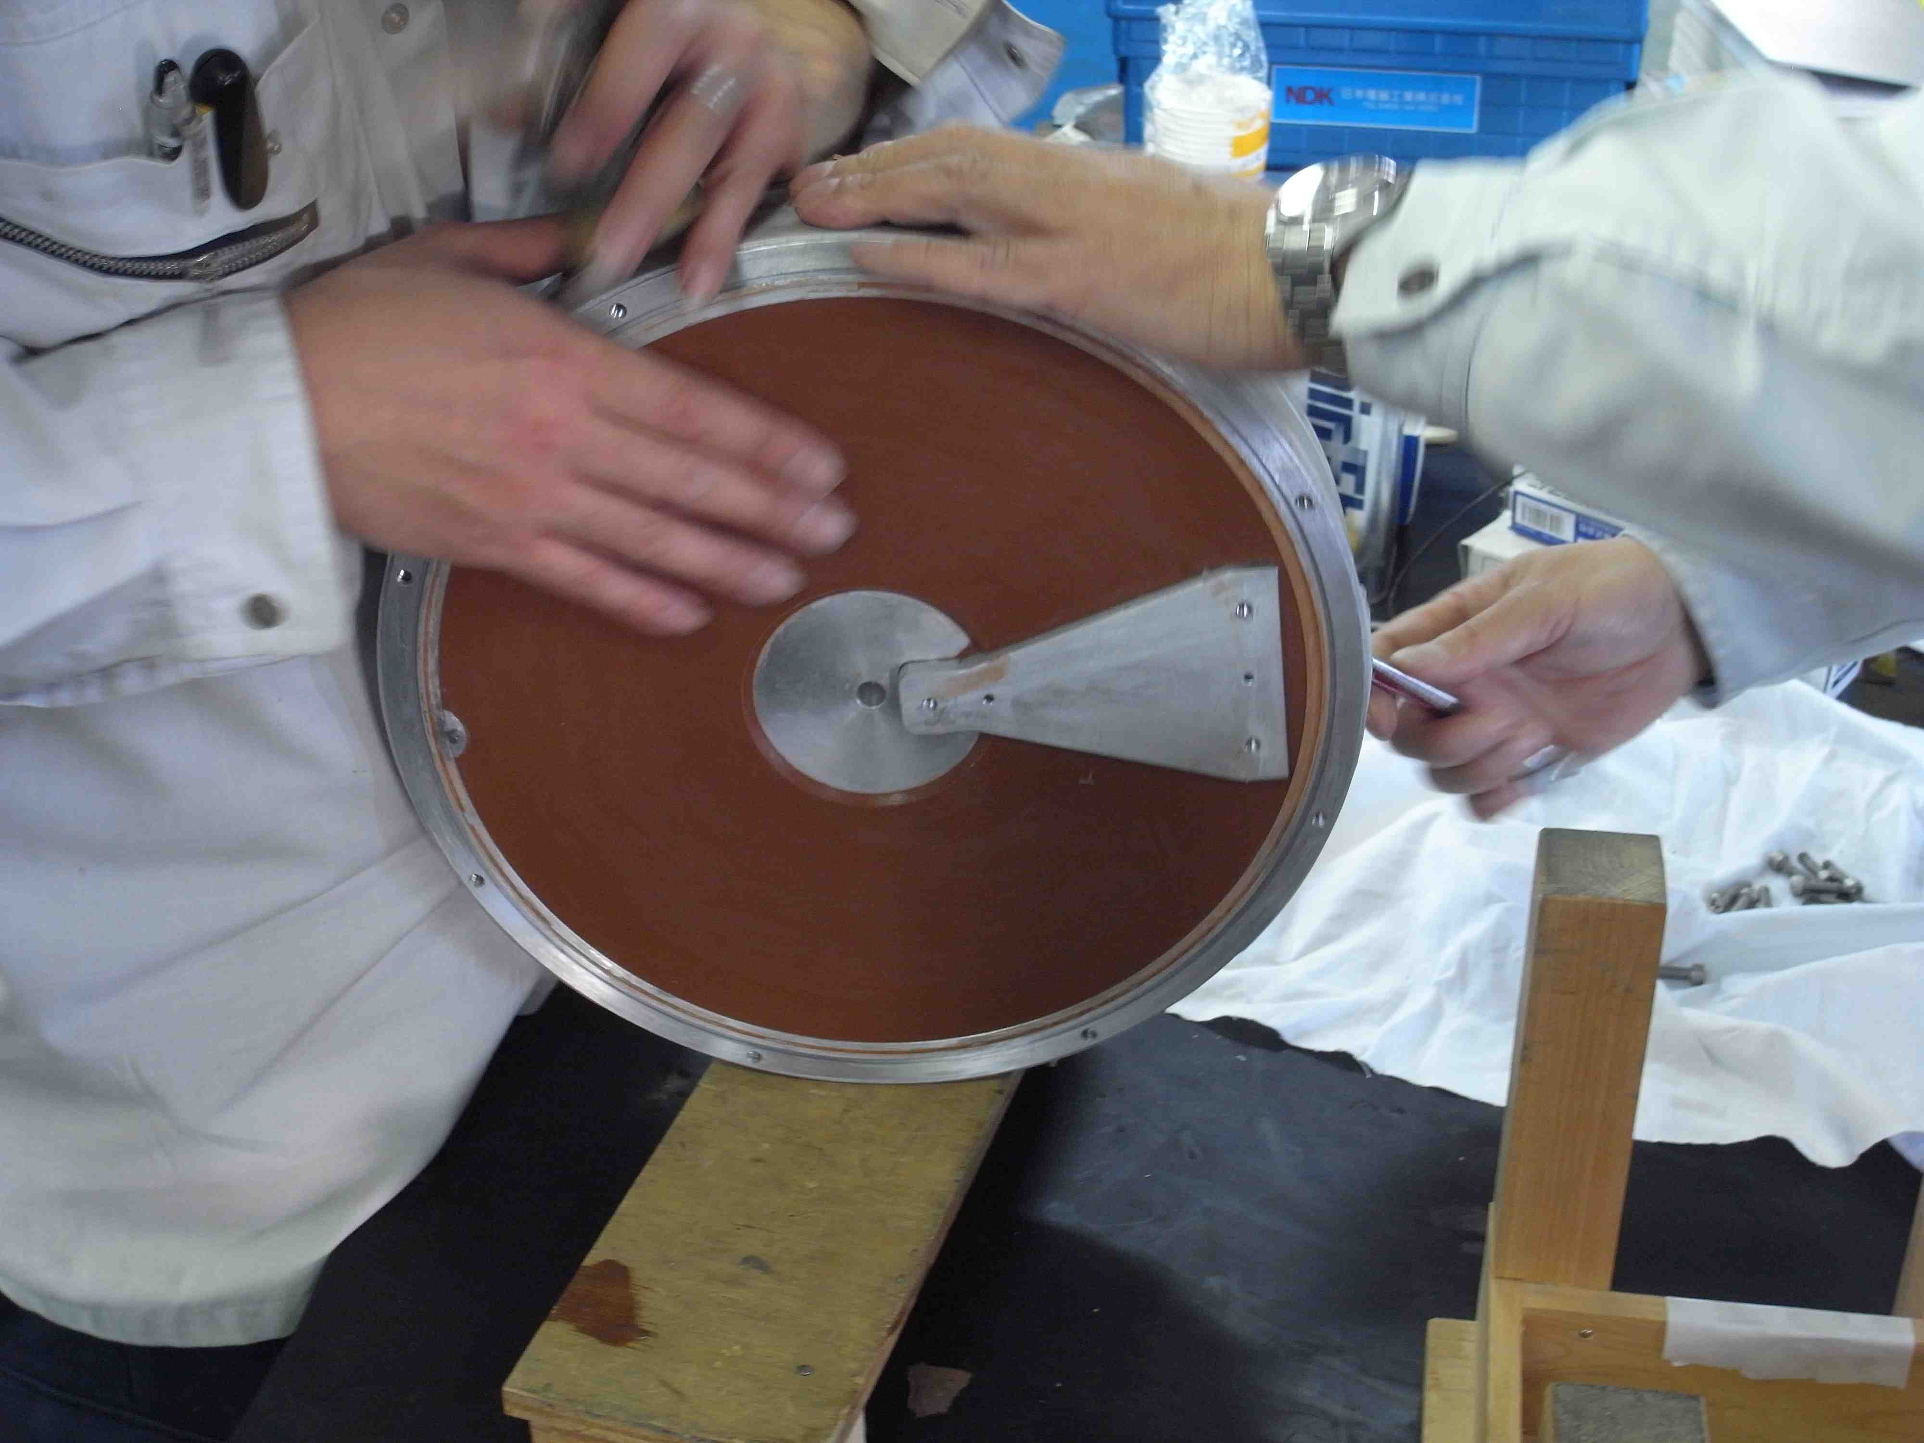
DR Inj. & Ext kicker R&D transmission kicker
Transmission kicker shows a better performance of rise time.
R&D for transmission kicker (SLC type, i.e. out-vacuum molded type) are being performed.
We need more time to develop it.

Slide 26
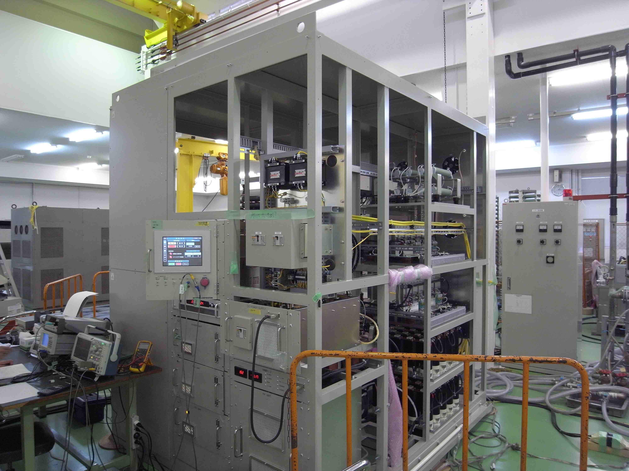
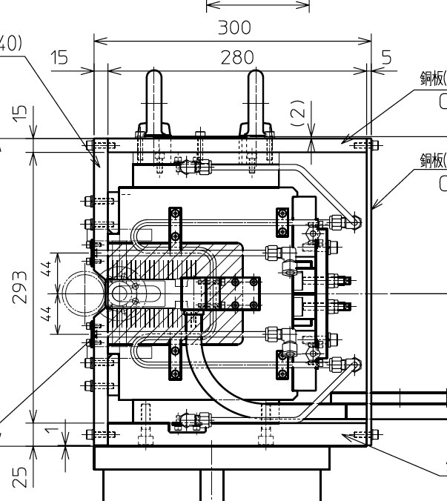
DR inj. & Ext. Septum
DR inj. Septum PS
 | Inj. | Ext
Deflection angle (mrad) | 80 | 103
No. | 1 | 1
Field strength (T) | 0.36 | 0.47
Type | Eddy-current | Eddy-current
Aperture (mm) | 70(H)x24(V) | 70(H)x30(V)
No. of coil turns | 1 | 1
Septum thickness (mm) | 2.5 | 2.5
Waveform | Full-sine | Full-sine
Pulse width (μs) | 300 | 300
Peak Current (A) | 8000 | 12500
Max rep. (Hz) | 50 | 50
Stability | <1E-3 | <1E-4
 | In-vacuum | Out-vacuum w/ ceramic duct
DR Ext. Septum mag.
No. of coil turns for DR ext. septum was changed 2 -> 1 to make the structure simple.

Slide 27
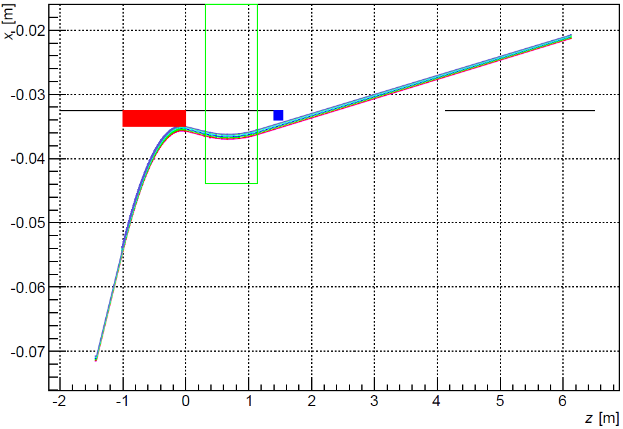
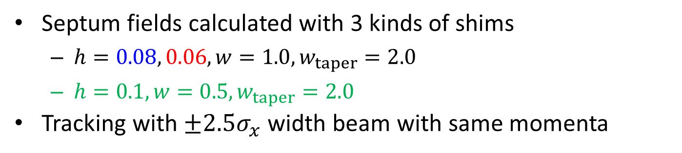
Tracking through Septum Field
Scaled to make
those averages the same
Septum field
Orbit
Septum fields calculated with 3 kinds of shims
$h=0.08, 0.06, w=1.0, w_{taper}=2.0$
$h=0.1, w=0.5, w_{taper}=2.0$
Tracking with $±2.5σ_{x}$ width beam with same momenta

Slide 28
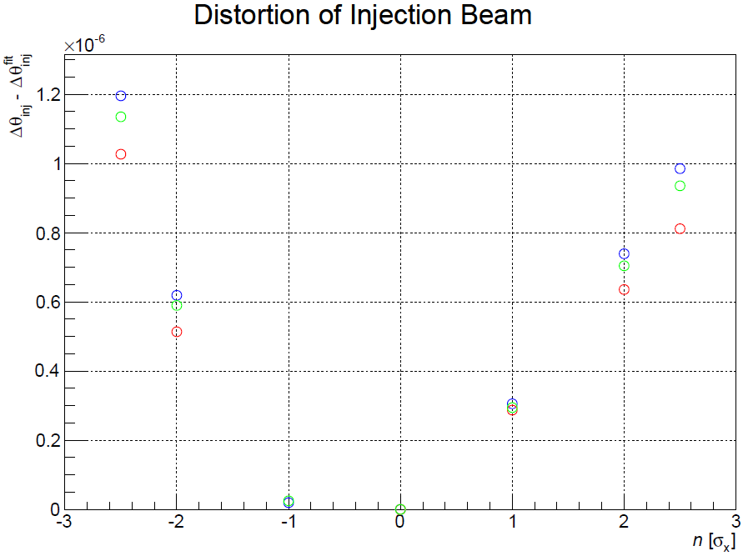
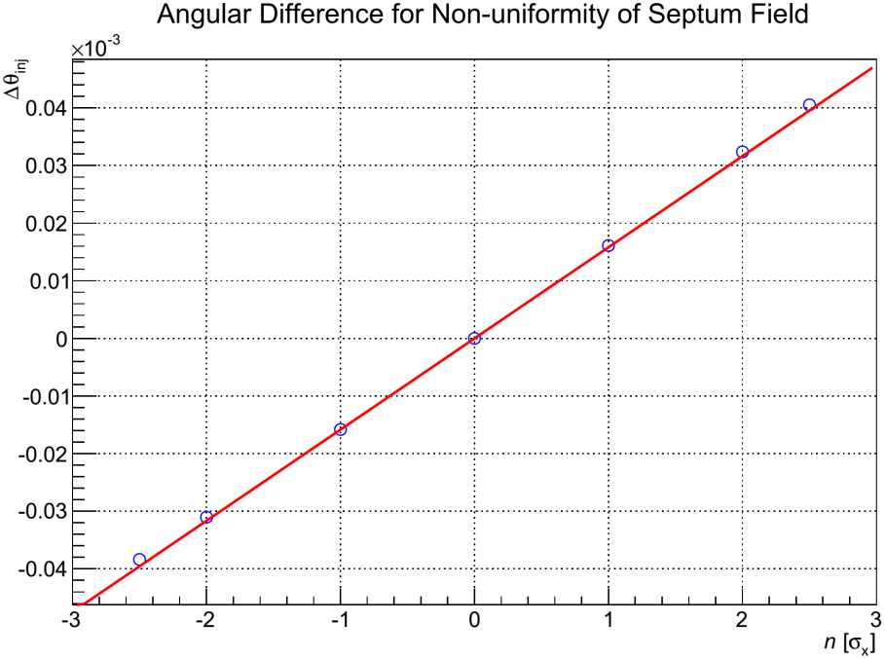
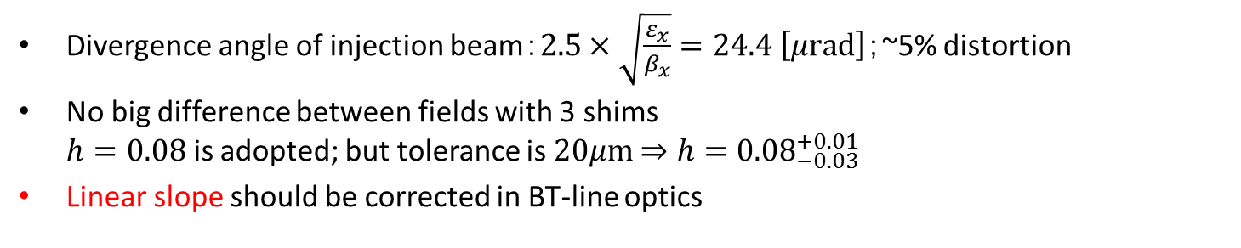
Distortion of Injection Beam
Angular difference
Distortion of injection beam through final septum
Divergence angle of injection beam：$2.5×\sqrt{\frac{ε_{x}}{β_{x}}}=24.4 \left[μ\text{rad}\right]$；~5% distortion
No big difference between fields with 3 shims $h=0.08$ is adopted; but tolerance is $20μ\text{m}$ $⇒h={0.08}_{−0.03}^{+0.01}$
Linear slope should be corrected in BT-line optics

