Slide 1
SuperKEKB Review /
Electron gun and transport
Mitsuhiro Yoshida
2015.02.24

Slide 2
SuperKEKB upgrade
for low emittance electron beam
 | KEKB obtained (e+ / e-) | SuperKEKB required (e+ / e-)
Beam energy | 3.5 GeV / 8.0 GeV | 4.0 GeV / 7.0 GeV
Bunch charge | e- → e+ / e- 10 → 1.0 nC / 1.0 nC | e- → e+ / e- 10 → 4.0 nC / 5.0 nC
Beam emittance (γε)[1σ] | 2100 μm / 300 μm | 6 μm / 20 μm
High charge low emittance is required for SuperKEKB.
5 nC 10 mm-mrad electron beam generated by RF gun.
+ 10mm-mrad emittance preservation is required.
Quasi –travelling side couple RF-Gun
with Yb laser system
B
A
Preliminary test using DAW RF-Gun
with Nd laser system
due to earthquake
10ps
30ps
J-ARC
C
1
2
3
4
5

Slide 3
RF-Gun for 5 nC
Space charge is dominant.
  Longer pulse length : 20 - 30 ps
Stable operation is required.
  Lower electric field : < 100MV/m
Focusing field must be required.
  Solenoid focus causes the emittance growth.
  Electric field focus preserve the emittance.
Total
Space charge
RF
Epaxial coupled cavity : BNL
Annular coupled cavity : Disk and washer / Side couple

Slide 4
S-band RF-Gun development strategy for SuperKEKB
Cavity : Strong electric field focusing structure
  Disk And Washer (DAW) => 3-2
  Quasi Traveling Wave Side Couple => A-1
  => Reduce beam divergence and projected emittance dilution
Cathode : Long term stable cathode
  Middle QE (QE=10⁻⁴～10⁻³ @266nm) and long lifetime
  Solid material (no thin film) => Metal composite cathode
  => Started from LaB₆ (short life time)
  => Ir₅Ce has very long life time and QE>10⁻⁴ @266nm
Laser : Stable laser with temporal manipulation
  LD pumped laser medium
    Nd doped solid laser => 3-2
    Yb doped fiber and solid hybrid laser => A-1
  Temporal manipulation => Yb doped
  => Minimum energy spread

Slide 5
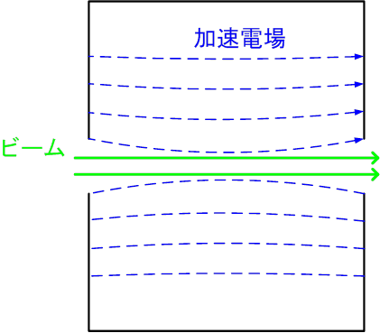
Pill-box cavity
Annular coupled cavity with nose
Accelerating field
Accelerating field
Beam
Beam
=> Weak focus
=> Strong focus
Field
Field
Focussing field
Accelerating field
Focussing field
Accelerating field
Accelerating field
Given force
Accelerating field
Given force
Focussing
field
Focussing field

Slide 6
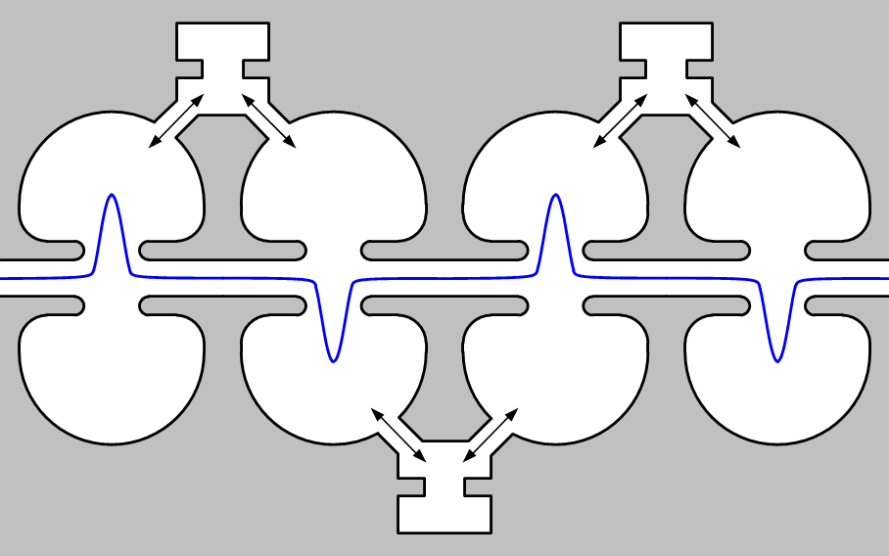
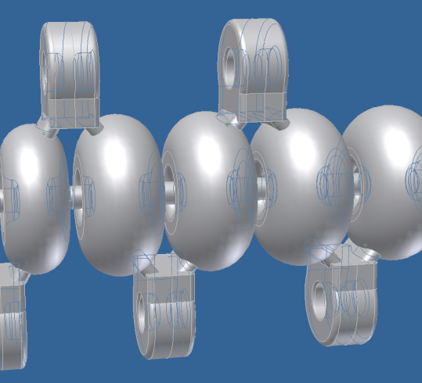
Closed gap makes focus field
Side coupled cavity is one candidate (or DAW / ACS / CDS …)
Concentrated field has focusing effect
This structure has long drift space
This structure has focusing field.
Long drift space is problem.

Slide 7
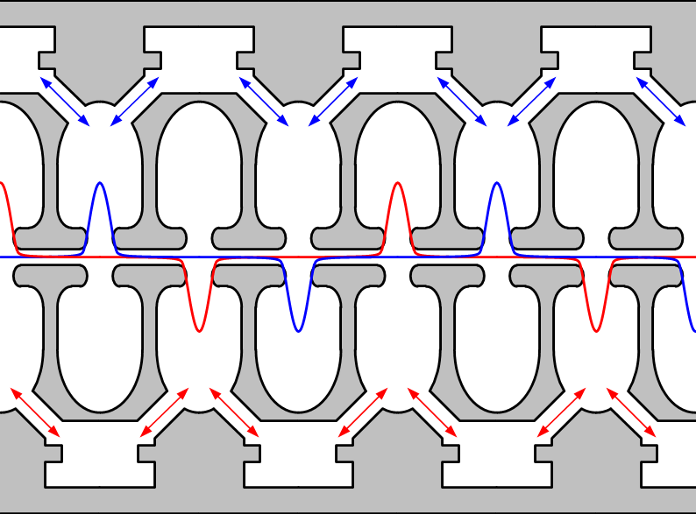
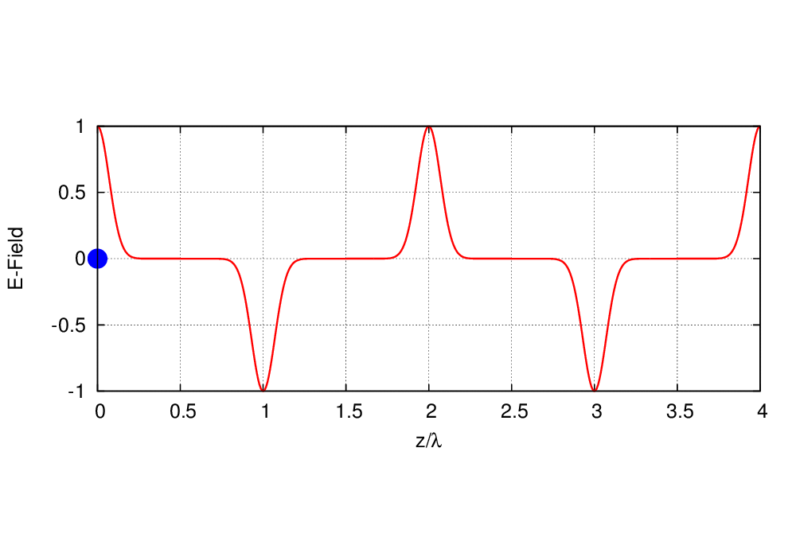
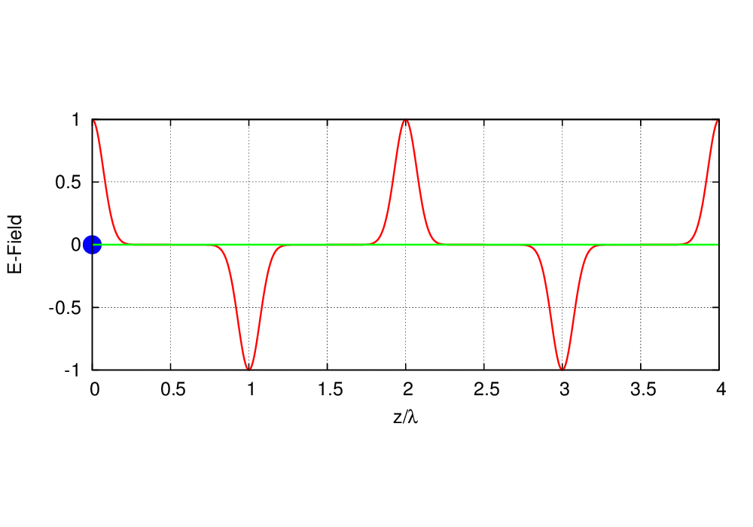
Design of a quasi traveling wave side couple RF gun
Normal side couple structure
Quasi traveling wave sidecouple structure
Quasi traveling wave side couple has stronger focusing and accelerated gradient than DAW.

Slide 8
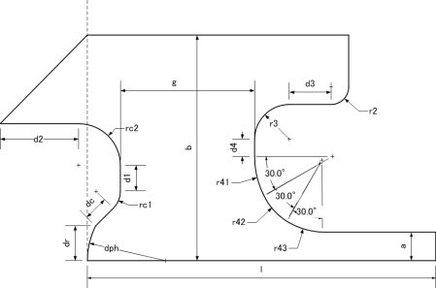
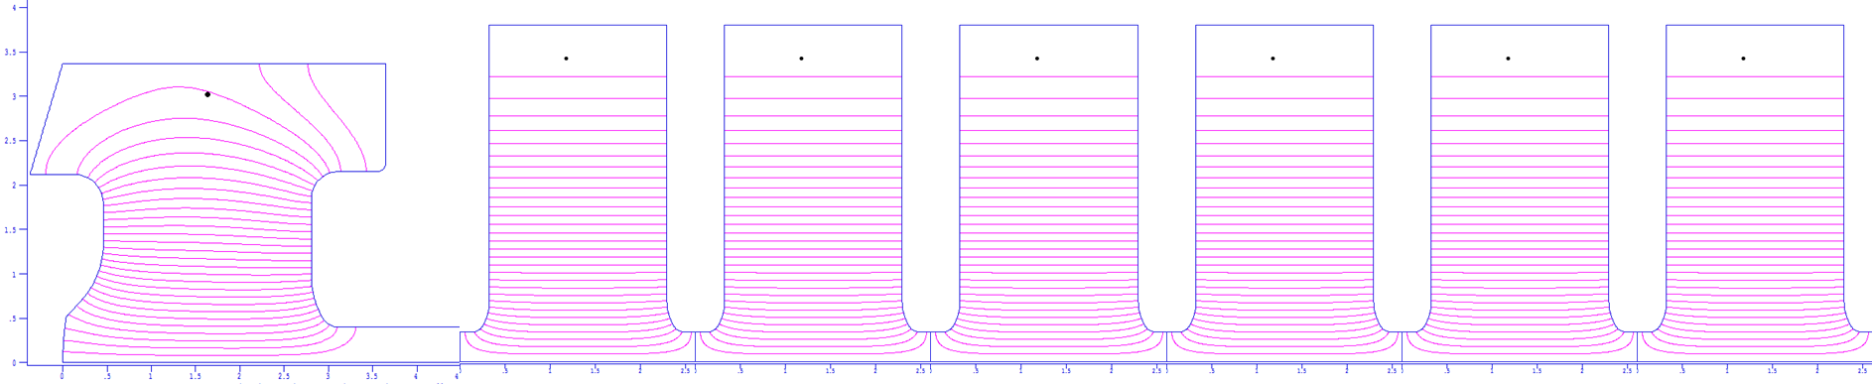
Quasi traveling wave side couple RF gun
This RF gun has total of seven acceleration cavities. These are divided into two standing wave structure of 3 and 4 side coupled cavities respectively.
Cathode cell
To avoid beam defocusing, emittance growth and field concentration, a lot of parameters were searched for design.
cathode
Maximum E-field at surface: 120 MV/m
Maximum E-field at surface: 100 MV/m
Emittance: 5.5 mm-mrad @ 5 nC
This RF gun can generate 10 nC beam
Notes:
RF gun designed with quasi-traveling wave cavity.
This is whole cavity design.
This RF gun has total of seven acceleration cavities. These are divided into two standing wave structure of 3 and 4 side coupled cavities respectively.
In the cathode cell, We need strong focus field. But it may cause emittance growth. Additionally, we must avoid the E-field concentration.
Designing is very complicated, I automatized this procedure by using downhill simplex method.
Finally we got a very good cavity design.
Result of beam tracking simulation, emittance is 5.5 mm-mrad at 5nC.
In addition, it can generate 10 nC beam. It is enough margin.

Slide 9
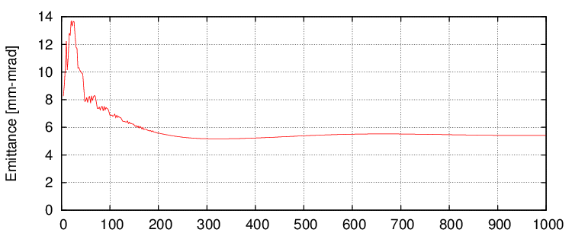
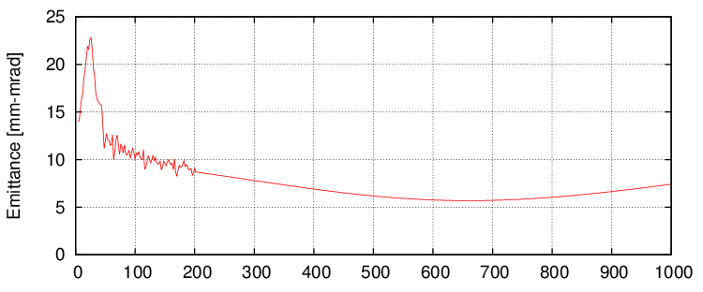
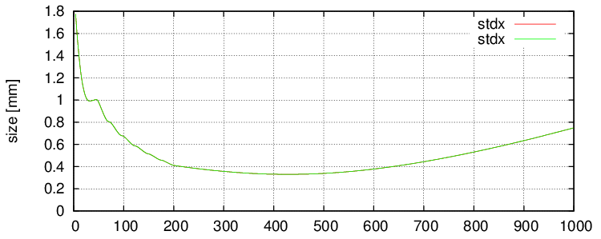
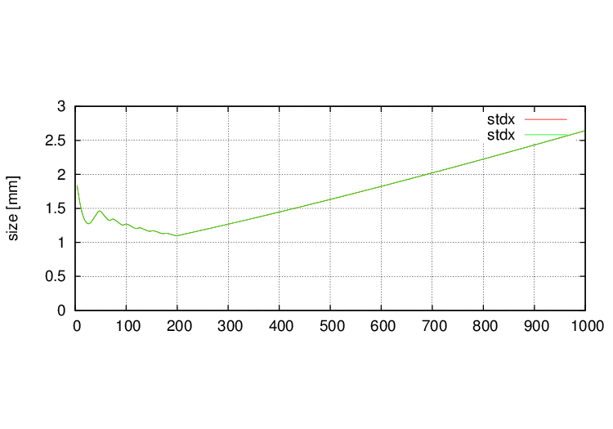
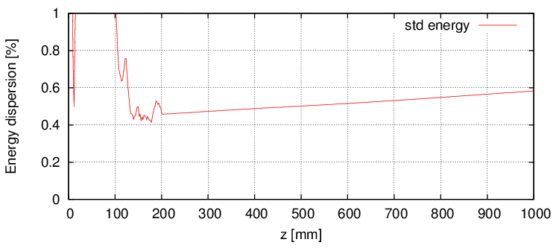
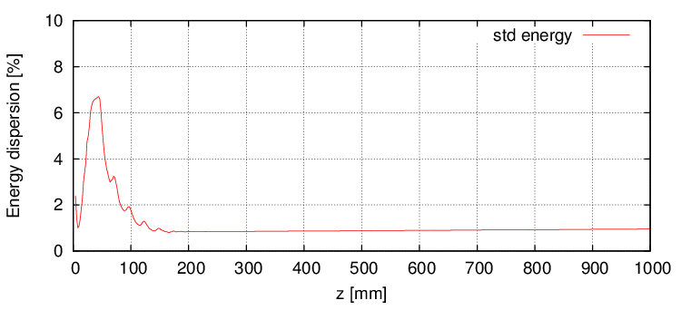
Beam tracking simulation result
5 nC
10 nC
Emittance 5.5 mm-mrad
Gun Exit
Size 0.4 mm
Energy spread 0.6%
Bunch shape
Notes:
This is the result of beam tracking simulation.
Emittance is very good and beam size will be small. It will be almost parallel beam at gun exit.
And energy spread is very small.

Slide 10
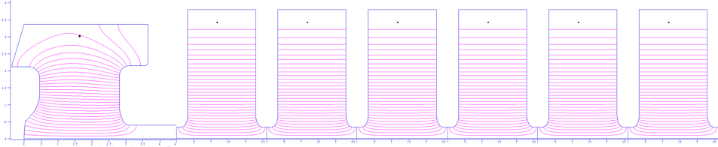
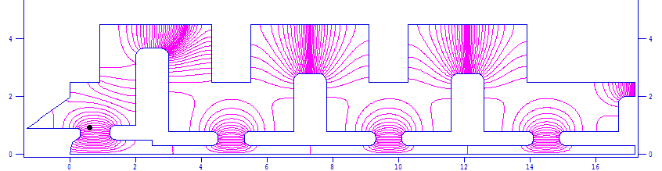
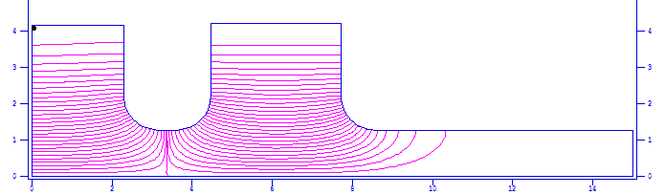
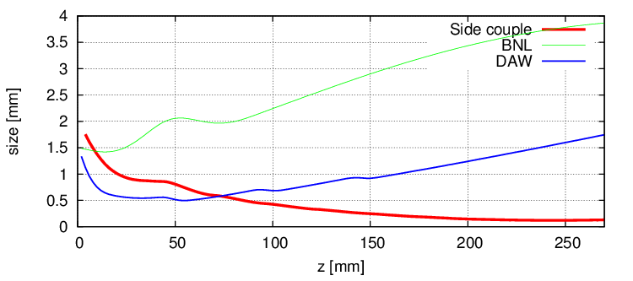
RF-Gun comparison
Quasi traveling wave side couple RF gun
(100 MV/m, 6mm-mrad, 13.5 MeV)
DAW-type RF gun
(90 MV/m, 5 mm-mrad, 3.2 MeV)
BNL-type RF gun
(120 MV/m, 11.0 mm-mrad, 5.5 MeV)
BNL (3.8 mm)
DAW (1.7 mm)
QTW (0.2 mm)
Beam Size
Notes:
で実際にどの程度，ビームが改善されているかをDAW型や一般的なRF gunにつかわれるBNL型と比較してみました．

Slide 11
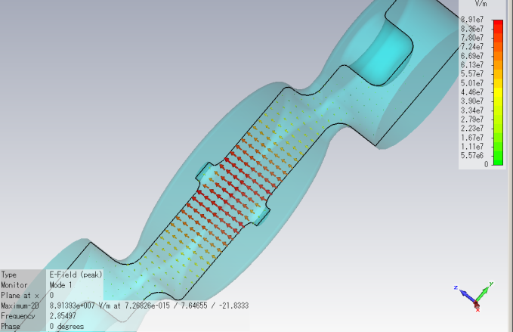
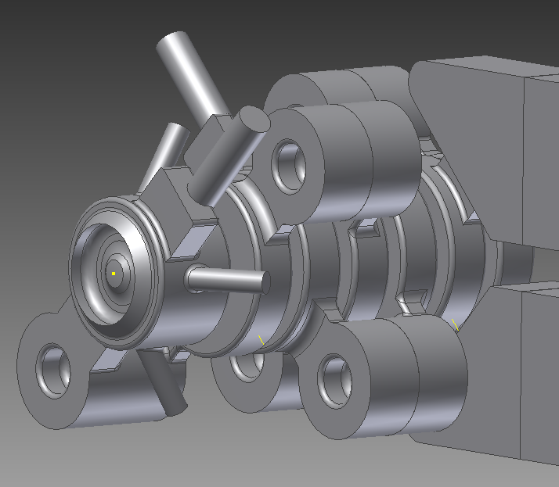
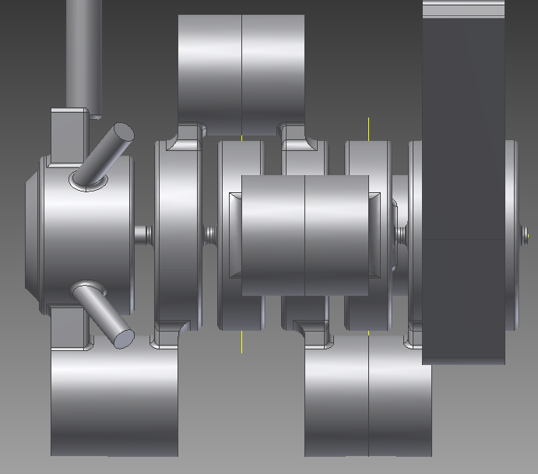
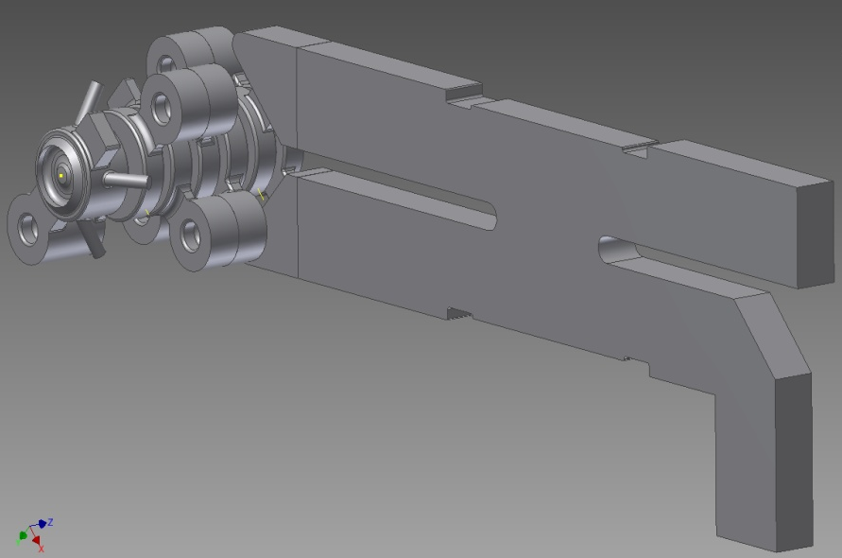
Cavity design
Field calculation
RF
90 deg hybrid
cathode
beam
coupling cavities
accelerating cavity
No reflection to klystron
Notes:
This is whole cavity shape. It is little bit complicated shape.
RF fed by using 90deg hybrid in to two ports.

Slide 12
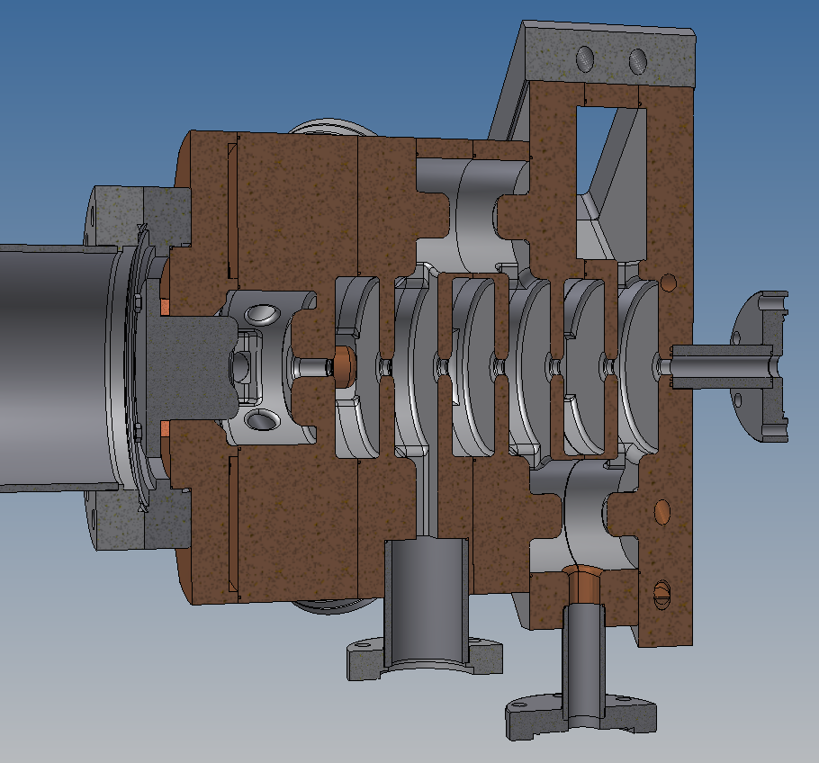
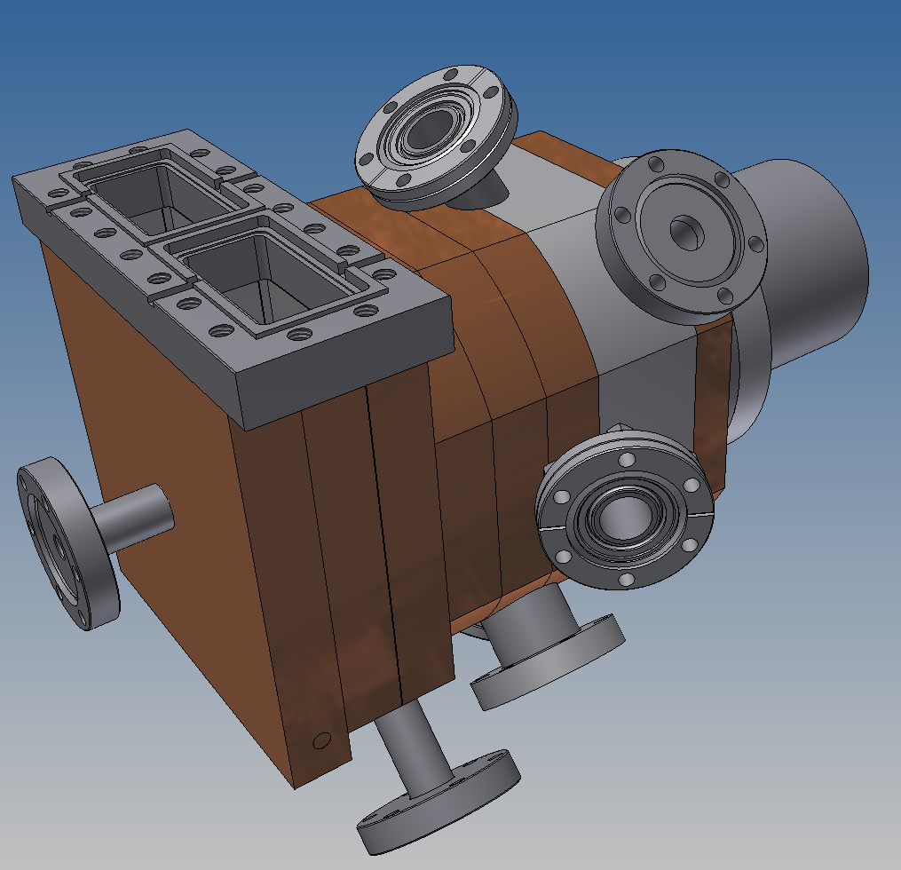
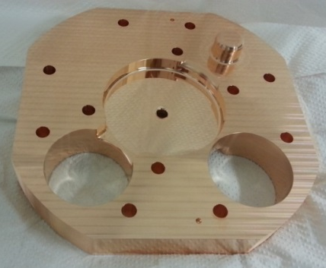
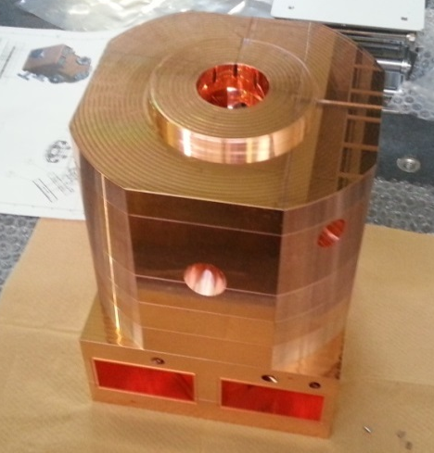
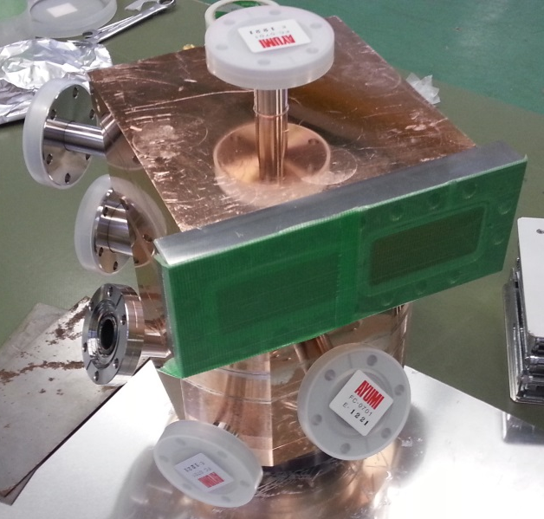
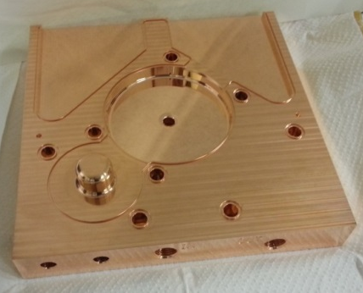
Mechanical design and manufacturing
Notes:
We finished cavity fabrication.
brazing

Slide 13
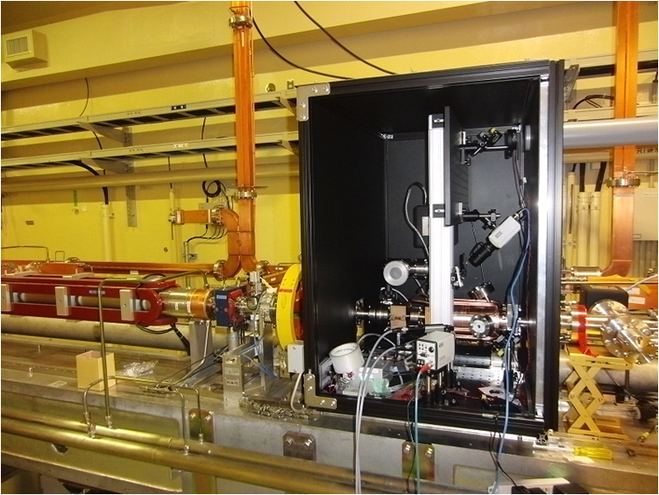
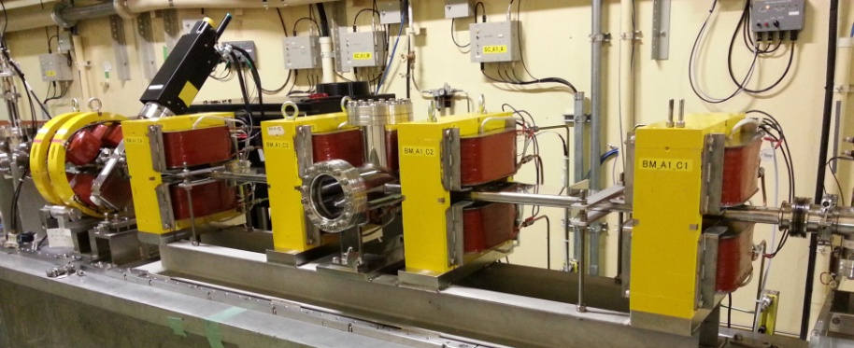
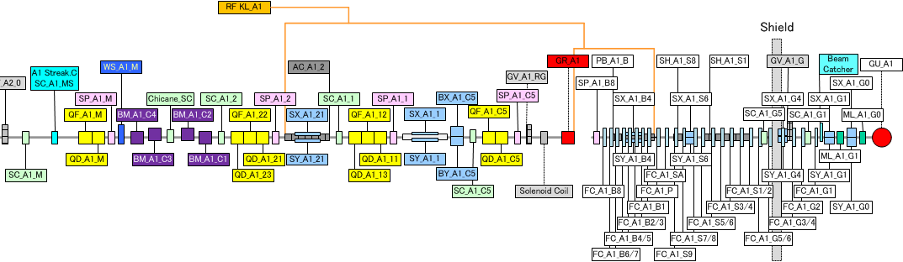
A-1 RF gun
- Quasi-travelling wave side couple RF-Gun
Yb based laser system
Existing DC-Gun & pre-buncher
Installed RF-Gun
Chicane for bunch compression
30ps => 10ps

Slide 14
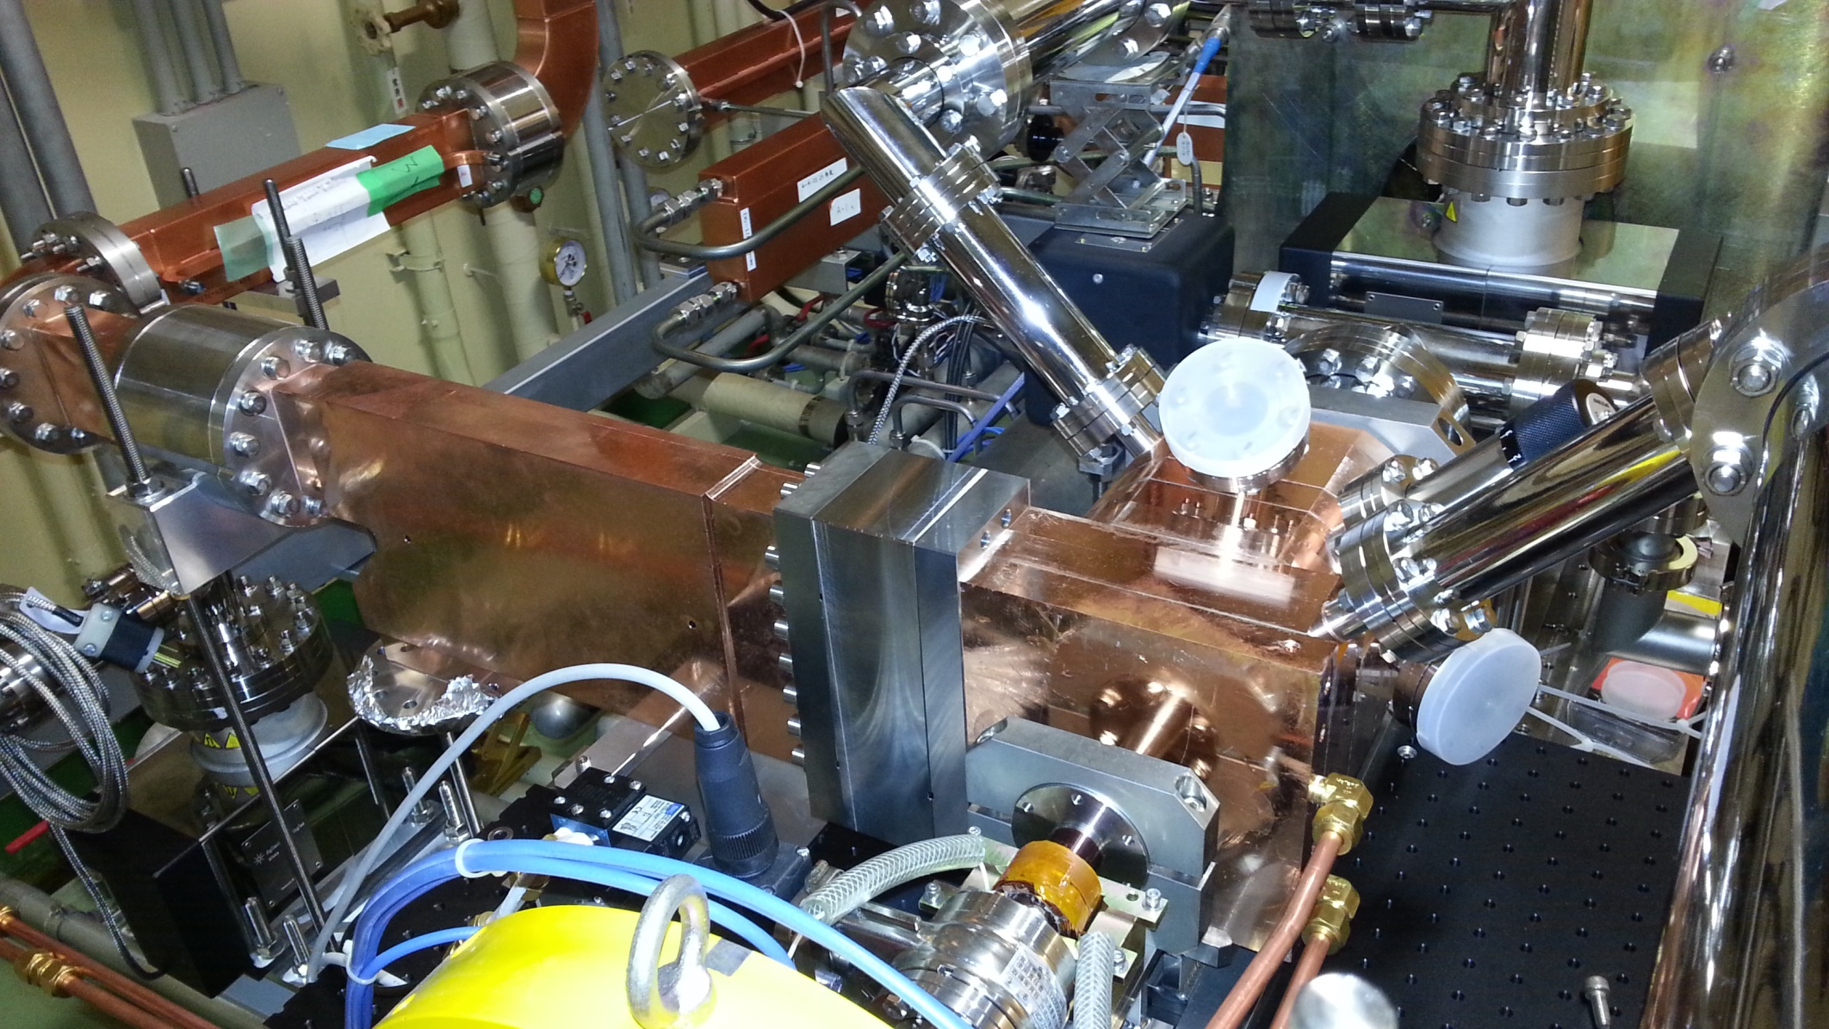
Installed RF gun
RF
Cathode
90 deg Hybrid
beam
Laser port
- 10 MeV @ 20 MW is designed value
- 6 MeV @ 12 MW is maximum power => Phase slip , Large energy spread

Slide 15
IrCe cathode

Slide 16
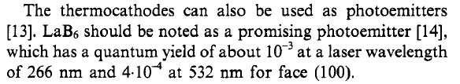
Cathode : Advantage of metal composite cathode
(LaB₆ or Ir₅Ce )
Justin Jimenez, A Systematic Cathode Study , Ph.D Thesis, Monterery, California
Low Workfunction (2.8 eV)
and enough QE (10⁻⁴)
at room temperature.
Inactive in air
Recover by heating or
laser cleaning
Best choice
for SuperKEKB 5 nC
long time operation
Physica Scripta. Vol. T71, 39-45, 1997.
Cathodes for Electron Guns
G. I. Kuznetsov

Slide 17
Lifetime measurement（LaB₆ / Ir₅Ce）
10⁻⁴
10⁻⁵
Condition
Continuous pulse laser 200μJ@266nm)
Irradation => 2.5 nC emission

Slide 18
Ir₅Ce Cathode
Condition
HV = 16kV
Vacuum ; 5.8×10⁻⁶ Pa
Cleaning time ; 10 min
Quantum efficiency improvement
by Laser cleaning
Carbon
LaB₆
SEM-EDX
Oxigen
Lower energy density
is enough to activate Ir₅Ce
×２０
SEM-EDX
Ir₅Ce
Carbon
No oxidization is observed
×20
[SUPER-KEKB e Linac]
Laser Power ; 233μJ/pulse
（λ=266nm）
Target value ; 5nC
Non activation
Laser cleaning
QE = 5.00×10⁻⁶
Max QE = 1.00×10⁻⁴

Slide 19
Laser system for A-1 RF-Gun

Slide 20
Requirement of laser system for RF-Gun
Laser energy
  500 μJ UV for Ir₅Ce cathode
  50 μJ UV for Ce₂Te cathode
50 Hz, 2-bunch (96ns spacing)
=> Difficult to adopt commertial products
using regenerative amplifier.
=> Multi-pass amplifier
or Special regenerative amplifier
Temporal pulse shaping
  Reduction of energy spread due to longitudinal wakefield
  Rhombus shape for laser injection with angle (higher QE)
  => Broadband laser crystal (Yb or Ti:Sapphire)
Continuous operation (limited cost / human resource)
  Support cost for commertial product is very high.
  (10-20万円=1,000-2,000$/day/person + α (margin) )
  No laser system company in Japan.
  Recovering time.

Slide 21
Required laser pulse energy
Current laser energy(500μJ)
Charge( C )
Ce₂Te
QE=10⁻⁴
QE=10⁻³
Offline measurement
S-polarization
Offline measurement
P-polarization
QE=10⁻⁵
5nC
ATF
Inclined injection
Normal injection (old 3-2)
Laser power ( J )

Slide 22
How to generate 2-bunch
Amplification time of standard regenerative amplifier (usually adopted in commertial product) is around 1 μs.
Two regenerative amplifier (not good)
Large regenerative amplifier (built & failed)
  Unstable output energy due to low gain.
  Difficult to compensate thermal lens.
High gain fast regenerative amplifier (built & failed)
  Difficult to reduce the ghost pulse from first bunch due to limted extinction ratio of pockels cell.
Multi-pass amplifier (current configuration)
  More gain is required for the balanced 2-bunch.
OPCPA (future candidate)

Slide 23
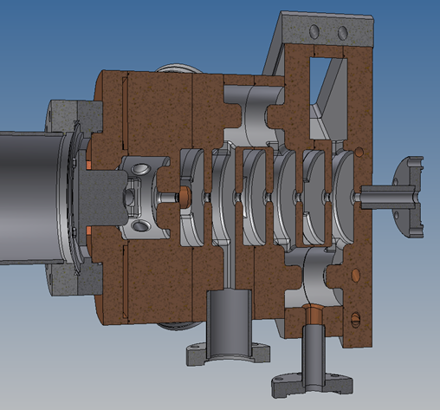
Rhombus pulse shaping for angled injection
Pulse shaping is necessary at angled injection for higher QE.
Mirror in vacuum
Beam
One of problem is beam hole in the cavity is too small. (less than cathode diameter.)
Redesign is required.

Slide 24
Energy spread reduction by pulse shaping
Energy spread of 0.1% is required for SuperKEKB synchrotron injection.
15nC
t
20nC
5nC
10nC
Gaussian
t
Square
5nC
10nC
15nC
20nC
5nC electron
15nC
Primary beam for positron production

Slide 25
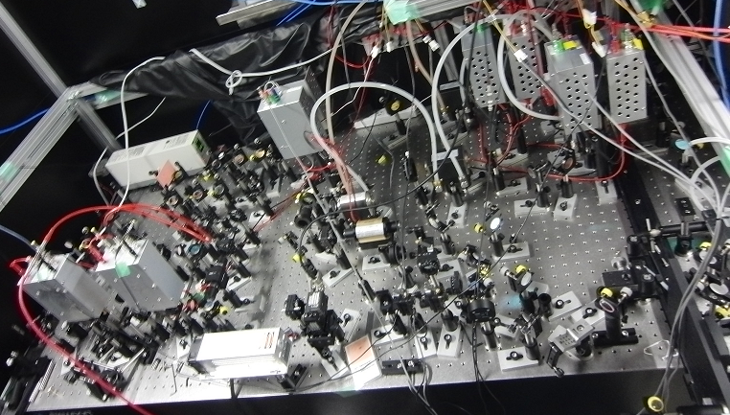
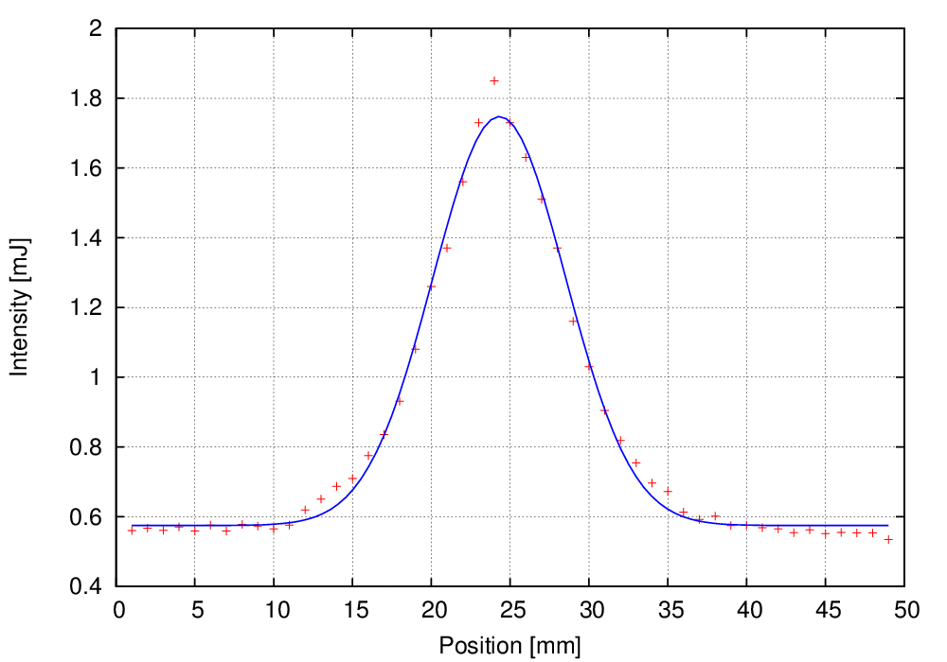
Properties of laser medium
Nd laser system for 3-2 RF-Gun
Nd-doped
τ～200μs, 40%
○ 4-state laser is easy to operate.
○ High power pump LD is available.
○ Large crystal is available
× Pulse width is determined by SESAM.
(Gaussian)
LD Pump
(808nm)
Nd:YVO4
Nd:YAG
SHG(532nm) 40%
FHG(266nm) 20%
5HG(213nm) 3%
808nm
1064nm
Yb-doped
○ Wide bandwidth => pulse shaping
○ Long fluorescent time => High power
○ Fiber laser => Stable
○ Small state difference
× ASE
× Absorption
τ～900μs, 40%
LD Pump
(941/976nm)
Yb-glass
Yb:YAG
Yb:BOYS
SHG(520nm) 40%
FHG(260nm) 20%
5HG(208nm) 3%
Best for RF-Gun
941/976nm
1040nm
Ti-doped
τ=200μs, 40%
τ～3μs, 40%
Pump
40%
SHG(400nm) 40%
THG(266nm) 20%
FHG(200nm) 10%
Pump
(808nm)
Nd:YAG
SHG
Ti:Sapphire
808nm
1064nm
532nm
800nm
○ Very wide bandwidth
○ High breakdown threshold
× Low cross section
× Short fluorescent time => Q-switched laser is required for pumping
Ti:Sapphire laser system for beam monitor.
TW laser is based on Ti-Sapphire

Slide 26
Yb laser system (Present status)
Yb Fiber Laser
Yb Fiber
Oscillator
Yb Fiber Amplifier
ASE problem
Amplitude modulator x 2
f_{rep}=52MHz
f_{rep}=52MHz→10MHz
Fiber strecher
& wavelength selection
Yb Fiber
Amplifier x 2
(20W + 70W pump)
Pulse picker
Yb PCF Amplifier
(70W pump)
λ₀→1030 - 1040nm
f_{rep}=10 MHz→50 Hz
Yb:YAG
Multipass
Amplifier
Yb:YAG laser
Failed
Yb:YAG
Regenerative
Amplifier
Yb:YAG
5-pass Amplifier ×4stage
Pulse
Compression
Yb:YAG
5-pass Amplifier
7 mJ @ 1030nm
Wavelength
conversion
0.7 mJ @ 258nm

Slide 27
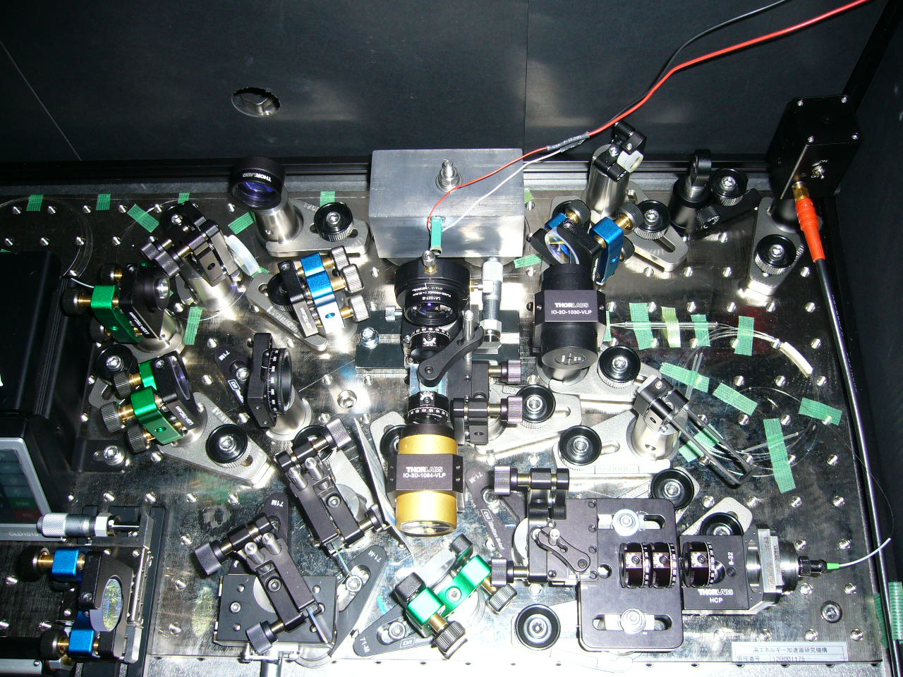
Yb Fiber Oscillator
Yb fiber oscillator:
30 fs is possible using non-linear
polarization rotation.
52 MHz is not suitable
=> 114 MHz will be installed
Improved items in FY2013:
Transmission grating
=> Stable modelock (higher efficiency)
Super-invar breadboard
=> Improve thermal stability.
Piezo mirror on large lead block
=> Reduce vibration.
Broadband oscillator (No.2) is stable.
Remaining problem:
LD was sometimes broken.
Bunch structure at higher output power.
=> SESAM is not effective.
=> Replace some components.
1030nm oscillator is not stable
1030nm component of broadband oscillator
is small => large ASE
WDM
LD
Yb Fiber
←
←
Transmission
grating pair

Slide 28
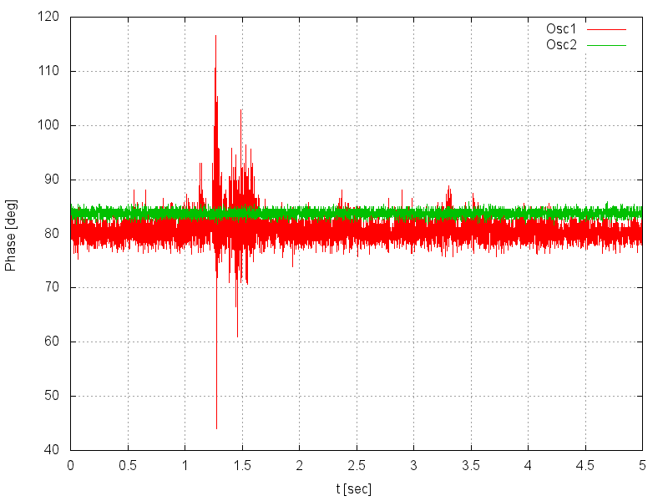
Yb:YAG fiber oscillator
Two 52 MHz oscillators are installed for the underground laser room.
Second oscillator is very stable
Yb:YAG bandwidth
Oscillator1: Narrow (Less ASE)
Oscillator2: Broadband (Stable)
Phase stability (sigma)
Oscillator1 : 2.38 deg
Oscillator2 : 0.58 deg = 560 fs

Slide 29
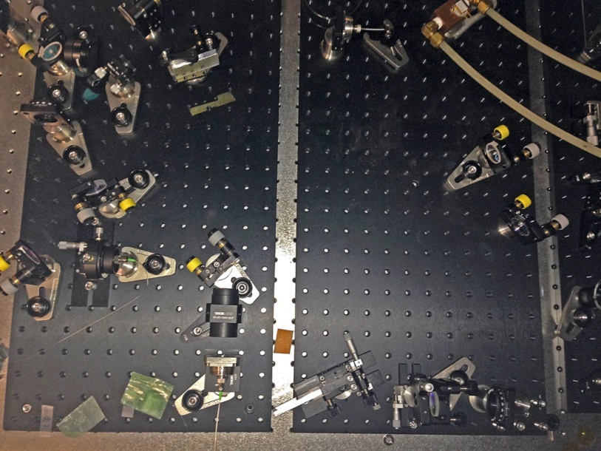
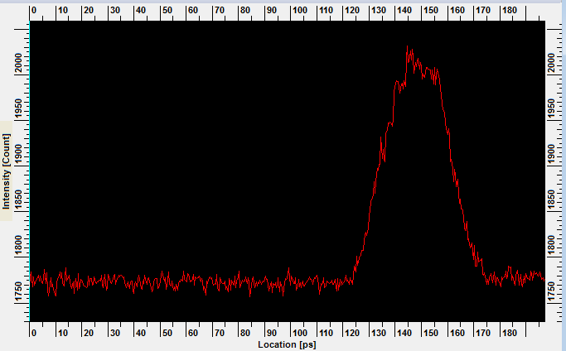
Pulse shaping using strecher
Strecher
Telescope lens
1740-grooves/mm
Measured by streak camera
Rectangular-like
30 ps pulse width
was obtained.
30 ps

Slide 30
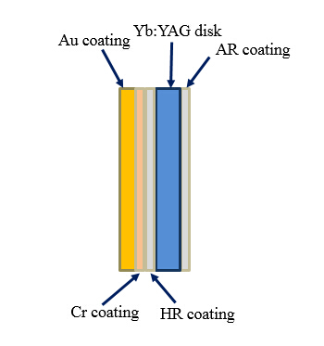
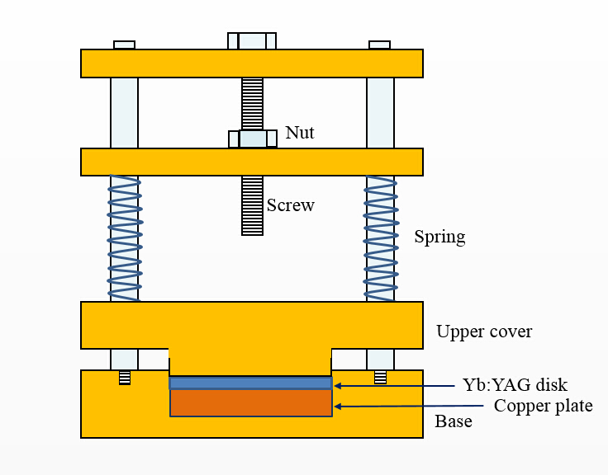
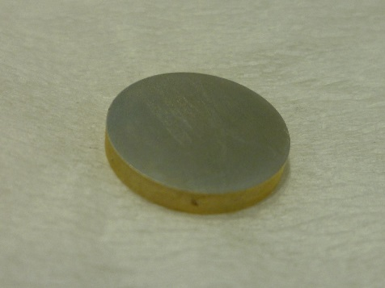
Yb:YAG solid state amplifier
Improvement of heat conductivity
by Au-Sn vacuum soldering.
Copper plate
Au-Sn coating
5 Hz =>
25 Hz operation was achieved.

Slide 31
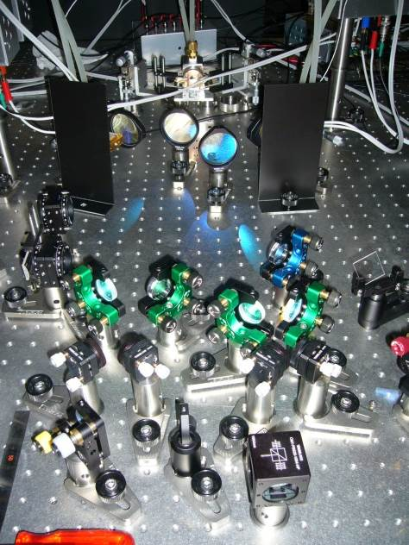
Original multi-pass amplifier (5-pass)
To obtain higher gain,
=> Higher pumping density
Thermal lens
Focused type amplifier to
avoid thermal lens.
LD
Balanced offset
lens to avoid
damage.
Laser Diode
5pass
4pass
3pass
2pass
1pass

Slide 32
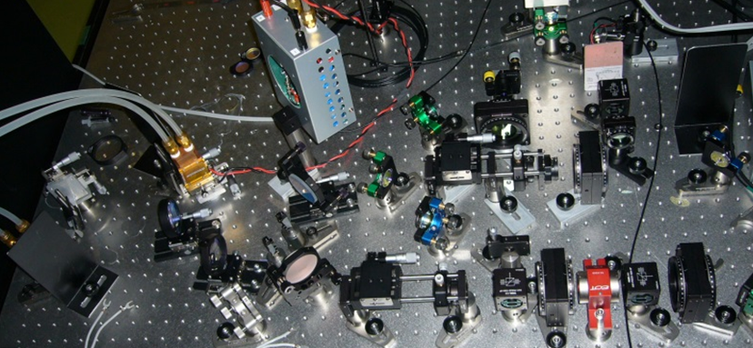
New high gain multi-pass amplifier(10-15 pass x 2 loop)
to simplify the laser
LD
Laser Diode
1pass
10-15pass
OUTPUT
INPUT
←

Slide 33
Issues on Yb based laser system
Yb-fiber oscillator
  1030nm oscillator is not stable.
  Broadband oscillator is very stable => Further ASE reduction is required.
Yb-fiber amplifier
  Lack of pulse energy =>
  Lifetime and stability of PCF fiber => Improve the injection
Yb-disk amplifier: (Regenerative amplifiers were failed)
=> Multi-pass amplifier for 2-bunch operation.
=> More gain is required for balanced 2-bunch energy.
  5 Hz => Soldered cryatal => 25 Hz operation
  => x 2 system => 50Hz before May 2015
  Reduce thermal lens effect and simplify laser system
  => Focused type high gain multipass amplifier x2
  + Non-focused multipass amplifier
Stability improvement
  Casing of each block.
  Gas filled or vacuum laser transportation to improve pointing stability.
  Assemble on one large optical table (new laser room).
  Feedback (pointing / amplitude).
  Increase monitor points (pointing / power / beam pattern).

Slide 34
Comissioning of A-1 RF-Gun

Slide 35
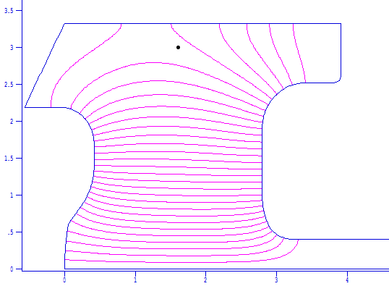
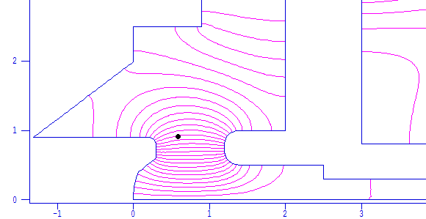
RF voltage
 | RF power [MW] | Maximum surface E-field [MV/m]
DAW @ 3-2 | 3.5 | 150
QTW @ A-1 target | 20 | 120
QTW achieved @ A-1 | 14 | 85
One week RF ageing
reach this target.
Beam hits anode.
Anode shape should be changed. (large beam hole)
DAW type RF gun is effective shape for multipactoring?
cathode

Slide 36
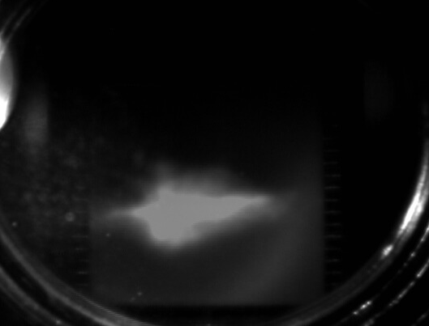
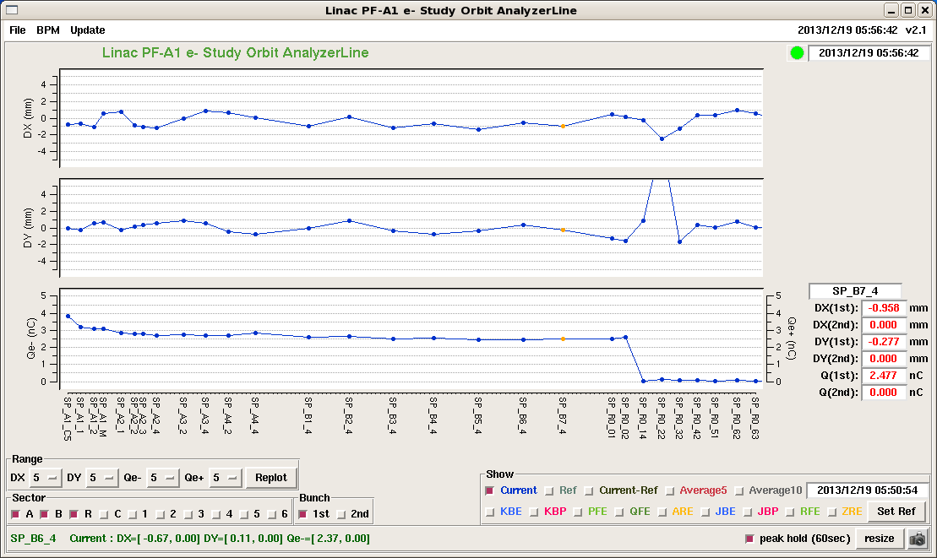
A-1 RF gun results
5.6 nC was achieved.
However beam profile is not good.
3 nC beam delivery was achieved.

Slide 37
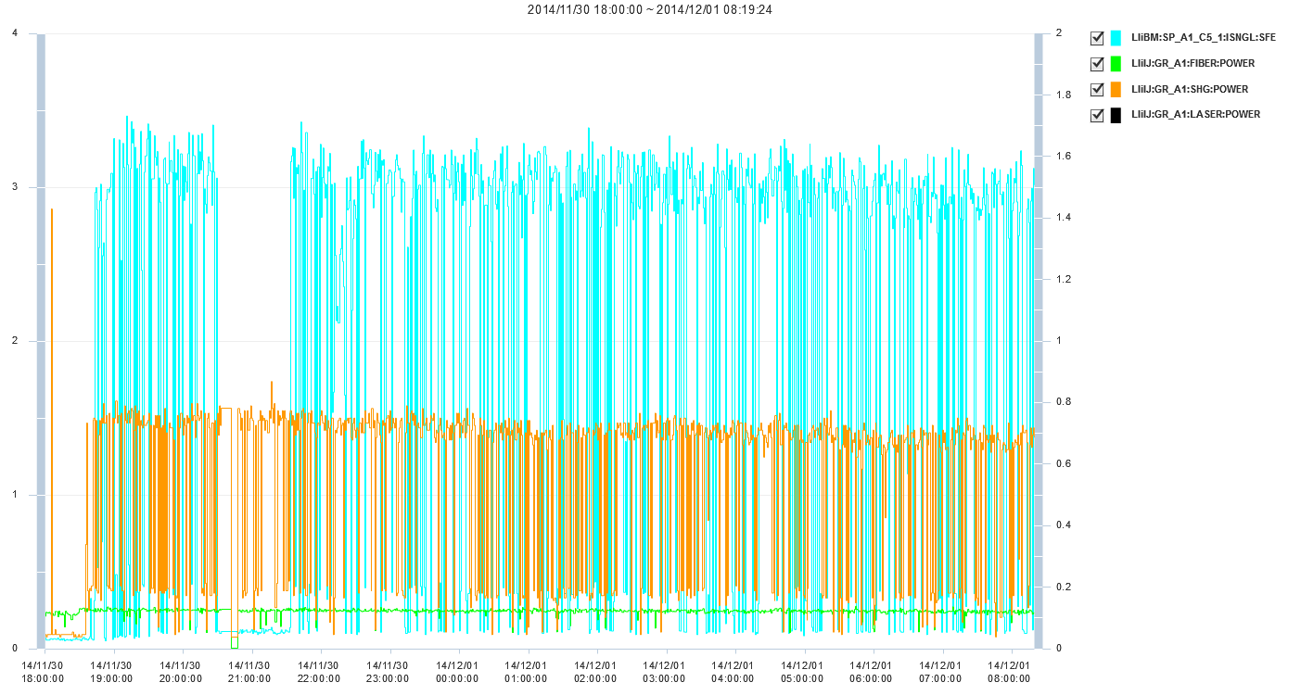
Charge history of A-1 RF-Gun (3nC)
QE : 3nC = 14nJ / 300μJ = 4.5×10⁻⁵ (QE)

Slide 38



Emittance measurement
beam charge : 0.6nC
beam energy : 30 MeV
Normalized emittance
X : 13.4 +/- 5.9 [mm-mrad]
Y : 8.05 +/- 0.47 [mm-mrad]
Q scan method
using screen
monitor
Normalized emittance
X: 95.0 ±27.4 mm-mrad
Y: 42.0 ±31.1 mm-mrad
(including the beam position jitter.)
Wire scanner
at B sector

Slide 39




Bunch compression and streak camera
10 psec
20 psec
Compression at chicane
No compression

Slide 40
Summary of issues
RF-Gun cavity
  Disk and washer (DAW) : very fast RF ageing, 2 MeV is not enough.
  Quasi travelling wave side couple structure :
    Lower electric field than designed value.
    => Thermal electron gun will recover for positron generation in May 2015.
Cathode
  Room temperature Ir₅Ce cathode seems best cathode !
  Laser injection angle for surface plasmon is effective.
  R&D for the QE improvement and cleaning.
  Preparation to use alkaline cathode
Laser & control
  Nd based laser system : 3-2 RF-Gun
    Oscillator: RF synchronization precision is not enough.
    Repetition rate 10 Hz operation => how to upgrade to 50 Hz ?
  Yb based laser system : A-1 RF-Gun => next page
Beam transportation and diagnostics
  Beam loss in first accelerating structure (will be solved in May 2015.)
  Old streak camera for beam diagnostics. (renewed for laser diagnostics)
  Single cavity RF-Deflector installation.

Slide 41
Plans & Schedule following
LINAC group strategy and
RF-Gun review (last week)

Slide 42
Schedule
These few months:
  Reconfigure thermal gun for positron generation
  Step by step RF-Gun RF ageing.
  New laser system in ground laser room.
    Increase pulse energy from fiber laser
    Simplify the laser system (new multi-pass amplifier)
Next summer:
  Second RF-Gun (nomal laser injection / cavity modification / cathode change)
  Simple Nd amplifier for Phase-I & II stable injection
Following the RF-Gun
reviewer’s comments
(Postponed the pulse shaping until Phase-III )
10 ps gaussian is enough for Phase-I (1nC) & II (2nC), postponed the pulse shaping until Phase-III

Slide 43
Strategy for emittance preservation and energy spread
Emittance preservation
  Alignment : Initial alignment / Continuous monitor / Active mover / Beam based alignment
  0.3 mm mis-alignment tolerance for 2 nC (until Phase-II)
  0.1 mm mis-alignment tolerance for 5 nC (Phase-III)
  => shorter bunch (5 ps) is required for 0.3mm
  mis-alignment
  Offset injection compensate the transverse wakefield
  (RF Deflector will be installed for beam diagnostics for offset injection)
Energy spread
  0.1 % is required for SuperKEB injection
  10 ps gaussian pulse is enough for 2 nC (until Phase-II)
  Laser pulse shaping is only required for Phase-III
  Bunch compression to 5 ps is required for Phase-III depending on the mis-alignment.

Slide 44
Beam line will be upgrade on up and down.
Thermionic DC gun will be installed to upper beam line.
10 nC
for positron primary
70 MeV
Thermionic DC gun
triplet
Acc.tube
buncher
prebuncher
SHB2
SHB1
Energy slope
Chicane
Acc.tube
RF gun
Bunch compression
30 MeV
20 psec
20 psec
5 nC
Low emittance

Slide 45



Reconfiguration of A-1 injector area
KL_A1_B
KL_A1_A
RF-Gun1
RF-Gun2
加速管

Slide 46

Second RF gun on the 45 degree line
Normal laser injection
Angled laser injection
Studies on
Improved RF-Gun cavity
Normal laser injection
Cathode change including alkaline cathode

Slide 47



Second Side coupled Quasi-travelling wave RF-Gun
Second RF-Gun under brazing
Conditioning progress was too slow.
Frequently brake down is big problem.
Cathode rod contact?
Cathode material fixation?
Cathode material sputtering due to laser?
We have to separate causes of brake down.
Cavity conditioning, used dummy cathode rod with out cathode material (all Cu).
Replace new cathode rod with material (new fixation is shrinkage fit).
For reduce multipactoring effect, another cathode cell design is required.
Current cathode
New cathode
shrinkage fit

Slide 48

Simplify and stabilize our laser system without pulse shaping
Existing laser system
114.2 MHz
Yb-doped fiber oscillator with Transmission grating
@ 1030 nm
PCF Yb-doped fiber amplifier
Yb:YAG thin-disk multipass amplifier
(25 Hz x 2)
Pulse picker
Menlo
@ 1064 nm
Simple Nd amplifier laser system without pulse shaping
according to RF-Gun reviewer’s comment
LIEKKI Yb-doped fiber amplifier
Commertial Nd:YAG rod
multipass amplifier (10 Hz => 50 Hz)
Pulse picker
Optilab YDFA-r-40-S, Output power of 20W
\3,500,000
Grating pair
Fiber Amplifier @1030 nm
Yb fiber Oscillator
Fiber Amplifier @1064 nm
Spatially dispersed

Slide 49

Strecher for Yb:YAG & Nd:YAG
 | Yb:YAG | Nd:YAG
Center wavelength | 1030 nm | 1064 nm
Gain spectrum width | ~2 ns | ~0.5ns
Distance of the Stretcher to 30 ps | 1.5 m | 6 m (×4)
Gain spectrum of Yb:YAG
Distance of grating pair
30 ps
Grating pair
2.0nm

Slide 50


Improvement of fiber collimation
PCF fiber damage is one issue => Improve the fiber collimation
Fiber coupler
Cooling system
Fiber coupler in ERL
Drum Lens
Higher output pulse energy from fiber amplifier
=> Reduce number of stages of Yb:YAG multi-pass amplifier

Slide 51


Temperature dependence of Yb:YAG
Improvement of thermal and emission property (Thermal lens effect) (Excitation density)
GM+He
10 W/m/K , dn/dT = 8ppm/K @ 300K
25 W/m/K , dn/dT = 3ppm/K @ 150K
↑150K 1/6 Thermal lens
Same gain @ 1/3 excitation density →
↓
150K => 1/20 thermal lens
Pertier
300K
30kW/cm²
300K P/P₀ = exp(g₀z) ～2
150K → g = 7 [cm⁻¹]

Slide 52
Schedule
These few months:
  Reconfigure thermal gun for positron generation
  Step by step RF-Gun RF ageing.
  New laser system in ground laser room.
    Increase pulse energy from fiber laser
    Simplify the laser system (new multi-pass amplifier)
Next summer:
  Second RF-Gun (nomal laser injection / cavity modification / cathode change)
  Simple Nd amplifier for Phase-I & II stable injection
Following the RF-Gun
reviewer’s comments
(Postponed the pulse shaping until Phase-III )
10 ps gaussian is enough for Phase-I (1nC) & II (2nC), postponed the pulse shaping until Phase-III

