Slide 1

Normal-Conducting RF Cavities for SuperKEKB / MR & DR
MR: Main Ring
DR: Damping Ring
Tetsuo ABE
For SuperKEKB-RF / ARES-Cavity Group
(T. Abe, T. Kageyama, H. Sakai, Y. Takeuchi, and K. Yoshino)
The 21th KEKB Accelerator Review Committee Meeting
2016-06-13

Slide 2
Contents
RF cavities for the Main Rings (MRs) (“ARES”)
Introduction
Operational status in Phase 1
Two serious troubles
RF Cavities for the Damping Ring (DR) (“DR Cavity”)
Introduction
Results of the performance tests

Slide 3
ARES for the MRs

Slide 4
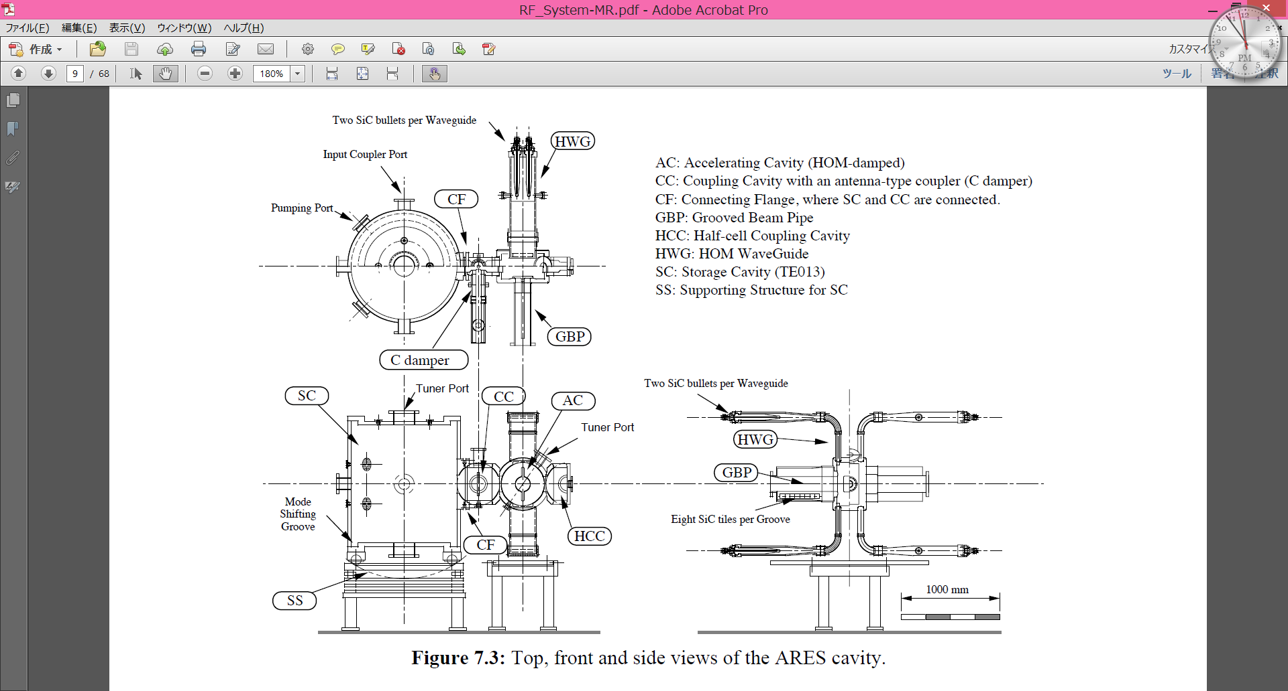
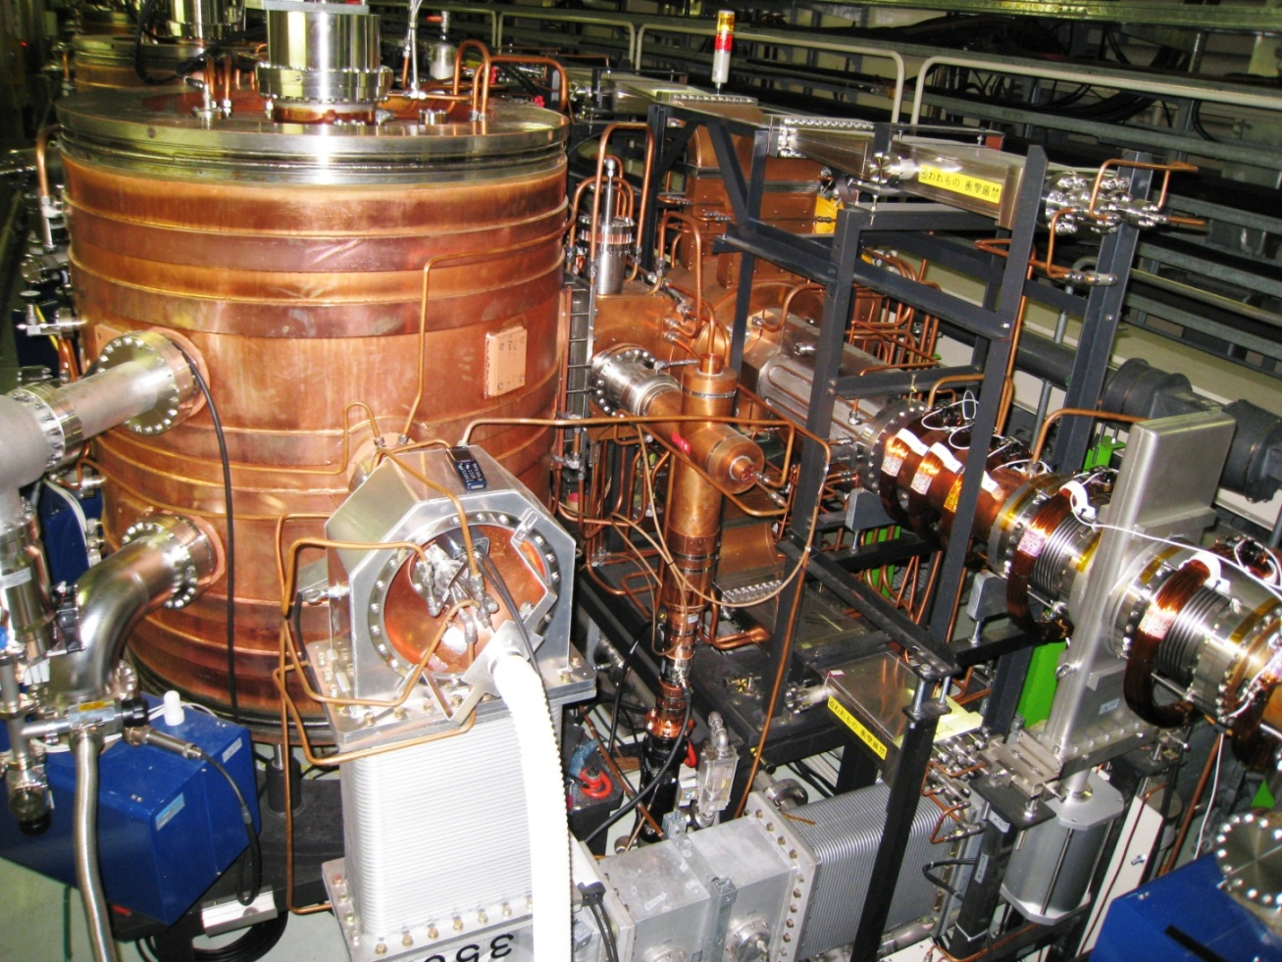
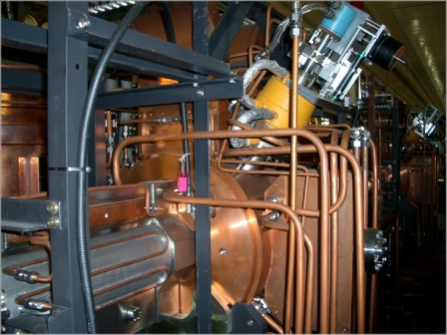
NC RF Cavity System for SuperKEKB (ARES) (Accelerator Resonantly coupled with Energy Storage) -- Three cavity system stabilized with the accelerating π/2 mode --
High-Purity Copper Resonators
Gap length: 256 mm
Three-cavity system (unique)
R_{sh}/Q₀=15 Ohms
Q₀=~1.1x10⁵
V_{c}=0.5 MV/cav
P_{c}=150kW (60kW in AC, 90kW in SC)
Loss factor: 0.48 V/pC (bunch length: 5 mm)
E_{sp}/E_{acc} = 3.8
(Cavity trip rate) < 1 /cav/3months
U_{s}/U_{a}=9 (explained in the next page)
High energy (U_{s}) stored as a low-loss mode (TE₀₁₃)

Slide 5
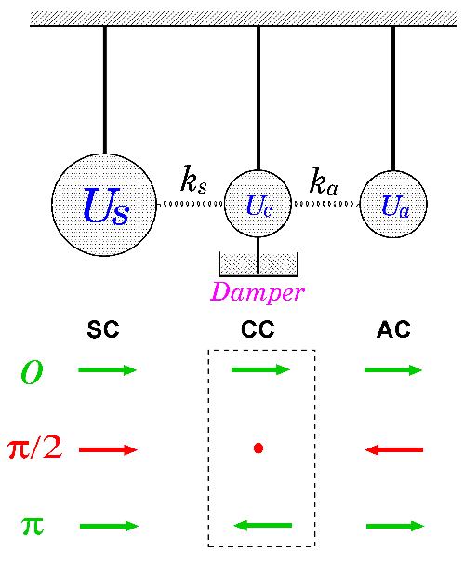
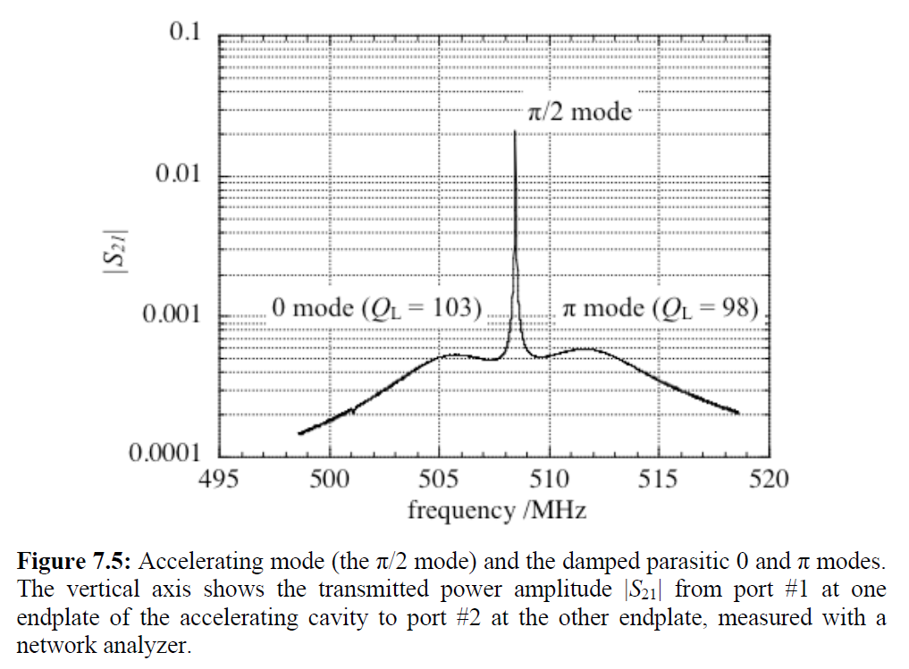
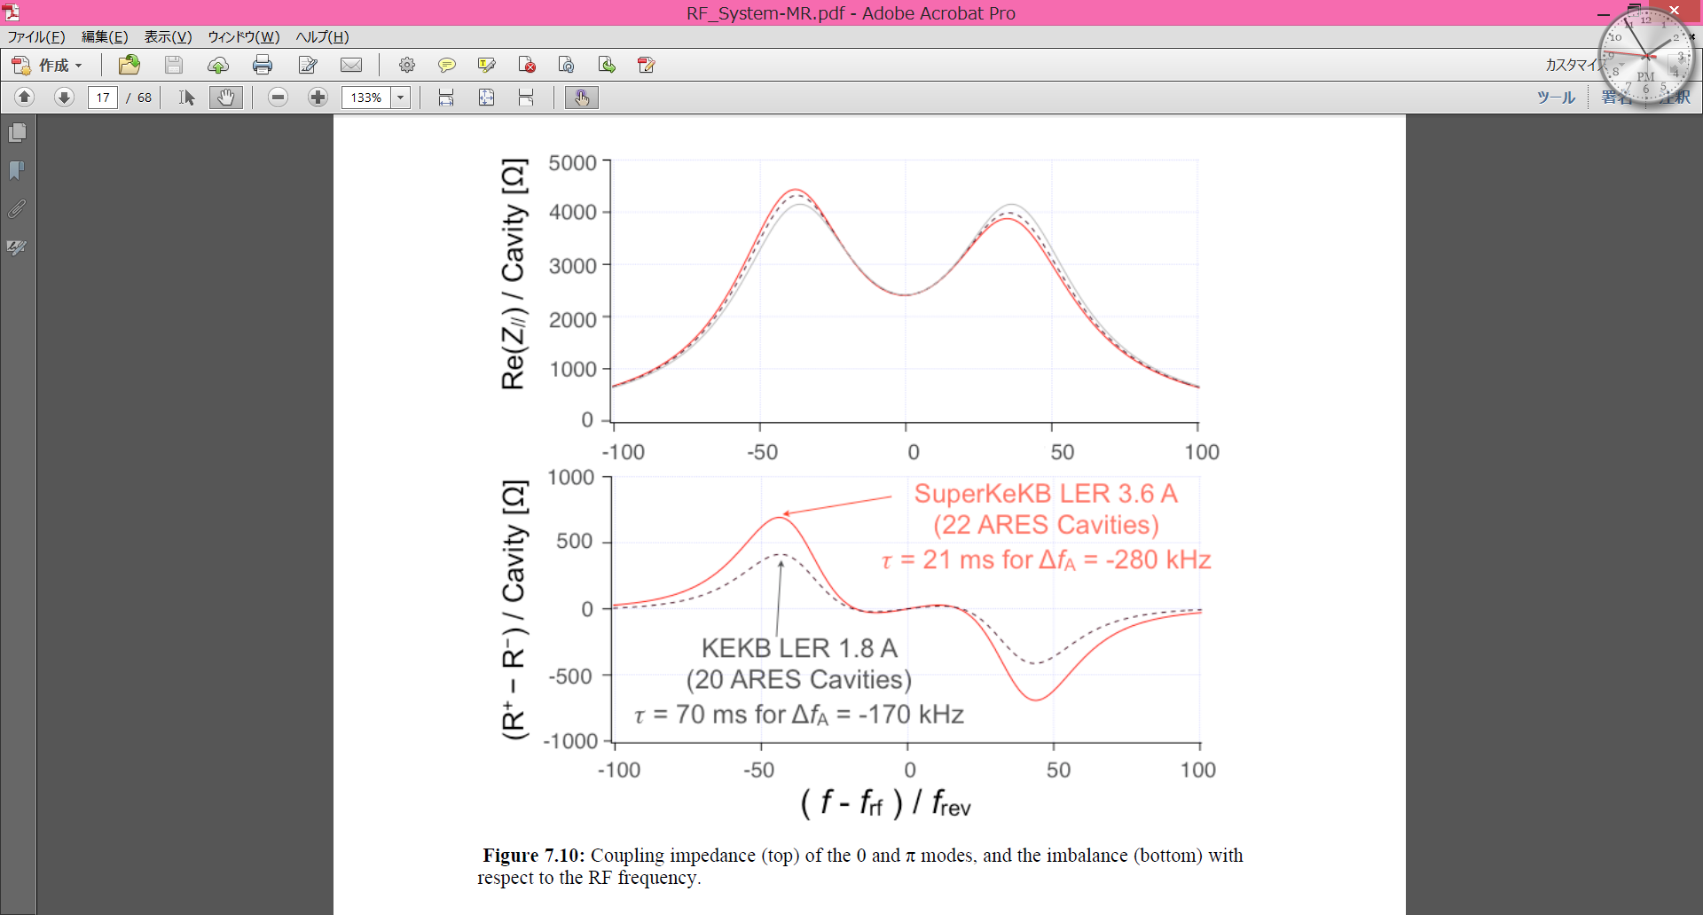
Three Main Characteristics of the ARES Cavity System
Large Storage Cavity (SC)
Optimum detuning suppressed by U_{s}/U_{a}(=9)
SC acts as an electromagnetic flywheel.
Δf_{π/2} = Δf_{a} / (1 + U_{s}/U_{a}) = Δf_{a} /10 < f_{rev}
Δf_{a} = -200kHz (KEKB design), -280kHz (SuperKEKB design)
f_{rev} = 99kHz
Therefore, coupled bunch instabilities (CBIs) driven by the accelerating mode are suppressed (Appendix A).
π/2-mode operation
Stable against the detuning and deformation
The stored-energy ratio: U_{s}/U_{a} changeable
U_{s}/U_{a} = k_{a}²/ k_{s}²
Parasitic 0 and π modes
Damped selectively out of CC by an antenna-type damper (“Coupling-Cavity Damper”)
Have a almost symmetric impedance w.r.t. f_{RF}
Hybrid HOM-Damped Structure
Explained in the next page
SC : Storage Cavity
CC : Coupling Cavity
AC : Accelerating Cavity

Slide 6
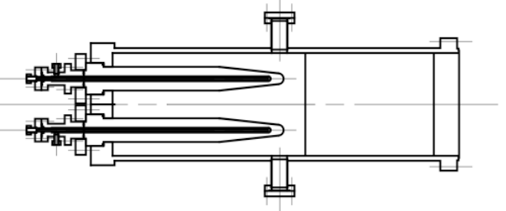
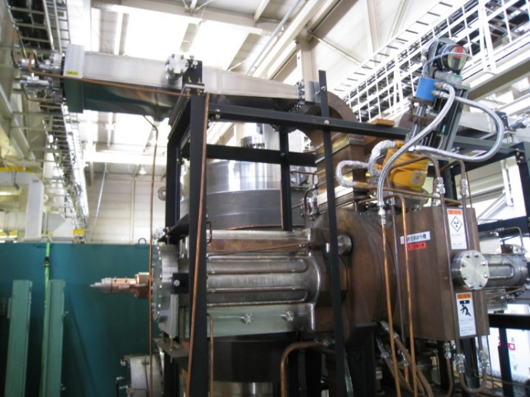
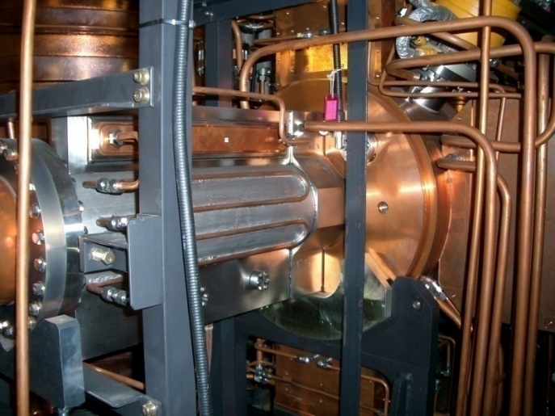
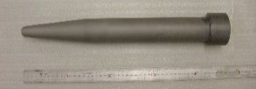

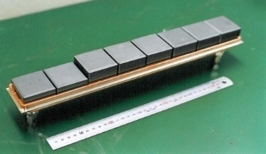
The ARES has -- Two-types of HOM-Damped Structures. --
To suppress CBIs driven by HOMs (Appendix A)
Type_1: HOM WG (HWG)
Type_2: Grooved Beam Pipe (GBP)
HOM absorber
Bullet-shaped SiC ceramics
Directly water-cooled
Note:
No HWG in the horizontal direction due to the (H)CC
HOM absorber
beam
SiC ceramics tiles
Indirectly water-cooled
For damping
Monopole HOMs
Vertically-polarized dipole modes
For damping
Horizontally-polarized dipole modes
T. Kageyama, “Grooved Beam Pipe for Damping Dipole Modes in RF Cavities," KEK-PREPRINT- 91-133, 1991.

Slide 7
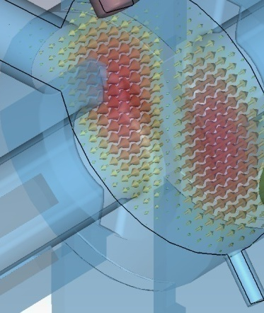
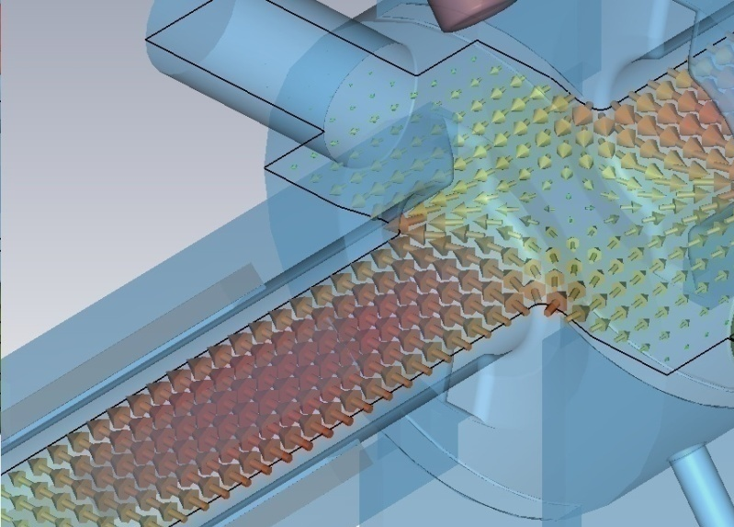
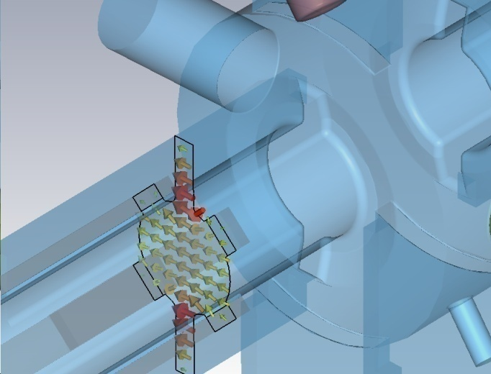
Type_2: Grooved Beam Pipe (GBP)
TM₁₁₀
Electric-field Vectors
TE mode in the
Grooved Beam Pipe

Slide 8
Upgrade of the ARES for SuperKEKB
(Selection)

Slide 9
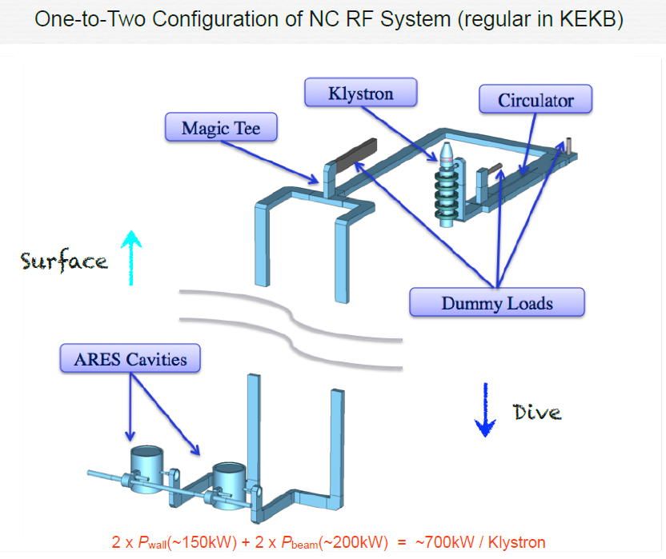
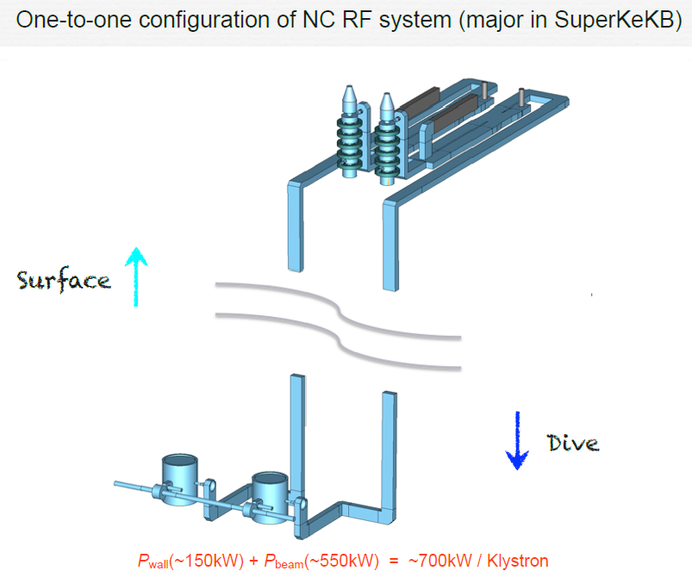
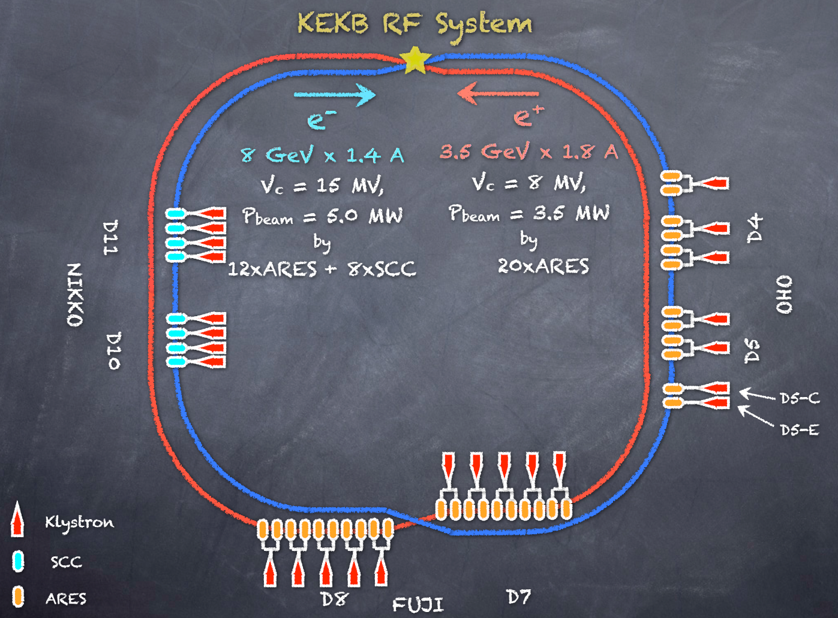
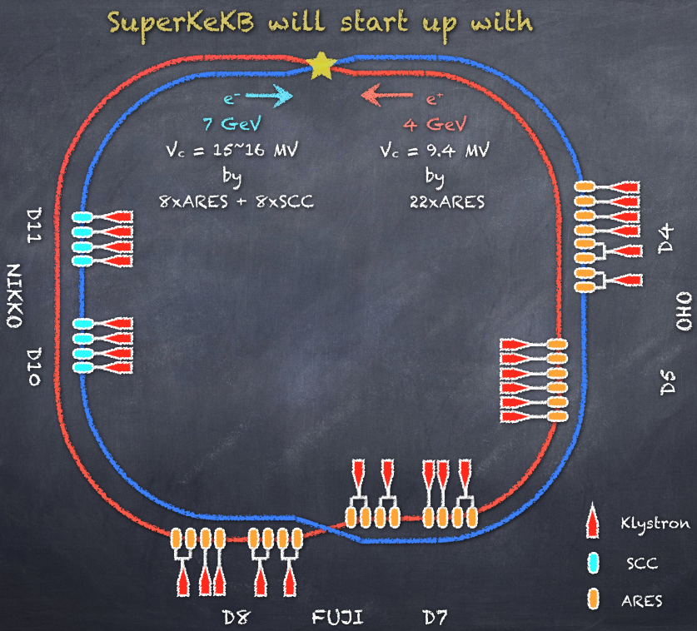
N_{Klys}:N_{Cav}=1:2
N_{Klys}:N_{Cav}=1:1
KEKB
SuperKEKB Phase 1
Relocation: HER → LER
(Shown by T. Kageyama at KEKB Review 2011)

Slide 10
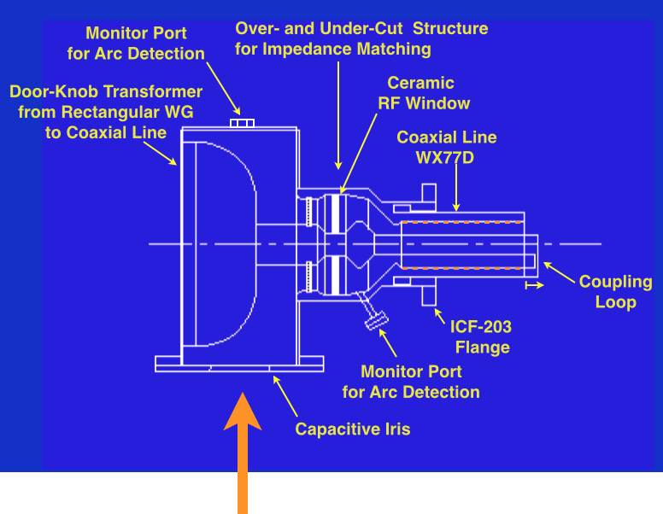
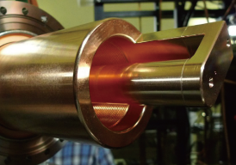
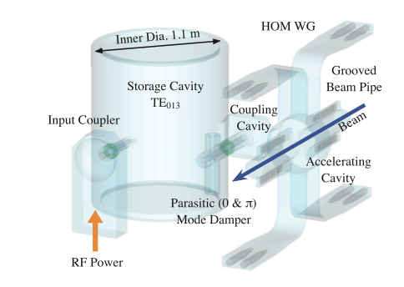
High-Power Input Coupler / Performance Upgrade
Fine grooving inside the outer conductor of the coaxial line to suppress multipactoring discharge.
(Appendix B)
2. The coupling loop is extended to increase the input coupling factor (up to β = 6).
The optimum input coupling factor β_{opt} is given by β_{opt} = 1 + P_{beam}/P_{c} .
(T. Kageyama, et al., Proc. of PASJ, TUPS126, 2011)
Input Coupler
Power Handling Capability (Spec.)
P_{input} P_{c} P_{beam}
SuperKEKB : 750 kW = 150 kW + 600 kW
KEKB : 350 kW = 150 kW + 200 kW
P_{c} = 150 kW generating V_{c} = 0.5 MV per ARES cavity.
3D Transparent View of ARES Cavity System
T. Kageyama

Slide 11
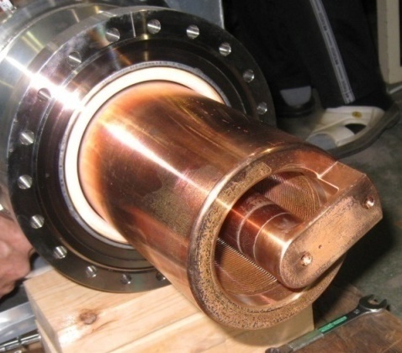
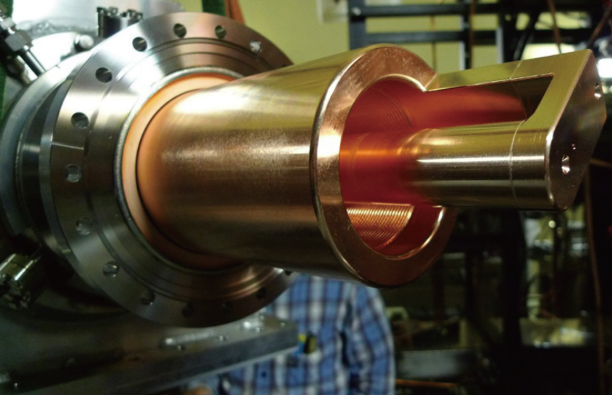
Upgraded Input Coupler Increasing the Input Coupling Factor
Input couplers with increased input coupling (β_{max} = 5→6) needed for the stations with the N_{klys}:N_{cav}=1:1 configuration to accelerate beams with the design current.
Used at the KEKB/MRs
With increased input coupling for the SuperKEKB
The high-power performance was demonstrated both at the test stand and in the KEKB operation.
P_{input} = 740 kW (= P_{c}: 130kW + P_{beam}: 610 kW)

Slide 12
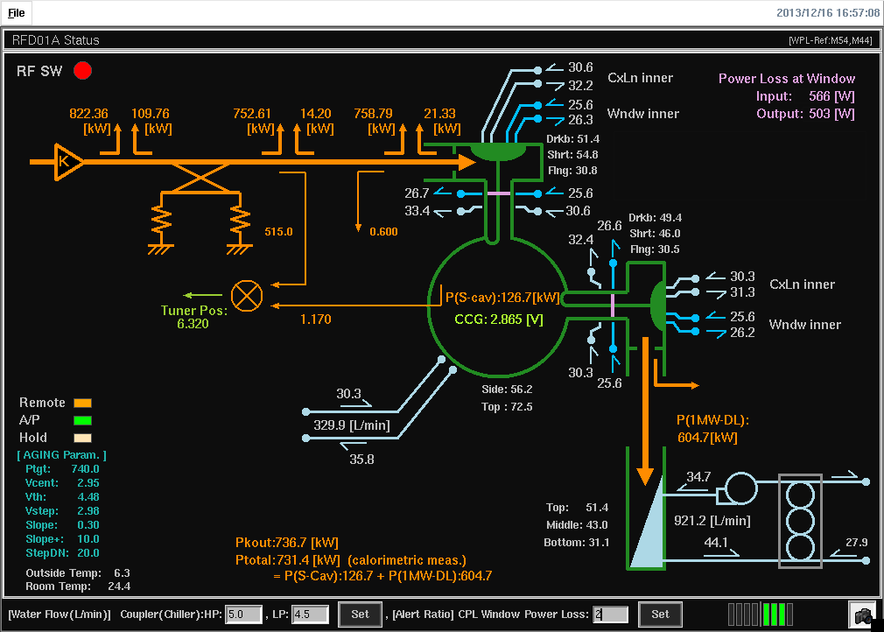
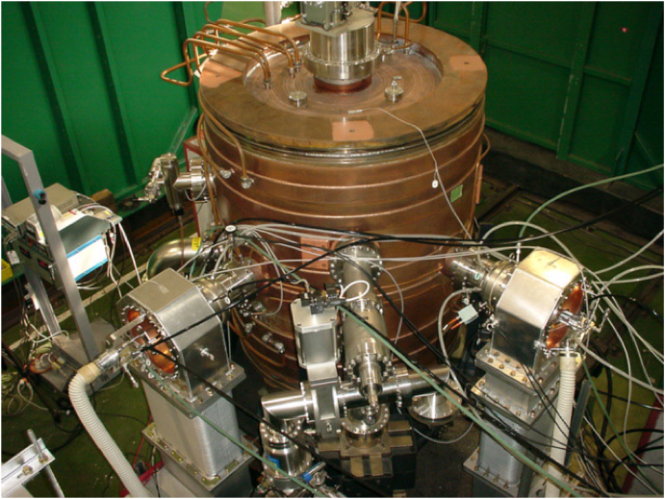
ARES Cavity System / Upgraded Input Coupler / Production & Processing
ARES
Storage Cavity
Input Coupler
used as
Output Coupler
Input Coupler
Under Test
High Power Test Stand
To 1MW Water Load
RF Power from
1MW CW Klystron
(TOSHIBA E3786)
Snapshot of Status Monitor for RF Processing
(Photo and diagram by T. Kageyama)
For the first two production couplers, stable power feeding was demonstrated
Up to P_{input} = 800 kW (= 750 kW + 50 kW) at the test stand.
So far, 13 couplers have been processed up to 750-800 kW.
The same shown in the last report
As of June, 2016, 5 couplers are waiting for high power test.
P_{input} = 850 kW (= 750 kW + 100 kW) to be demonstrated (after Phase 1)
(Max. RF power stably supplied by the high power source)

Slide 13
All the Input couplers for N_{Klys}:N_{Cav}=1:1 stations in OHO D4&D5 have been replaced by upgraded couplers.
One coupler has been replaced by an upgraded one for one of the FUJI D8 stations.
For other N_{Klys}:N_{Cav}=1:1 stations, to be replaced before starting Phase 2.
Almost no vacuum break before T=0

Slide 14
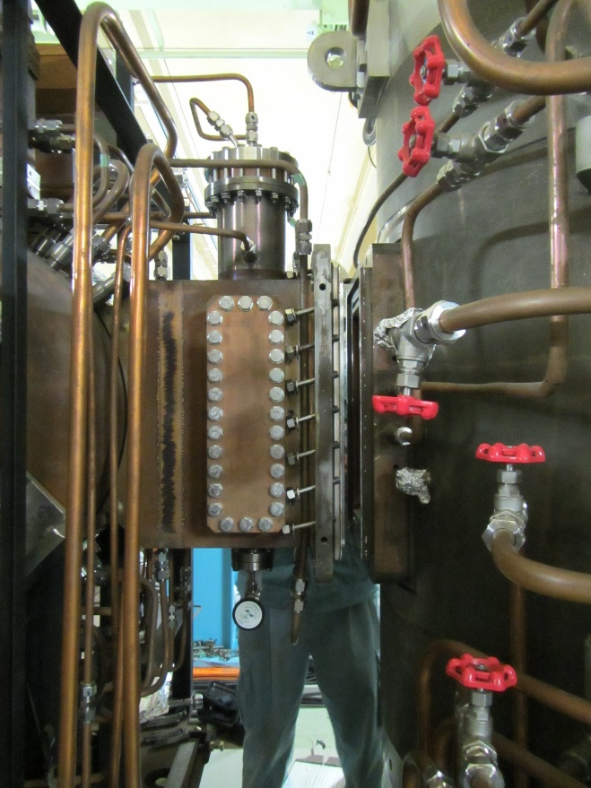
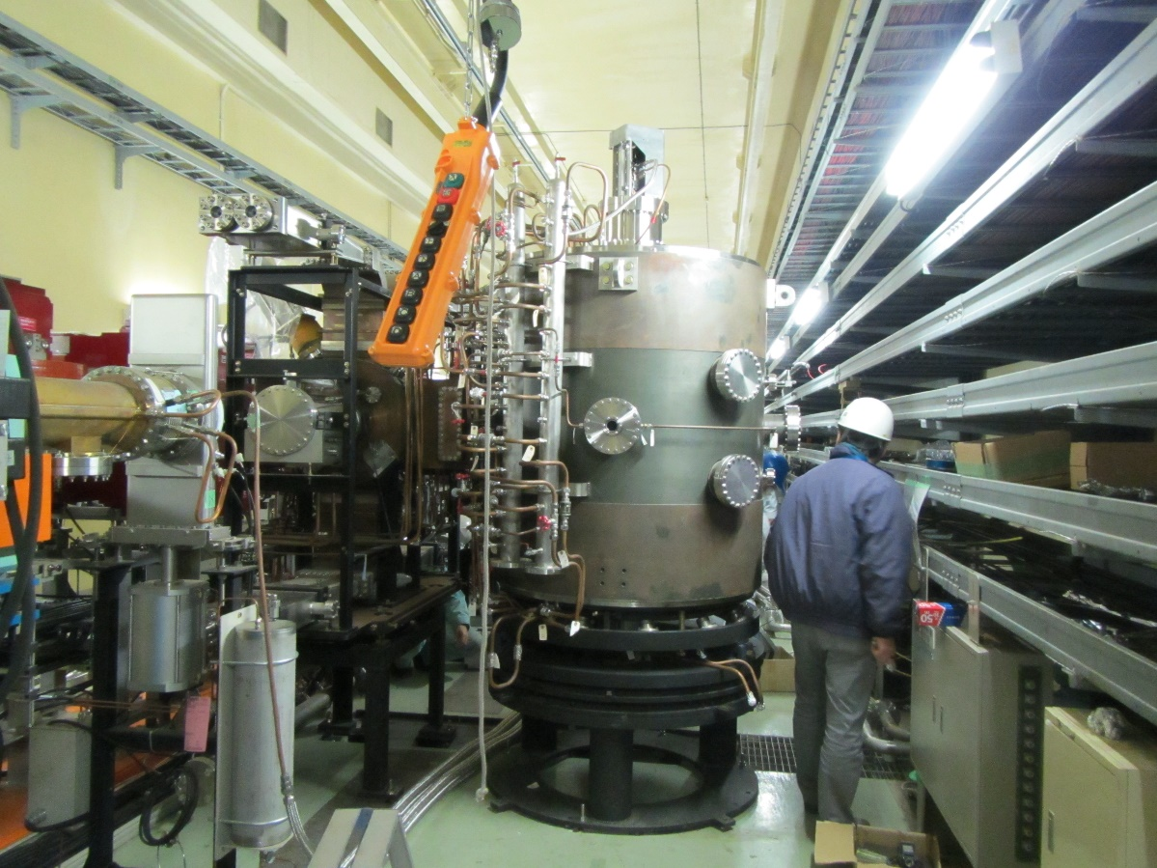
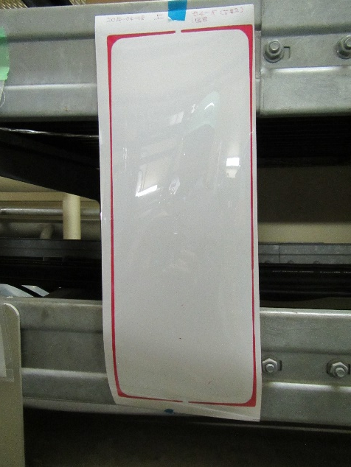
Two ARES Cavities Newly Installed in OHO D4-E,F
Pressure-sensitive paper →
to check the RF contact
between CC and SC

Slide 15
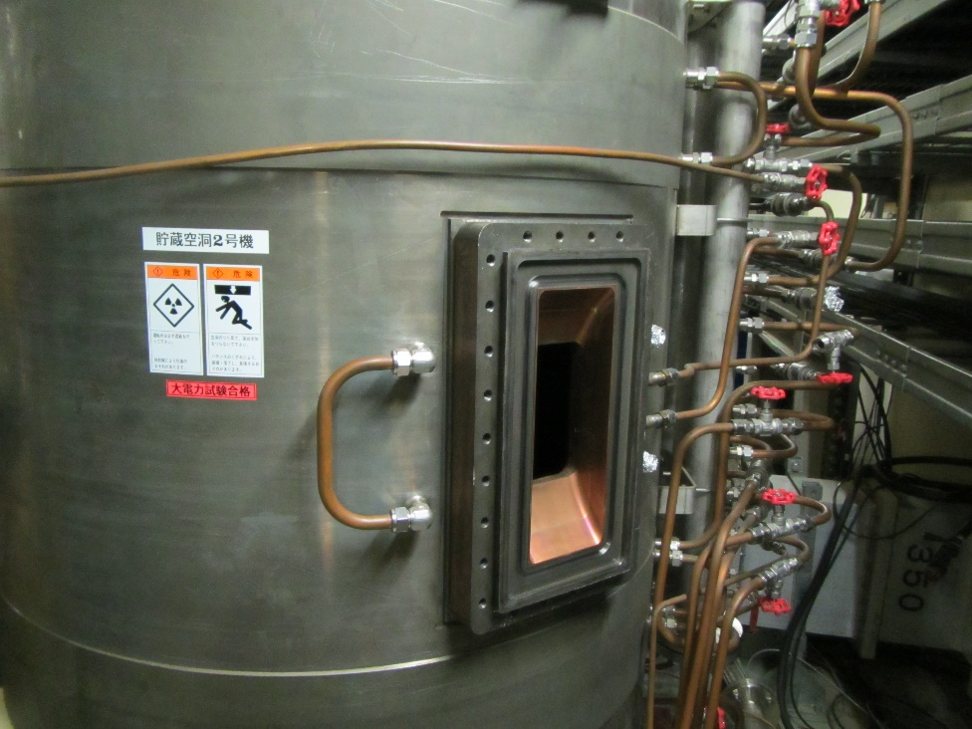
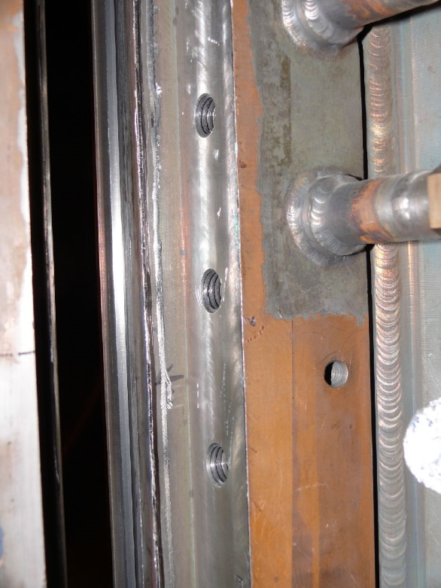
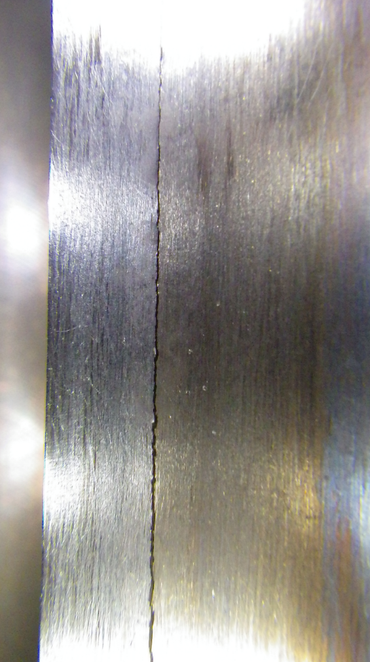
Crack found on the welding lip of the D4-F Cavity
→ Vacuum sealing impossible with lip welding
Sealed with a O-ring (non-metal)
→The vacuum pressure in this cavity is one order of magnitude higher than others.
To be fixed after Phase 1

Slide 16
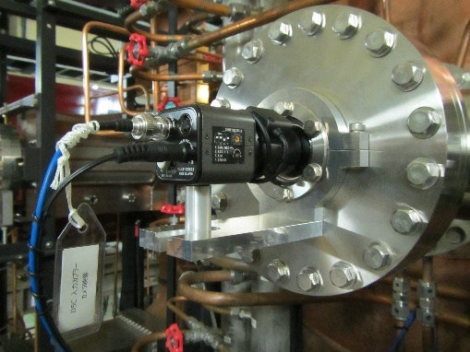
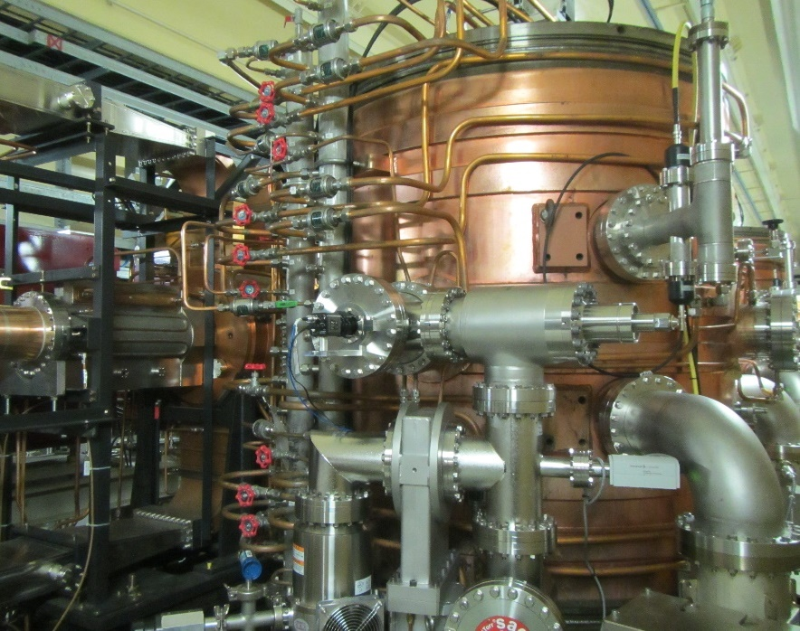
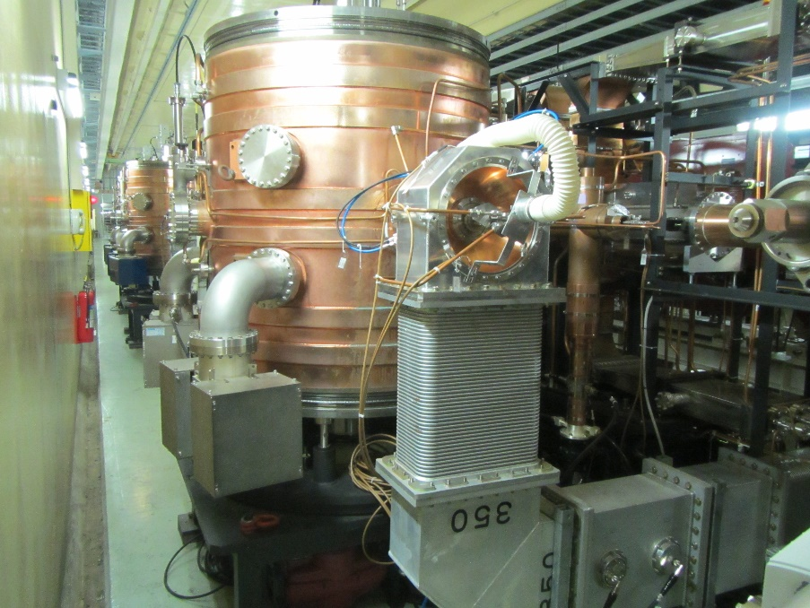
Monitoring ALL the Cavities with TV Cameras
(Top View)
TV Camera (NTSC)
TV camera attached in the opposite side of the input coupler
During the KEKB operation, only some cavities were monitored.
For SuperKEKB, all the cavities are to be monitored and recorded.
beam
Input Coupler

Slide 17
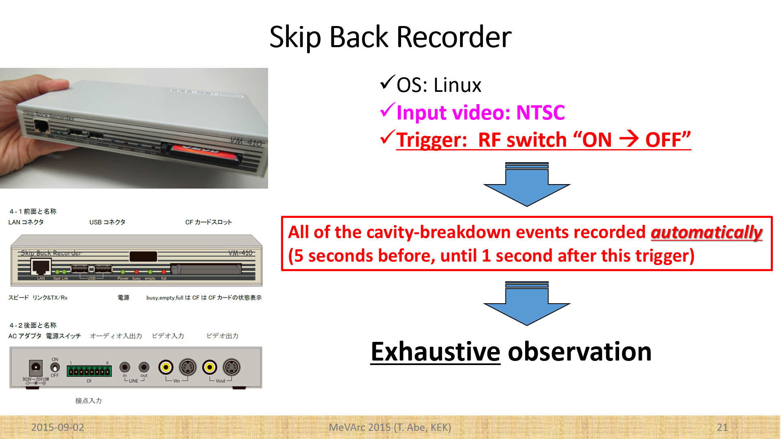

Slide 18
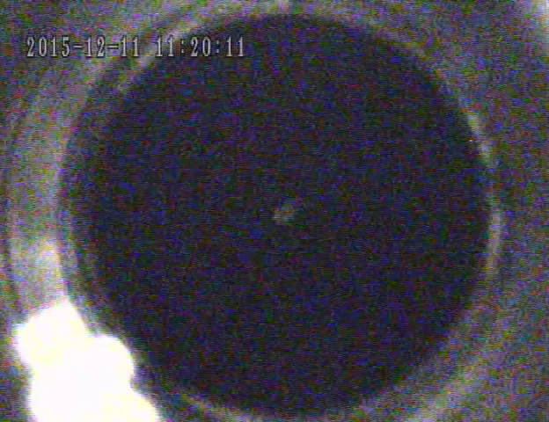
Example of the Recorded Videos
D5-B cavity
Vacuum interlock activated with RF input power of 60 kW during the RF conditioning.
(Top View)
beam
TV Camera
Input Coupler
Useful for isolating problems caused by input couplers
(Note: Input couplers are removable.)

Slide 19
Operational Status of the ARES in Phase1

Slide 20
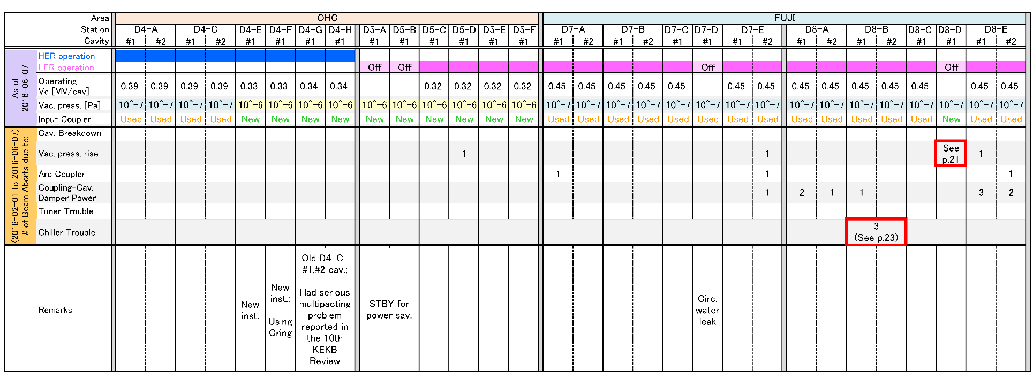
Operation Summary in Phase 1
Successful operation except for
Two serious troubles

Slide 21
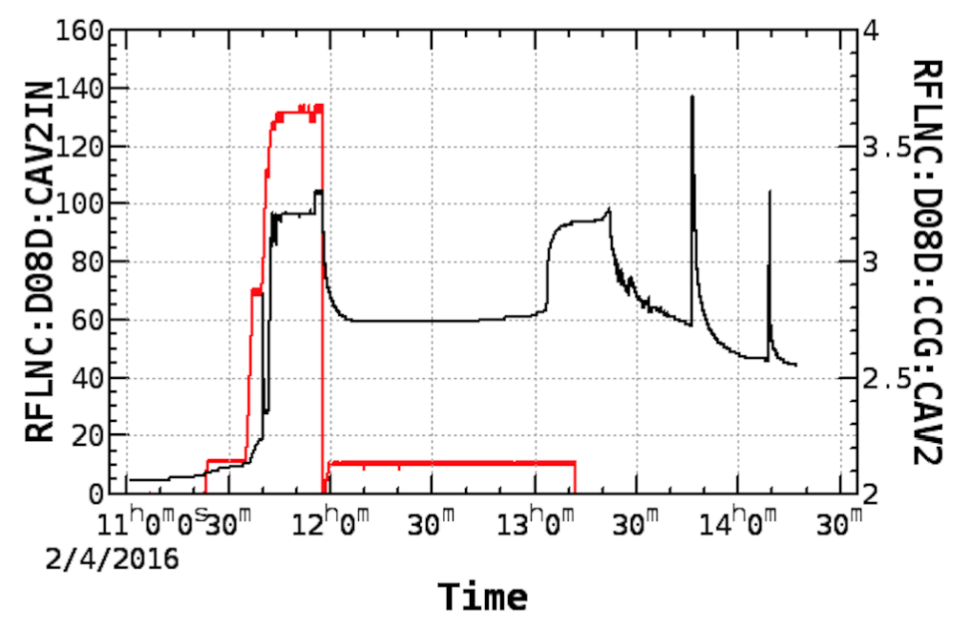
Vacuum Trouble of the D8-D Cavity
RF Input Power [kW]
Vacuum CCG [V]
Vacuum-pressure behavior for the ARES D8-D cavity,
plotted together with the RF input power.
(T. Kageyama)

Slide 22
Vacuum Trouble of the D8-D Cavity
The ARES cavity D8-D at the FUJI RF section for LER could not be operated due to abnormal vacuum pressure rise, sometimes observed other than during the RF operation.
The gas source may be some subsurface defects, possibly between the copper plating layer and the carbon steel structure of the storage cavity.
Now detuned → out of operation
Plans toward Phase 2:
Plan A: hopefully locate and remove the defects in situ, followed by high power testing for confirmation.
Plan B: replace this ARES cavity by a spare one.
<Notes>
Successful operation at KEKB
No vacuum break since KEKB
(Original version by T. Kageyama)

Slide 23
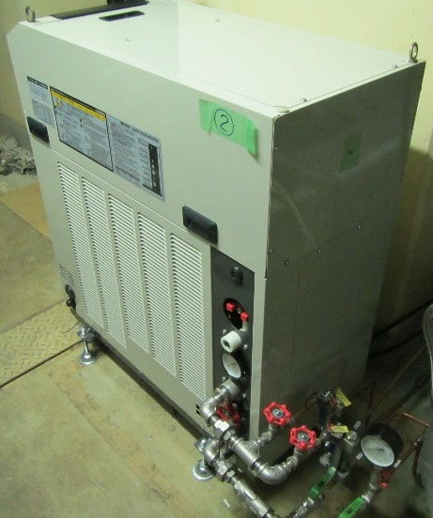
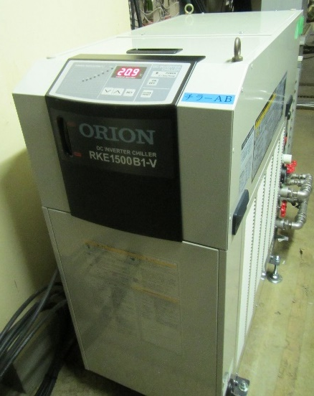
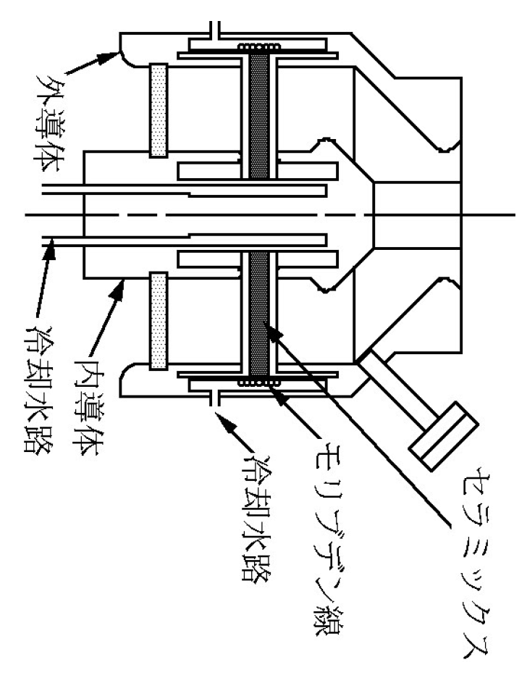
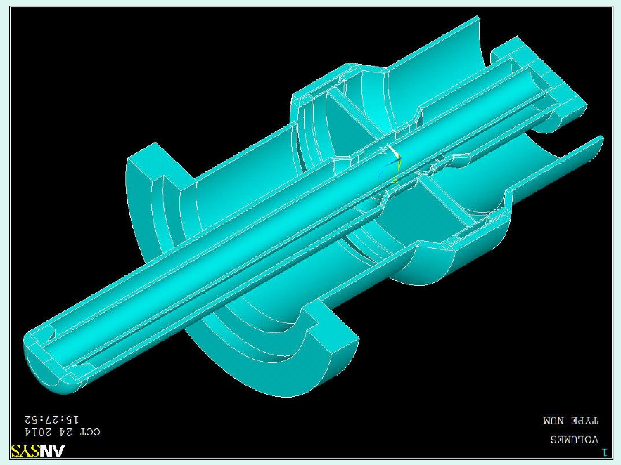
Other Serious Trouble: Chillers for RF Windows
Input Coupler
RF
Cooling
Channel
RF Ceramic
Window
Object to be cooled: RF Ceramic Windows
Coolant: water + antirust(5%), pH: 6 to 7 %
Coolant pressure: 0.2 to 0.3 MPa ( < 0.4 MPa)
Put in the sub-tunnel (not seen from the beam)
No trouble related to the chillers used at KEKB
RF Ceramic
Window
Cooling
Channel
Coupling-Cavity Damper
We have replaced all the 15 chillers used at KEKB for a long time.
(Further details on the chillers are
described in Appendix C.)
(Solid Model by K. Yoshino)

Slide 24
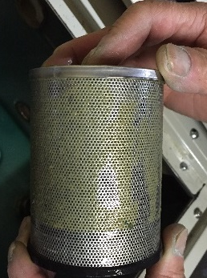
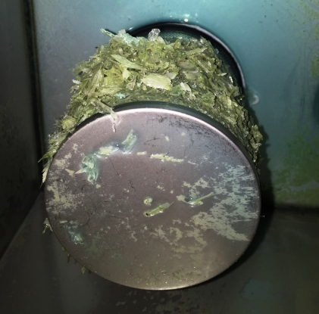
During Phase 1 Operation
Example of the filters with small amount of precipitates→
We observed precipitates growing in the coolant.
Especially in the FUJI D8 stations
Triggered LER beam aborts at D8-B (3 times)
The flow rate of the coolant decreased with precipitates.
Principal component : para tertiary butyl benzoic acid
Widely used as antirust
Temporary treatment
Cleaning the filers
Replacement of the coolant by new one
Measures toward Phase 2
Understanding of the chemical process of the precipitate creation (on-going)
Including basic test (beaker test)
Sealing the reservoir tanks against the (activated) air in the tunnel
From the basic test (beaker test) with H₂O+antirust(5%)+Cu+Mo
Precipitates created in the beaker open to the air
No precipitates created in the beaker sealed against the air
Monitoring of pH of the coolant during operation
Example of the filters with huge amount of precipitates

Slide 25
pH and Water Solubility
Water solubility of the antirust
- 12600 mg/L at 20degC (pH7)
- 47.1 mg/L at 20degC (pH4.3)
(K. Yoshino)

Slide 26
RF Cavities for the DR (“DR Cavities”)

Slide 27
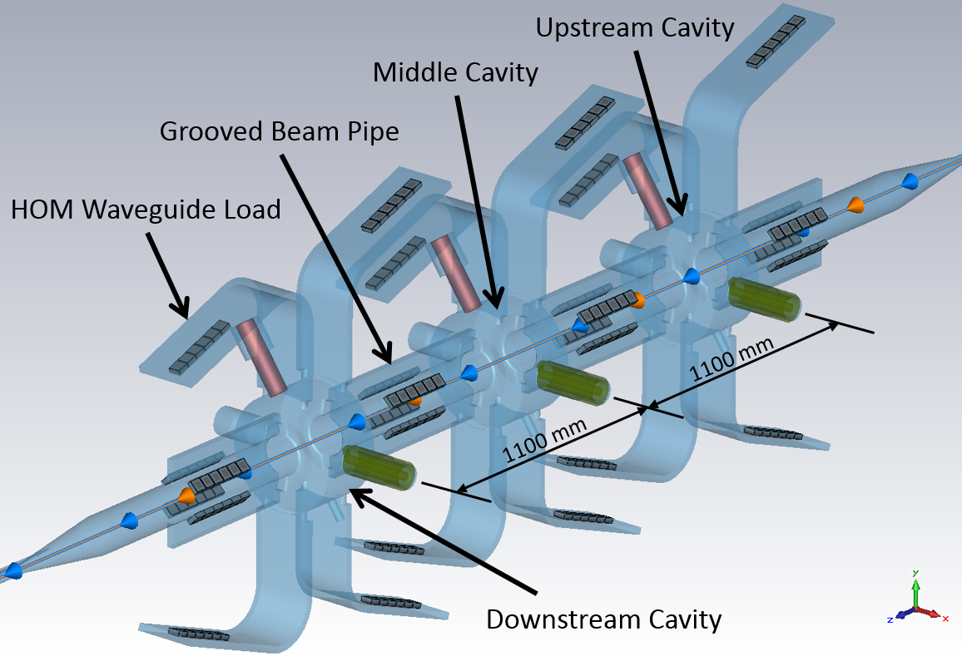
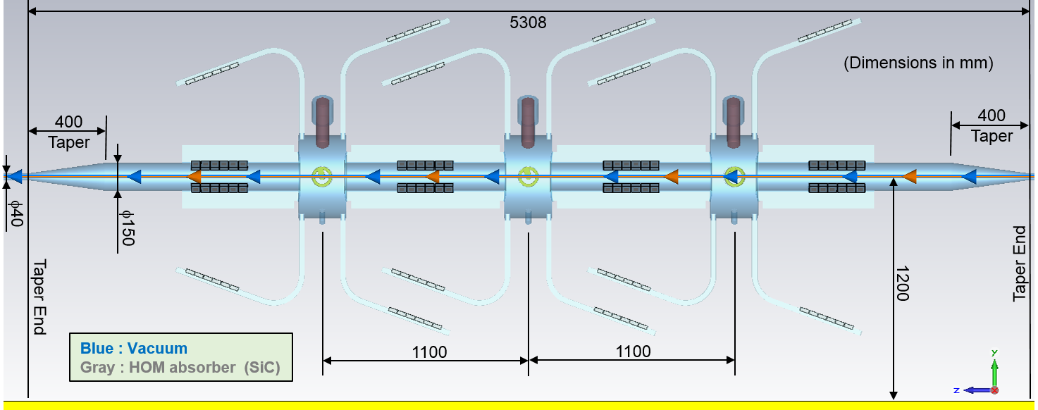
NC RF Accelerating Structure for the DR
RF operating frequency: 508.9 MHz
Same as that of the MRs
Based on the HOM-damped structure of the successful ARES cavity system
Three cavities at max. to be installed in a limited space originally designed for one cavity (3.8 m in the beam direction, excluding the taper sections)
Total V_{c} = 2.4 MV at max. with 0.8 MV/cavity
Apart from the CC and SC of the ARES, this DR cavity has the following space saving features that are not included in the ARES:
The HOM absorbers are all compact tile-shaped SiC ceramics;
The neighboring cavities share a GBP in-between; and
The cavity is connected directly to GBPs with lip welding for vacuum sealing at the outer periphery (“weld ring gasket”).
“Multi Single Cell” structure
Coupling of the Accel. mode and HOMs among the cavities significantly suppressed by the HOM absorbers on the GBPs
One big mechanical structure with solid connections of the components
Loss factor of this structure: 2.3 V/pC (bunch length: 6.0mm)
Vacuum pumps directly attached to each cavity
In the DR tunnel, we will assemble the cavities separating them with GBPs similar to LEGO blocks.
The blue, gray, green, and magenta regions indicate a vacuum, HOM absorbers, coaxial lines of input couplers, and plungers of movable tuners, respectively.
The colored arrows indicate the direction of the positron beam.
NC : Normal-Conducting
HOM: Higher Order Mode
MR: Main Ring
DR : Damping Ring
CC: Coupling Cavity
SC: Storage Cavity
GBP: Grooved Beam Pipe
1225
1225

Slide 28
Main Characteristics of the DR Cavity
3 cavities (max) in a limited space (3.8 m) originally designed for one cavity
Required Total V_{c} = 0.26 MV (until 2010) → 1.4 MV (from 2011)
Three cavities with 0.7 MV/cav (➔ tot. 2.1 MV) in operation
Up-down separation of the HOM waveguides
The neighboring cavities share a Grooved Beam Pipe in-between.
The cavity is connected directly to Grooved Beam Pipes with lip welding for vacuum sealing at the outer periphery (weld ring gasket)
Compact HOM absorbers (SiC tiles)
Complete HOM-damped structure
Based on the ARES cavity system
CBIs suppressed (Appendix D)

Slide 29
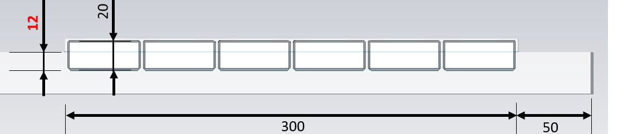
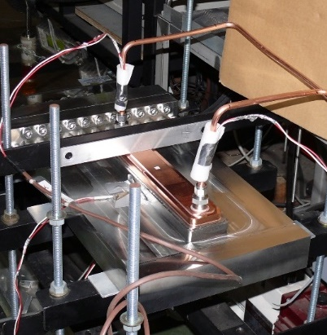
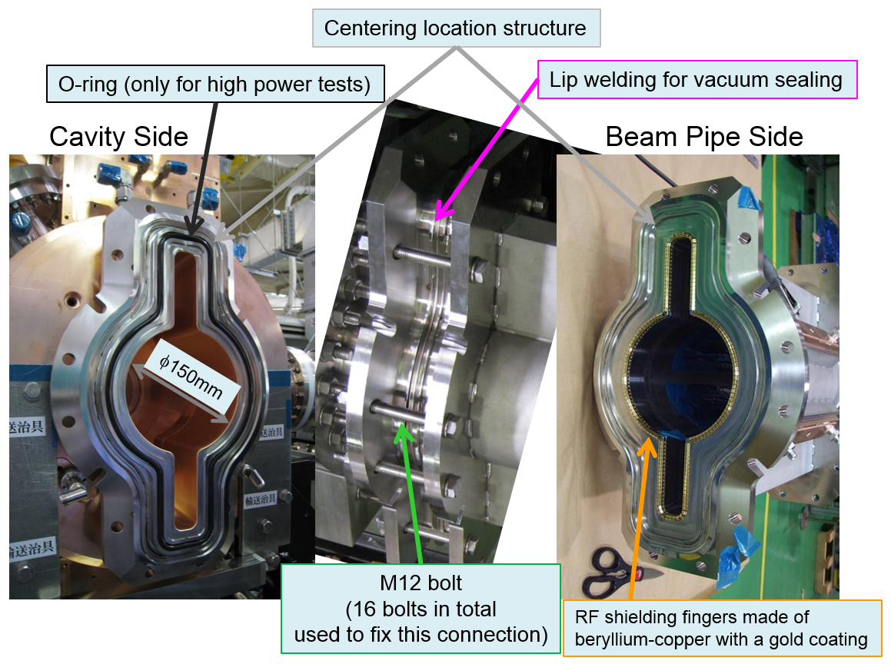
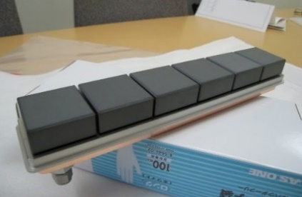


Components of the RF Structure except for the cavity
HOM WG Load
Solid connection between the cavity and GBP
One Set of six SiC ceramic tiles
GBP

Slide 30


RF Cavity for the DR (DR Cavity)
HOM Waveguide Load with SiC Tiles Inside
Grooved Beam Pipes
with SiC Tiles Inside
Design Parameters
Turbo-Molecular Pump
Sputter Ion Pump

Slide 31

History of the DR Cavity Development
No.2
No.1
0. Cavity No.0 (prototype) developed in JFY2011
Surface protection of the endplates: acid cleaning followed by chromating
1. Cavity No.1 fabricated in JFY2012
Surface protection of the endplates: Electropolishing (EP)
2. Cavity No.2 fabricated in JFY2013
Surface protection of the endplates: Electropolishing (EP)
No difference between No.1 and No.2 in the:
Electric design
Mechanical structure, and
Fabrication method
(3. Cavity No.3 to be fabricated in JFY2017?)

Slide 32

V_{c} = 0.95 MV/cav demonstrated at the Test Stand
(> 0.7 MV/cav required for DR operation)
Cavity No.1
Cavity No.2
During the RF conditioning
During the stability test after the RF conditioning
V_{c} [MV/cav] | Wall-Loss Power [kW] | Total Holding Time [hours] | Number of Cavity Trips
0.80 | 144 | 30.5 | 1
0.85 | 164 | 18 | 0
0.90 | 186 | 14.5 | 3
0.95 | 210 | 8 | 1
P_{in} (P_{refl}) : input power to (reflected power from) the cavity
Wall-loss power: P_{wall} = P_{in} – P_{refl} = ~0.99 x P_{in}
Cavity No.2 reached 0.95MV/cav successfully.

Slide 33

Configuration in the DR Tunnel
At the beginning of the DR commissioning
Ultimate
Total V_{c} = 1.4 MV
Total V_{c} = 2.1 MV
Dummy duct
Cavity No.3
If we need this,
depending on results of the DR commissioning and the budget.p

Slide 34

What We Learnt from the R&D of the DR Cavities
(Note: No EP applied to the barrel part.)
Electro-polishing (EP) for the end plates gives significant improvement in:
Q₀
Field emission during RF conditioning
Same performance between DR Cavity No.1 and No.2 in:
Q₀
Field emission
RF conditioning speed
Vacuum performance
High-gradient performance:
Significant Findings directly related to cavity breakdown
Breakdown Rate at V_{c}=0.90 MV/cav (after RF conditioning)
Cavity No.1: 5.0^{+4.8}_{-2.7} /24hrs
Cavity No.2: 3.3^{+1.3}_{-1.0} /24hrs

Slide 35


1. Improvements with the EP
 | Q₀(meas) / Q₀(sim)
Prototype | 92.9%IACS
Cavity No.1 | 97.1%IACS
Cavity No.2 | 97.3%IACS
= Indirect observation of the dark current:
Field emission
→Acceleration
→Impact on the inner surface
→Emission of X-ray

Slide 36


3. Significant Findings directly related to cavity breakdown
by the direct in-situ observation of the inside of DR Cavity No.2
using 3 TV cameras for Multi-directional and wide-field observation during the high-gradient test
All of the cavity-breakdown events recorded in storage media automatically
(5 seconds before, until 1 second after the moment of the breakdown)

Slide 37


Significant Finding (1)
60% of the cavity breakdown events are accompanied with a spot-type explosion
without any other significant phenomena.
Example of the spot-type explosion →
at the moment of the breakdown
(V_{c} = 0.56 MV/cav)
Intensity in the
green-square region
Frame Number

Slide 38


Significant Finding (2)
20% of the cavity breakdown events are accompanied with an explosion and disappearance of a stable bright spot
without any other significant phenomena.
Mini-Supernova
Example of the bright-spot explosion →
at the moment of the breakdown
(V_{c} = 0.95 MV/cav)
➔ This bright spot disappeared
Intensity in the
green-square region
Frame Number

Slide 39


Pyrotechnical phenomena are minority!
Flash
Lightning
A few % of the cavity breakdown events
For more details ➔T. Abe et al., “Breakdown study based on the direct in-situ observation of inner surfaces of an RF accelerating cavity during a high-gradient test”, submitted to PRAB.
(Preprint: KEK-Preprint_2015-25 )

Slide 40
Summary
ARES cavities for the MRs
Successful operation except for the two serious troubles:
Vacuum trouble on the D8-D cavity
Precipitate growth of the antirust in the chillers
DR Cavities
Good performance demonstrated
Significant findings directly related to cavity breakdown on the NC CW UHF cavities obtained through the high-gradient test
MR: Main Ring
DR: Damping Ring
NC: Normal-Conducting
CW: Continuous Wave
UHF: Ultra High Frequency

Slide 41

Photo on June 10, 2016, in the DR/RF section
(Assembly testing)
Thank You!

Slide 42
Appendices

Slide 43


Longitudinal CBI driven by the accelerating π/2 mode
Appendix A (1/5)
To be cured by the RF feedback systems
(shown in the next page)

Slide 44


Appendix A (2/5)
(S. Yoshimoto)
S. Yoshimoto, et al., presented in the 14th Symposium on Accelerator Science and Technology, Tsukuba, Japan, 2003 (PaperID: 1P072)

Slide 45
Longitudinal CBI driven by the parasitic 0 and π modes
Appendix A (3/5)
To be cured by the longitudinal
bunch-by-bunch feedback system

Slide 46


Longitudinal HOM Impedance (Simulation Results) and CBI Threshold at SuperKEKB/LER
Appendix A (4/5)
Both impedances from
wakepotentials in time-domain
← With the full structure (including SC)
← Only AC + half CC (without SC)
τ=13ms for SuperKEKB/LER / 22 ARES cavities
with 3.6 A beam current
< 21.6 ms (Longitudinal rad. damping time of LER)
Fastest longitudinal CBI source
To be cured by the longitudinal bunch-by-bunch feedback system

Slide 47

Horizontal HOM Impedance (Simulation Result) and CBI Threshold at SuperKEKB/LER
Appendix A (5/5)
(by T. Kageyama)
τ=300ms for SuperKEKB/LER / 22 ARES cavities
with 3.6 A beam current
>> Transverse radiation damping time
of LER: 43.2 ms
From wakepotentials in time-domain
From eigenmode analysis
0
1GHz
Frequency
←0.6GHz

Slide 48

Multipactoring suppression by fine grooving of conductor surfaces of coaxial-line input couplers
Appendix B
Ø77mm
Outer conductor of the coaxial line
T. Abe, et al., Phys. Rev. ST Accel. Beams 13, 102001, 2010

Slide 49
We have replaced all the 15 chillers used at KEKB for a long time.
Appendix C (1/2)
First, we used the same type of chiller with the almost the same specifications (ORION RKE-1500A-VW) at the test stand (D1-A) on the ground.
Performance and stability demonstrated
No trouble so far for 8-year operation
We purchased succession machines (ORION RKE-1500B1-V) for MR and DR operation, and replaced the old 15 chillers (ORION RKS-1500-V-C) by these (ORION RKE-1500B1-V).
Small amount of precipitates observed in the reservoir tanks in two of the chillers in FUJI D8 on 2015-10-07

Slide 50
Comparison between the Chillers
Appendix C (2/2)
 | Capacity of the reservoir tank | Top cover on the reservoir tank | Feed-water inlet | Overflow-water outlet
ORION RKS-1500-V-C (used in the KEKB tunnel) | 45 L | Yes (in addition to the top cover on the chassis) | Closed in operation | Closed in operation
ORION RKE-1500A-VW (used at the test stand (D1-A) on the ground) | 30 L | None (only the top cover on the chassis) | Closed in operation | Open always
ORION RKE-1500B1-V (used in the SuperKEKB tunnel) | 15 L | None (only the top cover on the chassis) | Closed in operation | Open always

Slide 51


CBIs driven by the HOM Impedances
Appendix D
From wakepotentials calculated, using GdfidL, for the whole RF section→
CBI thresholds for the DR design
Longitudinal
Transverse
Growth Time ＞ 20ms
＞ 5ms (rad. damping time)
Growth Time ＞ 30ms
＞ 10ms (rad. damping time)

Slide 52
EOF

