Slide 1
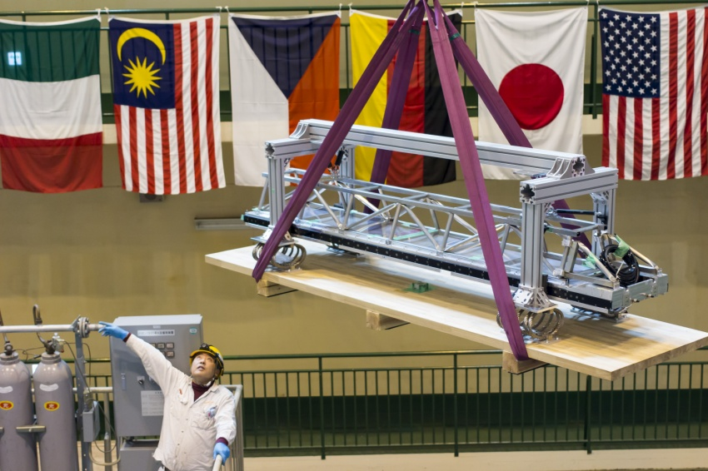
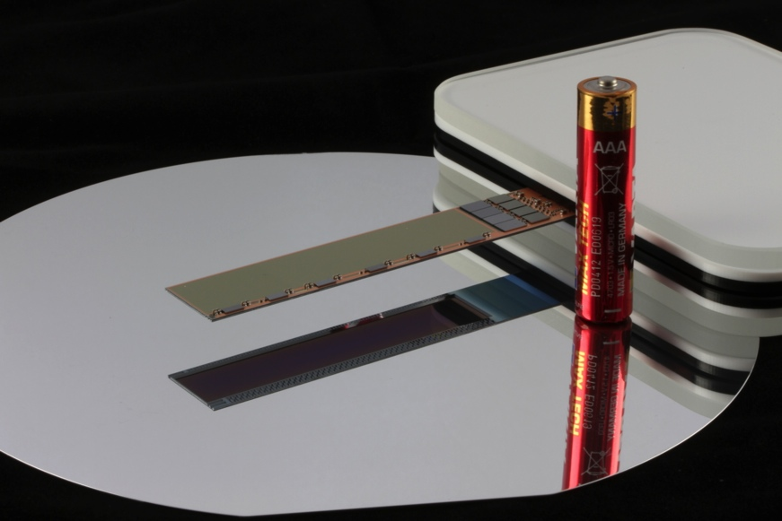
Belle II Physics and Construction Status
Tom Browder (University of Hawai’i at Manoa)
Complex phases in the weak interaction: V_{td} and V_{ts} and associated CPV asymmetries
Excitement and High Stakes in Flavor Physics:
-Connections to the charged Higgs
-Rare B Decays + NP
1st TOP module arriving at Tsukuba Hall
Flavor Physics, The Next Generation: Belle II/SuperKEKB
Apologies: I have borrowed slides from many excellent physicists and will aim for “a big picture overview”
In flavor physics but skip most details. BEAST results will
be covered by Nakayama-san.
1st DEPFET pixel plane

Slide 2
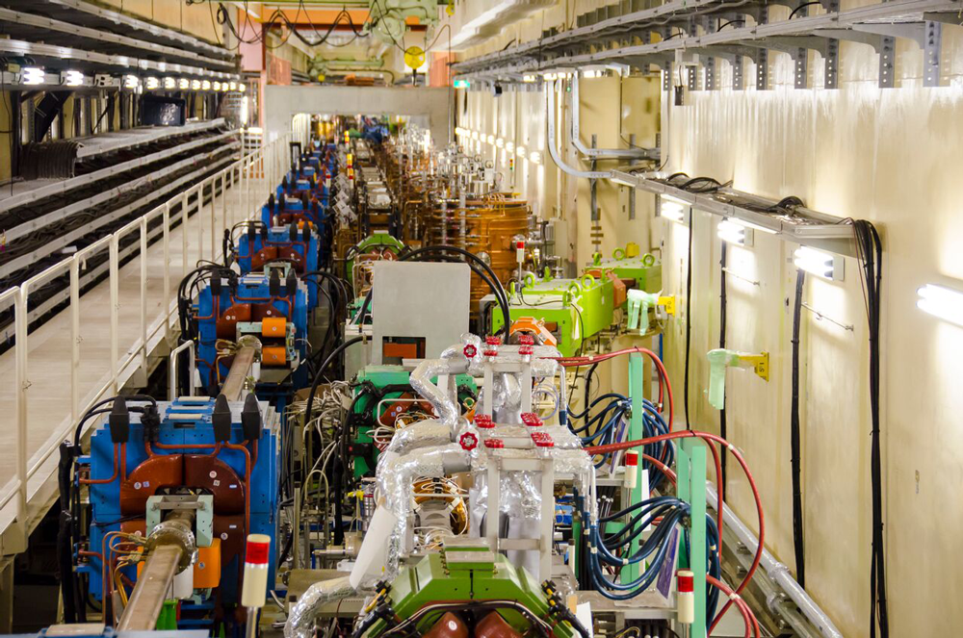
Feb 2016: First Turns at SuperKEKB (4 GeV e+’s and 7 GeV e-’s)
June 13, 2016 (LER beam current at 908 mA, HER at 828 mA)
2017: Collisions at the Υ(4S) will produce pairs of QM entangled (B-anti B) mesons
First new particle collider since the LHC (intensity frontier rather than energy frontier; e⁺ e⁻ rather than p p)
Notes:
Progress has been impressive. Approaching ampere level beam currents

Slide 3

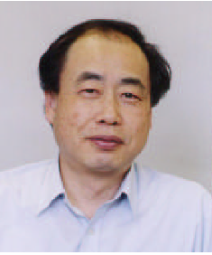
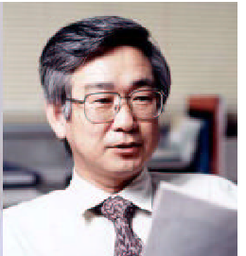
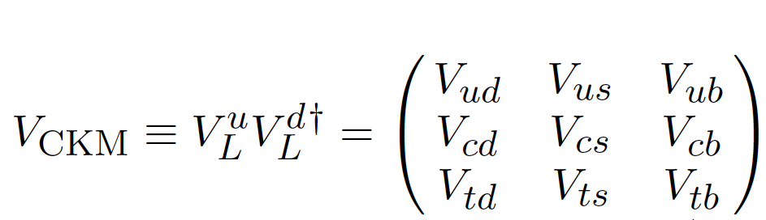
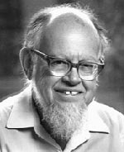
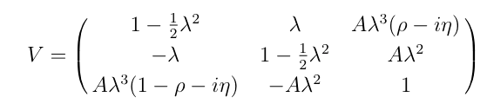
N. Cabibbo
M.Kobayashi
T.Maskawa
Amplitudes and Phases in the Weak Interaction
to O(λ³)
L. Wolfenstein (1923-2015)
Notes:
Let’s now discuss amplitudes and phases in the weak interaction. Weak interaction eigenstates are rotated versions of flavor eigenstates. Cabibbo et al realized that upper left portion of the mixing matrix is a rotation matrix. However, to accommodate CP violation, which was first observed 50 years ago,
Kobayashi and Maskawa realized that one needed three generations of quarks (only two were known at the time).
Wolfenstein provided a phenomenological parameterization of the mixing matrix. His version makes it crystal clear that the complex parts, which give raise to CP violation are in the corners (V_td and V_ub). N.B. that V_ts does NOT have a complex phase.

Slide 4
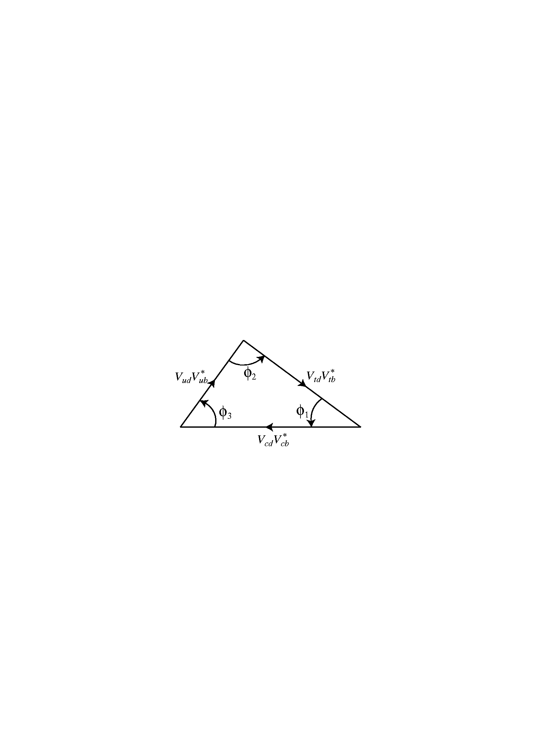
Three Angles: (φ₁,φ₂,φ₃) or (β, α, γ)
Time dependent B→ρπ Dalitz analysis
B⁰ → π⁻ π⁺
Unitarity implies that the weak couplings and phases form a triangle in the complex plane.
B⁰→Ψ K_{s},Ψ K_{L},
B⁰→D^{(*)0} h⁰
LHCb results on CPV in B_{s}→D_{S}^{-(*)} K⁺
B⁻ →D_{CP} K⁻
Big Questions: Are determinations of angles consistent with determinations of the sides of the triangle ? Are angle determinations from loop and tree decays consistent ?
Notes:
Check order of animations

Slide 5
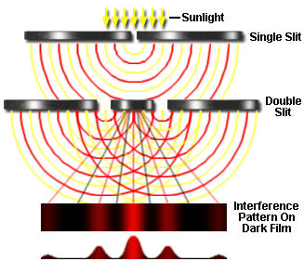
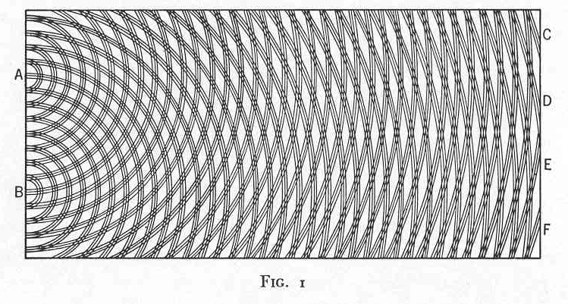
Time-dependent CP violation is
“A Double-Slit experiment” with particles and antiparticles
QM interference between two diagrams
box diagram + tree diagram
tree diagram
V_{td}
b
c
J/ψ
b
t
d
d
K_{S}
c
+
s
s
K_{S}
c
J/ψ
d
d
d
t
b
c
V_{td}
Measures the phase of V_{td} or equivalently the phase of
B_{d} –anti B_{d} mixing.
Notes:
Sometimes HEP physicists outside of our sub-field become lost in the formalism. What are we really doing ?

Slide 6
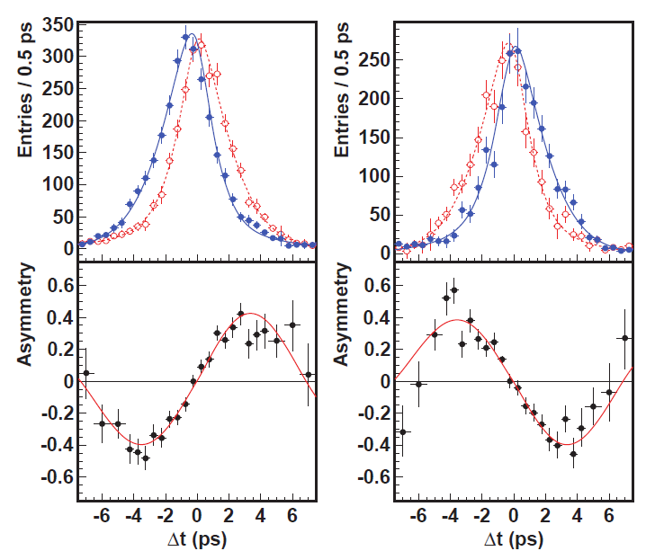
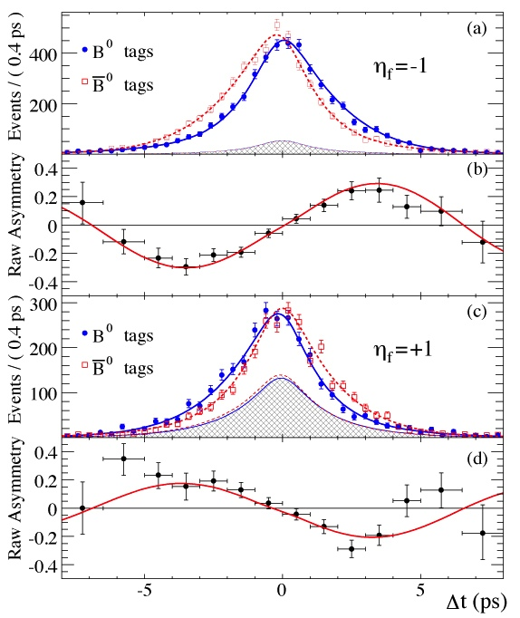

Measurement of sin(2φ₁)/sin(2β) in B→Charmonium K⁰ modes
(cc)K_{S}
J/ψK_{S}
J/ψK_{L}
J/ψK_{L}
sin2φ ₁=0.667±0.023±0.012
A_{f}=0.006±0.016±0.012
PRL108,171802 (2012)
sin2φ₁=0.687±0.028±0.012
A_{f}=-0.024±0.020±0.016
PRD79,072009 (2009)
Overpowering evidence for CP violation (matter-antimatter asymmetries). >>>> The phase of V_{td} is in good agreement with Standard Model expectations. This is the phase of B_{d} mixing.

Slide 7
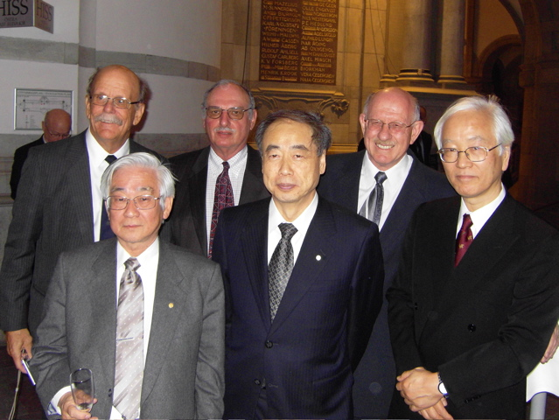
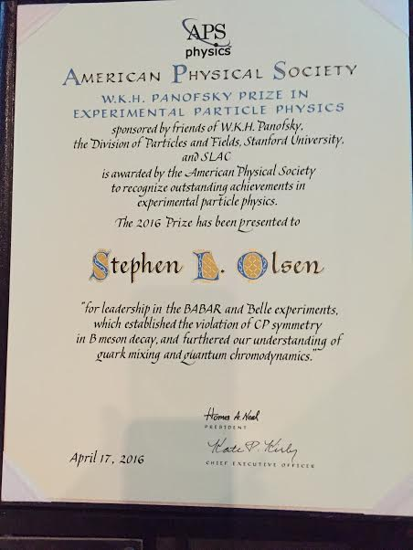
News from Utah, April 2016: APS Panofsky Prize for Experimental Particle Physics Awarded to
Steve Olsen, Dave Hitlin, Jonathan Dorfan, and Fumihiko Takasaki
“Founding Fathers of the B Factory Experiments”
A scene in Stockholm, Sweden (2008)
Front row 2008 Physics Nobelists: T. Maskawa, M. Kobayashi

Slide 8
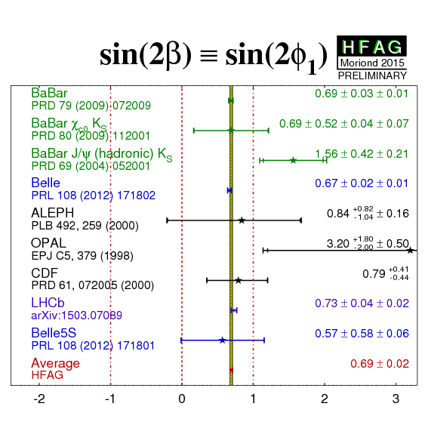
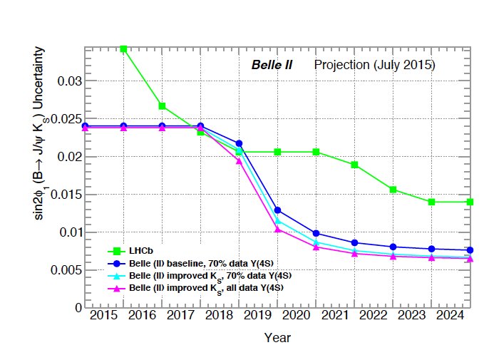
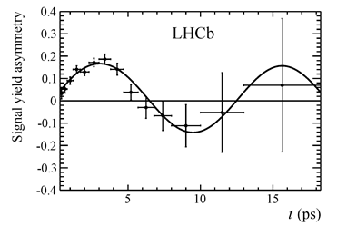

B factories: High precision CPV measurement and a calibration for NP.
2013: LHCb joins the game [±0.07(stat)]
2015: Latest LHCb measurement is comparable in precision to B factories (now uses same-side B tagging)

Slide 9
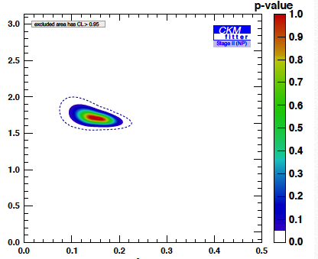
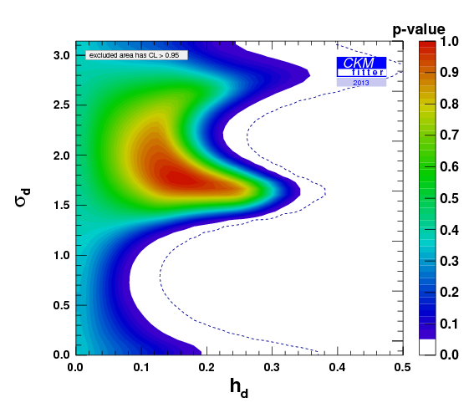
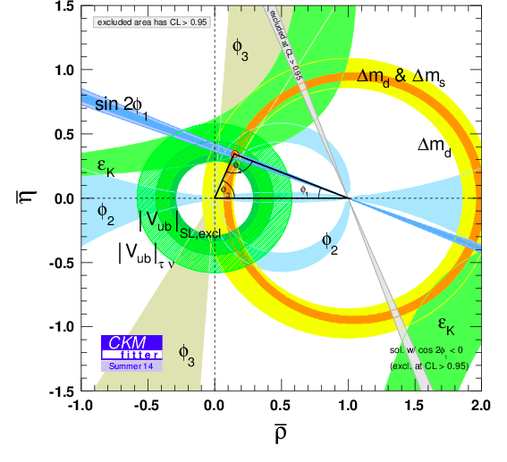
Results from Global Fits to Data (CKMFitter Group)
Great progress on ϕ₃ or γ (first from B factories and now in the last three years from LHCb).These measure the phase of V_{ub}
Similar results from UTFIT as well from G. Eigen et al.
J. Charles et al, Phys. Rev. D89 (2014) 033016
Wolfenstein Parameters
NP Phase
Extrapolation to 50 ab⁻¹
NP/SM amplitude ratio
But a 10-20% NP amplitude in B_{d} mixing is perfectly compatible with all current data.
Looks good
(except for an issue with |V_{ub} |)
Notes:
So what does this triangle mean ? Is NP completely ruled out ? The picture on the left is often wildly misinterpreted. Perhaps it is the most misinterpreted plot in the field of high energy physics.

Slide 10
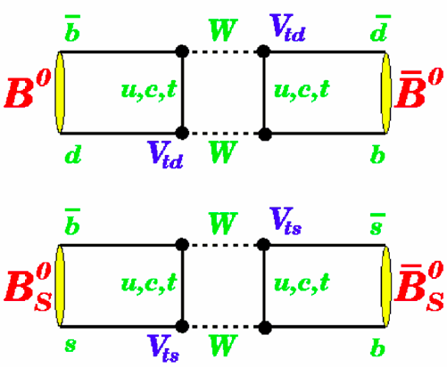

Boxes
Although B factories can run on the Upsilon(5S), LHCb dominates here
No phase expected from SM but possible from NP particles

Slide 11
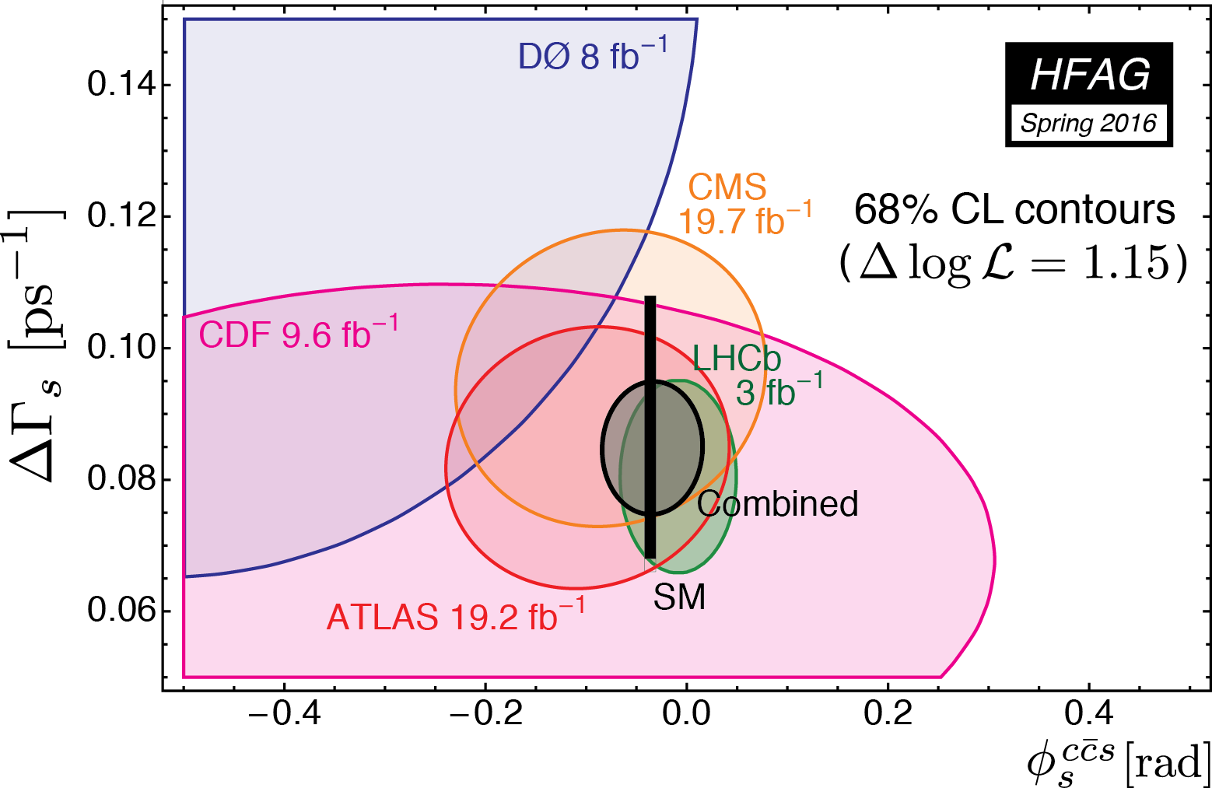
Results on the phase of B_{s}-anti B_{s} mixing (i.e. phase of V_{ts}) [use B_{s}→J/ψϕ; J/ψππ modes]
Width difference
B_{s} Mixing Phase
(Includes the most recent LHCb prelim result, gives WA of -33 ±33 mrad)
Notes:
Note that the SM black bar is slightly displaced from zero

Slide 12
Boxes
No phase expected from SM but possible from NP particles

Slide 13
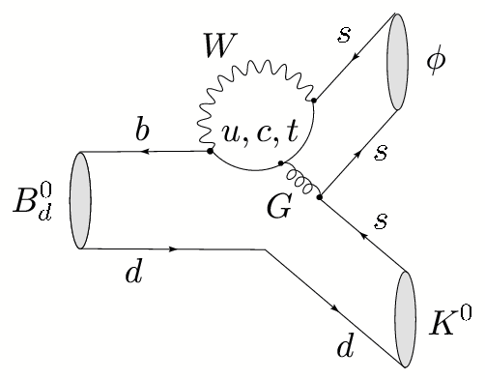
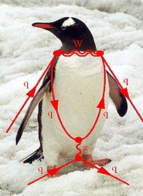
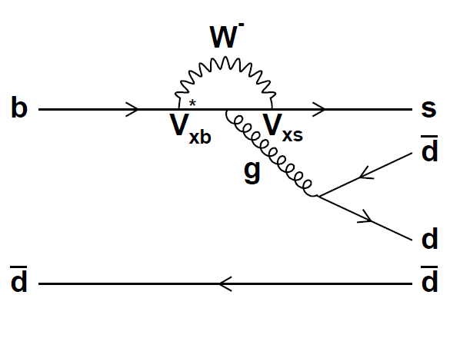
Phase of V_{ts}
Notes:
In the loop, NP particles can contribute to the phase.

Slide 14
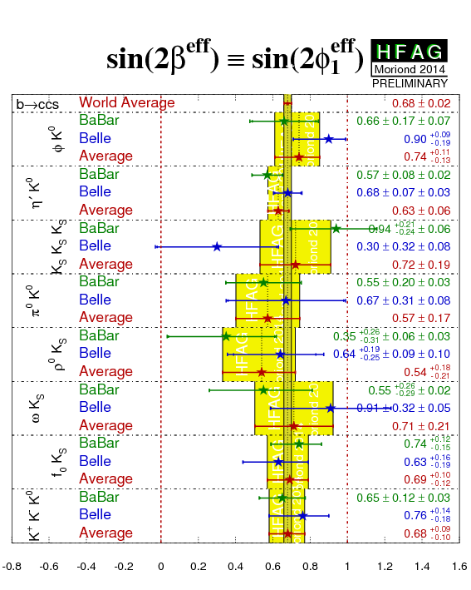
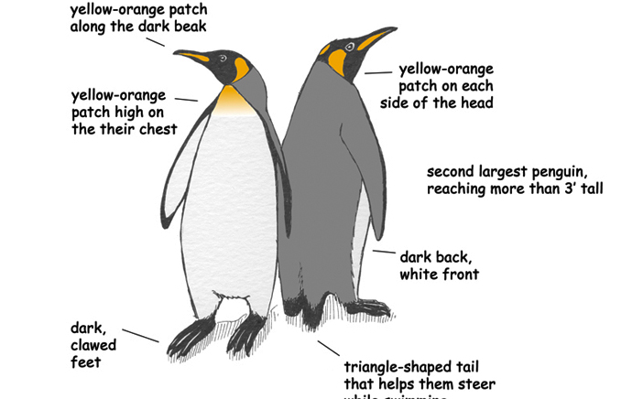
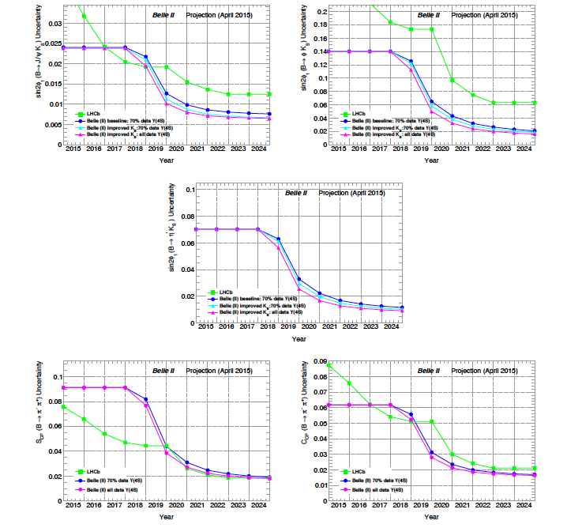
New Physics Phases in Penguin b→s decays
No evidence for NP at current level of sensitivity
B→η’ K_{S} CPV
LHCb is absent from this game (lower K_{S} eff and flavor tagging eff) but dominates in B_{S} modes (B_{s}→ϕϕ)
Notes:
Here we compare the phase to the phase of b->c cbar s decays. If the effective value of sin(2 beta) agrees with that of J/psi K_S decays,
Then we conclude there is no phase from New Physics.

Slide 15
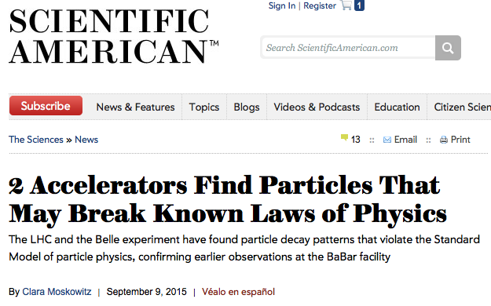

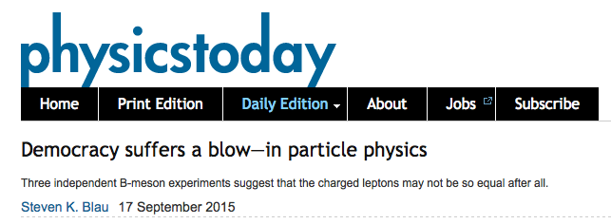
“Missing Energy” Decays
Notes:
Let’s now discuss “missing energy decays” and the excitement in this area.

Slide 16
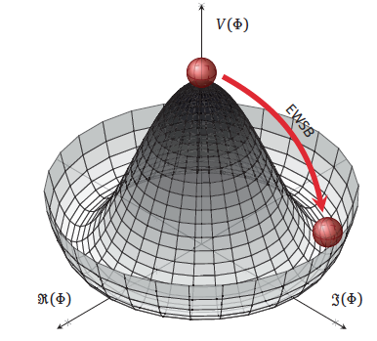

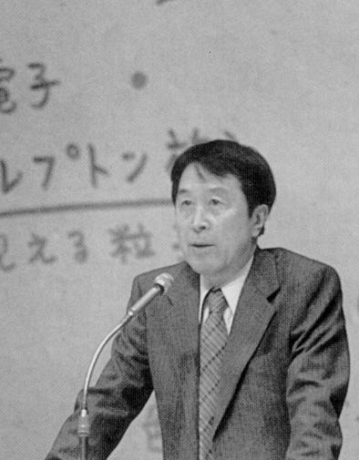
The BEH boson is now firmly established by experimental results from ATLAS and CMS. Now planning for future Higgs flavor factory facilities
(e.g ILC, HL-LHC, CEPC, FCC).
.
Does the GP (Brout-Englert-Higgs particle) have a “brother” i.e. the charged Higgs ?
Y. Nambu, 1921-2015
Measurements at Belle II and direct searches at hadron colliders take complementary approaches to this important question.
Notes:
This prompted Leon Lederman to write a new book entitled “Beyond the God Particle”.
Sensitivity from tau nu, D(*) tau nu decays and b→s gamma.
Hadron colliders directly search for H+ →tau nu.

Slide 17
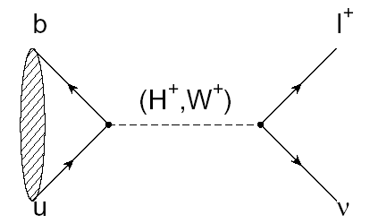
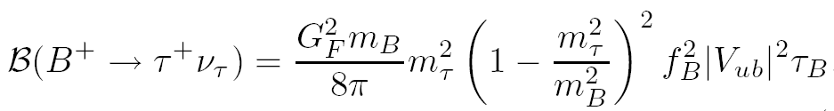

B→τ ν
(Decay with Large Missing Energy)
Sensitivity to new physics from a charged Higgs
W.S.Hou,. PRD 48, 2342 (1993)
The B meson decay constant, determined by the B wavefunction at the origin
(|V_{ub}| taken from indep. measurements.)
Notes:
In the SM this is mediated by a charged W. In addition there is a NP contribution from the charged Higgs.

Slide 18
Consumer’s guide to charged Higgs
Higgs doublet of type I (φ₁ couples to upper (u-type) and lower (d-type) generations. No fermions couple to φ₂)
Higgs doublet of type II (φ_{u} couples to u type quarks, φ_{d} couples to d-type quarks, u and d couplings are different; tan(β) = v_{u}/v_{d}) [favored NP scenario e.g. MSSM, generic SUSY]
Higgs doublet of type III (not type I or type II; anything goes. “FCNC hell”→many FCNC signatures)
Thanks to theorist Xerxes Tata
Notes:
Thanks to Xerxes Tata for corrections. Remaining mistakes are my own.

Slide 19
Why measuring B⁺→τ⁺ν is non-trivial
e⁺
ϒ(4S)
B⁻
B⁺
Most of the sensitivity is from tau modes with 1-prongs.
ν_{e}
B⁻→X
ν_{e}
The experimental signature is rather difficult: B decays to a single charged track + nothing
(This may be hard at a hadron collider)

Slide 20
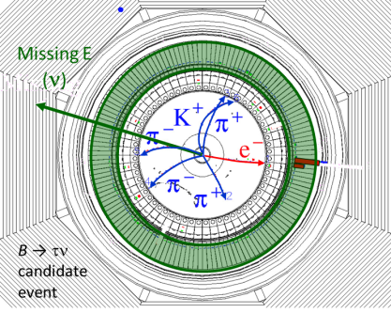

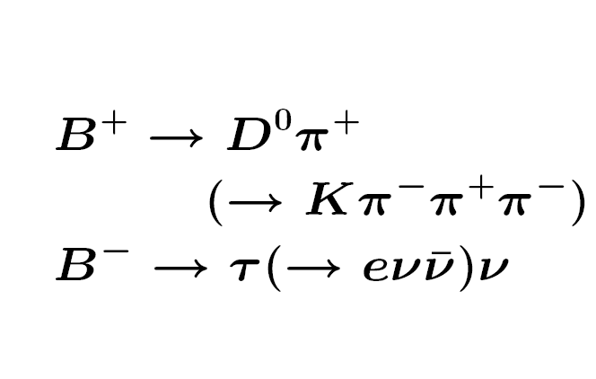
Example of a Missing Energy Decay (B→τν) in Data
The clean e+e- environment makes this possible
But we need to keep the beam-related backgrounds under control

Slide 21
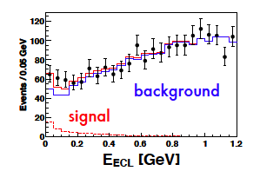
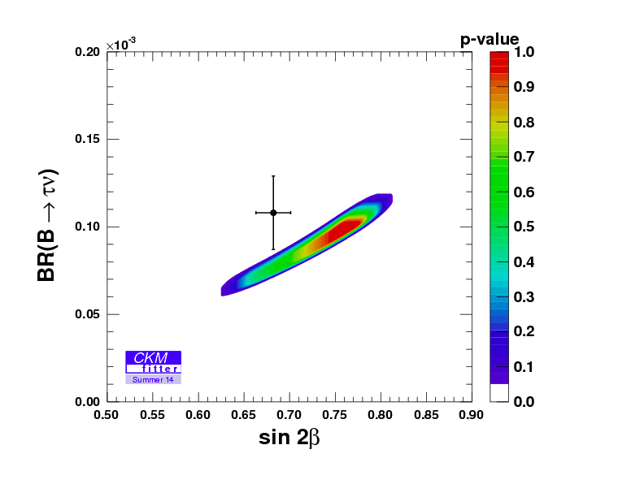
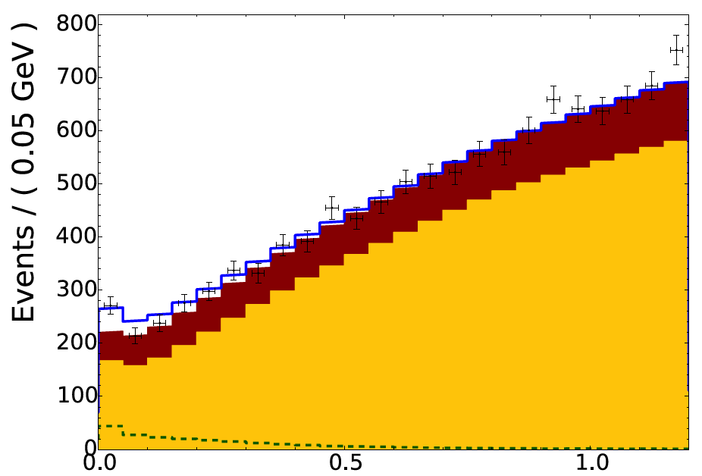
Example: Belle B→τν results with full reprocessed data sample and either hadronic or semileptonic tags (PRD 92, 051102 (2015))
Hadronic tags: 63±22.5 (3σ)
Idea: With the “single B meson beam”, we look for a single track from a τ, missing energy/momentun and extra calorimeter energy close to zero.
Semileptonic tags:
222±50 (3.8σ)
With the full B factory statistics only “evidence”. No single observation from either Belle or BaBar.
➔The horizontal axis is the “Extra Calorimeter Energy”
Notes:
The signal peaks at zero

Slide 22
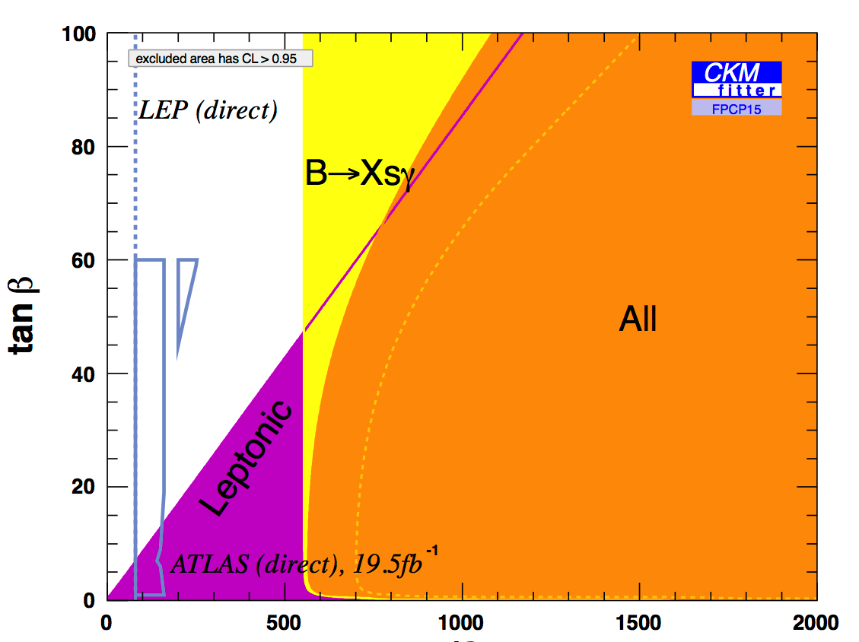
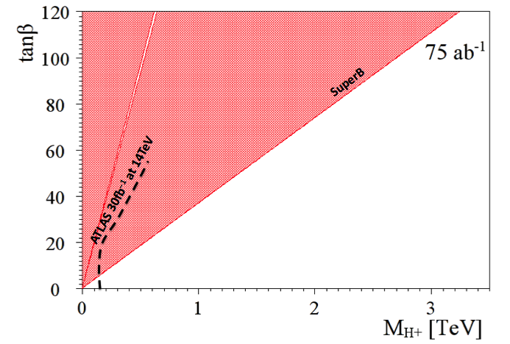
Complementarity of e+ e- factories and LHC
(Slide adapted from A. Bevan)
The current combined B→τυ limit places a stronger constraint than direct searches from LHC exps. for the next few years.
1 ab⁻¹
Belle II
Currently inclusive b→sγ rules out m_{H+} below ~480 GeV/c² range at 95% CL (independent of tanβ), M. Misiak et al. (assuming no other NP)
This region is allowed
http://arxiv.org/abs/1503.01789

Slide 23
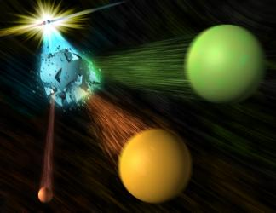
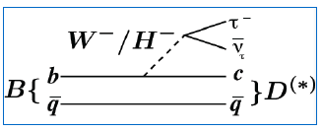
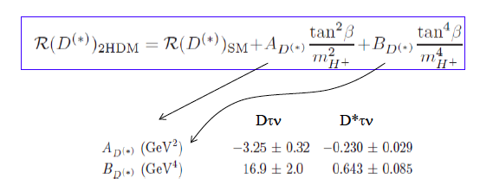

A three-body tale
Slide adapted from A. Soffer
Notes:
Let me tell you a fascinating three-body story

Slide 24
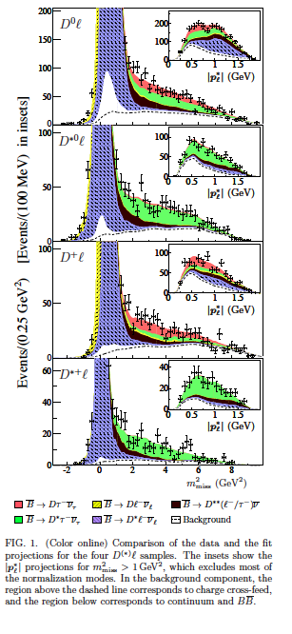
Example from a BaBar paper
Signals in B→D^{(*)} τν (489±63, 888±63)
Missing mass variable:
m_{miss}² =p_{miss}²=(p[e⁺e⁻]-p_{tag}-p_{D(*)}-p_{l})²
P_{l}* = momentum of lepton in B rest frame
But wait !!! Now possible at LHCb.
Production of B meson pairs at threshold is critical to the separation of backgrounds from the missing energy/ momentum signal.

Slide 25
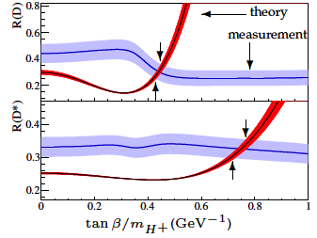
BaBar collaboration, Phys. Rev. Lett. 109, 101802 (2012)
“However, the combination of R(D) and R(D*) excludes the type II 2HDM charged Higgs boson with a 99.8% confidence level for any value of tan(β)/m_{H+}”
In other words, found NP but killed the 2HDM NP model.
Notes:
Shocking – who ordered that ?

Slide 26
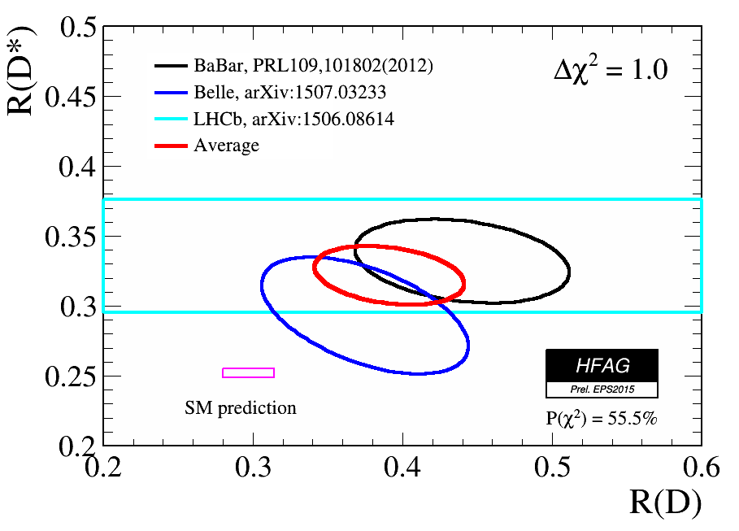
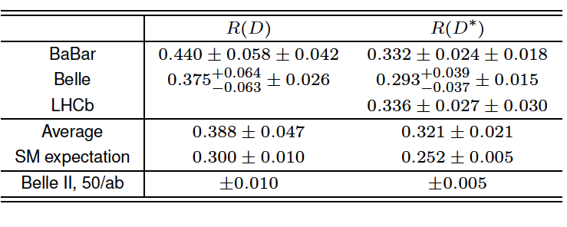
Apres Nagoya: World Averages for R(D) and R(D*)
July 23, 2015
Now 3.9σ from SM
It is obvious that we need two orders of magnitude of data to solve these issues related to the charged Higgs.
Notes:
Sumer 2015 HFAG plot for R_D and R_D*. Belle will try to squeeze a little more out of its data. LHCb will try to do D tau nu..

Slide 27
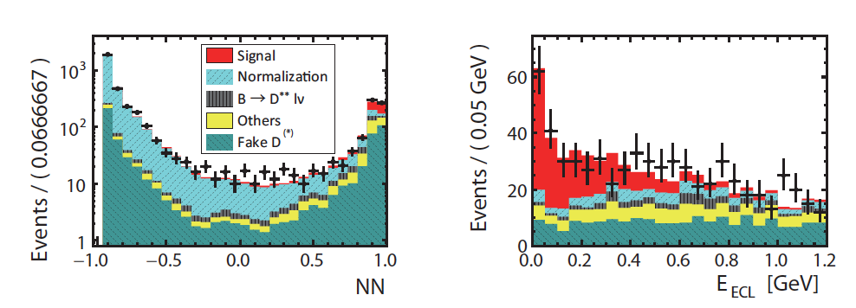

One more Belle update, March 2016 (Moriond)
Talk by P. Goldenzweig
(Karlsruhe)
Uses semileptonic tagging
April 2016:
The WA is now 4.0σ from the SM
arXIv: 1603.06711
Notes:
Need more data !

Slide 28

Last Belle update, March 2016
http://arxiv.org/abs/1603.06711
Try to distinguish SM and charged Higgs in kinematic distributions.
Both fit well.
Can also constrain other types of NP couplings (e.g. leptoquarks) , but need much more data

Slide 29


Credit: Djouadi
Simple message from the world’s flavor physicists:
WE NEED MORE DATA !!!
With apologies to Herodotus, Thucydides, Sparta, Persia…
Initial Belle II projections for charged Higgs sensitivity
Itoh, Sato

Slide 30

Red Hot Flavor Physics
The stakes are getting higher
Notes:
Now let me briefly turn to the most important and surprising result in flavor physics. First some pedagogical introduction.

Slide 31



High Energy Physics History: finding NP in A_{FB} (using interference)
Conclusion: There is a Z boson at higher energy even though colliders of the time did not have enough to produce it
Notes:
Gargamelle discovered weak neutral currents in 1973; SLAC found parity violation in e N scattering in 1978. This set the stage for the discovery of the Z⁰ boson by UA1 and UA2.

Slide 32

A_{FB}(B→K*l⁺l⁻)(q²)
Forward
Backward
The SM forward-backward asymmetry in b→s l⁺ l⁻ arises from the interference between γ and Z⁰ contributions.
l⁻
l⁺
B
B
θ
K*
θ
K*
l⁺
l⁻
Ali, Mannel, Morozumi, PLB273, 505 (1991)
Note that all the heavy particles of the SM (W, Z, top) enter in this decay.

Slide 33

More on A_{FB}(B→K*l⁺l⁻)(q²)
Can in effect vary √s for NP
A_{FB} depends on q²= M²(l⁺l⁻)
Ali, Mannel, Morozumi, PLB273, 505 (1991)
The “zero-crossing” of A_{FB} depends only on a ratio of form factors and is a clean observable.

Slide 34

B→K* l l angular variables
(skip today)
K* and l⁺ l⁻ helicity angles
Angle φ between the normals to the two decay planes.
N.B. Recent LHCb measurements include φ angle data
From http://xxx.lanl.gov/pdf/1606.00916v1

Slide 35

B→K*l⁺l⁻(q²) bootcamp (for reference)
Angular dependence
F_{L} is the longitudinal polarization fraction.
(-) means the term is only in
Introduce P_{4,5}’= S_{4,5}/sqrt[F_{L} (1-F_{L})] to reduce/eliminate dependence on form factors
Thanks to Rahul Sinha
Notes:
A little technical but may help with understanding the issues…..Thanks to Rahul Sinha for tutoring and debugging. All remaining mistakes are my own.

Slide 36


LHCb 3fb⁻¹ results on B→K* μ⁺μ⁻ (q²)
Angular Asymmetries based on 2398±57 signal events
“The P₅’ measurements are only compatible with the SM prediction at a level of 3.7σ…..A mild tension can also be seen in the A_{FB} distribution, where the measurements are systematically <=1σ below the SM prediction in the region 1.1<q²< 6.0 GeV²”
Blank regions are the J/ψ and ψ’ vetos
Theory from http://arxiv.org/abs/1510.04329
R. Aaij et al., JHEP 1602, 104 (2016)

Slide 37


Recent LHCb results on B→K* μ⁺μ⁻ (q²)
Is HEP History repeating itself ? [But be sure this is not a tricky SM form factor effect.]
Why does NP appear first in this mode
(and not others) ?
Possible answer: All the heavy particles of the SM (t, W, Z) and maybe NP (except the Higgs) appear here. Sensitive to NP via interference (linear effects and many types of couplings).
Notes:
Let’s think about this (along with Auguste Rodin).
However, there must be other signatures !

Slide 38



NP could mean “new particles” (bump in some mass spectrum at the LHC) or “new couplings” (flavor physics)
We would be happy to break the Standard Model.
Places where we might find New couplings
Right-handed currents:1- γ₅➔1+ γ₅
Notes:
We would he happy to break the Standard Model. Paradigm shift (find new couplings instead of new particles). But wait new couplings are due to new particles. This might be just beyond the reach of the LHC direct production

Slide 39


A recent example of NP Fits to B→s l l data
L. Hofer et al., Moriond March 2016
Fits use LCSR at low q² and lattice form factors at high q² and all data on b→s l l
Why should I care ?
These plots mean there are NP coupling(s) in the weak interaction
Notes:
What does this mean ? Why should you (a hard-nosed accelerator physicist) care ?

Slide 40

Theory issues on B→K* μ⁺μ⁻ (q²)
➔Check dependence on light-cone form factors (some checks already done by Lattice QCD groups)
Major concern
➔Can tails of large B→K* [c-cbar] or non-factorizable effects produce the anomalies found in the angular distributions ? (If all non-perturbative effects float with arbitrary normalization in the fit then the data can explained,
http://lanl.arxiv.org/abs/1512.07157)
→ Use data near q² =q²_{max} (K* at rest), where symmetry works (Heavy Quark Effective Theory) and constrains ratio of polarizations (no hadronic corrections)➔Still find NP
Notes:
Theory issues. Crab restaurant in Osaka.

Slide 41


Fit LHCb angular data at q²_{max} (HQET limit)
★ is the SM
SM
Contours at 1,3,5σ
Data with 1σ, 5σ uncertainties
5σ signal for NP, requires right-handed currents
A. Karan et al. (arXiv: 1603.04355) [R.Sinha group]
Still confirmation and more data is needed to close the case for NP

Slide 42


Paths to the future:
A_{FB}(q²) for Inclusive b→s l⁺ l⁻
(Skip today)
No form factors
~301 b→s l⁺l⁻ signal events in Belle data sample
Precise result useful for NP diagnosis but Belle II only (see
http://arxiv.org/abs/1503.04849)
http://arxiv.org/abs/1402.7134
To appear in PRD.

Slide 43



How can we establish NP in B→K* l⁻l⁺ ?
Ans: Observe and measure the rate for
and thus isolate the Z’ penguin (C₉) at Belle II
Answer from Buras et al.
Ans: Verify hint of lepton universality breakdown at Belle II (good electron eff)
According to http://xxx.lanl.gov/abs/1605.07633, no significant SM radiative corrections
R. Aaij et al. (LHCb collab); PRL 113, 151601 (2014)

Slide 44




“We need more data !!”
Apologies to Director Akira Kurosawa
To find out whether there are NP couplings in the weak interaction
P₅’
Signal of ~187 events
Belle I data S. Wehle,
DESY, arXiv: 1604.04042
Notes:
To find out whether there are new physics couplings in the weak interaction, we need more data.
For illustration, we show the Belle analysis by S. Wehle et al (DESY), which has about 200 events and measures P_5^’

Slide 45

SuperKEKB Luminosity Profile
(for reference)
Belle/KEKB recorded ~1000 fb⁻¹ . Now change units on y-axis to ab⁻¹
N.B. To realize this steep turn-on, requires close cooperation between Belle II and SuperKEKB [and international collaboration on the accelerator].
This plot assumes a full and stable operation funding profile.
Notes:
And full funding of operations is needed !

Slide 46




Physics Reach of Belle II and the LHCb upgrade
Competition and complementarity
Gelato flavors in Asakusa
Tofu Gelato ?

Slide 47
B→φK_{S}
B→ψK_{S}
Tight race
Belle II ahead
B→η’K_{S}
Belle II dominates here
Tight race
B→π⁺ π⁻ CPV
Notes:
And full funding of operations is needed !

Slide 48
Belle II Detector
BEAST (Background commissioning detector)
KL and muon detector:
Resistive Plate Counter (barrel outer layers)
Scintillator + WLSF + MPPC (end-caps , inner 2 barrel layers)
EM Calorimeter:
CsI(Tl), waveform sampling (barrel)
Pure CsI + waveform sampling (end-caps)
Particle Identification
Time-of-Propagation counter (barrel)
Prox. focusing Aerogel RICH (fwd)
electrons (7GeV)
Beryllium beam pipe
2cm diameter
Vertex Detector
2 layers DEPFET + 4 layers DSSD
positrons (4GeV)
Central Drift Chamber
He(50%):C2H6(50%), small cells, long lever arm, fast electronics
Notes:
Reuses the structure, solenoid and CsI(Tl) crystals and part of the barrel RPCs. Most other components are new.
We must prepare for backgrounds a factor of 10-20 higher. Hence the use of DEPFET pixels for inner vertexing and a new silicon vertex detector with the APV2.5 readout chip from CMS. The PID is based on Cherenkov counters. For the barrel, the Cerenkov light is totally internally reflected to an array of pixelated PMTs. High precision timing and position information is used to distinguish kaons from pions.

Slide 49


Outer Detector
CsI(Tl) crystals were retained. Improved waveform sampling readout.
Scintillator based endcap KLM was installed as well as two-scintillator-based layers in the barrel KLM. Barrel RPC (resistive plate chambers) were retained. Readout is new.

Slide 50


Barrel Particle Identification
A GEANT4 event display of a 2 GeV pion and kaon interacting in a TOP [time of propagation] quartz bar. (Japan, US, Slovenia, Italy)
Incoming track
Vertexing/Inner Tracking
Beampipe r= 10 mm
DEPFET pixels (Germany, Czech Republic, Spain…)
Layer 1 r=14 mm
Layer 2 r= 22 mm
DSSD (double sided silicon detectors)
Layer 3 r=38 mm (Australia)
Layer 4 r=80 mm (India)
Layer 5 r=115 mm (Austria)
Layer 6 r=140 mm (Japan)
FWD/BWD Italy
+Poland (software), Korea
Notes:
The most interesting features of Belle II are PID and vertexing. Pion is green and kaon is red

Slide 51


Belle II at Tsukuba Hall
May 2016:TOP in Belle II structure
First TOP module arriving at Tsukuba Hall
Update: May 20, 2016 all 16 TOP modules were installed into the Belle II structure. Magnetic field mapping then CDC installation in 2nd half of August.
CDC (Central Drift Chamber)
Notes:
Central drift chamber is partially instrumented and taking cosmic ray data.

Slide 52


Reduce the multiple scattering lever arm; reduce X₀ (to preserve intrinsic resolution)
In e⁺ e⁻ scattering at 10-11 GeV, a critical issue for vertexing is multiple scattering.
Belle: r(beampipe) 2 cm→1.5 cm
Belle II: r(beampipe) 1cm
Improved resolution and nano-beams will open new possibilities for vertex analysis
Large improvement in ΔS(B→[K_{S}π⁰] γ)
Ks track
π⁺ π⁻
γ
γ
B vertex
IP profile
γ
Larger radial coverage of SVD
B decay point reconstruction
from the K_{S} vertex, used in searches
for NP right handed currents.

Slide 53

“Full sized” pixel detector module 0
75 μm thick
Pixel detector group from many institutes and universities in Germany, also Czech Republic and Spain.
Notes:
Note locations of the ASICs, switchers on the side, SMDs in between the switchers, thinned area on the backside.

Slide 54


April 2016: Belle II VXD beam test at DESY
(DESY provides the infrastructure and facilities for this critical beam test)
Incident DESY (2-6 GeV) e- test beam

Slide 55


April 2016: Two full-sized Belle II DEPFET pixel detector
modules at DESY (readout full system with beam)
Working examples of L3, L4, L5, L6 SVD ladders
Test the integrated PXD-SVD system. This includes ROI (region of interest) extrapolation from the SVD tracker to the PXD, which is needed to reduce the large data volume.
Test full-sized PXD modules in a beam. [Measure efficiency and S/N].

Slide 56

For reference: PXD schedule and milestones

Slide 57




Belle II at IPMU in 柏の葉, Japan
Constructing two layers of the Belle II SVD detector in the clean room on the 1st floor. Dr T. Higuchi is the L6 leader.
Production on both layers has started.
Japan (Layer 6) and India/Tata Institute (Layer 4)
L4 mechanical prototype

Slide 58

For reference: Ladder production schedule
End of FW/BW production:
Jul 2016
End of L6 production: Sep. 2017
To be updated next week at the Belle II general meeting

Slide 59

For reference: Integration schedule
SVD ready: Dec 2017
Start of ladder mount:
Feb 2017
VXD integration:
from Dec 2017
To be updated next week at the Belle II general meeting

Slide 60
SVD ladder production status
Pisa (FW/BW) 85% (66%) of the backward (forward) sub-assemblies completed as of Jun 6, 2016
Melbourne ( L3 ) start of class A production delayed by L3 bridge reproduction delays, bond machine troubles and L3 cooling studies – to start after the June B2GM
TIFR ( L4 ) one class A ladder completed (out of 10), assembly of second one started on June 13, 2016
HEPHY ( L5 ) third class A ladder (out of 12) to be completed on June 17, 2016
Kavli IPMU ( L6 ) first class A ladder (out of 16) will be completed on June 15, 2016
C. Schwanda, T. Higuchi et al

Slide 61
Executive Summary of
Detector Construction Status
Outer detector: EKLM, BKLM, TOP are installed; CDC in August; readout and DAQ integration is a lingering concern. Delay in endcap ARICH schedule (HV hardware and sparking of HAPDs) may impact Phase II startup schedule. Roll-in of outer detector by Christmas.
Inner detector: SVD production has started; some technical surprises; concerns about L6 schedule and manpower; PXD production is gearing up. Problems with SVD-PXD readout/DAQ integration revealed by April 2016 DESY beam test. Tests of CO₂ cooling and RVC (Remote Vacuum Connection) on track in Germany but need to be integrated at Tsukuba Hall in 2017.
Overall, Belle II construction and integration are on-track but the schedule is tight. The Belle II collaboration is fully mobilized and performed well for the outer detector.

Slide 62


Some Belle II jargon
BEAST PHASE I: Simple background commissioning detector (diodes, diamonds TPCs, crystals…). No final focus. Only single beam background studies possible [started in Feb 2016].
See talk by H. Nakayama-san for results and details.
BEAST PHASE II: More elaborate inner background commissioning detector. Full Belle II outer detector. Full superconducting final focus. No vertex detectors.

Slide 63


Belle II Schedule
HEP world: When do we start Belle II ?
BEAST PHASE I: Started in Feb 2016 (Belle II roll-in at the end of the year)
BEAST PHASE II: Starts in ~Nov 2017 [incl. first collisions; limited physics without vertex detectors]
Belle II Physics Running: Fall 2018 [vertex detectors in]
QCSL at KEK, Dec 2015

Slide 64
Conclusions
Flavor physics is exciting and fundamental. Did we just find NP via new weak interaction couplings ?
Flavor could be the path for the future of HEP but we need much more data.
Time for a Paradigm Shift ?
SuperKEKB commissioning started in February. Belle II rolls in at the end of the year. First collisions in fall 2017. Belle II physics runs in 2018 [and the LHCb upgrade in ~2021]. These facilities will inaugurate a new era of flavor physics and the study of CP violation.
Notes:
2014 was the 50th anniversary of the discovery of CP violation. We are now entering the 2nd generation. Time for a paradigm shift ?

Slide 65


2015 ARC Recommendation
Strong interaction physics
Weak interaction physics
B Bbar threshold
BaBar has already taken ~30 fb⁻¹ here
N.B. broken horizontal scale
R. Mussa at QWG 2016
https://indico.hep.pnnl.gov/event/0/session/24/contribution/86/material/slides/1.pdf

Slide 66


Upsilon(5S)/(6S) energy region
Only 1-2 fb⁻¹

Slide 67

Issues for special Upsilon(nS) runs

Slide 68


Upsilon(6S) issues
A. E. Bondar, M. B. Voloshin
Phys. Rev. D 93, 094008 (2016)
R. Mizuk@B2TIP, Krakow

Slide 69


Upsilon(6S) issues
Voloshin,
B2TIP Pittsburgh
✔
✔

Slide 70


Hunting for (b bbar g) “QCD hybrids”
Tetraquark (4-quark) states such as the Z(4430) first seen by Belle in 2003
Pentaquark (5-quark) states first observed by LHCb in 2015
Page, Swanson and Szczepaniak
Phys. Rev D. 59, 034016 (1999)
Notes:
Tetraquark (4-quark) and Pentaquark states (5-quarks) are well established thanks to Belle and LHCb, respectively. What about the hybrid states, which are very fundamental predictions of QCD ?

Slide 71
Review of Phase II recommendations
Latest Proposal:
Once collisions are established, record ~2 fb⁻¹ at the Upsilon(4S); verify functionality of Belle II; check B meson reconstruction.
Take remaining ~20 fb⁻¹ at the peak of the Upsilon(6S)
(build a unique dataset for strong interaction physics to provide initial early Belle II physics publications.)

Slide 72

Backup slides

Slide 73

More backup material

Slide 74


S. Korpar, S. Nishida et al

Slide 75

S. Korpar, S. Nishida et al

Slide 76

S. Korpar, S. Nishida et al

Slide 77

Reminder: SVD ladder structure
SVD Classification scheme
Class A production, useable for the final detector
Class B, electrically working but some lower quality components
Class C
Mechanically accurate but not electrically working

Slide 78

Belle II DAQ
Slide from last two B2GM’s !!
Current major Belle II challenge is readout integration of outer detectors [still a key issue at this B2GM]
Large numbers of FPGAs on front-end; large number of CPUs.
Complexity of firmware and interfaces is problematic.

Slide 79


“Missing Energy Decay” in a Belle II GEANT4 MC simulation
Signal B→K ν ν tag mode: B→Dπ; D→Kπ
Zoomed view of the vertex region in r--phi
View in r-z
➔Belle II Software is in a fairly advanced state (T. Kuhr (LMU) is the Belle II software coordinator)

Slide 80


“Missing Energy Decay” in a Belle II GEANT4 MC simulation
B→τν, τ→eνν B→Dπ, D→Kπππ
Zoomed view of the vertex region
e

Slide 81


SuperKEKB vacuum scrubbing to reduce
LER beam gas backgrounds in Belle II
BEAST Phase I Highlight
LER integrated beam dose > 100 A-h
BEAST background in the LER vs time
BEAST data shows the LER backgrounds decreasing as vacuum scrubbing proceeds.

Slide 82


SuperKEKB vacuum scrubbing to reduce
HER beam gas backgrounds in Belle II
BEAST background in the HER vs time
BEAST data shows the HER backgrounds decreasing as vacuum scrubbing proceeds.

Slide 83

BEAST Phase I Highlight
April 2016: Large Touschek background observed in the LER
Bkg in BEAST
Vertical beam size from size monitor (not measured at IP)
→Will need excellent collimators to handle nano-beam backgounds.
Notes:
The collimators will be installed in Phase II

Slide 84



Innovative Technologies in Belle II
Pixelated photo-sensors play a central role
MCP-PMTs in the iTOP
HAPDs in the ARICH
SiPMs in the KLM, DEPFET pixels
Waveform sampling with precise timing is “saving our butts”. Front-end custom ASICs (Application Specific Integrated Circuits) for all subsystems ➔a 21st century HEP experiment.
Pixel detector [3 custom German ASICs: DCD, DHP, Switcher]
KL/muon detector (TARGETX ASIC)
Electromagnetic calorimeter
(New waveform sampling backend with good timing)
iTOP particle identification (IRSX ASIC)
Aerogel RICH (KEK custom ASIC)
Central Drift Chamber (KEK custom ASIC)
SVD (APV2.5 readout chip adapted from CMS)
Notes:
But readout integration is hard. Since all these technologies are fairly new, we need education and training. These technologies will be discussed further at this school.

Slide 85





Highlights of Belle II construction
SuperKEKB hardware is being finalized.
BEAST PHASE I beampipe installed
S/N
Hits
Final Belle II SVD ladder in CERN beam in June (working well !)
(a) CDC arriving at Tsukuba Hall; (b) first cosmics with partly instrumented electronics (6 layers)

Slide 86


Rare B Decays
Two event displays
Goa, India
J. Albrecht
Notes:
Flavor physics has become spicier with the latest breakthrough.

Slide 87


LHC found the rarest B decay; B_{s}→μ+ μ-
BF ~O( 10⁻⁹)
N. B. Here and in b→s l⁺ l⁻ all the heavy particles of the SM enter as virtual particles in the Feynman diagrams
Notes:
Will focus on only a handful of rare decays.

Slide 88

Skip today
LHCb
CMS

Slide 89


Tau Lepton Flavor Violation
Example of the decay topology
Belle II will push many limits below 10⁻⁹ ; LHCb has very limited capabilities.
Notes:
Belle and BaBar pushed many limits far beyond CLEO. Belle II will move below 10^-9

Slide 90

Mixing and CP violation in the D system
However, the x signal is marginal
There is a very strong y signal
Notes:
Belle and BaBar discovered D mixing in 2007. Next job is to disentangle x and y. So far there is a strong y signal but the x signal is 2\sigma, quite marginal. Clearly establishing x would be very important.

Slide 91

D mixing: Another new physics phase !
CPV in D system negligible in SM
CPV in interf. mix./decay:
The existence of D mixing (if x is non-zero) allows us to look for another poorly constrained new physics phase but this time from up-type quarks.
(c.f. CPV in B_{s} mixing)
Current WA sensitivity ~±20⁰, 50 ab⁻¹ go below 2⁰

Slide 92


CPV in the charged lepton sector
There is mixing in the neutrino (neutral lepton) sector. CP violation is possible too.
BaBar rate anomaly ??
Can we explore at Belle II ?
M. Bischofberger et al, Phys. Rev. Lett. 107, 131801 (2011)

Slide 93




Beast Phase II & New Triggers
Update to First-physics report: BELLE2-NOTE-PH-2015-003 Y(2S), Y(3S), Y(6S), Scan proposals
Beast Phase II Physics Task Force formed to study physics with this configuration (B. Fulsom).
Belle Y(1S) decay data used for Pythia 8 MC tuning in Belle II (U. Tamponi).
C. Hearty
C-H. Li
HLT & L1 Trigger Menu under design. Evolving Trigger Menu (Link).

Slide 94

Discussed in Nakada-san’s talk

Slide 95

LHCb Upgrade: Key Feature is Trigger-less readout
Notes:
N.B. Trigger-less read-out !!

Slide 96



B factories: Check CP violation in b→c [ubar d] processes
2015: First joint BaBar-Belle data analysis
M. Rohrken et al
“Color-suppressed” B→D h
where D⁰ is a CP eigenstate and h⁰=π⁰, η, ω
Combining Belle and BaBar datasets, ~1260 signal events, obtain a 5.4σ CP violation signal➔First observation
sin(2β_{eff})=0.66±0.10(stat)±0.06(sys)
Phase of V_{td} again
Conclusion: CP violation in b→c ubar d modes is the same as in b→c cbar s modes (e.g. B→J/ψ K_{S})

Slide 97
More backup

Slide 98



Belle II iTOP at Fuji Hall/Hawaii
Module 01 assembly at Fuji Hall
Module 04 assembly at Fuji Hall
Production testing of readout with single photo-electron laser pulses in Hawaii; electronics resolution ~35ps
All quartz and electronics in hand; now testing and assembling.

Slide 99

DESY contributions to SuperKEKB
An important piece of SuperKEKB
Also SuperKEKB beam background simulation: Synchrotron Radiation (SR)

Slide 100

Major DESY contributions to Belle II
Thermal mockup of the vertex detectors/CO₂ cooling
(many initial results, on-going)
Precise mapping of the 1.5 T
B field of the Belle II superconducting solenoid
(starts June 2016)
Software Alignment of Belle II detectors
(standard Belle II package)
GRID computing and Collaborative Computing Services for Belle II
(starts summer 2016)
Not a complete list !
Notes:
Now let’s move on the compelling physics motivation. Tracking contributions are not listed.

