Slide 1
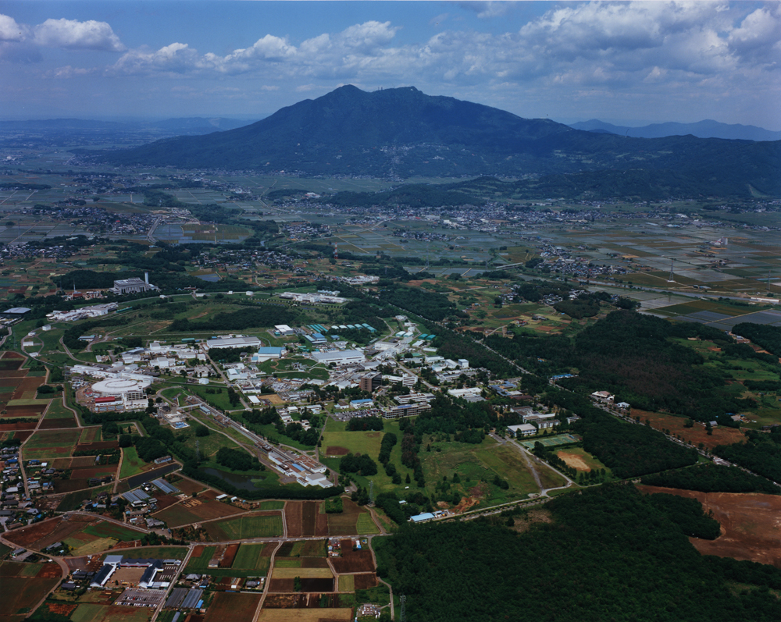
Overview of Phase 1 Commissioning
Y. Funakoshi for SuperKEKB Commissioning Group
Accelerator Laboratory, KEK
2016.06.13@21th KEKB Review

Slide 2
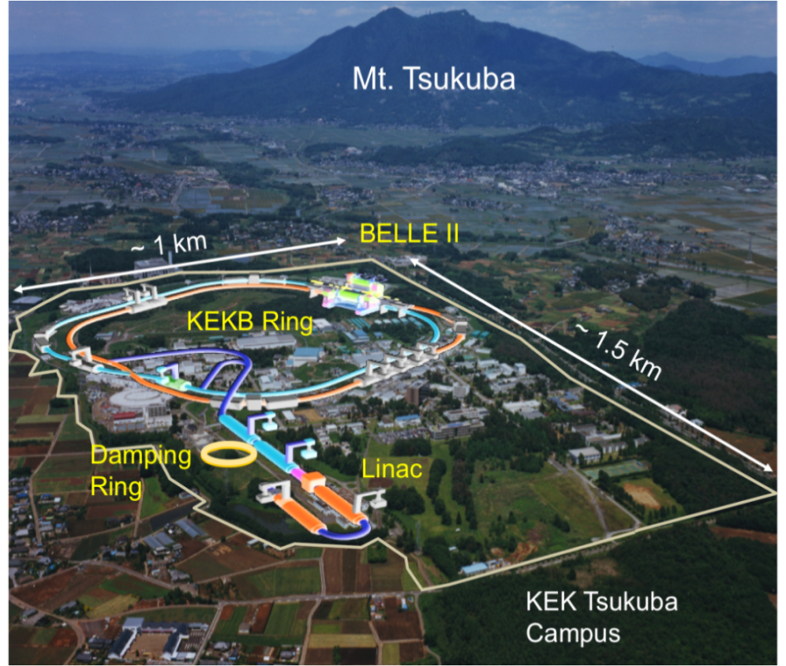
SuperKEKB
Upgrade project of KEKB B-factory
  Search for new physics beyond the standard model at B-meson regime
e⁻ - e⁺ two-ring collider consisting of
  Injector (Linac): L ~600 m
  Damping ring (e⁺): C ~100 m
  Main ring (MR): C ~ 3016 m
    HER: 7 GeV e⁻, 2.6 A
    LER: 4 GeV e⁺, 3.6 A
  Belle-II detector
Design luminosity
  80 x 10³⁴ cm⁻²s⁻¹
  (~40 times of KEKB)

Slide 3
SuperKEKB Commissioning Phases
2016 Feb. ~ June
~2017 Autumn (~ 5month)
~2018 Autumn
Phase 1
w/o QCS and Belle II
basic machine tuning
vacuum scrubbing
Optics tuning
BKG study
Phase 2
w/QCS and Belle II
w/o Vertex detector
DR commissioning
BKG study
Luminosity tuning
Target luminosity:
1 x 10³⁴ cm⁻² s⁻¹
Phase 3
w/ full Belle II
Physics Run
Luminosity tuning

Slide 4
Mission of Phase 1 operation
(Feb. 2016 ~ June 2016)
Startup of each hardware system
Establish beam operation software tools
Preparation for installation of Belle-II detector
  Enough vacuum scrubbing
    Request from Belle II group: ~1 month vacuum scrubbing with beam current of 0.5~1A (360~720Ah).
  Beam background study with test detector (named Beast)
High beam current operation
  Find/solve problems associated with high beam current operation
Optics study w/o IR (no detector solenoid)
  Low emittance tuning
Other machine studies

Slide 5
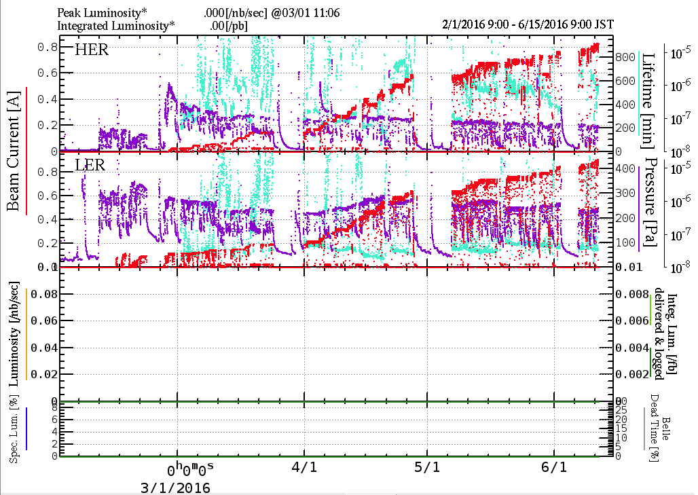
History of Phase 1 operation
HER wiggler ON
e-
e+
LER wiggler ON
Short break for
Injector work
Short break
Short break
Solenoid installation
at bellows (LER)
Red: total beam current
Purple: vacuum pressure
Cyan: beam lifetime
We plan to shutdown the rings on June 28th.
Regular maintenace

Slide 6
Machine parameters in Phase 1
 | LER | HER | Units
Beam energy | 4.000 | 7.007 | GeV
Beam current | 910 (~40) | 830 (~40) | mA | (): optics correction
# of bunches | 1576 | 1576
Bunch current | 0.58 | 0.52 | mA
Hor. emittance | 1.8 | 4.6 |  | Zero current
Momentum compaction | 2.45 x 10⁻⁴ | 4.44 x 10⁻⁴
Energy spread | 7.5 x 10⁻⁴ | 6.3 x 10⁻⁴
Total V_{c} | 7.56 | 12.45 | MV
Bunch length | 4.6 | 5.3 | mm | Zero current
ν_{s} | -0.019 | -0.025
Tune ν_{x}/ν_{y} | 44.59/44.63 | 45.57/43.61
U₀ | 1.76 | 2.43 |  | Wiggler ON
τ_{x,y}/τ_{x} | 46/23 | 58/29 |  | Wiggler ON
as of June 12th

Slide 7
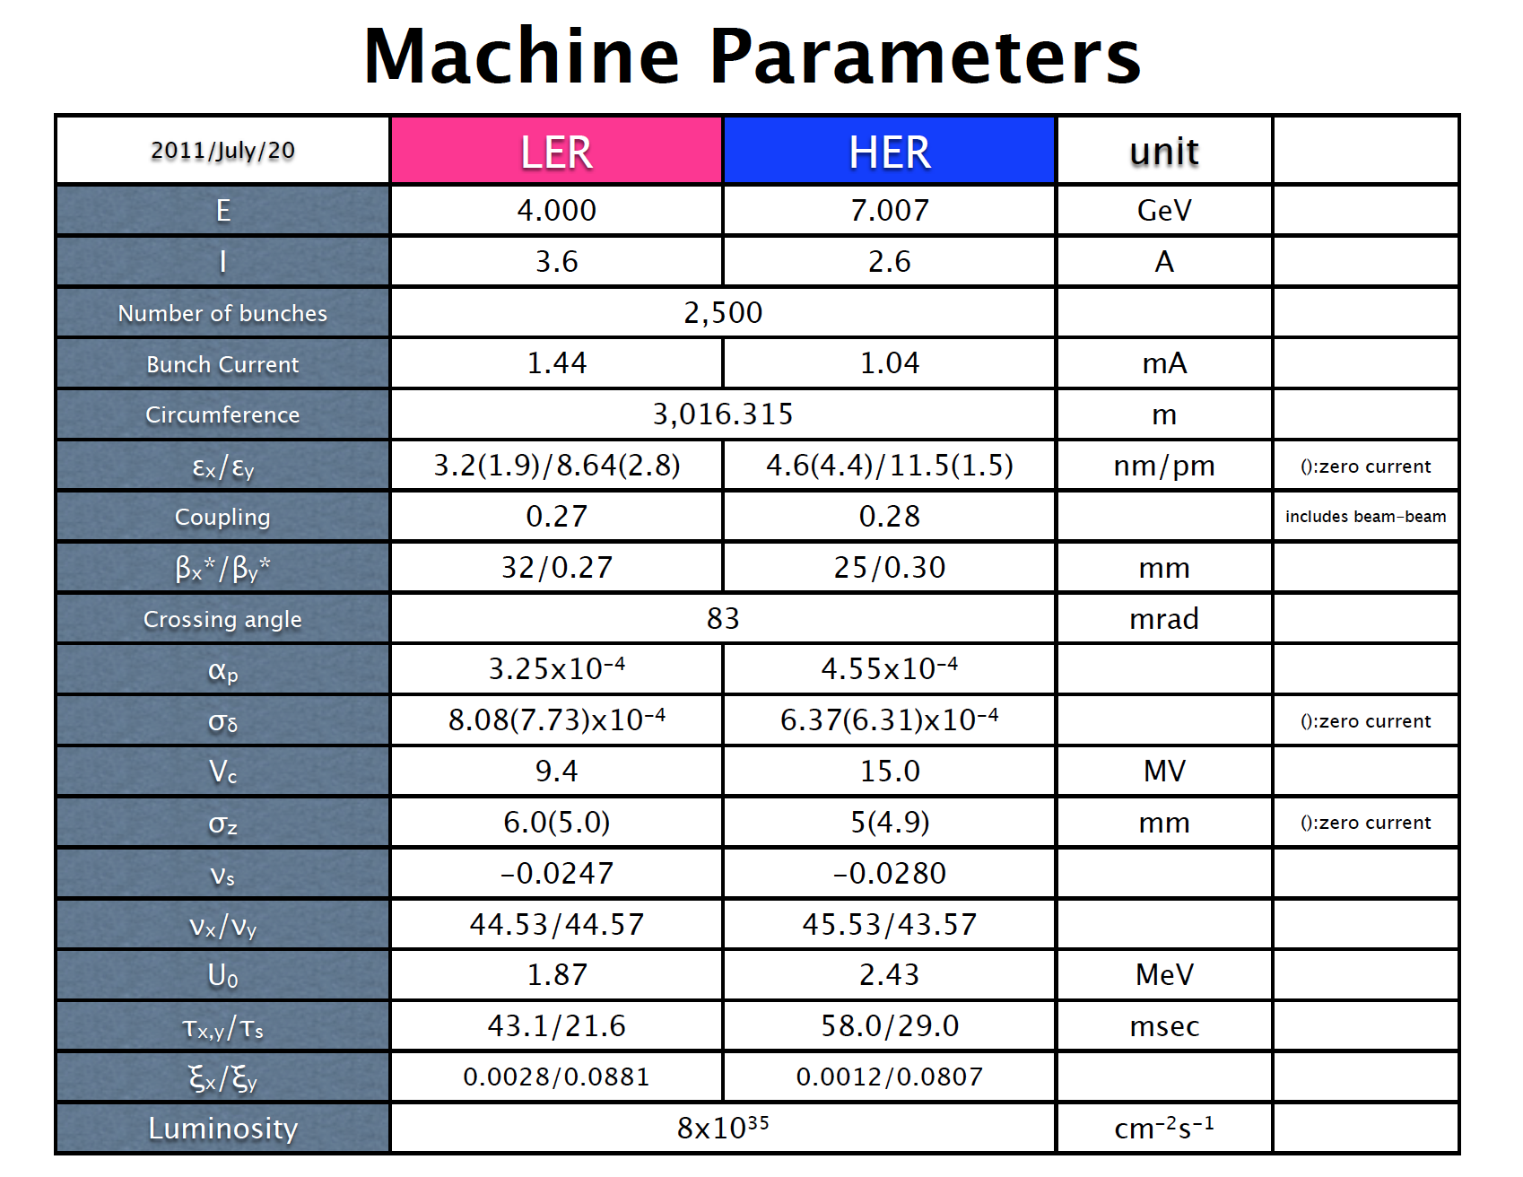
Machine parameters in Phase 3

Slide 8
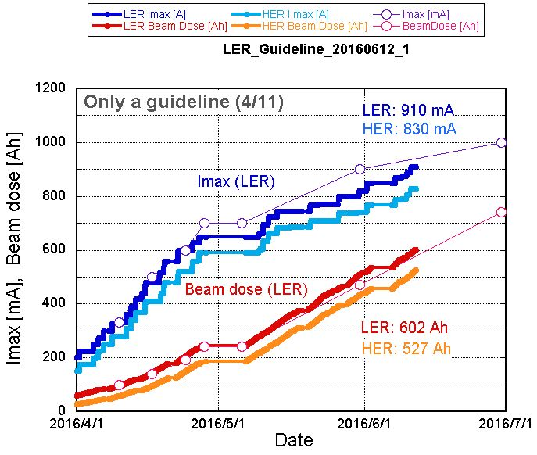
Y. Suetsugu
Guideline for vacuum scrubbing and achievement as of June 12th
    Request from Belle II group: ~1 month vacuum scrubbing with beam current of 0.5~1A (360~720Ah).

Slide 9
Startup of SuperKEKB (3 months)
Much faster startup than KEKB
  KEKB beam currents achieved after first 3 months
    LER: ~300mA, HER: ~200mA (540mA, 300mA: 4 months)
  SuperKEKB beam currents achieved after first 3 months
    LER: ~650mA, HER: ~590mA (820mA, 740mA: 4 months)
Compared with KEKB…
  Each hardware component has been upgraded with experiences at KEK and has worked fine (RF, Magent, Vacuum...)
  The bunch-by-bunch feedback system has more effectively suppressed instabilities.
  Operational tools (such as closed orbit correction system) has worked fine based on experiences at KEKB.
  Less machine troubles than KEKB so far

Slide 10
Beam background study using Beast detector
Touschek background
  Change vertical beam size by using ECK (Emittance Control Knob)
Vacuum background
  Vacuum bump study
Injection background
Collimator study
Details are given in the talk by H. Nakayama.

Slide 11

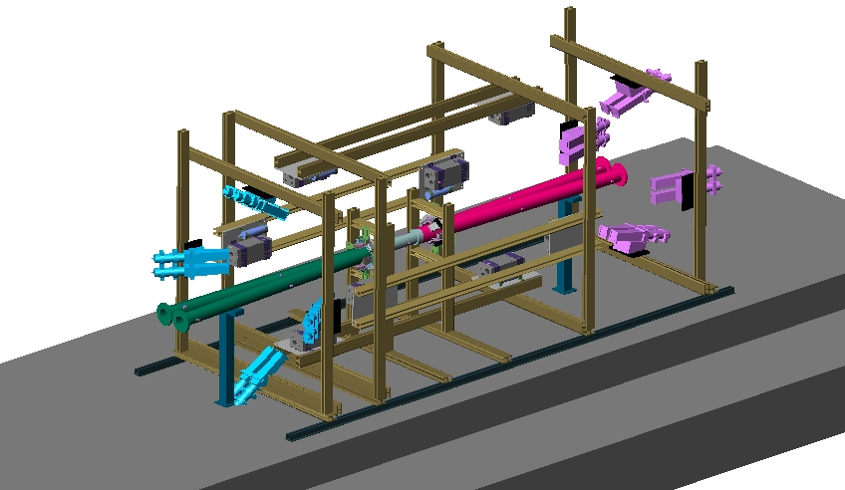
H. Nakayama
BEAST Phase1 sensors at IP
PIN diodes
LYSO/CsI
crystals
He3 tubes
(thermal neutrons)
Micro TPCs
（fast neutrons）
BGO crystals
CLAWS scintillators
Diamonds
Various measurements (fast charged particle, high-energy photons, thermal/MeV neutron, dosimetry, etc..) to validate beam loss simulation

Slide 12
Issues with high beam currents
Nonlinear vacuum pressure rise as function of beam current (LER)
Vertical beam size blowup as function of beam current (LER)
Frequent beam aborts associated with vacuum burst (LER)
Longitudinal coupled bunch instability (LER)
  Instability was first observed around 660mA. The mode number is ~600. We needed the use of longitudinal feedback system to suppress it. The source of the instability is still unknown. At KEKB, we never needed the longitudinal feedback system.
Longitudinal coupled bunch instability (HER)
  Sometimes, detuned cavities induce the instability due to the fundamental mode. -1 mode damper was set up to suppress the instability.
Hardware troubles due to the high beam currents
  Vacuum leakage by the direct hit by the beam at bellows near the abort kickers (HER) (Suetsugu’s talk)
  Damage to the feedthrough of the transverse FB kicker (LER) (Tobiyama’s talk)

Slide 13
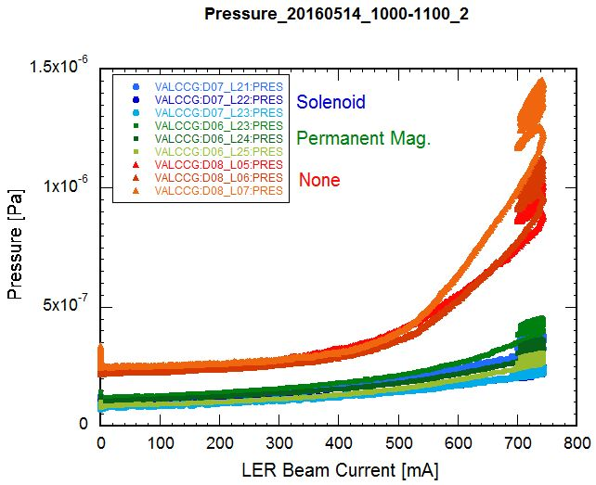
Nonlinear pressure rise against beam current in LER
Y. Suetsugu
  The pressures at whole LER ring showed the nonlinear behavior against the beam current.
  The behavior is quite similar to that of electron currents measured at aluminum parts without TiN coating.
  We have aluminum bellows chambers along the ring without TiN coating. The bellows chamber has a length of 0.2 m and located every 3 m on average. Number of such bellows chamber is 810.
  Countermeasure
    Installation of solenoid magnets at the bellows.
    We have installed permanent
    solenoid magnets at all of bellows chambers during short break (June 02-05)
Solenoid: 50~100Gauss
More details are discussed in the talk by Y. Suetsugu .

Slide 14
LER vertical beam size blowup
Blowup study with shorter bunch spacing
w/ emittance knob
w/o emittance knob
w/o emittance knob
3.06 spacing (1576 bunches)
3.06 spacing (1576 bunches)
June 1st (before installation of solenoids
at bellows chambers)
June 6th (after installation of solenoids
at bellows chambers)
One of the motivation of installing solenoids was to check their effects to the beam size.

Slide 15
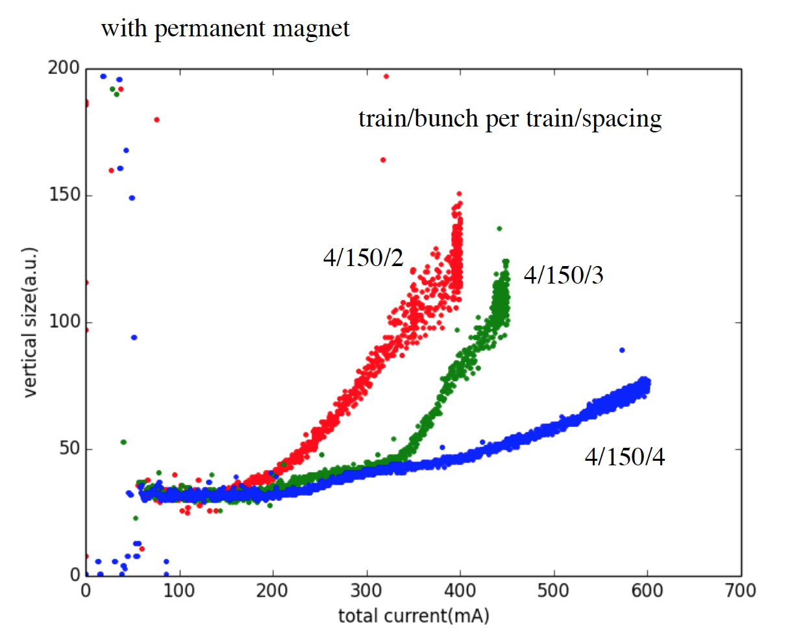
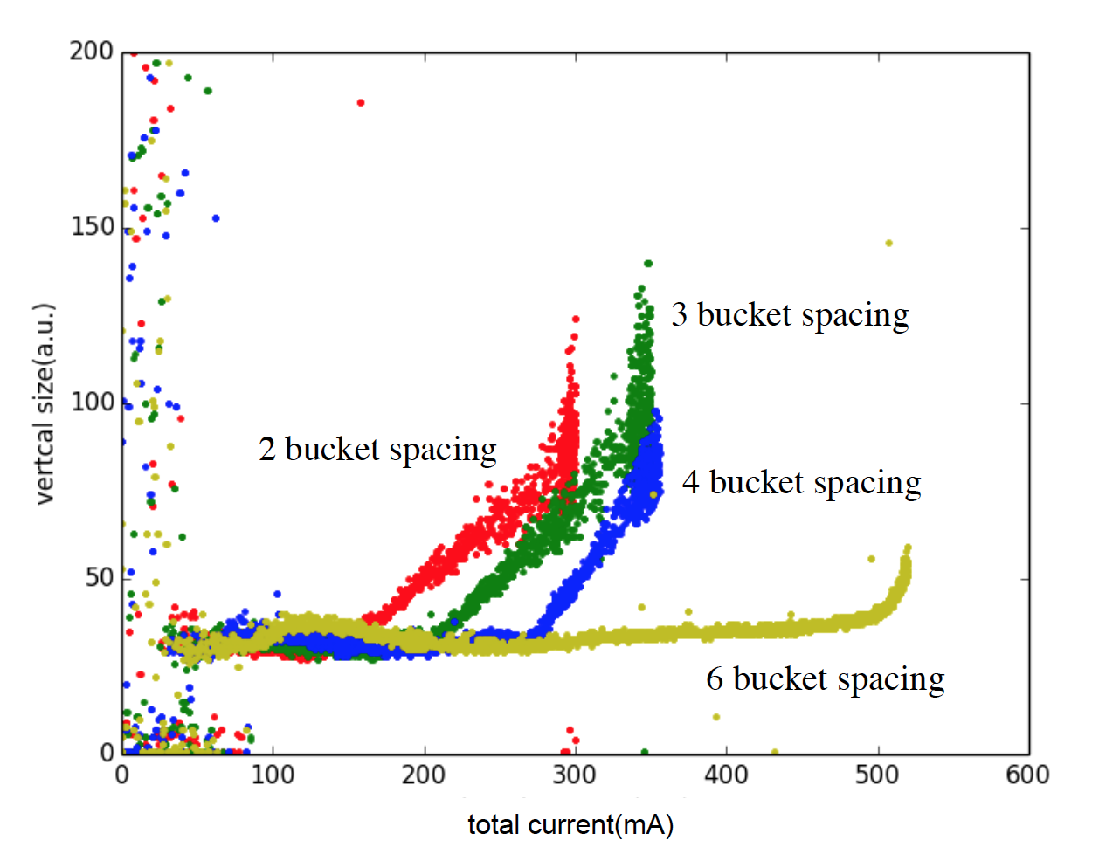
Blowup study
before
after
June 1st (before installation of solenoids
at bellows chambers)
June 8th (after installation of solenoids
at bellows chambers)
The solenoids at bellows were effective to raise the blowup threshold by a factor 1.5.
The electron clouds seem to be responsible for the beam blowup.
We may need more solenoids for higher beam operation.
More details will be given in the talks by Y. Suetsubu and K. Ohmi.

Slide 16
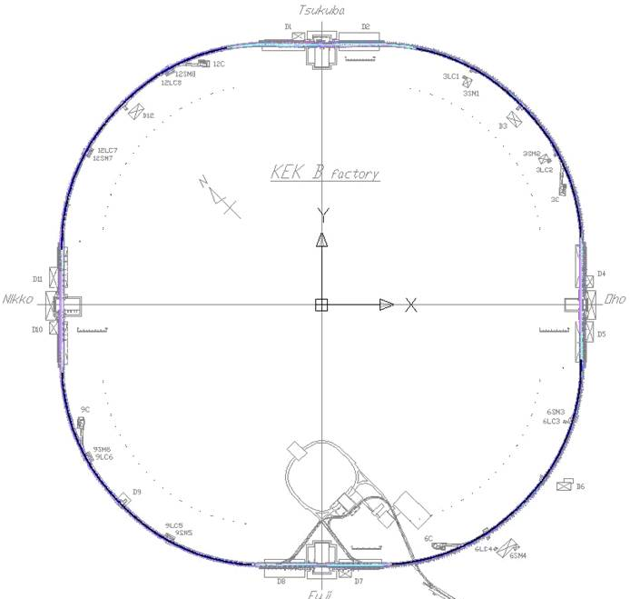
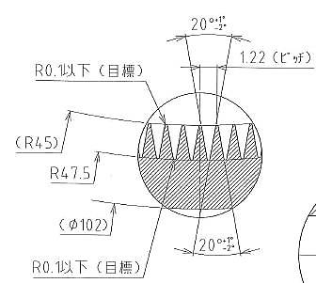
Vacuum burst in LER
Y. Suetsugu
Pressure bursts accompanying beam loss in LER
  One big concern is that beam aborts accompanied by localized pressure bursts have been frequently observed from the early stage of the commissioning in the LER.
  The beam loss monitors trigger the beam aborts.
  Frequent pressure bursts have occurred near or inside the aluminum beam pipes in dipole magnets.
    Our beam pipes for dipole magnets have a groove structure as a counter measure against electron cloud effects.
  The beam current where the bursts occurred has
  Increased gradually.
  The reason for the pressure bursts is not well understood.
  Possible causes are the discharge at poor
  electrical contacts by the wall current and
  the collision of dusts (small particle) with circulating
  beams. A knocker against vacuum chamber could
  reproduce the vacuum burst. This result seem to support
  the hypothesis that the burst is induced by dust particles.
More details are discussed in the talk by Y. Suetsugu.

Slide 17
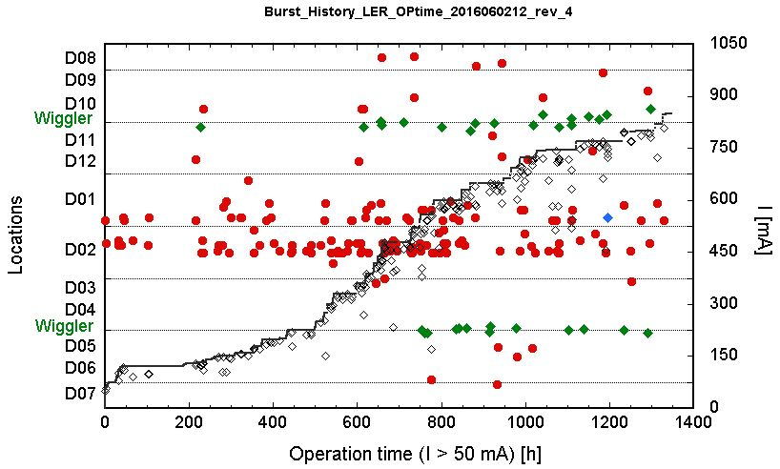
Locations of vacuum burst in LER
Artificial

Slide 18
Optics corrections
Base measurements for hardware system check
  BPMs
    BPM check with beams (orbit bumps) -> We found mis-connection or mis-cabling of BPM cables with ~>20 BPMs.
    Gain calibrations of BPMs have been done with beams.
    Quad-BPM measurements (to measure difference between field center of quadrupole magnets and the center of near-by BPM) have been almost finished.
  Steering magnet
    Check with beams (orbit bumps) -> We found an error with the excitation curve of steering magnets.
  Closed orbit correction system
    Closed orbit correction is a basis of optics correction. A reliable closed orbit correction system has been established based on the above measurements and modifications.

Slide 19
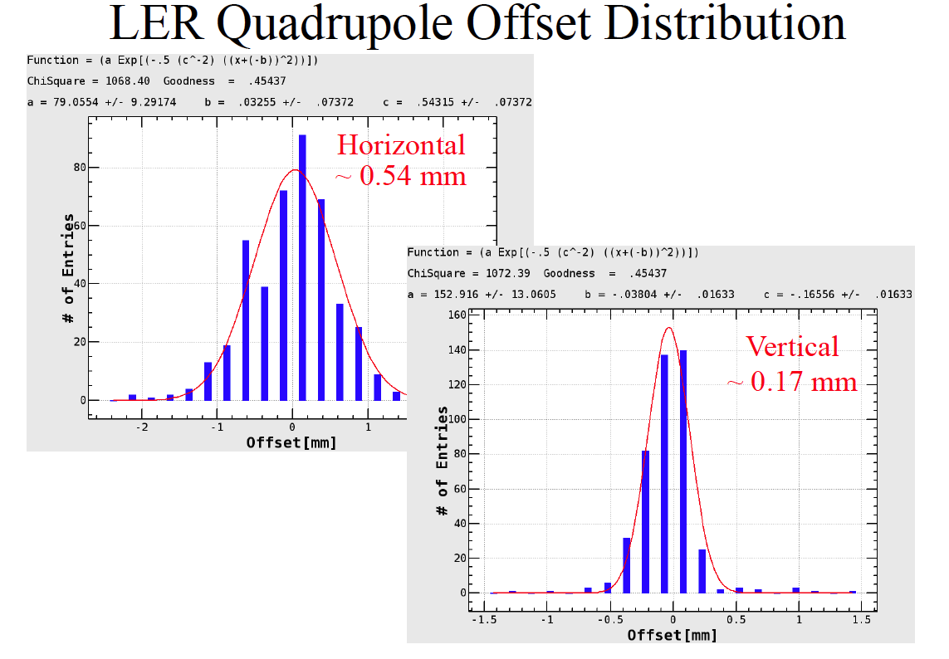
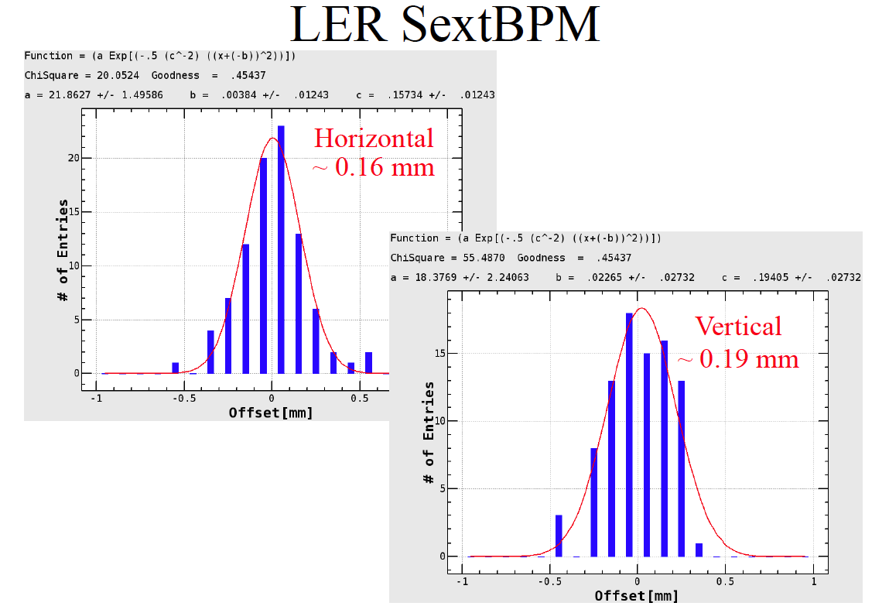
Beam based BPM offset measurement
(Quad-BPM, SextBPM)

Slide 20
Ring circumference
From the orbit measurement, we can know the ring circumference.
  LER: C_{Measurement} – C_{Design} ~2.0mm (Cir: 3016m)
  C_{LER} – C_{HER} ~ 0.2mm (LER chicane can adjust +/- 3mm)
  Magnet group has done a good job in the alignment work.

Slide 21
Method of optics correction
At SuperKEKB, we follow the method successfully used at KEKB.
Optics corrections on X-Y coupling, dispersions and beta-beat are done iteratively.
Since there are not enough single path BPMs, we rely on conventional BPMs.
For the measurements of X-Y coupling and beta-beta, orbit responses are measured with single kicks by steering magnets.
For the measurement of dispersion, we use a usual RF phase frequency change.
Details are given in the talk by H. Sugimoto.

Slide 22
Highlight of low emittance tuning
The X-Y coupling correction and dispersion correction are important to get a low vertical emittance.
While the HER corrections went well, we encountered a difficulty in the LER corrections.
  The obstacle of the corrections was leakage magnetic field from the Lambertson septum magnets whose main component is skew-Q.
    We have made two countermeasures against the problem.
      The use of skew-Q coils of the SF magnet nearby the Lambertson. (downstream of the Lambertson septum)
      Installation of permanent skew-Q magnet in the upstream of the Lambertson septum.

Slide 23
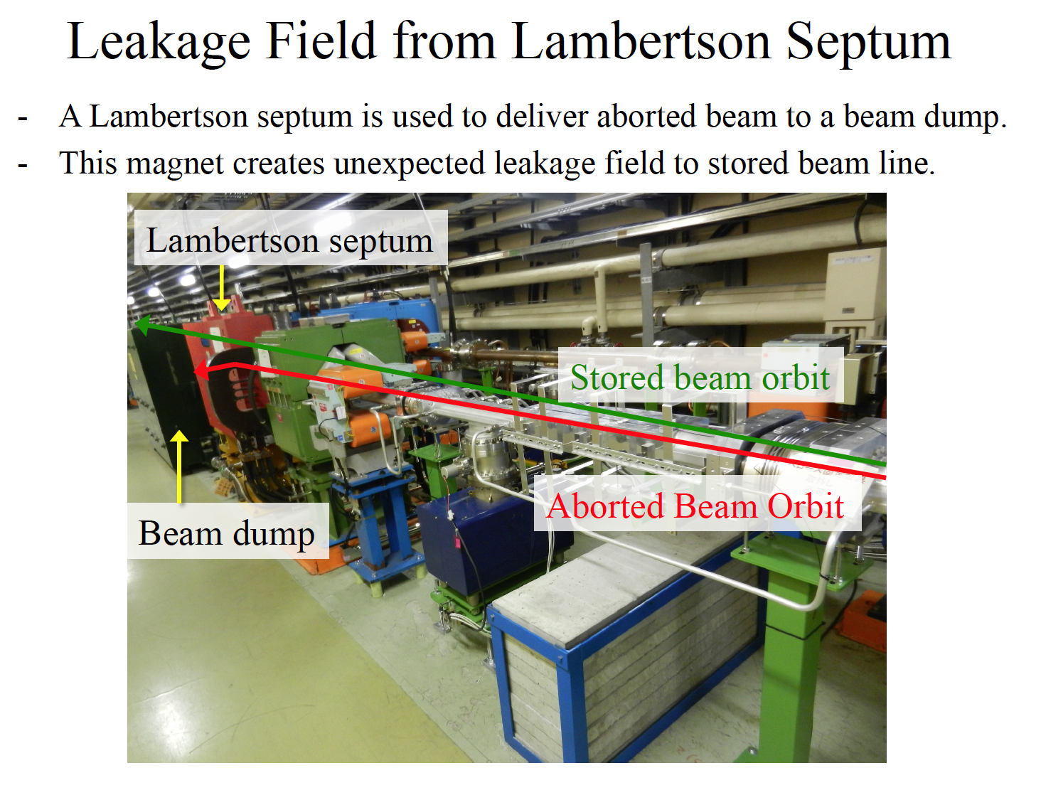

Slide 24
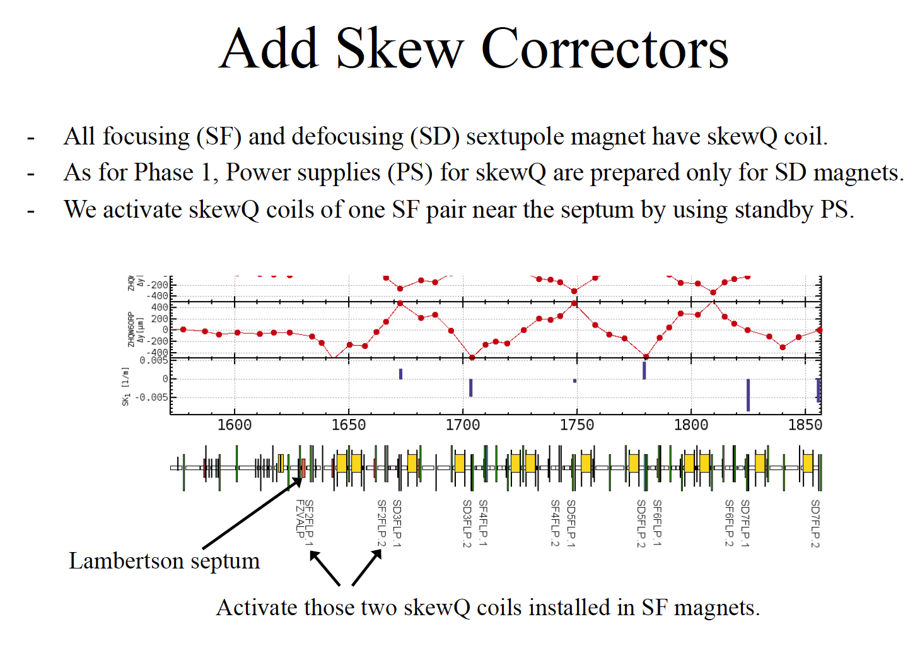
H. Sugimoto

Slide 25
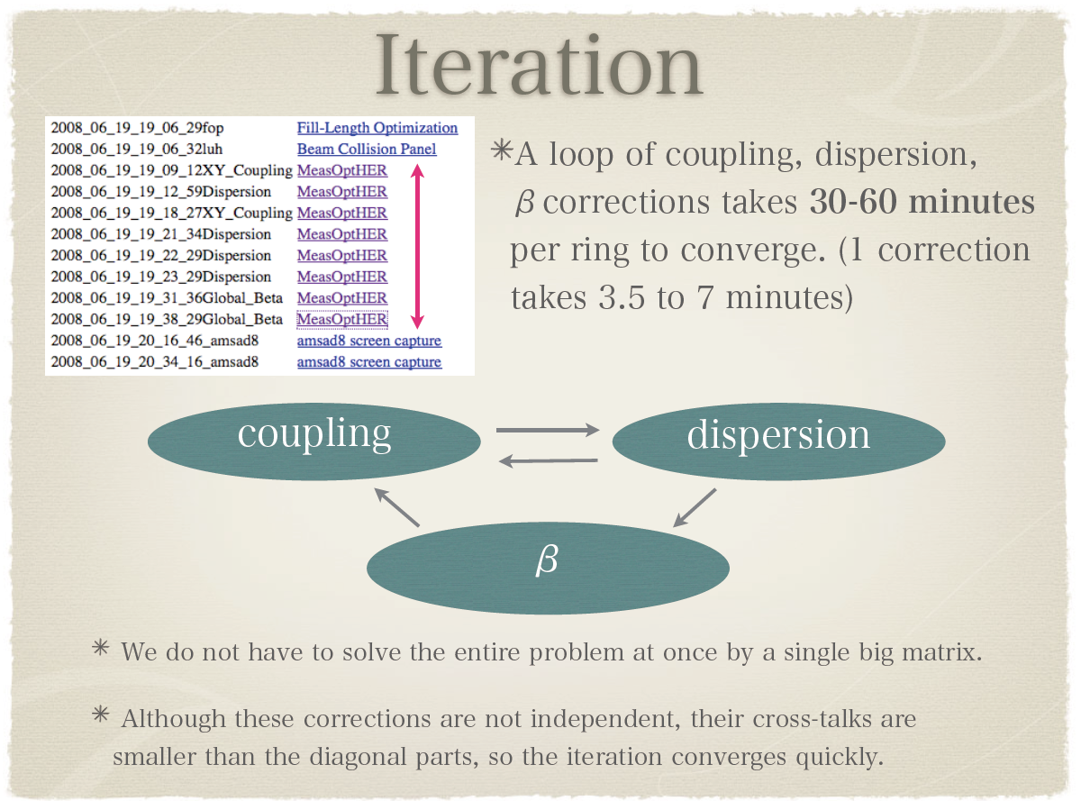
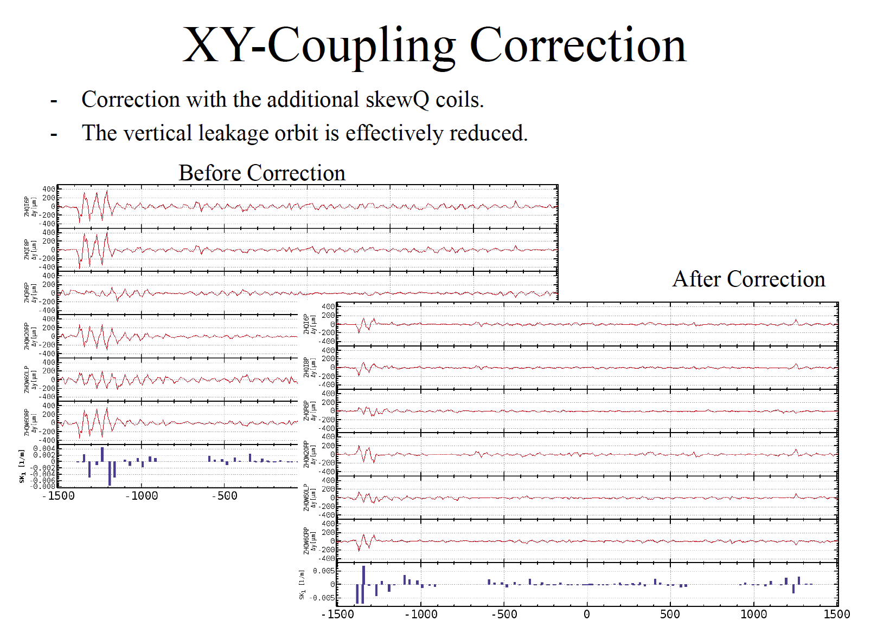
KEKB
H. Sugimoto
Measurement:
Vertical leakage orbit induced by
independent 6 steering kicks.
Induced horizontal orbit amplitude
Is about 2-3 mm in its peak.
Correctors:
SkewQ winding of sextupoles

Slide 26
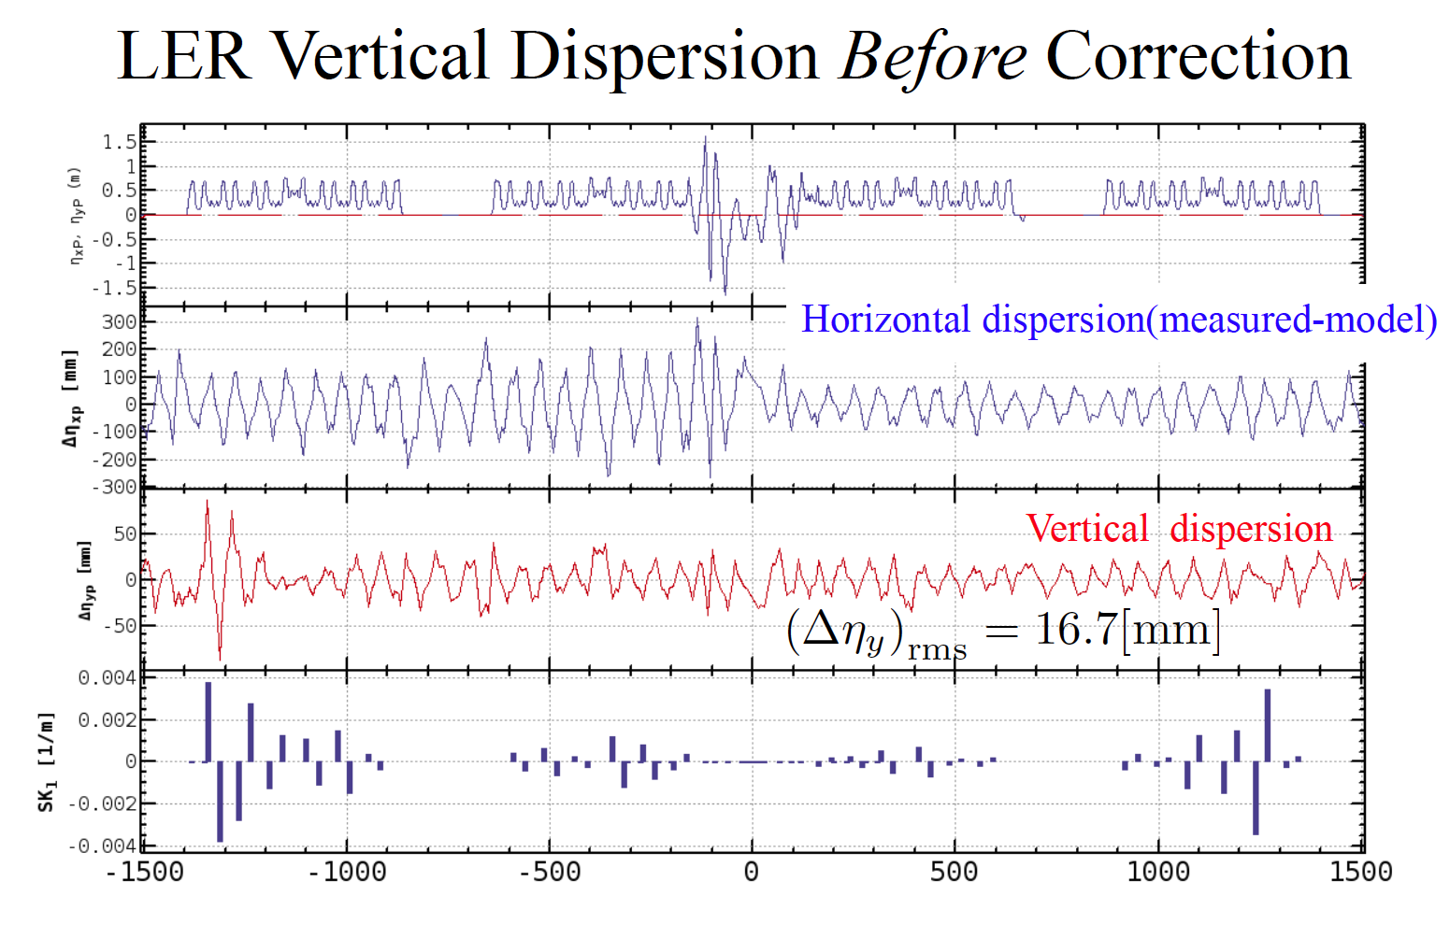
H. Sugimoto
Correctors:
SkewQ winding of sextupoles

Slide 27
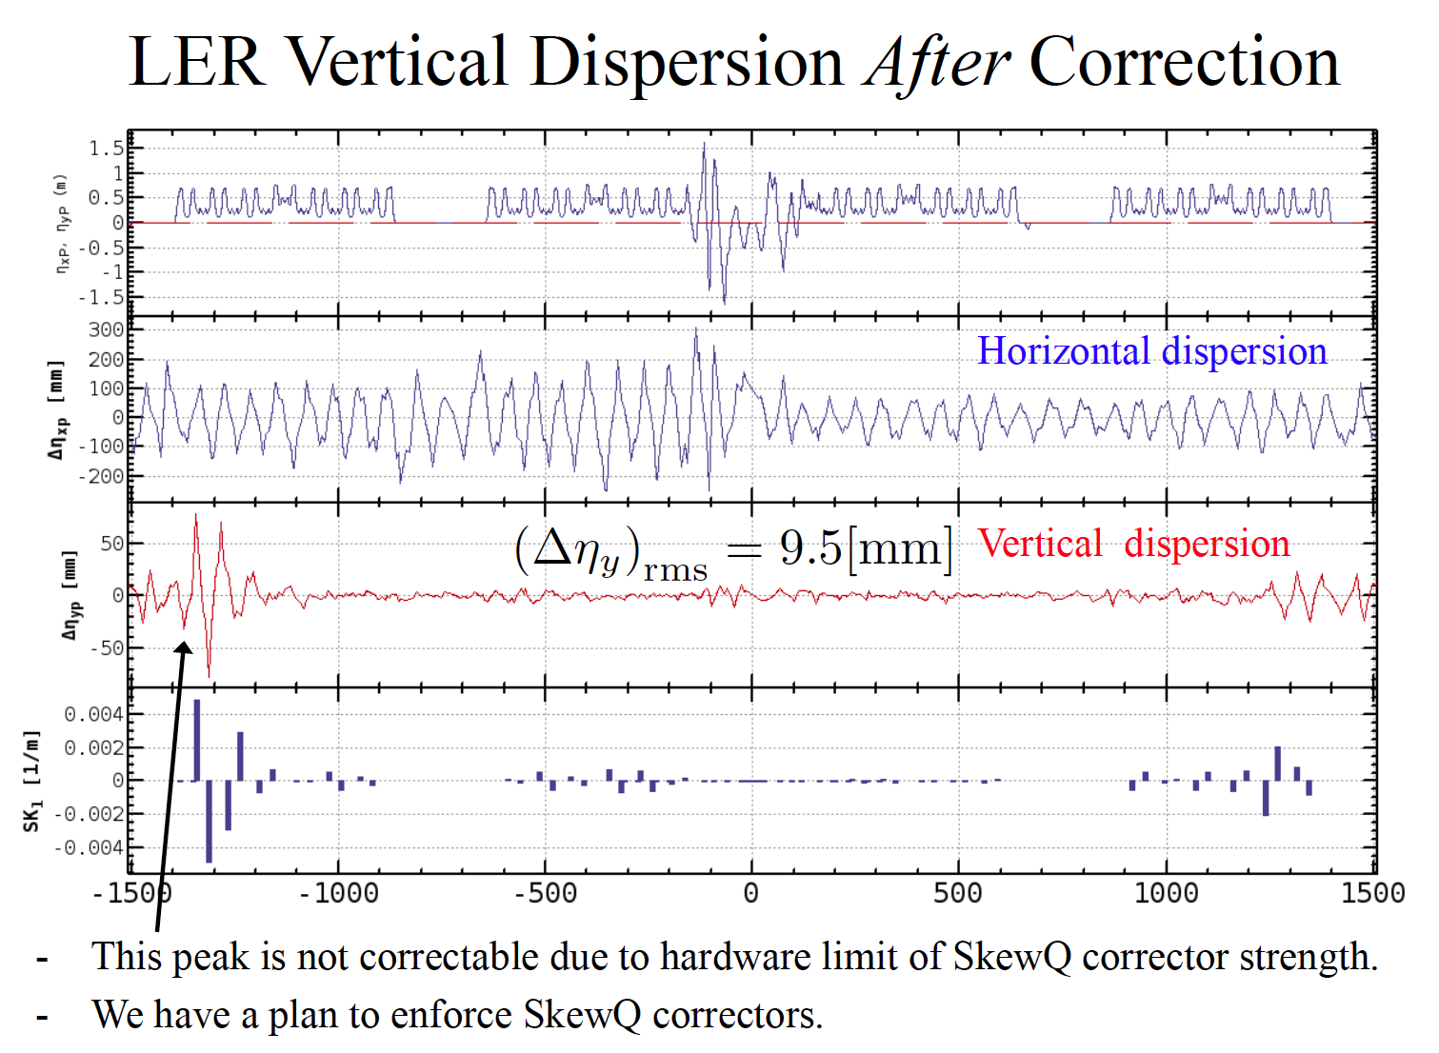
H. Sugimoto

Slide 28
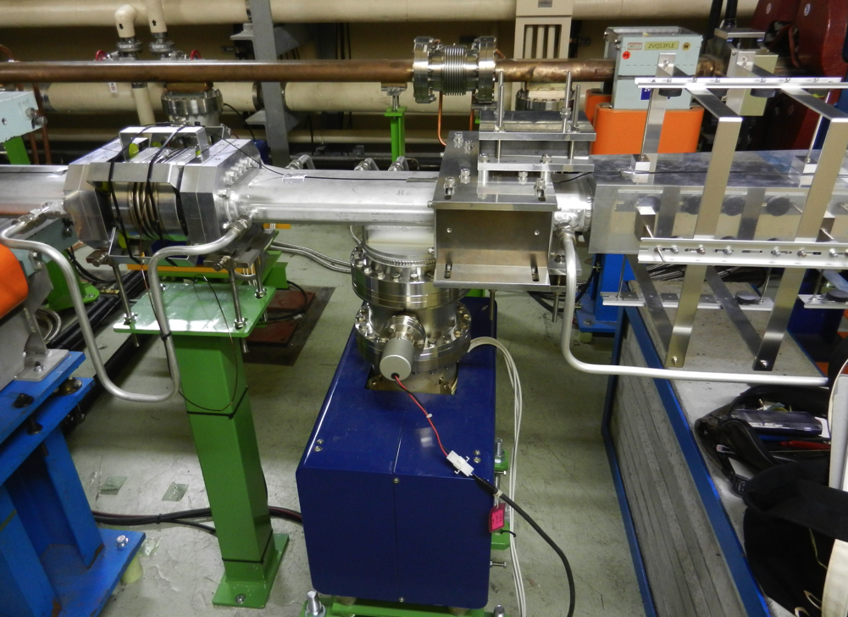
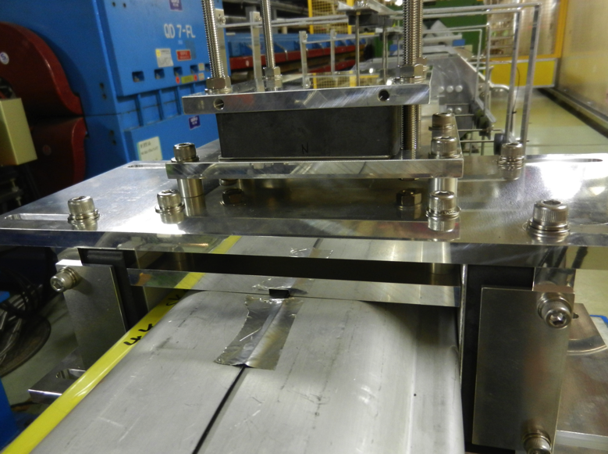
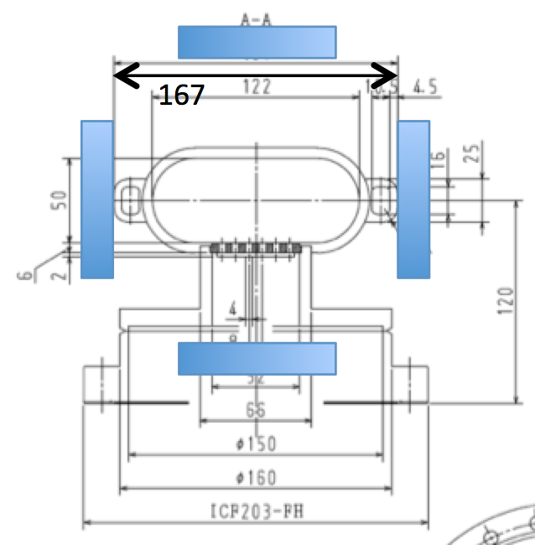
The skew quadrupole magnets to cancel the leakage field from the Lambertson
Ferrite block
Ferrite block
Size: 100 x 25.4 x 150 (mm)
B 〜 550 (Gauss)
r = 85.5 (mm)
→ SK1 = - 7.7e-3 (/m)
which is adjusted the requirement from optics.
N. Iida, M. Kikuchi, K. Kodama, T. Mimashi, T. Mori, T. Tawada

Slide 29
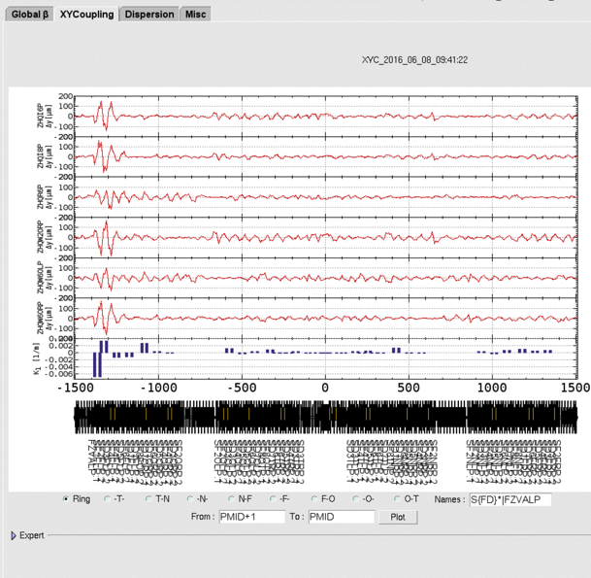
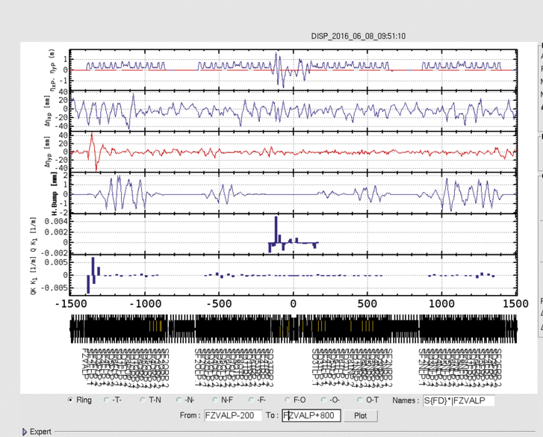
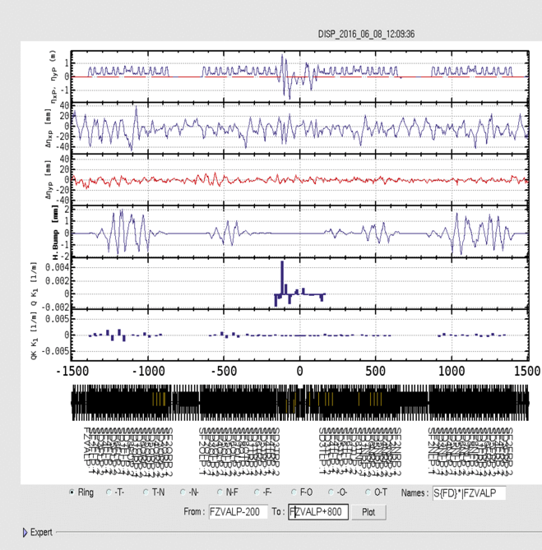
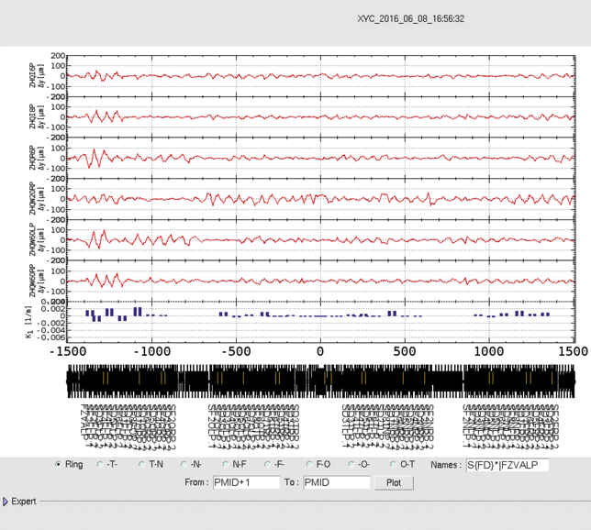
Before and after installation of Ferrite blocks
H. Sugimoto
X-Y Coupling
Vertical dispersion
<rms(Δyi)>
= 26.785 → 19.839 μm
Δη_{yp}= 6.2 mm → 4.2 mm

Slide 30
Present status of linear optics corrections
Items | LER | HER | KEKB typical value (LER) | Unit
X-Y coupling average of rms (Δy1-6 ) | 19.8 | 7.7 |  | mm
H. Dispersion rms (Δhx ) | 14.8 | 16.1 | 10 | mm
V. Dispersion rms (Δhy ) | 4.2 | 4.8 | 8 | mm
Beta-x rms (Δbx/bx ) | 4.9 | 4.3 | 6 | %
Beta-y rms (Δby/by ) | 5.3 | 3.7 | 6 | %
More details will be discussed in the talk by H.Sugimoto.

Slide 31
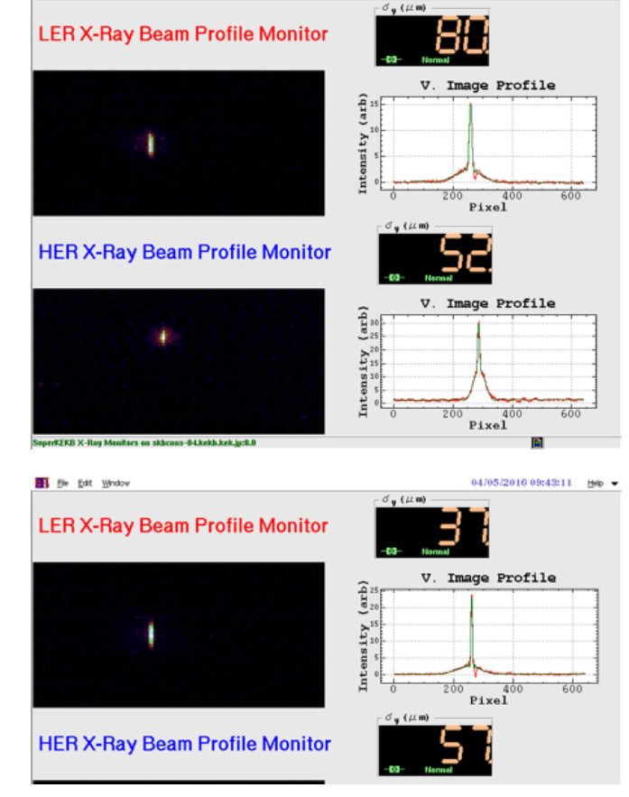
Beam size measurement by using X-ray monitor
March 23rd, 2016
ε_{y} = 96pm (by = 67 m @source)
ε_{y}/ε_{y} = 5.3% (ex = 1.8nm)
ε_{y} =356pm (by = 7.7 m @source)
ε_{y}/ε_{y} =7.7 % (ε_{y}= 4.6nm)
April 5th, 2016
ε_{y} = 20pm (by = 67 m @source)
ε_{y}/ε_{y} = 1.1% (ex = 1.8nm)
Target vertical emittance (LER) in Phase 1 is ~5pm.

Slide 32
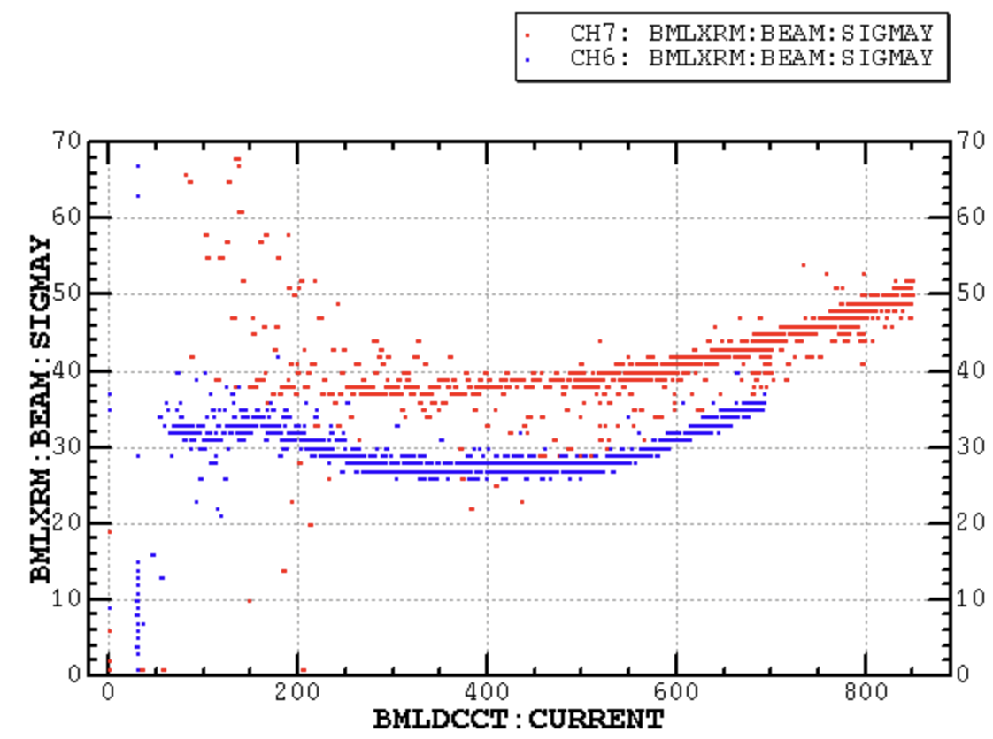
Vertical beam size measurement
(after permanent skew-Q installation)
Before ferrite installation
After ferrite installation
Target
εy〜20pm
εy〜10pm
εy〜5pm

Slide 33
HER Beam size measurement by using X-ray monitor
June 1st
HER σy@source point = 40μm? -> εy=210pm
This vertical emittance is inconsistent with optics correction results.

Slide 34
HER X-ray monitor study (June 9th)
Single slit
URA
ε knob=0
multi.
βy=7.636m (original)
βy=4.00m
knob=1.3
Single slit
Change camera gain
The current dependence of HER vertical beam size seems to be fake.

Slide 35

HER X-ray monitor study (June 9th)
βy=7.636m(original)
βy=4 m
Data with βy =7.636 x $\sqrt{4/7.636}$
The measured beam size does not scale the beta function.
Is there any offset in the measurement such as coupling from horizontal size?
More details are given in the talk by J. Flanagan.

Slide 36
Summary
After 5 year’s upgrade work from KEKB, Phase 1 operation of SuperKEKB (w/o Belle-II detector and IR) started in Feb. 2016 and on the way.
The startup of SuperKEKB operation is relatively smooth thanks to experiences at KEKB.
In preparation for installation of Belle II detector in Phase 2, vacuum scrubbing is being done and beam background study has been done with Beast detector.
The optics correction study is going on energetically.
The LER low emittance has been much improved by the correction of leakage field of Lambertson septum.
The calibration of X-ray monitor is an important tuning item.
We observed the vertical beam size blowup in LER. The source of the blowup seems to be the electron clouds.
Injector has worked stably. For Phase 2 and 3 operation, we will need more improvements.

Slide 37
Spare slides

Slide 38
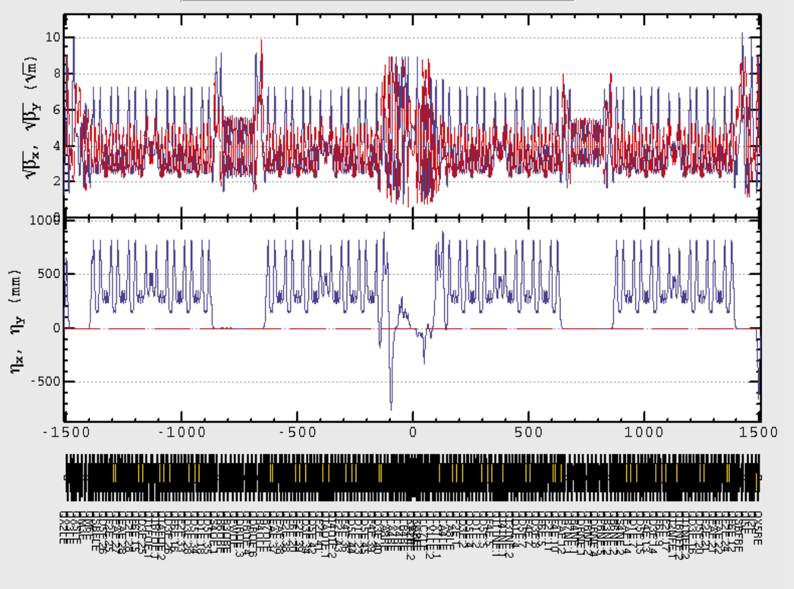
HER Phase 1 Lattice

Slide 39
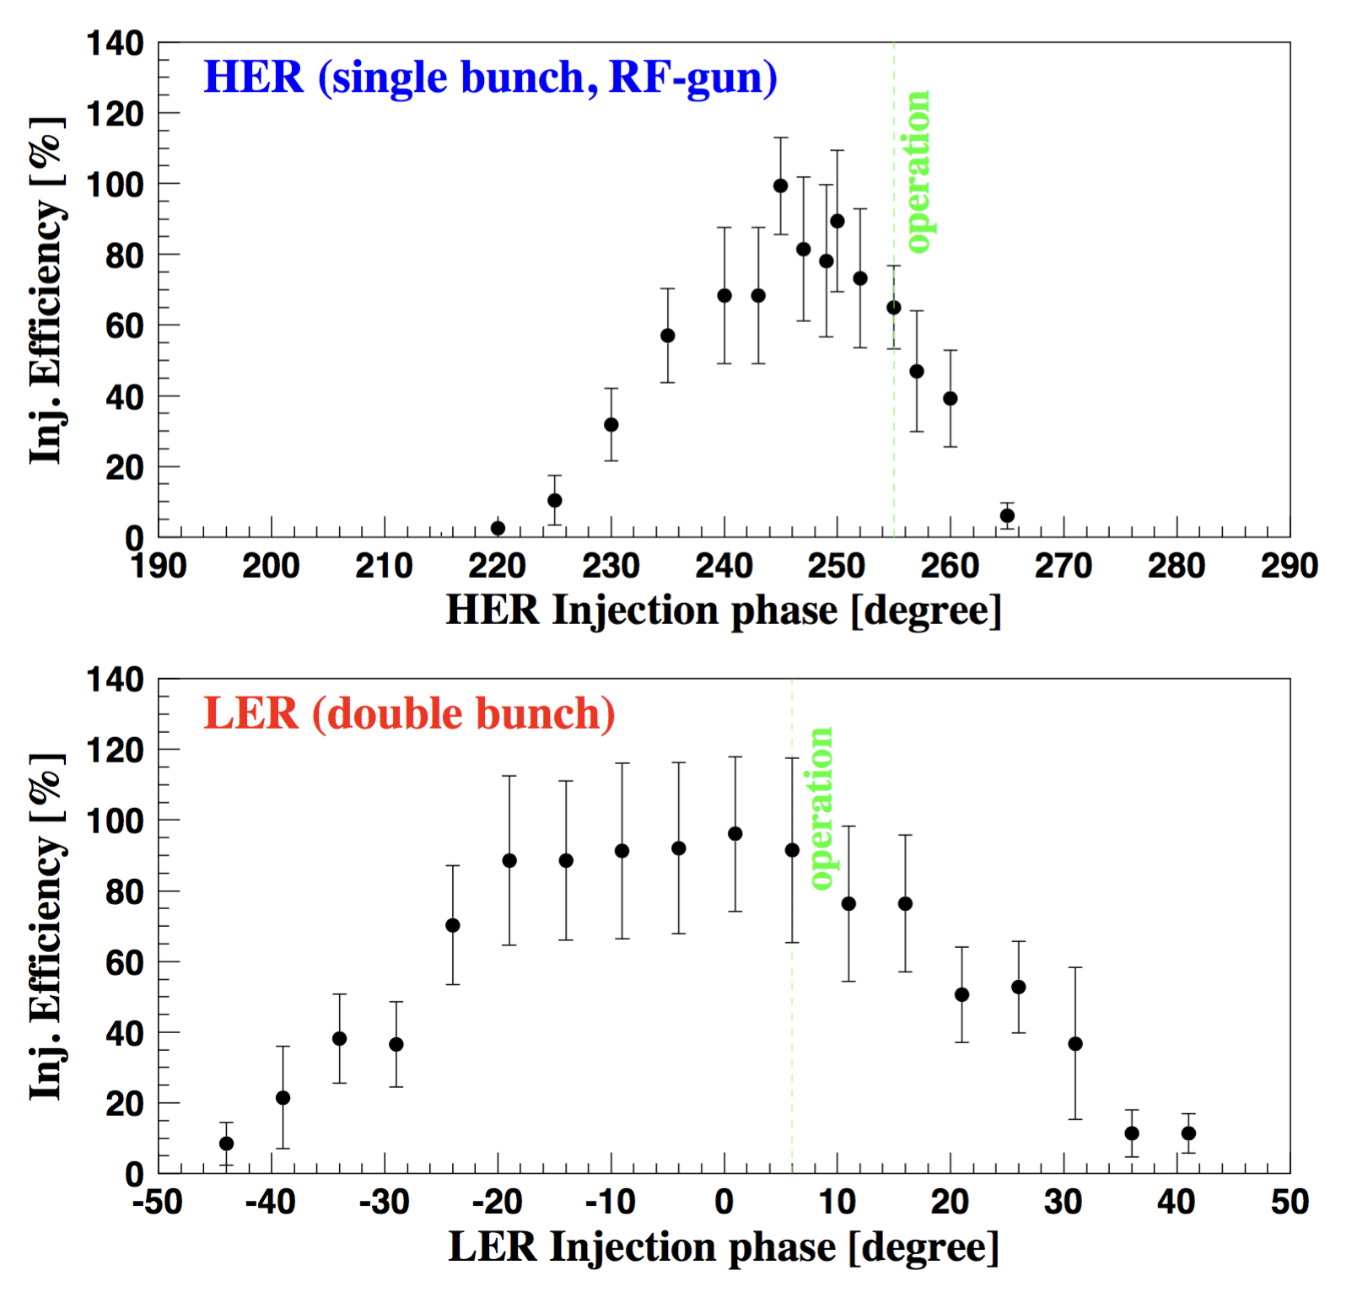
Injection phase vs efficiency
Error bar: RMS in 100 shots.
入射位相を変えながら入射
効率を測定した。
測定時の電流
HER: 40~95 mA
LER: 40~90 mA
・現在の設定値は最適な位相
からずれている
HER変更: 255° → 245°
LER変更: 6° → -5°
HER: Δφ_{full} = 45 deg. → 14 σ_{δ} ↔ 28 σ_{δ} (model); ); 16 σ_{δ} @ x/ σ_{x} > 25
LER: Δφ_{full} = 80 deg. → 28 σ_{δ} ↔ 32 σ_{δ} (model)
see next page

Slide 40
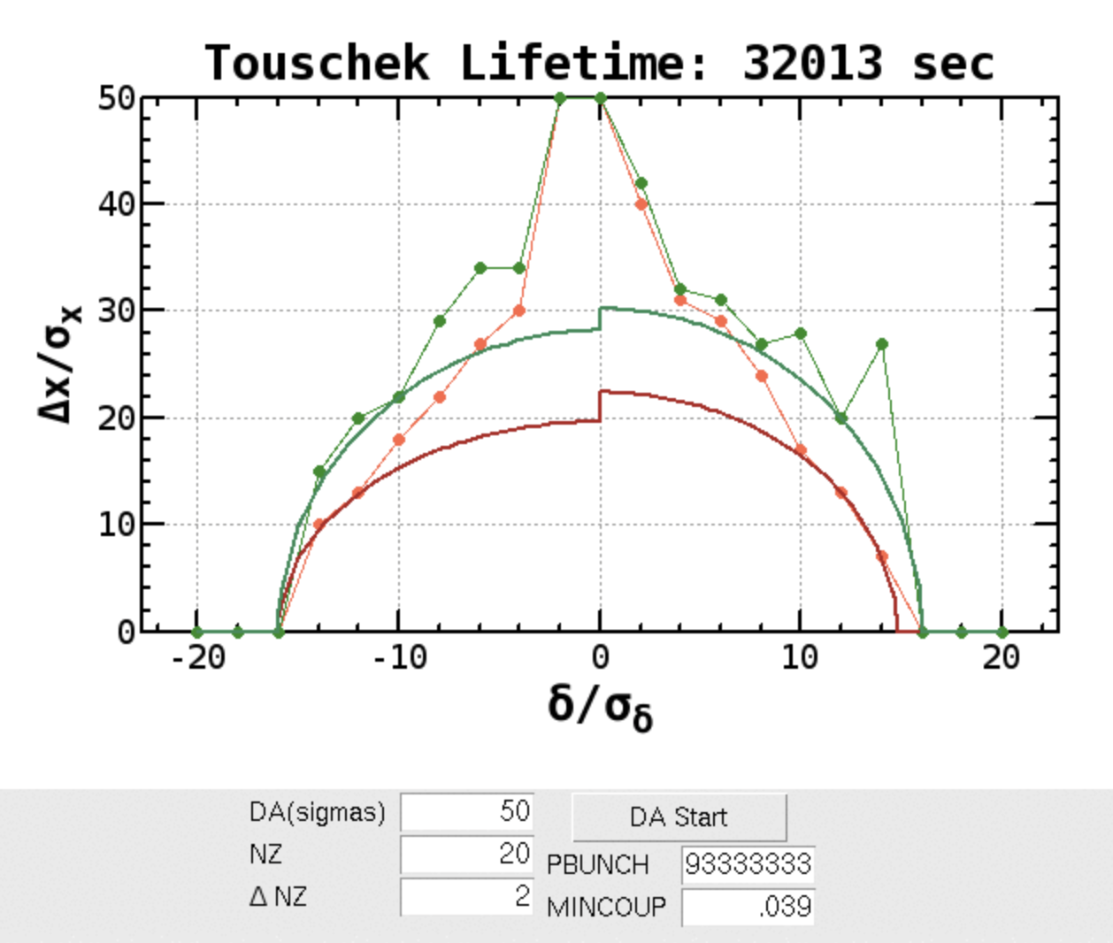
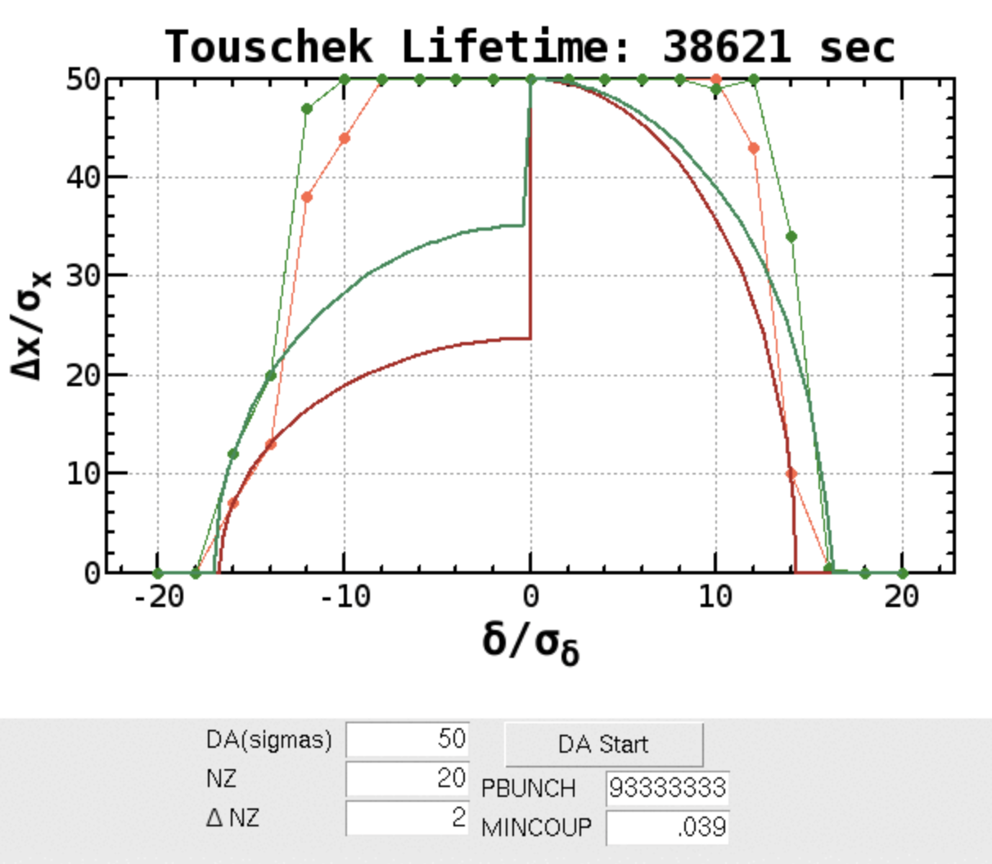
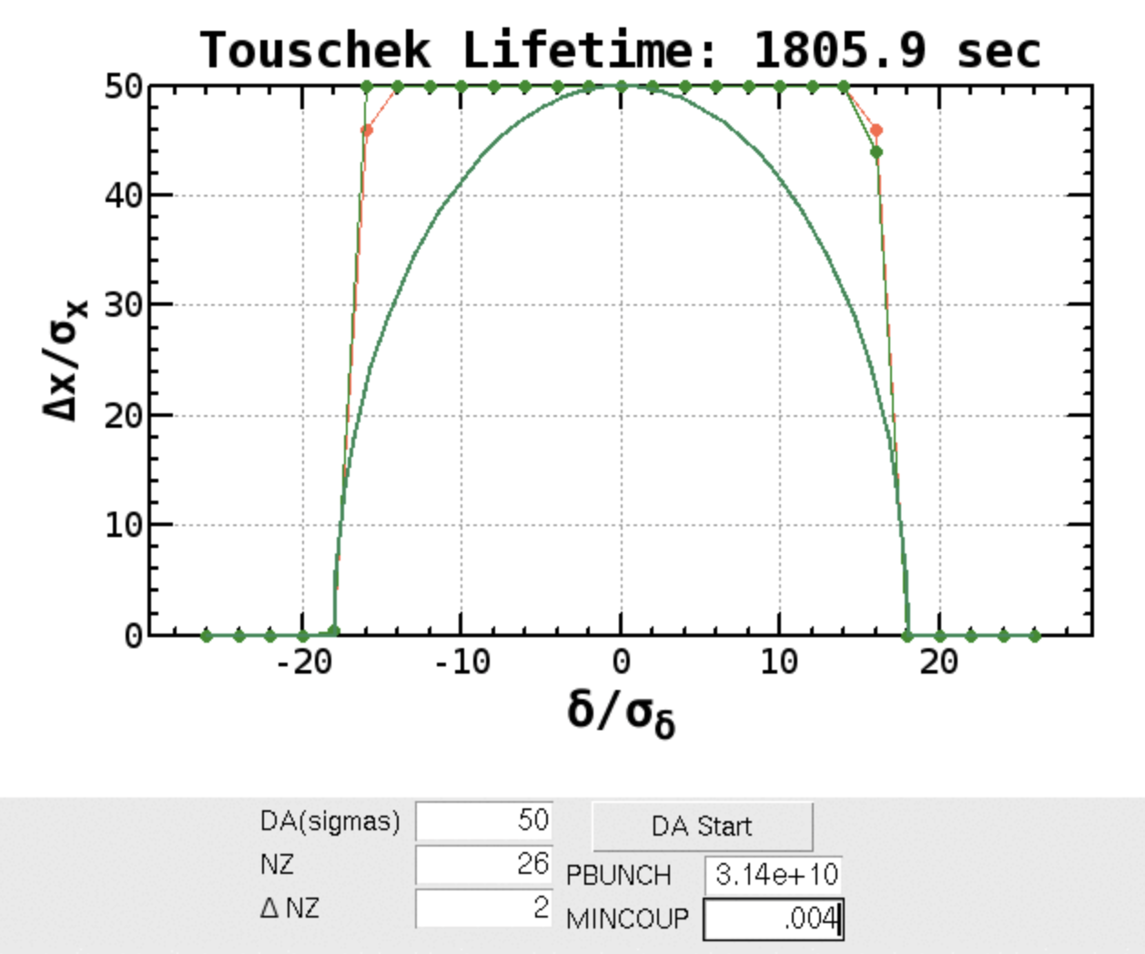
Comments
HERのε_{y} は、本当に巨大なのか？ (really big ?)
Touschek lifetime ~530 min
when ε_{y} =180 pm (ε_{y} / ε_{x} = 3.9 %)
HER
σ_{y} = 37 μm @ X-ray
HERのoptics測定からは推測できない (see next)
HER
abort sext. OFF
LER
abort sextをOFFすればoff-momentumの
横方向の口径はかなり大きくなる。

Slide 41
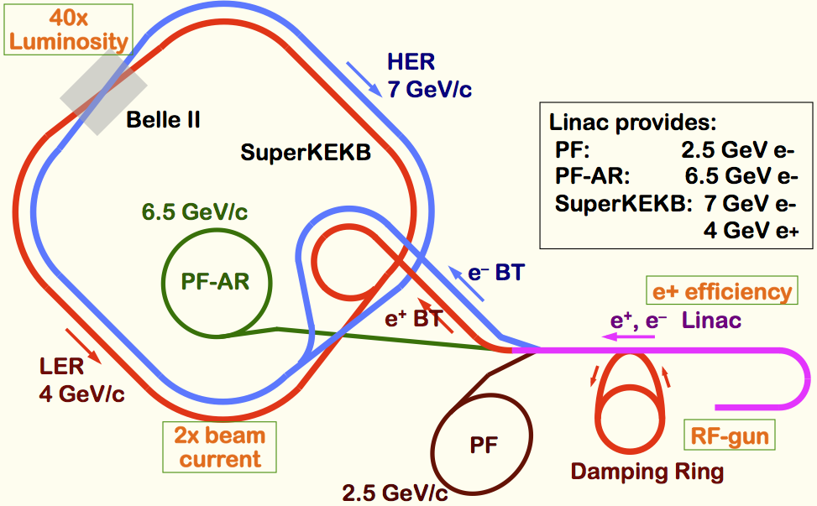
Injector Status
Requirements to Linac
  Higher charge for electron and positron
  Lower emittance for electron and positron
Linac challenges
  Low emittance and high intensity e-
    high-charge RF-gun
  Low emittance e+
    damping ring
  Higher e+ beam current
    new capture section
    with flux concentrator
  Emittance preservation
    precise beam control
Status in Phase 1
  RF gun: still under development
  Damping ring: under construction
  Flux concentrator: in practical use
  Charge at end of BT
    e-: ~0.6nC, e+:~0.6nC (2bunches)
  Dedicated machine study for injector: 1 day / week
SuperKEKB requirements (Phase 3)
 | KEKB (e+/e-) | SuperKEKB (e+/e-)
Charge [nC] | 1/1 | 4/5
Normalized emittance[μm] | 2100/300 | 100/50 (H)
 |  | 20/20 (V)
Target charge in Phase 1: ~1nC
Notes:
aHigher Injection Beam Current
To Meet the larger stored beam current and shorter beam lifetime in the ring
4~8-times larger bunch current for electron and positron
Reconstruction of positron generator, etc
Lower-emittance Injection Beam
To meet nano-beam scheme in the ring
Positron with a damping ring
Electron with a photo-cathode RF gun
Emittance preservation by alignment and beam instrumentation
Quasi-simultaneous injections into 4 storage rings
SuperKEKB e–/e⁺ rings, and light sources of PF and PF-AR
Improvements to beam instrumentation, low-level RF, controls, timing, etc

Slide 42
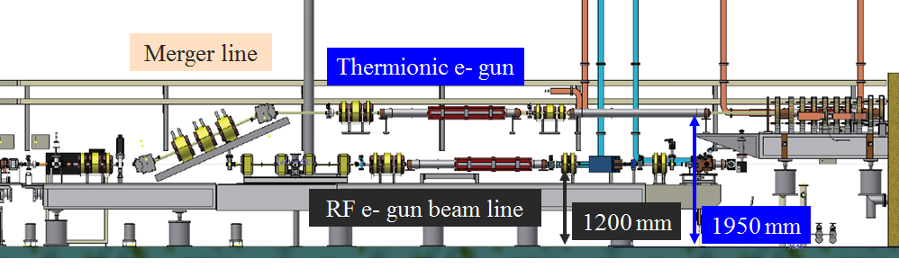
Layout of electron gun
(Thermionic DC gun and photo-cathode RF gun)

Slide 43
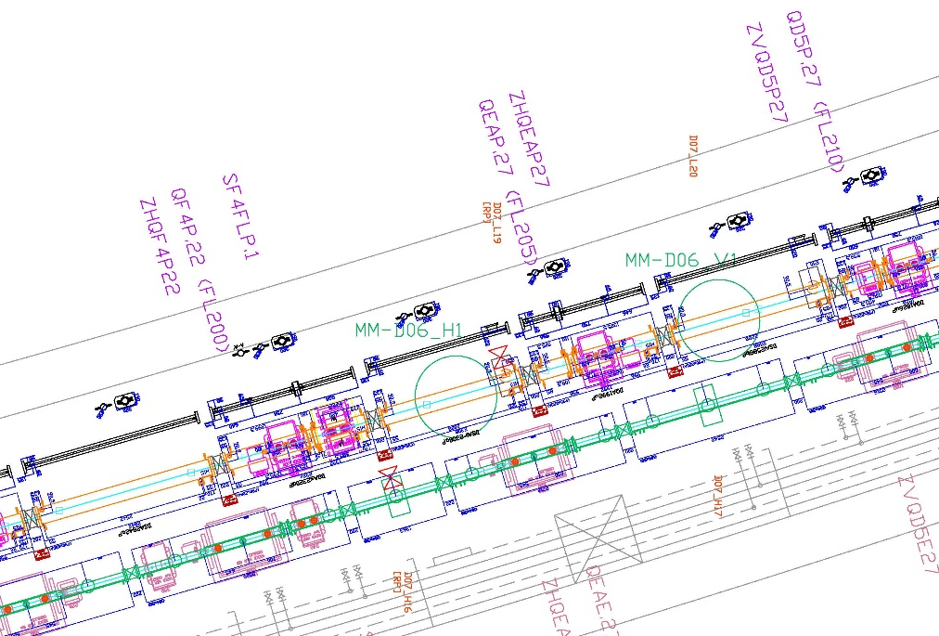
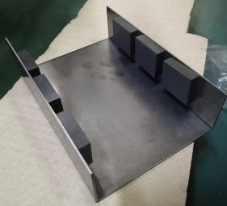
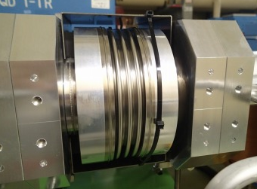
予備実験(4/25)
南トンネルの 3個のベローズに「永久磁石」を取り付けて、圧力の振る舞いを調べた。
N
S
N
S
N
CCG
S
30 x35 x6個 x上下
970G@磁石表面
ｔ1.6 Fe plate
S
N
ベローズ内部表面で
中央付近Bz = 60～120 G
磁石の真下で極性反転
S
N

Slide 44
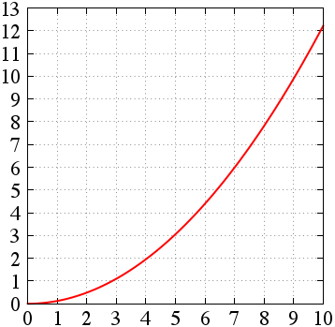
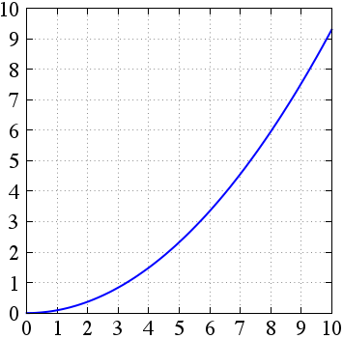
Vertical Emittance and Dispersion
LER
HER

Slide 45
Beam lifetime from vacuum and Touschek effect
  Change vertical beam size -> Lifetime measurement
  Lifetime from vacuum: 129.7 min. @(350 mA, 1576 bunches)
  Actual lifetime: 75min. -> Touschek Lifetime:177 min.
1/Lifetime
1/σ_{y}

Slide 46
Touschek lifetime from simulation
ε_{y}/ε_{x} = 15%, I_{b} = 0.25 mA
Lifetime from simulation: 113 min.
113min
15％

Slide 47
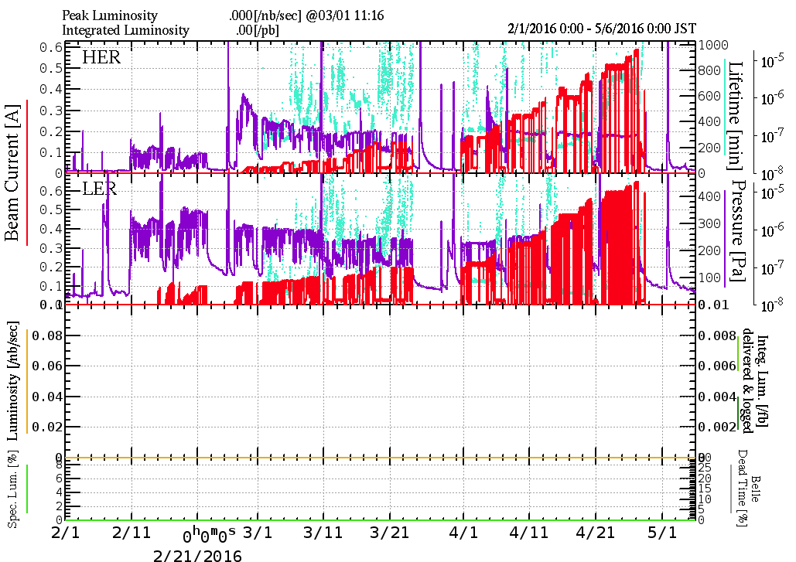
History of Phase 1 operation
e-
e+
HER injection tuning
Short break for
Injector work
Short break
LER injection tuning
BT tuning
Red: total beam current
Purple: vacuum pressure

Slide 48
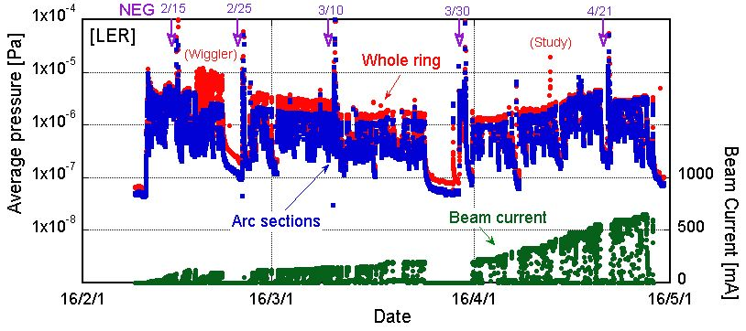
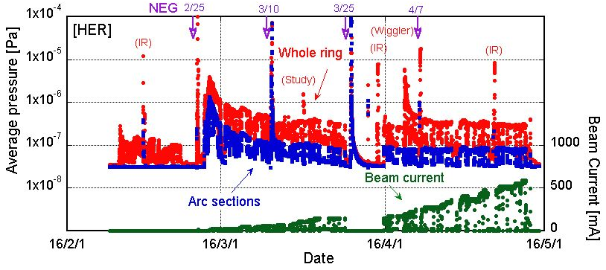
History of vacuum scrubbing
Y. Suetsugu
The beam currents and average pressures (2016/4/30)
[LER]
Max. Beam current: 650 mA
Avg. Pressure ~ 3x10⁻⁶ Pa
Life time ~ 60 min.
[HER]
Max. Beam current: 590 mA
Avg. Pressure ~ 3x10⁻⁷ Pa
(whole ring)
~ 1x10⁻⁷ Pa
(arc sections)
Life time ~ 600 min.
Request from Belle-II group: ~1 month vacuum scrubbing with beam current of 05~1A.

Slide 49
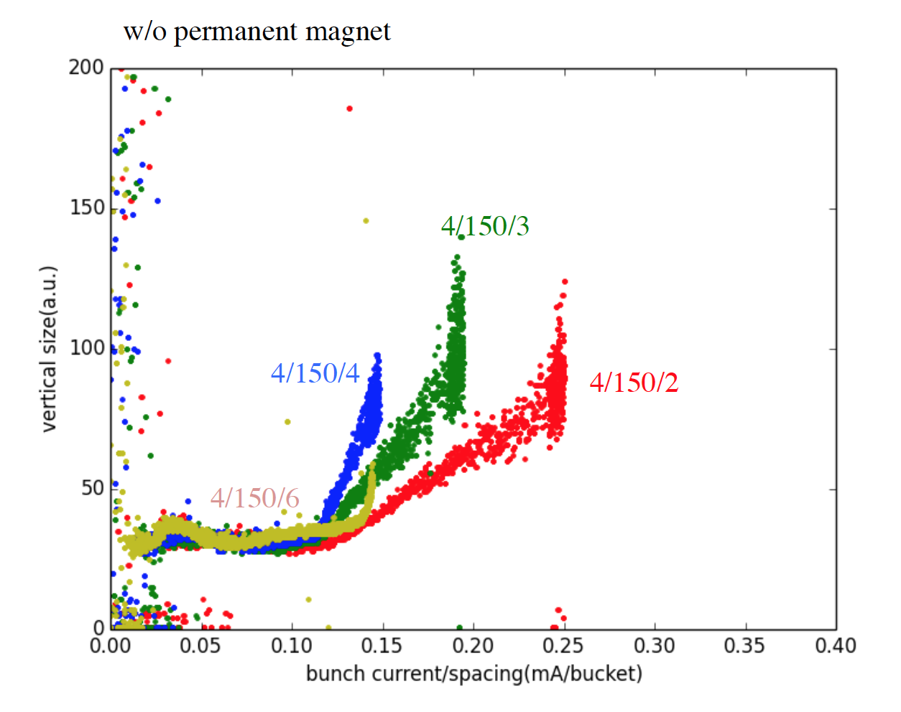
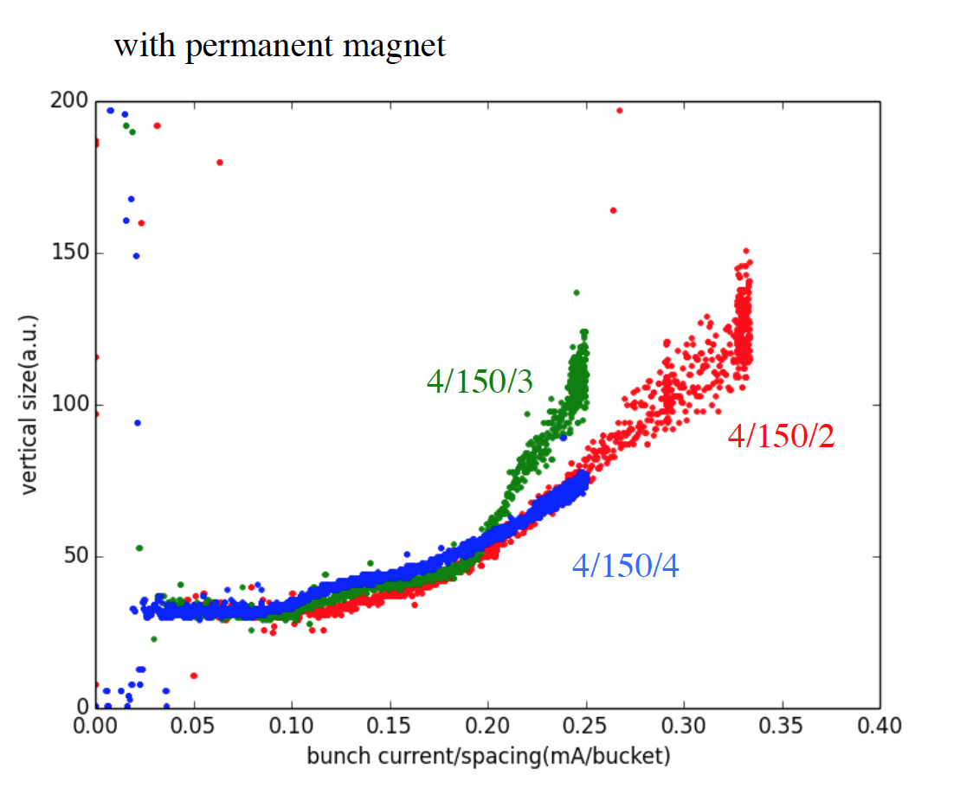
Blowup study

Slide 51
Machine study to be done in May and June (>30 shifts)
More optics study
X-ray monitor calibration
LER beam size blowup
Longitudinal/transverse bunch-by-bunch feedback system
Beast background study
Impedance measurement
Rotational sextupole magnet
Dithering coils
Beam transport line study
Linac study (RF gun etc.)

