Slide 1
Injector Linac upgrade status towards SuperKEKB
Kazuro Furukawa
Injector Linac, KEK

Slide 2
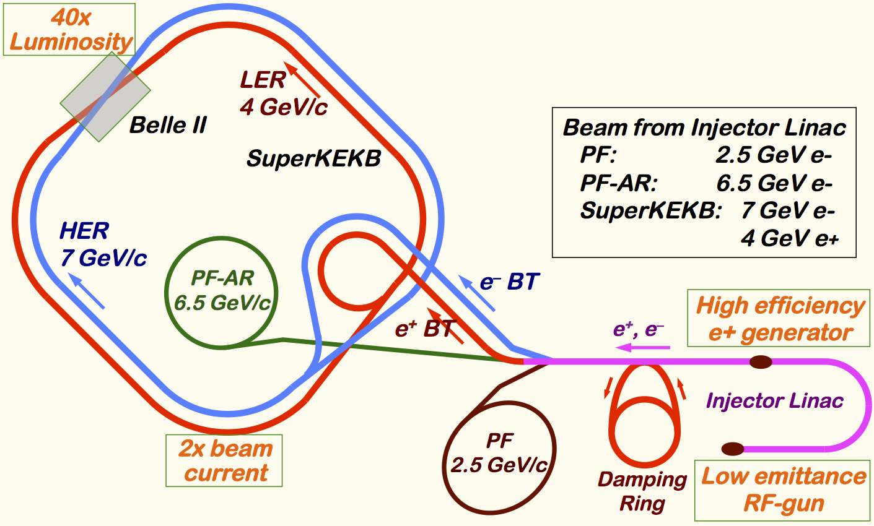
Mission of electron/positron Injector in SuperKEKB
Linac Upgrade Overview
40-times higher Luminosity
20-times higher collision rate with nano-beam scheme
→ Low-emittance even at first turn → Low-emittance beam from Linac
→ Shorter storage lifetime
Twice larger storage beam → Higher beam current from Linac
Linac challenges
Low emittance e-
with high-charge RF-gun
Low emittance e+
with damping ring
Higher e+ beam current
with new capture section
Emittance preservation
with precise alignment & beam control
4+1 ring simultaneous injection
Notes:
Higher Injection Beam Current
To Meet the larger stored beam current and shorter beam lifetime in the ring
4~8-times larger bunch current for electron and positron
Reconstruction of positron generator, etc
Lower-emittance Injection Beam
To meet nano-beam scheme in the ring
Positron with a damping ring
Electron with a photo-cathode RF gun
Emittance preservation by alignment and beam instrumentation
Quasi-simultaneous injections into 4 storage rings
SuperKEKB e–/e⁺ rings, and light sources of PF and PF-AR
Improvements to beam instrumentation, low-level RF, controls, timing, etc

Slide 3
Required injector beam parameters
Stage | KEKB (final) |  | Present Phase-I |  | SuperKEKB (final)
Beam | e+ | e– | e+ | e– | e+ | e–
Energy | 3.5 GeV | 8.0 GeV | 4.0 GeV | 7.0 GeV | 4.0 GeV | 7.0 GeV
Stored current | 1.6 A | 1.1 A | 1 A | 1 A | 3.6 A | 2.6 A
Life time | 150 min. | 200 min. | 100 min. | 100 min. | 6 min. | 6 min.
Bunch charge | Primary e-10nC → 1 nC | 1 nC | Primary e- 8nC → 0.4 nC | 1 nC | Primary e-10nC → 4 nC | 5 nC
Norm. Emittance (γβε) (μrad) | 2100 | 200 | 2400 | 150 | 100/20 (Hor./Ver.) | 50/20 (Hor./Ver.)
Energy spread | 0.125% | 0.125% | 0.5% | 0.5% | 0.1% | 0.1%
No. of Bunch / Pulse | 2 | 2 | 2 | 2 | 2 | 2
Repetition rate | 50 Hz |  | 25 / 50 Hz |  | 50 Hz
Simultaneous top-up injection (PPM) | 3 rings (KEKB e–/e+, PF) |  | No top-up |  | 4+1 rings (SuperKEKB e–/e+, DR, PF, PF-AR)

Slide 4
Progress
2010: Beam design and hardware developments
2011-2014: Recovery from earthquake, mainly because of soft-structure girder design
2012-: Construction and commissioning
2012-: Step-by-step acquirement of beam licenses
2016: Phase-1
Continuous: Light source injections
…

Slide 5
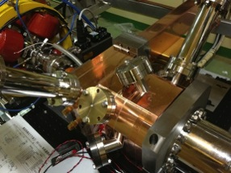
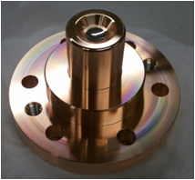
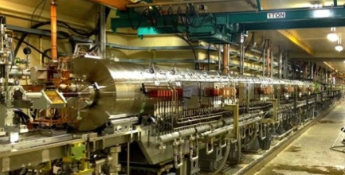
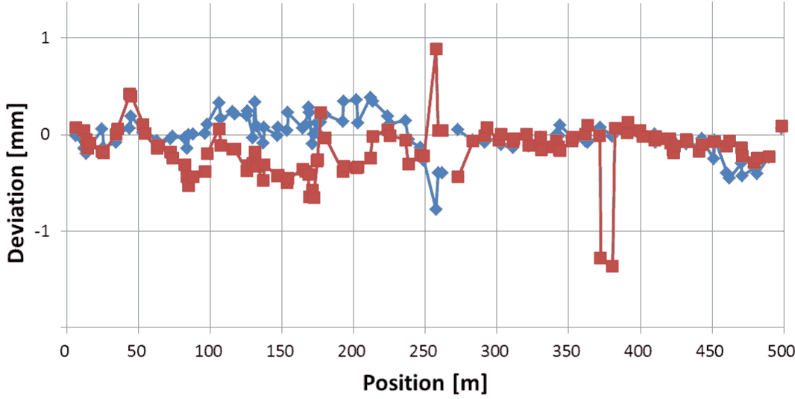
Linac Upgrade Progress towards SuperKEKB (1)
Linac Upgrade Overview
High-charge low-emittance RF gun development
QTWSC cavity and Ir5Ce photo cathode developments
Laser development is underway
Positron generator commissioning
Good agreement with the simulation results
Will solve discharge issues
Precise alignment for emittance preservation
Recovering after large earthquake in 2011
Reaching specification of 0.1~0.3mm
Longer term stability should be solved
Utility upgrade during FY2014
for electricity (+1.5MW) and cooling water (+1400L/min)
Quasi traveling wave side couple cavity
Ir₅Ce Cathode
Positron generator

Slide 6
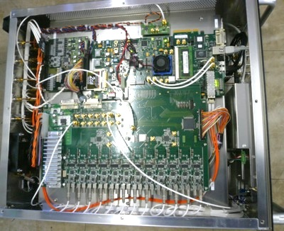
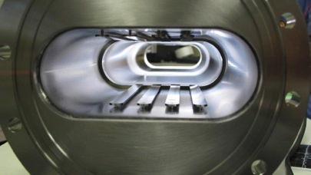
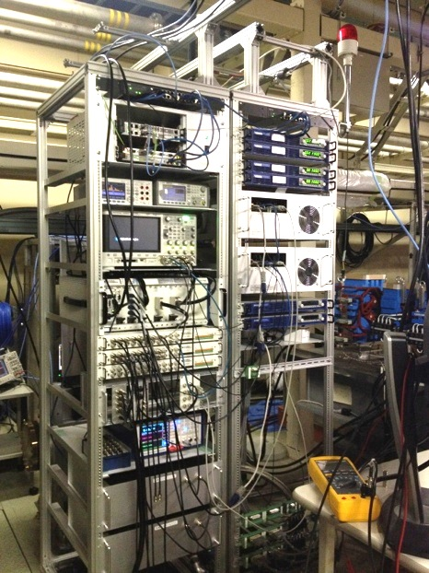
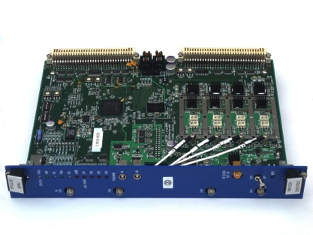
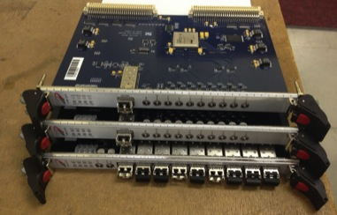
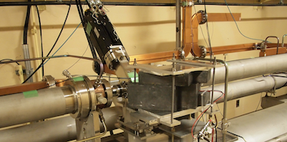
Linac Upgrade Progress towards SuperKEKB (2)
Linac Upgrade Overview
High-power microwave modulator upgrades
Low-level RF controls/monitor upgrades
Pulse-to-pulse modulation (PPM) between 4+1 rings
More spaces for increased number of devices
Beam instrumentation
Large/small aperture beam position monitors (BPM)
Precise/fast and synchronized BPM readout system
Wire scanners and beam loss monitors
Streak cameras
(Deflectors, etc.)
Pulsed magnet developments
~3 bends, ~30 quads, ~40 steerings
Even with energy recovery
Event-based control and timing system upgrades
Combination of MRF & SINAP modules
Essential for PPM operation
Precise timing & synchronized controls
Bucket selection at DR and MR
Pulse magnet tests
SINAP event modules
Beam wire scanner

Slide 7
Bucket selection in Phase-2 with DR
Without DR, simply wait up to 5120 x 96 ns ~ 490 μs
96 ns : highest common frequency between linac – ring
With DR, in order to select arbitrary bucket in MR, have to wait up to ~4.5 ms, even if a bucket in DR was carefully selected
Power supply can wait only 2 ms, one of only 2798 buckets in 5120 buckets can be selected, may have to change LLRF condition at latter half of linac every pulse
Can be a big challenge in LLRF precision
e⁻ Gun
KEKB
ARC
Primary e– (3.5GeV, 10nC)
e⁺ BT (3.5GeV, 0.6nC)
e⁺ Target
96ns
>100ns
e⁺ DR (1.1 GeV, 4nC)
e⁻ Gun
>100ns
SuperKEKB
ARC
96ns
Primary e– (3.5GeV, 10nC)
e⁺ BT (KEKB: 4GeV, 4nC)
e⁺ Target

Slide 8
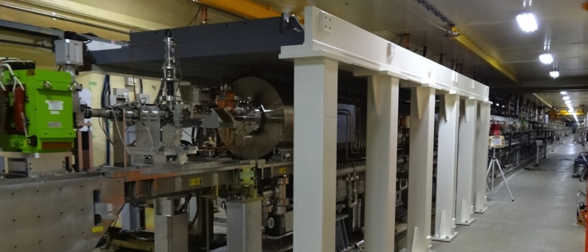
Beam Upgrade and Radiation Controls
Schedule
Step-by-step upgrade of beam limits
Towards 5 nC per bunch in Phase-3
Beam license applications
Fall 2013, 10 nA at #28 dump, 1250 nA at #A2 dump
Spring 2014, New utility rooms, 50 nA at #61 linac-end dump
Summer 2015, 200 nA at #15 positron target
Spring 2016, 800 nA at #15 target
Before Phase-3, 1250 nA at #15 target, 625 nA at #61 dump
Radiation shield additions …
For Gun, 180deg-arc, Target, Electron stopper, Collimator, Damping-ring dump, Linac-end dump, 5 utility rooms, etc
Even balancing with PF and PF-AR beam operations

Slide 9
SuperKEKB master schedule
・・・
JFY2010
JFY2011
JFY2012
JFY2013
JFY2014
JFY2015
JFY2016
JFY2017
・・・
Now (Jun, 2016)
KEKB operation
Dismantle KEKB
Phase 2 commissioning：
Low beta* tuning at IP
Collision tuning
Start physics data taking
SuperKEKB upgrade construction
Phase 3：
Physics run with full Belle II with VXD
Phase 1 commissioning goes as expected even with RF-gun
Startup, conditioning, etc.
Large Earthquake
Mar.2011
SuperKEKB operation
Phase 1
Phase 2、3
Phase 1 commissioning：
Basic machine tuning
Low emittance beam tuning
Vacuum scrubbing
Started on Feb.1.2016.
DR
For ~10 years
Belle II install,
QCS install
DR commissioning starts prior to Phase 2
Akai, Mar.2016.

Slide 10
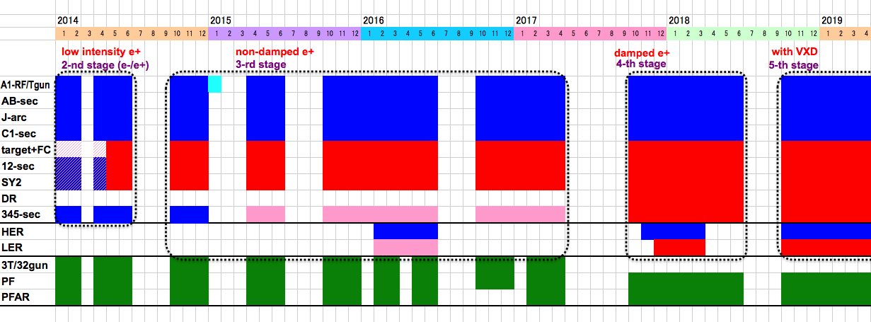
Linac Schedule Overview
Schedule
RF-Gun e- beam
commissioning
at A,B-sector
e- commiss.
at A,B,J,C,1
e+ commiss.
at 1,2 sector (FC, DCS, Qe- 50%)
e- commiss.
at 1,2,3,4,5 sector
Phase1: high emittance beam for vacuum scrub
Phase2,3: low emittance beam for collision
Time →
Location
↓
Beam Licenses in steps
Low Emittance Beams
4+1 Ring
Injections
DR Commiss.
1 nC
Phase1
2 nC
Phase2
4 nC
Phase3
Without Top-up
Direct PF-AR BT
: Electron
non damped e+ commiss.
at 1,2, 3,4,5 sectors
e- commiss. at A→5 sectors
damped e+ commiss.
at 1→5 Qe+ = 1~4nC
e- commiss.
at A→5 Qe- = 1~5nC
Improved RF gun
: Positron
: Low current electron

Slide 11
Subjects to Consider
Have to consider too many subjects !
Phronesis needed (Greek: Practical wisdom, Ability to understand the Universal Truth)
Nov.

Slide 12
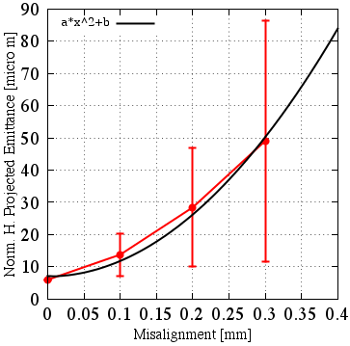
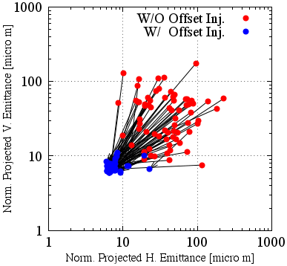
Emittance Preservation
Alignment
Offset injection may solve the issue
Orbit have to be maintained precisely
Mis-alignment should be <0.1mm locally, <0.3mm globally
Mis-alignment leads to Emittance blow-up
Orbit manipulation compensates it
100 samples
Sugimoto et al.

Slide 13
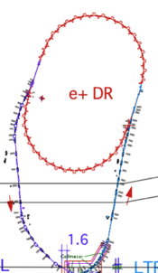
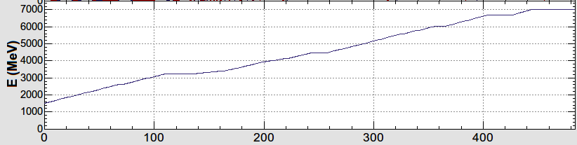
Injector Linac Energy Management
1.1 GeV
Damping Ring
circ. 136 m
e-/e+ beam with different bunch charge and energy are accelerated by 50 Hz repetition rate.
Low emittance
RF gun
1.5 GeV
3.5 GeV
10nC x 2 (prim. e-)
5nC x 2 (inj. e-)
BCS
ECS
PF
3T
RF gun
PF-AR
ECS
e+ target &
LAS capture section
chicane
HER
LER
5 nC x2
HER: 7GeV e-
PF-AR: 6.5GeV e-
4.219 GeV
5nCx1
e-
LER: 4GeV e+
4 nCx2
e+
1.1 GeV
PF: 2.5 GeV e-
e+ target
0.1nCx1
1.5 GeV
e-/e+ compatible optics
Optics is changed for each pulse by using
pulsed quads (Doublet) & steering magnets

Slide 14
Pulse-to-pulse modulation
Event-based Control System
Four PPM virtual accelerators for SuperKEKB project Based on Dual-tier controls with EPICS and event-system Independent parameter sets for each VA (20ms) >200 parameters for equipment controls many more for beam controls maybe with additional PPM VA of stealth beam for measurement
Every 20 ms
F.B
e⁻ Gun
F.B
ARC
PF Injection
e– (2.5GeV, 0.2nC)
F.B
e⁻ Gun
Damping ring
SuperKEKB-LER Injection
F.B
ARC
e– (3.5GeV, 10nC)
F.B
e⁺ Target
e⁺ (4GeV, 4nC)
e⁻ Gun
ARC
SuperKEKB-HER Injection
F.B
F.B
e– (7GeV, 5nC)
e⁻ Gun
F.B
ARC
PF-AR Injection
e– (6.5GeV, 5nC)

Slide 15
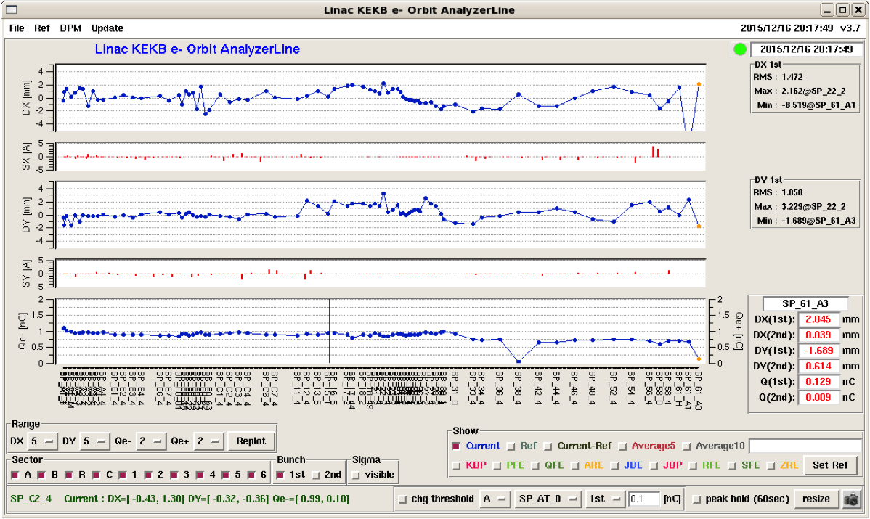
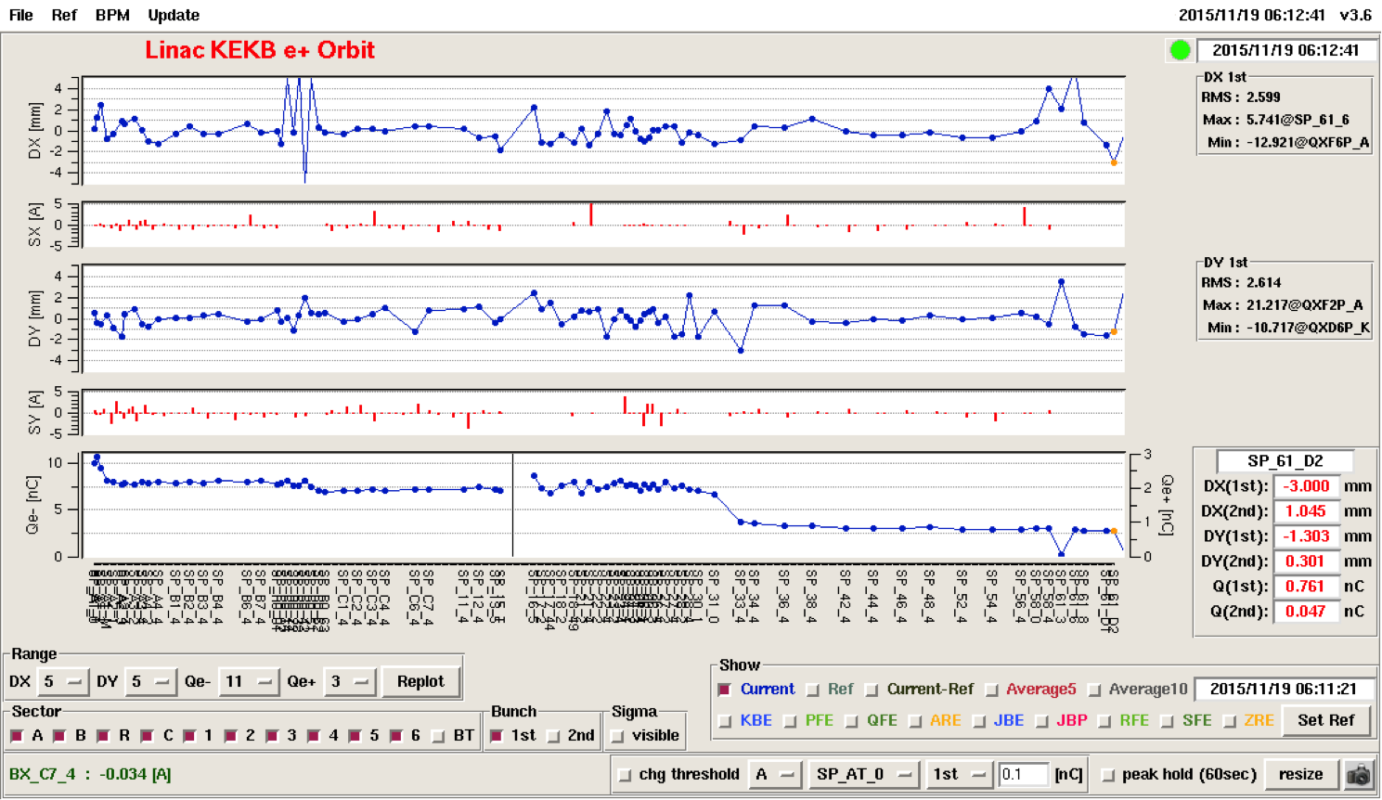
Injector Beam Commissioning for Phase-1
Electron beam
Thermionic gun at the beginning
1 nC per bunch
2 bunches per pulse
50 pulse per second
Positron beam
Primary electron with 7-8 nC per bunch
Positron of 0.7 nC at linac end without damping ring

Slide 16
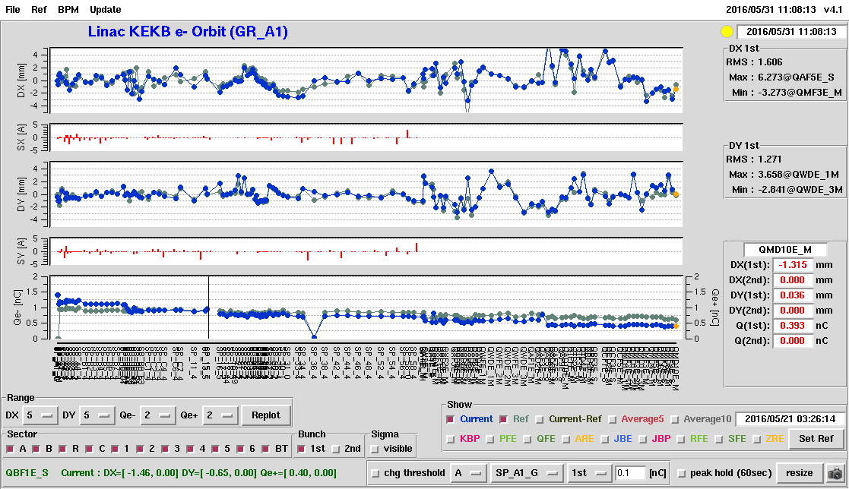

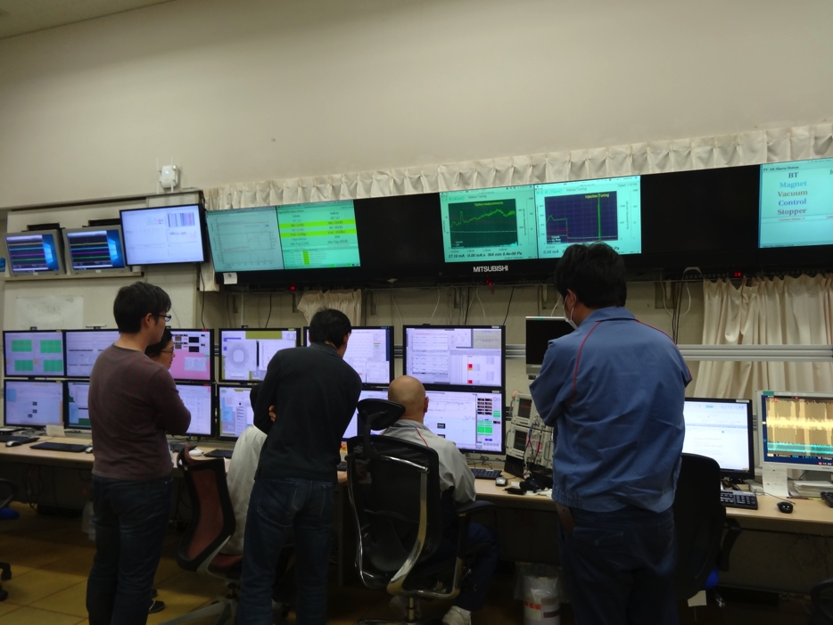
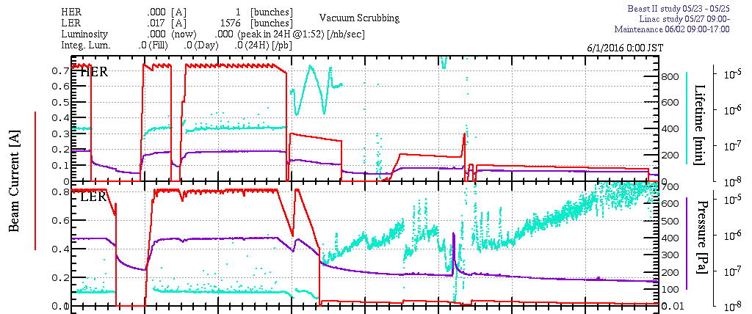
Progress: RF gun
MR injection from RF gun during Phase-1 was recommended in the last gun review, and was planned for May 2016 since the last year
On May 31, even an unusual centipede (~15cm!!) managed to visit the operation room to celebrate the first injection into HER
Ibaraki Nature Musium

Slide 17
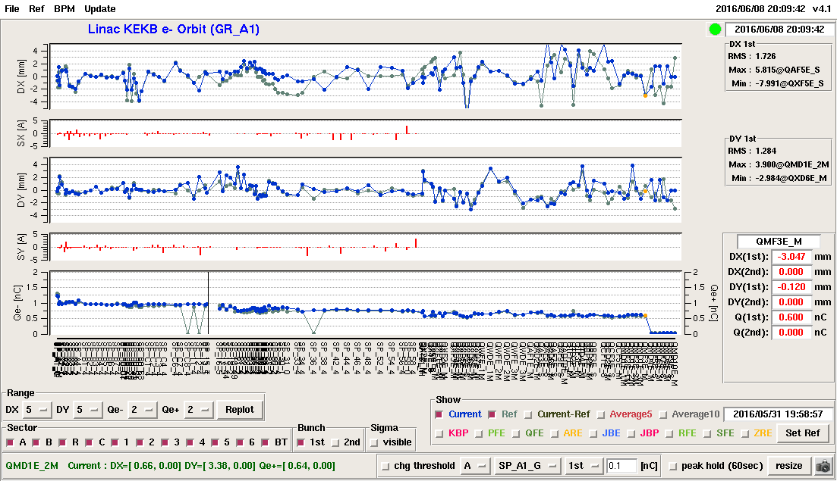
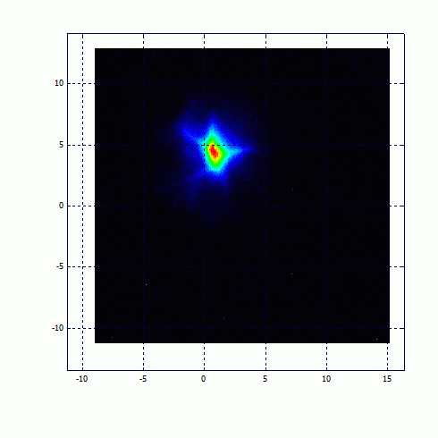
Beam from RF gun
Successful Injection into MR for the first time, on May.31
And continuing the RF gun operation since Jun.8

Slide 18
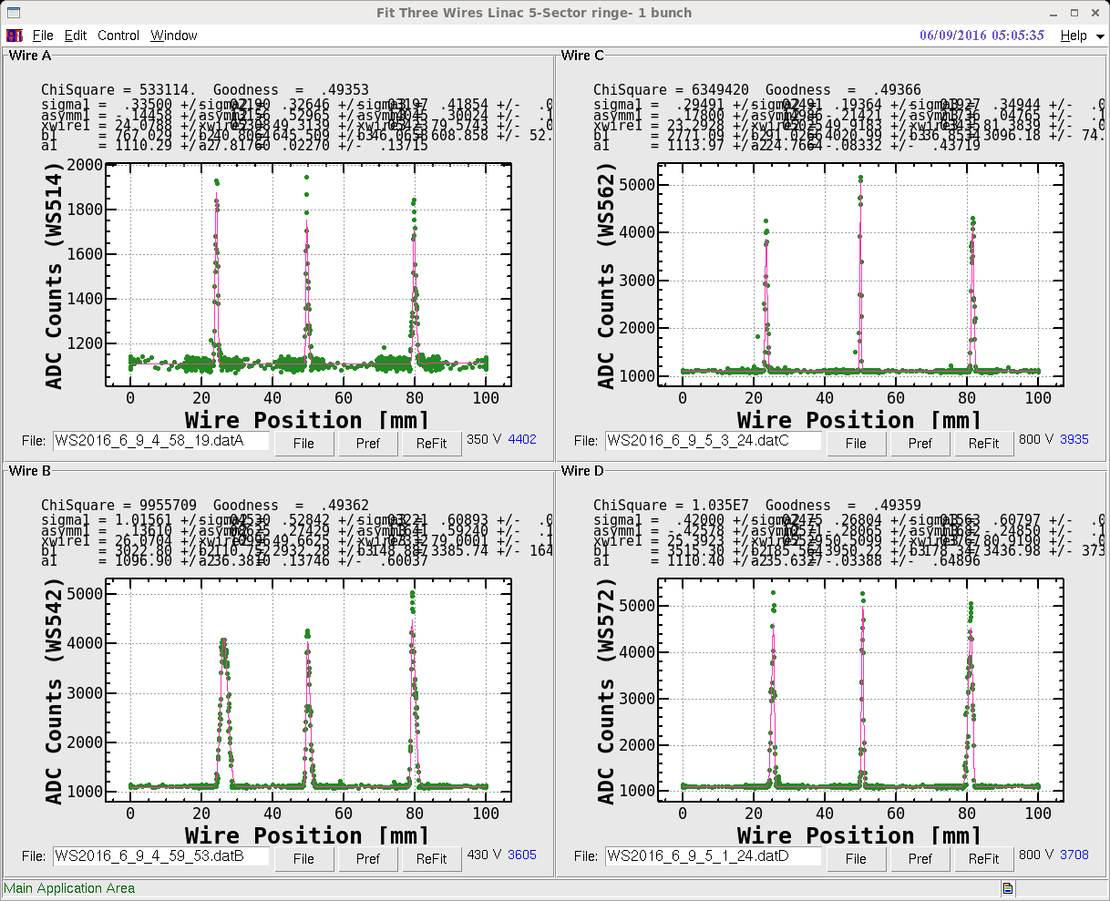
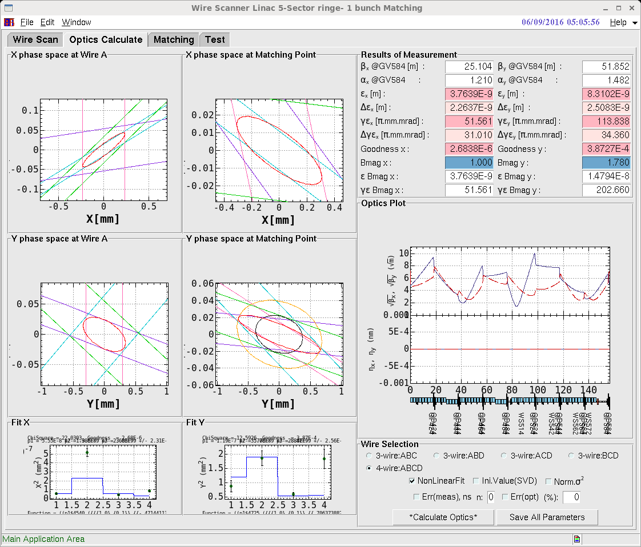
Wire Scanner Measurement
Present beam: 1nC/bunch, 25Hz, 20mm.mrad at the gun, 30~200 mm.mrad at the linac end, ? Energy spread
Phase-2: 2nC/bunch, 50Hz, 20 mm.mrad at the linac end, 0.1% energy spread
Phase-3: 4-5nC/bunch
Much room to enjoy the improvements

Slide 19
Injector Talks
RFgun Report, Y. Honda
RFgun and Electron Beam, M. Yoshida
Laser and RFgun, X. Zhou
Positron Generation and Beam, T. Kamitani
Injector Alignment, T. Higo
Injector Commissioning, M. Satoh
(Positron damping ring, M. Kikuchi)

Slide 20
Summary
Summary
We learned a lot during KEKB operation
Injection into SuperKEKB is another challenge with higher beam charge and lower transverse and longitudinal emittance
Steady progress towards designed injection beam in steps
Alignment: almost confident on the required precision (0.1-mm local, 0.3-mm global), need to maintain for longer term
Positron generator: another license test, need discharge analysis
Thermionic gun: re-commissioned for primary electron for positron generation
RF gun: following recommendations at review meetings
Need much more radiation shield
Will balance between final beam quality and progressive operation
Will select optimized route depending on available resources
Negotiation with light sources
Commissioing and development in parallel (no other choices)

Slide 21

Mt. Tsukuba
Thank you
SuperKEKB
dual rings
PF-AR
PF
600m Injector Linac

