Slide 1
Injector alignment
KEKB Accelerator Review Committee
14 June, 2016
Toshi Higo (Injector linac group)

Slide 2
Contents
Alignment scheme
Laser PD and tracker
Initial alignment
Accelerator girders and magnets
Floor movement
Refinement of PD measurement
Effort against emittance growth
Present development
Near future perspective
Conclusion

Slide 3
Who are contributing
Accelerator group
Enomoto, Higo, Kakihara, Tanaka, …..
Control group
Mikawa, Satoh, Seimiya, Suwada, ……
Injector group
Yoshida,
Mitsubishi Electric.
Mizukawa, Kimura, Kudo, Kusano, Suzuki, Toyotomi, Ushimoto, ….
Outside company
Nishitani, Chiyokura, …
Magnet group of KEKB ring
Masuzawa, Sugawara, ….. but still loose coupling

Slide 4
Requirement and strategy
Requirement
Strategy
Laser PD measurement
Initial alignment of girder
Hard ware alignment on girder

Slide 5
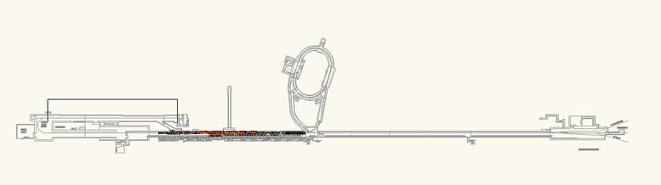
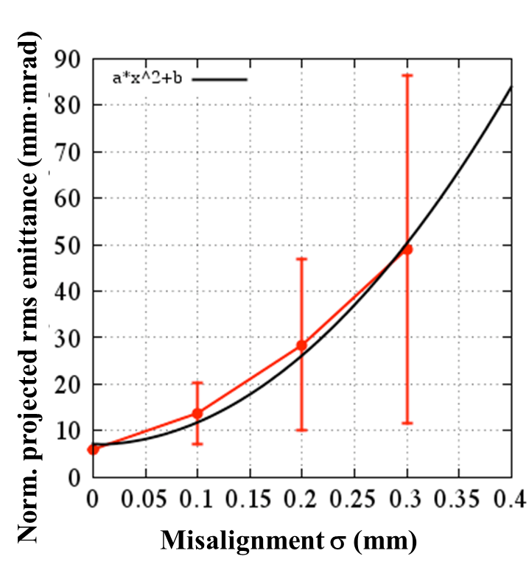
Linac layout and alignment requirement
120m
J-ARC
B
A
Rings
C
1
2
3
4
5
Laser
End PD
500m
σ < 0.1 mm→ βγε 20 mm·mrad
almost kept.
σ > 0.1 mm→ emittance preservation
required.
Requirement
Local σ < 0.1mm
Global σ < 0.3mm

Slide 6
Alignment scheme
Reflectors for laser tracker use
4
Reference point of girder
Hard ware
Mechanical reference
3
2
Girder set to laser reference by PD
Support set w.r.t. mecha. reference
Hard ware aligned with mecha. reference
Hard ware alignment checked by tracker
1
Laser PD
Girder

Slide 7
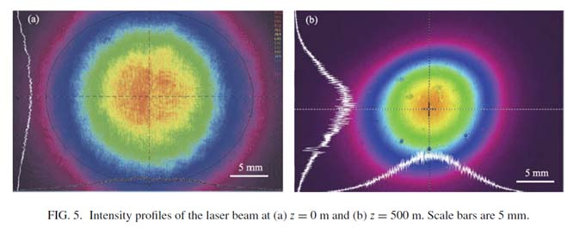
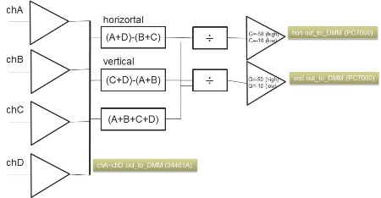
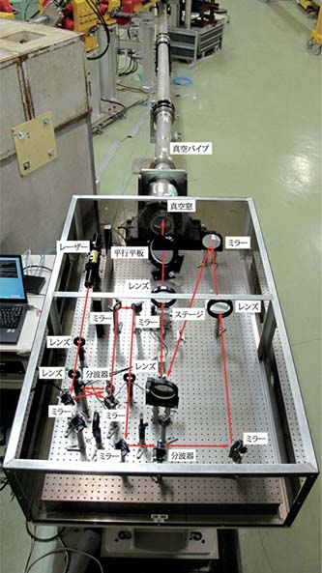
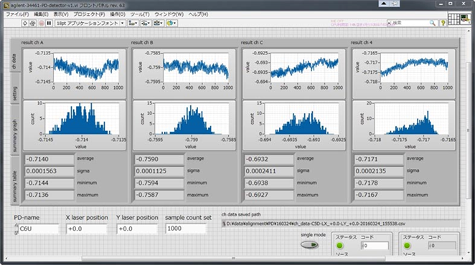
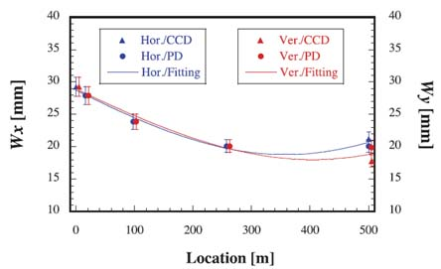
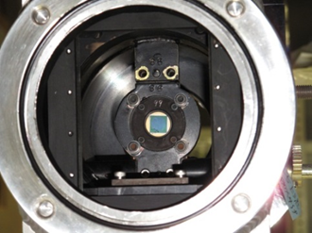
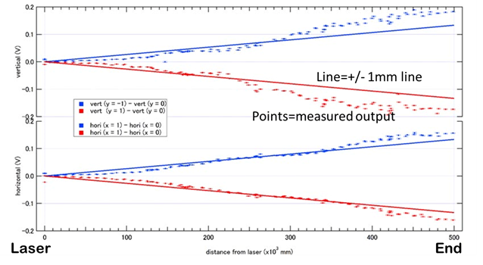
500m straight reference line by laser
500m laser line stabilized by laser passage tilt.
Improved data reliability with robust measurement.
Sensitivity calibration done with laser tilting
Some sensors automatically and continuously measuring now
Started PD radiation damage evaluation

Slide 8
Initial alignment of girders
Girders in sectors 3—5 were quickly aligned in 2011 after the earthquake.
Positron generation section was installed by summer 2014.
By late Jan. 2015, all units in 3—5 sectors were aligned straight.
These alignment reading is better than 0.1mm at the timing of installation.
Alignment has been measured from time to time without further re-alignment.

Slide 9
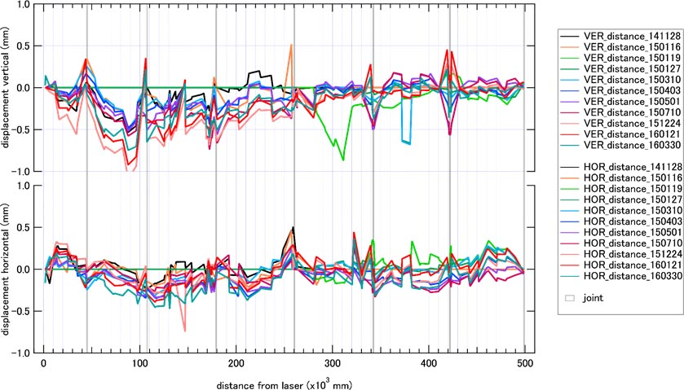
Measurement 141128 -- 160330
Vertical
Horizontal

Slide 10
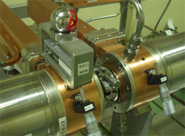
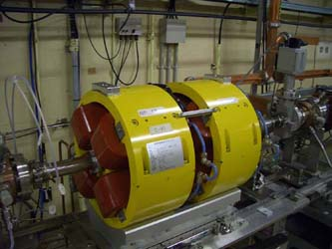
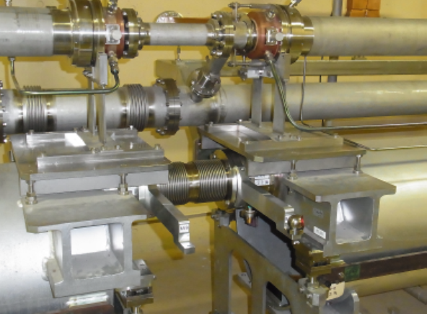
Mounting tracker reflector on each hard ware
Mounted on coupler OD
Reflectors for old Q-magnet
Arm from PD to reflector

Slide 11
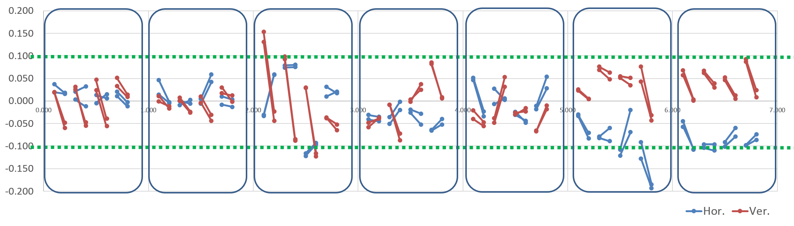
Hard ware alignment on each girder measured in Jan. 2016
B4
C5
26
36
46
54
55
σ=0.056mm
σ=0.051mm

Slide 12
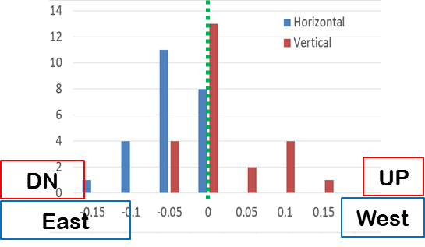
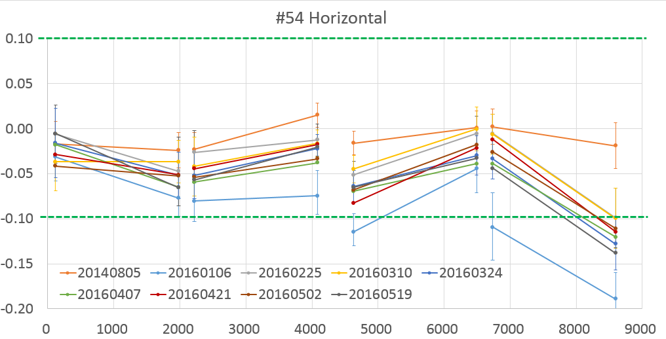
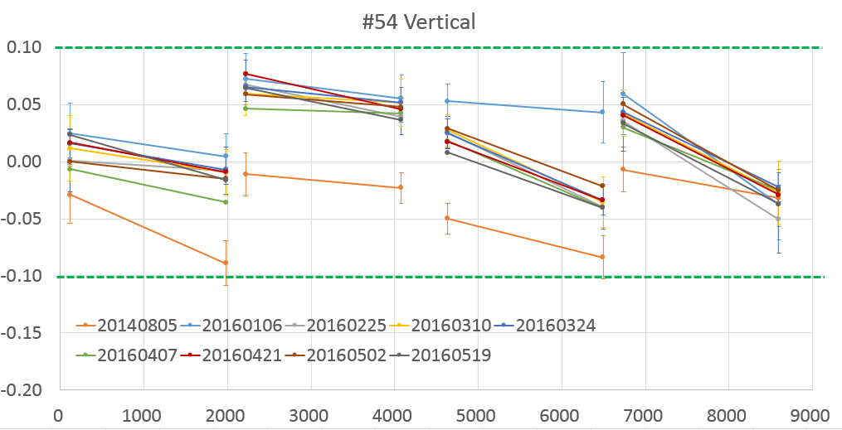
Accelerator position on girder unit 54 from August 2014 to May 2016
Movement in 1.5 year between July 2014 and January 2016
Unit 54 in nearly 2 years
from Aug. 2014 to May 2016
W
[mm]
E
[mm]
[mm]
U
ACC’s can be aligned on each girder within below +/-0.1mm.
It is speculated to be stable within +/-0.05mm.
This should be confirmed or realized.
D
[mm]

Slide 13
Floor movement
Laser PD measurement showed movement of larger than a millimeter
Severe at expansion joints
Started continuous measurement over 500m
Will start detailed 40m evaluation across a joint

Slide 14
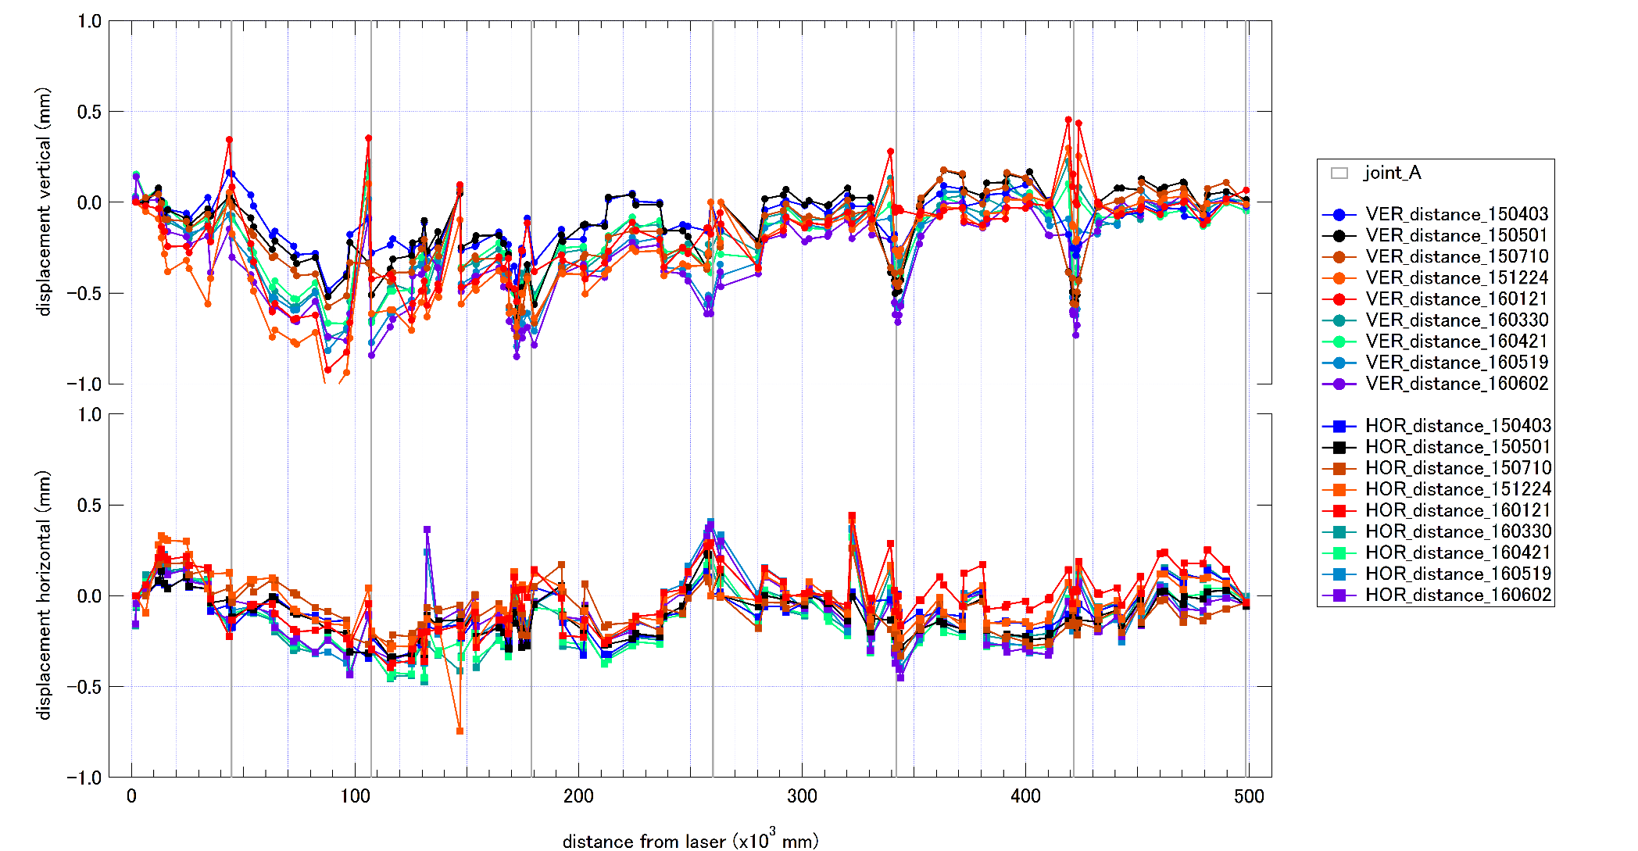
Floor moves by fraction of 1 mm example in more than a year (2015/4/3~2016/6/2)
Vertical
Horizontal

Slide 15
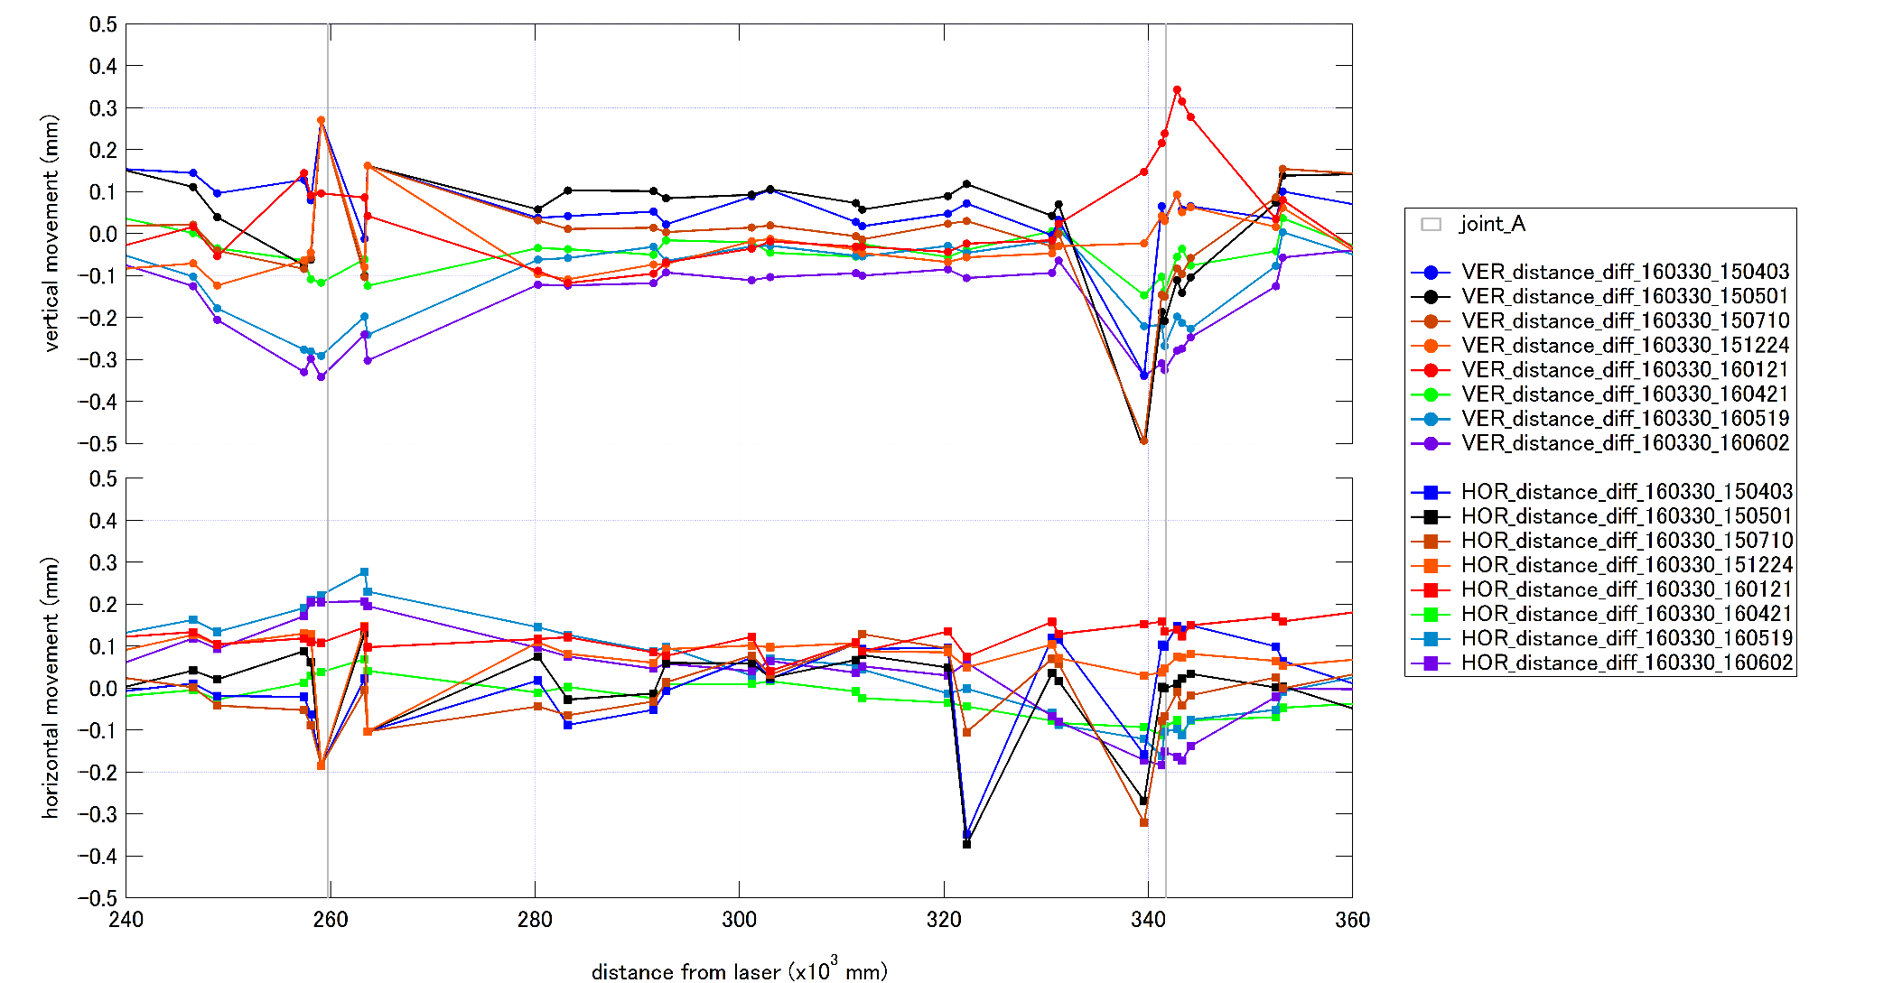
Floor movement close-up w.r.t. 2016/3/30
Expansion joint
Expansion joint
~20m from expansion joint is mostly moved.

Slide 16
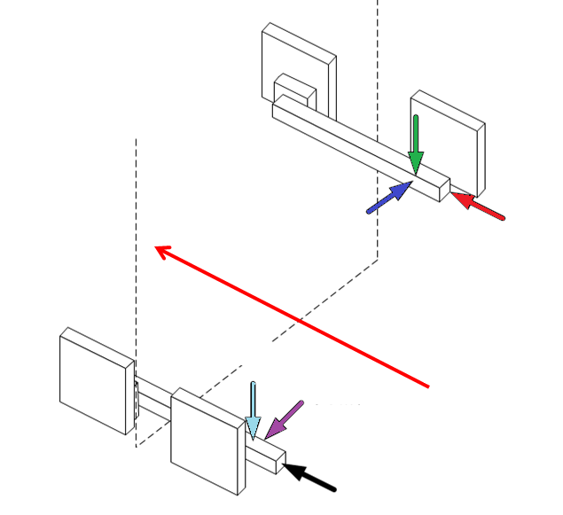
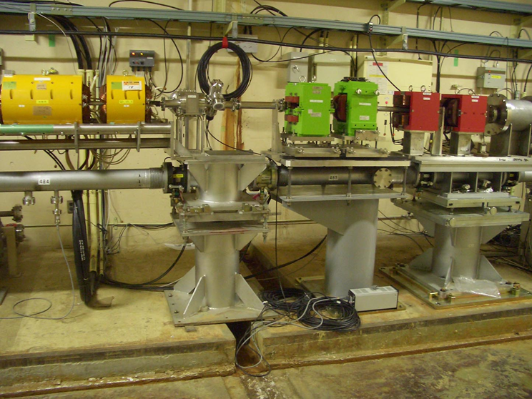
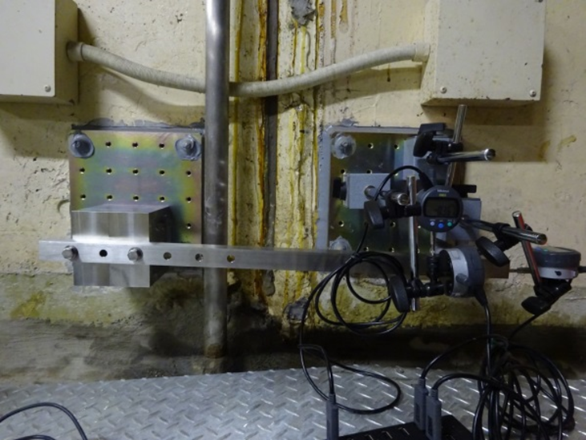
Expansion joint and evaluation
East wall
Down
Notrth
Beam
Up
South
West wall
Dial gauges
Expansion joint

Slide 17
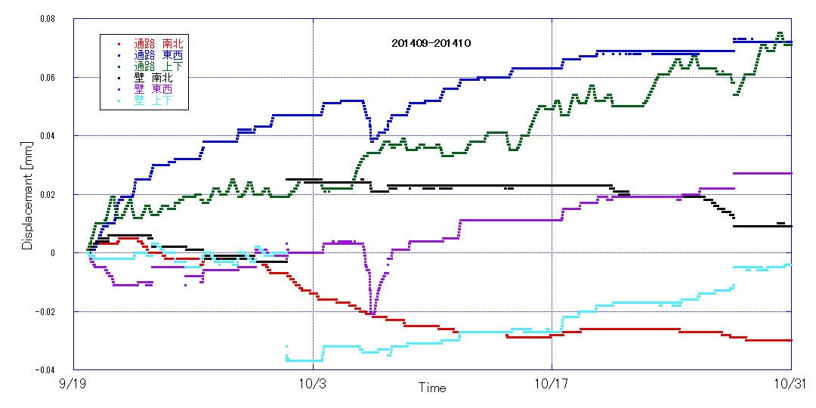
Relative movement across expansion joint at 28 unit
Up
North
Typhoon
East
OFF
Operation
19 Sep. 2014
31 Oct. 2014
Daily regular motion exists
Gradual drift over a month after operation starts
Sensitive on tunnel temperature
Big perturbation due to typhoon
Show a year cycling.
Notes:
台風による浸水
ドリフトしている

Slide 18
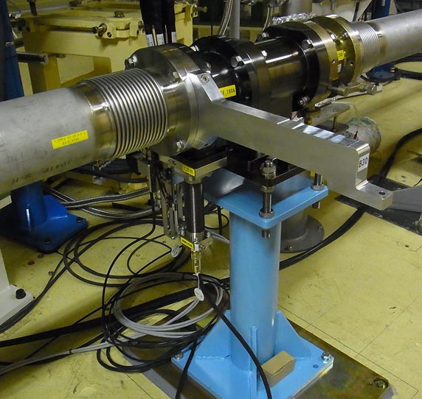
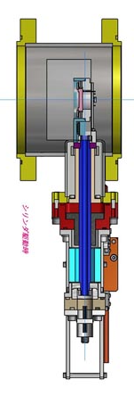
PD measurement automatic and continuous
Measurement in every 4 hours

Slide 19
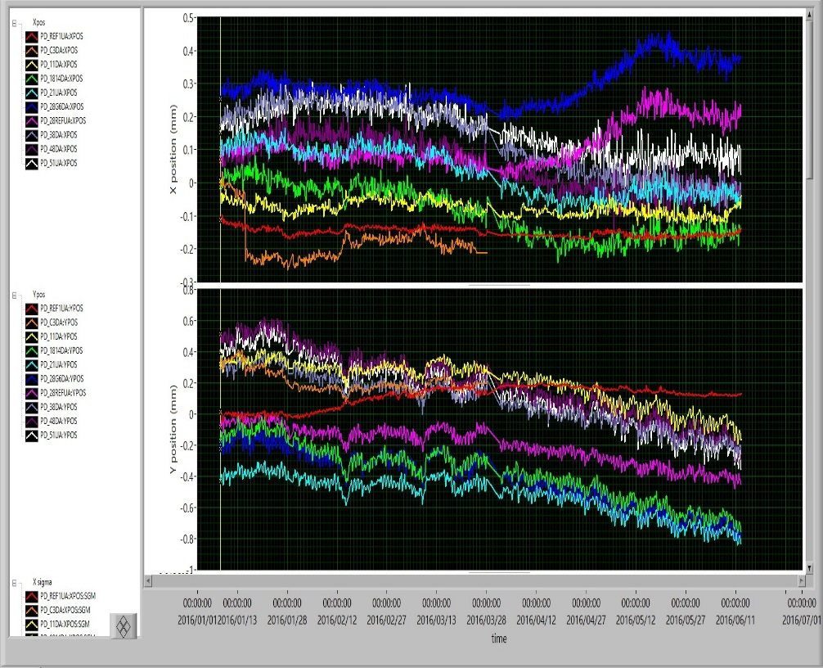
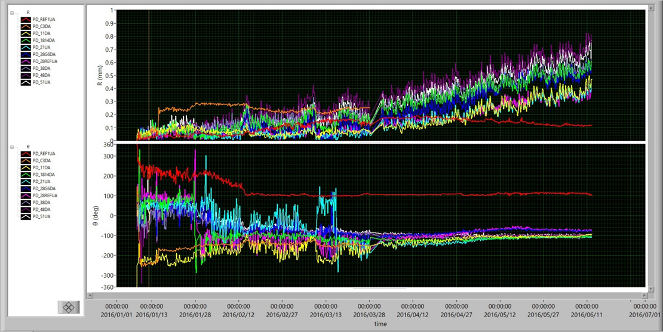
Automatic measurement in every 4 hours at 10 locations for half a year
from January to June in 2016
Horizontal
Absolute
Vertical
Rotation

Slide 20
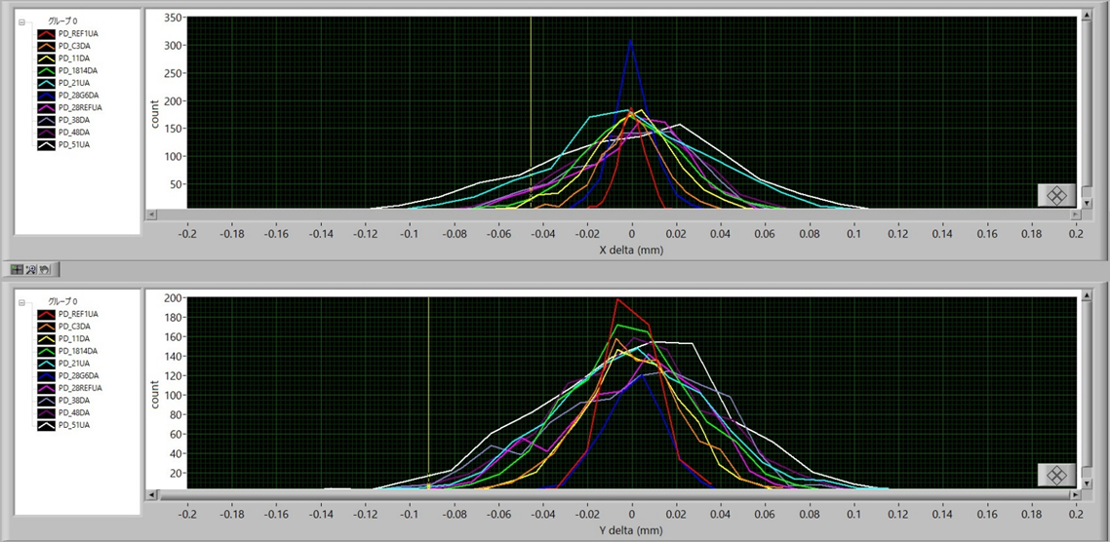
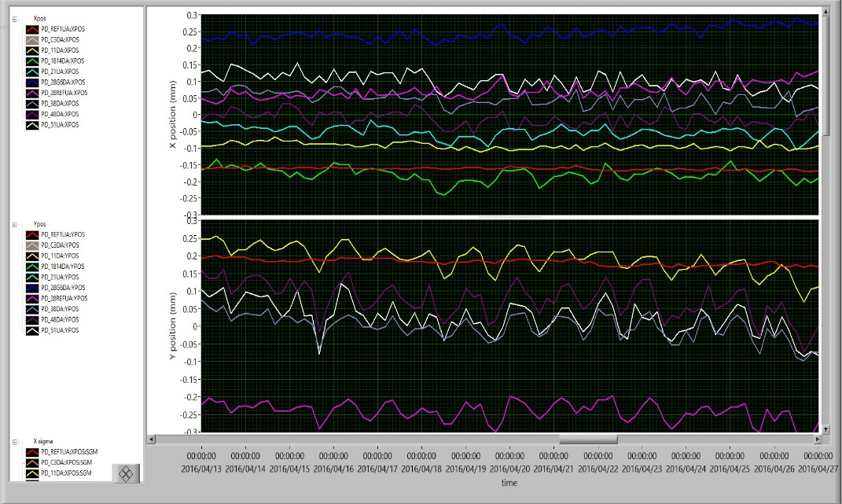
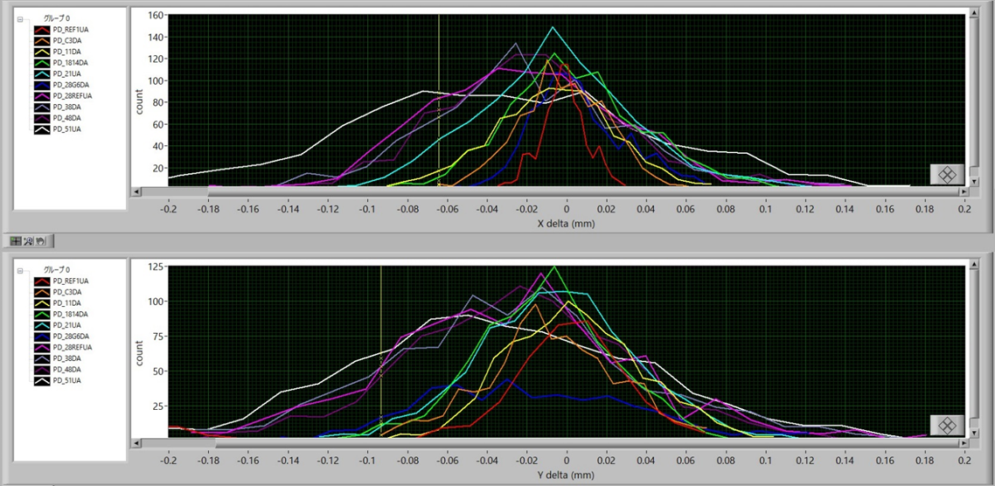
Daily motion Movement in 4 hours or those in a week
Red arrow = +/- 0.1mm band
4 hour motion
Hor.
Hor.
During 2 weeks
Ver.
Ver.
1 week motion
Hor.
Daily motion full ~ 0.1mm
Motion in 4 hours ~ 1 week +/- 0.1mm
Ver.

Slide 21
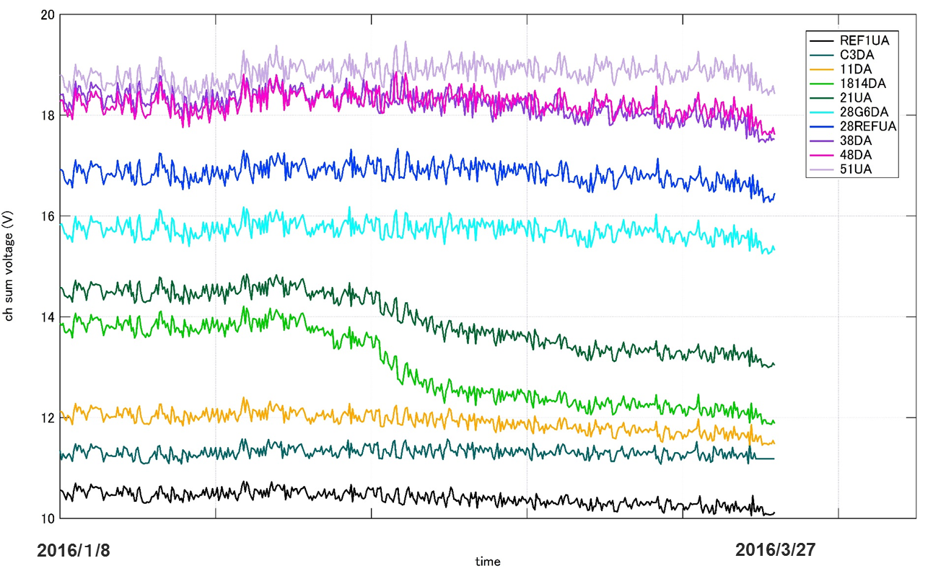
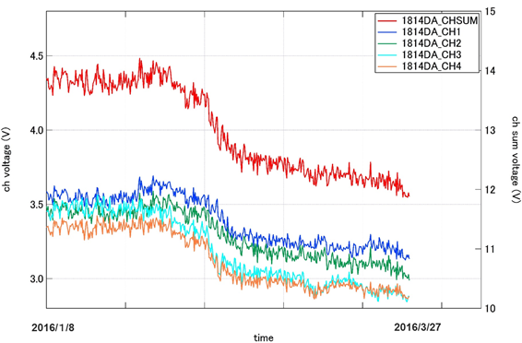
A concern PD deterioration due to radiation
Channel sum (V)
Sum
Ch1-4
Time
Deterioration observed during phase-1 operation for those at collimator.
How to use the PD information needs to be studied.

Slide 22
Simulation and cures
SAD simulation started
Possible cure methods are under consideration.
How to stabilize position to keep alignment?
Studies should be made how to compensate the floor movement
Do we need other tool to evaluate the floor motion? i.e. HLS or WPS
How to implement beam information into feedback
Compensation algorithm
One-to-one steering → Minimize residual error^2
DF or WF steering
How fast can we and how frequent should we apply offset injection?

Slide 23
SAD simulation on emittance growth along 500m straight section
Assumption
Procedure
Sector C~5 over 500m
ε_{inj} = 10 μm
σ_{z} = 10ps / 2.35
δ_{e} = 0.4%
σ_{Q} = 0.2mm (3σ cut)
X_{ACC}, Y_{ACC} = Girder(measured)
2a_{ACC} = 20mm (diam.) for wake calc.
W_{t} = Yokoya formula
Orbit correction at BPM without wake field
Offset injection (x, x’, y, y’) at the front of sector C with wake field ON
Add variation in misalignment of ACC and Q
Add jitter in ST and Q
Check response to beam injection jitter

Slide 24
60 seeds of misalignments
Phase-2
2nC
Phase-3
5nC

Slide 25
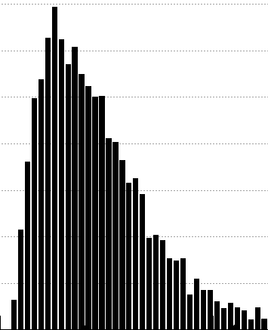

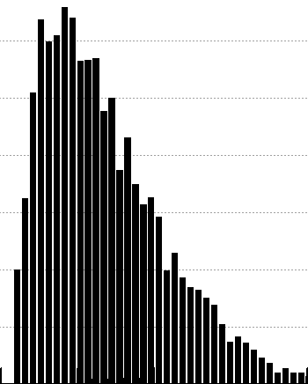
60 seeds of misalignments + perturbation unable to be compensated
Injection jitter
K-value jitter
ST: K jitter = Peak K value X 0.08% (P-P)
Q: K jitter = Peak K value X 0.32% (P-P)
Injected beam: No jitter
ST, Q: K jitter = Operation K value X 0.2% (P-P)
Injected beam position jitter ~ beam size:
Sigma 0.1mm Gaussian in 100 seeds
Mainly due to injection jitter
Jitter should be less than beam size
Mainly due to ST-K jitter

Slide 26
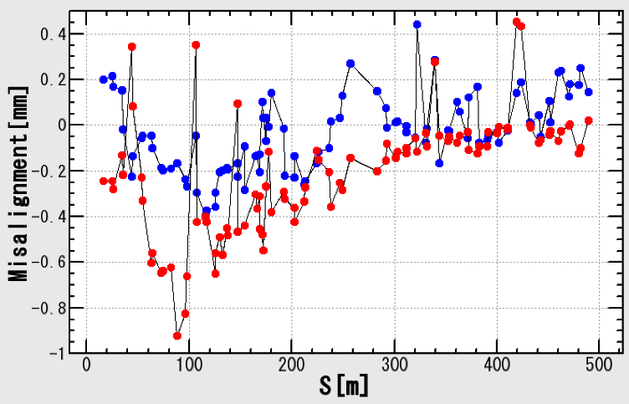
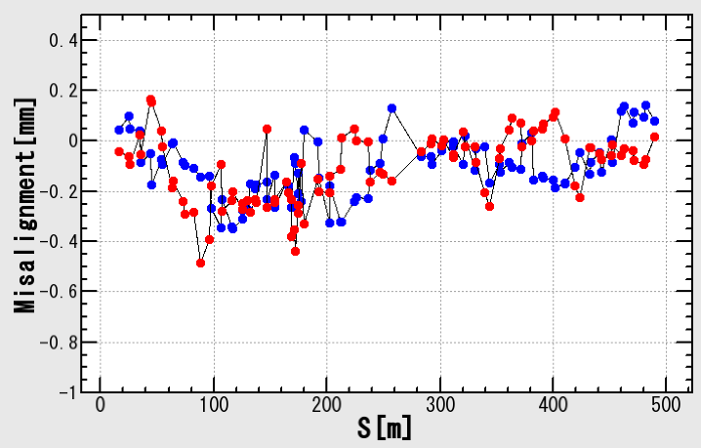
Emittance growth under measured misalignment + random movement not to be compensated
Black: σ_{ACC}=0.1mm, σ_{Q}=0.2mm
Red = X2
Red = X4
Red = X8
2016/01/21
2015/04/03
Uncompensated random movement of 0.4mm in sigma is marginal?

Slide 27
Floor movement to be compensated
Unit mm
 | Horizontal | Vertical
Daily | 0.1 | 0.1
Week | 0.1 | 0.1
Year | 0.5 | 1
Speed | 0.01mm/hr | 0.01mm/hr

Slide 28
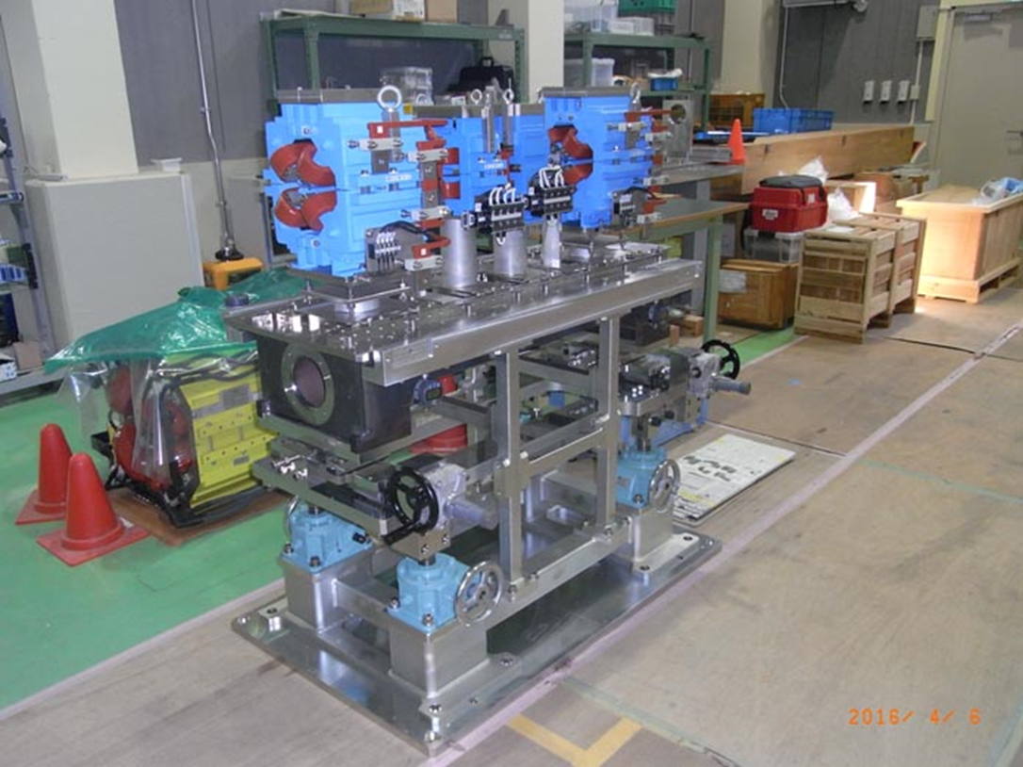
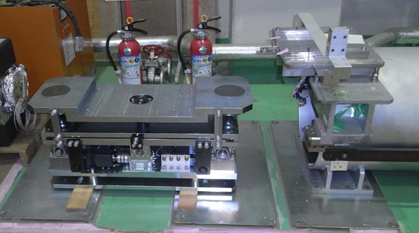
Movers under study
Mover tests for accelerator girder
Support structure being developed for pulse magnets

Slide 29
Requirements and strategy against floor movement
In phase-2 timeframe
Alignment as is with trial cures at some points
Confirm overall and year-scale floor movement
Evaluate distance scale from joint
Try to detect movement with beam
Investigate the cure algorithm with simulation
Study feasibility of mover or passive bridge
Development for phase-3
Alignment corrected once more and stabilized with movers or suppression mechanism near relevant expansion joints
Beam manipulation to keep golden orbit
Compensation such as offset injection is developed

Slide 30
Concluding remarks

Slide 31
Development toward Phase-3

Slide 32
Concluding remark
Initial girder alignment in 2014
Done with residual ~0.3mm in sigma over 500m line.
Hard wares alignment on girder improved
Done with errors 0.05mm in sigma
Kept for in a year scale
Floor continuous measurement
Movement mostly near expansion joints
Daily motion ~0.1mm to yearly ~1mm
Floor sophisticated evaluation
Will explore near expansion joint
Will design compensation mechanism
Compensation mechanism
Basic study of movers is under way
Passive structure design study to be made

Slide 33
Concluding remark (cont.)
Tools to identify the movement
Radiation resistive PD is being searched
Pending now to develop other evaluation tools
Should study how to use which beam information
Beam study
Should study beam emittance on floor movement
Study offset injection
Test girder
Installation in mid 2017
Should study effectiveness during phase-2
Full scale cures
Installation by Phase-3
Sophistication in parallel to phase-3 operation

