Slide 1
Beam Transport,
Injection
13/Jun/2016
21th SuperKEKB Review
N.Iida for KEKB/BT Group

Slide 2
Contents
Introduction
Upgrades for SuperKEKB
  Changes of the beam energies
  New septum magnets
Phase1 Commissioning and status
  Orbit, charge, and Injection
  Optics measurement with wire scanners
Issues
  Water interlock
  X-Y Coupling in e+ line
Summery

Slide 3
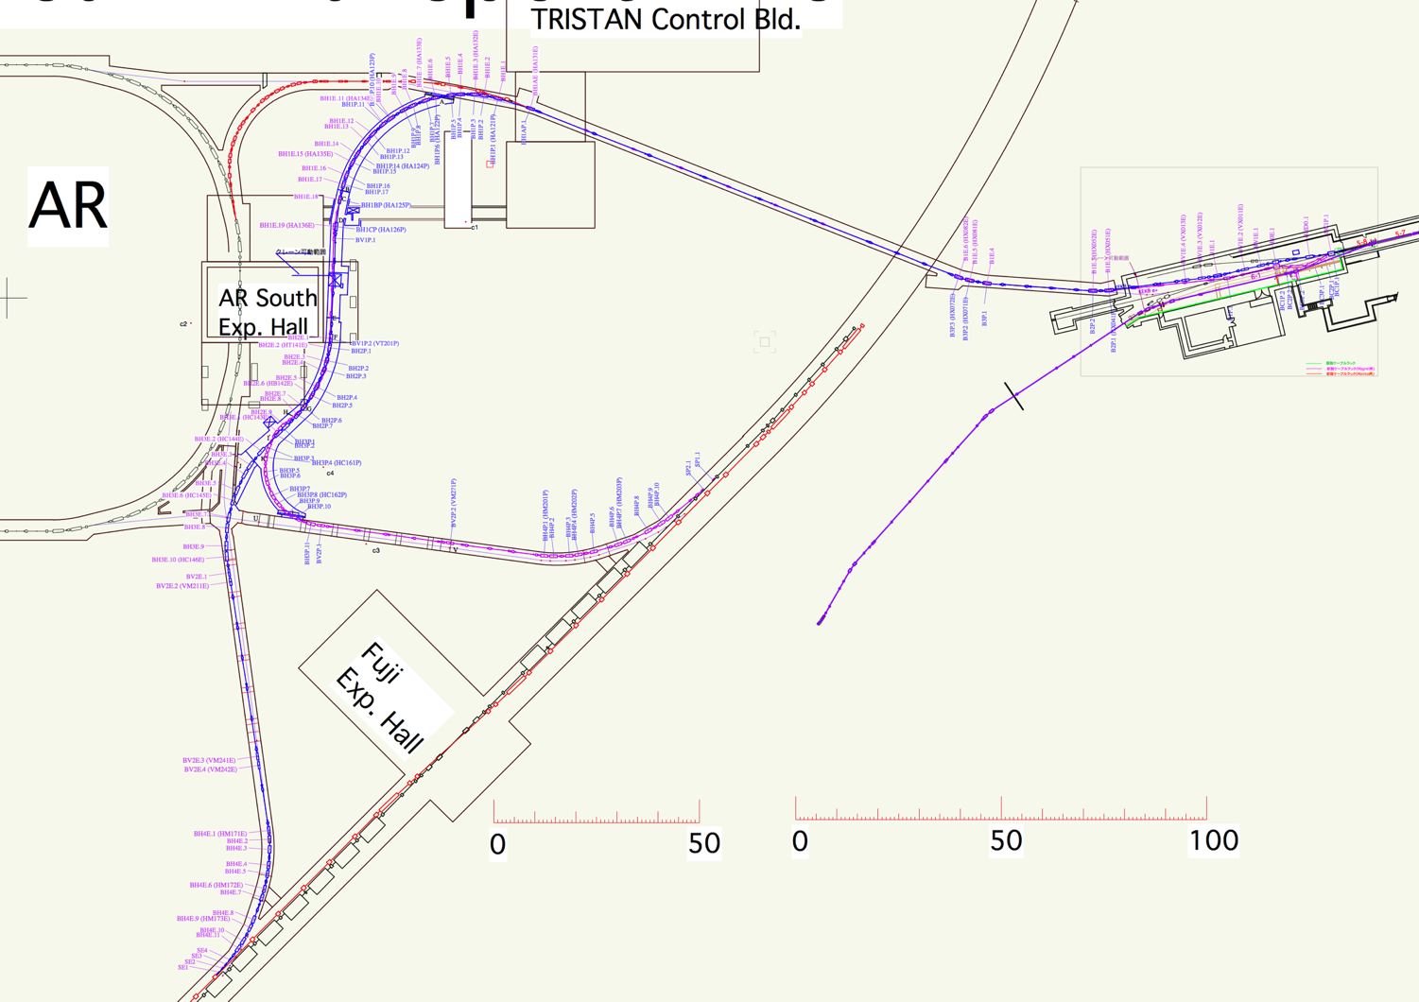
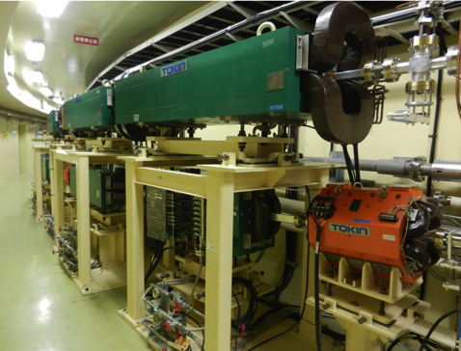
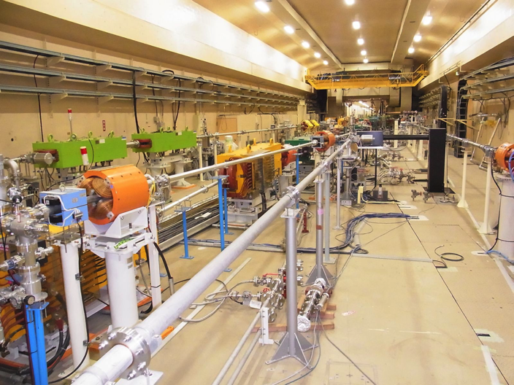
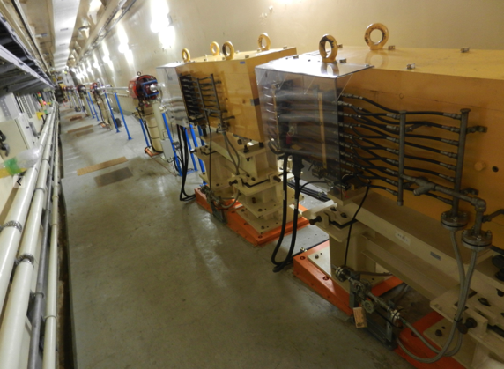
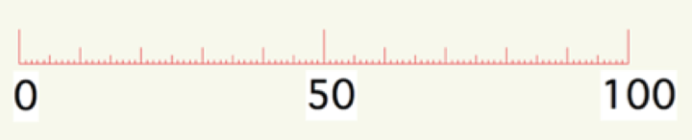
Introduction
BT for AR
The half of BT lines have double-story structure of e- and e+ lines
e-/e+
0th Arc
1st Arc
LINAC
2nd Arc
LER
Switching Yard 3
(SY3)
3rd Arc
4th Arc
BT for PF/AR
Slope down to the MR
11 m underground.
e- Dump
New
AR/BTe-
PF/BTe-
KEKB/BTe+
KEKB/BTe-
4th Arc
e+ Dump
HER
Notes:
This is a layout of the BT.
The e- and e+ beams come from LINAC, they are branched off in the Switching Yard 3, whose picture is here.
Many ring wait for the LINAC beams.
The half of BT lines are double-story structure of e- and e+ lines.
Each line has 5 arcs like these.
After the 3rd Arc, there are slope down to the KEKB Main rings eleven m under ground.

Slide 4
Components of BT lines
Introduction
Magnet, PS | e- |  | e+
 | Magnet | Power Supply | Magnet | Power Supply
Dipole | 65 | 18 | 58 | 16
Quadrupole | 53 | 23 | 53 | 53
Sextrupole (Phase2) | 2 | 2 | 2 | 2
Steering | 45 | 45 | 50 | 50
Backleg | 25 | 25 | 16 | 16
Injection Septum | 4 | 4 | 2 | 2
Injection Kicker | 3+3 | 3+3 | 3+3 | 3+3
Monitor, Collimator | e- | e+
BPM | 60 | 60
Screen monitor | 20 | 20
Wire scanner | 5 | 6
Collimator | 4 | 9
Beam shutter | 2 | 1
Notes:
The components and their numbers are like these.
The sextupoles will be used in Phase 2.

Slide 5
Upgrades for SuperKEKB
  Changes of the beam energies
  New septum magnets

Slide 6
1. Change of the Beam Energy
Upgrades for SuperKEKB
e- : 8 GeV to 7 GeV, and e+: 3.5 GeV to 4 GeV
  The layout of Switching Yard 3 (SY3) has been reconstructed.
Increase of e+ energy
  Some dipoles :
  The power supplies are upgraded.
  Dipoles in 2nd and 3rd Arc :
  The gaps have been made narrower, which increase magnetic fields without upgrading their power supplies nor the water cooling of magnets.
Notes:
the energy of the beams are changed.
With the change, the layout of SY3 has been reconstructed, because the 1st …
For the increase of e+ energy, Some of …
And the gaps of dipoles…

Slide 7
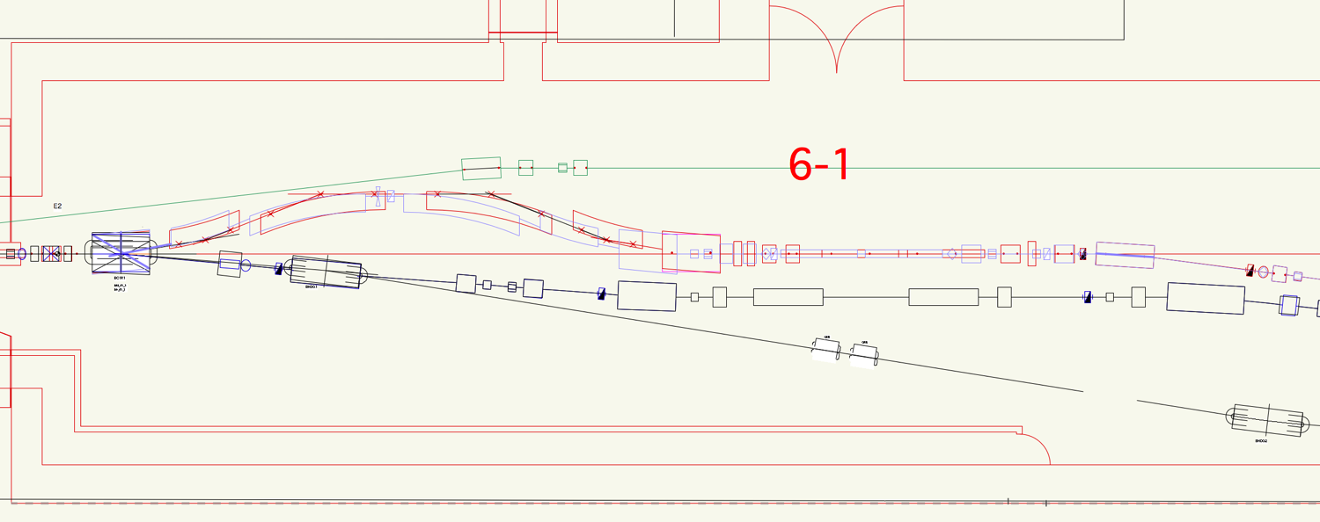
Energy Compression System(ECS) at SY3
Upgrades for SuperKEKB
from KEKB to SuperKEKB
Chicane of ECS
Cavitis of ECS
e+/e-
e+
e-
1st Dipole of ECS
(Separation dipole)
8
e+
3.5
7
4
    The 1st dipole of Energy Compression System(ECS), whose magnetic field is static, is also used as a separator of e- and e+.
    The orbits are changed from KEKB operation.
    The dipoles other than 1st one are renewed.
e-
Notes:
This is a layout of the SY3 with positron ECS.
There is a chicane and cavities for ECS.
The 1 dipole of …

Slide 8
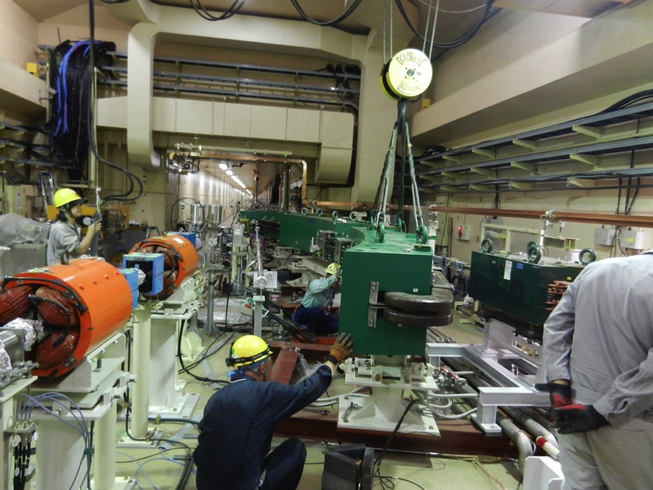
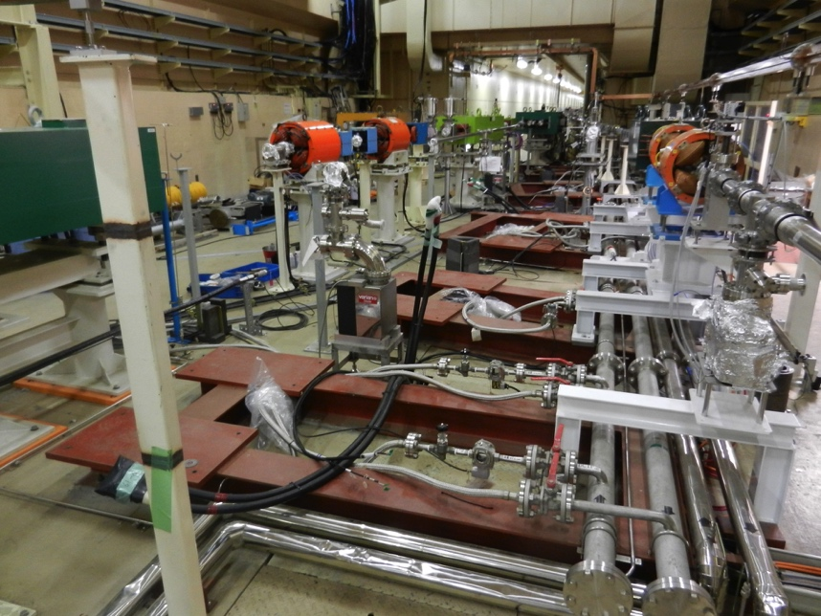
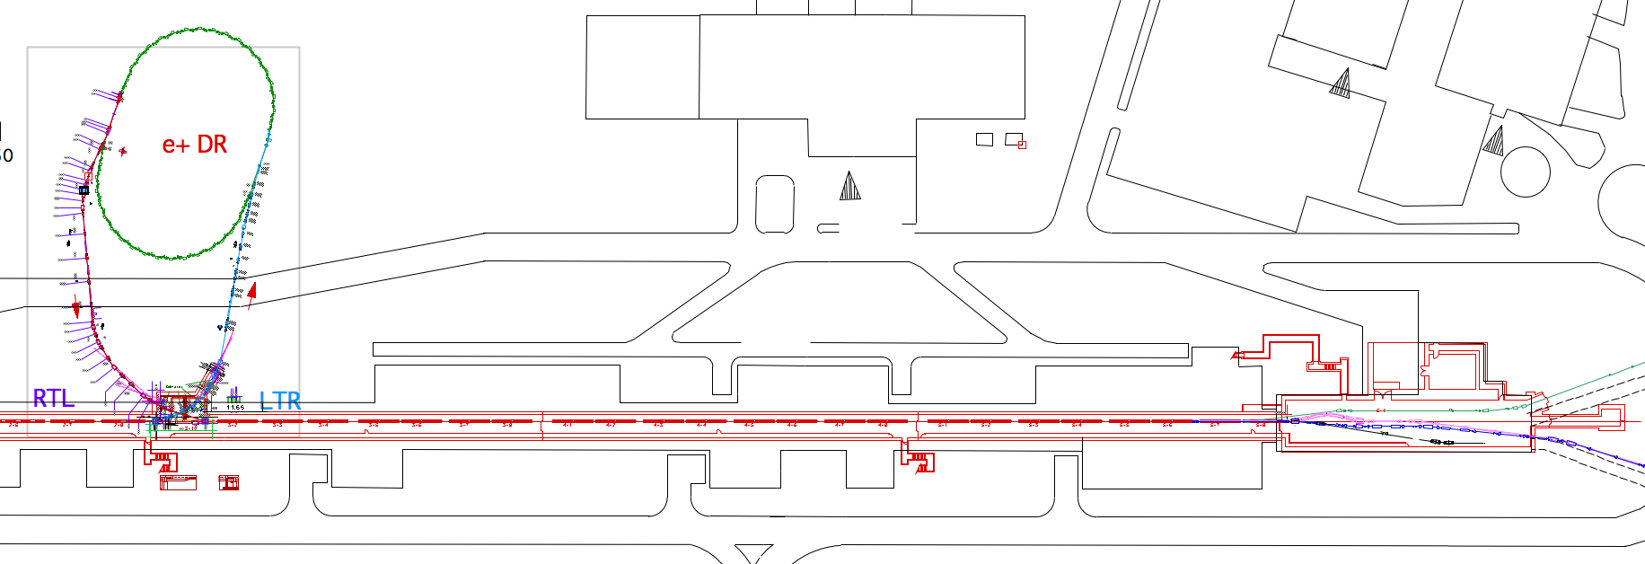
SY3 Construction changed
Upgrades for SuperKEKB
N. Iida, 18th MAC
20/Jul/12
New Energy Compression System(ECS) of positron line at the end of LINAC is under construction, which is needed to change the energy of positron from 3.5 GeV to 4 GeV.
Magnets of ECS were removed
and the new ones will be installed
in this summer.
DR
Chicane of ECS
PF
SY3
LER
HER
Notes:
Here is the 3rd switching yard.
I already reported in 18th MAC.

Slide 9
1. Change of the Beam Energy
Upgrades for SuperKEKB
e- : 8 GeV to 7 GeV, and e+: 3.5 GeV to 4 GeV
  The layout of Switching Yard 3 (SY3) has been reconstructed.
Increase of e+ energy
  Some dipoles :
  The power supplies are upgraded.
  Dipoles in 2nd and 3rd Arc :
  The gaps have been made narrower, which increase magnetic fields without upgrading their power supplies nor the water cooling of magnets.
Notes:
the energy of the beams are changed.
With the change, the layout of SY3 has been reconstructed, because the 1st …
For the increase of e+ energy, Some of …
And the gaps of dipoles…

Slide 10
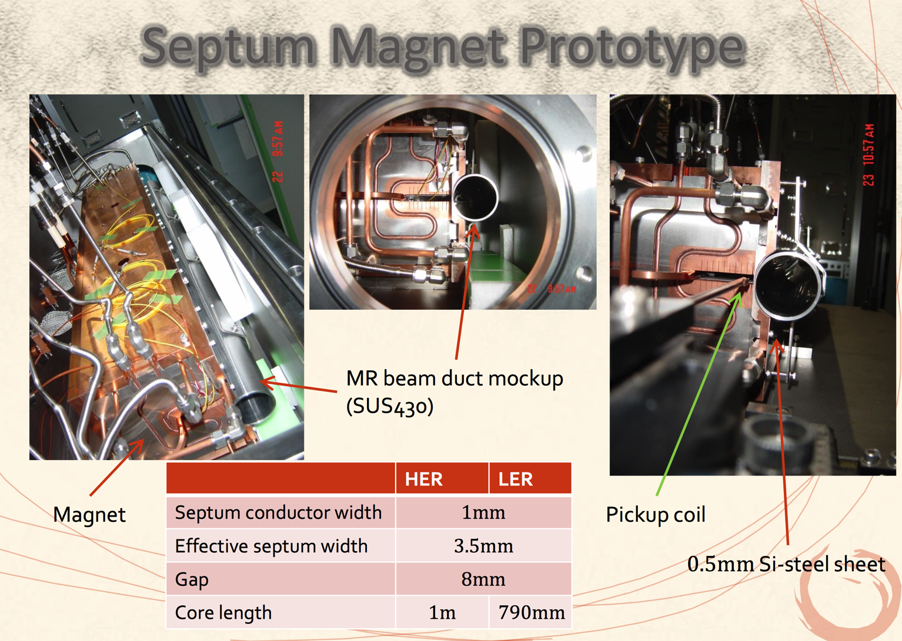
2. New Septum Magnets
Upgrades for SuperKEKB
T. Mori, 19th MAC
For smaller injection error, the effective septum thickness is narrowed from 5mm to 3.5mm.
(only HER in Phase1, and LER in Phase2)
Notes:
This is also reported in the 19 MAC by Mori-san.
The HER septa work well now.

Slide 11
Phase 1 Commissioning and Status
  Orbit, charge, and Injection
  Optics measurement and matching with wire scanners

Slide 12
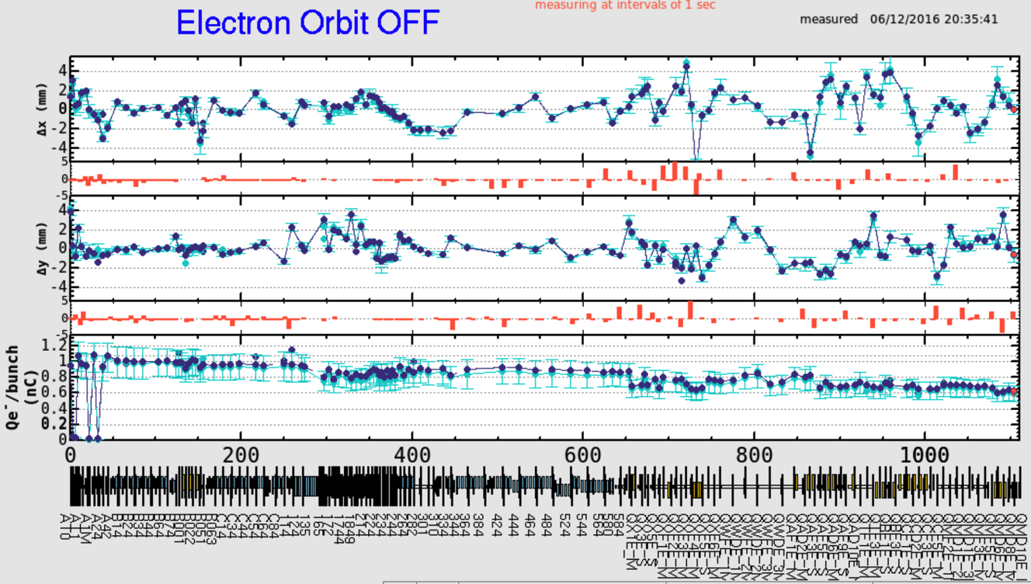
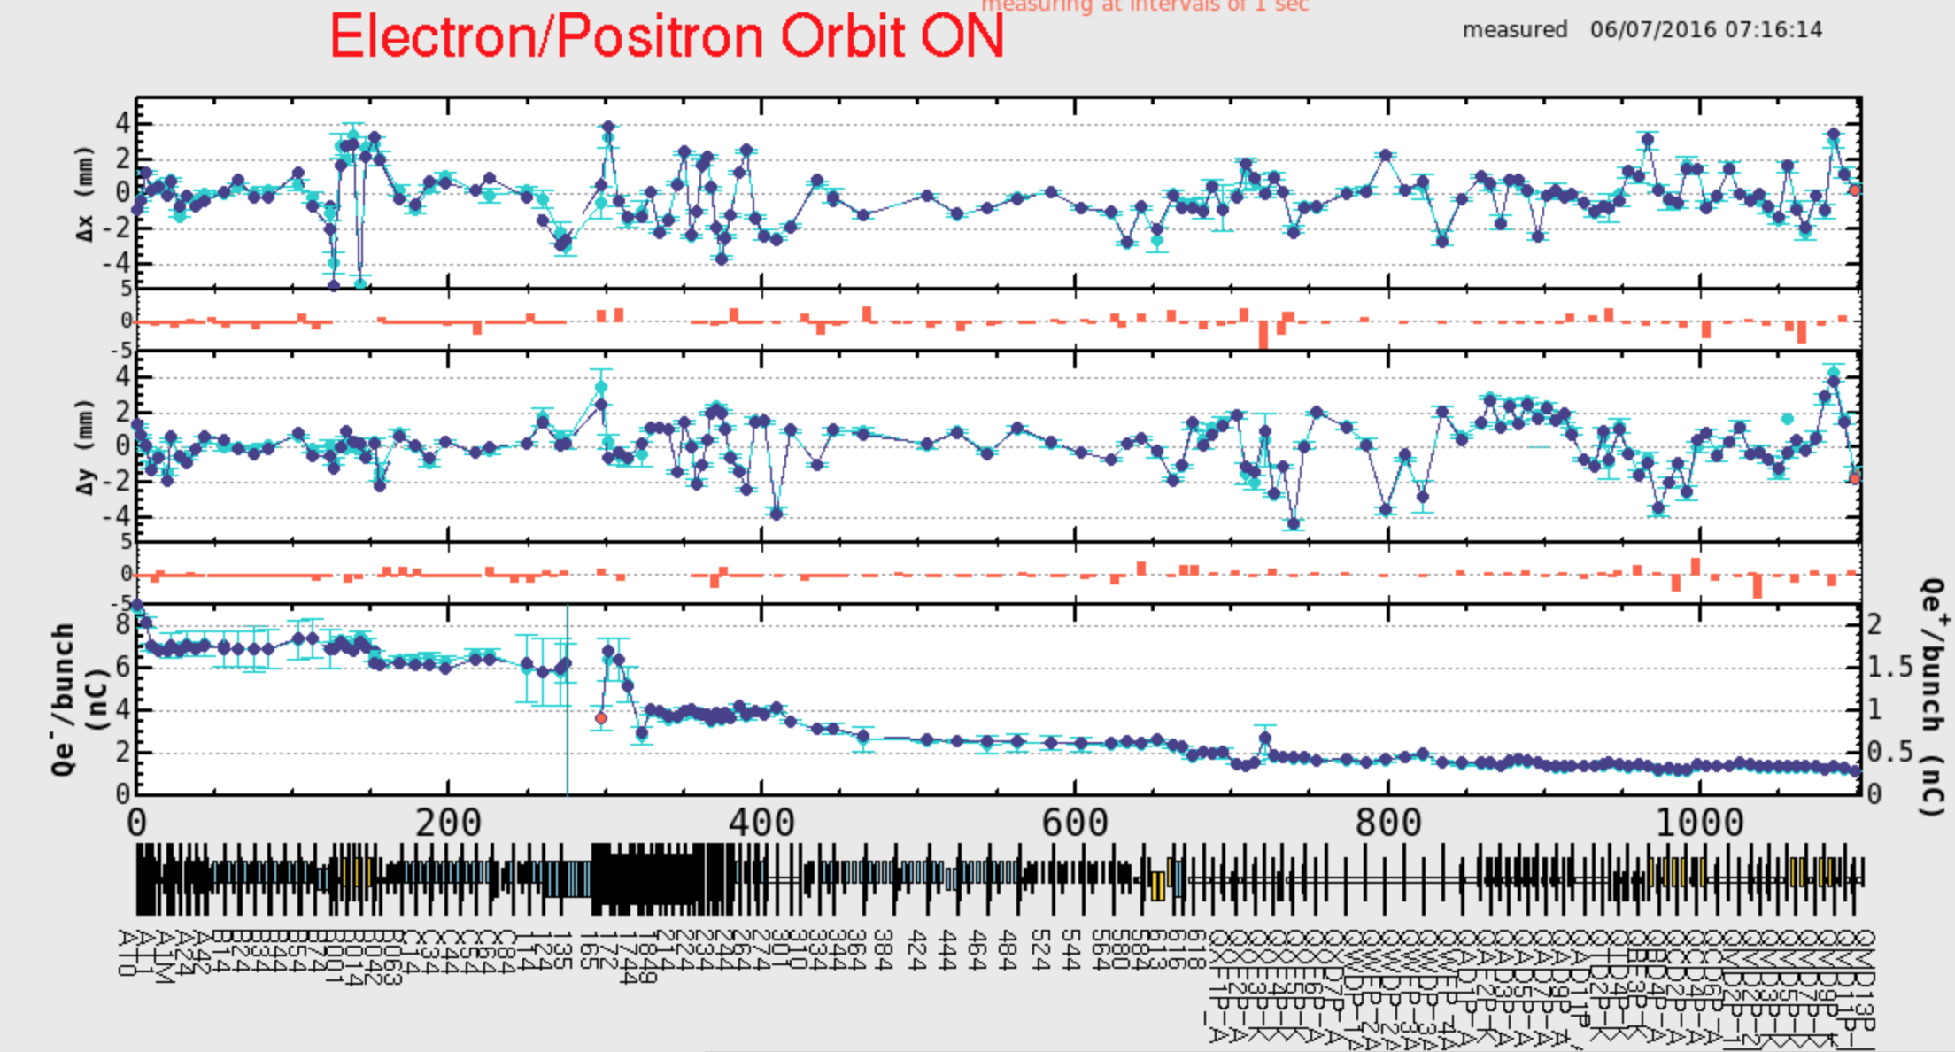
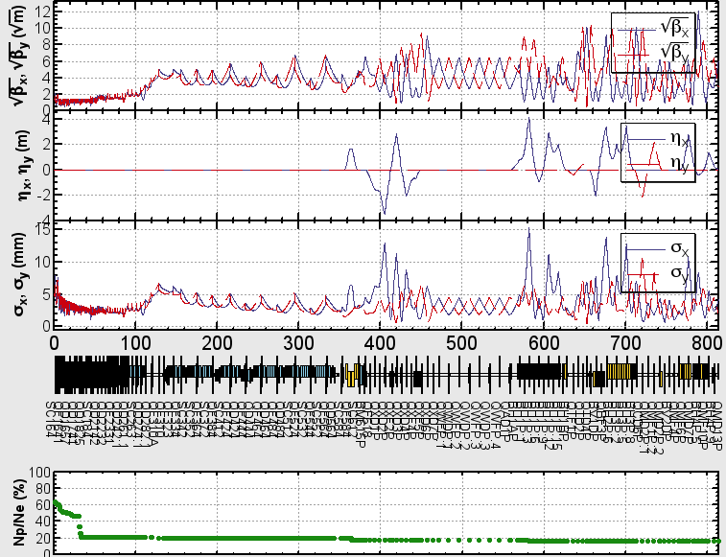
1. Orbit, Charge
Phase 1 Commissioning and Status
The e+ beam with huge emittance comes from the Flux Concentrator without Damping ring now.
We use the collimators to guard the cavities.
LINAC
BT
e+ Simulation
F. Miyahara,
T. Miura,
N. Iida
LINAC
BT
Collimation
Collimation
0.45 (nc)
γεx=1400μm
γεy=1590μm
e+ Target
e+ Target
Notes:
These show the orbit and charge of electron and positron from LINAC to the end of BT.
This is the horizontal and vertical orbits, and here is the charge.
The huge e+ beam comes from the FC w/o DR.
We collimate the e+ to guard the cavities.
The charge amount is consistent with the simulation.

Slide 13
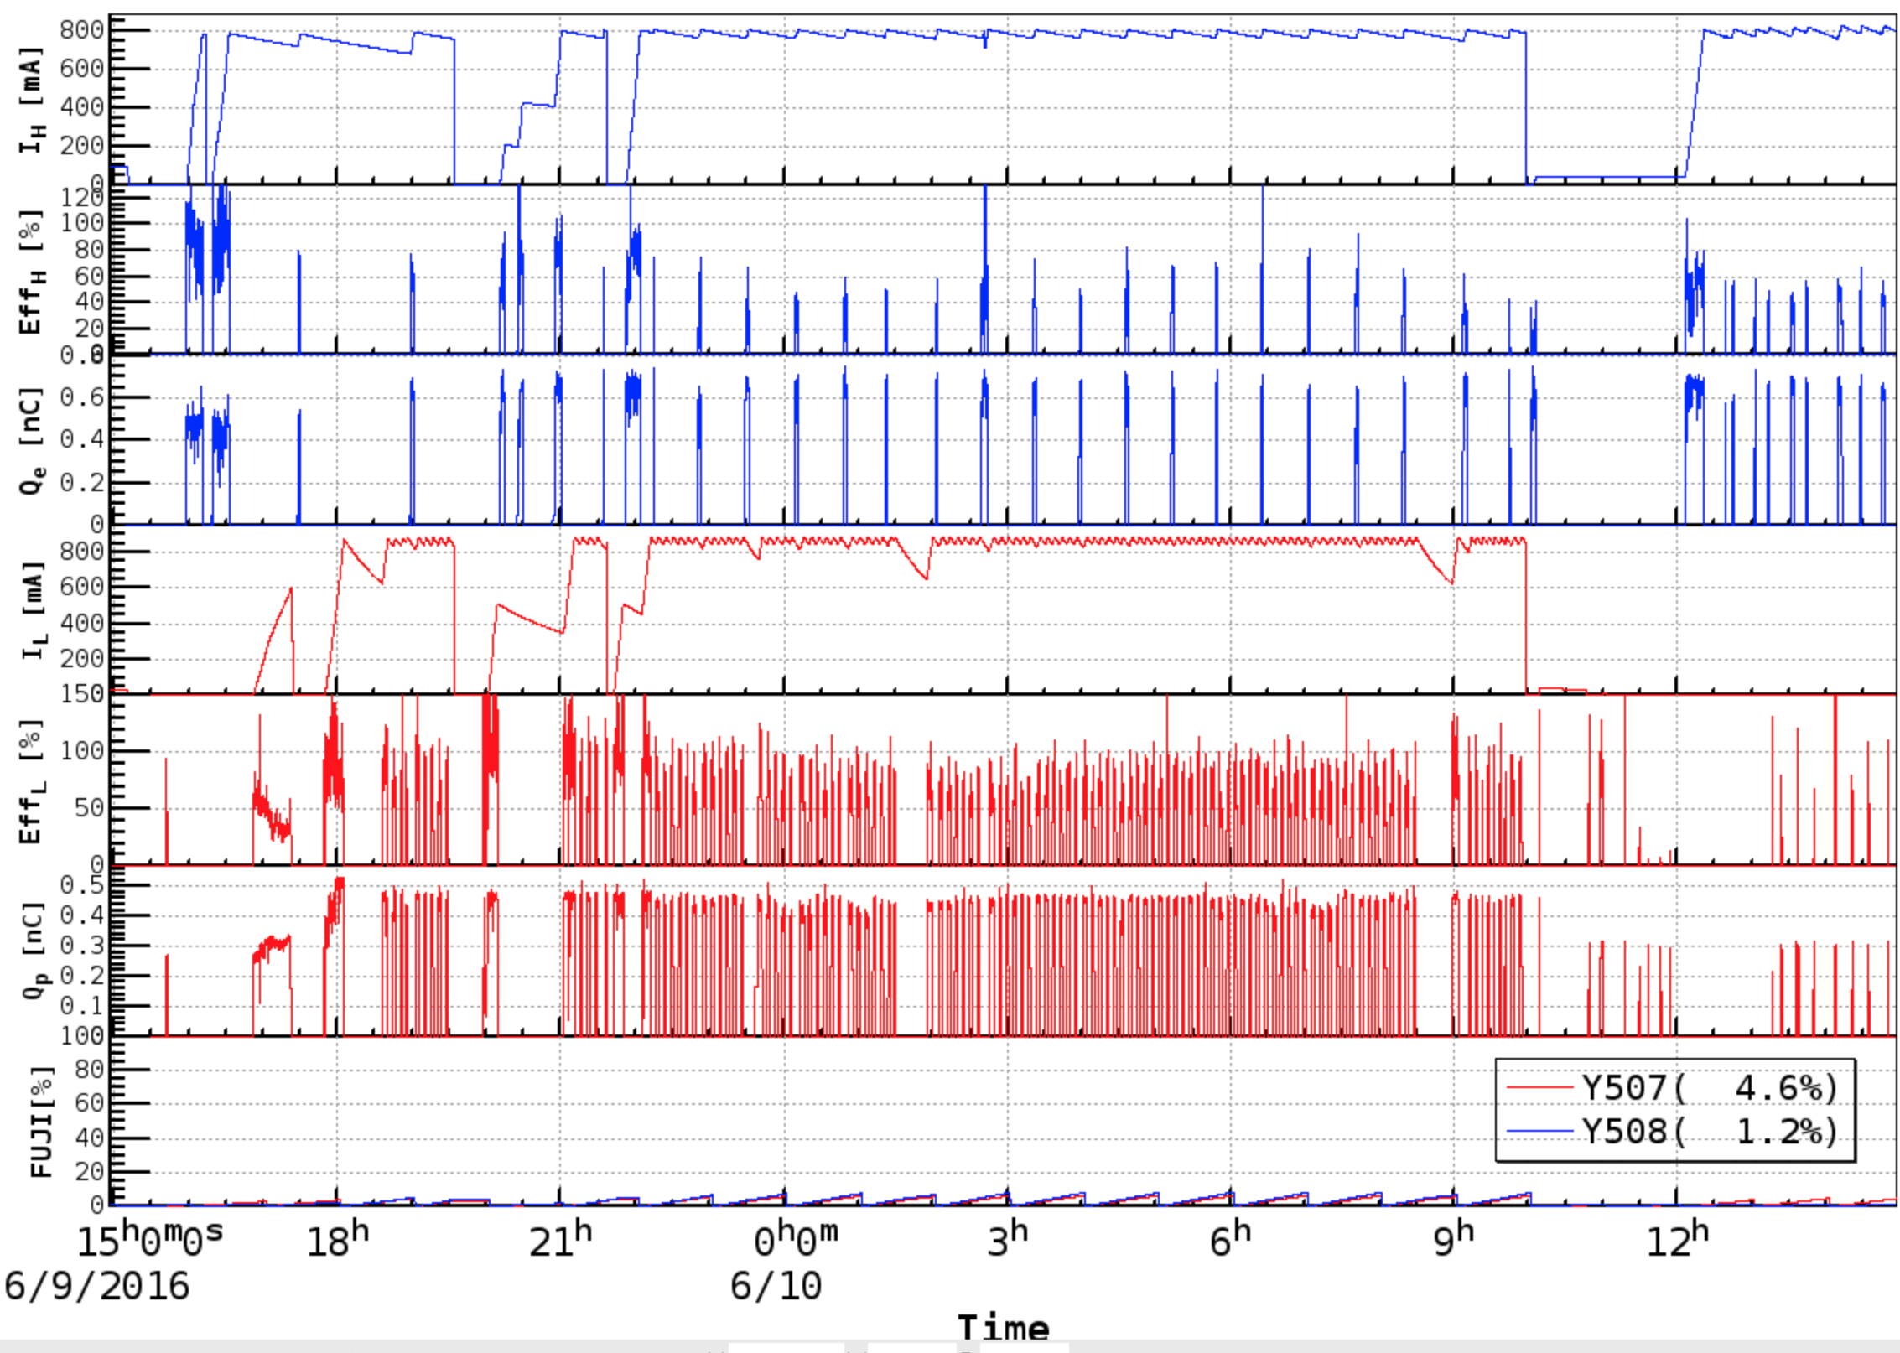
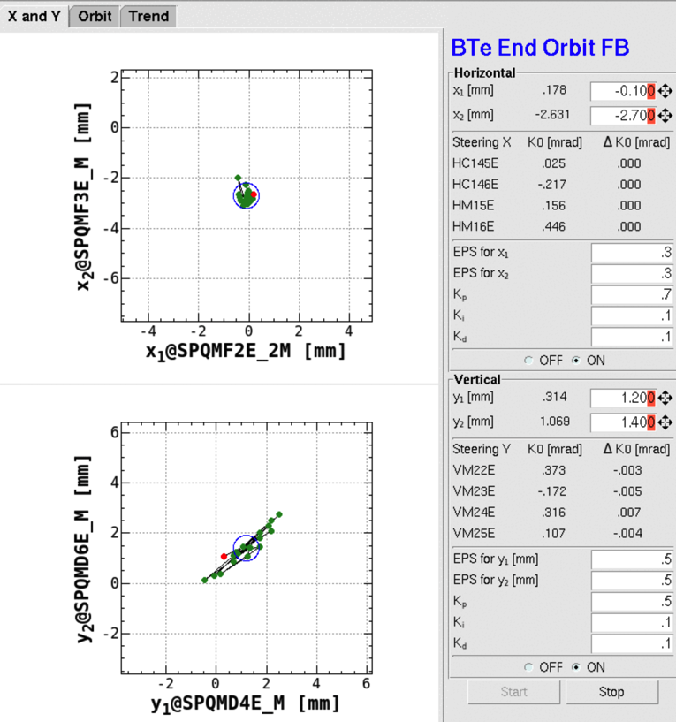
1. Injection
Phase 1 Commissioning and Status
The injection efficiencies are good for the both rings.
Orbit FB Panel at the end of BT
Y. Ohnishi
Horizontal position
of 2 BPMs
Vertical position
of 2 BPMs
The vertical jitter of the electron beam is large, which affects the injection efficiency.
Notes:
This shows the injection status of one day.
The injection efficiencies are almost good for the both rings.
This is a BT end orbit FB panel.
The vertical jitter of the electron beam affects the injection efficiency.
I will talk about it later.

Slide 14
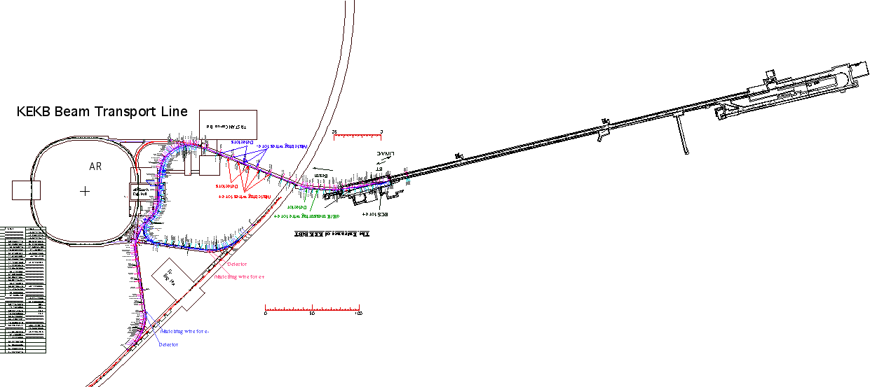
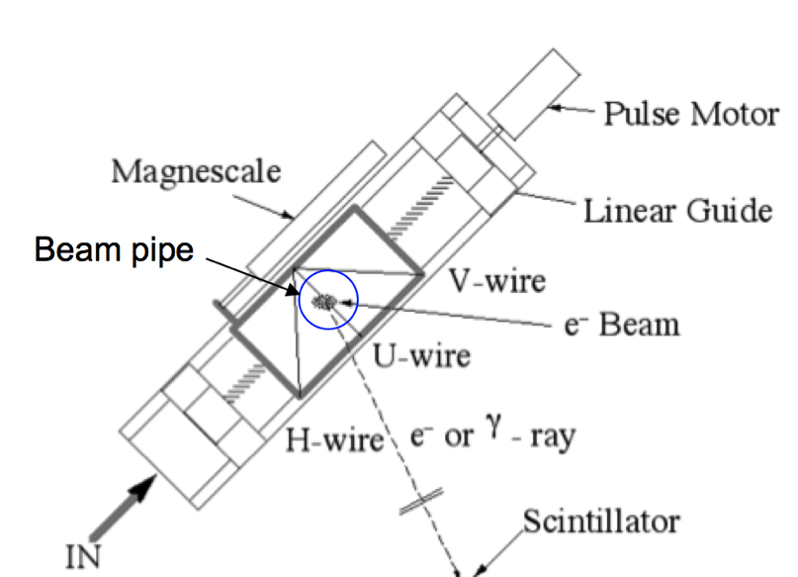
2. Optics Measurement with Wire scanners (WS’s)
Phase 1 Commissioning and Status
F. Miyahara, Y. Yano, N. Iida
Several wire scanners are in LINAC and BT.
A set of 4 wires is installed at each location.
KEKB Ring
SectorC(4)
Sector2(4)
BT e-(4)
Sector5(4)
Sector3(4)
SectorB(4)
LINAC
BT e+(4)
SectorA(1)
Wire moving
BT e+(1)
BT e-(1)
Detector:
Optical Fiber
Notes:
The next topic is about the optics matching with wire scanners.
We have several wire scanners in LINAC and BTs.
A set of 4 wires is installed at each location.
The wire is set as this.
Three wires measure the horizontal, 45 degree, and vertical beam sizes.

Slide 15
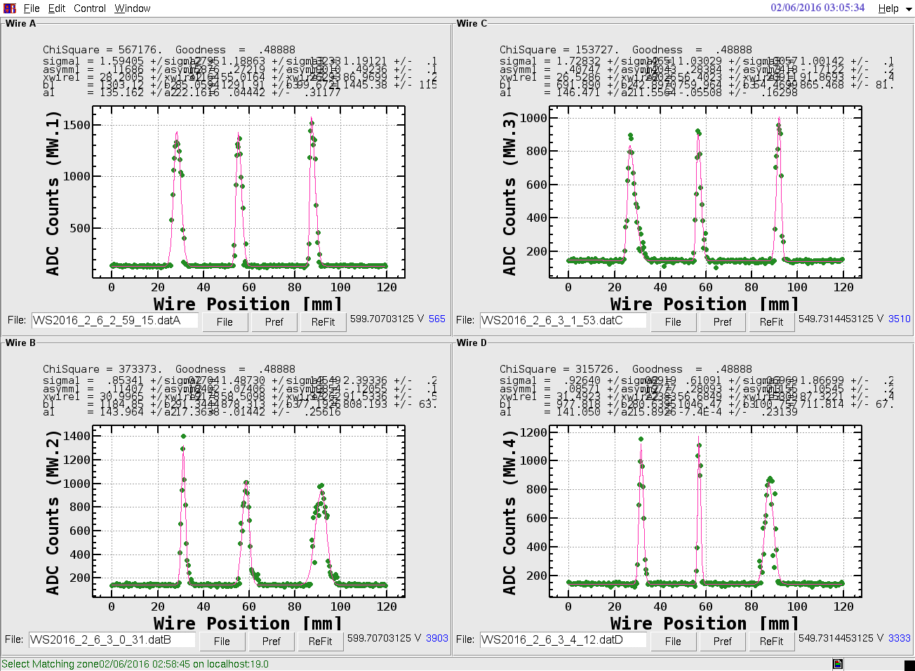
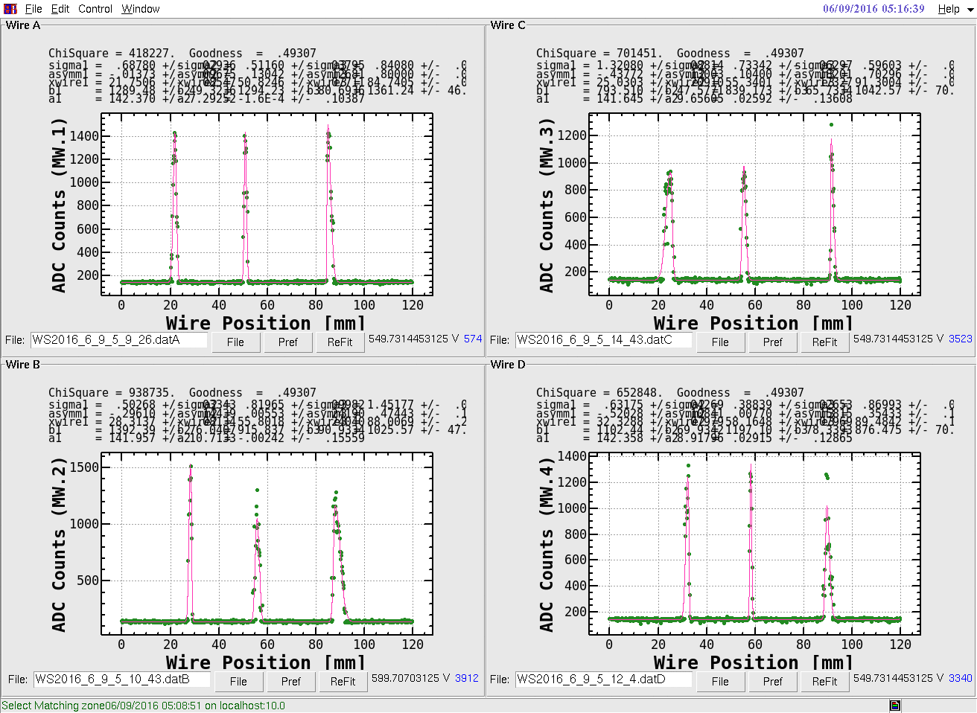
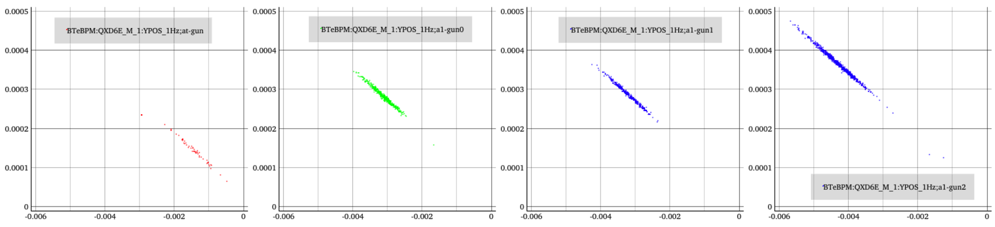
Beam size measurements of e- at upstream of BT
Phase 1 Commissioning and Status
e- from the Thermal gun
e- from the RF-gun
jitter from LINAC
Y
X
Y
X
Y
X
Y
X
Y
X
Y
X
Y
X
Y
X
Leak of Dispersion of BT
The beam sizes of RF-gun is small than those of Thermal gun.
T. Mori
V. Phase space at QXD6E
Thermal gun
RF gun
The measured vertical jitters for 20min. of e- beam in the vertical phase space are almost same for the both of guns. (All scales are same)
Notes:
For example, the measurement of e- beam at the BT is shown.
The beam sizes are fit by asymmetric Gaussian.
These are thermal gun and this is RF gun.
This peak is broader than other ones, which is due to jitter from LINAC beam.
The horizontally, maybe there is leak of dispersion.
The vertical jitters of …

Slide 16
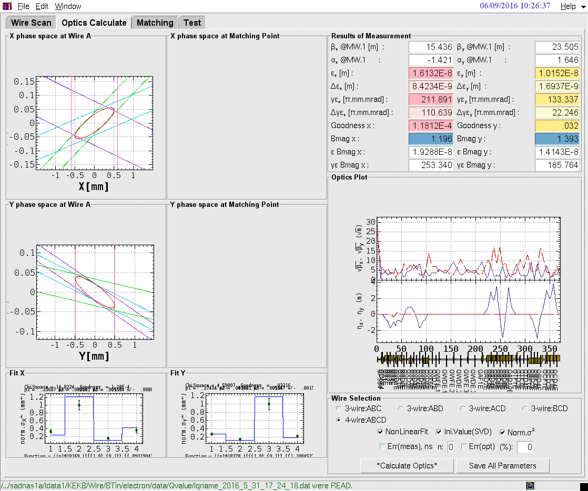
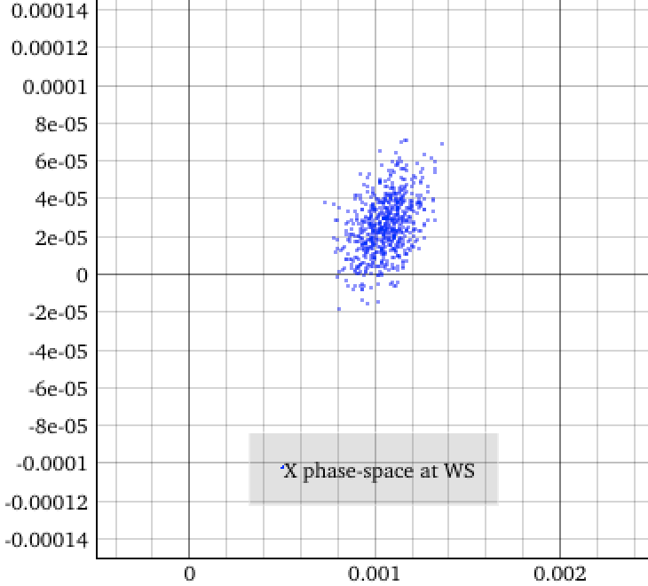
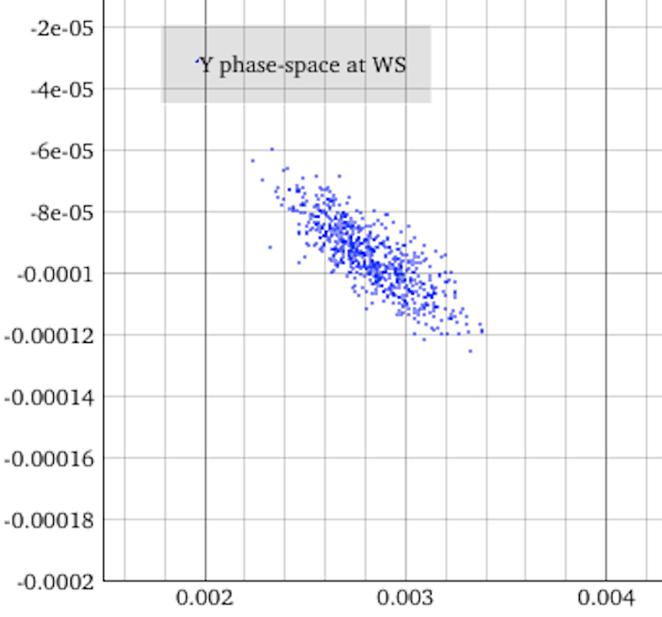
Phase 1 Commissioning and Status
e- from RF-gun
T. Mori, N. Iida
Phase spaces at the 1st Wire scanner
Beam size X by WS
Jitter X
The red circle shows emittance coresponding to 1σ of beam size.
The vertical jitter is large and comparable with 1σ of the beam distribution.
Beam size Y by WS
Jitter Y
Notes:
These are measured phase space at the wire scanner.

Slide 17
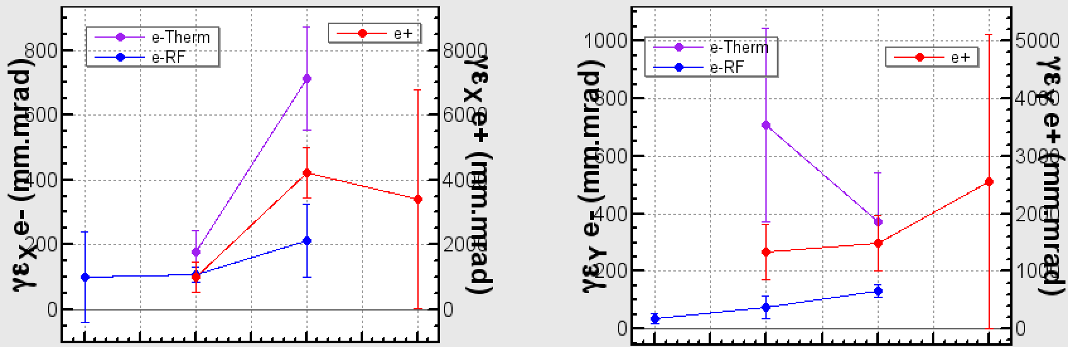
Measured Emittances by WS
Phase 1 Commissioning and Status
These blow-up caused by leak of the dispersion at BT
The emittance of RF gun is smaller than thermal gun.
SectorC
Sector5
BT
BTend
SectorC
Sector5
BT
BTend

Slide 18
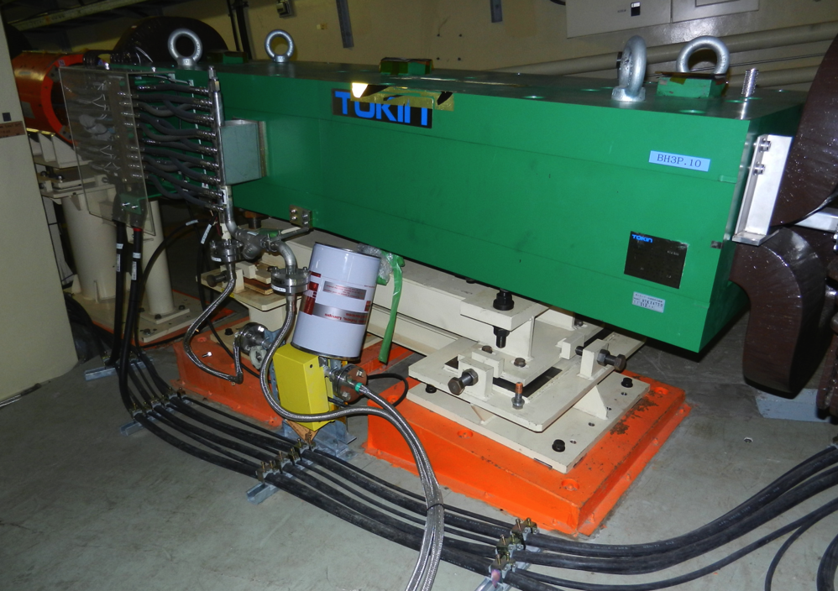
Issues
Water interlock
  The dipoles are down due to the water interlock 2-3 times for a week.
    The water of the cooling system is polluted by CuO. The Cu is dissolved from the cooling-water pipes.
  The water interlocks of some dipoles whose gap is narrowed work by the leaked magnetic field (20~30Gauss) from the dipoles.
    The iron cans are covered over the flow meter.
    The reason is thought the interlock switches became older.
X-Y Coupling in e+ line
〜450mm

Slide 19
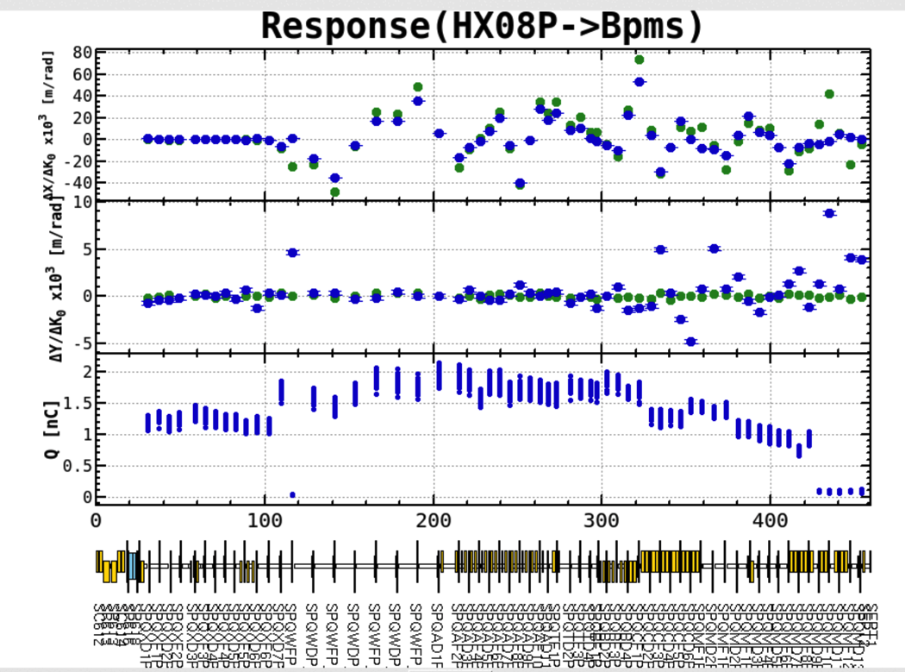
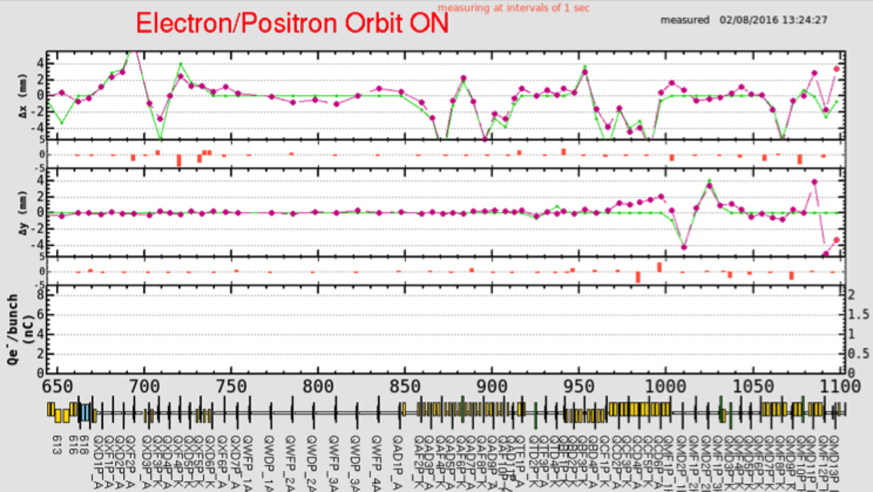
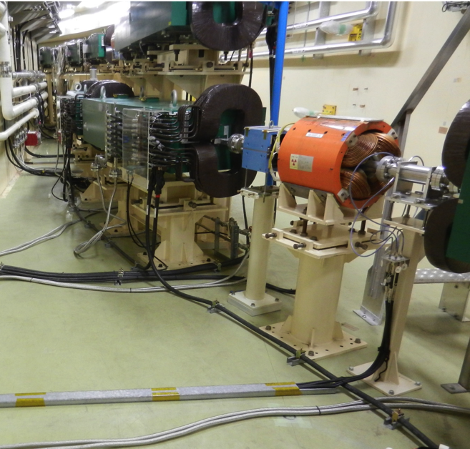
Abnormal X-Y Coupling in the e+ BT
Issues
H. Sugimoto
Horizontal position/kick
When the beam is kicked horizontally the vertical orbit distortion appears.
Vertical position/kick
A large vertical dispersion exits around the same place where the vertical design dispersion is zero and horizontal dispersion exits.
Between 2nd and 3rd Arc

Slide 20
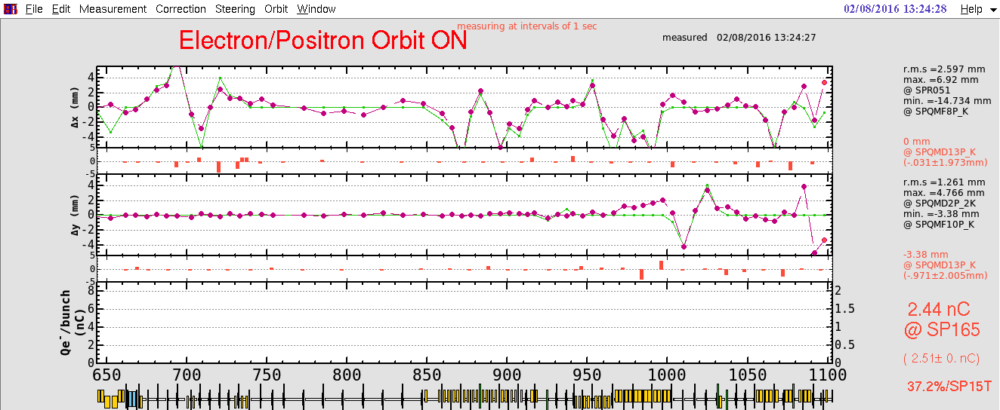
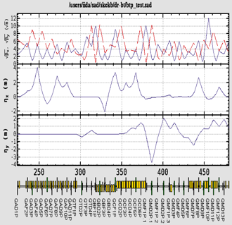
Abnormal X-Y Coupling in the e+ BT (Cont’d)
Issues
Y. Onishi, N. Iida
Measurement
Simulation
Some hypothesis can be thought to explain the dispersion pattern.
  The quadrupole, QCD2P, is rotated -107 mrad.
  Some of the quadrupoles around the 3rd Arc are rotated ~10mrad.
  The dipoles of the 3rd Arc, BH3P, have sextupole components.
    K2=0.1 at ΔY=10mm.
    The magnetic measurements of the dipoles were not so large.
    The interference from the neighbor magnets are also suspended.
All of them are not realistic.
We will study more.

Slide 21
Summery
The performance of BT is almost well.
Some issues are not serious in Phase 1, but they should be improved by the beginning of Phase 2.

Slide 22
Thank you.

Slide 23
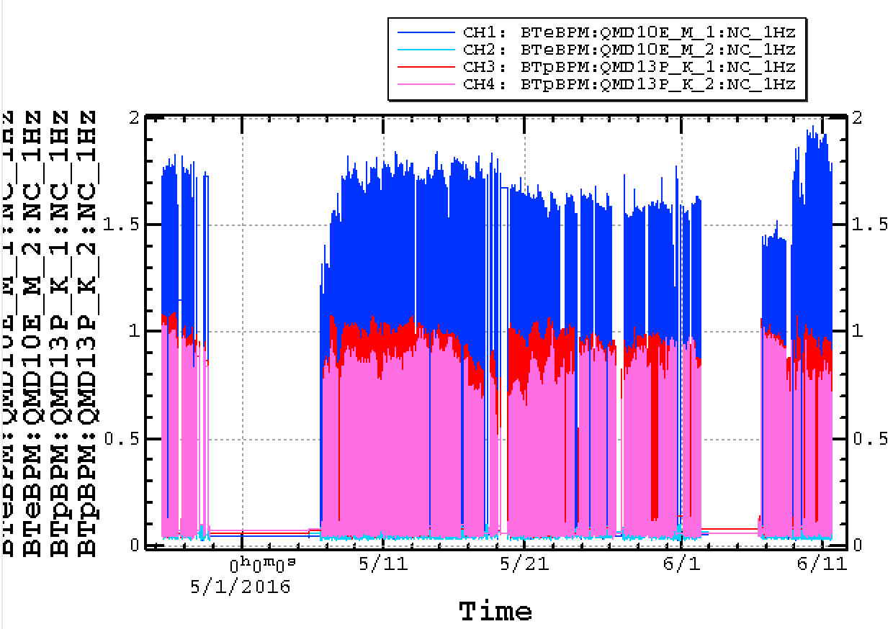
Charge at the end of BT
Phase 1 Commissioning and Status
e- injection
from RF Gun

Slide 24
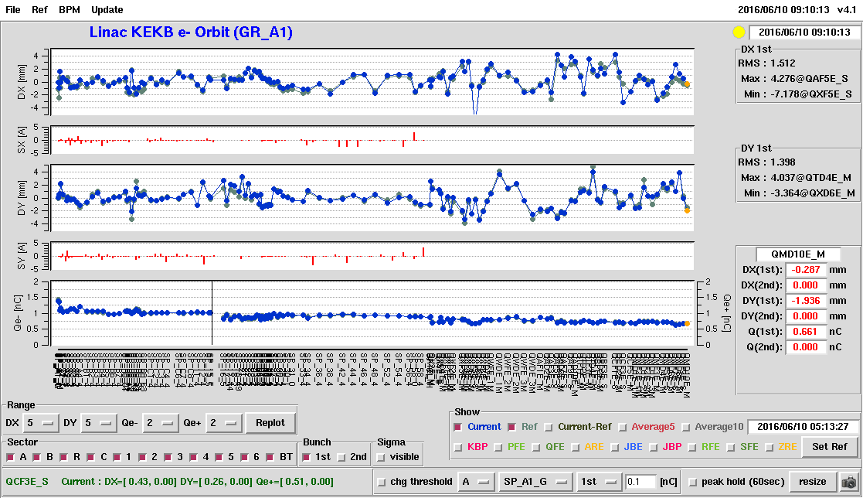
e- Orbit from RF-Gun

Slide 25
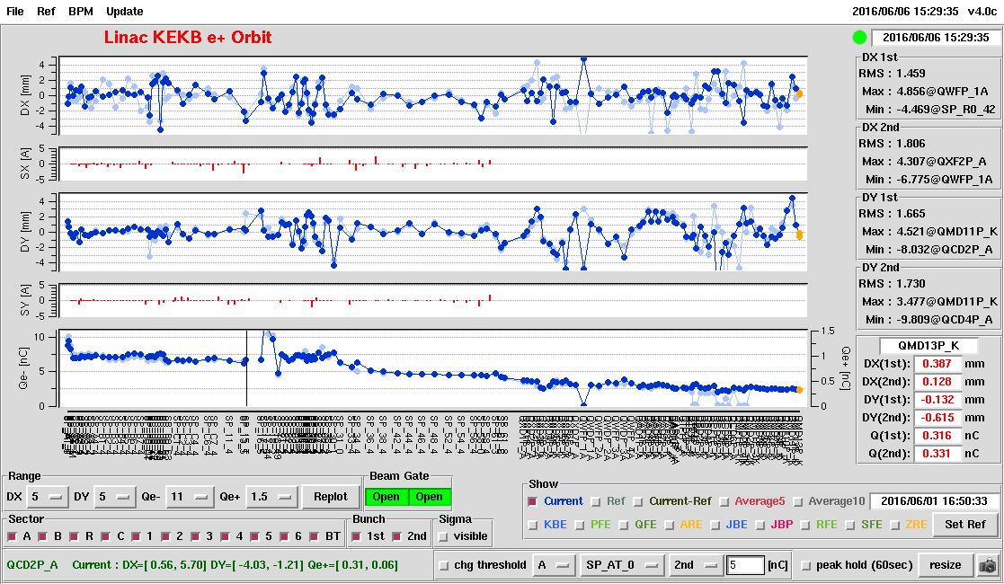
e+ Orbit

Slide 26
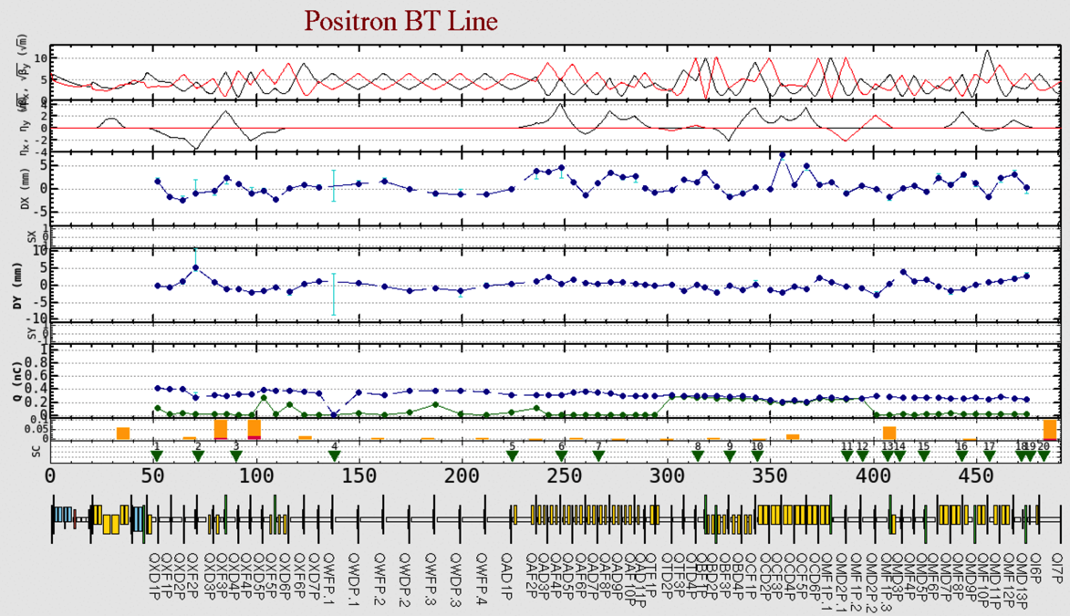
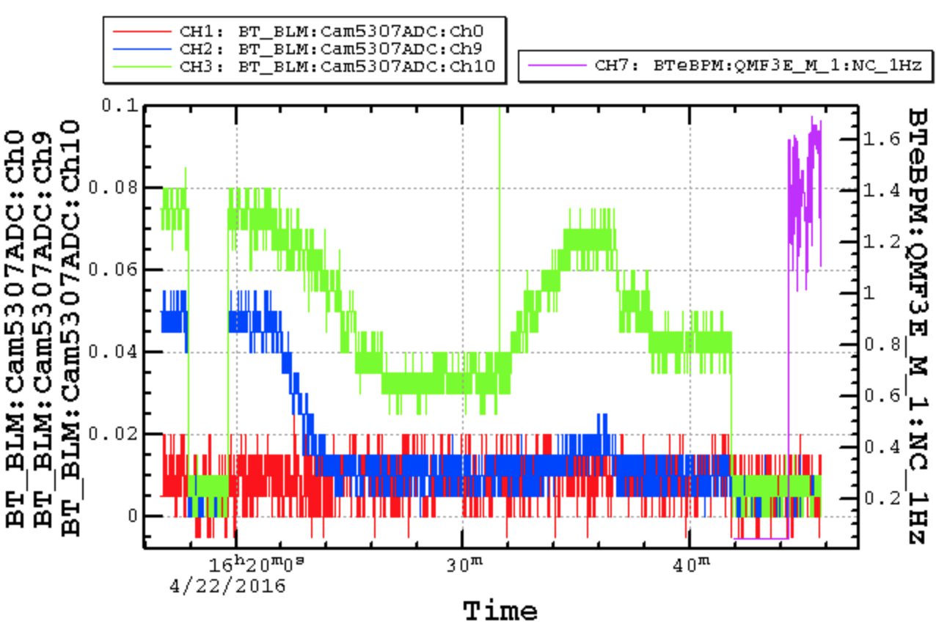
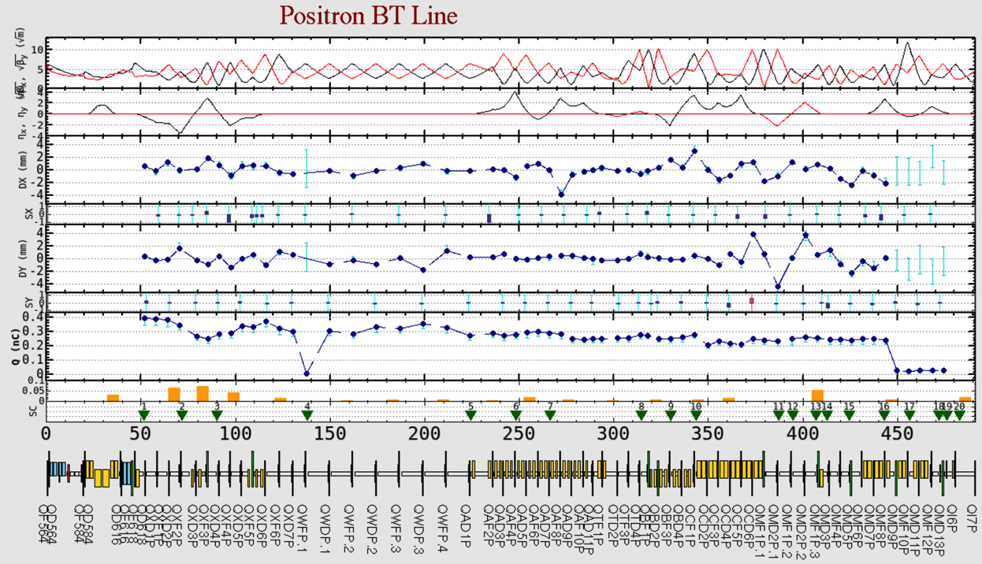
Collimation
Phase 1 Commissioning and Status

Slide 27
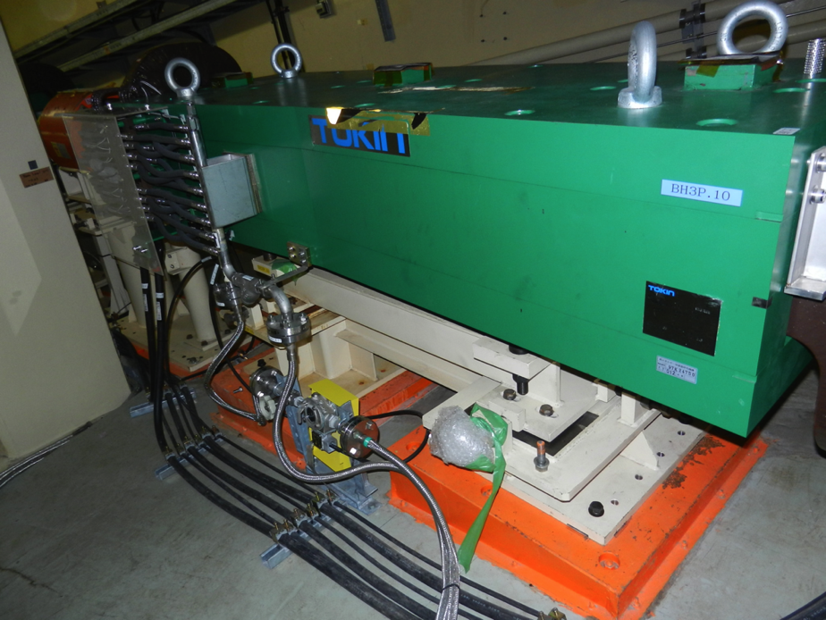
〜450mm

Slide 28
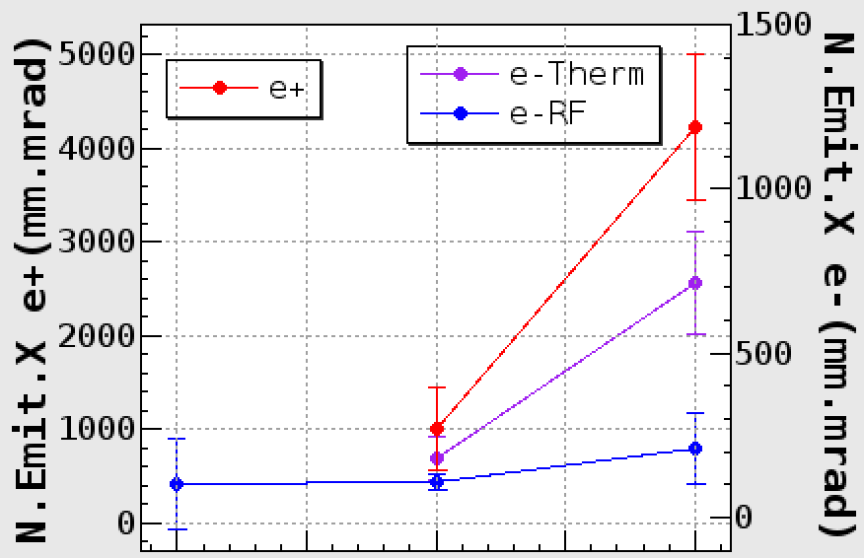
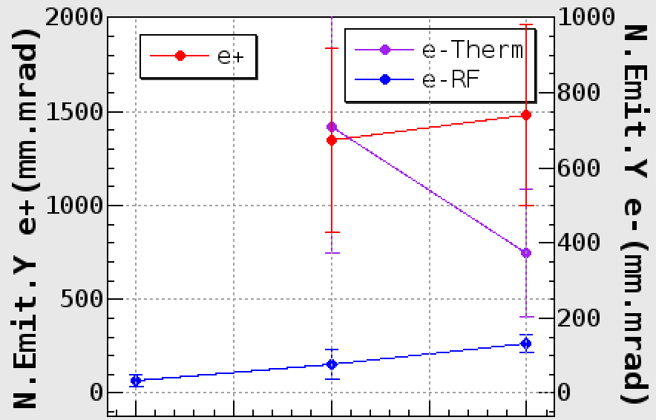
Measured Emittances
Phase 1 Commissioning and Status
These blow-up caused by leak of the dispersion at BT
The emittance of RF gun is smaller than thermal gun.
SectorC
Sector5
BT
SectorC
Sector5
BT

