Slide 1
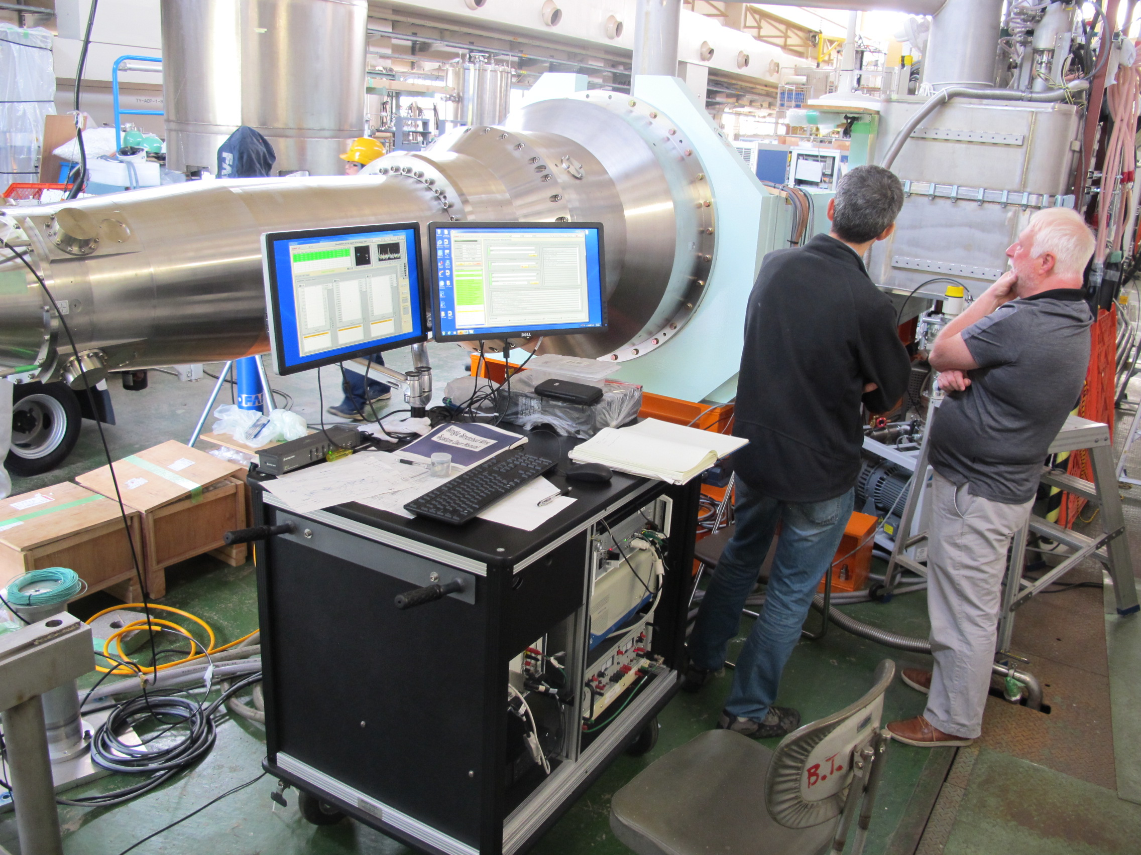
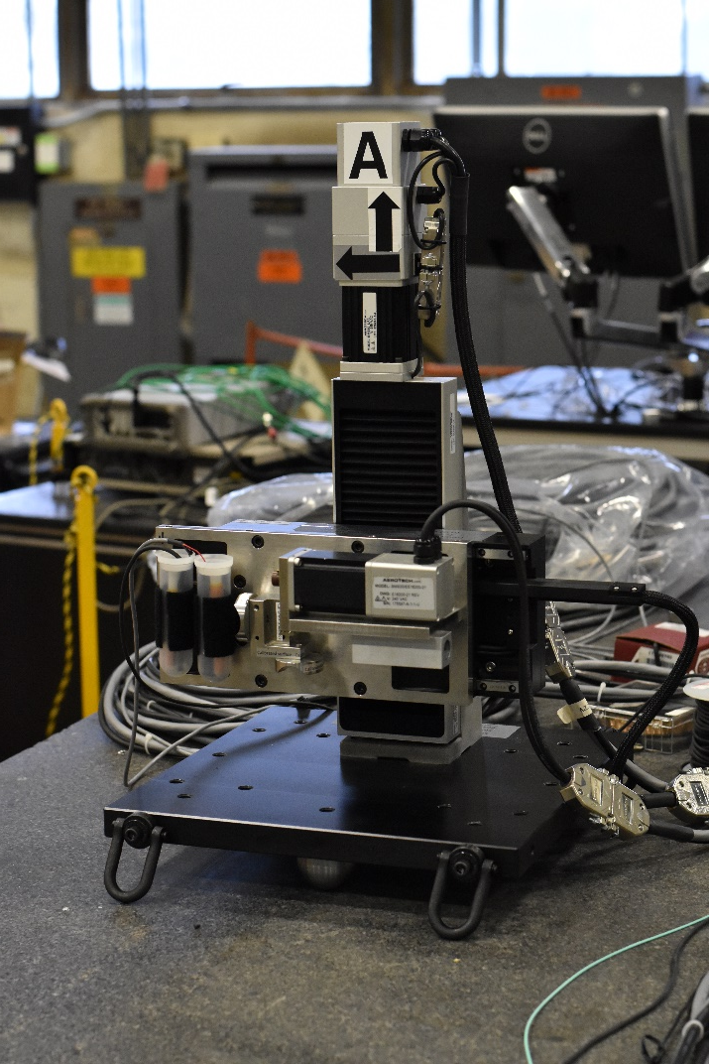
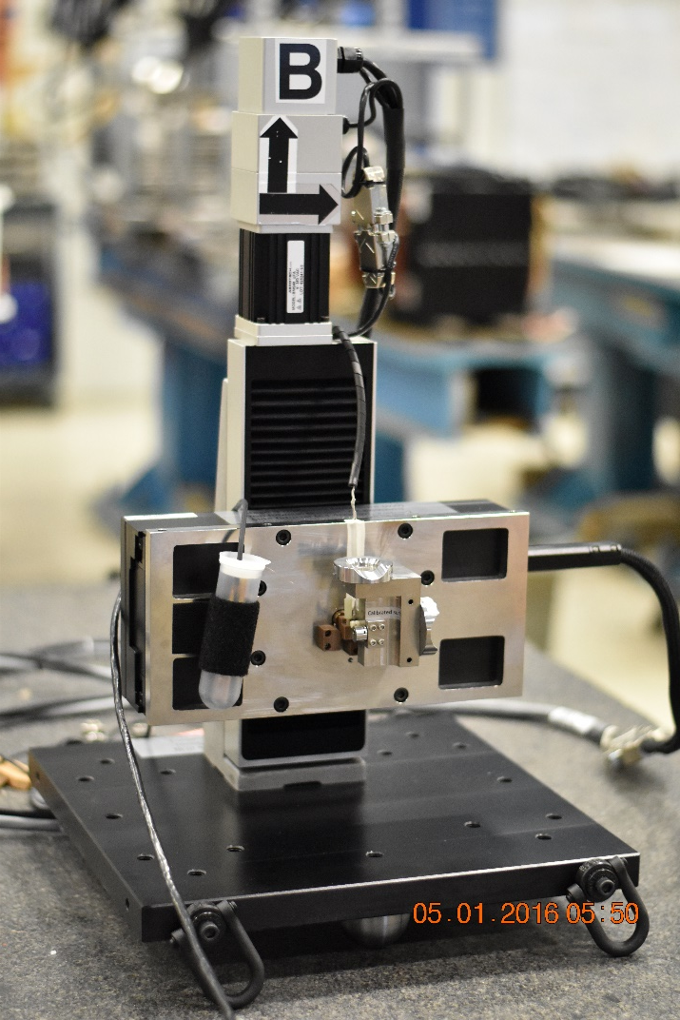
Measurement of the magnet center with Single Stretched Wire system
Y. Arimoto, N. Ohuchi,
M. Masuwawa, R. Ueki, Y. Ohsawa, T. Kawamoto
and H. Iinuma

Slide 2
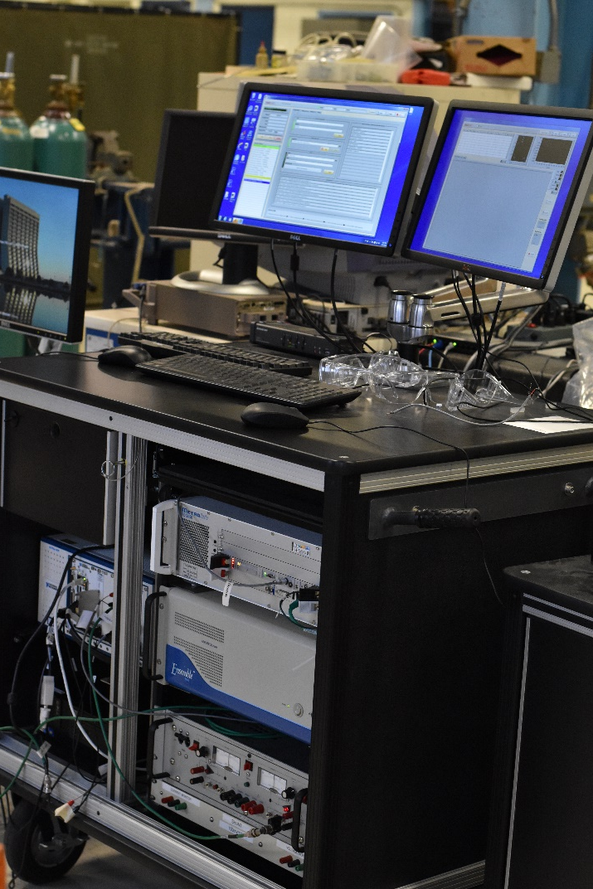
in stage coordinate system

Slide 3
Co-directional motion (finds nodal point (average axis))
Stage motion causes the wire to move in the B- field to generate change in flux, Φ, measured by the SSW data acquisition system.
Counter-directional motion (to find true axis)
Move wire ends till δ_{CO}→0 and δ_{CN}→0
Output wire ends points in stage coordinates (x, y)
Input z positions from design
Sag corrections
Measure roll angles, too.
Find magnets center positions (x, y)

Slide 4
Test bench, just across the street
SSW system delivered on May 12
We care the stage levels ~ 0.17mrad
After earthquake, we need to arraign them again

Slide 5
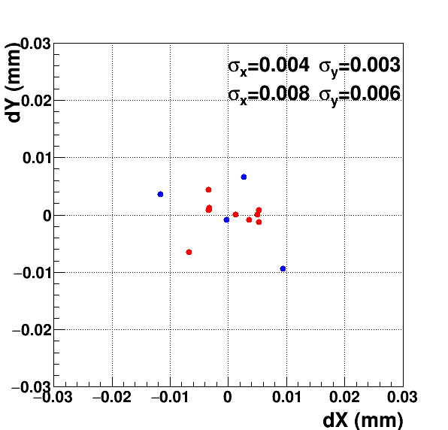
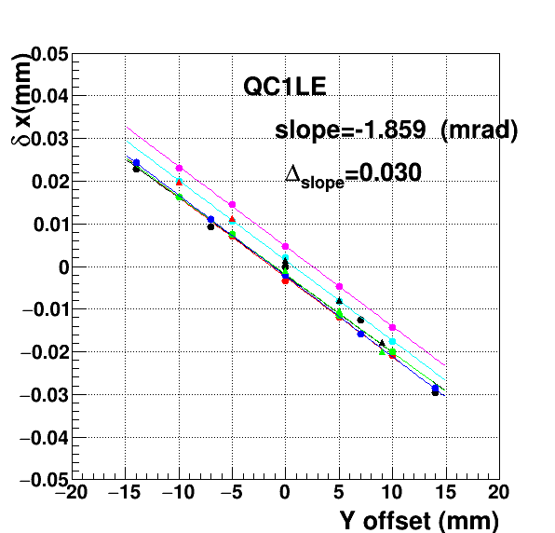
Repeatability check
Red 10 points
Blue 4 points
Repeat from the wire set

Slide 6
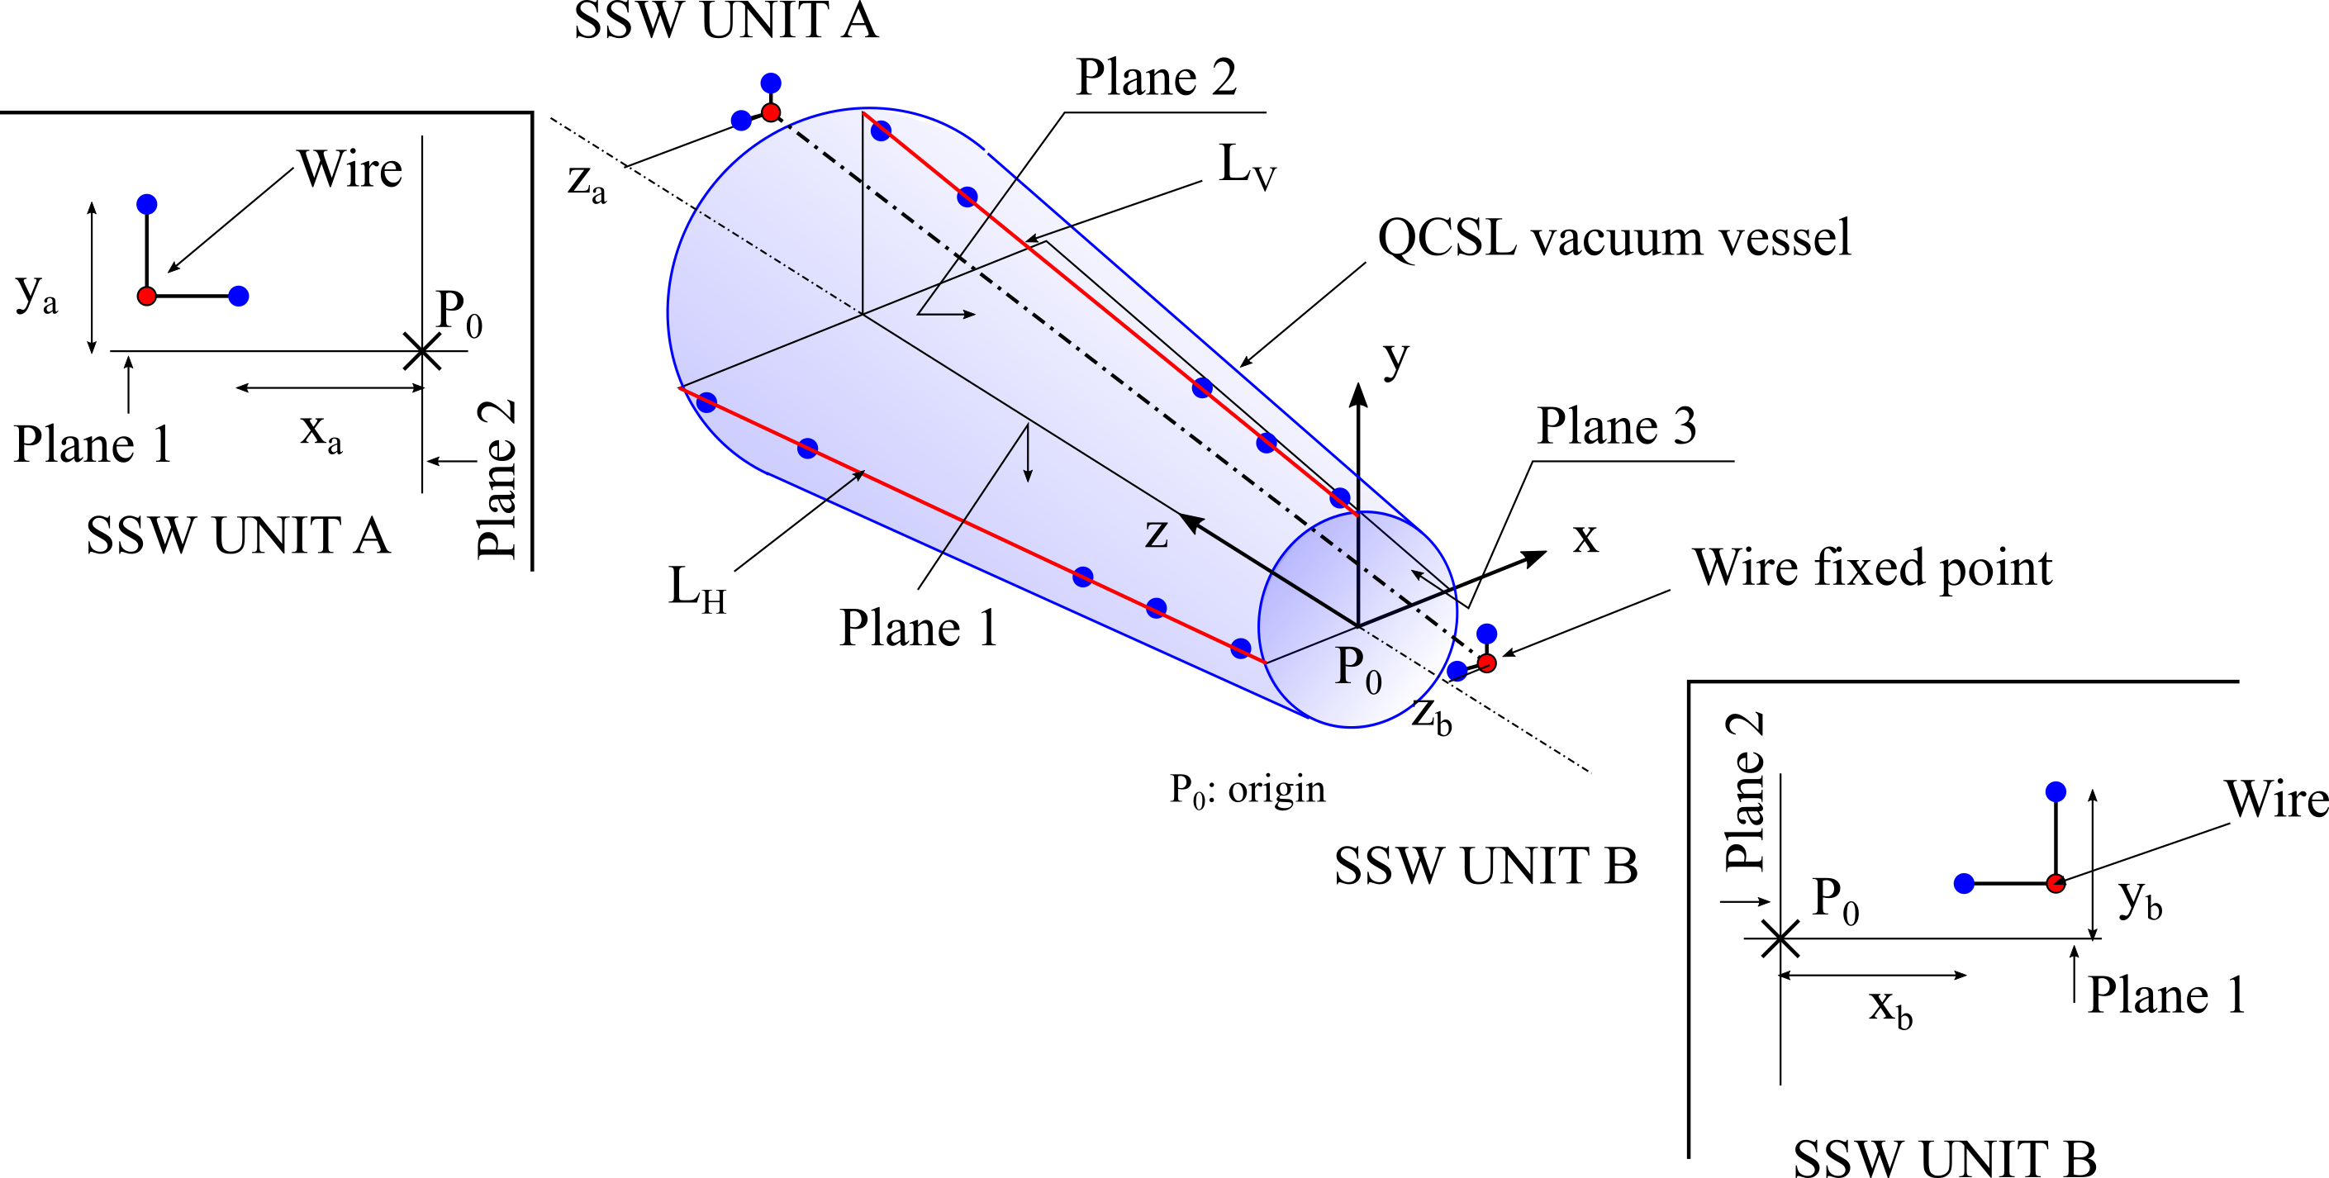
To convert fix coordinate, we apply laser tracker survey
Survey data is consistent with design values and stable within few tens of microns

Slide 7
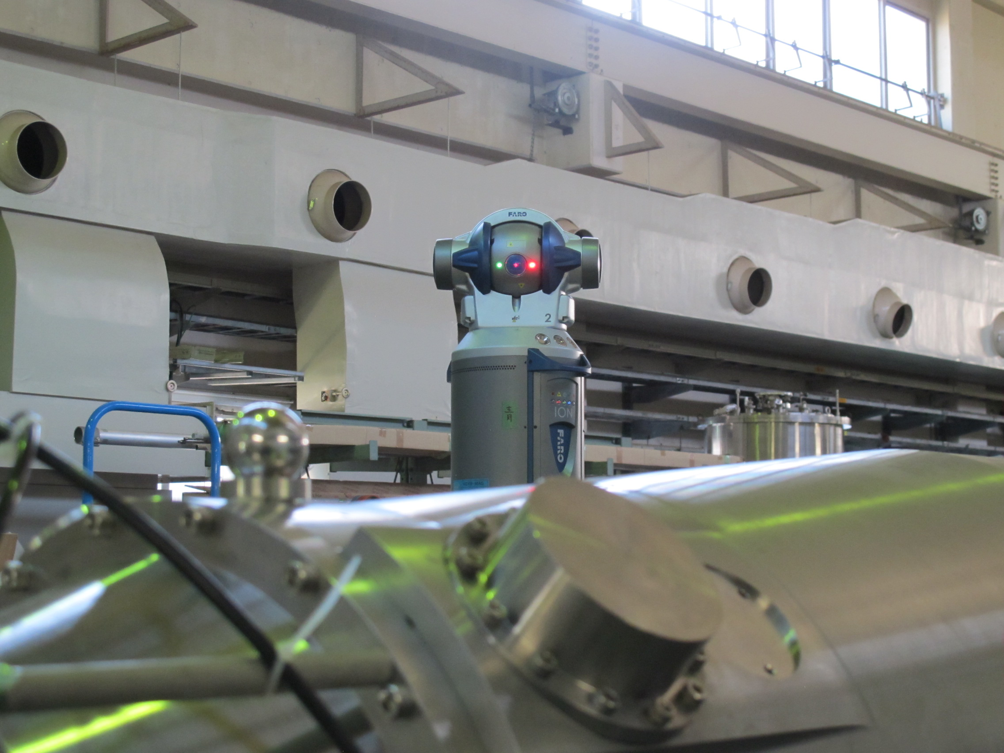
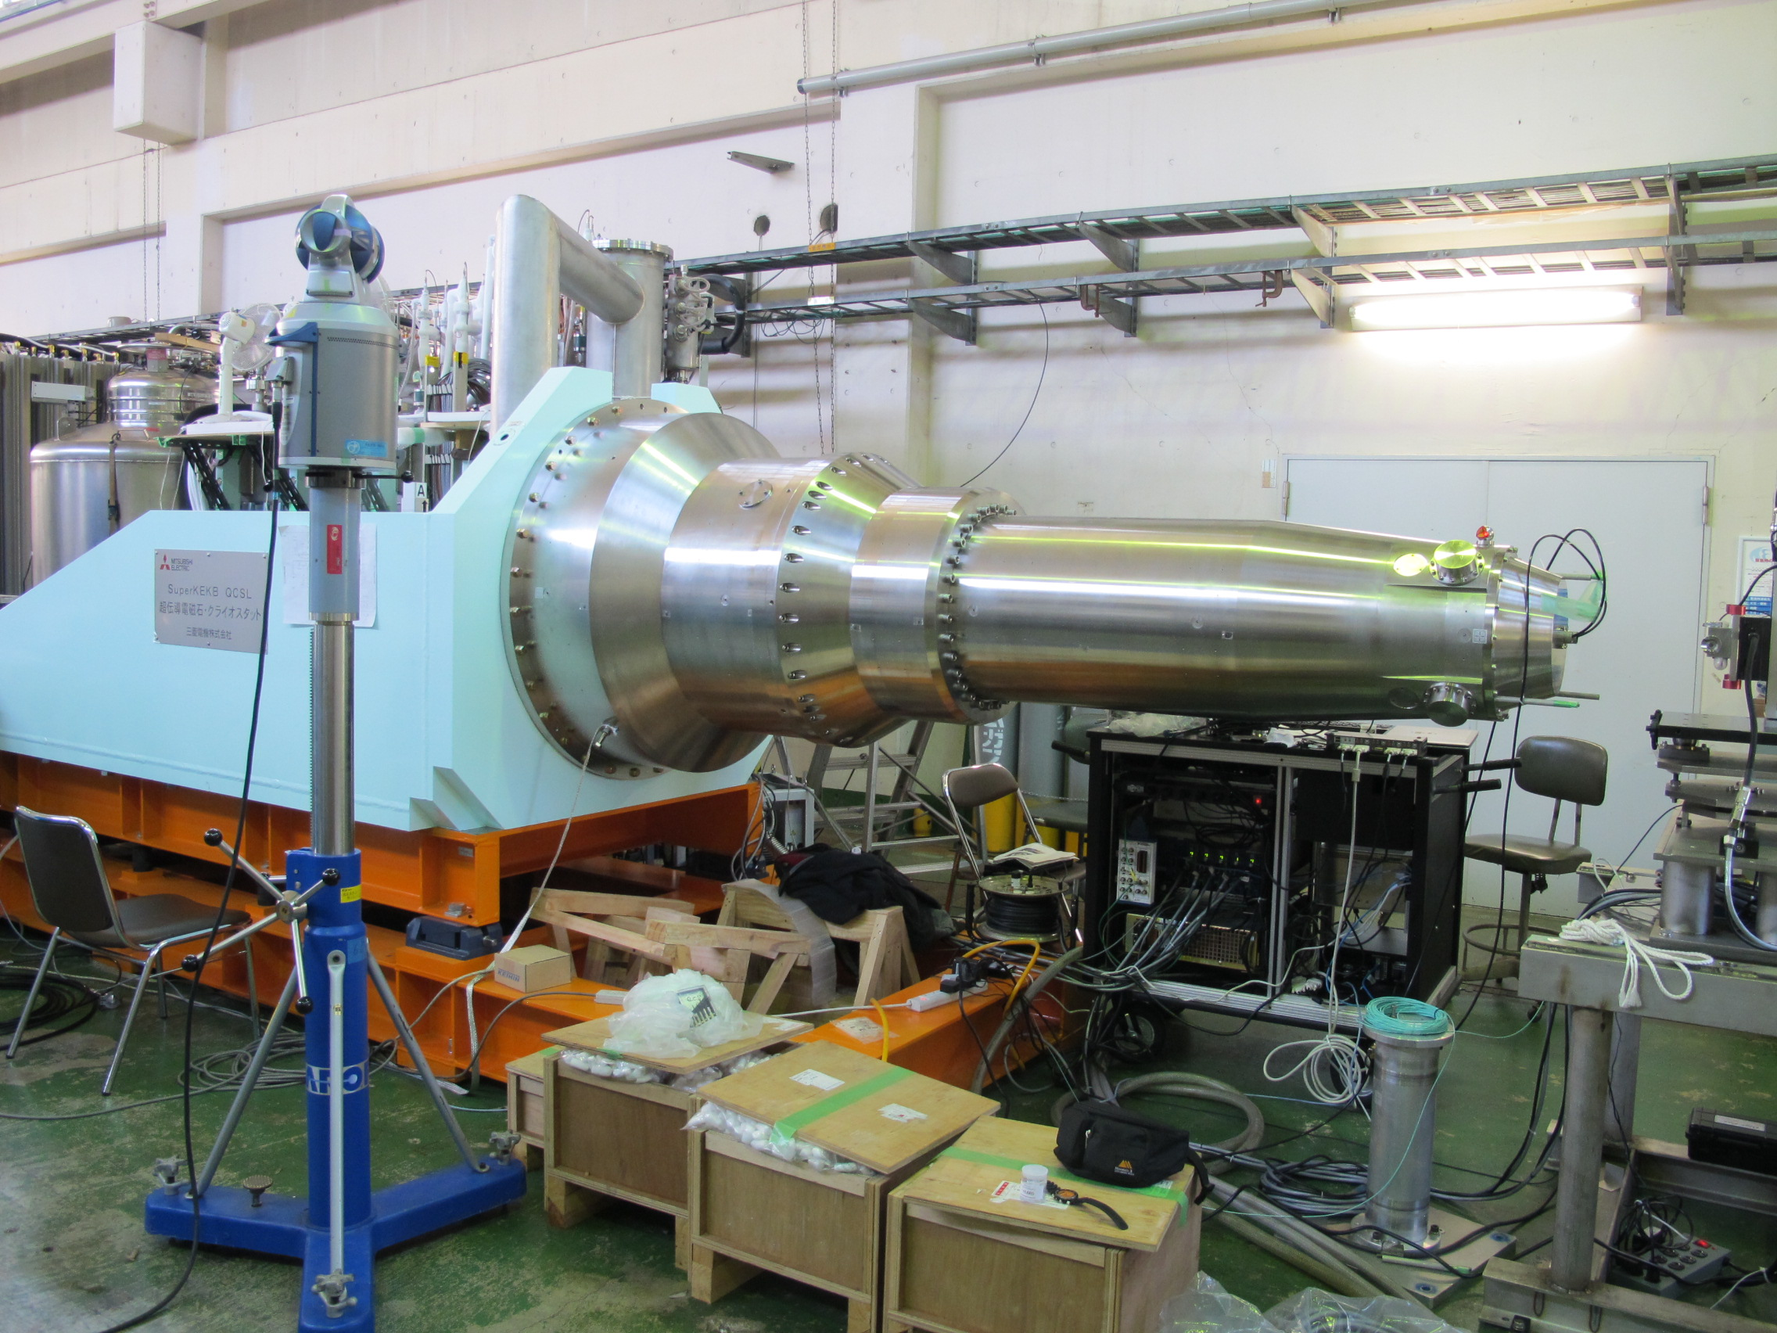
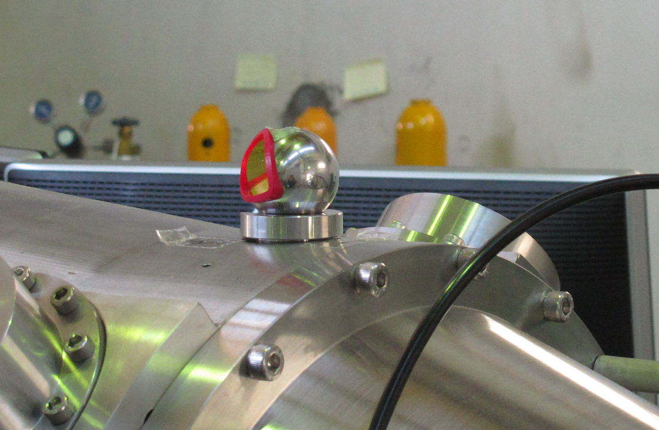
Survey by Laser tracker

Slide 8
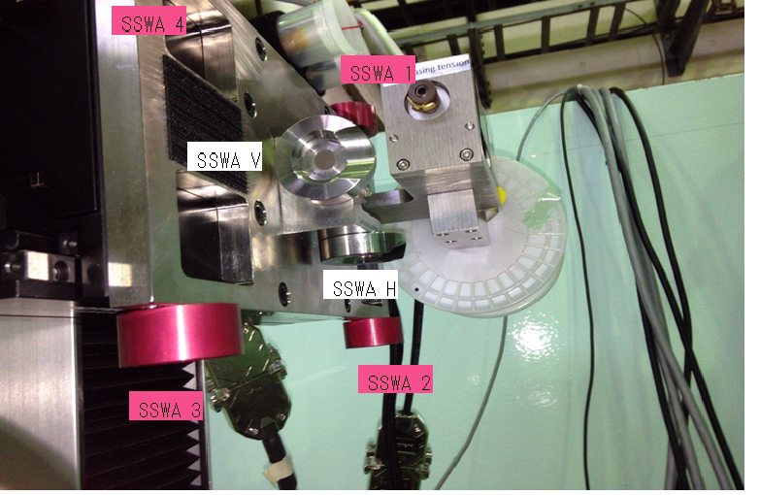
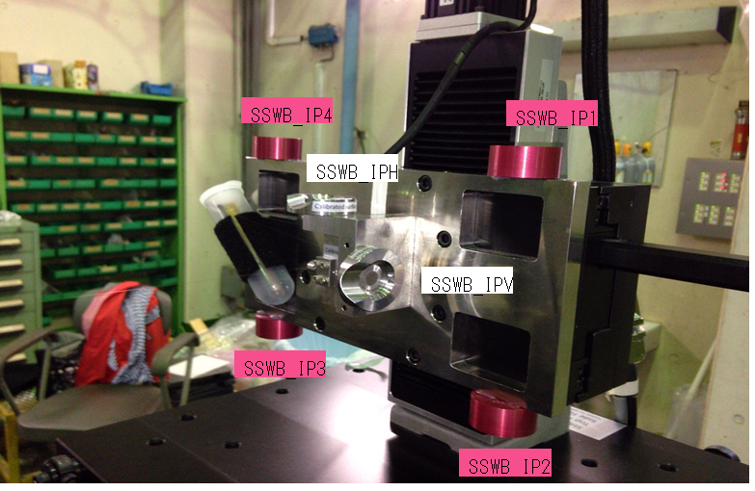
We added 4 points for each stage to increase accuracy

Slide 9
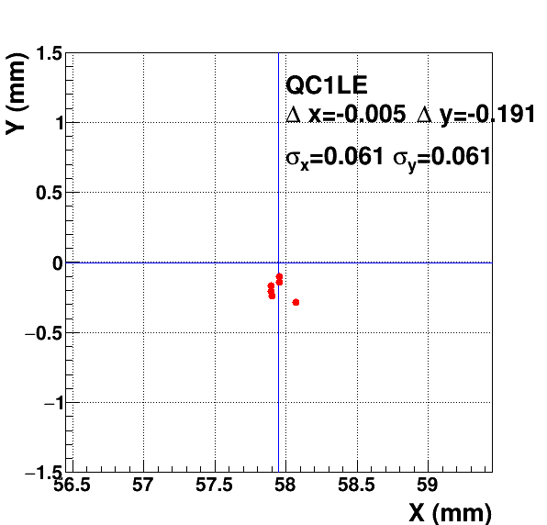
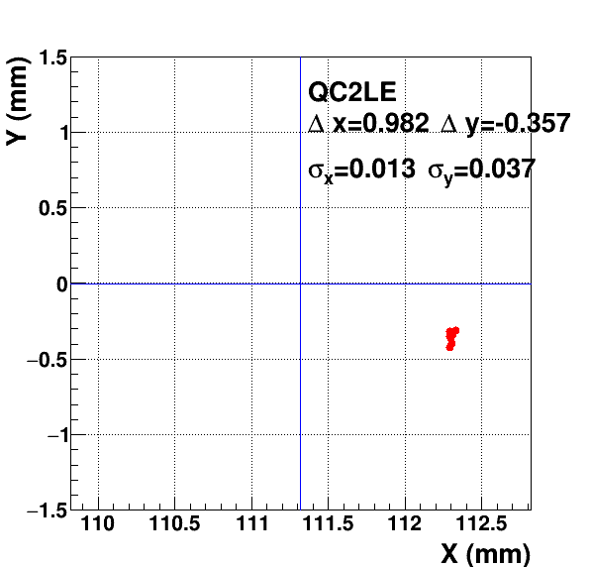
Measured magnet centers vs. designs: HER
Magnet center positions with several conditions (AC: 300K, ~50K, 4K and DC) are stable within 50~80μm for x and y directions
AC 300K

Slide 10
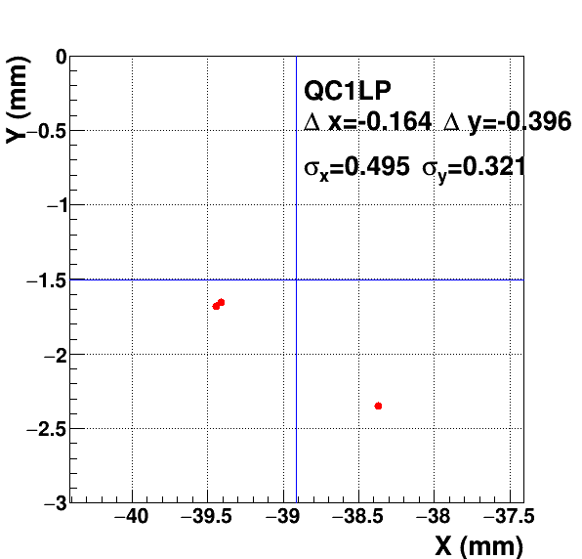
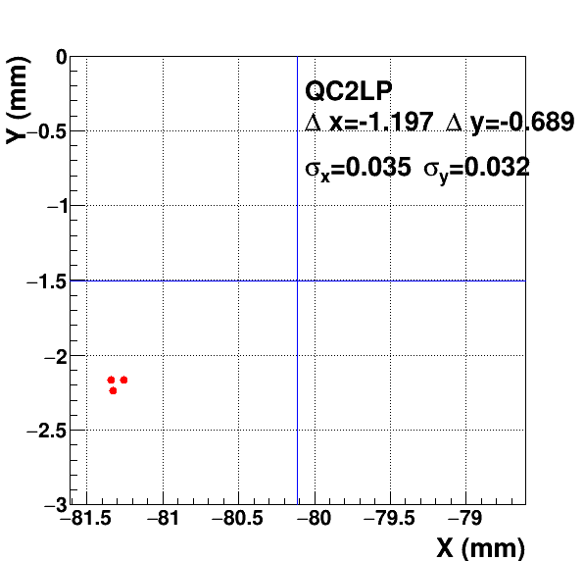
Measured magnet centers vs. designs :LER
AC 300K

Slide 11
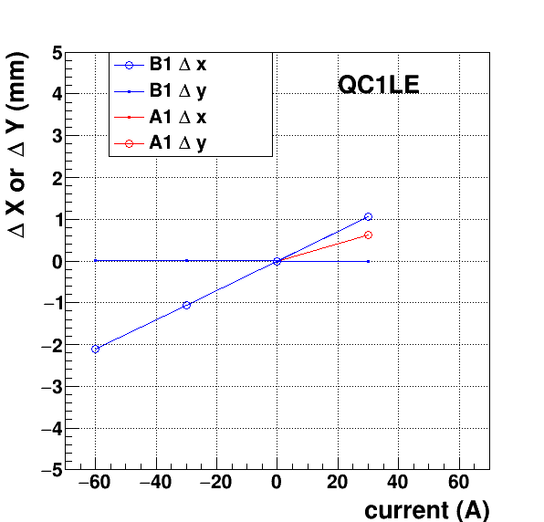
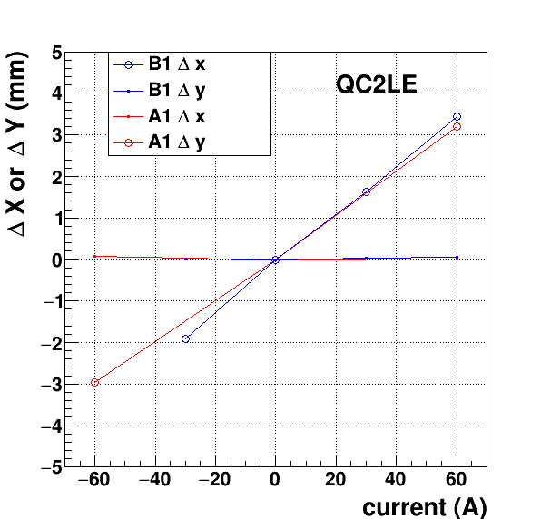
Corrector coil measurement

Slide 12
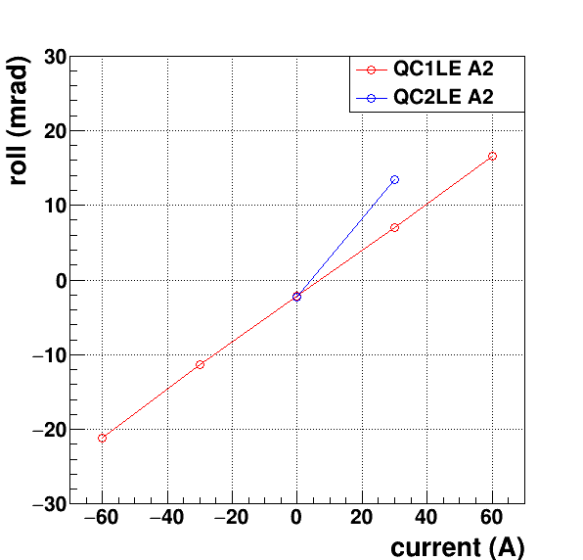
Corrector coil measurements
QC1LE+A2
ハーモニックコイルの結果よりも10%多めに磁場が回転しています

Slide 13
Roll Angle Summary
-2 mrad
-2 mrad
-15 mrad
-7 mrad

Slide 14
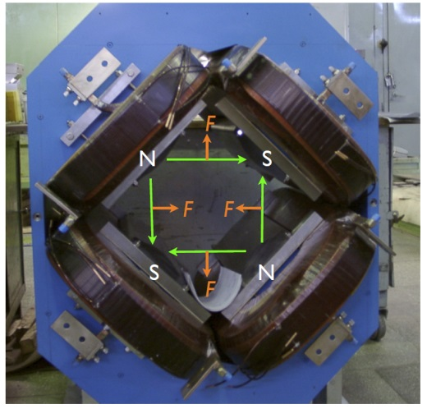
Summary
From measurements so far：
Magnet center positions with several conditions (AC: 300K, ~50K, 4K and DC) are stable within 50~80μm for x and y directions
Horizontal magnet centers of QC2LP and QC2LE differ ~1mm from the design.
True?
B1 corrector coil can correct
How about QC1LP and QC2LP ? → we will measure soon.
Vertical positions differ 100～600 μm compared to the design values
True?
Hard to correct especially for QC1LP
Roll angles also differ ~2mrad.
A2 corrector coils are available
Careful comparison with Harmonic coils’ dataと
Next:
We will resume SSW measurement in the next week.
Understanding (hidden) systematic uncertainties … use normal magnets
Measurements of QCSR in November…
seeing is believing

Slide 15
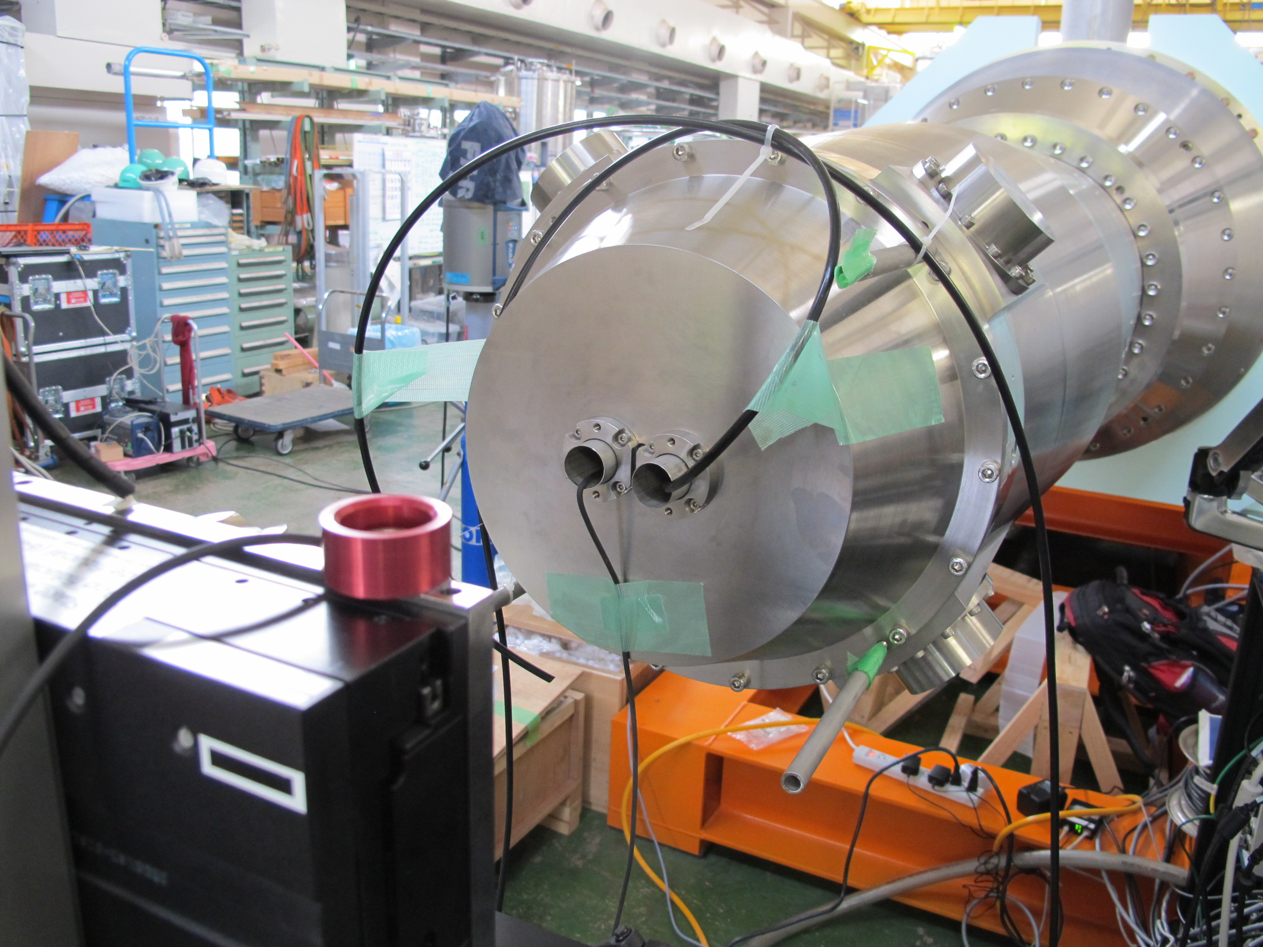
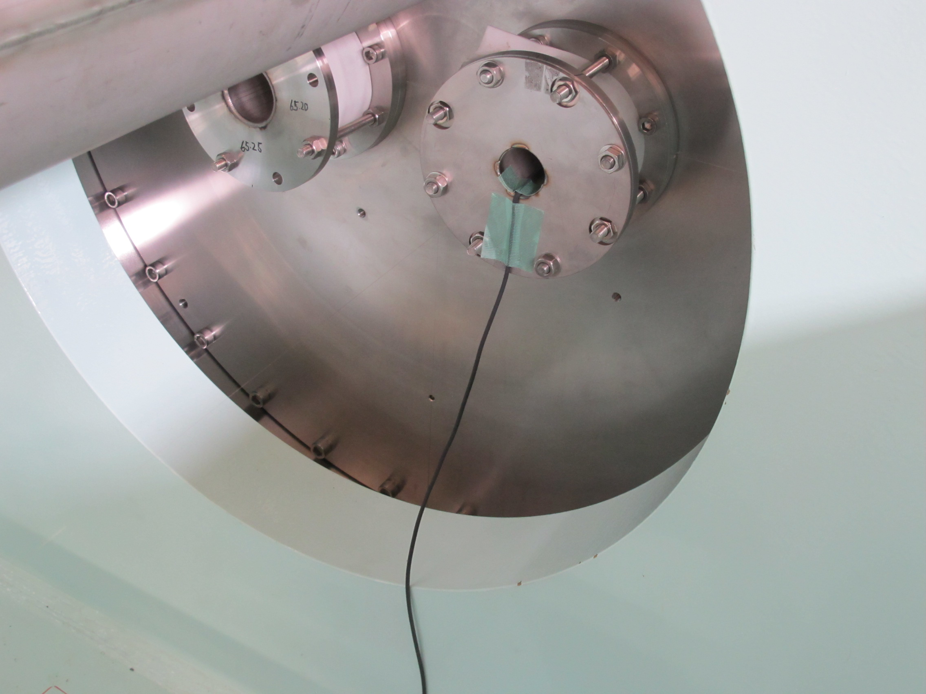
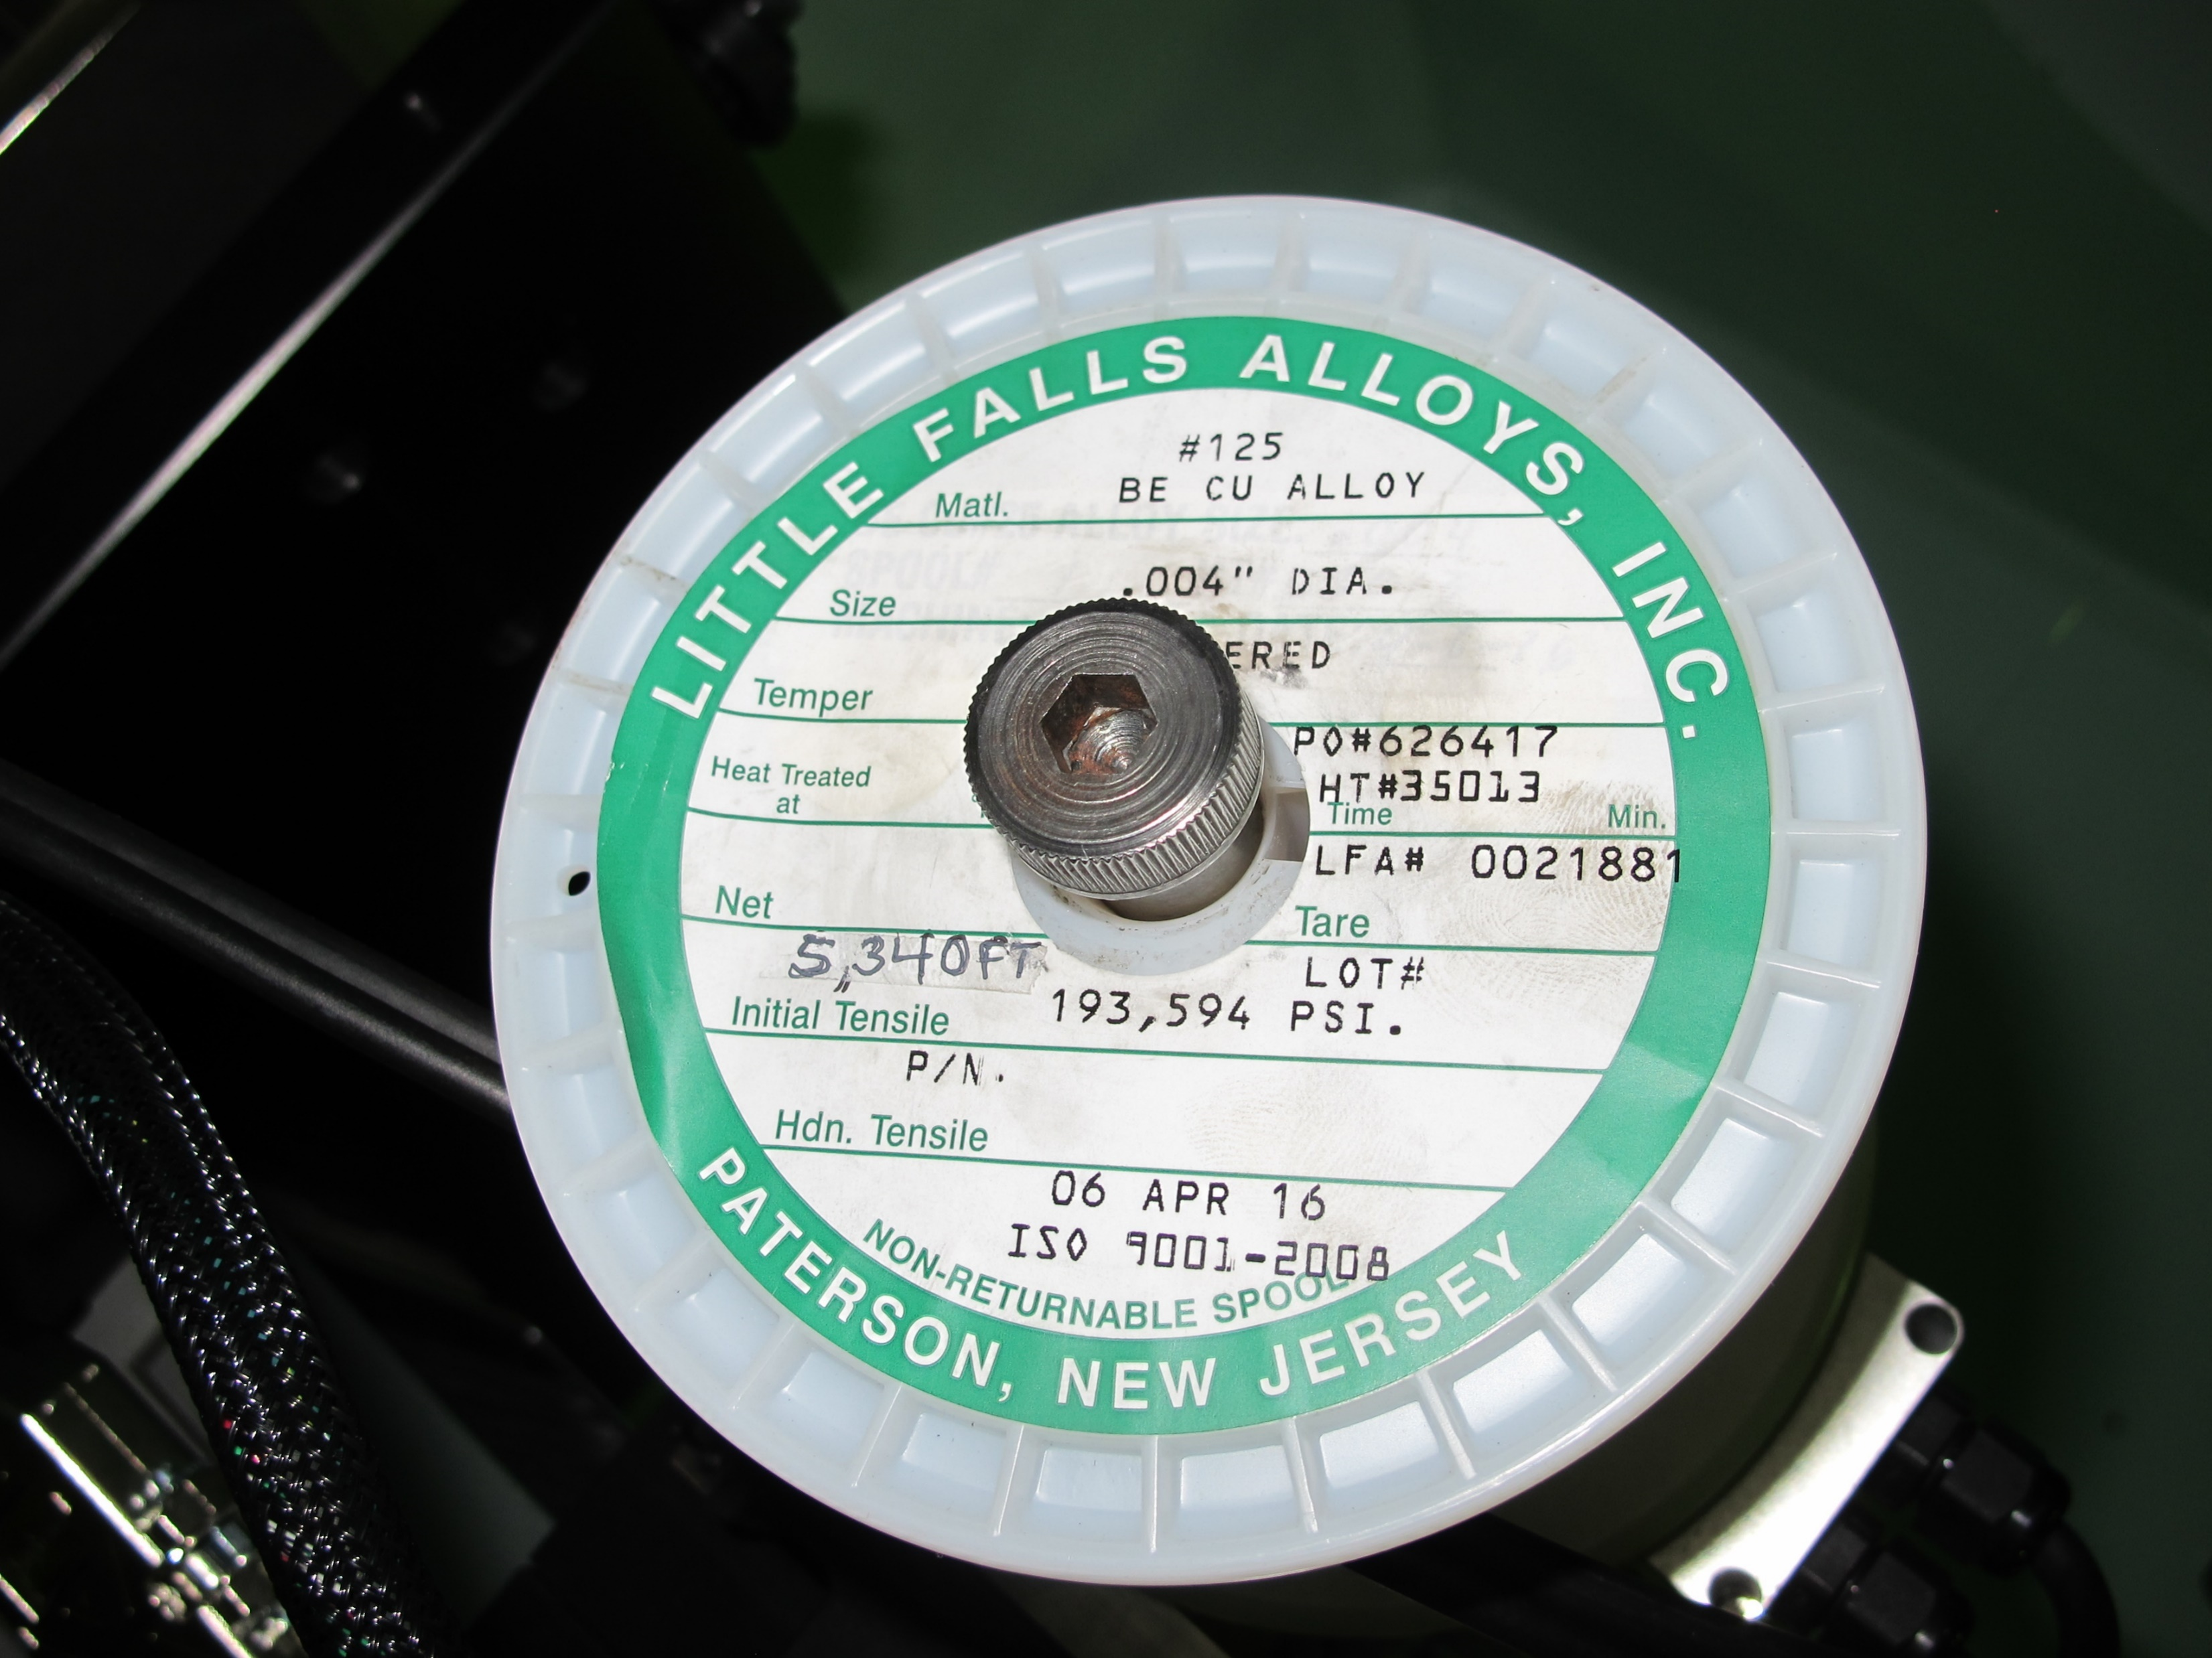
Return is also in the pipe

Slide 16
Axis Repeatability

Slide 17
Strength measurements at full field
Need to understand variations – e.g. slight wire susceptibility may influence large step measurements in strong magnet (perhaps sag calibration measurements can be used to extrapolate this to “infinite tension”)

Slide 19
QC1LE+A2
ハーモニックコイルの結果よりも10%多めに磁場が回転しています

Slide 20
QC1LE
 |  |  |  |  |  |  |  |  |  |  | sag_correction
 |  |  | trackStageA | trackStageB | trackMagA | trackMagB | center | TrackSagMagA | TrackSagMagB | center | magA | magB
20160517_221336 | AC 4.5K | x | 167.617 | 12.08 | 65.70022453 | 50.10140086 | 57.9008127 | 65.71455733 | 50.08015574 | 57.89735654 | 0.014333 | -0.0212451
SURVEY0 |  | y | 0.512 | -0.509 | -0.15701784 | -0.259414048 | -0.208215944 | -0.091425432 | -0.323755047 | -0.20759024 | 0.065592 | -0.064341
20160518_002642 | DC | x | 167.637 | 12.06 | 65.69401424 | 50.09117896 | 57.8925966 | 65.71852526 | 50.07478121 | 57.89665323 | 0.024511 | -0.0163978
SURVEY0 |  | y | -3.808 | 1.321 | -0.447184623 | 0.067203379 | -0.189990622 | -0.475856962 | 0.142960117 | -0.166448423 | -0.02867 | 0.07575674
20160518_234111 | AC53K | x | 167.587 | 12.09 | 65.69643483 | 50.10162276 | 57.8990288 | 65.69814867 | 50.10102994 | 57.89958931 | 0.001714 | -0.0005928
SURVEY2_10mmstep |  | y | -0.178 | -0.269 | -0.237628426 | -0.246754827 | -0.242191627 | -0.266604528 | -0.213391969 | -0.239998249 | -0.02898 | 0.03336286
20160524_101959 | AC 4.7K | x | 167.487 | 12.21 | 65.74059147 | 50.16784322 | 57.95421734 | 65.74757512 | 50.15436334 | 57.95096923 | 0.006984 | -0.0134799
SURVEY3 |  | y | 1.362 | -0.729 | -0.008143294 | -0.217849925 | -0.112996609 | -0.007694291 | -0.20179481 | -0.10474455 | 0.000449 | 0.01605512
20160524_124446 | DC | x | 166.667 | 12.55 | 65.68069009 | 50.22427838 | 57.95248423 | 65.63983751 | 50.26843836 | 57.95413793 | -0.04085 | 0.04415998
SURVEY3 |  | y | 0.012 | -0.209 | -0.132811893 | -0.154976008 | -0.143893951 | -0.166476934 | -0.117781314 | -0.142129124 | -0.03367 | 0.03719469
20160512_202305 | AC room | x | 167.527 | 12.36 | 65.85266978 | 50.29095345 | 58.07181162 | 65.86419547 | 50.27400258 | 58.06909902 | 0.011526 | -0.0169509
SurveyWarm1 |  | y | -1.978 | 0.431 | -0.399484842 | -0.157885954 | -0.278685398 | -0.381126052 | -0.192837735 | -0.286981893 | 0.018359 | -0.0349518
 |  |  |  |  |  |  |  |  | ave_x | -57.94 | design_x | -57.95
 |  |  |  |  |  |  |  |  | ave_y | -0.19 | design_y | 0

Slide 21
QC2LE
 |  |  | trackStageA | trackStageB | trackMagA | trackMagB | center | TrackSagMagA | TrackSagMagB | center | magA | magB
20160518_024910 | DC | x | 169.827 | 9.34 | 123.884311 | 100.712315 | 112.2983 | 123.82473 | 100.76752 | 112.2961 | -0.05958 | 0.055203
SURVEY1 |  | y | -0.898 | 0.591 | -0.4717433 | -0.2567533 | -0.36425 | -0.4641617 | -0.259269 | -0.36172 | 0.007582 | -0.00252
20160518_035039 | AC 4.5K | x | 169.307 | 10.28 | 123.782266 | 100.821073 | 112.3017 | 123.77206 | 100.81551 | 112.2938 | -0.0102 | -0.00557
SURVEY1 |  | y | -0.748 | 0.351 | -0.4333888 | -0.2747091 | -0.35405 | -0.4425508 | -0.256245 | -0.3494 | -0.00916 | 0.018464
20160518_195218 | AC | x | 169.287 | 10.37 | 123.793755 | 100.848445 | 112.3211 | 123.80034 | 100.81964 | 112.31 | 0.006588 | -0.02881
SURVEY2 |  | y | -0.638 | 0.181 | -0.4035445 | -0.2852928 | -0.34442 | -0.3881773 | -0.291196 | -0.33969 | 0.015367 | -0.0059
20160519_043749 | DC | x | 169.957 | 9.1 | 123.908391 | 100.682972 | 112.2957 | 123.90066 | 100.70762 | 112.3041 | -0.00773 | 0.024644
5mmstep+SURVEY2 |  | y | -1.008 | 0.881 | -0.4672351 | -0.1944909 | -0.33086 | -0.5701009 | -0.22443 | -0.39727 | -0.10287 | -0.02994
20160525_102933 | AC | x | 169.307 | 10.24 | 123.770815 | 100.803846 | 112.2873 | 123.77013 | 100.80837 | 112.2892 | -0.00069 | 0.004522 | 1/f2
SURVEY4 |  | y | -0.868 | 0.671 | -0.4274297 | -0.2052205 | -0.31633 | -0.4146487 | -0.222609 | -0.31863 | 0.012781 | -0.01739 | 1/f2
20160525_140642 | DC | x | 169.687 | 9.58 | 123.853094 | 100.735964 | 112.2945 | 123.85557 | 100.73068 | 112.2931 | 0.002481 | -0.00528 | 1/T
SURVEY4 |  | y | 0.542 | -2.139 | -0.2254911 | -0.6125887 | -0.41904 | -0.1791846 | -0.66073 | -0.41996 | 0.046307 | -0.04814 | 1/T
20160513_001236 | AC_room | x | 169.217 | 10.52 | 123.786735 | 100.873189 | 112.33 | 123.81087 | 100.84881 | 112.3298 | 0.024137 | -0.02438
surveyWarm2 |  | y | -0.208 | -0.449 | -0.2769912 | -0.3117881 | -0.29439 | -0.3146003 | -0.305977 | -0.31029 | -0.03761 | 0.005811
 |  |  |  |  |  |  |  |  | ave_x | -112.30 | design_x | -111.32
 |  |  |  |  |  |  |  |  | ave_y | -0.36 | design_y | 0

Slide 22
QC1LP & QC2LP
 |  |  | trackStageA | trackStageB | trackMagA | trackMagB | center | TrackSagMagA | TrackSagMagB | center | magA | magB
20160516_045401 | AC | x | -166.783 | -13.79 | -46.312957 | -32.572255 | -39.4426 | -46.3466782 | -32.53125995 | -39.438969 | -0.033721 | 0.040995055
surveyA |  | y | -2.188 | -1.579 | -1.70846 | -1.65376416 | -1.68111 | -1.70778584 | -1.654880837 | -1.6813333 | 0.0006742 | -0.001116676
20160516_222636 | DC | x | -171.243 | -12.84 | -46.513005 | -32.2864161 | -39.3997 | -46.554758 | -32.26478877 | -39.409773 | -0.041753 | 0.021627337
surveyB |  | y | -4.138 | -1.159 | -1.7922701 | -1.52471829 | -1.65849 | -1.80819186 | -1.505194702 | -1.6566933 | -0.015922 | 0.019523584
20160513_025418 | AC_room | x | -168.833 | -13.32 | -46.378654 | -30.361624 | -38.3701 | -46.3225859 | -30.42501199 | -38.373799 | 0.0560682 | -0.063388043
surveyWarm3 |  | y | -9.578 | -0.889 | -2.7360909 | -1.95570902 | -2.3459 | -2.61632632 | -2.08254121 | -2.3494338 | 0.1197646 | -0.126832186 | sagBig?
 |  |  |  |  |  |  |  |  | ave_x | 39.07 | design_x | 38.91
 |  |  |  |  |  |  |  |  | ave_y | -1.90 | design_y | -1.5
 |  |  | trackStageA | trackStageB | trackMagA | trackMagB | center | TrackSagMagA | TrackSagMagB | center | magA | magB
20160516_024430 | AC(~4K) | x | -167.813 | -14.61 | -89.7101568 | -72.80354746 | -81.25685213 | -89.69582928 | -72.8192085 | -81.25751889 | 0.014328 | -0.01566
surveyD |  | y | -2.288 | -2.079 | -2.181451863 | -2.158387815 | -2.169919839 | -2.179956122 | -2.155532459 | -2.16774429 | 0.001496 | 0.002855
20160517_022234 | DC | x | -172.913 | -10.79 | -90.26274348 | -72.37177383 | -81.31725866 | -90.21191545 | -72.43588234 | -81.32389889 | 0.050828 | -0.06411
suevryC |  | y | -6.538 | 1.201 | -2.592660134 | -1.738628231 | -2.165644182 | -2.519728924 | -1.950059456 | -2.23489419 | 0.072931 | -0.21143
20160513_043512 | AC_room | x | -168.323 | -14.36 | -89.83270902 | -72.84223043 | -81.33746973 | -89.78941716 | -72.88746965 | -81.3384434 | 0.043292 | -0.04524
surveyWarm4 |  | y | -2.308 | -2.029 | -2.165765884 | -2.134977035 | -2.15037146 | -2.170340417 | -2.159442026 | -2.164891222 | -0.00457 | -0.02446
 |  |  |  |  |  |  |  |  | ave_x | 81.31 | design_x | 80.11
 |  |  |  |  |  |  |  |  | ave_y | -2.19 | design_y | -1.5

Slide 23
QC2LE+A1, B1 and A2
Harmonic coilの結果との比較も準備します。
 | QC2LE_correction coils |  |  | dx | dy
 | SSW_R_20160525_200006_DC_SO | 2016/05/25 08:00:10.618 PM | QC2LE_main | 0 | 0
A1 | SSW_R_20160525_200348_DC_SO | 2016/05/25 08:03:51.900 PM | QC2LE+A1_+60A | 0.0140205 | 3.1974287
 | SSW_R_20160525_200555_DC_SO | 05:58.8 | QC2LE+A1_+60A | 0.0162405 | 3.1938276
 | SSW_R_20160525_201033_DC_SO | 2016/05/25 08:10:37.272 PM | QC2LE+A1_-60A | 0.0811598 | -2.960667
 | SSW_R_20160525_201222_DC_SO | 2016/05/25 08:12:26.095 PM | QC2LE+A1_-60A | 0.0795518 | -2.960187
 | SSW_R_20160525_201514_DC_SO | 2016/05/25 08:15:18.648 PM | QC2LE+A1_-60A | 0.0788113 | -2.957992
B1 | SSW_R_20160525_204744_DC_SO | 2016/05/25 08:47:48.893 PM | QC2LE+B1_+60A | 3.4432189 | 0.0451268
 | SSW_R_20160525_205039_DC_SO | 2016/05/25 08:50:43.432 PM | QC2LE+B1_+60A | 3.450505 | 0.0439505
 | SSW_R_20160525_205524_DC_SO | 2016/05/25 08:55:28.708 PM | QC2LE+B1_+60A | 3.4449356 | 0.0481159
 | SSW_R_20160525_212356_DC_SO | 2016/05/25 09:24:00.510 PM | QC2LE+B1_+30A | 1.6387746 | 0.0264326
 | SSW_R_20160525_212816_DC_SO | 2016/05/25 09:28:20.002 PM | QC2LE+B1_-30A | -1.903114 | 0.0035128
 |  |  |  | Angle.avg | Angle.sdev
 | SSW_R_20160525_214658_DC_RA | 2016/05/25 09:47:02.568 PM | QC2LE | -2.284629 | 0.1364434
A2 | SSW_R_20160525_215436_DC_RA | 2016/05/25 09:54:40.081 PM | QC2LE+A2_+30A | 13.45524 | 0.119109
ヒステリシス5%くらい

Slide 24
QC1LE+A1, B1 and A2
Harmonic coilの結果との比較も準備します。
 | QC1LE_correction coils |  |  | dx | dy
 | SSW_R_20160526_144713_DC_PY | 2016/05/26 02:47:17.466 PM | QC1LE | 0 | 0
B1 | SSW_R_20160526_150302_DC_SO | 2016/05/26 03:03:05.936 PM | QC1LE+B1_+30A | 1.056283 | -0.01793
 | SSW_R_20160526_151312_DC_SO | 2016/05/26 03:13:16.228 PM | QC1LE+B1_-30A | -1.05438 | 0.006157
 | SSW_R_20160526_151629_DC_SO | 2016/05/26 03:16:33.615 PM | QC1LE+B1_-60A | -2.1083 | 0.013085
A1 | SSW_R_20160526_152959_DC_SO | 2016/05/26 03:30:03.461 PM | QC1LE+A1_+30A | -0.01298 | 0.622072
 | SSW_R_20160526_153649_DC_SO | 2016/05/26 03:36:53.593 PM | QC1LE+A1_-30A | -0.01758 | -0.62879
 | roll |  |  | Corrected.Angle.avg | Corrected.Angle.sdev
 | SSW_R_20160526_160723_DC_RA | 2016/05/26 04:07:27.939 PM | QC1LE | -2.20886 | 0.078277
A2 | SSW_R_20160526_163254_DC_RA | 2016/05/26 04:32:58.000 PM | QC1LE+A2_30A | 7.076841 | 0.060697
 | SSW_R_20160526_164510_DC_RA | 2016/05/26 04:45:14.000 PM | QC1LE+A2_-30A | -11.4009 | 0.061995
 | SSW_R_20160526_165800_DC_RA | 2016/05/26 04:58:03.922 PM | QC1LE+A2_-60A | -21.2021 | 0.072452
 | SSW_R_20160526_171628_DC_RA | 2016/05/26 05:16:32.788 PM | QC1LE | -2.93344 | 0.078084
A2 | SSW_R_20160526_172655_DC_RA | 2016/05/26 05:26:58.874 PM | QC1LE+A2_+60A | 16.56536 | 0.082787

