Slide 1
Positron Source Status
KEKB Review 2016
(2016 June 14)
KEKB injector linac
Takuya Kamitani

Slide 2
Positron source members
KEK
  Y. Enomoto, Yokoyama, Zang, Fukuda, Kamitani
  Tanaka, Ikeda, Kakihara, Arakida, Ohsawa, A. Enomoto
  Nakajima, Akemoto, S. Matsumoto, Higo
  Miura, Miyahara, Sugimoto, Seimiya, Iida, Ohnishi
  Okada, Takatomi, Someya, Kazama
Mitsubishi Electric System Service Co.
  Ushimoto, Suzuki, Kimura
Toyama Co.
  Iino, Morota, Sakai, Satoh

Slide 3
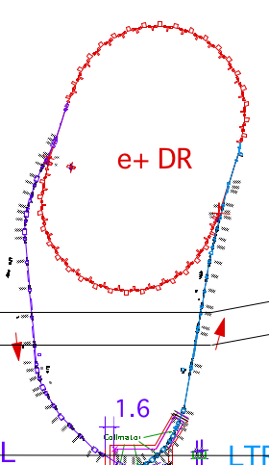
SuperKEKB Injector
SuperKEKB injector
low emittance
photo-cathode
RF gun
+ thermionic gun
for primary e-
50 Hz (e+ or e-)
pulse-by-pulse
mode switching
1.1 GeV
Damping Ring
circ. 136 m
PF
AR
3.0 GeV e-
(-> 6.5 GeV)
2.5 GeV e-
0.1nC x 1
Bunch
Compressor
LER
3.5 GeV
10nC x 2 (prim. e-)
5nC x 2 (inj. e-)
Energy-spread
Compression System
S-band
linac
4.0 GeV e+
4nC x 2
3T
RF gun
ECS
e+ target &
LAS capture section
HER
7.0 GeV e-
5nC x 2
Upgrade items in positron source
Low emittance e+
positron damping ring introduced
new positron focusing lens: flux concentrator (3.5 T) + bridge coils (1.0 T)
large-aperture (2a=30mm) accelerating structure (LAS) in capture section
positron focusing beam line layout reorganized with 100 new quad. magnets
e+ intensity (x4)

Slide 4
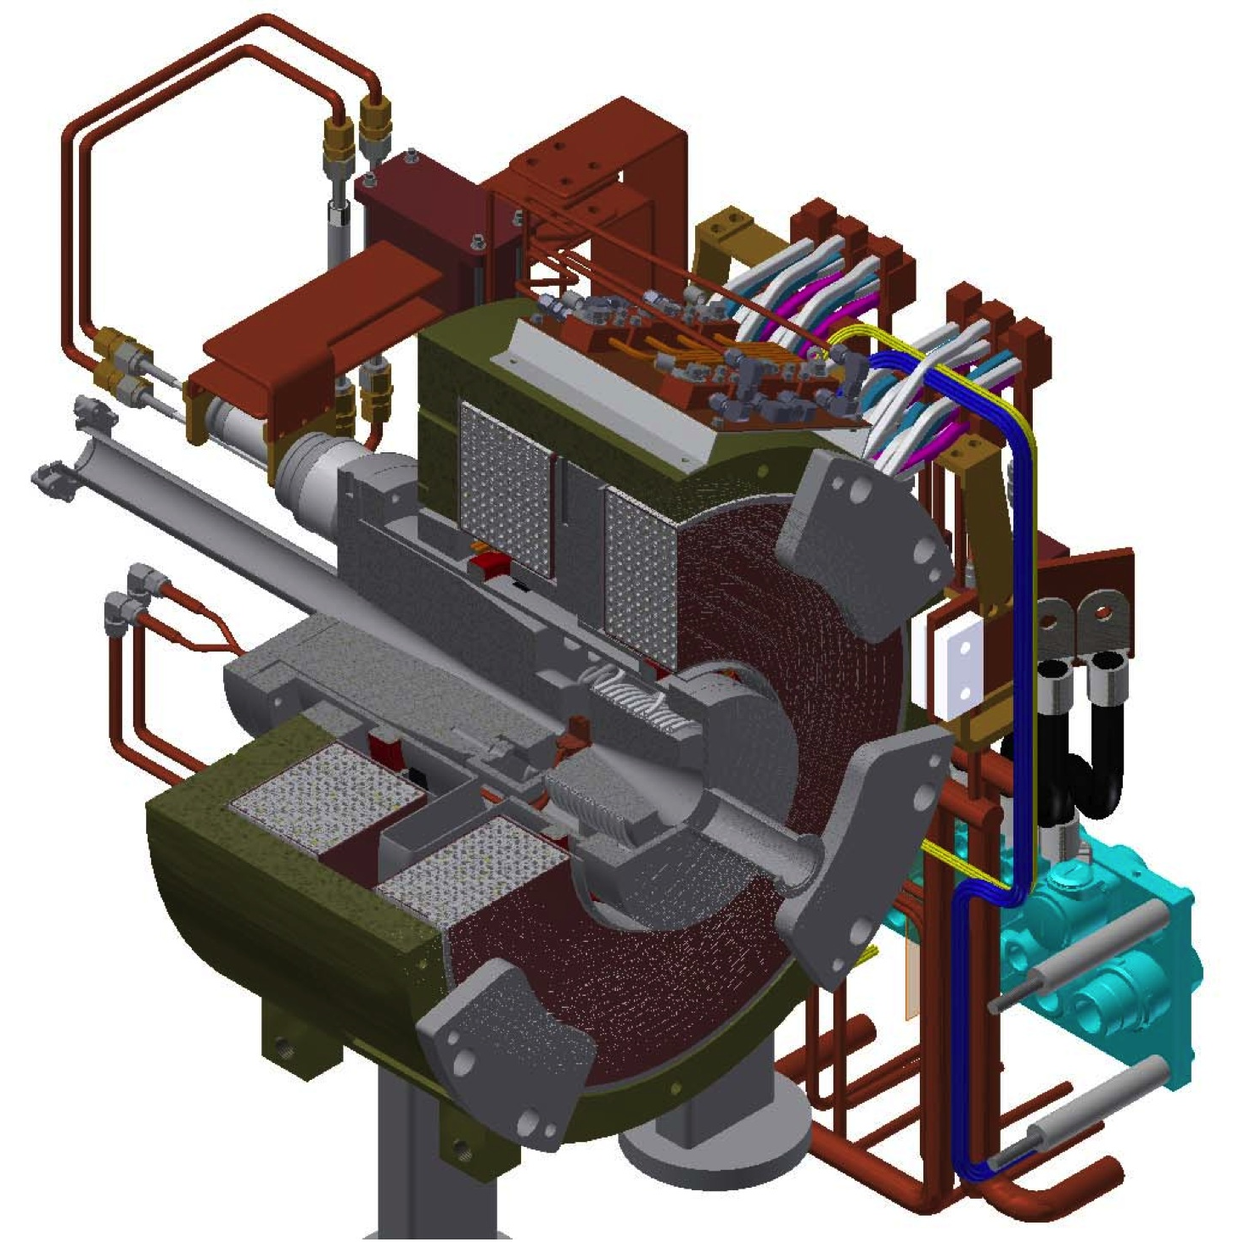
SuperKEKB positron source
primary
e- beam
3.3 GeV
positron
production
Target
Flux
Concentrator
Bridge
Coils
e+ beam

Slide 5
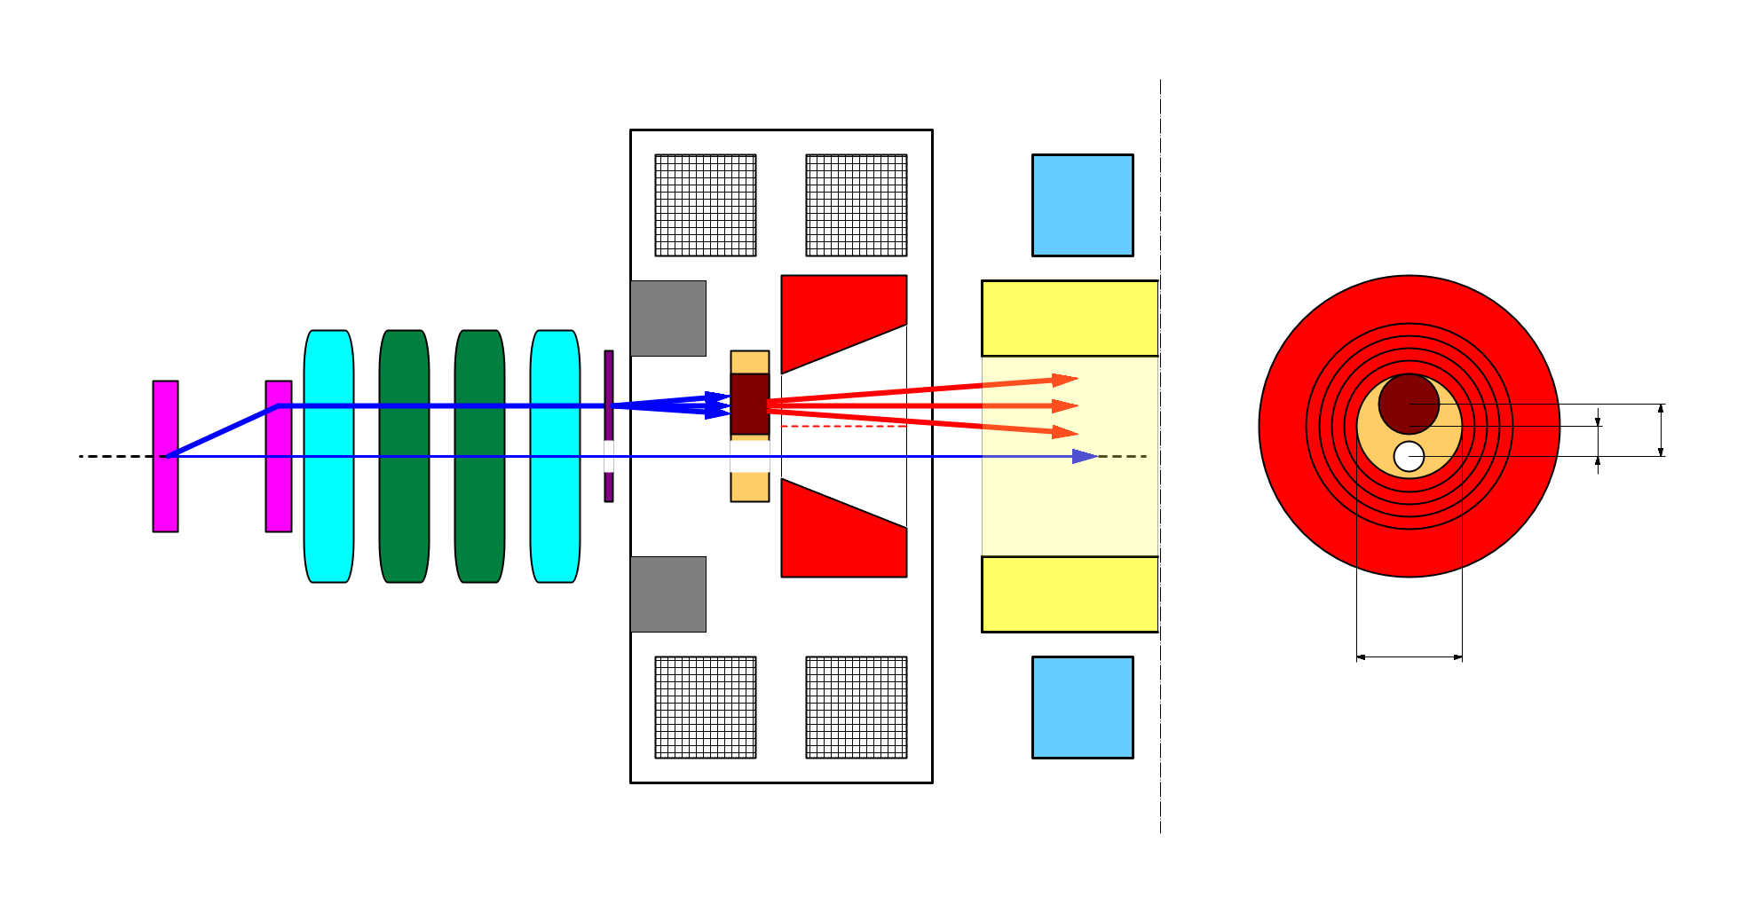
target offset & beam hole
side view
bridge coils
rear view
solenoid
target
diameter
4.0 mm
primary e-
DC QM
Accel.
structure
spoiler
target
offset
3.5 mm
target
e+
beam
hole
injection e-
2.0 mm
FC offset
hole
diameter
2.0 mm
Flux
Concentrator
pulse ST
7.0 mm
FC aperture
pulse QM
injection e- beam : on axis to preserve low emittance
primary e- beam : 2.5 mm off axis to minimize e+ yield degradation
(target offset 3.5 mm, FC offset 2.0mm)

Slide 6
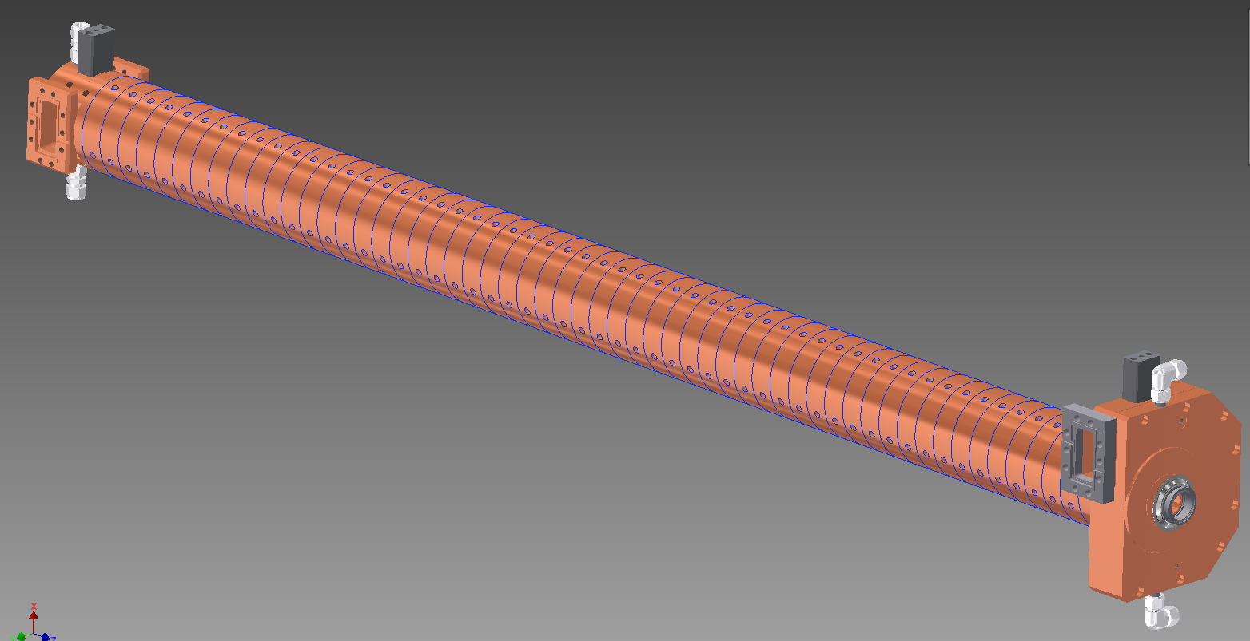
Positron Capture Section
SLED
SLED
KLY
1-5
KLY
1-6
target
+FC
LAS : Large Aperture
S-band structure
LAS 14 MV/m
deceleration & phase slip
& acceleration
LAS 10 MV/m
acceleration
Solenoids
operated at 10 MV/m
with SLED detuned
Large Aperture
S-band structure
(LAS)
LAS with SLEDs for sufficient field gradient
breakdown issue of LAS in solenoid field
needs careful RF conditioning

Slide 7
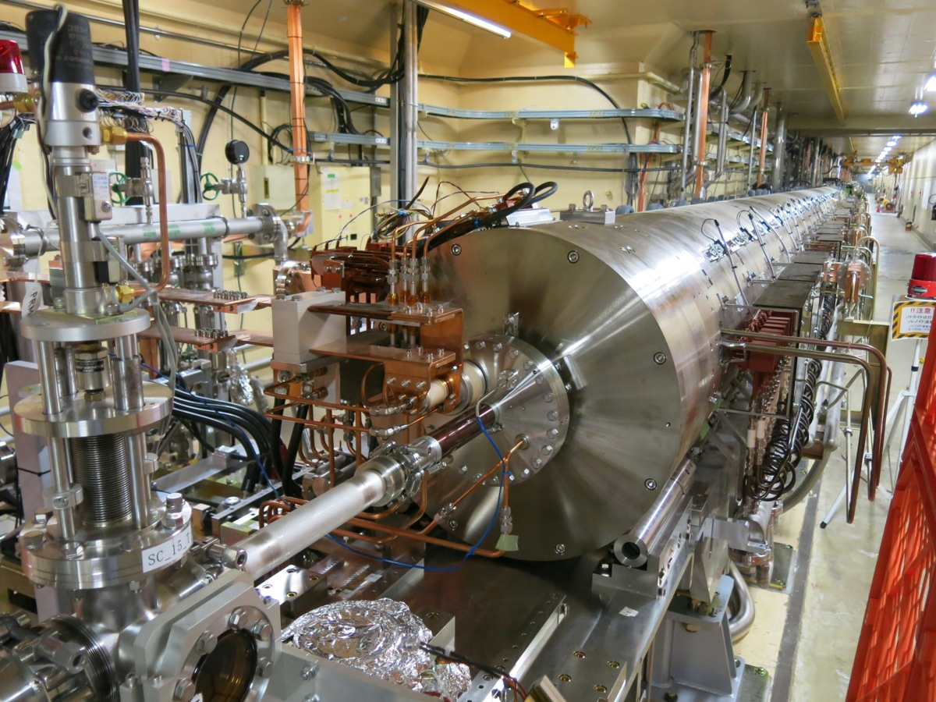
e+ capture section in linac tunnel
Flux concentrator,
target, bridge coil
(inside)
DC solenoids
& LAS accel. structures
elecron beam

Slide 8
e⁺ status at previous Review (2015/02/24)
e⁺ source components had been installed and
operated at limited performance
  FC : I_{FC} = 6 kA (spec. 12 kA) with temporary pulse modulator
  BC : I_{BC} = 600 A (=full spec)
  DC Solenoids : I_{DC} = 370 A (spec. 650 A)
  Acc. field : E_{ACC} = 10, 12 MV/m (spec. 14, 10 MV/m)
  DR not yet available
(Linac stand-alone) e⁺ initial commissioning (first e⁺ for SuperKEKB)
  Q(e+) = 0.12 nC@SY2 with Q(e-) = 0.60 nC, E(e-) = 3.1 GeV
  spec. (5.0 nC after DR -> 4.0 nC) (10.0 nC) (3.3 GeV)
  Y(e+) = (0.12 nC / 0.60 nC) = 20% @SY2 (= at entrance to DR)
FC coaxial feeder cable accident
-> renewal planned for thicker cable (insulator 2.3 -> 7.4 mm)
and parallel plate feeder line (two plates -> triplate)
higher voltage tolerance
lower induced voltage

Slide 9
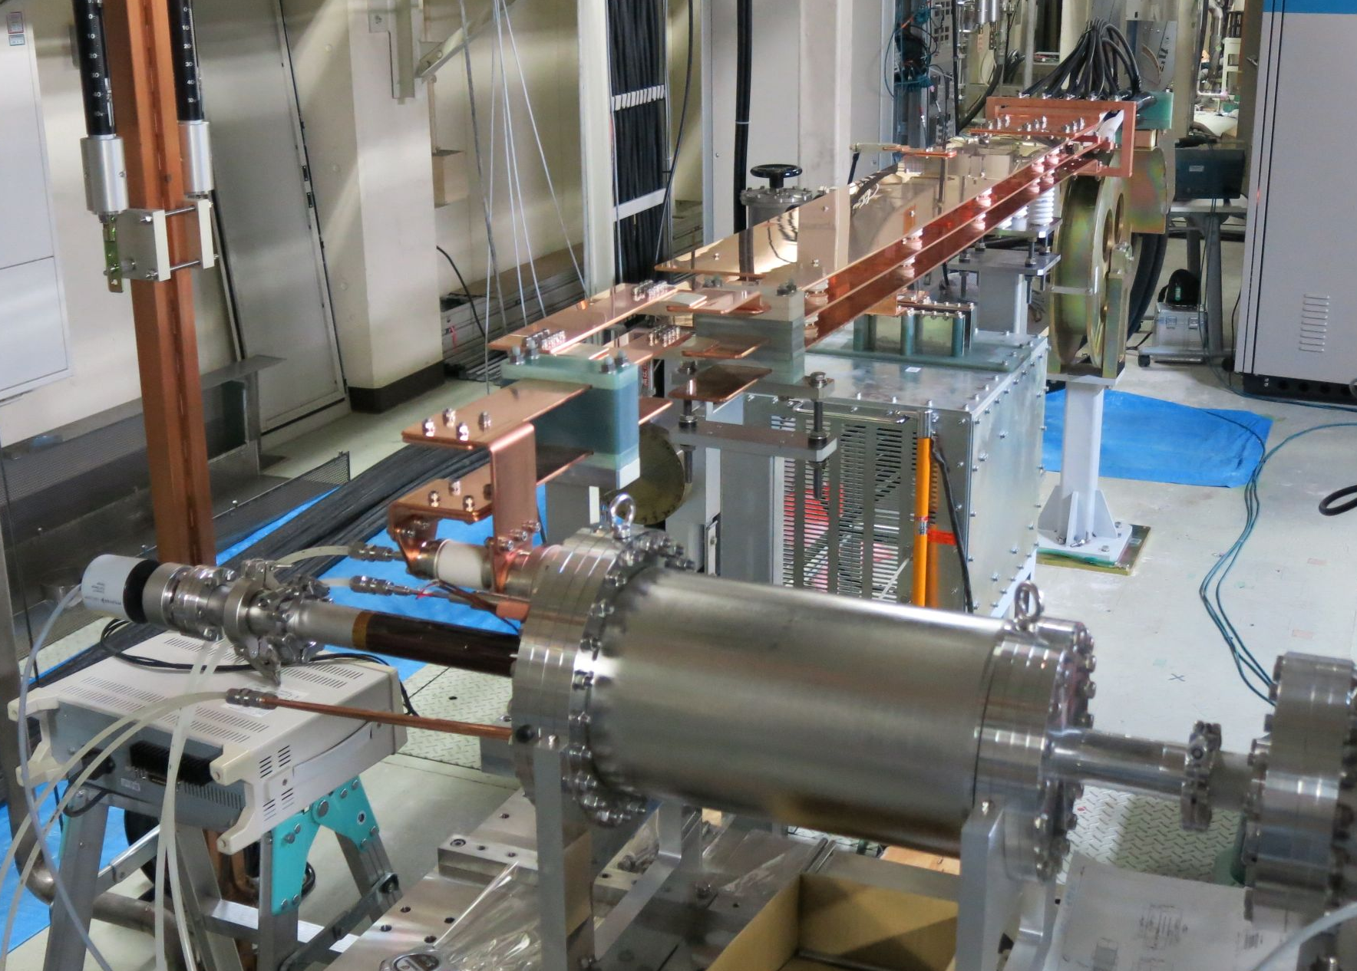
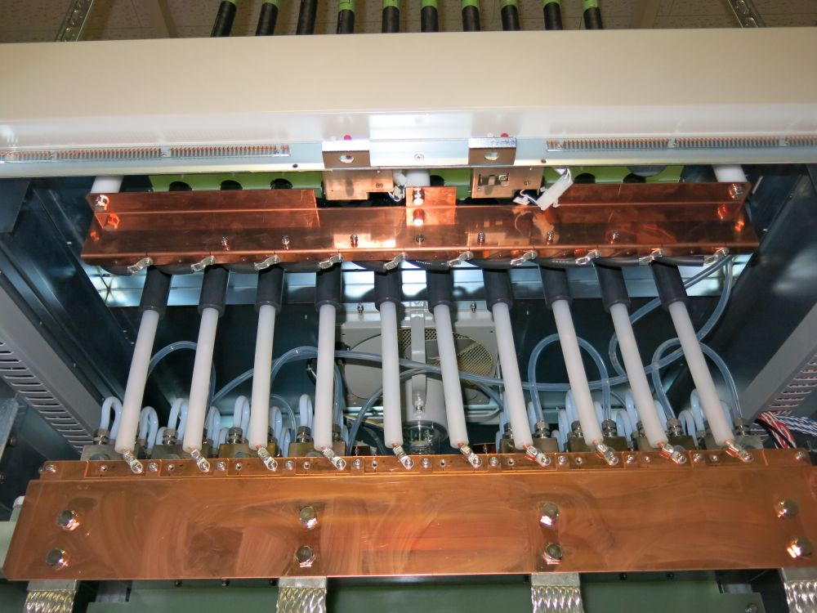
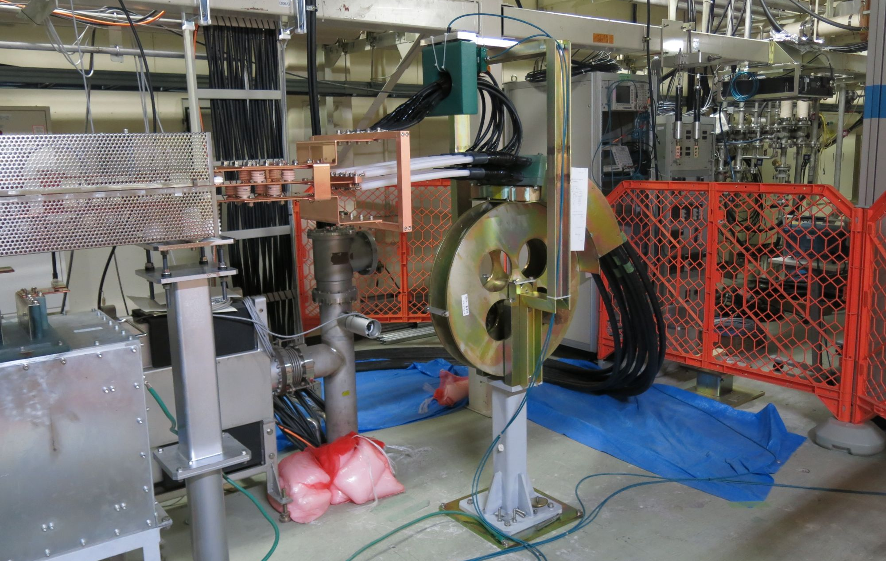
FC test stand (2015 July)
test operation performed with
  spare FC-base (#4)
  12-kA pulse modulator
  new coaxial cables
  new triplate feeder line
  snubber circuit
  but w/o bridge coils
full-spec (12 kA) operation for continuous 200 hours achieved with no serious breakdowns and problems
triplate
feeder line
snubber
circuit
FC-base (#4)
coaxial
cables
cable connection
inside modulator

Slide 10
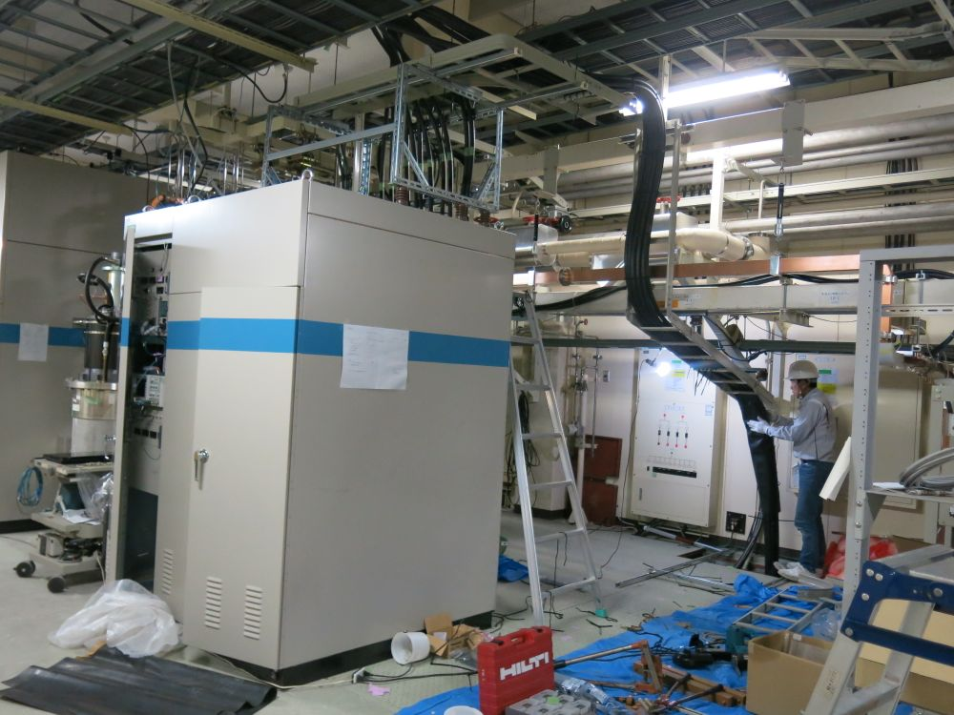
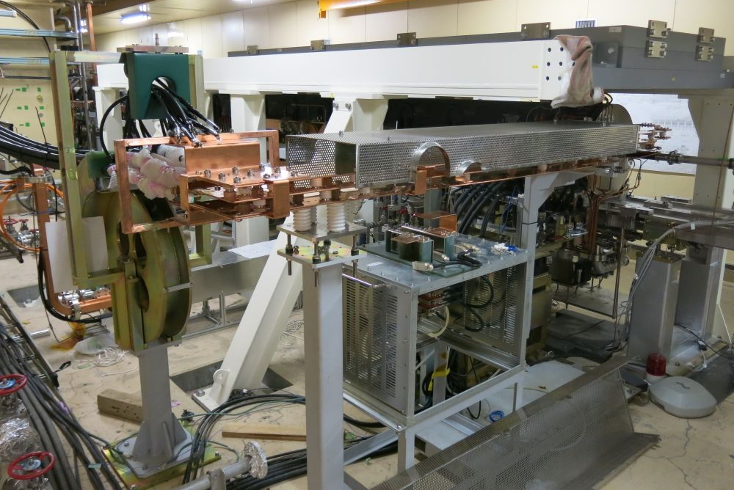
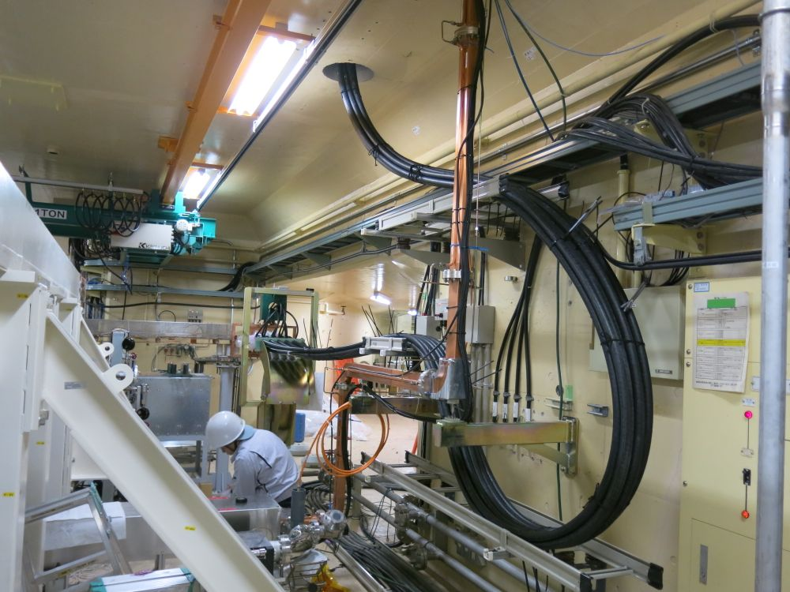
Installation in linac tunnel (2015 August)
Installed for beam operation
  12-kA pulse modulator
  new coaxial cables
  new triplate feeder line
  snubber circuit
Same as before
  FC assembly #1 (FC-base #3)
  Bridge Coils
  DC solenoids & accel. structures
12 kA
pulse
modulator
radiation shield
FC &
target
triplate
feed line

Slide 11
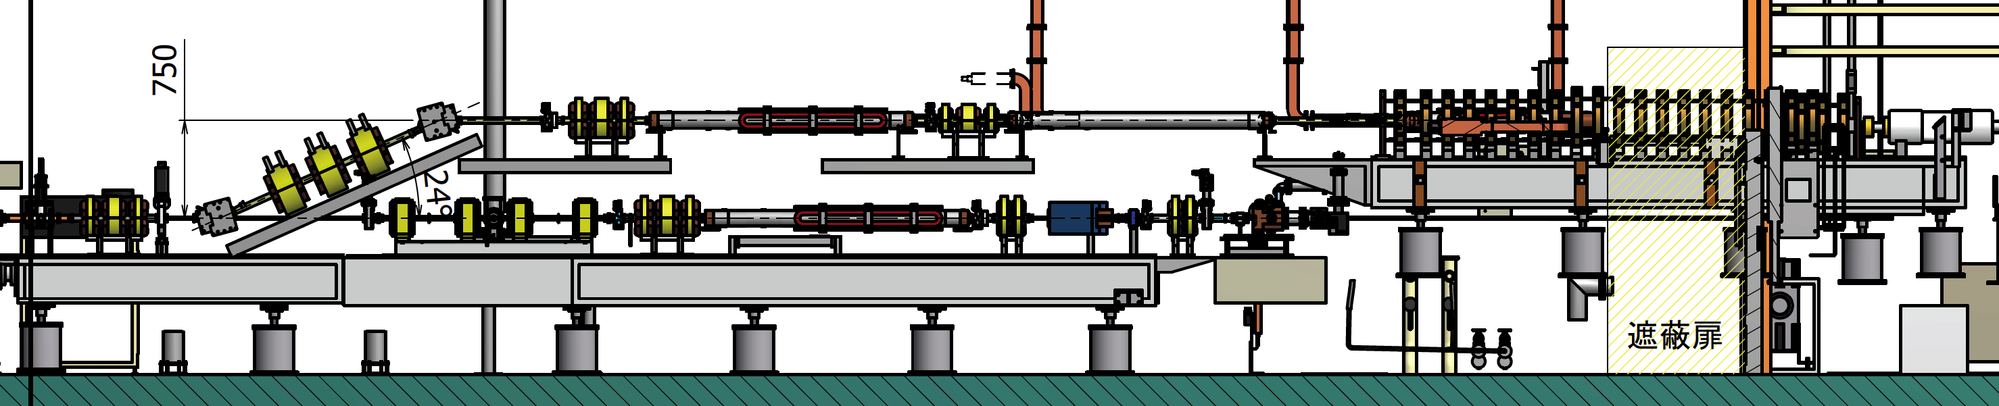
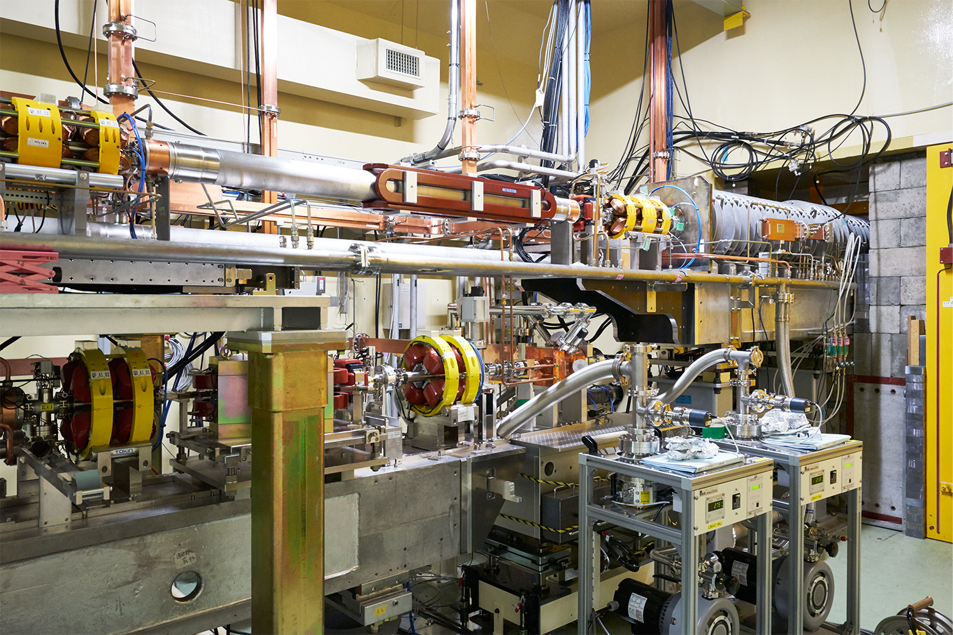
Double-deck pre-injectors
Upper deck (former KEKB pre-injector, reconstructed !)
thermionic gun + RF bunching section
Gun 200 kV (=> 5 MV/m) 1300 ps
Sub Harmonic Buncher 1 (114 MHz) 500 ps
Sub Harmonic Buncher 2 (571 MHz) 330 ps
Prebuncher (2856 MHz) 70 ps
Buncher (2856 MHz) 10 ps
bunch
length
shield
wall
e- beam for
e⁺ generation
Lower deck
photo-cathode RF gun
+ magnetic bunching
RF gun 25 ps
Chicane 10 ps
bunch
length
e- beam for
HER injection

Slide 12
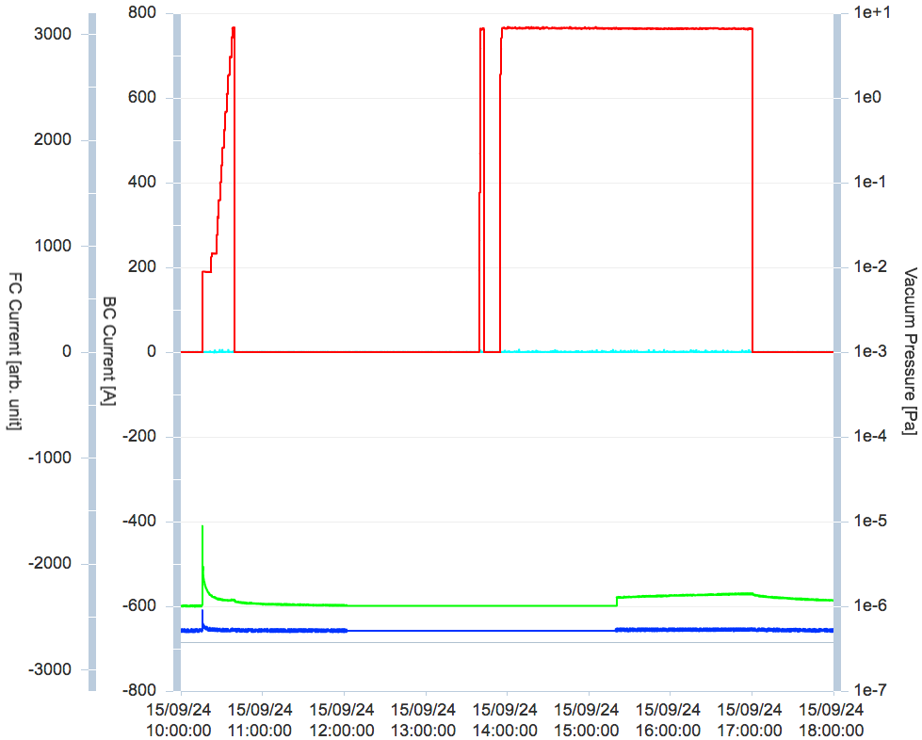
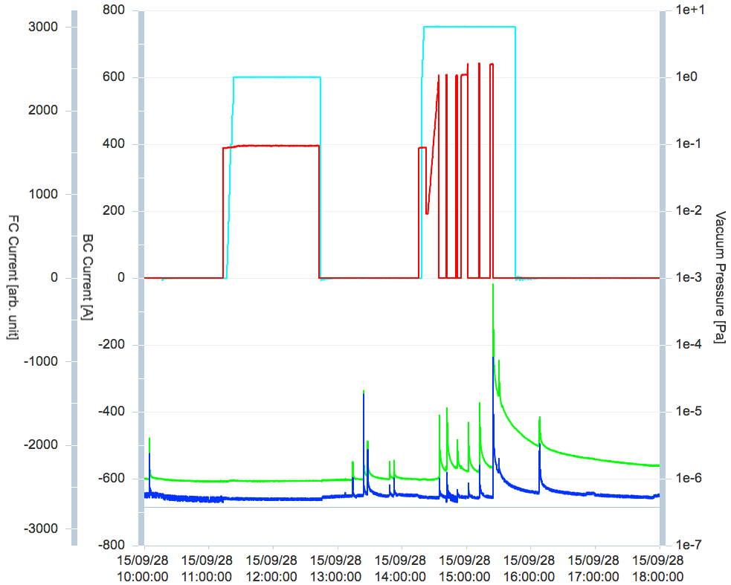
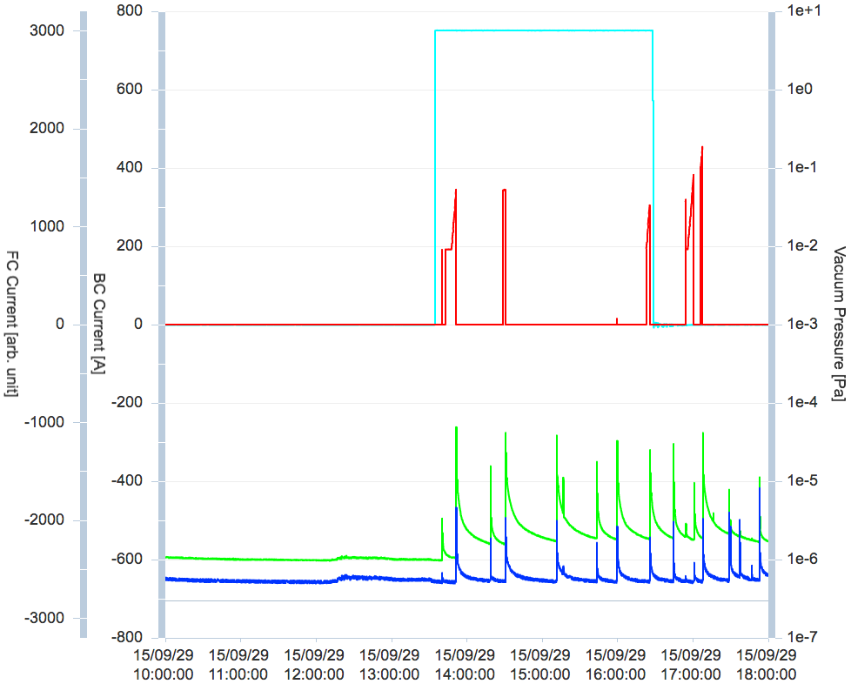
FC processing with BC field
2015.09.24
FC stable at I_{FC} = 11.5 kA
w/o BC field
2015.09.28
Huge gas burst occurred
at I_{FC} = 9.8 kA @I_{BC} = 750A
2015.09.29
Gas bursts occurred
even w/o BC field
Irreversible damage in FC
by breakdown !!
Operable current
lowered -> 6 kA
Currents
of FC and of BC
Vacuum Pressures [Pa]
at FC and at LAS

Slide 13
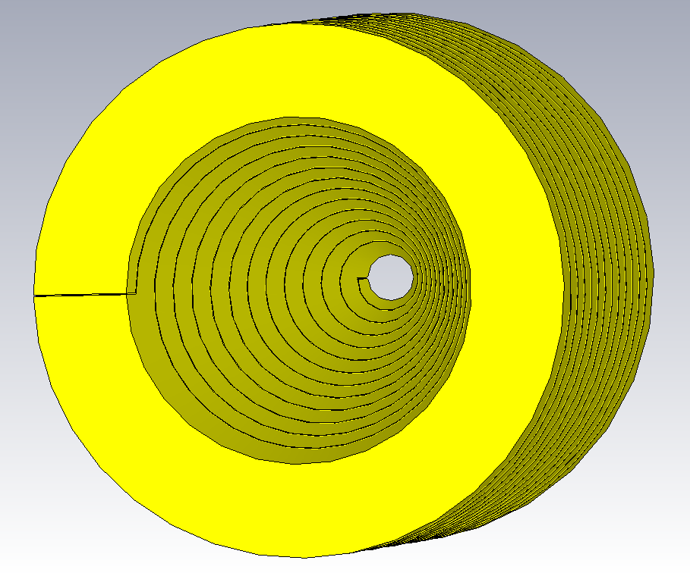
FC copper block work hardening
Y. Enomoto and T. Higo visited SLAC and discussed with the positron experts (A. Kulikov and E. Bong) on the FC gas bursting issue.
They suggested that the work hardening of the OFC block of FC is essential against the damage by breakdown. (We neglected this process!)
"Work hardening (strain hardening)" is a method of strengthening of a metal by repeated plastic deformation.
When a breakdown occurs in FC,
the spiral structure is deformed but
it springs back to the original shape
if it is work hardened.
Unless work hardened, deformation
remains permanently and makes
very narrow gap in the slit.

Slide 14
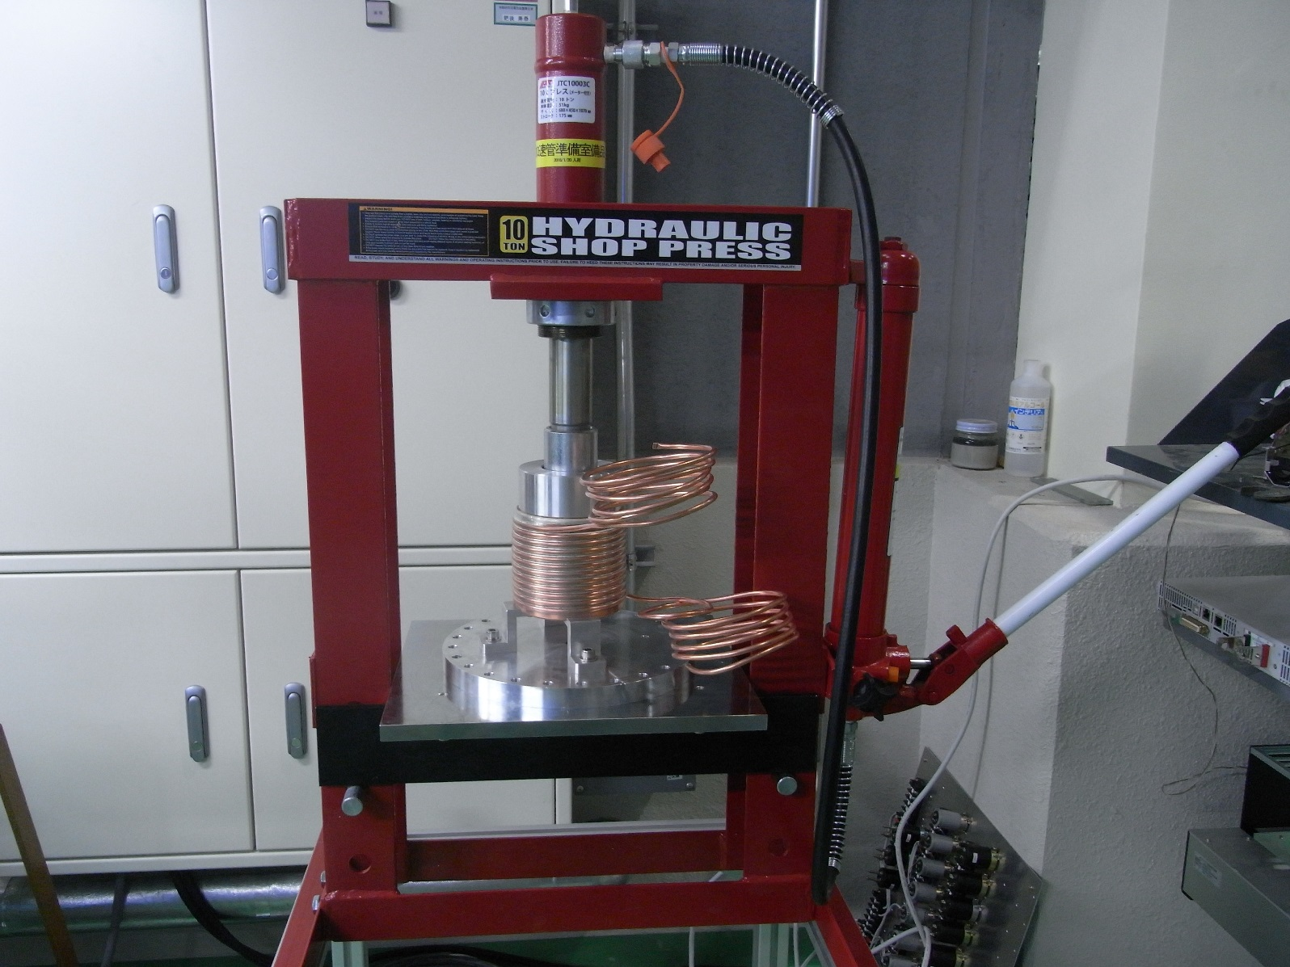
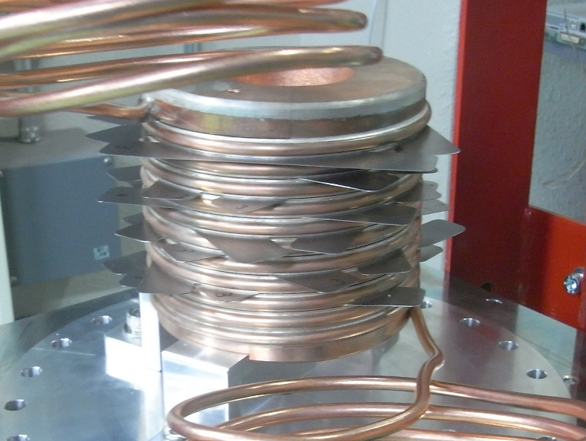
Hardening test
Hardening Procedure
Press FC-head till the gaps are contacted.
Insert spacers into the slit.
Remove the spacers.
Measure the gap size.
Repeat them from (1) (~ 100 times)
# of trials
natural gap size (mm)
slit position (downstream <- upstream inside FC)
The natural gap size transfers to the spacer thickness (0.3 mm) by repeated hardening.

Slide 15
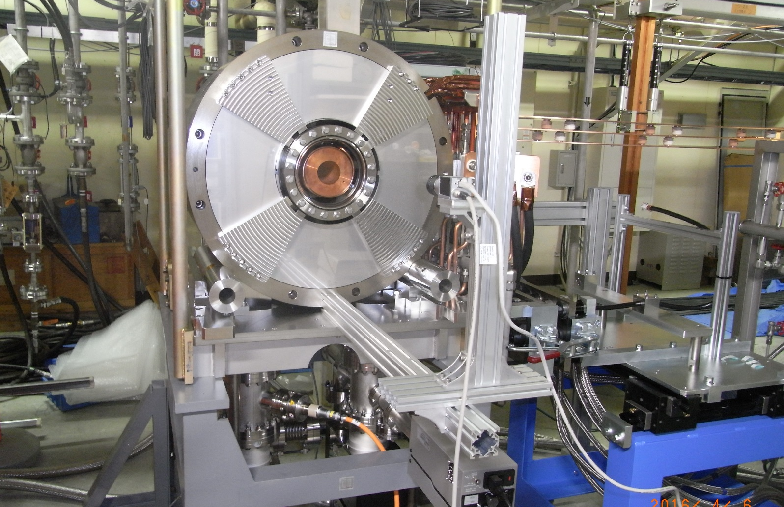
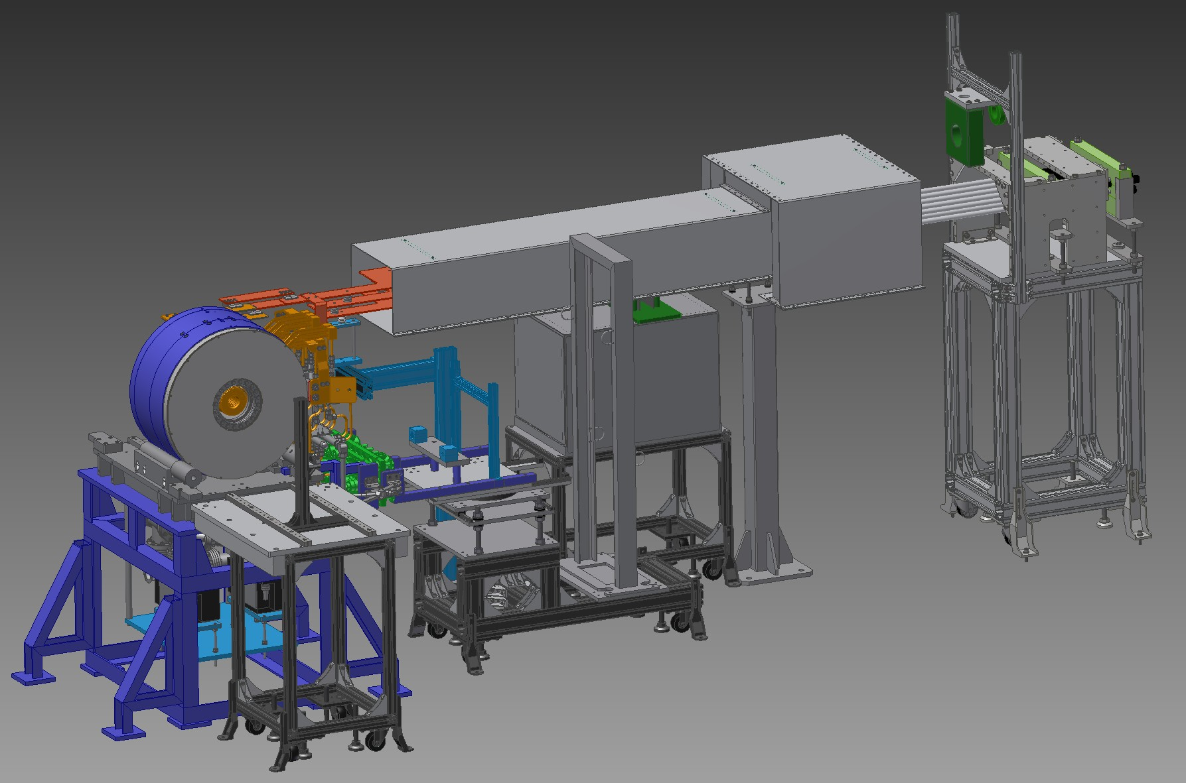
FC assembly #2 & test stand
Operation test with BC field is essential.
FC assembly #1 is radio-activated in the beam line.
Construct assembly #2 for operation with BC field at test stand.
Test-1: operation with FC-head #4
(not work-hardened model) to see what happens in the same situation as the damaged FC.
[2016 June, soon]
Test-2: operation with FC-head #5
(well work-hardened model) to check the operability at full current (12 kA) under the BC field.
[2016 August ~]

Slide 16
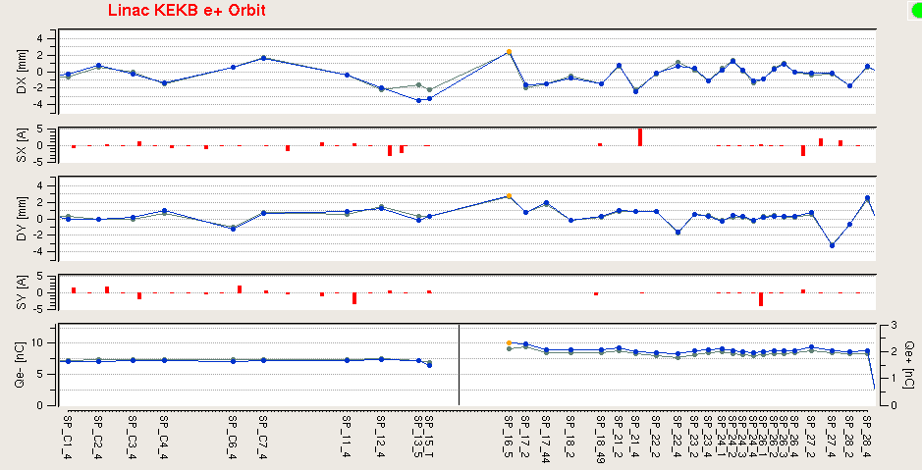
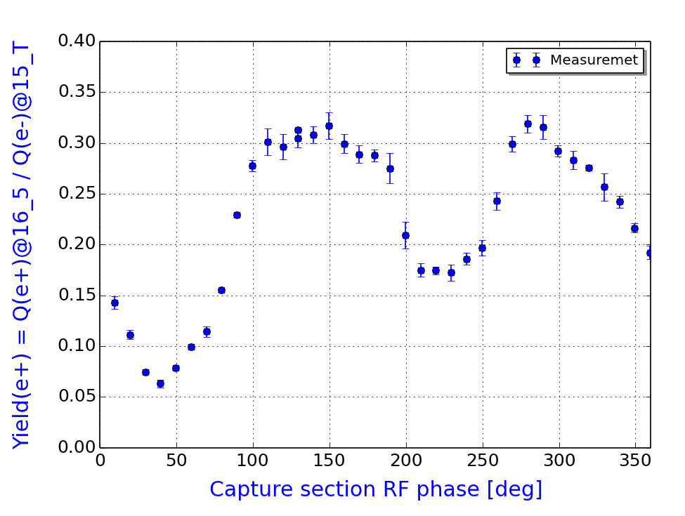
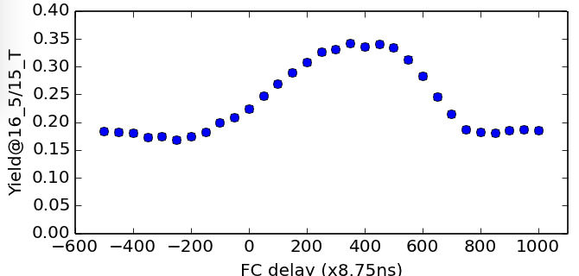
e⁺ beam performance (2015 Nov.)
Beam tuning to optimize e+ yield performed in 2015 Oct ~ Dec.
I_{FC} = 6 kA (design 12 kA)
enhancement by FC ~ 1.8
Q(e-) = 6.3 nC @ target
Q(e+) = 1.9 nC at SY2
Y(e+) = 1.9/6.3 => 30 % (design 50 %)
Primary Electron
intensity at target
Q(e-) = 6.3 nC
Q(e+) = 1.9 nC
at entrance
of DR LTR line
beam
intensity [nC]
target
Sector-2 end
Y(e+) upon capture RF phase
Y(e+) upon FC pulse timing
operation
phase
FC on
timing
FC off
timing
Deceleration
Capture
Acceleration
Capture
Yield enhancement by FC (6 kA) ~ 1.8

Slide 17
Is achieved e⁺ charge consistent with simulations ?
(committee member’s question)
We do not have a simulation result which reflect all the operation condition.
(GEANT simulation [e⁺ generation at target]
+GPT simulation [e⁺ capture simulation]
+SAD tracking simulation [e⁺ transport in linac & BT line)
  precise beam spot size on the target is unknown
  -> planning to install thin screen monitor and triggered camera
  in this summer shutdown
  DC solenoid field distribution modified to optimize e+ intensity
  FC 6 kA situation
  Lower LAS acceleration field situation
Possible comparison
simulation expectation now is Y(e+) ~ 45 % at capture section exit and the observed Y(e+) ~ 30 % at after the 1-6 chicane.
It is my homework for next KEKB Review.

Slide 18
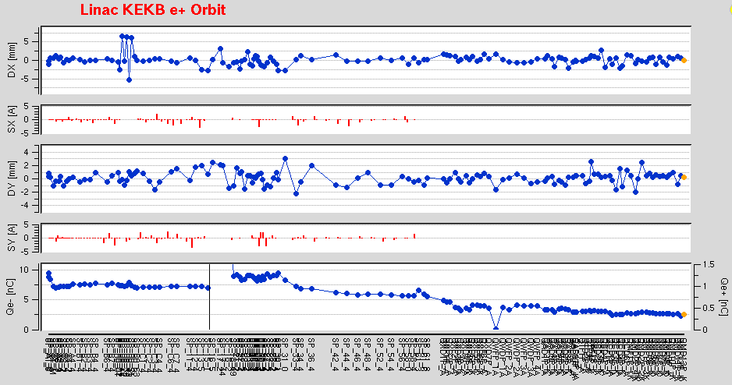
SuperKEKB e⁺ injection beam
Typical e⁺ injection beam at linac and BT-line
orbit-X
[mm]
orbit-Y
[mm]
Primary Electron
intensity at target
Q(e-) = 7.0 nC
Q(e+) = 1.3 nC at SY2
[2.0 nC if no collim.]
Q(e+) = 0.75 nC
at linac-end
Q(e+) = 0.3 nC
at BT-line end
beam
intensity [nC]
target
Gun
J-arc
Linac end
BT end
Beam collimators inserted to localize
beam loss in low energy region.
Due to limited beam acceptance, inevitable beam loss
occurs in linac & BT-line in direct injection w/o DR.

Slide 19
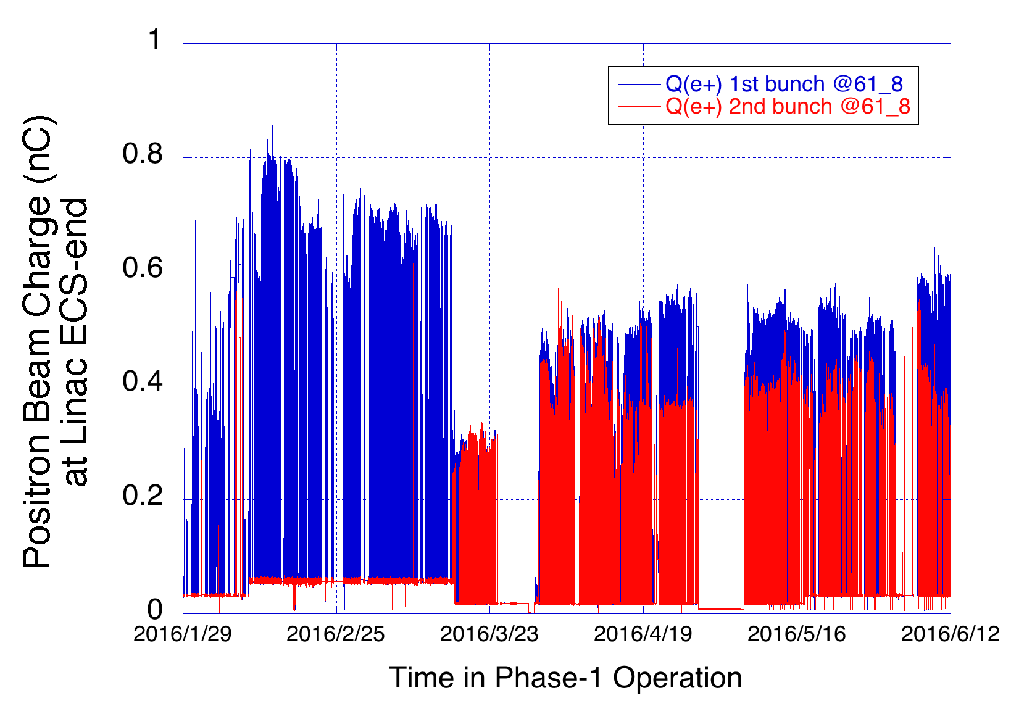
SuperKEKB e⁺ beam performance
e⁺ beam intensity history (2016 Jan ~ June)
I_{FC} = 5.2 kA
I_{FC} = 2.2 kA
with temporary
pulse modulator
FC OFF

Slide 20
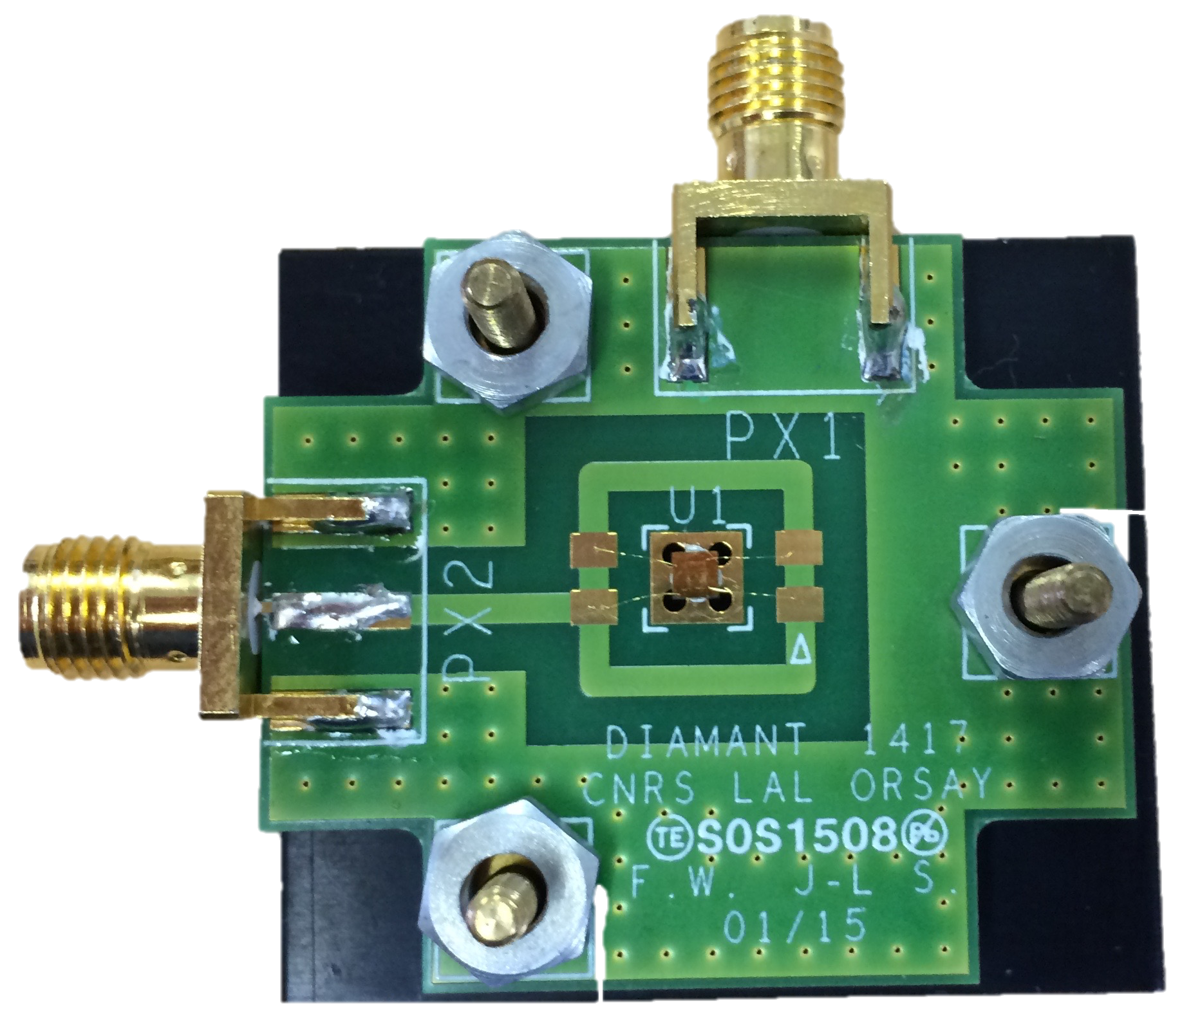
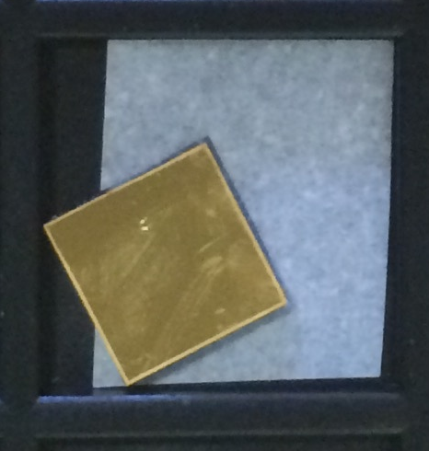
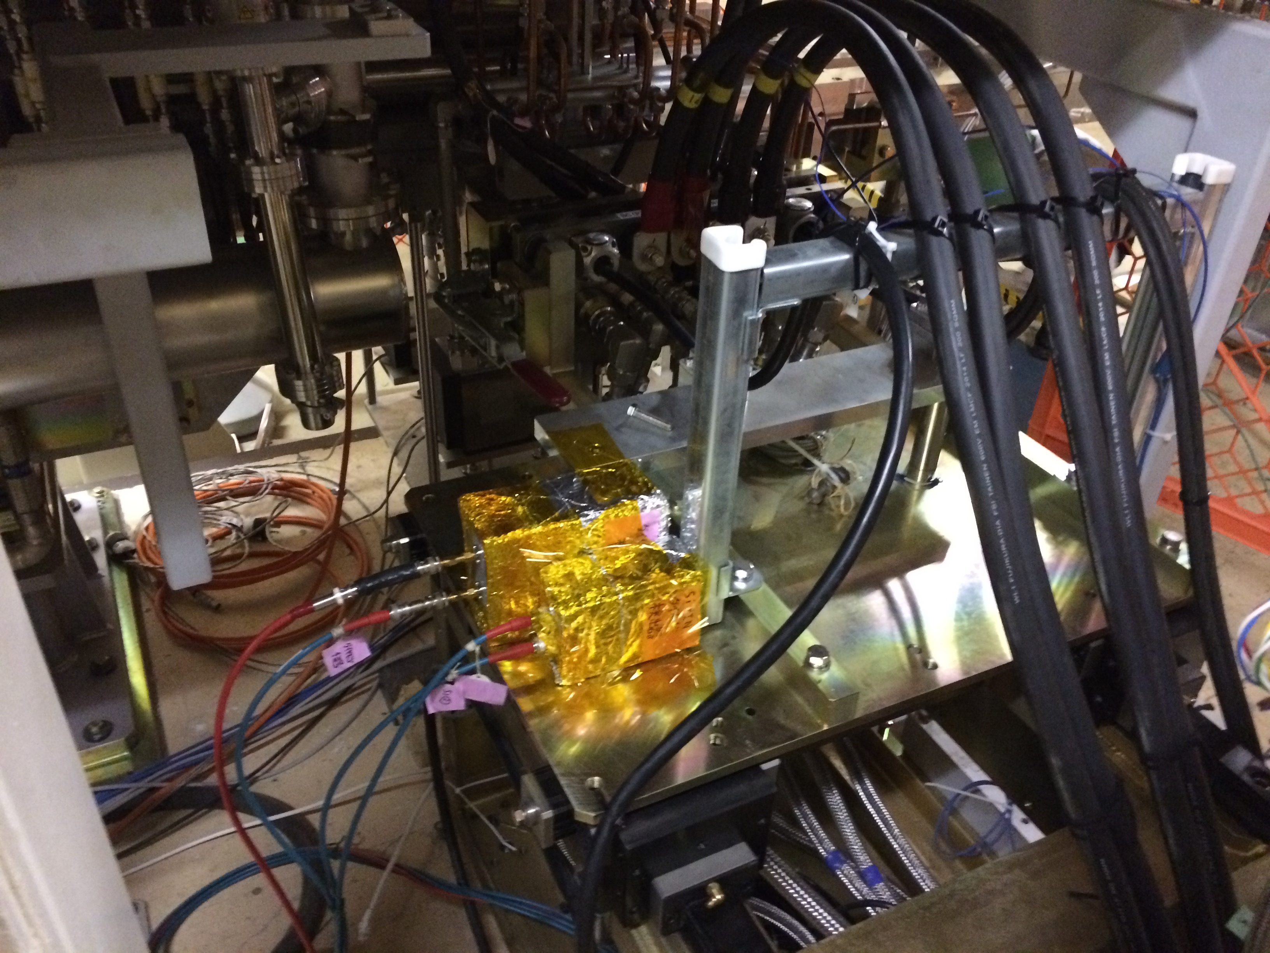
Diamond beam loss monitor
Radiation-hard diamond beam loss monitor was developed by S. Kazama in collaboration with V. Kubytskyi and P. Bambade (LAL Orsay)
single crystal CVD diamond
2.0 mm x 2.0 mm x 0.5 mm
with electrode (Ti, Pt, Au)
operated at 400 V.
Detect beam hit/no-hit
(1) on beam spoiler and (2) on target
2mm
20nsec
typical
signal
linearity to
beam charge

Slide 21
Summary
Though test operation of spare FC (#4) with new modulator, new cables, new triplate feeder but w/o BC was successful up to 12 kA, a serious damage occurred in FC (#3) with BC field (2015 Sep.) and operable current has been 5 ~ 6 kA.
Importance of work-hardening process of FC-head was recognized. Test stand with FC assembly #2 has been constructed to perform tests of not-hardened and well-hardened models with BC field. (2015 June ~)
Positron yield Y(e+) = 30% (Q(e+)=1.9nC/Q(e-)=6.3nC) achieved with 6 kA FC current at entrance of DR-LTR line. Stable e⁺ injection to LER has been achieved (Q(e+)@BT-end ~ 0.3nC x 2-bunch) since 2016 Feb. Beam loss in linac and BT line is due to operation w/o DR.
After finishing operation at test stand, FC assembly #2 will be installed in the beam line in 2016 Dec. ~ 2017 Jan.
DR commissioning and LER injection in Phase-2 will be started in 2017 Nov.

