Slide 1
Main Ring Magnet system Mika Masuzawa
Magnets:
Magnet design &
Field measurements
Installation
Survey & alignment
Power supply design
Testing
Tuning
Installation
Cabling
Check
T. Oki’s talk

Slide 2
Contents
Introduction of the MR magnet upgrade
Things needed to be done for the MR start-up
Magnet installation
Survey & Alignment
Magnetic field measurements
For Phase II
Summary

Slide 3
Introduction of the MR magnet upgrade

Slide 4
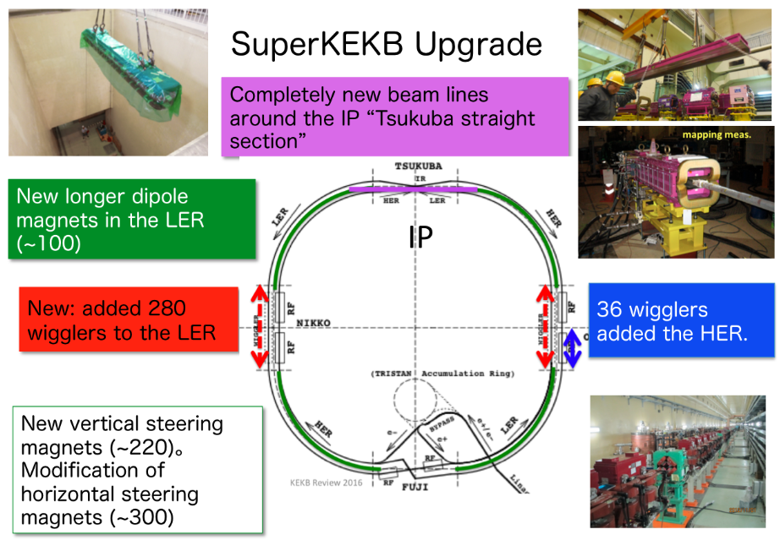

Slide 5
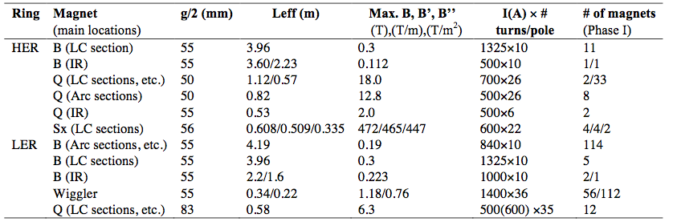
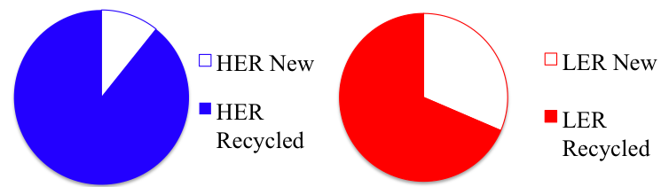
Parameters of the newly fabricated MR main water-cooled magnets
Arc dipoles, wigglers
Mainly Tsukuba straight section magnets
+ ~250 steering magnets

Slide 6
Things needed to be done for the MR start-up

Slide 7
Things needed to be done for the MR start-up
Magnet installation
In the north tunnel.
Survey and alignment
2nd round survey of the entire tunnel followed by final alignment of the magnets.
Magnetic field measurements (to evaluate the magnetic coupling between adjacent magnets)
Cooling water
Water flow check and balancing among 2000 magnets
Power supply system (T. Oki’s presentation)
Full-scale start-up and tuning of the power supplies.
Cabling checks, including polarity.
Completion of the database
➔ Integration of all this in time was needed.

Slide 8
North tunnel Dither coils (phase II)
Magnet installation

Slide 9
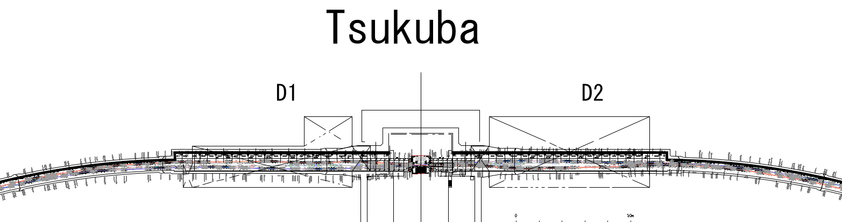
Magnet installation in the north tunnel
We needed to wait until the vacuum chambers were ready to be installed.
IP

Slide 10
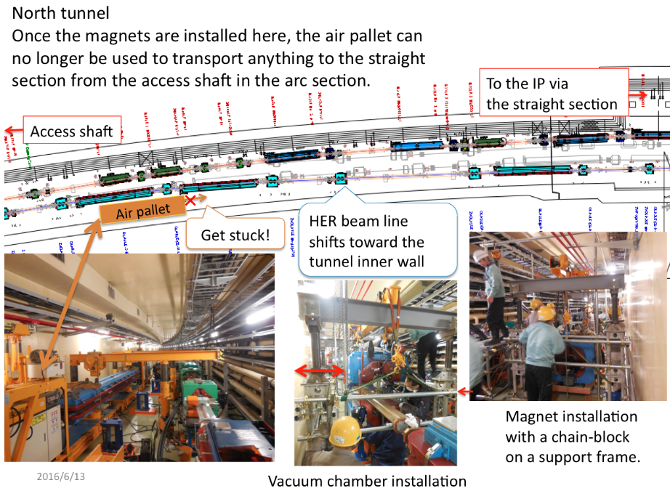

Slide 11
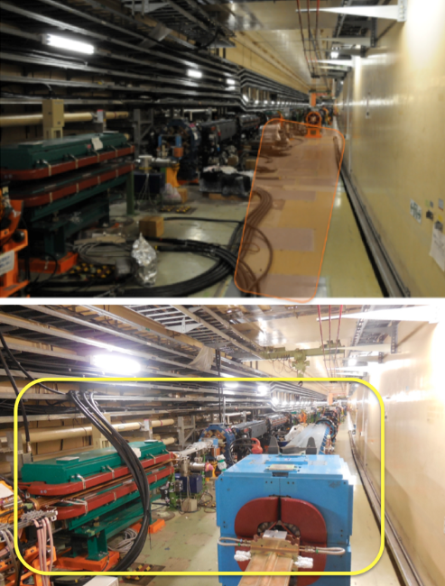
North tunnel
Magnet installation completed
In May 2015.
Replacement of a vacuum pipe
in a quadrupole magnet would be a nightmare.
Because the air pallet can not go beyond this point and
We need to build a support frame from which to suspend the chain-block to open the quads.

Slide 12
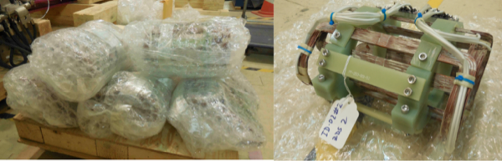
Installation of the dither coils
The dithering coils were designed, fabricated, and field measured by SLAC, and shipped to KEK in April, 2015

Slide 13
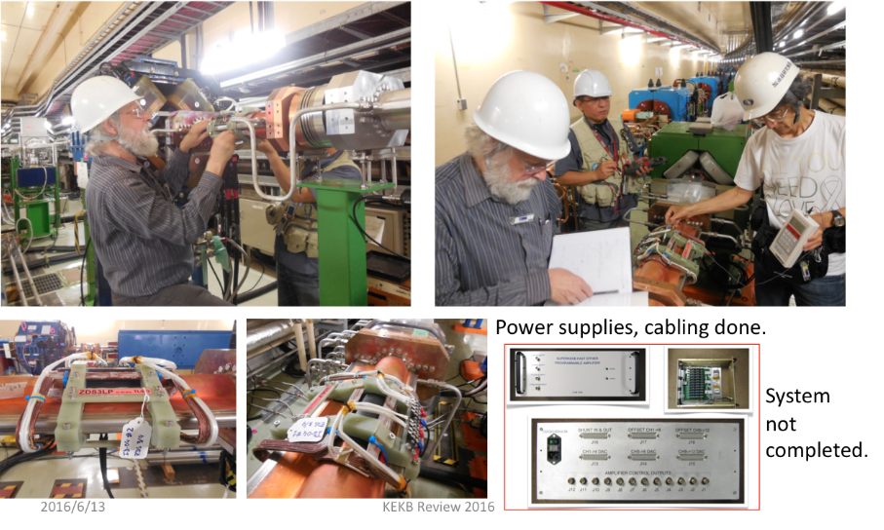
Installation
Installation and checks completed in June, 2015. Many many thanks to Uli and the SLAC team.

Slide 14
Survey Results, Strategy for the final alignment Tunnel motion monitoring
Survey and alignment

Slide 15
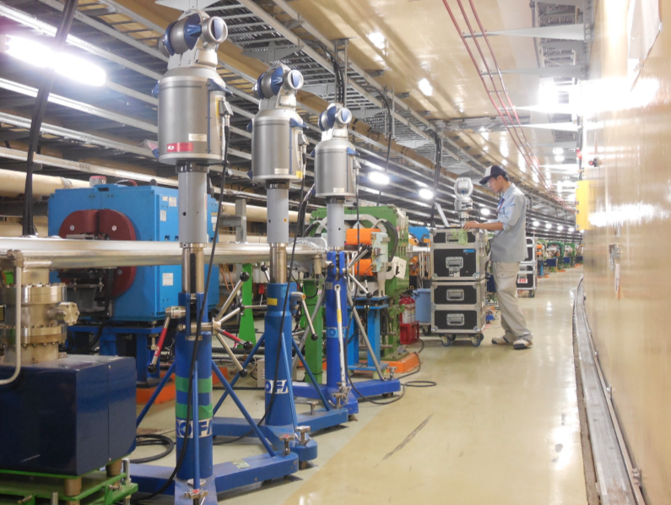
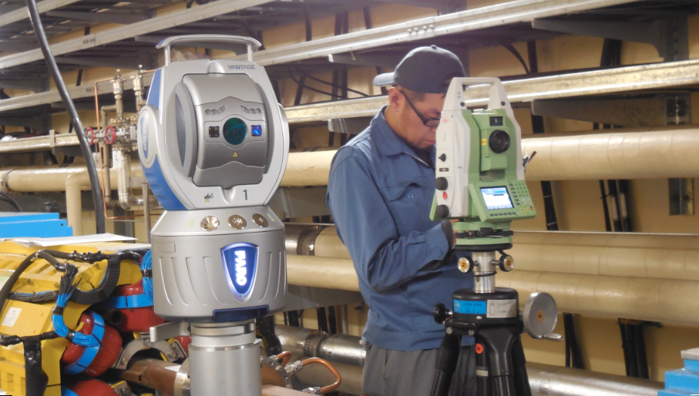
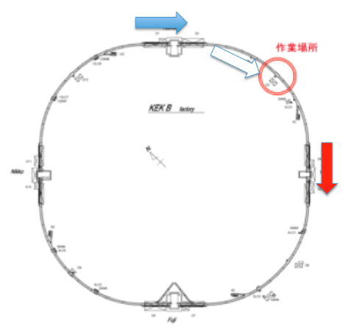
2nd round survey campaign June and July 2015
Survey was carried out by 3 teams.
Calibration of the laser trackers was done carefully.
Special attention was paid to systematic errors, as even very small systematic errors can result in a large error at the end over hundreds of measurement sets.
(long) distance being compared
with TS30

Slide 16
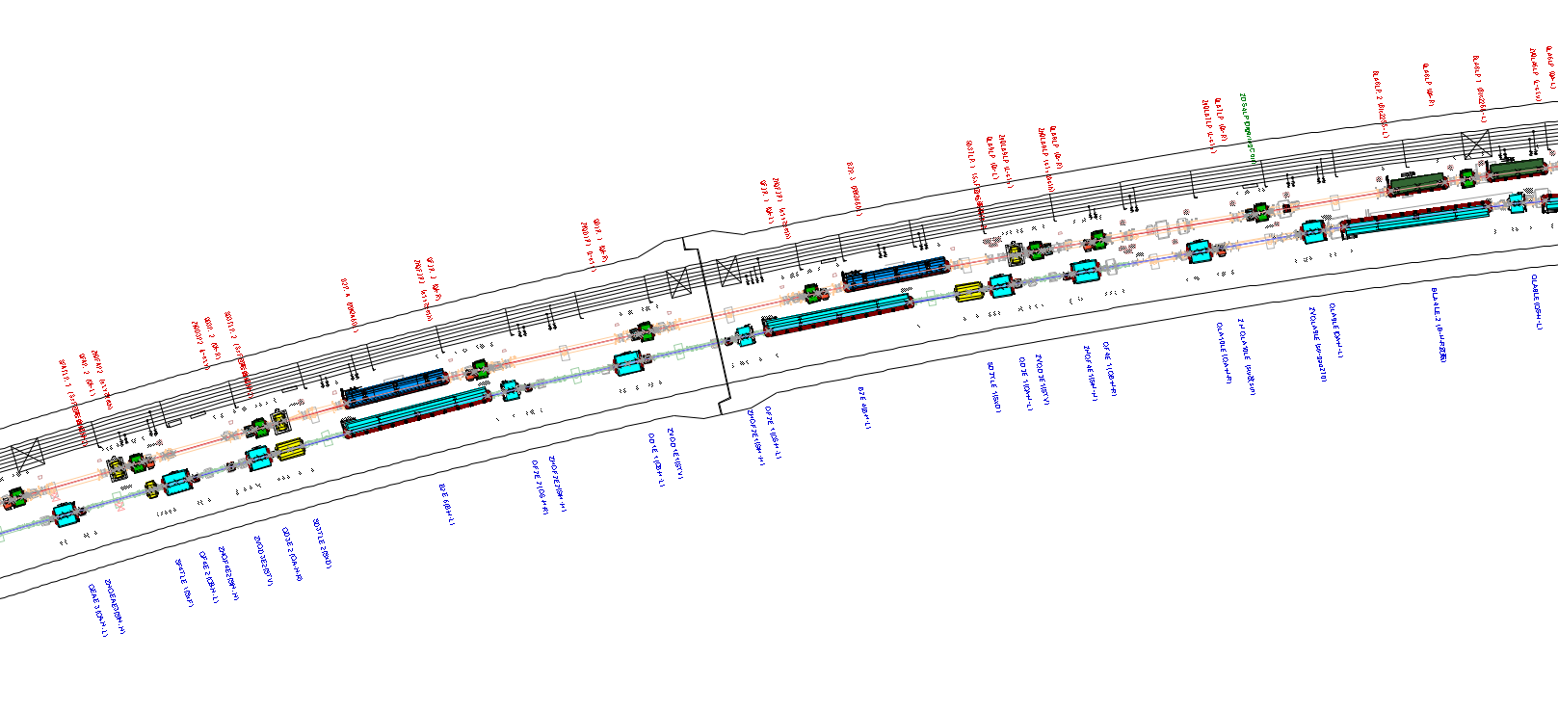
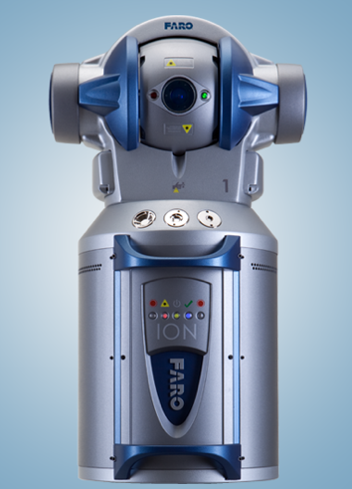
2nd round survey campaign June and July 2015
Constraints on the working area/time
Alignment can not coexist with PS test, PS test can not coexist with water flow check, none can coexist with RF high power test (if in the same area)…,civil engineering can not coexist with survey/alignment…
More than 1200 network control points in the tunnel
More than 4000 reference points for the magnets
More than 5000 points to be surveyed and analyzed. More than 400 LT settings, with overlaps

Slide 17
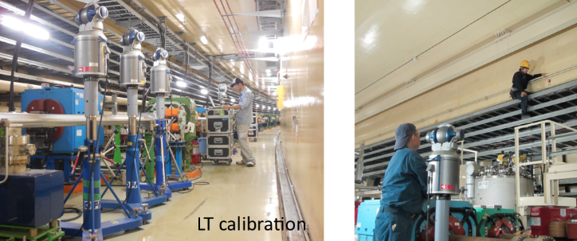
In the Horizontal Plane (x,y)
Survey Results
We got hundreds of data points every day from 3 teams,
which were analyzed and cross-checked by T. Adachi, T. Kawamoto & M.Masuzawa independently everyday. If we found something funny, we requested the survey team to go back before they moved a long distance down the tunnel.

Slide 18
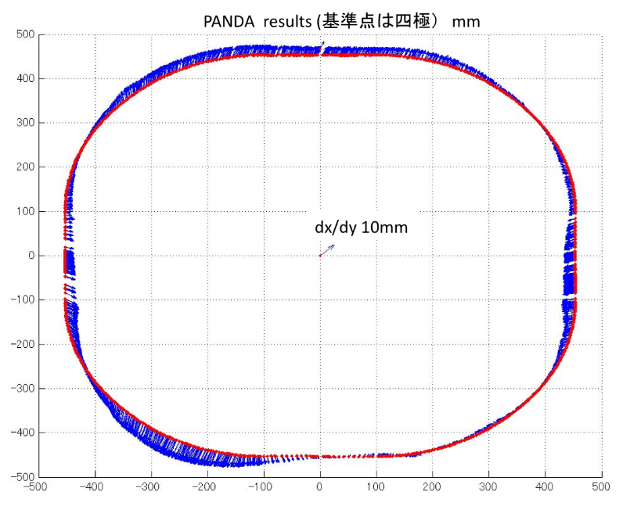
Survey Data and analysis results
The north and west parts expands to the outside as large as 10 mm. This probably happened when the TRISTAN monuments were first built.
Does this matter?
➔No. Deformation of low order does not matter.
Constraints:
The rings have to close.
➔Smooth periodic curves will do.
Our choice was Fourier series (n=60). We tried FS with n=30 but the # of magnets to be adjusted increased, the amount of the adjustment became larger…
(of course we can do it but it would have affected
other accelerator components such as vacuum chamber and rf…)
IP

Slide 19
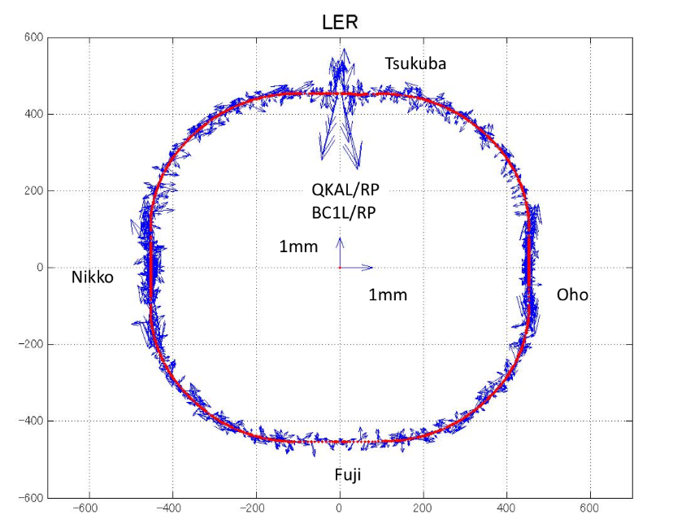
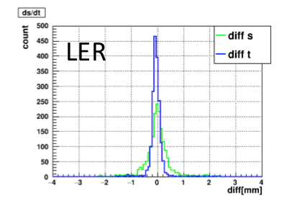
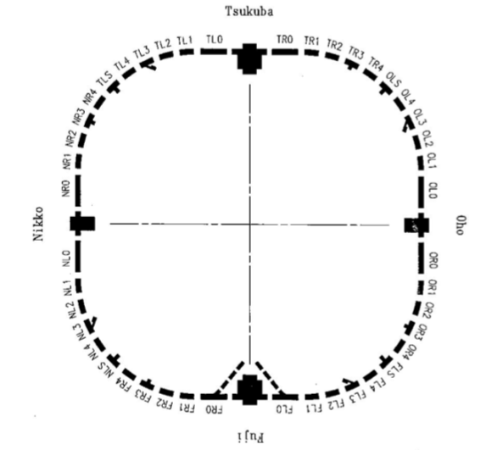
Survey Data and analysis results Deviation from smooth curves (we call it the “Adachi Curve”)
We used the old lattice (oops)
S: Beam direction
T: perpendicular to the beam
The spread in “s (beam direction)” is larger.
This is due to the expansion joints.
The temperature was NOT controlled during the SuperKEKB construction.
The temp. differ between when we did the 1st rough alignment and the 2nd survey.

Slide 20
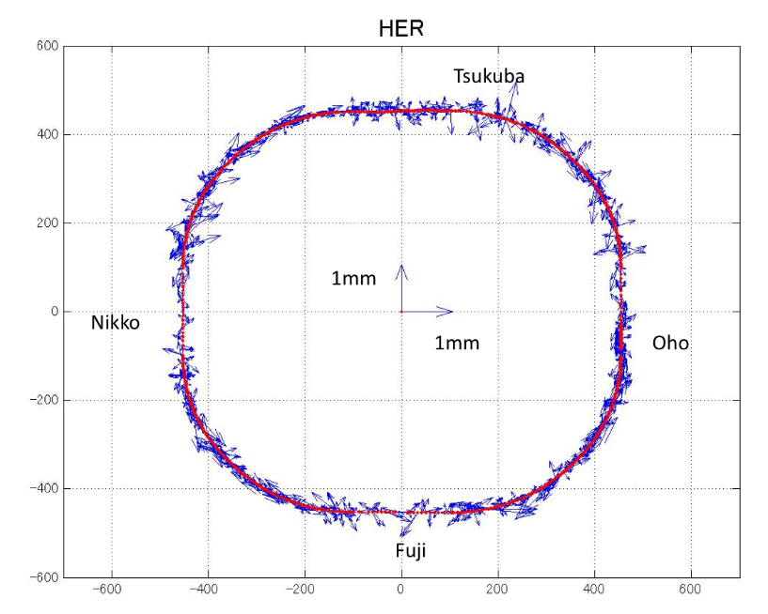
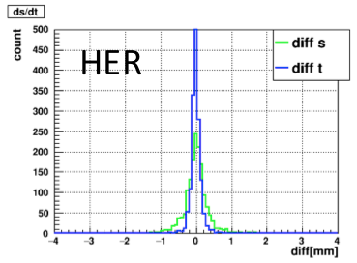
Survey Data and analysis results Deviation from smooth curves (we call it the “Adachi Curve”)
S: Beam direction
T: perpendicular to the beam
Expansion joints to absorb the thermal expansion & contraction.
The spread in “s (beam direction)” is larger.
This is due to the expansion joints.
The temperature was NOT controlled during the SuperKEKB construction.
The temp. differs between when we did the 1st rough alignment and the 2nd survey.

Slide 21
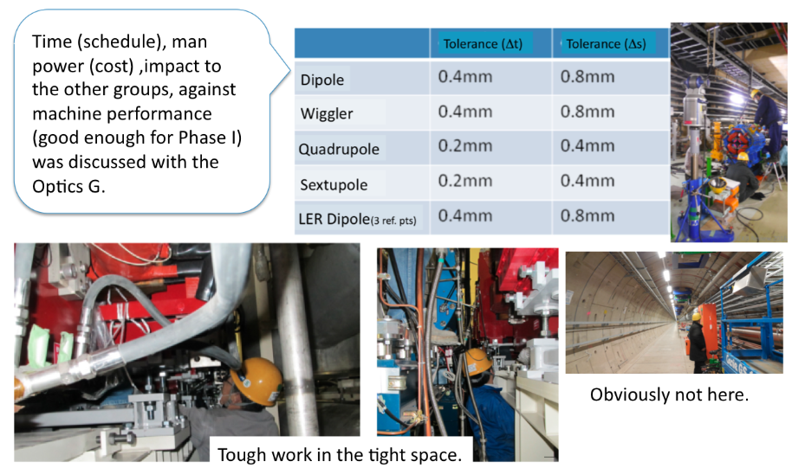
Alignment strategy
Discussion with the optics group

Slide 22
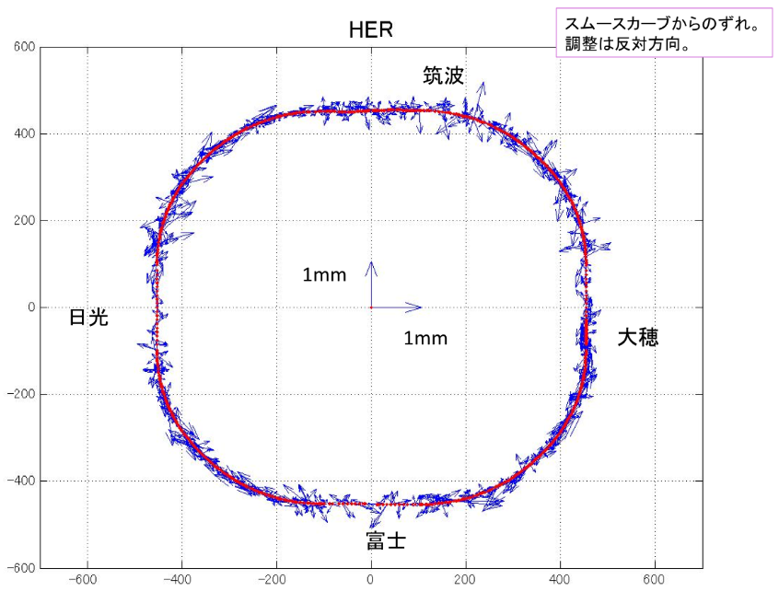
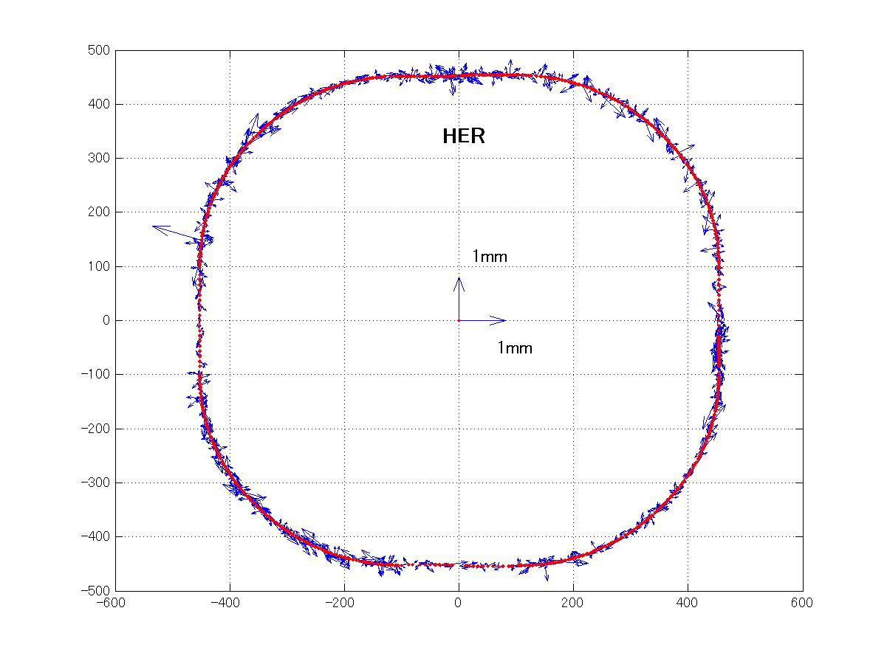
Alignment strategy
Alignment was carried out by two teams, followed by a survey team dedicated to
checking the alignment.
Before
Found a misalignment,
which was fixed right away.
B2E_26
安心して下さい

Slide 23
Vertical (Level)
Survey Results

Slide 24
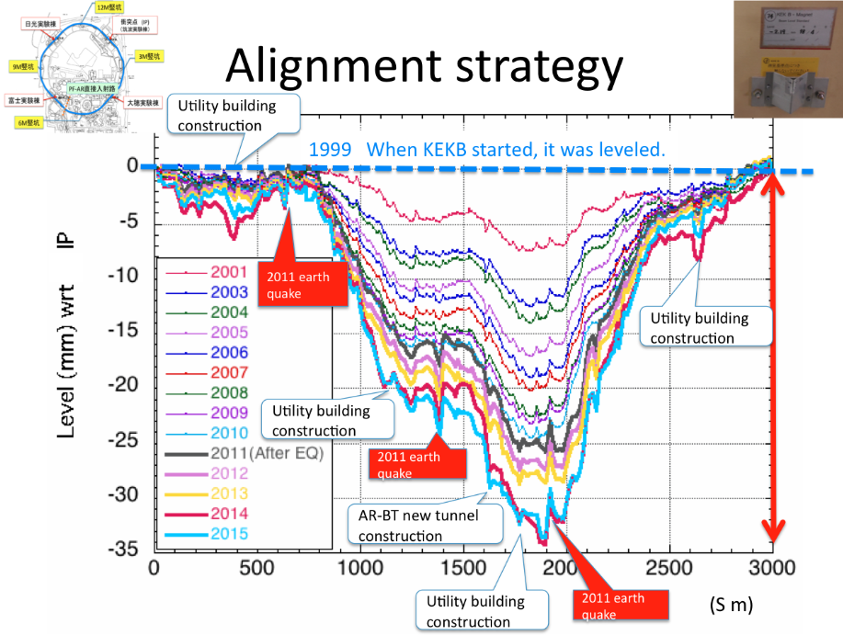
Tunnel sinking continues

Slide 25
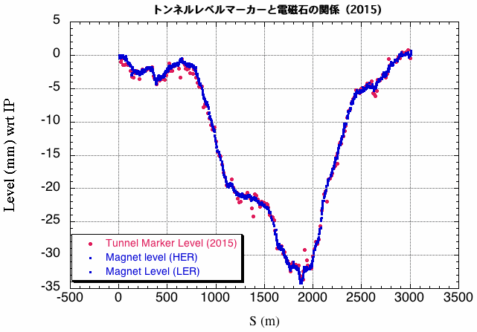
Survey Data and analysis results
We fixed the gap in the magnet level from the 2011 Earthquake
The data were used to “pre”-set the V-steering magnets when circulating the beam.

Slide 26
Circumference prediction for a smooth start up of the beam circulation
Survey Results

Slide 27
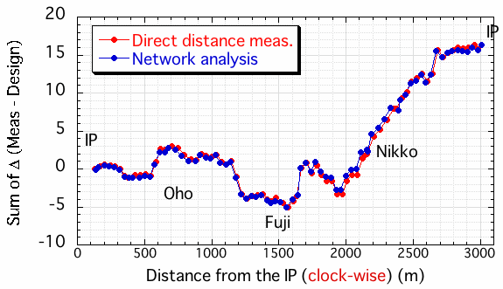
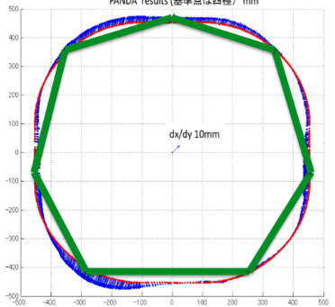
Circumference estimate
Our best guess from the survey and analysis was that the circumference is about 16.4 mm longer than the SuperKEKB design. This information was used when injecting the LER beam to the ring on Feb.9, 2016 and the beam said Yes!

Slide 28
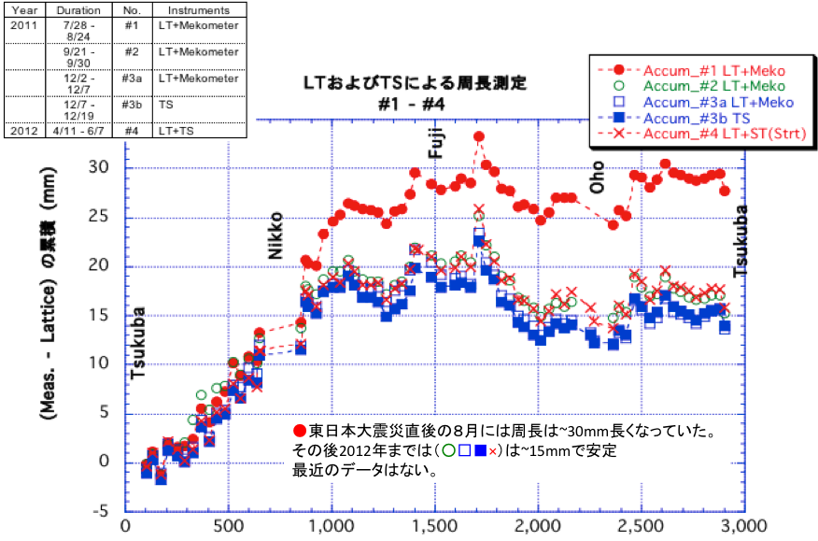
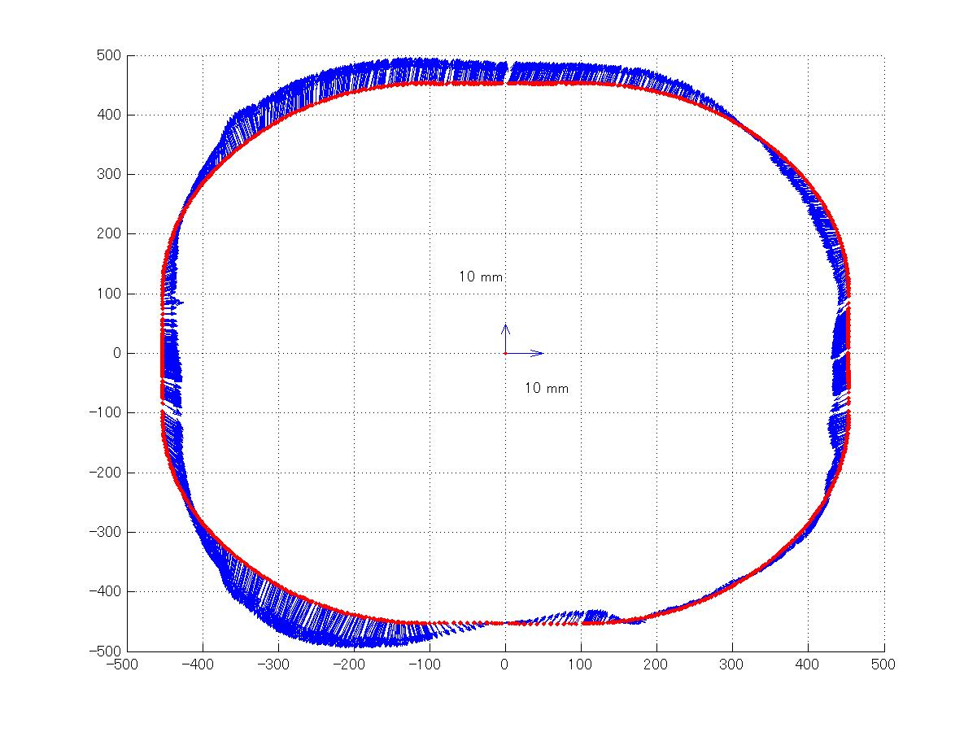
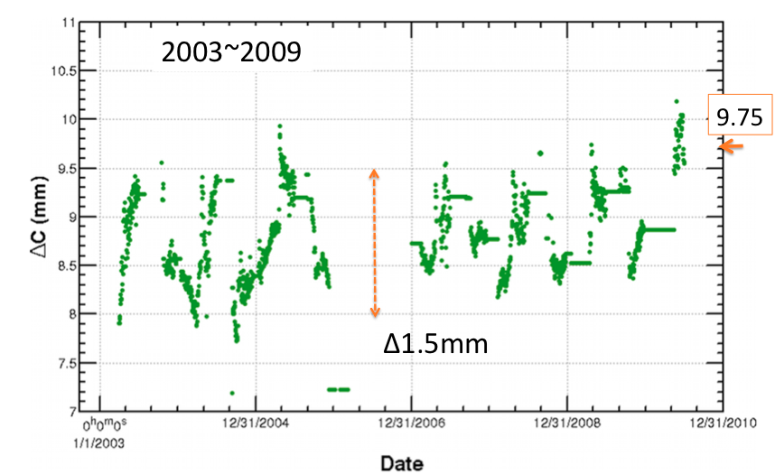
Our rings look like this (Our rings have been always larger than the design)
Our rings were the largest right after the Great East Japan Earthquake in 2011. They started shrinking but not back to the level of KEKB.

Slide 29
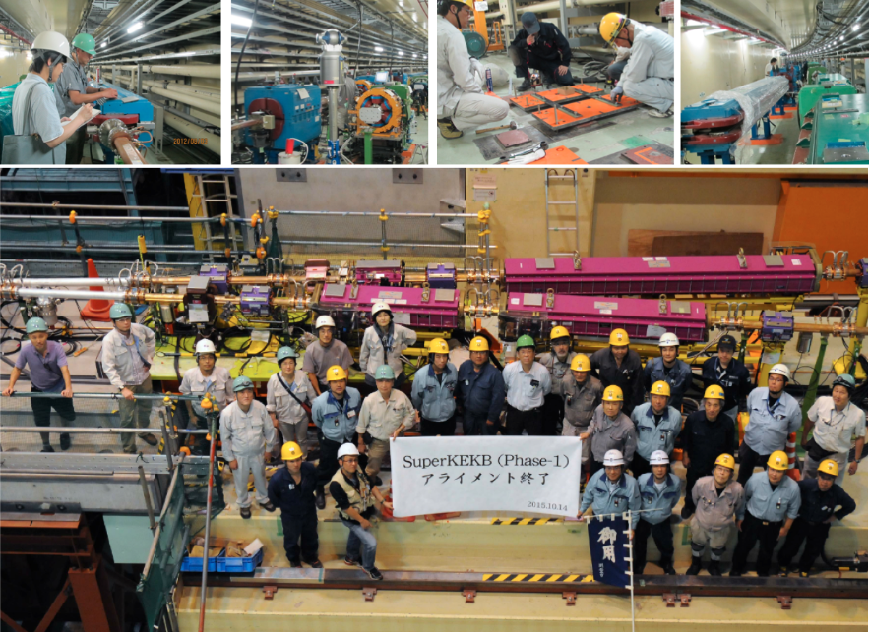

Slide 30
HLS (Hydrostatic leveling sensors)
Tunnel Motion Monitoring

Slide 31
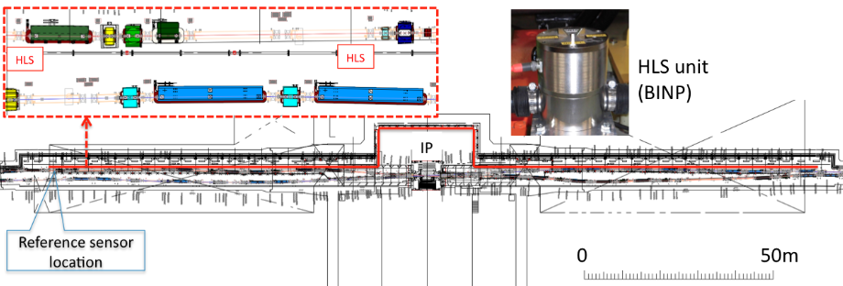
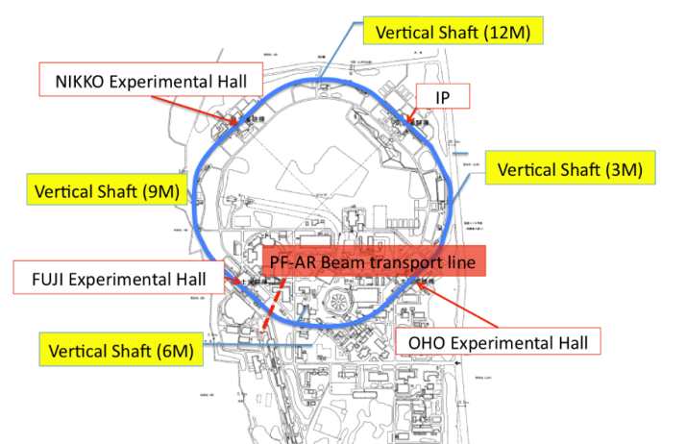
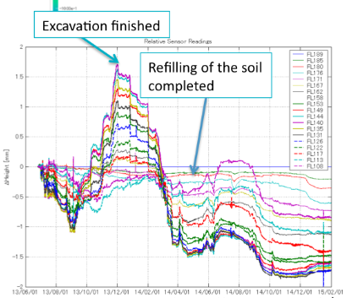
Tunnel motion monitoring
The HLS system was used to monitor the tunnel motion during the PF-AR BT tunnel construction (presented at 2015 review).
It was relocated to the straight sections on ether side of the IP in Aug.2015.

Slide 32
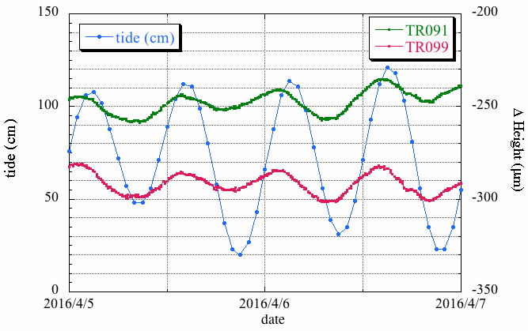
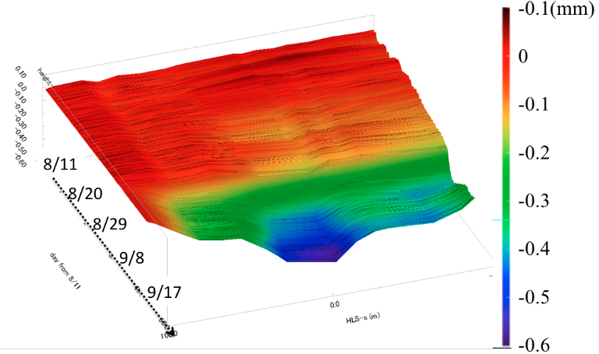
Tunnel motion monitoring
A clear tidal (vertical) motion is seen
around the IP.
The amplitude is ~20μm
(P-P) during this period.
1 day
IP sank with respect to the ends of the
straight sections by ~0.6mm due to heavy rainfall in the area.

Slide 33
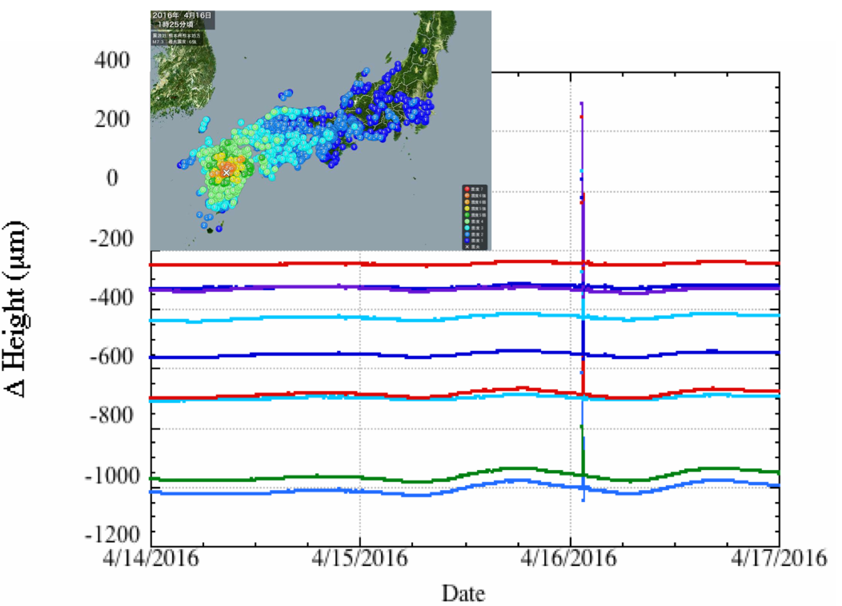
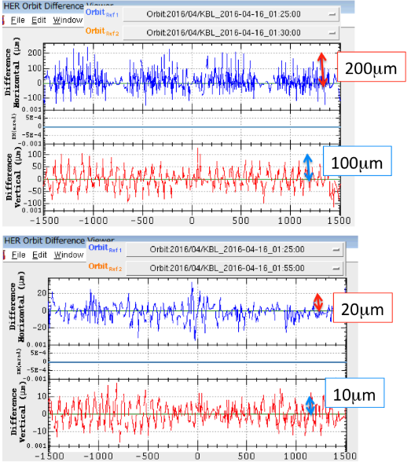
Tunnel motion monitoring
HLS data
The 2016 Kumamoto earthquake (magnitude 7.3) hit Kumamoto.
It took ~ 4 minutes for the seismic wave to arrive at the SuperKEKB ring.
It disturbed the accelerator components but the abort system for the circulating beams was not triggered.
Orbit difference
During the EQ – before EQ (top)
After the EQ – before EQ (bottom)

Slide 34
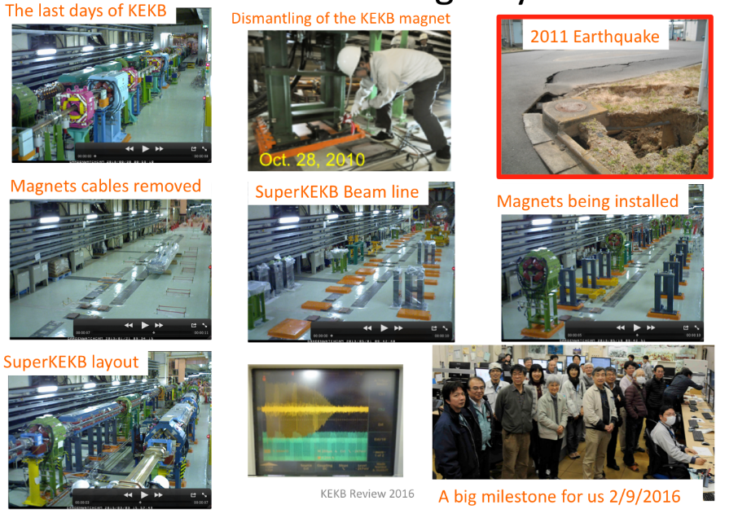
We came a long way

Slide 35
coupling between adjacent magnets
Magnetic field measurements

Slide 36
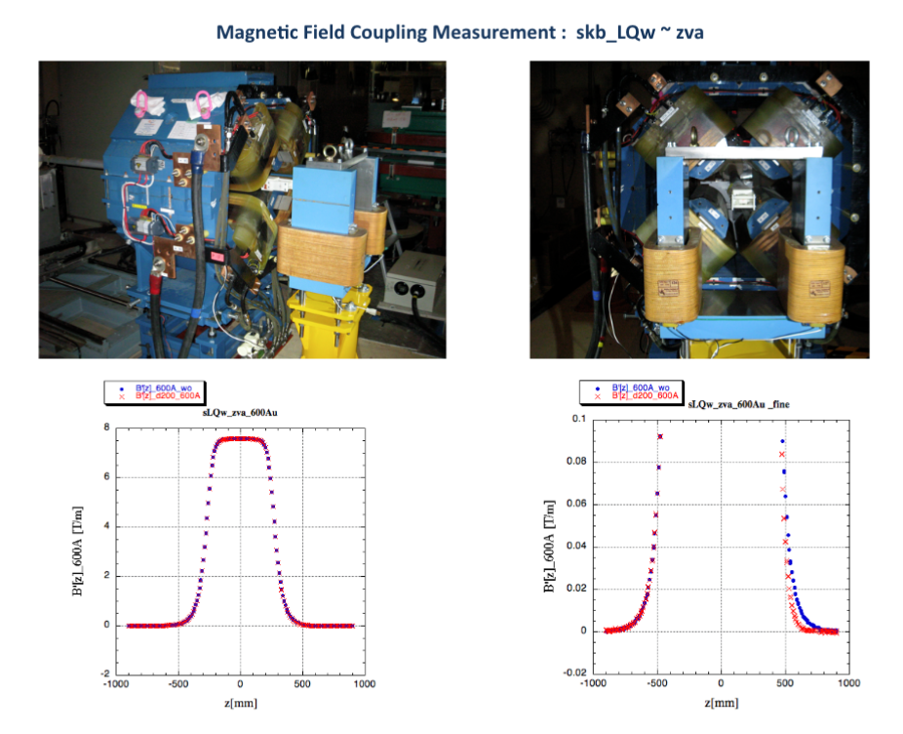
Magnetic coupling between adjacent steering magnet and Quadrupole magnet was evaluated & measured by K. Egawa

Slide 37
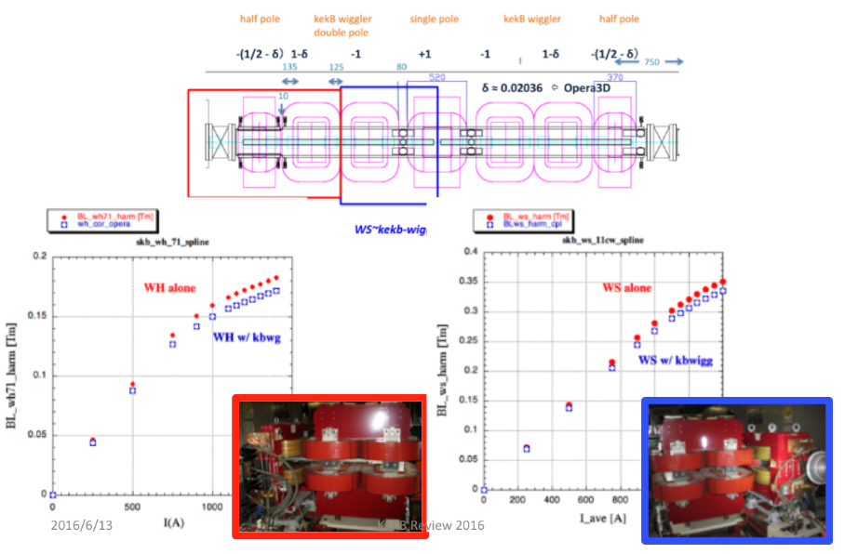
Magnetic coupling between adjacent wigglers was evaluated
& measured by K. Egawa

Slide 38
For Phase II
Preparation for New IR, Installation & alignment of the QCS magnet system, design and fabrication of the collision FB (“iBump” )magnets, building the dithering system, and so on.
Survey of the rings after a long shut-down and before Phase II.
Alignment of the ring magnets, if needed.

Slide 39
Summary
The SuperKEKB MR magnet system was completed in time for Phase I commissioning.
The prediction for the circumference agreed with the actual circumference within 1 ppm accuracy and the difference in the circumference in both rings was found to be a couple of hundred microns, which contributed to a smooth start-up of the MR.
We would like to add more (BINP) HLS sensors to monitor the tunnel level change, especially at the IP & LCC sections.
The power supply system is up and running smoothly with very high stability➔T. Oki’s talk.

Slide 40
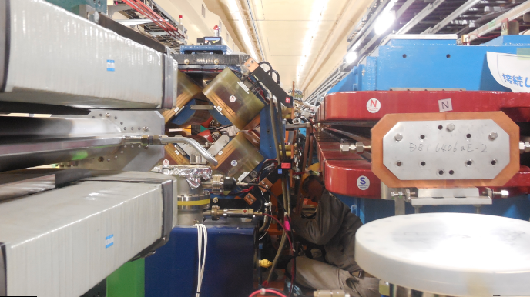
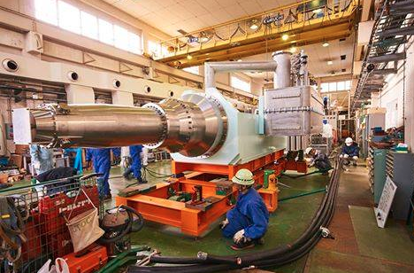
Summary
We will investigate any problems found
by beam commissioning:
Misalignment if any,
Improvement in the magnet data
Magnetic coupling of wigglers, near-by magnets, for example.
We are preparing for the installation of the QCS system, which will take place in the summer, 2016.
We have started to work closely with
the QCS group on the alignment of
the Single Stretched Wire (SSW) system,
which affects the cryostat alignment to
the beam line.

