Slide 1
Beam Abort System
2016.6.13
21th SuperKEKB Review
Toshihiro Mimashi

Slide 2
Contents
HER Beam Abort System
Requirements
Design
Components
Beam Abort Kicker Magnets
Extraction Window
Lambertson Magnet and Abort BPM
Ceramic Chamber
Spattering
Kicker Power Supplies
Issues
What’s going on in the case of failure of kicker magnets

Slide 3
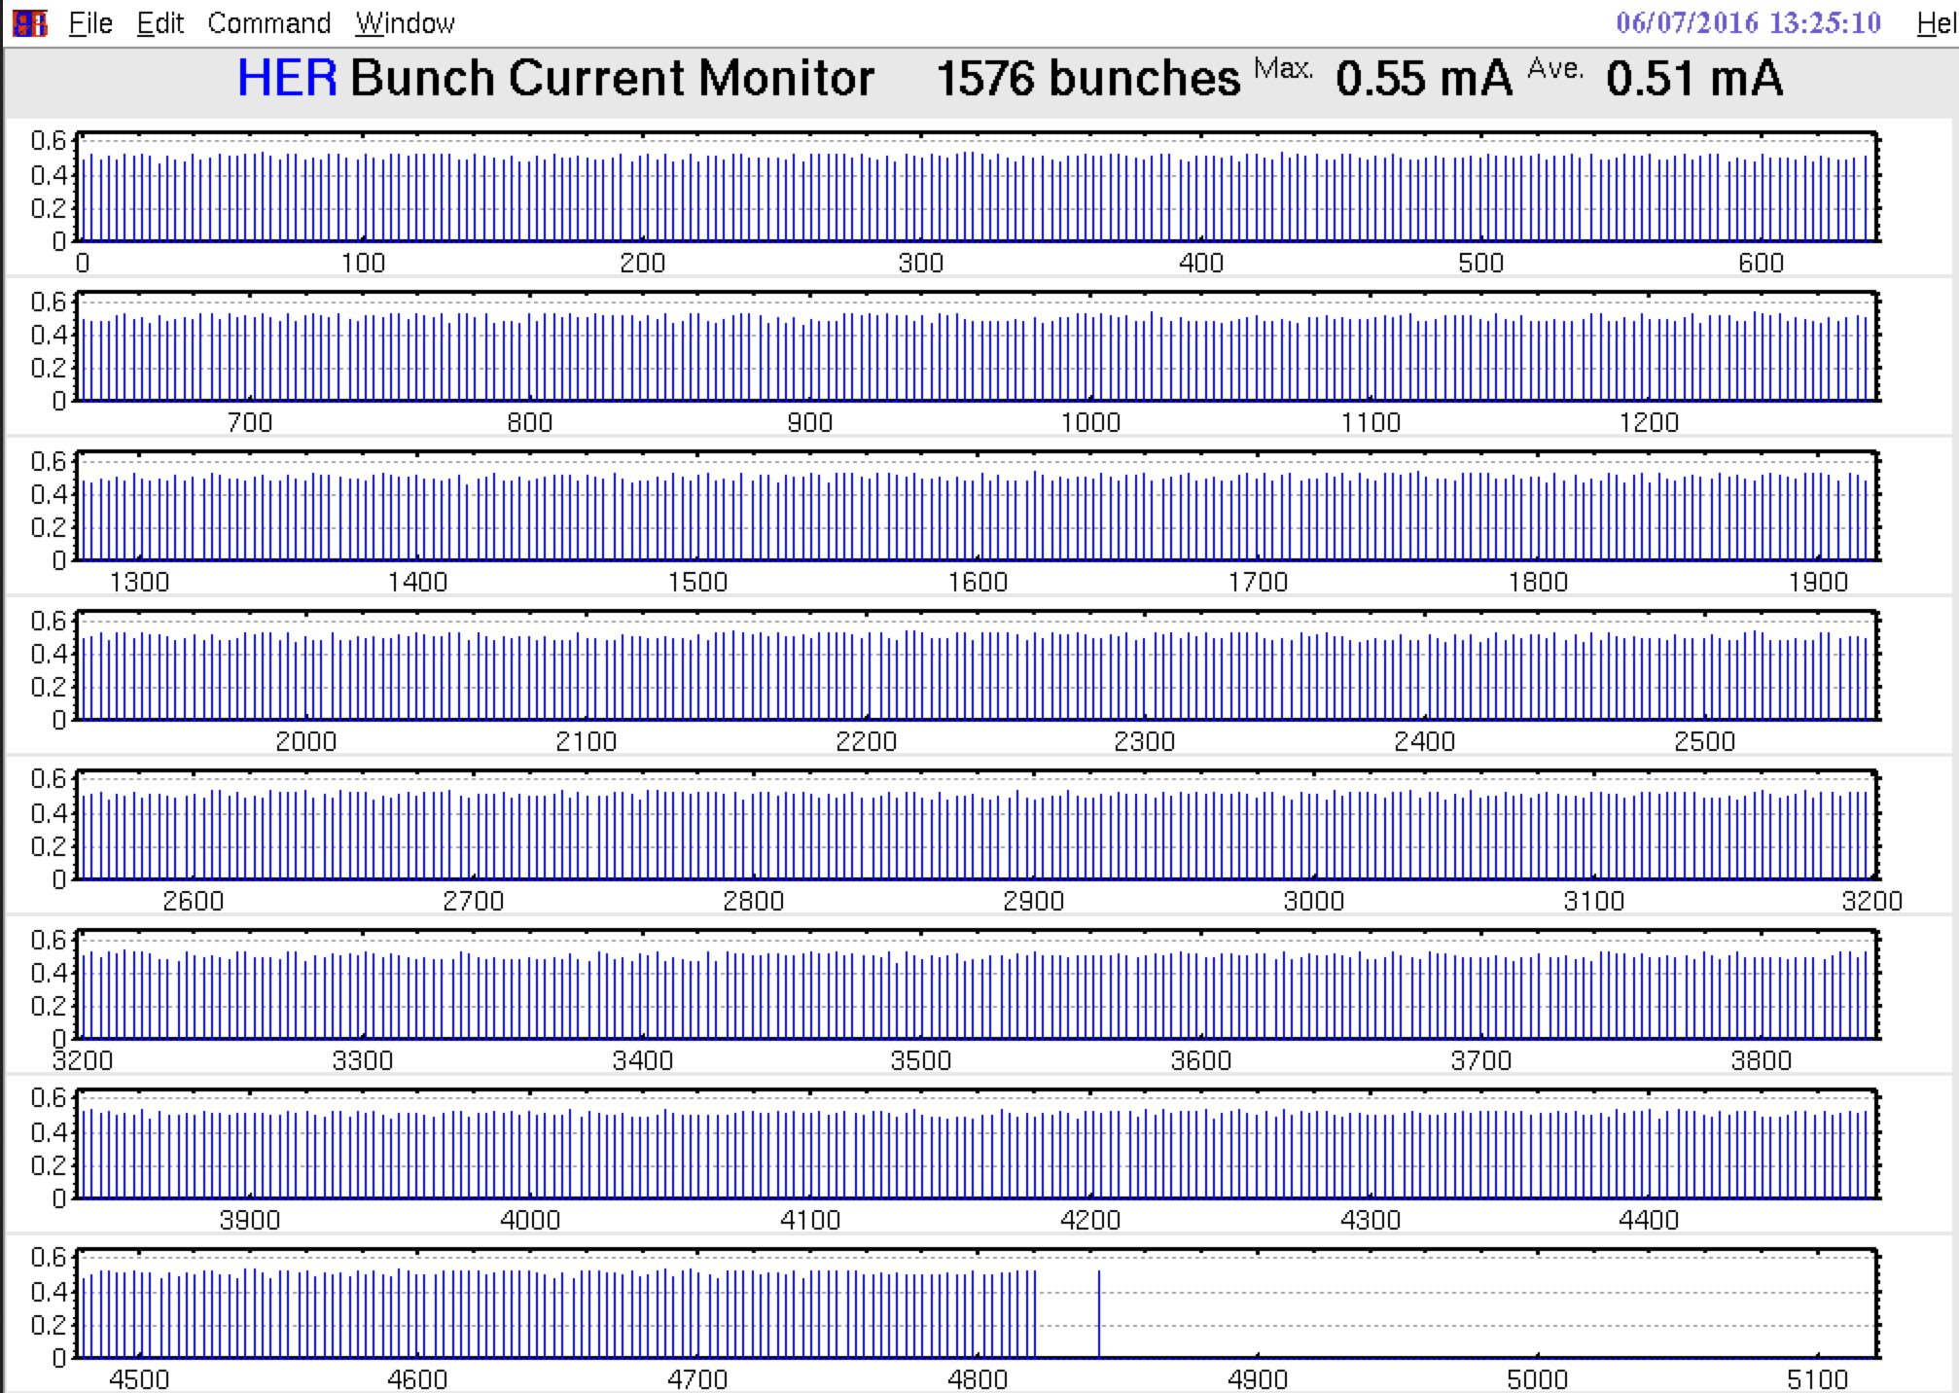
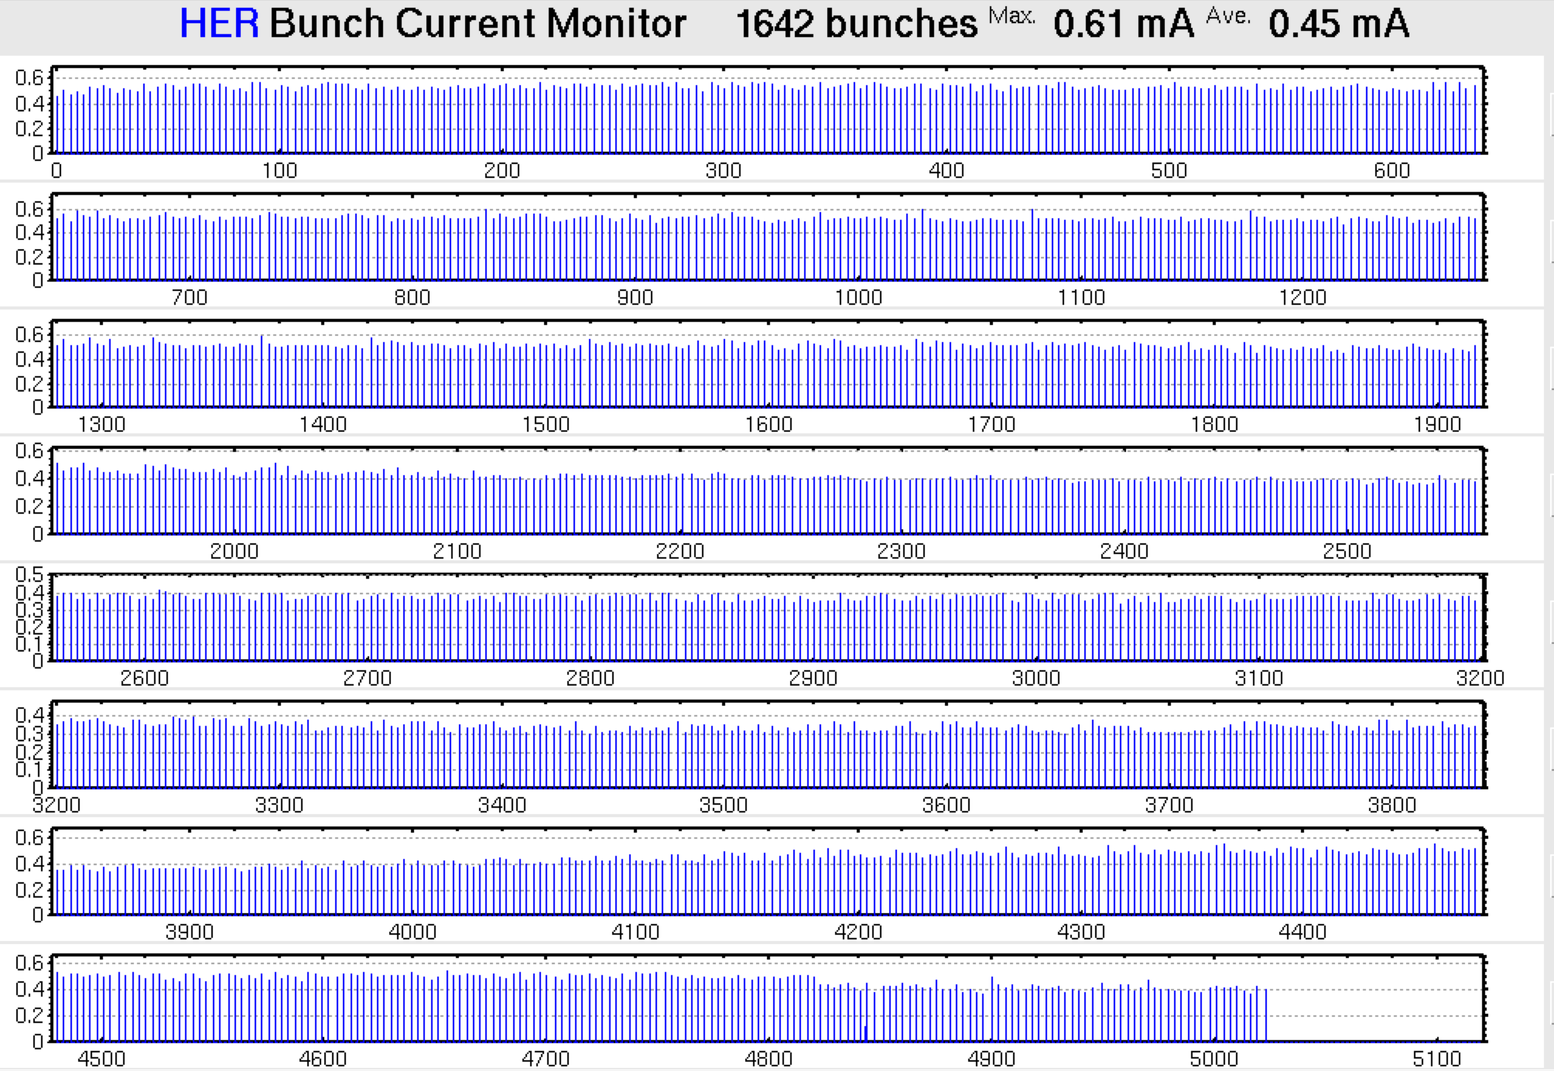
Requirements for The Beam Abort System
Beam Abort Gap < 200nsec (KEKB abort gap 500nsec)
(For Stable operation of RF cavities)
Enlarge Horizontal Beam size at the extraction window
(To protect extraction window)
Perfect Beam extraction
All or Nothing
HER Bunch Current Monitors

Slide 4
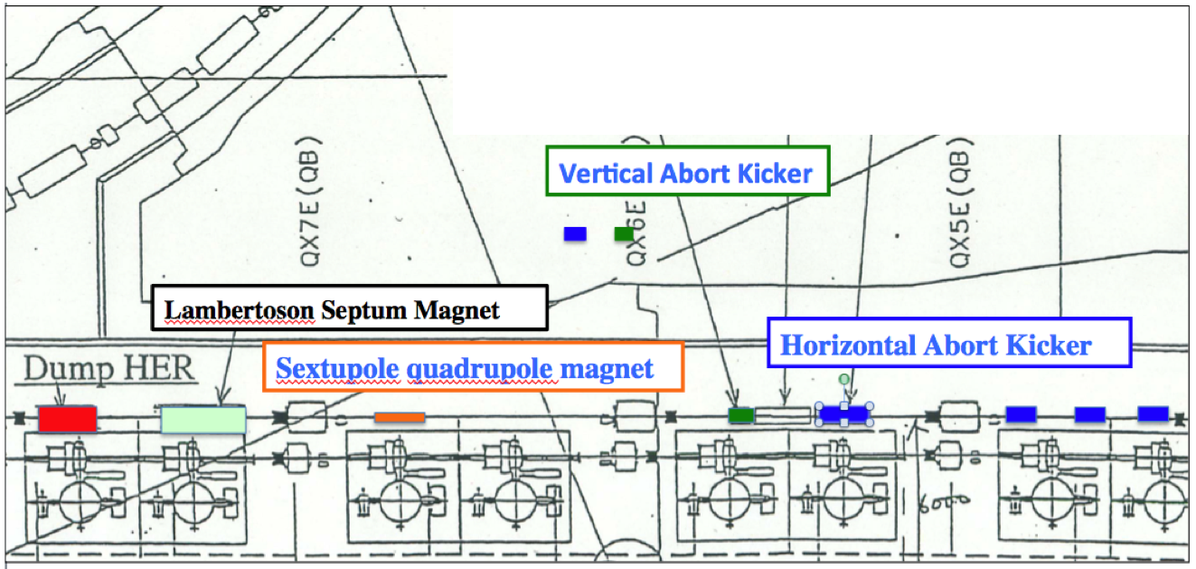
Beam Abort System

Slide 5
Hardware Components

Slide 6
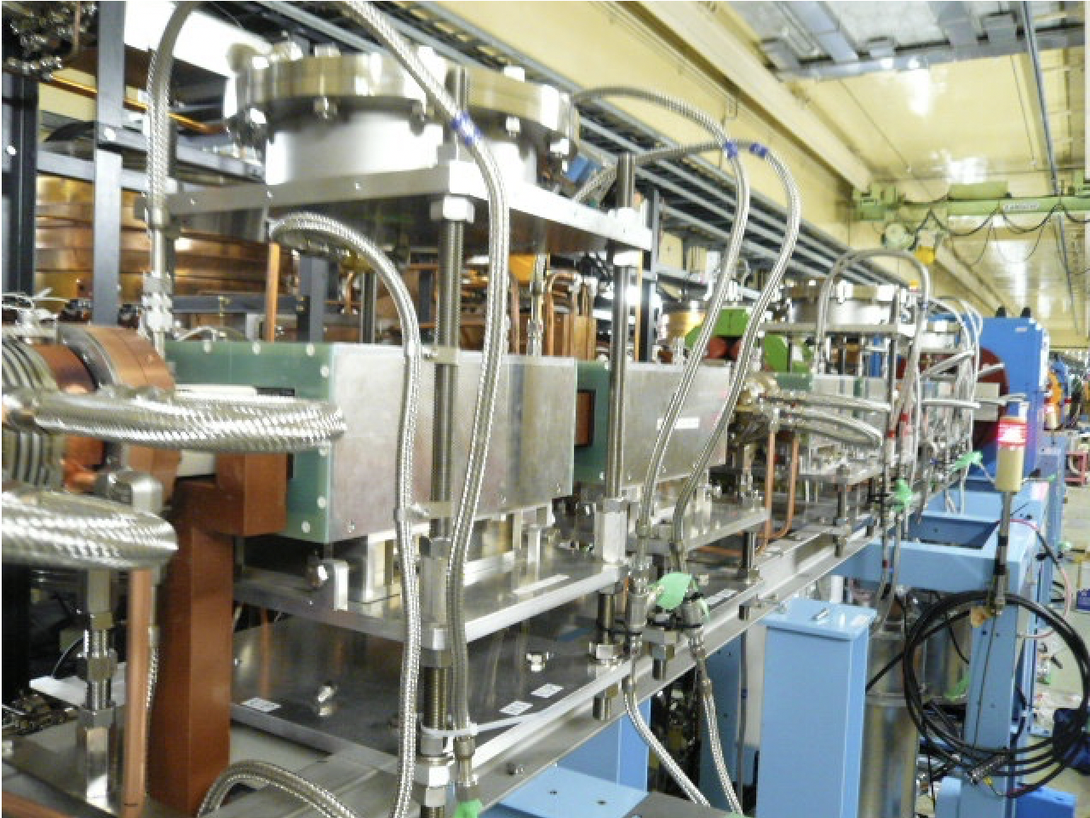
Abort Kicker Magnets(@7 GeV HER)
Parameters | Horizontal Kicker | Vertical Kicker
Θ(mrad) | 2.72(Total) | 1.38
B(T) | 0.02 | 0.092
I (kA) | 1.2 | 2.1 (3 Turn)
Length of Ferrite | 385 x 8 | 350 x 1
# of coils | 4 | 1
Ceramic Length (mm) | 500 x 8 | 500 x 1

Slide 7
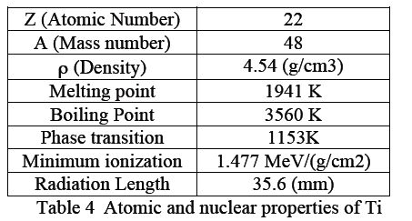
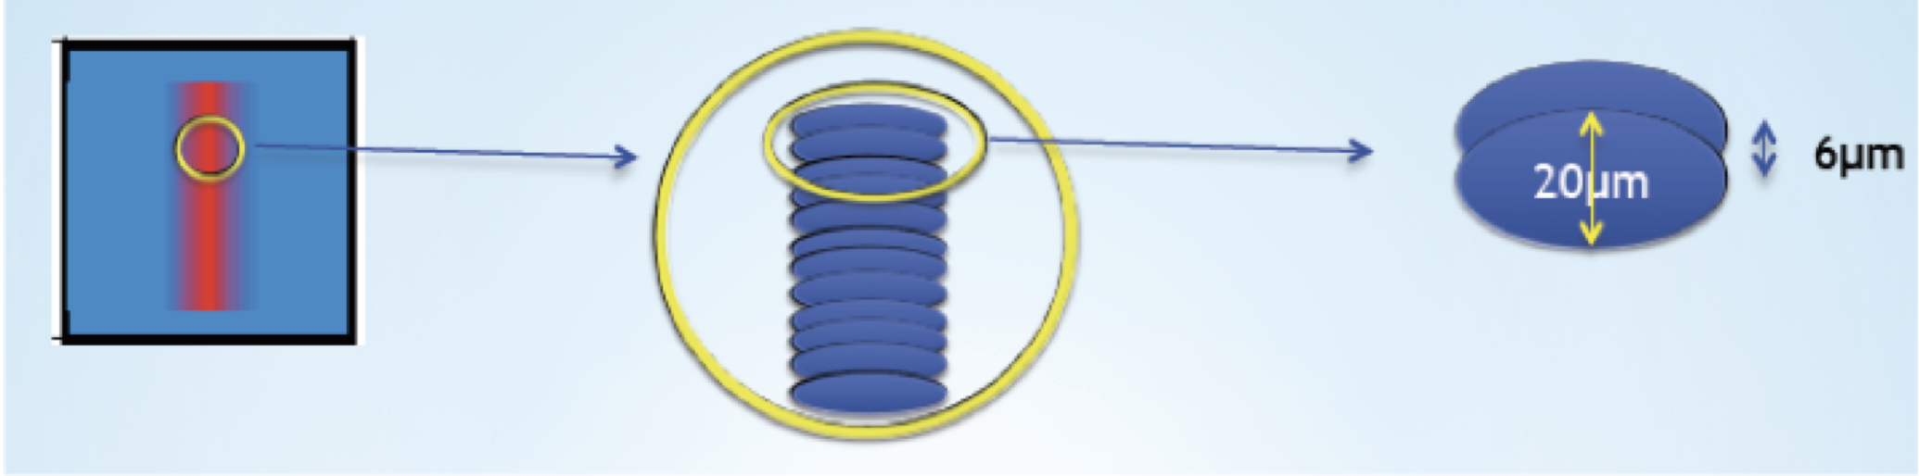
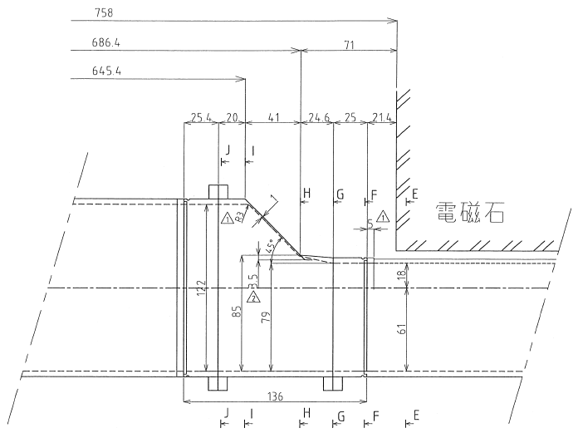
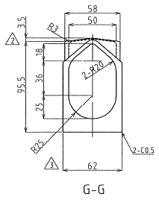
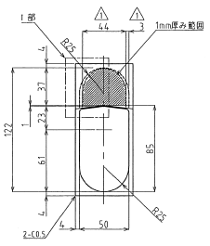
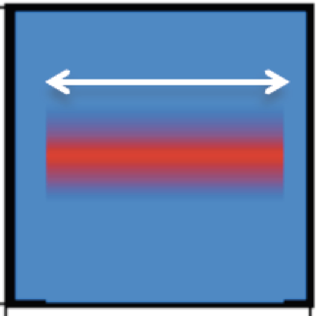
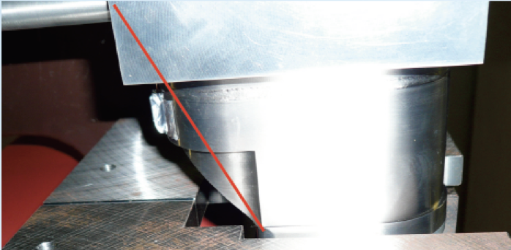
Extraction Window
H-H

Slide 8
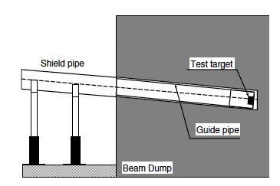
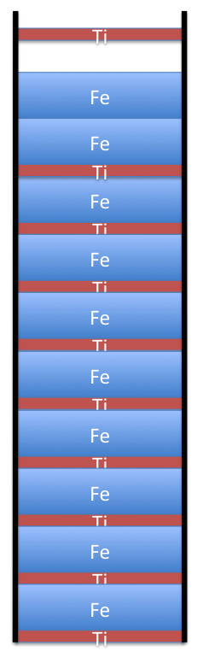
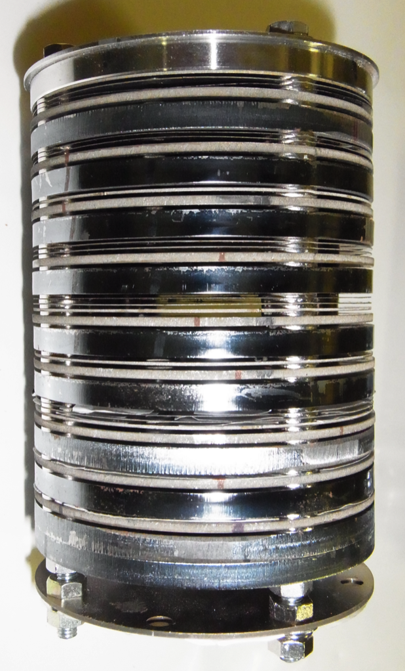
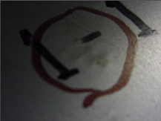
 | KEKB (LER) | SKEKB (HER)
E (GeV) | 3.5 | 7
εx (nm) | 24 | 4.6
σx(mm)@window | 0.68 | 1.1
Vertical Sweep (mm) | 10 | 12-15
I (A) | 2 | 2.6
I/σx /δY(A/mm²) | 0.3 | 0.15-0.2
Extraction window Damage Test:
I/σx /δY(A/mm²): 0.53 ⚪️ 0.77 ✖️

Slide 9
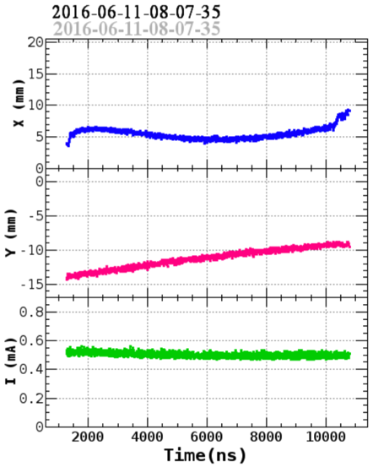
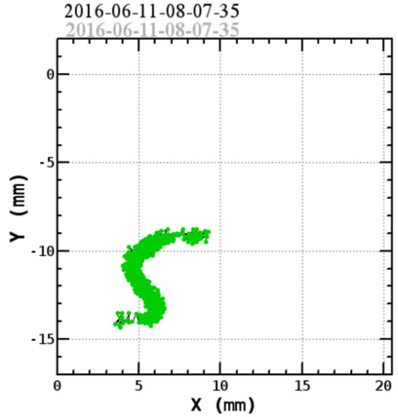
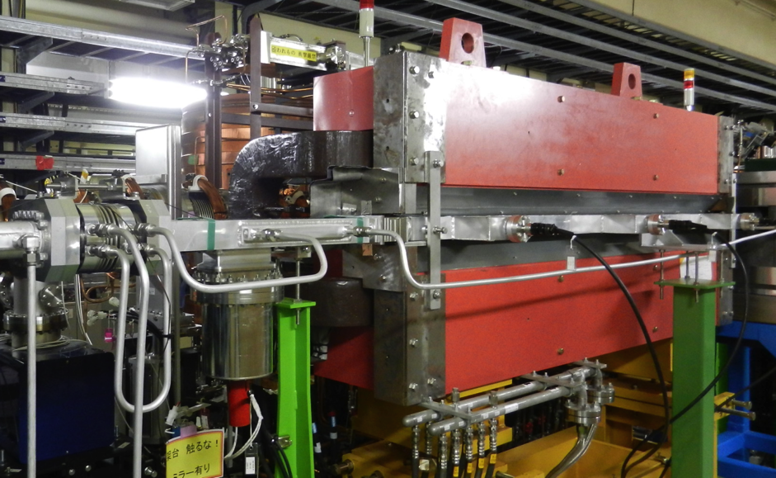
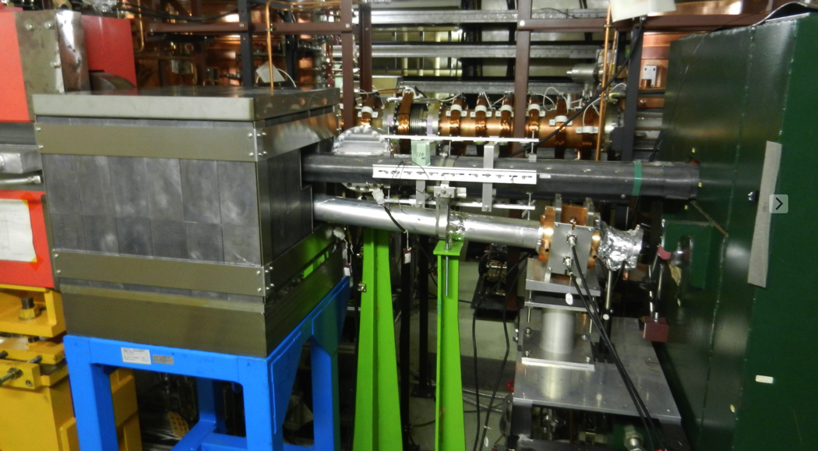
Monitors for the HER extracted beam
N.Iida
BPM
In front of the dump
Alumina fluorescent screen
In front of the Lambertson
In front of the dump
Lambertson
Dump

Slide 10
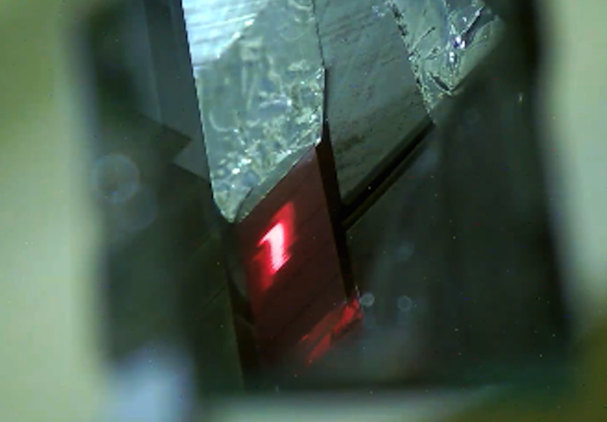
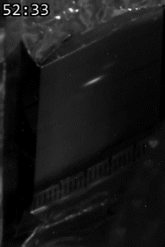
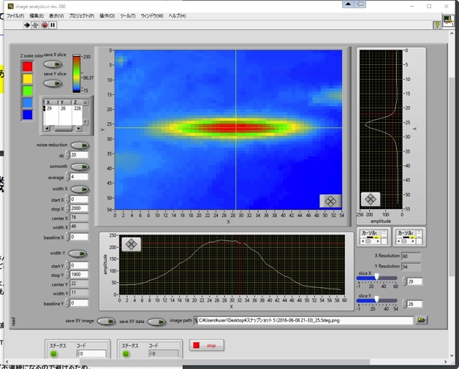
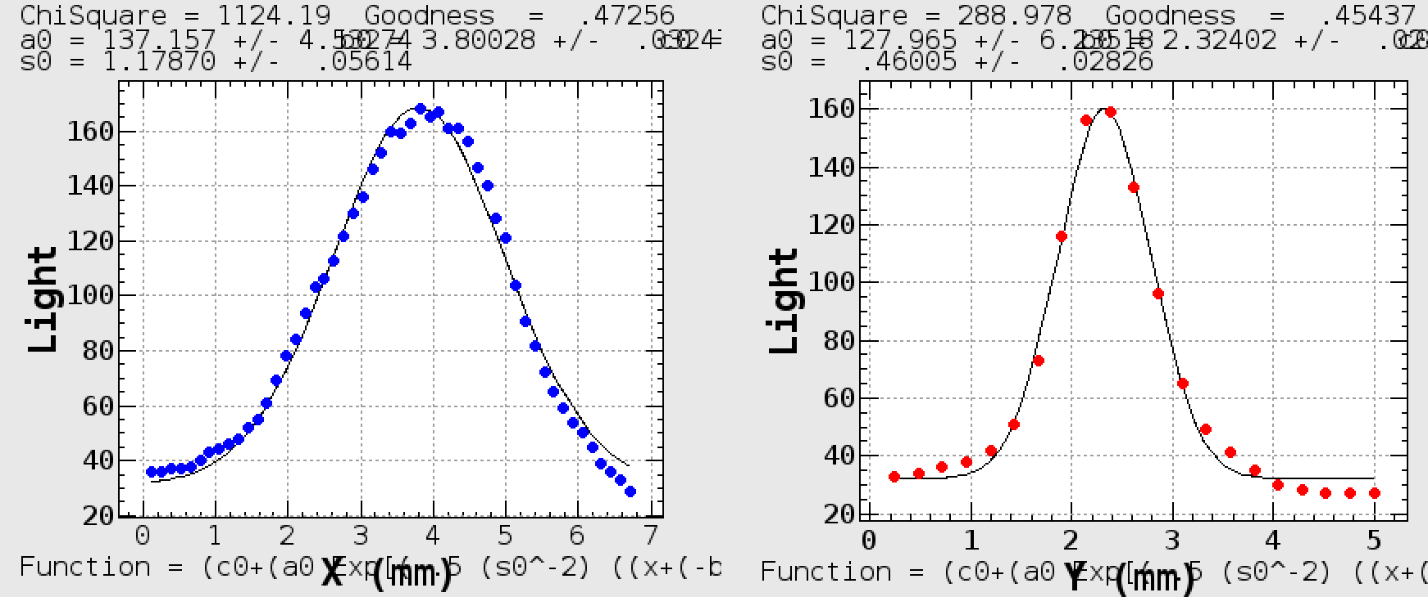
Beam profile measurements at the “extraction window”
N. Iida, Y. Enomoto,
Y. Suetsugu
An alumina fluorescent screen (Δt=0.2mm), is installed behind the extraction window.
(The extracted beam profile)
2. The horizontal beam size of single bunch is measured.
σx = 1.18 ± 0.16(mm) Design:1.1(mm)
σy = 0.46 ± 0.13(mm)
These are included the multiple scattering at the window and the thickness of the fluorescent screen.
Horizontal beam size
Vertical beam size

Slide 11
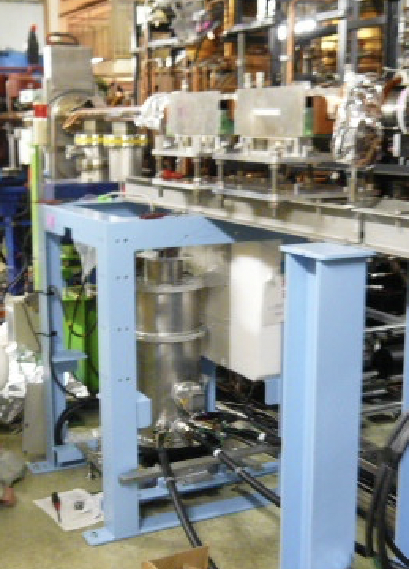
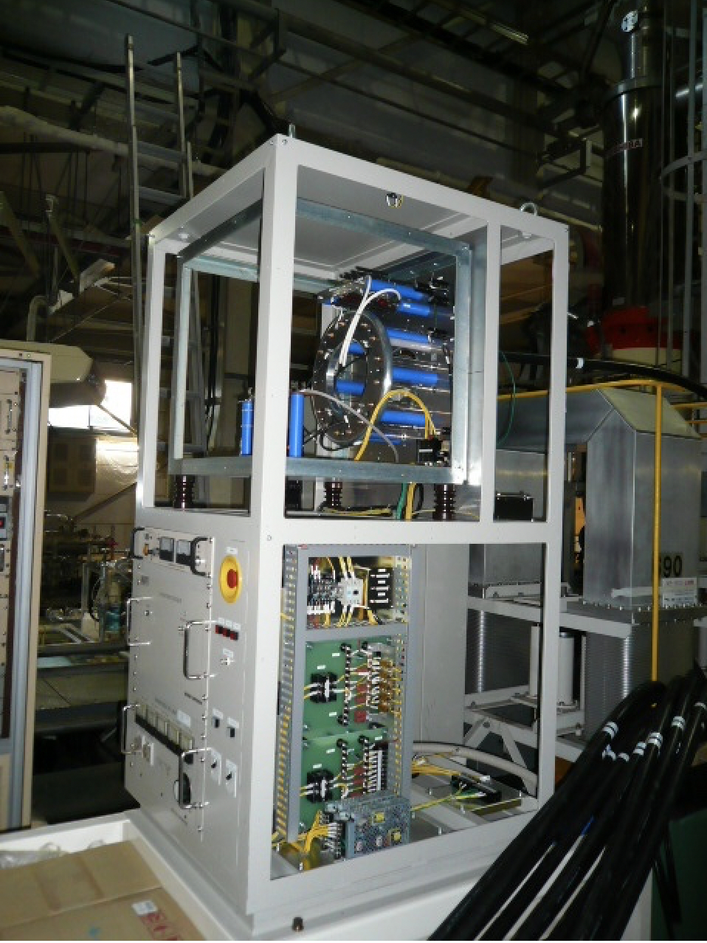
Power Supply (HER)
Common Thyratron switch
Each Horizontal kicker has main capacitor, saturable inductance and power crowbar diodes.
Charger＋Thyratron Switch
Saturable inductance
+ Main Capatitance
+ Power Crober
Saturable inductance
+ Main Capatitance
+ Power Crober
Saturable inductance
+ Main Capatitance
+ Power Crober
Saturable inductance
+ Main Capatitance
+ Power Crober
Main Capacitor +Transformer
Hor. kicker
Hor. kicker
Hor. kicker
Hor. kicker
V kicker

Slide 12
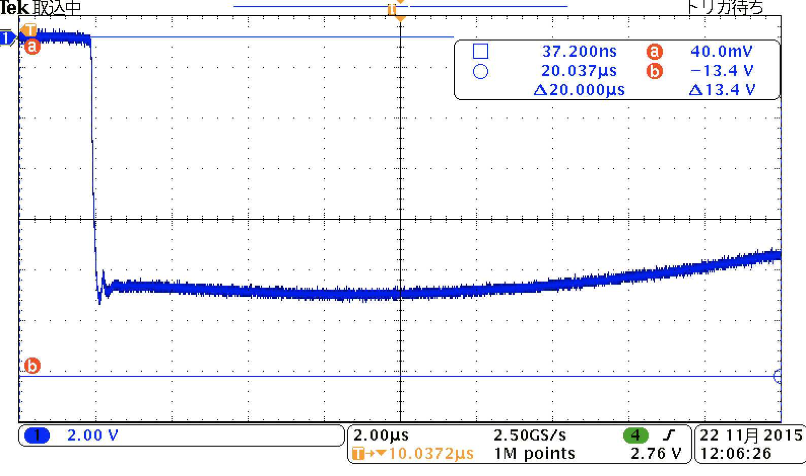
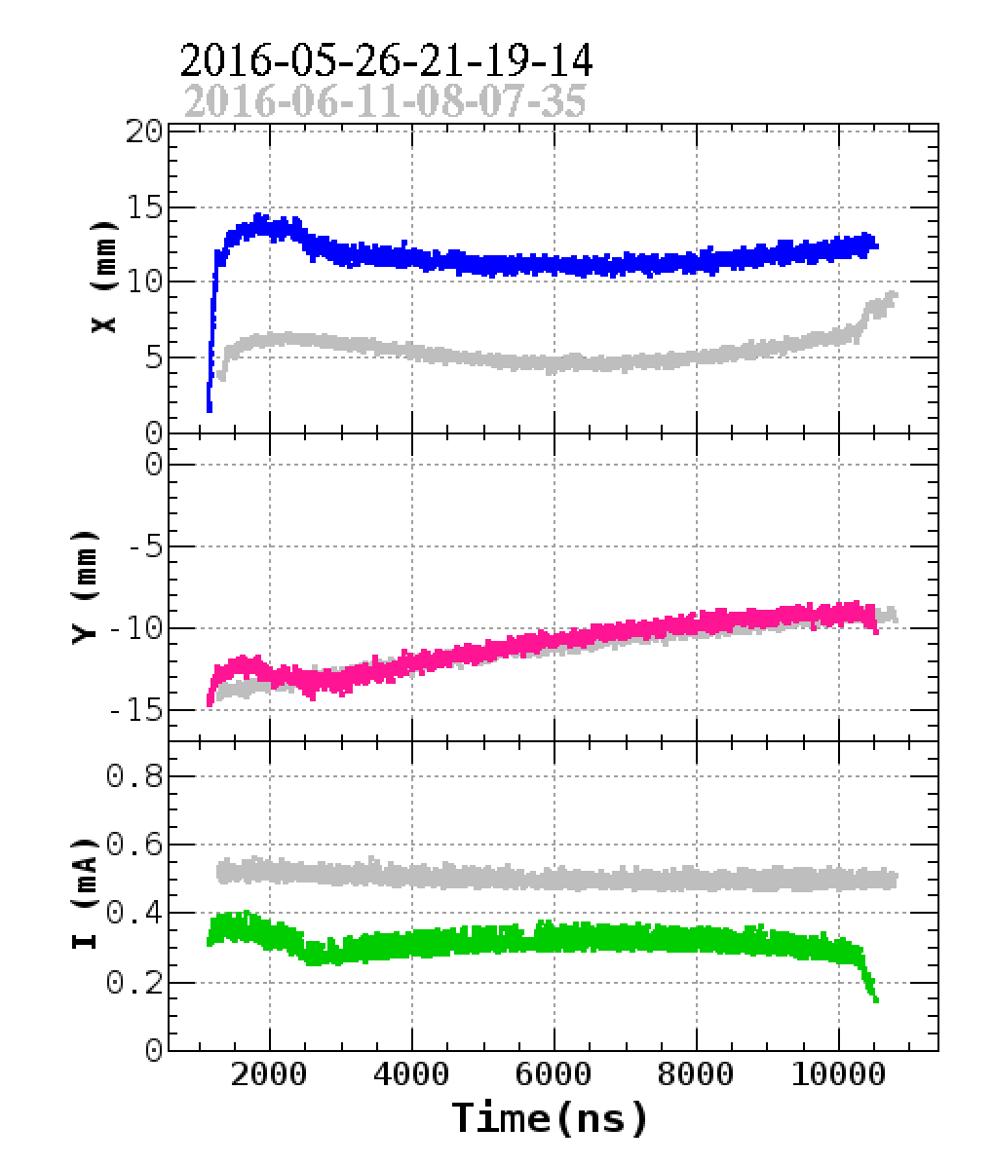
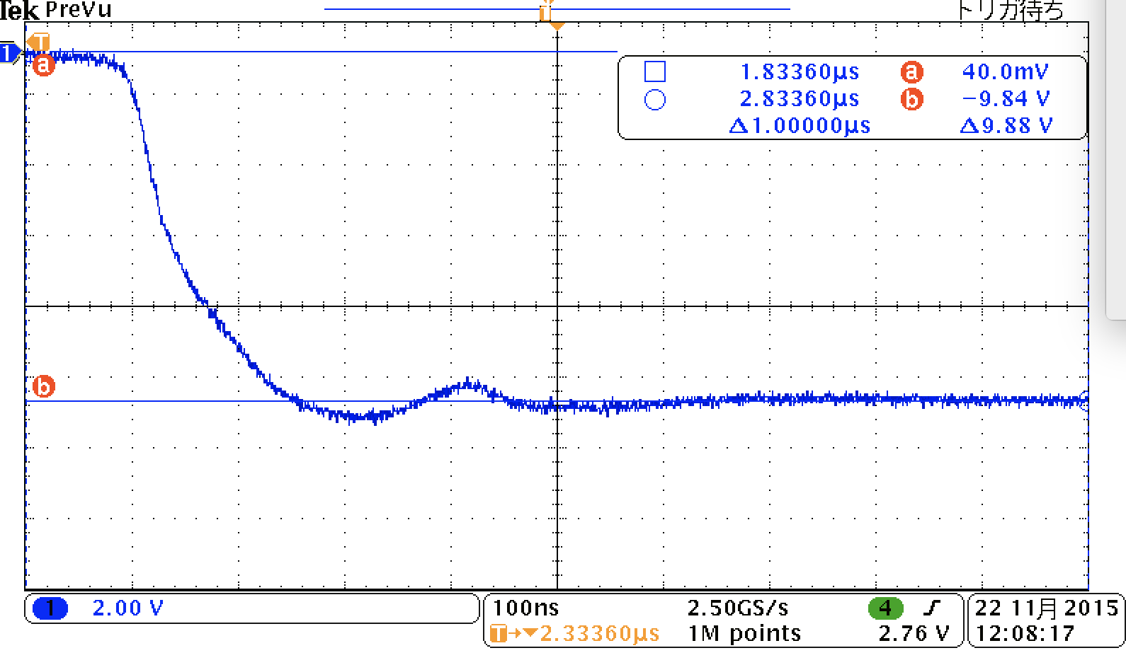
Horizontal Kicker current
Saturable
Inductance
Power Crowbar
200nsec
10μsec
Saturable
Inductance
Power Crowbar
200nsec

Slide 13
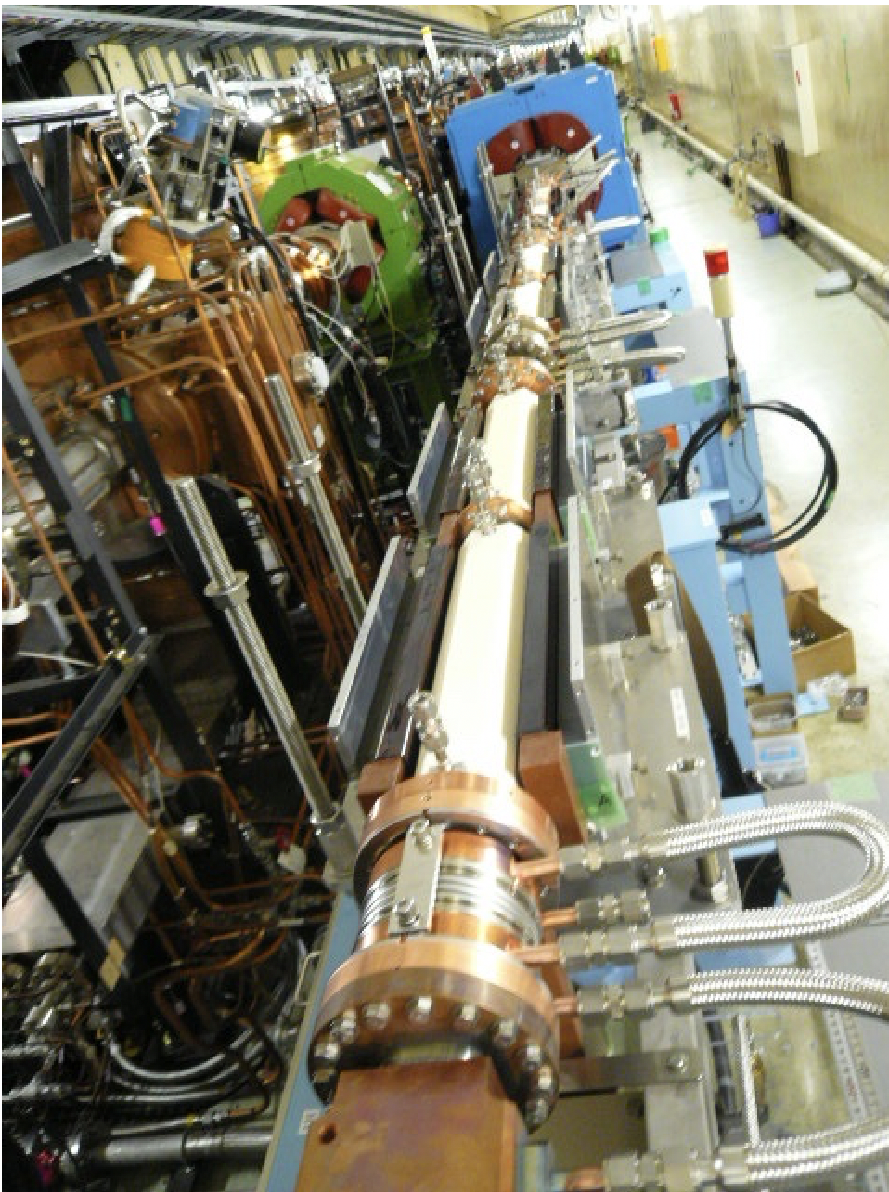
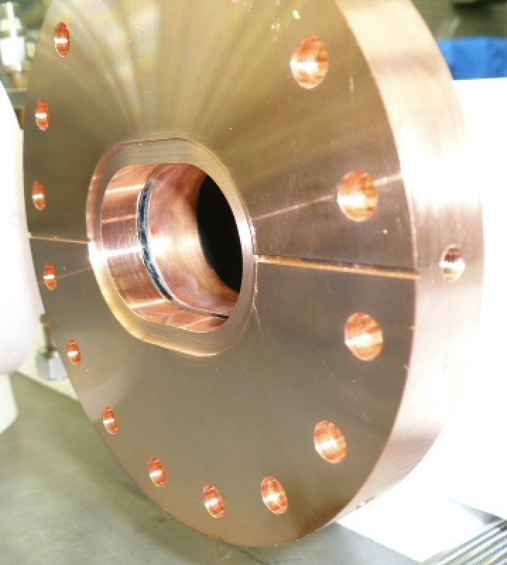
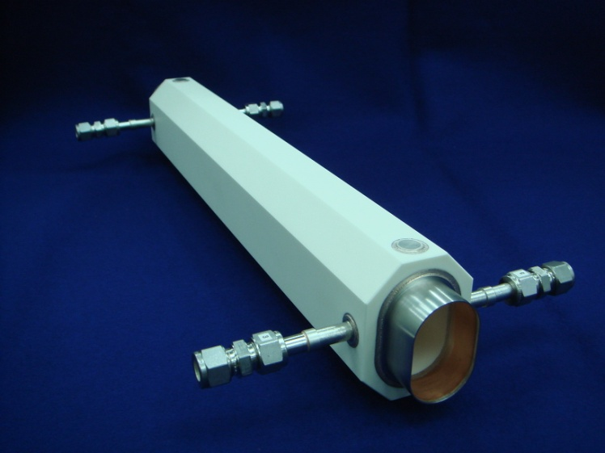
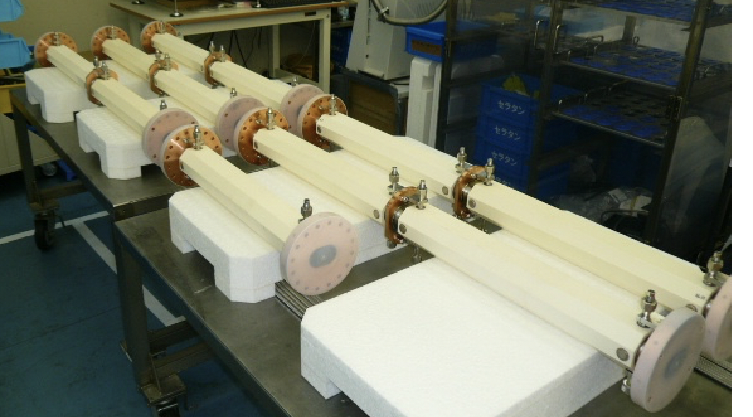
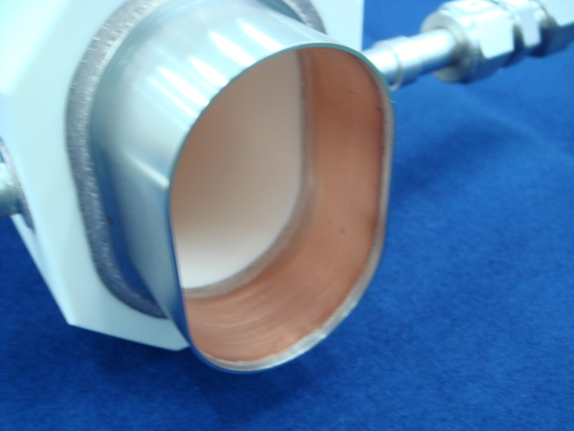
Ceramic chamber (Water-cool)
Requirements of Ti-coated ceramic chamber：
・Penetrate fast kicker magnetic field
・Beam image current passes surface of Ti coating
・Heating on Kovar Sleeve must be small
100μm Cu Conducting layer coated inner wall of Kovar (ΔT ＜ 20℃@ 2.6A）

Slide 14
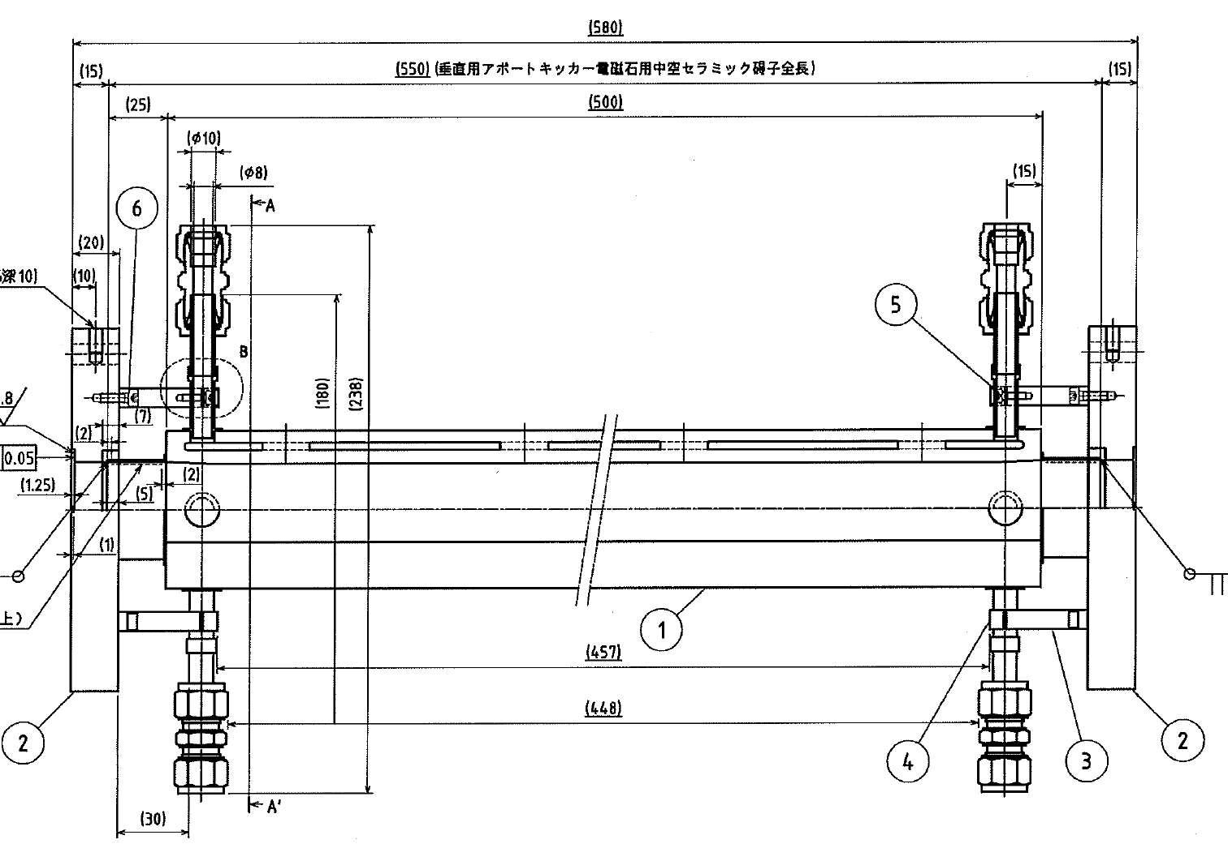
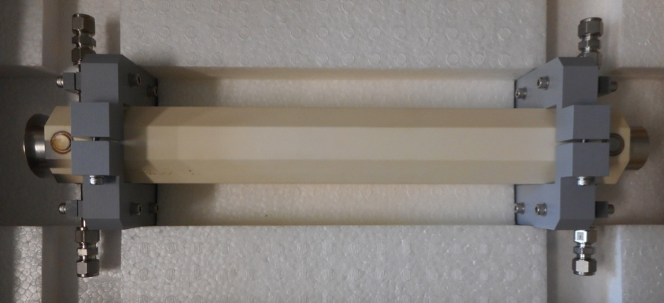
Ti Coating Ceramic Chamber with Sputtering
The 500mm long hollow type ceramic which include cooling water path inside
500 mm
Why do we use sputtering for Ti-coating?
・Structural change of chamber decreases acceptable temperature
difference between inside and outside.
・Vapor deposition with Ti wire heating(KEKB) → Sputtering(SKEKB)
ΔT < 300-400℃→ ΔT < 100℃

Slide 15
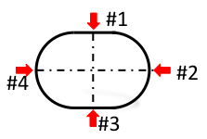
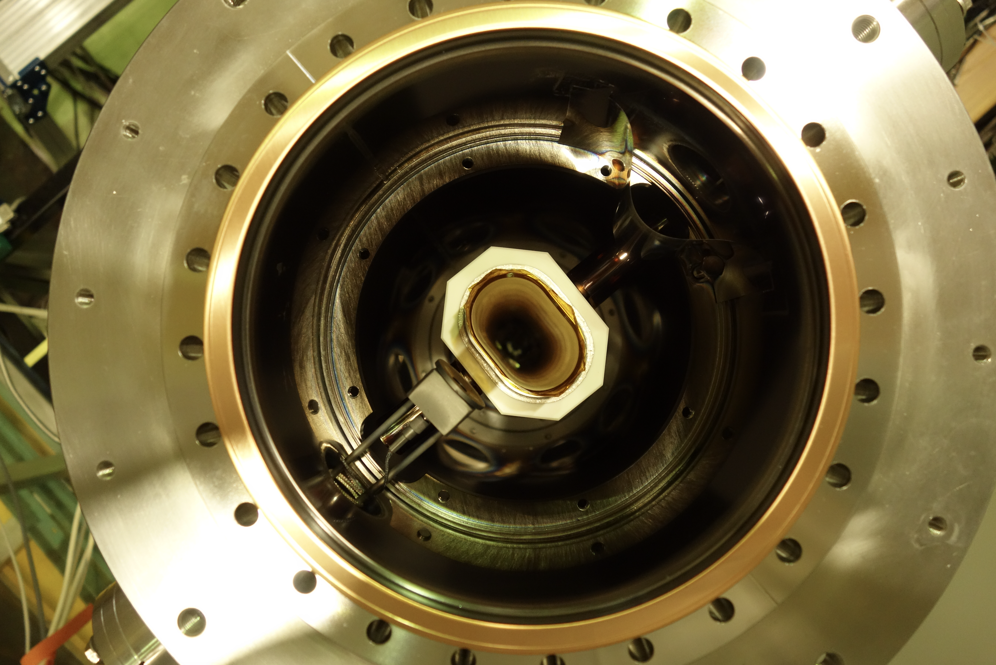
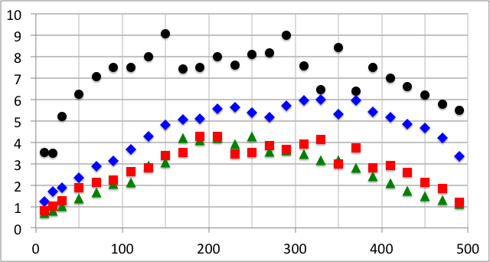
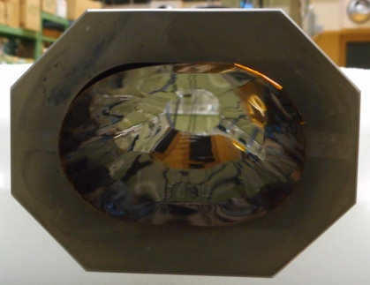
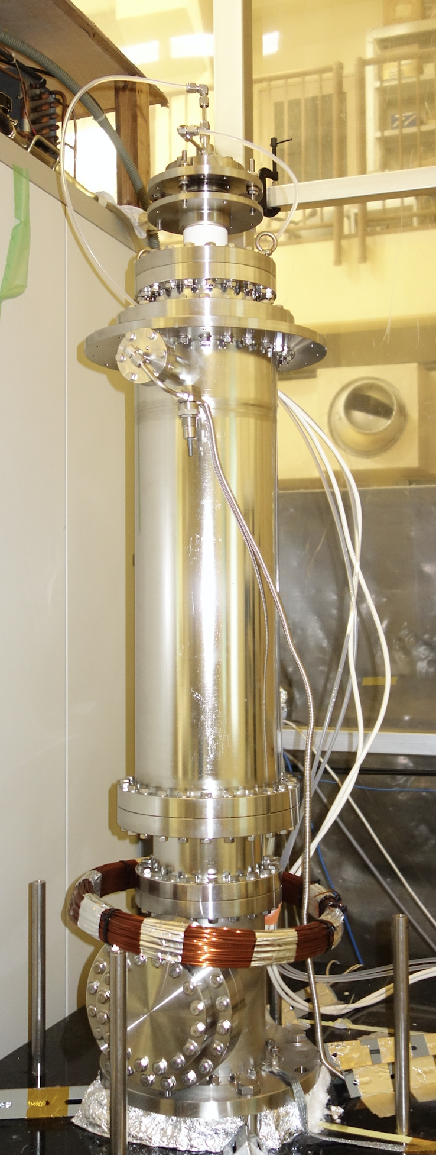
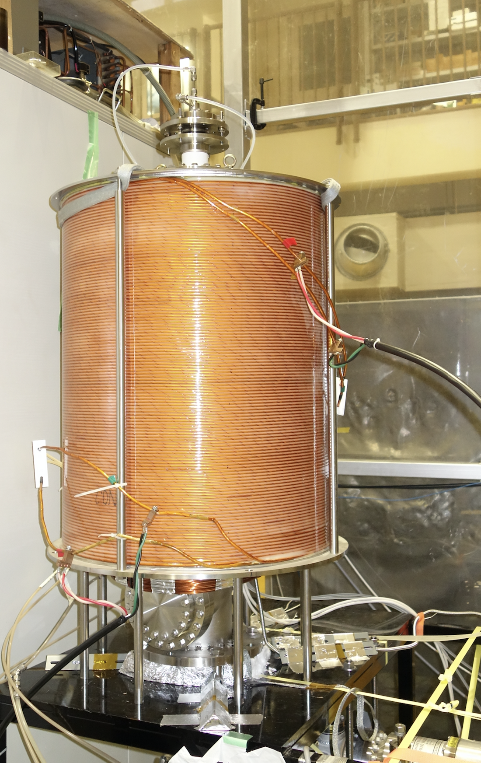
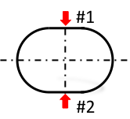
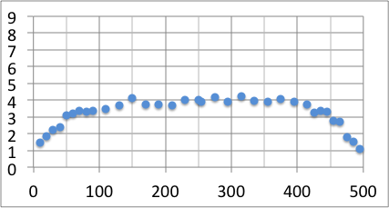
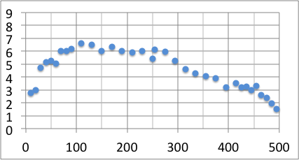
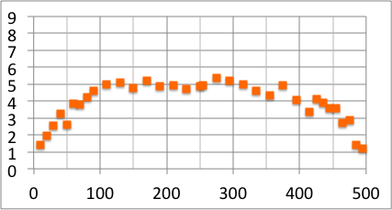
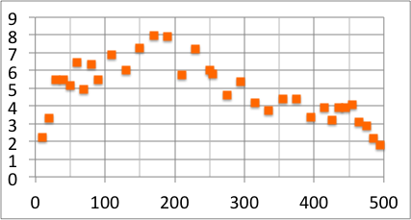
Ti-Thickness Distribution
Kapton sheet test
#1
#2
Ti Thickness [μm]
#3
#4
Position [mm]
Typical Ti thickness for ceramic chamber
Good uniformity sample
Non-uniformity sample
#1
#1
Ti Thickness [μm]
Ti Thickness [μm]
#2
#2
Position [mm]
Position [mm]

Slide 16
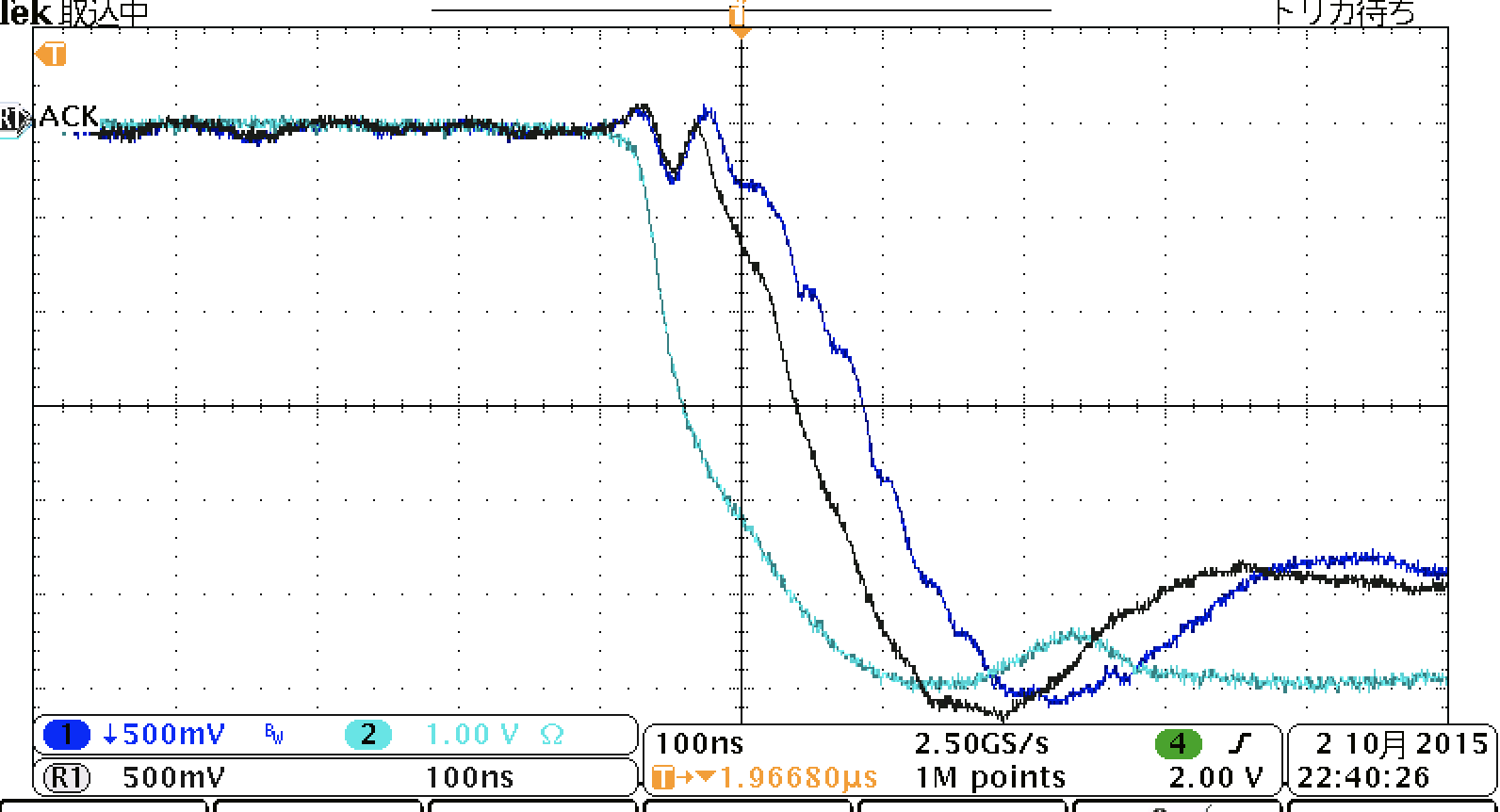
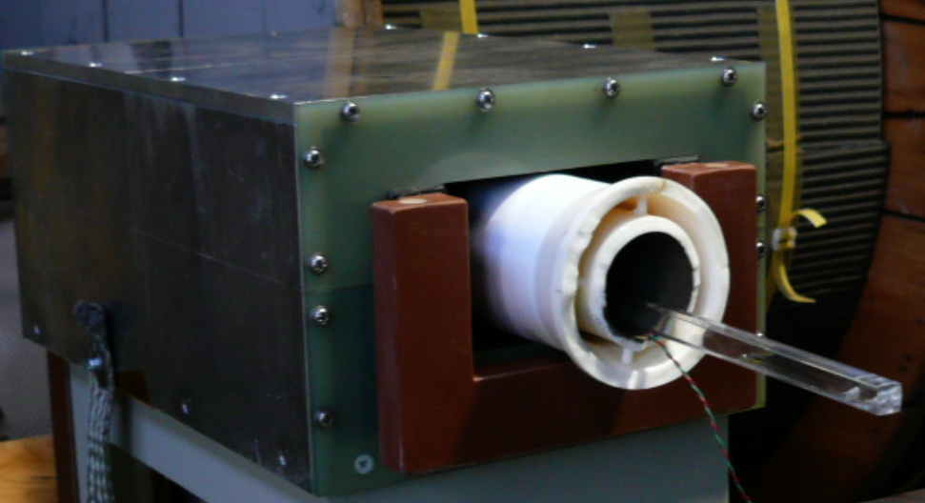
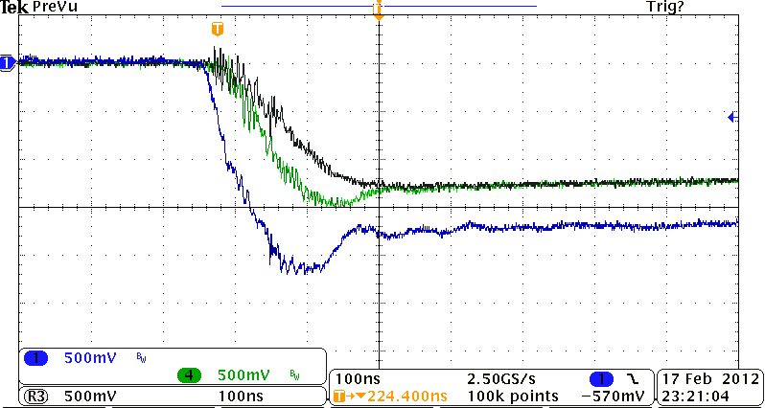
Magnetic Field Response and Chamber Temperature
Magnetic field response with Ti-coating ceramic chamber
ー : CT
ー : Magnetic field w/o chamber
ー : Magnetic field with chamber
ー : CT
ー : Magnetic field with chamber
ー : Magnetic field w/o chamber

Slide 17
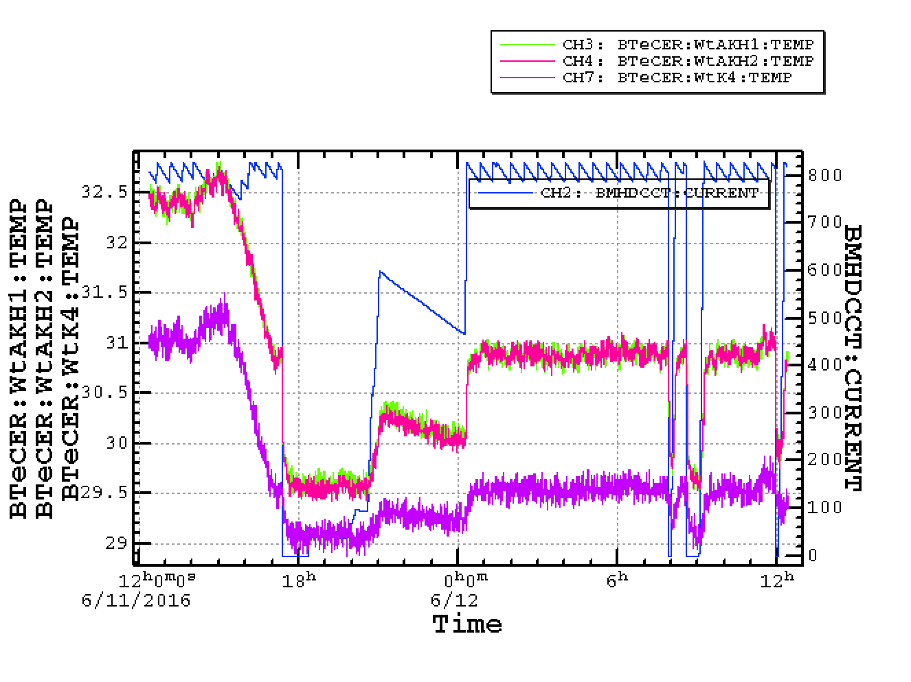
Temperature Rise(Cooling Water)
Beam Current (HER)
 | LER KEKB | HER KEKB | LER SKEKB | HER SKEKB
I max | 1.6A | 1A | 3.6A | 2.6A
# Bunch | 1584 | 1584 | 2500 | 2500
ΔT | 2.7 | 1.4 | 8.6 | 2.9 (8.6)
Power | 0.56kW | 0.29kW | 1.8kW | 0.6kW (1.8kW)
New Ceramic
Abort Kicker: New Ceramic Chamber (Spattering)
Injection Kicker: used Ceramic Camber (KEKB)
Old Ceramic
ΔT(New Chamber)
= 3 x ΔT(Used Chamber)
Same Beam Current
But differrent Temperature Rise
(1 Train 1576 Bunches )

Slide 18
Issues

Slide 19
Abort System Failure possibility
Failure Events | What happen in the system | Damage
Thyratron Break Down | 2% of Total Beam loss | No Damage
Gate circuit mulfunction | 2% of Total Beam loss | No Damage
Thyratron misfire | Turn weak Bend magnets | No Damage
Gate circuit misfire | Turn weak Bend magnets | No Damage
H cap break down (charging) | Turn weak Bend magnets | No Damage
V cap break down (charging) | Turn weak Bend magnets | No Damage
Charger fault | Turn weak Bend magnets | No Damage
H cap break down (discharge) | Peak current will be low | Damage ?
H kicker Bias circuit fault | Turn weak Bend magnets | No Damage
H kicker Power Crober fault | Turn weak Bend magnets | No Damage
V kicker Cap Break Down (discharge) | No Vertical Sweep | Serious Damage
V kicker Bias circuit fault | No Vertical Sweep | Serious Damage

Slide 20


Vertical Kicker (Pulsed Transformer circuit)
Kicker Current
cap Voltage
Beam
Exist

Slide 21

Beam Loss at the end of train

Slide 22


Radiation Damage of diode of crowbar circuit
7mm Pb +200mm Polyechiren +1mm Pb
Reduce 1/10 radiation damage

Slide 23


Leakage Field from Lambertson Magnet

Slide 24
End

Slide 25
Backup

Slide 26



Layout around the Lambertson
Lambertson
Lambertson
The skew quadrupoles are equipped at the both sides of Lambertson to cancel the leakage field of Lambertoson Magnet
e+
e+
Skew Quad of ferrite blocks
Sextupole with skew winding
e+
Lambertson

Slide 27



The skew quadrupole parmanent magnets to cancel the leakage field from the Lambertson
N. Iida, M. Kikuchi, K. Kodama, T. Mimashi, T. Mori, T. Tawada
Ferrite block
Ferrite block
Size: 100 x 25.4 x 150 (mm)
B 〜 550 (Gauss)
r = 85.5 (mm)
→ SK1 = - 7.7e-3 (/m)
which is adjusted the requrement from optics.

Slide 28

Vertical beam size measurement
Y. Ohnishi
Before ferrite installation
After ferrite installation
Target
εy〜20pm
εy〜10pm
εy〜5pm

Slide 29



Slide 30


