Slide 1
Instabilities simulation and observation
K. Ohmi, J. Flanagan, H. Fukuma, Y. Funakoshi, H. Ikeda, Y. Suetsugu, S. Terui, M. Tobiyama, D. Zhou
21-th KEKB Accelerator Review Committee
KEK, 13-15 June, 2016

Slide 2
Contents
Beam size blow-up due to Electron cloud
Coupled bunch instability due to electron cloud
Coupled bunch instability in HER
Tune shift measurement and transverse impedance
Bunch length measurement

Slide 3
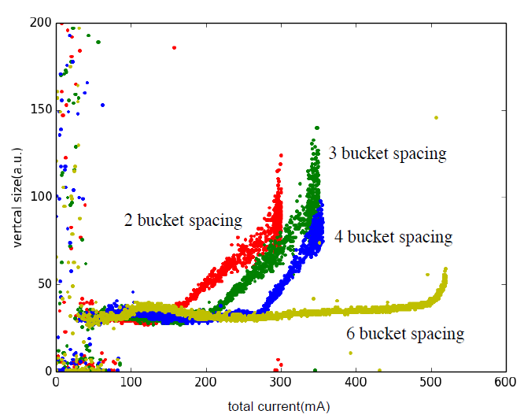
Beam size blow-up in LER
Beam-size blowup observed in KEKB has been seen in early stage of SuperKEKB commissioning
Threshold I~300mA in Apr 19 (Y. Funakoshi)
Electron cloud has been monitored at AL chamber w and w/o TiN coating (Y. Suetsugu).
Beast study threshold I~600mA, N_{bunch}=1576 in May 17 (Nakayama et al)
Systematic study in 1 June ( H. Fukuma et al.)
Permanent magnets are set at aluminum bellows.(Y. Suetsugu et al.)
Systematic studies in 8 July ( H. Fukuma et al.)
June 1, 2016
4 train x150 bunches, N_{bunch}=600
Threshold beam current
160, 200, 260,500 mA for 2, 3, 4, 6 bucket spacing
H. Fukuma et al.,

Slide 4
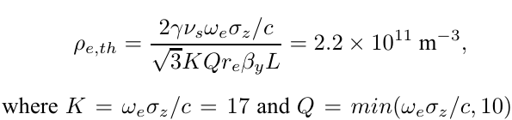
Instability simulation at SuperKEKB design stage
Using code PEHTS
ρ_{e}=4.2x10¹¹ at 4000-th turn
Simulation, ρ_{eth}=3.8x10¹¹ m⁻³.
Design target for vacuum system: ρ_{e}<10¹¹ m⁻³ in average of whole ring

Slide 5
Simulation studies using beam study condition
Threshold of the electron density
ε_{x}=2nm, ε_{y}=15pm, σ_{z} =6mm, ν_{s}=0.019
Np=1.6x10¹⁰ I_{th}=160mA, 4ns spacing
Np=2.7x10¹⁰
I_{th}=260mA, 8ns spacing
Np=2.1x10¹⁰, ε_{y}=100pm
Np=2.4x10¹⁰, ε_{y}=100pm
Np=2.1x10¹⁰
I_{th}=200mA, 6ns spacing
Np=5.2x10¹⁰
I_{th}=500mA, 8ns spacing

Slide 6
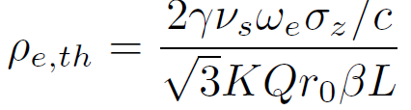
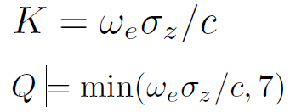
Simulated threshold electron density (condition before solenoid installation)
N_{b}=600, ε_{x}=2nm, ε_{y}=15pm, σ_{z} =6mm, ν_{s}=0.019
spacing | I_{p,th} (mA) | N_{p,th} (10¹⁰) | ω_{e}/2π (GHz) | ω_{e}σ_{z}/c | ρ_{eth} (Q=10) (10¹¹m⁻³) | ρ_{eth} (Q=6) (10¹¹m⁻³) | ρ_{eth} (Simu) (10¹¹m⁻³)
2 (4ns) | 160 | 1.6 | 61 | 7.7 | 1.91 | 2.45 | 3.4
3 (6ns) | 200 | 2.1 | 71 | 8.9 | 1.65 | 2.45 | 3.4
4 (8ns) | 260 | 2.7 | 80 | 10.1 | 1.47 | 2.45 | 3.8
6 (12ns) | 500 | 5.2 | 111 | 14.0 | 1.47 | 2.45 | 5.0
3.06 | 500 | 2.0 | 37 | 5.5 | 2.89 | 2.90 | 4.4
3.06 | 600 | 2.4 | 41 | 6.0 | 2.63 | 2.65 | 4.4
N_{b}=1576, ε_{y}=100pm
6

Slide 7
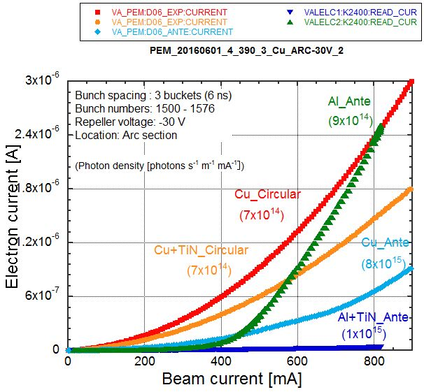
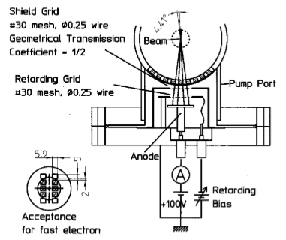
Electron cloud measurement
Retarding bias, V=500V or 0V, select electrons with E>500eV or all, respectively.
Electron E=500eV, v=1.3x10⁷m/s. R/v=3.8ns, R=5cm, density can be estimated considering volume with energy gain 500eV from a bunch. 500eV may be critical for 2 (4ns) spacing.
For V=0V, electron rate production including secondary is detected.

Slide 8
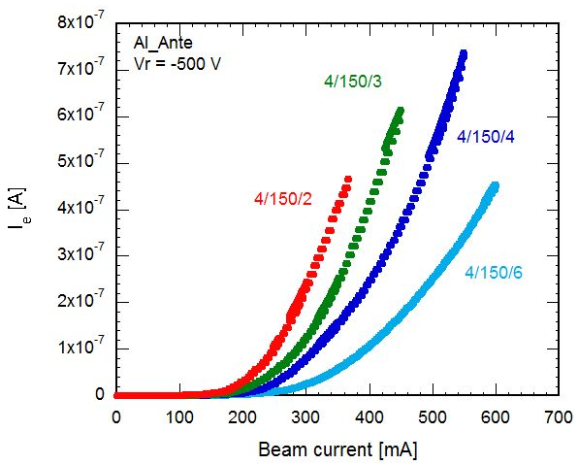
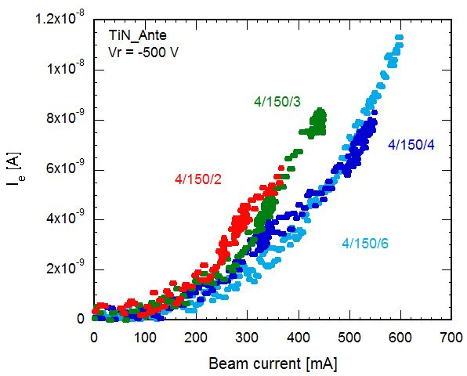
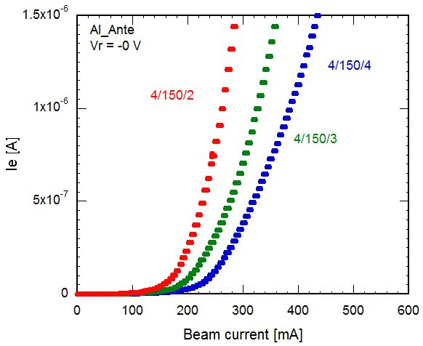
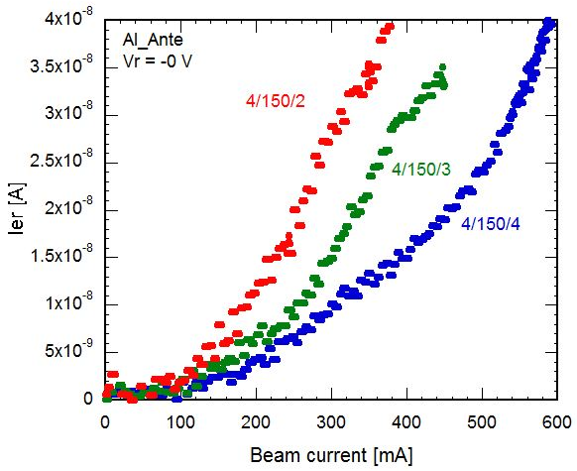
Measured electron current
Y. Suetsugu
Vr = -500 V
Vr = -500 V
Al部分
Al wo coating
Al w TiN coating
Vr = 0 V
Vr = 0 V
Al wo coating
Al w TiN coating
For V=0V, 1μA, electron production rate is 0.3x10⁹ m⁻¹/bunch

Slide 9
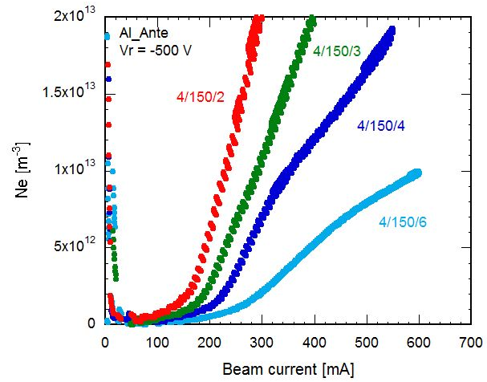
Electron density at the blow-up threshold
Simulated electron density at the threshold current
Measured threshold current and density
Only Al part
Simple formula Q=6

Slide 10
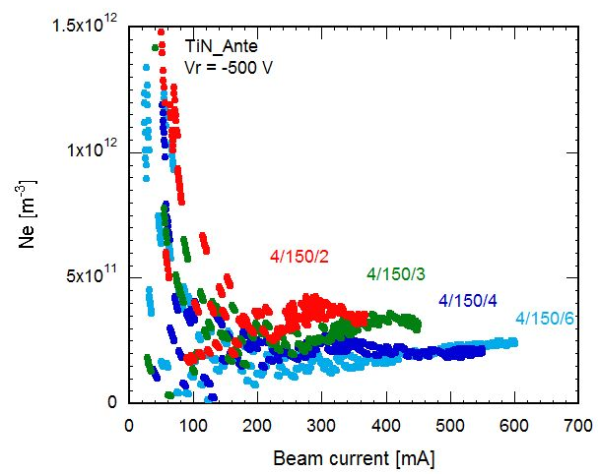
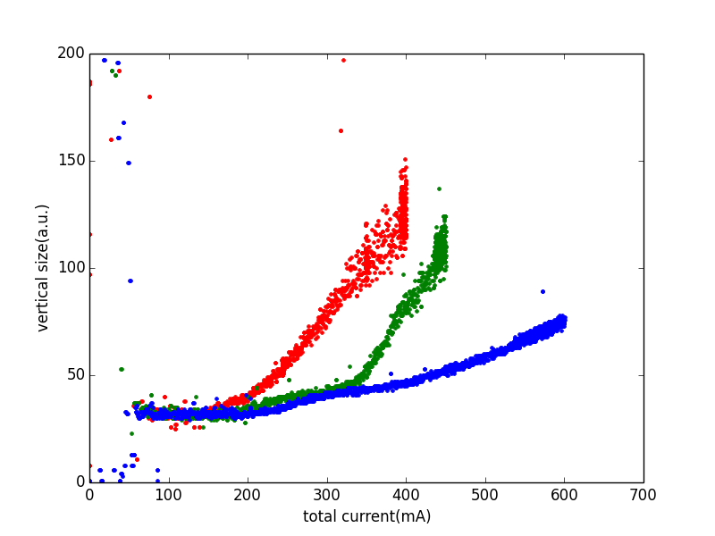
After installation of permanent solenoid at Al bellows
Simulated electron density at the threshold current
2016/6/8
I_{th}=200 mA
I_{th}=330 mA
4/150/2
4/150/3
4/150/4
I_{th}>600 mA
Simple formula Q=6

Slide 11
Threshold of electron cloud density after solenoid attach
spacing | I_{p,th} (mA) | N_{p,th} (10¹⁰) | ω_{e}/2π (GHz) | ω_{e}σ_{z}/c | ρ_{eth} (Q=10) (10¹¹m⁻³) | ρ_{eth} (Q=6) (10¹¹m⁻³) | ρ_{eth} (Simu) (10¹¹m⁻³)
2 (4ns) | 200 | 2.1 | 71 | 8.9 | 1.65 | 2.45 | 3.4
3 (6ns) | 330 | 3.5 | 91 | 11.5 |  | 2.45 | 4.8
4 (8ns) | >600 | >6.3
6 (12ns)
3.06 | 500 | 2.0 | 37 | 5.5 | 2.89 | 2.90 | 4.4
3.06 | 600 | 2.4 | 41 | 6.0 | 2.63 | 2.65 | 4.4

Slide 12
Simulated electron cloud build up in Drift
Np=2.5x10¹⁰, I=240 mA for N_{b}=150x4=600
Np=4x10¹⁰, I=380 mA for N_{b}=600
ρ_{e}(r=0)~λ_{e}x1000
Np=9.4x10¹⁰, I=900 mA for N_{b}=600
Beam current: Slightly higher than measured threshold
I_{th}=330 mA
2016/6/8
I_{th}=200 mA
4/150/3
4/150/4
4/150/2
I_{th}>600 mA
Y₁=Photon numberx0.1x0.01

Slide 13
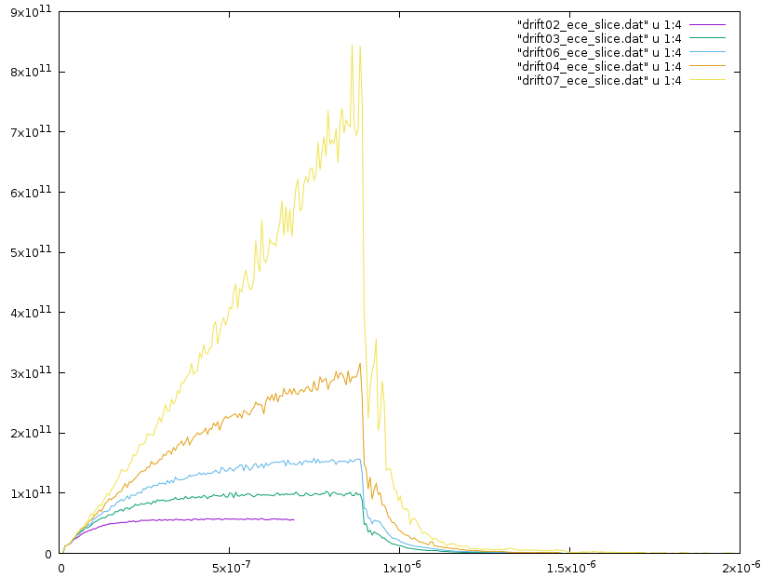
E cloud buildup
CLOUDLAND, Fukuma
δmax=1.5
Np=3.13x10¹⁰,
Density R<4mm
Y₁=Photon numberx0.1x0.01
quantum eff. antechamber
electron density near beam(m⁻³)
δmax=1.4
δmax=1.3
δmax=1.2
δmax=1.0
計算を打ち切った。
t(sec)

Slide 14
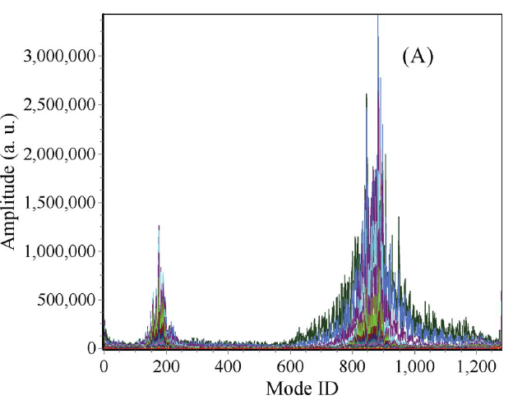
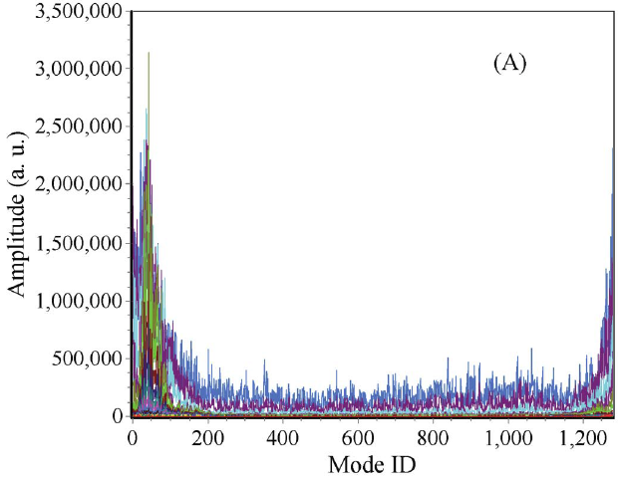
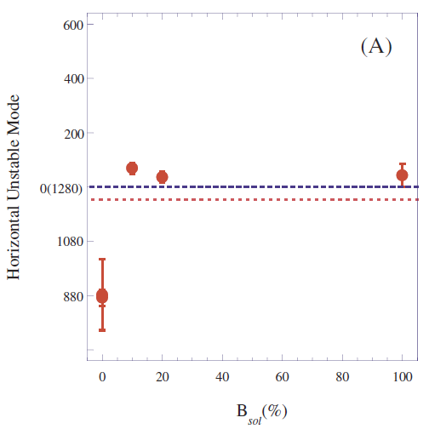
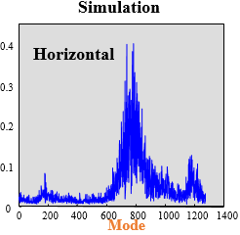
Coupled bunch instability caused by electron cloud
Electron cloud motion reflects coupled bunch instability mode.
Electrons in drift, short range wake ~10ns
Electrons in solenoid, slow rotation around chamber surface.
KEKB
400 f₀
1000 f₀

Slide 15
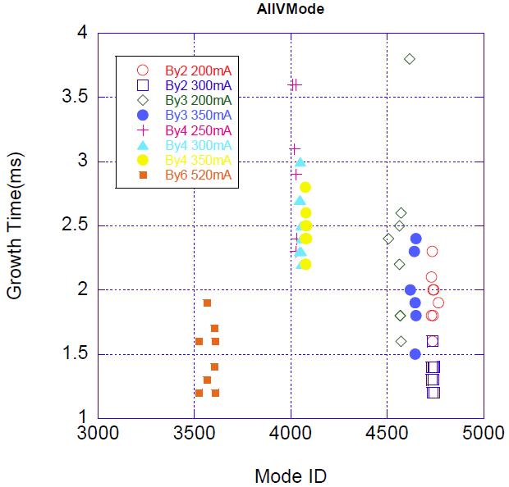
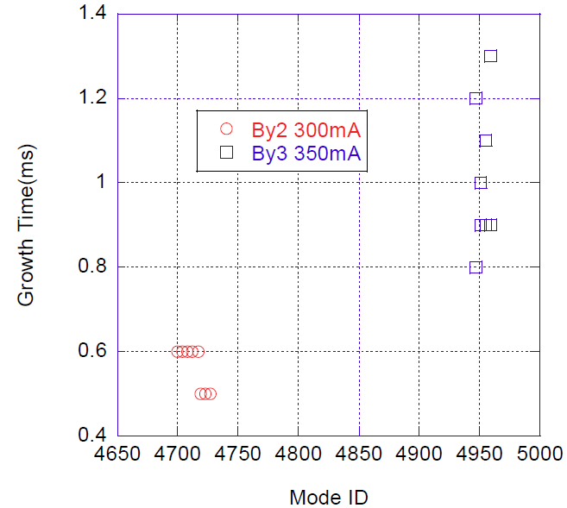
Unstable mode (before solenoid installation)
M. Tobiyama
Typical signal of coupled bunch instability caused by drift electrons
1000 f₀
400 f₀
Fast, strong
400 f₀

Slide 16
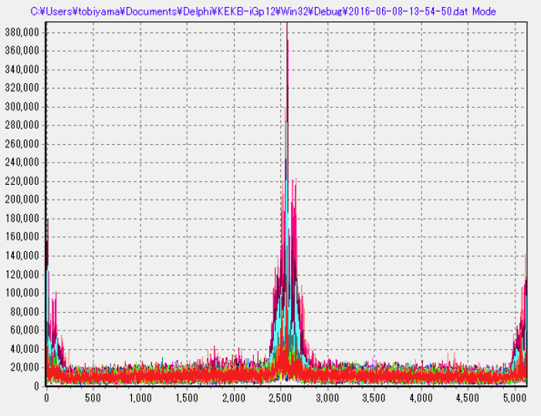
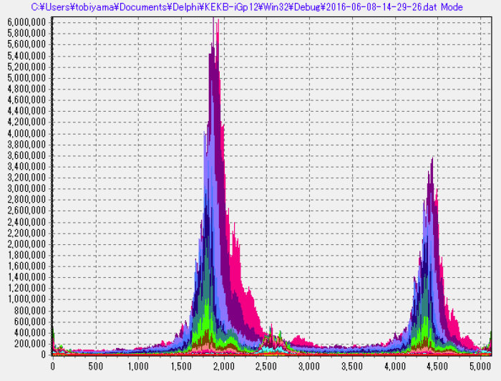
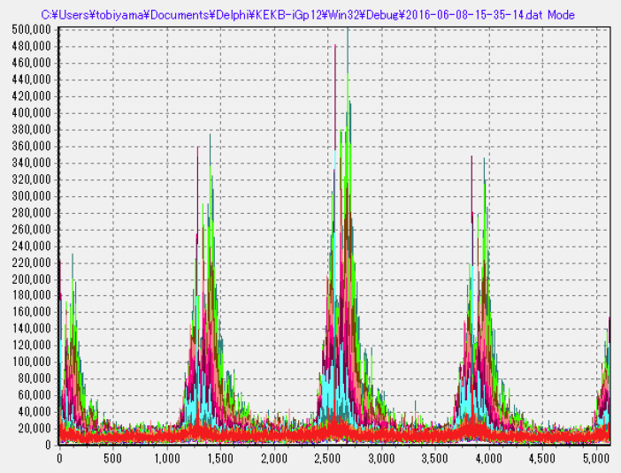
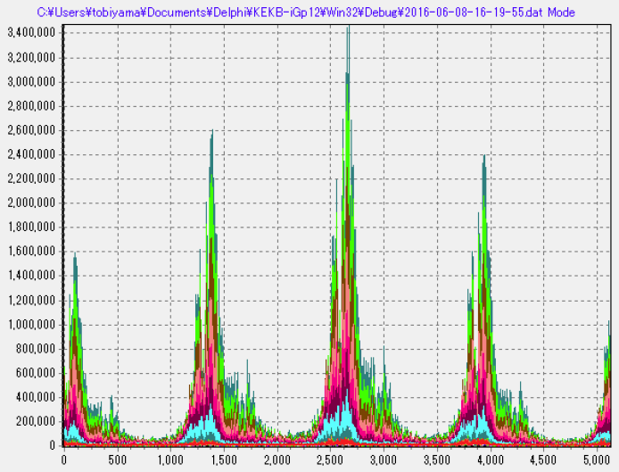
Mode spectrum
By 2 ver 300mA 400mA
By 4 ver 350mA 600mA
Solenoid origin
Drift origin
Solenoid origin
Solenoid origin

Slide 17
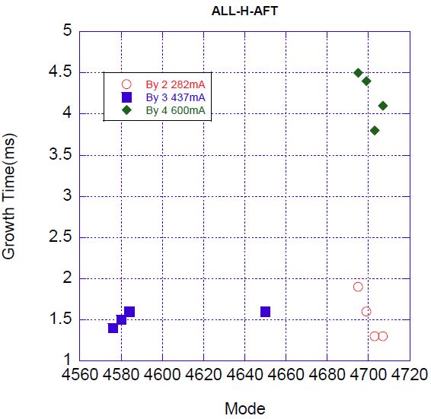
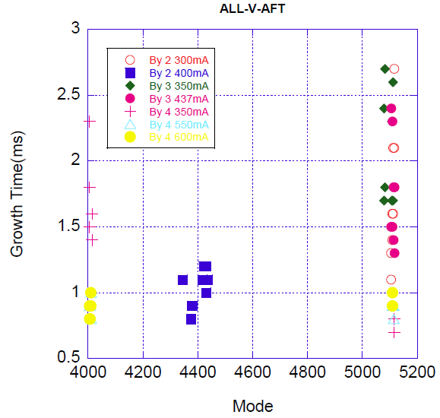
Unstable mode (after solenoid installation)
Typical mode caused by electrons in solenoid is seen.
Mode seems to change to those of drift origin at high current.
Solenoid modes
400 f₀
540 f₀
700 f₀
Fast, strong

Slide 18
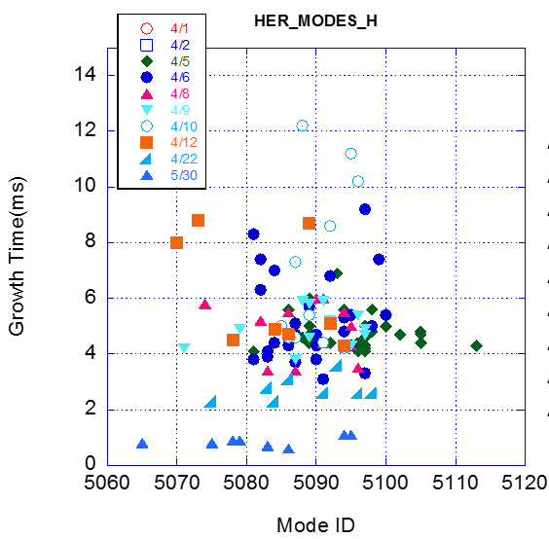
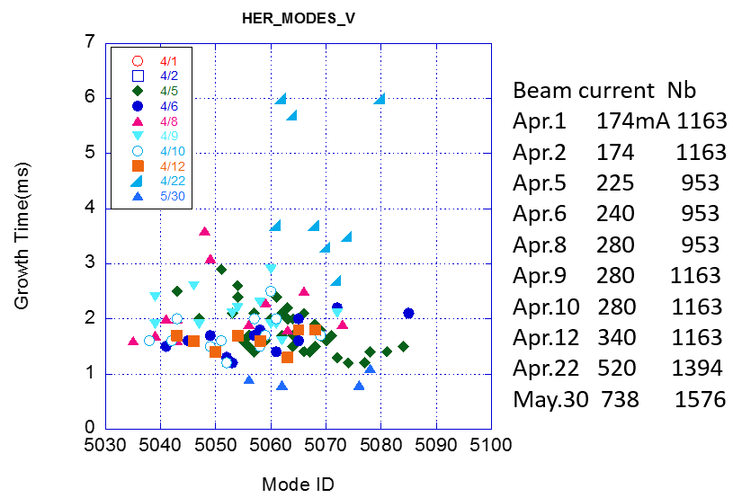



Coupled bunch instability in electron ring (HER)
M. Tobiyama
Ion?
Fast, strong
$$Mode=5120−\frac{ω_{i,xy}}{ω_{0}}$$
CO
Resistive wall
5120-1=5119

Slide 19



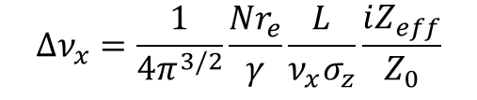

Impedance estimation- transverse
Tune shift as function of bunch current
$$Δν_{x}=\frac{1}{4π^{3/2}}\frac{Nr_{e}}{γ}\frac{L}{ν_{x}σ_{z}}\frac{iZ_{eff}}{Z_{0}}$$
$$iZ_{eff}(kΩ)=33.3\frac{Δν_{x}}{I(mA)}$$
$$=58.2\frac{Δν_{x}}{I(mA)}$$
LER
HER
$$iZ_{eff}=31 \left(x\right) 53 \left(y\right) kΩ/m$$
$$iZ_{eff}=43 \left(x\right) 145 \left(y\right) kΩ/m$$
LER x
Collimator dependence
HER y
KEKB-LER: -0.0034mA⁻¹, 81kΩ/m
coll. open 33-46 kΩ/m T. Ieiri, EPAC00

Slide 20
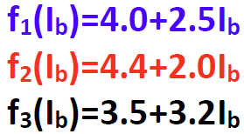
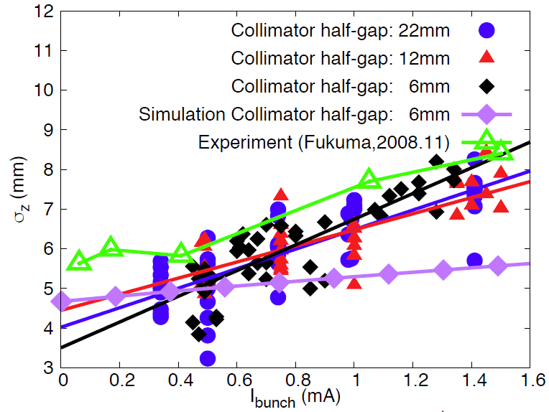
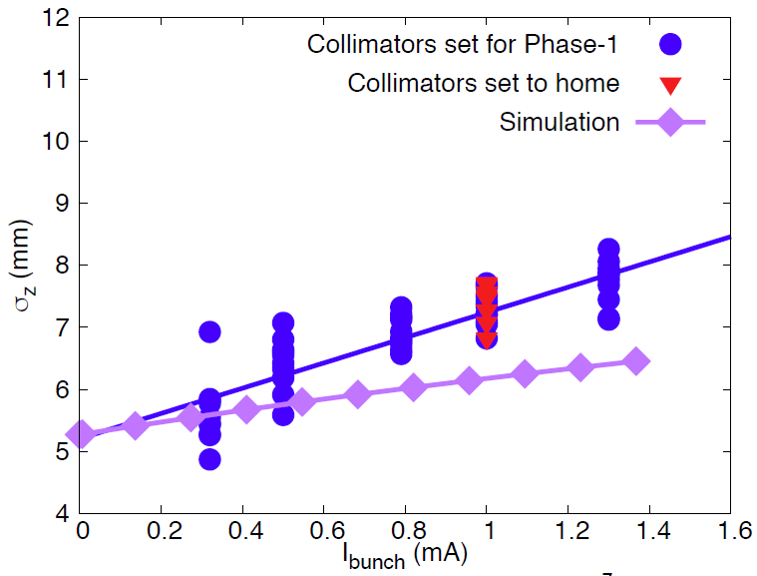

Longitudinal impedance issue-Bunch length measurement
L
Measured by a Streak camera
The behaviors are similar as KEKB for both of LER and HER.
Bunch lengthening is stronger than that of simulation.

Slide 21
Summary
Beam size blow-up has been observed since early stage of SuperKEKB commissioning.
Electron density at Al bellows part (5% of circumf.) is high (ρ_{e}>10¹²m⁻³). Simulations show the electrons can cause fast head-tail instability.
Coupled bunch instability caused by electron cloud has also been observed as is predicted.
Installation of Permanent solenoid reduced the blow up. It is possible to operate with 1A, 4 bucket spacing at present condition.
Tune shift as function of bunch current was measured to estimate transverse impedance. It was 30-50kΩ/m, similar as KEKB.
Bunch length was measured by a streak camera. Bunch lengthening, which was similar as KEKB, was observed, 7-8 mm at the design current, while no bunch lengthening in prediction.

Slide 22
Thank you for your attention

Slide 23


Rough estimation of Electron density
Electron current, I_{e}=1μA.
Acceptance of the electron detector, S_{mon}=1 cm².
Number of electron absorbed (=produced) at chamber wall, d=10cm.
Electron stay time in the chamber, τ_{e}=100ns. Electron density
$$n_{e}=\frac{{10}^{−6}×0.1π}{1.6×{10}^{−19}×{10}^{−4}}=2×{10}^{16} m^{−1}s^{−1}$$
$$ρ_{e}=\frac{2×{10}^{16}×{10}^{−7}}{{0.05}^{2}π}=2.5×{10}^{11} m^{−3}$$

Slide 24
Emittance dependence
Vertical emittance knob
β_{y}=67m

Slide 25
Design current & spacing
Np=9.4x10¹⁰, I=3600 mA

Slide 26
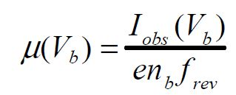
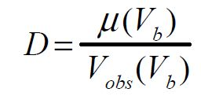
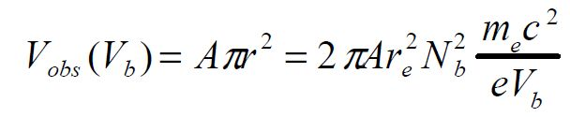
金澤氏の式を使った電子密度の算出*
＊PAC2005, p.1054
e = 1.602E-19 [C]
f_{rev} = 1E5 [s⁻¹]
r_{e} = 2.818E-15 [m]
m_{e} = 9.109E-31 [kg]
c = 3.0E8 [ms⁻¹]
n_{b} = バンチ数
πA = 通過確率 = 0.0003x1/4 = 7.5E-5
V_{b} = グリッド電圧 [V]
N_{b} = バンチ内のe⁺の数
N_{b} =
I
n_{b}f_{rev}e
I = ビーム電流 [A]
まとめると、
I_{obs}n_{b}V_{b}
D = 2.630E13 x
I²
例えば、2/150/3 V_{r} = -30 V, I = 200 mA, I_{obs} = 1E-7 A の場合 (平均で)
n_{b} = 600, V_{b} = 30
D = 1.18E12 [e⁻ m⁻³]

Slide 27
Simulated electron cloud build up in Bend
Np=2.5x10¹⁰, I=240 mA for N_{b}=600
Np=4x10¹⁰, I=380 mA
bucket
bucket
Np=9.4x10¹⁰, I=900 mA
I_{th}=200 mA
4/150/2
I_{th}=330 mA
4/150/3
4/150/4
I_{th}>600 mA
bucket
Multipactoring arises Y_{2max}>=1.5 at the threshold beam currents.

Slide 28
KEKB
Solenoid-Off
4
Experiment
Simulation
5
x 10
Horizontal
0.4
Horizontal
4
3
0.3
2
0.2
1
0.1
0
0
200
400
600
800
1000
1200
1400
0
0
200
400
600
800
1000
1200
1400
Mode
Mode
x 10
3
Vertical
3
1.2
Vertical
2
0.8
1
0.4
0
0
200
400
600
800
1000
1200
1400
0
Mode
0
200
400
600
800
1000
1200
1400
Mode
Su Su Win et al,(EC2002)

