Slide 1
Ring magnet system —Power supplies—
T. Oki
T. Adachi
T. Kawamoto
S. Nakamura
21th KEKB Accelerator Review Committee

Slide 2
List of Magnet power supplies
Newly fabricated or old power supplies for Main Ring
Output power | Newly fabricated PS | Reused PS (#overhauled)
0.95 MW | 2 | 0 | Main dipoles
0.4-1 MW | 9 | 0 | Wigglers
0.1-0.5 MW | 0 | 18# | Main quadrupoles
2-105 kW | 92 | 335# | Bend./Quad./Sext.
0.3-2.4 kW | 138 | 1681 | Steering magnets/ corrector coils
Total | 359 | 2034
・ Newly fabricated or to be fabricated (*) QCS power supplies
2kA, 15V | 2+6* | 0 | QCS Main quads.
<500 A, 20 V | 3* | 0 | QCS Solenoids
±70A, ±10V | 45 | 0 | QCS correction coils

Slide 3
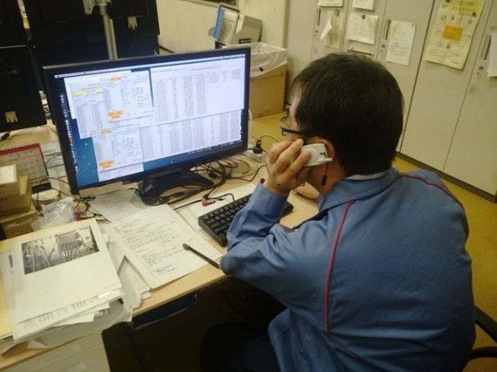
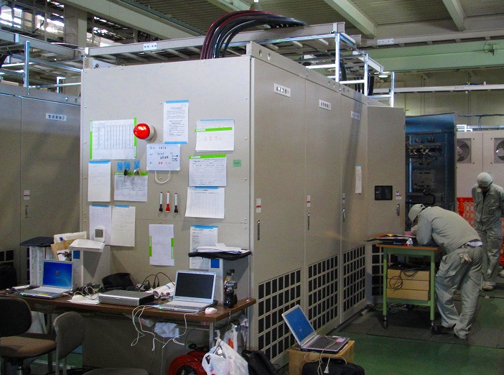
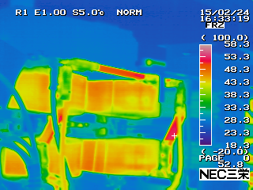
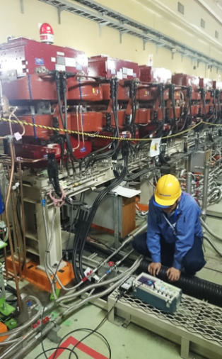
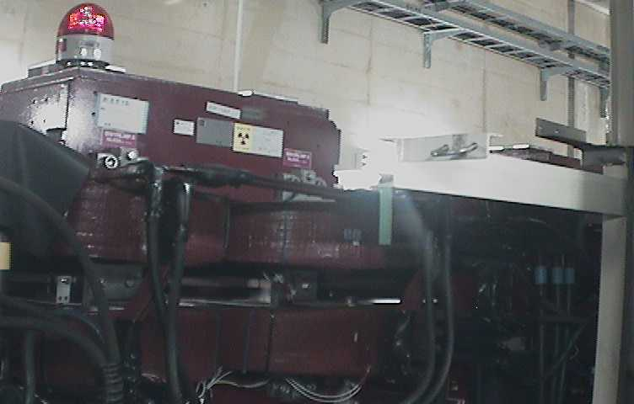
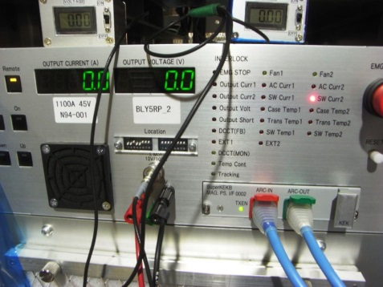
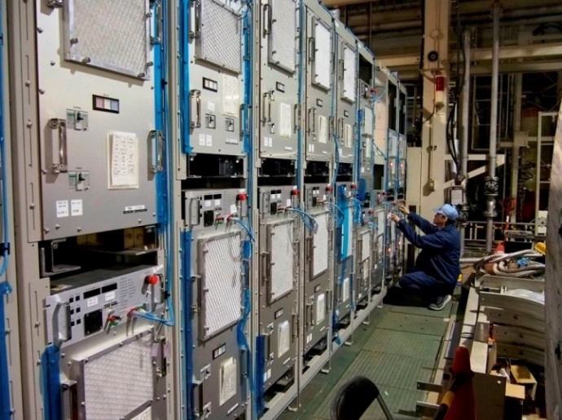
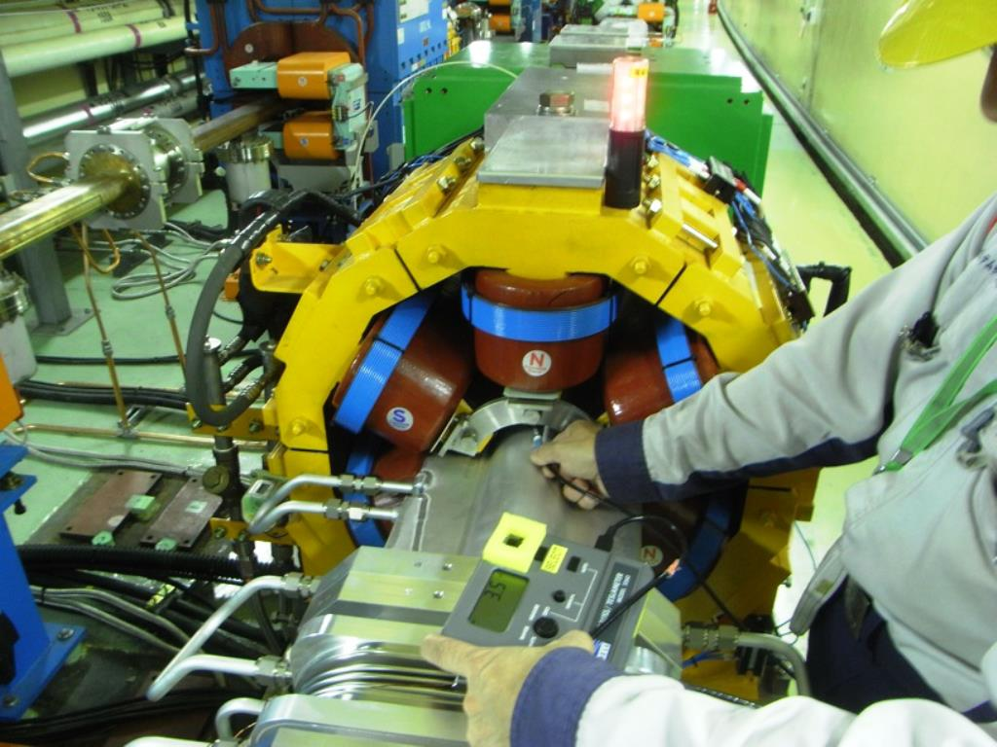
Start up: system check and full power load test
Full-scale start-up tasks such as network test, interlock system test, full power load test, cable connection check to avoid abnormal heating, polarity check, magnet standardization test and so on were completed before Feb.8 beam injection to the MR.

Slide 4
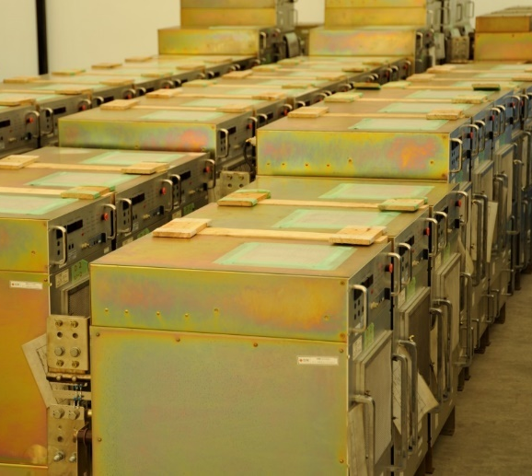
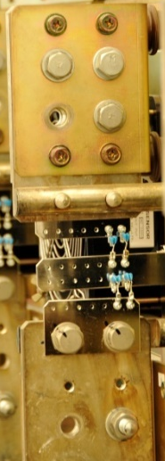
Test example 1/2 —switching noise
Old medium-class power supplies were overhauled. Replacement of chemical capacitors, AC-DC converters, circuit breakers and IGBTs was performed.
In order to reduce switching noise, ceramic capacitors are added at the output terminal. Switching noise is reduced to 1/20.
Ceramic capacitors
W/O capacitor
W/ 1 μF capacitor
V_{P}
V_{N}
V_{P}
V_{N}
5 V/div
0.1 V/div
10 μs/div
10 μs/div

Slide 5
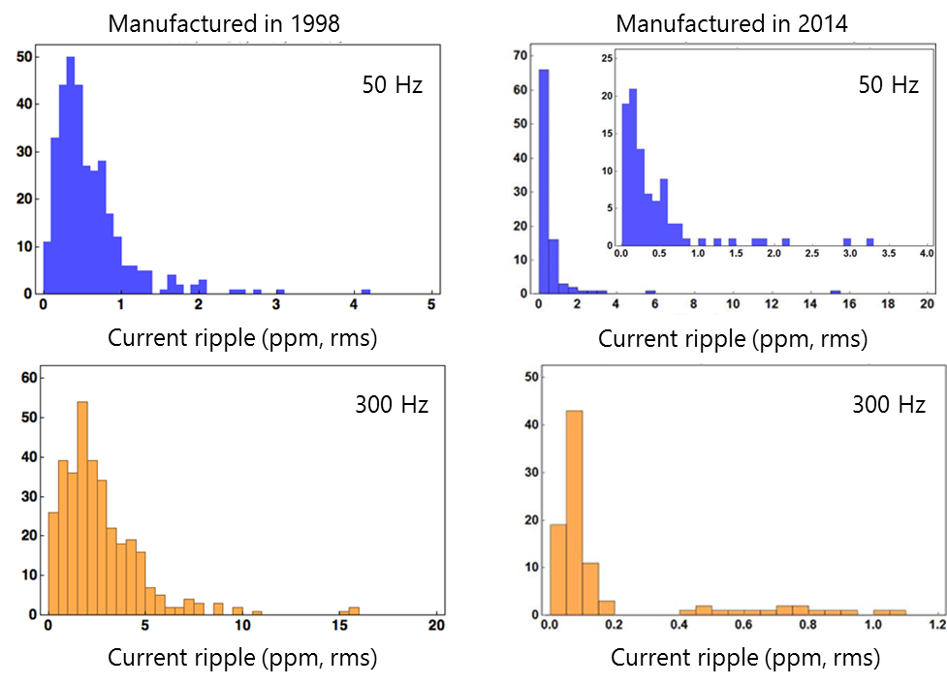
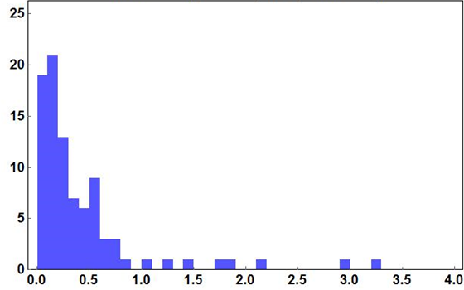
Test example 2/2 —ripples
Newly fabricated medium class power supplies were designed to be lower current ripples. Histograms of current ripples are compared with the results of old (overhauled) power supply.
Overhauled 335 of old PS
Newly fabricated 92 of PS
1 ppm
0.6 ppm
50 Hz
#of PS’s
5 ppm
0.2 ppm
#of PS’s

Slide 6
First Commissioning in Phase 1
Magnet power supply system works well except for following failures occurred up to now.
Failures in Large class PS | # of event | comment
AC input over current | 3 | AC distortion (RF system crowbar work)
AC input over current | 6 | AC distortion (VAR system# work in line facility)
AC input Stop, CB Fault | 2 | Earthquake
Failures in Medium class PS | # of event | comment
Thermostat | 4 | Thermal control equipment was repaired.
Over current (IGBT modules) | 2 | Modules were replaced. Repaired.
Cable GND fault | 1 | The fault cable was disconnected.
Tracking error | 1 | Fault in the polarity inversion circuit. Repaired.
Failures in small class PS | # of event | comment
DC-DC board failure Output over voltage etc. | 17 | Power supplies themselves were replaced.
#) Compensation system for a reactive power in the AC power distribution facility. AC line phase-advancing capacitor equipment was automatically controlled. However, unexpected operation occurred in early stage of Phase 1. Since capacitors has been manually operated, failures doesn't occur.

Slide 7
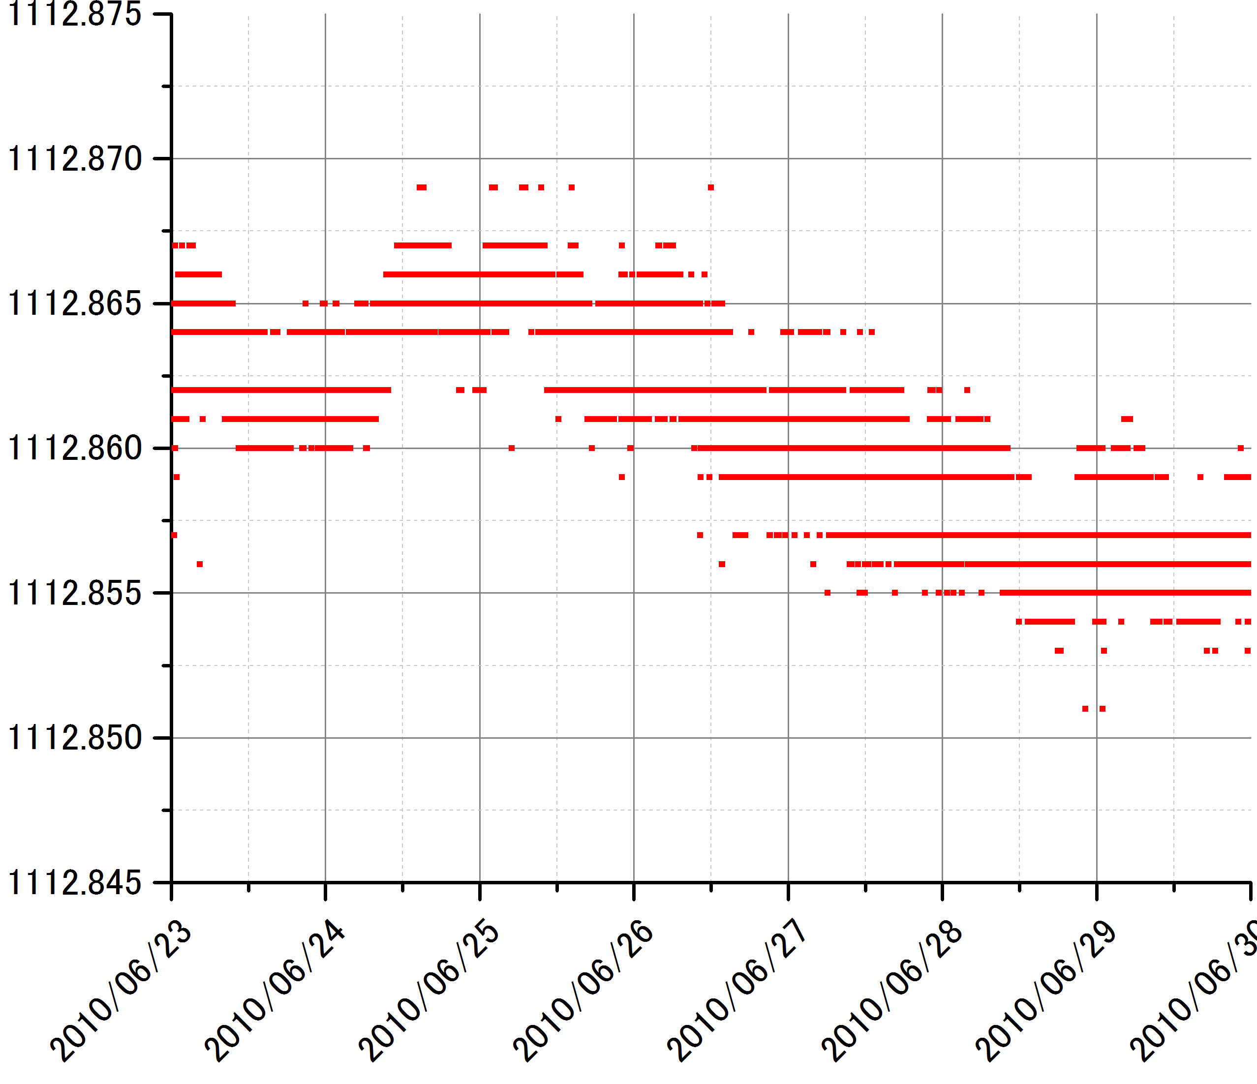
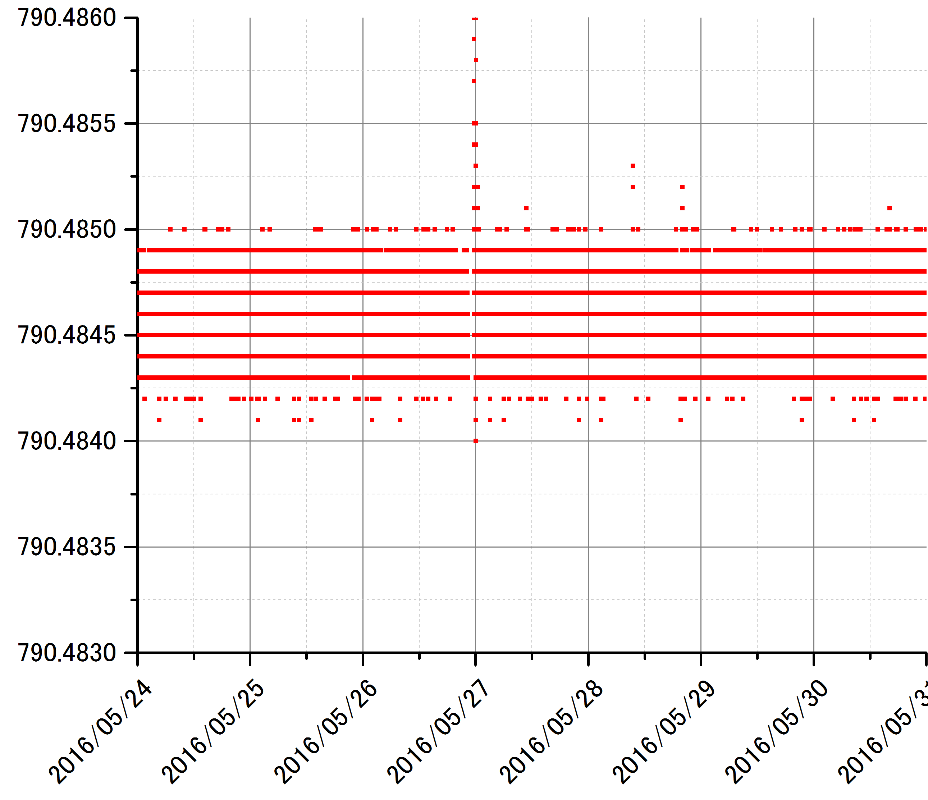
First Commissioning in Phase 1-cont.
standardization
How the system works well? Current stability of Main dipole magnet power supply is compared with one of KEKB.
KEKB (1250 A, 770 V)
SuperKEKB (860 A, 1100 V)
5 mA
0.5 mA
standardization
~20 ppm(p-p)/week
1.3 ppm(p-p)/week
1 week
1 week

Slide 8
Two prompt contributions to Phase 1 commissioning
As Funakoshi-san and Sugimoto-san reported: in order to compensate a leak field of a lambertson magnet, additional coils of SX and skew Q magnet were wound/ applied for this purpose.
As Funakoshi-san and Suetsugu-san reported: Solenoid coils were tentatively wound over LER vacuum chamber by vac. group, and small class power supplies also support to drive it.
Shift report (April. 8)
Y. Suetsugu (IPAC16)

Slide 9
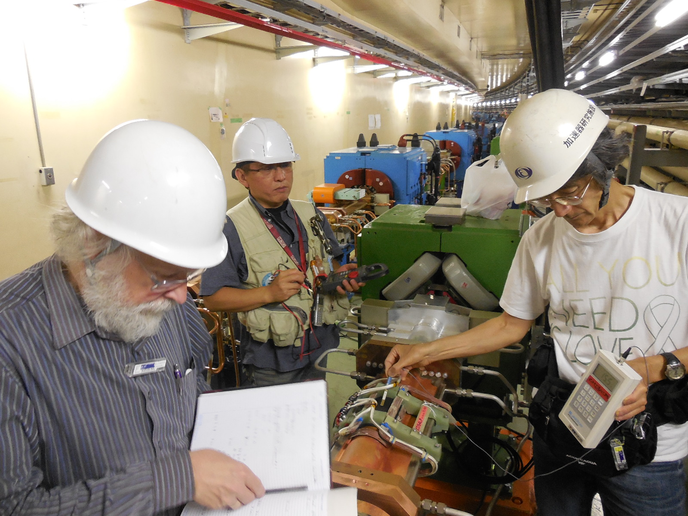
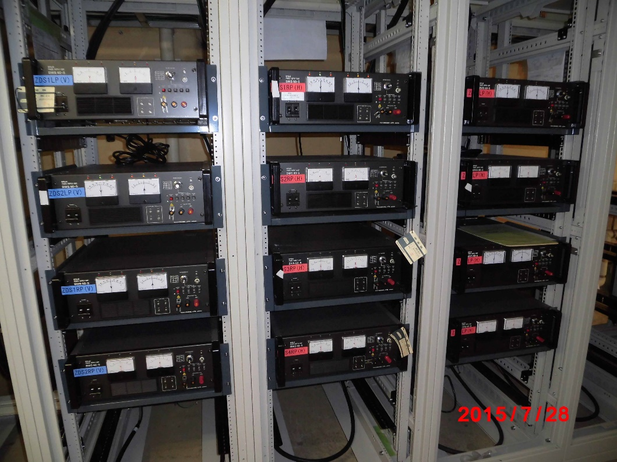
Preparations for Phase 2: IP collision feedback system
SLAC Dithering coils for IP horizontal collision feedback system were installed.
Power supplies were also installed, and cabling for the coils were completed. Magnetic polarity check was done.
Coil installation was performed with U. Wienands, SLAC.

Slide 10
Preparations for Phase 2: QCS power supply system
Many works are in progress to be ready for the QCS operation, which starts in Nov. 2016 for L-side or Feb. 2017 for R-side.
Power supplies
Prototype power supply for both of main and corrector coils was developed. Mass production and fabrication of anti-solenoid PS’s has been carried out.
Cabling
Cable laying work from PS building to IR was completed. Work for the connection of the cables to PS’s or QCS is planed in this summer.
Facility for power supply
AC power distribution board and water cooling system has been designed. These will be ready by the end of this Oct.
Interlock/monitor system
PLC system has been fabricated, and will be derived by the end of this July.

Slide 11
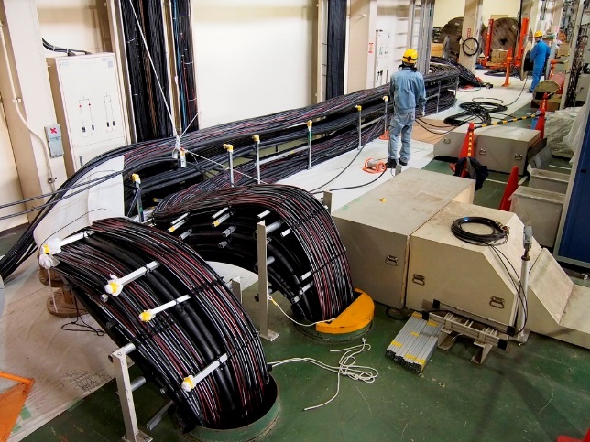
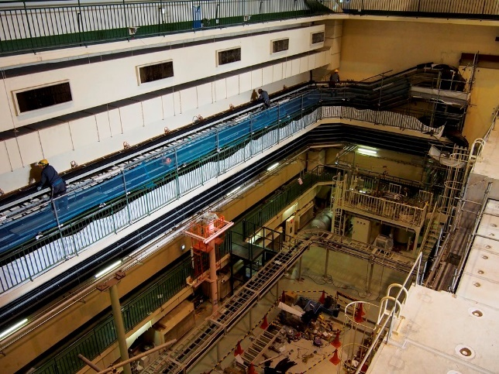
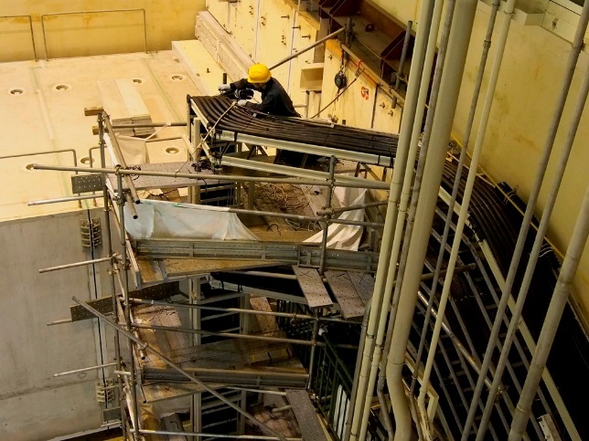
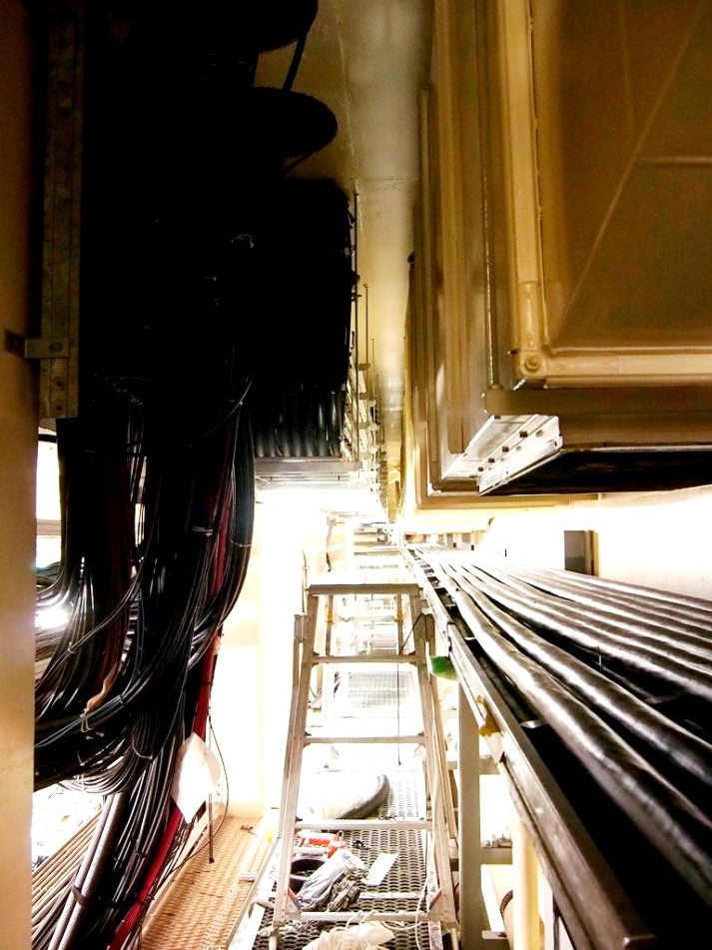
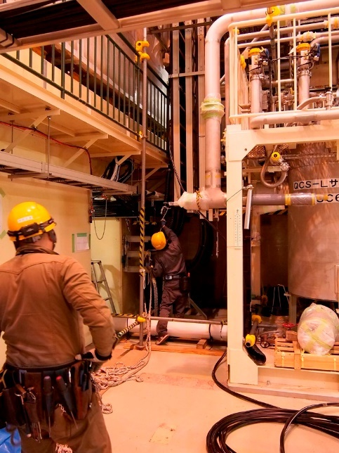
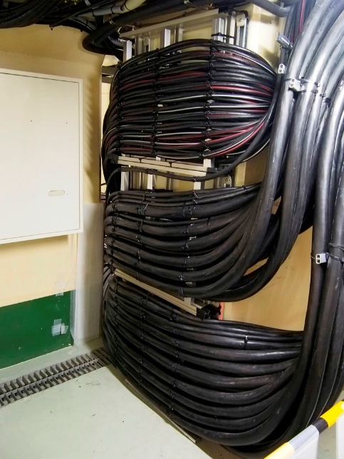
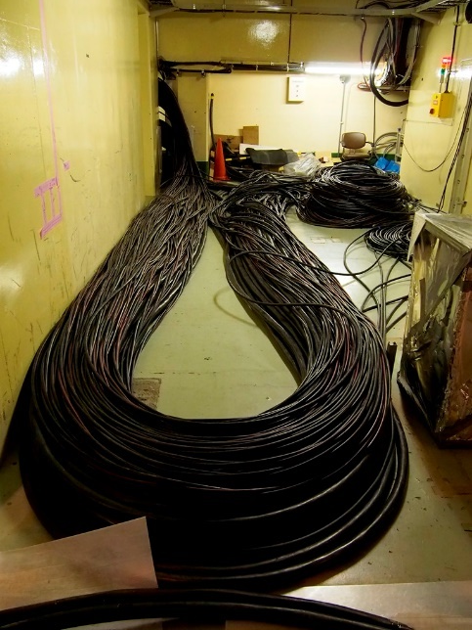
Cables were laid from PS building…
QCS cable laying work
and cable rack to the interaction region…
through vertical shafts…
Cables to be connected with QCS magnets

Slide 12
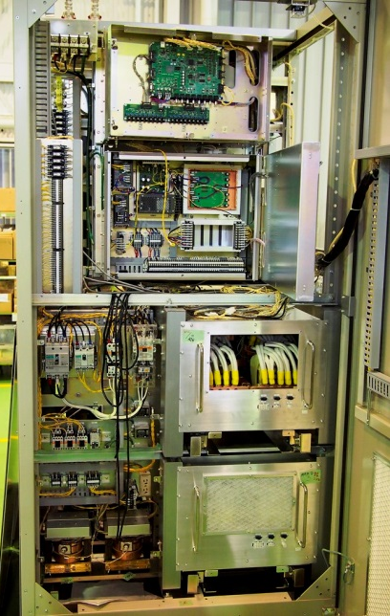
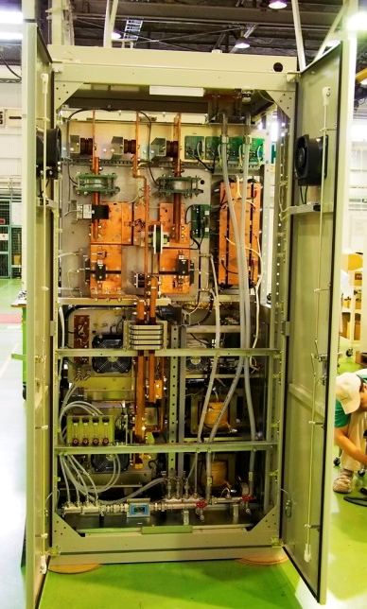
A full-scale prototype of QCS power supply
Aiming spec.
Rated output | DC 2 kA, 10 V
Current setting resolution | < 0.1 ppm
Current stability | < 2 ppm/8 hrs.
Current ripple (< 10kHz) | < 1 ppm (rms)
Current noise (> 10kHz) | < 1 ppm (0-peak)
(1) For low ripple and noise: Symmetric structure
DCCTs on both output terminals.
Symmetric circuit structure with respect to ground.
Shielded high-frequency transformer

Slide 13
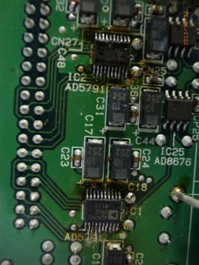
Digital feedback control for QCS power supply
(2) For high stability: Digital feedback with 24-bit control board
24-bit control board
Major setting value (20 bits)
+
+
DAC
+
-
-
Minor setting value (4 bits)
+
1/2⁴
DAC
-
Analog current control loop
Two 20bit DACs
(AD5791)
Error
Digital feedback loop
8.5-digit DMM
1/2
+
Output terminal
N
P
DCCT(N)
1/2
DCCT(P)

Slide 14
Temp. coefficients of the system
0.125 ppm/K (AD5791 DAC with Buffer amps.)
0.3 ppm/K (Keithley 2002)
1.5 ppm/K (TOPACC) (or 0.5 ppm/K (TOPACC optional))
---------
Total: 1.925 ppm/K
Constant climate chamber keeps temp. within 0.2 deg.
→ 0.385 ppm for 0.2 deg

Slide 15
Test result of the digital feedback system
Performed by using a medium-class power supply (15 V, 500 A).
Digital feedback loop well corrects DAC input by 24bit resolution
Output current measured by DCCT (0.25 mA/div)
1 hour
1.9 ppm
Test result of QCS prototype: 1.9 ppm (p-p)/8 hrs.
Ripple, noise, quench protection test, etc :OK.
→Mass production has been carried out.
8 hrs.

Slide 16
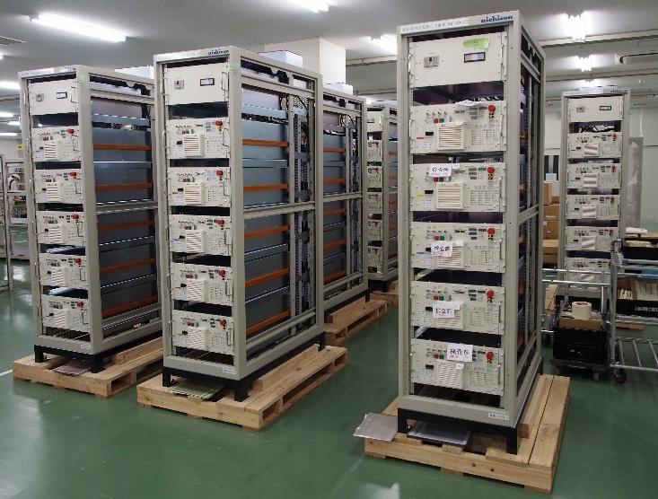
QCS corrector power supply
45 of QCS corrector power supplies was fabricated.
Rated output | DC ± 70 A, 10 V
Current setting resolution | < 1 ppm
Current stability | < 5 ppm/8 hrs.
Current ripple (< 10kHz) | < 5 ppm (rms)
Current noise (> 10kHz) | < 5 ppm (0-peak)
Test results: Stability 2.1 ppm/24 hrs. with temp. coeff. of 0.6 ppm/℃
24 hrs.
12.34 ppm
20.5 ℃
Ripple, noise, quench protection test and so on: also OK.

Slide 17
Summary
Magnet power supply system was integrated and finished before Phase 1. Where the full-scale start-up tasks were completed.
In the full-scale load test, both the old and newly fabricated medium-class power supplies showed low ripple and low noise characteristic, successfully.
Magnet power supply system has been worked well during Phase 1 commissioning except for several minor failures. The current stability of main dipole power supply should be remarkably mentioned.
Preparations for Phase 2 have been in progress. Dithering coils for the IP collision feedback system and power supplies have been already installed.
For the QCS system, many works are in progress to be ready for the QCS operation, which starts in Nov. 2016 for L-side or Feb. 2017 for R-side.

