Slide 1
Injector Commissioning
(Phase I & II)
Masanori Satoh
(Accelerator Laboratory, KEK)
for Linac Commissioning Group
The 21th KEKB Accelerator Review Committee, June 13-15, 2016

Slide 2
Contents
Injector overview
Requirements for SKEKB injector
  Operation scheme
  Low emittance preservation
  Simultaneous top-up injection
Recent results of injector commissioning
Summary and plan

Slide 3
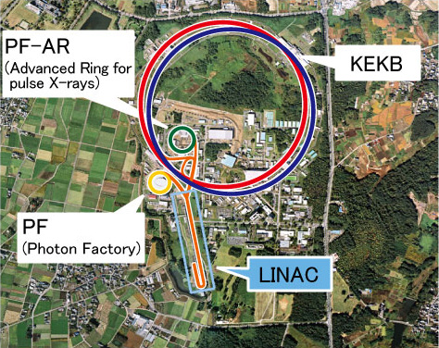
Injector overview
Injector linac
  Provide e-/e+ for 4 independent storage rings
  600-m-long, 25 Hz (Max. rep. 50 Hz)
  Two bunch operation (96 ns interval)
SuperKEKB
  HER: 7 GeV, 1 nC
  LER: 4 GeV, 1 nC
    Damping ring: 1.1 GeV
Two light sources:
  PF: e-, 2.5 GeV, 0.3 nC
    three times daily injection or top-up
  PF-AR: e-, 3 GeV, 0.3 nC
    three times daily injection

Slide 4
Requirements for SKEKB injector
Low emittance e-/e+ beam:
  e-: 1 nC, 300 mm⋅mrad (KEKB) => 5 nC, 50 (H)/20 (V) mm⋅mrad (Phase III)
  e+: 1 nC, 1500 mm⋅mrad (KEKB) => 4 nC, 100 (H)/20 (V) mm⋅mrad (Phase III)
  (*) 1 nC (w/o low emittance) for Phase I, 2 nC (w/ low emittance) for Phase II
  Low emittance photocathode rf gun. DR for e+. Fine component alignment (0.1 mm – 0.3 mm (σ)). Precise beam orbit measurement and control for low emittance preservation.
High intensity e+:
  Flux concentrator, Large aperture S-band accelerating structure
Event based timing system (bucket selection for DR/MR)
Fast rf monitor, high precision BPM readout, pulsed quads and steering magnets.
Simultaneous top-up injection (short beam life time (～ 6 min.))
  SKEKB HER/LER (+ damping ring), PF, and PF-AR

Slide 5
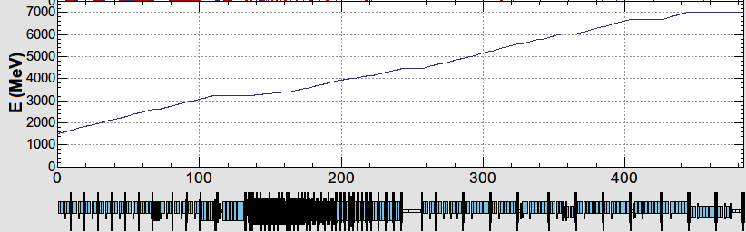
Operation scheme
10 nC x 2 bunches x 50 Hz (SuperKEKB e+)
5 (1) nC x 2 bunches x 50 Hz (SuperKEKB e-)
5 nC (0.3) x 1 bunch x 5 (25) Hz (PF-AR)
0.3 nC x 1 bunch x 25 Hz (PF)
B
A
e-/e+ beams are delivered to 4-rings with different bunch charge and energy.
Beam acceleration modes must be switched by 50 Hz pulse-by-pulse for top-up injection.
Compatible settings for e-/e+ beams (DC Quads)
Pulsed Quad (Doublet) for pulse-by-pulse switching
low emittance
RF gun
1.5 GeV e-
1.1 GeV
DR
C
1
2
3
4
5
e+ target
e-:Chicane
HER: 7 GeV e-
5 nC x2
PF-AR: 6.5 GeV e-
4.219 GeV
Decelerate
5 nC x1
same energy
e-
LER: 4 GeV e+
4 nC x2
e+ target
e+
1.1 GeV
PF: 2.5 GeV e-
0.3 nC x1
1.5 GeV
C
1
2
3
4
5

Slide 6
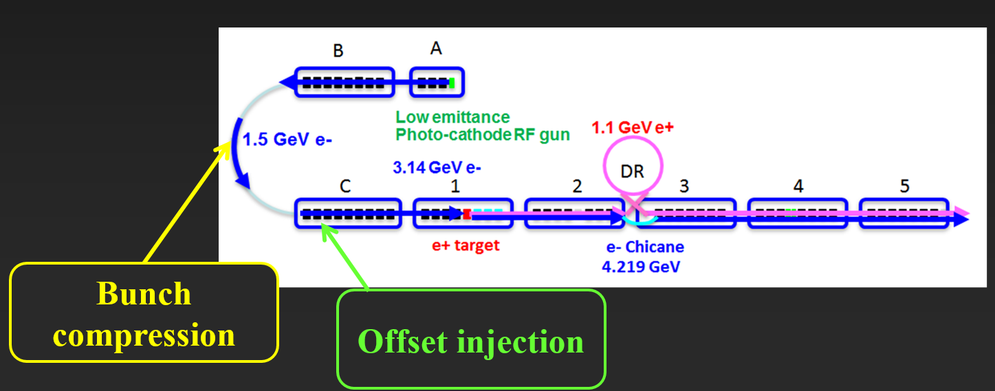
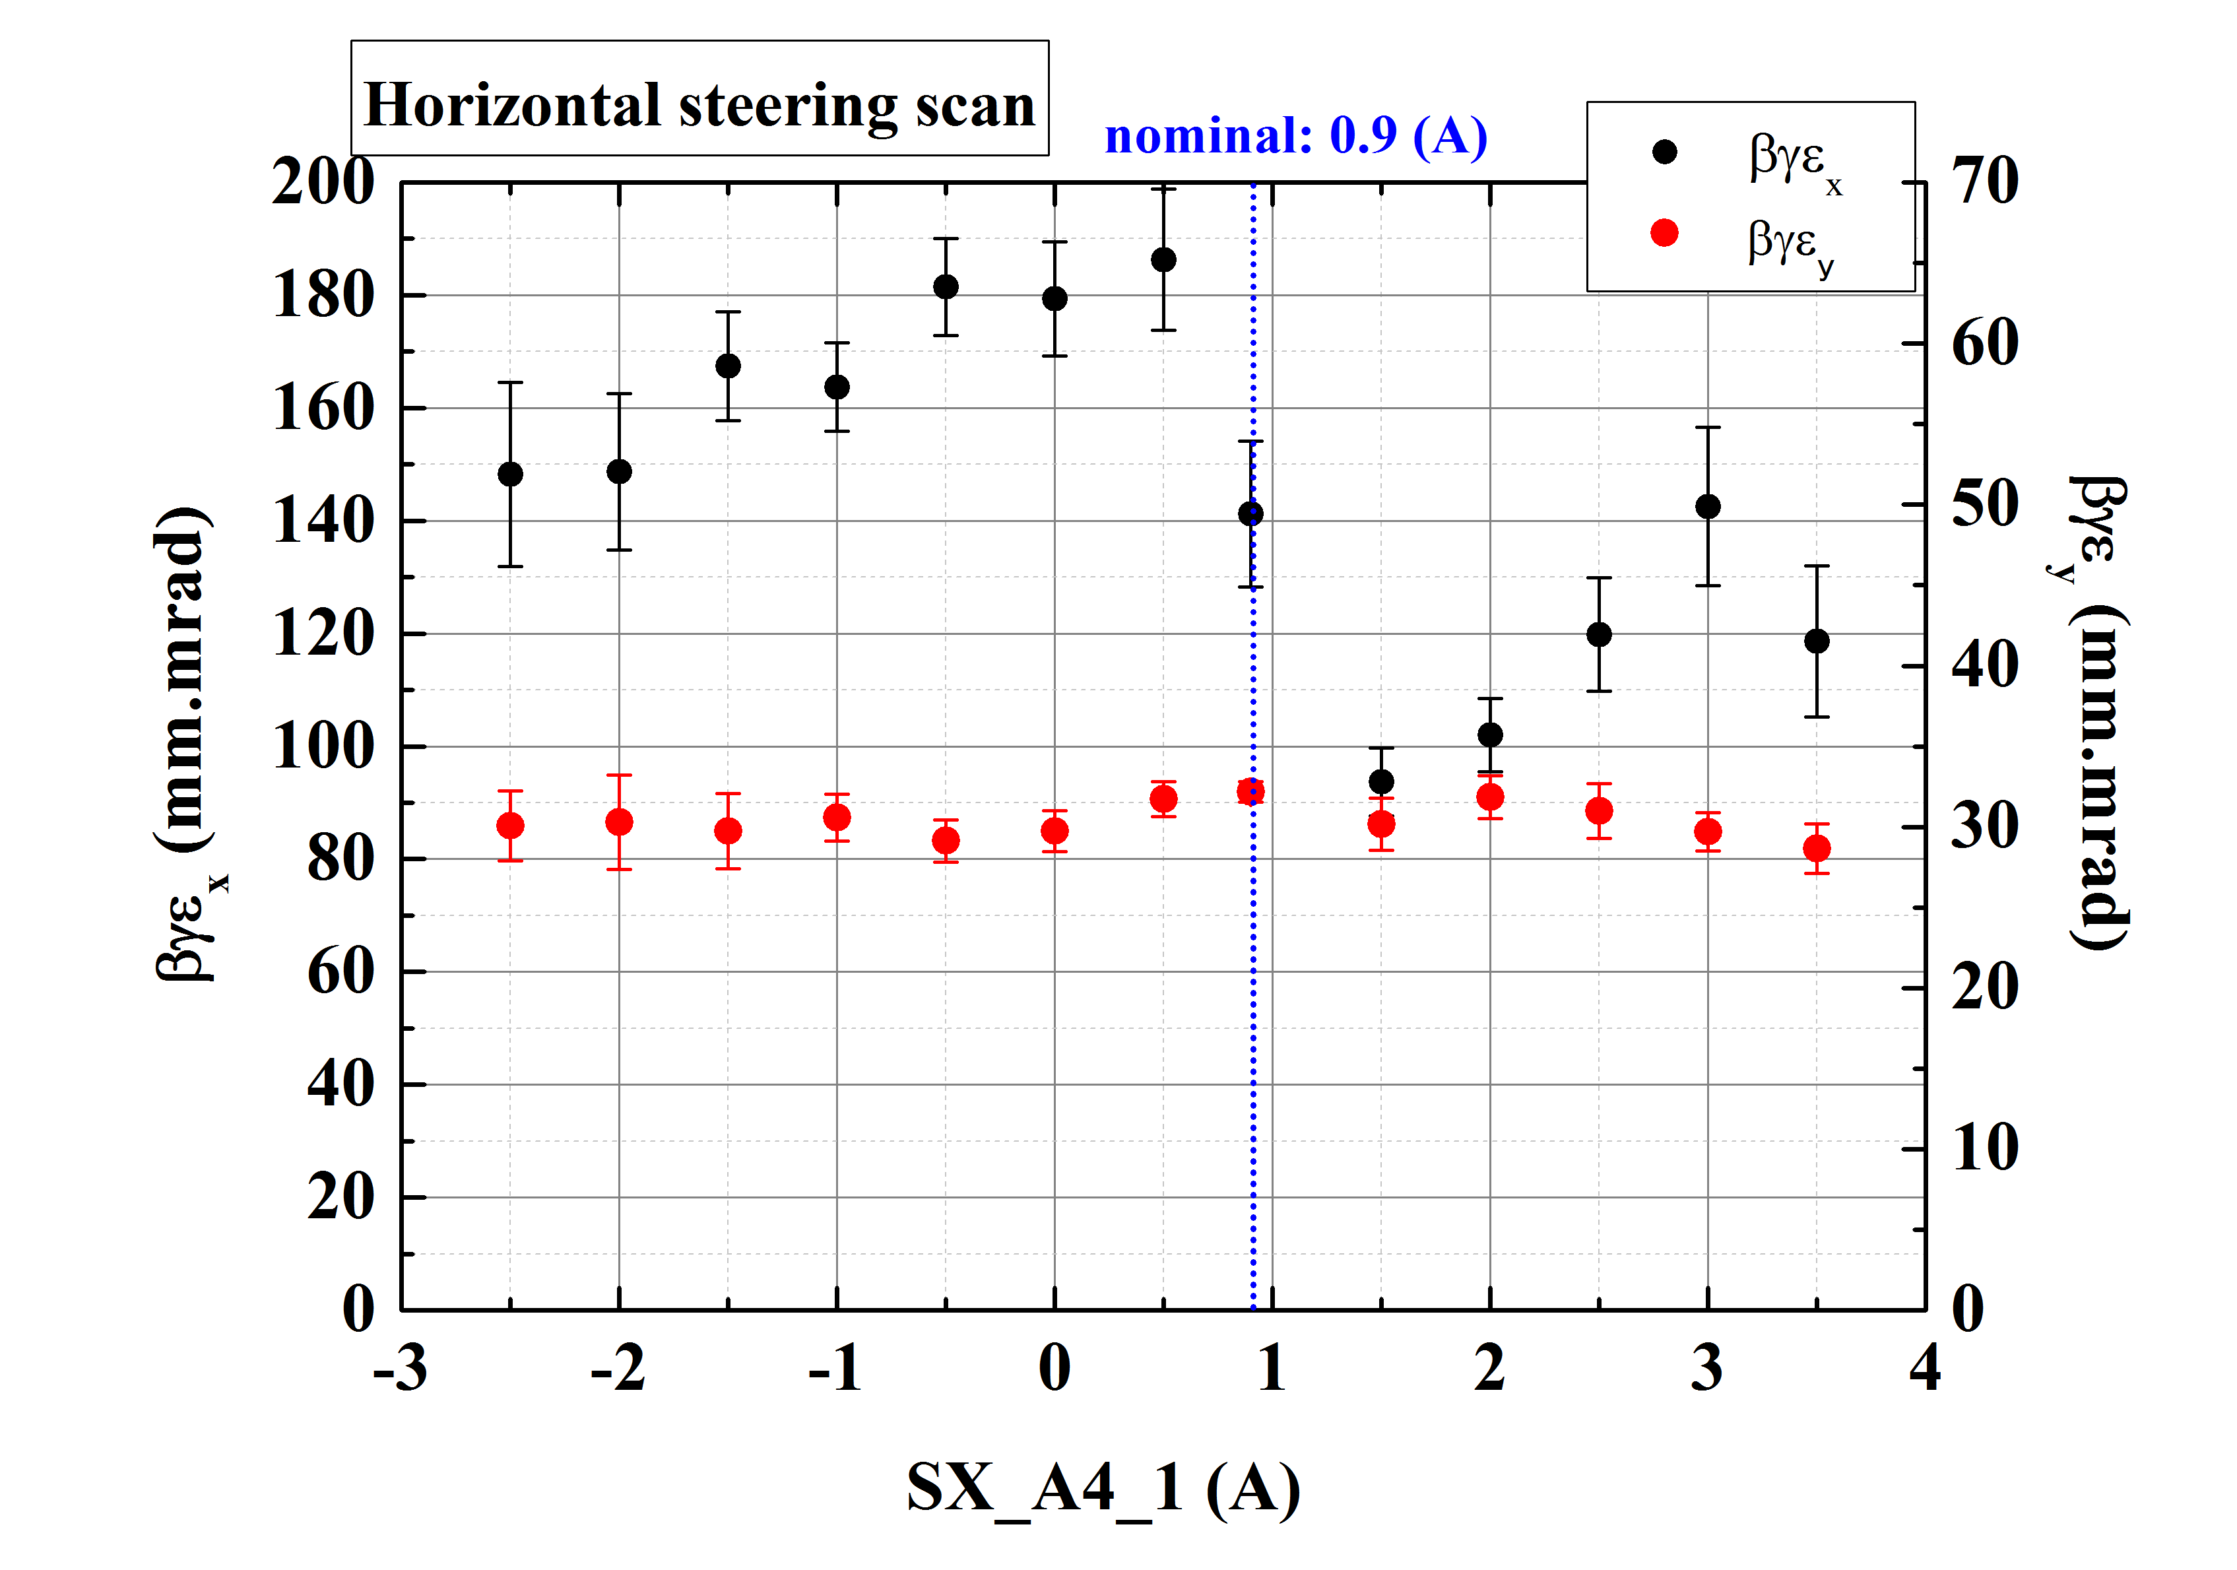
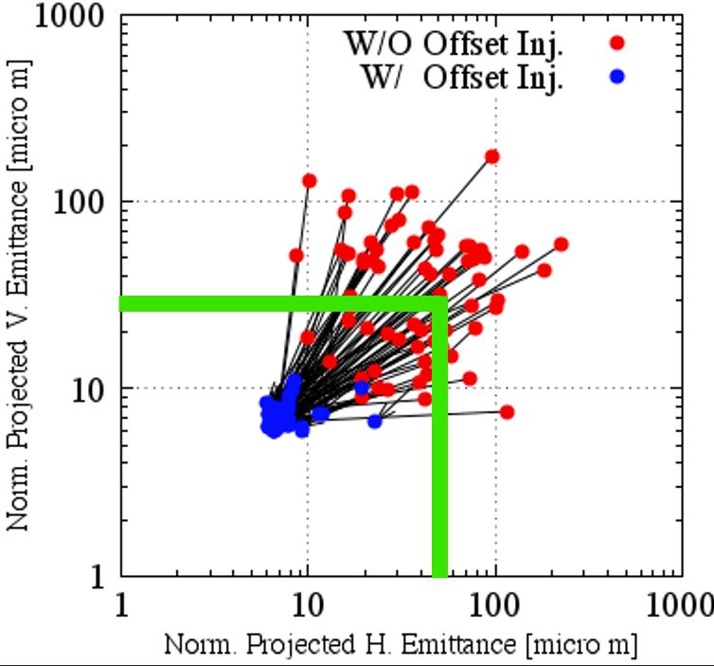
Low emittance preservation
Low emittance e- beam transport w/o damping ring
Emittance preservation w/ precise beam orbit control is key issue for e- beam.
Simulation results show the feasibility of emittance preservation w/ bunch compression and offset injection. Beam study was also conducted.
Beam study was also conducted at Sector A and B (125 m straight section)
- Simulation -
Quads and acc. w/ misalignment of 0.3 mm (σ)
50 different error seeds
All seeds can be corrected.
- Experiment -
Control steering at Sector A
Emittance was changed at Sector B

Slide 7
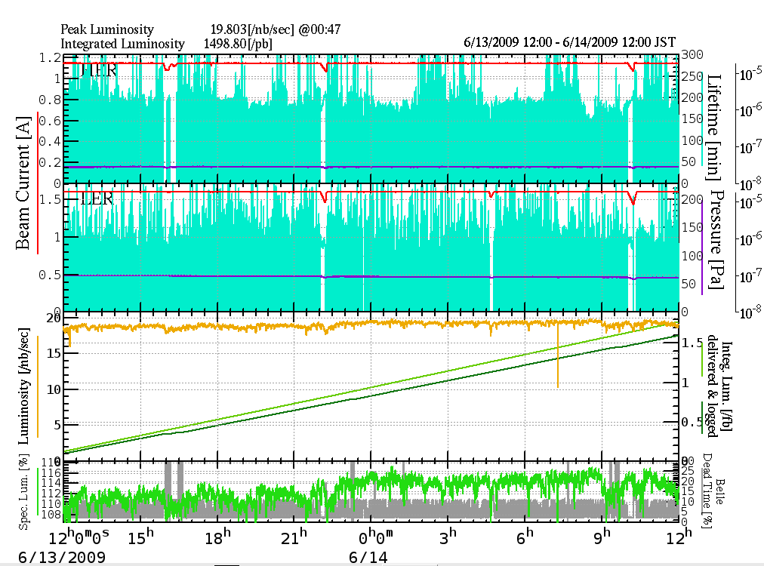
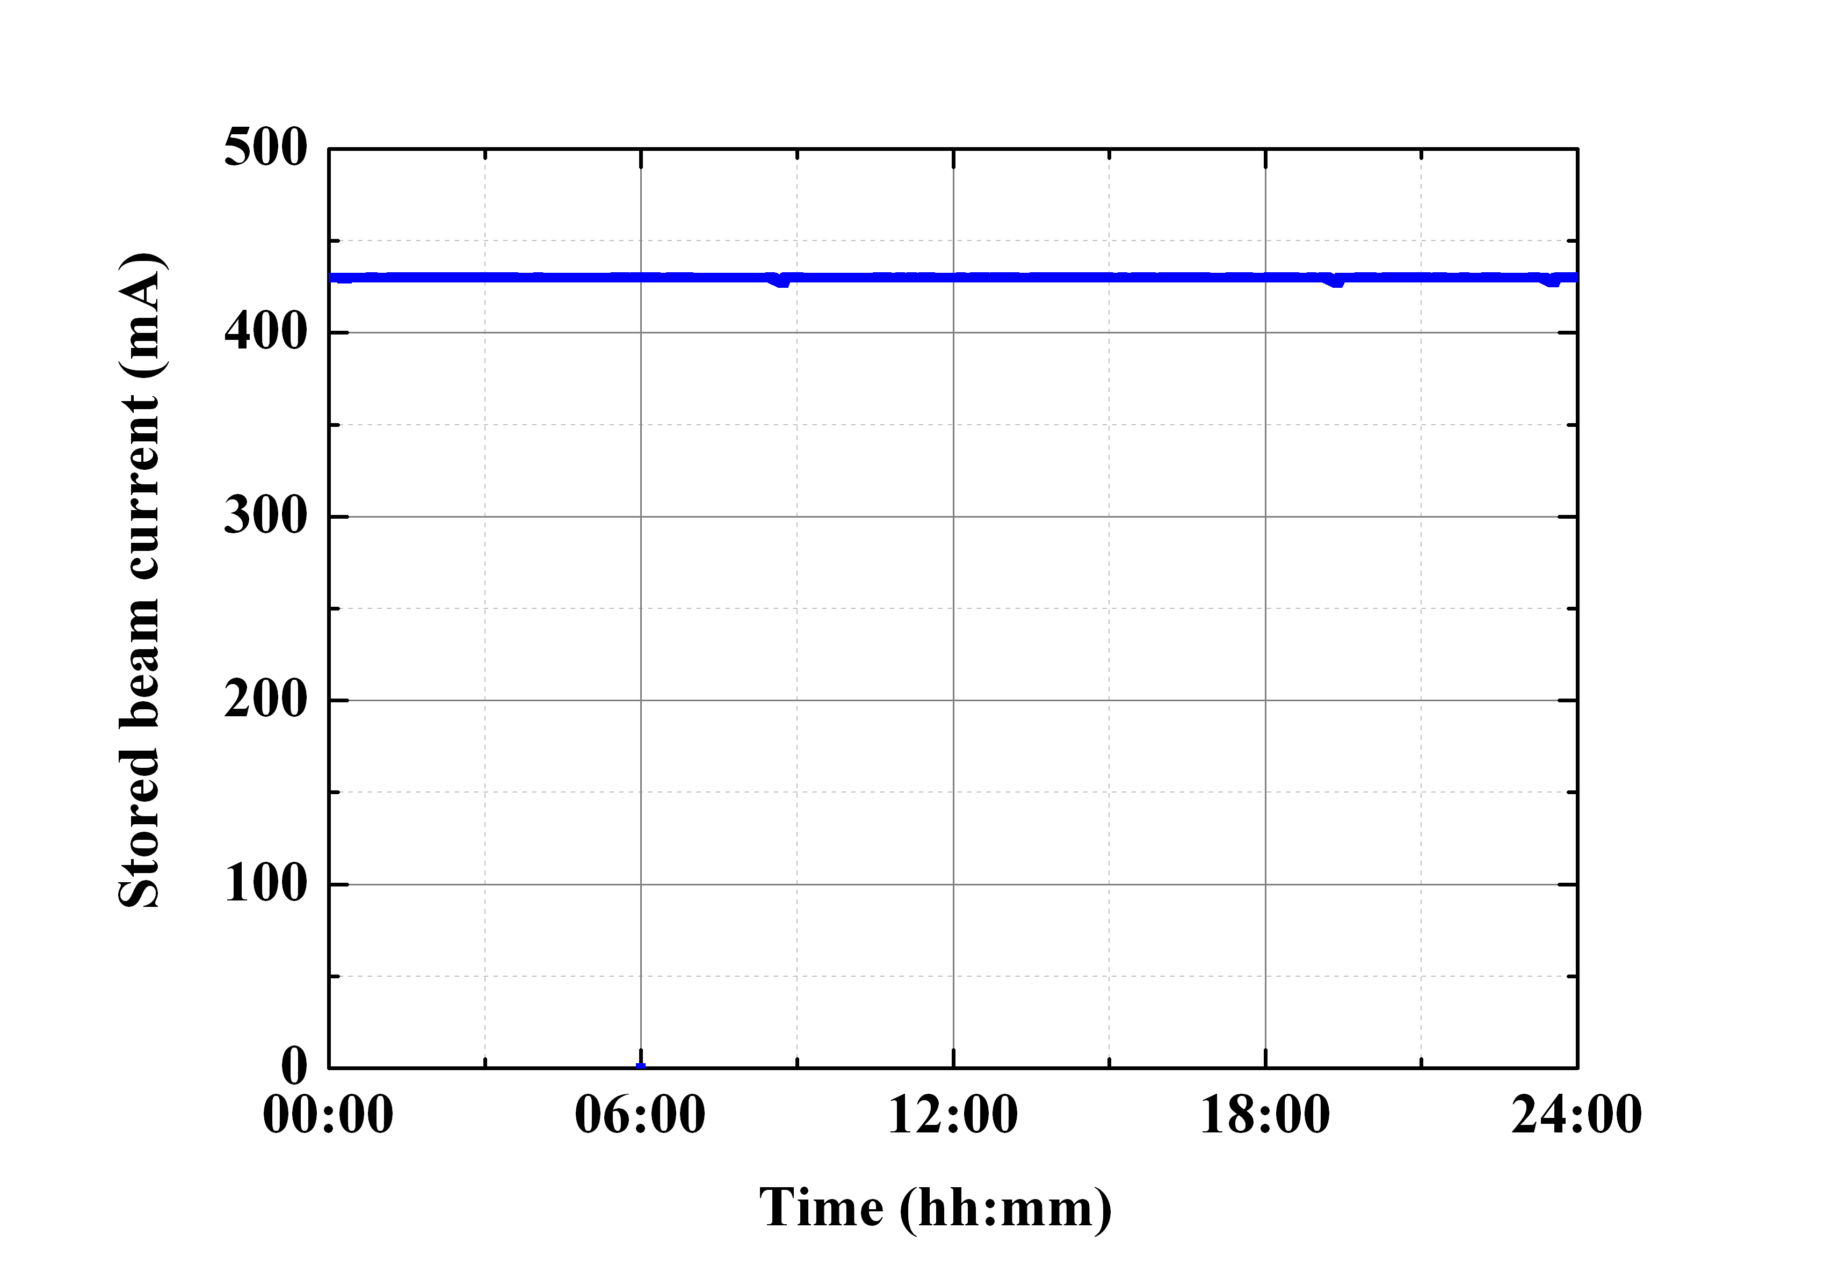
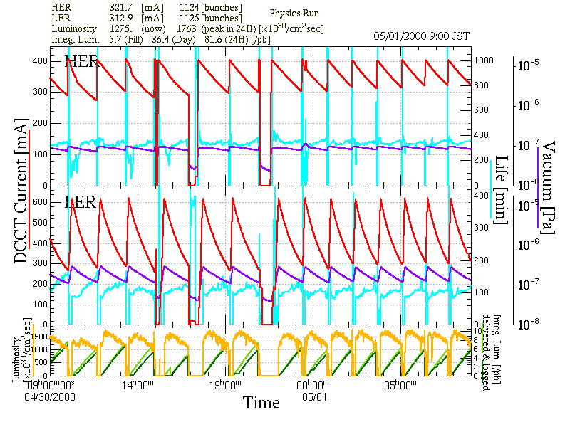
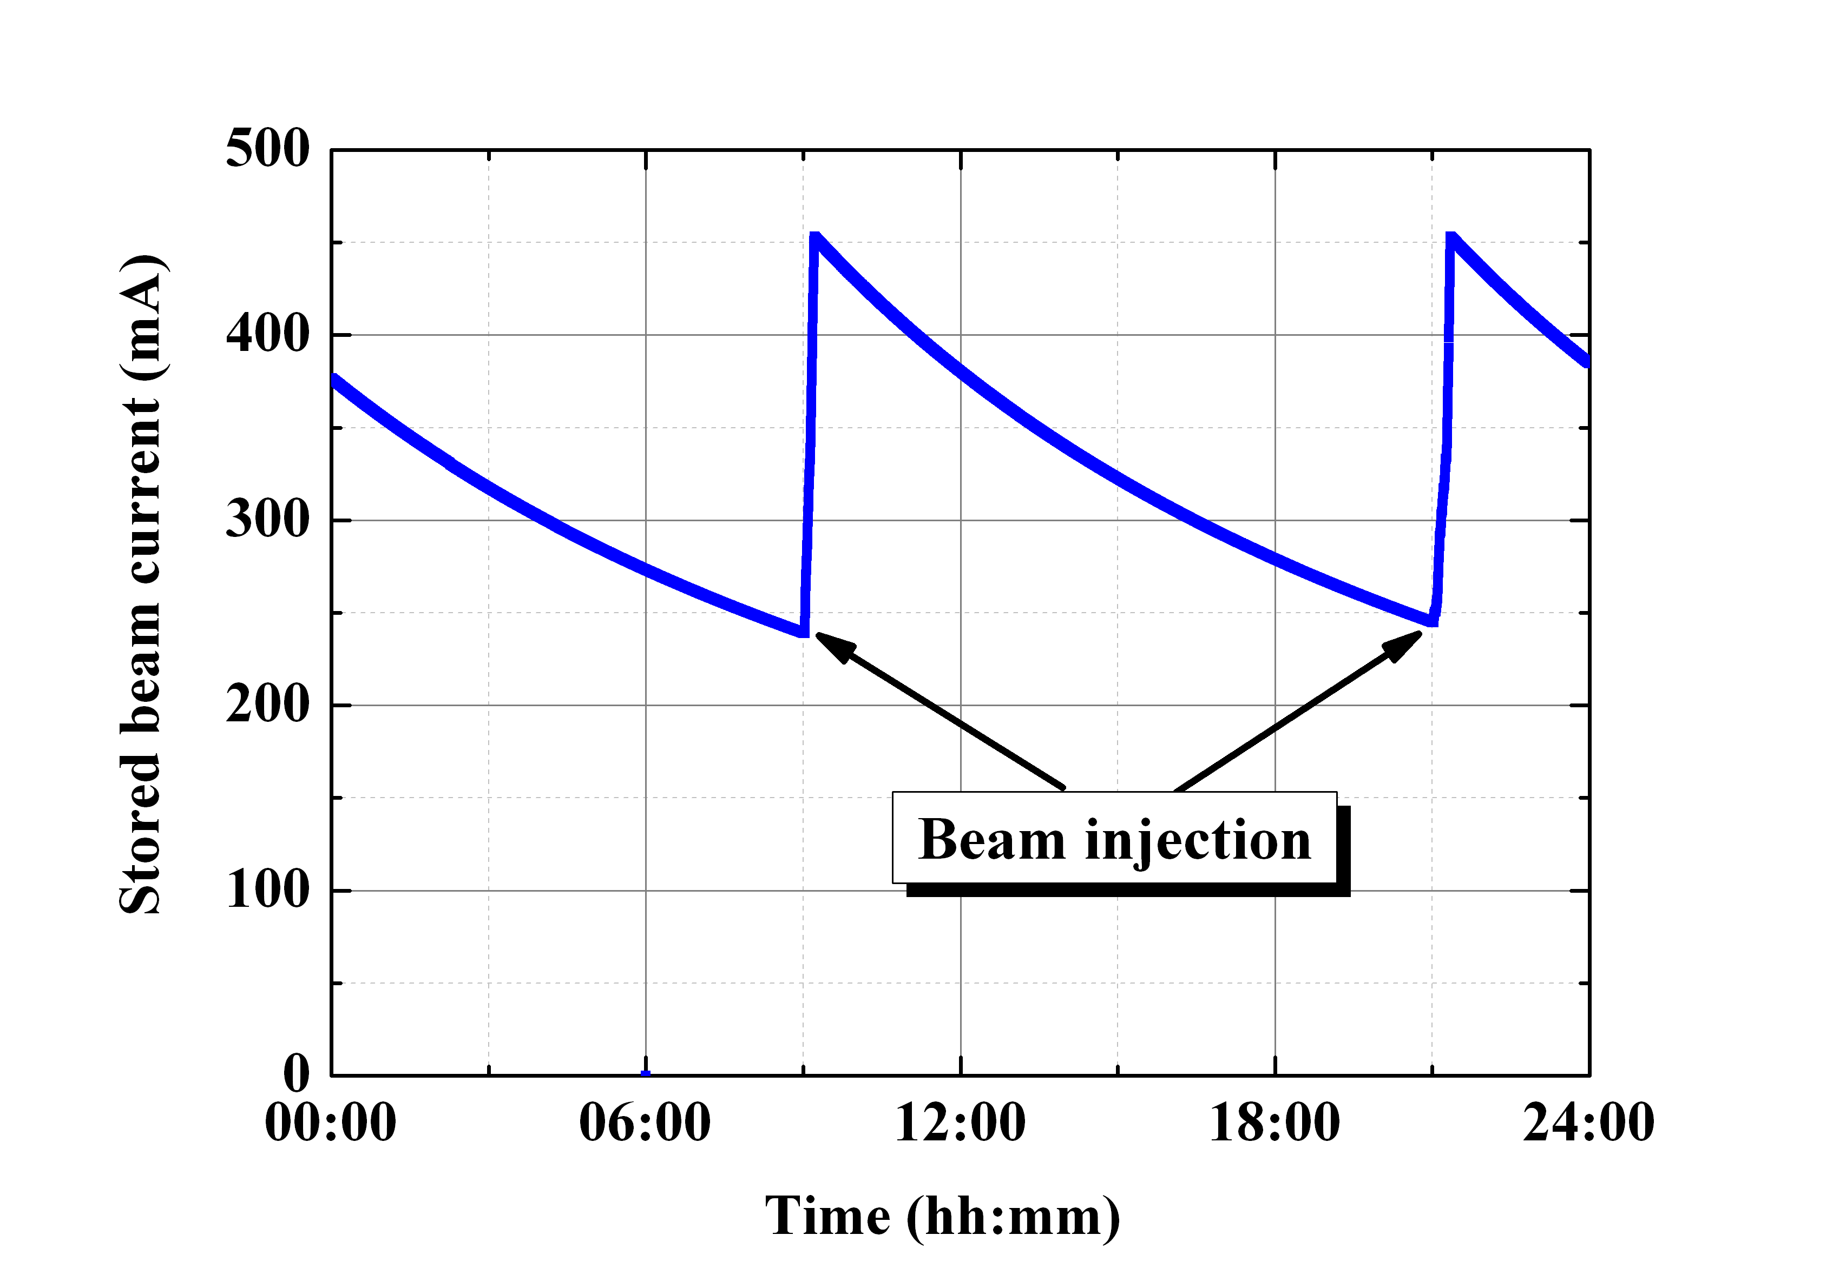
Simultaneous top-up injection for three rings
PF-AR injection (twice daily) interrupt KEKB injection.
Big issue for SuperKEKB operation.
Beam lifetime ~ 6 min.
Stored beam current stability in Apr. 2010.
- KEKB: 1 mA (~ 0.05%) : e-: 12.5 Hz, e+: 25 Hz
- PF: 0.05 mA (~ 0.01%) : 0.5 Hz
Stored beam current stability in 2000.
- KEKB: 300 mA (~ 50%)
- PF: 240 mA (~ 53%)
PF
KEKB e-
KEKB e+
Luminosity

Slide 8
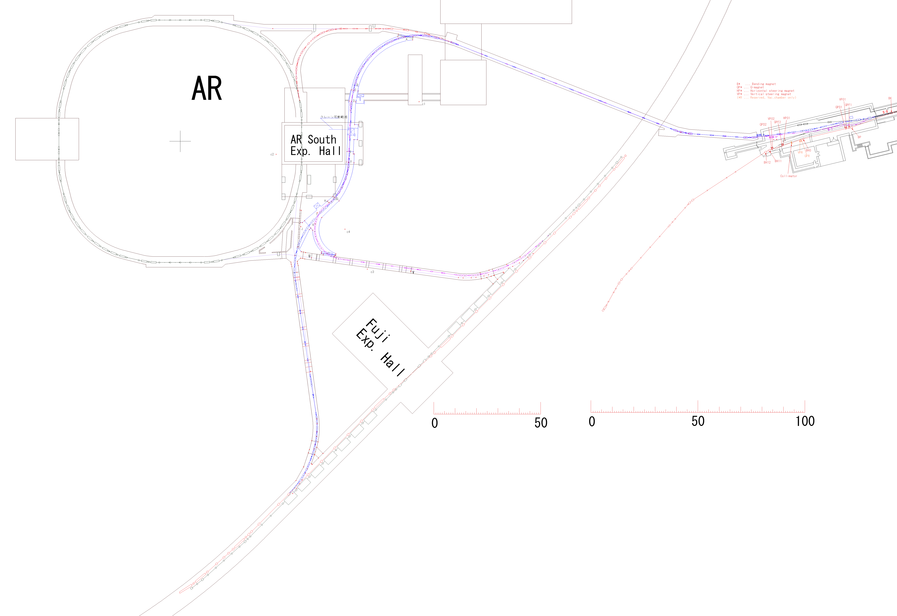
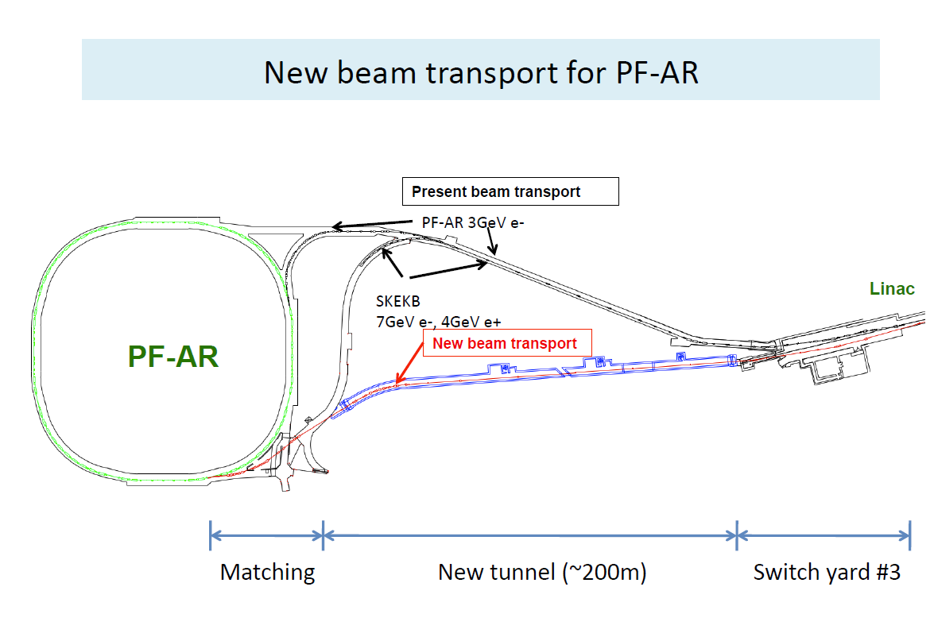
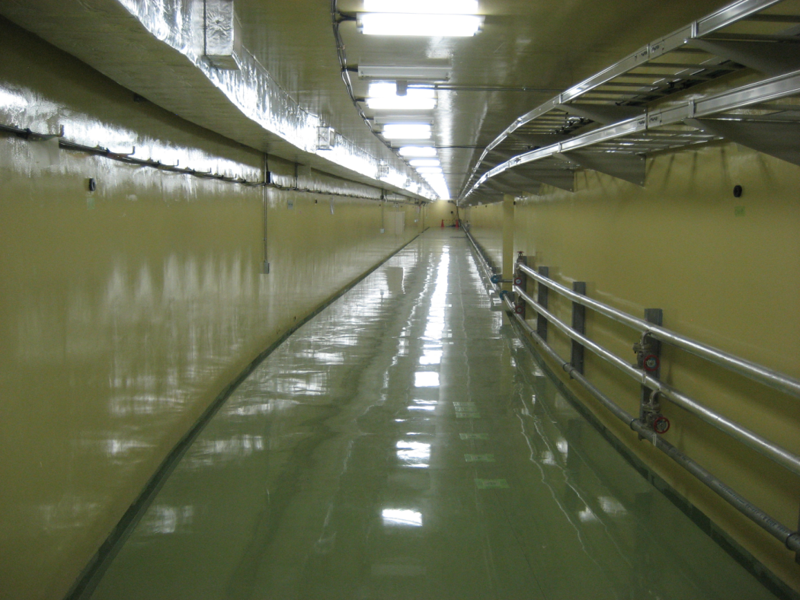
Simultaneous top-up including PF-AR injection
PF-AR and KEKB share the long part of BT line.
Existing tunnel space is very tight.
New tunnel has been constructed in Mar. 2014.
Pulsed bend will be installed at #3 switch yard of linac.
New BT commissioning will be conducted in Feb. 2017.
H. Takaki (KEKB review 2013)

Slide 9
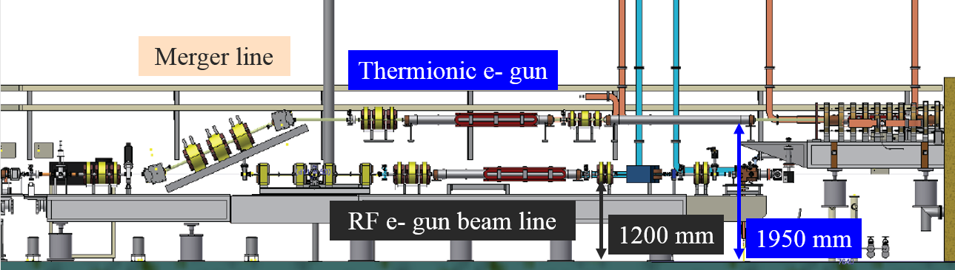
Injector commissioning for Phase I
Thermionic e- gun was reinstalled in end of April 2015.
  e+ primary e- generation (10 nC). (rf gun achieved the maximum bunch charge of 5.6 nC)
  Keep the beam line for rf gun in original position.
  Beam line level of thermionic gun was changed from 1200 mm to 1950 mm.
  Spare magnets have been reused for the thermionic gun beam line.
Thermionic e- gun commissioning has been successful in May 2015.
MR (both of HER and LER) injection by thermionic e- gun started in this February.
June 8th ~:
  HER injection: rf e- gun, LER injection: thermionic e- gun

Slide 10
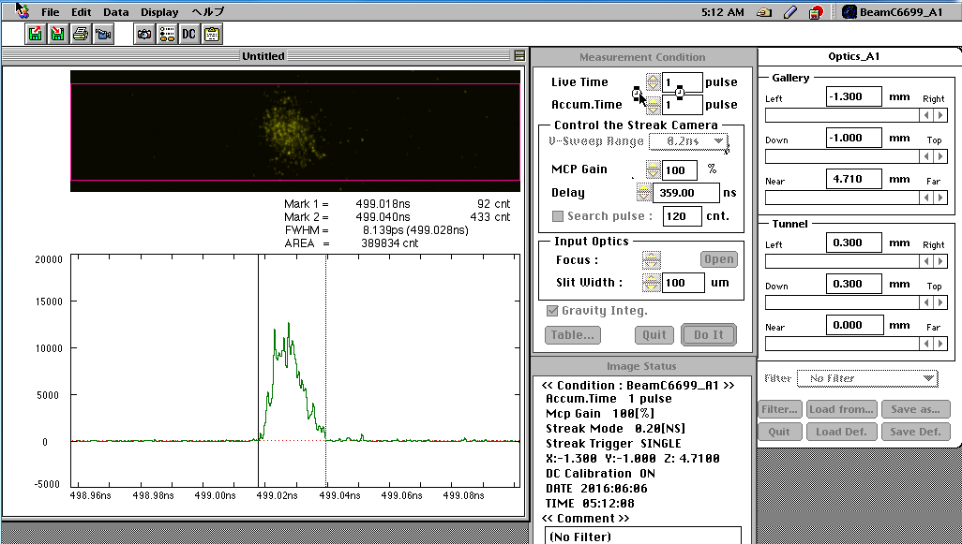
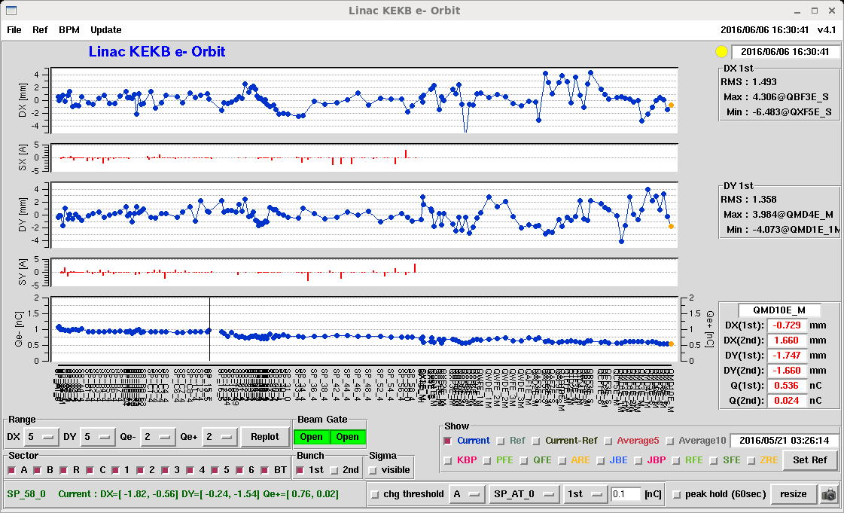
Thermionic e- gun (HER injection)
Typical operation:
  1 nC (gun), 1 nC (linac end), 0.5 nC (BT end)
  12.5 Hz, single bunch
x (mm)
y (mm)
First bunch
~ 8 ps
(streak camera measurement)
I (nC)
Linac
BT

Slide 11
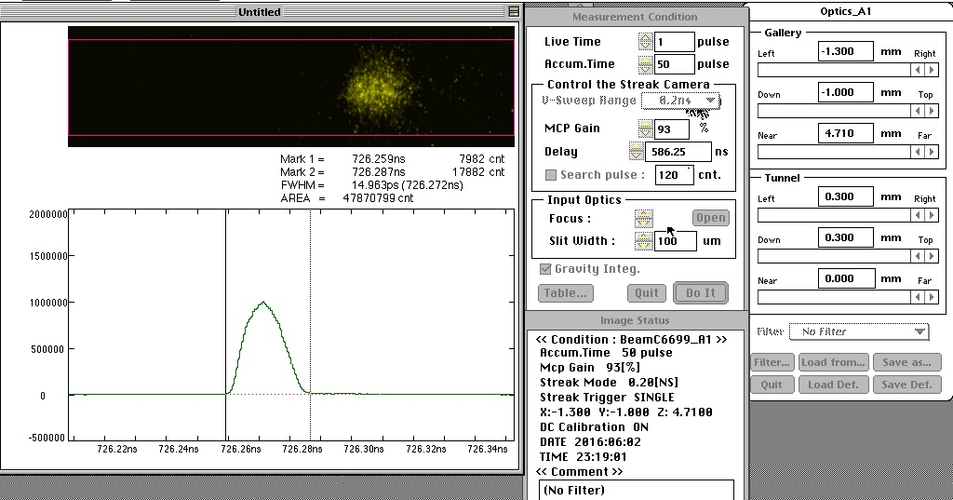
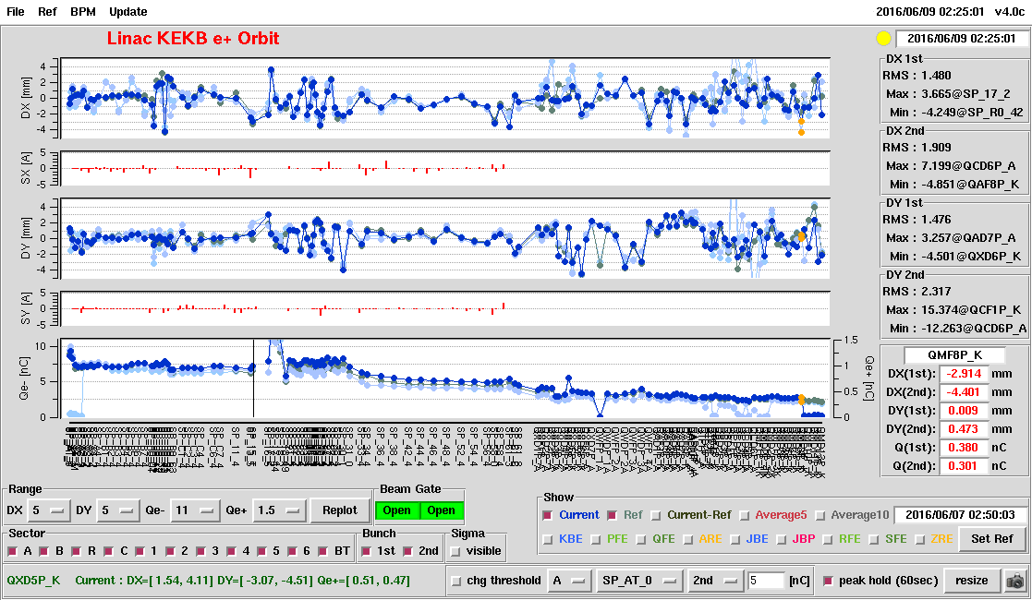
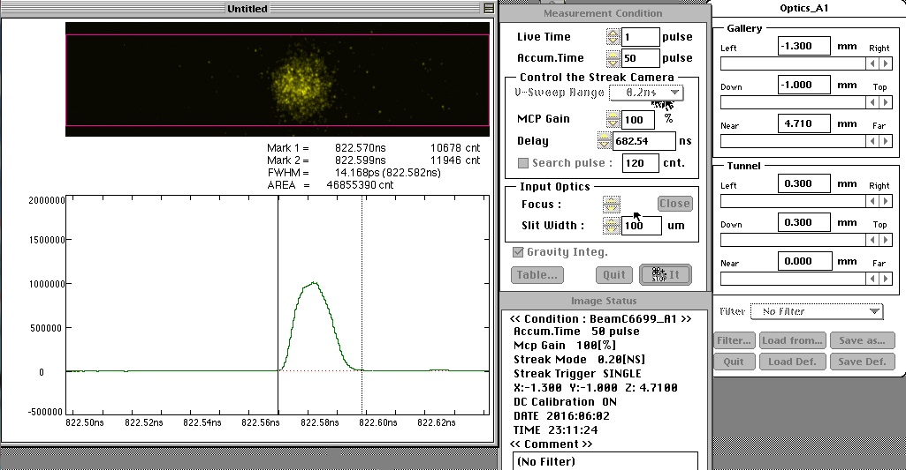
Thermionic e- gun (LER injection)
Typical operation:
  Primary e-: 10 nC (gun), 7 nC (target)
  e+: 0.7 nC (linac end), 0.4 nC (BT end)
  25 Hz, two bunch
First bunch
~ 15 ps
(streak camera measurement)
x (mm)
y (mm)
Second bunch
~ 15 ps
(streak camera measurement)
I (nC)
Linac
BT

Slide 12
Thermionic e- gun (Injection rate)
LER:
  Injection rate: ~ 0.5 mA/s, efficiency: 70% ~ 100%
HER:
  Injection rate: ~ 0.8 mA/s, efficiency: 80% ~ 100%
Two bunch injection
Single bunch injection

Slide 13
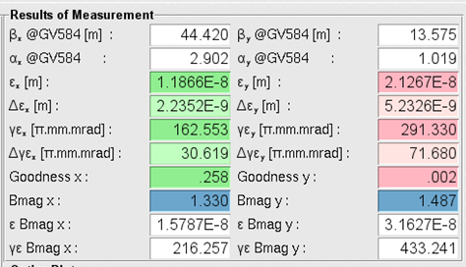
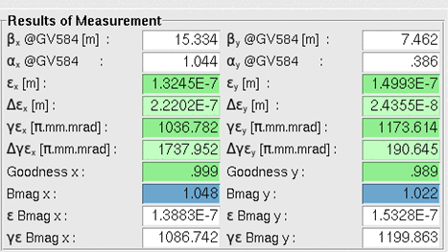
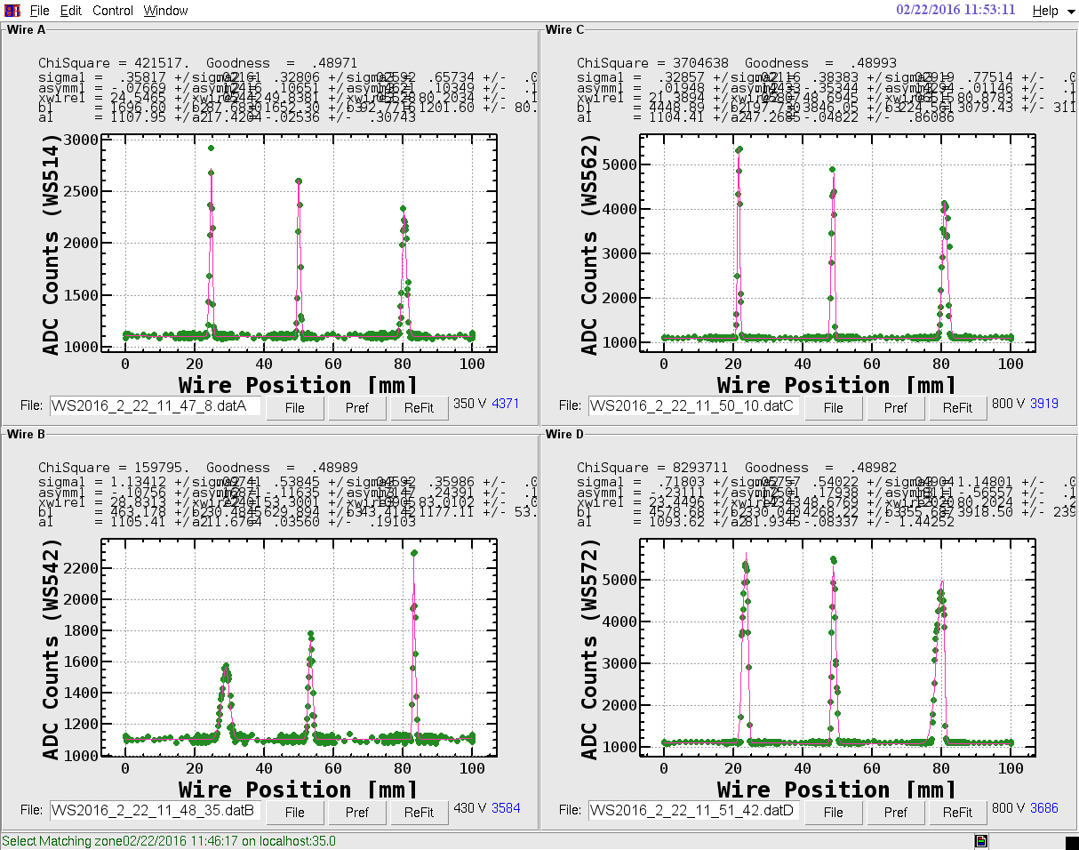
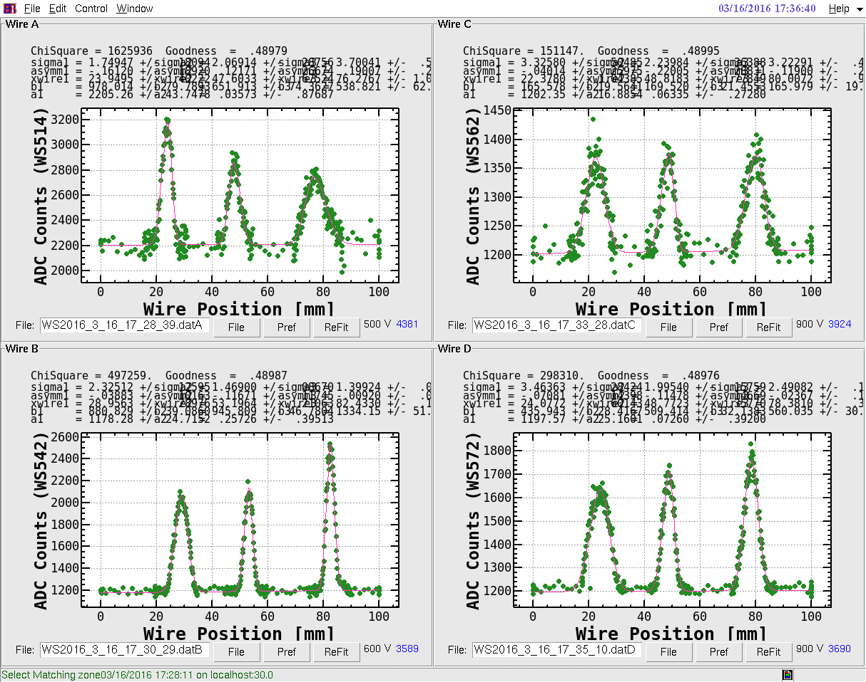
Thermionic e- gun (emittance)
Emittance was measured by the multiple wire scanner situated at Sector 5.
e- beam: εnx ~ 160, εny ~ 300 (mm·mrad)
e+ beam: εnx ~ 1000, εny ~ 1200 (mm·mrad)
e- beam
e+ beam

Slide 14
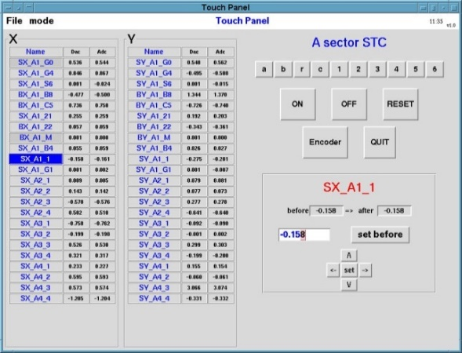
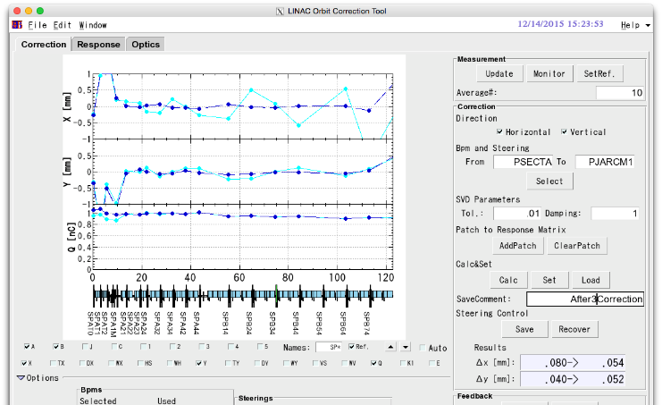
Commissioning tools
All parameters can be access via EPICS PVs
  ~ 150 IOCs
Parameter logging: Archiver (CA, CSS)
  42000 PVs
  CLI and Web-based data browser
EPICS CSS alarm
Tools based on SAD, Python, CSS
Parameter management tool
Orbit correction and feedback software is almost ready (both of model and measured response can be applicable to correction).
Energy feedback EPICS IOC is almost ready for operation.
Energy spread monitor and feedback will be prepared in this autumn.
Synchronized measurement over 91 BPMs is ready. Similar tools for fast rf monitor is also ready. Combination of them could be a strong analysis tools.

Slide 15
MR injection from rf e- gun
MR injection w/ rf gun was success at the first time (May 31, 2016).
Bunch charge is around 1 nC w/o emittance preservation.
e- beam emittance was measured by the Quads scan (Qscan) and multiple wire scanner (WS).
Qscan can be conducted by using a profile monitor and a GbE network attached camera w/ external trigger input.
Measured location | Horizontal εn (mm·mrad) | Vertical εn (mm·mrad)
Unit A1 chicane (Qscan) | 28.3 | 26.4
A1_M (Qscan) | 20.3 | 17.7
Dump @ Sector B (Qscan) | 48.5 | 21.7
Sector C (WS) | 100 ± 138 | 34.2 ± 16.5
Sector 5 (WS) | 106 ± 24.9 | 76.5 ± 38.9
BT (WS) | 211 ± 110.6 | 133 ± 22.2

Slide 16
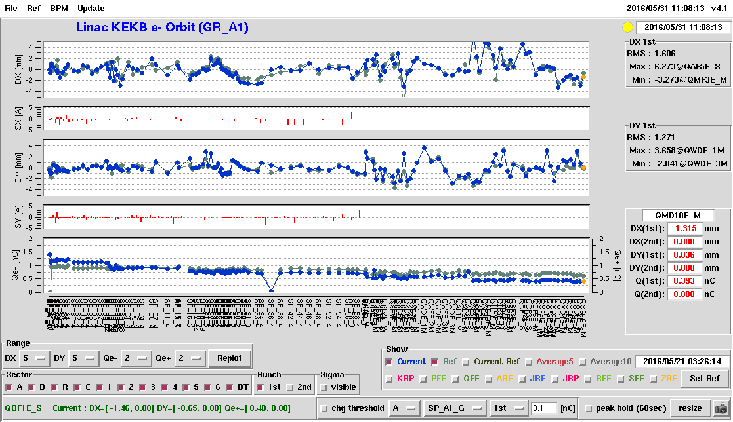
Beam orbit
w/o bunch compression (rf e- gun)
x (mm)
Horizontal steering x (A)
y (mm)
Vertical steering x (A)
I (nC)
Linac
BT

Slide 17
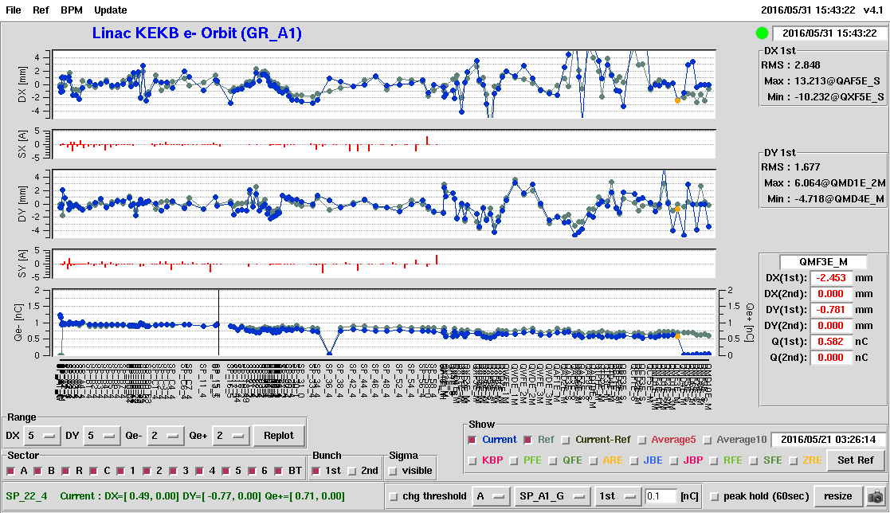
Beam orbit
w/ bunch compression (rf e- gun)
x (mm)
Horizontal steering x (A)
y (mm)
Vertical steering x (A)
I (nC)
Linac
BT

Slide 18
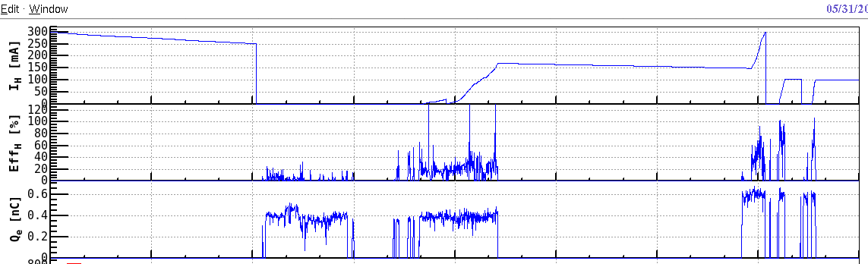
Main ring injection w/ rf e- gun
After bunch compression w/ chicane of unit A1, the injection efficiency reaches almost 100%.
Injection tuning
HER current (mA)
Injection efficiency (%)
Bunch charge (nC)
w/o bunch compression
w/ bunch compression

Slide 19
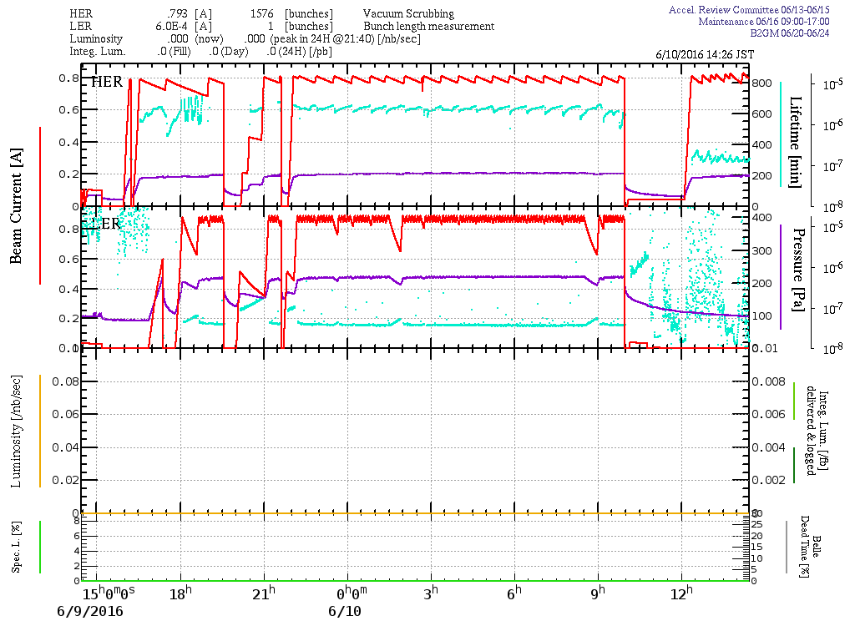
Stable HER injection w/ rf e- gun
24 hours

Slide 20
Bunch charge stability (rf e- gun)
RF e- gun has been utilized for HER injection since last Wednesday (June 8th) w/o any significant trouble.
Bunch charge fluctuation is about 4% ~ 5%. (~ 20% in 2014)
  1% ~ 2% (thermionic e- gun)
Bunch charge stability is almost same for different beam repetition.

Slide 21
Position stability (rf e- gun)
Position fluctuation is almost same for different beam repetition.
Beam position fluctuation in horizontal direction is larger than one in vertical direction.
σx,y: 0.1 mm ~ 0.2 mm (thermionic e- gun)

Slide 22
Summary and plan
Reinstallation of thermionic e- gun was completed in May of 2015.
MR Phase I commissioning successfully started w/ thermionic e- gun for HER and LER injection.
MR injection w/ rf e- gun was success at the first time (May 31, 2016).
Rf gun has continuously been utilized for daily operation since last Wednesday. Bunch charge stability has been much improved.
Towards Phase II (Oct. 2017):
  Low emittance beam (2 nC, 20 mm·mrad)
    rf e- gun (2 nC, 10 mm·mrad)
    Pre-alignment and countermeasure for ground motion
    Low emittance preservation study in this autumn
      BPM readout will be replaced by the high precision one (VME module) in this autumn. (12/91 have been already replaced.)
    Development of commissioning tools especially for low emittance preservation

Slide 23
Summary and plan (cont’d)
Towards Phase II (Oct. 2017):
  Positron generation
    Flux concentrator: New one (work hardening process) will be installed in this Nov. for 12 kA operation.
  Simultaneous top-up (HER, LER (+ damping ring), PF, PF-AR)
    Commissioning of New PF-AR BT (Feb. 2017)
    Pulsed Quads will be tested by real beam soon. Control and monitor system is under preparation. All pulsed Quads (30) and steering magnets (36) will be installed in the next summer.
    Safety system upgrade for simultaneous top-up operation

Slide 24
Backup

Slide 25
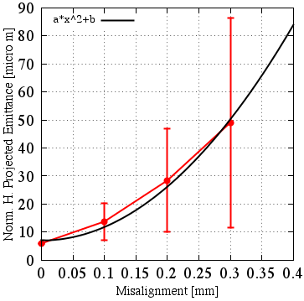
Emittance growth due to component misalignment
Sector Cto5: -10 deg rf phase
R56 =-0.20
Simulation results from 100 different seeds.
Misalignment of Quadrupole magnets and Accelerating structure:
  σ < 0.1 mm: βγε 20 mm·mrad is almost satisfied.
  σ > 0.1 mm: emittance preservation is required by some methods.
<Emittance growth>
・quadratic curve as a function of misalignment
・final emittance depends on error seed
Norm. projected rms emittance (mm⋅mrad)
Simulation
SAD code, Elegant
Initial bunch charge: 5 nC
Initial emittance: 6 mm⋅mrad
Initial bunch length: 10 ps (FWHM)
Initial energy spread : 0.4%
Initial beam energy: 20 MeV
Uniform longitudinal beam distribution
20 mm·mrad
Misalignment σ (mm)

Slide 26
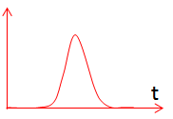
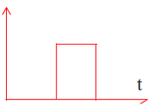
Energy spread requirement
For the synchrotron phase space injection, small energy spread (0.1%) is required.
A rectangular beam distribution in the longitudinal direction is required for the beam with bunch charge of 5 nC (Phase III).
Laser shaping technique (temporal manipulation)
Gaussian shape
0.1
Rectangular shape
S. Kazama et al., IPAC’15, MOPWA053

Slide 27
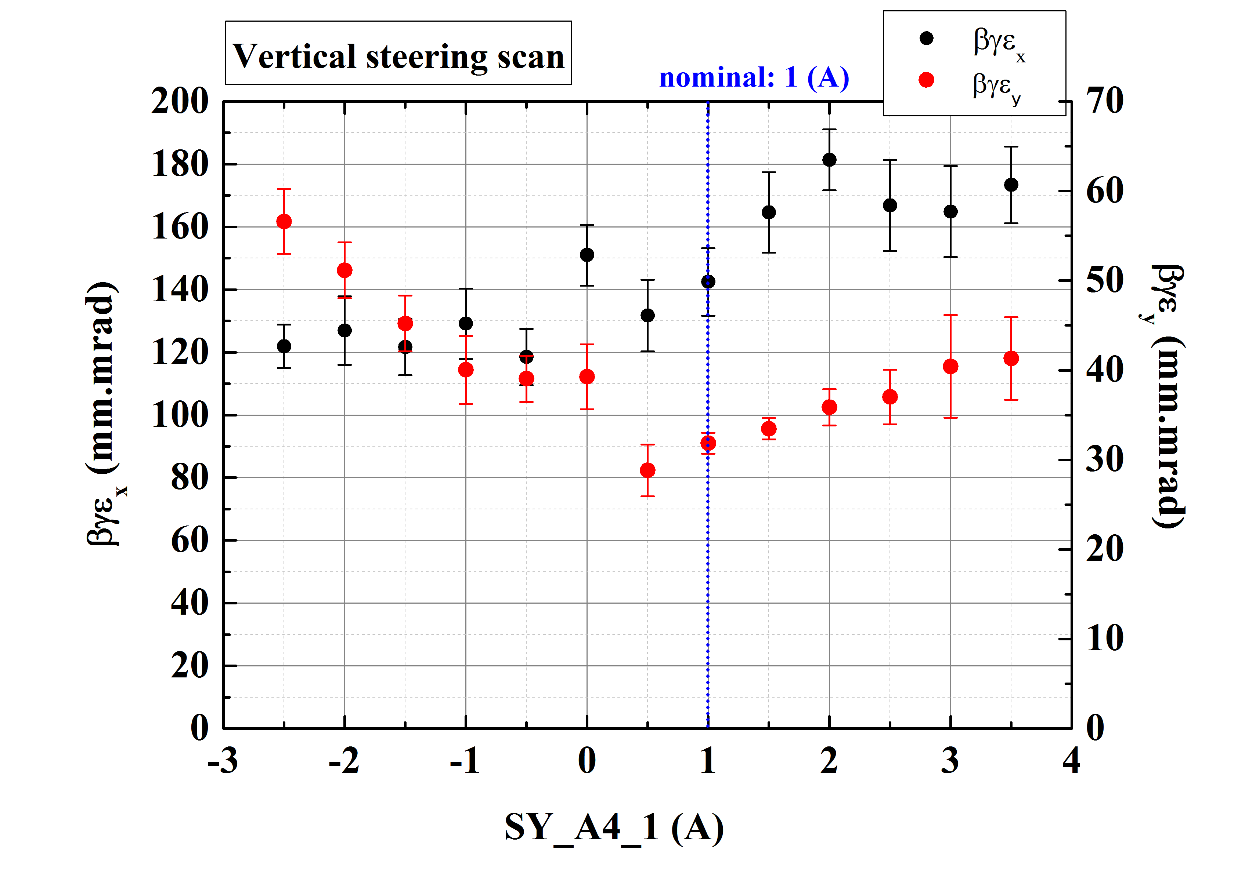
Offset injection (experiment)
Feasibility of offset injection was studied w/ bunch charge of 0.3 nC (thermionic gun).
Changing the excitation current of steering magnet at Unit A4.
Emittance was measured multiple wire scanner at Sector B end.
We will conduct this measurement w/ rf gun.

Slide 28
Emittance w/ bunch charge fluctuation
Emittance simulation w/ 10 misalignment seeds (accelerating structure).
Sector C to Sector 5 (Linac end)
Assuming 5 nC, initial emittance of 10 mm⋅mrad (SectorC)
When bunch charge increases by 10%, emittance increases by 6.5%.
Try simulations w/ measured component misalignment, dynamic beam line movement, energy jitter.
12.4 => 13.2 mm⋅mrad
5 nC => 5.5 nC

Slide 29
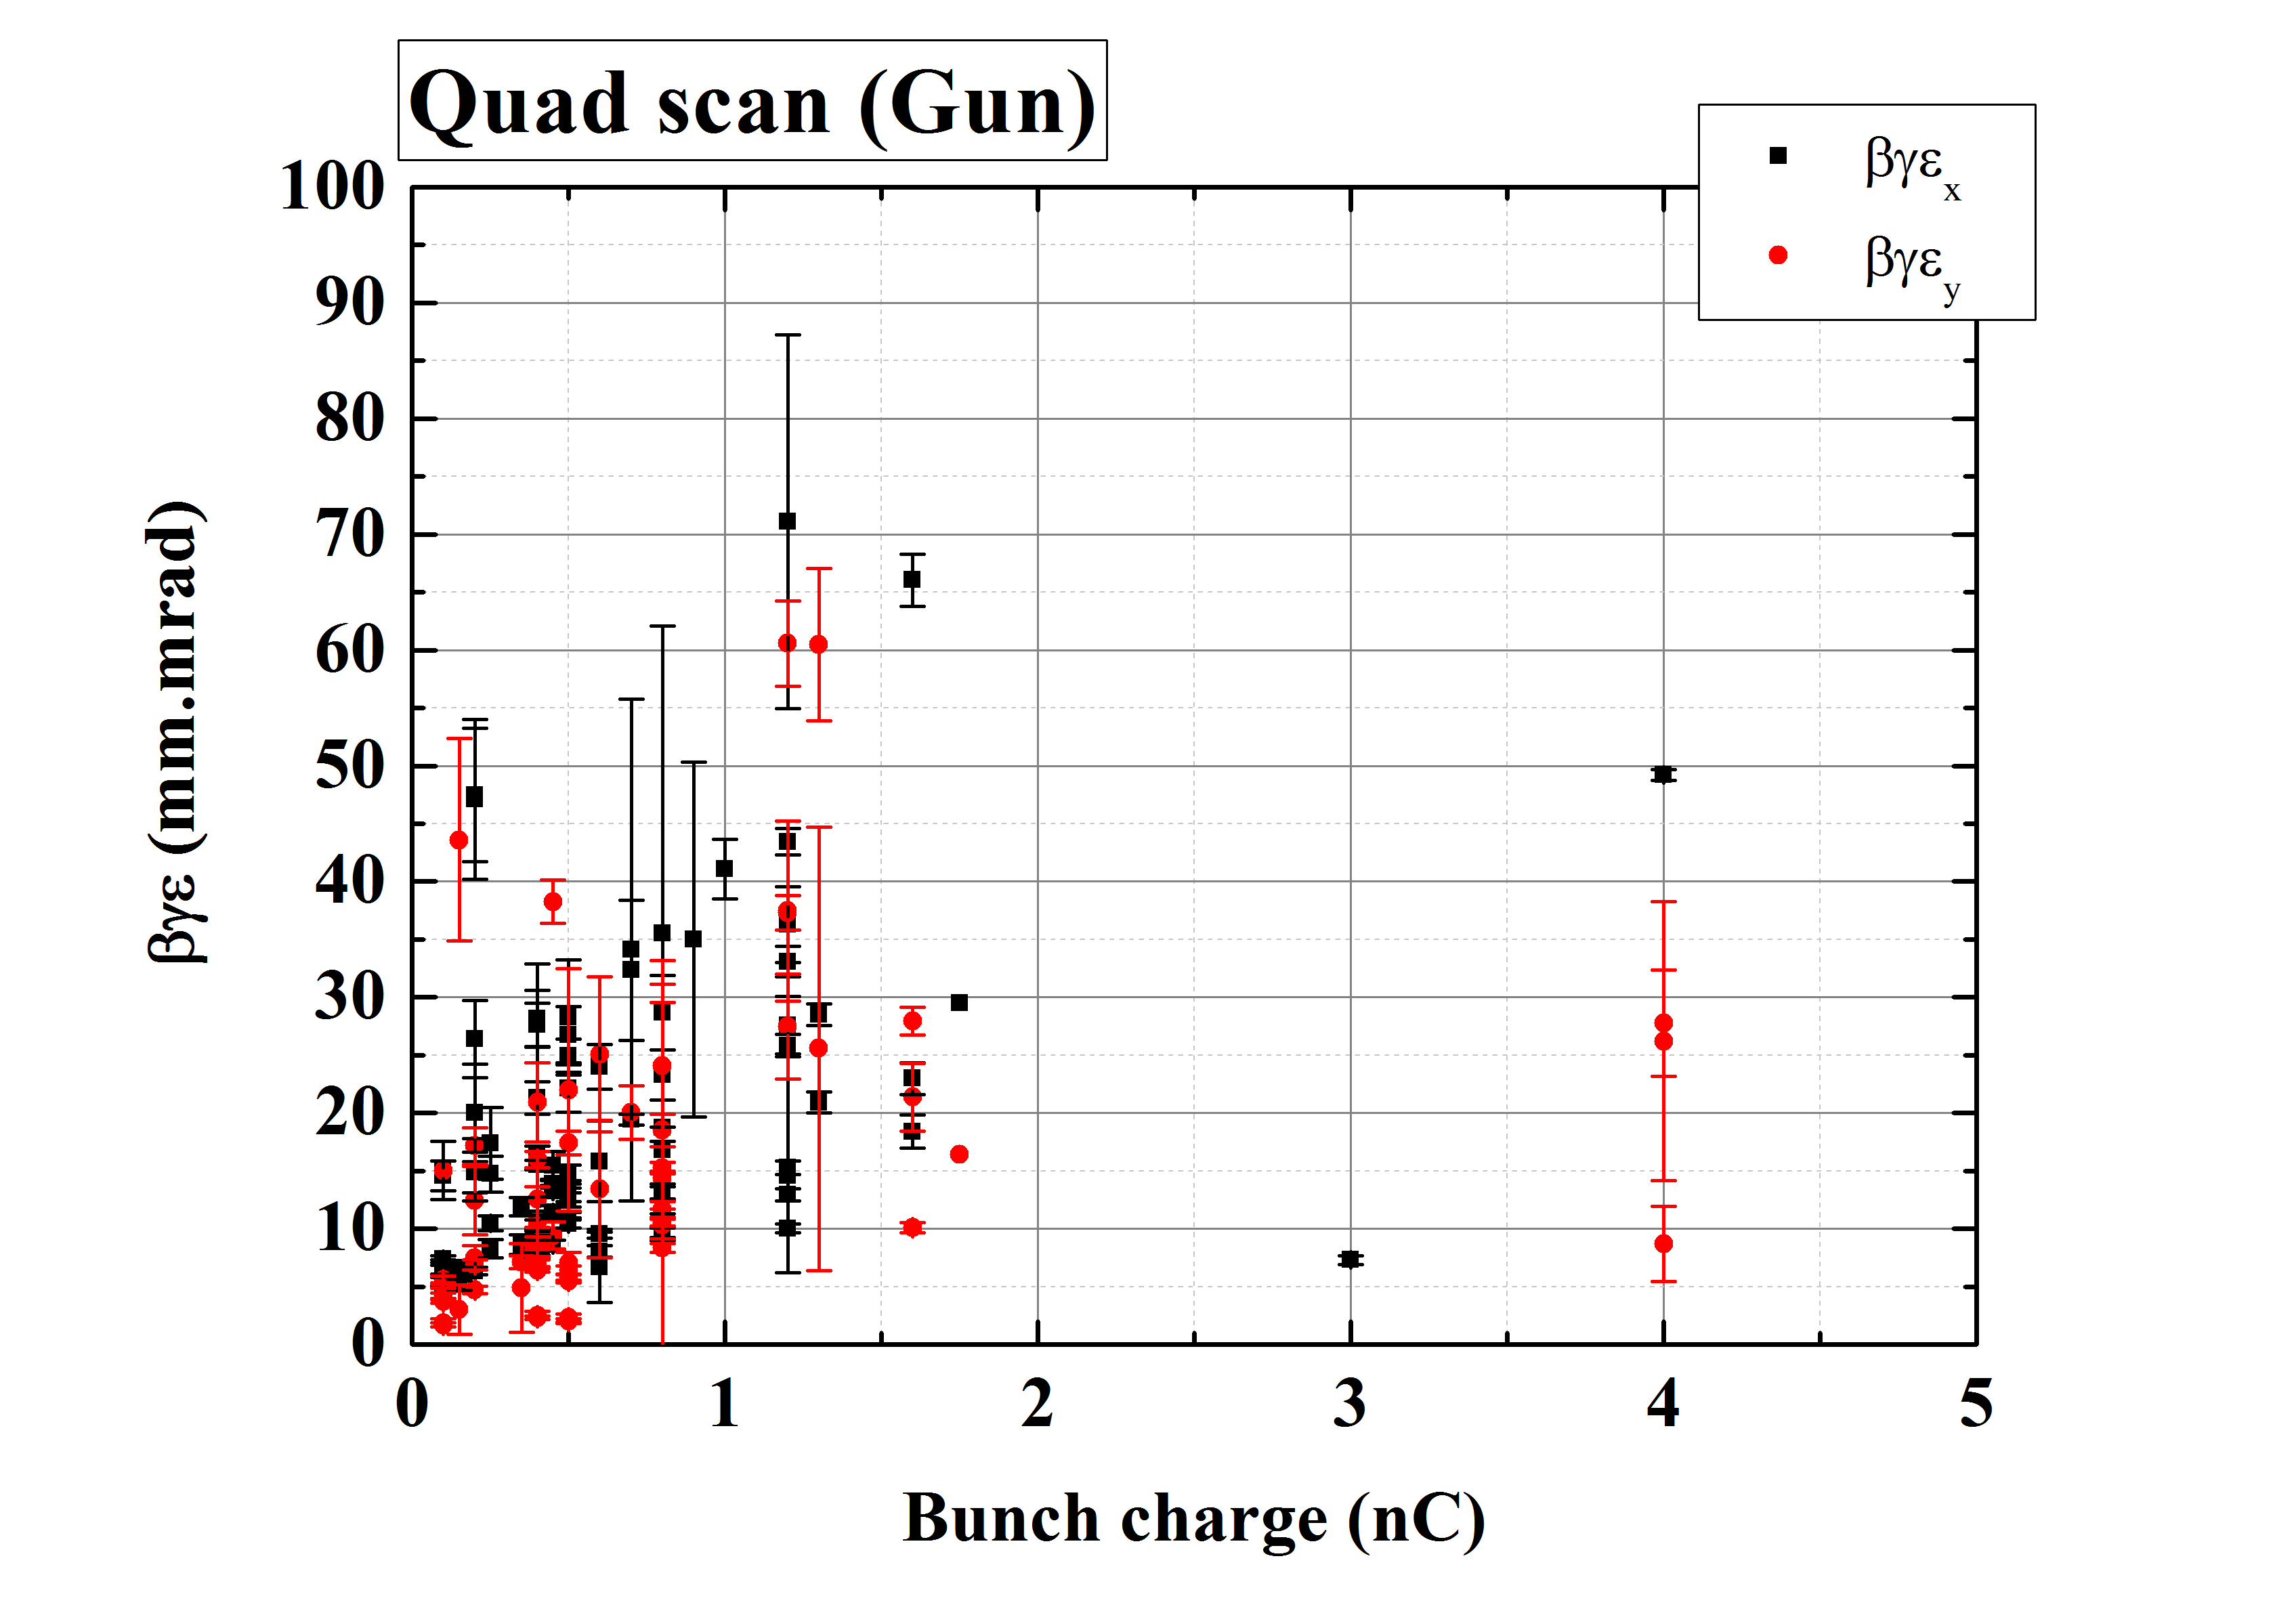
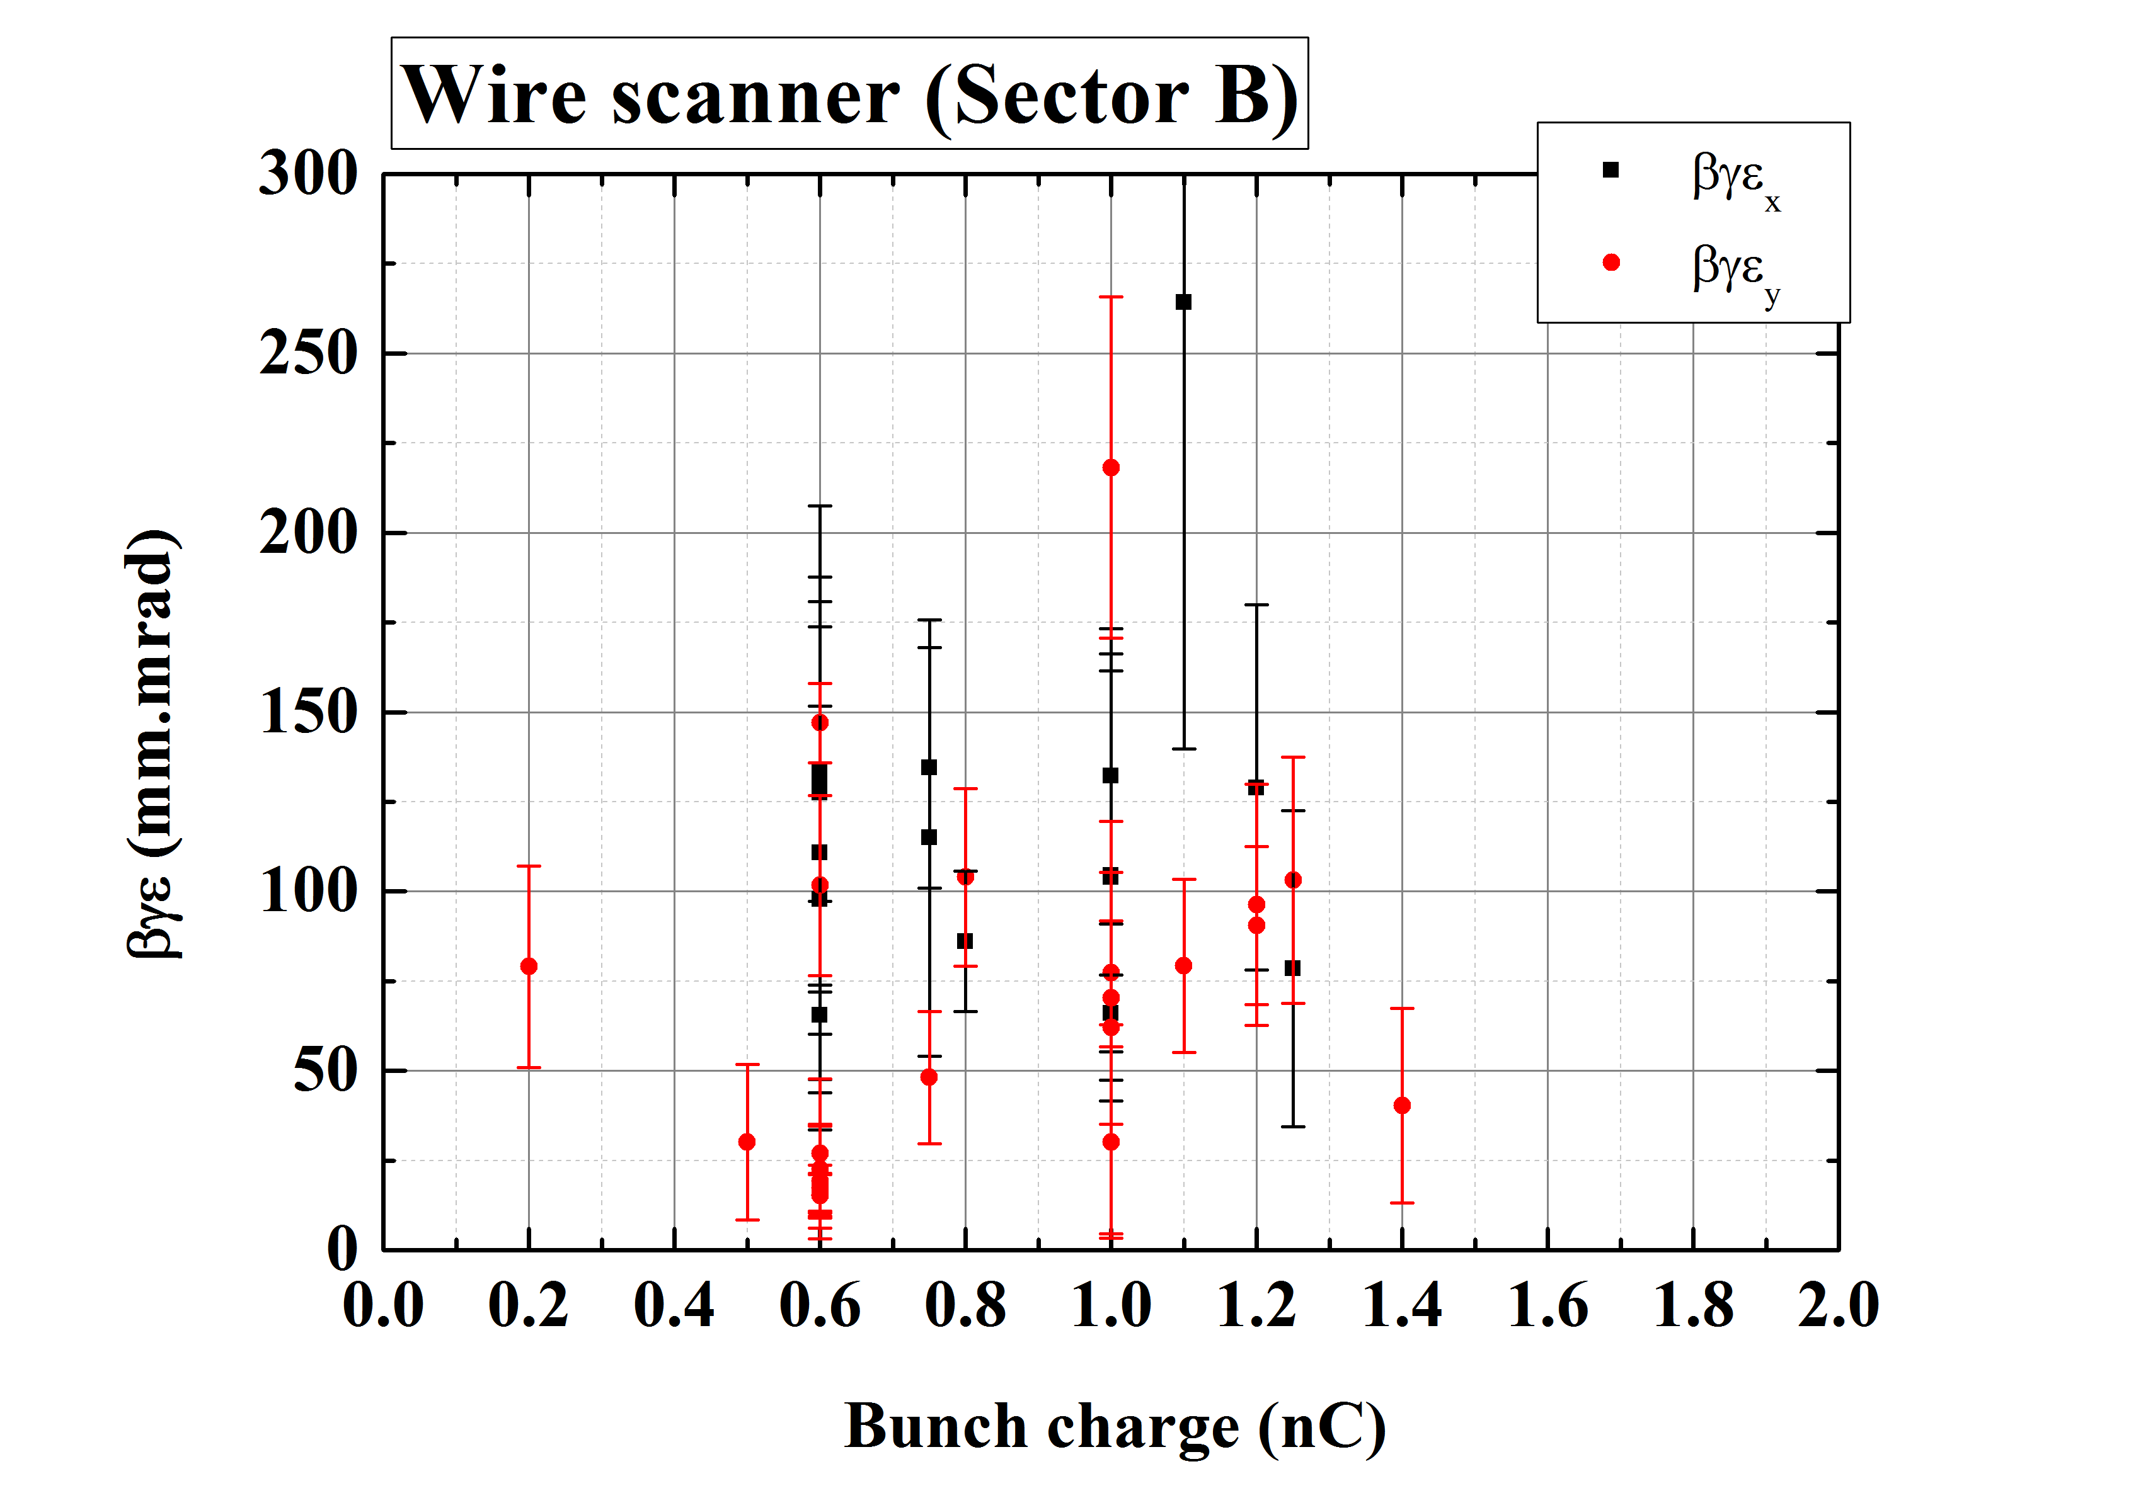
Emittance measurement
Emittance as function of bunch charge (drop the results w/ large error )
Small bunch charge (< 1 nC) shows good emittance at injector section.
  < 10 mm⋅mrad (Vertical), < 15 mm⋅mrad (Horizontal)
Results at SectorB show larger emittance than our goal.
20

Slide 30
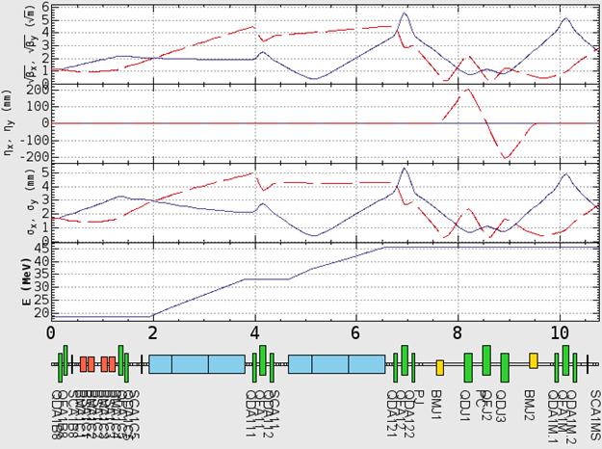




Optics design
Quadrupole triplets will be installed in merger line.
Beam size is not so large in comparison with bore radius of vacuum chamber .
Merger line
$\sqrt{β_{x}}$ $(\sqrt{m})$
$\sqrt{β_{y}}$ $(\sqrt{m})$
$$η_{x} (mm)$$
$η_{y}$ (mm)
Hor. beam size (mm)
Ver. beam size (mm)
Beam energy (MeV)

Slide 31
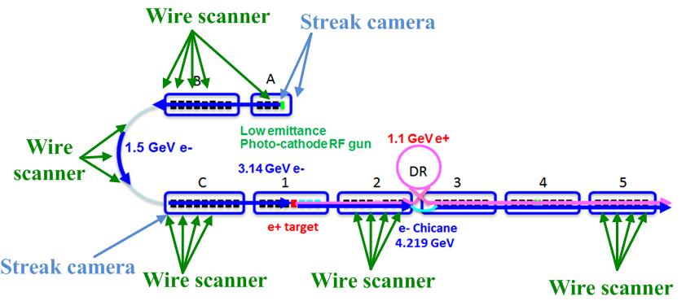
Beam diagnostics
Beam position measurement
  BPMs x 91 (strip-line type electrodes)
Beam profile/Emittance measurement
  Fluorescent screen monitors x100
  Single wire scanner x1
  Multiple wire scanner x5
Bunch length measurement
  Streak camera x3

Slide 32
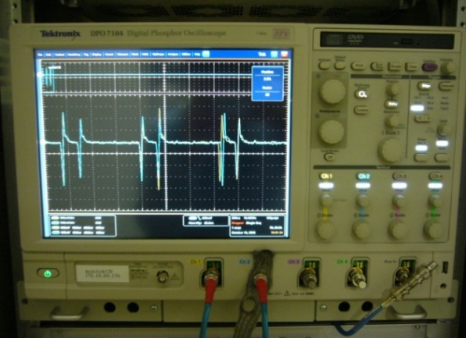
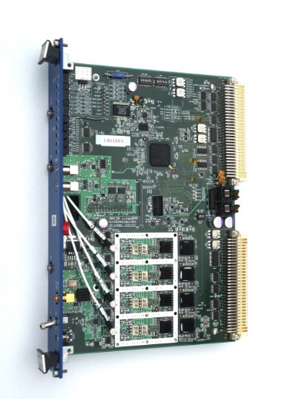
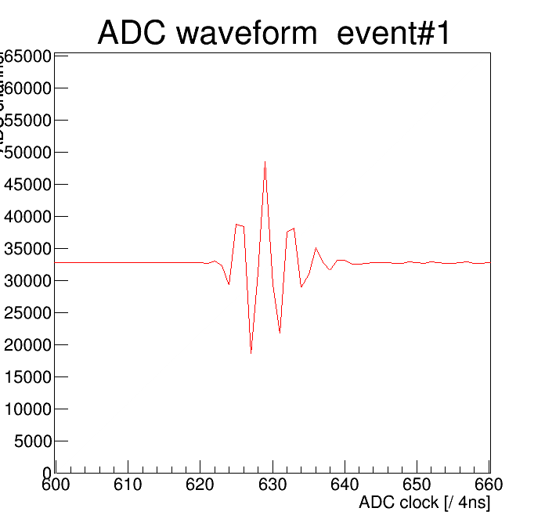
New BPM readout system
Current system:
  Windows-based digital oscilloscope
    10 GSa/s, 8 bit, 1 GHz bandwidth, 4 channels
    Twenty four systems process the signals from 92 BPMs
    Position measurement precision: 25～50 μm (3-BPM method)
New system:
  VME module w/ band-pass sampling scheme
    250 MSa/s, 16 bit ADC,
    BPF (fc: 180 MHz, BW: 60 MHz, 22 MHz)
    Signal can be well damped within 80 ns
    (first and second bunch interval: 96 ns)
  Measurement precision: 3 μm
  104 modules have been manufactured.
  12 modules have been successfully utilized for daily operation.
80 ns

Slide 33
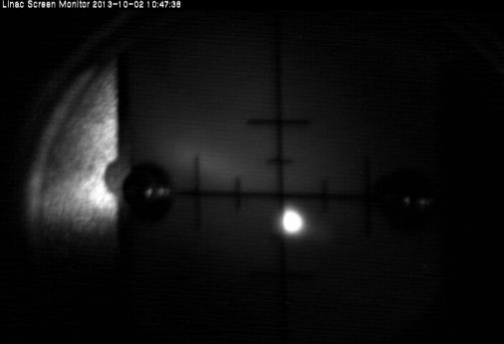

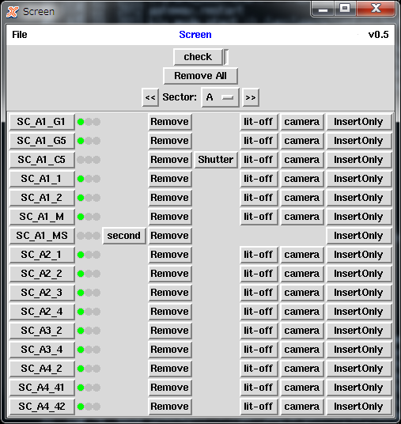
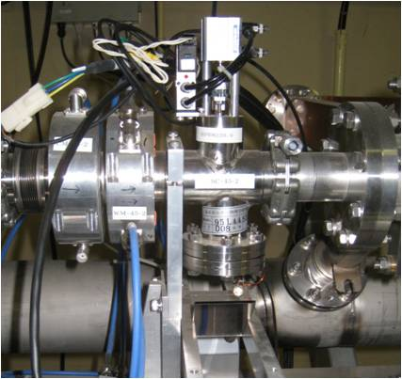
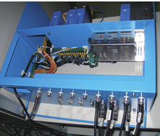
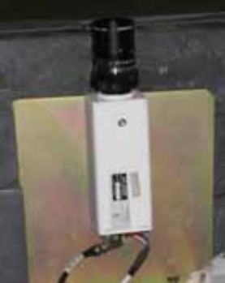
Profile monitor
Screen material is made of 99.5% Al2O3 and 0.5% CrO3 (AF995R, Demarquest Co.). (t: 1 mm)
Linux/PLC (x31) control profile monitor (insert/remove, video signal select, limit switch, LED illumination, pneumatic air pressure).
EPICS IOC is running on Linux/PLC. HLA is implemented by Python.
Beam profile
Controller and HLA
Monitor and CCD camera

Slide 34
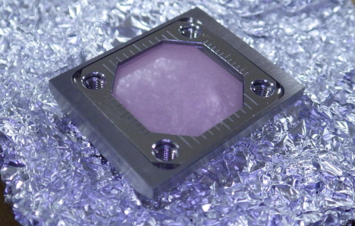
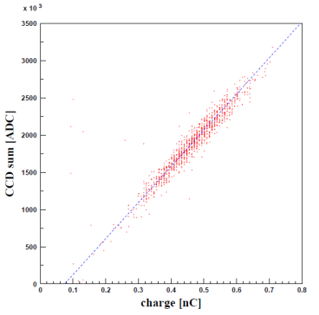
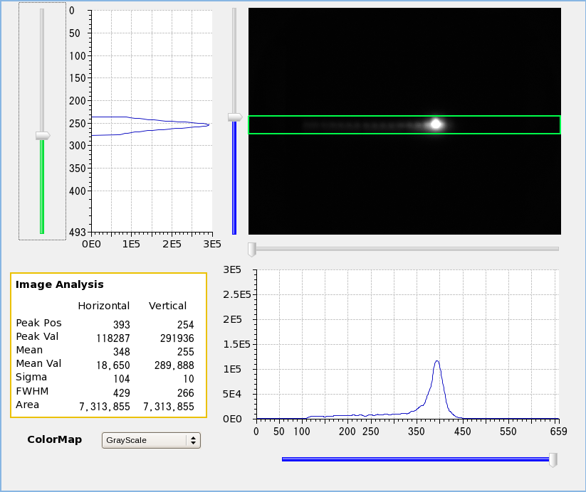
Profile monitor (cont’d)
7/97 were replaced by 30-μm-thick one for precise beam size/emittance measurement (Quadrupole scan).
CCD cameras have been replaced by new one.
  Allied Vision: GC650 w/ GbE
  Ext. trigger input
  EPICS IOC, CSS for HLA

Slide 35
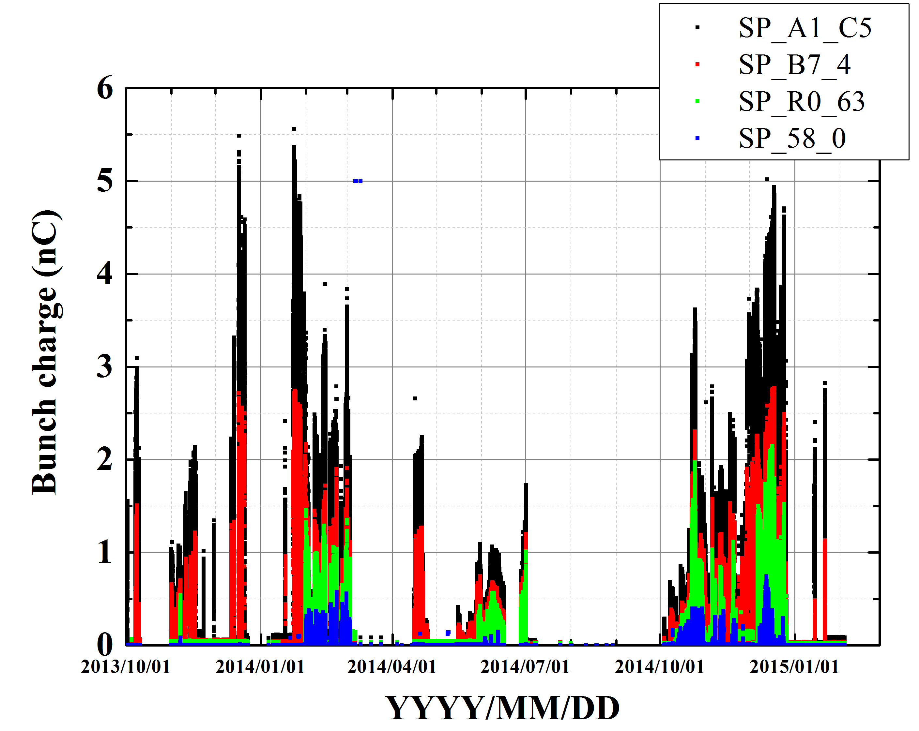
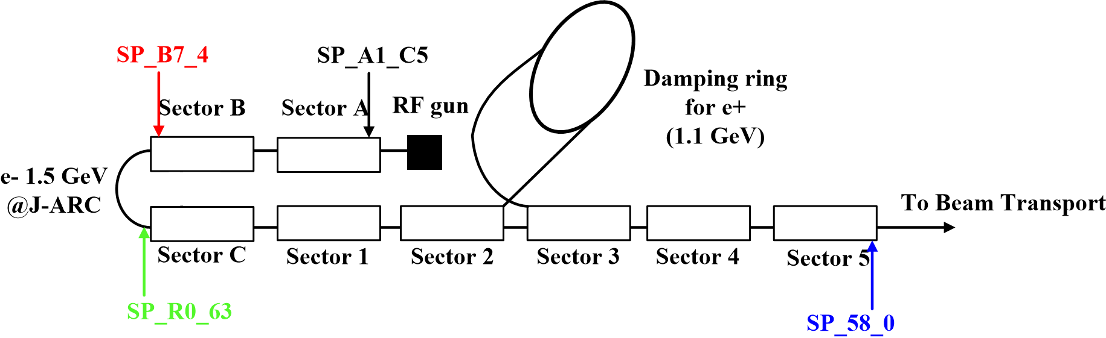
Bunch charge history (rf gun)
5.6 nC
0.75 nC

Slide 36
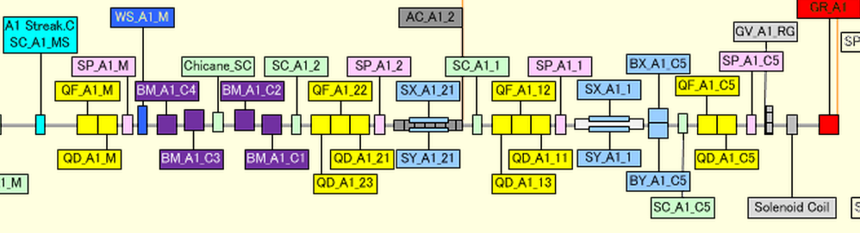



Bunch compression at Unit-A1
Chicane
Laser length
w/ bunch compression
w/o bunch compression
30 ps
10 ps
30 ps
A1 RF Φ -30°: 10 ps
A1 RF Φ 0°: 30 ps

Slide 37

Bunch charge from rf gun in last Dec.
1 week

Slide 38

Typical beam charge stability
1 hour
σI: 10% ~ 20%
~ 2.5% (KEKB operation)

Slide 39

Bunch charge and laser power
Bunch charge (1st BPM) as a function of laser power.
Clear correlation between them
Bunch charge (nC)
Laser power (Arb. Units)

Slide 40

Bunch charge fluctuation
Bunch charge fluctuation as a function of bunch charge (2D histogram)
Oct. of 2013 – Dec. of 2014
Requirement for Phase-I

Slide 41
e- beam parameters
 | SuperKEKB | KEKB
Energy (GeV) | 7.0 | 8.0
HER stored current (A) | 2.6 | 1.1
HER beam lifetime (min.) | 6 | 200
Maximum beam repetition (Hz) | 50 | 50
Max. # of bunch in an rf pulse | 2 | 2
Emittance (mm⋅mrad) | 50/20 (Hor./Ver.) | 310
Charge (nC) | 5 | 1
Energy spread (%) | 0.1 | 0.05
Bunch length σz (mm) | 1.3 | 1.3
Damping ring | - | -
Simultaneous top-up injection | 4 rings (SuperKEKB e-/e+, PF, PF-AR) | 3 rings (KEKB e-/e+, PF)

Slide 42
e+ beam parameters
 | SuperKEKB | KEKB
Energy (GeV) | 4 | 3.5
LER stored current (A) | 3.6 | 1.6
LER beam lifetime (min.) | 6 | 133
Maximum beam repetition (Hz) | 50 | 50
Max. # of bunch in an rf pulse | 2 | 2
Emittance (mm⋅mrad) | 100/20 (Hor./Ver.) | 1400
Charge (nC) | 4 | 1
Energy spread (%) | 0.07 | 0.125
Bunch length σz (mm) | 0.7 | 2.6
Damping ring | 〇 | -
Simultaneous top-up injection | 4 rings (SuperKEKB e-/e+, PF, PF-AR) | 3 rings (KEKB e-/e+, PF)

Slide 43

Shot-by-shot beam profile stability

Slide 44

Beam position stability @ SP_A1_C5
Measured beam position at first BPM (SP_A1_C5)
  σx ~ 0.57 mm
  σy ~ 0.11 mm
Fluctuation of horizontal beam position is larger than vertical one.
30 min.

Slide 45


Energy spread measurement @ J-ARC
Measure beam energy spread by screen monitor (middle of J-ARC) w/ and w/o bunch compression at A1 chicane.
Bunch compression at A1 unit is effective for energy spread compensation.
A1 chicane On
(w/o bunch compression)
A1 chicane Off
(w/ bunch compression)

Slide 46

Bunch compression @ J-ARC
Isochronous (w/o bunch compression), R56 = -0.3 m (w/ bunch compression) w/ different RF Φ in SectorA/B
Clear bunch compression has not yet been measured.
Emittance measurement by multiple wire scanner at Sector2 w/ and w/o J-ARC bunch compression.
Streak camera at SectorC

Slide 47

Bunch compression at J-ARC
Mitigate transverse wakefield and emittance growth
Initial bunch length 10 ps => 5 ps (bunch compression at J-ARC)
  First stage compression at A1 unit (30 ps => 10 ps)
Control R56 and energy spread at J-ARC
Jarc
Bunch compression

Slide 48


Emittance (misalignment σ = 0.3 mm)
Bunch compression is effective.
However, still not enough for 20 mm⋅mrad.
R56 = 0 (w/o compression)
R56 = -0.30 (w/ compression)
20 mm⋅mrad

Slide 49

Bunch compression at A1 unit
To mitigate space charge effect, bunch length is compressed from
30 ps to 10 ps.
First Accelerating structure
Laser hut
Streak
camera
Chicane
RF gun

