Slide 1
Present status of
the SuperKEKB Vacuum System
Y. Suetsugu, KEK
on behalf of KEKB Vacuum Group
Contents
  Brief review of the vacuum system
  Requirements, features, construction, ….
Present status
  Vacuum scrubbing
  Status of new components
  Major problems
    Non-linear pressure rise (E-cloud effect)
    Pressure bursts accompanying beam loss
    Etc.
Summary and plan

Slide 2
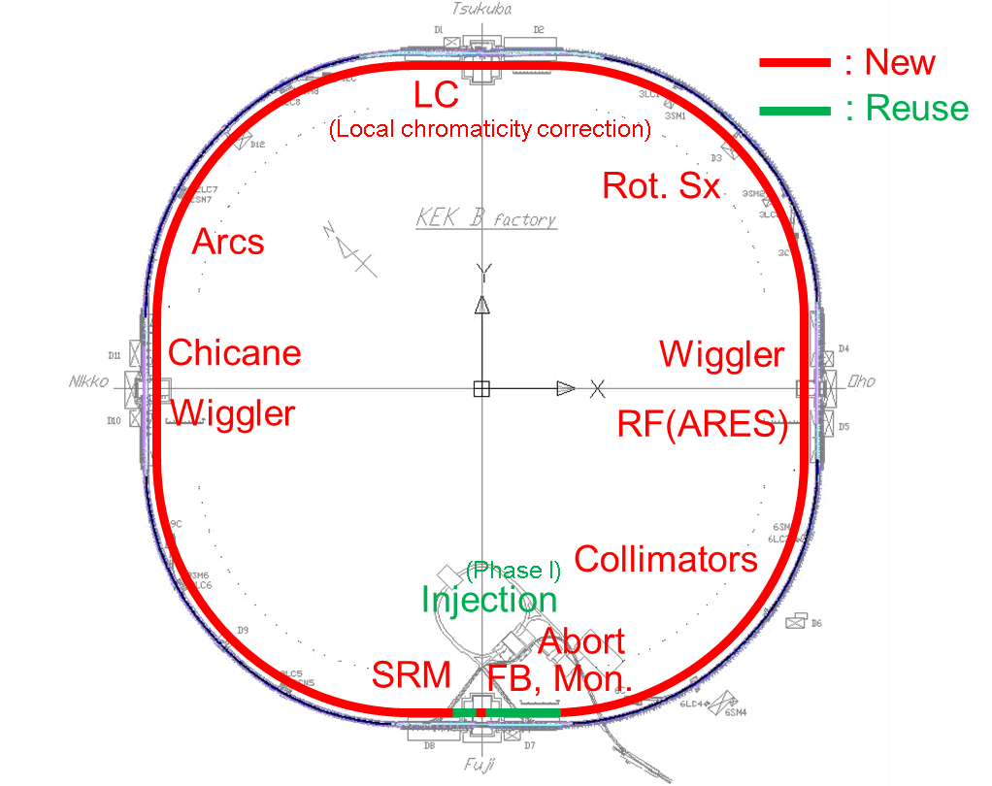
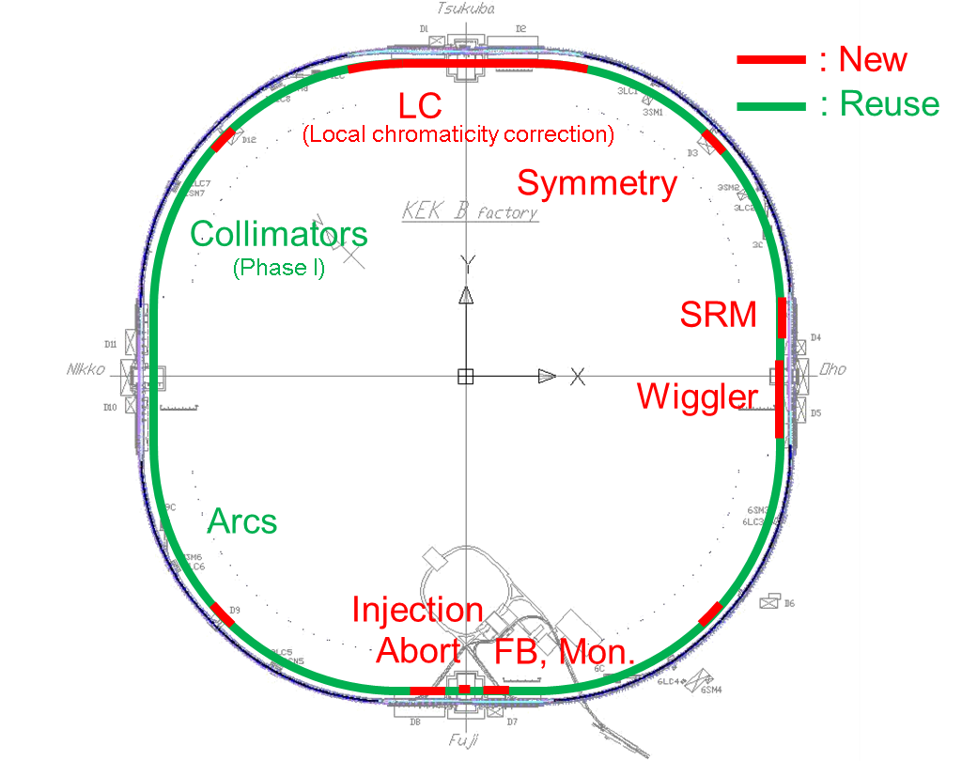
Outline of upgrade
LER: Approximately 93% of beam pipes in length are renewed.
HER: Approximately 82 % are reused.
LER
HER
New: 93%
New: 18%
(2610m/2800m)
(500m/2800m)
Sub systems, such as cooling water system, compressed air system, were basically reutilized, with necessary upgrades.
Control system was also reused, but the antique components are updated.

Slide 3
Requirements to vacuum system
Ultra-high vacuum to keep small beam emittance, to reduce background noise of detector, to avoid ion instability (HER)
  Target pressure : ~ 10⁻⁷ Pa with beams
High tolerance against high current beams for stable operation
  New RF shields for bellows chambers and gate valves
Low beam impedance to keep small beam emittance and short bunch length, and to avoid beam instabilities
  Beam pipe with antechamber, step-less (MO-type) connection flange, new collimators with low impedance
Suppression of electron cloud effect (ECE) to avoid beam size blow up (LER)
  Beam pipe with antechamber, solenoid field, coating of TiN film, etc.
Efficient use of KEKB resources as much as possible
  82% of HER beam pipes are reutilized.
  Cooling water system , control system, etc. are also basically reused.

Slide 4
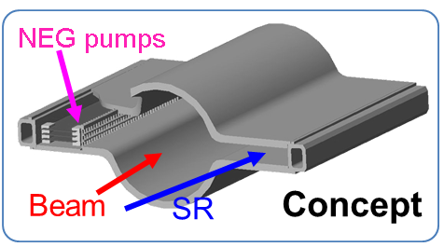
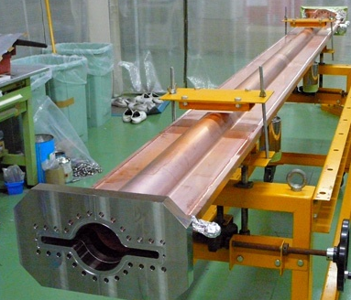
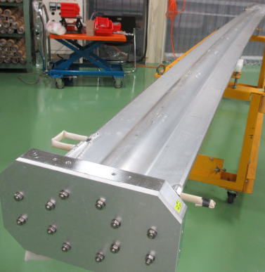
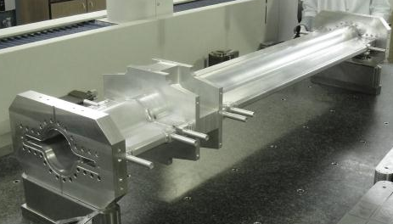
Beam Pipe
New beam pipes with antechambers
  Realize low beam impedance by putting SR mask and pump ports in antechambers
  Effective to reduce photo electron effect
  LER arcs: Aluminum alloy (A6063)
    Formed by extrusion method
  HER and Wigglers: OFC (C1011)
    Formed by cold-drawing method
  ~1230 pipes in total
Typical size: φ90 x ^{w}220
Beam pipes for wigglers
Beam pipes for bending magnets
Beam pipes for quad magnets

Slide 5
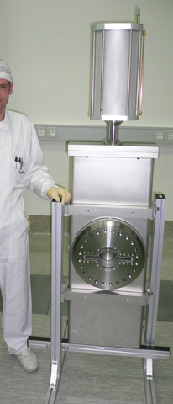
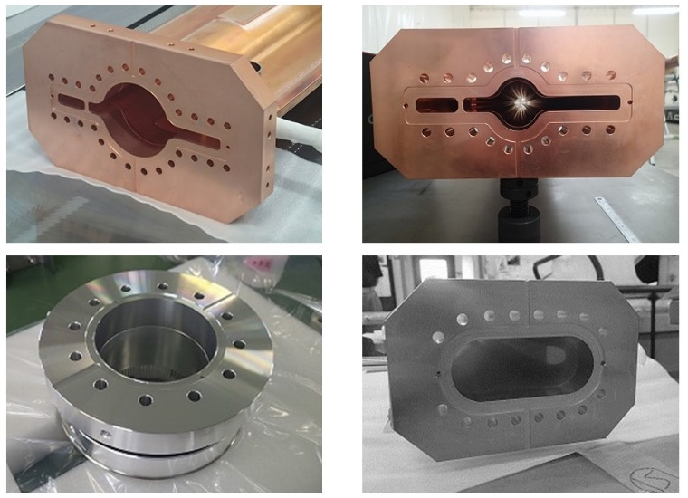
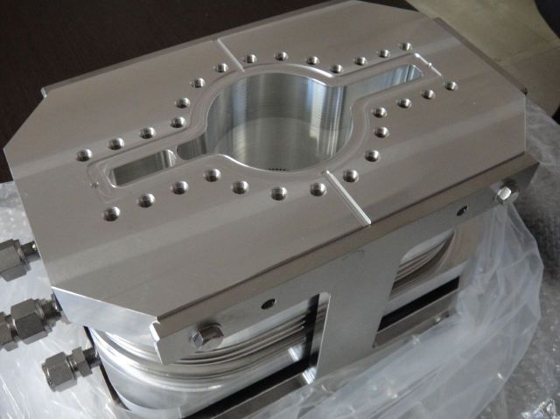
Bellows, Gate Valve and Flange
New bellows chambers and gate valves with comb-type RF shield inside
  High thermal strength
  Applicable to cross sections with antechambers
  Bellows chambers: ~1240, GVs: ~40
Gate valve for antechamber
MO-type flanges
  Little step inside and low beam impedance
  Adaptable to various types of cross sections
  ~ 5000 flanges
RF-shield
Aluminum alloy bellows chamber
Various types of MO flange

Slide 6
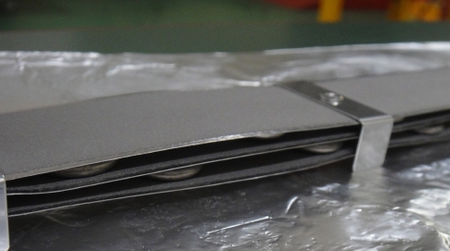
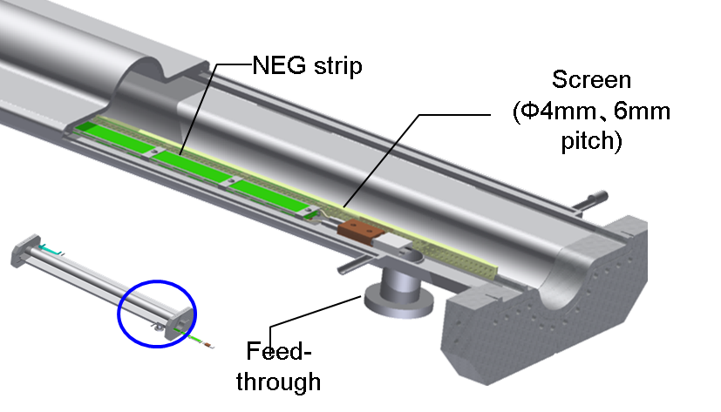
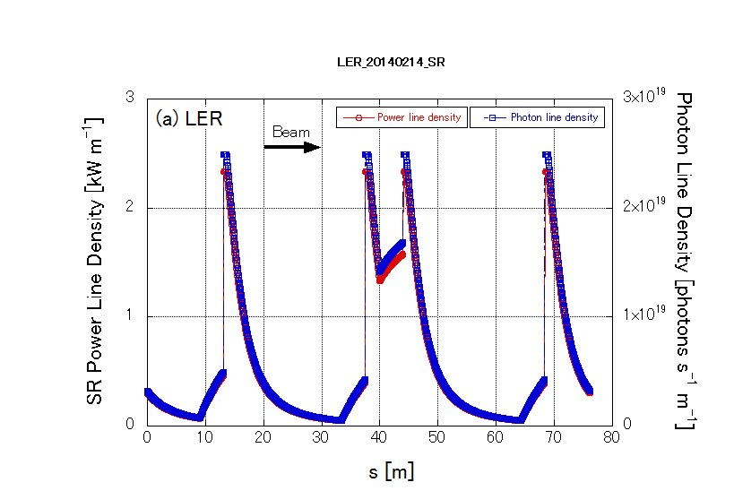
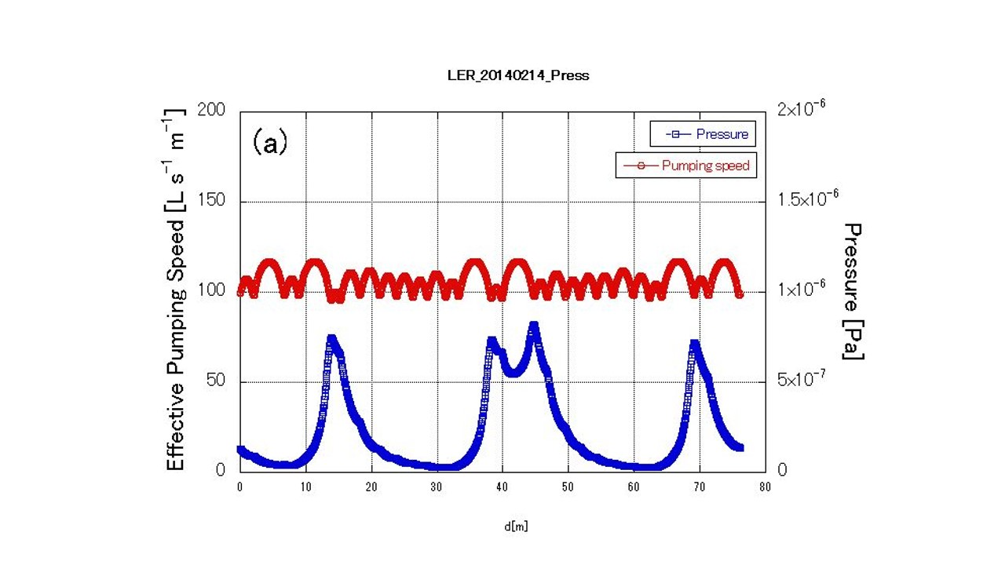
Pump system
Main: Three layers of NEG strips ST707 (arc)
  Installed into an antechamber: provide effective distributed pumping system
  Activation by micro-heaters (sheath heaters) inserted between strips
  Screens (RF shield) between pump and beam
3 layer NEG strips
  Average pumping speed of 0.14 m³s⁻¹m⁻¹ for CO
  ~ 1130 pieces
Aux: Ion pumps
  Noble pump with a pumping speed of ~ 0.4 m³s⁻¹
Photon line density at arc
Effective pumping speed and pressure
(η=1×10⁻⁶ mole. pho.⁻¹)
Eff. pumping speed
0.11 m³s⁻¹m⁻¹
Pressure
2.3×10⁻⁷ Pa
in average
Bending magnets

Slide 7
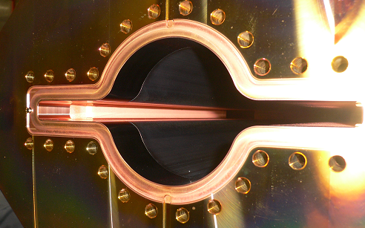
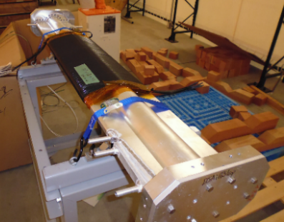
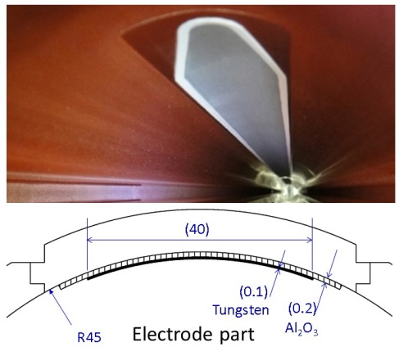
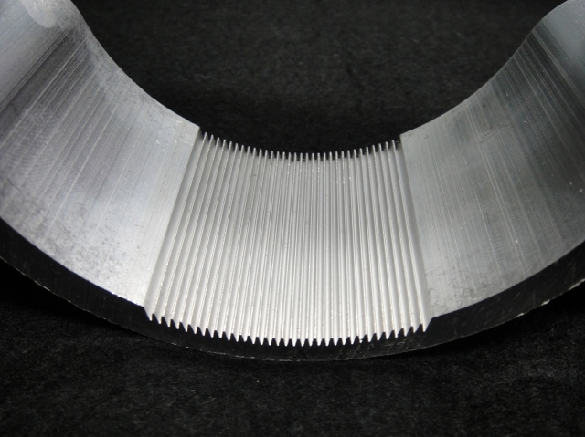
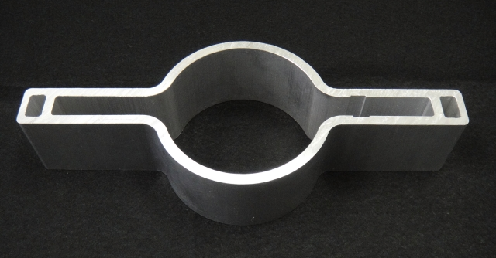
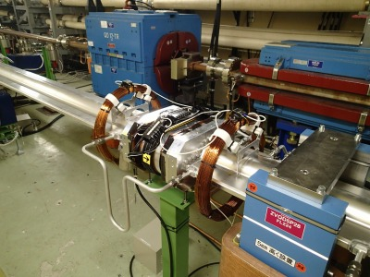
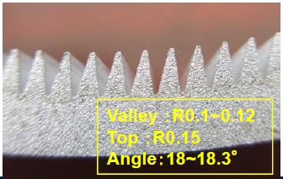
Countermeasures against ECE
Electron cloud instability can be a serious problem for LER (e⁺)
  Blow up of beam size ⇒Deterioration of the luminosity
For the SuperKEKB, the threshold of electron density to excite the head-tail instability: ~2x10¹¹ e⁻ m⁻³. (Ohmi-san et al.)
Various mitigation techniques were adopted in the SuperKEKB.
  Antechambers
  TiN coating
  Solenoid field
  Clearing electrode (w)
  Grooved surface (B)

Slide 8
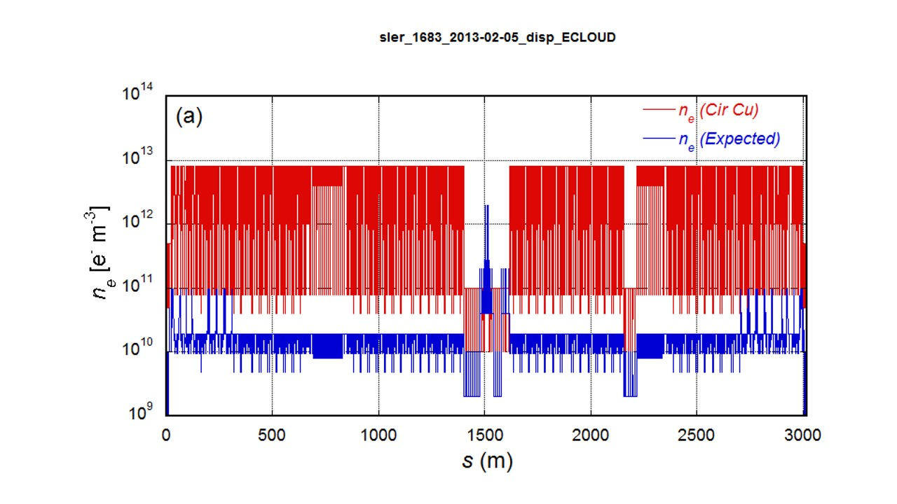
Countermeasures against ECE
Countermeasures in SuperKEKB positron ring (Final configuration*)
Sections | L [m] | L [ %] | Countermeasure | Material
Total | 3016 | 100
Drift space (arc) | 1629 m | 54 | TiN coating + Solenoid | Al (arc)
Steering mag. | 316 m | 10 | TiN coating + Solenoid | Al
Bending mag. | 519 m | 17 | TiN coating + Grooved surface | Al
Wiggler mag. | 154 m | 5 | Clearing Electrode | Cu
Q & SX mag. | 254 m | 9 | TiN coating | Al (arc)
RF section | 124 m | 4 | (TiN coating +) Solenoid | Cu
IR section | 20 m | 0.7 | (TiN coating +) Solenoid | Cu or Al
*Solenoid coil has not yet applied.
Electron density along the ring
With above countermeasures,
n_{e} ~2x10¹⁰ e⁻ m⁻³
is expected.

Slide 9
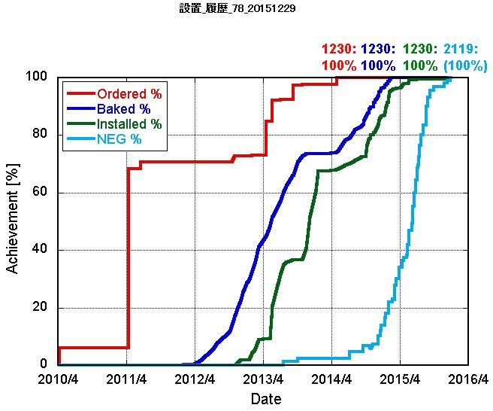
Construction
Achievement of construction
Fabrication of main components finished in FY2014.
Pre-installation work, including TiN coating (LER) and baking, also finished in FY 2014.

Slide 10
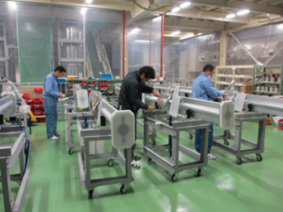
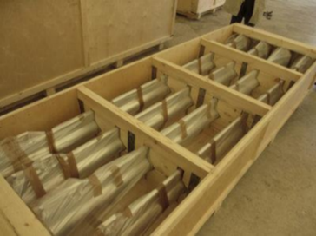
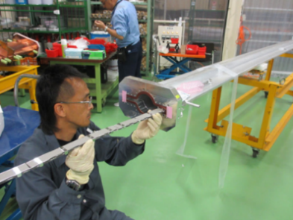
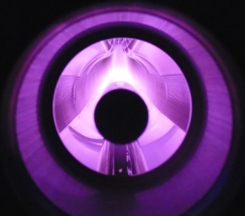
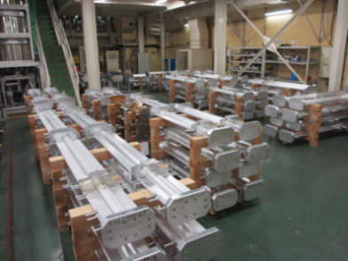
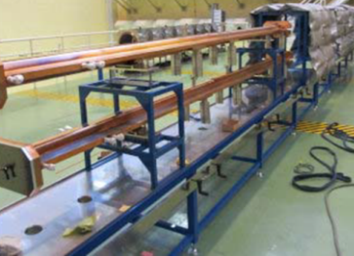
Pre-installation work
Basically all beam pipes are baked at 150°C for ~24 hours including NEG activation before installing them into the tunnel.
Inside of LER beam pipes are coated with thin TiN to mitigate ECE.
Delivery
Clean room
Unpacking
Storage
LER
Inside check
Clean room
Pre-baking
Assembling
TiN coating
HER
TiN coating
Assembling
(pumps)
Pre-baking +
NEG activation
Storage
Baking
Storage
(Filled with N₂)
Installation

Slide 11
Construction
Achievement of construction
Fabrication of components finished in FY2014.
Pre-installation work, including TiN coating (LER) and baking, also finished in FY 2014.
Installation of components into the tunnel completed in 2015.
The upgrade of sub systems also completed.

Slide 12
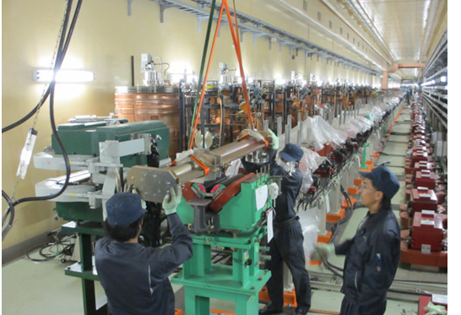
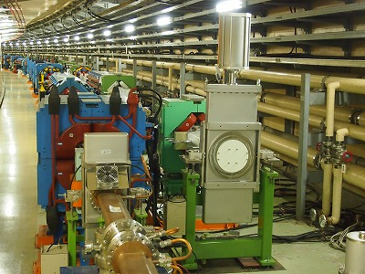
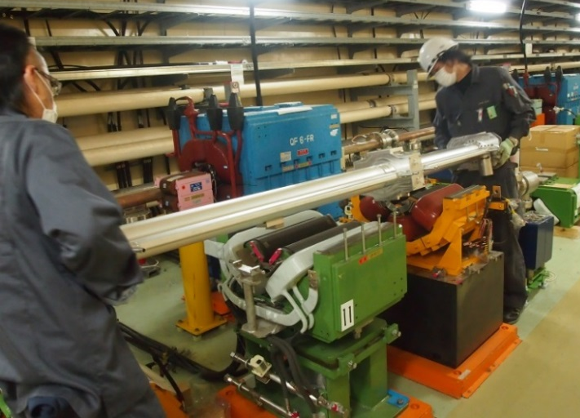
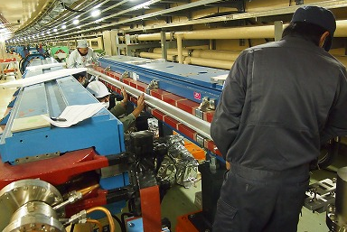
Installation into the tunnel
Installation of beam pipes (2013)
Beam pipe for wiggler
Gate valve at arc
Beam pipe for quad
Beam pipe for bend

Slide 13
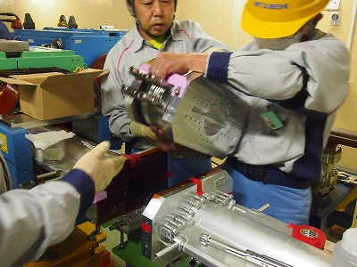
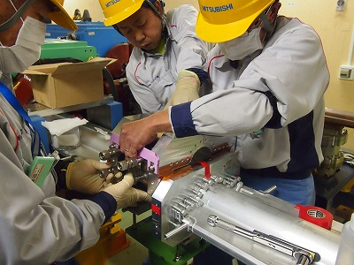
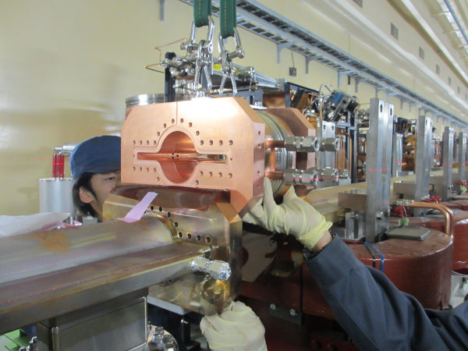
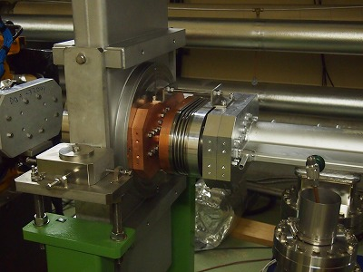
Installation into the tunnel
Installation of bellows chambers follows the beam pipes (2014)
Al bellows chamber
Cu bellows chamber
Cu-Al bellows chamber for GV

Slide 14
Construction
Achievement of construction
Fabrication of main components finished in FY2014.
Pre-installation work, including TiN coating (LER) and baking, also finished in FY 2014.
Installation of components into the tunnel completed in 2015.
The upgrade of sub systems also completed.
NEG activation in the tunnel finished by the end of 2015.

Slide 15
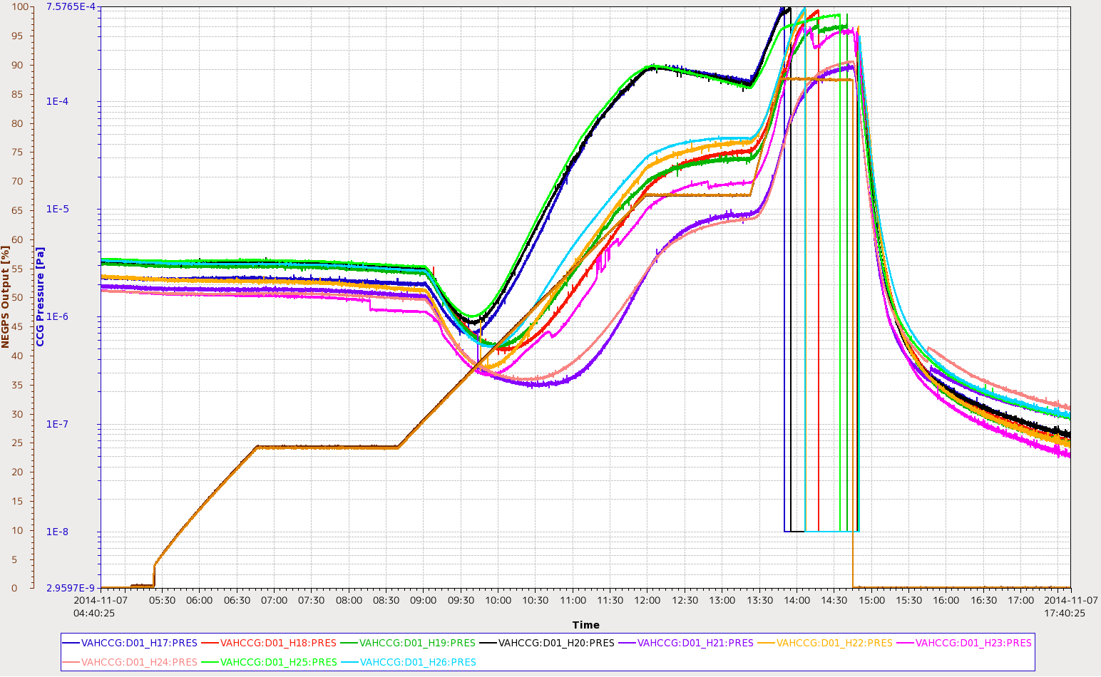
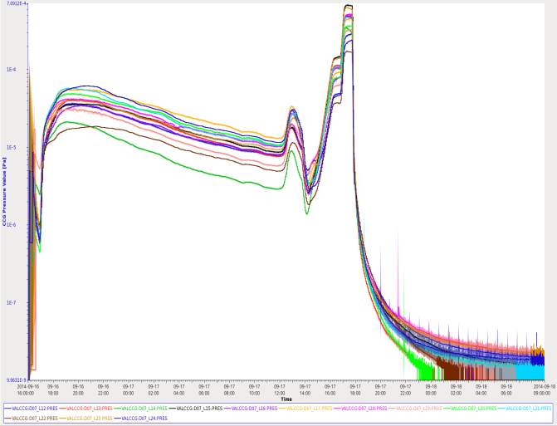
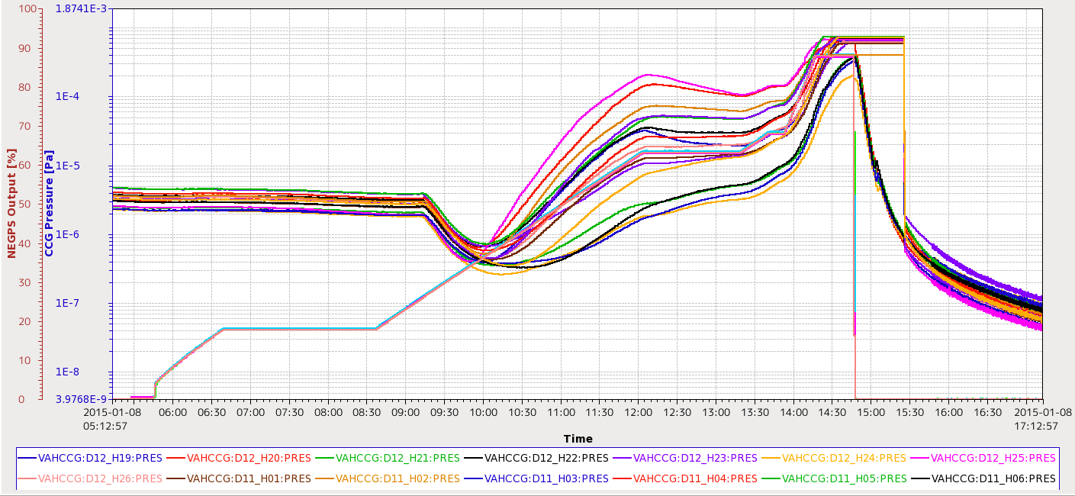
Activation of NEG pumps
Regions between gate valves in the tunnel are evacuated in series.
  We have approximately 40 gate valves in a ring.
After rough pumping and He leak check, ion pumps are baked for one day. NEG pumps are finally activated at the last phase of the baking.
No beam pipe baking in the tunnel
After NEG activation, average pressures of less than 1x10⁻⁷ Pa were successfully obtained.
NEG act
NEG act
NEG act
1E-7 Pa
1E-7 Pa
1E-7 Pa

Slide 16
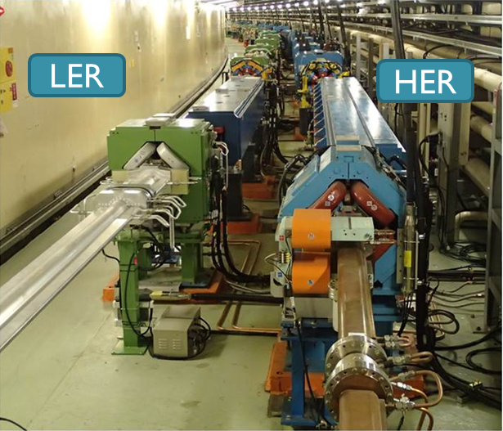
Construction
Achievement of construction
Fabrication of main components finished in FY2014.
Pre-installation work, including TiN coating (LER) and baking, finished in FY 2014.
Installation of components into the tunnel completed in 2015.
The update of sub systems also completed.
NEG activation in the tunnel finished by the end of 2015.
Beam commissioning (Phase-1) started in February, 2016.

Slide 17
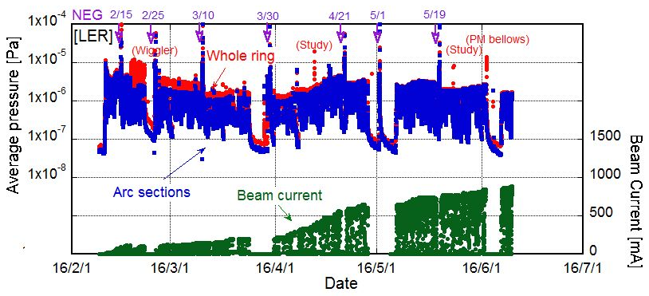
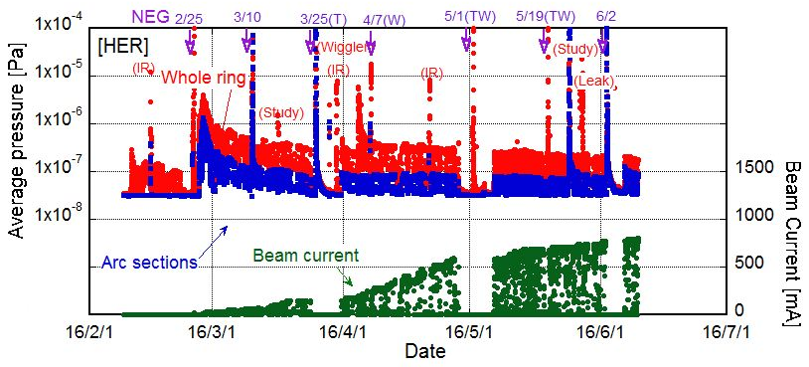
Present status - 1
Overall, the vacuum system made a good start.
Beam currents and average pressures (- 2016/6/10)
[LER]
Base pressure ~5x10⁻⁸ Pa
Max. Beam current: 910 mA
Avg. ~ 2x10⁻⁶ Pa
Lifetime ~ 75 min.
(with emittance knob)
[HER]
Base pressure ~3x10⁻⁸ Pa
Max. Beam current: 830 mA
Avg. ~ 2x10⁻⁷ Pa
(whole ring)
~ 1x10⁻⁷ Pa
(arc sections)
Lifetime ~ 600 min.

Slide 18
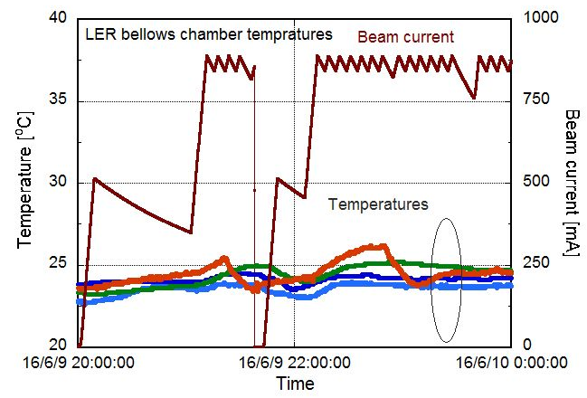
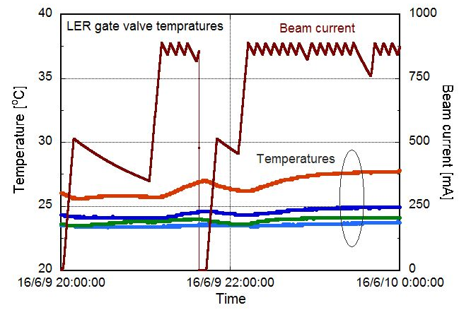
Present status - 2
Status of new vacuum components
  Confirming the stability of the new vacuum components was a major subject for the Phase-I beam commissioning.
  No extra heating or abnormal pressure rise in these components has been observed so far.
  The temperature rises in the bellows chambers, gate valves and flanges are less than 3-4 °C at 890 mA, for example.
Bellows chamber
Gate valve

Slide 19
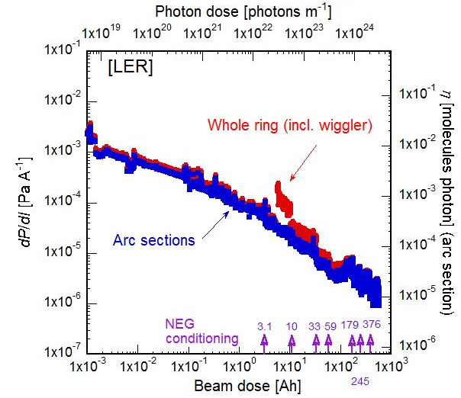
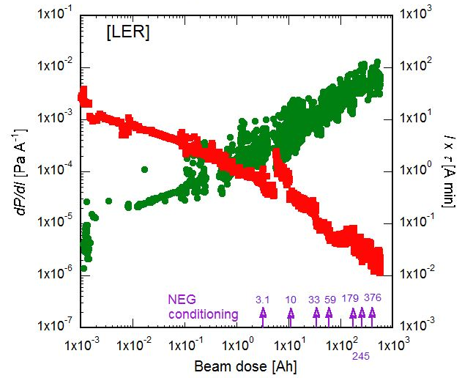
Present status - 3
Vacuum scrubbing: LER (1)
  The dP/dI value for arc section, where all of the beam pipes were newly fabricated, was ~2x10⁻⁶ Pa A⁻¹ at the beam dose of 500 Ah. The η was ~1x10⁻⁵ molecules photon⁻¹ [for pumping speed = 0.4 m³s⁻¹m⁻¹].
  The decrease rate of dP/dI slowed down from the beam dose of 100 Ah. −> Nonlinear behavior of pressures against the beam current (discussed later).
-2016/6/10
-2016/6/10
Pressure
I x τ

Slide 20
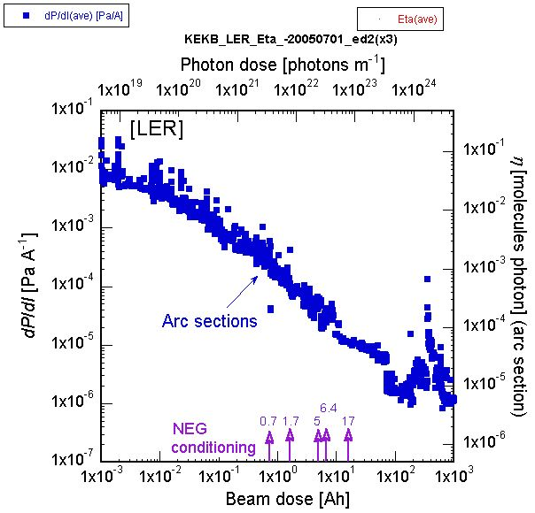
Present status - 3
Vacuum scrubbing: LER (2)
  Compared to the case of the KEKB, which used circular copper beam pipes without any coating, dP/dI value at the initial stage was lower by several factors. Recently, however, dP/dI value is almost the same as the case of KEKB at the same beam dose.
[KEKB]
-2016/6/10
-2005/7/1

Slide 21
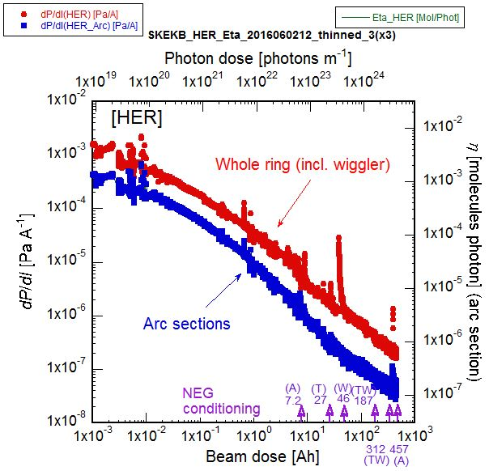
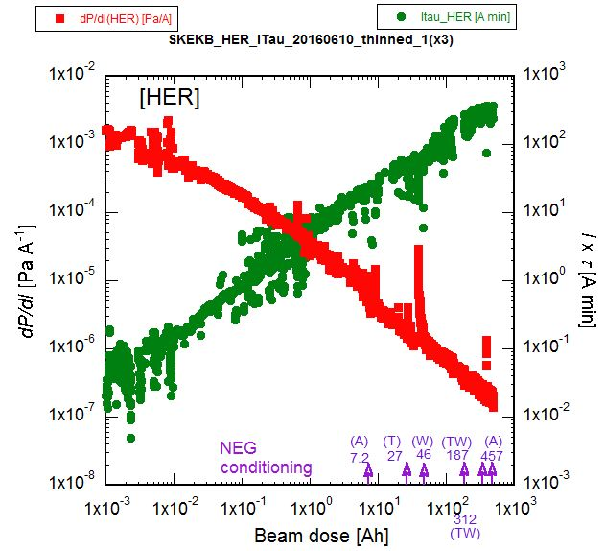
Present status - 3
Vacuum scrubbing: HER (1)
  The dP/dI value at the arc section, where most of the beam pipes was reused from KEKB, was ~5x10⁻⁸ Pa A⁻¹ at the beam dose of 500 Ah. The η was ~1x10⁻⁷ molecules photon⁻¹ [for pumping speed = 0.3 m³s⁻¹m⁻¹]. The η is much smaller than that of LER.
-2016/6/10
-2016/6/10
Pressure
I x τ

Slide 22
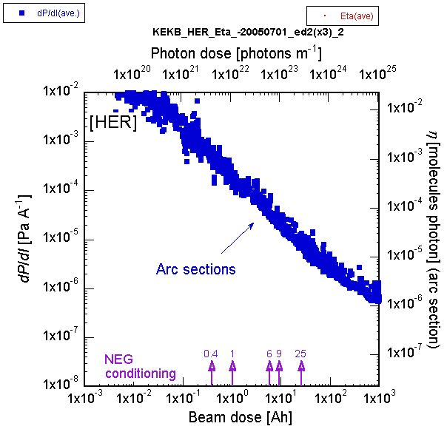
Present status - 3
Vacuum scrubbing: HER (2)
  The dP/dI value is comparable to that in the case of KEKB at the final stage. This means that the surface of the reused beam pipes “remembers” the conditions in the KEKB, even though the beam pipes were exposed to the air for vacuum work.
  Now η is almost the same value with the final value of the KEKB HER.
-2016/6/10
[KEKB]
-2005/7/1

Slide 23

Present status - 4
Residual gases
  Residual gases during the beam operation have been monitored with a quadrupole mass analyzer (QMA) at an arc section.
  The QMA is located just above a sputter ion pump.
  The main gases are hydrogen (m/e = 2), carbon monoxide (m/e = 28), methane (m/e = 16), water (m/e = 18), and carbon dioxide (m/e = 44).
    The high partial pressure of methane should be due to the pumping system using NEG as a main pump.
    Because the beam pipes were not baked in the tunnel, water vapor still remains in the beam pipe.
H₂
CO,N₂
CH₄
H₂O
CO₂
Ar
O₂

Slide 24



Present status - 5
Effect of antechamber and TiN coating (1)
  In relation to the ECE, we set up two electron current monitors used in the experiment in KEKB for measuring the electron numbers around the circulating beam in the new aluminum beam pipe
    The measured electron currents almost reflect the electron density around the beam orbit.
  The electron currents in an aluminum beam pipes with and without TiN coating can be measured at the same time.
    Note that all of other new beam pipes were coated with TiN.
[Al_Ante+TiN]
[Al_Ante]
Retarding grid
Curtesy of Kanazawa

Slide 25

Present status - 5
Effect of antechamber and TiN coating (2)
  The electron currents were measured during the beam operation, and compared with the data of KEKB.

Slide 26

Present status - 5
Effect of antechamber and TiN coating (2)
  The electron currents were measured during the beam operation, and compared with the data of KEKB.
Low current region (I_{e} < 400 mA)
  Electron currents of the beam pipe with antechambers are much lower than those without antechambers.
  Reduction of photoelectrons by antechamber structure was reconfirmed.

Slide 27

Present status - 5
Effect of antechamber and TiN coating (3)
  The electron currents were measured during the beam operation, and compared with the data of KEKB.
High current region (I_{e} > 500 mA) (1)
  Electron current at aluminum with TiN coating is much lower than that without it, and is comparable with copper antechamber taking into account the difference of photon flux.
  TiN coating on aluminum is working well.
  The estimation of SEY is in progress. Furthermore, change in SEY of the TiN-coated surface after long time storage is now investigated in the laboratory.

Slide 28


Present status - 6
Clearing electrode (preliminary results)
  Clearing electrodes were prepared in the LER wiggler magnets to absorb electrons, as a countermeasure against ECE.
  A DC voltage of 300 V were applied during the beam operation.
    The voltage was stably kept at a beam current of 910 mA.
  Electron current saturates at approximately 100 V.
  Electron currents is still independent of the bunch fill pattern -> photoelectrons?

Slide 29


Present status - 7
Beam collimator (1)
  Two horizontal-type collimators were manufactured for test.
  The collimators were installed at an arc section in the ring, and the performance was tested with beams.
  No excess heating at bellows behind the jaw.
  Transverse impedance is almost coincident with the simulation result.
Schematic of a horizontal-type collimator
Collimator installed in the tunnel

Slide 30

Present status - 7
Beam collimator(2)
A result in the BEASTII study (by Nakayama-san)
As we change D06H3OUT width from 24mm to 17mm,
LYSO/CsI BG shows step-like decrease at every time collimator get narrower.
This is the clear evidence of BG suppression by the collimator!

Slide 31



Present status - 8
Control system
  The control system were updated.
  For example, a CAMAC data logger system were replaced with a CompactRIO (cRIO) system.
  Control System Studio (CSS) is used as GUI of the control panel on X terminals. NEG activation, for example, can be remotely controlled from control panels.
  Interlock logic with a PLC and beam abort logic with a ladder sequence program are working well so far.

Slide 32


Problems - 1
Non-linear pressure rise against the beam current in LER -1
  The pressures at whole LER ring showed a nonlinear behavior against the beam current over ~500 mA.
The behavior is quite similar to that of electron currents measured at aluminum region without TiN coating.
  Electron current in Al is much large that that in TiN, over 20 times!
Pressures of 9 gauges in arc sections
Pressure [Pa]
Beam current [mA]

Slide 33

Problems - 1
Non-linear pressure rise against the beam current in LER - 2
The behavior is quite similar to that of electron currents measured at aluminum parts without TiN coating.
Actually, we have aluminum bellows chambers without TiN coating along the ring. The bellows chamber has a length of 0.2 m and located every 3 m on average. ~5 % in the ring.
Pressures of 9 gauges in arc sections
Pressure [Pa]
Beam current [mA]

Slide 34
Problems - 1
Non-linear pressure rise against the beam current in LER - 3
The behavior is quite similar to that of electron currents measured at aluminum parts without TiN coating.
Actually, we have aluminum bellows chambers without TiN coating along the ring. The bellows chamber has a length of 0.2 m and located every 3 m on average. ~5 % in the ring.
Pressures of 9 gauges in arc sections
Pressure [Pa]
Electron stimulated desorption (ESD) in the aluminum bellows chambers by electrons (electron cloud)?
Actually, beam size blow up was also observed at the same time.
Beam current [mA]

Slide 35



Problems - 1
Non-linear pressure rise against the beam current in LER - 4
As a test, we applied a magnetic field of axial direction by solenoids or permanent magnets at nine aluminum bellows chambers (~30 m section). The strength is 40 ~ 100 G near the inner wall at the center of bellows.
As a result, the rate of pressure rise at this section relaxed!
Permanent magnets
Pressures of 9 gauges in arc sections
Pressure [Pa]
Solenoid coils
Beam current [mA]

Slide 36


Problems - 1
Non-linear pressure rise against the beam current in LER - 5
We put permanent magnets on most of aluminum bellows chambers (~800) all around the ring (arcs) on 2 - 4, June.
As a result, the rate of pressure rise relaxed in whole ring!
Permanent magnets
Average pressures in two arcs
Pressure [Pa]
Beam current [mA]

Slide 37
Problems - 1
Non-linear pressure rise against the beam current in LER - 6
We put permanent magnets on most of aluminum bellows chambers (~800) all around the ring (arcs) on 2 - 4, June.
As a result, the rate of pressure rise relaxed in whole ring!
However, the non-linear pressure rise is still seen at high beam current > 700 mA.
Average pressures in two arcs
Pressure [Pa]
Electron cloud still remains!
We will put permanent magnets at a part of drift region for test soon.
The ECE problem will be discussed later by Ohmi-san
Beam current [mA]

Slide 38


Problems - 2
Pressure bursts accompanying beam loss in LER -1
Beam aborts accompanied by local pressure bursts have been frequently observed in the LER.
  The beam loss monitors trigger the beam aborts
  Beam loss started at several hundreds microseconds before the beam abort.
Beam current
400 μs /div.

Slide 39


Problems - 2
Pressure bursts accompanying beam loss in LER - 2
Features
  The locations of the pressure bursts have spread to more than 20 points along the ring.
  More frequent in the Tsukuba straight section.
-2016/6/10
FUJI
TSUKUBA
NIKKO
D01
D02
D12
D03
D11
D04
TSUKUBA
NIKKO
OHO
D10
D05
OHO
D09
D06
D08
D07
FUJI
FUJI

Slide 40

Problems - 2
Pressure bursts accompanying beam loss in LER - 3
Features
  The locations of the pressure bursts have spread to more than 20 points along the ring. More frequent in the Tsukuba straight section.
  In most cases, the bursts were observed near aluminum beam pipes in dipole magnets, with groove structure. (except for wiggler section)
Position of pressure burst estimated by the distribution of pressures observed in several vacuum gauges
Quadrupoles
Bending magnets

Slide 41
Problems - 2
Pressure bursts accompanying beam loss in LER - 4
Features
  The bursts seems likely to occur when the maximum beam current is increased.
  The locations spreads for high beam current, but still near bending magnets.
  Beam orbits (horizontal) and bunch fill patters had no effect.
-2016/6/10
FUJI
TSUKUBA
NIKKO
D01
D02
D12
D03
D11
D04
TSUKUBA
NIKKO
OHO
D10
D05
D09
OHO
D06
D08
D07
FUJI
FUJI

Slide 42
Problems - 2
Pressure bursts accompanying beam loss in LER - 5
One possibility was discharges by wall current at inner wall of beam pipes, but….
  No extra heating around these points.
  Almost no small pressure bursts, which should be likely observed in discharging phenomena.
  Do discharges emit heavy materials leading to the beam loss toward beam orbit direction?
Bunch
Discharging at small gaps, dusts, whiskers or poor electrical contacts

Slide 43
Problems - 2
Pressure bursts accompanying beam loss in LER - 6
One possibility was discharges by wall current at inner wall of beam pipes, but….
  No extra heating around these points.
  Almost no small pressure bursts, which should be likely observed in discharging phenomena.
  Do discharges emit heavy materials leading to the beam loss toward beam orbit direction?
Another possibility: Collision of “dusts” with circulating beams.
  Groove structure is likely to catch the dusts.
  Aluminum grooves were formed by extrusion process, at the first stage of beam pipe fabrication.
  Beam pipes in wiggler sections have clearing electrodes at the top side.
UFO problem!
Or
Bunch

Slide 44


Problems - 2
Pressure bursts accompanying beam loss in LER - 7
Knocking test
  A “knocker” was set at a beam pipe in a bending magnet, where the burst had been observed frequently.
  We succeeded in reproducing the phenomena three times by knocking the beam pipe!
Artificial beam aborts

Slide 45
Problems - 2
Pressure bursts accompanying beam loss in LER - 8
Knocking test
  A “knocker” was set at a beam pipe in a bending magnet, where the burst had been observed frequently.
  We succeeded in reproducing the phenomena three times by knocking the beam pipe!
Collision with dusts is the most possible cause of the pressure bursts, and then the beam aborts.
However, It is not yet clear whether the dusts are falling or attracted by the positive beam.
Countermeasure is now in consideration.
  Wait? : Dusts should be limited. Fortunately, the frequency of bursts seems to gradually decrease.
  Knocking all beam pipes during a long shut down.?

Slide 46

Problems - 3
Air leak at a flange of a tapered beam pipe -1
  Occurred at a flange of a tapered beam pipe where the cross section of 104 mm x 50 mm reduces to 60 mm x 40 mm.
Air leak
TSUKUBA
e⁻ beam
NIKKO
OHO
SR mask
104x50
race track
60x40
race track
FUJI

Slide 47



Problems - 3
Air leak at a flange of a tapered beam pipe -1
  Occurred at a flange of a tapered beam pipe where the cross section 104 mm x 50 mm reduces to 60 mm x 40 mm.
A trace of “beam” was found on the inner wall across the flange.
  The SR from the bending magnet hit the opposite side.
  High residual radioactivity had been reported.
  Instantaneous temperature rise was observed at the flange at the timing of beam abort.
  Loss monitor (PIN diode) signals were observed at this point.
  Pressure bursts have been sometimes observed around here at the timing of beam aborts.

Slide 48

Problems - 3
Air leak at a flange of a tapered beam pipe-2
  Occurred at a flange of a tapered beam pipe where the cross section 104 mm x 50 mm reduces to 60 mm x 40 mm.
The cause is not completely understood yet.
One possible process is
  The beam loses the energy at other point -> veers from the normal orbit (oscillation?) -> hit the pipe wall.
Countermeasure
  Optimize the collimator positions.
    We closed the horizontal and vertical beam collimators after the accident. The pressure bursts still remains, but the magnitude becomes small. -> seems working!
  Add mask in the tapered beam pipe in the future.
Beam mask?
We have ceramics chambers for beam aborts at the downstream of this chamber.
SR mask

Slide 49
Problems - 4
Other problems
  Air leak at a gate valve
    Leak was found when the valve open just before starting the commissioning. -> Replace with new gate valve.
  Heating of beam pipes in wiggler sections
    The temperature of beam pipes in wiggler sections are very sensitive to misalignment of beam pipes or bump of beam orbit. -> Re-alignment of beam pipes and adjustment of orbit
  Stop of water flow meters
    Wheels in flow meters stop the rotation due to any debris in water (copper oxide?).-> Cleaning, replacement
  Fake abort signals
    Noise? or malfunction of circuit? -> still investigation.
  Heating of HER bellows chambers
    Damage? -> Cooling fan, temporally.
  Malfunction of temperature sensors, and so on.
We are dealing with these problems according to the situation.

Slide 50
Summary and plan
Construction of SuperKEKB vacuum system had finished in 2015. and the commissioning started in February, 2016.
Overall, the vacuum system made a good start.
Present status
  No abnormal temperature rises or vacuum pressure has been observed for the new vacuum components so far.
  Vacuum scrubbing is progressing steadily.
    The reused beam pipes for HER remembered the condition in the KEKB.
  Residual gases are typical one for the NEG pump system.
  Effects of the antechambers and TiN coating against ECE were confirmed.
  Beam collimators are working well up to now.
  Control system is also working well.

Slide 51
Summary and plan
Major problems
  Nonlinear behavior of pressures were observed in the LER, which was due to ESD in aluminum bellows chambers. -> cured by setting permanent magnets.
    But the effect of ECE is still seen at higher beam current.
  Pressure burst accompanying beam aborts is a major concern recently. Most probable cause is the collision of beam with dusts.
    The frequency seems to decrease recently.
  A fraction of steered beams seems to hit a narrow tapered-beam pipe.
    Beam collimators seems helpful.
Lots of useful information have been obtained in Phase-I.
The stored beam currents will be gradually increased to ~1 A during the Phase-I commissioning.
  Checking the soundness of the system.

Slide 52
Summary and plan
Plans for Phase-II
  Installation of new IR beam pipes (Kanazawa-san’s talk)
  Fabrication of five beam collimators and the installation.
  Change of beam pipes at the LER injection region.
  Replacement of damaged bellows chambers and other components.
  Rearrange of cooling water pass at wiggler section.
  Etc.
KEKB Vacuum group would like to thank all of KEKB accelerator staff for their cooperation and kind consideration for allowing the long enough time for vacuum scrubbing.

Slide 53
Thank you for your attention.

Slide 54
Main parameters related to vacuum system
 | LER (positron) | HER (electron) | Unit
Material of new beam pipe | Al-alloy (arc) OFC (wiggler) | OFC (arc), OFC (wiggler)
Cross section of new beam pipe | φ90 + Antechambers | Racetrack (50×104) φ50 + Antechambers
Main pumps | NEG (strip) | NEG (strip + cartridge)
Total Power of SR | 1.1 (arc:2200 m) 6.3 (wiggler:300 m) | 5.2 (arc: 2200 m) 1.1 (wiggler:100 m) | MW
Critical Energy of SR | 1.9 (arc) 9.2 (wiggler) | 7.2 (arc) 17 (wiggler) | keV
Max. SR power line density | 2.6 (arc) 13 (wiggler) | 7.7 (arc) 9 (wiggler) | kW m⁻¹
Avg. photon flux line density | ~5.5×10¹⁸(arc) ~4.7×10¹⁹(wiggler) | ~6.8×10¹⁸(arc) ~1.3×10¹⁹(wiggler) | photons s⁻¹ m⁻¹
Linear pumping speed | ~0.1 (arc) | ~0.06 (arc) | m³ s⁻¹ m⁻¹
Ave. pressure with beam | ~10⁻⁷ |  | Pa
Ave. base pressure | ~10⁻⁸ |  | Pa

Slide 55

History of pressure bursts for HER
FUJI
TSUKUBA
NIKKO
D01
D02
D12
D03
D11
D04
TSUKUBA
NIKKO
OHO
D10
D05
OHO
D09
D06
D08
D07
FUJI
FUJI
[h]

