Slide 1
RFgun and Electron Beam
SuperKEKB review @ 14, June, 2016

Slide 2
SuperKEKB upgrade for low emittance electron beam
 | KEKB obtained (e+ / e-) | SuperKEKB required (e+ / e-)
Beam energy | 3.5 GeV / 8.0 GeV | 4.0 GeV / 7.0 GeV
Bunch charge | e- → e+ / e- 10 → 1.0 nC / 1.0 nC | e- → e+ / e- 10 → 4.0 nC / 5.0 nC
Beam emittance (γε)[1σ] | 2100 μm / 300 μm | 6 μm / 20 μm
High charge low emittance is required for SuperKEKB.
5 nC 10 mm-mrad electron beam generated by RF gun.
+ 10mm-mrad emittance preservation is required.
Quasi –travelling side couple RF-Gun with Yb-fiber and Nd/Yb solid laser system
B
A
10ps
30ps
Preliminary test using DAW RF-Gun with Nd laser system => Yb-fiber & Nd:YAG
due to earthquake
J-ARC
Cut Disk Structure RF-Gun will be installed
C
1
2
3
4
5

Slide 3
Schedule
Last Year
Reconfigure thermal gun for positron generation
Step by step RF-Gun RF ageing.
Done
SuperKEKB injection using stabilized existing undergroud laser (25Hz)
New laser system in 3-2 and A-1 ground laser room
Increase stability & pulse energy from fiber laser
Simplify the laser system (Nd/Yb Regenerative amplifier)
On going
Third RF-Gun (nomal laser injection / cavity modification / cathode change)
Simple Nd amplifier for Phase-I & II stable injection
Following the RF-Gun reviewer’s comments
(Postponed the pulse shaping until Phase-III )
10 ps gaussian is enough for Phase-I (1nC) & II (2nC), postponed the pulse shaping until Phase-III

Slide 4
RF-Gun for 5 nC
Space charge is dominant.
Longer pulse length : 20 - 30 ps
Stable operation is required.
Lower electric field : < 100MV/m
Focusing field must be required.
Solenoid focus causes the emittance growth.
Electric field focus preserve the emittance.
Total
Space charge
RF
Epaxial coupled cavity : BNL
Annular coupled cavity : Disk and washer / Side couple

Slide 5
S-band RF-Gun development strategy for SuperKEKB
Cavity : Strong electric field focusing structure
Disk And Washer (DAW) => 3-2
Quasi Traveling Wave Side Couple => A-1
Cut Disk Structure => A-1 90 deg line and normal laser injection
=> Reduce beam divergence and projected emittance dilution
Cathode : Long term stable cathode
Middle QE (QE=10⁻⁴～10⁻³ @266nm) and long lifetime
Solid material (no thin film) => Metal composite cathode
=> Started from LaB₆ (short life time) => Ir₅Ce has very long life time and QE>10⁻⁴ @266nm
Laser : Stable laser without/with temporal manipulation
LD pumped laser medium
Nd doped solid laser => 3-2
Yb doped fiber and Nd/Yb solid hybrid laser => A-1
Temporal manipulation => Yb (posteponded until Phase-III) => Minimum energy spread

Slide 6
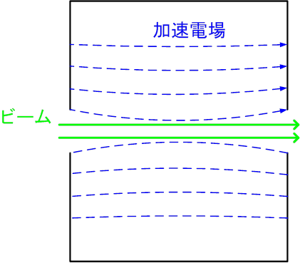
Pill-box cavity
Annular coupled cavity with nose
Accelerating field
Accelerating field
Beam
Beam
=> Weak focus
=> Strong focus
Field
Field
Focussing field
Accelerating field
Focussing field
Accelerating field
Accelerating field
Given force
Accelerating field
Given force
Focussing
field
Focussing field

Slide 7
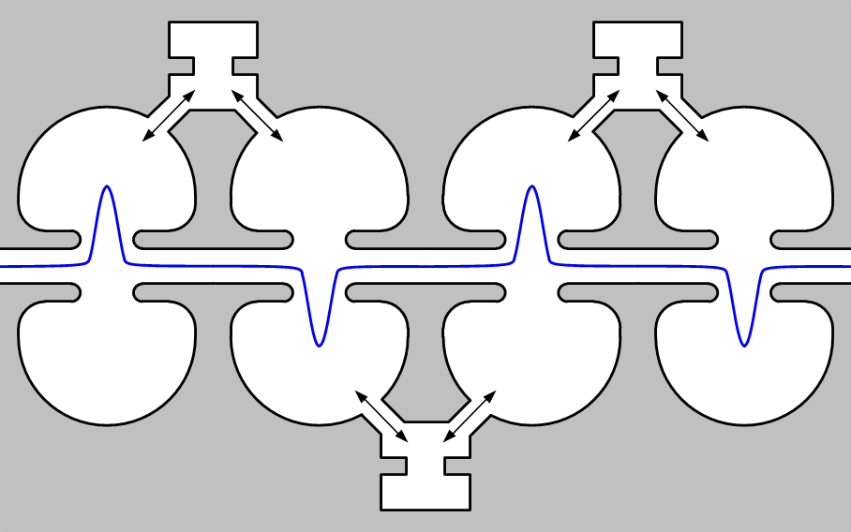
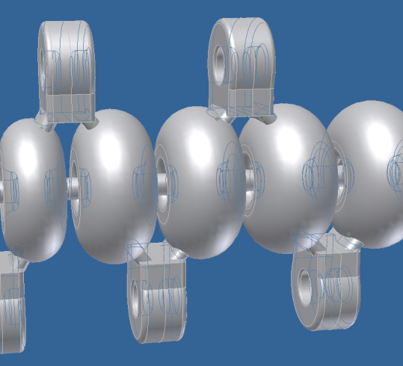
Closed gap makes focus field
Side coupled cavity is one candidate (or DAW / ACS / CDS …)
Concentrated field has focusing effect
This structure has long drift space
This structure has focusing field.
Long drift space is problem.

Slide 8
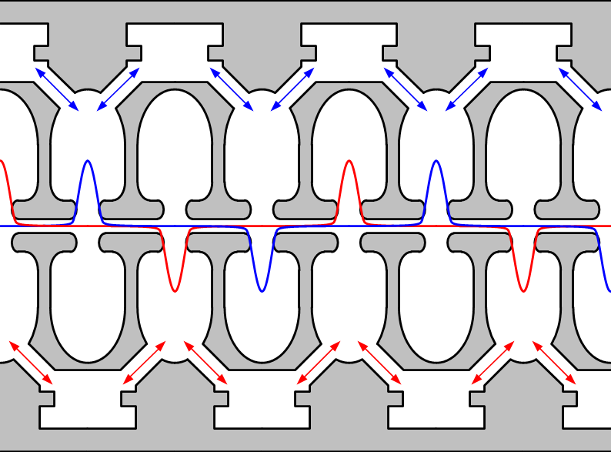
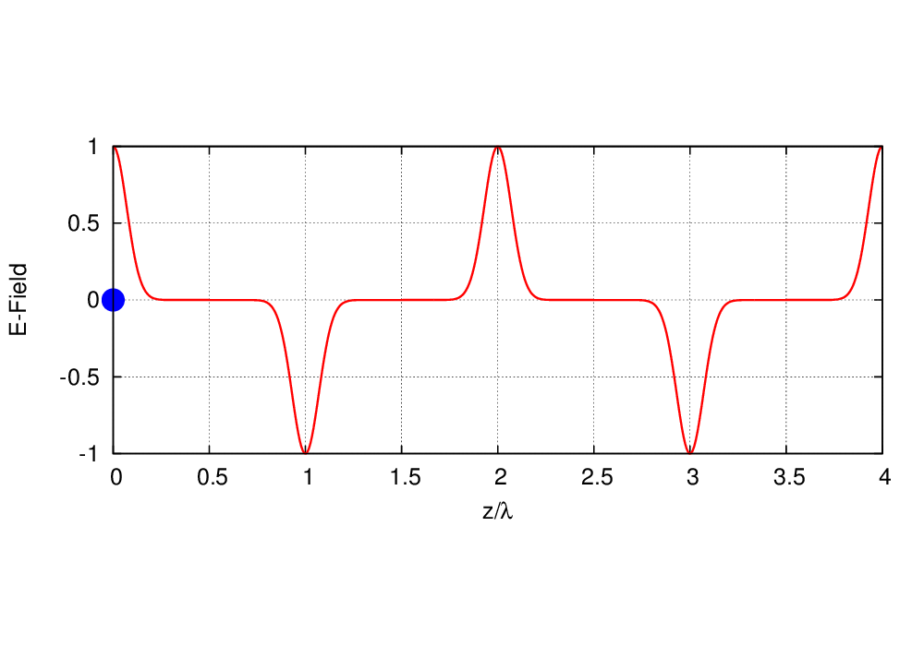
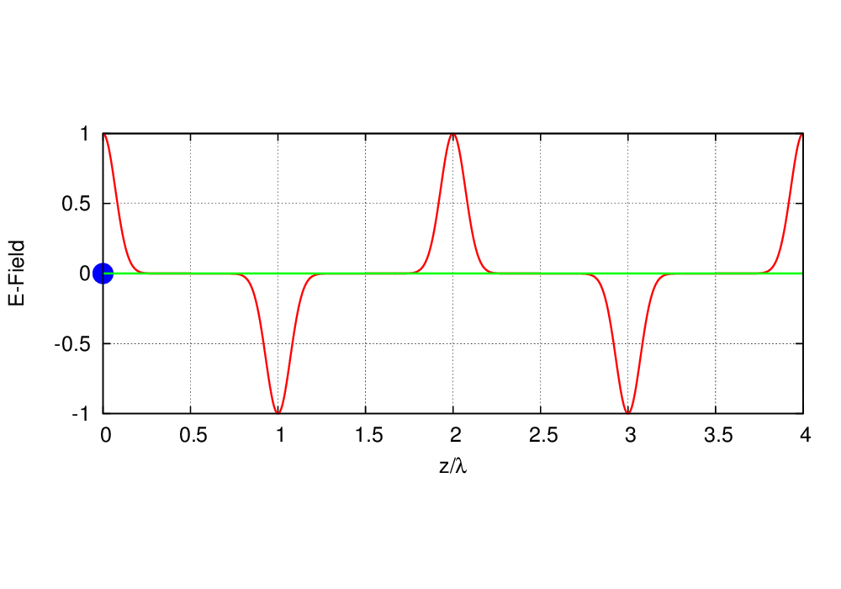
Design of a quasi traveling wave side couple RF gun
Normal side couple structure
Quasi traveling wave sidecouple structure
Quasi traveling wave side couple has stronger focusing and accelerated gradient than DAW.

Slide 9
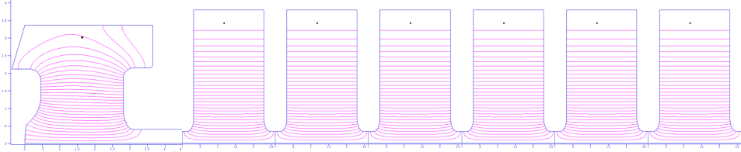
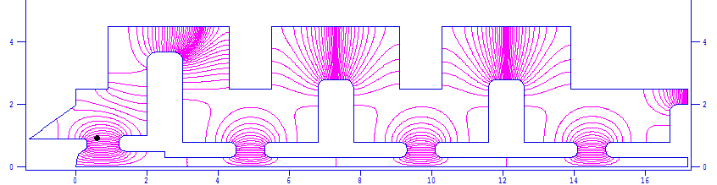
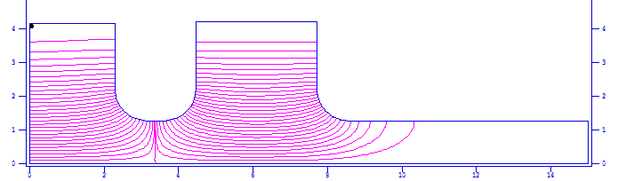
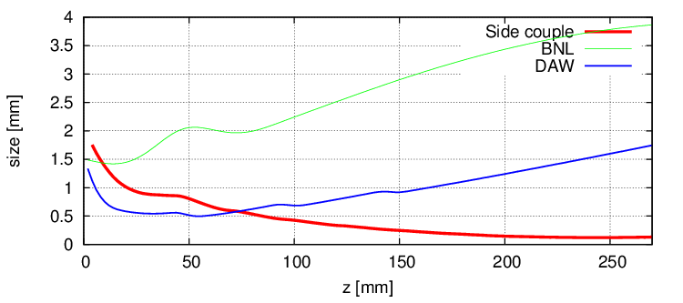
RF-Gun comparison
Quasi traveling wave side couple RF gun (100 MV/m, 6mm-mrad, 13.5 MeV)
DAW-type RF gun (90 MV/m, 5 mm-mrad, 3.2 MeV)
BNL-type RF gun (120 MV/m, 11.0 mm-mrad, 5.5 MeV)
BNL (3.8 mm)
DAW (1.7 mm)
QTW (0.2 mm)
Beam Size
Notes:
で実際にどの程度，ビームが改善されているかをDAW型や一般的なRF gunにつかわれるBNL型と比較してみました．

Slide 10
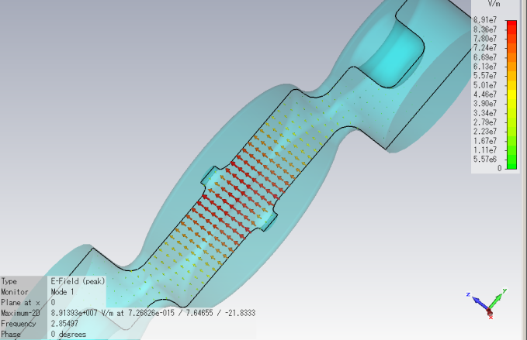
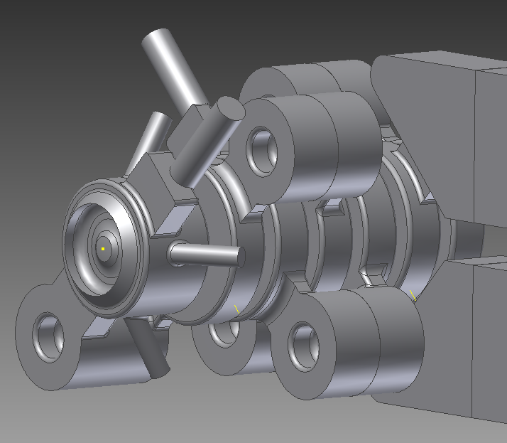
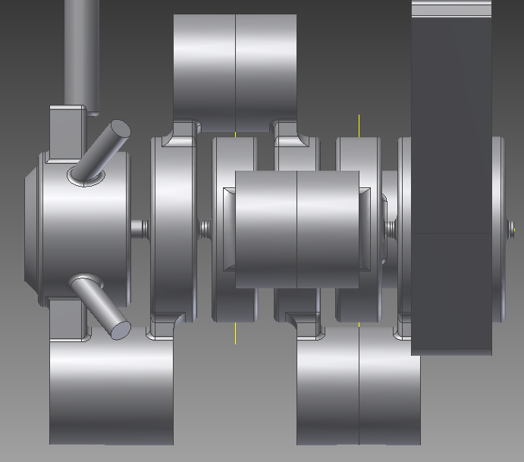
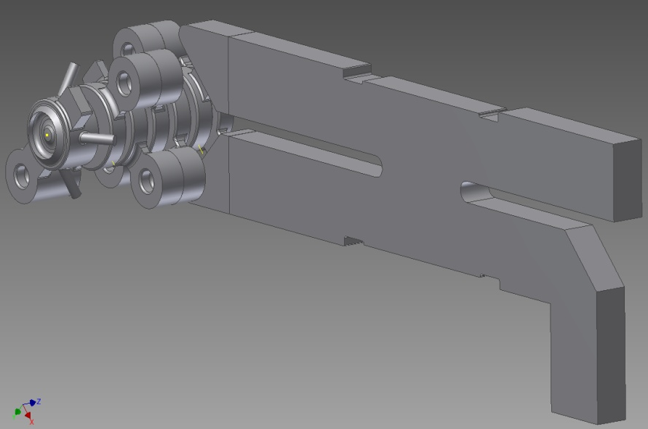
Cavity design
Field calculation
RF
90 deg hybrid
cathode
beam
coupling cavities
accelerating cavity
No reflection to klystron
Notes:
This is whole cavity shape. It is little bit complicated shape.
RF fed by using 90deg hybrid in to two ports.

Slide 11
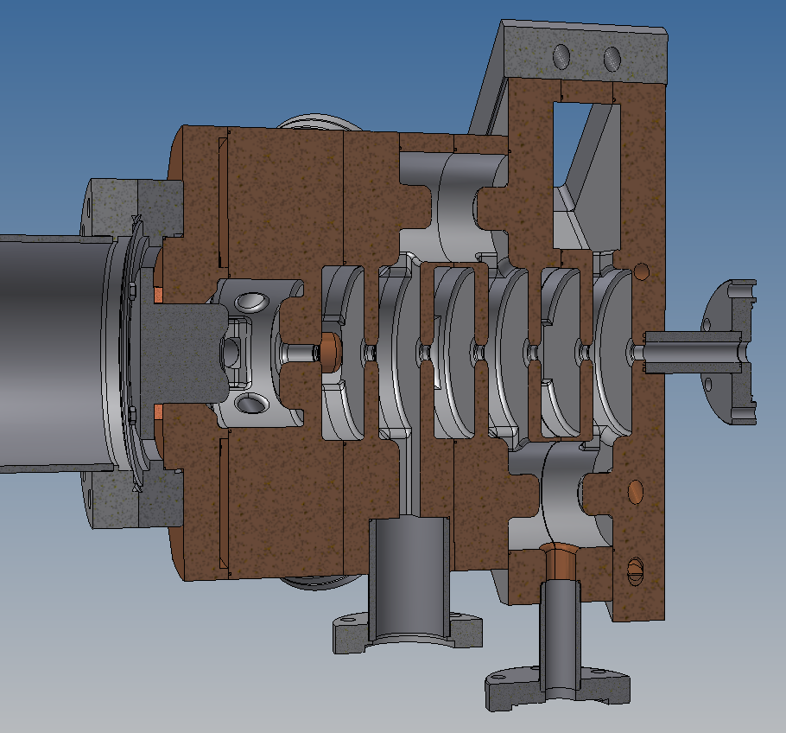
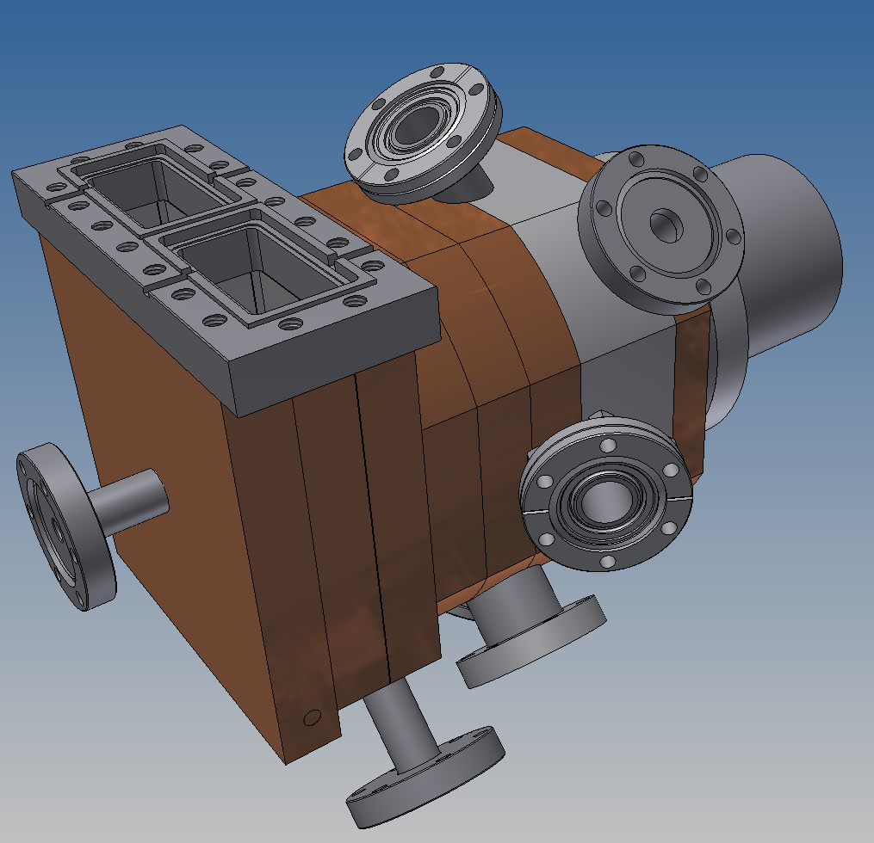
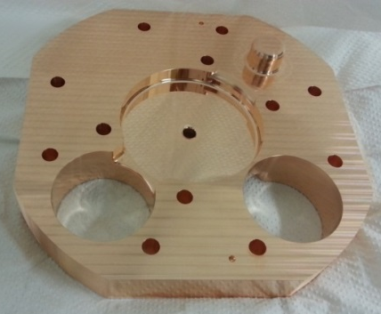
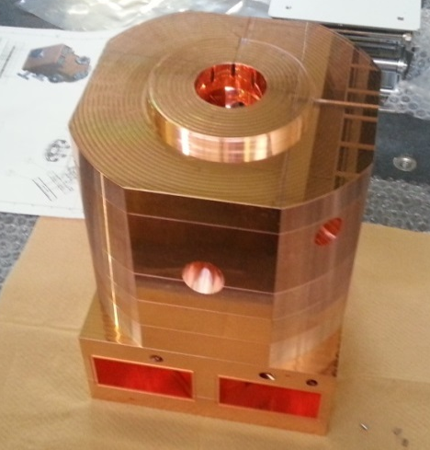
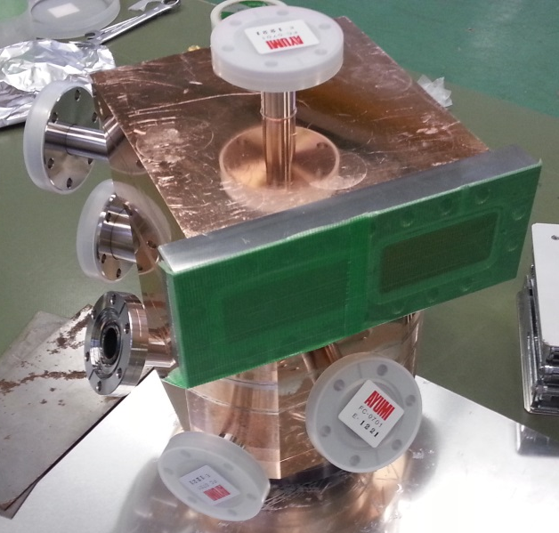
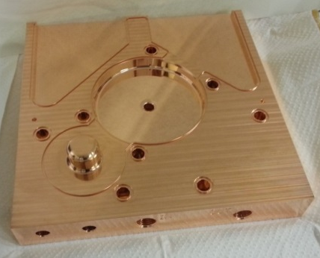
Mechanical design and manufacturing
Notes:
We finished cavity fabrication.
brazing

Slide 12
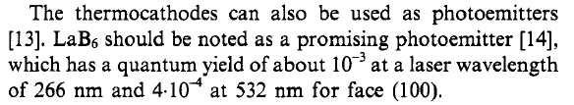
Cathode : Advantage of metal composite cathode (LaB₆ or Ir₅Ce )
Justin Jimenez, A Systematic Cathode Study , Ph.D Thesis, Monterery, California
Low Workfunction (2.8 eV) and enough QE (10⁻⁴) at room temperature.
Inactive in air
Recover by heating or laser cleaning
Best choice
for SuperKEKB 5 nC long time operation
Physica Scripta. Vol. T71, 39-45, 1997.
Cathodes for Electron Guns
G. I. Kuznetsov

Slide 13
Lifetime measurement（LaB₆ / Ir₅Ce）
10⁻⁴
10⁻⁵
Condition
Continuous pulse laser 200μJ@266nm)
Irradation => 2.5 nC emission

Slide 14
Ir₅Ce Cathode
Condition
HV = 16kV
Vacuum ; 5.8×10⁻⁶ Pa
Cleaning time ; 10 min
Quantum efficiency improvement by Laser cleaning
Carbon
LaB₆
SEM-EDX
Oxigen
Lower energy density is enough to activate Ir₅Ce
×２０
SEM-EDX
Ir₅Ce
Carbon
No oxidization is observed
×20
[SUPER-KEKB e Linac]
Laser Power ; 233μJ/pulse
（λ=266nm）
Target value ; 5nC
Non activation
Laser cleaning
QE = 5.00×10⁻⁶
Max QE = 1.00×10⁻⁴

Slide 15
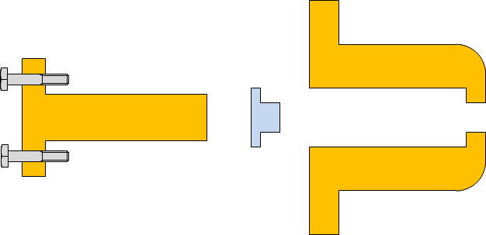
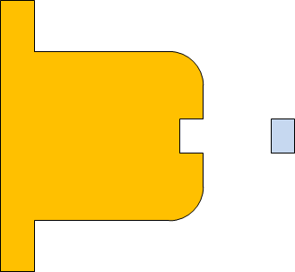
Cavity RF conditioning
Conditioning progress was too slow aroung 12 MW input. Frequently brake down was big problem.
Cathode rod contact?
Cathode material fixation?
Cathode material sputtering due to laser?
We have to separate causes of brake down.
Cavity conditioning, used dummy cathode rod without cathode material (all Cu).
Replace new cathode rod with material (new fixation is shrinkage fit).
For reduce multipactoring effect, another cathode cell design is required.
Build 6-1 ageing stand
A-1 RF-Gun
Third RF-Gun cavity
Current cathode
New cathode
shrinkage fit

Slide 16
History of GR_A1 RF conditioning
Reduce RF-Gun power for dummy load RF conditioning
2015/9/25
2015/10/15

Slide 17
Curent injector beam line on up and down.
Thermionic DC gun was installed to upper beam line.
10 nC
for positron primary
70 MeV
Thermionic DC gun
triplet
Acc.tube
buncher
prebuncher
SHB2
SHB1
Energy slope
Chicane
Acc.tube
RF gun
Bunch compression
30 MeV
25 psec
1 nC (Phase-I)
2 nC (Phase-II)
5 nC Low emittance (Phase-III)
10 psec

Slide 18
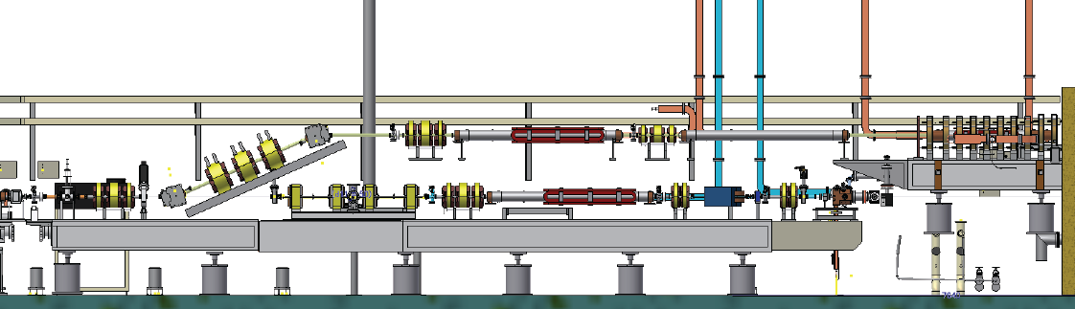
Current setup of unit A1
Thermionic e- gun has been temporarily back in the end of May,2015.
Radiation control license inspection
10 nC e- beam for e+ production
Beam line remodeling
Keep the rf gun beam line almost unchanged (1st acc. stracture was removed)
Thermionic e- gun beam line: 1200 mm to 1950 mm
Spare magnets have been used for the merger beam line.
Merger line
Thermionic e- gun
RF e- gun beam line
1200 mm
1950 mm

Slide 19
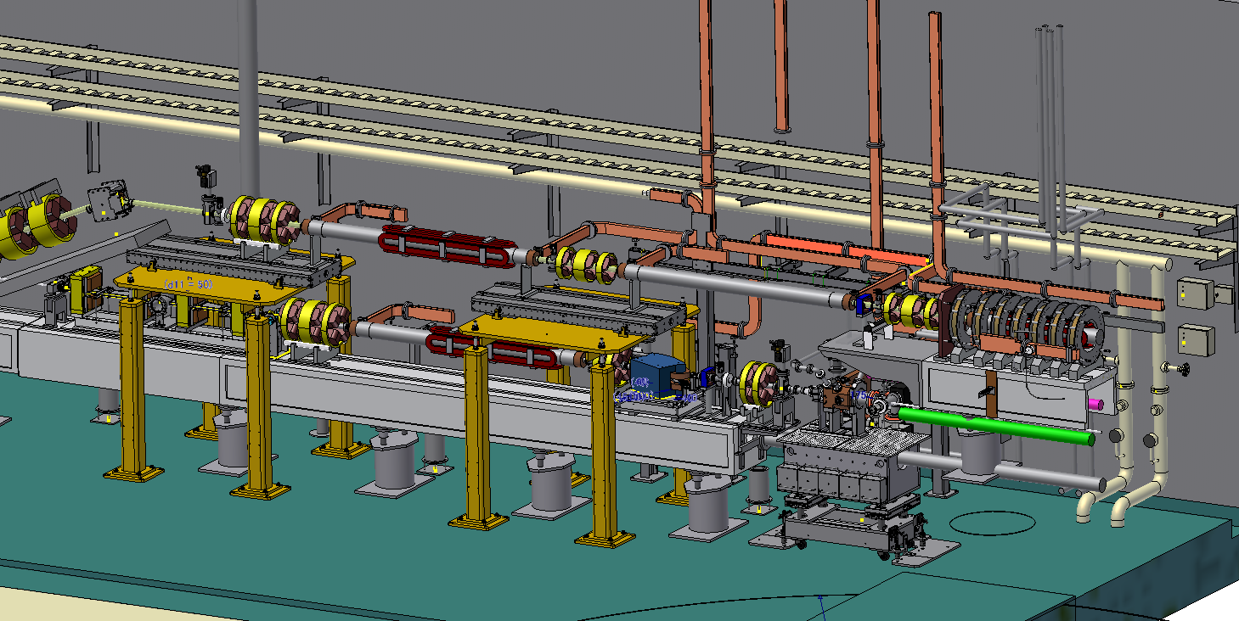
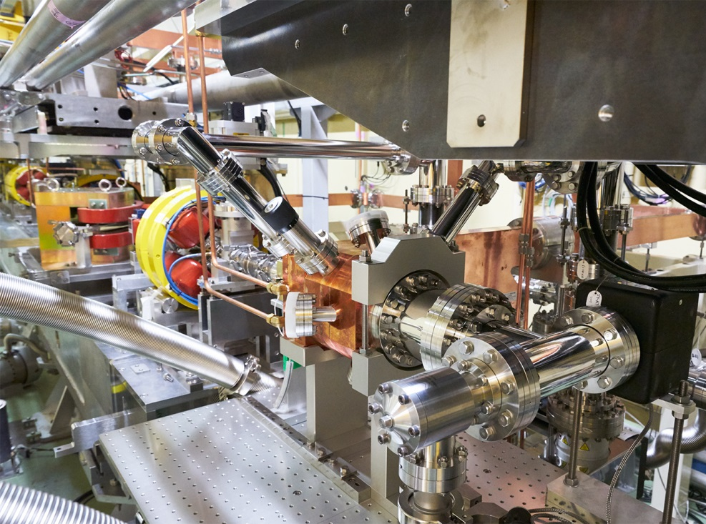
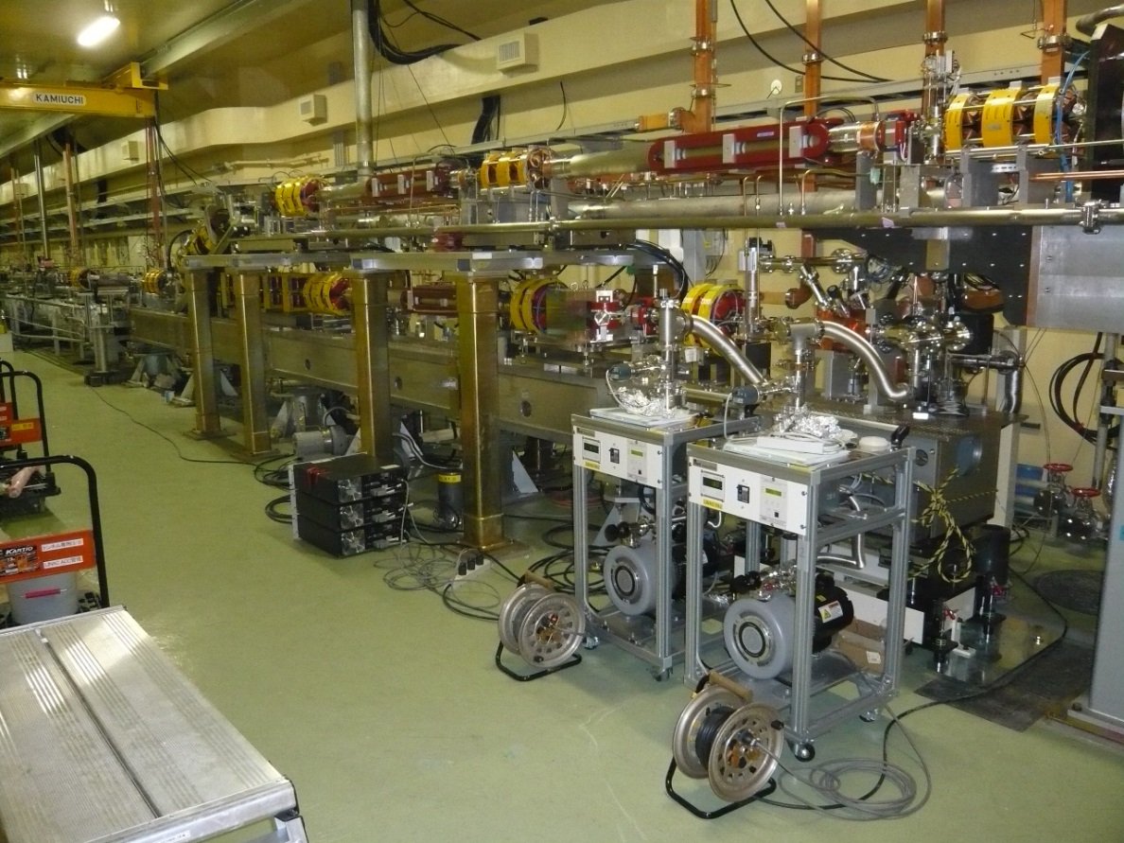

Slide 20
Recent achievement
Successful injection from RF-Gun to SuperKEKB HER ring with stabilized existing underground laser system.
RF-Gun
The ageing process of the choke structure was done at 6-1 ageing station.
Improvement on laser system(Zhou)
Yb fiber laser => 25 ps pulse length is obtained by strecher adjustment. Nd solid laser (3-2)
Yb solid laser (A-1 underground)

Slide 21
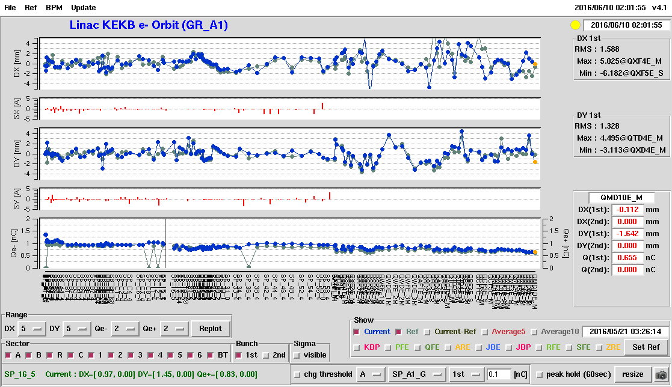
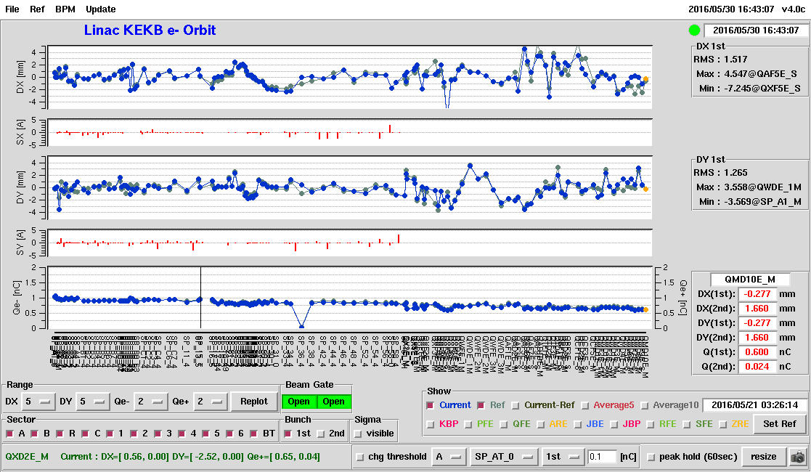
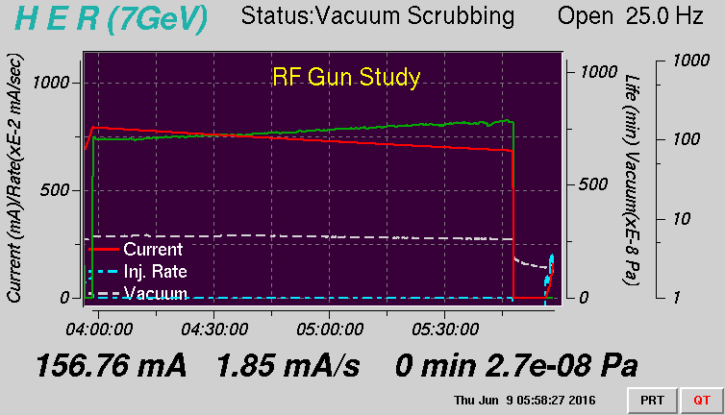
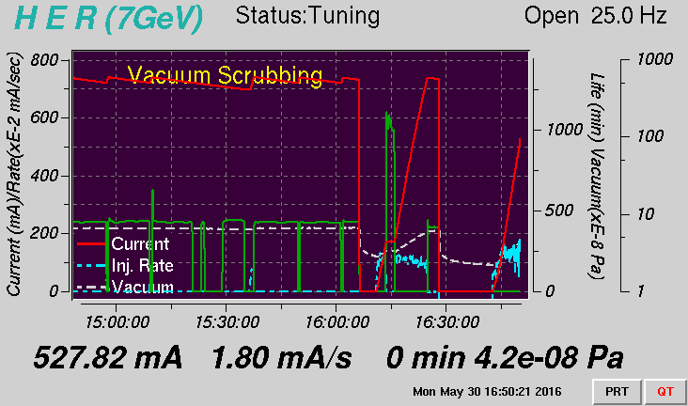
SuperKEKB HER (electron) injection
GR_A1 (RF-Gun)
GU_AT (Thermal Electron Gun)
Current(blue)：2016/06/10 02:01、GR_A1 KEKB HER e- injection
Ref(green)：2016/05/21 03:26、GU_AT KEKB HER e- injection
Current(blue)：2016/05/30 16:43、GU_AT KEKB HER e- injection
Ref(green)：2016/05/21 03:26、GU_AT KEKB HER e- injection
GR_A1 KEKB HER e- injection
GU_AT KEKB HER e- injection

Slide 22
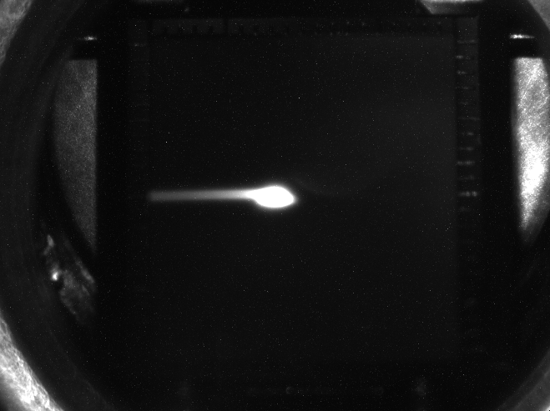
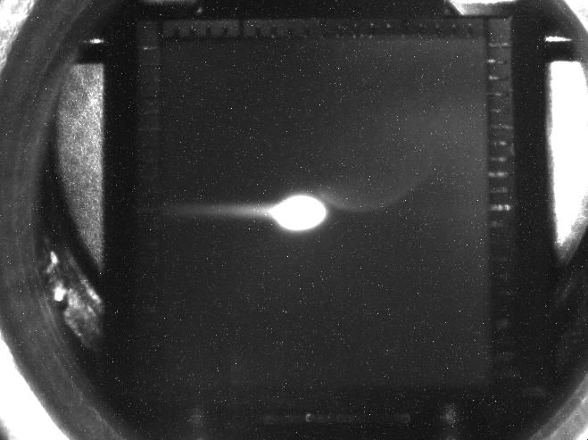
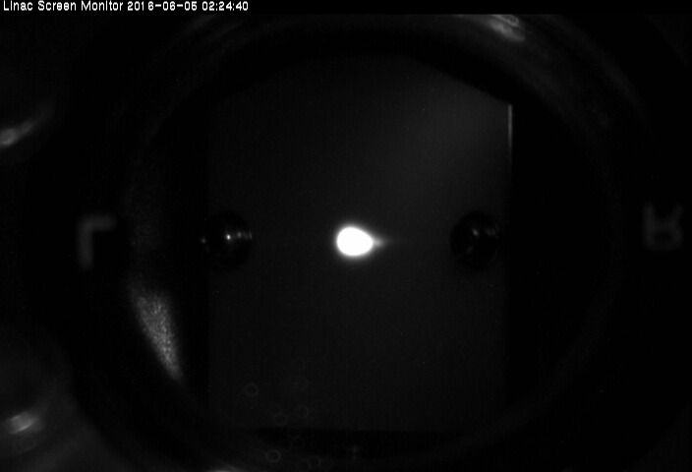
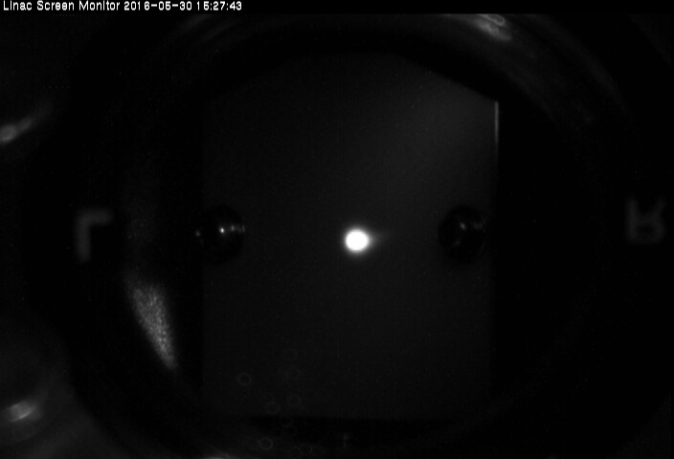
GR_A1 (RF-Gun) screen at J-ARC
GU_AT (Thermal Gun) screen at J-ARC
SC_R0_31
SC_R0_31
SC_61_H
SC_61_H

Slide 23
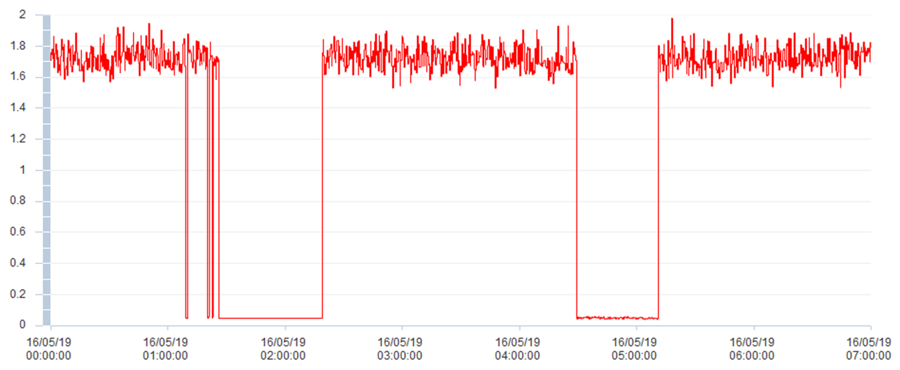
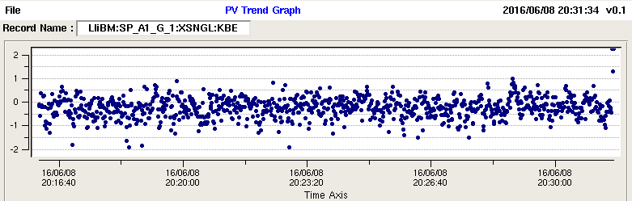
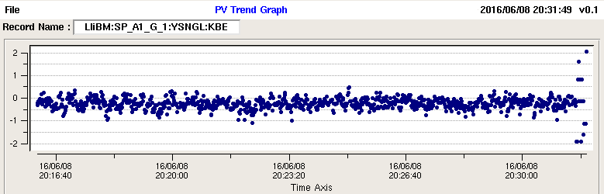
7 hours beam charge stability. (5/19)
Pointing stability
X
1σ : 0.44 mm
y
1σ : 0.23 mm

Slide 24
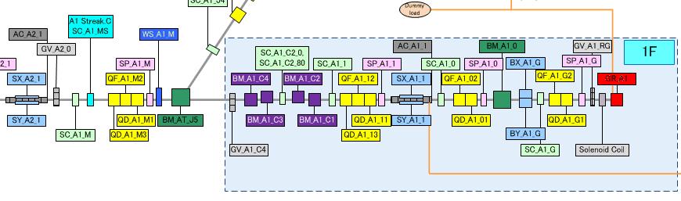
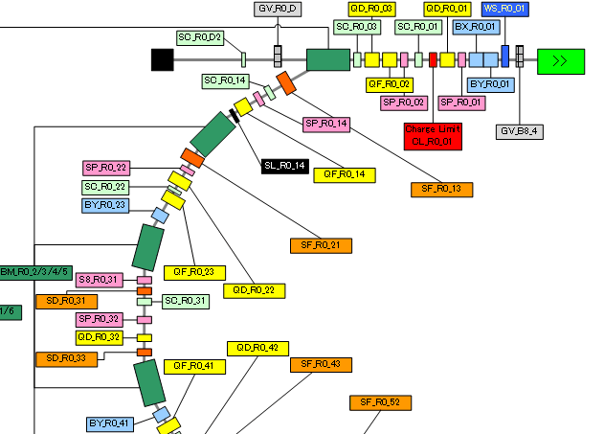
Emittance measurement (Q scan method)
 | Horizontal (projection) | Vertical (projection)
A1 chicane | 28.3 (31.8) | 26.4 (29.4)
A1 M | 20.3 (20.8) | 17.7 (18.3)
B sector dump | 48.5 (52.7) | 21.7 (22.2)
Should improve
Laser Profile & jitter
Perpendicular laser injection
QE uniformity of IrCe cathode

Slide 25
On-going R&D for RF-Gun
RF-Gun
New CDS-type RF-Gun is under fabrication Larger beam aperture Simple structure enough for 5 nC generation
Second RF-Gun installation with 90-degree arc section.
Cathode
QE improvement of IrCe cathode : Ir₇Ce₂ => better uniformity Single Crystal => better QE
Thermal assist for higher QE & cathode cleaning

Slide 26
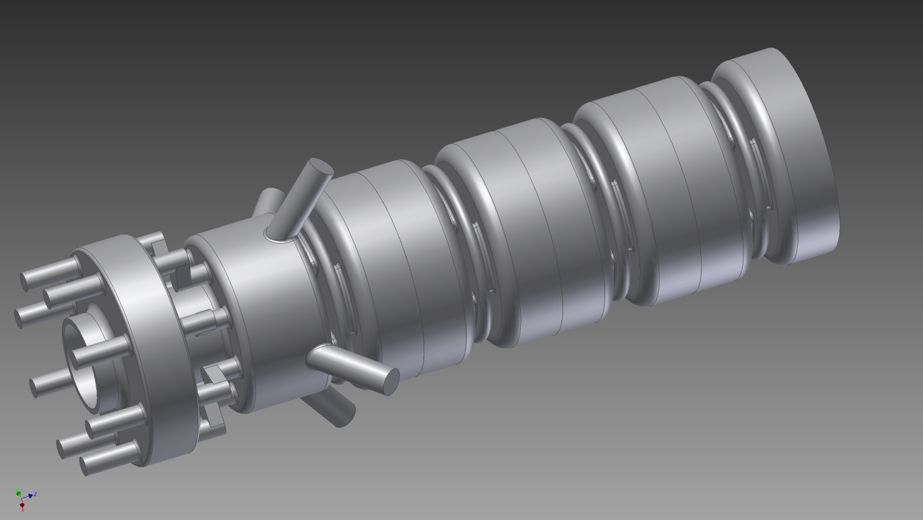
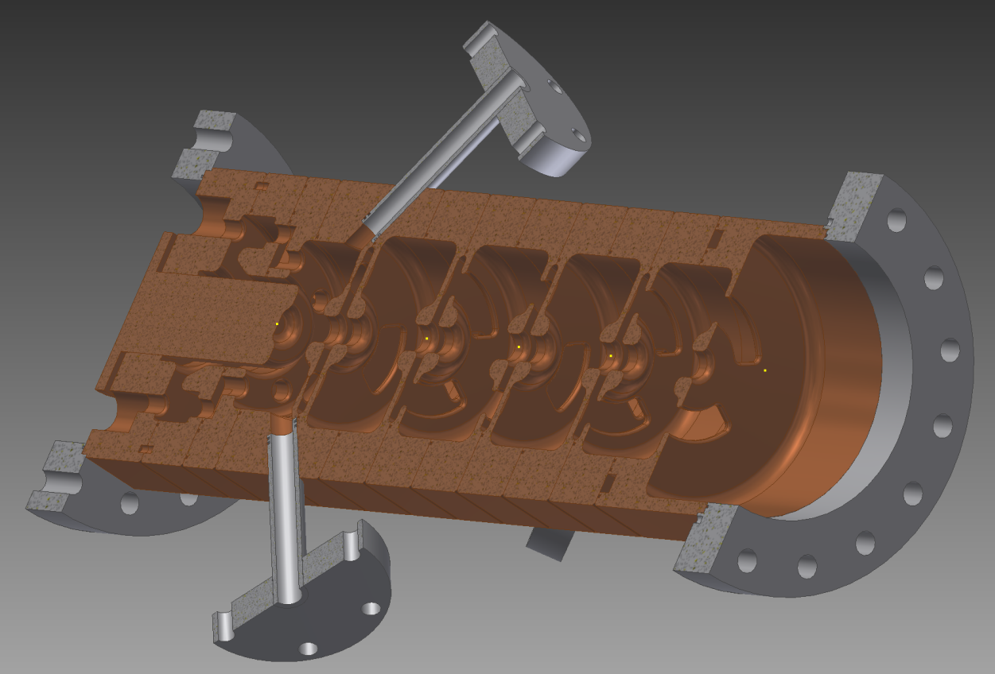
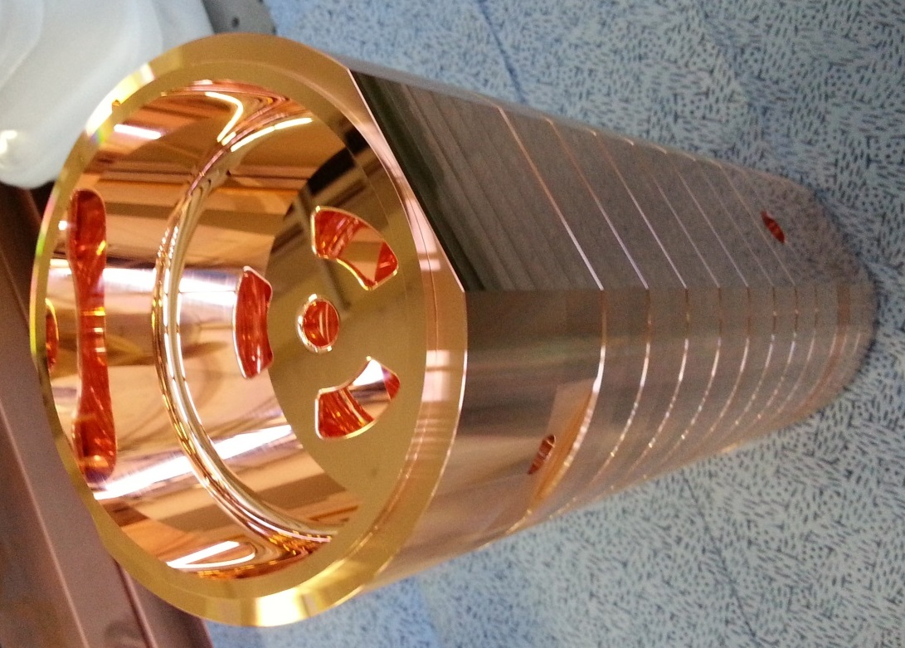
Simple cavity RF gun is developed for test
Cut Disk Structure
(CDS)

Slide 27
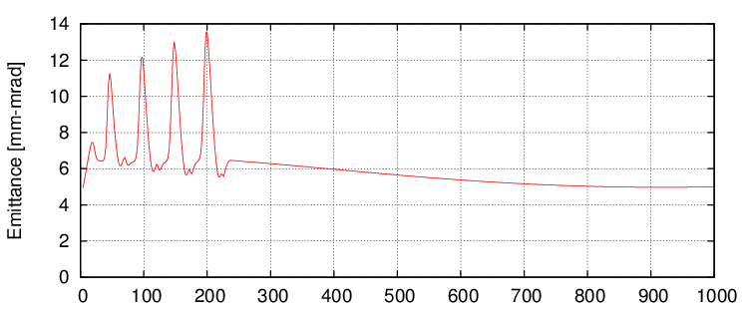
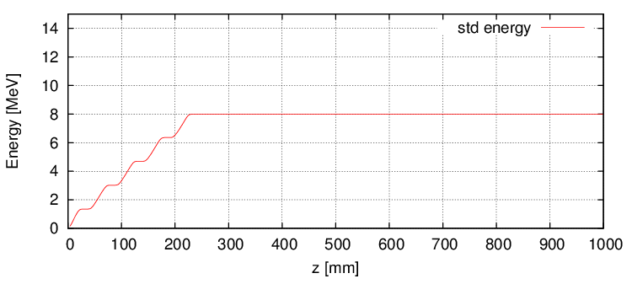
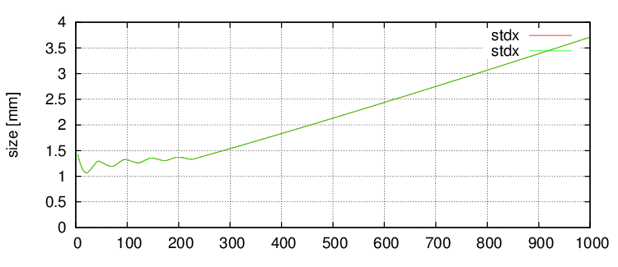
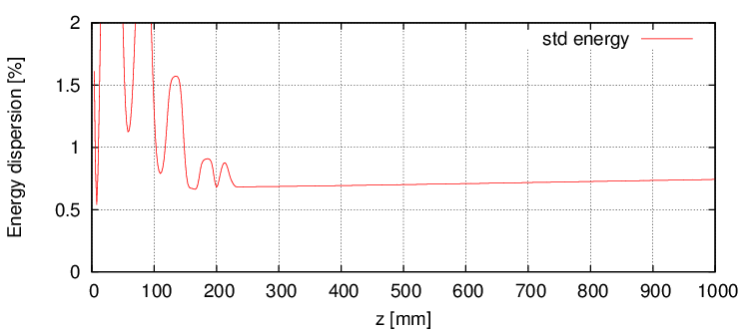
In the simulation, 5 nC beam generation is possible

Slide 28
Second RF gun on the 45 degree line
Normal laser injection
RF conditining at 6-1 is on going before installation.
Studies on
Improved RF-Gun cavity
Normal laser injection
Changeable cathode including alkaline cathode
Angled
laser
injection

Slide 29
Schedule
Last Year
Reconfigure thermal gun for positron generation
Step by step RF-Gun RF ageing.
Done
SuperKEKB injection using stabilized existing undergroud laser (25Hz)
New laser system in 3-2 and A-1 ground laser room
Increase stability & pulse energy from fiber laser
Simplify the laser system (Nd/Yb Regenerative amplifier)
On going
Third RF-Gun (nomal laser injection / cavity modification / cathode change)
Simple Nd amplifier for Phase-I & II stable injection
Following the RF-Gun reviewer’s comments
(Postponed the pulse shaping until Phase-III )
10 ps gaussian is enough for Phase-I (1nC) & II (2nC), postponed the pulse shaping until Phase-III

