Slide 1
High-energy laser source of RF gun
Xiangyu Zhou

Slide 2
Contents
Laser system, underground
  Yb-doped fiber & Thin-disk Yb:YAG @ 1030 nm
New laser system, on the ground
  Yb-doped fiber & Rod Nd:YAG @ 1064 nm
  Yb-doped fiber & Thin-disk Yb:YAG @ 1030 nm

Slide 3
Requirement of laser system for RF-Gun
Laser energy
  500 μJ for Ir₅Ce cathode
  50 μJ for Ce₂Te cathode
50 Hz, 2-bunch (96ns spacing)
Temporal pulse shaping to reduce energy spread
=> Broadband laser crystal (Yb or Ti:Sapphire)
Continuous operation
=> High power pump LD (Yb or Nd)
15nC
5nC
10nC
20nC
t
Gaussian
t
Square
5nC
10nC
15nC
20nC
5nC electron
15nC
Primary beam for positron production
  No laser system company in Japan.
  Support cost for commercial product is very high.
Yb-doped ◎
Nd-doped △
Ti-doped ×
○ Wide bandwidth => pulse shaping
○ Long fluorescent time => High power
○ Fiber laser oscillator => Stable
○ Small state difference
× ASE
× Absorption
○ 4-state laser is easy to operate.
○ High power pump LD is available.
○ Large crystal is available
× Pulse width is determined by SESAM.
(Gaussian)
○ Very wide bandwidth
○ High breakdown threshold
× Low cross section
× Q-switched laser is required for pumping

Slide 4
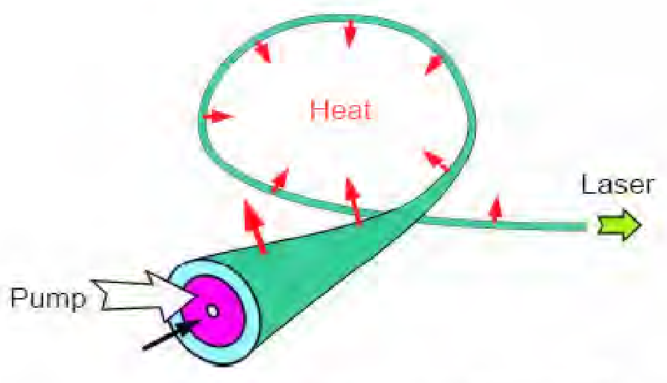
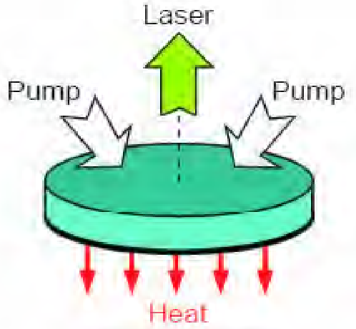
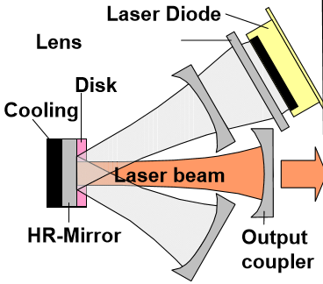
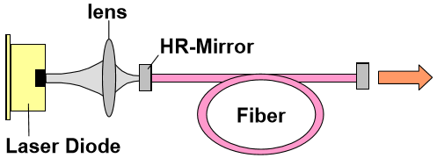
Yb-doped Solid-state laser
fiber
disk
Fiber amplifier
Thin-disk amplifier
○ Long gain media
○ Compact
○ No need cooling
○ Good beam quality
× Pulse energy
× Thin gain media (low gain)
× Cooling system
× Thermal lens effect
○ High pulse energy

Slide 5
Underground laser system
0.2 nJ @ 1030 nm
Yb-doped fiber oscillator with Transmission grating
Yb-doped fiber pre amplifier
Transmission grating pair stretcher
Pulse picker
Yb-doped fiber pre amplifier
51.9 MHz
10 MHz
>μJ @ 1030 nm
2, 5, 25 Hz
Single or Double bunch
Synchronization system
Yb-doped fiber main amplifier
Yb-doped fiber main amplifier
Pulse picker
2856 MHz trigger
From Accelerator
Yb:YAG thin-disk multi-pass cavity amplifier
Yb:YAG thin-disk multipass amplifier ×3
RF GUN
SHG
SHG

Slide 6
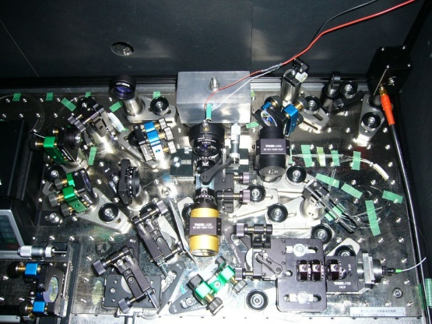
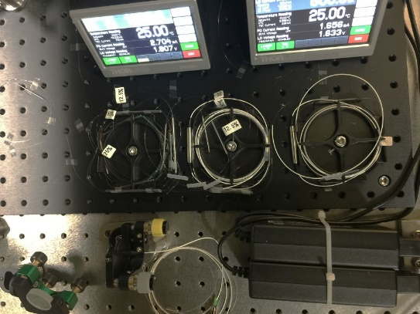
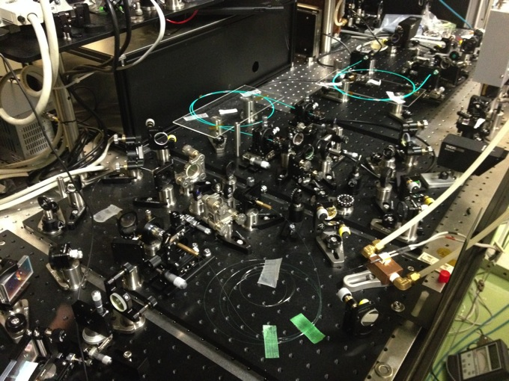
Fiber Oscillator & Amplification
Yb fiber Oscillator
WDM
coupler
SMF
PIEZO
SMF
LD
Pump
51.9 MHz
Stable
Collimator
λ/4
P.D.
250mW
976 nm
Grating pair
Output
1000-grooves/mm
Isolator
λ/4
λ/4
Yb-doped fiber
Polarizing
λ/2
Collimator
Low power amplifier
High power amplifier
Collimator
Isolator
Yb-doped Double cladding Fiber
PM
Collimator
Yb-doped Fiber
4μm
Dichroic mirror
HR@976 nm
HT@1050 nm
Ɵ=20°
WDM
coupler
75 W
LD
Pump
750 mW
LD
Pump
Low loss
Compact
High amplify efficiency

Slide 7
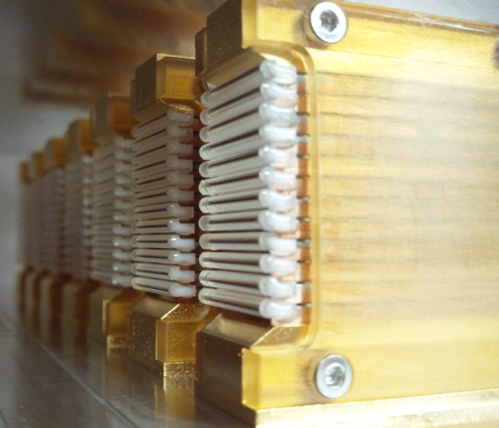
Yb:YAG thin-disk amplifier
LD
Cavity multi-pass amplifier (15 pass x 2 loop) to simplify the laser
Laser Diode
To obtain higher gain,
=> Higher pumping density
Focused type amplifier to
avoid thermal lens.
LD
Yb:YAG disk
10 % doped
0.5mm thickness
1pass
10-15pass
OUTPUT
INPUT
←
Laser Diode
Balanced offset
lens to avoid
damage.
940nm LD (2.4 kW / module)
5pass
4pass
3pass
2pass
1pass

Slide 8
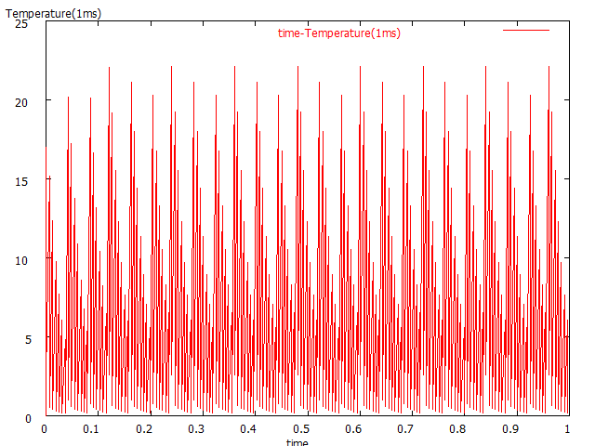
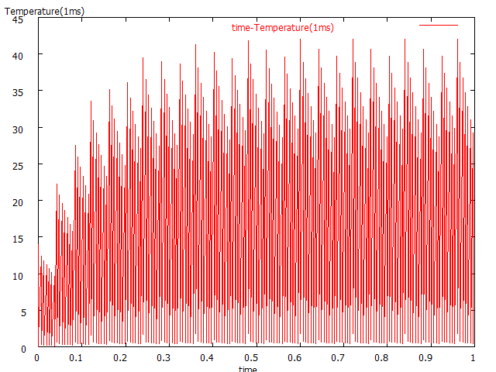
Temperature of the Yb:YAG thin-disk amplifier
10% dope, α=12/cm, 5kW/cm², 25Hz
0.5t
1t
Repetition rate limitation of 25 Hz is reached!

Slide 9
Spectral Range Adjustment
For chirped pulse, the pulse shaping in the time domain can be controlled by adjusted the spectral shaping of the pulse.
Width of the slit
d
Spatial Mask
Spatially dispersed
~200fs
~30ps
Chirp
t
l
Pulse shaping
Distance of the grating pair
t

Slide 10
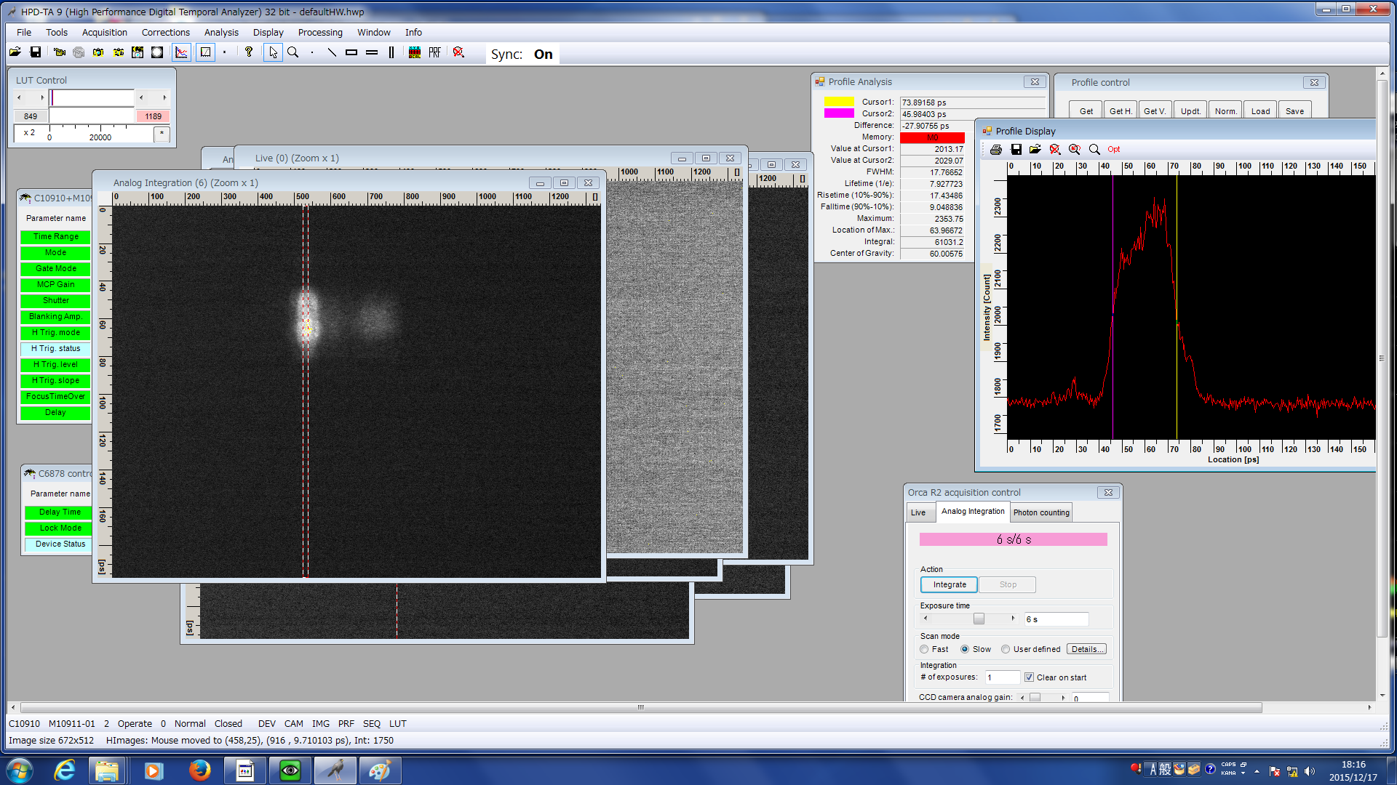
Optimized pulse shape by streak camera
(After adjustment 2015.12.17)
ω：~10 mJ, 2ω： ~2 mJ, 4ω： 230 μJ
Due to the Non-linear effect was occurred, Output power limitation is reached!

Slide 11
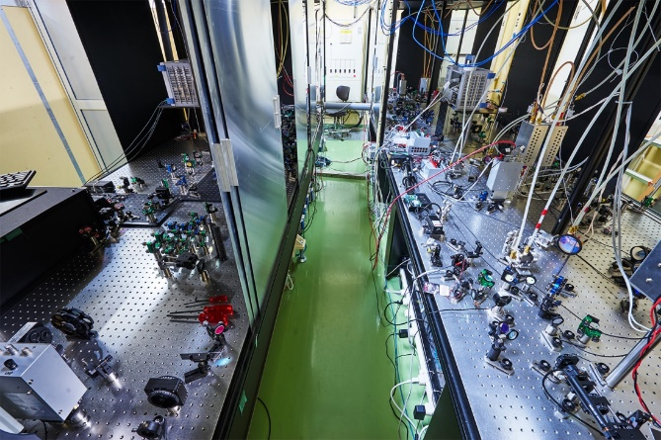
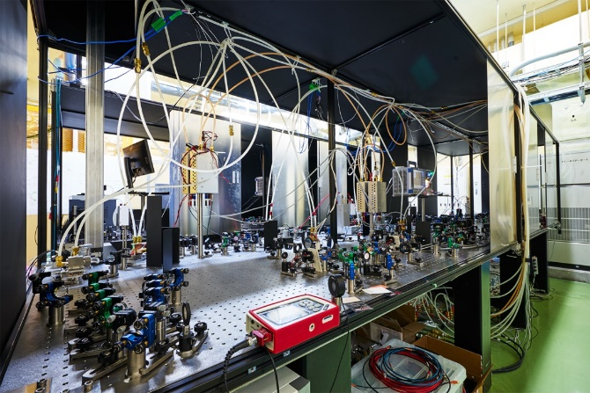
Layout of A1 laser room
Control
rack
Entrance
PCF fiber
amplifier
20 μJ
Thin-disk Multi-pass
cavity amplifier
Yb-doped
Fiber
Oscillator
1
EO Pulse
picker
PCF fiber
amplifier
Thin-disk
multi-pass
amplifier
SOA Pulse
picker
Fiber
pre
amplifier
Elevator
0.2 nJ
Thin-disk
multi-pass
amplifier
Yb-doped
Fiber
Oscillator
2
Grating pair
stretcher
Fiber
pre-amplifier
Sheld
SHG
1033nm
↓
532nm
Streak camera
Thin-disk
multi-pass
amplifier
Entrance
3 mJ
10 mJ
To GR_A1

Slide 12
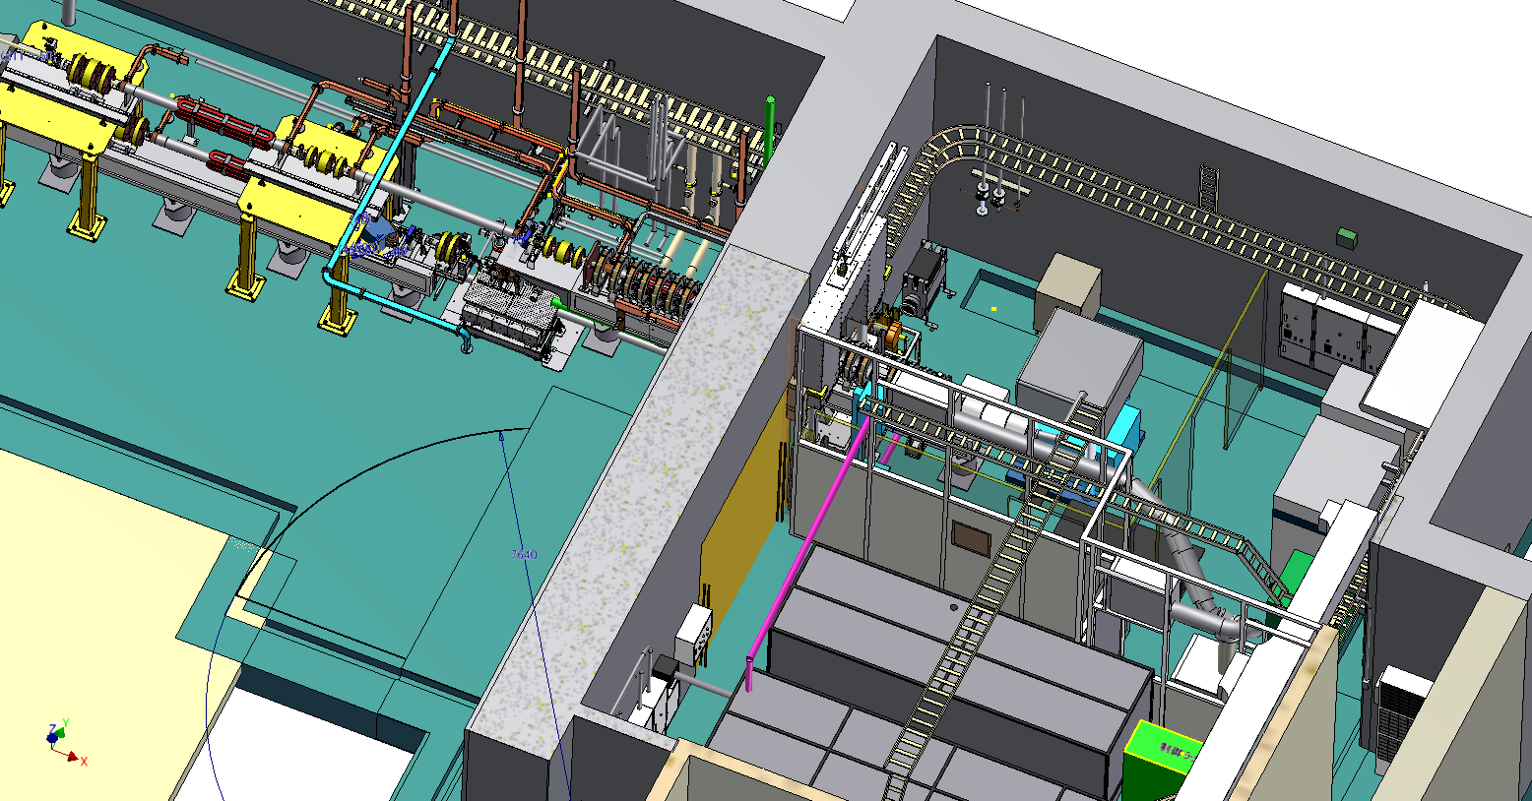
Laser line underground
Tunnel
RF-Gun
2nd SHG stage
Laser Hut
Energy loss of the UV in the air: >50%
Laser line to RF-Gun

Slide 13
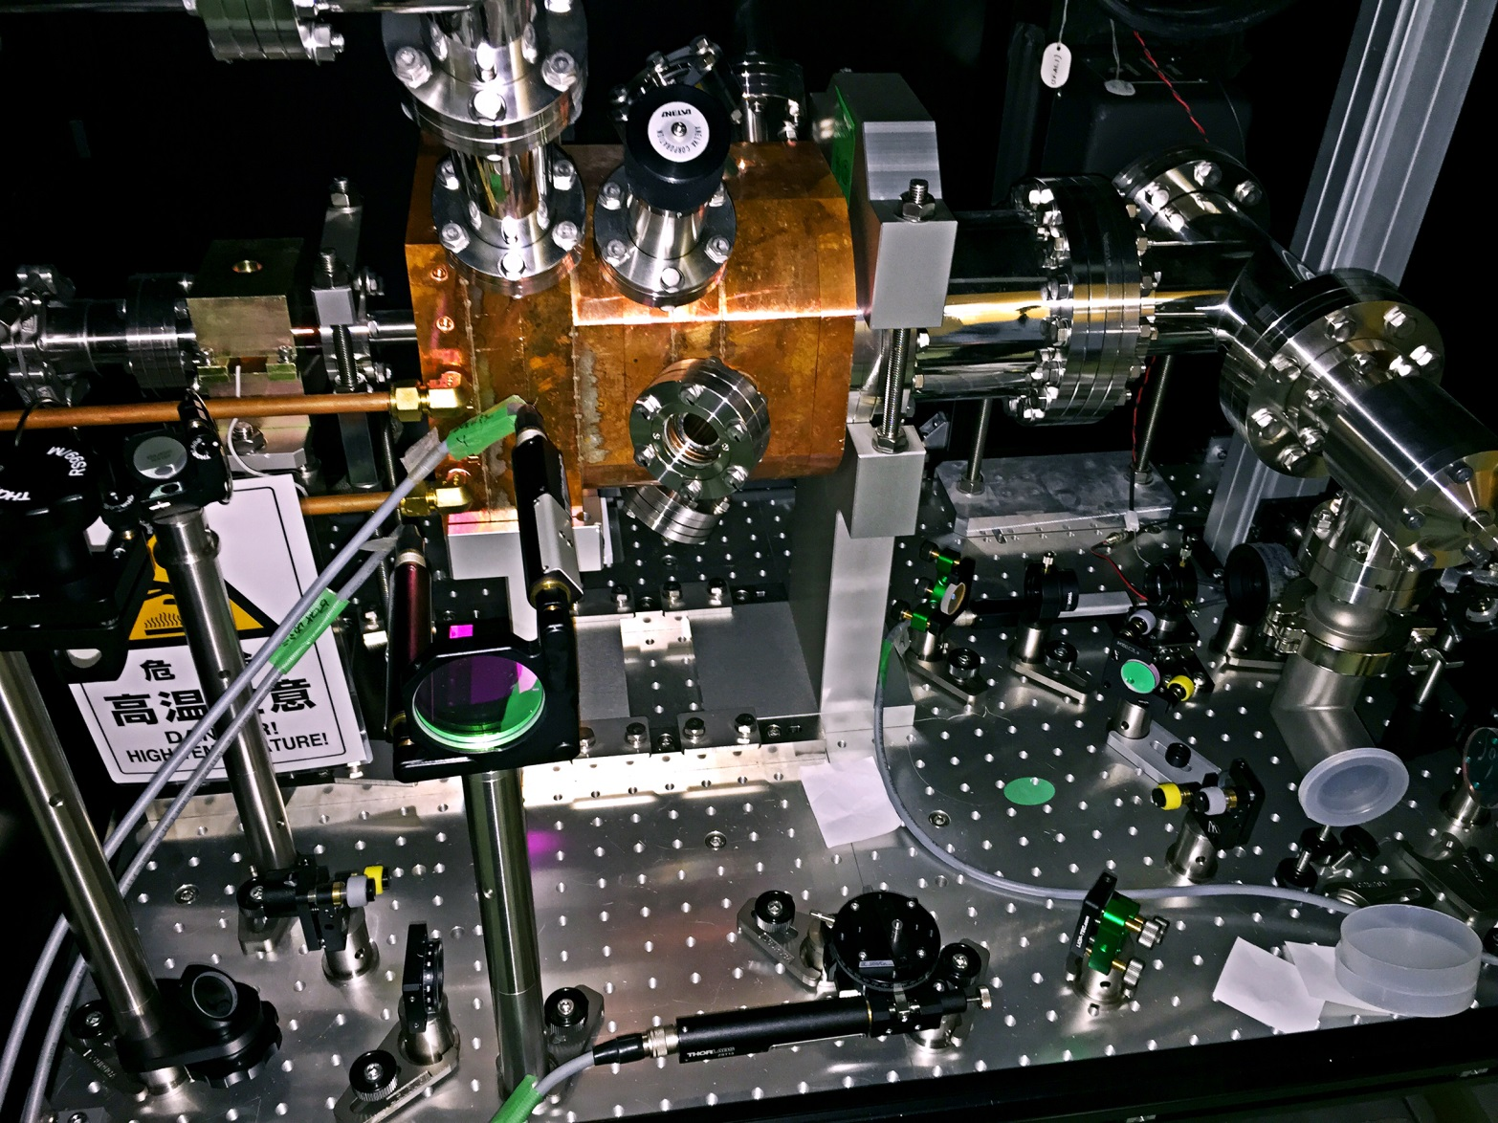
SHG for the 4ω
Motorized Translation Stages

Slide 14
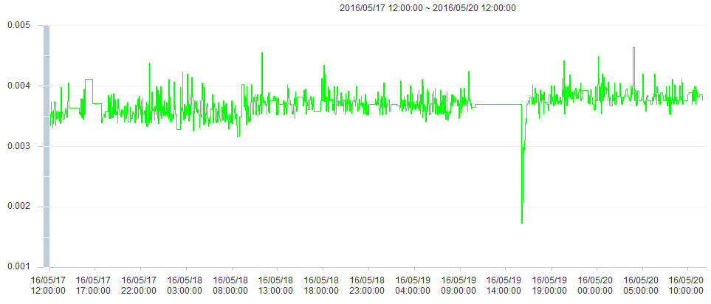
Stability of lasers (3 days)
Elevator maintenance
Laser off

Slide 15
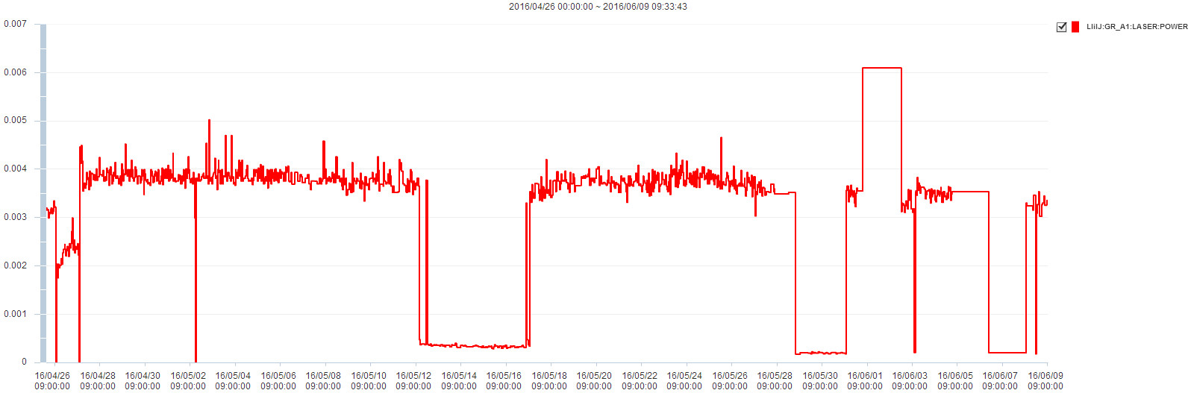
Stability of lasers (4/26—6/9)
Last laser Maintenance
Trig stoped
No signal, LD work on

Slide 16
Summary of the underground laser
Yb-doped fiber & Thin-disk Yb:YAG hybrid system @ 1030 nm
Development of Underground Laser is finished.
The stability of laser is improved.
The laser is employed for the Phase-I study.
The limitation of the output power (10 mJ) and repetition rate (25 Hz) is reached.

Slide 17
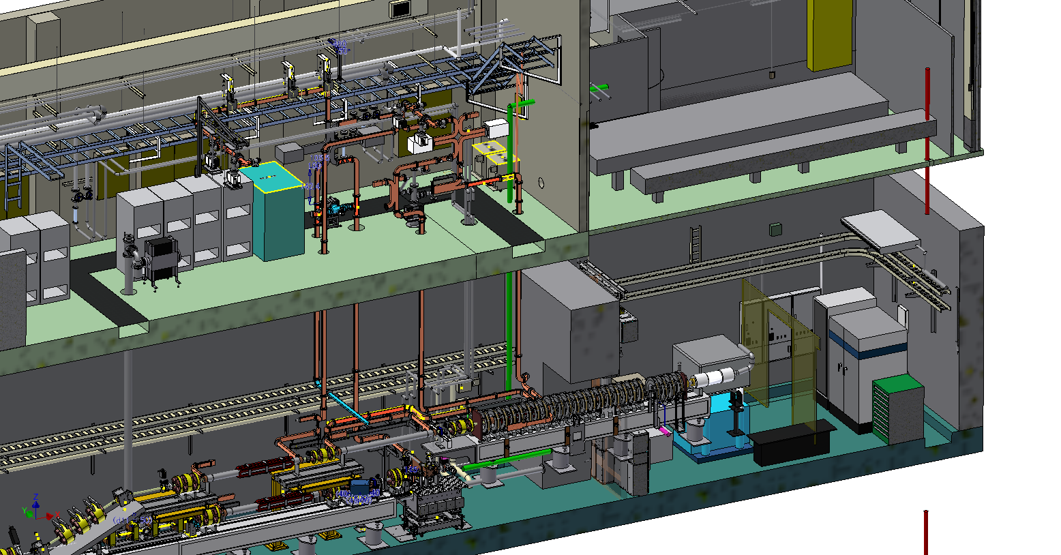
Laser line on the ground
KLY Gallery
Laser Hut
Tunnel
RF-Gun
Laser line to RF-Gun

Slide 18
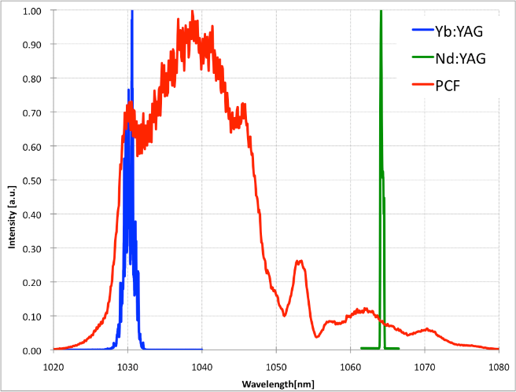
Yb fiber laser system on the ground
Fiber part
Repetition frequency
114.24MHz
Wavelength selection
1030nm & 1064nm
Repetition frequency
10MHz
1030-64 nm ANDi type oscillator
Grating stretcher
(Transmission)
SOA
pulse picker
Yb single mode
fiber amp
Menlo
1030nm oscillator
(commercial)
Yb-doped double clad
fiber amp
ASE rejection
grating pair
1064nm
10Hz
1030nm
EO module
pulse picker
Yb-doped PCF
fiber amp
1064nm
Nd:YAG
regenerative amplifier
Yb:YAG Thin disk
regenerative amplifier
Output(1064nm)
Output(1030nm)

Slide 19
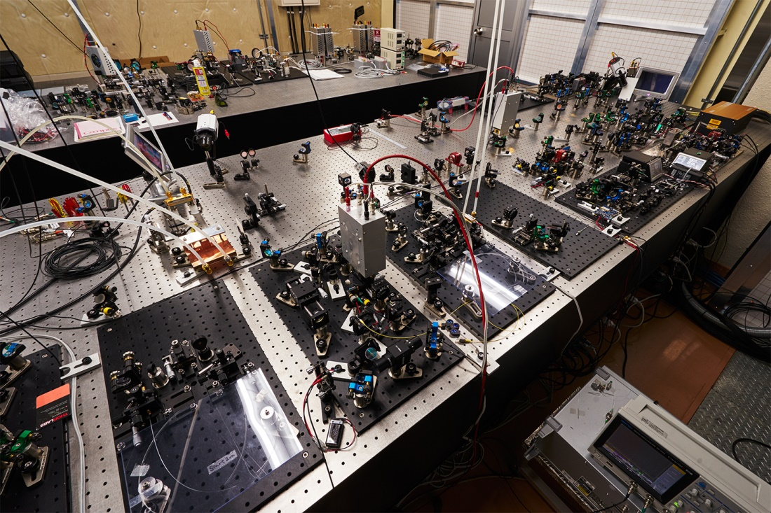
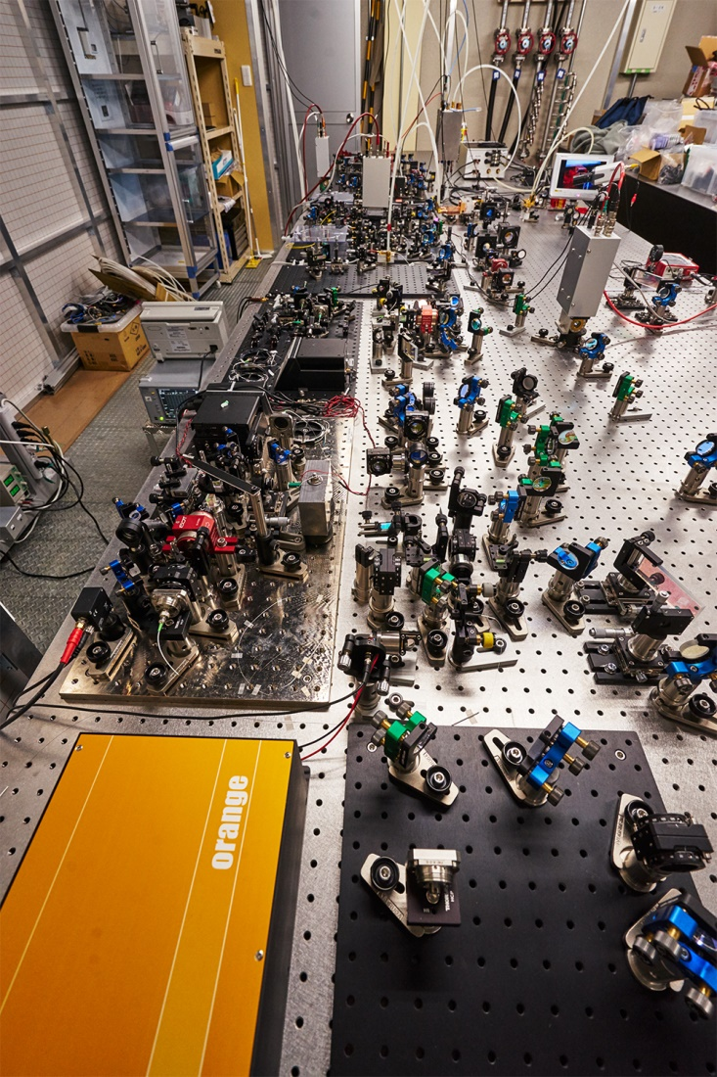
New System
Fiber+Yb:YAG Thin-disk
Amplifier @1030 nm
Grating pair
Yb fiber Oscillator
Spatially dispersed
Fiber+Nd:YAG Rod Amplifier @1064 nm

Slide 20
Issue of the underground laser
Complex structure (Stability, Maintenance)
50 Hz double bunch repetition rate
  10 MHz oscillator
  High energy fiber amplifier
  Yb:YAG & Nd:YAG Regenerate amplifier
Amplifier efficiency & Non-linear effect
  Chirped Pulse Amplification (CPA) system

Slide 21
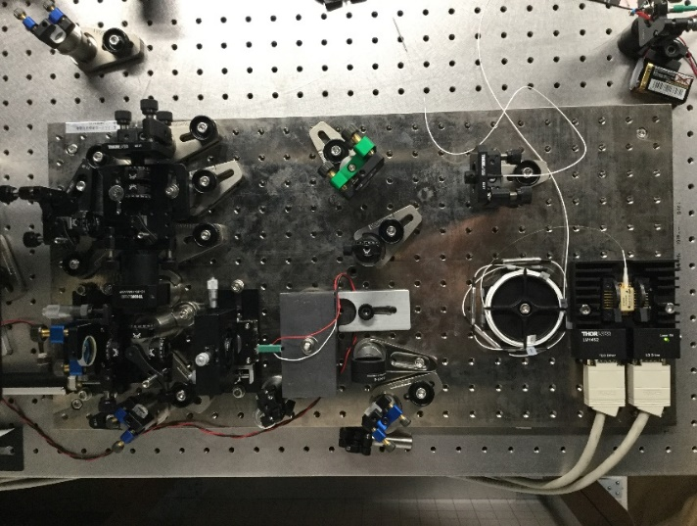
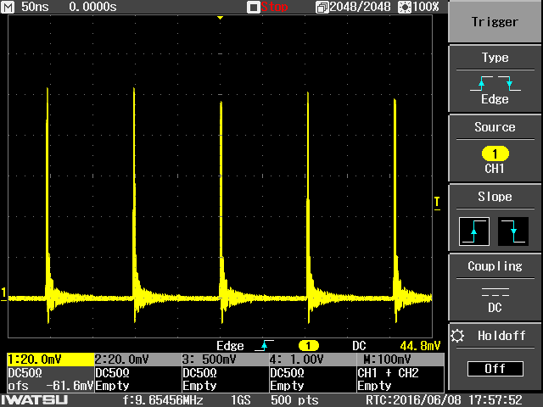
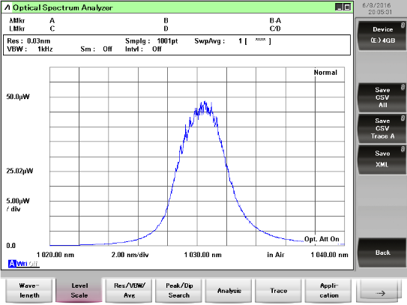
Oscillator of 10 MHz repetition rate
Repetition rate | Cavity length | Fiber length
114.24 MHz | 2.6 m | ~1 m
10.38 MHz | 28.9 m | ~20 m

Slide 22
Chirp Pulse Amplification (CPA)
Under ground Yb laser system
Yb fiber Oscillator
Stretcher
Yb PCF
amplifier
Thin-disk amplifier
Harmonic generation
30 ps
On the ground Yb laser system
Yb fiber Oscillator
Stretcher
Yb PCF
amplifier
Thin-disk amplifier
Compressor
Harmonic generation
2 ns
30 ps

Slide 23
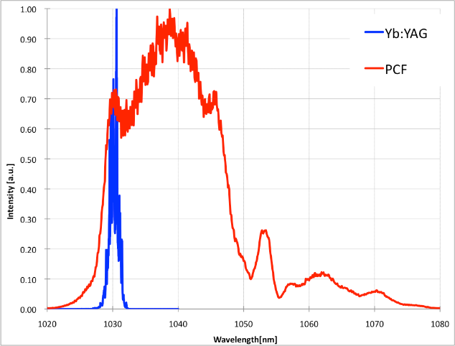
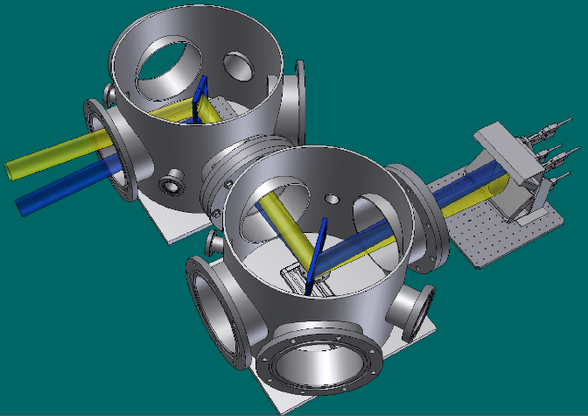
Grating pair compressor
Canon transmission grating
Size: 180mm×50mm
Groove density: 1740 lines/mm
Diffraction efficiency: 95%
180 mm
2ns pulse can be dechirped
l
ΔƟ
Vacuum Chamber
63.65°
 | Δλ | ΔƟ | l
Fiber amp | 20 nm | 4.5° | 1020 mm
Yb:YAG Gain Spectrum | 2 nm | 0.45° | 10173 mm

Slide 24
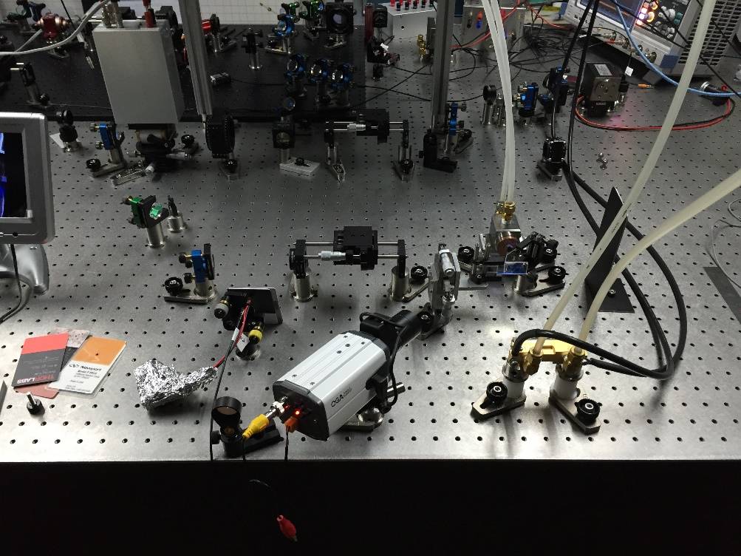
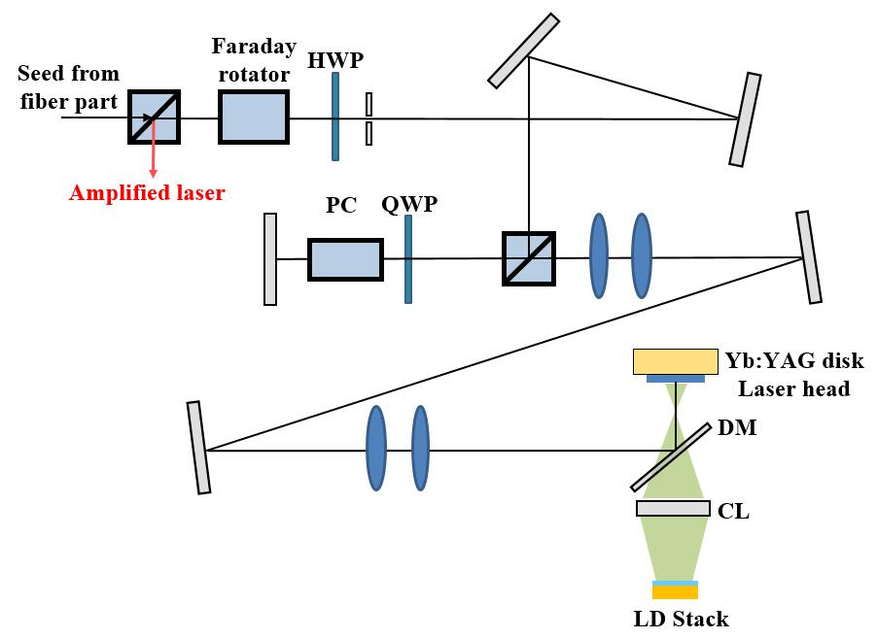
Yb:YAG thin disk regenerative amplifier
For picosecond and nanosecond laser pulse, the regenerative amplifier is very powerful
Strong amplification factor can help relieve stress of multi-pass amplifier stages and reduce thermal effect
New dichroic mirror with high optical quality and high damage threshold

Slide 25
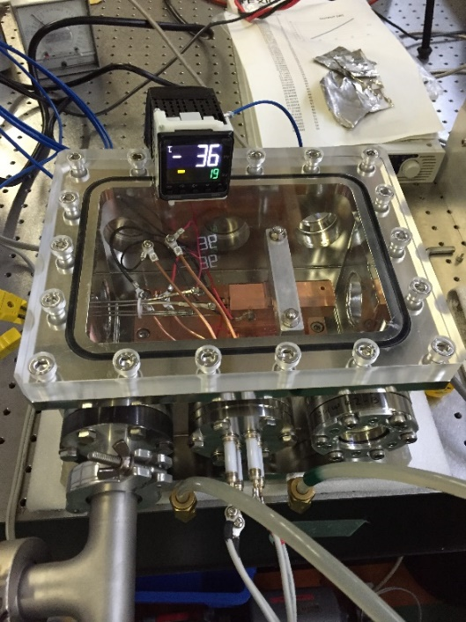
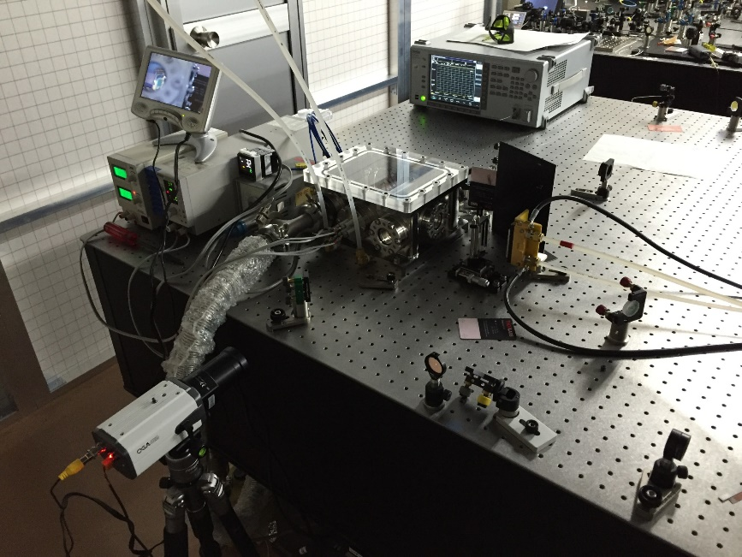
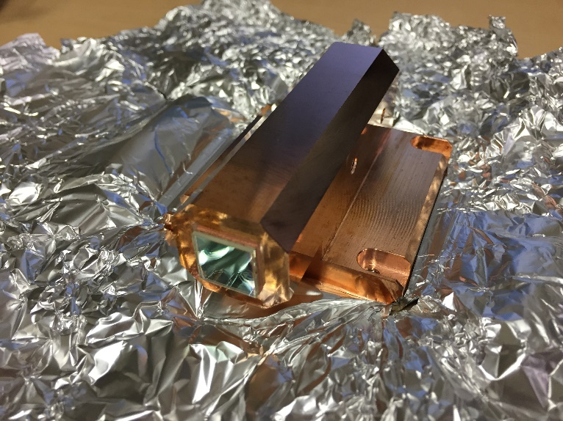
Low temperature Yb:YAG thin disk laser
Low temperature laser operation feasibility analysis
  Available high gain is possible
  Low amplified spontaneous emission (ASE)
  Simpler and more stable (compare with cryogenic laser)
Current low temperature laser operation
  Peltier cooling plates: 23 ºC ←→ -36 ºC
  Small vacuum chamber
  Home made laser soldering laser head
  50 Hz repetition rate test

Slide 26
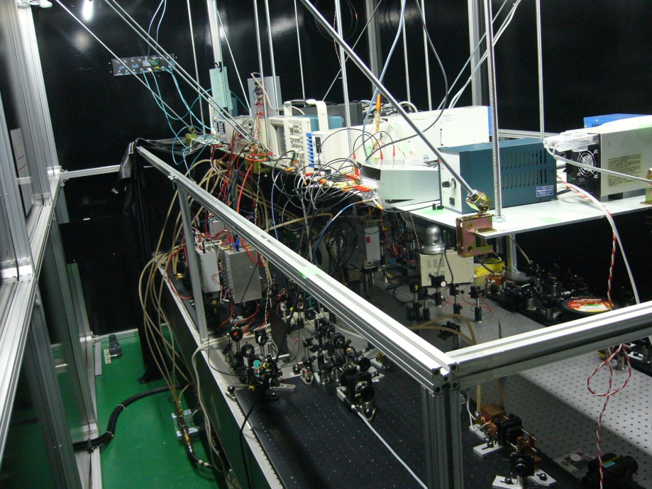
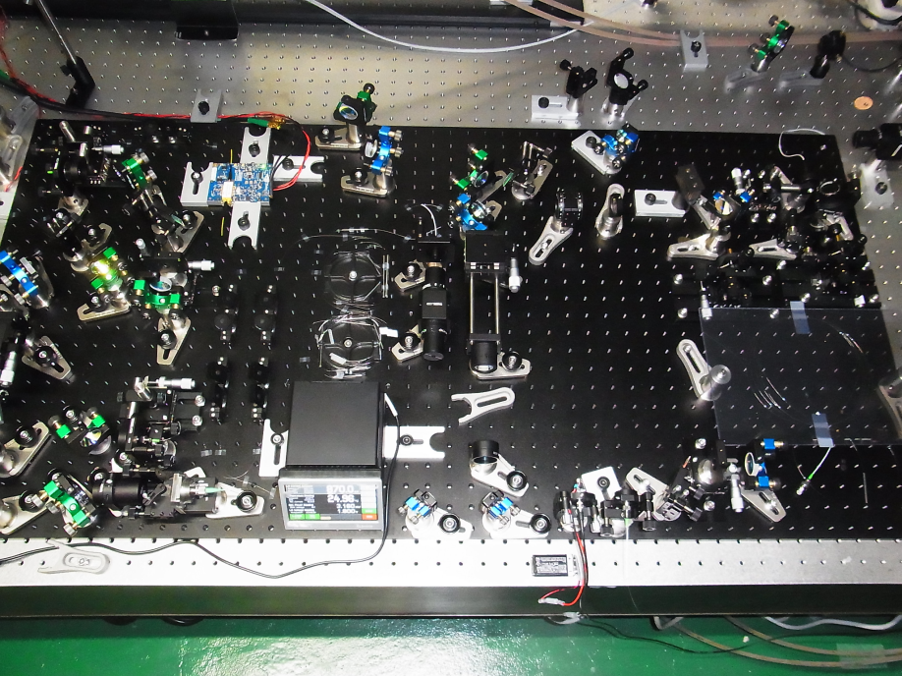
Yb fiber and Nd:YAG multi-stage laser @ 3-2
・Laser energy
4.0mJ@1064nm
550uJ@532nm
120uJ@226nm
・Under beam comissioning

Slide 27
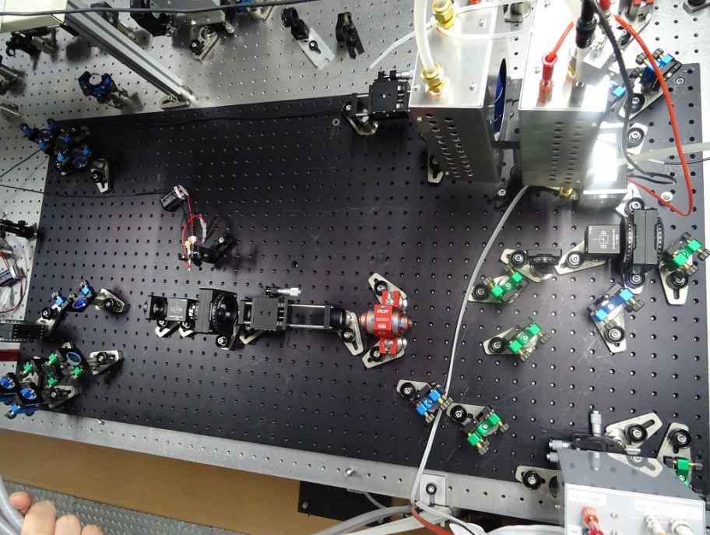
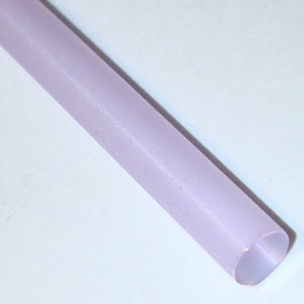
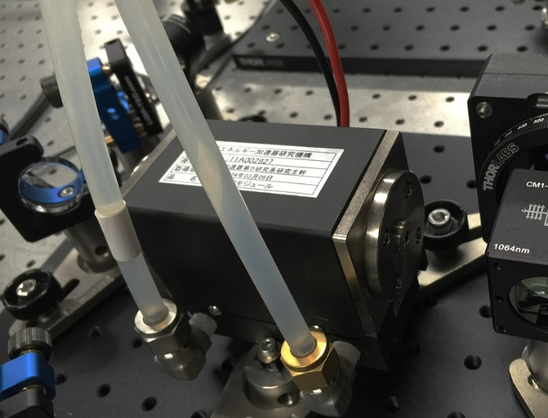
Nd:YAG Diode-pumped solid-state
(DPSS) Regenerative amplifier
○ 4-state laser is easy to operate.
○ High power pump LD is available.
  808nm : Commercial product
○ High gain efficiency.
○ Large crystal is available
× Small gain bandwidth. (Gaussian)
1.1% Dia. 4×93mm AR/AR@1064nm

Slide 28
Plan A
Developed
Developing
Yb fiber + CPA + Yb:YAG
114 MHz fiber oscillator
Grating stretcher
To 30 ps
SOA
pulse picker
Yb single mode
fiber amp
10 MHz ANDi type oscillator
Stretcher to 2 ns
Yb-doped PCF
fiber amp
EO module
pulse picker
10Hz
Grating pair Compressor to 30 ps
SHG × 2
High-energy Yb-doped ROD PCF fiber amp
1030nm
< mJ
Yb:YAG Thin disk
regenerative amplifier
1064nm
Output
Nd:YAG
regenerative amplifier

Slide 29
Plan B
Yb fiber + Nd:YAG
114 MHz fiber oscillator
Grating stretcher
To 30 ps
SOA
pulse picker
Yb single mode
fiber amp
10 MHz ANDi type oscillator
Stretcher to 2 ns
Yb-doped PCF
fiber amp
EO module
pulse picker
10Hz
Grating pair Compressor to 30 ps
SHG × 2
High-energy Yb-doped ROD PCF fiber amp
1030nm
< mJ
Yb:YAG Thin disk
regenerative amplifier
1064nm
Output
Nd:YAG
regenerative amplifier

Slide 30
Summary
Laser system, underground
  Yb-doped fiber & Thin-disk Yb:YAG @ 1030 nm
    Development of Underground Laser is finished.
    The stability of laser is improved.
    The limitation of the output power and repetition rate is reached.
    The laser is employed for the Phase-I study.
New laser system, on the ground
  Yb-doped fiber & Rod Nd:YAG @ 1064 nm
    Fiber parts are finished.
    Nd regenerative amplifier for the Phase-II stable injection.
  Yb-doped fiber & Thin-disk Yb:YAG @ 1030 nm
    10 MHz oscillator to simplify the laser system
    High-energy fiber ROD amplifier μJ→mJ
    CPA system to avoid non-linear effect
    Yb regenerative amplifier for the Phase-III

