Slide 1

Cryostat performance
Zhanguo ZONG, Norihito OHUCHI, Masanori KAWAI, Yoshinari KONDOU, Hiroshi YAMAOKA, Yasushi ARIMOTO, Xudong WANG, Kiyosumi TSUCHIYA,
SC Magnet Group, SuperKEKB, Accelerator Laboratory, High Energy Accelerator Research Organization (KEK)
The 21th KEKB Accelerator Review 2016-06-14 (Tues.)

Slide 2
Contents
Cooling requirements of the SuperKEKB QCS SC magnets
Introduction to the magnet cryostats
Sub-cooled LHe for the SC magnet cryostats
Cryogenic systems, and their cooling powers.
Cold tests of the QCS-L cryostat in the experimental laboratory
Set-up to cool the QCS-L cryostat with the 1000 L dewar
Thermal performance of the QCS-L cryostat
Some issues (support rods, measured heat leaks and working point of the refrigerators)

Slide 3
SC magnets and cryostats of the SuperKEKB IR
QCS-L Cryostat
QCS-R Cryostat
IP
Cryostats | QCS-L |  | QCS-R
Helium vessels | Rear | Front | Front | Rear
Main quadrupoles | QC2LE | QC1LP QC2LP QC1LE | QC1RP QC2RP QC1RE | QC2RE
Compensation solenoids | - | ESL | ESR1 | ES2/ES3
Correction/Cancel coils | 4 | 16 | 19 | 4
Cold mass at LHe (kg) | 273.5 | 1460 | 1981.3 | 1152.1

Slide 4
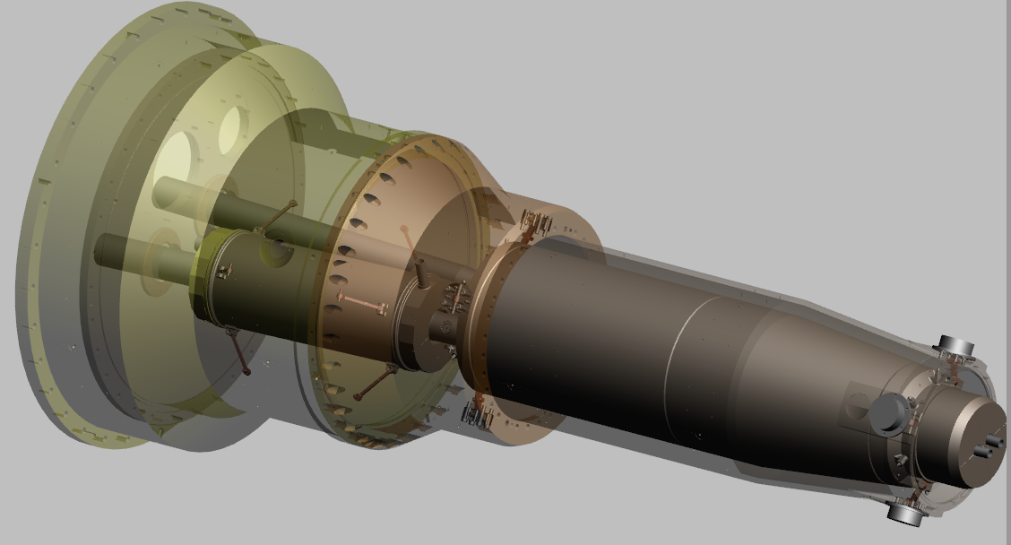
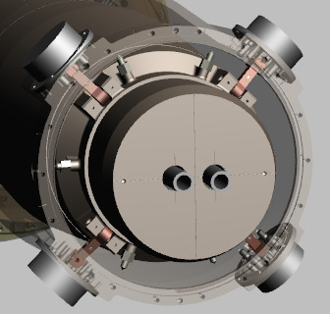
Cryostat of the SC magnets
Cooling the rear and front vessels in series by one LHe flow.
Front LHe vessel
Rear LHe vessel
LHe Return
LHe Supply
Multi-layer insulation and LN₂ shields applied to intercept heat leaks
Support rods
8 rods/vessel (16 for each cryostat)
Made of Ti-6Al-4V(ELI)
Largest heat leaks to the LHe vessels

Slide 5
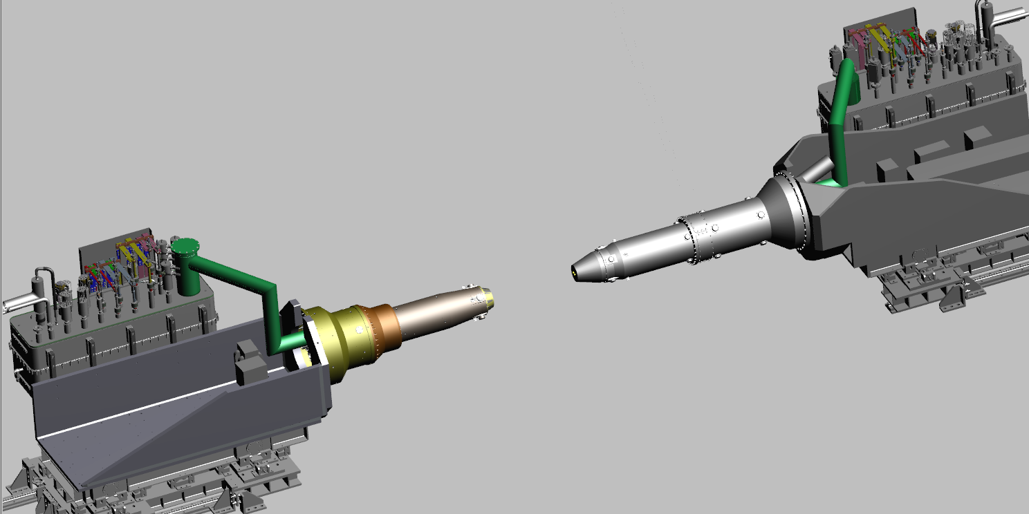
Service cryostats of the SuperKEKB IR SC magnets
Ring-out
Ring-in
Cryostats | QCS-L | QCS-R
Service cryostats | To access cryogenic multi-channel lines, and to accommodate cryogenic control valves, signal wires, current leads

Slide 6
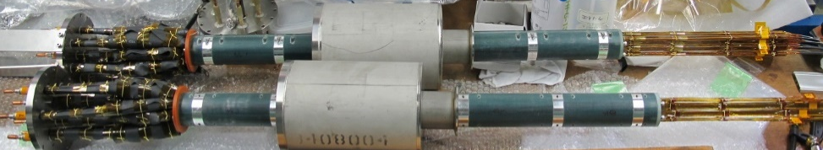
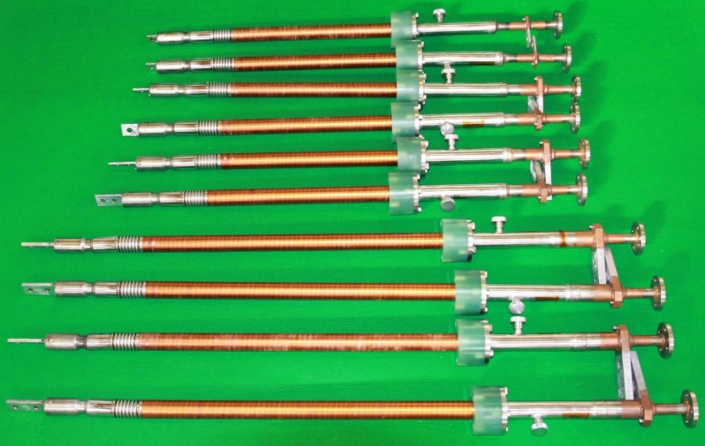
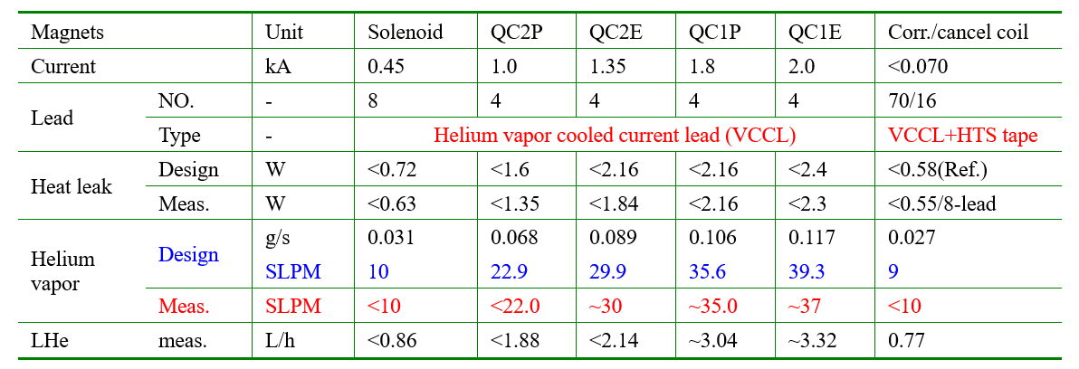
Cooling requirements of SC magnets
Vapor cooled current leads for the SC magnets
Large lead number (111 leads) and total current (33.1 kA to/from): 51 leads for the left, 16.2 kA and 60 for the right to transfer 16.9 kA.
Rated at 2.0 kA, 1.8 kA, 1.35 kA, 1.0 kA, 450 A and 60 A, for the main quadrupoles, compensation solenoids and SC correction/cancel coils.
The leads with large currents were commercially supplied. The compact units were developed at KEK.
Lead performance
Designed with the vapor cooled type.
Tested at the KEK lab with LHe before delivery to the factory.
Heat load for each side: <30 L/hour (LHe)

Slide 7
Cooling requirements of the SC magnet cryostats
Cooled by sub-cooled single phase LHe at the normal operation
The magnet cryostats were designed under the stringent space constraints, especially in the radial direction, and the annular helium channels in the cryostats are slim.
The cryostats are cooled by sub-cooled single-phase LHe, to avoid the instability of two-phase flow, and to exclude the occurrence of the helium vapor bubble.
Cryostat performance is very important because heats are absorbed by the sensible heat of the liquid helium (0.5 W/g/s, ΔT=0.1 K).
The refrigerators and sub-coolers
The refrigerators supply a flow of 20 g/s at 1.6 bar and the sub-coolers cool the flow to ~4.4 K along the isobaric line.
In the cryostat, return from 4.4 K (Point C) to 4.74 K (Point B), (13.3–11.2) J/g*20 g/s= ~40 W, available for each cryostat.
Liquid region
Two phase region (Liquid-vapor)

Slide 8
Heat leak estimations of the left cryostats
Items | Cold mass |  | Remarks
 | Rear | Front
Support rod (Thermal anchor: 110 K) | 1.76 | 6.68 | Ansys
Current lead pipe | - | - | Ansys
Thermal radiation from beam pipes | 1.1 | 3.18 | 5 W/m²
Thermal radiation from LN2 shields | 0.3 | 0.9 | 0.5 W/m²
Instrument signal wire | 0.01 | 0.01 | Estimation
Summary | 3.17 | 10.77 | 13.94 W
Main heat leaks are from the support rods (~8.4 W)
A source: thermal radiation from warm beam pipes (from ~300 K to LHe temperature)
Experimentally studied (total MLI layers vs. heat flux in the narrow gaps (from 3.5 to 6 mm)

Slide 9
Cryogenic systems for the cryostats

Slide 10
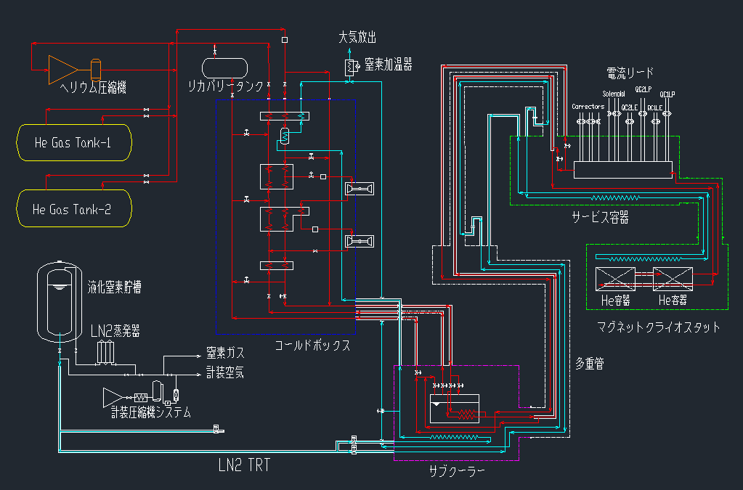
Cold box and sub-cooler for each cryostat
To maintain SC magnets in the single phase LHe cooling
A: outlet from Coldbox: 1.6 bar (20 g/s, ~4.74 K, saturated LHe, two phase)
A->B->C: in the sub-cooler and multi-channel transfer lines
C->B: single liquid phase in the service cryostat and cryostat, a part to current leads
B->D: J-T valve in the service cryostat.
D->E: in the multi-channel transfer lines and subcooler, return to coldbox at E point

Slide 11
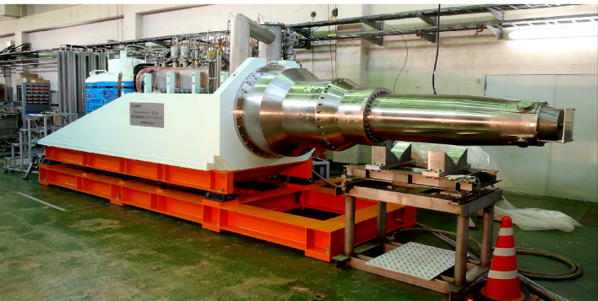
Cold tests of the QCS-L cryostat
Cooling the SC magnets down to ~4.5 K in the experimental laboratory (Feb.~Jul.)
To see the temperature profile in the SC magnet cryostat
To measure heat leaks of the cryostat
To excite all the SC magnets in the independent or combined modes (main quadrupole+corr.+ESL)
For magnetic field measurements (by harmonic coils, SSW, and Hall probe)

Slide 12
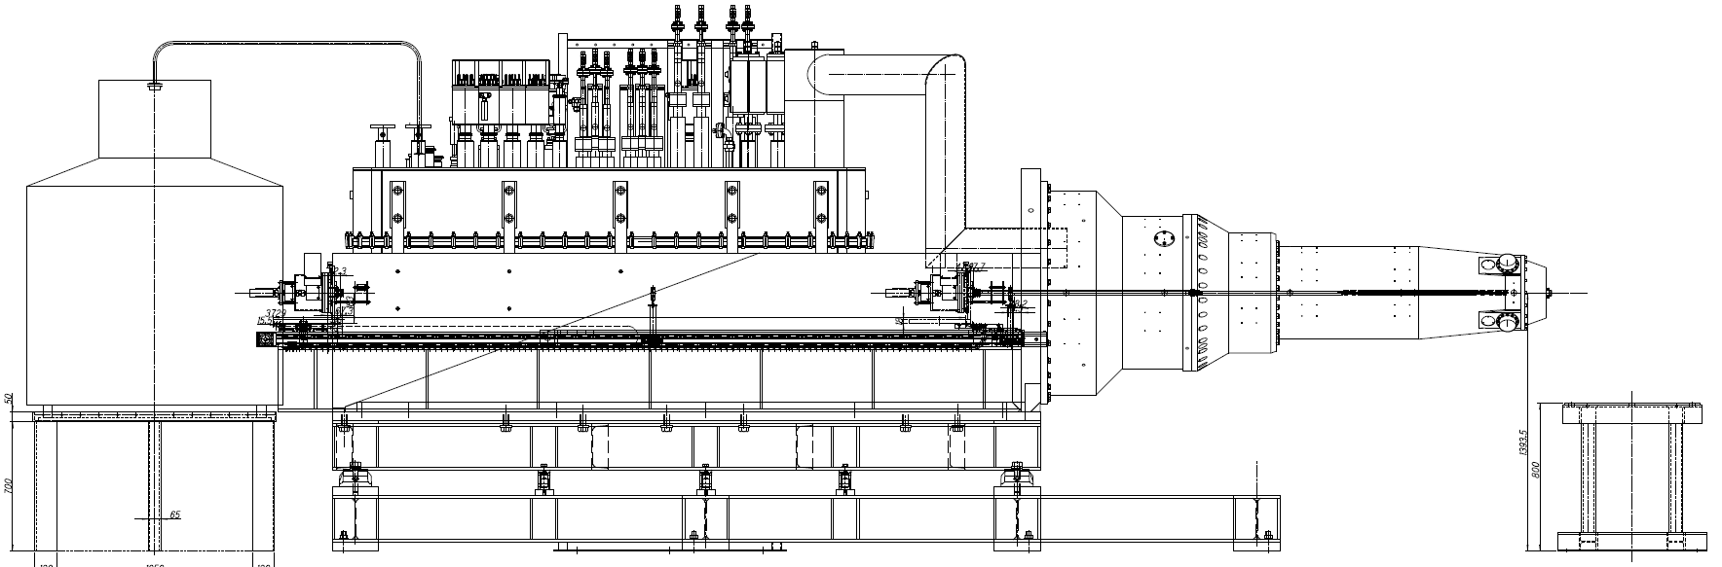
Setting-up to cool the SC magnet cryostat
1000 L
LHe dewar
Saturated LHe (two phase-vapor and liquid) instant of the single phase LHe
LHe was transferred into the service cryostat from the pressurized LHe dewar (1000 L, 1.4~1.6 bar). Helium gas vents through current leads or return line from the cryostat (~1.2 bar).
Not higher temperatures in the cooling process

Slide 13
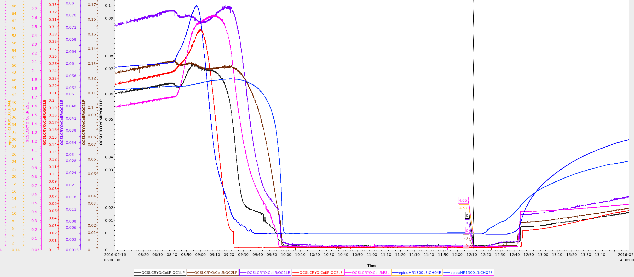
Cold tests of the QCS-L cryostat in the experimental laboratory
The cryostat was pre-cooled with LN₂ and was cooled with LHe on Feb. 12 2016 (Fri.)
With LN₂ cooling the LN₂ shields (~ 40 L/hour) and use 1000 LHe a day.
A small current (0.05~0.5 A) to monitor the evolutions of the coils’ resistances with temp..
To see the SC state of the magnets with the temperatures (on Feb. 16, 2016, Tue.)
Vacuum level of the cryostat:10⁻⁵ (~50 K, in the morning) ~ 10⁻⁶ Pa (at LHe temperature)
ESL
QC2LP
QC1LP
QC1LE
to SC
Rear/Front: 4.57 K/4.65 K
QC2LE
to SC

Slide 14
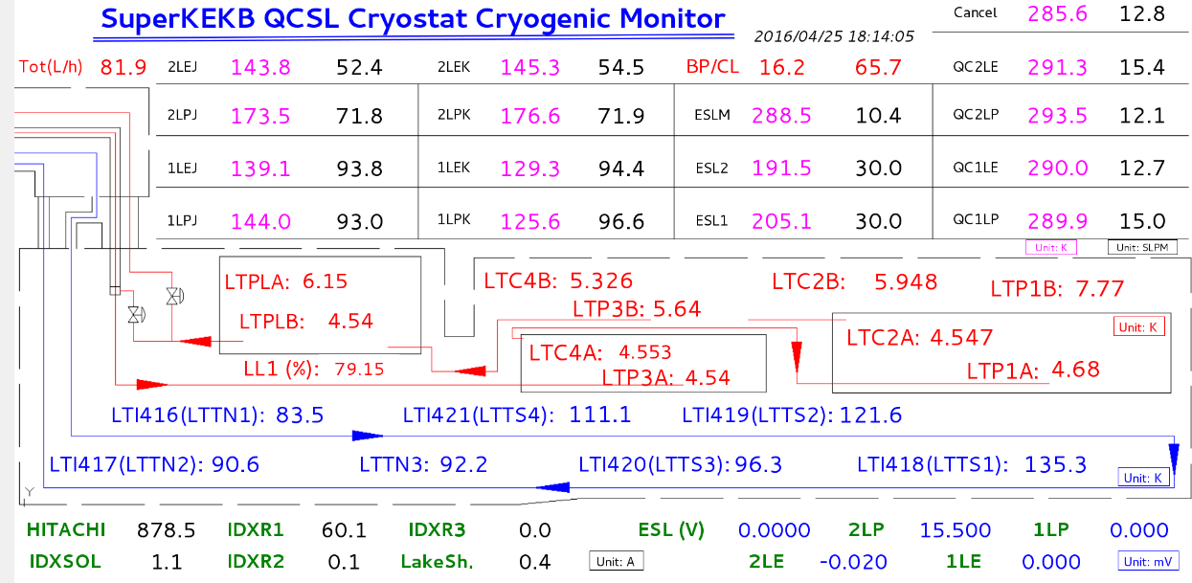
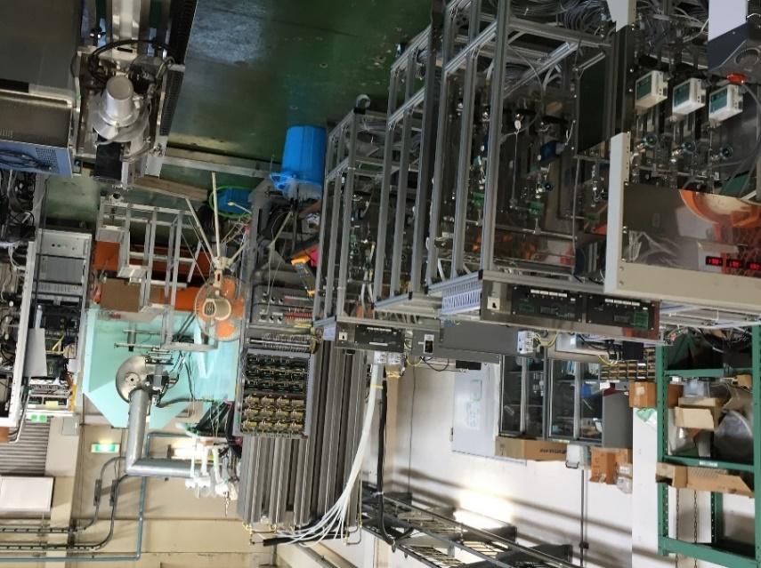
Cold tests of the QCS-L cryostat in the experimental laboratory
Cryogenic ready (Once an hour to check and have a log of the main parameters)
LHe level: LL1
Flows of current leads
Flows of by-pass line
Temperatures at LHe
LN₂ shield temperatures
Flow meter interlock with current sources
Unit: K, SLPM (Standard liter per minute), L/hr)

Slide 15
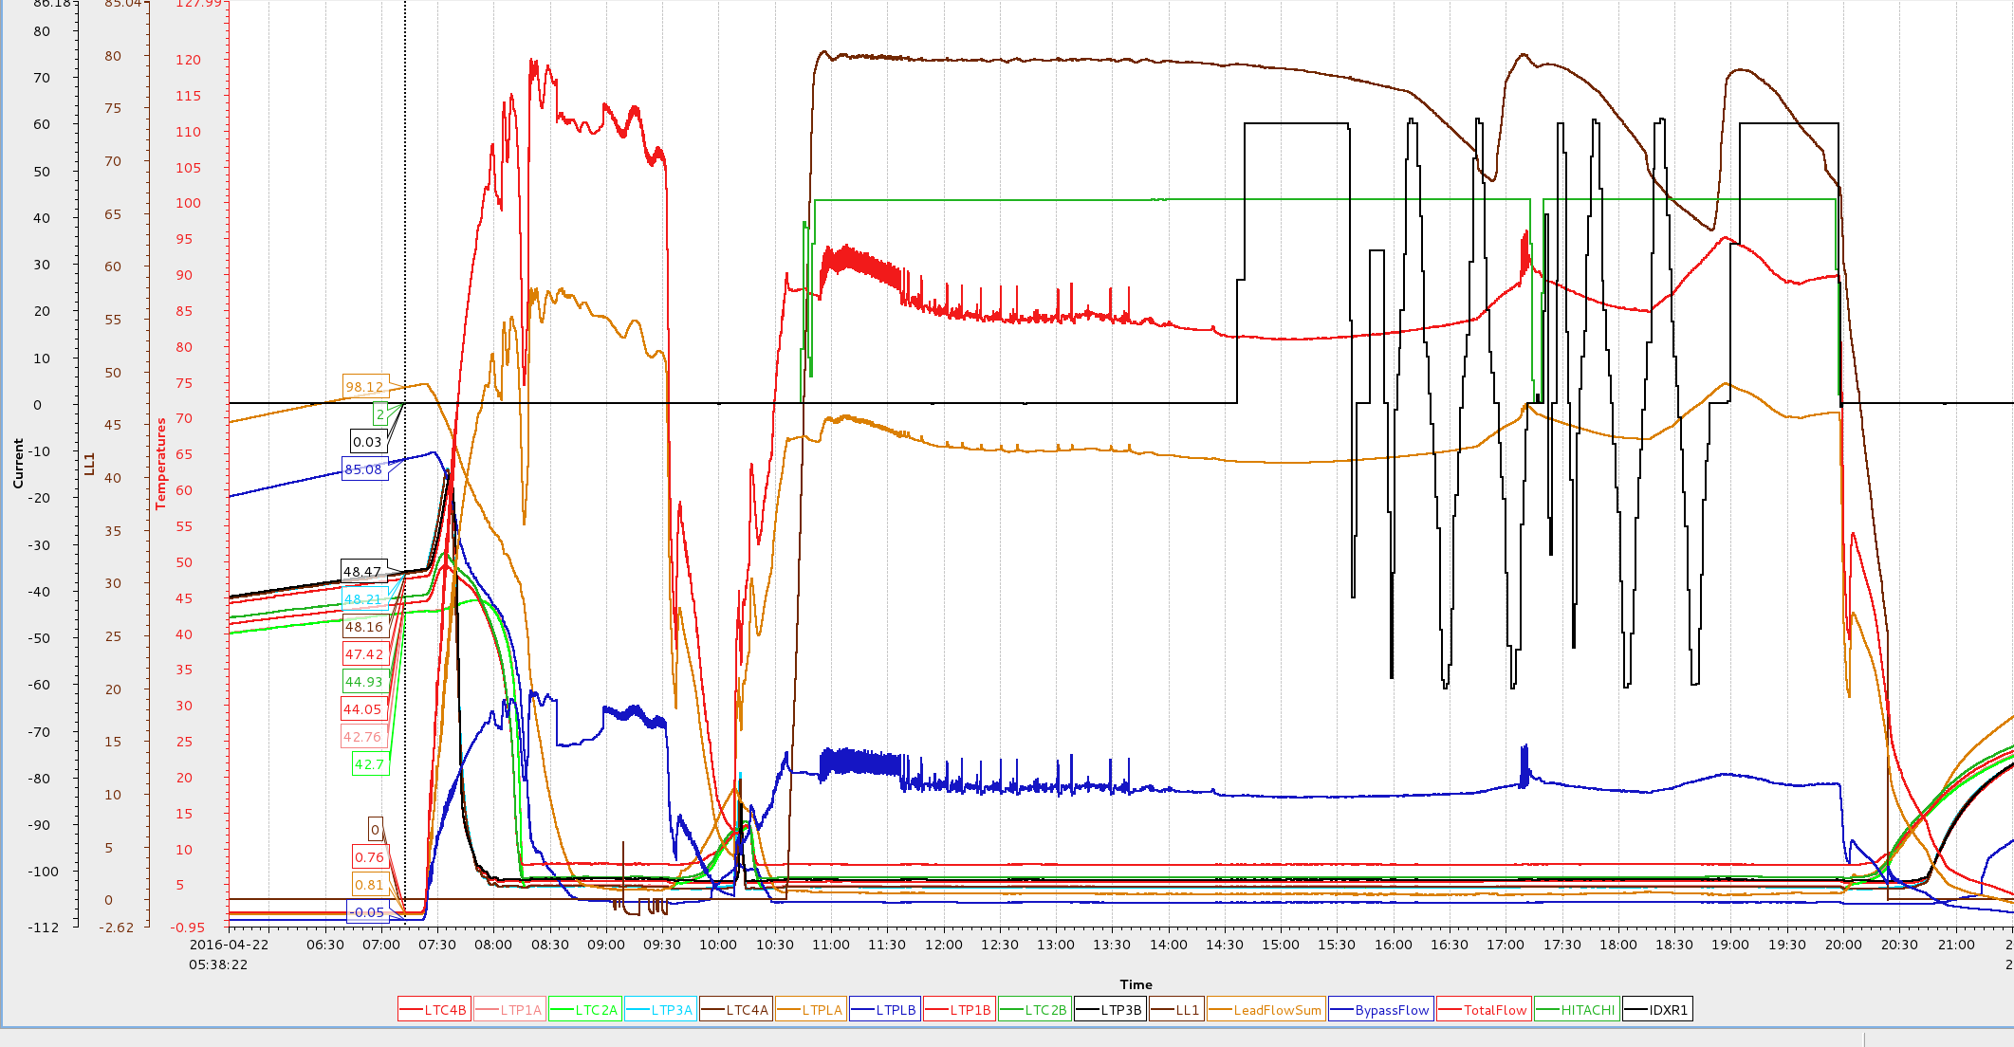
A typical one-day for magnetic field measurement
Cool down from ~45 K and keep more than 10 hours (consuming >1000 L LHe a day)
About 2 hours cooling down and have the LL1 of about 80%, and then energize the SC magnets
The SC magnets were sufficiently cooled and no quench happened due to the cooling conditions.
Dewar change
LHe level
Corr. Coil Current (±60A)
QC2LP: 1 kA
Flows of current lead: 69.5 L/hr
Bypass: 18.8 L/hr

Slide 16
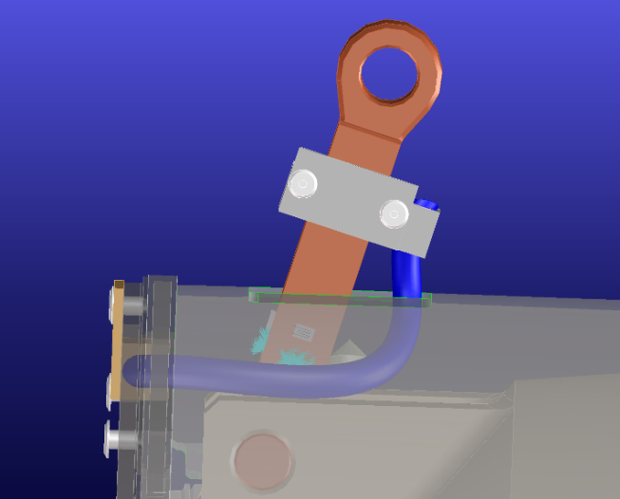
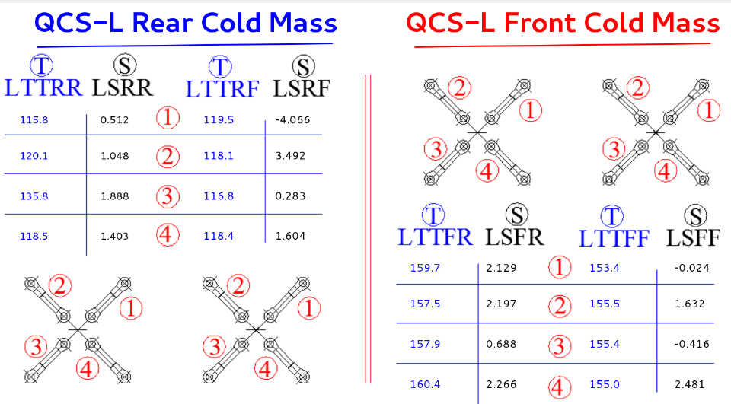
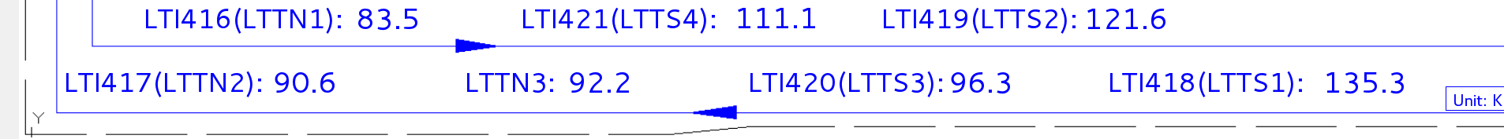
Some issues – Higher temperatures of LN2 level
Higher temperatures of LN₂ shields (110 K to 130 K)
Because of the temporary setting-up in the experimental laboratory (counter usage of the inlet and outlet of the LN₂ shields to fit the port types) (needs more analysis)
For the next step, use the design set-up.
High temperatures of thermal anchors of support rods
110 K to 155 K ( design about 90~100 K), increase the heat leak to LHe level
Because of the higher LN2 shield temperatures
Because of the thermal anchor cross-sections
Item | Rear | Front |  | Total
Dimensions (mm) | 120*7.5 | 133.5*13.5 | 83.5*13.5 | W
Heat leaks (120/155K) | 0.9/1.1 | 4.2 | 7.2 | 13.4
Heat leaks (110 K) | 1.76 | 2.44 | 4.24 | 8.44
Unit: K

Slide 17
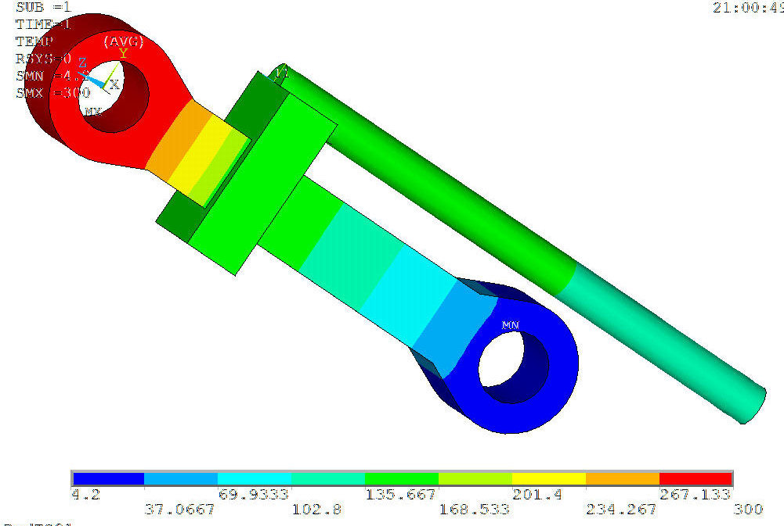
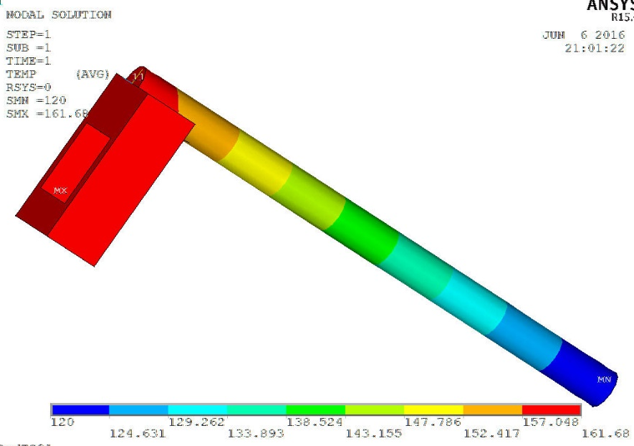
Some issues – Higher temperatures of LN2 level
High temperatures of thermal anchors of support rods
The cross-section areas are not sufficient to intercept heat leaks from room temperatures.
For the QCS-R cryostat, we will confirm the thermal anchor design (cross-section areas and contact surfaces between the copper braids and LN2 shields)
Item | Rear | Front |  | Total
Dimensions (mm) | 120*7.5 | 133.5*13.5 | 83.5*13.5 | Design
Thermal anchor | Φ7 | 2.5*25 | Φ7 | Design
ΔT (K) | 23 | 45.6 | 41.6 | Cal.
ΔT=41.6 K
(~ 39.3 K, by formula)

Slide 18
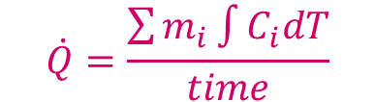
Summary of the QCS-L cryostat cold test
Items | Cold mass |  | Remarks
 | Rear | Front
Total heat leaks at the cryostat side | 11.5 | 23.6 | 35.1 W (Measured)
Total heat leaks at the service cryostat (calculated) |  |  | 13.25
Multi-Channel transfer line between sub-cooler and the service cryostat |  |  | <10 W
$$\dot{Q}=\frac{\sum{m_{i}\int{C_{i}dT}}}{time}$$
Heat leak meas. with temp. increase from 10 to 16 K
Estimated working point of the refrigerator (for the left side)
Summary: The left cryostat has successfully been cooled down at the KEK lab and the field measurements have been performed. The heat leaks are higher than expected and still affordable for the refrigerator. More analysis is needed for the next stage.

