Slide 1
Status of RF Accelerating Cavities for SuperKEKB Positron Damping Ring
Tetsuo ABE (KEK)
for SuperKEKB-RF / ARES Cavity Group
(T. Abe, S. Enomoto, T. Kageyama, H. Sakai, Y. Takeuchi, and K. Yoshino)
The 22nd KEKB Accelerator Review Committee Meeting
2018-03-14

Slide 2
Contents
Overview and Fundamentals of the RF Accelerating Structure
Installation into the SuperKEKB Positron Damping Ring (DR)
Status of Cavity No.0 (prototype)
Summary

Slide 3
1. Overview and Fundamentals of the RF Accelerating Structure

Slide 4
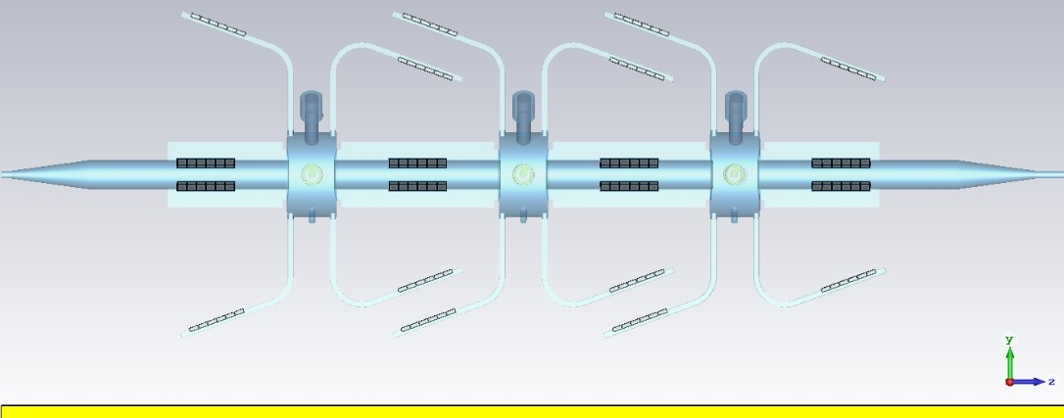
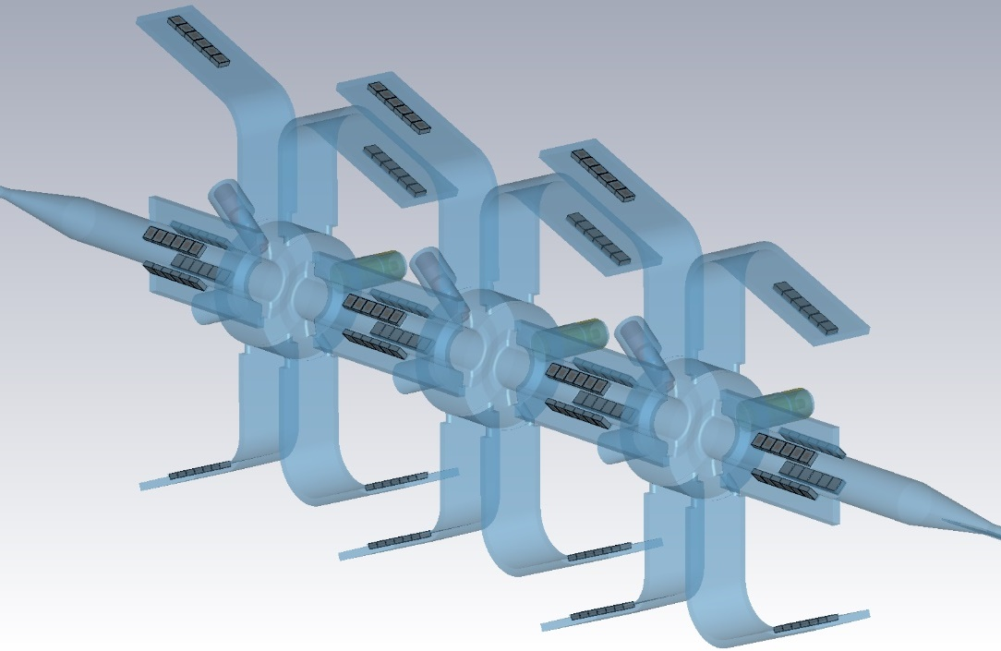
Overview of the RF Accelerating Structure
Operational frequency: 508.9 MHz (CW) (same as for the MRs)
HOM-damped structure based on the successful ARES cavity system
Max. three cavities to be installed in a space originally designed for one cavity
Max. total V_{c} = 2.4 MV to be supplied to the DR
“Multi Single Cell” structure
Electromagnetic field in each cavity has high independence by the contribution the HOM absorbers between the cavities.
Number of cavities is variable; Cavities are replaceable.
Assembled in the DR tunnel like LEGO blocks
One big mechanical structure with solid connections of the components
Vacuum pumps directly attached to each cavity
Blue region: vacuum during operation
Gray region: HOM absorbers (SiC ceramics)
e⁺→
e⁺→
Middle Cavity
Downstream
Cavity
e⁺→
Design Parameters
Operational frequency | 508.9 MHz
R_{sh}/Q₀ | 150 Ω
Q₀ | ∼30000
Cavity Voltage (DR spec) | 0.7 MV / cavity
Cavity Voltage (Cavity spec) | 0.8 MV / cavity
Wall-loss power @ 0.7 - 0.8 MV / cavity | ~110 - 140 kW / cavity
1100
MR: Main Ring
HOM: Higher-Order Mode
SiC: Silicon Carbide
1100
e⁺→
Upstream Cavity

Slide 5
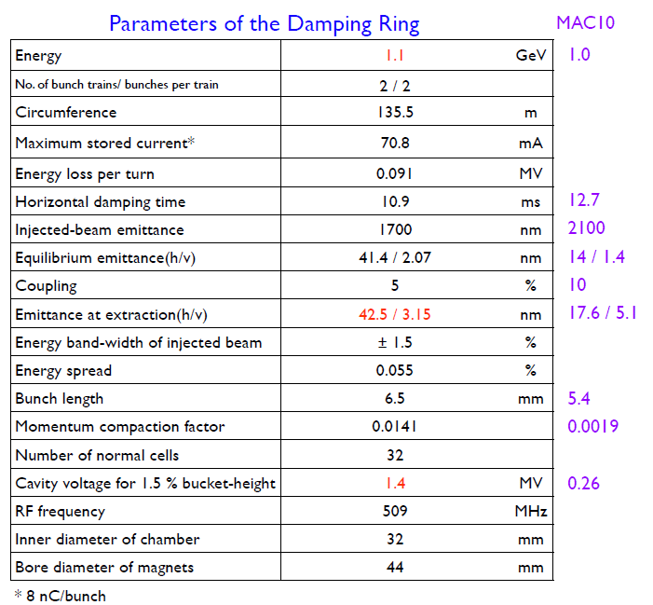
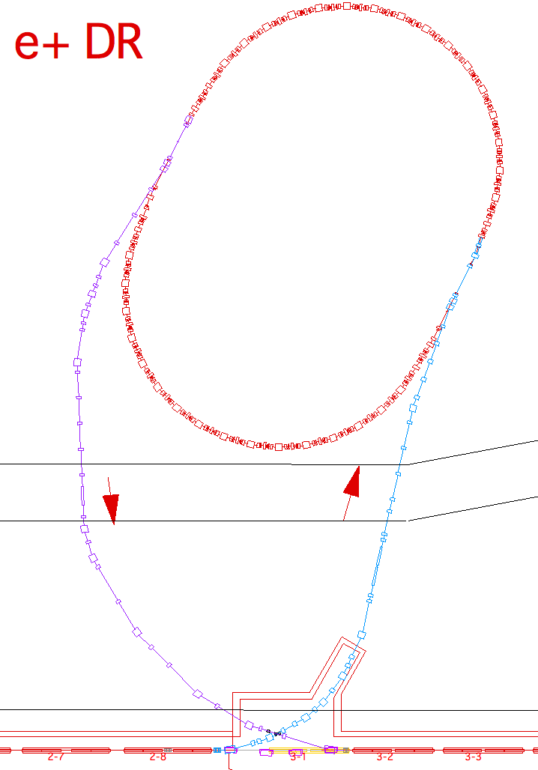
Due to predicted CSR effects, the required acceleration voltage was increased fivefold!
(N.Iida)
RF section
CSR
Injector Linac
To supply an accelerating voltage higher than 1.4 MV to the DR in the limited space of a sole RF section, which was originally designed for one cavity, this RF accelerating structure has unique space-saving features (→ next page).
(CSR : Coherent Synchrotron Radiation)

Slide 6
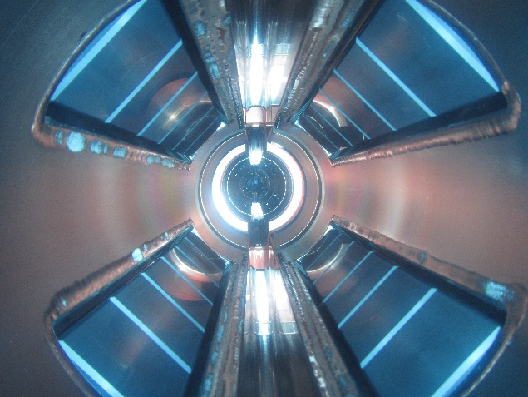
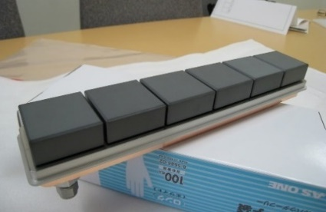
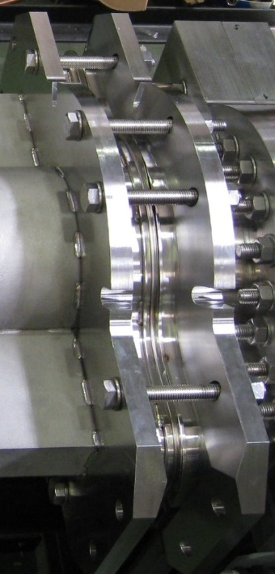
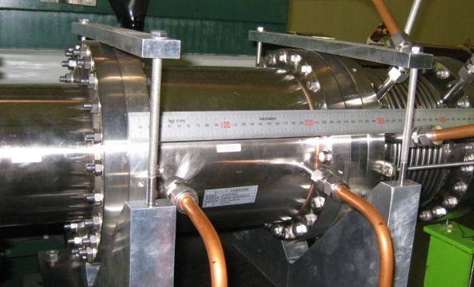
Space-Saving Features
The HOM absorbers in the grooved beampipes absorb not only TE modes but also higher-order TM modes.
The HOM absorbers are all compact tile-shaped SiC ceramics (48 x 48 x 20 mm³).
3.8 m
The neighboring cavities share a grooved beampipe in-between.
➔
No additional HOM absorbers (such as SiC ducts) needed
E.g. SiC duct used at the MR / RF section
The cavity is connected directly to grooved beampipes without bellows.
Fixed with 16 M12 bolts
Vacuum-tight lip welding at the outer periphery (“weld ring gasket”)
(280 mm long)

Slide 7
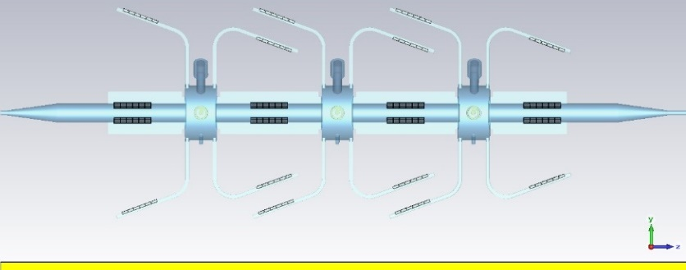
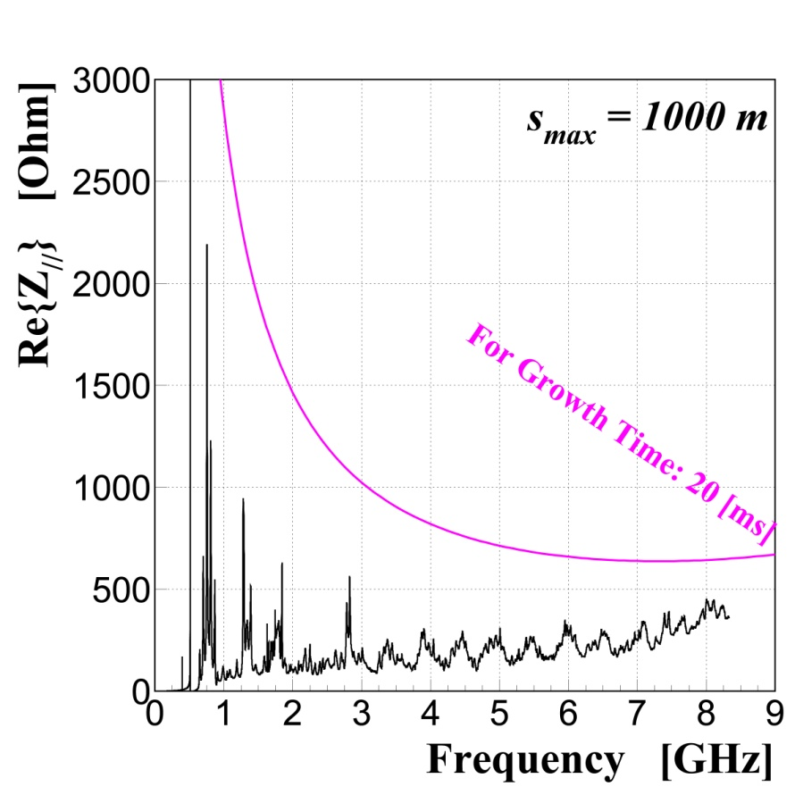
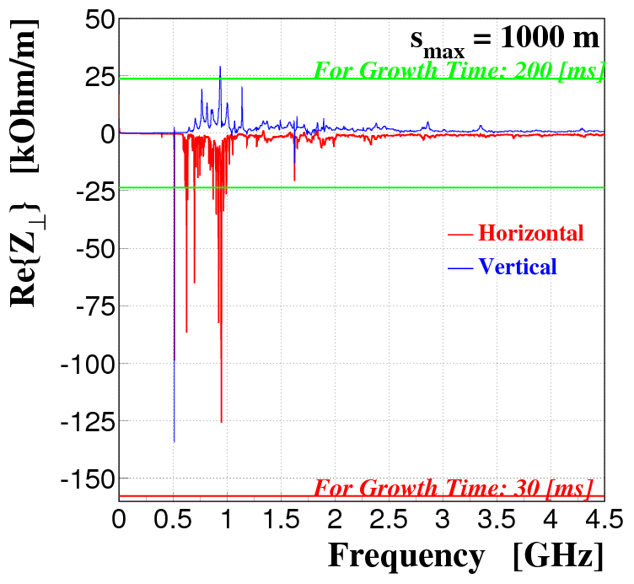
HOM impedances of the RF section are low enough below CBI thresholds.
(CBI: Coupled Bunch Instability)
From wakepotentials calculated, using GdfidL, for the whole RF section→
CBI thresholds were calculated for the DR design (8 nC / bunch).
Longitudinal
Transverse
Growth Time > 20 ms
> 5 ms (radiation damping time)
Growth Time > 30 ms
> 10 ms (radiation damping time)

Slide 8
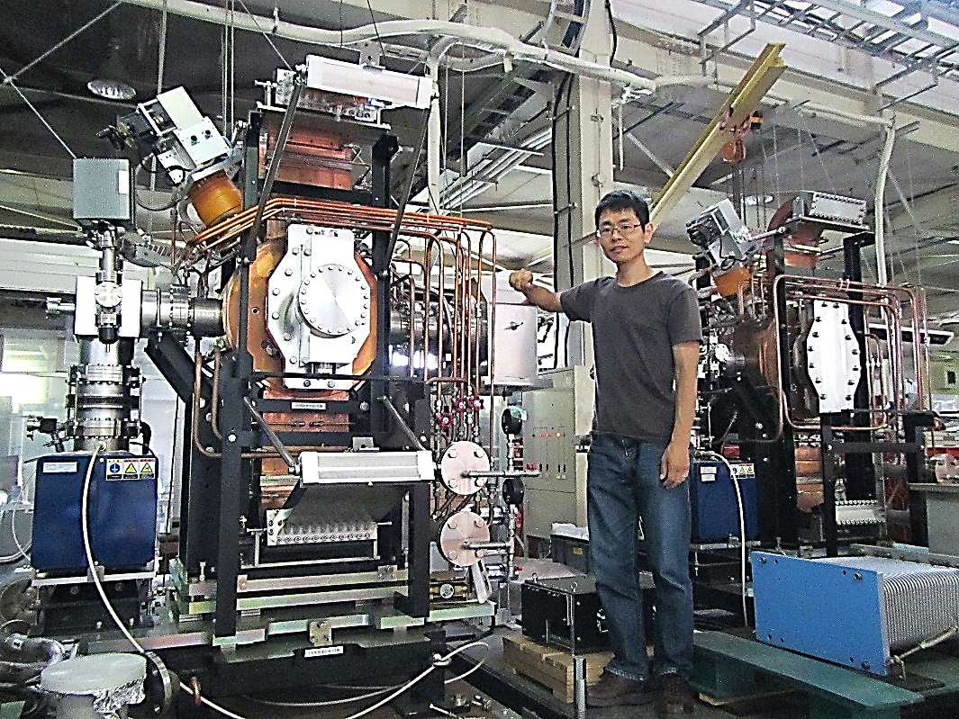
DR Cavities
No.2
No.1
0. Cavity No.0 (prototype) developed in JFY2011
Surface protection of the endplates: acid cleaning followed by chromating
1. Cavity No.1 fabricated in JFY2012
Surface protection of the endplates: Electropolishing (EP)
2. Cavity No.2 fabricated in JFY2013
Surface protection of the endplates: Electropolishing (EP)
No difference between No.1 and No.2 in the:
Electric design
Mechanical structure
Fabrication method
Low-power performance
High-power performance

Slide 9
2. Installation to the DR Tunnel
(November, 2016)

Slide 10
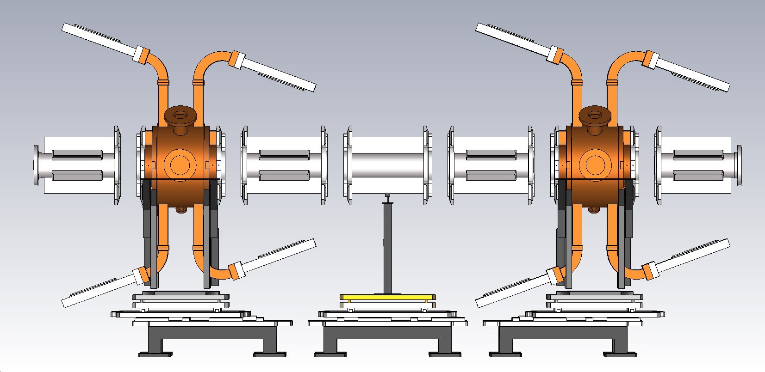
Components of the RF Accelerating Structure for the DR
Upstream Cavity
Downstream Cavity
Upstream
Middle Beampipe
Downstream
Middle Beampipe
Downstream
End Beampipe
Upstream
End Beampipe
Dummy Pipe
e⁺→
e⁺
→
544
556
544
556
544
556
544
Seven components (= two cavities + five beampipes) to be aligned ➔

Slide 11
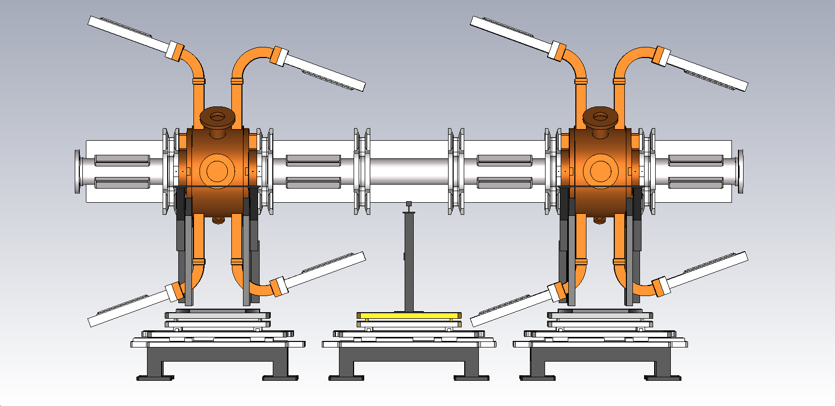
Into one big mechanical structure (3.8 m long)
e⁺→
e⁺→
3844 mm
Seven components (two cavities and five beampipes) to be aligned ➔Connected
10

Slide 12
Alignment Policy
Accuracy
0.3 mm in the transverse directions
Same as for the ARES cavities at the MRs
(1.0 mm in the longitudinal direction)
What to be aligned: beam-port flanges (not cavities)
Beam axis defined by the quadrupole magnets next to the RF section (upstream and downstream)
Position measurement of the Beam-port flanges prior to the installation

Slide 13
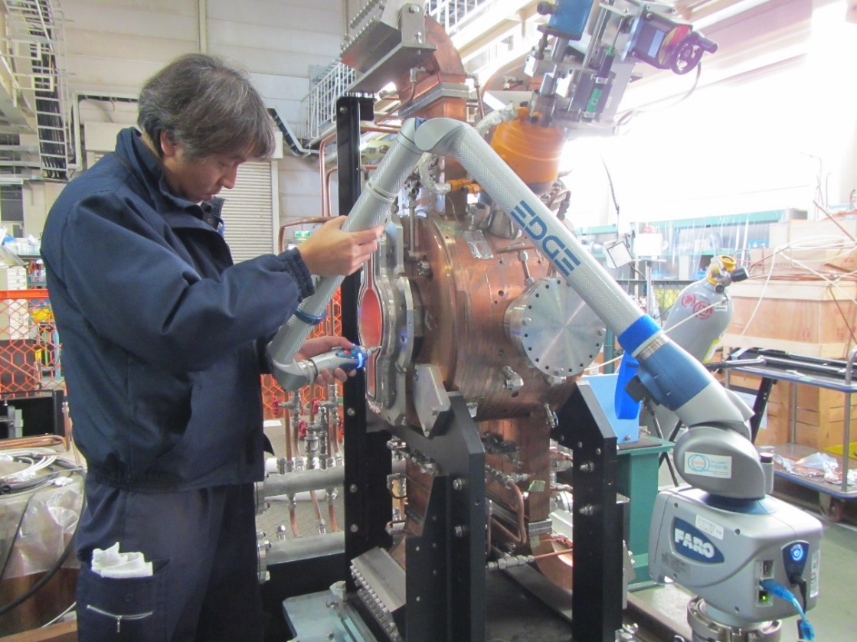
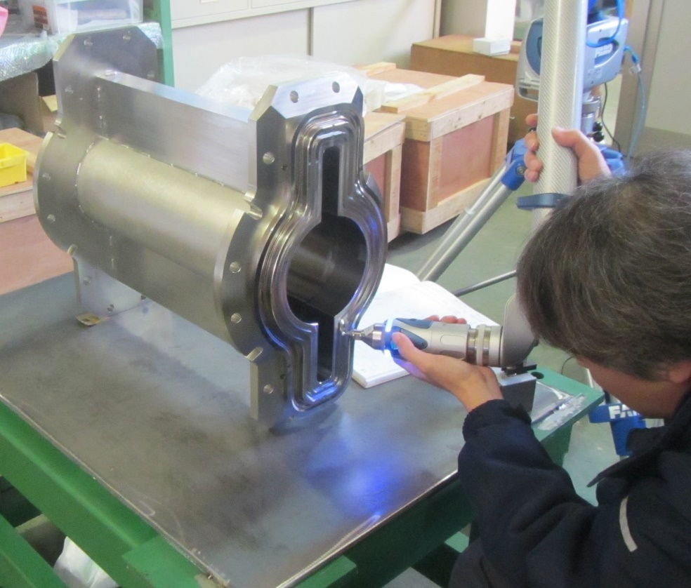
Position measurement of the beam-port flanges
using FaroArm Edge (portable CMM):
Measurement range: 1.8 m (in diameter)
Five axes
Precision at a fixed point: 0.024 mm (spec)
FaroArm Edge
from KEKB monitor group →

Slide 14
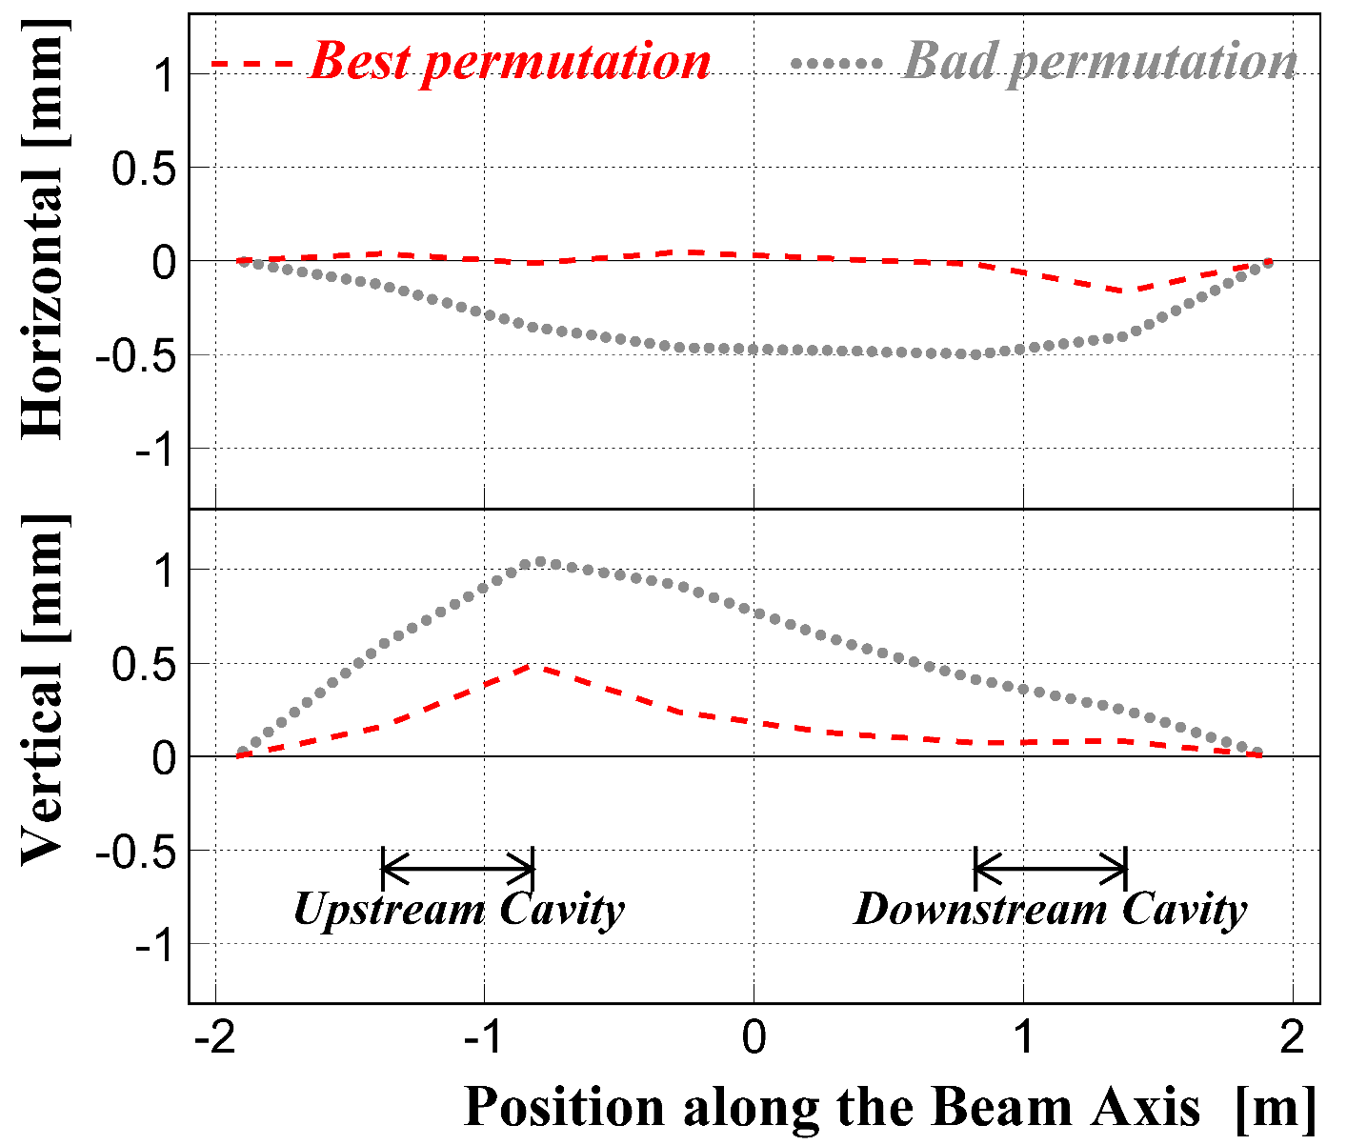
Offsets of the component centers predicted from the measurement results using FaroArm Edge
beam axis
We selected the best permutation
out of 2048 permutations of the components
to make the offsets as small as possible,
or to make the structure as straight as possible.
1 mrad unexpected bend
beam axis
For details on the algorithm to select the best permutation,
please see:
(Cavity No. 2)
(Cavity No. 1)
T. Abe, Y. Takeuchi, H. Sakai, T. Kageyama, K. Yoshino, M. Masuzawa, T. Kawamoto, “Installation of Normal-Conducting RF Accelerating Cavities into the SuperKEKB Positron Damping Ring”, in Proceedings of the 14th Annual Meeting of Particle Accelerator Society of Japan, 2017 (Paper ID: TUOL06).

Slide 15
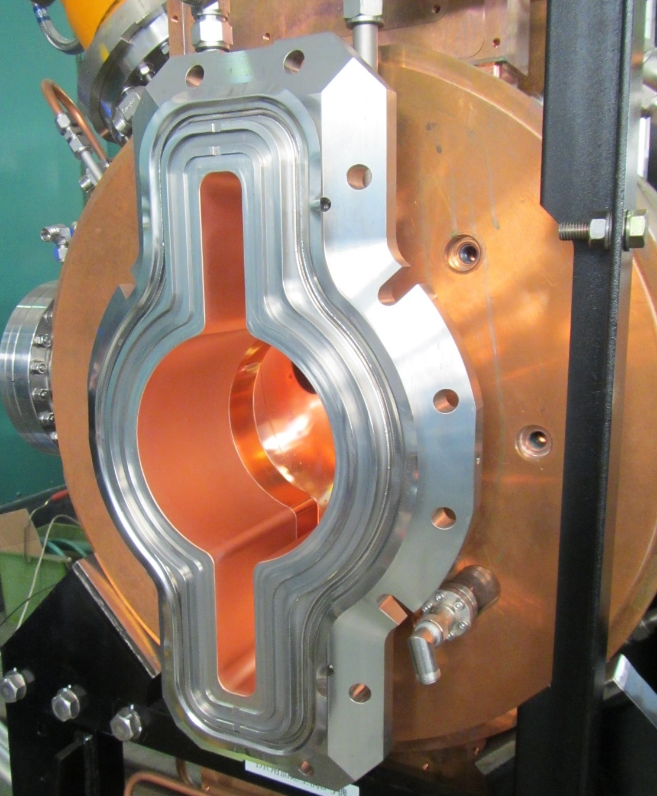
We also measured distances between the ∅150-duct center and the reference planes of the beam-port flanges.
~245 mm
~150 mm
∅150
To be used in the position measurement after the installation

Slide 16
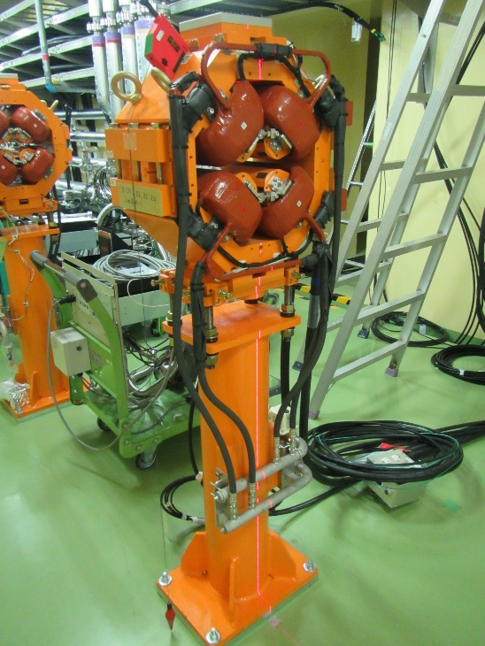
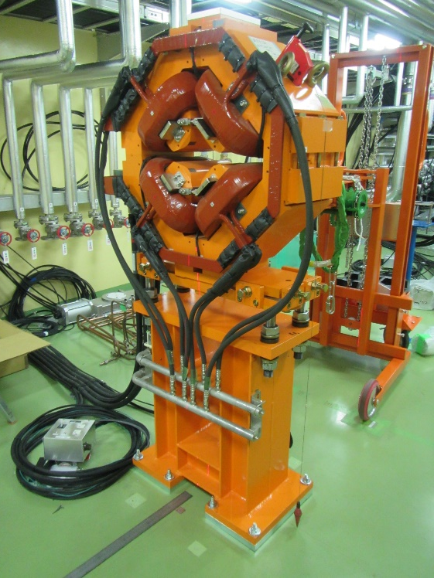
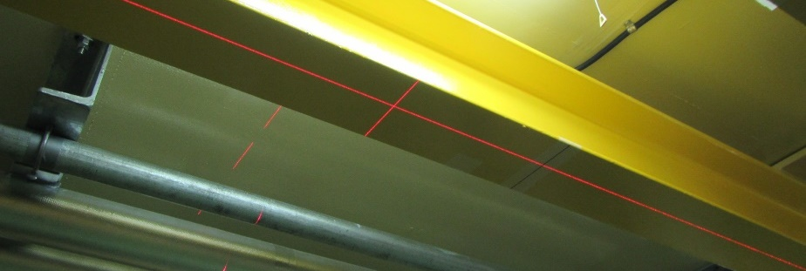
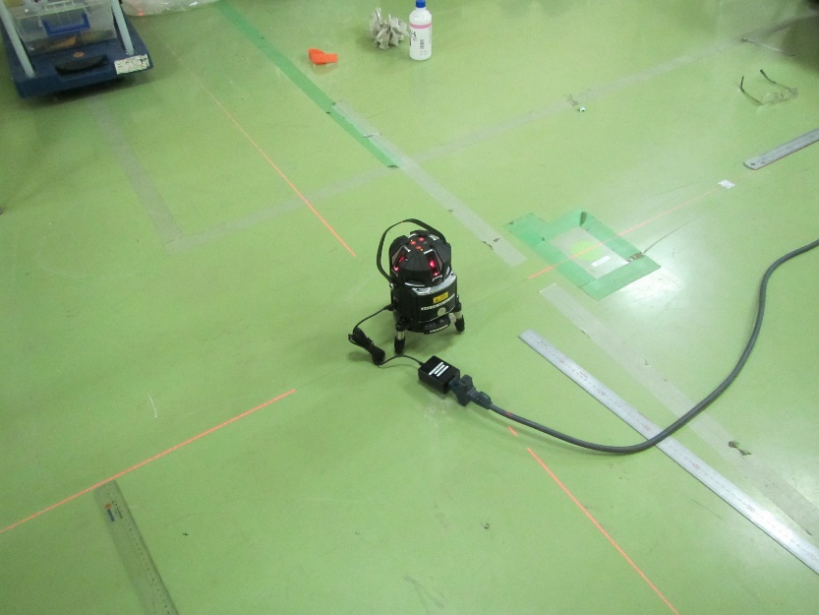
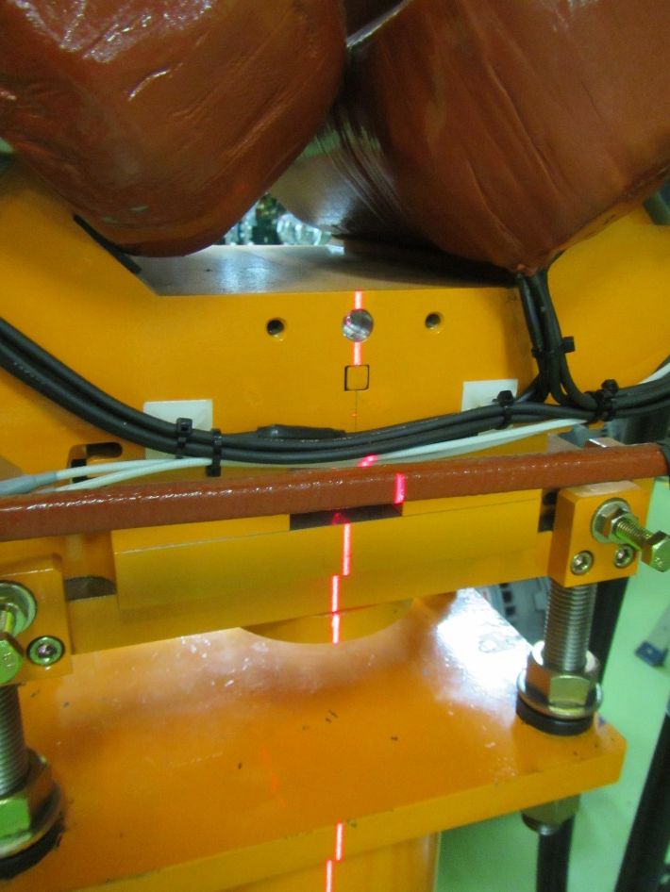
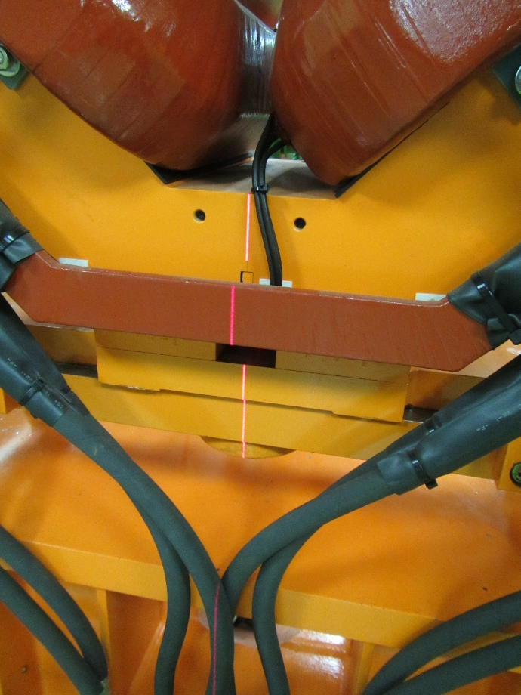
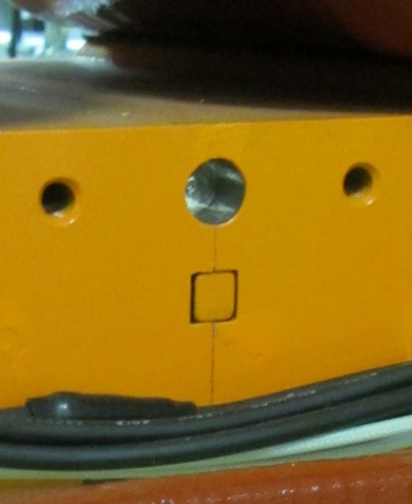
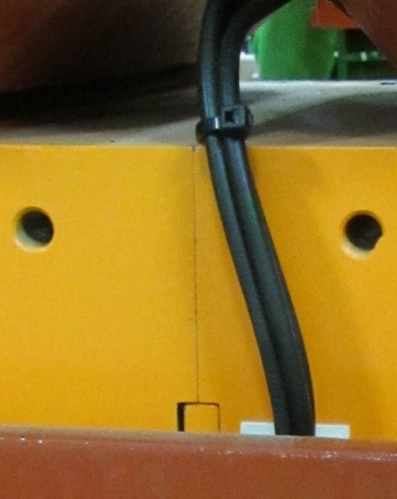
We defined and marked the beam axis (horizontal).
Upstream Q-mag
Downstream Q-mag
Boundary
Boundary
The 22nd KEKB Review (2018-03-14)

Slide 17
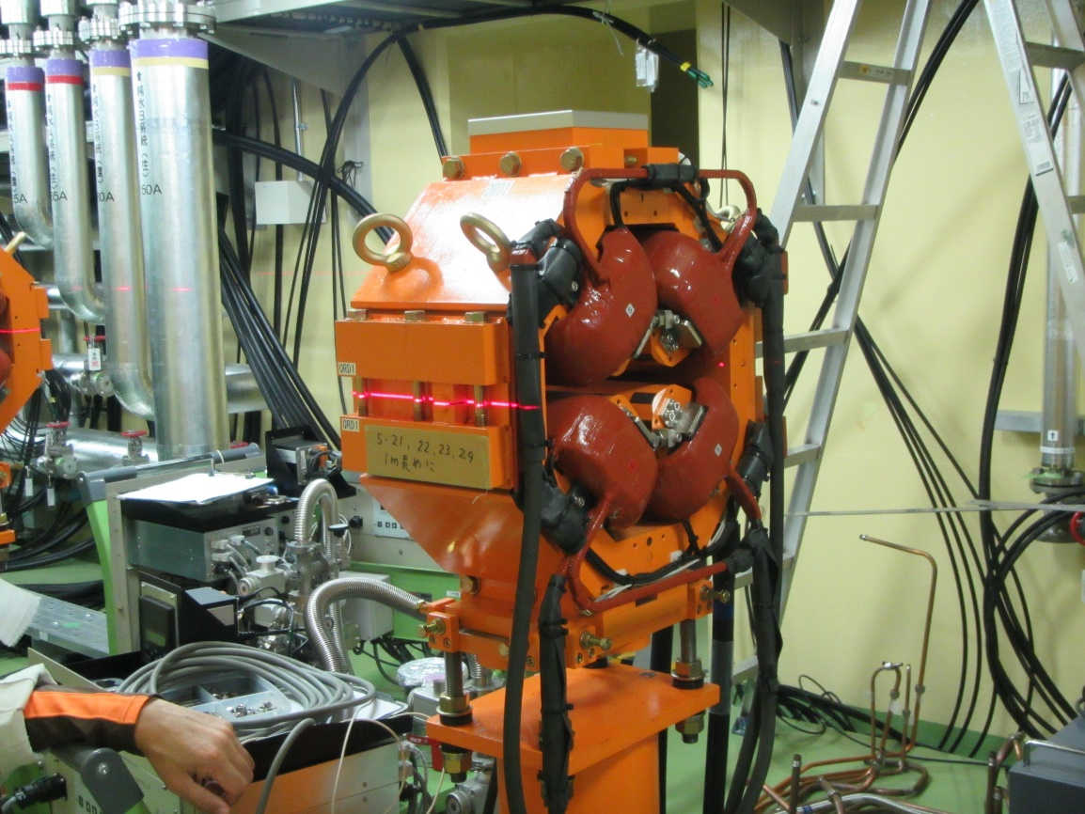
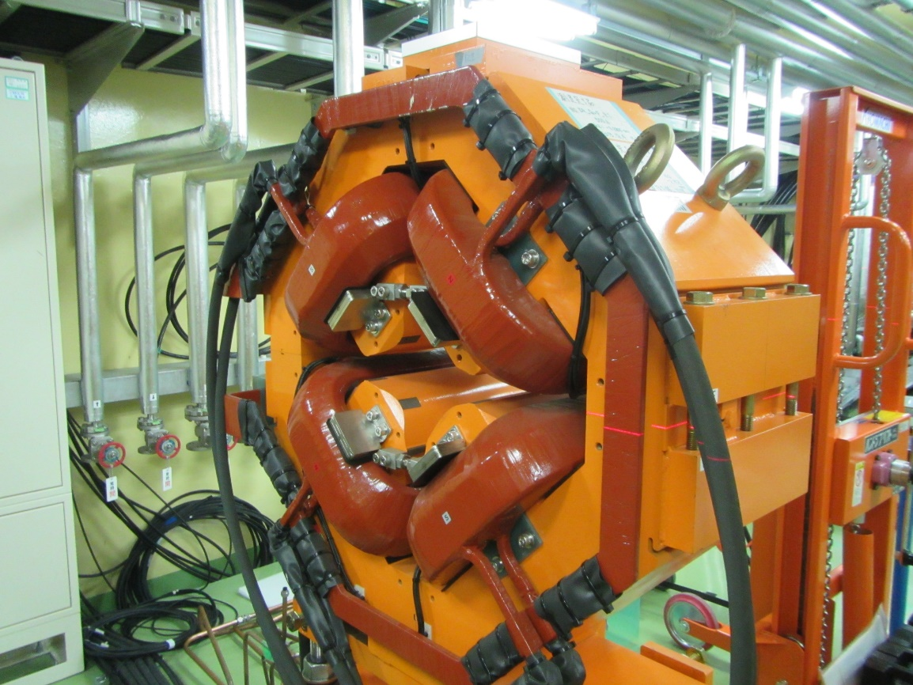
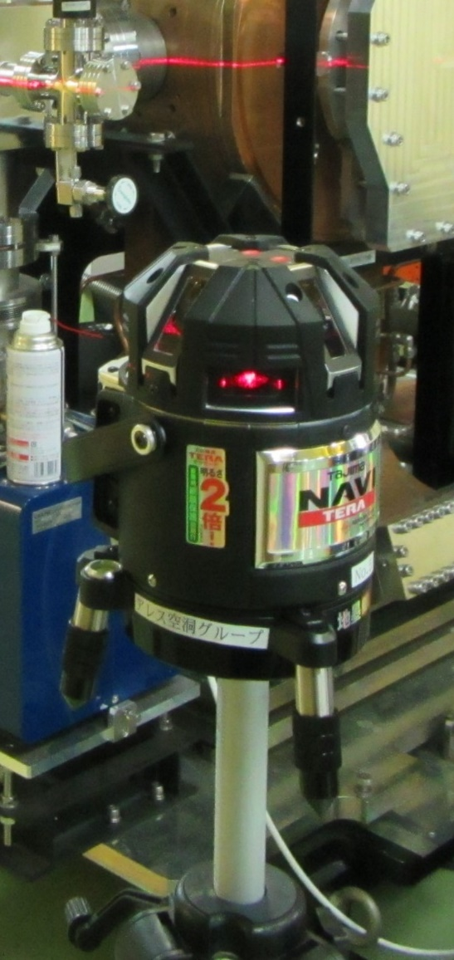
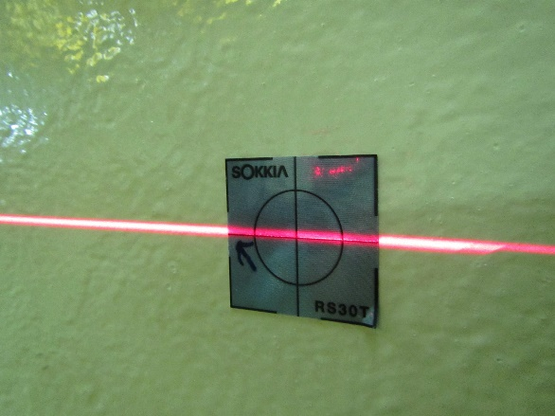
We defined and marked the beam axis (level).
Upstream Q-mag
Downstream Q-mag

Slide 18
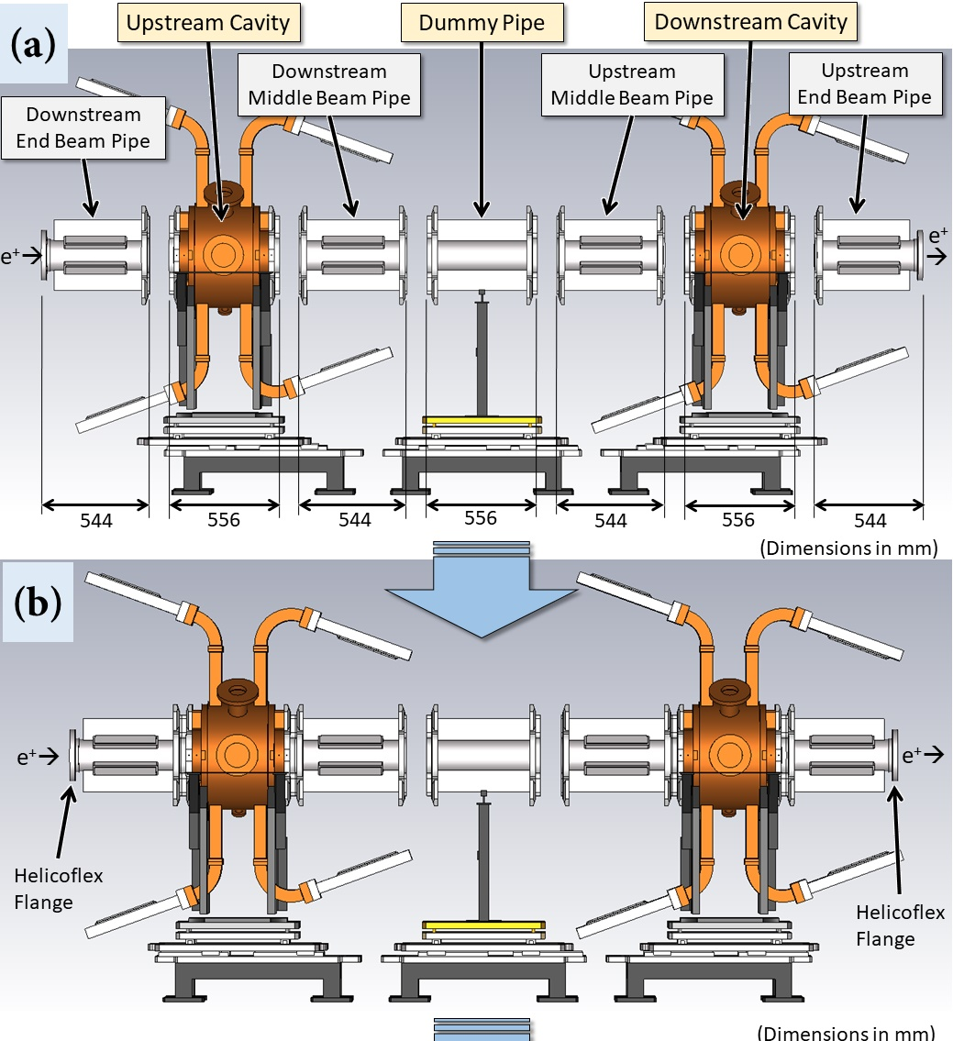
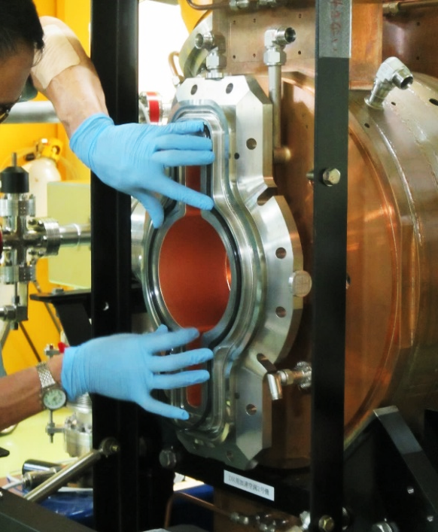
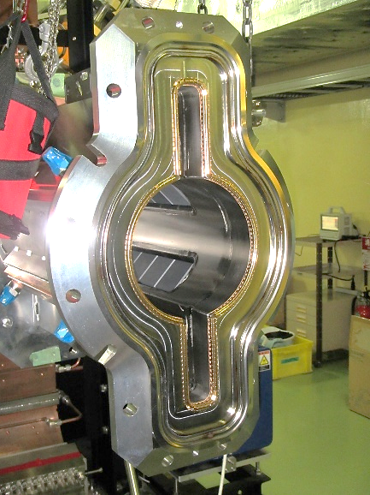
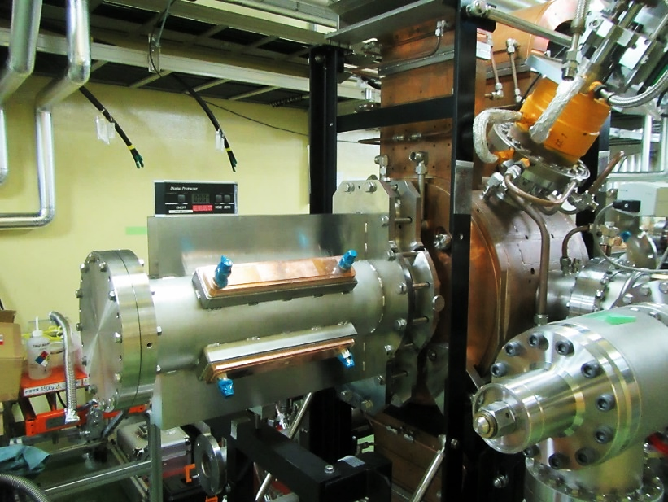
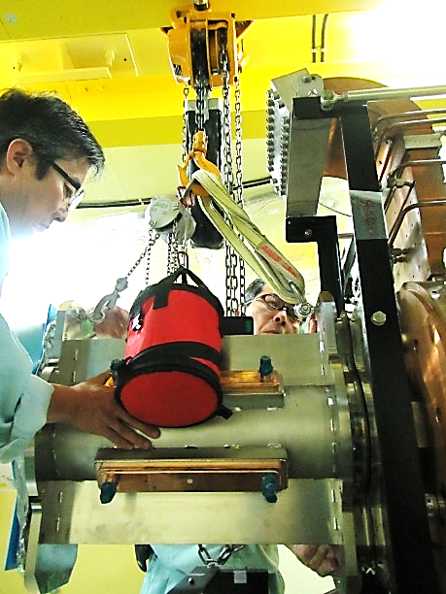
Connecting the grooved beampipes to the cavities
Viton O-Ring
+
=
➔

Slide 19
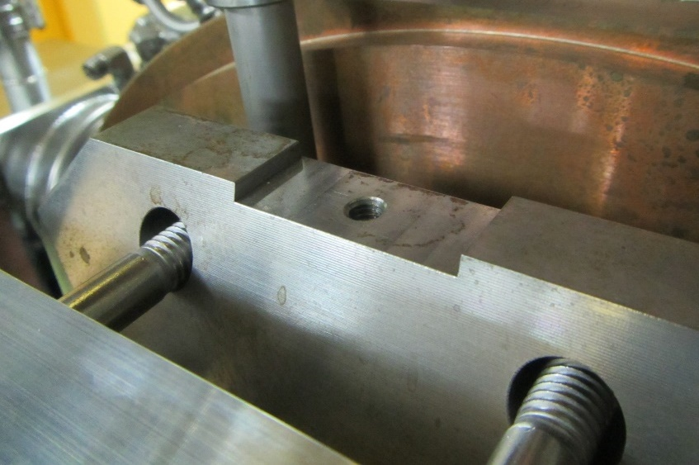
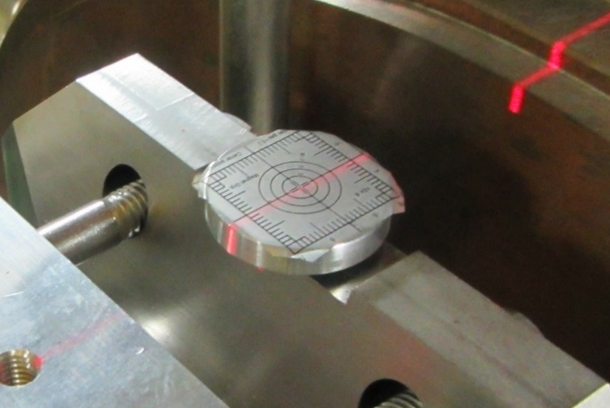
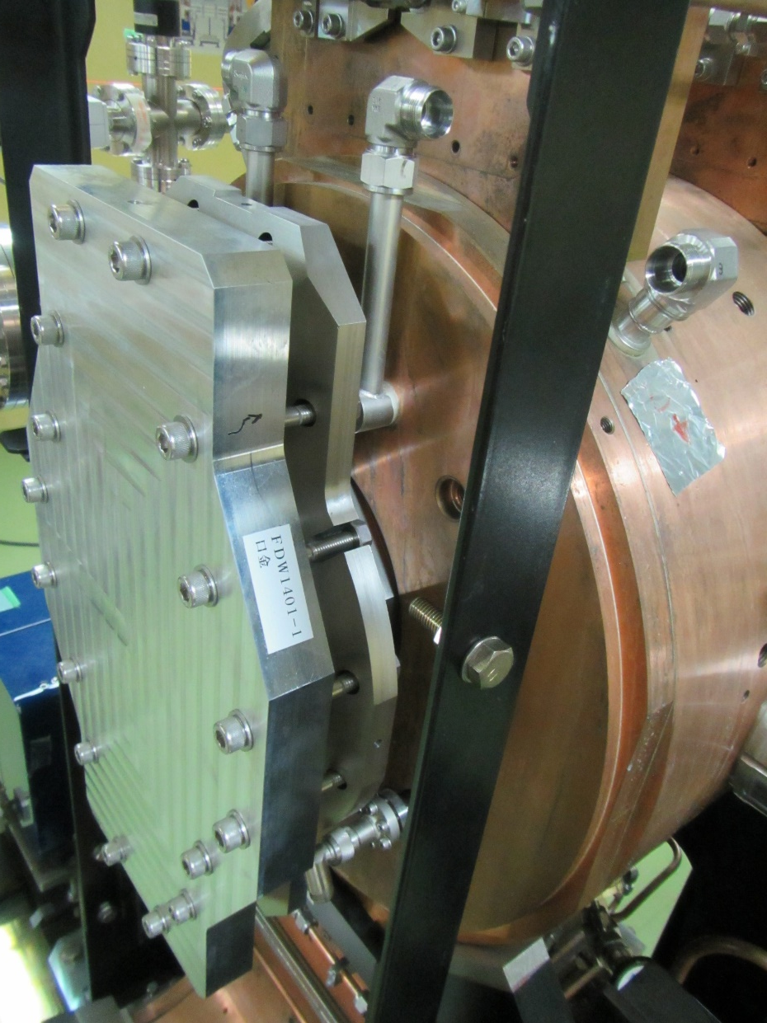
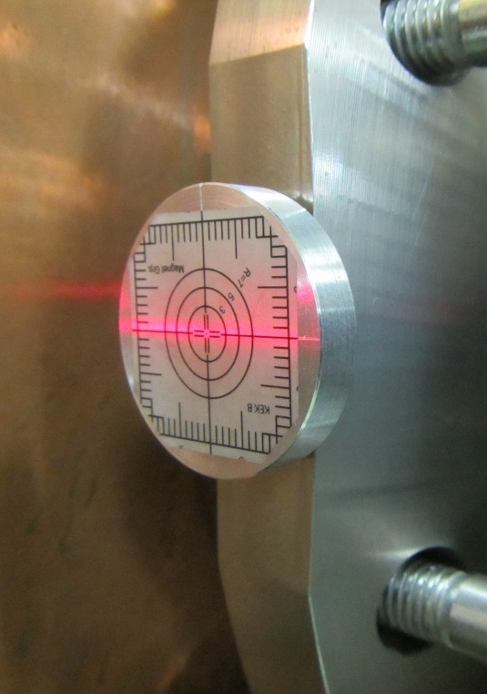
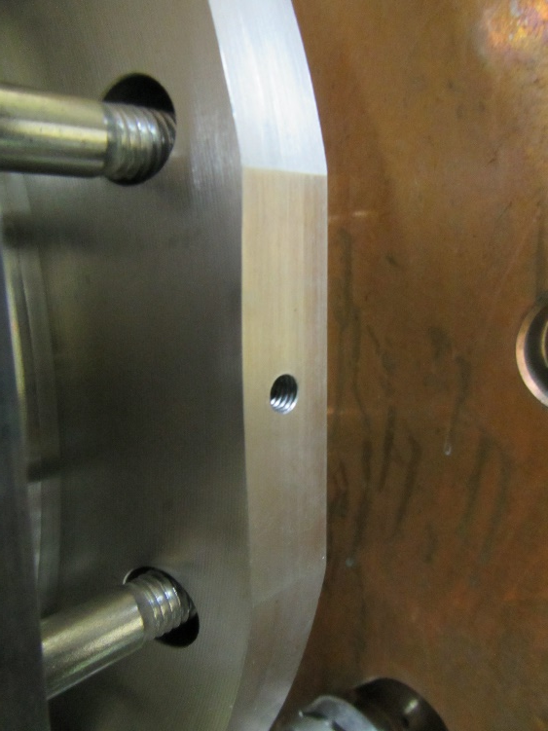
Alignment of the Beam-Port Flanges of the Cavities

Slide 20
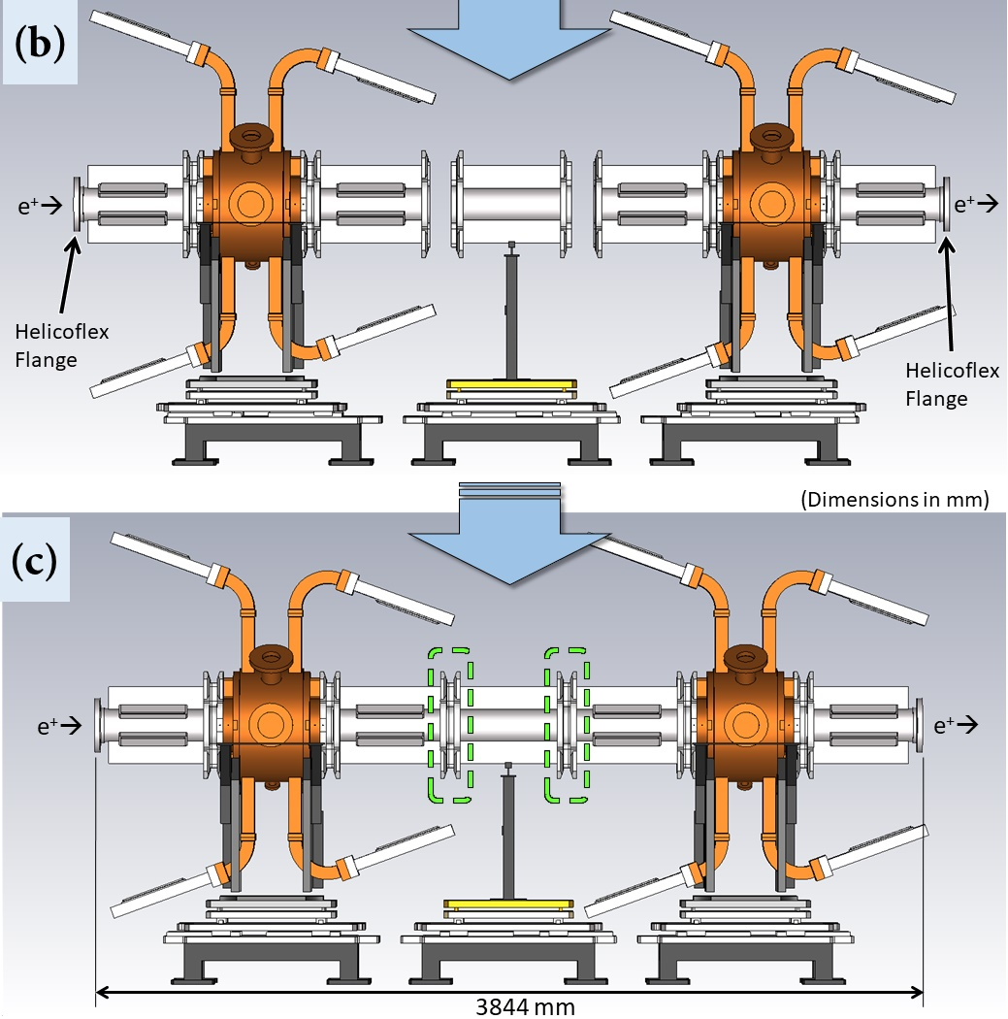
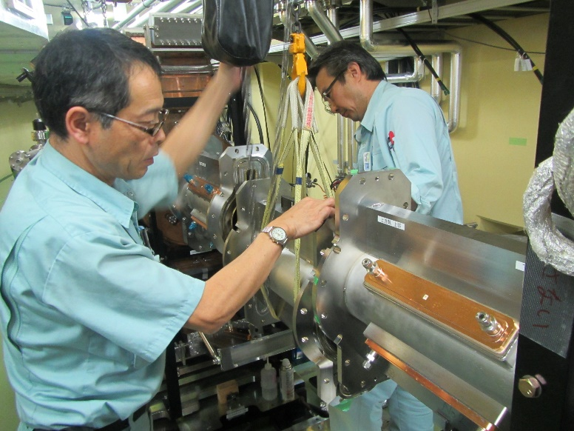
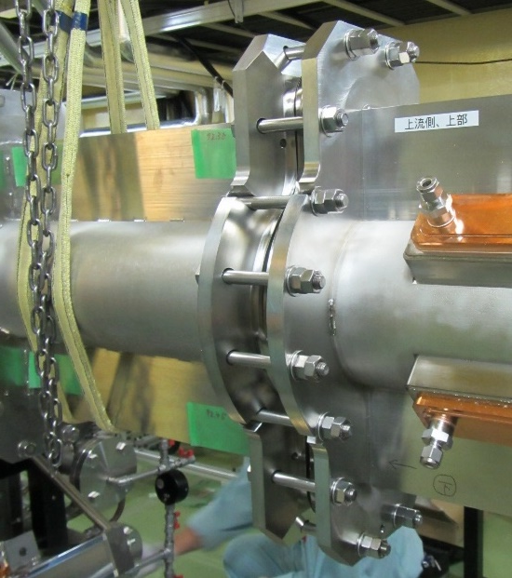
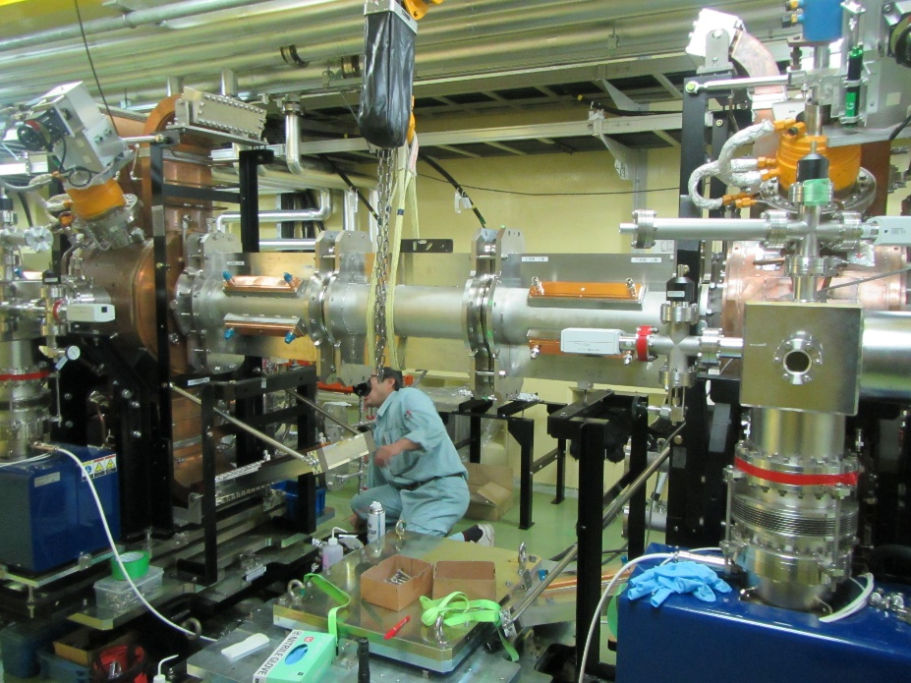
Then, we connected the dummy pipe.
Dummy pipe
Fixed with double nuts to avoid too much stress

Slide 21
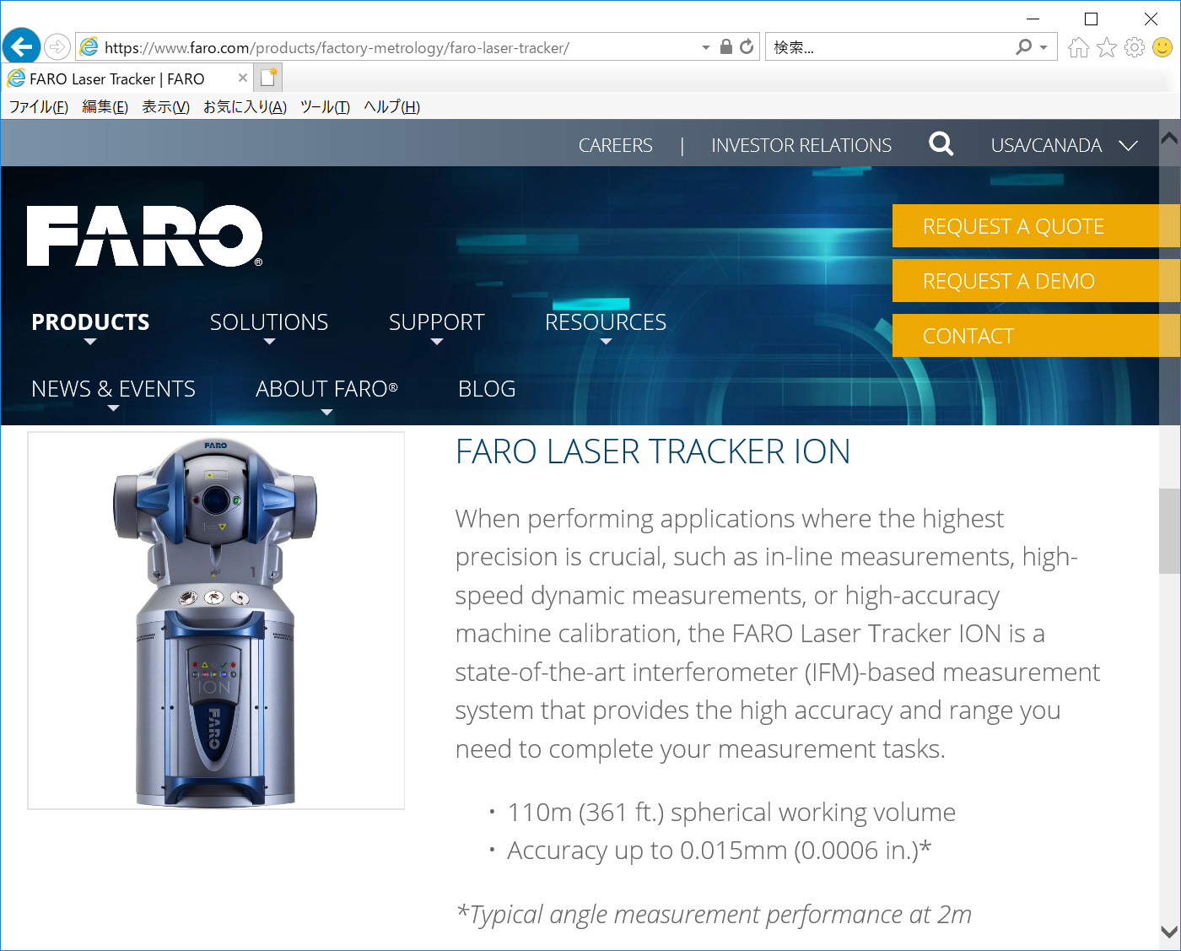
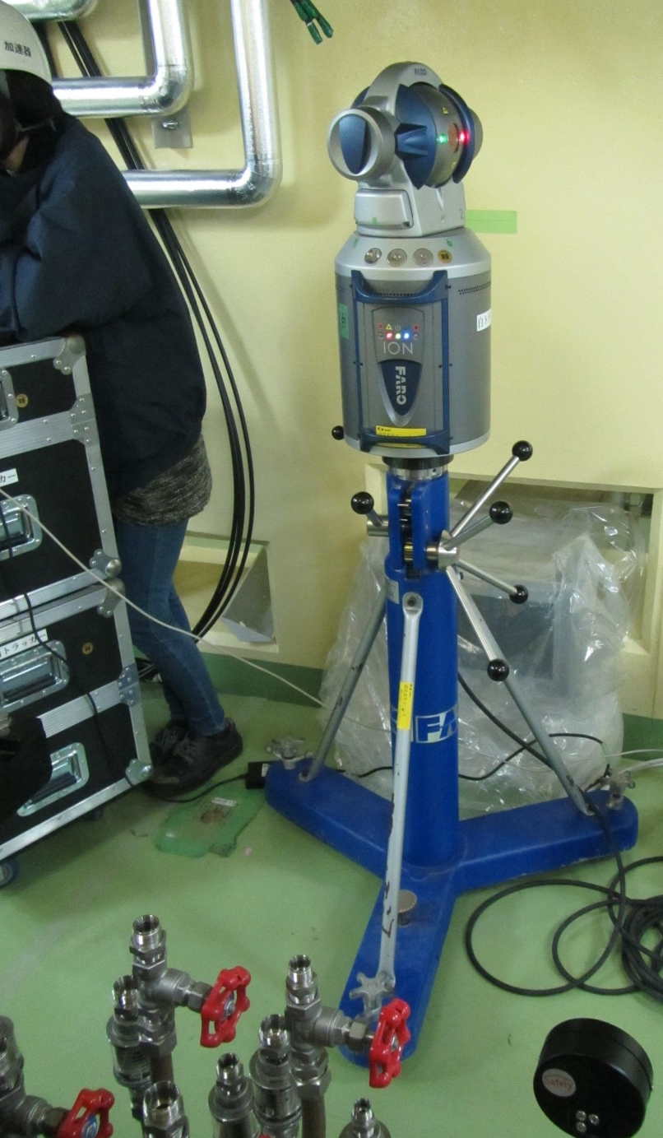
Position Measurement of the Beam-Port Flanges after the Installation
From KEKB Magnet Group
to check the installation accuracy
Using FARO Laser Tracker ION

Slide 22
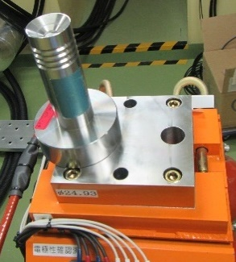
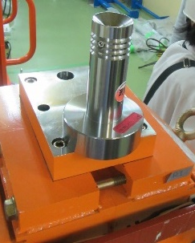
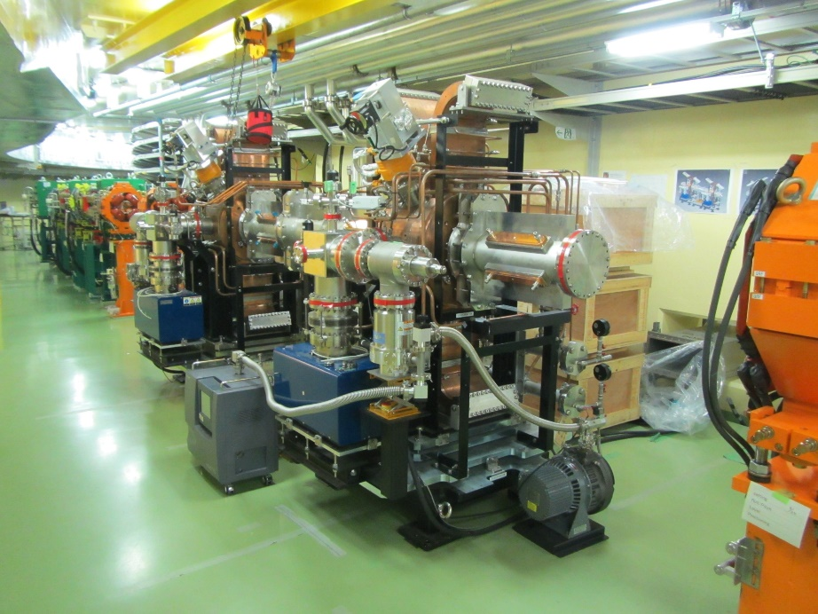
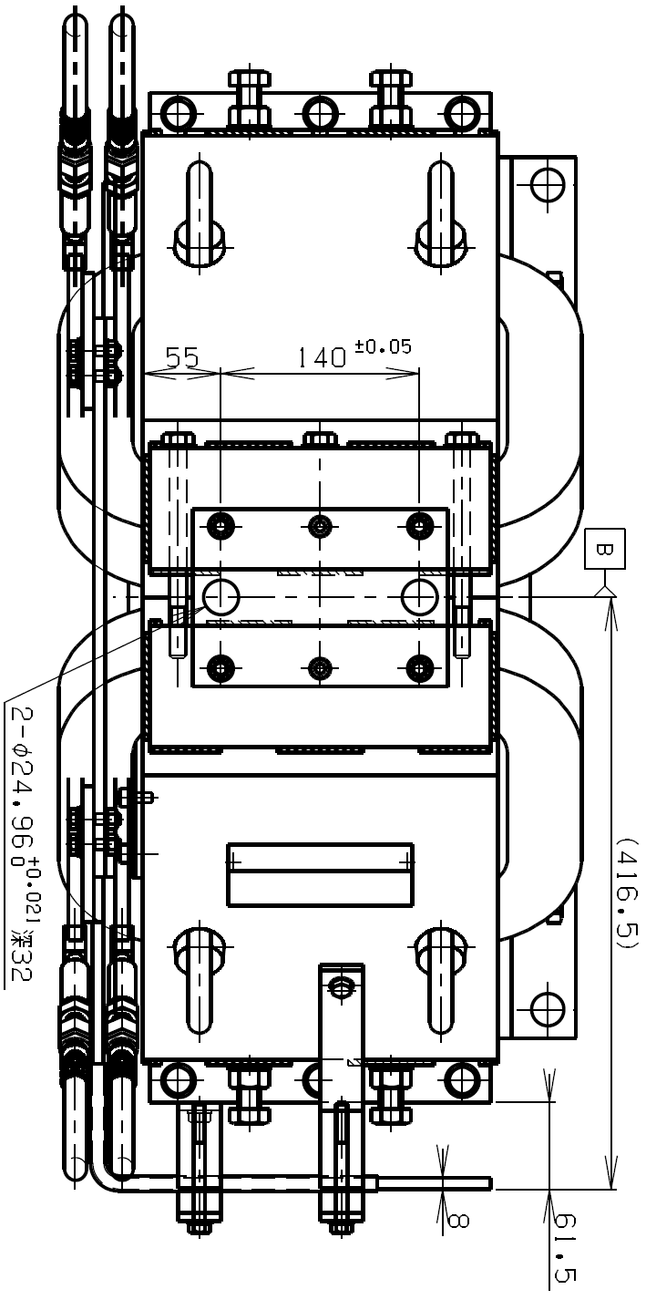
Redefined the beam axis based on the reference base plates of the Q-magnets
(Upstream)
(Downstream)
5660 mm

Slide 23
Position Measurement using the laser tracker
⬅
M6 tap
Target Holder
1.5-inchi Reflector Target

Slide 24
Two-step measurement
Meas. 1
Meas. 2
Q-mag
(upstream)
Upstream Cavity
Downstream Cavity
Q-mag
(downstream)

Slide 25
Measurement using the laser tracker by Masuzawa-san and Kawamoto-san
(From KEKB Magnet Group)

Slide 26
Combined with the measurement results using FaroArm Edge on the distances between ∅150-duct center and the reference planes of the beam-port flanges,
Using FaroArm Edge
∅150
~245 mm
~150 mm

Slide 27
We obtain deviations of the beampipe center from the beam axis.
(Inner)
■ Meas. 1 (using the laser tracker)
▲ Meas. 2 (using the laser tracker)
★ Measurements during installation (using a laser marker)
- - - Theoretical prediction based on the beam-port flange meas.
beam axis
(Outer)
(Top)
beam axis
(Bottom)
We achieved an alignment accuracy of 0.3 mm as a whole!

Slide 28
After all the installation works
Taken by Nobukazu Toge (KEK)

Slide 29
High-Power RF Conditioning after the Installation
For two weeks from May 19, 2017
Only daytime, weekdays
Note: High-power RF conditioning of each cavity was completed at a test stand beforehand.
Total V_{c} (blue) [MV]
Klystron Output Power (red) [kW]
Break due to other works in the DR tunnel
Smoothly reached Total V_{c} = 1.6 MV (350 kW klystron output)
over the DR spec: total V_{c} = 1.4 MV

Slide 30
However,
After maintaining total V_{c} = 1.6 MV (350 kW klystron output) during the conditioning,
small vacuum leaks (10⁻⁹ to 10⁻⁸ Pa m³/sec)
occurred at the 7 rectangular flanges of the HOM waveguides .
HOM waveguide load
Possible cause is a thermal cycle
accompanied by high temperature
at the rectangular flanges
(~50 degC at max. for total V_{c} = 1.6 MV)
The vacuum leaks stopped by increasing the clamping torque except for one waveguide flange*.
(*The gasket was replaced, and then no leak)

Slide 31
Measures against thermal cycles
(taken in Oct., 2017)
1. We added more cooling pipes on the E-bends of the HOM waveguides to suppress the thermal cycle at the rectangular flanges.
High thermal-conductivity glue (Devcon)
E-bend
Cooling pipe brazed on the E-bend during the fabrication of the cavity
Cavity
2. We inserted rubber bushes at the end of the support bars to make small degree of flexibility.
(EPDM)
No vacuum leak since we took these measures
(last leak test performed on Feb.22, 2018)

Slide 32
3. Status of Cavity No.0 (prototype)

Slide 33
Cavity No.0 was used for Lip Welding Test in 2012.
Cavity No.0
Grooved beampipe (prototype)
We have demonstrated:
(1) It is possible to perform vacuum-tight lip welding in the DR tunnel after the installation of the cavities, and
(2) Lip welding → Leak test: OK → Disassembly -> Re-welding → Leak test: OK → Disassembly

Slide 34
Cavity No.0 was re-tested on its high-power performance.
March, 2017
Conditioning Histories up to V_{c} = 0.90 MV/cavity
The light blue lines indicate the reference vacuum pressure specified by the computer controlled automatic aging.
If the vacuum pressure is higher than the reference, the input RF power (P_{inp}) is slightly stepped down until the vacuum pressure becomes lower than the reference, and then P_{inp} is slightly stepped up as long as the vacuum pressure is lower than the reference. P_{refl} and V_{c} indicate the reflected RF power and cavity voltage, respectively.
(1) Reached V_{c} = 0.90 MV (radiation limit) smoothly.
(2) Maintained V_{c} = 0.90 MV for six hours.
→ Comparable performance with Cavity No.1 and No.2.

Slide 35
We decided to promote Cavity No.0 to be a spare cavity for DR operation.
Enough high-power performance
Four HOM waveguide loads to be made soon
Bellows for vacuum-tight lip welding to be replaced

Slide 36
Status of the Bellows of Cavity No.0
To be replaced by new one!
Downstream side
Upstream side
Blank flange
Used in the lip welding test performed in 2012
Grooved beampipe (prototype)
Grooved beampipe (prototype)
Cavity No.0

Slide 37
Replacement Test of Bellows
Using the grooved beampipe prototype
(performed in 2017)
Bellows for vacuum-tight welding is welded
on a SUS frame.
Flange
The end mill revolved around the beam axis (14 rounds),
scraping the SUS frame (0.5 mm / round).
End mill
(0.5 mm / round)

Slide 38
By End Milling
Before
After the 4th round
After the 14th round (last)
…
➔
…
➔
➔
➔
Bellows for vacuum-tight welding
Flange
The bellows was removed after the 1st round.
The SUS frame was completely removed.

Slide 39
New bellows (0.2mm-thick bellows welded on a SUS frame)
Lip welding test
➔ No leak detected

Slide 40
Summary
Cavity No.1 and No.2
Were successfully installed to the DR tunnel / RF section
~0.3 mm accuracy in the transverse directions achieved
Position measurement of the beam-port flanges prior to the installation was successful and useful.
High-power performance re-checked: OK
Now accelerating positrons without any serious problems
Cavity No.0
To be promoted to be a spare cavity for DR operation
High-power performance re-checked: OK
Its bellows for vacuum-tight lip welding to be replaced by new ones this coming spring
Will be a spare cavity during Phase II

Slide 41
Thank you for your attention!

Slide 42
Backup Slides

Slide 43
2 → 3 Cavity Configuration
Total V_{c} = 1.4 MV for nominal DR operation @ Phase II
(0.7 MV/cavity)
Total V_{c} = 2.4 MV at max. @ Phase III?
(0.8 MV/cavity)
Ultimate!
Starting with 2 cavities
(if necessary)

Slide 44
The Endplates of DR Cavity No.1 and No.2 were Electropolished (EP).
Material: OFC (class1), 40μm etching, Skin depth(δ)@500MHz: 3μm
Before EP
After EP
R_{a}=1.5μm, R_{y}=8μm
R_{a}=0.2μm, R_{y}=1μm ( < δ = 3μm)
(Upstream)
Fixed End Plate (FEP)
w/o tuning bump
φ500mm
(Downstream)
Tuning End Plate (TEP)
w/ tuning bump

Slide 45
Low-Power Measurements of Unloaded Q-factor (Q₀)
 | Q₀(meas) / Q₀(sim)
Prototype | 92.9%IACS
Cavity No.1 | 97.1%IACS
Cavity No.2 | 97.3%IACS
4% improvement with EP
(Note: No EP applied to the barrel)
of the coaxial-type input coupler

Slide 46
Setup of High-Gradient (HG) Test
Toshiba
CW Klystron
E3732
(1MW, 508.9 MHz)
(No beam injected into the cavity during the HG test)

Slide 47
Detection of Cavity Breakdown by the Decay Time in Pickup Signal
The interlock system was activated with a reflection level over the threshold.
Check the decay time of the pickup signal of the accelerating mode
~8 μs ➔ Not cavity breakdown
<< 8 μs ➔ Cavity breakdown
Q_{L} = ~13000 →
T. Abe, T. Kageyama, H. Sakai, Y. Takeuchi, and K. Yoshino, “Breakdown Study based on Direct In Situ Observation of Inner Surfaces of an RF Accelerating Cavity during a High-Gradient Test”, Phys. Rev. Accel. Beams 19, 102001 (2016).

Slide 48
Histories of the RF Conditioning
83 hours to reach Vc=0.90 MV
95 hours to reach Vc=0.90MV
107 hours to reach Vc=0.95MV
The light blue lines indicate the reference vacuum pressure specified by the computer controlled automatic aging.
If the vacuum pressure is higher than the reference, P_{in} is slightly stepped down until the vacuum pressure becomes lower than the reference, and then P_{in} is slightly stepped up as long as the vacuum pressure is lower than the reference.
P_{in} (P_{refl}) : input power to (reflected power from) the cavity
Wall-loss power: P_{wall} = P_{in} – P_{refl} = ~0.99 x P_{in}
Cavity No.2 reached 0.95MV/cavity successfully.
Comparable conditioning speeds btwn Cavity No. 1 and 2

Slide 49
After the RF Conditioning (up to V_{c}=0.95MV) completed, Stability Test with Holding V_{c} = 0.90 MV
> V_{c} = 0.70 MV
(required for DR operation)
Example of the daily histories →
Cavity No.1: 3 breakdowns for 14.5 hours in total = 5.0^{+4.8}_{-2.7} /24hrs
Cavity No.2: 11 breakdowns for 80 hours in total = 3.3^{+1.3}_{-1.0} /24hrs
Same high-power performance between DR Cavities No. 1 and No. 2 within the statistics

Slide 50
Radiation Dose Rate
= Indirect observation of the dark current:
Field emission
→Acceleration
→Impact on the inner surface
→Emission of X-ray
for the DR Cavity No.2
No significant difference
between DR Cavity No. 1 and No.2
Constant during the stability test
(20 cavity breakdowns in this period)

Slide 51
Permittivity of the SiC ceramic tiles
Typical Measurements of SiC ceramics
Permittivity of SiC ceramics largely depends on
Source SiC powders
Sintering conditions of SiC ceramics
We aggressively controlled the permittivity by changing the amount of aluminum contained in the SiC powder so that the permittivity should be close to that used in designing the accelerating structure.
Relative permittivity of the SiC ceramics (CERASIC-B), as a function of frequency, used in designing this accelerating structure.
These permittivity values are typical measurements on the SiC ceramic tiles used for the GBPs of the ARES.
Y. Takeuchi, et al., “Control of RF Dielectric Properties of SiC Ceramics for HOM Absorbers", in Proceedings of the 8th Annual Meeting of Particle Accelerator Society of Japan, Aug. 2011 (Paper ID: TUPS137)

Slide 52
End of This File

